Slide 1
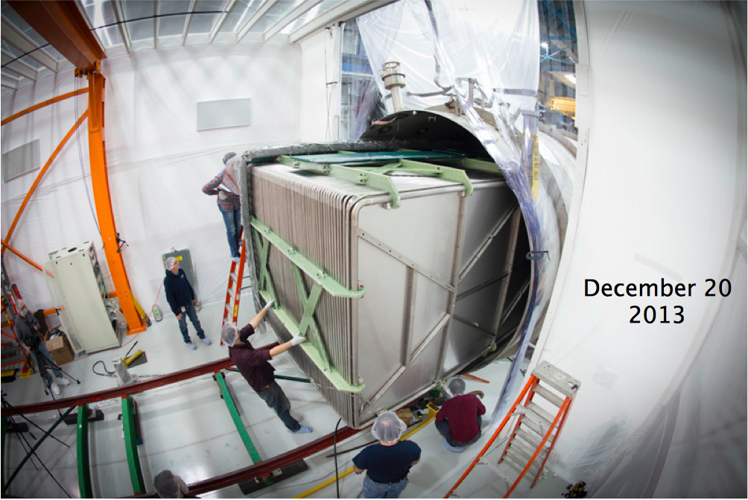
LAr Detector Technology for Neutrino Physics: Light Detection, MicroBooNE, and Beyond
M. Toups, MIT
SLAC Experimental Seminar
April 22, 2014

Slide 2
Outline
Neutrino Oscillation Physics
Experimental Approaches
Liquid Argon Time Projection Chambers (LArTPCs)
MicroBooNE
Liquid Argon Scintillation Light
LAr Light Studies at Fermilab
Nitrogen Contamination in LAr
Argon/Methane Mixtures
Characterizing LAr Light Guide Performance

Slide 3
Outline
Neutrino Oscillation Physics
Experimental Approaches
Liquid Argon Time Projection Chambers (LArTPCs)
MicroBooNE
Liquid Argon Scintillation Light
LAr Light Studies at Fermilab
Nitrogen Contamination in LAr
Argon/Methane Mixtures
Characterizing LAr Light Guide Performance

Slide 4
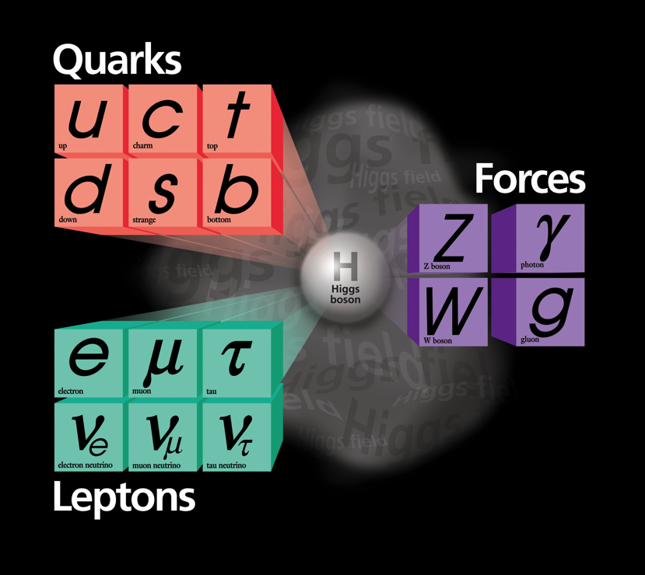
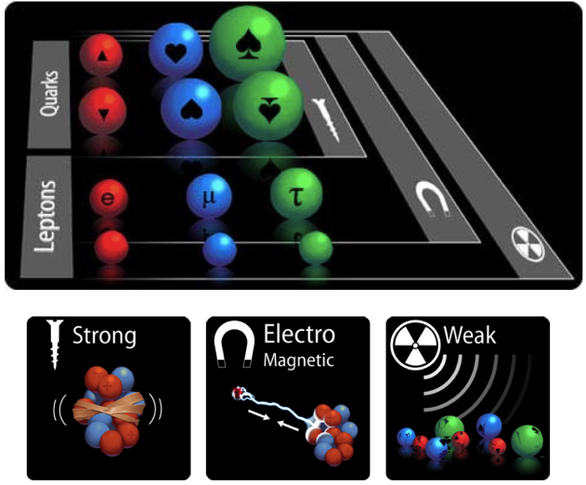
Neutrinos in the Standard Model

Slide 5
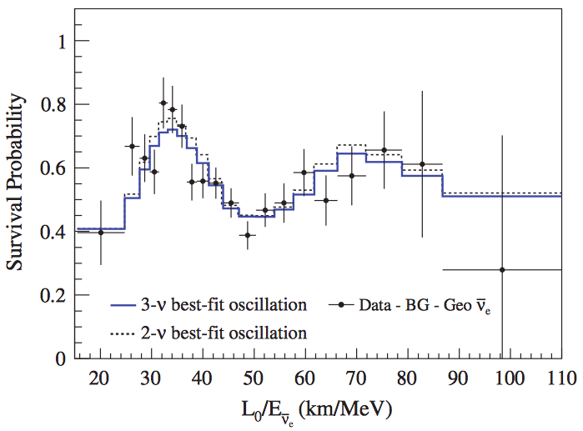
Neutrino Flavor Change a.k.a. “Oscillations”
KamLAND, Phys. Rev. D 83, 052002

Slide 6
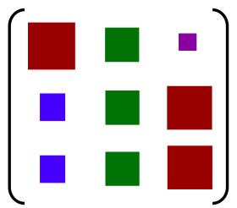
What Have We Learned from ν Oscillations?
Neutrino Flavor Eigenstates
Unitary Mixing Matrix
Neutrino Mass Eigenstates

Slide 7
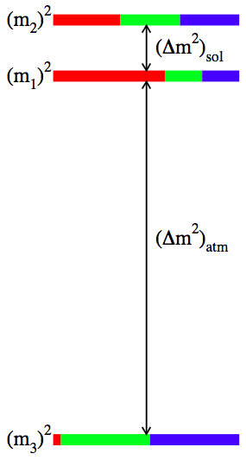
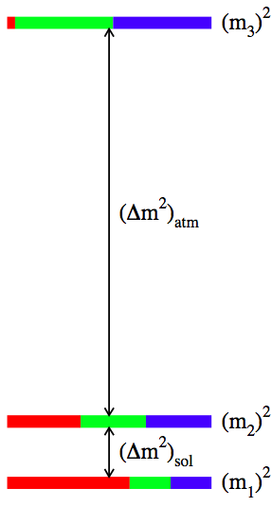

What More Can We Learn From ν Oscillations (I)?
Mass Hierarchy
“Inverted”
“Normal”

Slide 8
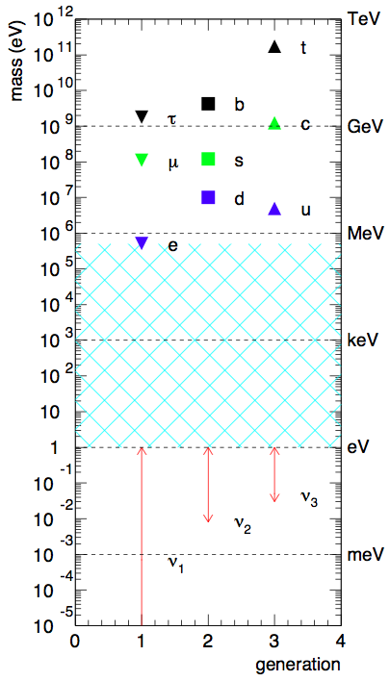
What More Can We Learn From ν Oscillations (I)?
Mass Hierarchy
“Inverted”
“Normal”

Slide 9
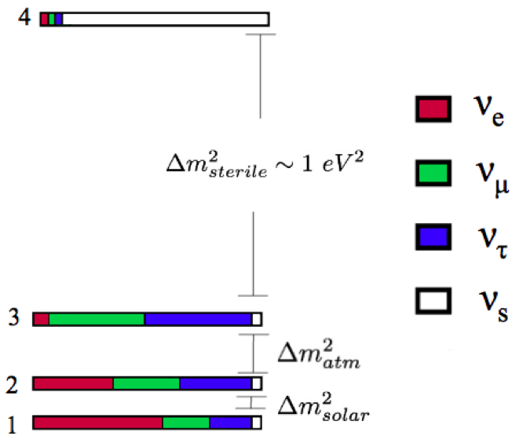
What More Can We Learn From ν Oscillations (II)?
Are there light sterile neutrinos?

Slide 10
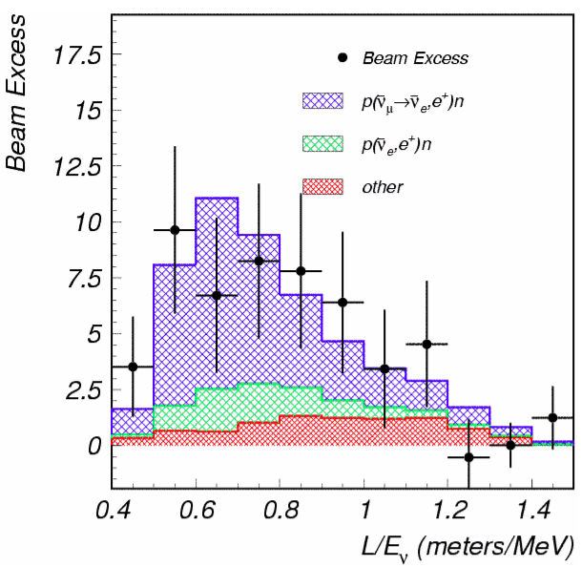
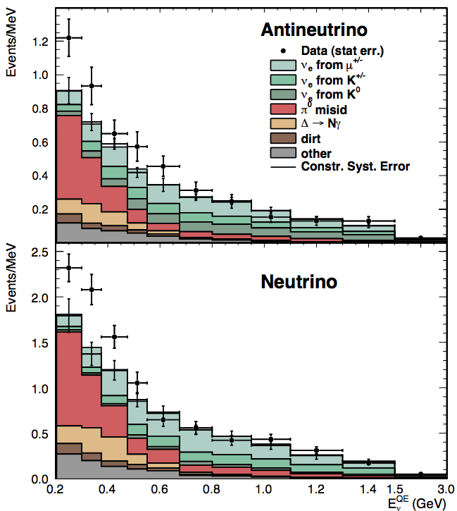
What More Can We Learn From ν Oscillations (II)?
LSND
MiniBooNE
Are there light sterile neutrinos?

Slide 11
What More Can We Learn From ν Oscillations (III)?
?
?
Do neutrinos violate CP?

Slide 12
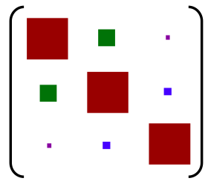
What More Can We Learn From ν Oscillations (III)?
?
VS.
?
Do neutrinos violate CP?

Slide 13
Outline
Neutrino Oscillation Physics
Experimental Approaches
Liquid Argon Time Projection Chambers (LArTPCs)
MicroBooNE
Liquid Argon Scintillation Light
LAr Light Studies at Fermilab
Nitrogen Contamination in Lar
Argon/Methane Mixtures
Characterizing LAr Light Guide Performance

Slide 14
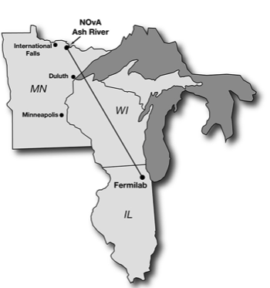
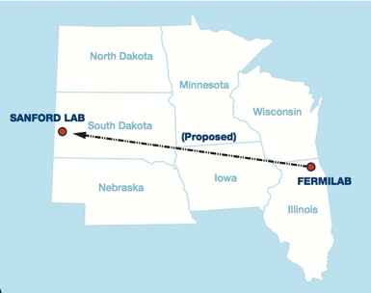
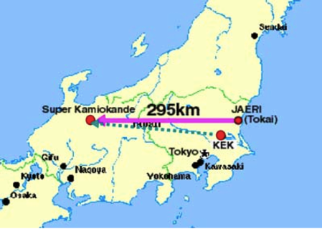
Mass Hierarchy & CP violation
“Long baseline” (> 100 km) oscillation experiments
Sterile Neutrinos & MiniBooNE Low Energy Excess
“Short baseline” (< 1 km) oscillation experiments
OscSNS, MicroBooNE, plus a dozen others
T2K
810 km
1300 km
NOvA
LBNE

Slide 15
Mass Hierarchy & CP violation
“Long baseline” (> 100 km) oscillation experiments
Sterile Neutrinos & MiniBooNE Low Energy Excess
“Short baseline” (< 1 km) oscillation experiments
OscSNS, MicroBooNE, plus a dozen others
T2K
810 km
1300 km
NOvA
LBNE

Slide 16
Mass Hierarchy & CP violation
“Long baseline” (> 100 km) oscillation experiments
Sterile Neutrinos & MiniBooNE Low Energy Excess
“Short baseline” (< 1 km) oscillation experiments
OscSNS, MicroBooNE, plus a dozen others
T2K
810 km
1300 km
NOvA
LBNE

Slide 17
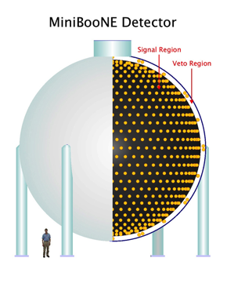
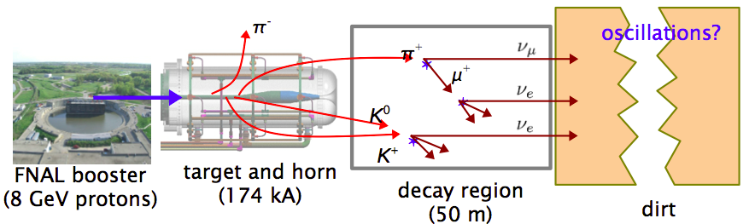
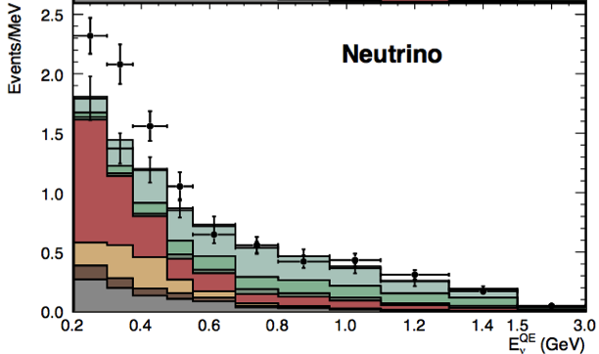
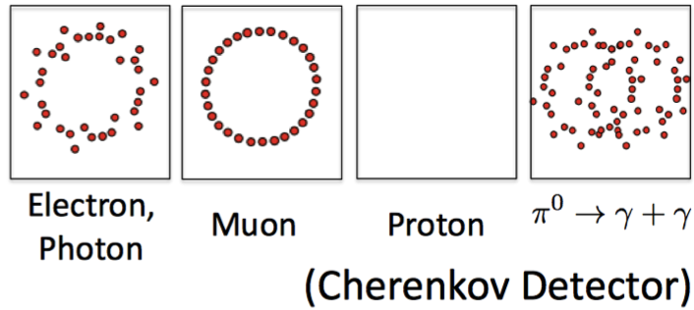
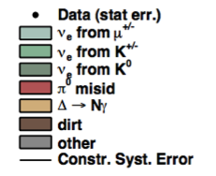
Addressing the MiniBooNE “Low-Energy Excess”
~ 500 m
MiniBooNE

Slide 18
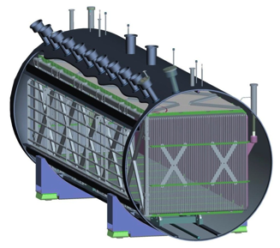
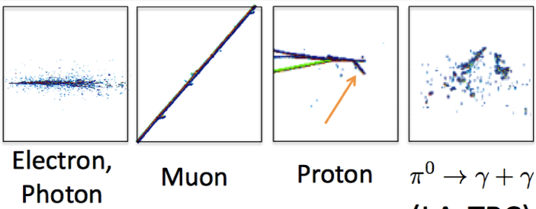
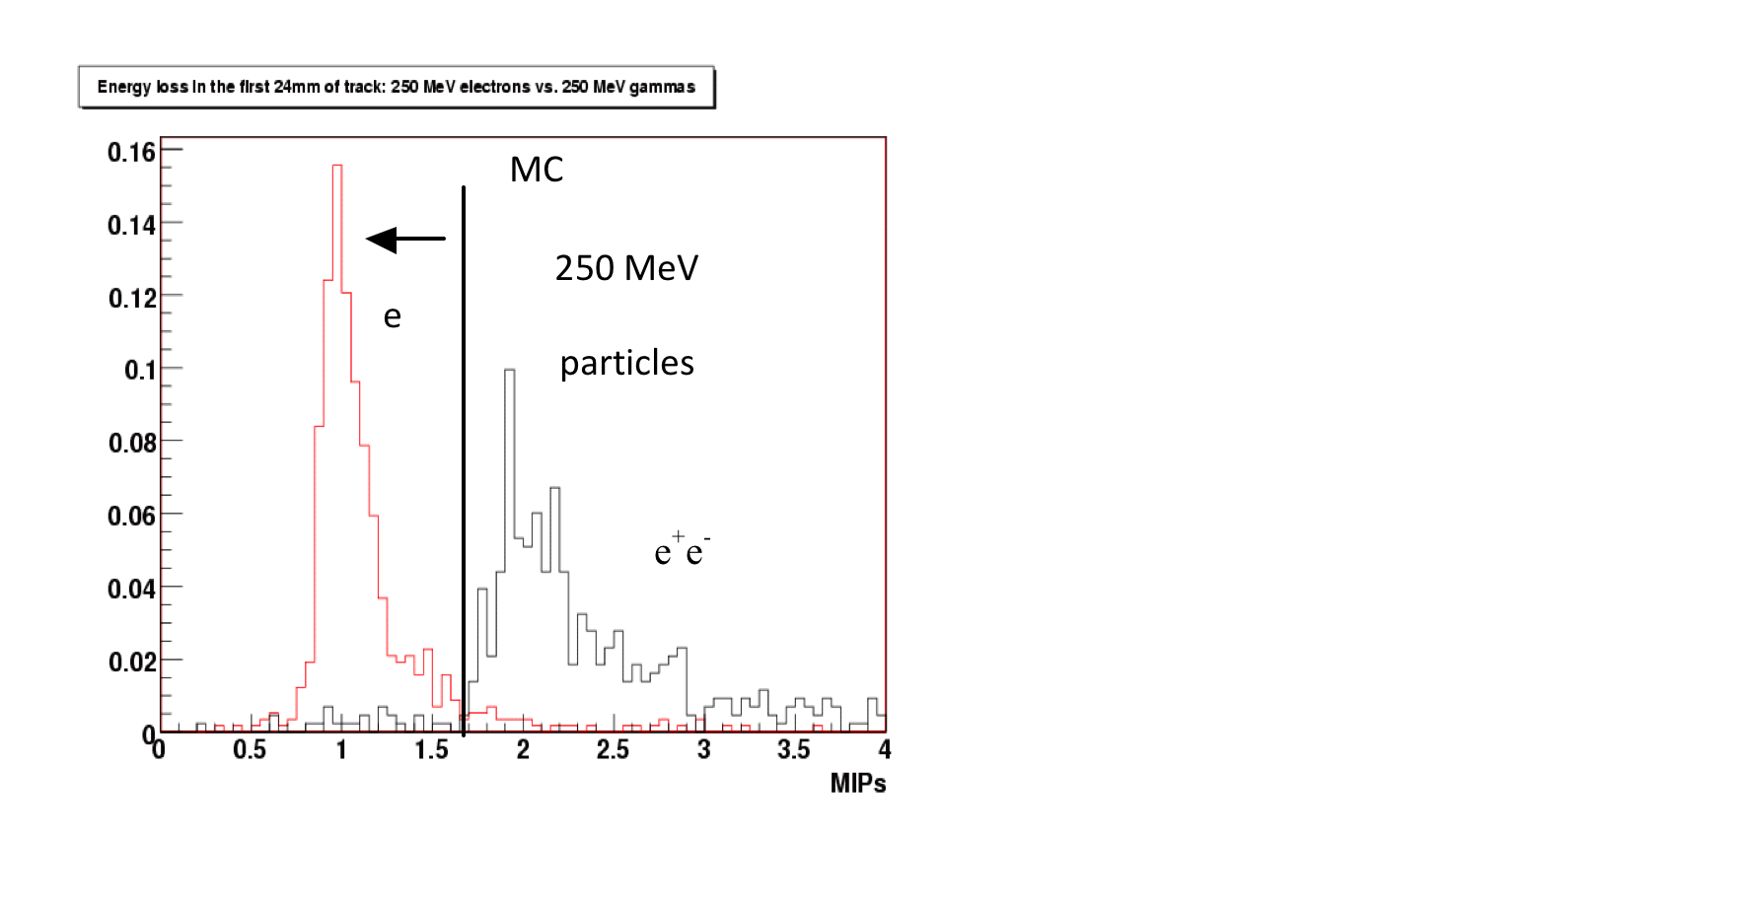
Addressing the MiniBooNE “Low-Energy Excess”
LArTPC Detctor
~ 500 m
Energy loss in first 2.4 cm of track
Liquid Argon Time Projection Chamber (LArTPC)
LArTPC = “Modern Bubble Chamber” with 3D track reconstruction

Slide 19
Outline
Neutrino Oscillation Physics
Experimental Approaches
Liquid Argon Time Projection Chambers (LArTPCs)
MicroBooNE
Liquid Argon Scintillation Light
LAr Light Studies at Fermilab
Nitrogen Contamination in LAr
Argon/Methane Mixtures
Characterizing LAr Light Guide Performance

Slide 20
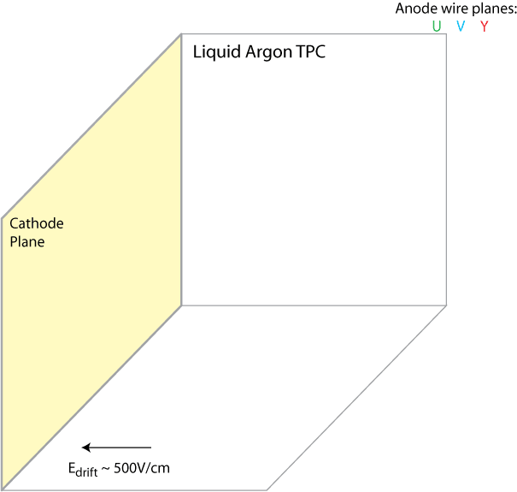
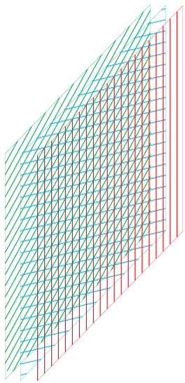
Bo Yu (BNL)

Slide 21
Bo Yu (BNL)
Charged particle tracks ionize Argon atoms
⁴⁰Ar
ν

Slide 22

Bo Yu (BNL)
Charged particle tracks ionize Argon atoms
Scintillation light (~ns) is detected by PMTs at same time

Slide 23
Bo Yu (BNL)
Then ionized electrons are collected by anode wires (~ms)

Slide 24
Bo Yu (BNL)
Then ionized electrons are collected by anode wires (~ms)
Electrons near the wires are collected first, and electrons far from the wires are collected last, so drift coordinate information is converted to electron drift time

Slide 25
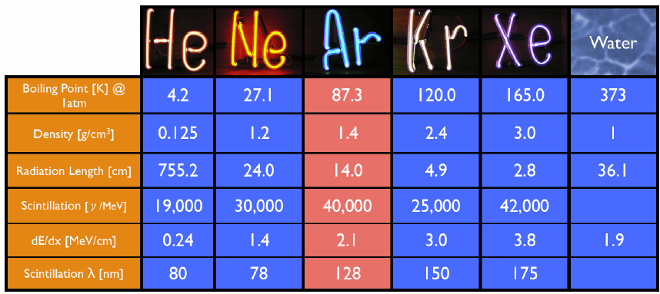
Why LAr?
Relatively inexpensive, easy to obtain, easy to purity
Ionization electrons can be drifted over large distances
Good dielectric properties accommodate high voltages necessary for large drift fields
Bright scintillator (transparent to its own scintillation light)
M. Soderberg

Slide 26
Outline
Neutrino Oscillation Physics
Experimental Approaches
Liquid Argon Time Projection Chambers (LArTPCs)
MicroBooNE
Liquid Argon Scintillation Light
LAr Light Studies at Fermilab
Nitrogen Contamination in LAr
Argon/Methane Mixtures
Characterizing LAr Light Guide Performance

Slide 27
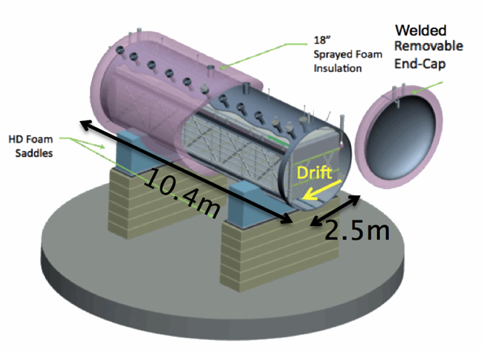
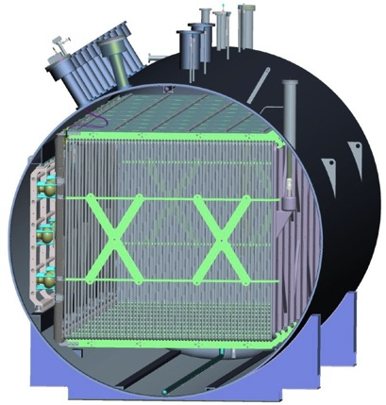
The MicroBooNE Detector
ν beam
Largest LArTPC in America (80 ton active mass)
8256 wires (3 mm pitch)
3456 collection channels (oriented vertically)
4800 induction channels (oriented at ±60˚)
32 8” Cryogenic PMTs + 4 light guide “paddles”
UV laser calibration system
2.3 m
Anode Wires
PMTs
HV Cathode
Drift

Slide 28
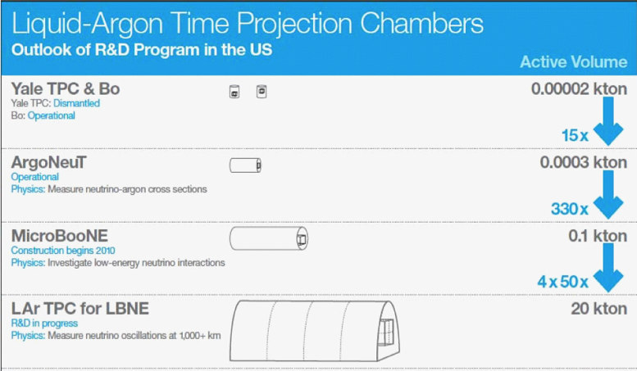
MicroBooNE Goals
Address MiniBooNE low energy excess
ν cross section measurements on Argon
R&D for future LArTPCs
Long drift length (2.5 m)
Cold electronics (CMOS ASICs in LAr)
LAr fill without evacuation (GAr purge)
Related to scalability

Slide 29
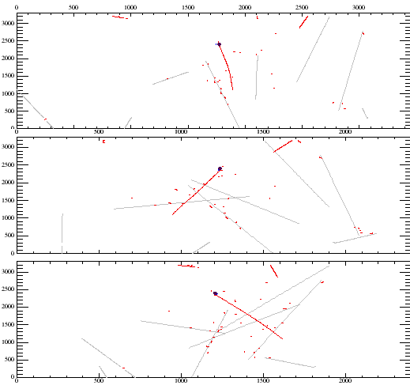
Light Detection in MicroBooNE
Provides interaction time for non-accelerator events
Triggers detector readout
Input to reconstruction (particle ID, lower E_{thresh}, etc.)
Cosmic background rejection
Essential for a surface LArTPC!
Test bed for future technologies (light guide detectors)
Induction Plane 1
Induction Plane 2
Collection Plane
Time
1.6 ms
~10 m
Ben Jones
Wire number

Slide 30
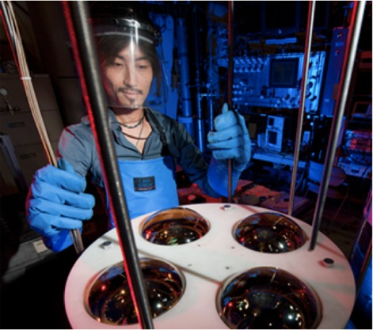
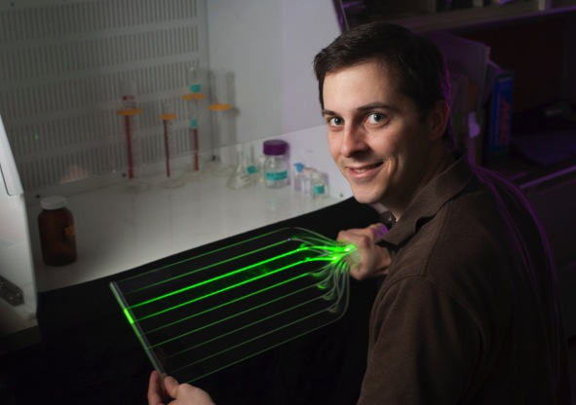
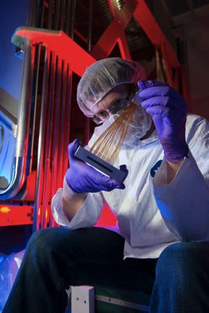
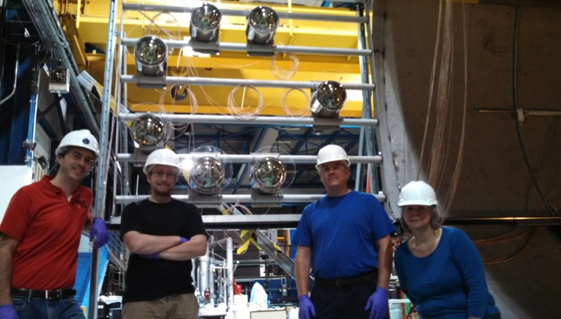
Our Role in MicroBooNE
T. Katori
M. Toups
B. Jones
T. Briese, et. al., JINST 8 (2013) T07005
M. Toups, B. Jones, E. James, J. Conrad

Slide 31
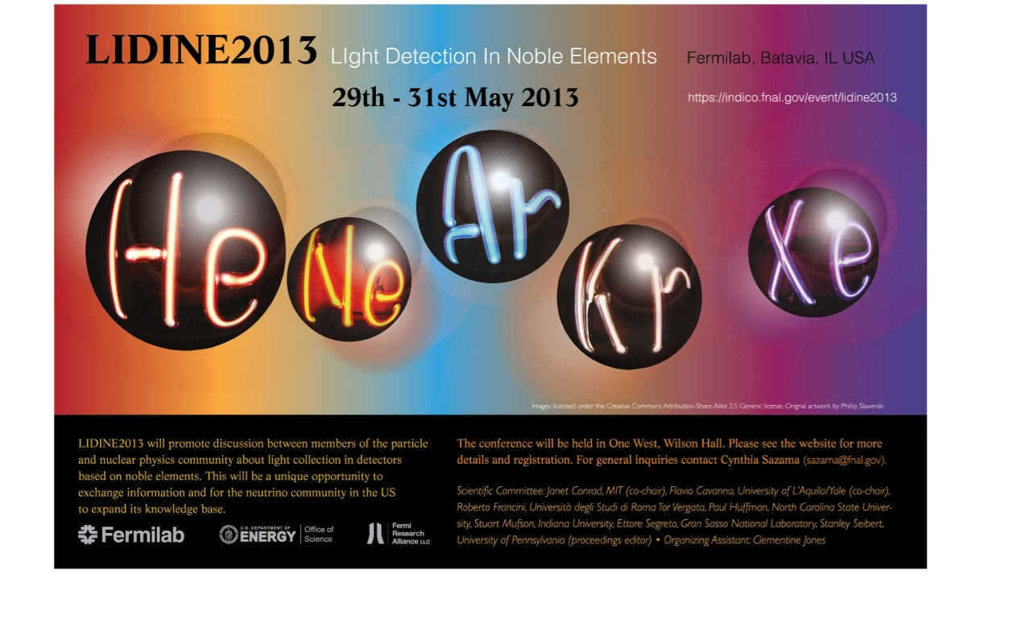
Light Detection Beyond MicroBooNE
Dark matter, neutron EDM, neutrinoless double beta-decay, etc.

Slide 32
Outline
Neutrino Oscillation Physics
Experimental Approaches
Liquid Argon Time Projection Chambers (LArTPCs)
MicroBooNE
Liquid Argon Scintillation Light
LAr Light Studies at Fermilab
Nitrogen Contamination in LAr
Argon/Methane Mixtures
Characterizing LAr Light Guide Performance

Slide 33
Production Pathways
+
Singlet excimer
p
*
*
τ ~ 6 ns
Ar
Ar
Ar
Ar
γ
Self-trapped exciton luminescence
Ar
128 nm
-
Ar
+
e
Triplet excimer
Ar
*
+
Ar
Ar
τ ~ 1.5 μs
e
-
Ar
Ar
Recombination luminescence
Production ratio depends on ionization density particle ID!
Notes:
----- Meeting Notes (12/9/11 16:36) -----

Slide 34
Quenching Processes
+
+
-
Ar
-
Ar
e
e
+
+
Ar
Ar
-
-
e
E-field
e
In an electric field
*
Ar
Ar
Ar
Ar
N
N
N
N
By trace impurities
Sets strict limits on impurity concentrations in LArTPCs

Slide 35
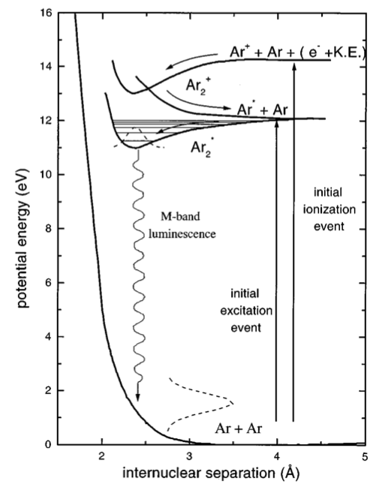
Propagation: LAr is self-transparent
D.E. Grosjean et al., Phys. Rev. B 56 (1997) 6975-6981.

Slide 36
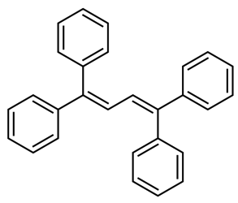
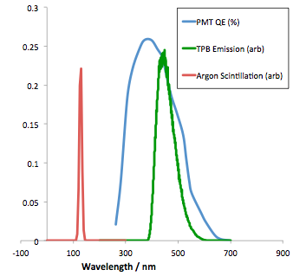
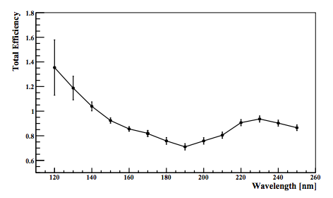
Wavelength-shift to Visible Spectrum
Tetraphenyl butadiene (TPB)
C.S. Chiu, et al. JINST 7 (2012) P07007
B.J.P. Jones, et al JINST 8 (2013) P01013
TPB evaporative coating
V. Gehman et al, NIM A 654, 116 (2011)

Slide 37
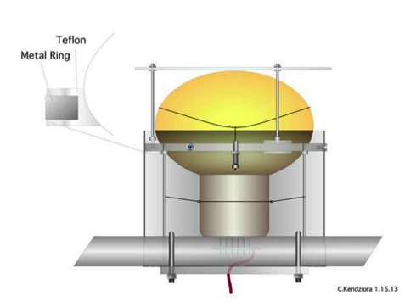
Photodetection
128 nm light
TPB-coated acrylic plate
450 nm light
a la MicroBoonE
In large neutrino LArTPCs thin profile photo-detectors are desirable to maximize TPC active regions—
LAr 128 nm scintillation light
Visible light
SiPM / PMT
a la LBNE, LAr1-ND
TPB coated acrylic light guide
L. Bugel et. al. NIM A, 640, (2011)

Slide 38
Outline
Neutrino Oscillation Physics
Experimental Approaches
Liquid Argon Time Projection Chambers (LArTPCs)
MicroBooNE
Liquid Argon Scintillation Light
LAr Light Studies at Fermilab
Nitrogen Contamination in LAr
Argon/Methane Mixtures
Characterizing LAr Light Guide Performance

Slide 39
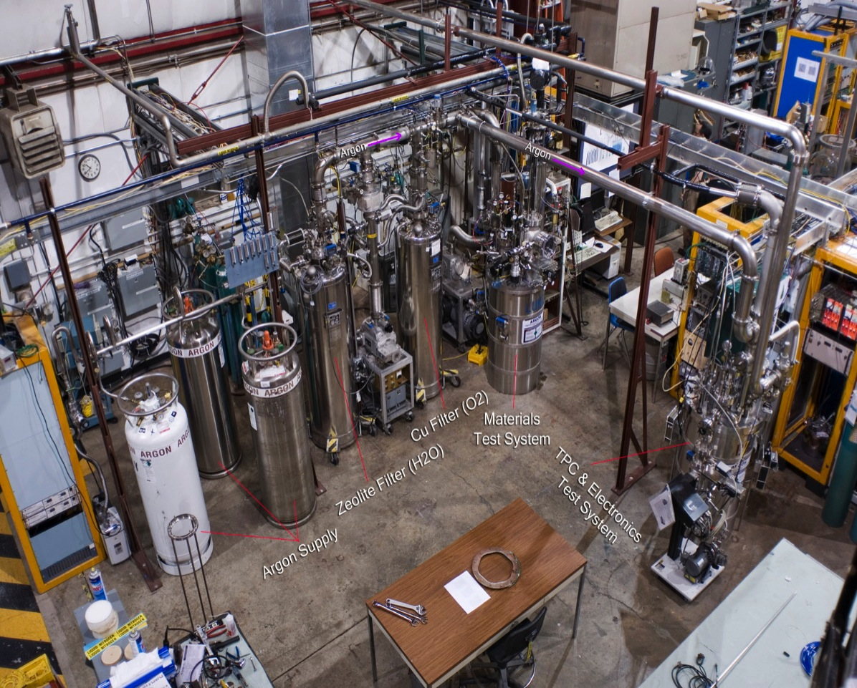
Light Detection Test Stand
Commercial Argon 1 ppm Oxygen, H₂O

Slide 40
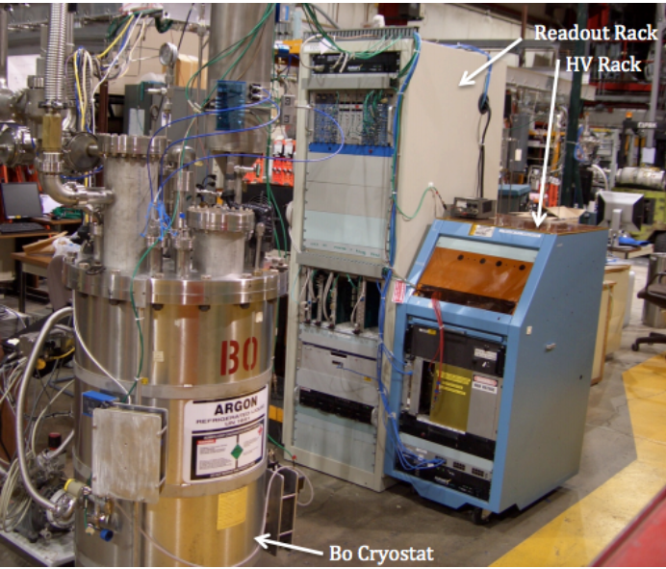
“Bo” Light Detection Test Stand
40”, 250 L vacuum-insulated cryostat
Recently upgraded to 84” (“Tall Bo”)
High purity LAr delivery system
Condenser tower allows for closed system operation

Slide 41
Outline
Neutrino Oscillation Physics
Experimental Approaches
Liquid Argon Time Projection Chambers (LArTPCs)
MicroBooNE
Liquid Argon Scintillation Light
LAr Light Studies at Fermilab
Nitrogen Contamination in LAr
Argon/Methane Mixtures
Characterizing LAr Light Guide Performance

Slide 42
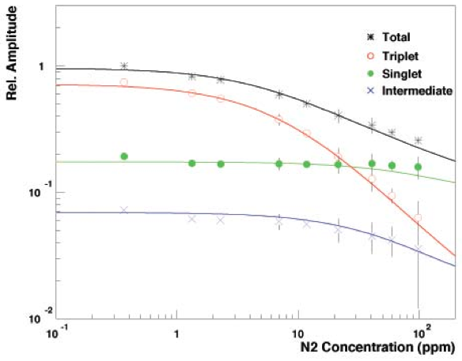
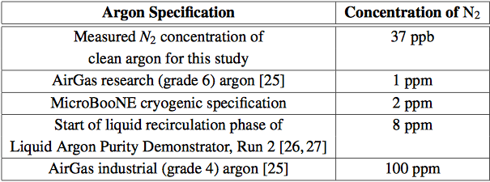
Two distinct effects on light collection
LAr scintillation light production may be quenched by impurities
LAr scintillation light en route to a photo-detector may be absorbed by impurities in the bulk material
No measurements of this existed!
R Acciarri et al 2010 JINST 5 P06003

Slide 43
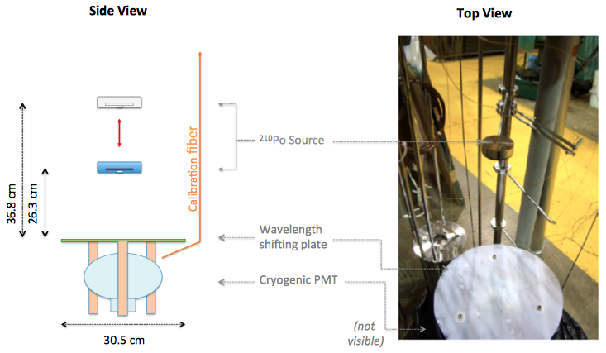
The Experiment Setup
²¹⁰Po source serves as standard candle (5.3 MeV alpha)
Inject controlled quantities of Nitrogen in Bo and look for:
Differences in the relative amount of light seen from a mono-energetic alpha source as a function of Nitrogen concentration for 2 source-detector distances

Slide 44
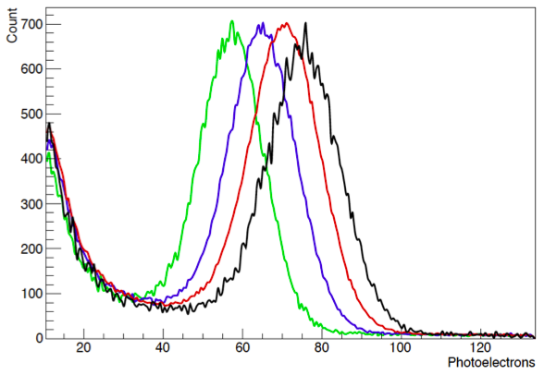
Peak of pulse area distributions decreases as a function of nitrogen concentration
37 ppb
3.7 ppm
7.4 ppm
15.5 ppm

Slide 45
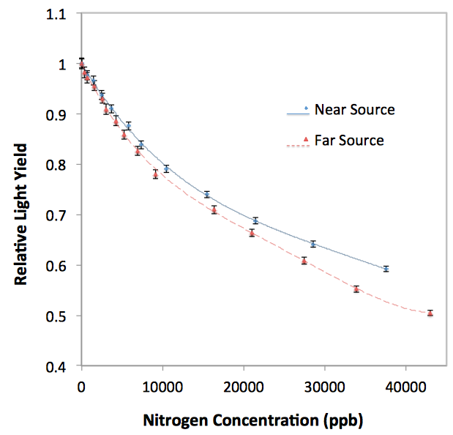
For a given nitrogen concentration, quenching has the same effect on both source configurations
The fact that the two curves diverge tells us there is a distance-dependent light loss mechanism at play

Slide 46
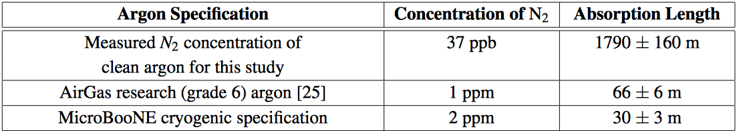
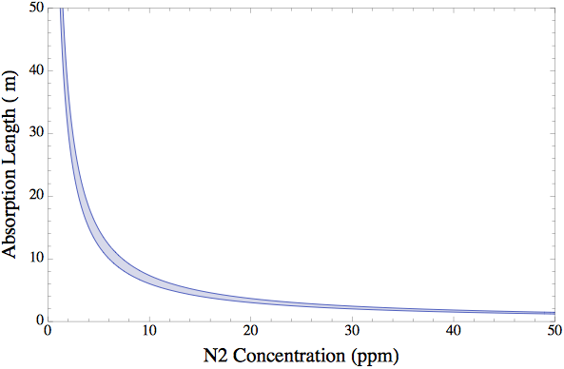
Relatively loose purity specifications of ppm-level nitrogen contamination required by current- and next-generation LAr particle physics experiments
B J P Jones et al 2013 JINST 8 P07011 B J P Jones et al 2013 JINST 8 E09001
$$$$
$

Slide 47
Outline
Neutrino Oscillation Physics
Experimental Approaches
Liquid Argon Time Projection Chambers (LArTPCs)
MicroBooNE
Liquid Argon Scintillation Light
LAr Light Studies at Fermilab
Nitrogen Contamination in LAr
Argon/Methane Mixtures
Characterizing LAr Light Guide Performance

Slide 48
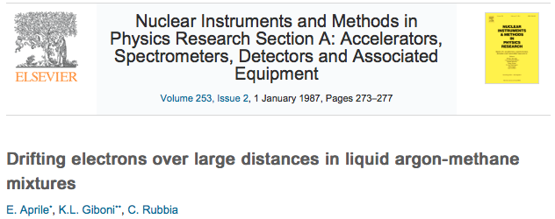

Why Study Light Production in CH₄-doped LAr?
Long electron drift distances demonstrated for CH₄ concentrations of several %
Introduces inverse-beta-decay interaction channel ( )
Potentially broadens low-energy neutrino physics program of LArTPCs
Some evidence in the literature that CH₄ may act as a wavelength-shifter
May provide an important input for LAr-based dark matter detectors that produce Ar from underground CO₂ wells and rely on light collection
arXiv:1204.6024v2 [astro-ph.IM]

Slide 49

The Experiment Setup
Inject controlled quantities of CH₄ in Bo and look for:
Quenching and/or absorption of LAr scintillation light
LAr scintillation light wavelength-shifted to visible light

Slide 50


B J P Jones et al 2013 JINST 8 P12015
For detectors larger than O(1 cm), CH₄ concentration should be < O(100) ppb to limit absorption losses to less than a few percent
Quenching is also at observed, but is subdominant
No significant amount of LAr scintillation light is wavelength-shifted to visible

Slide 51
Outline
Neutrino Oscillation Physics
Experimental Approaches
Liquid Argon Time Projection Chambers (LArTPCs)
MicroBooNE
Liquid Argon Scintillation Light
LAr Light Studies at Fermilab
Nitrogen Contamination in LAr
Argon/Methane Mixtures
Characterizing LAr Light Guide Performance

Slide 52


Different Wavelength-Shifting (WLS) Coatings
IU spray coatings with WLS melted into surface
TPB vs. bis-MSB
Compare 10, 20, 35, & 50 coats
MIT hand-painted TPB coatings
arXiv:1210.3793 [physics.ins-det]
Tall Bo

Slide 53

All cosmic data triggering SiPMs
More light
Less light
D. Whittington, IU

Slide 54

We would like to evaluate the performance of these light guides by measuring their attenuation lengths at room temperature
But attenuation lengths measured at room temperature do not track attenuation lengths measured with cosmics in LAr
LAr, warm, 245 nm light
D. Whittington, IU

Slide 55

Attenuation Length Measurement
Set up currently installed in Tall Bo to make this measurement
Expect results soon!
Tall Bo
SiPMs (trigger)
²¹⁰Po sources
TPB-coated light guide
2” Cryogenic PMT

Slide 56

Preliminary Results

Slide 57
More LAr Light Studies Yet To Come
MicroBooNE-specific R&D
LAr Scintillation Light Time Constants
Rayleigh Scattering
²²²Rn Tracing in LAr
Ar/Xe Mixtures

Slide 58
More LAr Light Studies Yet To Come
MicroBooNE-specific R&D
LAr Scintillation Light Time Constants
Rayleigh Scattering
²²²Rn Tracing in LAr
Ar/Xe Mixtures

Slide 59
²²²Rn Tracing in LAr

Slide 60

Mapping LAr Flows
E. Voirin, for μBooNE
Ion concentration for velocity field (fluid velocity + drift velocity of 8 mm/sec)

Slide 61

²²²Rn Tracing
A new technique to map flows in a neutrino LArTPCs
Inject ²²²Rn into detector and look for correlated ²²²Rn-²¹⁸Po decays
Reconstruct positions to measure flow
²²²Rn→²¹⁸Po
5.48MeV alpha
3.8 days
²¹⁸Po→²¹⁴Pb
6MeV alpha
3 minutes
Short- lived
Long- lived
These will remain in your detector, but accelerator-based neutrino experiments only require negligible background in beam window

Slide 62
We would like to test this idea in Bo
New infrastructure is required
Field cage (for drift)
Array of SiPMs (for position reconstruction)
Radon injection system
We have already located enough Ra at FNAL to generate enough ²²²Rn for this test!

Slide 63
Argon/Xenon Mixtures

Slide 64
Adding O(10 -100 ppm) Xe to LAr
Shifts light to earlier times
Roughly 3/4 of the LAr scintillation light produced by a MIP is in the slow component with τ = 1.6 μs
Doping with Xe shifts the time scale of this slow component from O(1 μs) → O(10 ns)
Easier to collect in a neutrino LArTPC
Wavelength-shifts light to 175 nm
At concentrations of O(100 ppm) LAr scintillation (late) light is converted to 175 nm
More efficient detection
We have already made one attempt to inject Xe in Bo, and we would like to pursue this further

Slide 65
In a Nutshell
Argon/Xenon Mixtures
μBooNE R&D
μBooNE
²²²Rn Tracing in LAr
LBNE
Nitrogen contamination in LAr
LAr Scintillation Light Time Constants
DarkSide
Rayleigh Scattering
Argon/Methane Mixtures
LAr1-ND
Characterizing Light Guide Performance

Slide 66
Summary (I Hope I Convinced You That):
Light detection is an important (and often overlooked) part of neutrino LArTPCs
Research in noble liquid light detection cuts across many fields
There is plenty of room for improving our use of light information in noble liquid detectors

Slide 67

End.

Slide 68
μBooNE R&D

Slide 69

PMT Vertical Slice Test
Bo was used to develop a full vertical slice of the μBooNE optical system, including:
8” PMT, base, mount, and wavelength shifting plate
PMT cables and feed through
PMT splitter
High voltage + interlocks
Readout electronics
This was an incredibly valuable resource for the development of a new LAr optical system and led to tweaks in the design of almost every item on the above list

Slide 70
Quantum Efficiency Studies
²¹⁰Po source serves as standard candle (5.3 MeV alpha)
128 nm light
TPB-coated acrylic plate
450 nm light
Light yield incident on TPB plate predicted from known LAr light yield, alpha energy, and solid angle subtended by plate
Measured photo electrons then gives global efficiency (photoelectrons/incident photon) for input to MC
Can use this technique for other optical detectors as well

Slide 71


PMT Reception Testing and B-Field Shield R&D
B-field Shield Test Stand
C. Kendziora
T Briese et al 2013 JINST 8 T07005

Slide 72
LAr Scintillation Light Time Constants

Slide 73

Intermediate LAr scintillation time constant reported by WArP but attributed to PMT instrumental effects
R Acciarri et al 2010 JINST 5 P06003
We submitted an NSF grant proposal to study this effect in Bo

Slide 74

Single Photo-Electron Coincidence Counting
Measure LAr scintillation light time profile in SPE regime and use SiPMs as well as PMTs to understand potential instrumental effects
²¹⁰Po source with wavelength shifter
8” cryogenic (trigger) PMT (multi-PE regime)
6 mm x 6 mm SensL SiPM (SPE regime)
2” cryogenic PMT inside enclosed cylinder with pin hole (SPE regime)

Slide 75
Rayleigh Scattering

Slide 76

In Large ν LArTPCs Rayleigh Scattering is Important
Predicted to be 90 cm ± 35%, which is in rough agreement with the data
G. Seidel, et. al. NIM A489 (2002) 189-194
N. Ishida, et. al. NIM A384 (1997) 380-386.

Slide 77


Measuring Scattering Lengths in LAr
We would like to study scattering lengths and angular distributions under known purity conditions in Bo
We plan to build a lift system to remotely articulate sources inside Bo
This a general-purpose tool useful for many future LAr studies
Design by C. Kenziora based off of system used in Luke
We submitted an NSF grant proposal to study this in Bo

Slide 78
²²²Rn Tracing in LAr

Slide 79
Mapping LAr Flows
E. Voirin, for μBooNE
Ion concentration for velocity field (fluid velocity + drift velocity of 8 mm/sec)

Slide 80
²²²Rn Tracing
A new technique to map flows in a neutrino LArTPCs
Inject ²²²Rn into detector and look for correlated ²²²Rn-²¹⁸Po decays
Reconstruct positions to measure flow
²²²Rn→²¹⁸Po
5.48MeV alpha
3.8 days
²¹⁸Po→²¹⁴Pb
6MeV alpha
3 minutes
Short- lived
Long- lived
These will remain in your detector, but accelerator-based neutrino experiments only require negligible background in beam window

Slide 81
We would like to test this idea in Bo
New infrastructure is required
Field cage (for drift)
Array of SiPMs (for position reconstruction)
Radon injection system
We have already located enough Ra at FNAL to generate enough ²²²Rn for this test!

Slide 82
Argon/Xenon Mixtures

Slide 83
Adding O(10 -100 ppm) Xe to LAr
Shifts light to earlier times
Roughly 3/4 of the LAr scintillation light produced by a MIP is in the slow component with τ = 1.6 μs
Doping with Xe shifts the time scale of this slow component from O(1 μs) → O(10 ns)
Easier to collect in a neutrino LArTPC
Wavelength-shifts light to 175 nm
At concentrations of O(100 ppm) LAr scintillation (late) light is converted to 175 nm
More efficient detection
We have already made one attempt to inject Xe in Bo, and we would like to pursue this further

Slide 84

Papers from LAr light studies at Fermilab
Published
Papers
Whitepaper
for LIDINE
LIDINE
Proceedings
(Peer
Reviewed)

Slide 85





Slide 86


MicroBooNE Sensitivities (6e20 POT)
Low energy excess events are electrons
Low energy excess events are photons

Slide 87

Bo Yu (BNL)
Charge Signal Formation
Drift Distance (cm)
Time (μs)
U
Induction
(small, bipolar)
V
Induction
(small, bipolar)
u
v
y
Y
Collection
(large, unipolar)
Current
Out of Wire
3 mm

Slide 88
Ambiguity occurs if track is parallel to wire plane…
2 wire planes
T
T
T
X
Y
ν
Y
X

Slide 89
Ambiguity occurs if track is parallel to wire plane…
3 wire planes
T
T
T
T
X
Y
U
Y
X

Slide 90






Warm amps S/N = 15
Amps in liquid S/N >30
wire
wire
wire
Raw Data
Raw Data
Drift Time
Drift Time
Carl Bromberg

Slide 91
LArTPCs: A Historical Perspective
1968: L.W. Alvarez proposes the use of Liquid Noble Gases for particle detectors
1974: W. Willis and V. Radeka propose the use of LAr ionization chambers
1977: Carlo Rubbia proposes LArTPC for neutrino physics
1985: ICARUS proposal at Gran Sasso

Slide 92

LAr scintillates at 128 nm
E Morikawa et al., J Chem Phys vol 91 (1989) 1469

Slide 93
MIT LAr Studies Program
We have performed both experiment-specific and generic R&D with the Bo high purity test stand over the past 2 years
We are responsible for the light detection system in MicroBooNE
We first proposed LAr light guide detectors, which are integral to the LBNE reference design
arXiv:1101.3013v1 [physics.ins-det]

Slide 94

Pulse shape discrimination

Slide 95

Nitrogen Absorption Sanity Check

