Slide 1
Estimating the Sensitivity of the DM Radio Experiment
Saptarshi Chaudhuri
Princeton University
August 13, 2020

Slide 2
Outline
DM Radio circuit model
Quantifying the axion signal
Statistical noise and sensitivity bandwidth
Scan strategy
Estimated sensitivity and scaling relations

Slide 3
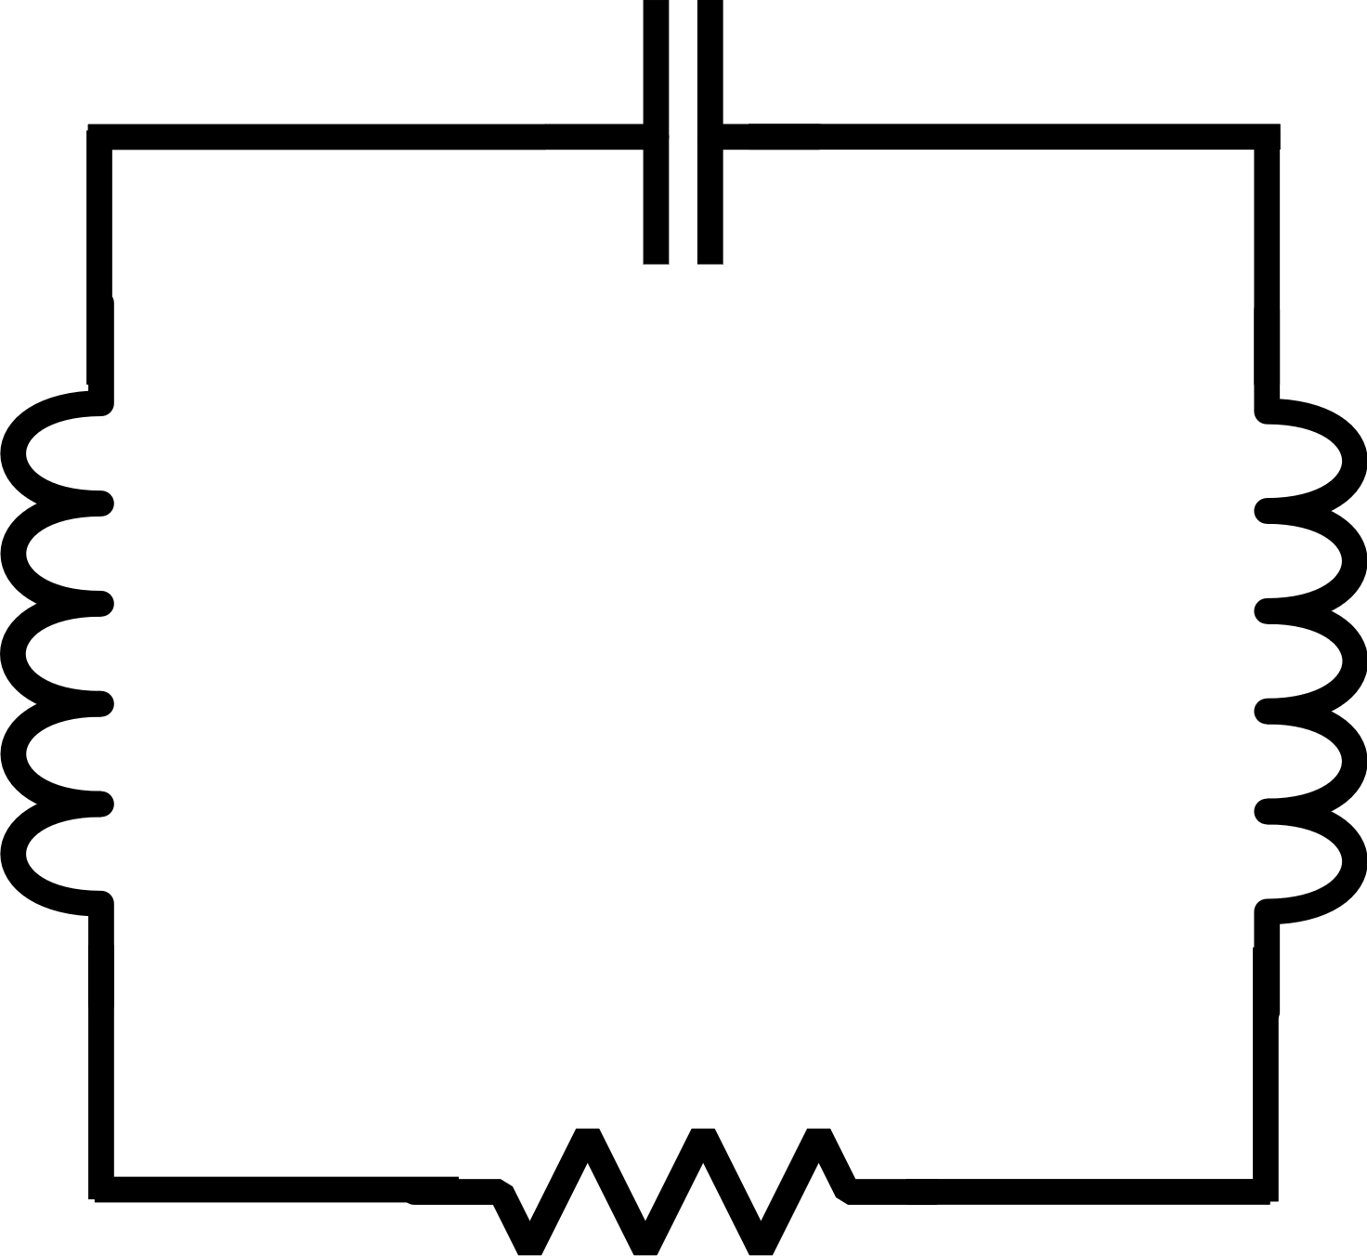
Circuit model for axion detection
Solenoidal pickup inductor placed
in sheath center hole
Tunable capacitor
Φ_{ax}
C
I_{ax}
I_{res}
>
>
>
Φ_{SQ}
>
L_{sheath}
L_{PU}
L_{IN}
X
X
SQUID current readout
R
X
X

Slide 4
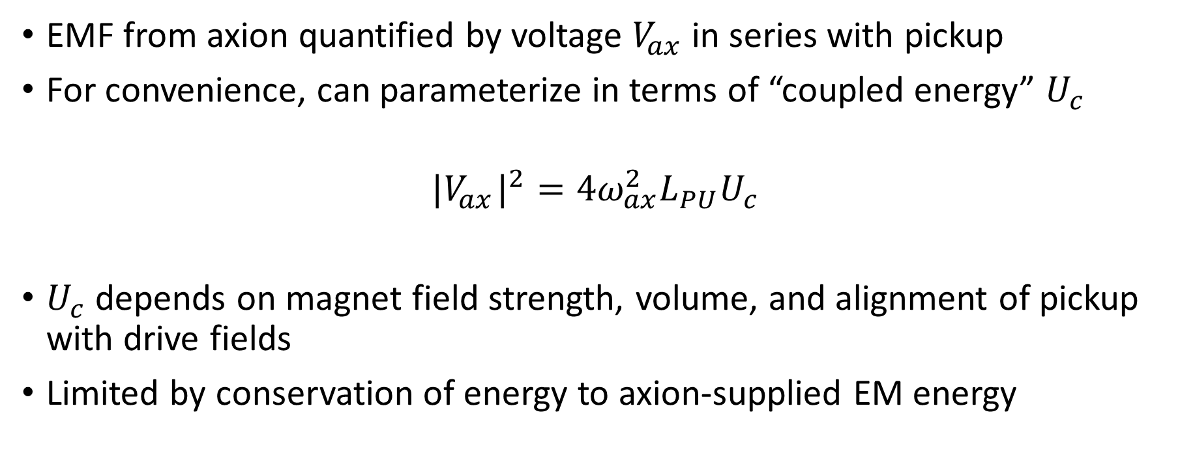
Axion voltage signal quantified by coupled energy
EMF from axion quantified by voltage $V_{ax}$in series with pickup
For convenience, can parameterize in terms of “coupled energy” $U_{c}$
$${|V_{ax}^{}|}^{2}=4ω_{ax}^{2}L_{PU}U_{c}$$
$U_{c}$ depends on magnet field strength, volume, and alignment of pickup with drive fields
Limited by conservation of energy to axion-supplied EM energy

Slide 5
Signal and noise voltage sources
Solenoidal pickup inductor placed
in sheath center hole
Tunable capacitor
Φ_{ax}
C
I_{ax}
I_{res}
>
>
>
Φ_{SQ}
>
L_{sheath}
L_{PU}
L_{IN}
X
X
V_{ax}
SQUID current readout
R
X
X

Slide 6
Two fundamental statistical noise sources
Φ_{ax}
C
I_{ax}
I_{res}
>
>
Φ_{SQ}
>
>
L_{sheath}
L_{PU}
L_{IN}
X
X
V_{ax}
V_{th}
R
Thermal + Vacuum Noise

Slide 7
Two fundamental statistical noise sources
Φ_{ax}
C
I_{ax}
I_{res}
>
>
Φ_{SQ}
>
>
L_{sheath}
L_{PU}
L_{IN}
X
X
V_{ax}
Readout Noise
V_{th}
R
Thermal + Vacuum Noise

Slide 8
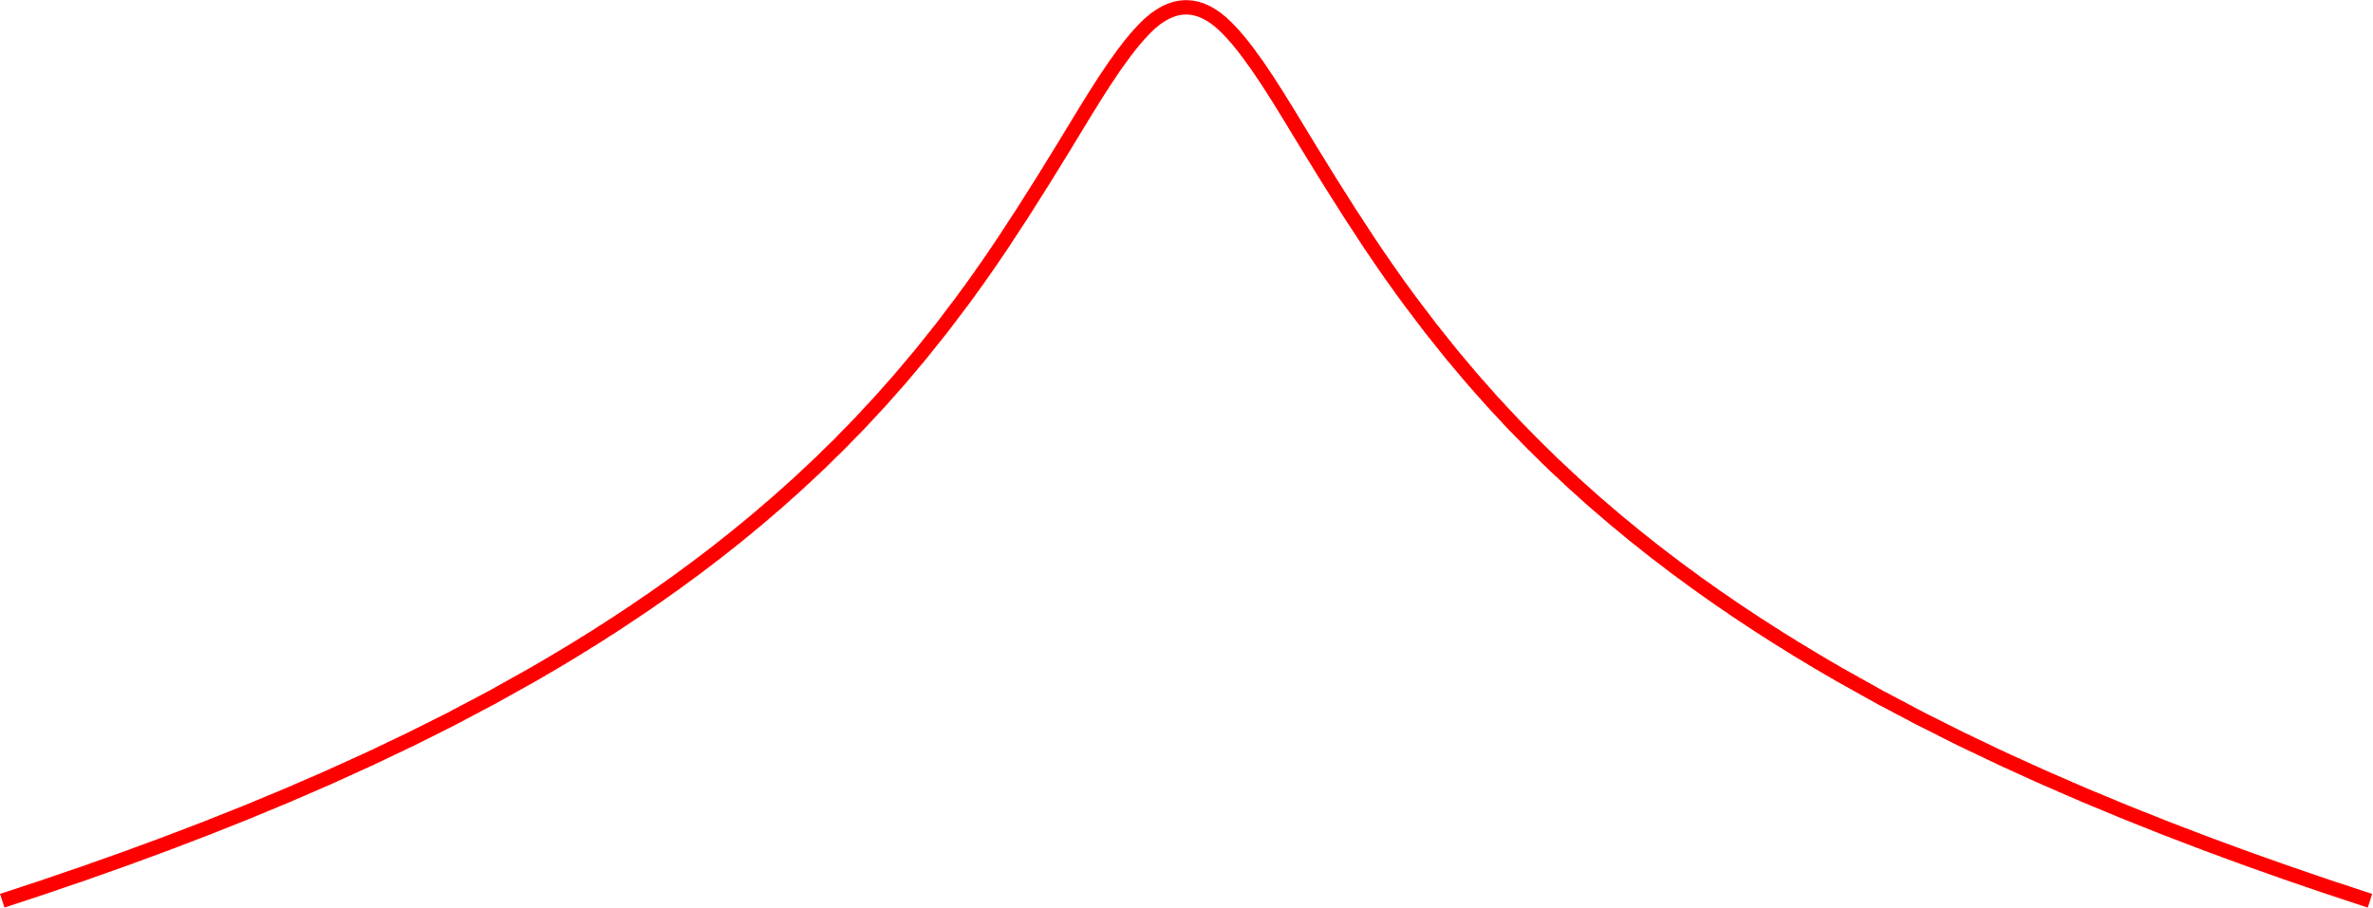
Noise in receiver circuit
Current Response
Resonator Line Shape
Thermal + Vacuum Noise
Readout Noise
Frequency

Slide 9
Tuned to dark matter signal: max response
Current Response
Resonator Line Shape
DM 1
Thermal + Vacuum Noise
Readout Noise
Frequency
Resonator Bandwidth

Slide 10
Detuned DM signal: SNR the same!
Current Response
Resonator Line Shape
DM 2
Thermal + Vacuum Noise
Readout Noise
Frequency
Resonator Bandwidth
SNR not degraded when readout subdominant to thermal noise

Slide 11
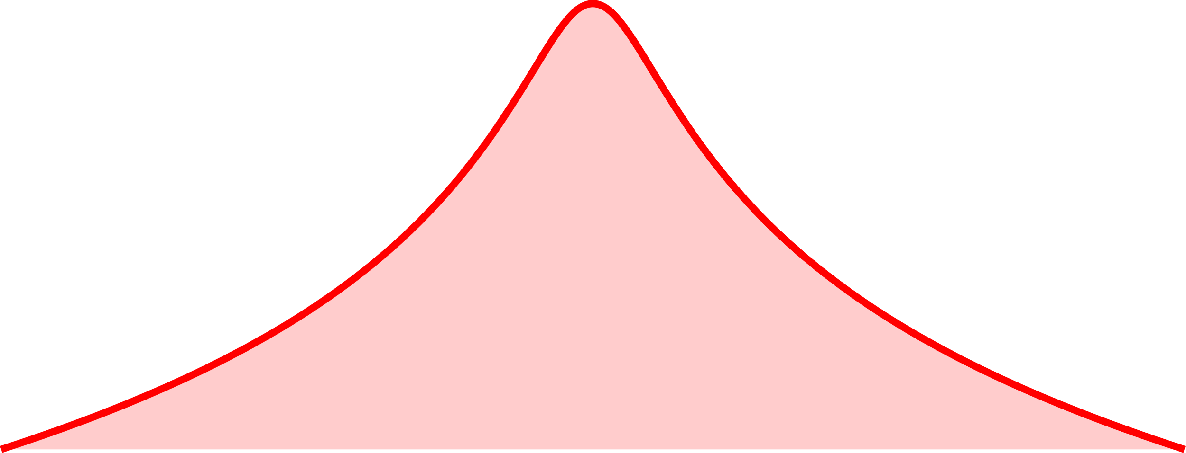
Scan rate enhancement from sensitivity BW
Current Response
Resonator Line Shape
Thermal + Vacuum Noise
Readout Noise
Frequency
Resonator Bandwidth
Sensitivity Bandwidth

Slide 12
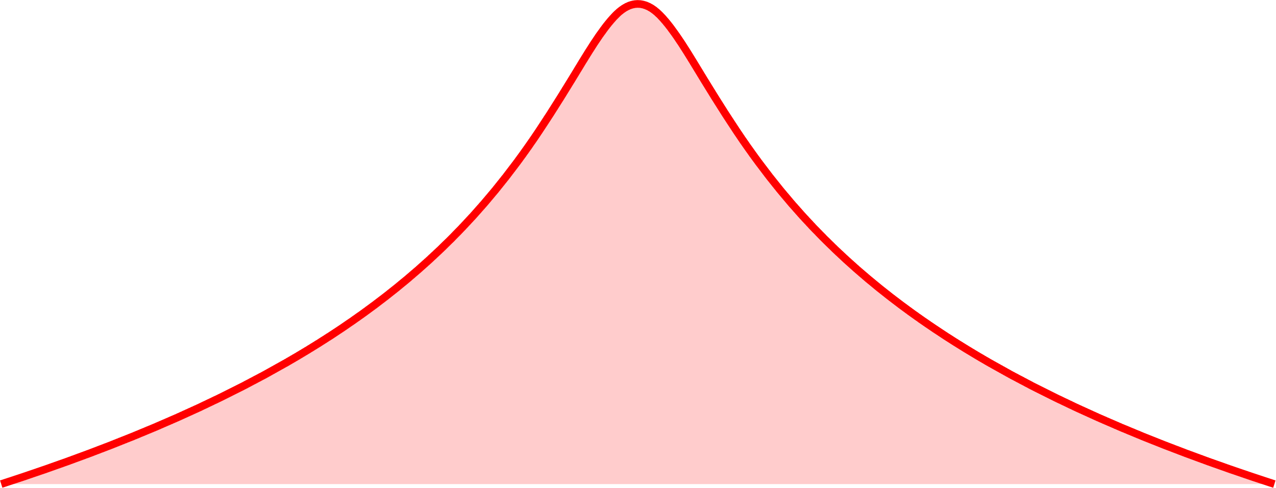
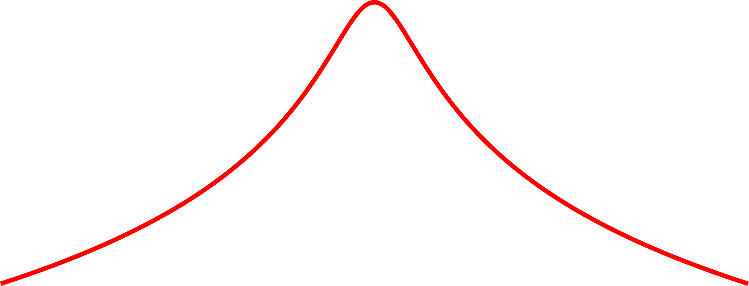
Readout noise is just the tip of the iceberg
Response
Thermal + Vacuum Noise
Readout Noise
Readout: Imprecision
Frequency
Sensitivity BW
Thermal + Vacuum Noise
Readout: Backaction
Frequency
Sensitivity BW

Slide 13
Increase coupling to lower imprecision noise
V
I
>
Response
Readout
L
C
R
Readout: Imprecision
Thermal + Vacuum Noise
Readout: Backaction
Frequency
Sensitivity BW

Slide 14
Backaction is exchanged for imprecision
V
I
>
Response
Readout
L
C
R
Imprecision
Thermal + Vacuum Noise
Backaction
Frequency
Sensitivity BW

Slide 15
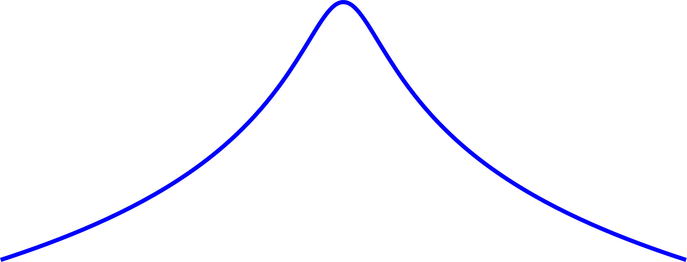
Optimize coupling to maximize sensitivity BW
V
I
>
Response
Readout
L
C
R
Thermal + Vacuum Noise
Backaction
Imprecision
Frequency
Sensitivity BW

Slide 16
Combine ingredients to get sensitivity formula
Energy coupled to pickup- depends on DM physics, as well as receiver parameters
Optimized amplifier coupling function
Quality factor
Time allocation function (scan strategy)
Resonator thermal occupation number
Complicated!
Invert to get limit on axion-photon coupling
See Chaudhuri et al, Arxiv: 1803.01627, Section VI

Slide 17

Parametrizing coupled energy in the quasi-static limit
From Biot-Savart,
$$U_{c}={\left({c_{PU}g}_{aγγ}^{}B_{0}^{}V^{1/3}\right)}^{2}ρ_{DM}V$$
Assumes quasi-static limit for pickup
Axion-photon coupling
Dark matter density
Geometry factor ~0.1
Spatially-integrated rms DC magnetic field
Field volume

Slide 18
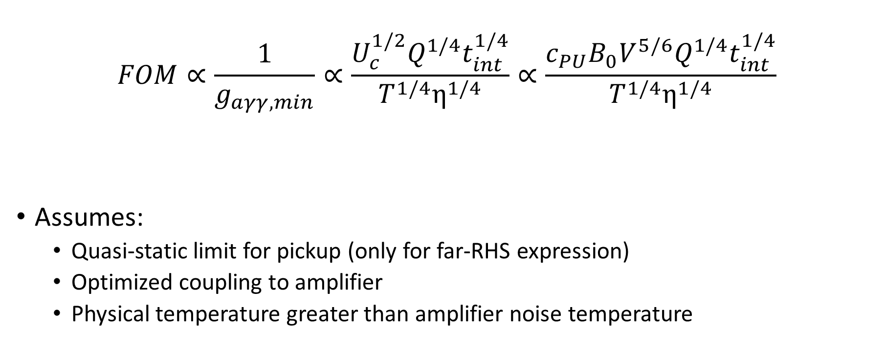
Performance figure of merit
Integration time
$$FOM∝\frac{1}{g_{aγγ,min}}∝\frac{{U_{c}^{1/2}Q}^{1/4}t_{int}^{1/4}}{T^{1/4}η^{1/4}}∝\frac{c_{PU}B_{0}V^{5/6}Q^{1/4}t_{int}^{1/4}}{T^{1/4}η^{1/4}}$$
Assumes:
Quasi-static limit for pickup (only for far-RHS expression)
Optimized coupling to amplifier
Physical temperature greater than amplifier noise temperature
Physical temperature
Amplifier noise temperature, normalized to ½ photon SQL

Slide 19
50L Estimated Performance Parameters
Parameter | Estimated Value | Informed By
B₀ | 0.68 T | OPERA simulations (Sebastian Leder)
V | 48.12 L | OPERA simulations (Sebastian), COMSOL simulations (Chiara)
cPU | 0.06 | COMSOL simulations (Chiara)
Q | 940k (theoretical) | HFSS simulations (Alex Droster), Resonator design code (Joe), upcoming dip probe campaign (Joe)
T | 20 mK | ANSYS simulations (Maria)
η | 100 | Upcoming SQUID dip probe campaign (Cady)
Integration time | 2 years live time | Kent

Slide 20
Projected Sensitivity
Projected Sensitivity

Slide 21
Next steps
Next 3-month plan
Tying up loose ends, combining component simulations
Simulations of other components: tuning system, transformers, readout
Other statistical noise sources (mechanical, vibration)
Experimental campaigns

