Slide 1
Nano-Beams & Final Focus Systems for Electron Colliders
Glen White, SLAC

Slide 2
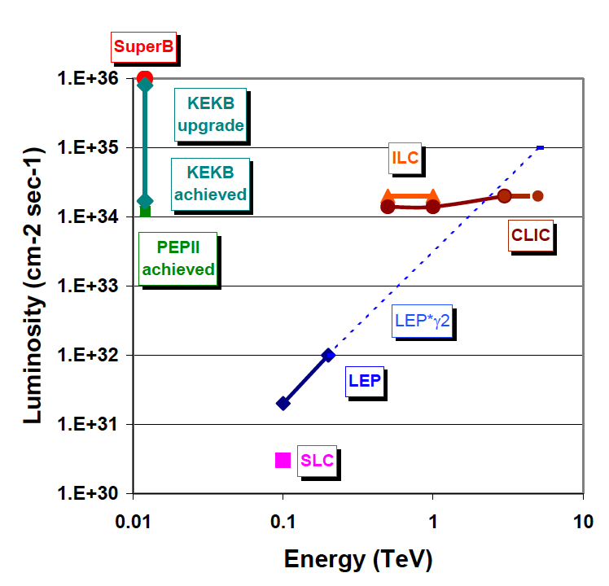
Lepton Collider Energy and Luminosity Frontiers
High energy linear colliders
  Future LC designs O(5-10) times LEP energy for new physics discoveries
  Physics cross-sections typically scale as E², demanding O(100) increase in luminosity, or O(1000) increase over SLC
High precision B factories:
  O(100) increase in luminosity over current PEPII/KEKB designs to allow physics investigations beyond the standard model
PWFA @ E_{cm}=10TeV
L(99%)

Slide 3
How to Increase Luminosity?
(Linear Colliders)
Beam-beam effects
  Beamstrahlung
  Disruption
Strong focusing
  Optical aberrations
  Stability, tolerance
Linac technology
    Efficiency
  Available power
RF power strong cost driver, try and keep power requirements to minimum & limited scope for efficiency improvements
Luminosity improvements must come mainly from smaller beams

Slide 4
Storage Ring vs. LC
LEP f_{rep} = 44 kHz
LC f_{rep} = 5, 50 Hz (ILC 0.5, CLIC 3TeV)
  Power limited
Already factor 8,800 / 880 down in L
Must push hard on beam cross-section at interaction
  LEP σ_{x}/σ_{y} = 130 / 6 um
  LC σ_{x}/σ_{y} = 474 / 3.8 , 40 / 1 nm (ILC 0.5, CLIC 3TeV)
  > factor 10⁶ gain to get > 2 x 10³⁴ luminosity
Also, LC can push harder on beam-beam (H_{D}), but there are limits.

Slide 5
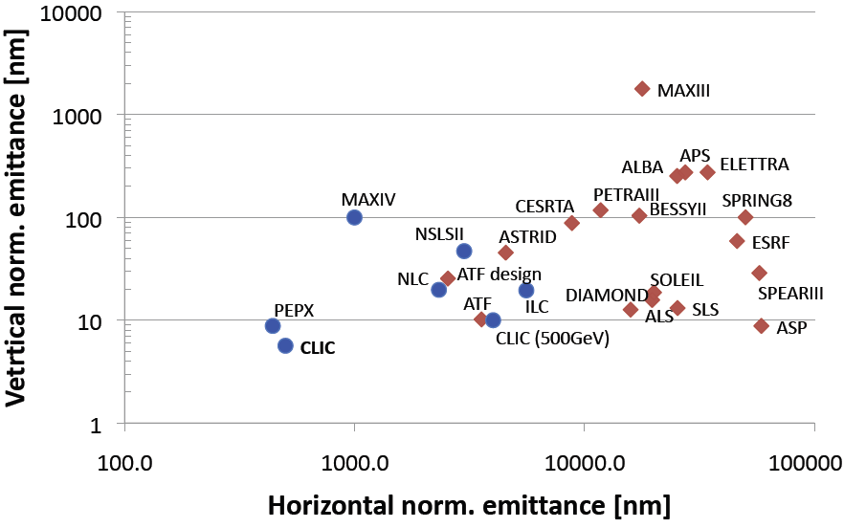
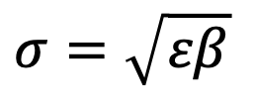
Emittance Generation
Low beam emittance from Damping Rings
$$σ=\sqrt{εβ}$$
Colliding beam size product of “optics” focusing (β) and phase space of beam (emittance, ε)
Hard to push much further on vertical emittance
For LC have to also worry about emittance transport to IP over long distances

Slide 6
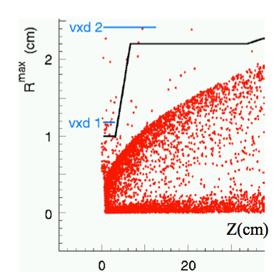
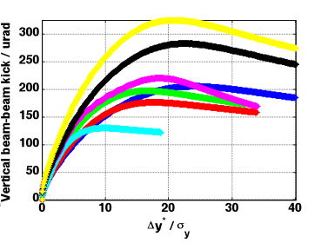
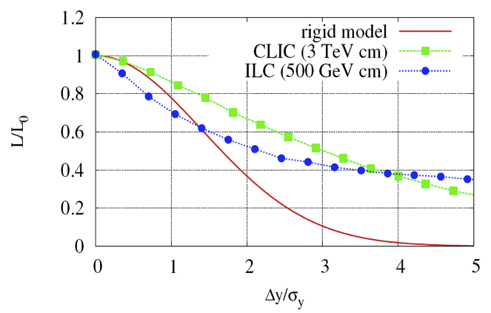
Beam-Beam Interaction
Strong mutual focusing of beams (pinch) gives rise to luminosity enhancement H_{D}
  Good for LC, but for storage ring
  where need to re-circulate beam, must keep beam-beam parameter small
  For ILC H_{D} ~ 6
As e± pass through intense field of opposing beam, they radiate hard photons [beamstrahlung] and loose energy
  Degrade luminosity spectrum
Interaction of beamstrahlung photons with intense field causes copious e+e- pair production [background]
Strong nonlinear response to beam-beam offsets

Slide 7
Interacting Beam Stabilization
For ILC
  Strong disruption parameter -> tight collision tolerance (<1nm)
For CLIC
  Looser disruption parameter but very small vertical beam size, still require <<1nm collision stability
B factories
  ~35nm vertical beam size still requires few-nm collision stability
Feedback on interacting beams
  LC beam structure requires intra-pulse train feedback
    ~MHz - GHz bandwidth
  B factories determined by circulation frequency
    ~kHz bandwidth

Slide 8
Beamstrahlung
RMS energy loss
For luminosity, want to keep σ_{x}.σ_{y} small
BUT to reduce δ_{BS} want to keep (σ_{x}+σ_{y}) large
Use FLAT beams with σ_{x} >> σ_{y}
SET σ_{x} to fix desired value for δ_{BS} and make σ_{y} as small as required to get desired luminosity.
If σ_{z}<100nm, beamstrahlung switches off altogether due to radiation formation length >> bunch length
  Possible alterative LC design using low-emittance RF gun driven e-e- collisions with round beams…

Slide 9
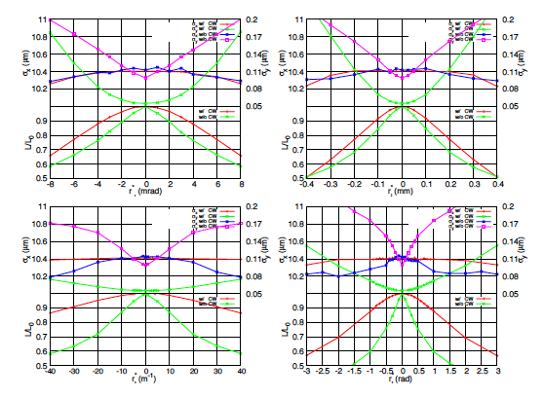

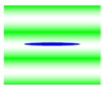
Large Aspect-Ratio Beams
The downside of large x/y ratios at interaction point is sensitivity to coupling terms
Super(KEK)B
  Places tolerances on magnet alignment
  Requires tuning knobs?
LC
  Need tight control of coupling terms using tuning knobs
ATF2
  As LC, also alignment fringes of Shintake Monitor for beam size measurement important
SuperKEKB (D. Zhou et al.)
θ
ATF2

Slide 10
Limits for Vertical Beam Focusing
(Hour-Glass Effect)
Beam-beam determined by Disruption Parameter
σ_{z} : bunch length
f_{beam} : “focal length” of beam
“Hour-glass” effect
β* gives depth of focus
Reasonable limit is β*~σ_{z}
σ_{z} limits from energy spread and stability requirements
  Can be pushed beyond what traditionally considered?

Slide 11
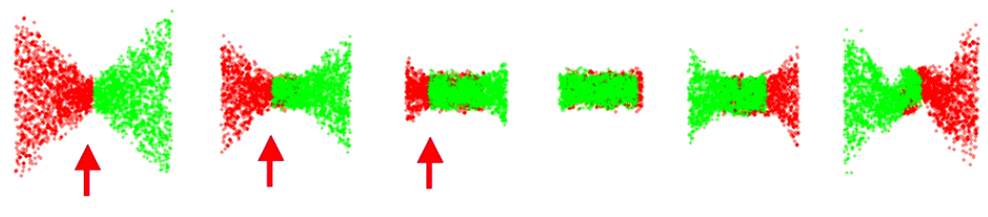
Overcoming the Hour-Glass
ILC – Travelling Focus
Suggested by V.Balakin – use beam-beam forces for additional focusing of the beam
Travelling focus created using a transverse deflecting cavity giving a z-x correlation in one of the FF sextupoles and thus a z-correlated focusing
The figure shows a simulation of the traveling focus
  The arrows show the position of the focus point during collision
So far not yet tested experimentally

Slide 12
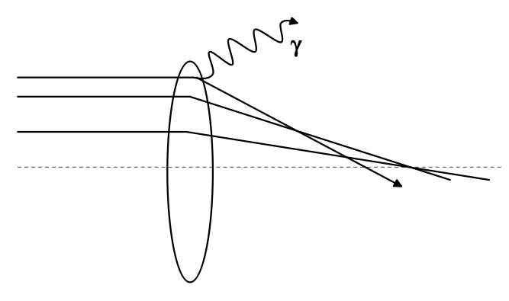

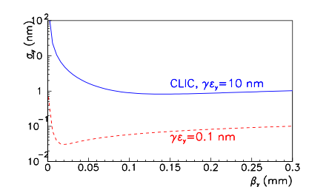

Ultimate Limit to Focusing?
CLIC – The “Oide Limit”
Synchrotron radiation in final doublet limits achievable focused beam size
Minimum beam size dependent only on achievable emittance
Places fundamental limit of ~1nm for achievable emittances
Need different focusing scheme to mitigate
  E.g. Plasma lens (extreme focusing gradients & stability issues pose severe technical challenges)

Slide 13
LC Parameters

Slide 14
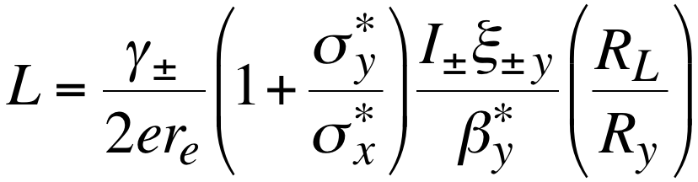
How to Increase Luminosity?
(B Factories)
Beam-beam parameter
Lorentz factor & classical electron radius
Beam-size ratio
Geometric reduction factor
Increase beam currents
  HOM in beam pipe
  heating, instabilities, power, costs
  Detector backgrounds increase
Decrease interaction vertical beta function
  Chromaticity increase
  smaller dynamic aperture
Decrease bunch length
  RF voltage increase
  costs, instabilities
  Shorter LER Touschek lifetime

Slide 15
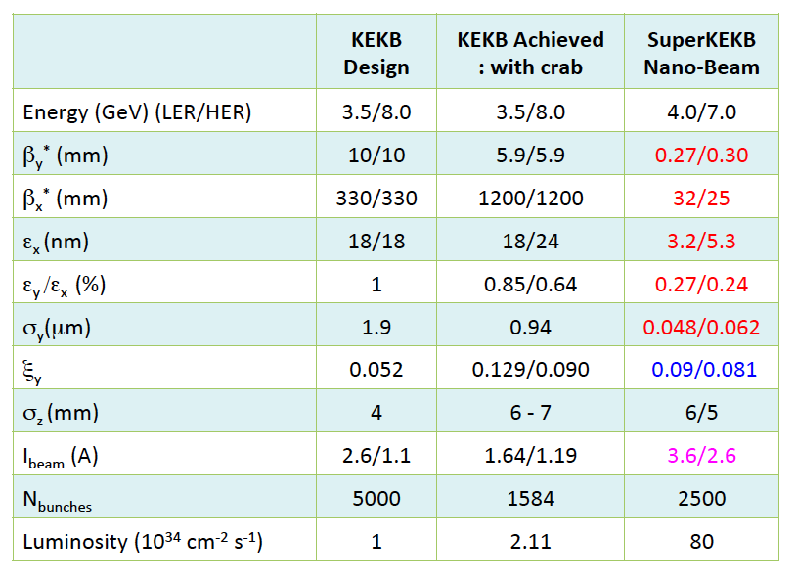
Super-KEKB Parameters
~ X 20
~ X 1
~ X 2

Slide 16
Final Focus for Nano-Beams
Future Linear Collider and B-factories call for higher luminosity through tight focusing of vertical beam at interaction point
This calls for betatron focusing at the IP many orders of magnitude beyond experience of operational colliding beams
New, untested final focus optics schemes proposed
Now look at proposed schemes and how to verify that they will work

Slide 17
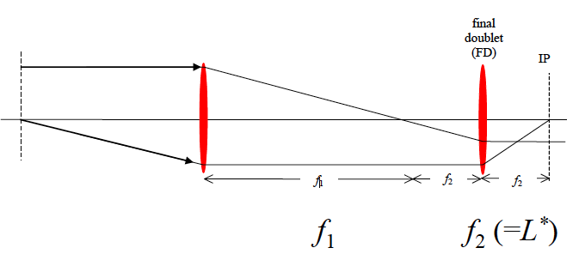

Final Telescope
Use telescope optics to demagnify beam by factor m = f1/f2= f1/L*
Min # quads for FT =4
If no energy spread, this would serve as final focusing system
Short f requires strong fields
  For LC ~ 250 T/m gradients required
  β at quads very large ~ 100 km

Slide 18
Final Focus Chromaticity
ξ_{y}* L*_{y} / β＊_{y}
Δσ/σ ~ σ_{E}.L*/β*
f = L*
For LC
  L* ~ 3 - 5 m
  β* ~ 0.05 – 0.4 mm
  σ_{E} ~ 0.1 – 0.2 %
=> Δσ/σ ~ 10 – 200 : Too Big!
Chromaticity of final doublet must be compensated

Slide 19
Chromatic Correction
Correct chromaticity in FFS through the introduction of sextupole magnets in a dispersive section of lattice generated by horizontal bend magnets and at regions of high beta
Sextupole strength introduces 2nd order kicks:
  Δx’ = -½ K_{s} ( x² + 2.x.η.δ + η².δ² – y² )
  Δy’ = K_{s}.x.y + K_{s}.η.δ.y
For thin-lens FD:
  Δx’ = x.δ / L* + η.δ² / L*
  Δy’ = - y.δ / L*
To make first-order chromaticity vanish:
  1 / L* - η.K_{s} = 0
Balance between high dispersion and strong sextupoles
  High dispersion -> emittance degradation due to sync. radiation
  Strong sextupoles -> need for more precise cancelation of geometric terms

Slide 20
Complications
Geometric terms and second-order dispersion remain:
  Δx’ = - 1/2.η.L* (x² – y²) + η.δ²/2.L*
  Δy’ = x.y / η.L*
Can cancel geometric terms by separating sextupoles in pairs with –I transform between them.
Can cancel second-order dispersion by arranging for upstream beta-matching section (for LC) to have equal horizontal chromaticity as FD
  Running horizontal correction sextupoles twice as strong cancels second-order dispersion

Slide 21
Further Complications
For high-energy LC applications, a full treatment of the optics reveals a larger set of important aberrations that need to be cancelled in addition.
  Chromatic sensitivities in the lattice providing –I transform between sextupoles introduces 3rd-order chromaticity and other 4th-order chromo-geometric terms.
  Finite-lengths of sextupoles yields octopole-like 4th-order aberrations.
Designing a FFS which yields the proposed horizontal and vertical interaction spot sizes becomes a complex, non-linear process requiring multiple computer-aided tools.

Slide 22
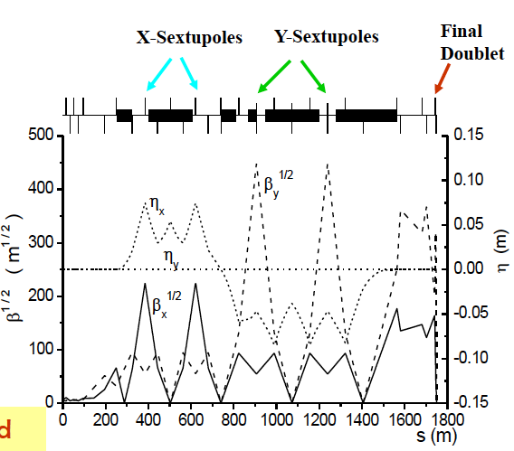
“Traditional” FFS Design
“Non-local” correction of FD chromaticity in dedicated upstream sections
Pairs of sextupoles with –I transforms
Tested at FFTB
Some problems
  Compensation of aberrations non-ideal as –I transform destroyed for off-energy particles
  Large aberration generated in beam tails
  Separated correction sections makes FFS very long

Slide 23
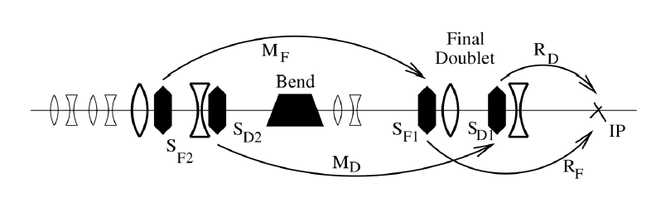
FFS with Local Chromatic Correction
Originally proposed by P. Raimondi & A. Seryi (~2000)
Correct chromaticity locally within final doublet using pairs of interleaved sextupoles
Upstream bend magnet generates required horizontal dispersion
Geometric aberrations cancelled with additional sextupoles placed upstream of bends in non-dispersive region.
Improvements over non-local system
  Shorter (e.g. NLC 1800m -> 300m)
  Improved momentum bandwidth
  Less halo generation

Slide 24
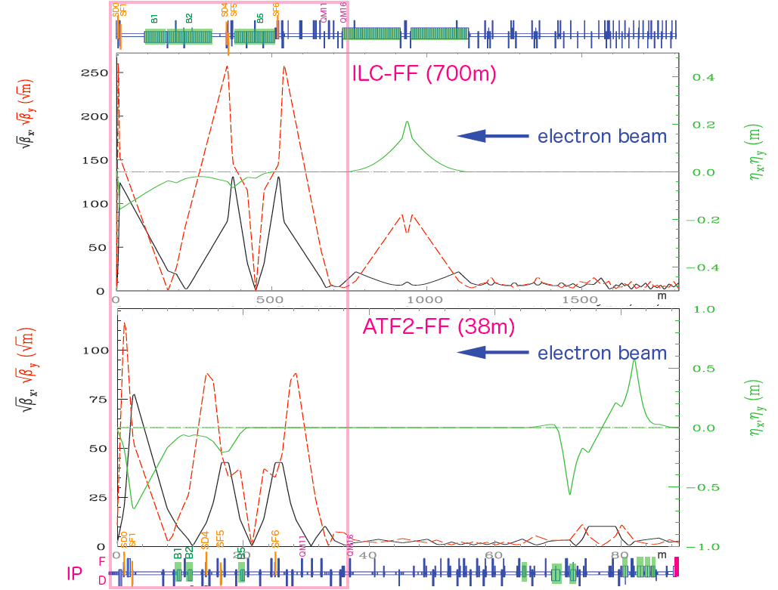
Test Local FFS Optics @ ATF2
Scaled design of ILC local-chromaticity correction style optics.
Same chromaticity as ILC optics.
At lower beam energy, this corresponds to goal ~37nm IP vertical beam waist.
Typical DR Parameters
ε_{x} / ε_{y} = 1.3nm / 12pm
E = 1.282 GeV
ATF2 IP parameters
β_{x} / β_{y} = 4cm / 0.1mm
σ_{x} / σ_{y} = 5um / 37nm
Rep. Rate = 1.56 Hz

Slide 25
Operational Challenges
Complicated “balancing of higher-order terms” in FFS design leads to very tight tolerances
  Try to model effects where realistic error conditions destroy properties of FFS
  Overcome these weaknesses by designing “tuning knobs” and simulate their effectiveness
  ATF2 validated this procedure by comparisons of accelerator tuning with expected results from simulations
Once tuned, dynamics effects cause drifts on multiple timescales of IP beam size and position
  Model all expected sources of dynamic drift and design countermeasures
  Test in detailed simulations
  ATF2 experience and implementation of dynamic drift countermeasures validated simulations

Slide 26
‘Static’ Error Sources
Installed positions
  Horizontal / vertical / roll
  Survey tolerances for ATF2 typically ~100um / 300urad
Alignment
  BPM -> magnet field centres
  Installation tolerances for ATF2 few-100 um
Magnetic fields
  Systematic and random integrated field strength deviations from model
  Quality of fields – relative strengths of magnetic multipoles

Slide 27
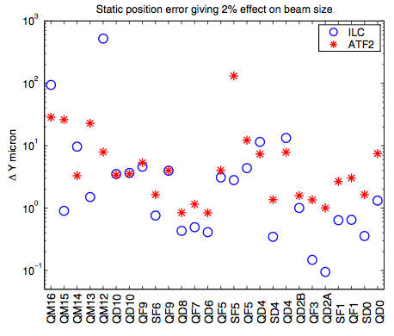
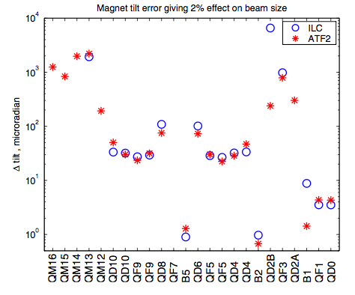
Tolerances on Placement Errors
Tolerances for many magnets much tighter than can be realised
Need to rely on active tuning

Slide 28
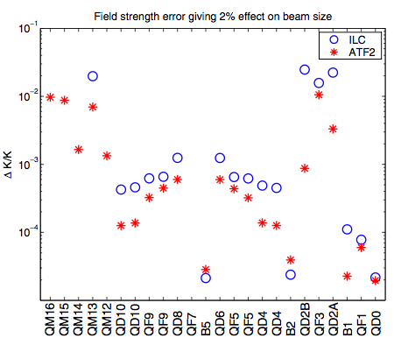
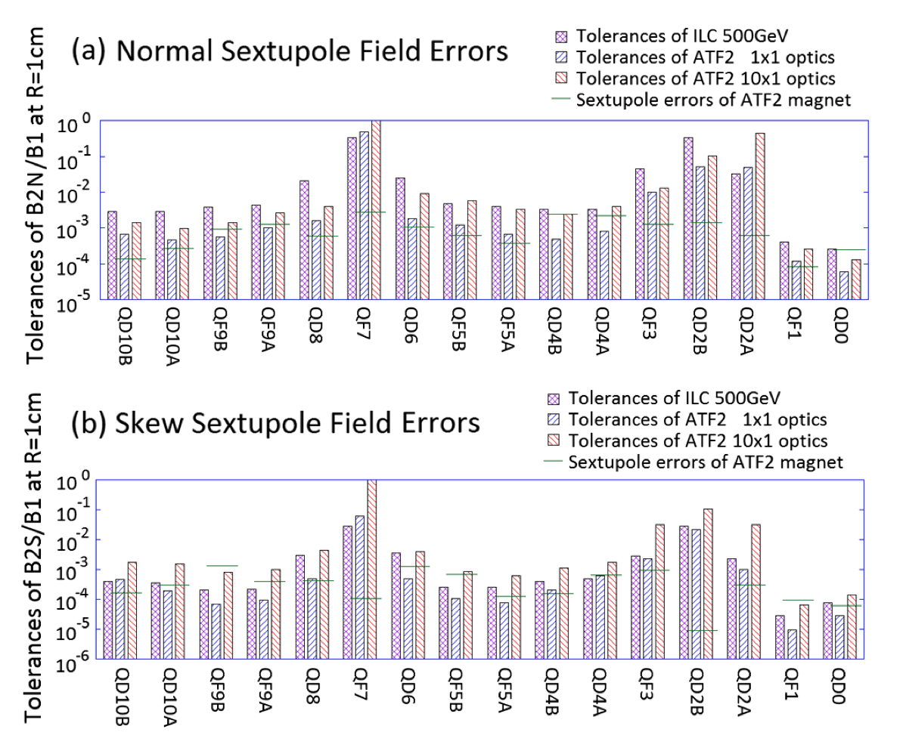
Tolerances on Magnetic Field Errors
Field strength and quality requirements also high

Slide 29
FFS Tuning
Have no expectations of producing or placing magnetic elements with these extremely tight tolerance requirements
Instead, design “tuning knobs” to remove the aberrations at the IP that exceeding these tolerance requirements generates
This generates a new set of “dynamic” tolerances for the optics design based on the ability for the designed tuning knobs’ ability to remove the expected aberrations
Simulations including tuning knobs and all expected error sources must be run to assess the design of the FFS

Slide 30
Sextupole Tuning Knobs
Deliberately offsetting the beam orbit using the FFS sextupoles (mounted on magnet mover systems) provides tuning knobs for dispersion, waist-shift, coupling and other higher-order terms at the IP
Orthogonal knobs are computed by inverting the sextupole move -> IP aberration matrix formed by scanning the sextupoles in turn and measuring the IP terms.
Tolerances on movers is tight
  ILC ~ 50nm position sensitivity

Slide 31
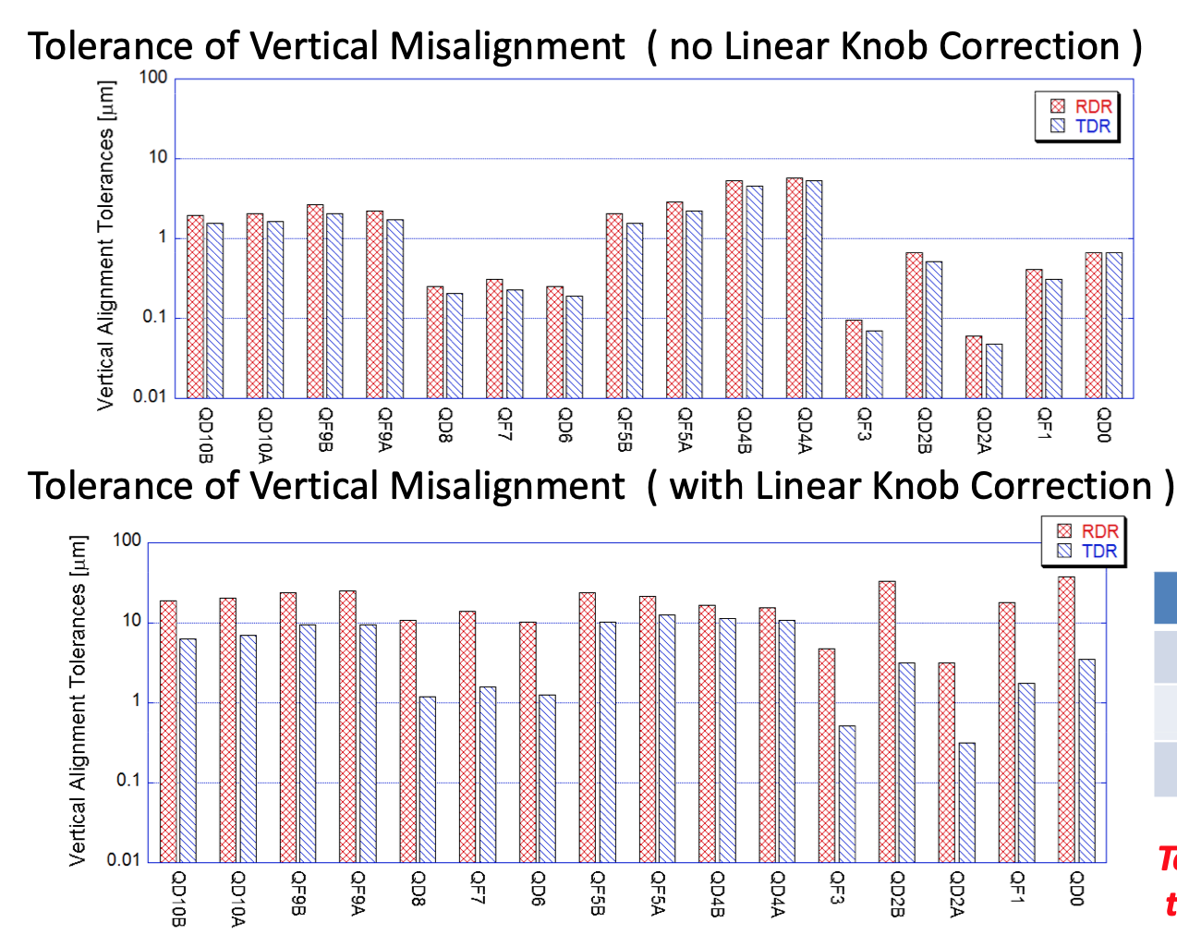
Linear Tuning Knobs
Removes sensitivity to beam waist offsets, coupling & momentum dispersion
Second-order aberrations still important

Slide 32
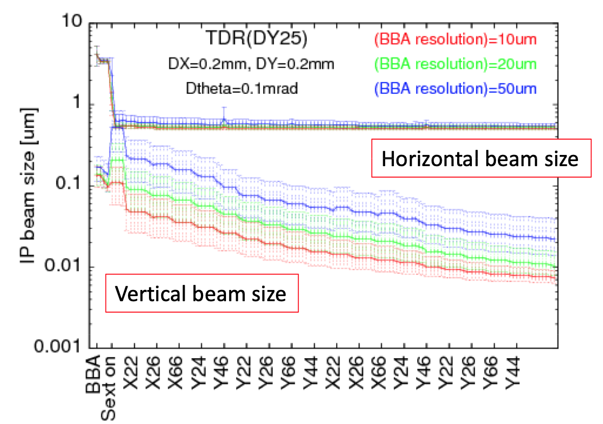
Beam Size Tuning
Beam size reduced by repeated application of both linear and non-linear knobs
Non-linear knobs involve sextupole, skew-sextupole & octupole rotations & strength changes

Slide 33
Dynamic Error Considerations
Need to worry about
many jitter sources at
nanoscale
Ground motion
  Natural and cultural
  Especially final doublet
Mechanical jitters
Temperature drifts
  e.g. 1⁰C degree ~ 10um
  motion in most metals
Magnetic field drifts
Parallel-point focusing
Tolerance of FD ~nm!

Slide 34
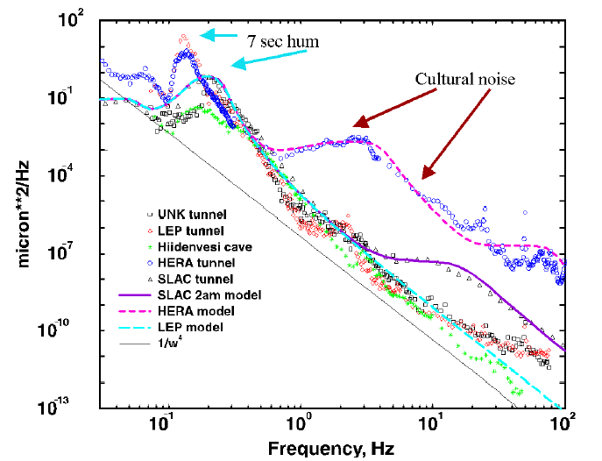
Ground Motion
Ground motion spectra specific to individual sites
Underlying power law, overlaid with cultural noise source which dominate above a few Hz

Slide 35
Collision Stability at LC
Luminosity loss through fast motion of final doublets causing offset in beam collisions
  Mitigated by MHz-scale intra-train feedback close to IP
Emittance dilution due to orbit growth on longer timescales
  Mitigated by distributed orbit feedback systems
IP + Orbit FB
NO FB
IP FB

Slide 36
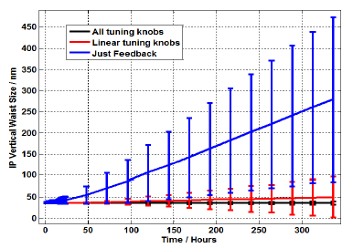
Long-Term Stability
Feedback & Orbit control not enough for long term beam size stability
Need to periodically tune using all available aberration correction knobs
Concept of “tuning knob dither feedback”
Design of tuning system integral part of understanding luminosity capabilities of collider

Slide 37
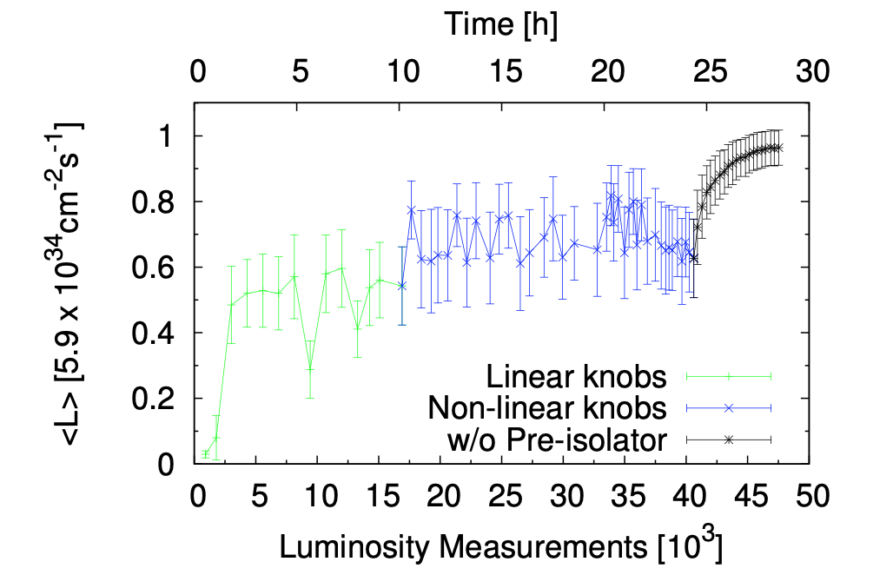
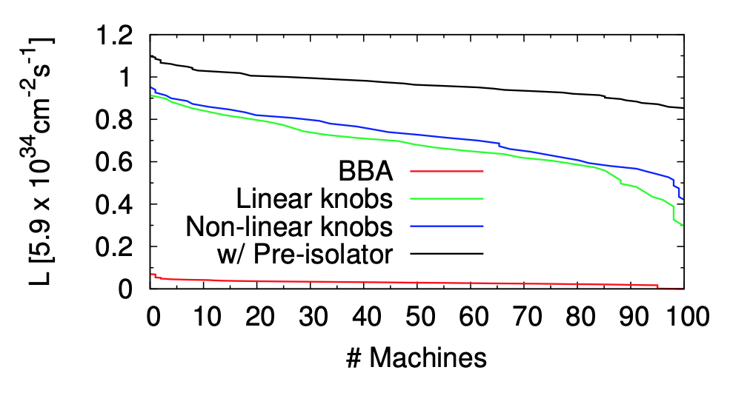
Tuning at the extremes- CLIC 3 TeV
E. Marin et. al., IPAC 2018
Simulations with many imperfections (but not all) performed in close to realistic (but still not close enough) conditions
E_{cm}<1TeV machines look tunable
CLIC 3 TeV still hasn’t been shown to be tunable

Slide 38
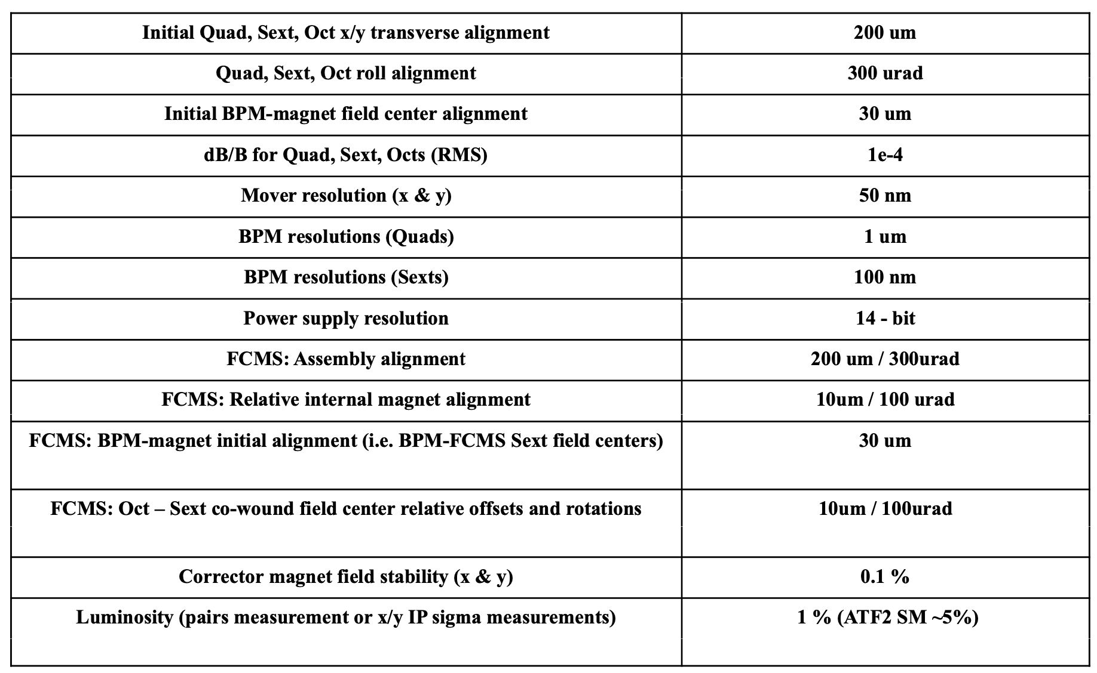
Required Tolerances for Tuning to Work
ILC
CLIC
10 um
1 nm
10 nm
10 nm

Slide 39
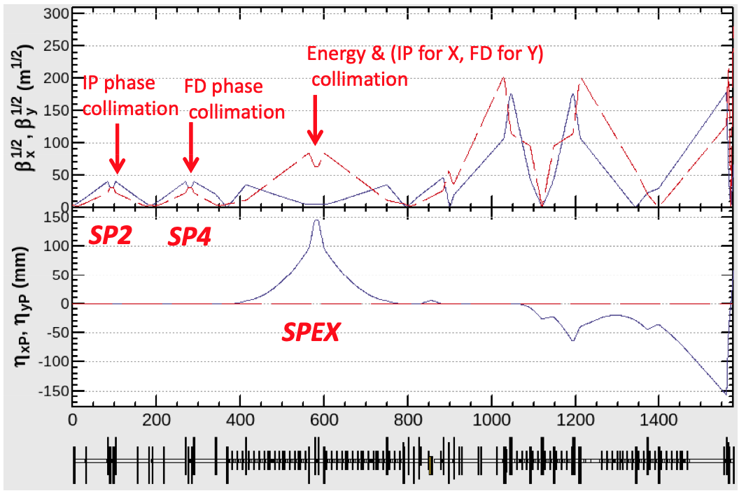
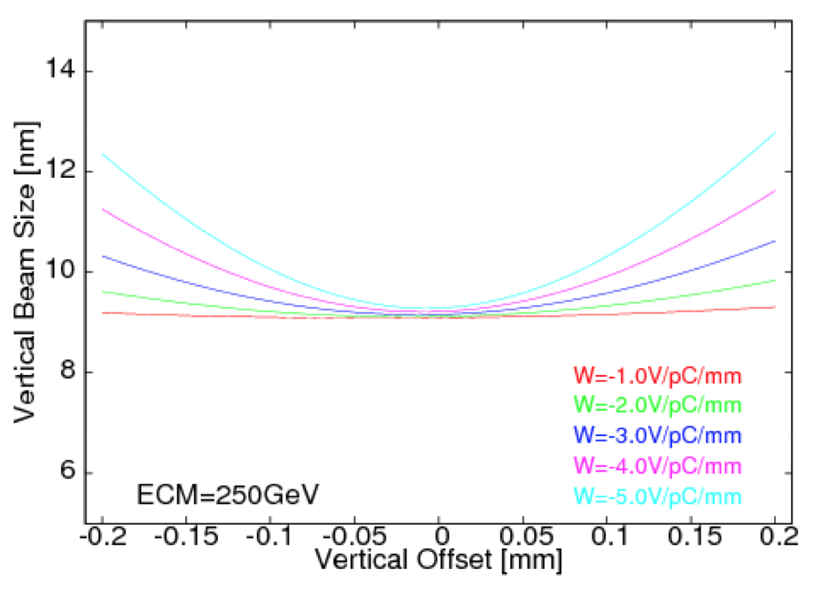
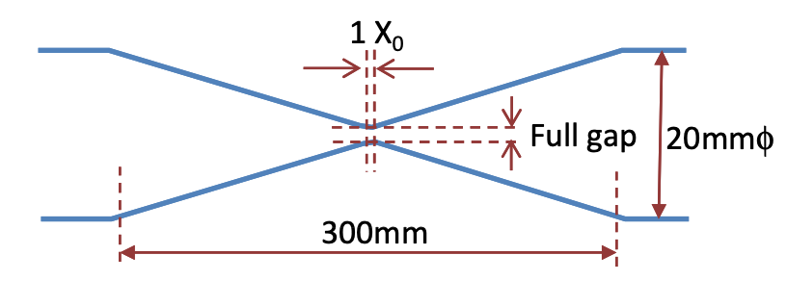
Collimation & Wakefields
Collimation required to remove halo particles to protect detector
Tight collimation requirements require careful design to avoid wakefields
Large beta functions in BDS also require careful consideration of wakefield issues

