Slide 1
Understanding Neutrino Events at Liquid Argon Detectors
Shirley Li
Collaborator: A. Friedland
Precision Investigations of the Neutrino Sector, July 2019

Slide 2
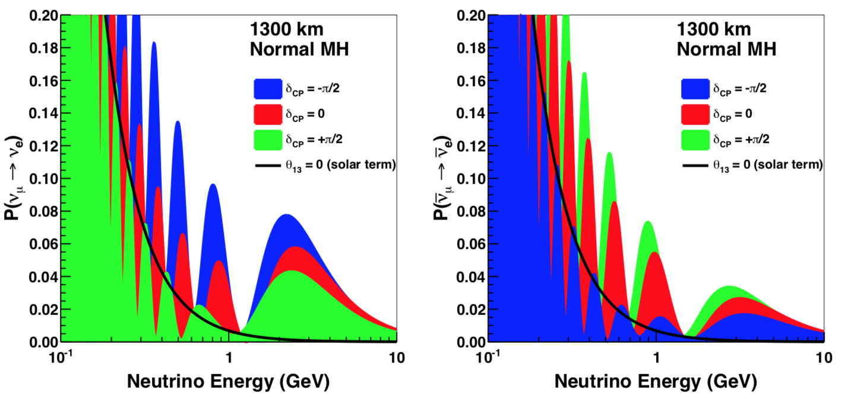

Measuring $δ_{CP}$ and MH
~1000 km
0.5—5 GeV $ν_{μ}$ $ν_{e}$
DUNE CDR
Need to measure $N(E_{ν_{e}})$
2/31

Slide 3

DUNE detector
40 kton liquid argon TPC
Detects charged particles above thresholds
3/31
Notes:
DUNE and NOvA

Slide 4
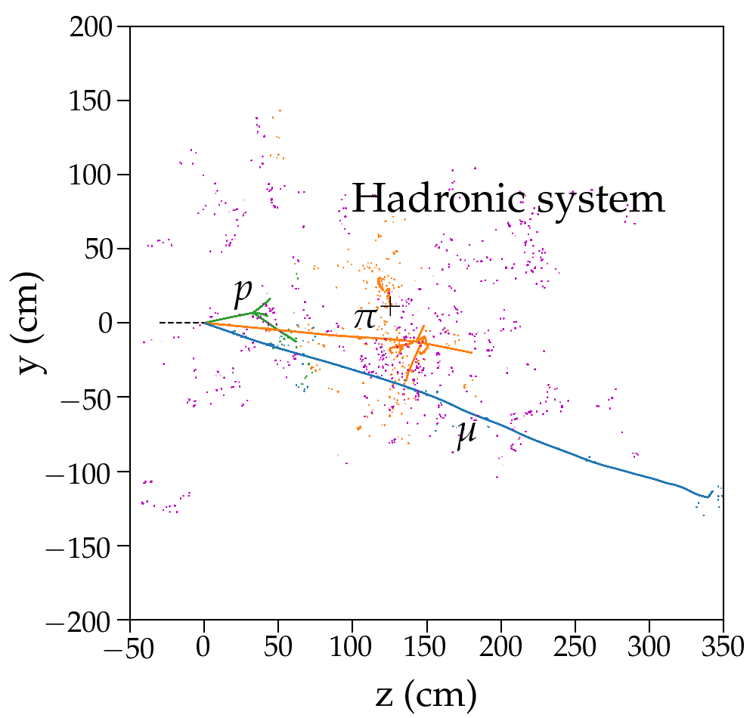
The overarching question
How well can we measure neutrino energy?
Simulated with GENIE+FLUKA
Friedland & Li, 2018
4/31

Slide 5
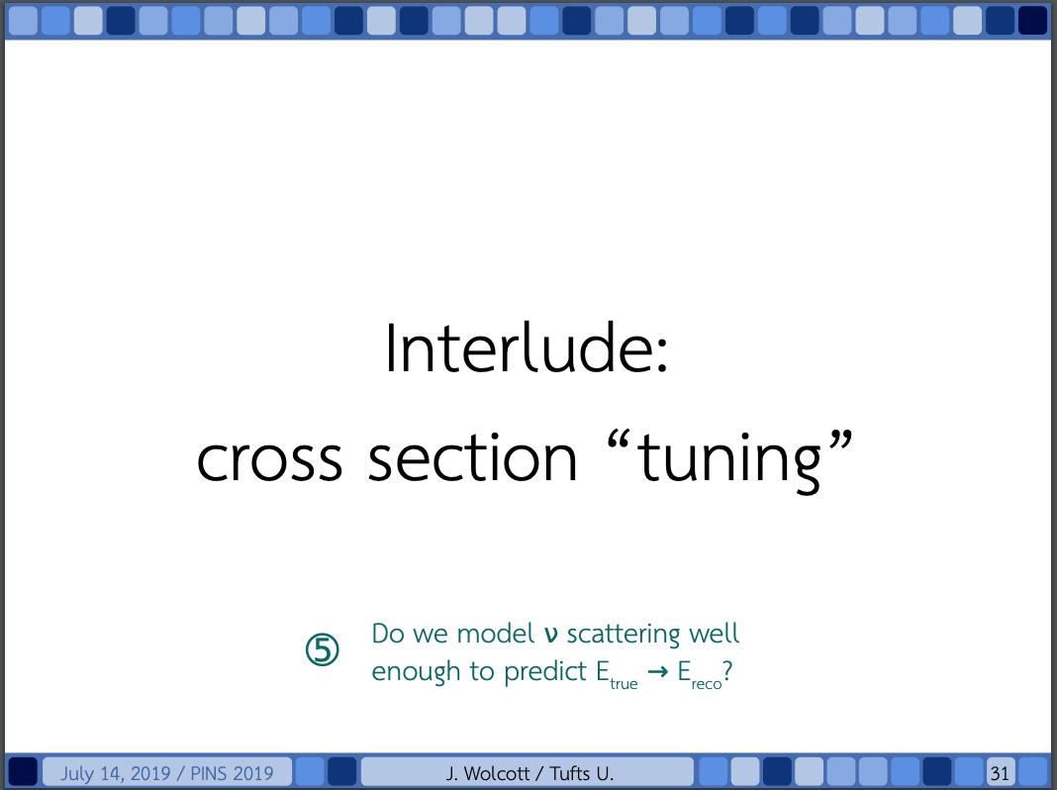

Slide 6
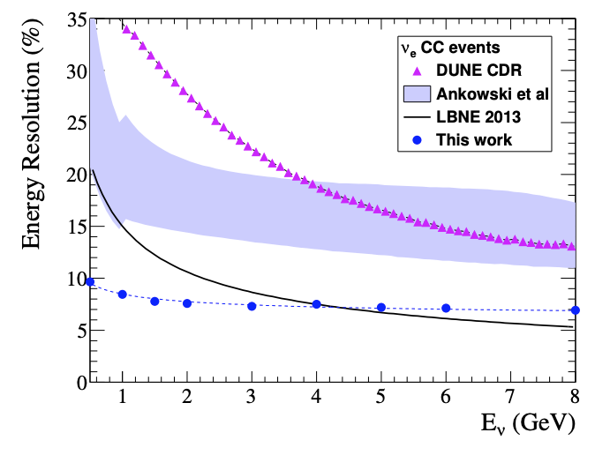
No consensus in the field
Energy resolution from prior work
Romeri, Fernandez-Martinez & Sorel, 2016
5/31

Slide 7
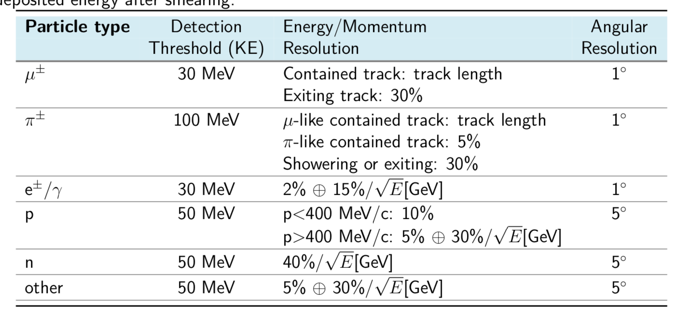
Two types of performance studies
Fast Monte Carlo type
DUNE CDR
See physical connection; not quantitative
6/31

Slide 8
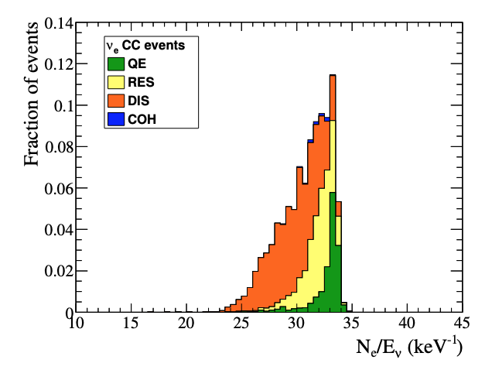
Two types of performance studies
Full propagation type
Romeri, Fernandez-Martinez & Sorel, 2016
Complete; hide physical connection
7/31

Slide 9
No consensus in the field
Energy resolution from prior work
Romeri, Fernandez-Martinez & Sorel, 2016
8/31

Slide 10
Our goal:
Understanding the physics of energy reconstruction

Slide 11
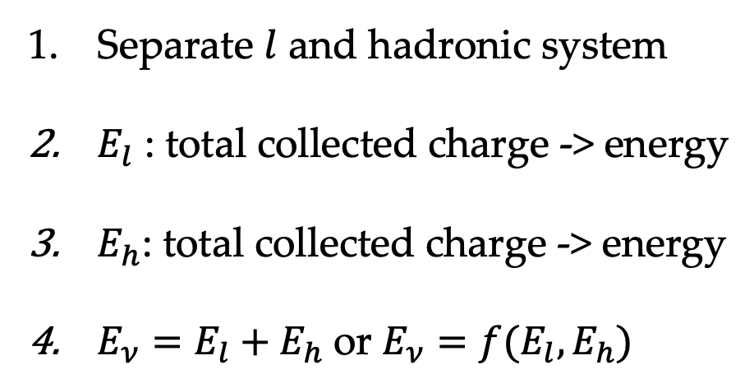
Calorimetric energy reconstruction
Signal: $ν_{l}+A→l+X$
Simulated with GENIE+FLUKA
Friedland & Li, 2018
Separate $l$ and hadronic system
$E_{l}$ : total collected charge -> energy
$E_{h}$: total collected charge -> energy
$E_{ν}=E_{l}+E_{h}$or $E_{ν}=f(E_{l}, E_{h})$
How to characterize its performance?
10/31

Slide 12
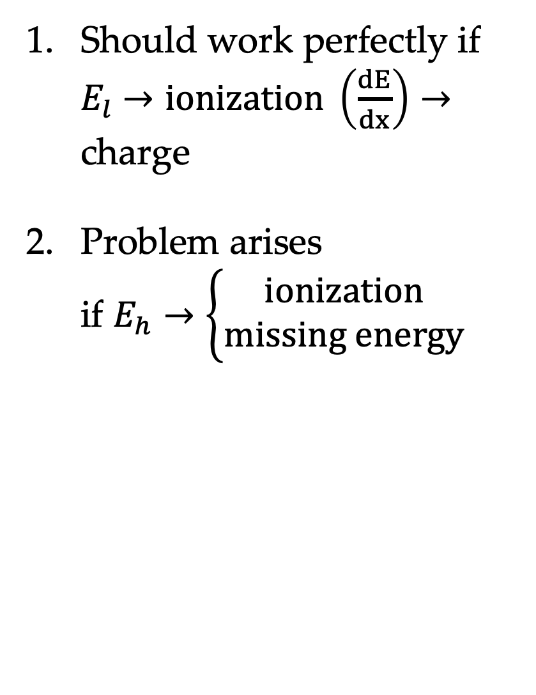
Calorimetric energy reconstruction
Signal: $ν_{l}+A→l+X$
Should work perfectly if $E_{l}$ $→ionization \left(\frac{dE}{dx}\right)→$ charge
Problem arises if $E_{h}→\left\{\begin{aligned}ionization \\ missing energy\end{aligned}\right.$
Understanding missing energy is the key
11/31

Slide 13
Hadronic system
Prompt $ν$ vertex: $ν_{l}+A→l+X$
Friedland & Li, 2018
GENIE default model
30 – 40% of neutrino energy, large fluctuations
12/31

Slide 14
Hadronic system
GENIE simulation
Varied composition
Friedland & Li, 2018
Multiple species contribute, large fluctuations
13/31

Slide 15

Missing energy in $E_{h}$
After primary vertex
Friedland & Li, 2018
Prompt neutrons are the biggest issue
14/31

Slide 16
Secondary particle propagation
Charged particles
Friedland & Li, 2018
Many re-interactions
15/31

Slide 17
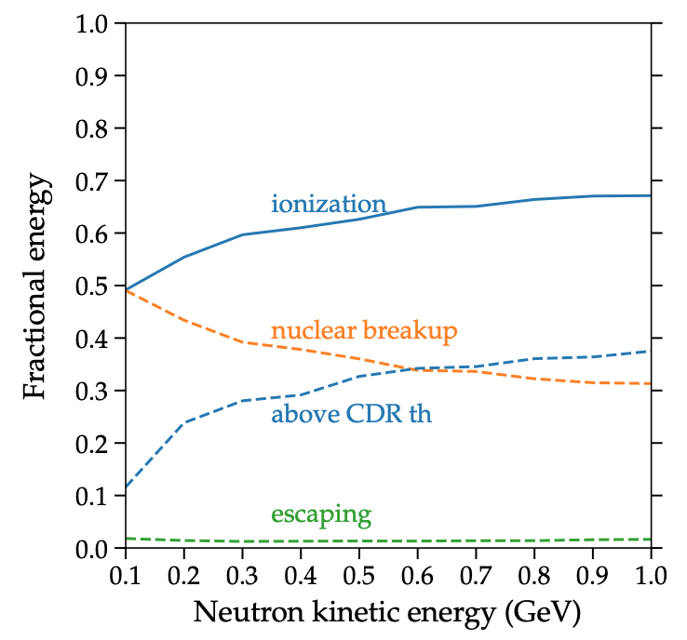
Secondary particle propagation
Neutrons
Friedland & Li, 2018
Simulated with FLUKA
Neutron deposit ~ 50% of its energy in ionization
16/31

Slide 18
Secondary particle propagation
Neutrons
Friedland & Li, 2018
Simulated with GENIE+FLUKA
Extremely challenging to reconstruct neutrons
17/31

Slide 19
Secondary particle propagation
Neutrons
Friedland & Li, 2018
Simulated with GENIE+FLUKA
Extremely challenging to reconstruct neutrons
17/31

Slide 20
Secondary particle propagation
Neutrons
Friedland & Li, 2018
Simulated with GENIE+FLUKA
Extremely challenging to reconstruct neutrons
17/31

Slide 21
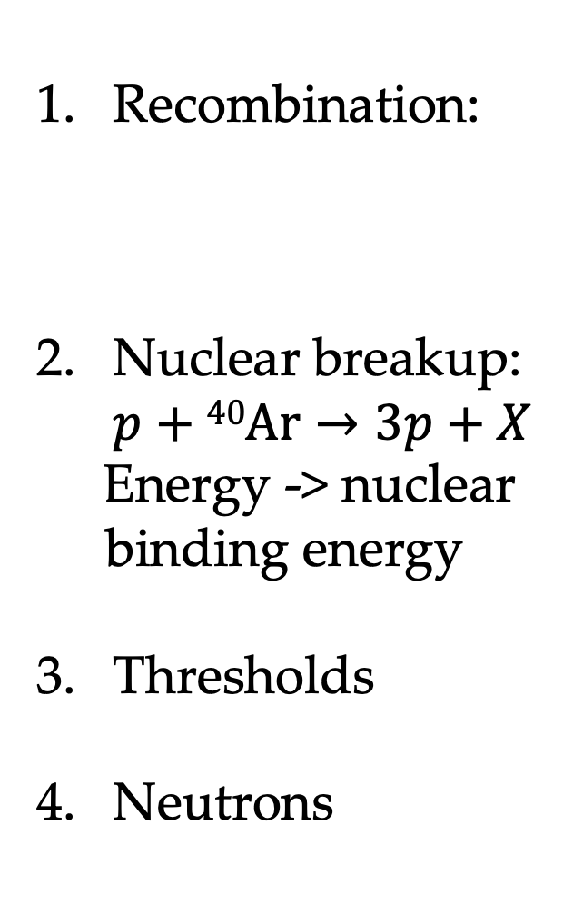
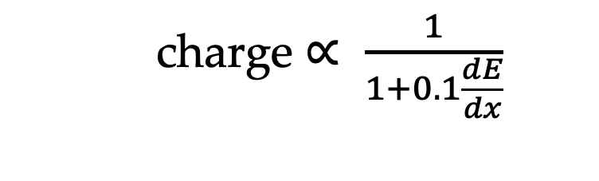
Missing energy in $E_{h}$
Recombination:
Nuclear breakup: $p+40Ar→3p+X$
Energy -> nuclear binding energy
Thresholds
Neutrons
After full propagation
  charge $∝ \frac{1}{1+0.1\frac{dE}{dx}}$
Friedland & Li, 2018
18/31

Slide 22
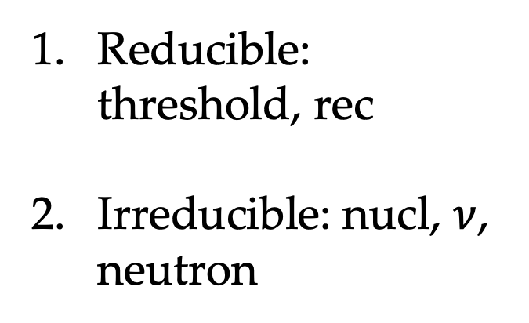
Missing energy in $E_{h}$
Friedland & Li, 2018
Reducible vs. irreducible
Reducible: threshold, rec
Irreducible: nucl, $ν$, neutron
Irreducible missing energy has to be simulated correctly
19/31

Slide 23
Energy reconstruction results
Friedland & Li, 2018
CDR th: method as it is
Charge: collect all charges with no thresh.
Best rec: no thresh., correct for recombination
20/31

Slide 24
Two types of performance studies

Slide 25
Two types of performance studies
Full propagation
Fast Monte Carlo
Romeri, Fernandez-Martinez & Sorel, 2016
DUNE CDR
22/31

Slide 26
Protons
Friedland & Li, in prep
Energy distribution
23/31

Slide 27
Protons
Friedland & Li, in prep
Energy distribution
24/31

Slide 28
Protons
Friedland & Li, in prep
Visible energy
Large missing energy fraction
25/31

Slide 29
Protons
Friedland & Li, in prep
Energy resolution
Neutron-created charges are important
26/31

Slide 30
Charged pions
Friedland & Li, in prep
27/31

Slide 31
Neutrons
Friedland & Li, in prep
28/31

Slide 32
Friedland & Li, 2018
29/31

Slide 33
Conclusions
Basic performance of liquid argon were not understood
We understand missing energy of neutrino events: neutrons, nuclear breakup, recombination
Improve reconstruction strategy
Details in arXiv:1811.06159, PRD 2019
Test beam data will be crucial for simulation validation
30/31

Slide 34
Outlook
A framework to evaluate neutrino-nucleus cross section uncertainty impact on oscillations
Full propagation studies guarantee no missing physics
fastMC type studies need full, correct inputs
Easy to see physics connections
31/31

Slide 35
Backup

Slide 36
Bi-probability plot

Slide 37
Comparisons to other work
Romeri, Fernandez-Martinez & Sorel, 2016
Friedland & Li, 2018
Further studies warranted

