Slide 1
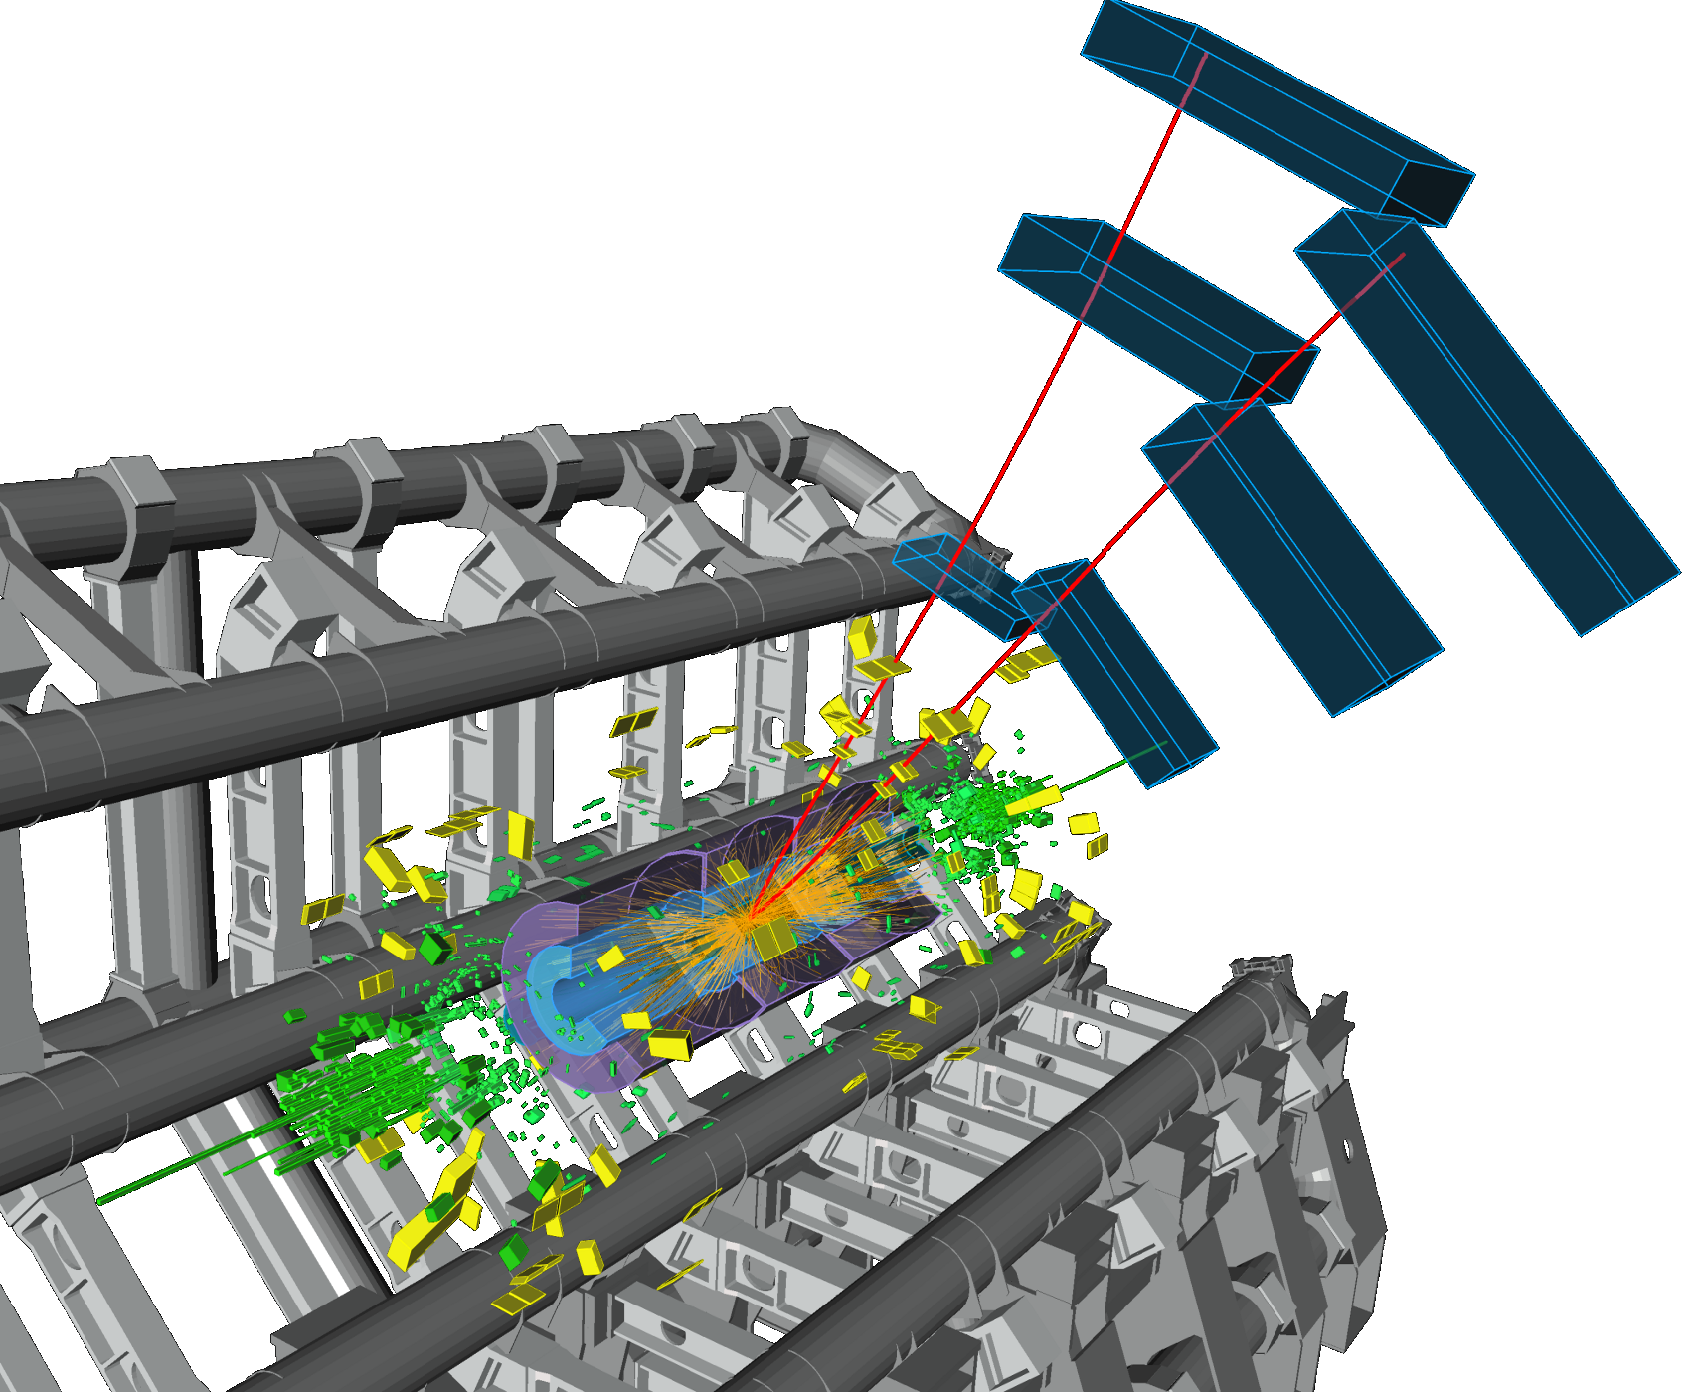

Finding Muons in ATLAS
Nicoletta Garelli
SLAC

Slide 2
Outline
Introduction
  Run1, Long Shutdown 1 and beginning of Run 2
A new readout system for the Cathode Strip Chambers (CSC)
  Limitations of the previous system
  The RCE
  Commissioning and first results
Muon spectrometer run coordination
  Highlights of LS1 activities
  Recombine the 4 muon systems for Run 2
Conclusions

Slide 3
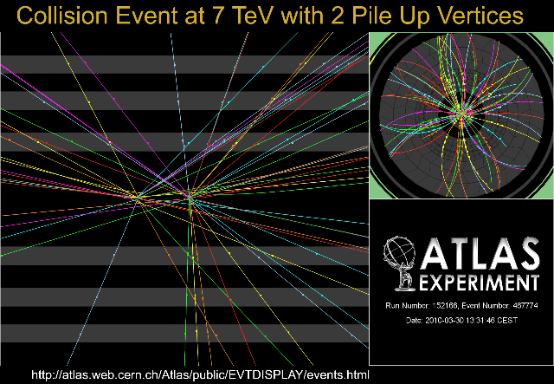
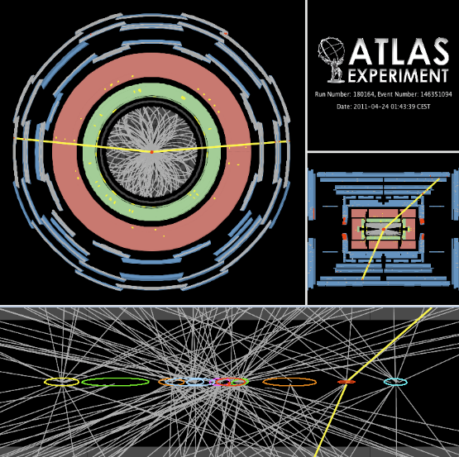
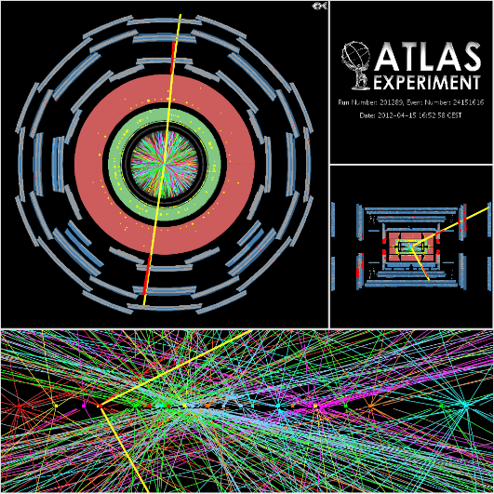
LHC Run-1 in a Nutshell
50 ns bunch spacing
Pb-Pb
Pb-Pb
p-Pb
2009
2010
2011
2012
2013
30 Nov 2009:
Collisions@2.36TeV
30 March 2010:
Collisions@7TeV
5 April 2012:
Collisions@8TeV
14 Feb 2013:
Start of LS1
ATLAS pile-up (interactions per bunch crossing) increasing O(2) → O(10) → O(25)
The design value was O(20)

Slide 4
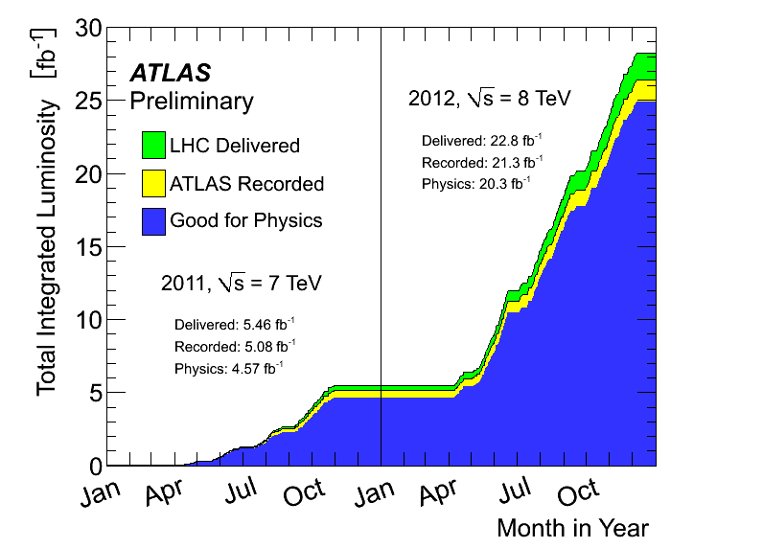
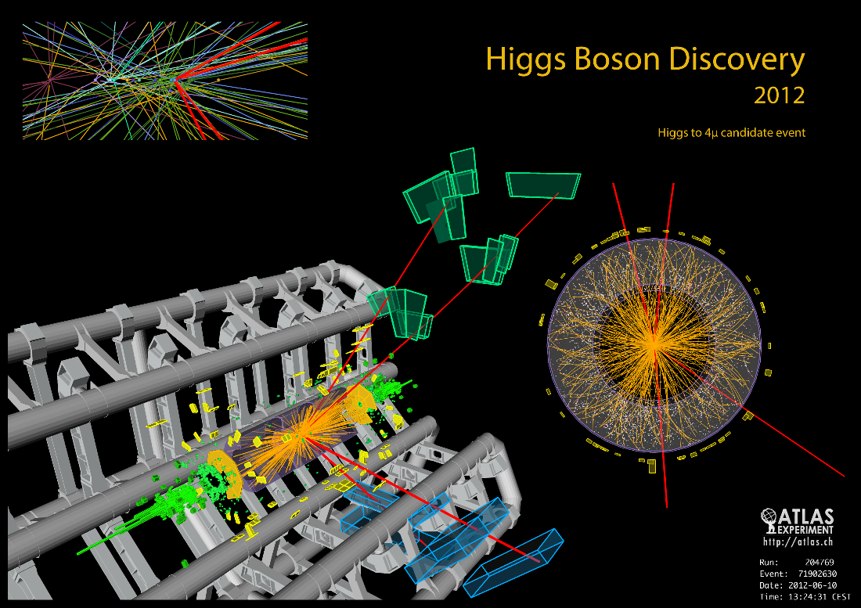
ATLAS Run-1 Achievements

Slide 5
Run-2 LHC Plans & Conditions
Long Shutdown 1 (LS1) = 2 years for upgrading the machine
Parameter | Run 1 | Run 2
Center of Mass Energy | 7 (8) TeV | 13 (14) TeV
Bunch spacing | 50 ns | 25 ns
Integrated Luminosity | ~ 30 fb⁻¹ | ~100 – 150 fb⁻¹
Peak Instantaneous luminosity | 7.5 10³³ cm⁻² s⁻¹ | 1.3-1.5 10³⁴ cm⁻² s⁻¹
# bunches | 1400 | 2550-2800
Pile-up | ~30 | ~40

Slide 6
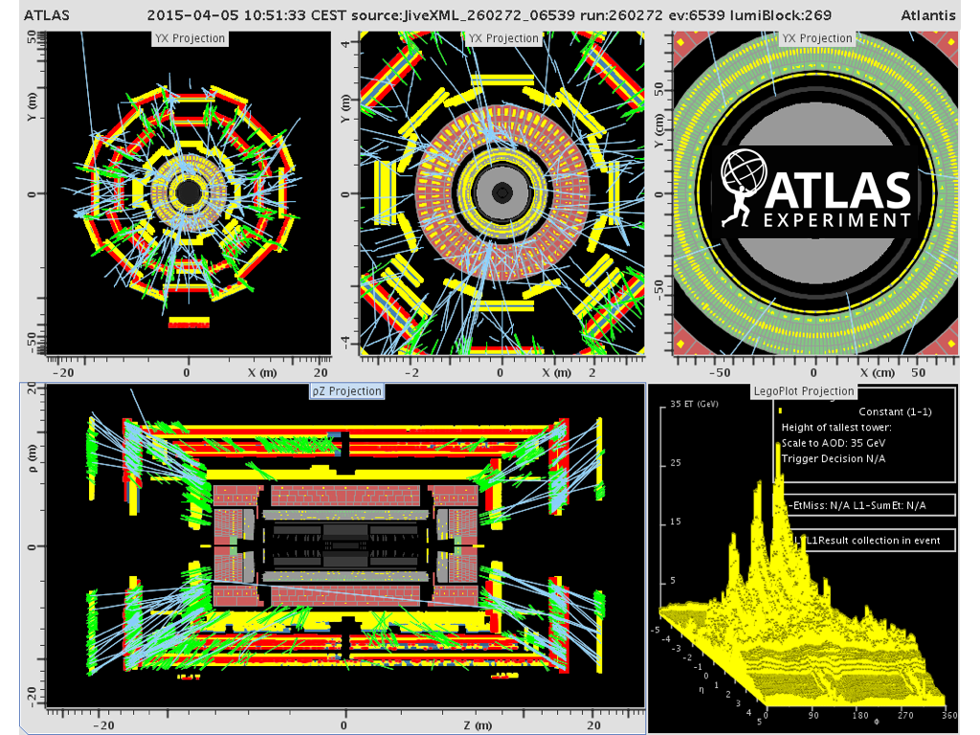
LHC Restart
Feb 2014: ATLAS shafts closed
Eastern April, 5th: First beams
Small Note: One big wheel of the muon trigger system could not operate reliably till few hours before the first beam splashes → mistake in the configuration settings of the Trigger, Timing and Control distribution
Little example to show how important the re-commissioning phase is

Slide 7
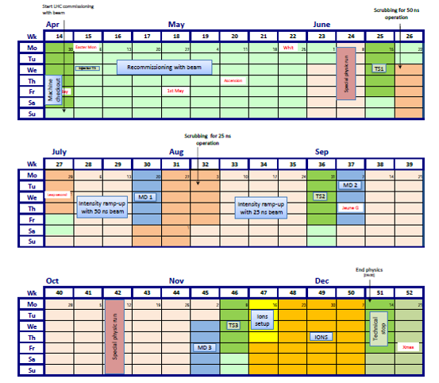
LHC Schedule for 2015
We are here
Jul 16: ~100 pb⁻¹ so far… a long way to go before stable LHC operation

Slide 8
ATLAS Improvements and Additions during LS1 (best of)
Additional fourth pixel sensors layer installed (Insertable B-Layer)
New beam-pipe support with reduced material → reduced contribution to physics background
Equipped and commissioned double layer RPC trigger chambers in the barrel feet region
Repair broken front-end boards of LArg Calorimeter → back to 100% working detector
New readout system for small muon wheels (CSC)

Slide 9
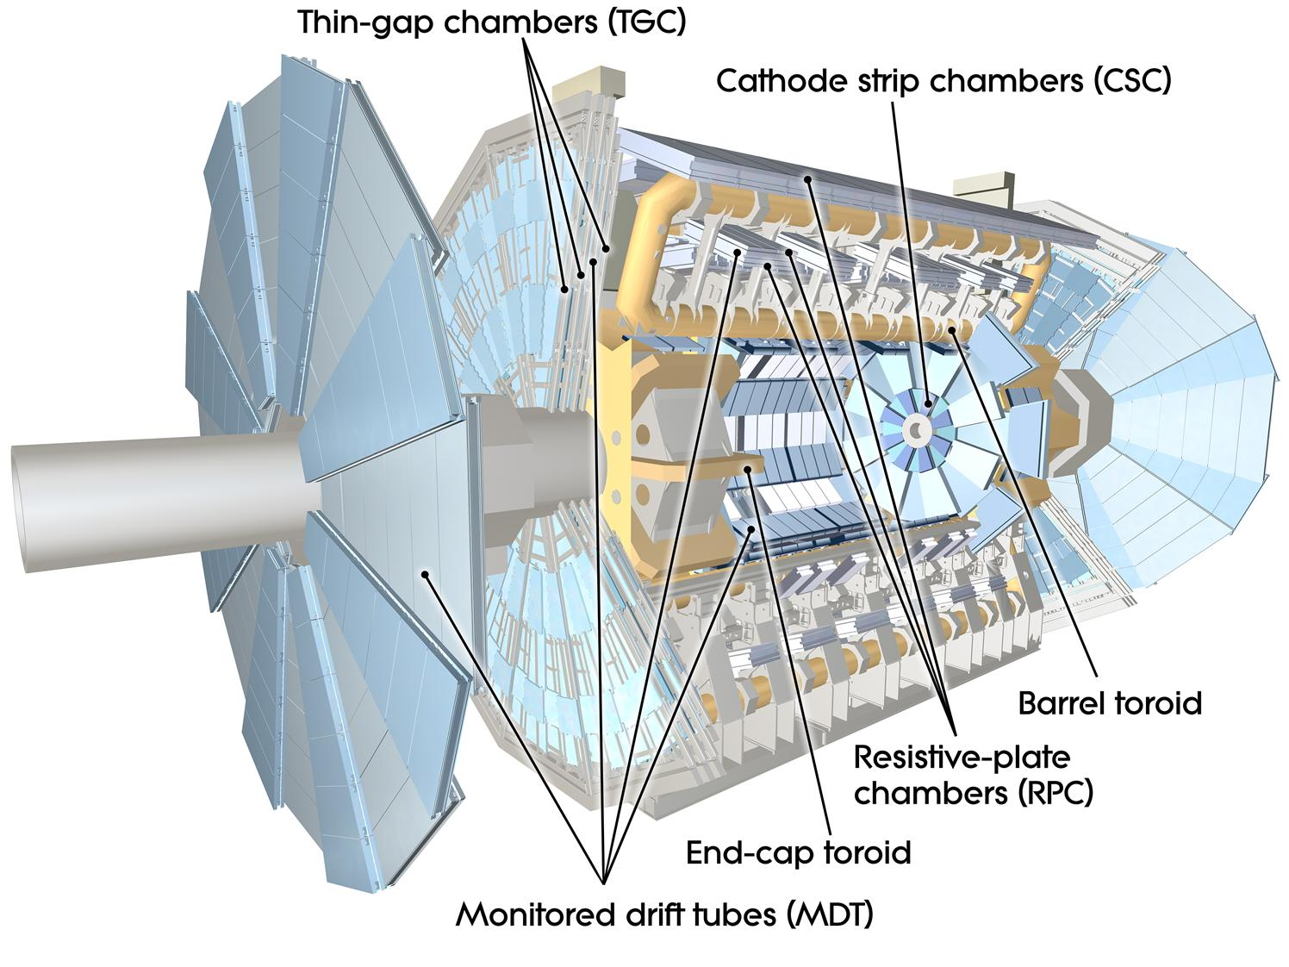
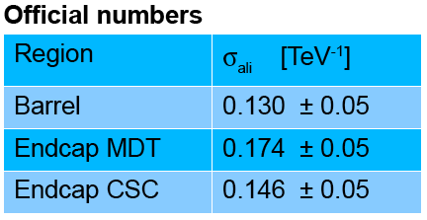
The ATLAS Muon Spectrometer
Muon Detection: charged particles emerging from calorimeters
Muon Spectrometer: 4 sub-systems (different technologies) in air-core toroid magnet
  Trigger chambers: RPC (~600) and TGC (~3600)
  Precision chambers:
  CSC (32) and MDT (~1200)
Momentum resolution 2011

Slide 10
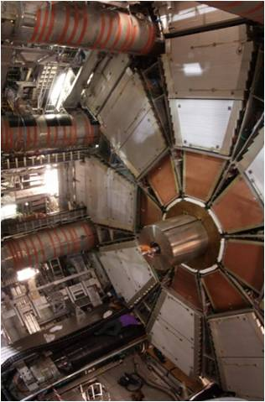
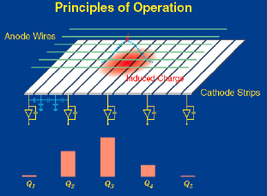
Cathode Strip Chambers (CSC)
Located in the innermost layer of the EndCaps of the Muon spectrometer covering the region
2.0 ≤ Ƞ ≤ 2.7
Multiwire proportional chambers operated using Ar/C02 (80%:20%) at atmospheric pressure
The position is measured by
the induced charge on the segmented cathode strips
by the avalanche formed on
the anode wire

Slide 11
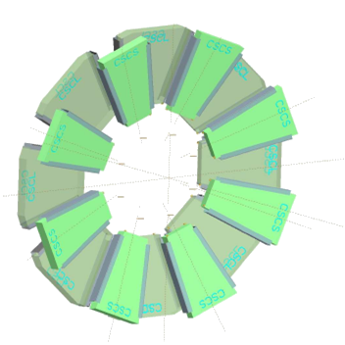
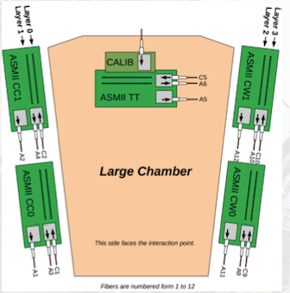
The CSC Detector
16 chambers per wheel; large and small alternating and partially overlapping
Each chamber:
  4 precision (η) layers with 192 channels each
  4 transverse (φ) layers with 48 channels each
On-detector electronics composed of 5 Amplifier-Shaper Modules (ASM) boards to amplify, shape, transmit events
  Bipolar pulse with 140 ns shaping time
  Pulse sampled every 50 ns, each sample digitized to 12 bits of data

Slide 12

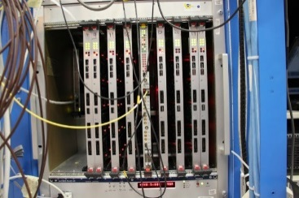
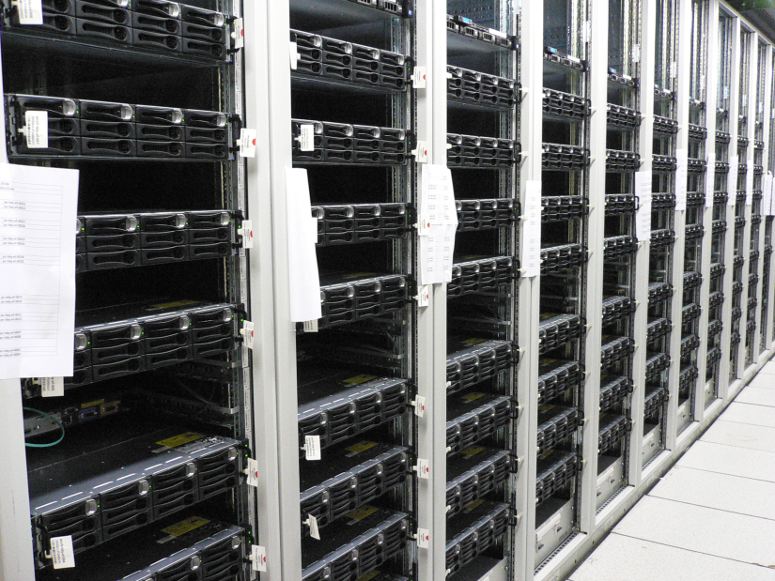
Big Data to Process
On-detector
readout
Off-detector
readout
Central DAQ
and Trigger
1 event = 5760 B
570 MB/s
@ 100 kHz
Max bw =
200 MB/s
ADC
ATLAS fragment
Read-Out Driver
(ROD)
time
Despite being a small detector, CSC produces a large data volume of unsparsified data
ROD must perform the “feature extraction”: threshold cut, out-of-time rejection and cluster finding
  Nominally process 4 time-samples (50 ns blocks) per event

Slide 13

The Off-Detector Electronics (Run I)
All ATLAS detectors use ROD boards plugged in a VME crate
Common:
  VMEbus communication
  Single Board Computer in each crate where common software controls and configures the system
  Rack infrastructure (cooling, monitoring)
Custom
  Firmware
  Interface with the central trigger and timing system. CSC used one Timing Interface Module (TIM) per crate
  Rear modules to connect the RODs to the DAQ and Trigger system
2 VME crates
1 crate = 1 SBC, 8 RODs, 1 TIM

Slide 14
Run 1 CSC Readout System Performance
In 2008 CSC could not join the ATLAS data taking runs
  ROD could not cope fast enough with the data processing
SLAC team redesigned software and firmware to enable data taking in time for beam turn-on
  Maintaining the same hardware
CSC met design goals, but ROD limitations reached in 2012: ~2% deadtime with peak luminosity of ~ 4 10³³ cm⁻² s⁻¹ and L1 rate of 70 kHz
Several methods introduced to improve the situation
  Data samples reduced from 4 to 2
  Higher thresholds applied [ADC count should be greater than the threshold, which is configurable]

Slide 15
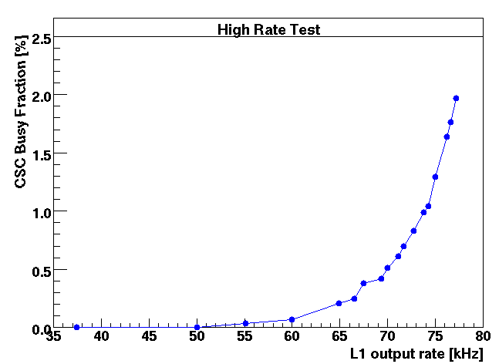
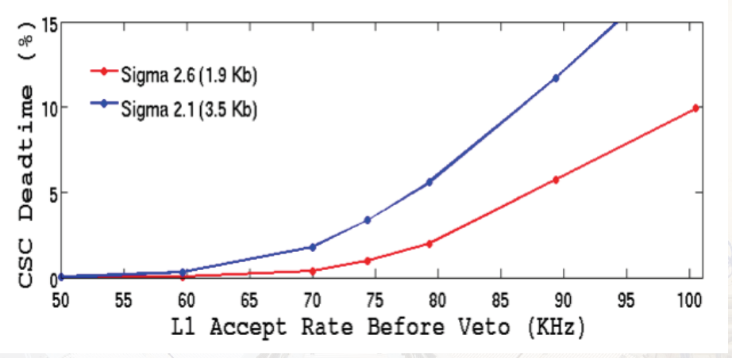
Run 1 ROD Limitations
Busy (dead-time) beyond 1% at 75 kHz, ok for Run 1, but not sustainable for Run 2
Run 1 – max performance
Run 2 expectations
Old ROD: Deadtime > 10%
SLAC team engaged to deliver a new readout system within 2 years

Slide 16
The RCE: the Implementation for the CSC
We decided to use the Reconfigurable Cluster Element (RCE), a generic DAQ R&D component developed at SLAC
  Based on Advanced TeleCommunication Architecture (ATCA)
We could have upgraded the VME-based hardware, but
  CSC project: perfect match for the new RCE-based DAQ
  LS1: the right moment for deploying a new system which can be used in the upgrade phases
  Very stimulating to commission a new architecture into a well established project (the ATLAS DAQ system)
NEW

Slide 17
What is RCE?
RCE (Reconfigurable Cluster Element ): bundled set of hardware, firmware & software.
Physically it is a System-On-Chip (Xilinx ZYNQ) + interfaces + memory
ZYNQ
  New generation of Xilinx programmable device
  Combine an FPGA with a processor, ARM dual-core @ 800 MHZ
  Processor-centric: processor boots at reset and then configure FPGA
  Software-centric development: user can use C/C++ for programming the processor

Slide 18
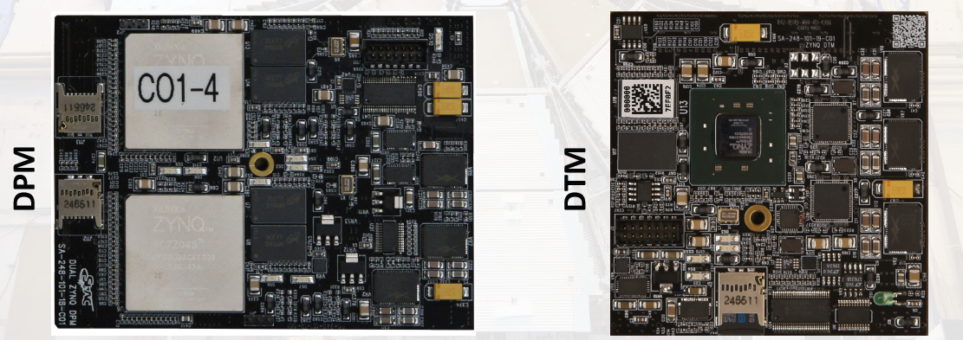
DPM & DTM
RCEs housed in
  Data Processing Modules (DPM): main task ‘feature extraction’
  Data Transport Modules (DTM)
1 DPM per CSC chamber (each chamber read-out individually)
TIM functionality replaced in DTM/DPM instead of dedicated hardware
Software:
  RTEMS (Open Source Real-Time kernel) for DPM
  ArchLinux for DTM

Slide 19
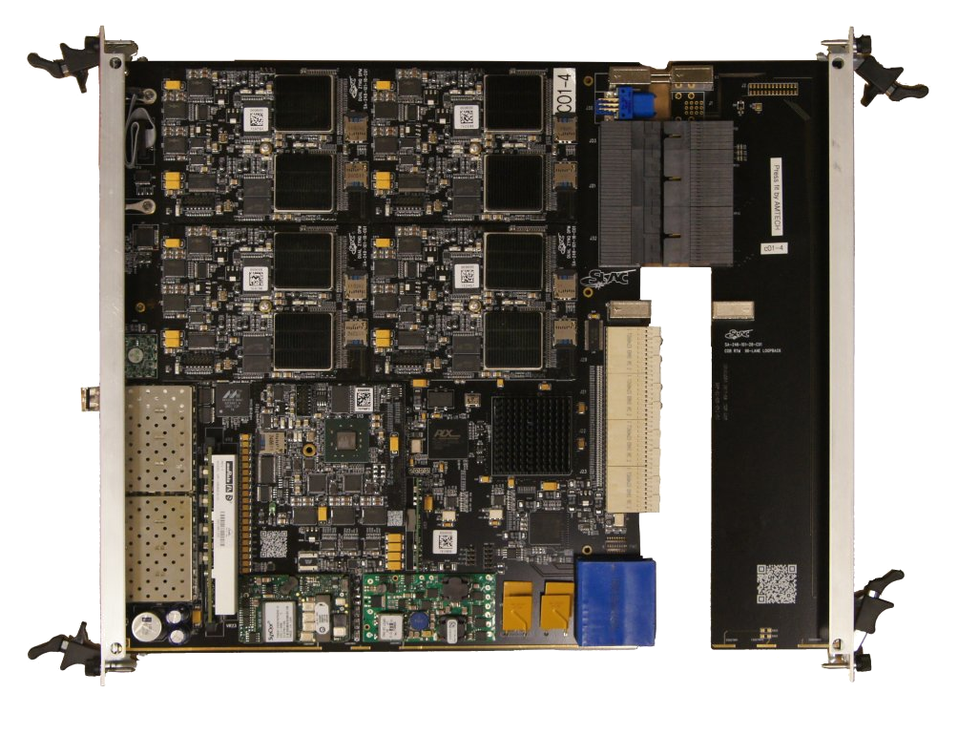
Cluster On Board (COB)
Rear Transition Module (RTM)

Slide 20
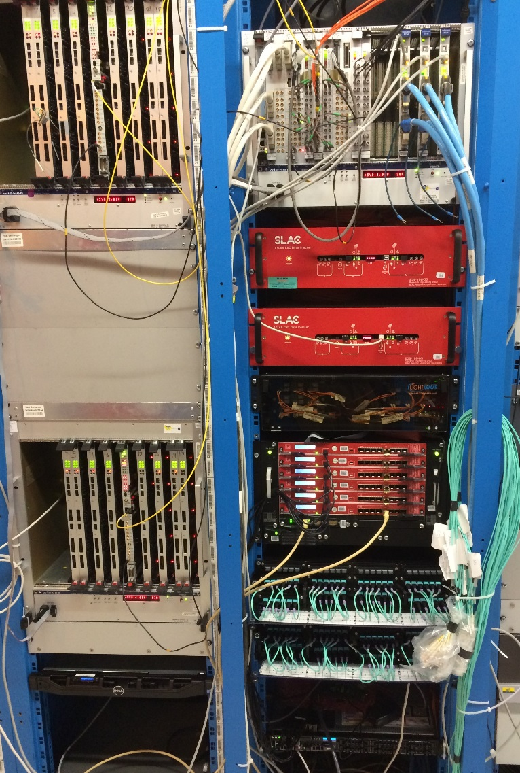
New Hardware
1 ATCA shelf with 6 COBs +RTM
1 PC, the control processor
  24 core netbooted PC
1 Ethernet switch
CSC NETWORK
ATCN
OLD
COB
NEW
Uplink for DHCP traffic
COB
COB
CSC SWITCH
Control Processor
ATCN SWITCH
COB
COB
Run Control
COB

Slide 21
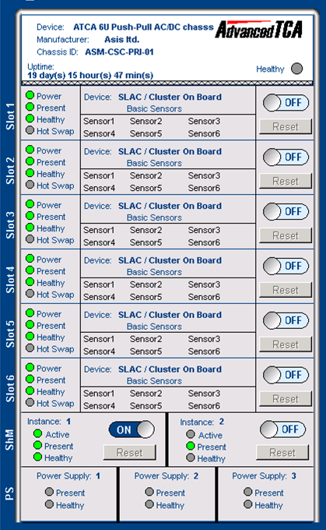
The New Rack Infrastructure
Equipping the new rack in the service counting room was not easy
  Establish the rack cooling distribution: ATCA shelves require horizontal cooling; VME crates vertical cooling
  Design and install a patch panel for fast and safe interchange of readout systems (old and new) during the commissioning
The ATCA shelf is monitored and controlled via the ATLAS Detector Control System (DCS)
  Led to the development of a common interface between the ATCA and the DCS SCADA system

Slide 22
The Control Processor
Connected ATLAS Technical Control Network (ATCN) and CSC network
RCE are embedded
system not exposed
to external world
and vice-versa
On the control processor one Readout Application per chamber (for a total of 32) is started to initiate data taking
  Readout Application implements interface with ATLAS run control finite state machine and sends/receives data from RCEs via network
CSC NETWORK
ATCN
COB
Uplink for DHCP traffic
COB
COB
CSC SWITCH
Control Processor
ATCN SWITCH
COB
COB
Run Control
COB

Slide 23
The RCE Middleware
Establish communication protocol between control processor and RCEs via Ethernet (CSC network)
First implementation: “VMEbus over TCP”
  We simply ported the old interface software to TCP calls
  System functionality proved
We evaluated different options compatible with the network stack of RTEMS (no IPV6 support/headers)
1980’s technology to the rescue: Open Network Computing (ONC) Remote Procedure Call (RPC)
  We just need to execute a function call over the network
  RTEMs includes a port of ONC/RPC
  External Data Representation for data serialization
  We use strings as argument and return values to RPC
  Payload is a string in JSON encoding
New middleware in production system since May 2015

Slide 24
Automated Recoveries
During Run 1 ATLAS deployed automated procedures to minimize deadtime during data taking in case of a malfunctioning component
It is possible without stopping the run to:
  Restart a part of the detector readout
  Remove a component which is misbehaving
  Eventually recover it later
CSC had a poor implementation of the stop-less procedures in Run 1
NOW: robust and fast recoveries with the new readout system
  And we needed them in very few cases so far…

Slide 25
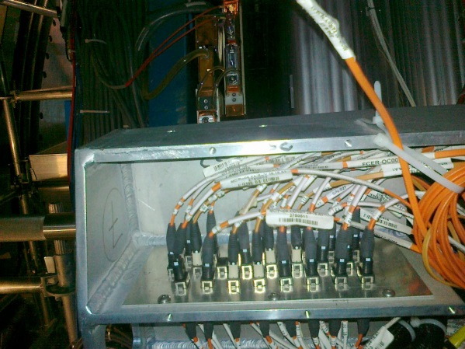
Detector - Counting Room Connection
Data transferred from on-detector readout electronics via high-speed fiber optics (G-Links)
  Single optical fibers from chambers grouped in bundles of 12 fibers (MPO) connected to 2 patch panels on the calorimeter support structure
    Patch panel connections very dense and
    difficult to manipulate
    One broken connector after the
    opening/closure of end-cap during LS1
  From the patch panel, MPO fibers
  reach ROD system in counting room
  320 G-links for event data + 120 G-links for configuration data
    MPO fibers 7,8 not used

Slide 26
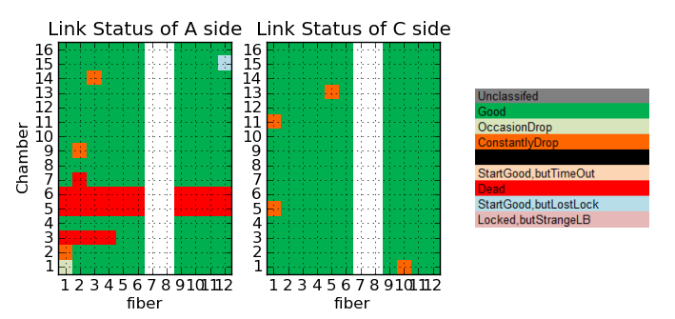
The G-link Issue 1/2
At configure, the RCE firmware establish the G-link protocol
  All chambers must be ‘locked’ to transmit data
Some hardware problems
But also some
firmware bugs
promptly fixed
25.01.2015 G-link lock status

Slide 27
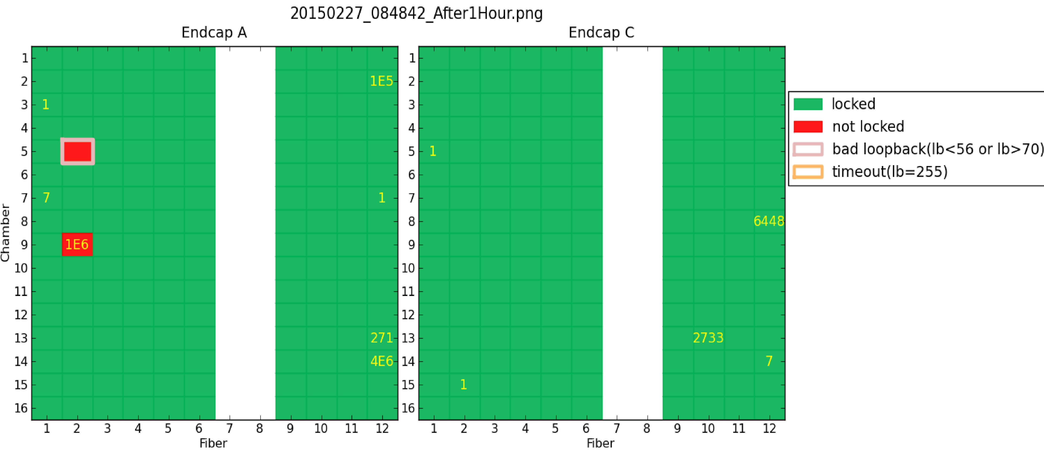
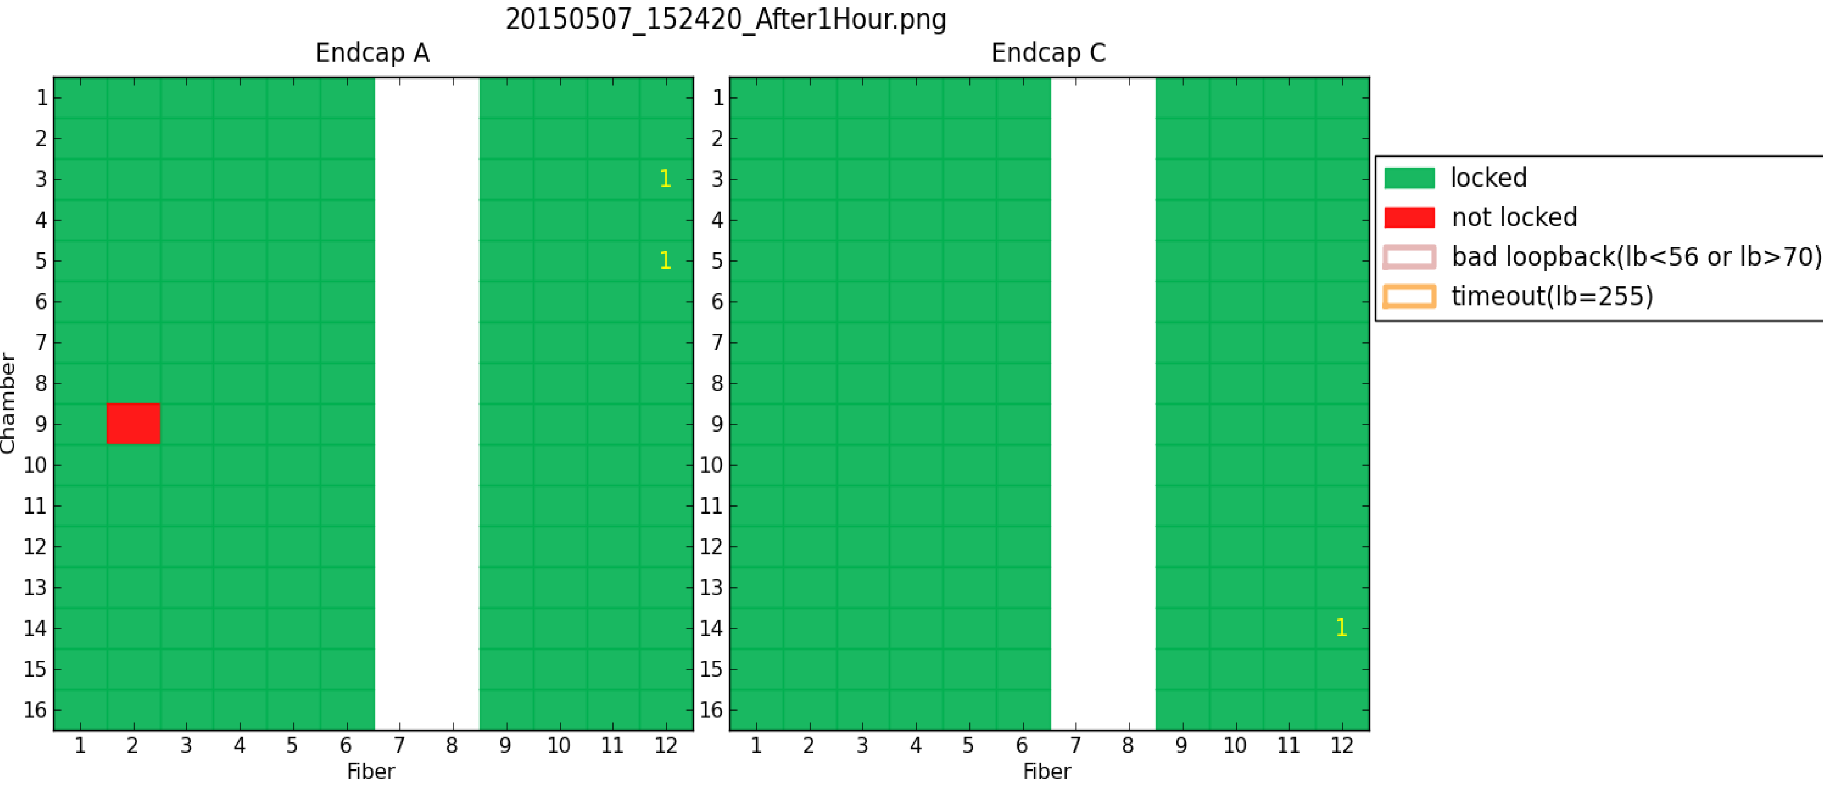
The G-link Issue 2/2
Status in March and June 2015
Still one G-link misbehaves… investigations on-going
Installed splitter + patch panel to recover a single broken fiber
Some G-links become bad while running and recover few minutes later

Slide 28
The Feature Extraction (FEX)
FPGA (firmware)
  Extract from the wave-form 4 (nominal), 8, 12 (new, useful for signal tail studies) 50 ns time samples
  Peak occurs in the second or third time sample
  Threshold comparison: second or third time sample is compared to the threshold: if time sample > threshold → strip accepted as well as nearest strips
  Handle also overlapping events, when an additional L1 trigger arrives within 200 ns of the previous L1
ARM (software)
  Receive time samples from the FEX firmware
  Convert bit map of accepted channels to a list of clusters
  DMA’s the data from the firmware
  Assembles time samples into events
  Formats the event, i.e. the assembled time samples
  Outputs the formatted event to the DAQ and Trigger system

Slide 29
The Data Reduction
5760
B/RCE/event
824 (*)
B/RCE/event
1096 (*)
B/RCE/event
FPGA
ARM
Each RCE is handling about 5Gbits/sec, or, with 6 active RCEs, 30Gbits/sec @ 100kHz event rate per COB
  This is well below RCE actual capabilities (by a factor of >10)
Future direction:
  33% inflation of the data volume from the FPGA data to the output
  ARM is adding control/meta information and performing a checksum
  A new design could reduce these 1096 bytes to just around 500 bytes
  (*) Data reduction varies with luminosity (from 1/60 to 1/6)

Slide 30
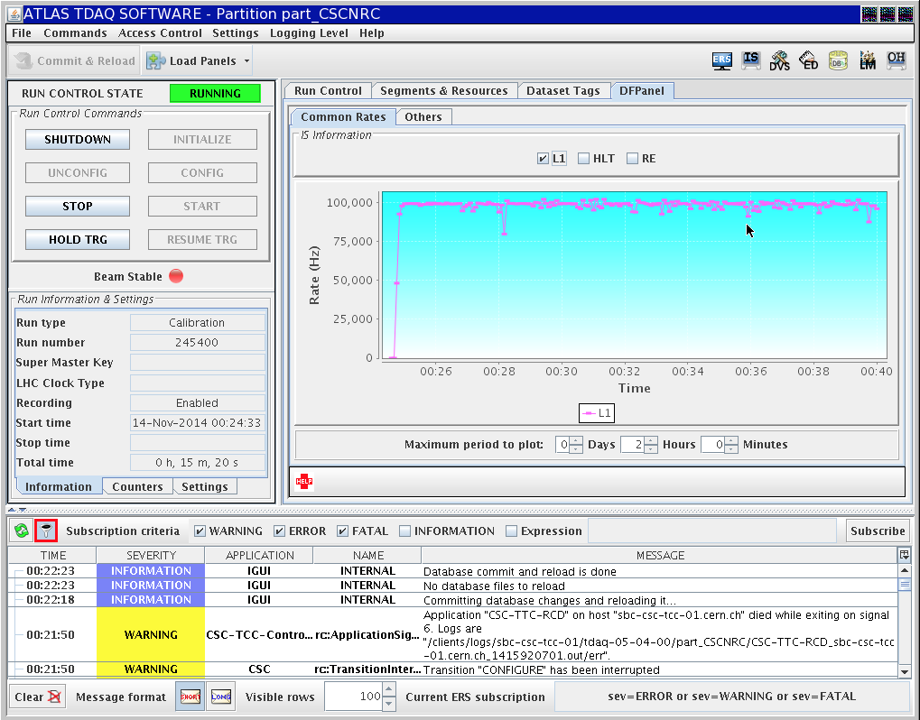
CSC Running at L1=100 kHz

Slide 31
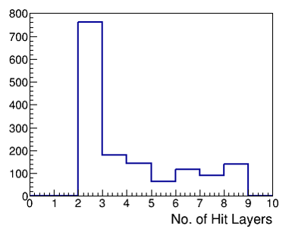
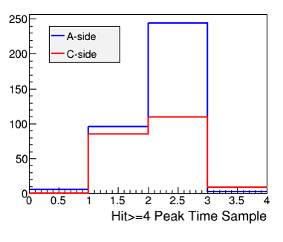
First Achievements with Cosmic Data
Combined cosmic data taking with muon triggers
Some events with all 8 layers hit
Event rate ~6Hz for events with more than 4 layers hit

Slide 32
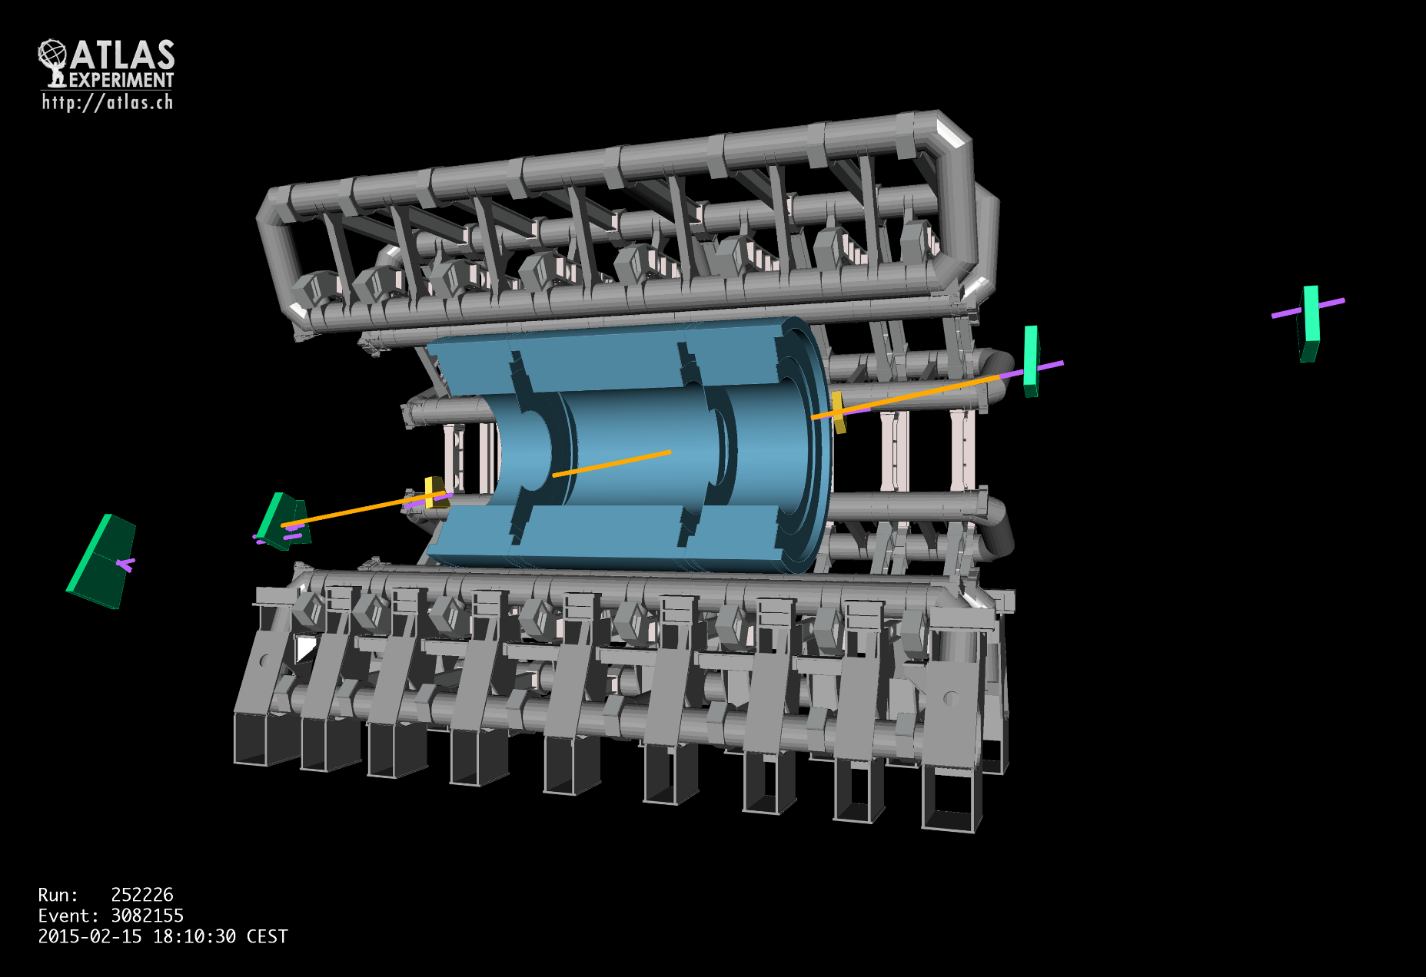
ATLAS Event Display of Cosmic Ray Event

Slide 33
CSC Timing
Beam Splash data (left) showed the correct time difference between the two endcaps (50 ns)
Collision data (right) show the same peaking time for the two endcaps
A
A
C
C

Slide 34

New CSC Readout: a Success
Within 2 years we put together a readout system from scratch which meets (exceeds) all the requirements
OLD ROD | NEW ROD
L1 max rate ~ 70 kHz | L1 max rate > 100 kHz
1 ROD treats 2 chambers | 1 RCE treats 1 chamber
Extra board for the TTC distribution | Directly embedded distributed TTC system
Usage of bulky HOLA card | S-link logic in RCE firmware
Usage of high power G-link HDMP chips | G-link logic in RCE firmware
Work in Progress to produce a plot showing the 100 kHz rate capability at Run 2 occupancy, next seminar

Slide 35
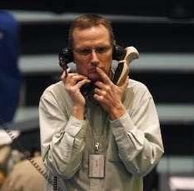
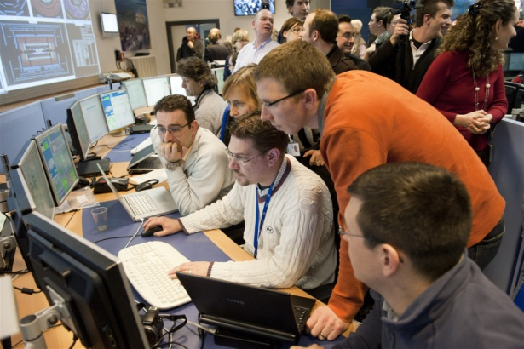
Coordinating all Muon Systems
Since early 2014 I am Muon Run Coordinator  also take care of all other Muon subsystems
  Completion of LS1 activities
  Ensure smooth data taking
  Arrange special runs (e.g. alignment, timing)

Slide 36
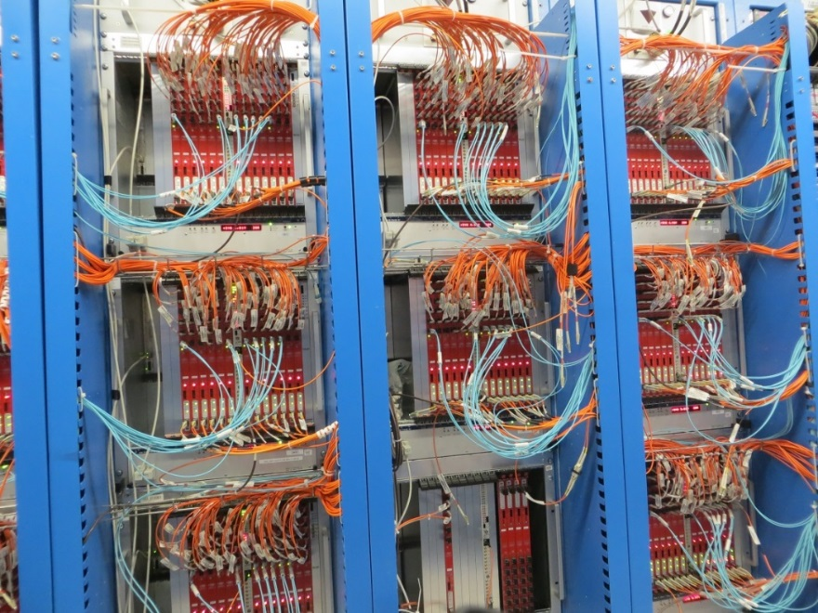
MDT
MDT = Monitored Drift Tube Chambers
Precision muon tracking detectors in both barrel and endcap
  Working chambers close to 100%
Endcap chambers doubled the readout rate in LS1, removing potential bottleneck

Slide 37
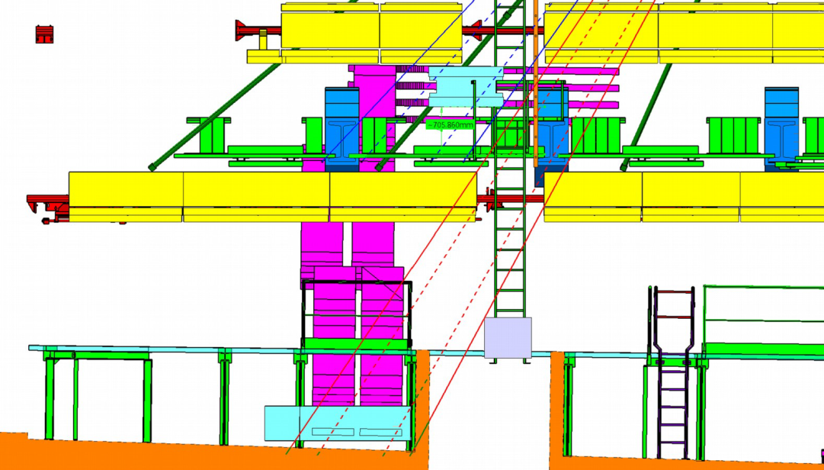
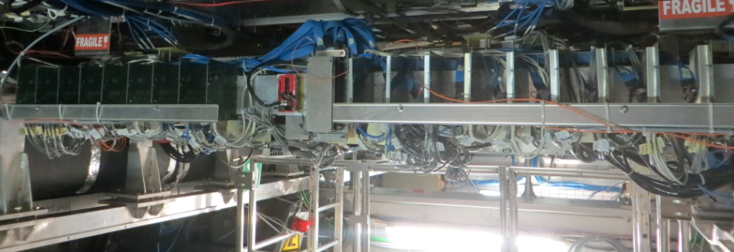
MDT/RPC Elevator Chambers
Close coverage holes (0.9%) in sector 13
BME = sMDT + new-type 1mm-gap RPC
  RPC secondary readout enters MDT mezzanine boards (phase 2 studies)
BME
BOE
Service connections
  More complicated and
  time-consuming than expected
BME status
  sMDT & RPC secondary readout included in ATLAS run
  RPC chambers still to be commissioned

Slide 38
MDT Actual Point of Attention
Regular noise bursts during physics runs
  Inner barrel A sectors 6-13 (HV from the same rack)
A month ago MDT reported noise bursts too, also seen by the electromagnetic calorimeter, which disappeared by itself
  Inner barrel C and the Larg C side
  All those chambers shared the HV line

Slide 39
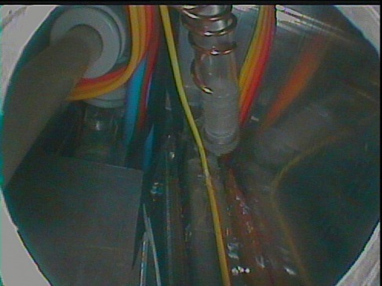
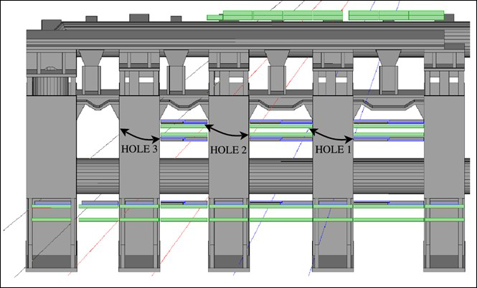
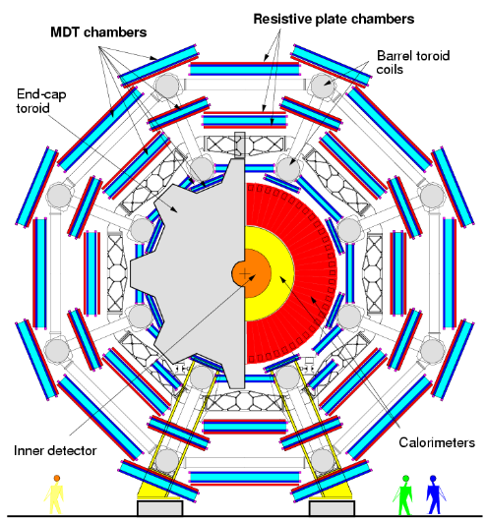
Resistive Plate Chambers (RPC)
Barrel trigger
Gas inlet repair work in LS1
  ~400 chambers with leaks, 100 of them found in 2014
RPC chambers in feet sectors
  Two layers of RPCs in BO feet sectors (12/14), to cover holes (2.8%)
  20 chambers installed since
  before Run 1 w/o readout/trigger
  electronics
  Commissioning to be finished

Slide 40
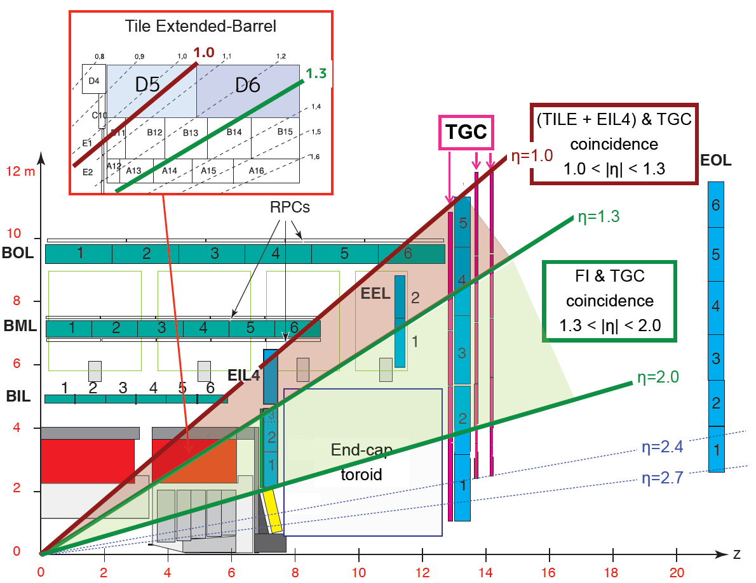
TGC Additional Coincidence
Thin Gap Chambers (TGC)
TGC inner chambers (EI/FI) in small wheel added to coincidence logic with big wheel (1.0 < η < 1.9)
Not available in Run 1
New boards installed at the end of LS1
Trigger validation on-going
Tile-μ coincidence using Tile calorimeter (D5, D6 layers)
and TGC EIL4 chambers (1.0 < η < 1.3)
Commissioning on-going

Slide 41
TGC Points of Attention
During Run 1 TGC system produced large fraction of deadtime caused by series of large size of data in a short time (Noise burst events)
  FIFO overflow
  Timing misalignment
Noise burst stopper for Run 2
  Firmware to veto noise burst events
  Still under commissioning
Storm of corrupted fragments during Run 2 causing deadtime
  Cause not understood
  Burst of events?

Slide 42
Alignment & TGC Timing
To bring all regions to 50 μm resolution:
  A toroid-off cosmic run for the barrel
  A toroid-off collision run to collect 30M-50M muons for the endcap
    Start collecting data on Sat 4 July → LHC problems → ATLAS decided to postpone it
In the shade of the attempted endcap alignment: TGC time scan
1
2
We keep Run 1 settings

Slide 43
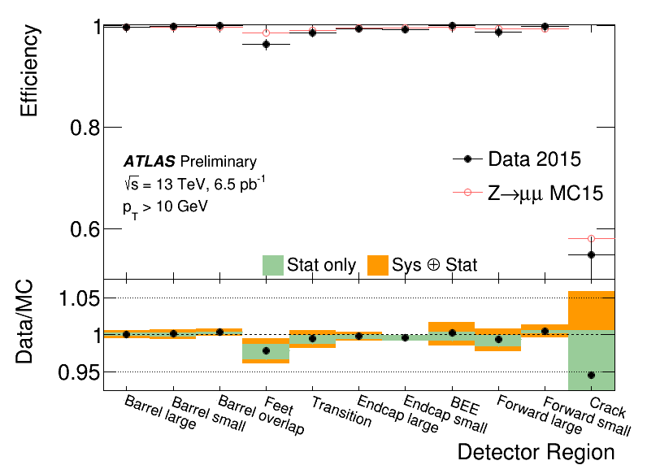
Efficiency
Muon reconstruction efficiency measured using Z → μ⁺μ⁻ decays
TGC shows a very good data/MC agreement
RPC is ~10% less efficient in data
  3% feet /elev. chambers, 4% timing, 3% to be understood

Slide 44
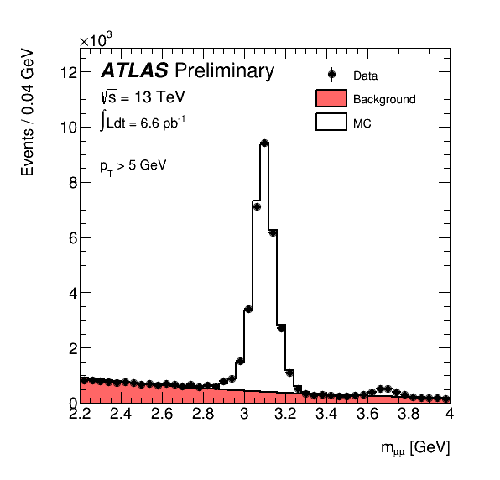
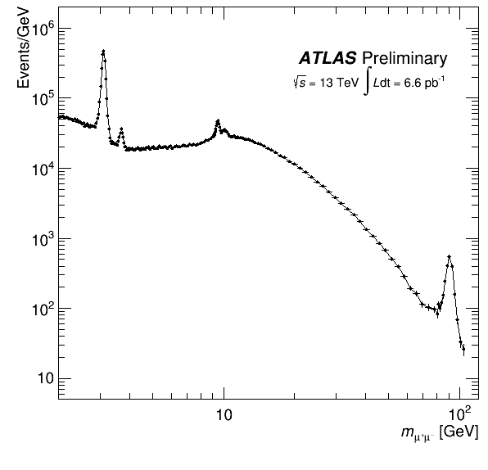
First Run 2 Data
Dimuon invariant mass distribution for oppositely charged, muon pairs with p_{T} > 4 GeV and η|< 2.5 GeV
J/Ψ mass. MC calibration done with Run 1 data → good agreement with data
J/Ψ
Ψ’
Υ
Z

Slide 45
Conclusion
During LS1 the ATLAS experiment carried on many upgrade activities to face the challenge of Run 2
  Higher beam energy, higher trigger rates
The new readout system for the small muon wheels (CSC) was one of the critical update and it has been successfully developed, deployed and commissioned
  Work well and reliably at 100kHz L1 rate
All four muon systems had a dense program during LS1 and some items are still under final commissioning
  Work on going to consolidate the new additions
Muon Spectrometer getting ready to 25 ns LHC operations

Slide 46
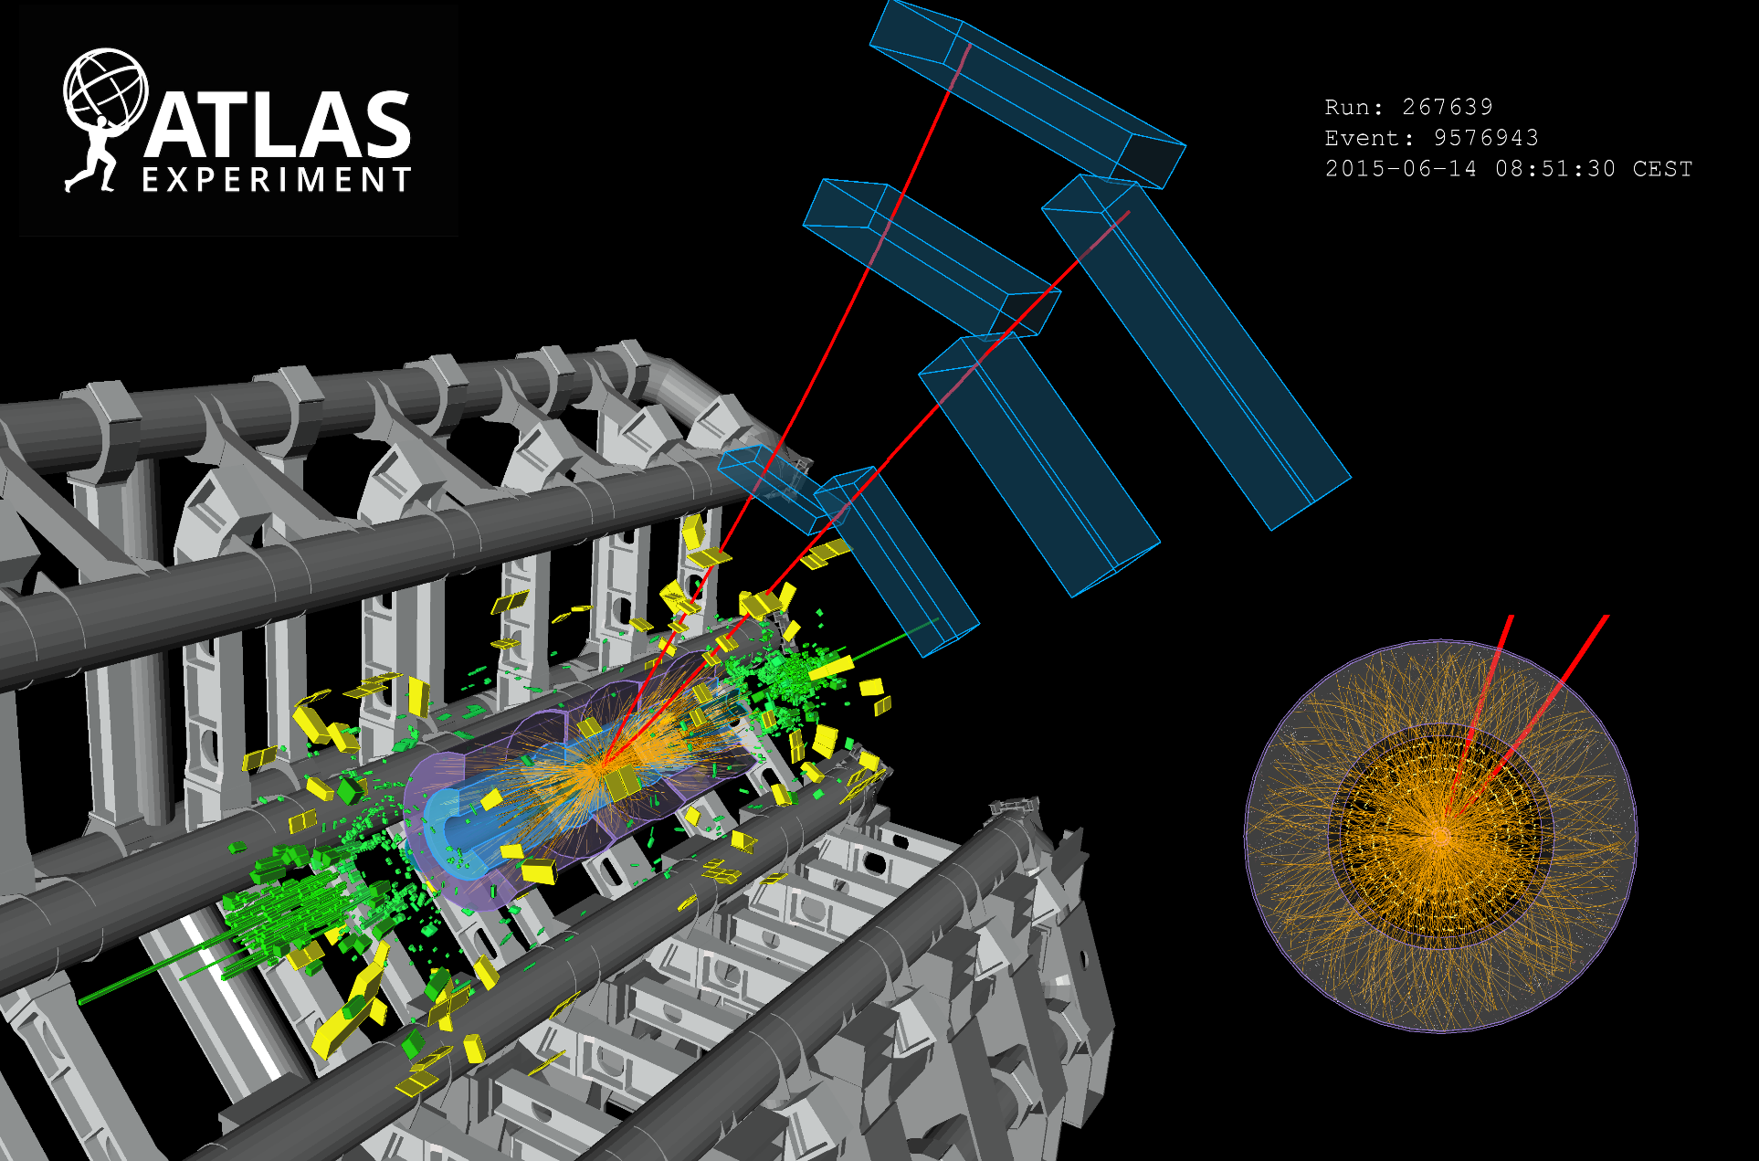
THANK YOU

Slide 47
Backup

Slide 48
Naming Convention
All MDT chamber names consist of 7 characters
Chambers with same station Index (and same side) form a projective tower = crossed by tracks from the IP. Losing eg 2 MLs in the same tower = hole in coverage/momentum rec.

Slide 49
Link to Offline Processing
Each CSC chamber is now read out individually
  Additional flexibility for the system
The event format is close to the old CSC format
  Contains the data (RPU block) of one chamber instead of two due to the new doubled ROS links (16 fragments → 32 fragments)
A new, disjoint set of source IDs (to distinguish from the old data)
  adapted ROD decoder and bytestream converter
All changes implemented downstream (HLT)
  Region selector, cabling map, geometry, etc.
All successfully tested at the end of 2014

