Slide 1
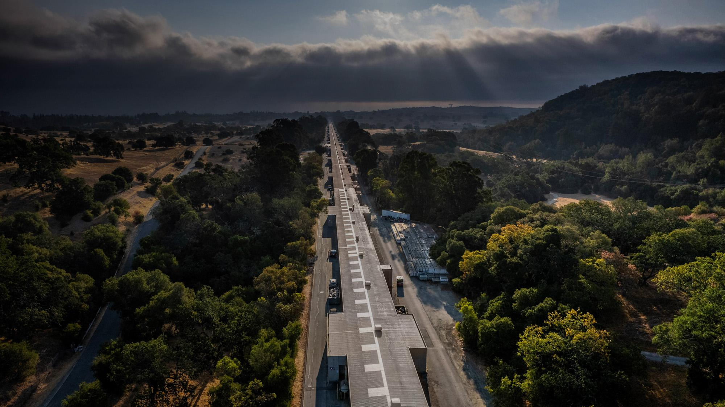


Accelerator Physics Research
at SLAC
Emilio Nanni
Associate Professor of Particle Physics and Astrophysics, and of Photon Science
nanni@slac.stanford.edu
On behalf of SLAC Accelerator and Technology Innovation Directorates

Slide 2
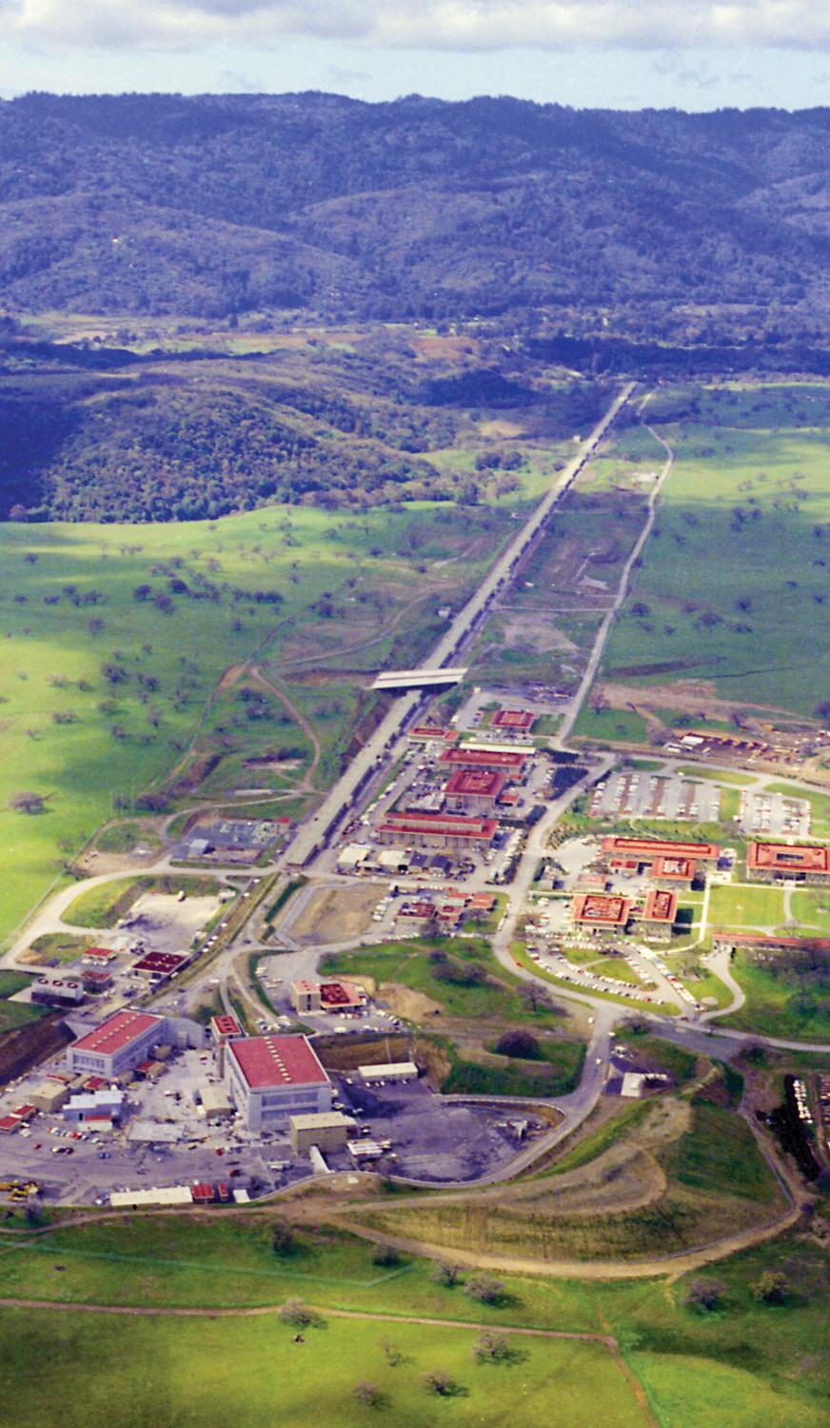
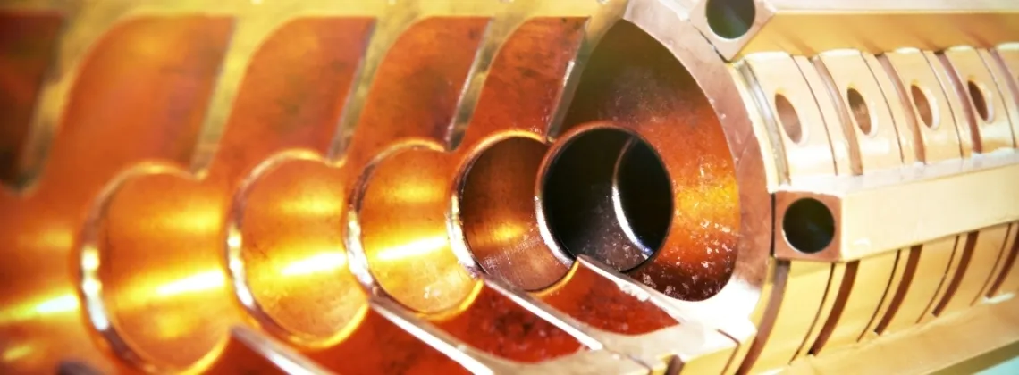
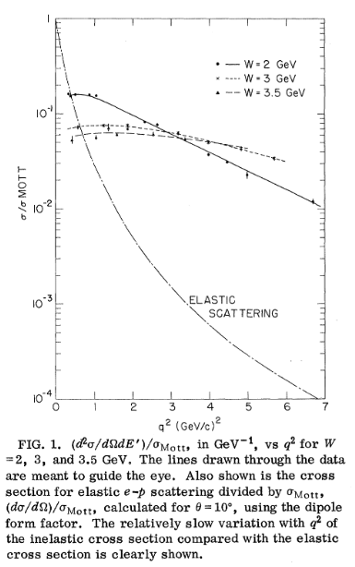
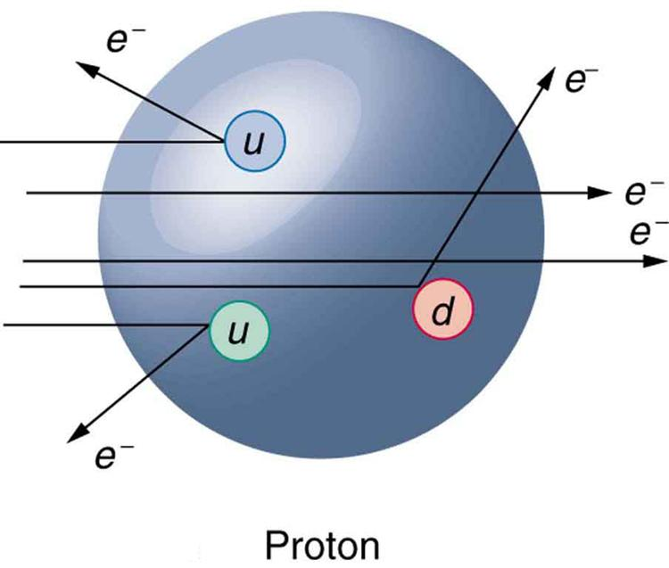
Accelerators at SLAC
SLAC c.1965
S-band copper RF structure
Electron-Proton scattering
PRL 23, 935, 1969.
SLAC was approved by the Atomic Energy Commission in 1961. Quarks were discovered at SLAC just eight years later.

Slide 3
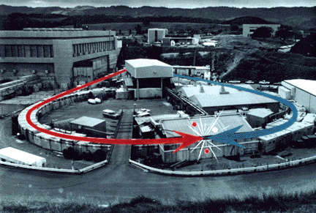
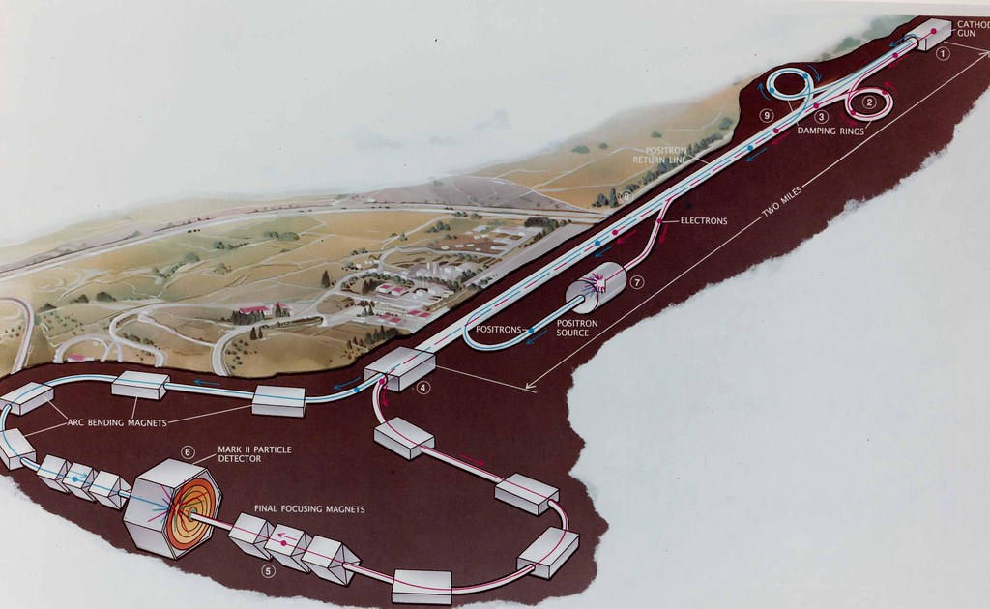
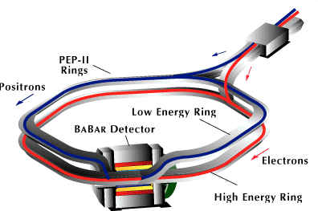
SLAC: Four Decades of Colliders
SLAC developed leadership in many areas of collider physics and continues to contribute expertise to the design and operation of colliders around the world.
SPEAR (1972-1990)
SLC (1988-1998)
PEP-II (1998-2008)

Slide 4


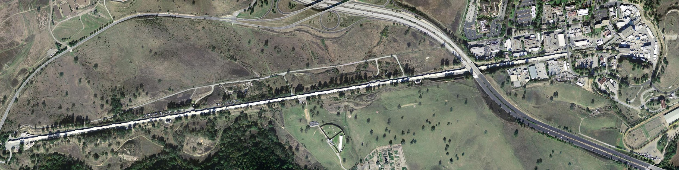


SLAC Evolved: Lightsource Leadership
LCLS-II
World’s Highest Rate XFEL
World’s First X-Ray FEL
FACET-II
Accelerator R&D Facility
Pioneering synchrotron Light Source

Slide 5
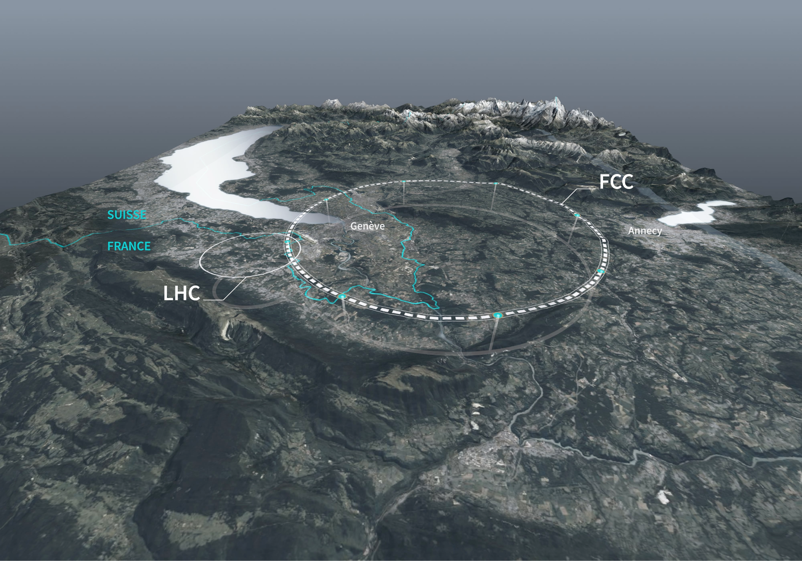
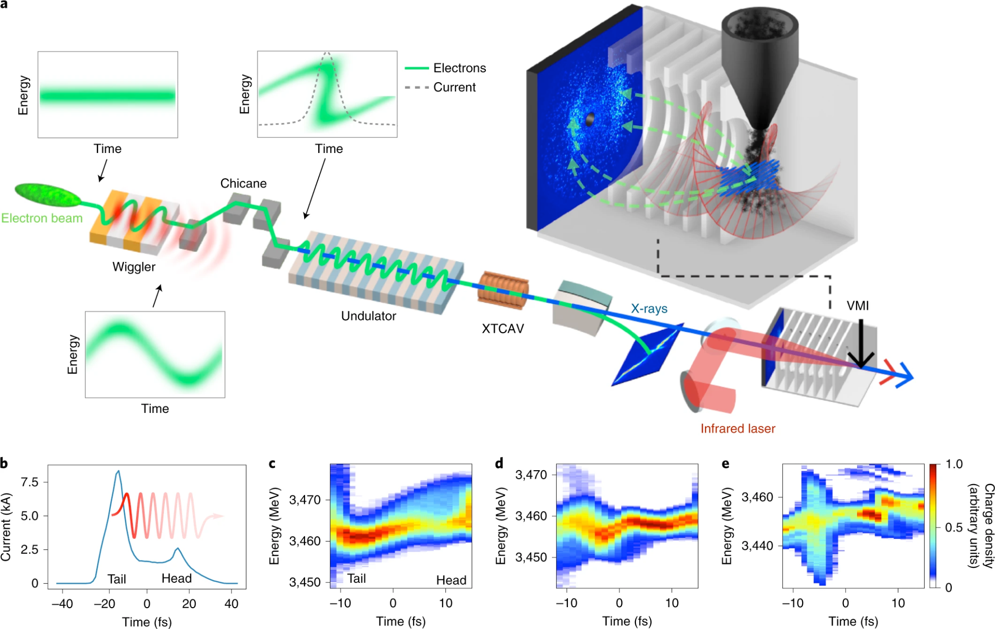
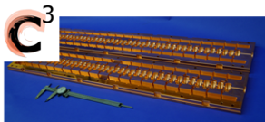
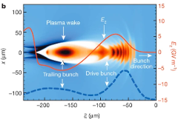
What motivates particle accelerator research?
Improve the performance of existing and planned facilities, like the FCC.
Develop new modes of operation, like the attosecond pulses at LCLS.
Create new accelerator technologies like cryo-cooled copper and plasma wakefields for more compact, less expensive accelerators.

Slide 6
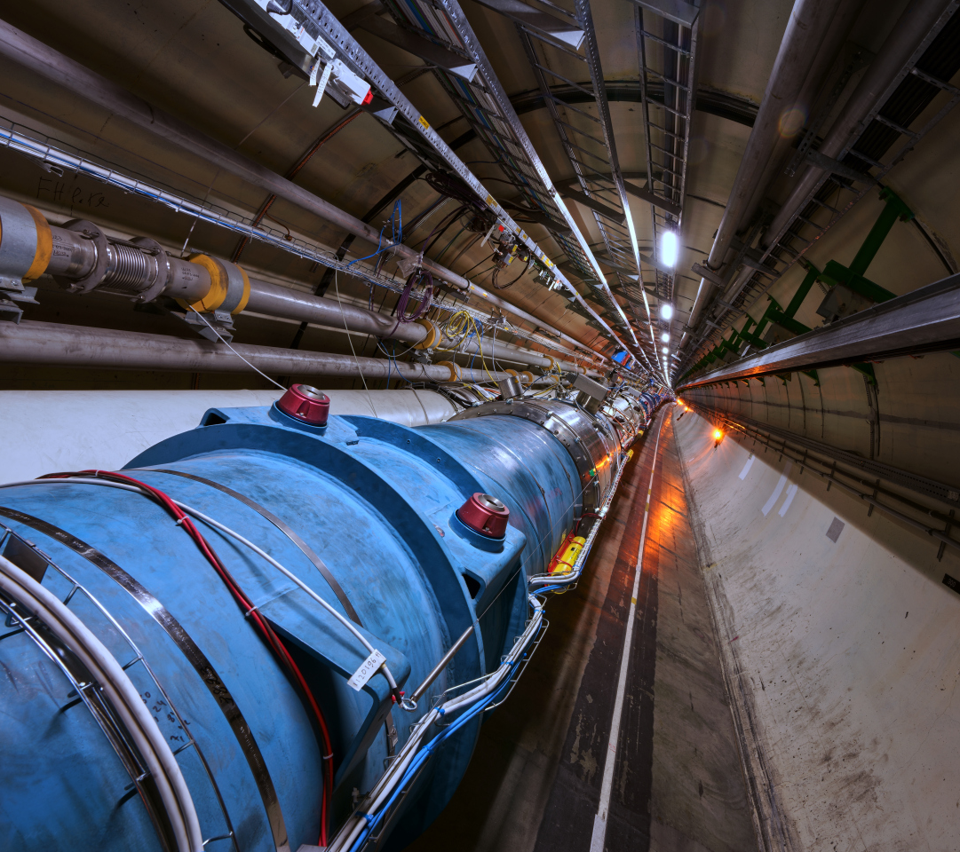
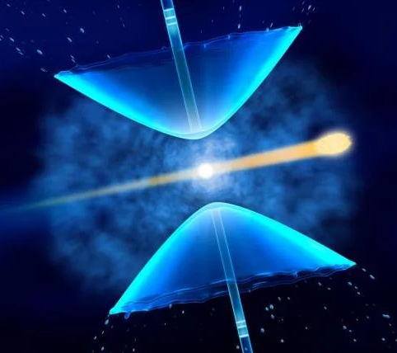
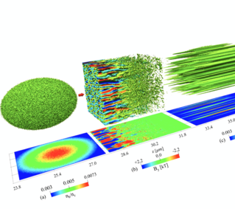
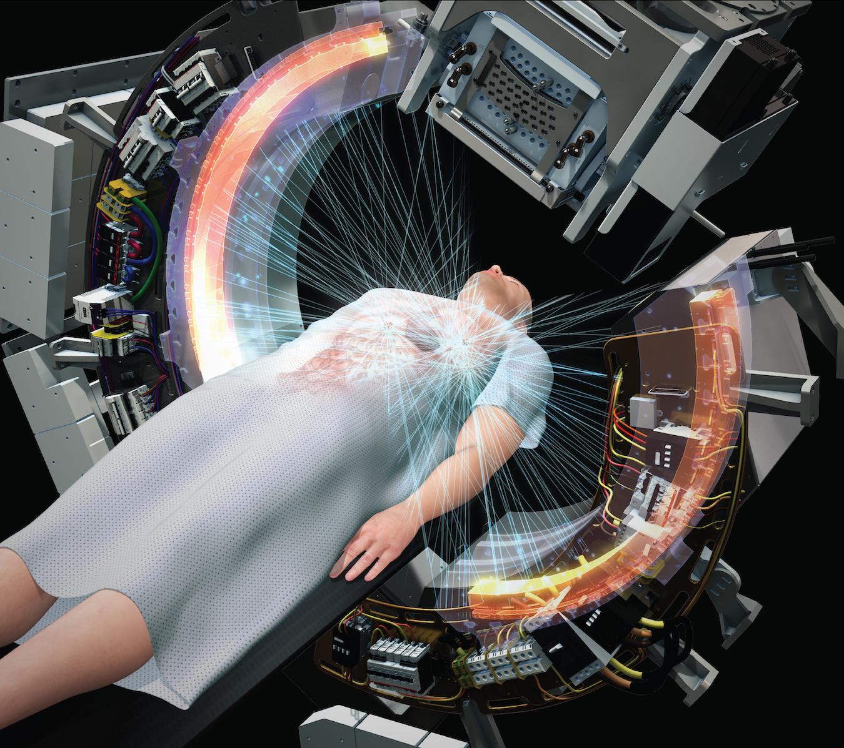
Accelerator Research at SLAC
Energy
Frontier
Ultrafast
Science
Extreme
Fields
Societal
Applications

Slide 7
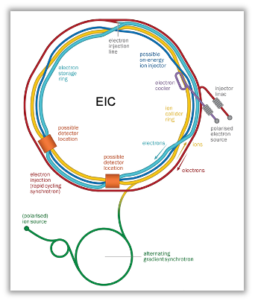
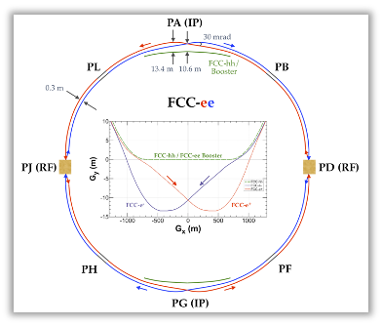
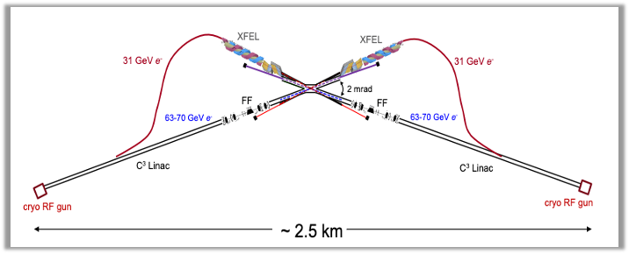
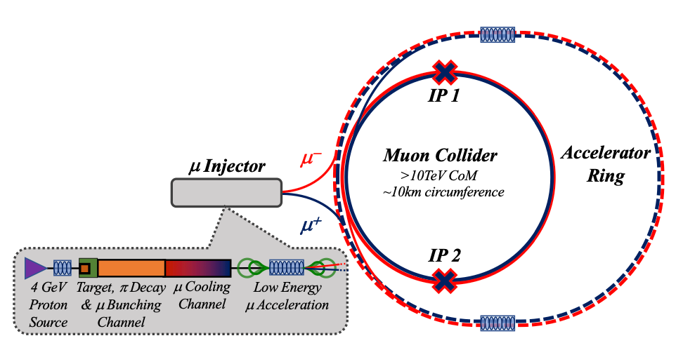
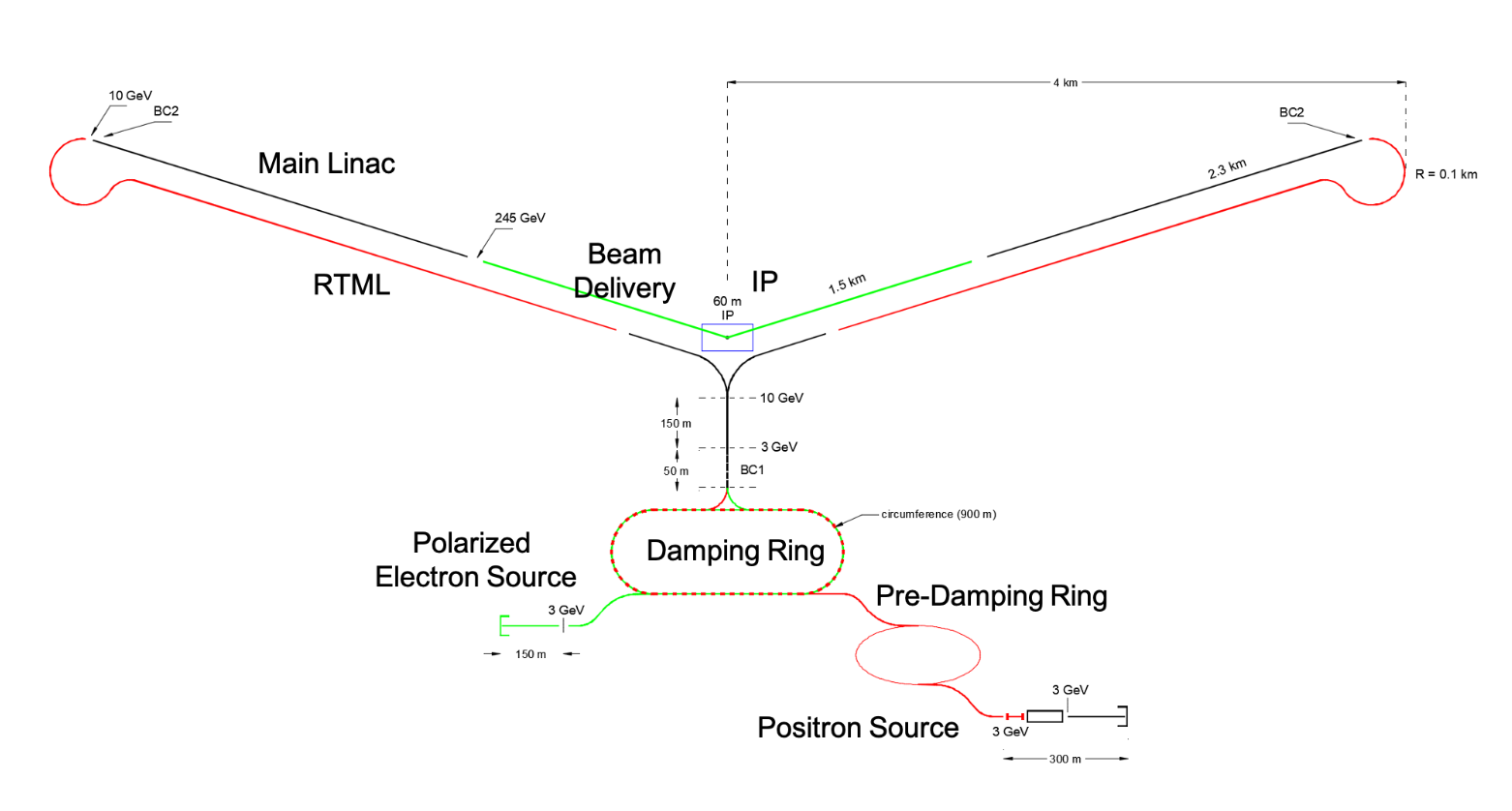
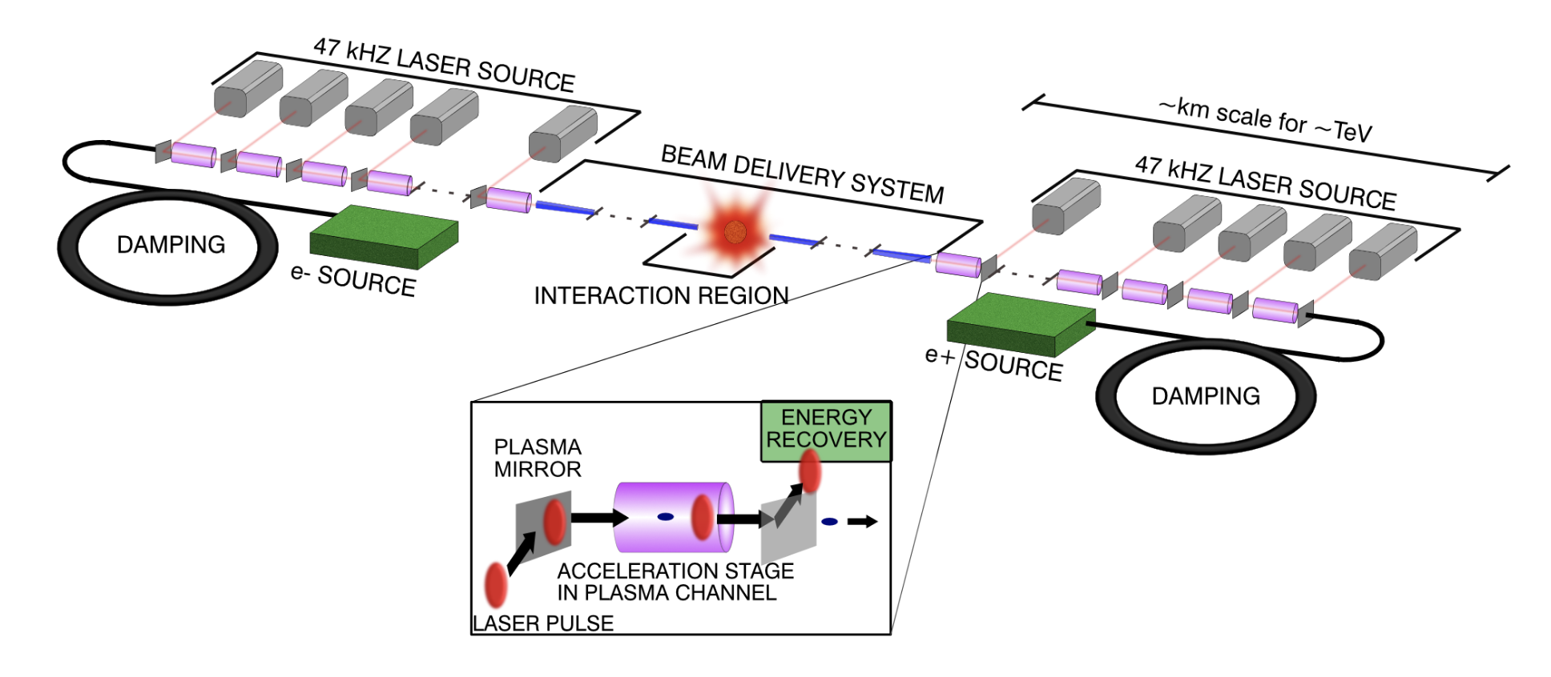
Future Colliders
Contacts:
Spencer Gessner sgess@slac.stanford.edu
Emilio Nanni nanni@slac.stanford.edu
Tor Raubenheimer tor@slac.stanford.ed
The Electron-Ion Collider at Brookhaven is under way. Student research will address:
Beam-Beam effects
Polarization preservation
Novel beam cooling techniques
The FCC at CERN is the leading candidate for future Higgs Factories. Students contribute R&D on machine:
Control of beam instabilities
Precision energy measurements
Laser-electron beam interactions
Next-Generation concepts for higher energy
C3, γγ, Plasma and Muon Collider
Innovation is required to build new machines that can see beyond the LHC. Graduate students in accelerator physics will strongly influence the path to an HEP collider.

Slide 8
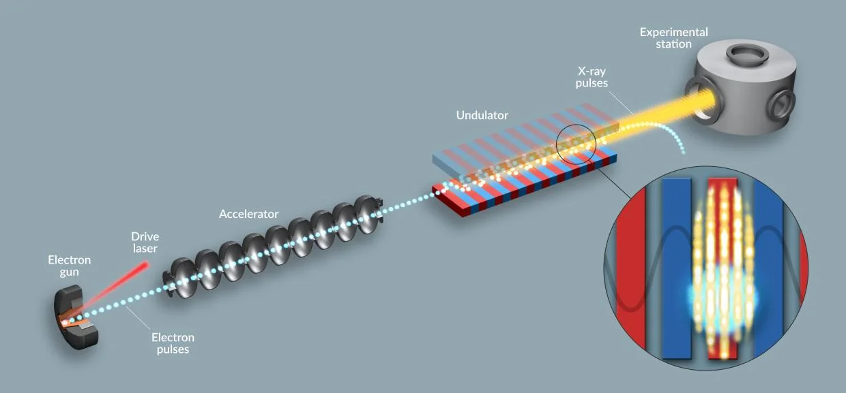
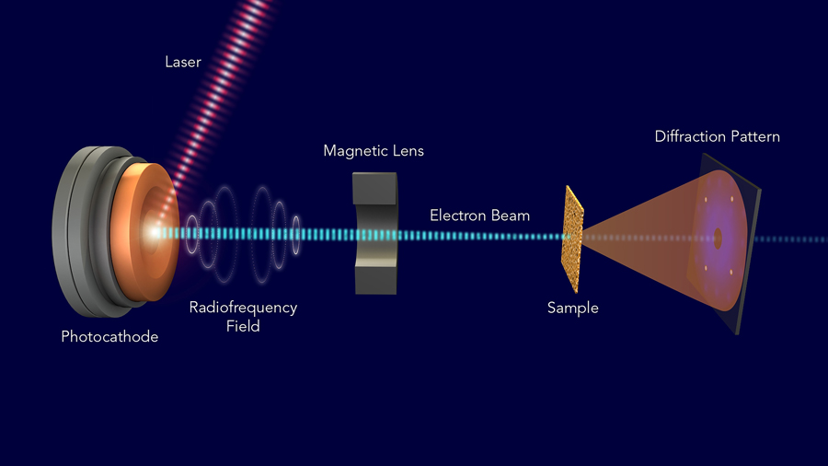
Ultrafast Science
Contacts:
Ago Marinelli marinelli@slac.stanford.edu
Zhirong Huang zrh@slac.stanford.edu
LCLS-II: The most advanced x-ray free-electron laser
UED: Ultrafast electron diffraction
Probing matter with atomic resolution and femtosecond to attosecond timescales.
Research:
Accelerator development (new injectors, high power linac etc.)
X-ray and e-beam pulse shaping
Attosecond pump/probe experiments
Cavity-based X-ray sources (XLO, XFELO, RAFEL)

Slide 9
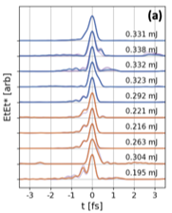
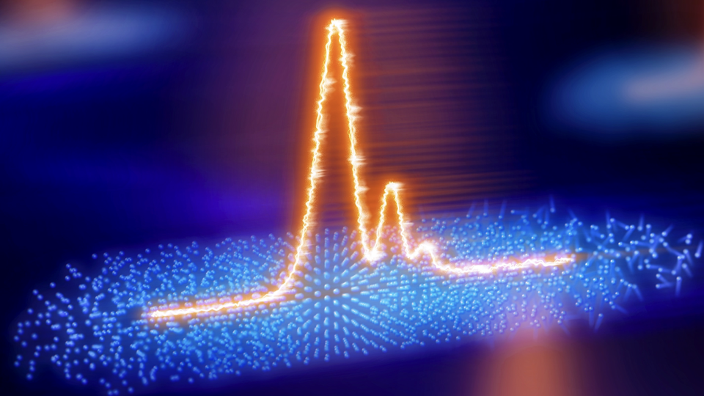
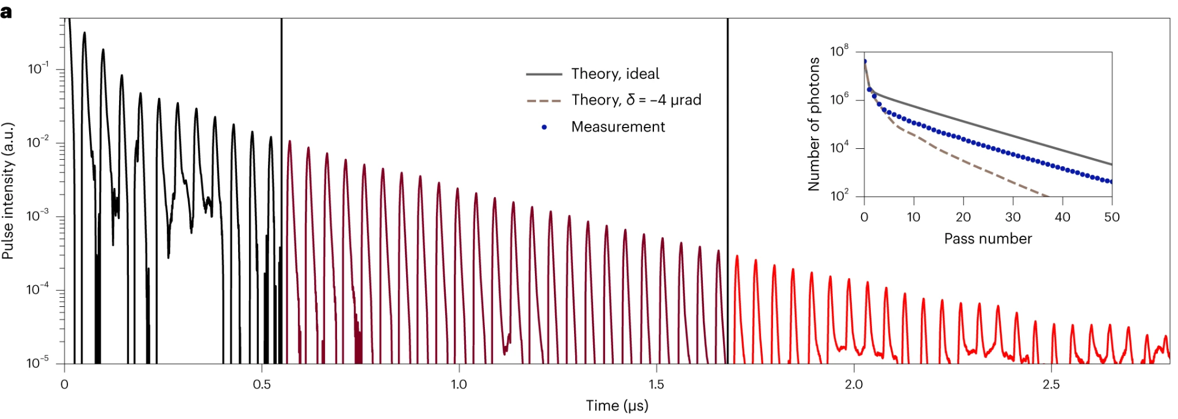
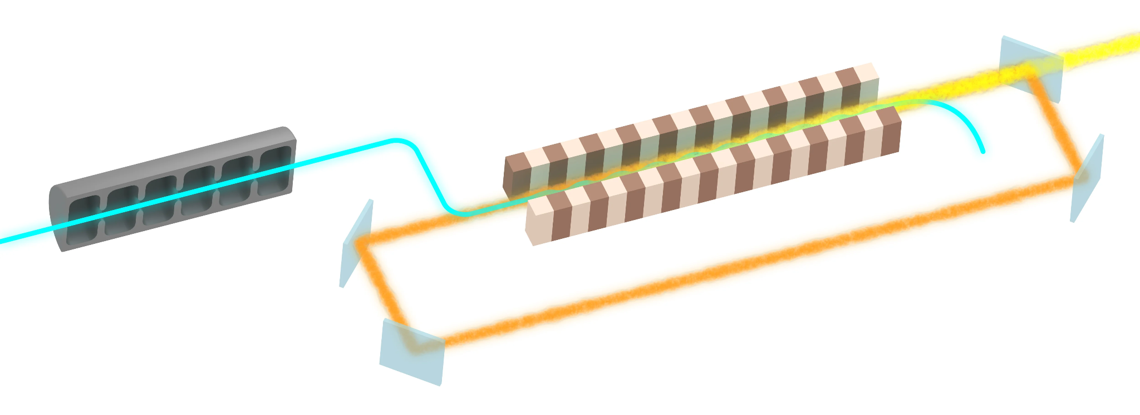
FEL R&D Program
Contacts:
Ago Marinelli marinelli@slac.stanford.edu
Zhirong Huang zrh@slac.stanford.edu
Franz, Paris, et al. Nature Photonics (2024): 1-6.
World-leading program in FEL R&D:
Faster, brighter, more coherent pulses.
Enabling and driving new ultrafast science.
Student-led high impact research program
Margraf, Rachel, et al. Nature Photonics 17.10 (2023): 878-882.
Notes:
Two examples: terawatt attosecond pulses using soliton-like XFELs and development of x-ray cavities for x-ray regenerative amplifiers and oscillators.

Slide 10
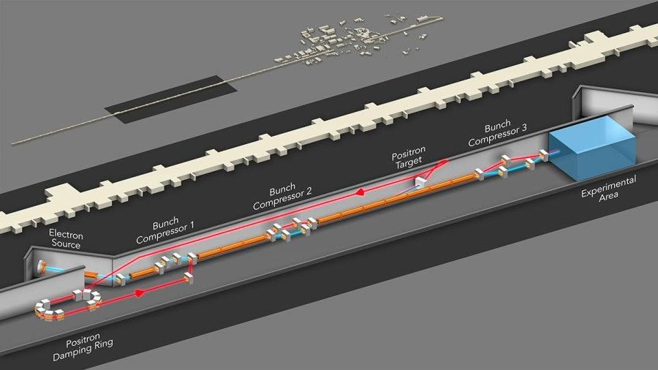
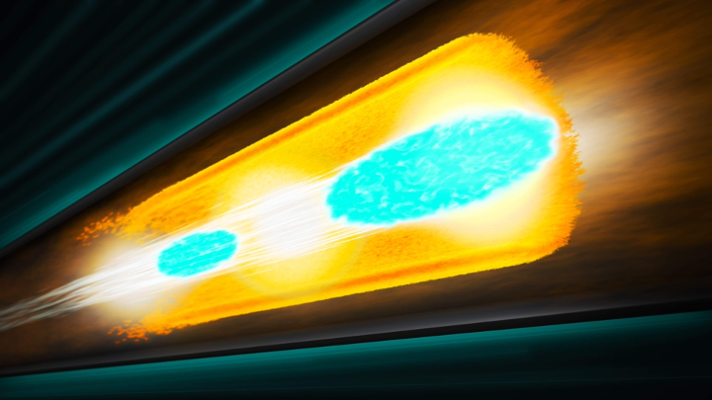
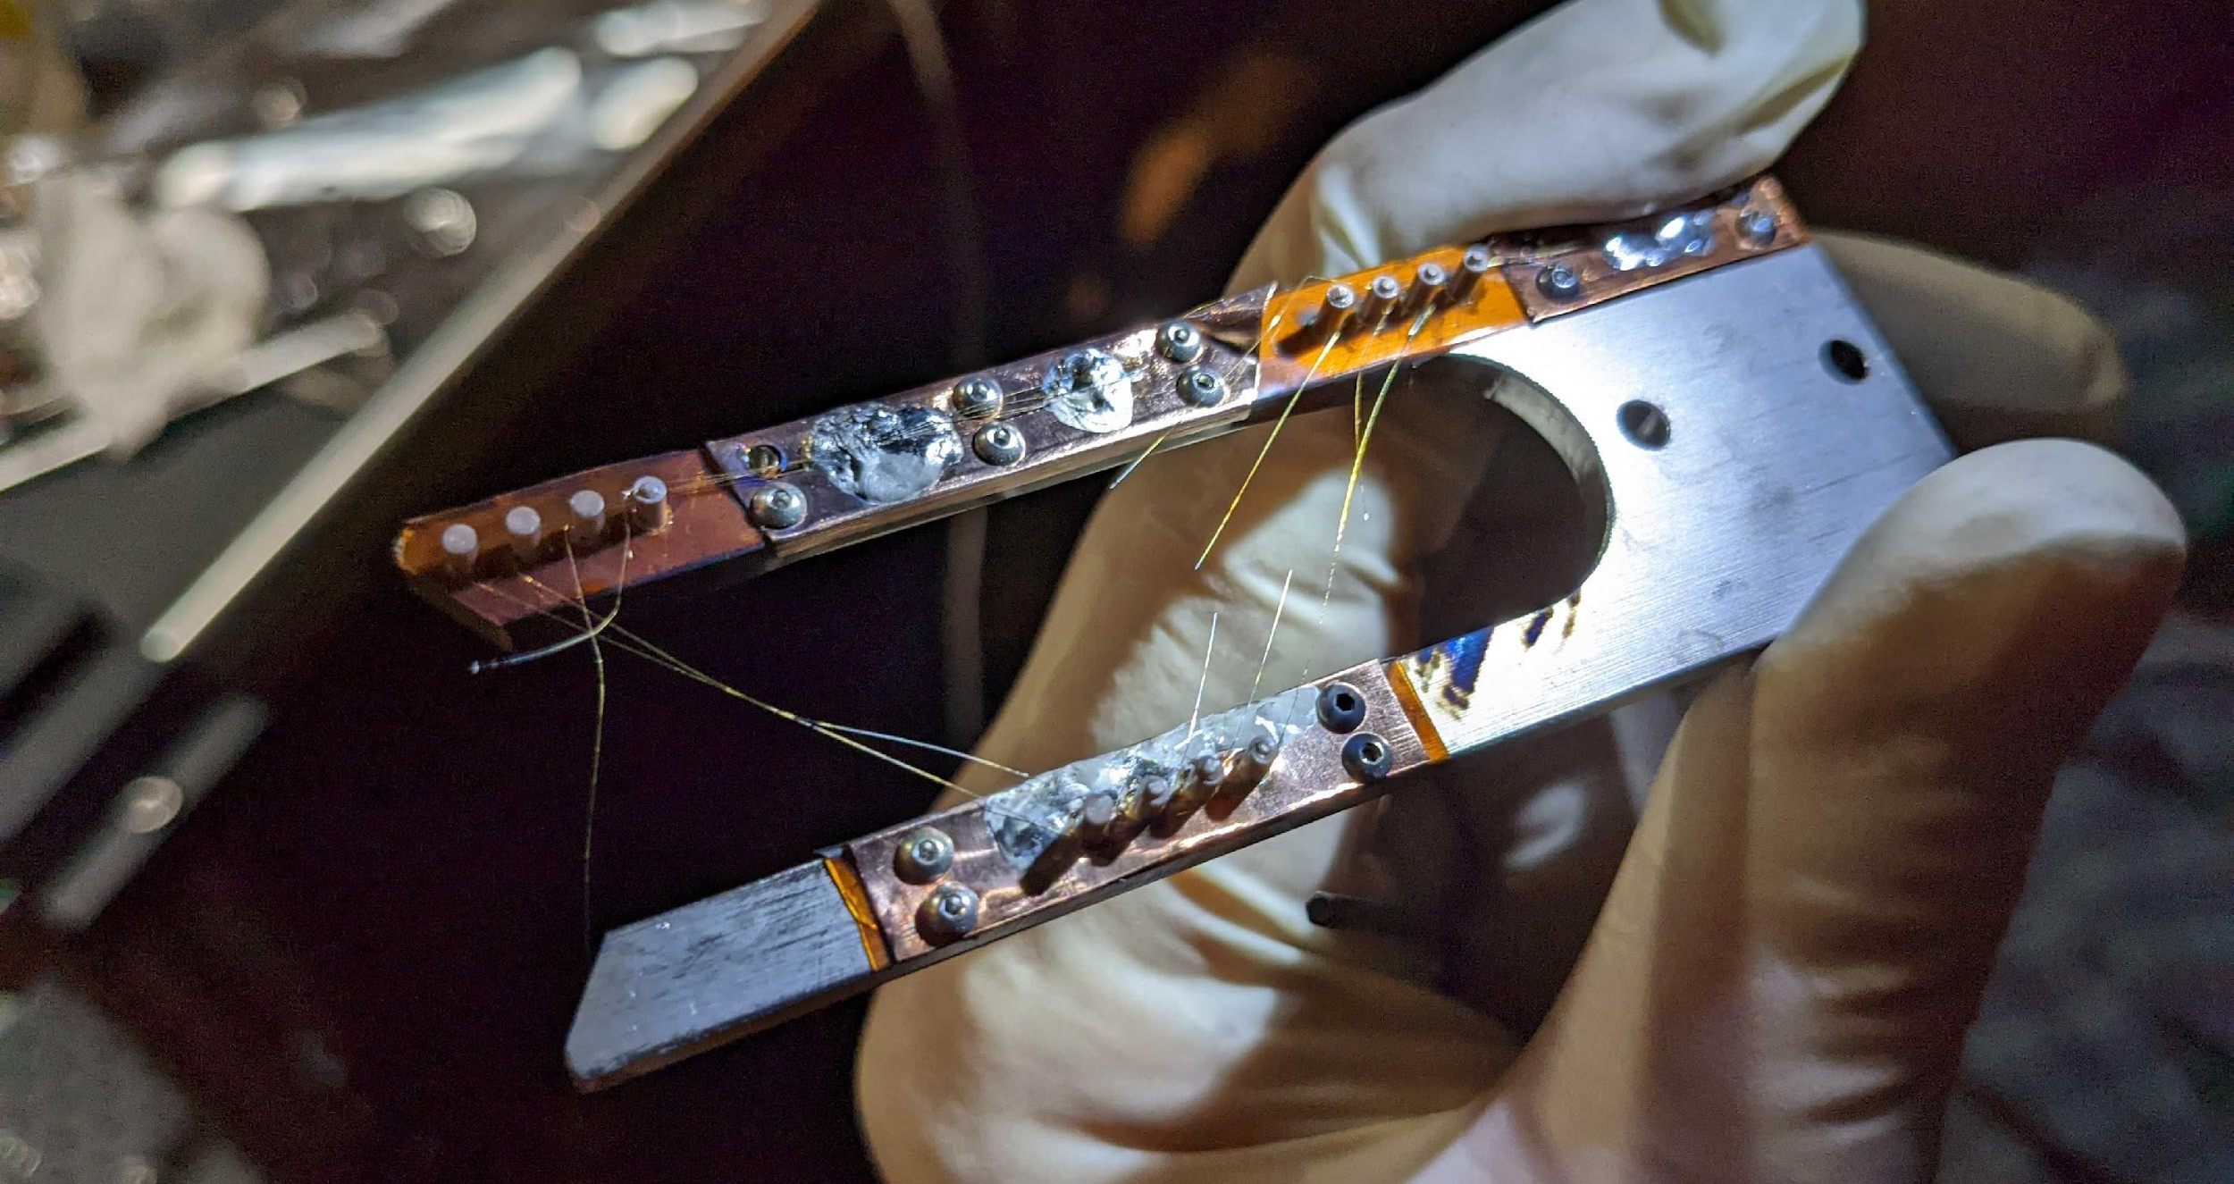
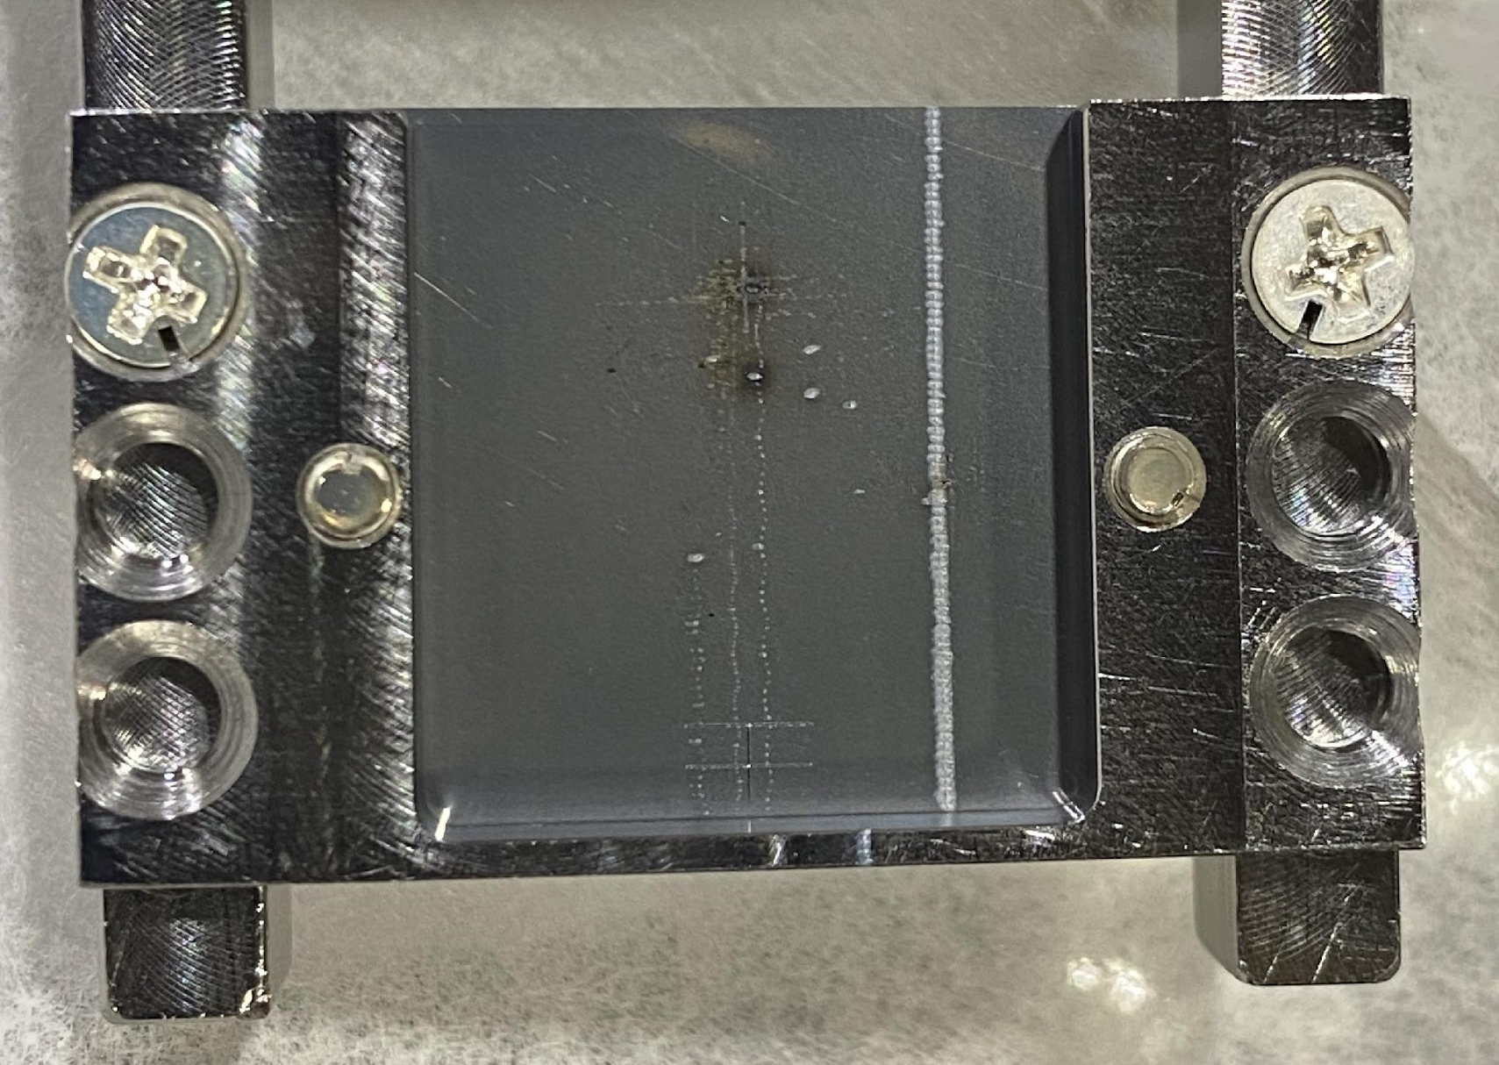
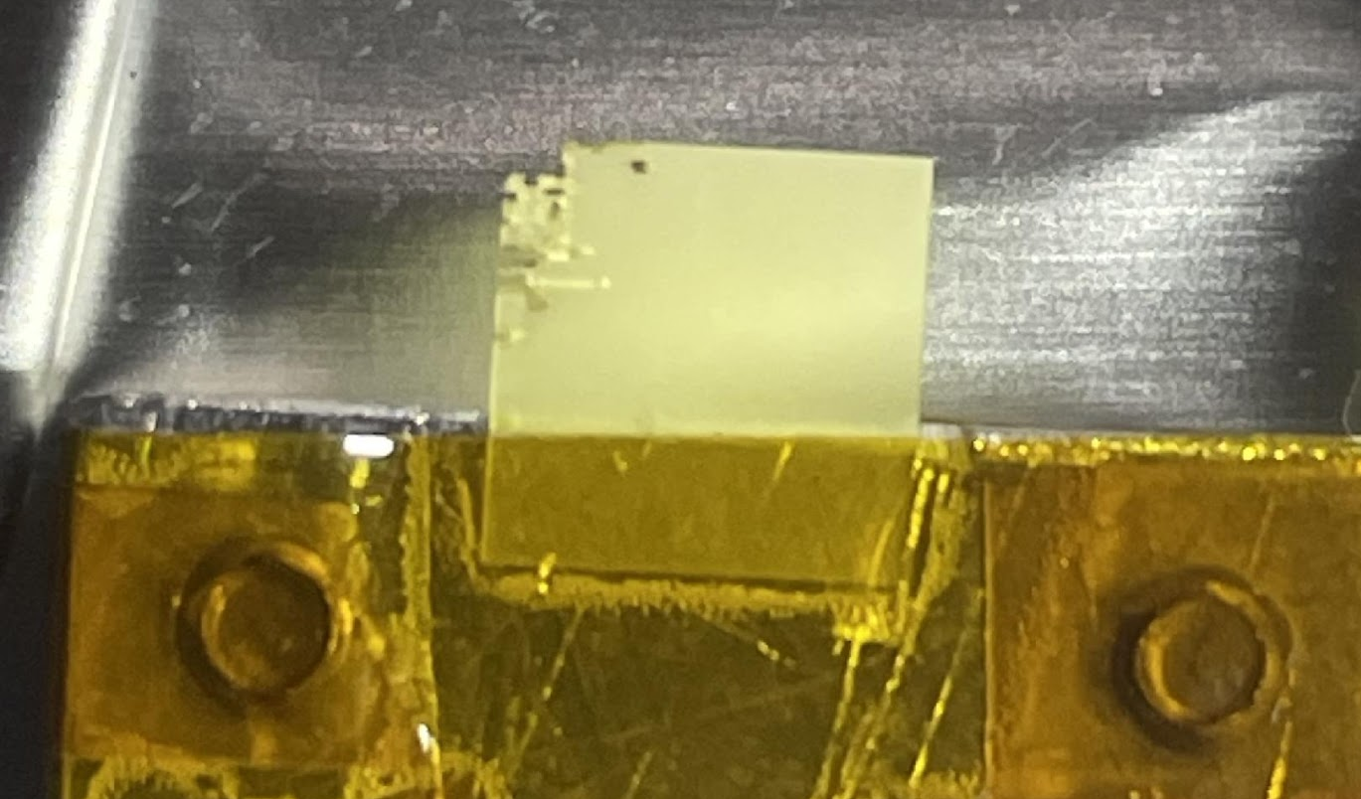
FACET-II provides unique beams
Contacts:
Brendan O’Shea boshea@slac.stanford.edu
Spencer Gessner sgess@slac.stanford.edu
FACET-II delivers electron beams with nanocoulomb charge at 10 GeV energy.
FACET-II has three compressor chicanes to reduce the length of the bunch delivered to experiments.
The radial electric field of the electron bunch is about 100 GV/m in the lab frame!
FACET-II facility layout
Wire scanner. . . shredded
OTR foil. . . drilled
YAG crystal. . . swiss-cheesed
Beam-Driven Plasma Wakefield

Slide 11
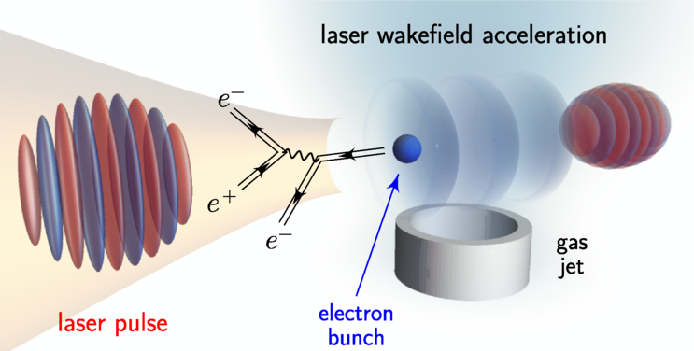
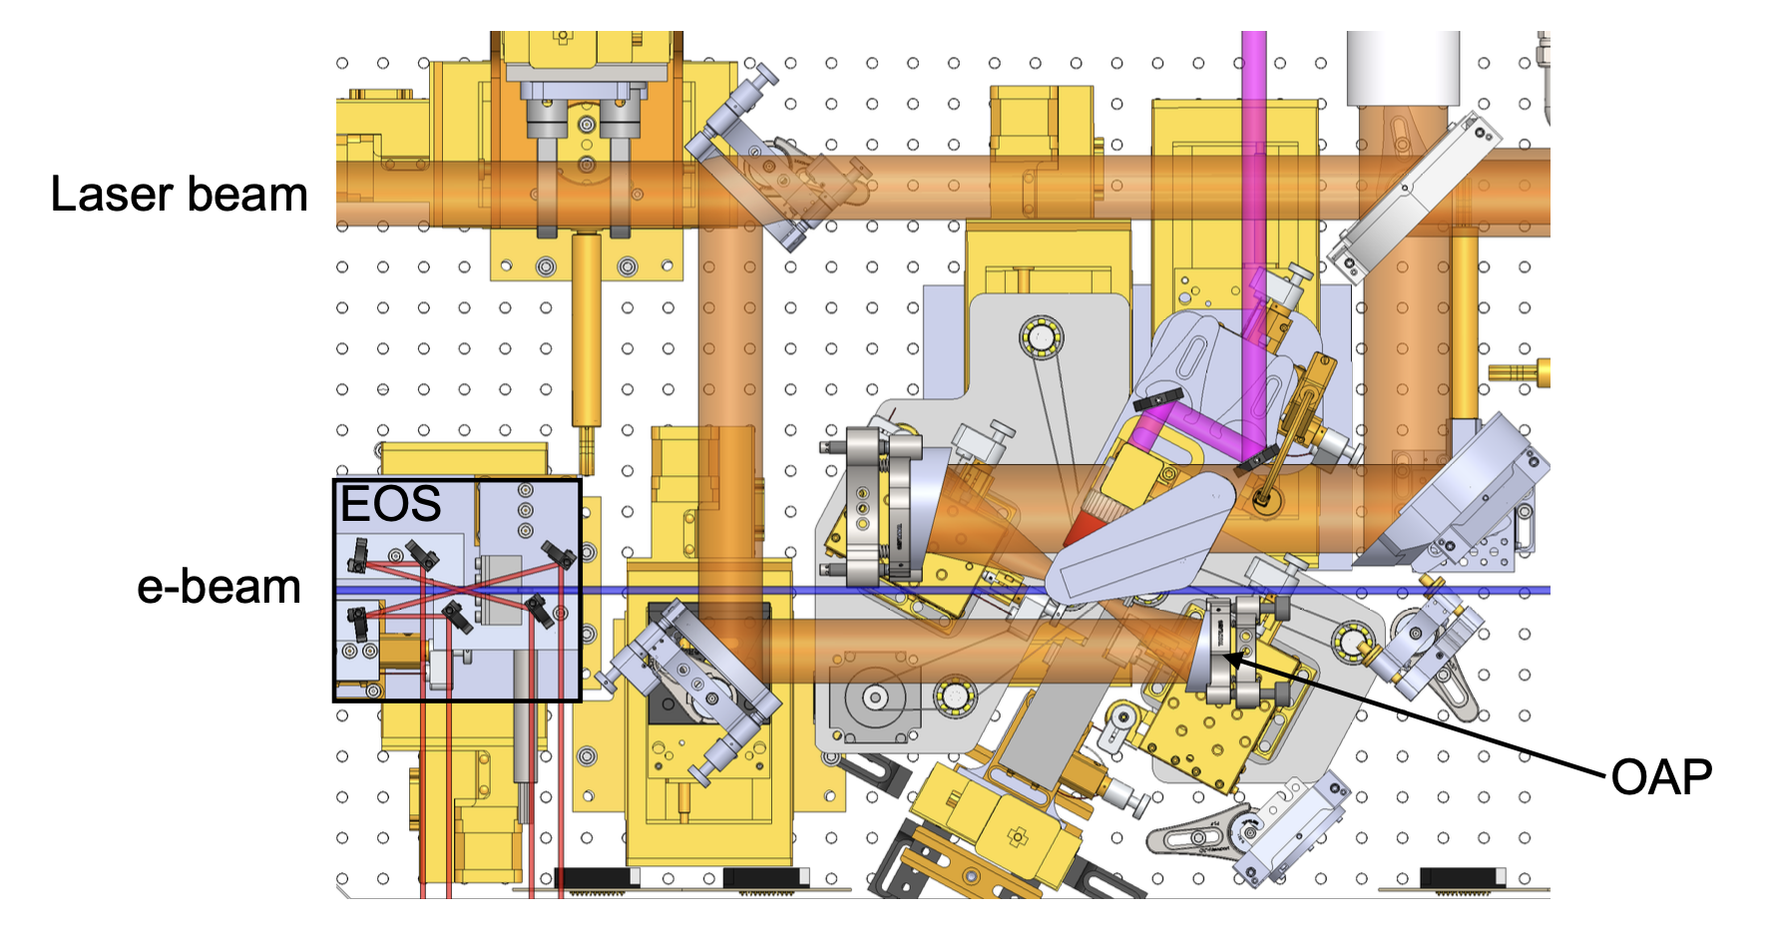
Strong Field QED at FACET-II
Contacts:
David Reis dreis@stanford.edu
FACET-II has a 20 TW laser that can be used to collide with electron beam for inverse Compton scattering experiments.
The motivation for this research is to probe strong field QED effects:
Nonlinear Compton scattering
Coherent pair creation
Trident cascade
Violation of local constant field approximation
SLAC E320 Experiment

Slide 12
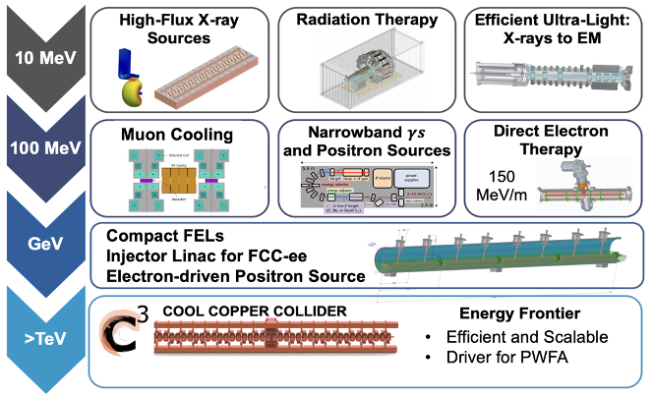
Societal Applications
Contacts:
Emilio Nanni nanni@slac.stanford.edu
Emma Snively esnively@slac.stanford.edu
Near-term applications of particle accelerators for medicine, industry and security provide societal benefits today and pave the way for ambitious science facilities.

Slide 13
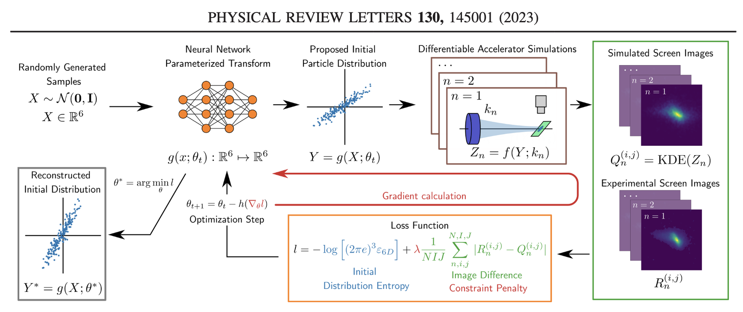
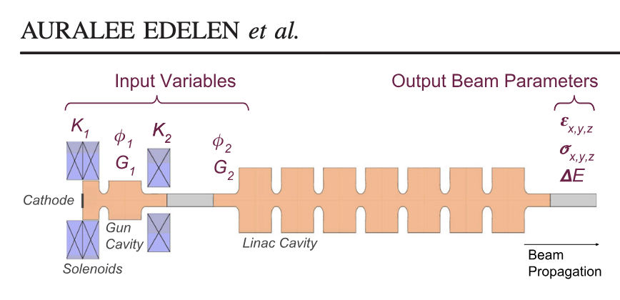
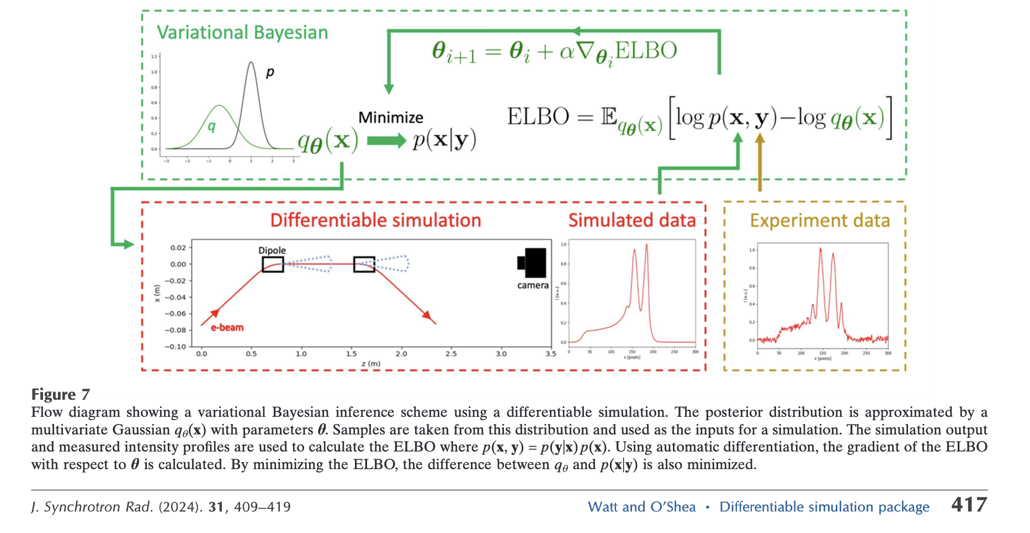
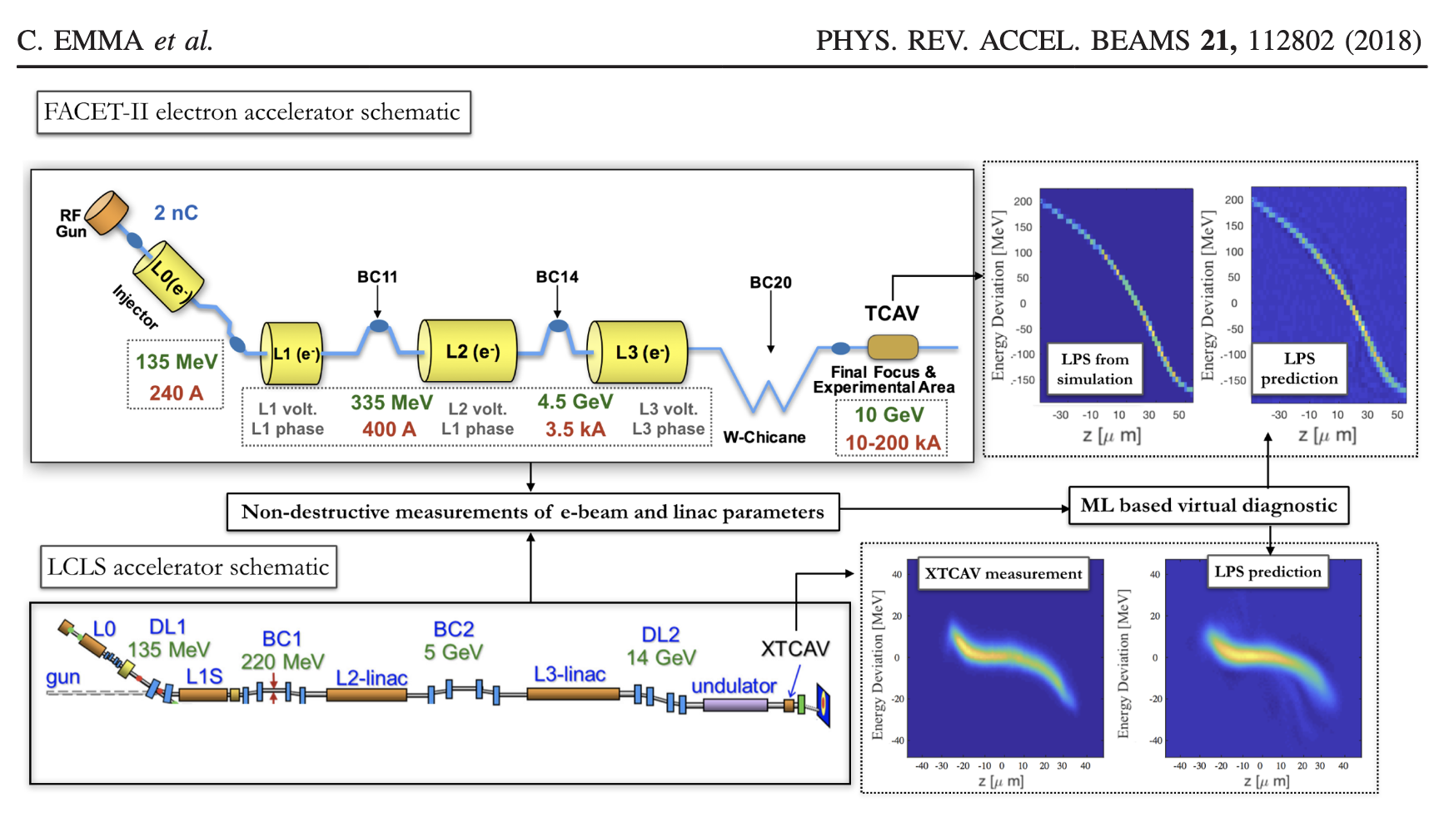
Machine Learning
Contacts:
Auralee Edelen edelen@slac.stanford.edu
Brendan O’Shea boshea@slac.stanford.edu
R. ROUSSEL et. al.
SLAC hosts a world-leading team of researchers that apply AIML techniques to challenges in accelerator physics.

Slide 14
The Accelerator Physics PhD Experience
Theory/simulation of a concept under development.
Hardware development for testing with beam.
Experimental beamtime at one of SLAC’s facilities.
Data acquisition and analysis.
Write-up results for publication.
Graduate students in accelerator physics can expect to contribute to the theory, execution, and analysis of experiments.

Slide 15
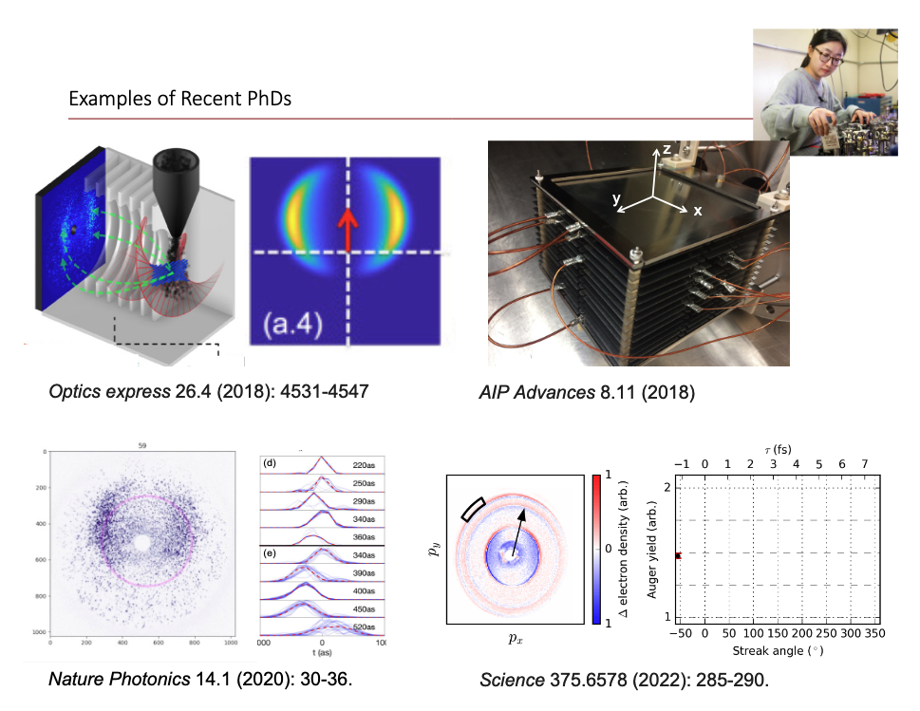
The Accelerator Physics PhD Experience
Siqi Li
-Stanford Ph.D. 2020
-APS DPB Thesis Prize 2020
-SLAC Staff Scientist 2020-2024
-University of Hawaii Faculty 2024 –

Slide 16
Opportunities
Accelerator physics is a deep and diverse field of research with excellent career prospects at national laboratories and universities.
Graduate students can have an enormous impact in accelerator physics and influence the future of High Energy Physics and Next-Gen Light Sources.
If you are interested in pursuing a Ph.D. in Photon Science, consider rotating with an FEL group for a quarter to learn about FELs and how they might be improved in the future.
If you are interested in pursuing a Ph.D. High Energy Physics, especially Collider Physics, consider rotating with an accelerator physics group. Students are critical to the success of the field!

