Slide 1

C³ Update
7/16/2026

Slide 2
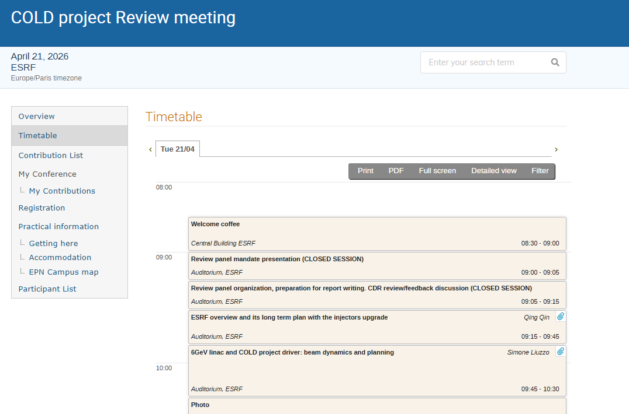
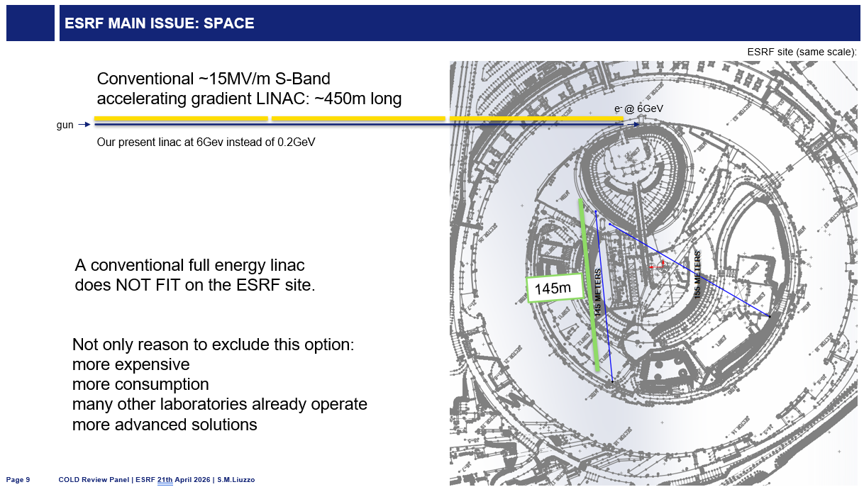
April 2026 – COLD Project Review
COLD project at ESRF had first review
SLAC participation:
Design and build “quarter cryomodule”
  Contains one raft / 2 m of accelerating structures – the repeating unit of the main linac
  Deliver summer 2027
Raft and accelerating structures meet full precision and alignment requirements for C3
Structures include damping features
Participate in experiments with structures at high gradient and beam acceleration
Notes:
Sustainability lcws talk and paper

Slide 3
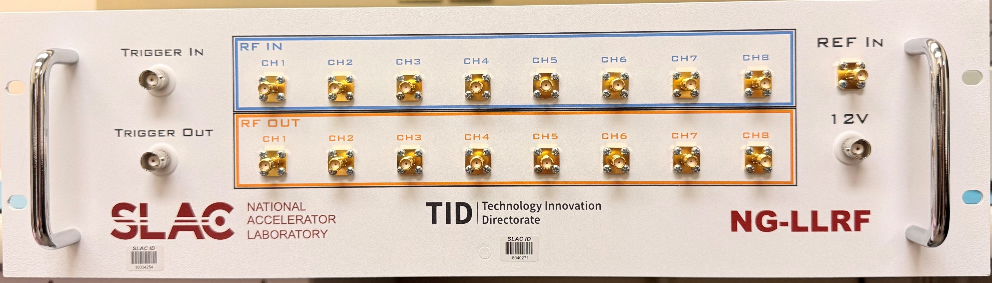
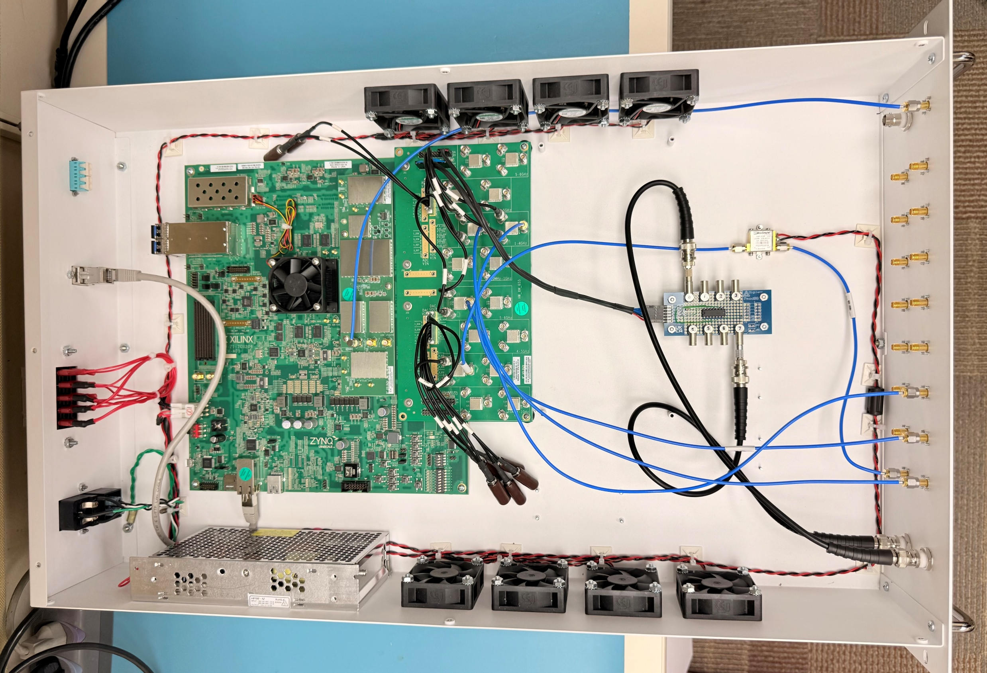
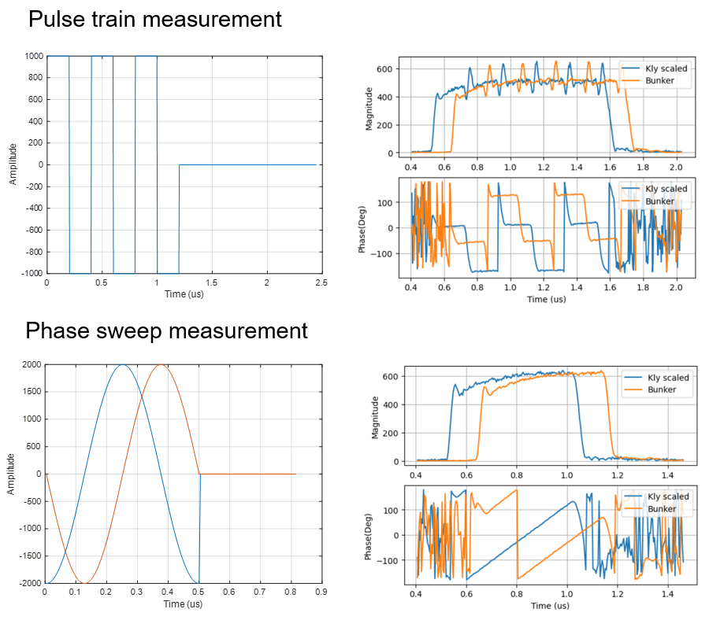
Next Gen LLRF based on AMD Zynq ZCU208
Uses RF System on Chip (RFSoC) to directly sample up to 6 GHz
Integrates high-speed data converters, FPGAs and processors
Can directly sample and drive S -band and C-band systems
RFSoC
Integrated RF Drive and sampling with a 2U unit

Slide 4
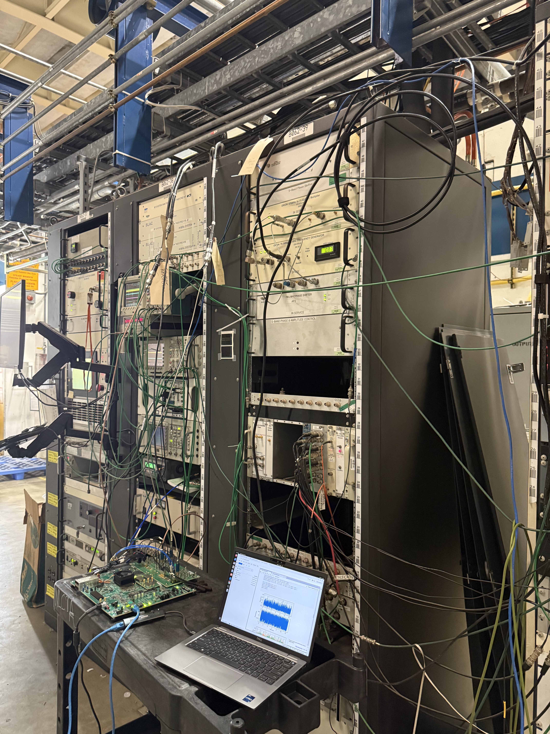
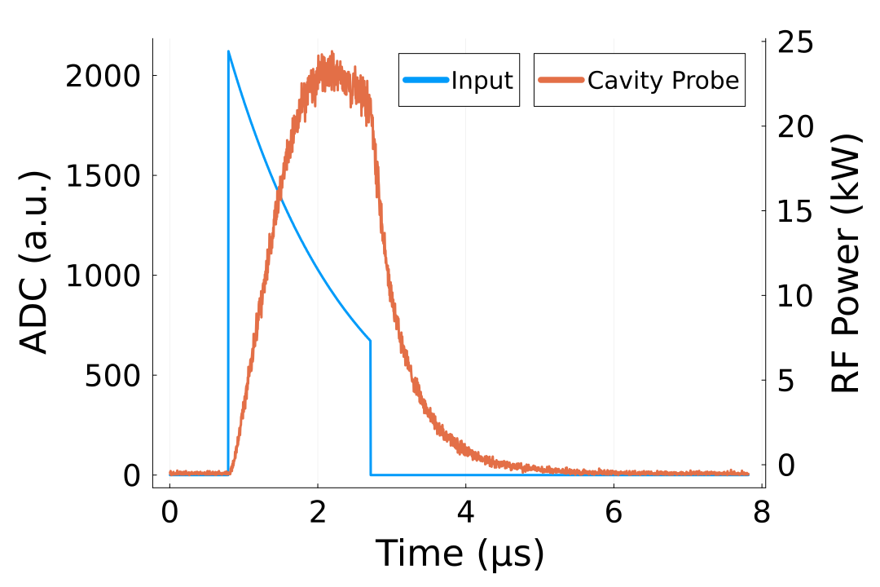
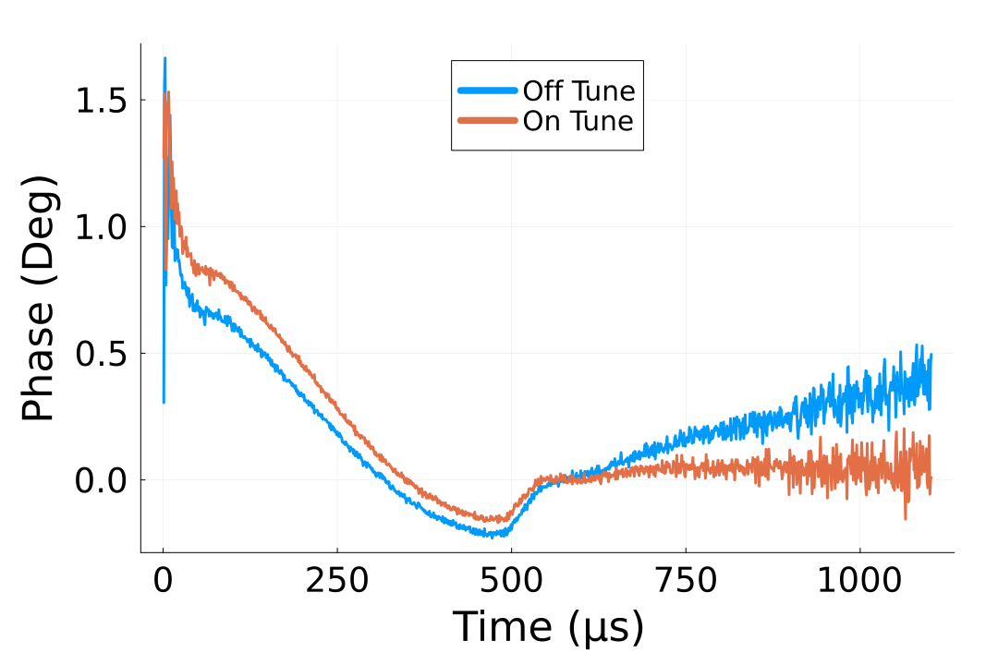
RFSoC Deployment at NLCTA for S-band RF Tests
Demonstration of pulse shaping to tailor cavity fields demonstrated, developing automation
RFSoC is able to directly sample RF signals from test cavity, allowing to automatic pulse shaping and tuning
Digitizers can also directly sample non-RF signals like faraday cups
Goal is to build fully automated conditioning scheme
  Utilize feedback from cavity probe to keep fields flat
  Use phase information to stay on resonance
Pulse Shaping
Tuning

Slide 5

LCWS 2026
Registration and abstract submission open - https://agenda.linearcollider.org/event/11000/registrations/372/
Notes:
Sustainability lcws talk and paper

