Slide 1
Laser-Based Collimation of Beam Halo Electrons via Compton Scattering
FCC meeting
Ching-En Lin
2026 Aug 04

Slide 2
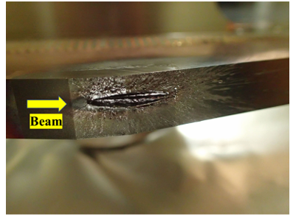
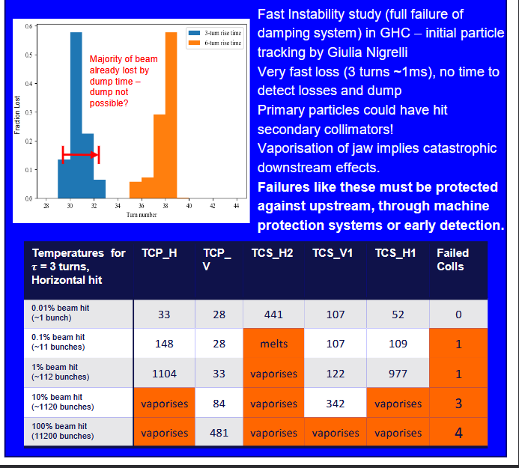
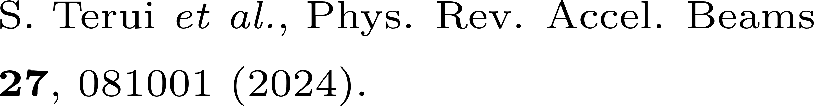
Motivation: Collimation Challenges
Richard Cowan, FCC Week 2026
SuperKEKB has already experienced catastrophic collimator damage.
FCC-ee collimators may not survive a fast instability.
Fast instabilities cause catastrophic collimator damage.

Slide 3
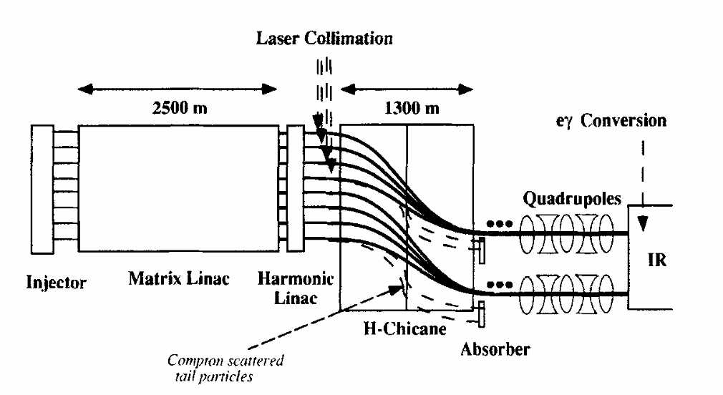
Laser Collimation as a Defense-in-Depth Layer
The closer the collimator jaws are to the beam, the more impedance issues, and they are more susceptible to damage.
normal collimator
laser collimator
F. Zimmermann, AIP Conf. Proc. 472, 103–117 (1999).
An additional, non-material layer to reduce the load on conventional collimators.

Slide 4
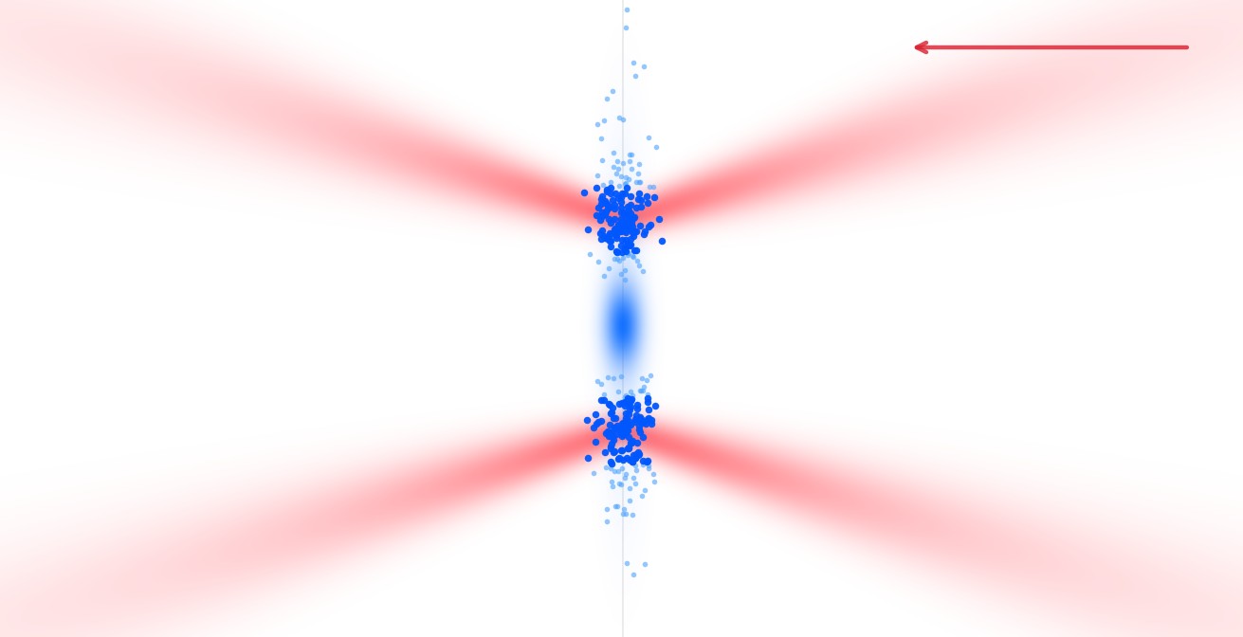
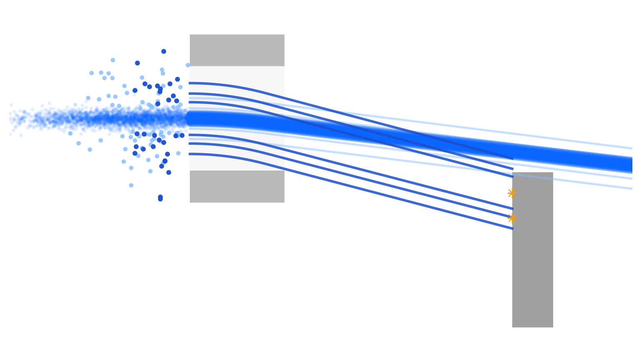
Laser Collimation Concept
magnet dipole
halo electrons
donut laser
main bunch
beam dump
Donut-laser scattering separates halo electrons from the main beam.

Slide 5
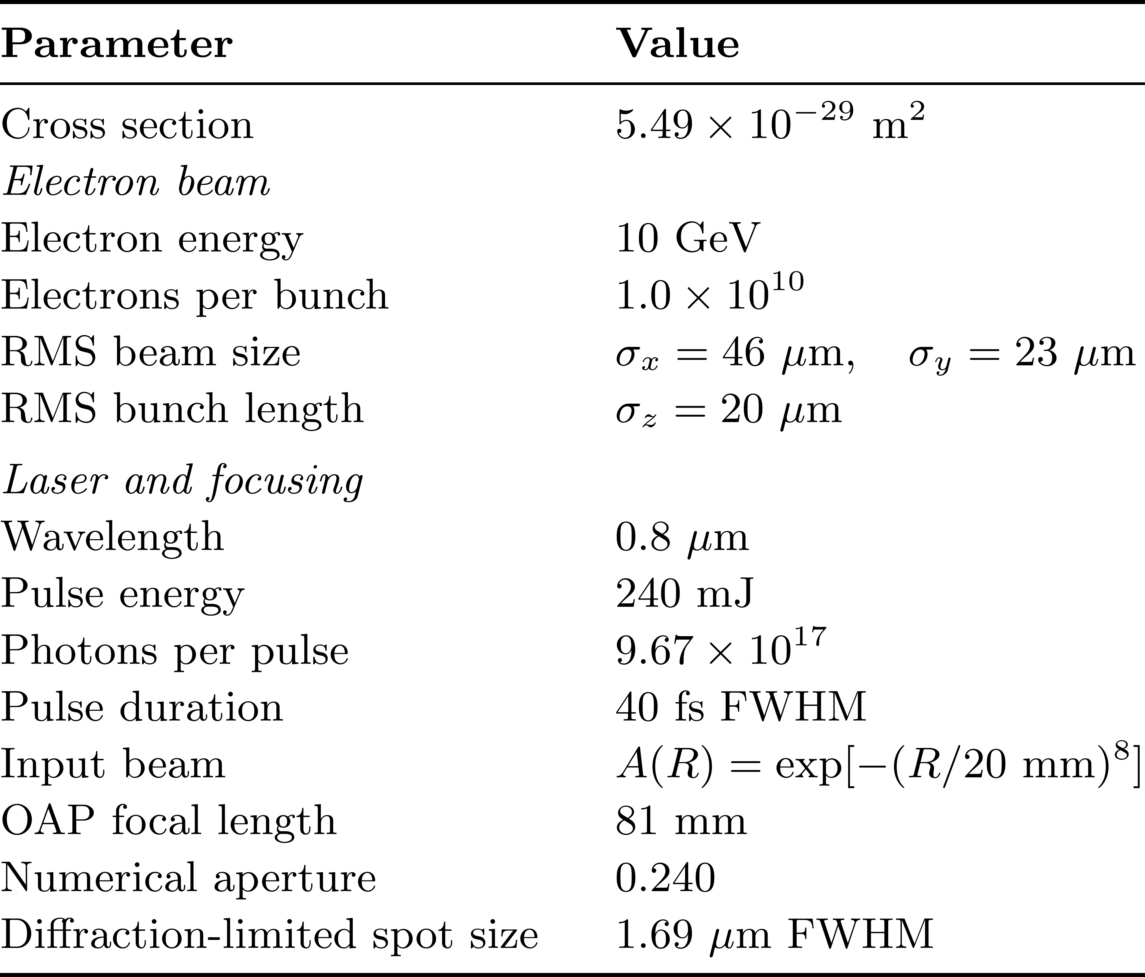
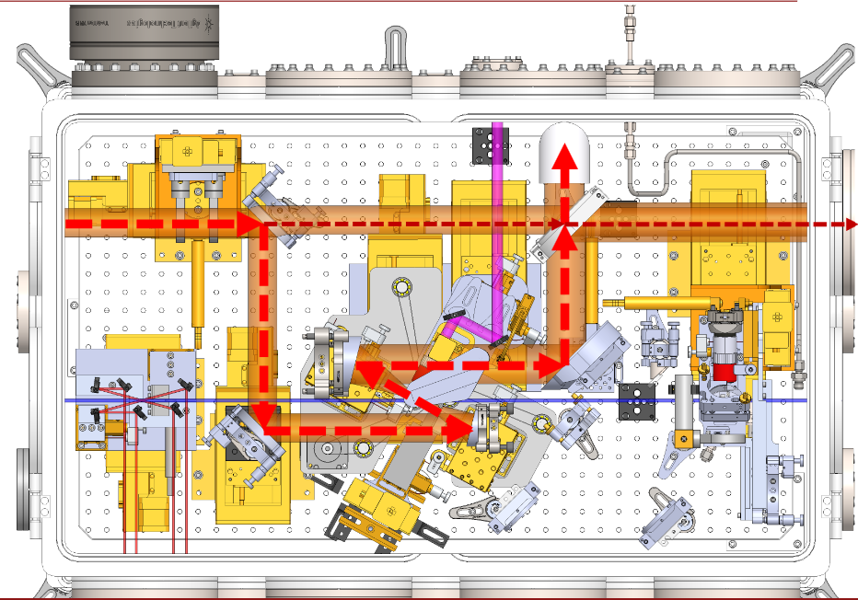
E344: Laser-Collimation Test at FACET-II
Built on the established E320 platform
Axicon
OAP
FACET-II enables a near-term test of laser collimation.
Notes:
E320 is a nonlinear QED experiment in which a high-intensity laser collides with an electron beam. It has already established the interaction geometry, synchronization, diagnostics, and experimental workflow. E344 mainly adds the beam-shaping optics needed to test laser collimation.

Slide 6
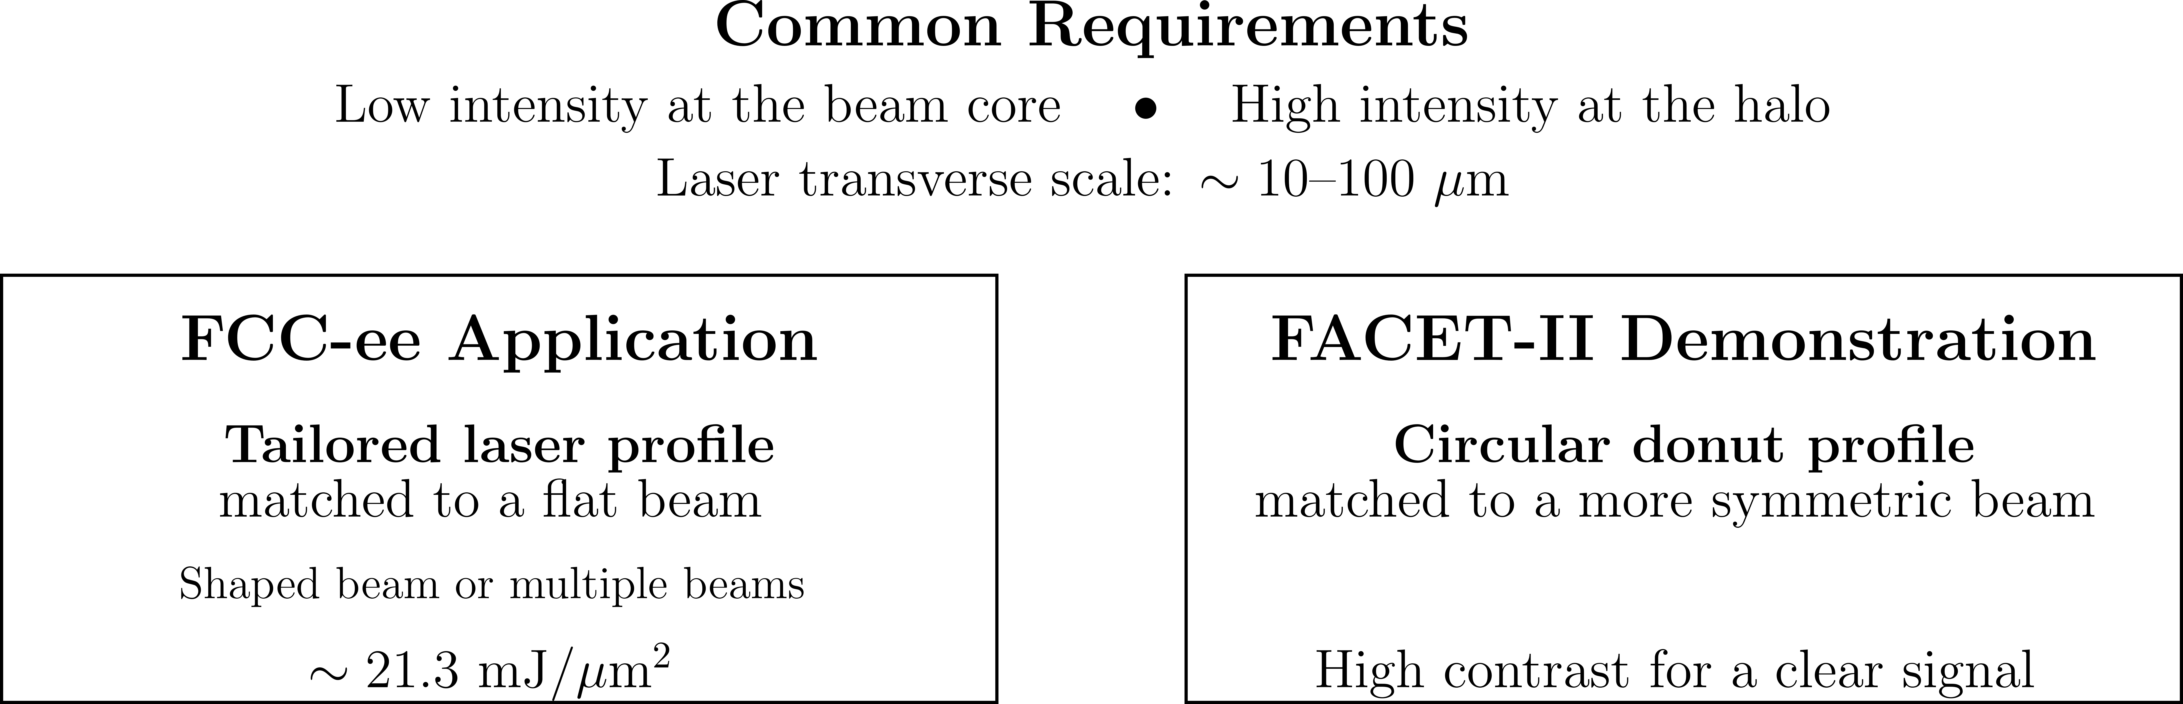
Laser Requirements: FCC-ee vs FACET-II

Slide 7
Comparison of Optical Schemes
Property | High-NA axicon + OAP | Low-NA axicon + focusing optic | Spiral phase plate + high-NA OAP
Ring radius | broadly tunable | broadly tunable | tied to diffraction scale
Ring thickness | thin | thick | moderate
Radius/thickness independent control | good | good | limited
Peak intensity | high | low | high
Main-ring energy concentration | high | moderate-high | moderate
On-axis suppression | good | moderate | excellent
Input beam size sensitivity | low for radius | low for radius | high
Notes:
For FCC-ee, it is possible to generate a light-sheet beam or other tailored beam profiles. It is also possible to use multiple laser beams.

Slide 8
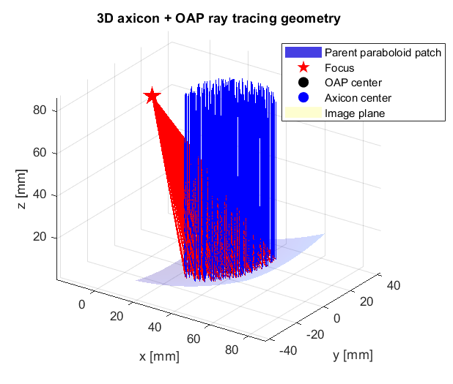
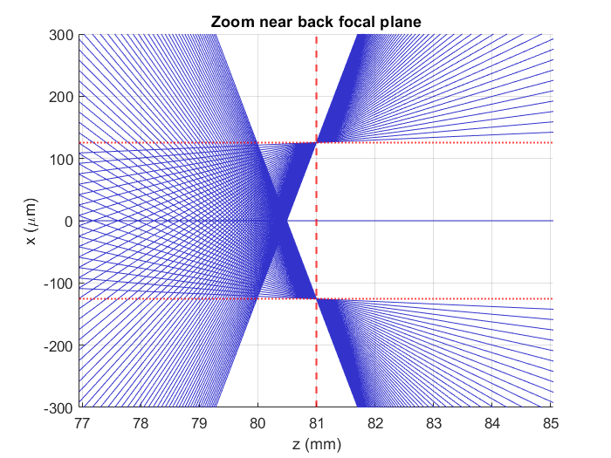
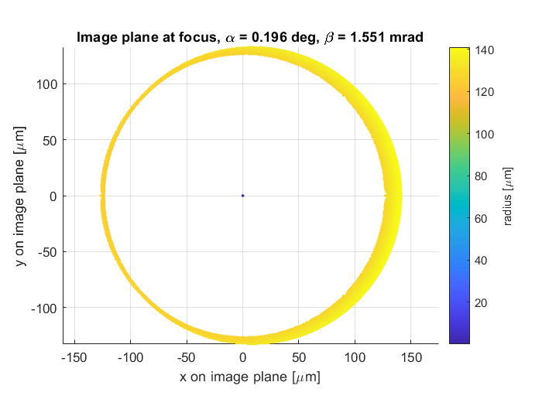
Ray-Tracing Simulation
1+1D simplified ray tracing
3D ray-tracing
Notes:
The thickness of the ring at focus is determined by two main factors: (1) the diffraction limit and (2) astigmatism.
If one wants a thicker ring or other beam structures, phase-retrieval methods such as the Gerchberg–Saxton (GS) algorithm can be used.

Slide 9
Ray-Tracing Simulation
β
α

Slide 10
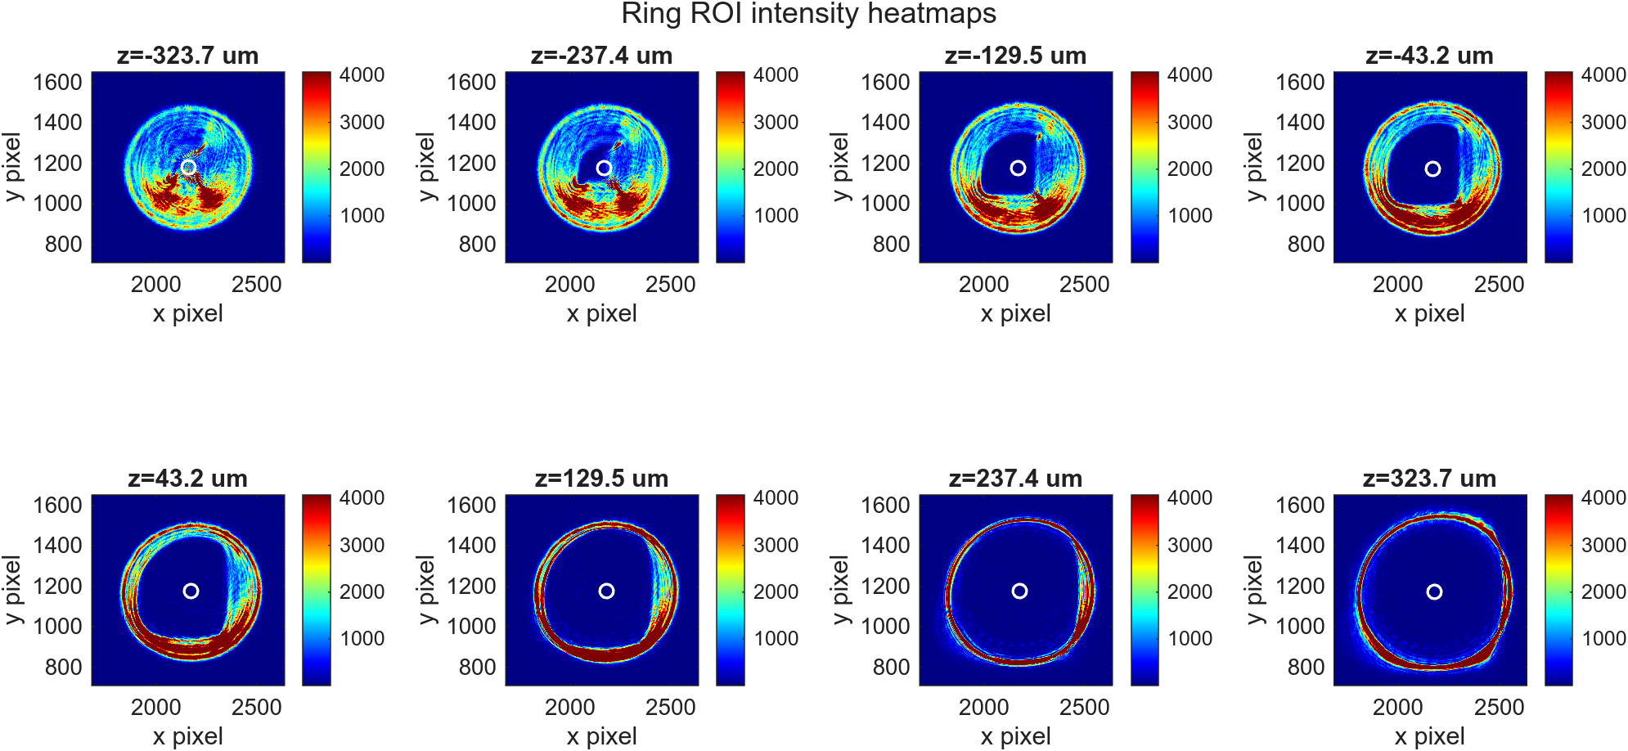
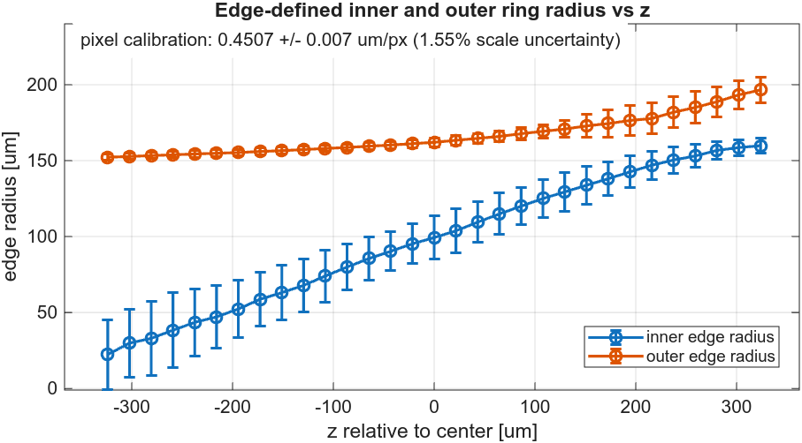
Donut-Beam Profile Measurement
Target radius: 125 μm
Measured radius: 131 μm
Difference likely from residual alignment error
Notes:
800nm CW Fiber laser

Slide 11
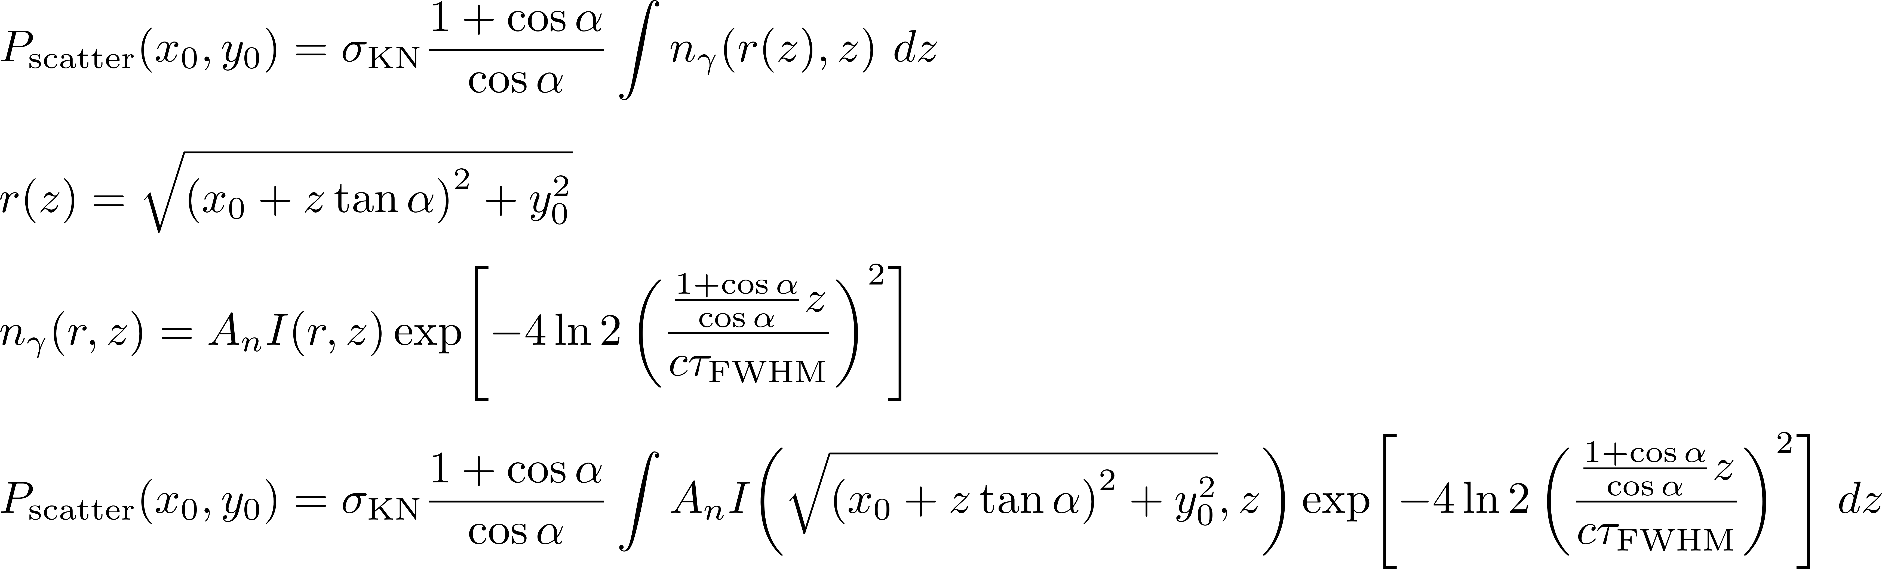
Scattering Probability
Notes:
Klein–Nishina formula has relatively weak scaling with laser photon or electron energy.

Slide 12
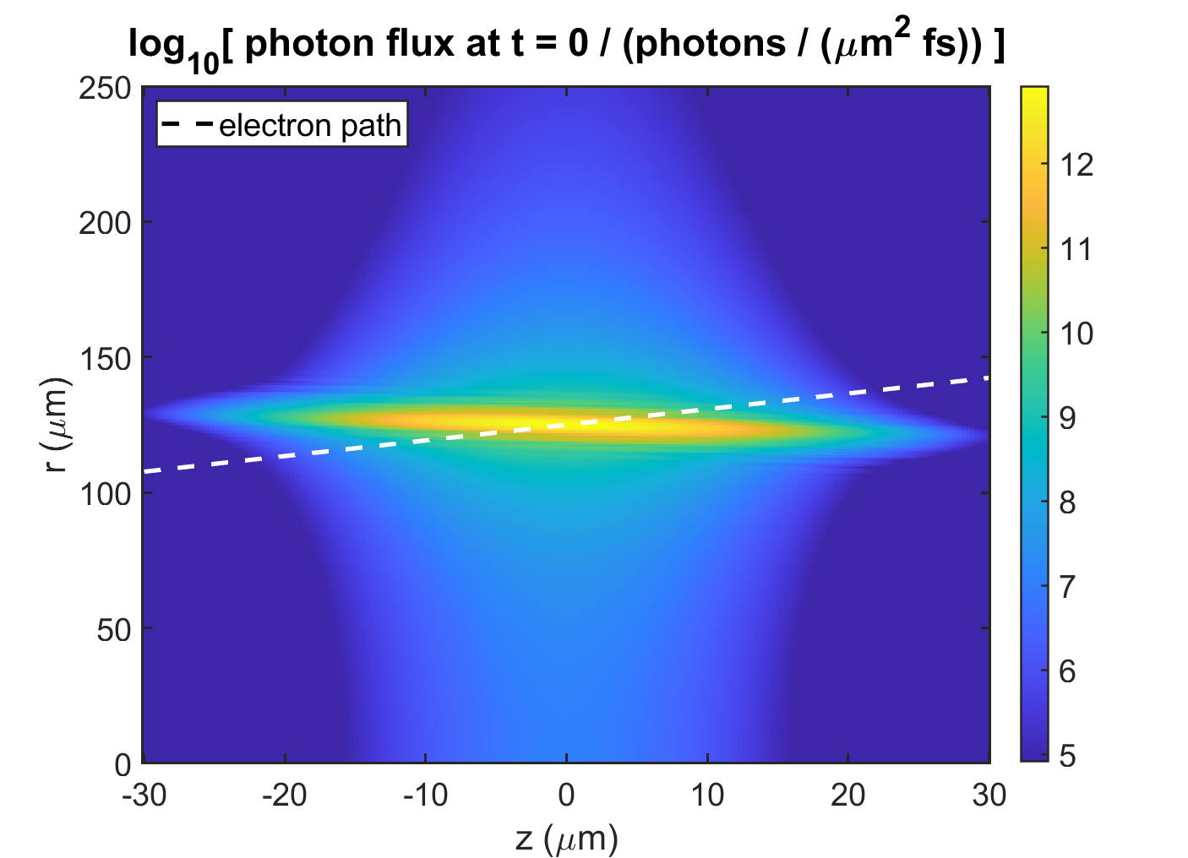
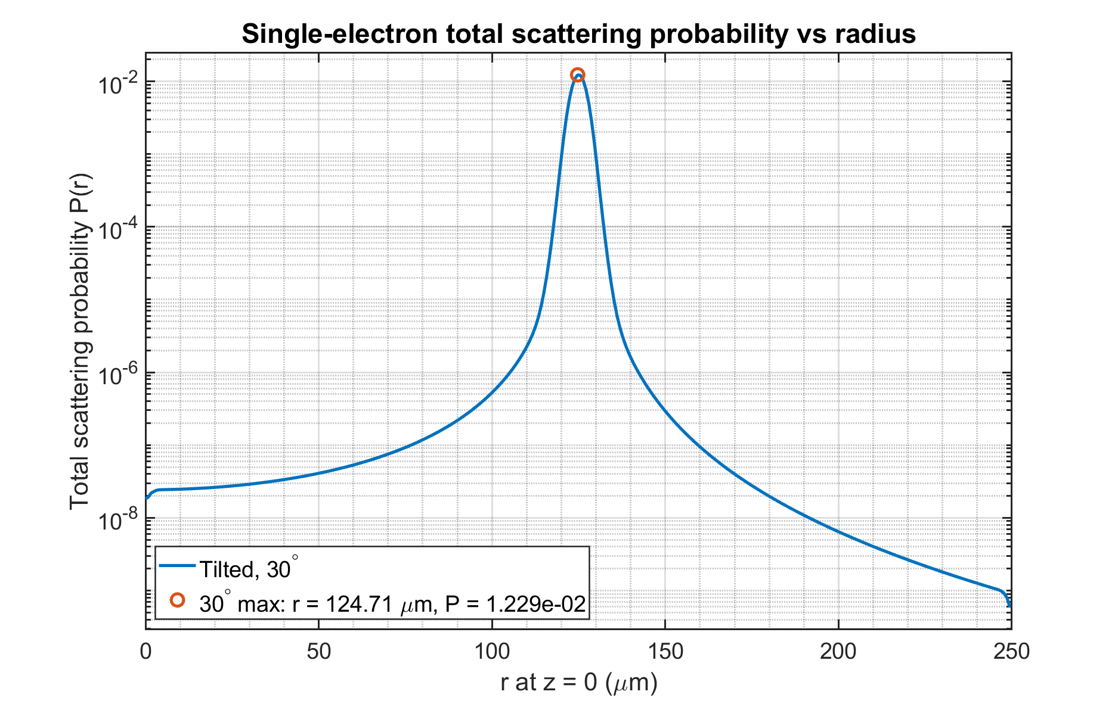
Scattering Probability
~1% Scattering Probability for Single Electron
Notes:
Need to consider the electron beam size: σx ≈ 46 μm, σy ≈ 23 μm.

Slide 13
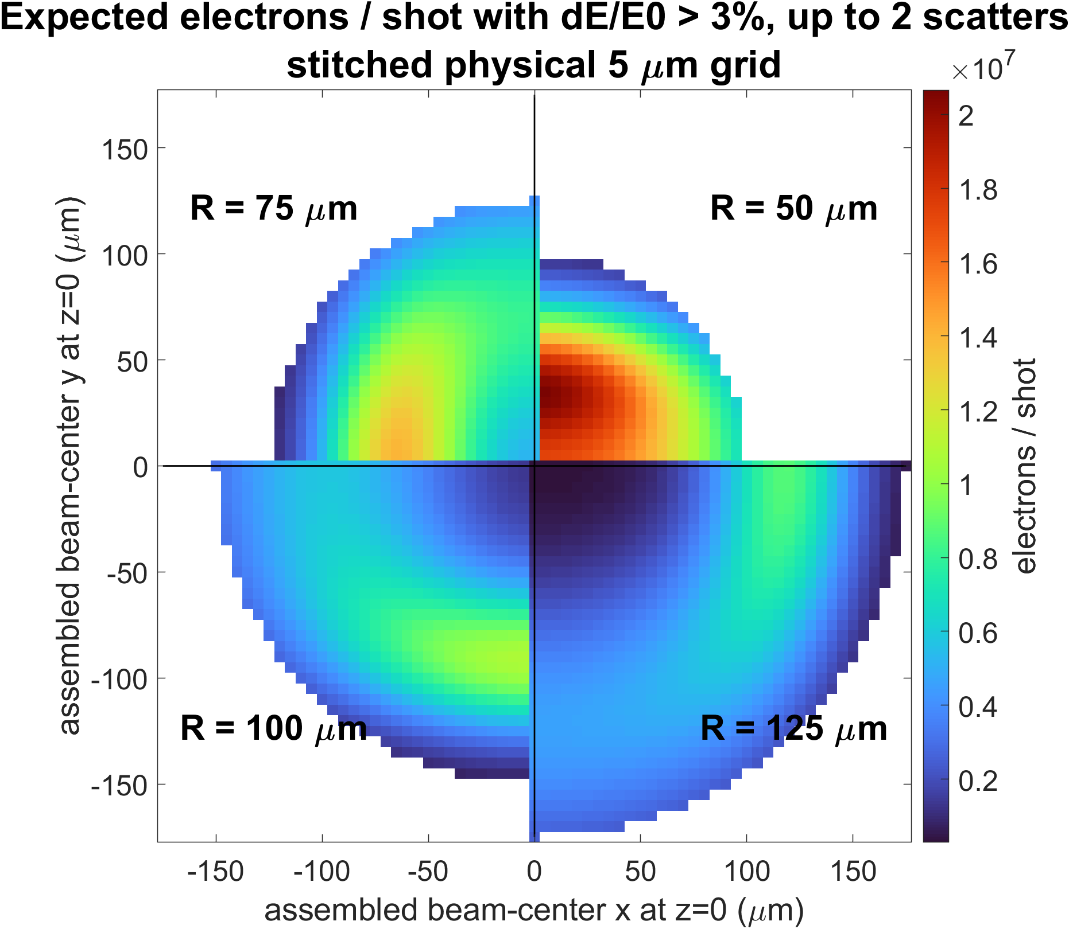
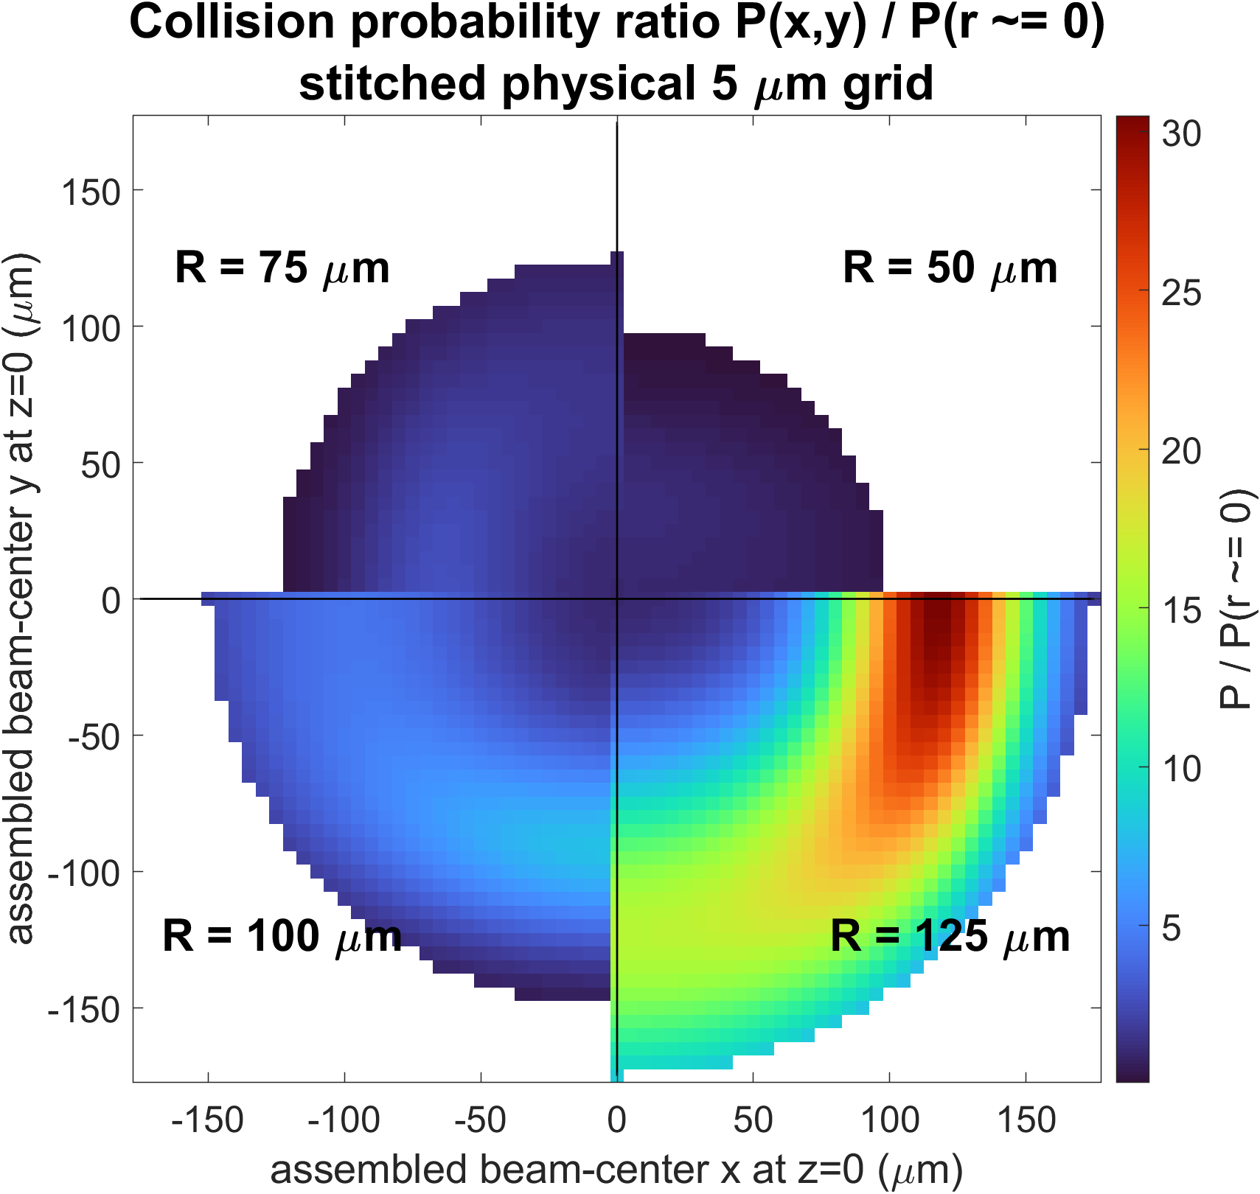
Choosing the Ring Radius
An Axicon w. $R=125μ$m Maximizes a Clear Proof-of-Concept Signal.
Notes:
Since the interaction length is about 35mum, and the laser spatial profile does not change much over this range, numerical calculations verify that the scattering probability for a 30 deg incident angle differs from that for 0 deg by only a few percent.

Slide 14
Toward Collider-Scale Laser Collimation
High-Repetition-Rate Operation
Cavity-enhanced laser system
∼30 MHz interaction rate
Efficient pulse recycling
(30W pump laser?)
Flexible Laser Profiles
Light sheet · LG modes · Multiple beams · Target intensity profiles via phase masks

Slide 15
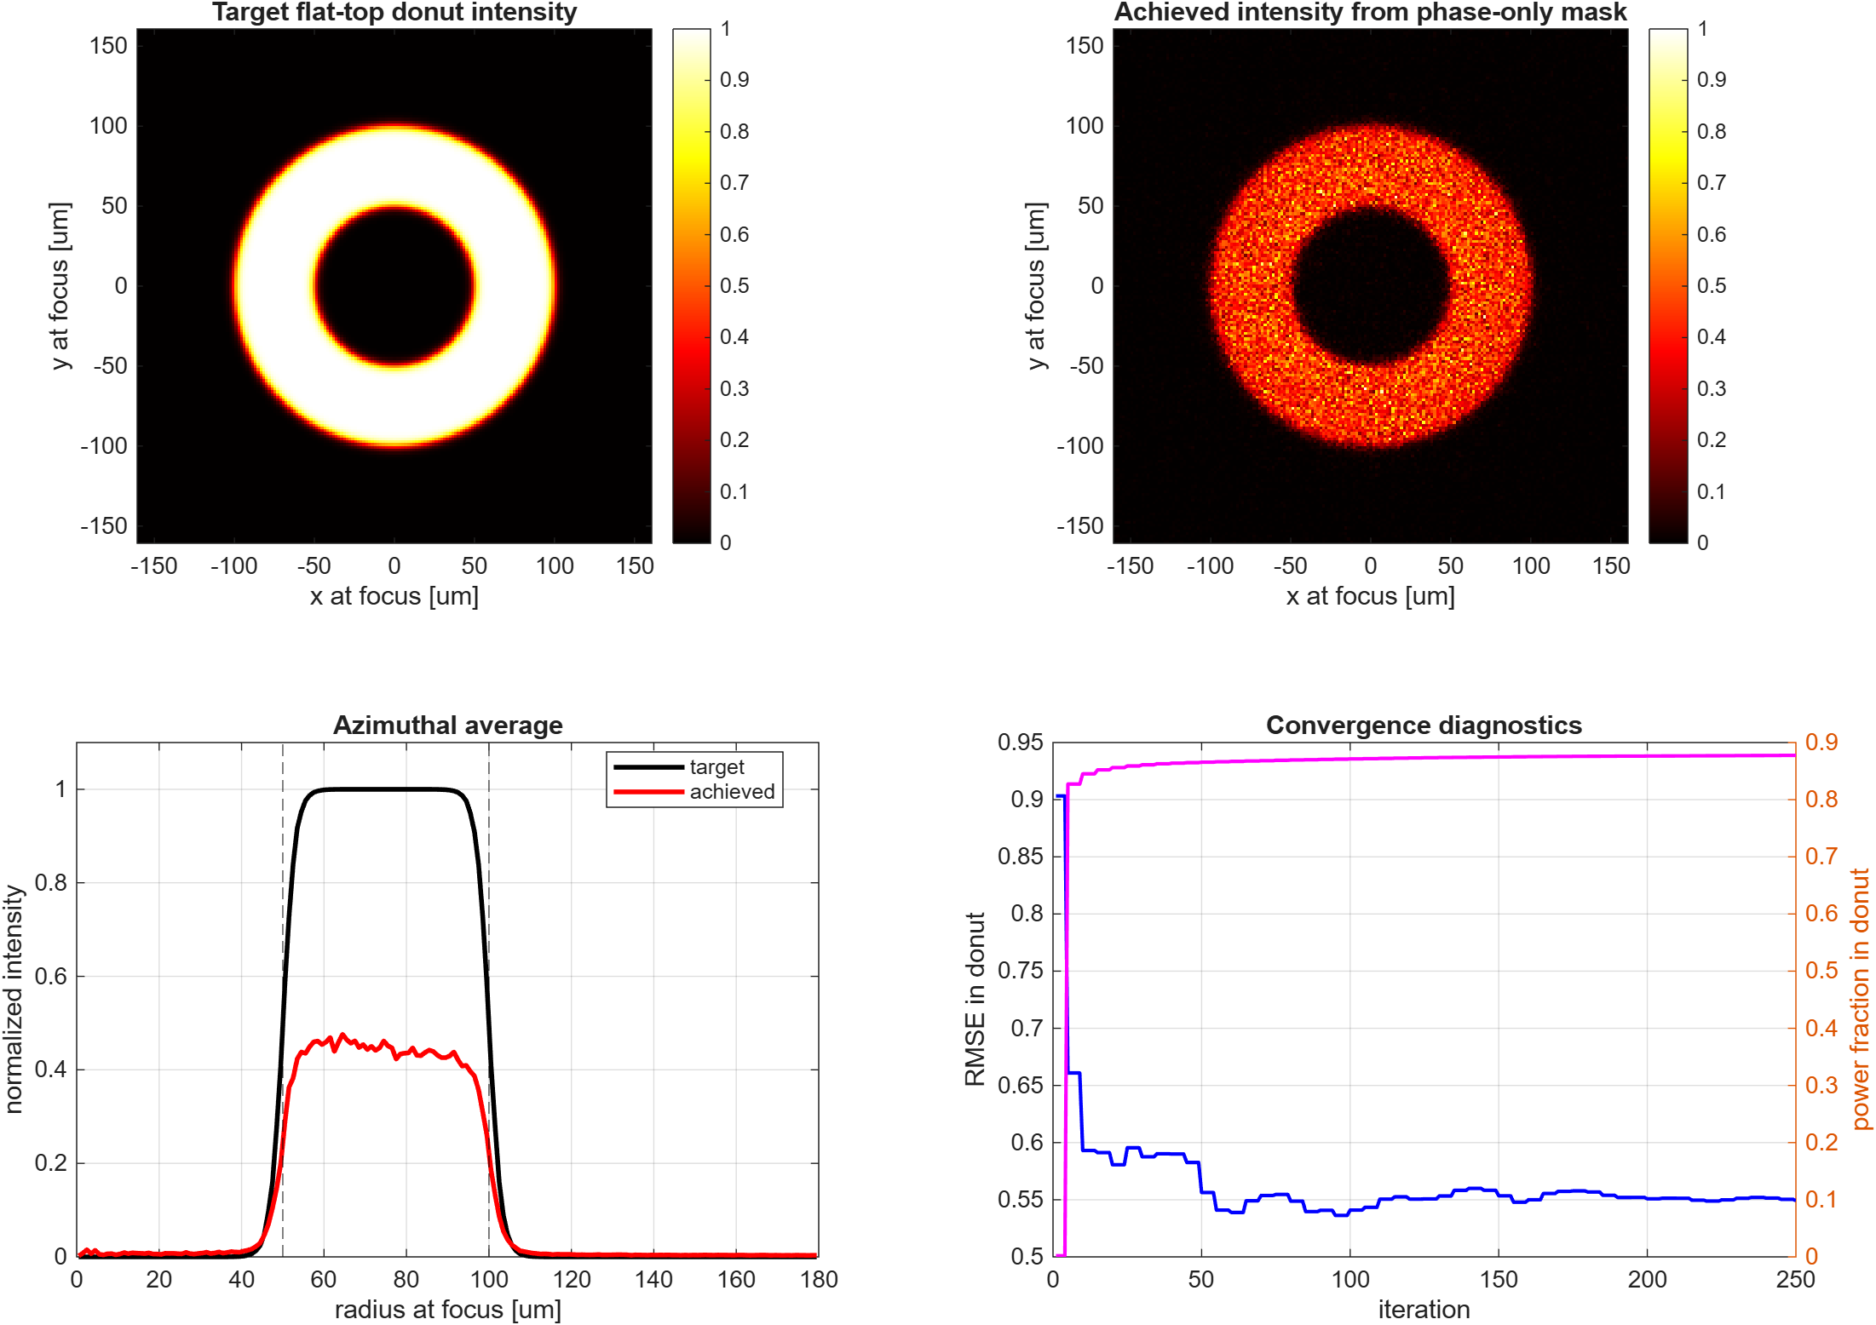
Intensity design with phase mask

Slide 16
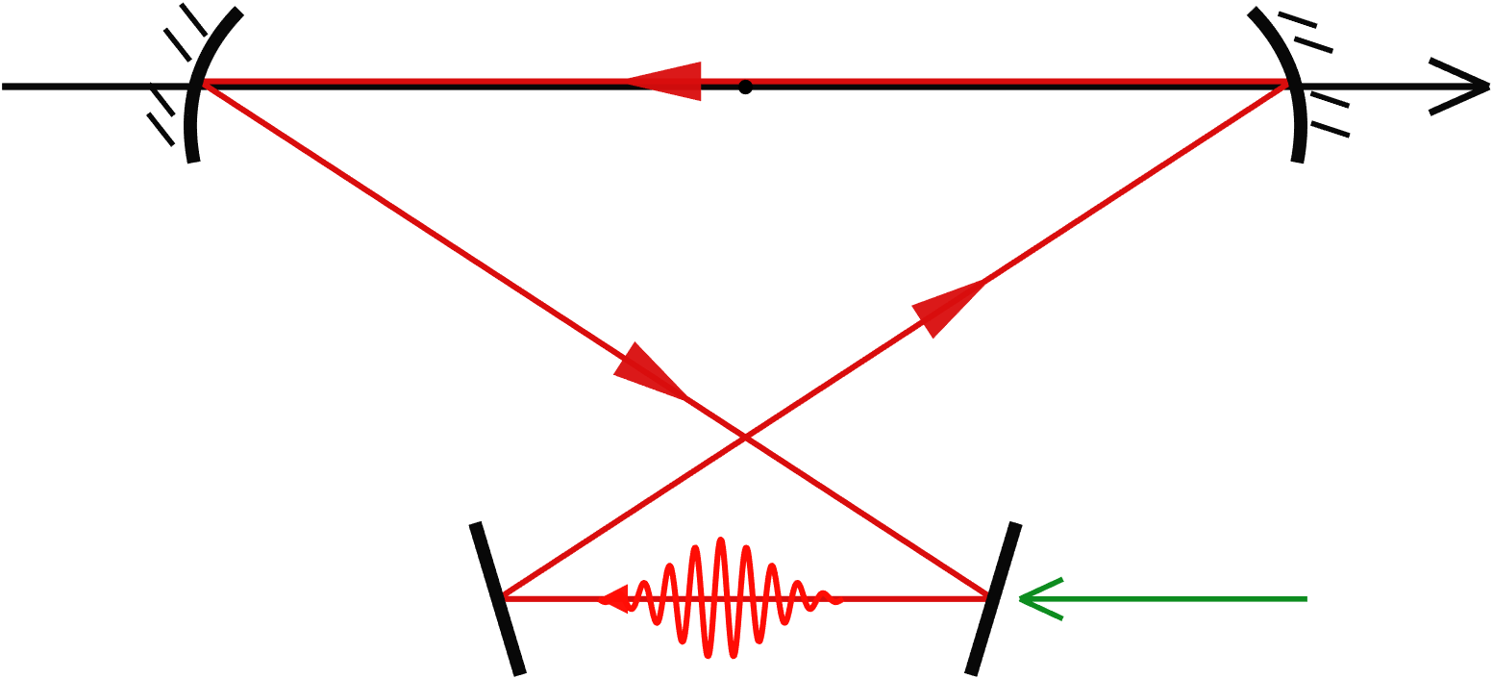
Cavity Geometry
electron
laser

Slide 17
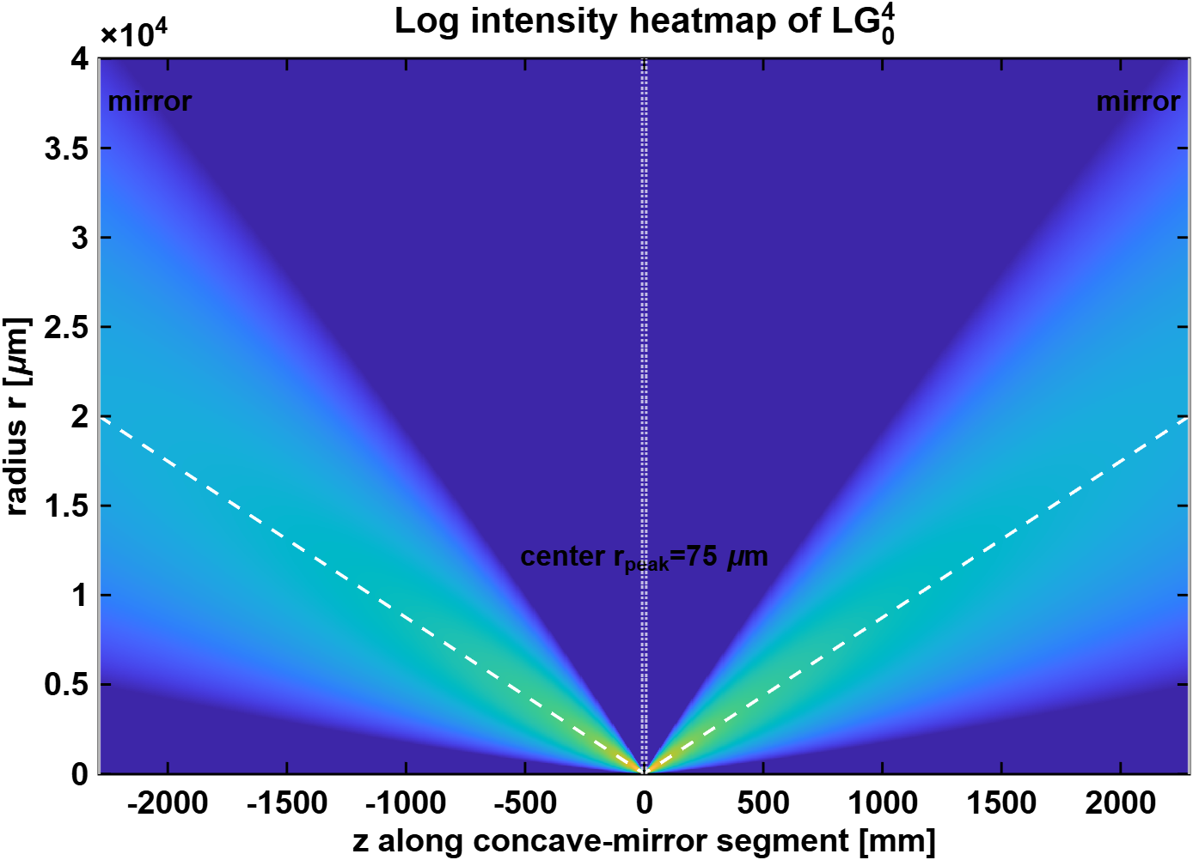
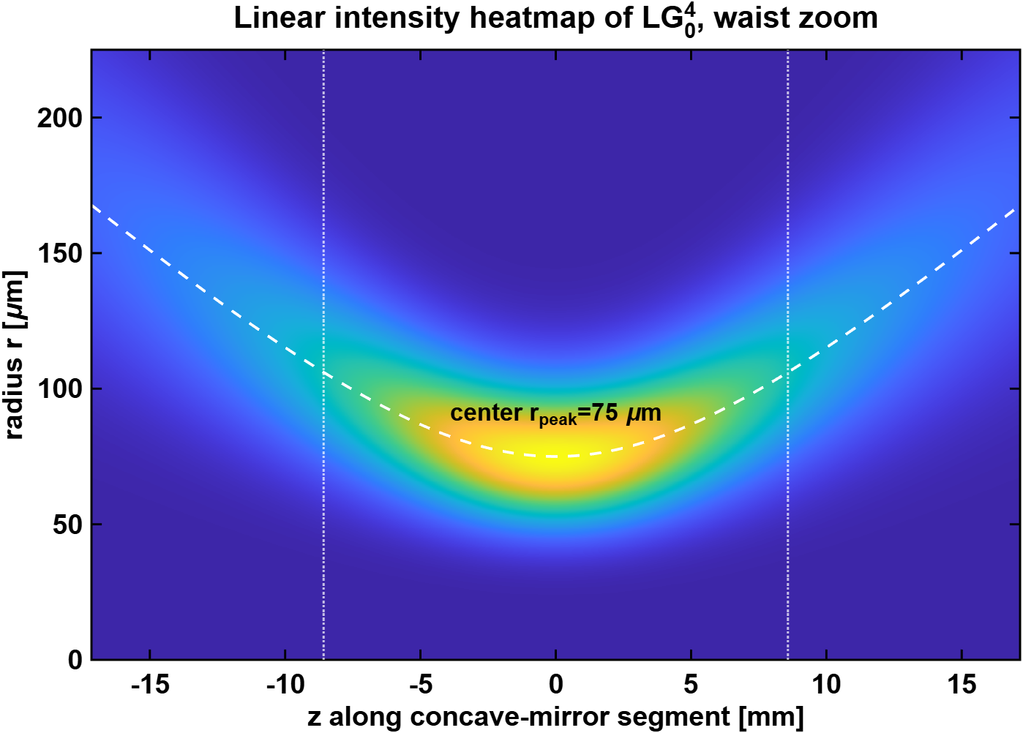
Intensity heatmap

Slide 18
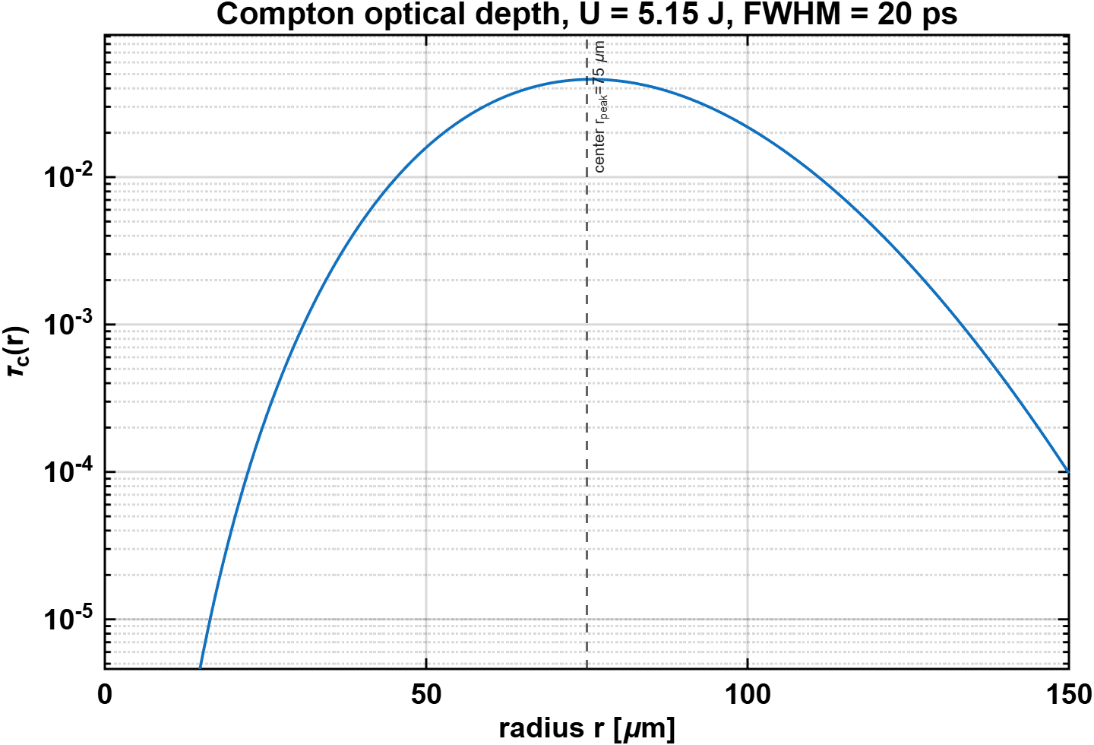
Optical depth versus r

Slide 19
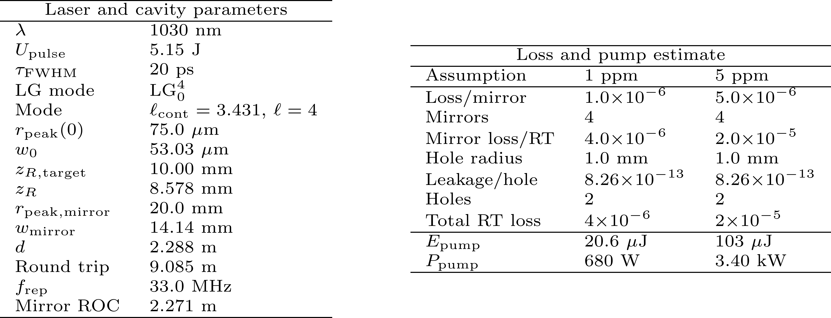
Cavity parameters
The laser requirements are still too demanding for a single LG mode.

Slide 20
Choosing the Laser Profile for FCC-ee Halo Cleaning
A light-sheet profile may be more energy-efficient than a round or donut beam because it can concentrate photons only near the halo region to be cleaned. A round beam may still work, but it would spend more laser energy in regions that do not contribute to halo cleaning. The optimal profile depends on the actual FCC-ee collimation target area.
A tightly focused beam reduces the illuminated area and pulse energy, but its short Rayleigh length makes it diffract over the FCC-ee bunch length (~10 mm). Away from the waist, the broadened laser can lose halo intensity and overlap the beam core, creating background.
Notes:
A tightly focused light sheet minimizes the illuminated transverse area, which reduces the required laser pulse energy. However, it also has a short Rayleigh length. Since the FCC-ee Z-pole bunch length is of order 10 mm, the laser profile should remain well localized over a comparable longitudinal scale. Otherwise, the sheet diffracts away from the waist, reducing the photon density at the halo and potentially overlapping the beam core, which would generate unwanted background.
In an ideal top-hat estimate, the required cleaning area is very small because the FCC-ee beam is extremely flat. This gives an optimistic mJ-level pulse-energy requirement for 99% scattering probability after 100 encounters. The real challenge is therefore not only the photon fluence, but also the optical mode engineering: generating a sharply bounded, highly asymmetric light sheet and maintaining it in an optical enhancement cavity.
The key trade-off is:
Smaller sheet thickness gives a smaller illuminated area and lower pulse energy, but a shorter Rayleigh length.
Larger waist gives a longer Rayleigh length and lower core leakage, but a larger illuminated area and higher pulse energy.

Slide 21
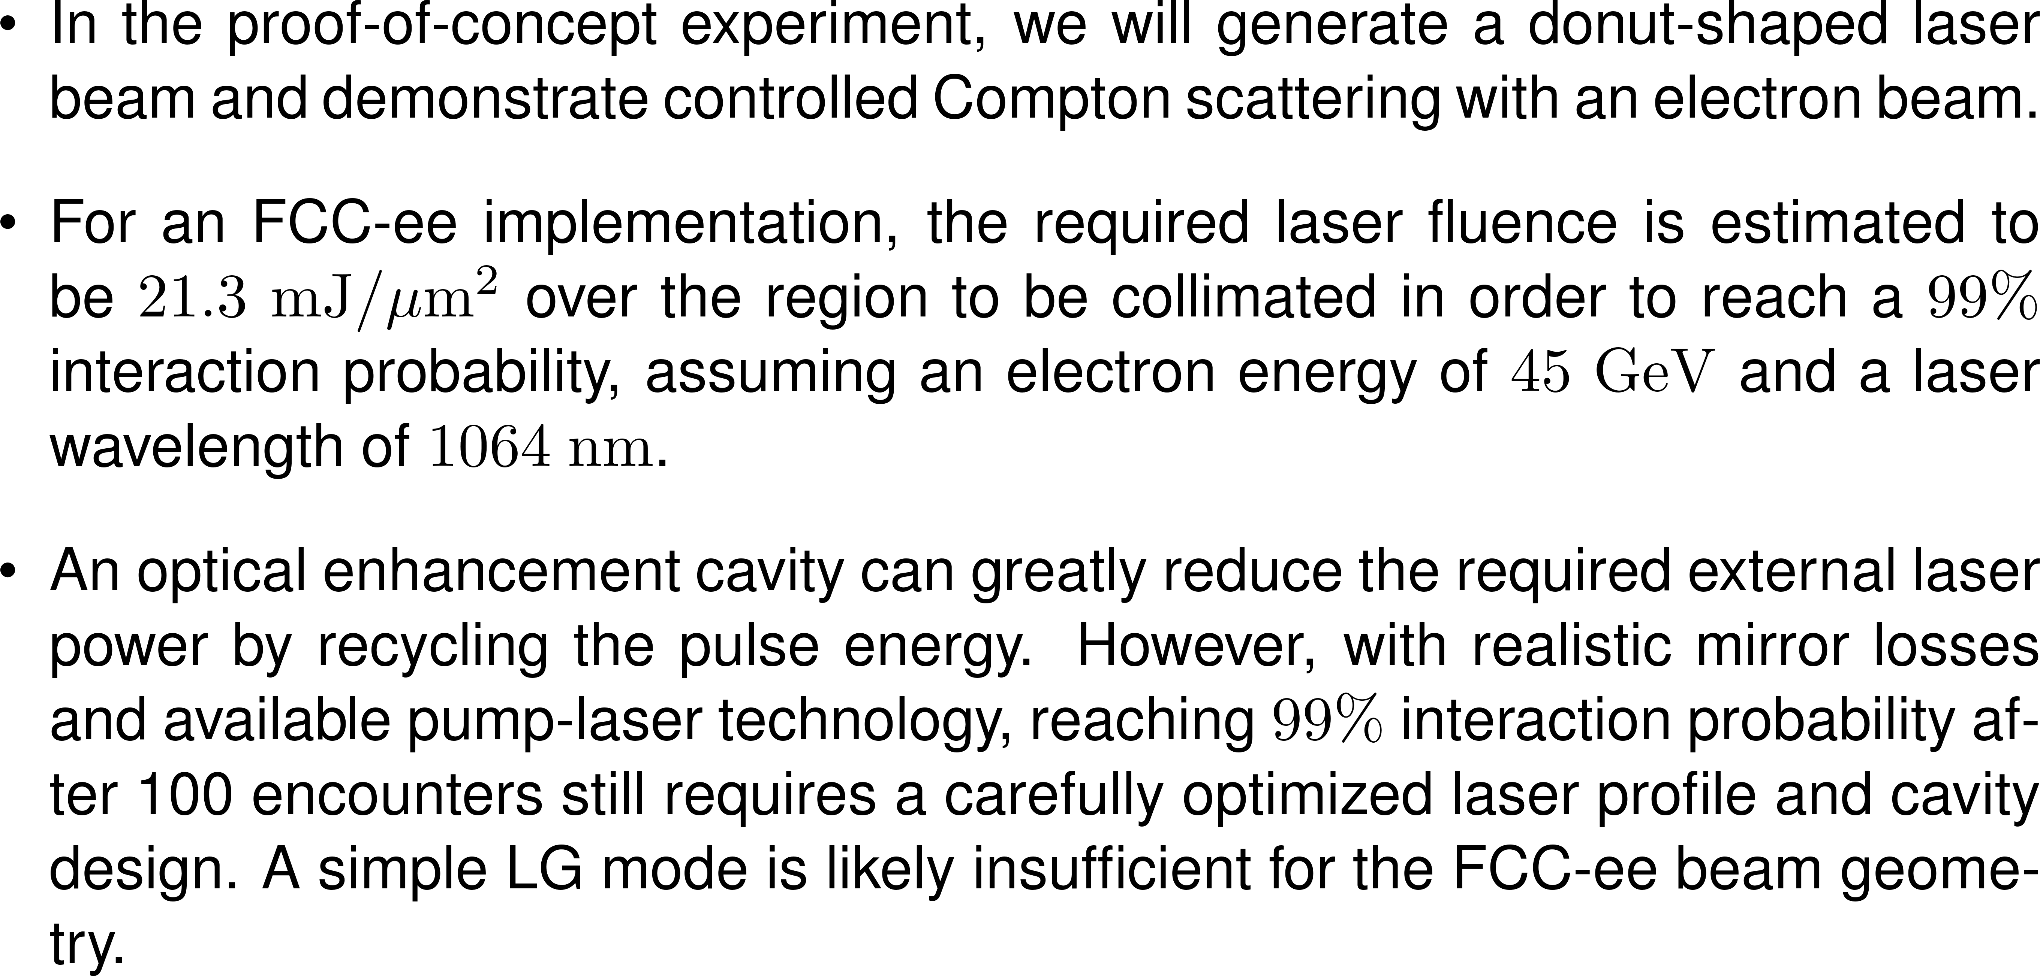
Conclusion
Notes:
Klein–Nishina formula has relatively weak scaling with laser or electron energy.

Slide 22
References
[1] S. Terui et al., “Collimator challenges at SuperKEKB and their countermeasures using nonlinear collimator,” Phys. Rev. Accel. Beams 27, 081001 (2024). https://doi.org/10.1103/PhysRevAccelBeams.27.081001
[2] R. Cowan et al., “Mechanical Design of FCC-ee Collimators,” presented at FCC Week 2026, Helsinki, Finland (2026). https://indico.cern.ch/event/1552126/
[3] F. Zimmermann, “New final focus concepts at 5 TeV and beyond,” AIP Conf. Proc. 472, 103–117 (1999). https://doi.org/10.1063/1.58898
[4] F. Zimmermann and T. O. Raubenheimer, “Controlling e+/e− circular collider bunch intensity by laser Compton scattering,” in Proc. IPAC’22, Bangkok, Thailand, pp. 1695–1698 (2022). https://doi.org/10.18429/JACoW-IPAC2022-WEPOST010
[5] C. Munting, P. Kicsiny, E. Barbi, N. Gonzalez, S. Gessner, and I. Drebot, “Laboratory Tests of Laser Control of Electron Beams for Future Colliders,” arXiv:2601.19865 [physics.acc-ph] (2026). https://arxiv.org/abs/2601.19865
This work is supported by the SLAC LDRD Program and by U.S. Department of Energy under contract DE–AC02–76SF00515.

