Slide 1
Dark-field shadowgraphy: Latest results and prospects
Sheldon Rego
E340 collaboration
July 10th, 2026

Slide 2
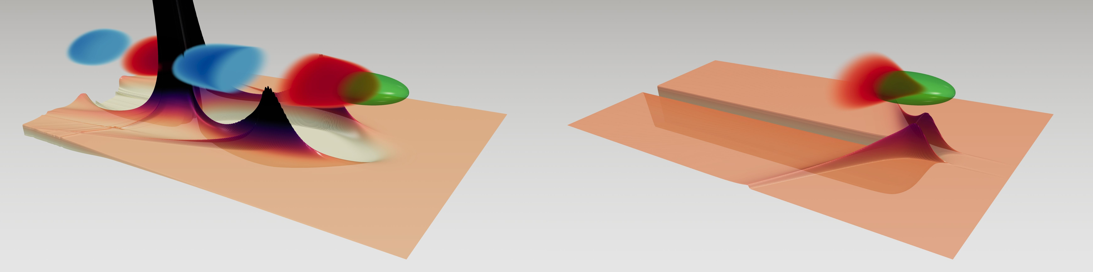
Introduction
2 main aspects of the E340 experiment:
Control of beam-ionized plasma regime, ie. the transition between,
      Plasma Wakefield Acceleration (PWFA) regime: wide plasma channel, many plasma oscillations, longitudinal accelerating field,
      Wakeless regime: narrow plasma channel with transverse restoring force, no plasma oscillations, no accelerating field.
Observation of plasma wakes via dark field shadowgraphy, an ultrasensitive and non-destructive imaging method.
Multiple oscillations behind driver
No oscillations behind driver
Batterie de l’Yvette - Palaiseau

Slide 3
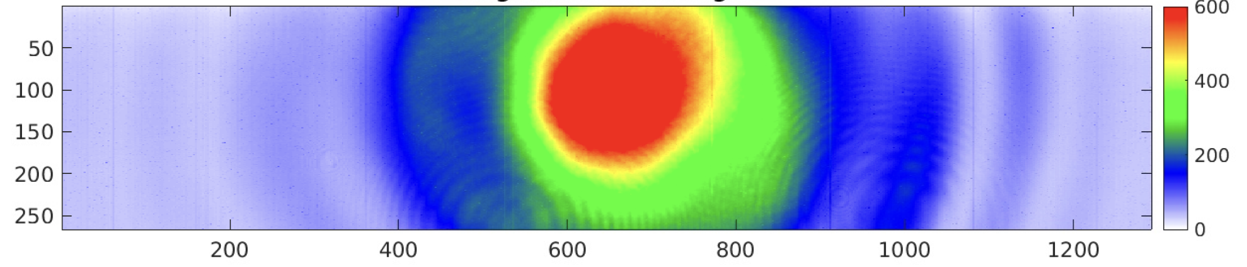

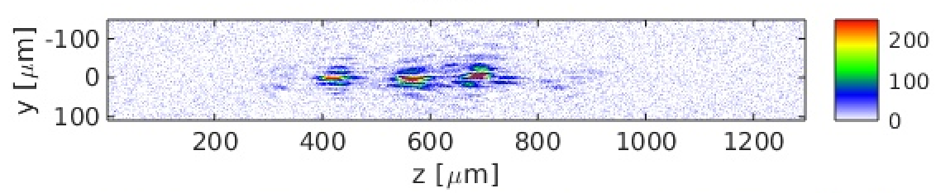
Setup
Shadowgraphy camera
e- beam axis
Lens 2
f = 20 cm
Mask retracted [BRIGHT MODE]
Hydrogen plasma channel – behind e-beam
(n_{e} = 1.65e17/cc)
Mask inserted [DARK MODE]
Lens 1
f = 60 cm
Probe laser
Spatial filter (currently no hole)
Hydrogen gas fill – ahead of e-beam
(5 Torr)
Iris
2 mm ∅
Alignment camera

Slide 4
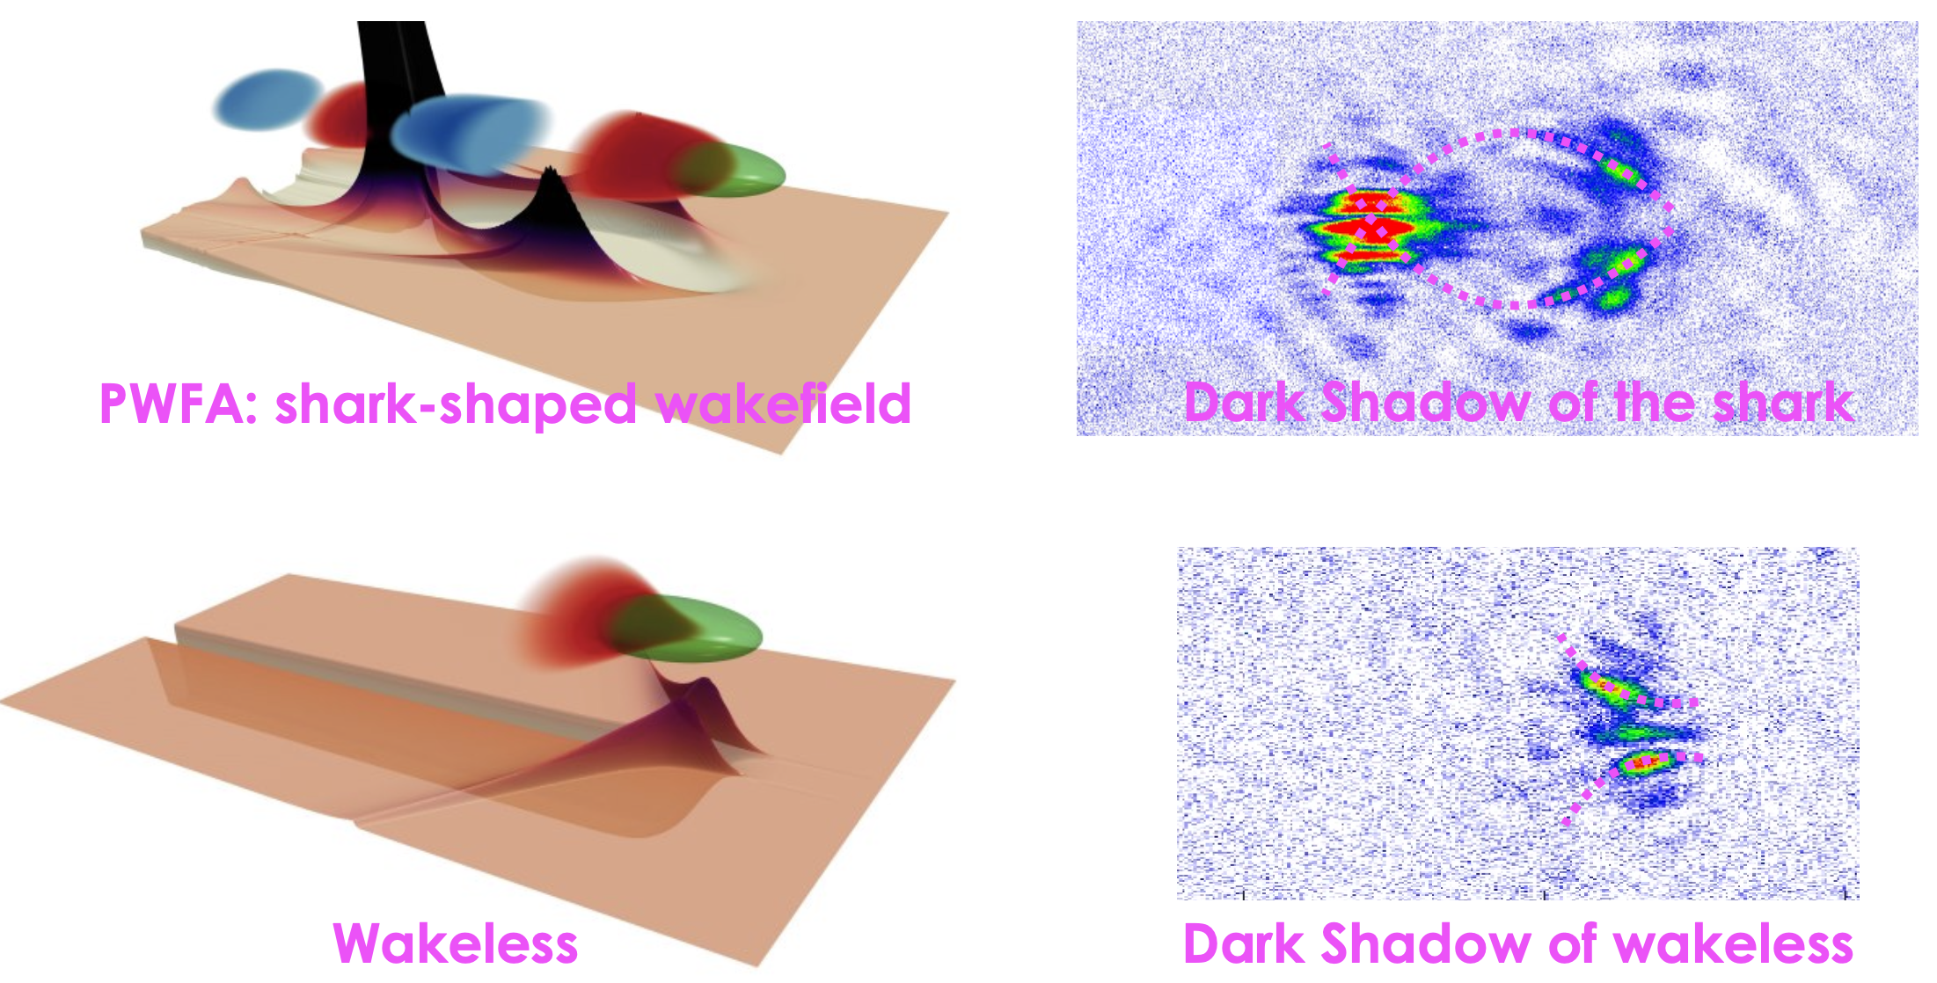
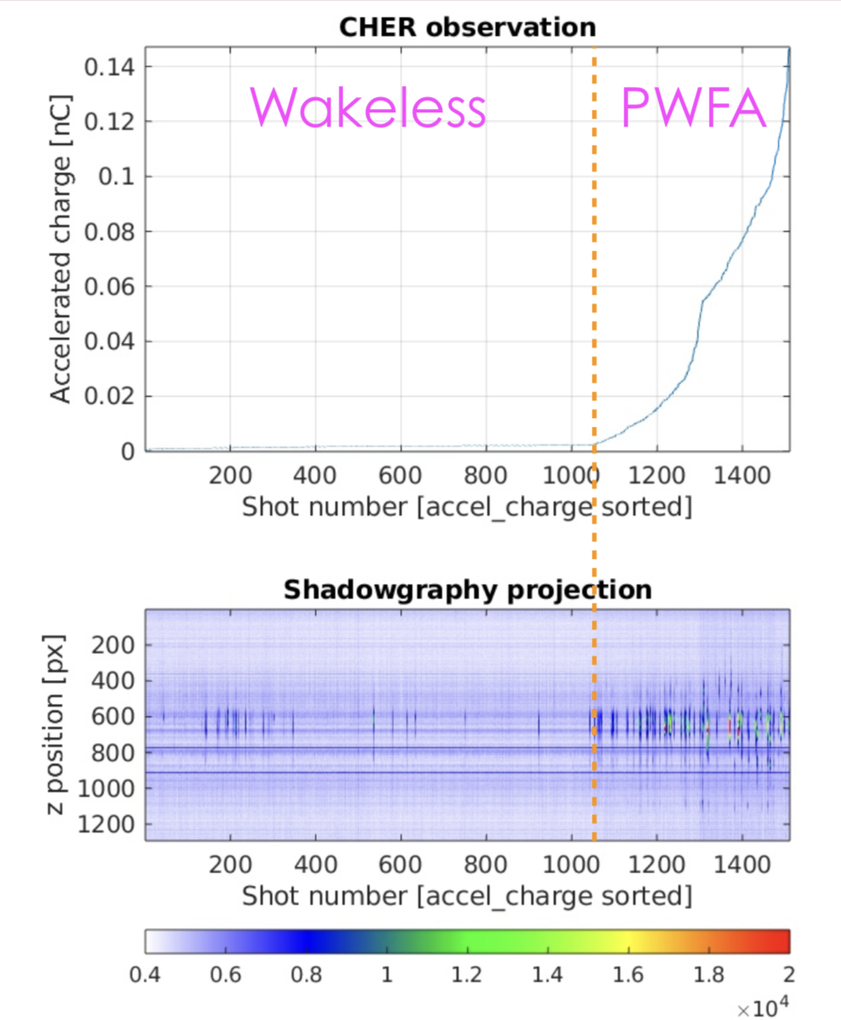
Summary of previous results
Past successes:
Worked out alignment and synchronization of dark-shadowgraphy diagnostic
Captured shadowgraphy images at both PWFA and wakeless working points
Shadowgraphy roughly correlated with electron spectra at dump
Past challenges:
No EOS – lack of shot-to-shot timing information
Low statistics at good working point
λ_{p} mismatch from plasma density in PWFA
More charge accelerated
Stronger shadowgraphy trace

Slide 5
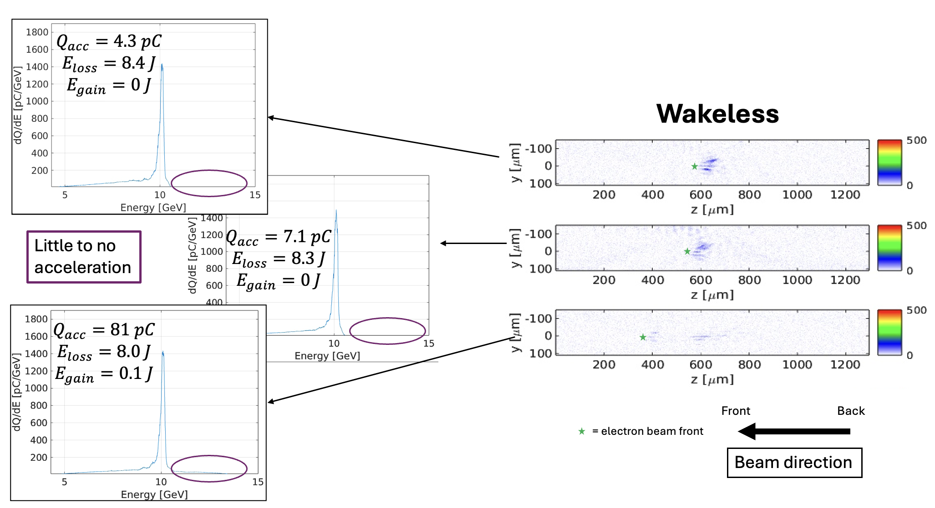
Summary of previous results

Slide 6
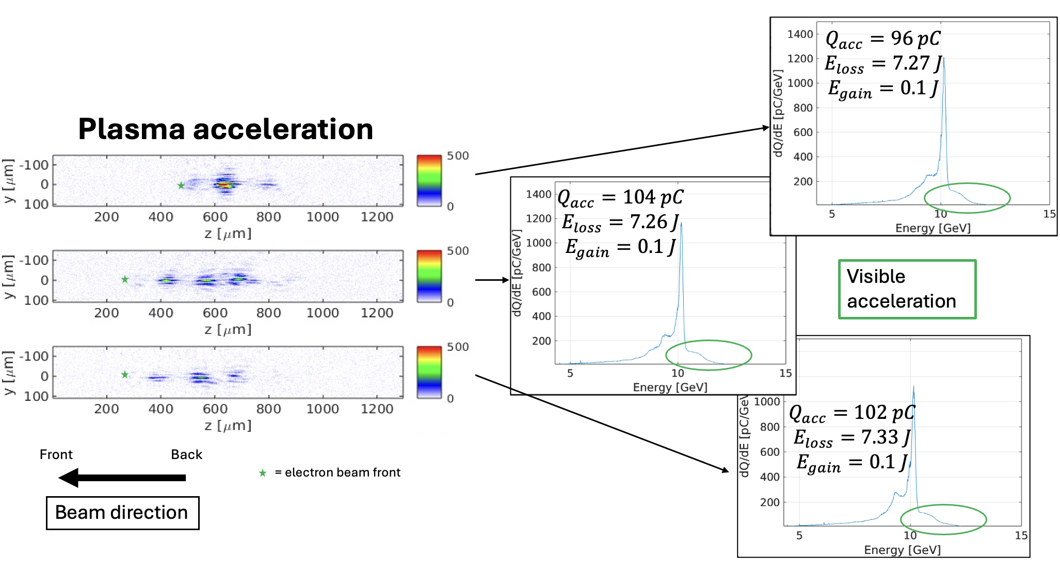
Summary of previous results

Slide 7
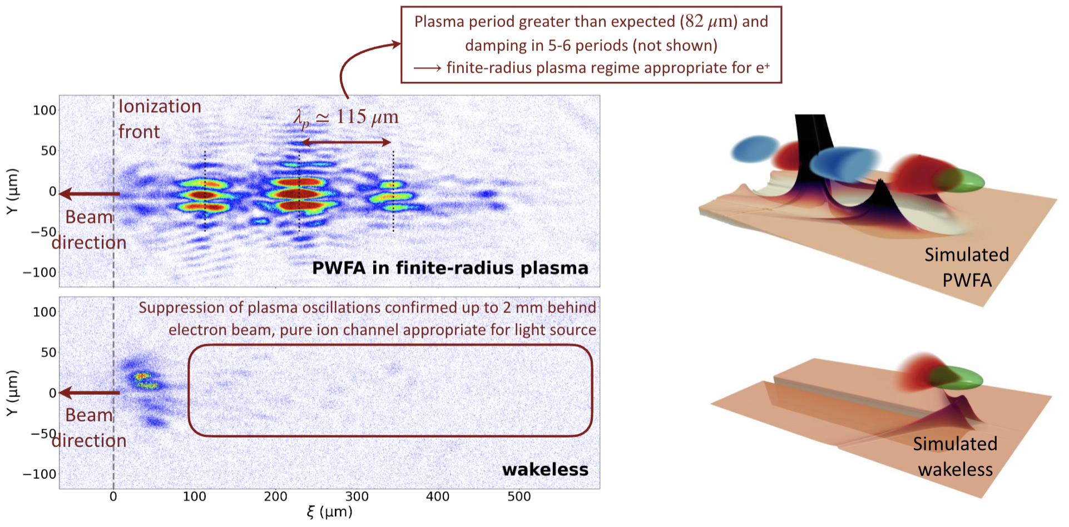
Latest results 1 – Shadowgraphy snapshots

Slide 8
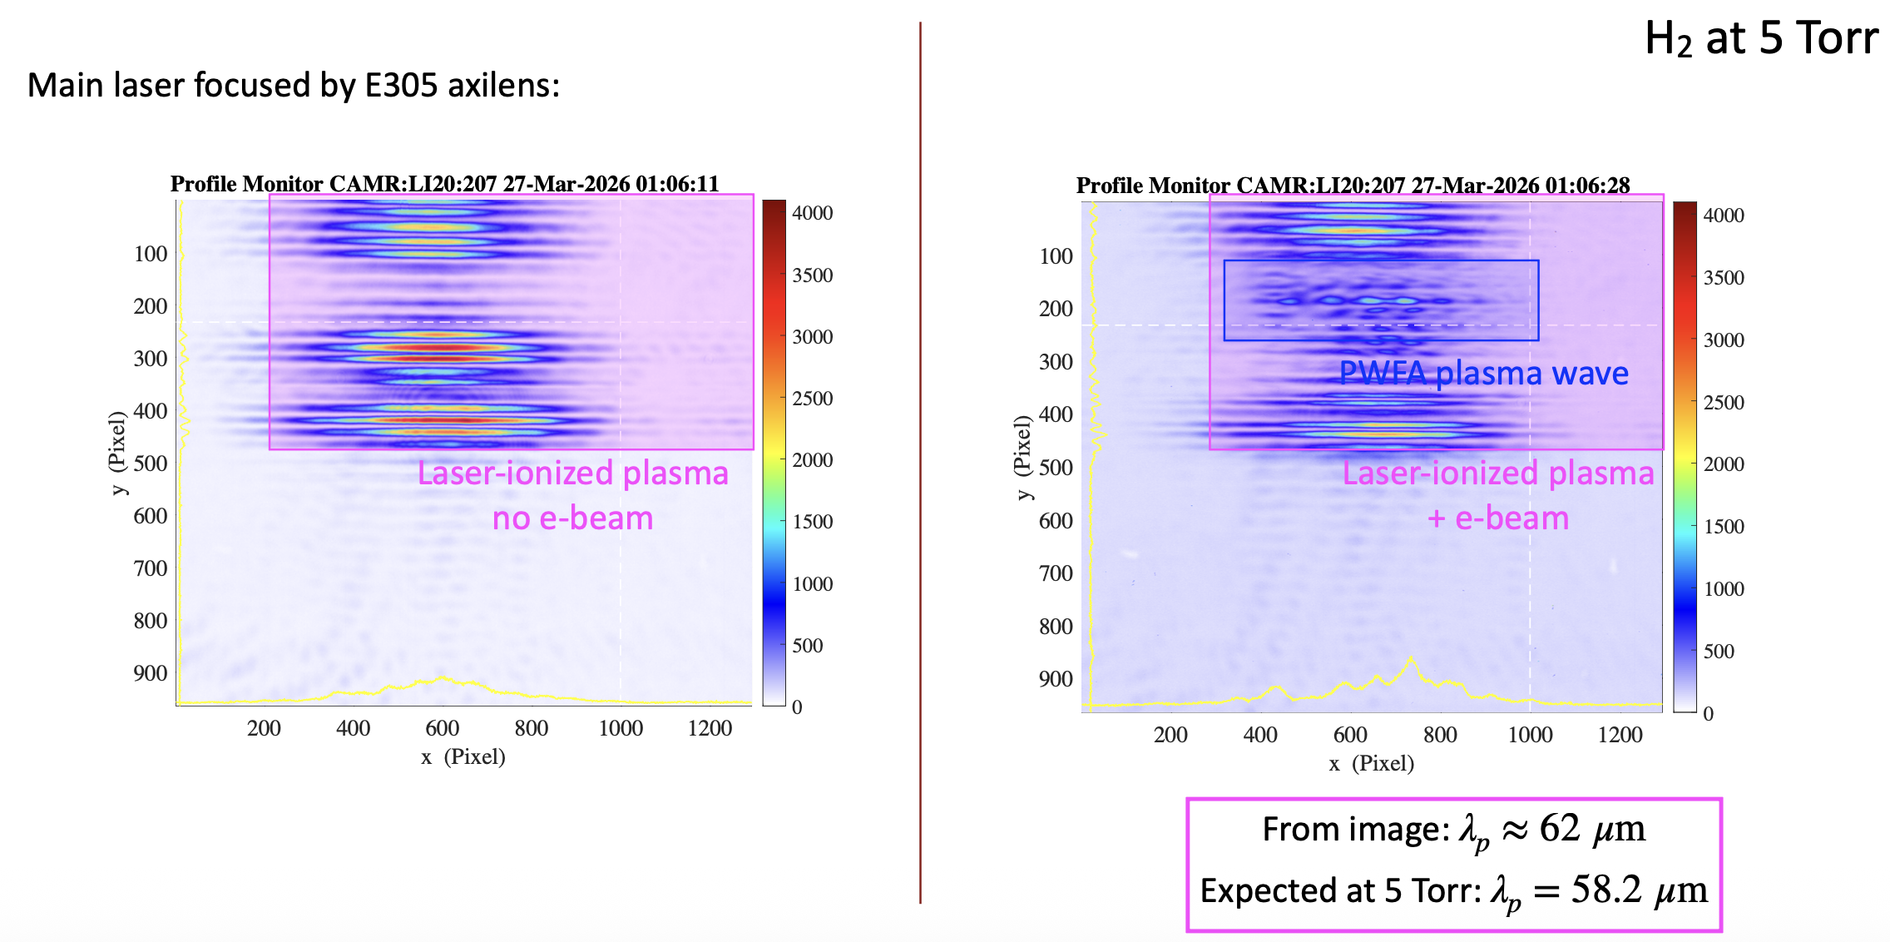
Latest results 1 – Shadowgraphy snapshots
Double ionization of H₂

Slide 9
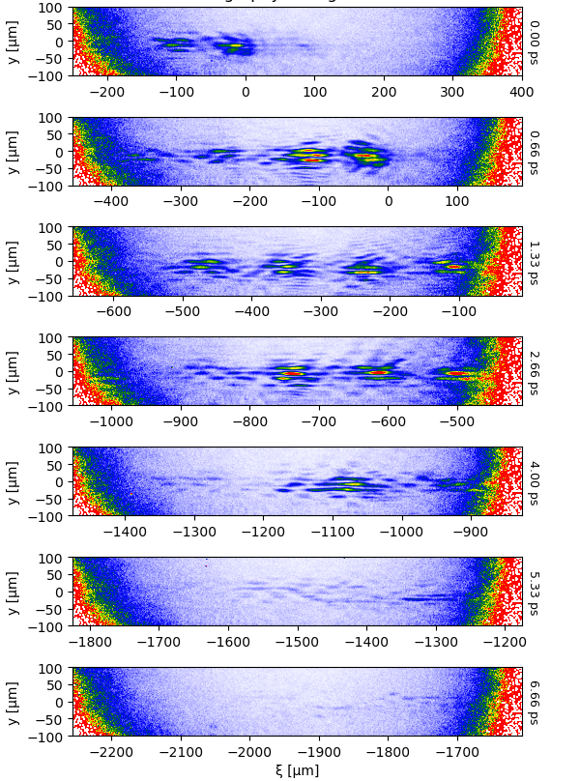
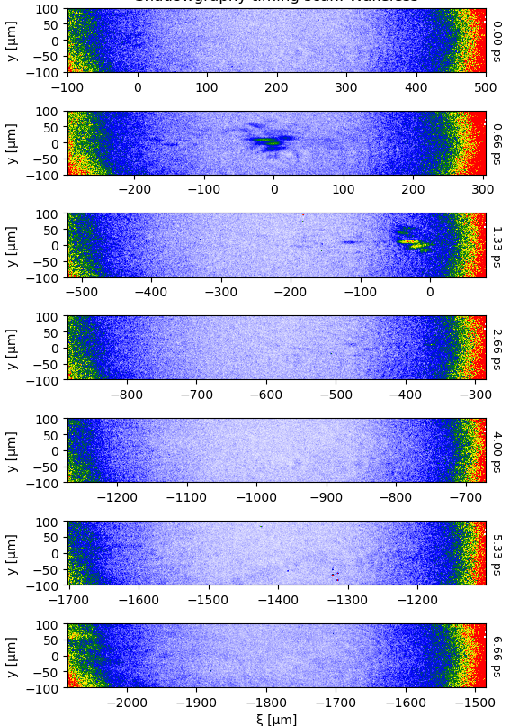
Latest results 1 – Shadowgraphy snapshots
Excellent snapshots of PWFA and wakeless regimes in dark mode
(lots of DAQs saved at the optimal working points!)
Clear signal visible behind ionization front
Beam direction
Only driver is clearly illuminated
Beam direction
~6 oscillation periods visible
Faint lines near main axis
EOS correction to delay stage timing works!
No signal visible far behind driver
Extended λ_{p} further back

Slide 10
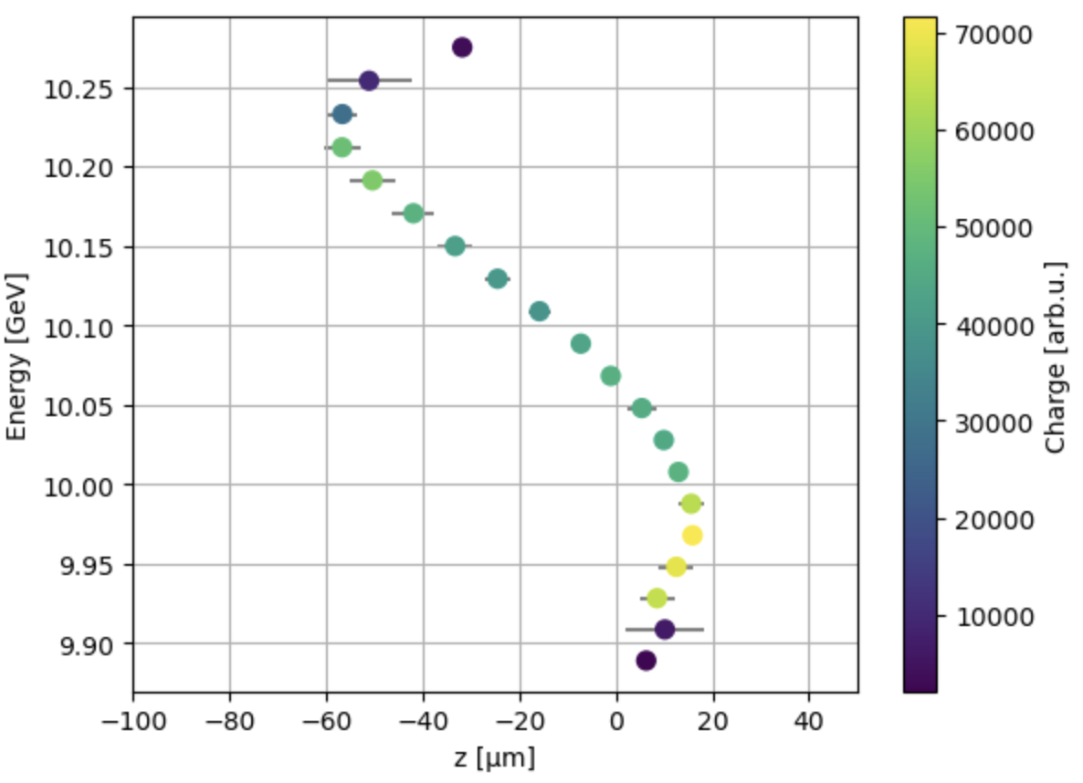
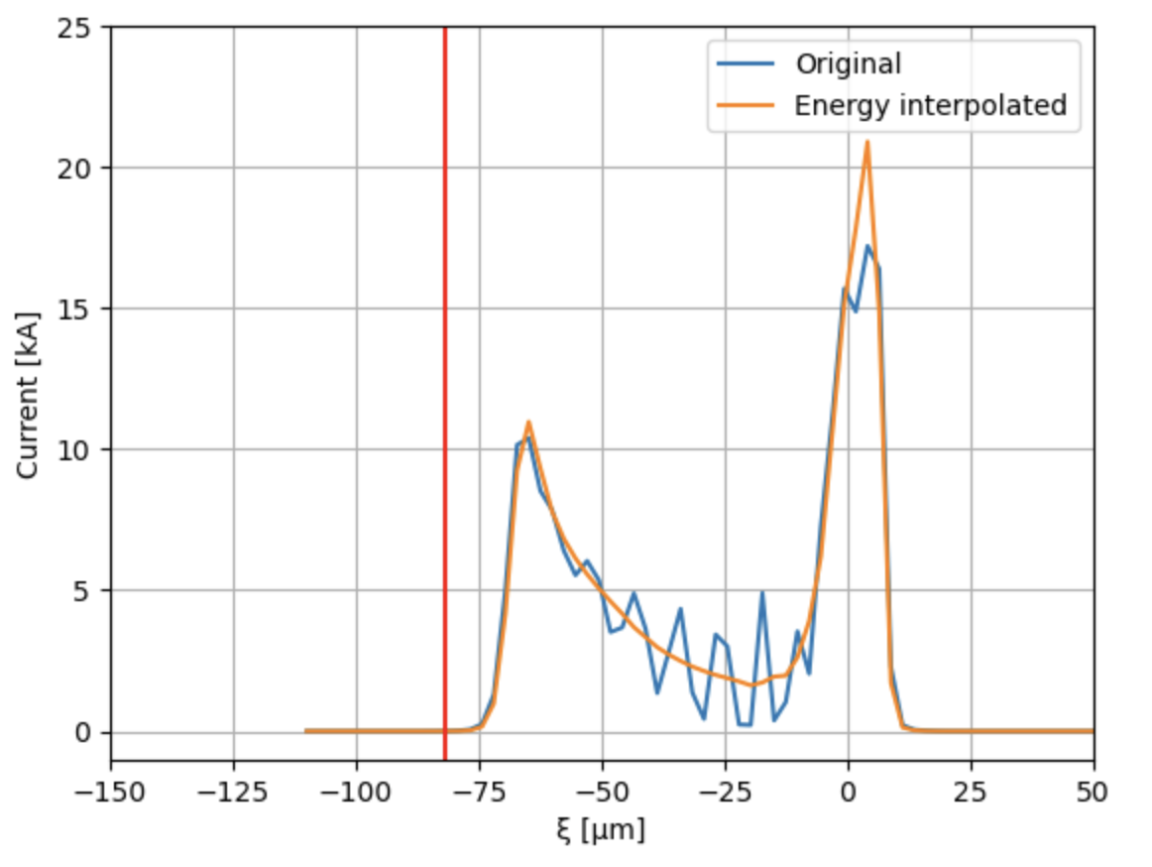
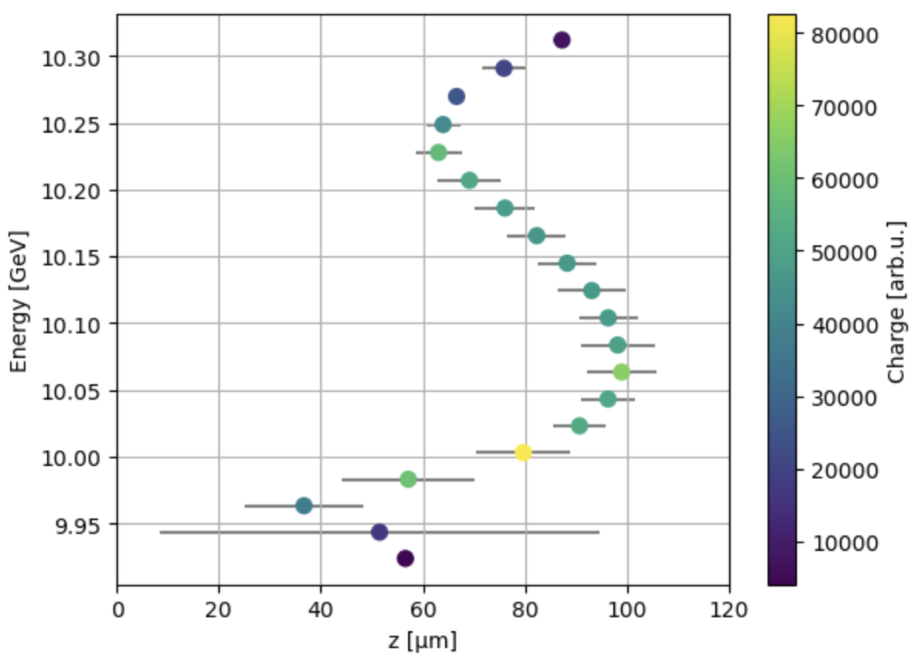
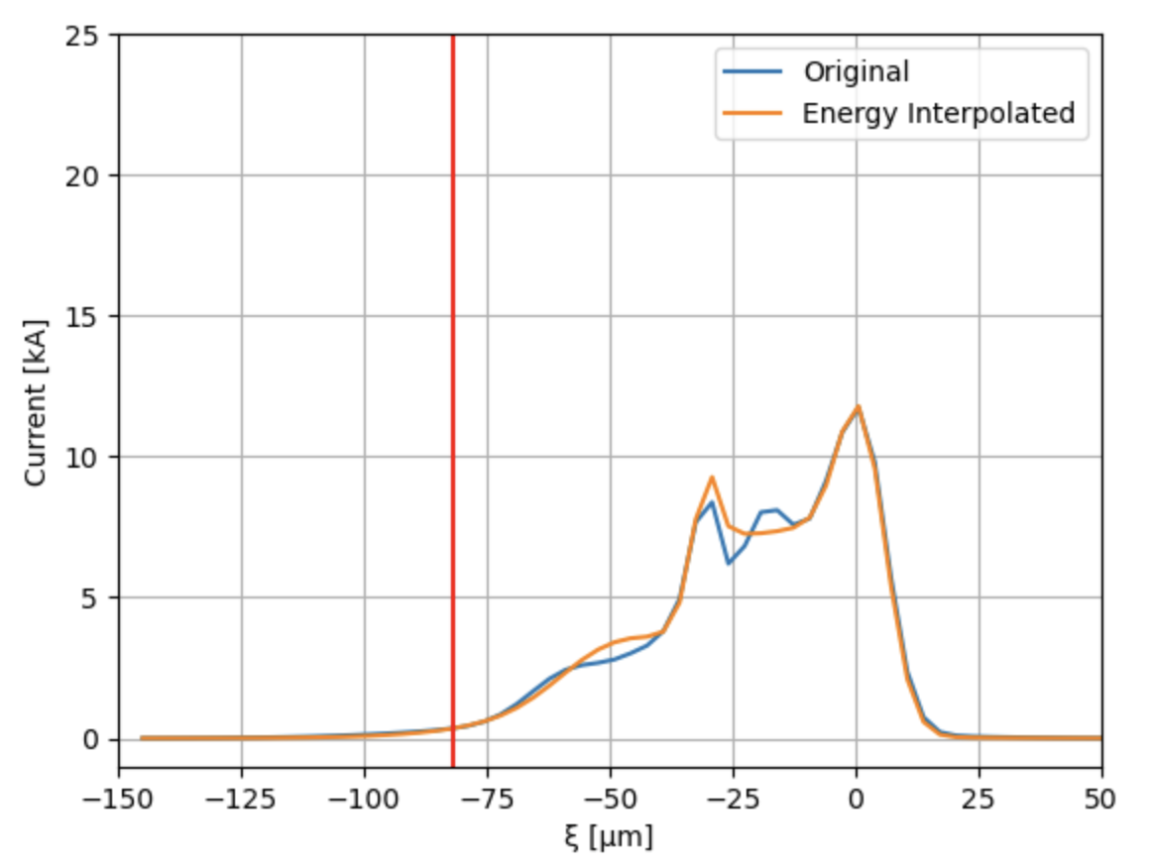
Latest results 2 – Longitudinal phase space reconstruction
Beam direction
PWFA
BLEN11 = 10k
BLEN14 = 65k
λ_{p} = 82 μm
Beam direction
σ_{z} = 28 μm
Wakeless
BLEN11 = 6k
BLEN14 = 20k
Beam direction
λ_{p} = 82 μm
Beam direction
σ_{z} = 22 μm

Slide 11
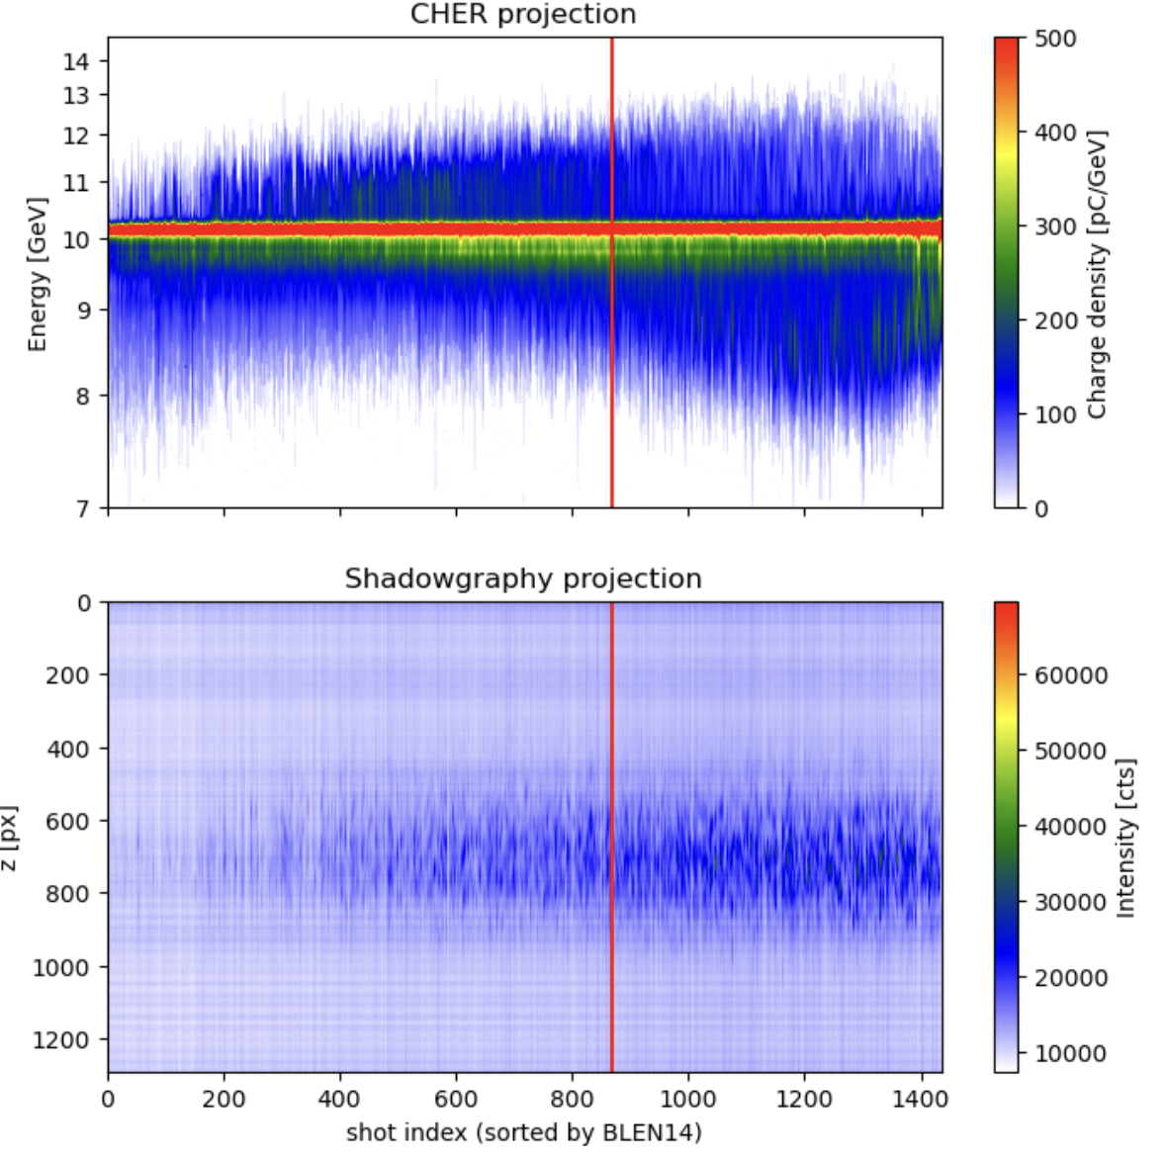
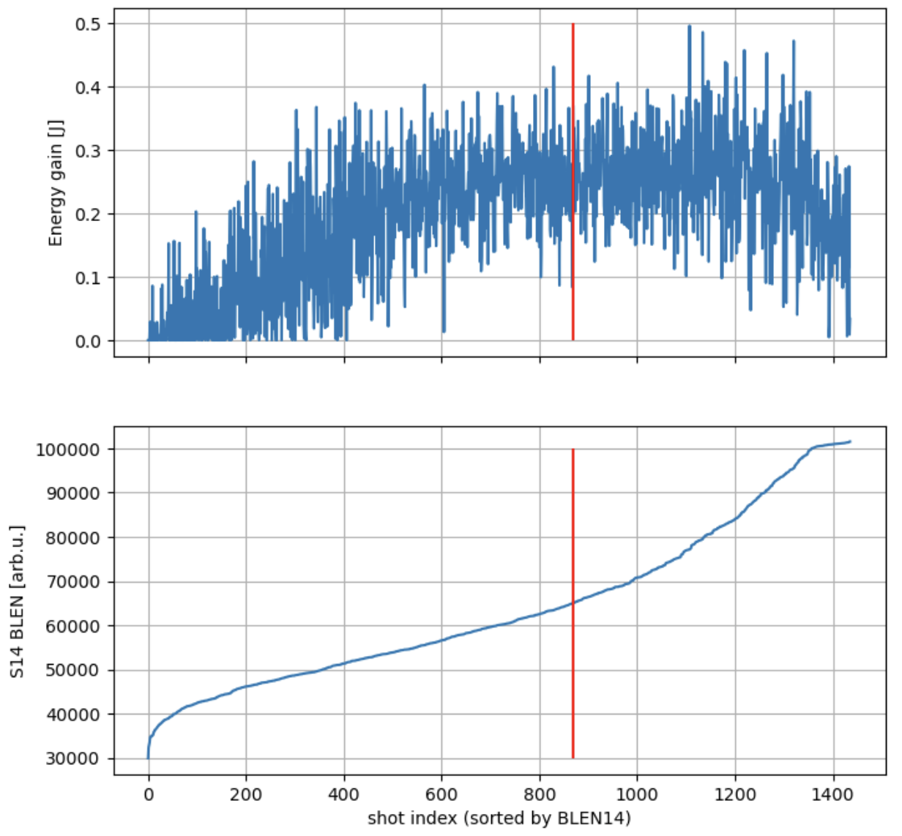
Latest results 3 – Correlation with electron spectra
Even better correlation between accelerated charge and shadowgraphy signal
PWFA working point
PWFA working point

Slide 12
Preparing the first E340 publication
The first E340 publication will focus on exotic regimes (wakeless, finite-radius PWFA) in beam-plasma interaction, and dark-field shadowgraphy as a tool to probe them.
Important elements to show in both PWFA and wakeless:
Shadowgraphy images of delay scan showing difference in plasma wake images
TCAV reconstruction of working points (incl. longitudinal current profile)
PIC simulations using TCAV reconstruction as input
Correlate Cherenkov electron spectra with shadowgraphy regimes
Finite-radius PWFA: extended plasma bubbles and damping of plasma oscillation
We have all the data we need for a first publication.
Target journal: Nature Physics

Slide 13
Preparing the first E340 publication
Goal | Status | Target timeframe
Initial data analysis (shadowgraphy snapshots, CHER, TCAV) | Ongoing | Now – end July 2026
Advanced data analysis (extended bubbles and damping) | Not started yet | Now – end September 2026
Start-to-end simulations | LINAC simulations completed last year, need to match with 2026 TCAV reconstruction; PIC simulations to be continued | End July 2026 – end August 2026
Simulations for finite-radius PWFA | Not started yet | Mid August 2026 – November 2026
Preparation of figures for paper | Draft for delay scan figure, not started others yet | August 2026 – end September 2026
Writing the paper | Not started yet | Mid August 2026 – end November 2026
Final submission |  | End of year 2026
Meetings are scheduled for every 2 weeks (starting next week!)
Preparing a first publication with the June 2026 (+2025?) data is the top priority for E340.

Slide 14
Future outlook
E340 in FY27 depends strongly on our progress on the publication. We could focus on more precise studies of the PWFA-wakeless transition and trajectory mixing with dark-field shadowgraphy including:
Regime control with beam parameters,
      Laser heater shaping
      Collimators
Synergies with E333: studies with laser pre-ionized plasma with E305 axilens (gas jet, He/H₂ mixture, etc.) using dark-field shadowgraphy
Synergies with E304: modification of the plasma wake by the density downramp-injected beam
Synergies with E305: extensive use of dark-field shadowgraphy with gas jet at higher densities
Shadowgraphy improvements for lower density plasmas (<1e17/cc): Add spatial filter

Slide 15








Many thanks to all collaborators

Slide 16
Thank you! Questions?
sheldon.rego@polytechnique.edu

Slide 17
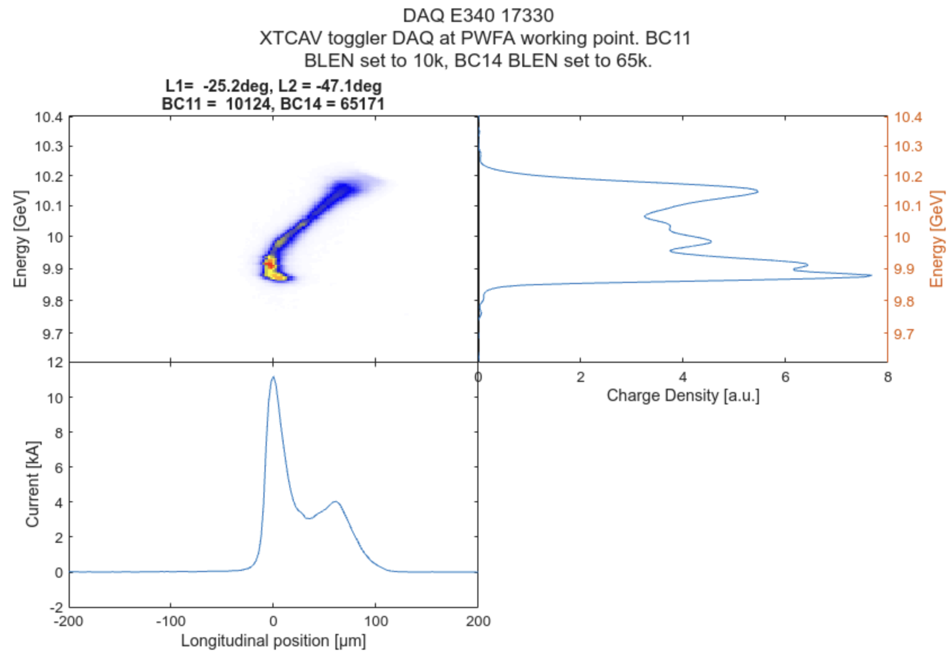
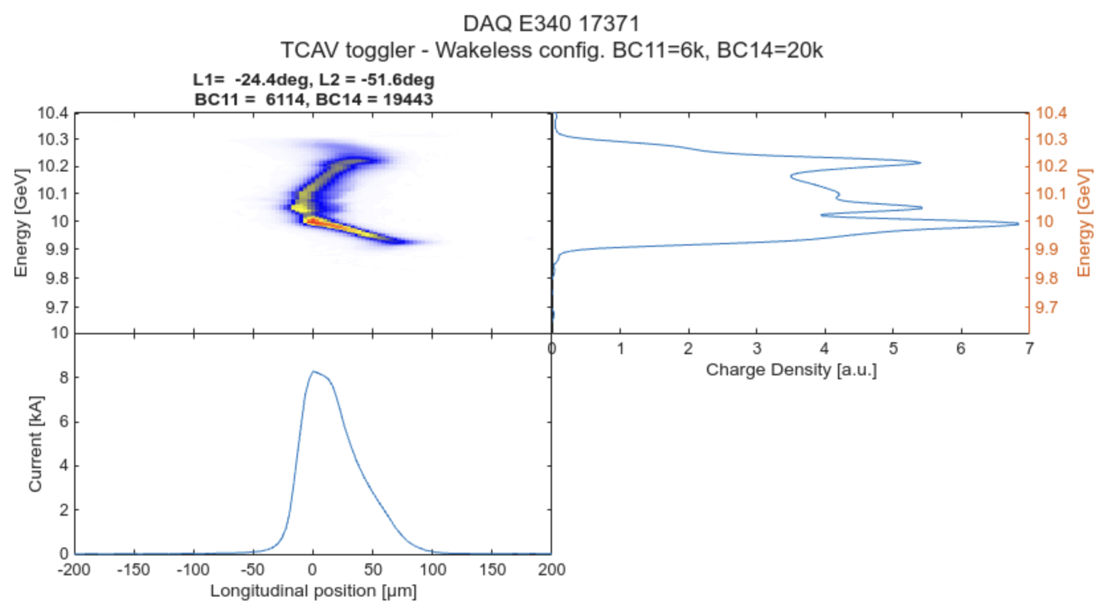
Raw TCAV images
PWFA
Wakeless

