Slide 1


Plasma-based positron sources
for wakefield acceleration studies at EuPRAXIA
Gianluca Sarri
g.sarri@qub.ac.uk
School of Mathematics and Physics, The Queen’s University of Belfast
DISCLAIMER: not a final design, still very much work in progress…
10 TeV collider working group, 29/06/2026

Slide 2
Introduction
Gianluca Sarri

Slide 3
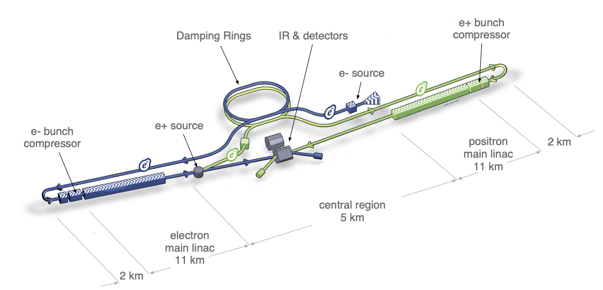
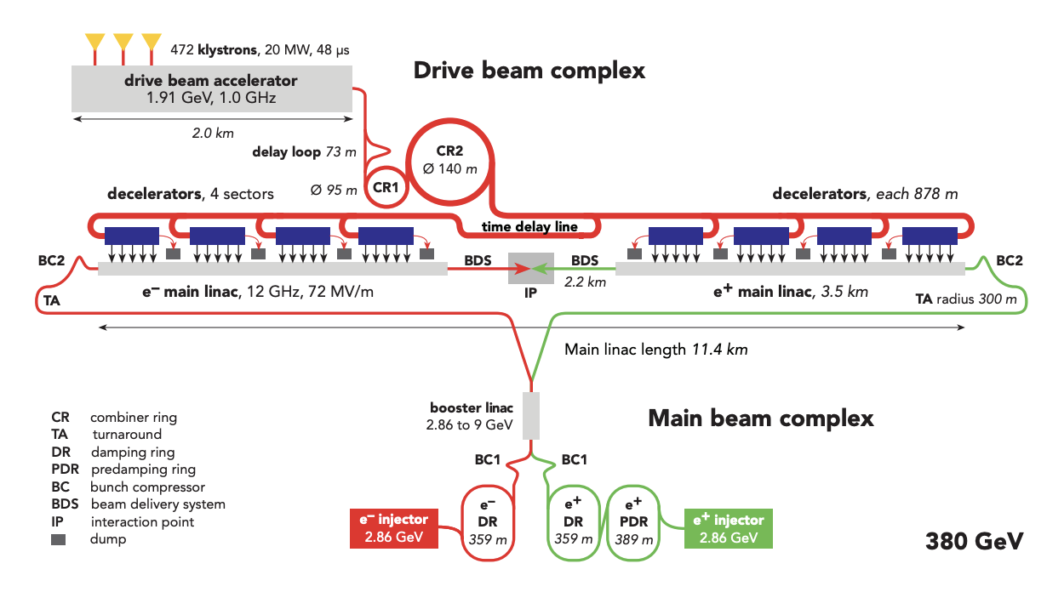
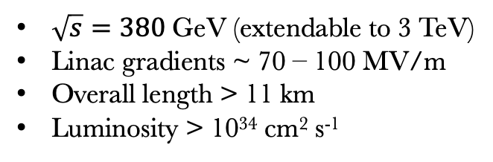
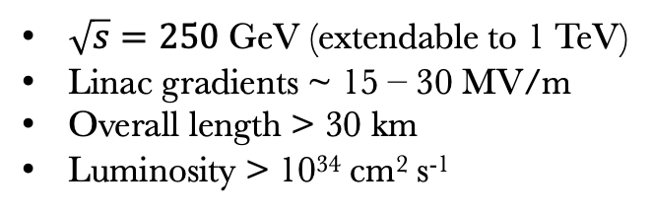
Novel collider designs
Several collider designs have been proposed, based on “conventional” RF technology, to approach, and potentially surpass, the TeV barrier
International linear collider (ILC)
Compact Linear collider (CLIC)
$\sqrt{s}=250$GeV (extendable to 1 TeV)
Linac gradients ~ 15 – 30 MV/m
Overall length > 30 km
Luminosity > 10³⁴ cm² s⁻¹
$\sqrt{s}=380$GeV (extendable to 3 TeV)
Linac gradients ~ 70 – 100 MV/m
Overall length > 11 km
Luminosity > 10³⁴ cm² s⁻¹
arXiv:1306.6327 (2013)
arXiv:1812.06018v3 (2013)
Gianluca Sarri

Slide 4
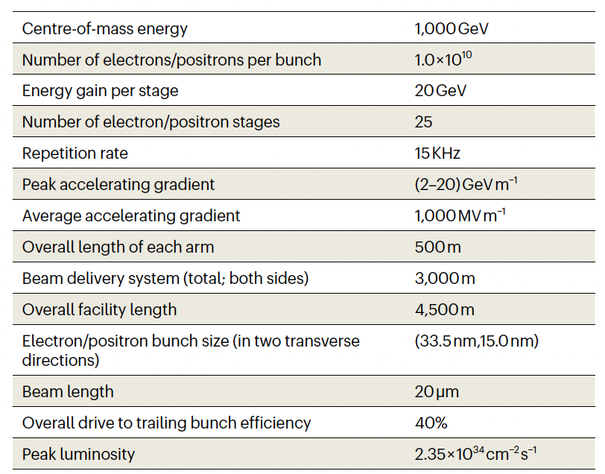
Plasmas?
Plasma-based accelerating cavities can sustain much higher accelerating gradients (1 – 100 GV/m) than RF cavities (<100 MV/m). The parameters are challenging though!
High charge
Metre-scale plasmas
Staging
High rep-rate
Beam delivery limits compactness
These requirements are challenging for electrons but not fundamentally impossible. What about positrons though?
C. Joshi et al., Nature Physics (2025)
Gianluca Sarri

Slide 5
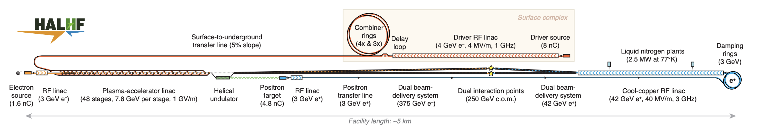
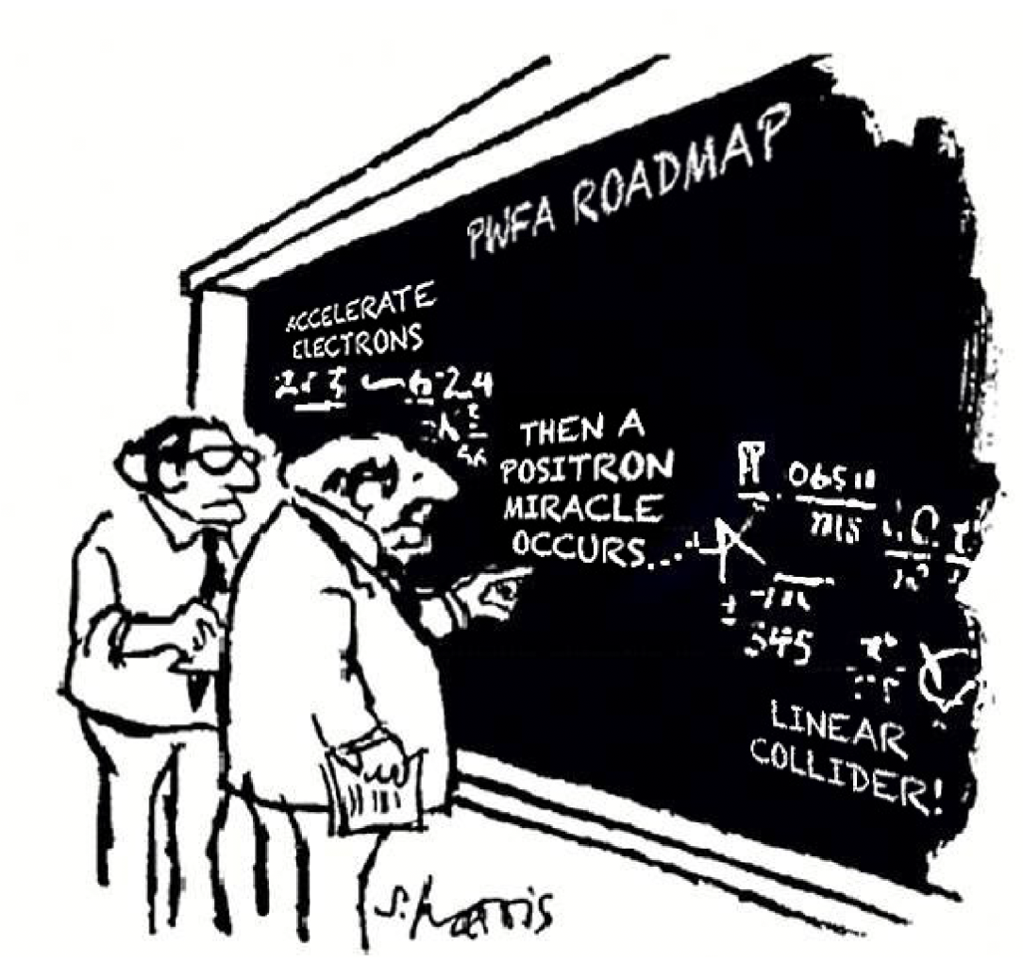
HALHF
The “positron problem” is so difficult, that ingenious solutions have been proposed to circumvent the problem altogether
Asymmetric collisions (375 GeV for e- and 41.7 for e+ for the 250 GeV case)
The asymmetry must carry onto other beam parameters too
Staged plasma acceleration for electrons
RF linac technology for positrons
arXiv:2503.19880v2 (2025)
Gianluca Sarri

Slide 6
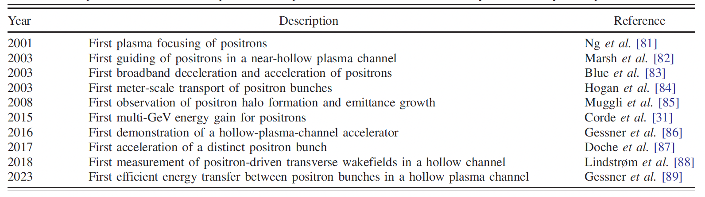
Positron acceleration in a plasma
Typical non-linear wakes have only narrow regions suitable for plasma acceleration, with highly non-uniform longitudinal (energy spread growth) and transverse (emittance growth) fields.
Several more advanced schemes have been numerically proposed, but experimental progress has been limited, and it is currently hampered by a lack of suitable facilities.
G. J. Cao et al., PRAB (2024)
Gianluca Sarri

Slide 7
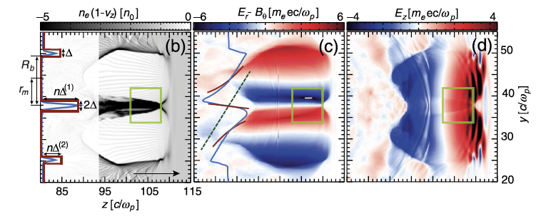
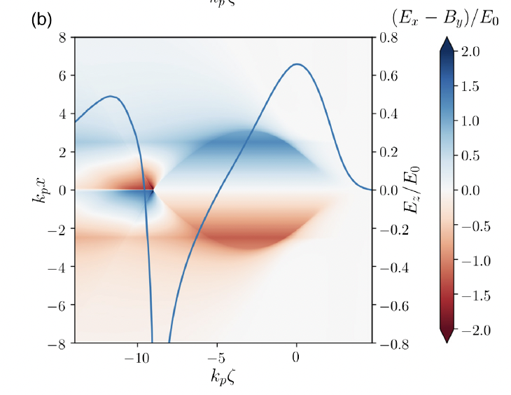
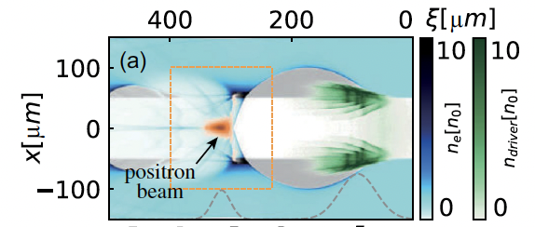
Positron acceleration in a plasma
Typical non-linear wakes have only narrow regions suitable for plasma acceleration, with highly non-uniform longitudinal (energy spread growth) and transverse (emittance growth) fields.
Several more advanced schemes have been numerically proposed, but experimental progress has been limited, and it is currently hampered by a lack of suitable facilities.
Efforts mainly focused on tailoring the distribution of the driver and/or the plasma
Doughnut-shaped drivers
Finite channels
Asymmetric drivers
X Efficiency-quality trade-off
X Potentially unstable propagation
X Efficiency-quality trade-off
X Complex
X Potentially low efficiency
J. Vieira et al., PRL (2014)
S. Diederichs et al., PRAB (2019)
S. Zhou et al., PRL (2021)
Gianluca Sarri

Slide 8
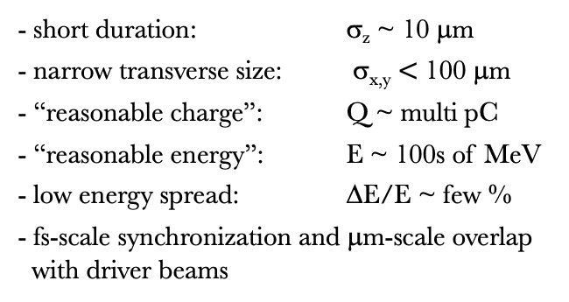
Laser-driven positron sources
Plasma-based positron acceleration
is a challenging task!
Most research has been carried out numerically
In preparation for the design of a plasma-based
(or plasma-assisted…) positron arm for a collider,
it is necessary to experimentally test
these accelerators, in order to identify the
best and most practical ways to accelerate
positrons in a plasma.
A first step would thus be to provide positron
beam facilities to the community
For meaningful experimental studies, it is necessary to provide witness beams with remarkably demanding characteristics:
- short duration: σ_{z} ~ 10 μm
- narrow transverse size: σ_{x,y} $<$ 100 μm
- “reasonable charge”: Q ~ multi pC
- “reasonable energy”: E ~ 100s of MeV
- low energy spread: ΔE/E ~ few %
- fs-scale synchronization and μm-scale overlap
with driver beams
A possible roadmap for the experimental development of high-quality positron beams could be:
SHORT TERM ( 5-10 years) Development of positron test beam facilities in Europe
      (e.g. EuPRAXIA, EPAC…)
MEDIUM TERM (10 – 20 years) - Converging onto specific acceleration schemes
- Experimental demonstration of 10s of GeV high-quality beams
LONG TERM (>20 years): - Demonstration of ~100 GeV high quality beams in a hybrid scheme
  (conventional injector + plasma accelerating modules)
Gianluca Sarri

Slide 9
EuPRAXIA
Gianluca Sarri

Slide 10
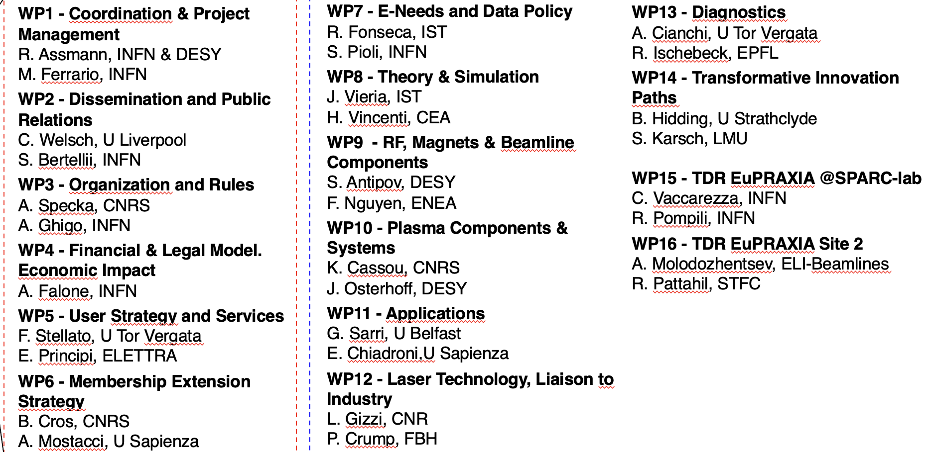
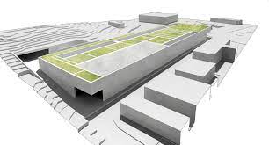
EuPRAXIA
EuPRAXIA is the first accelerator user facility based on plasma acceleration technology.
The first ESFRI plasma accelerator project and their first accelerator project since 2016.
EuPRAXIA Conceptual Design Report: R. Assman et al., Eur. Phys. J. Special Topics 229, SUPPL 1 (2020)
Gianluca Sarri

Slide 11
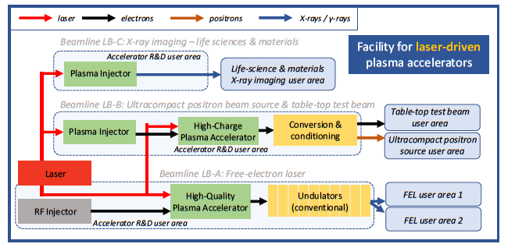
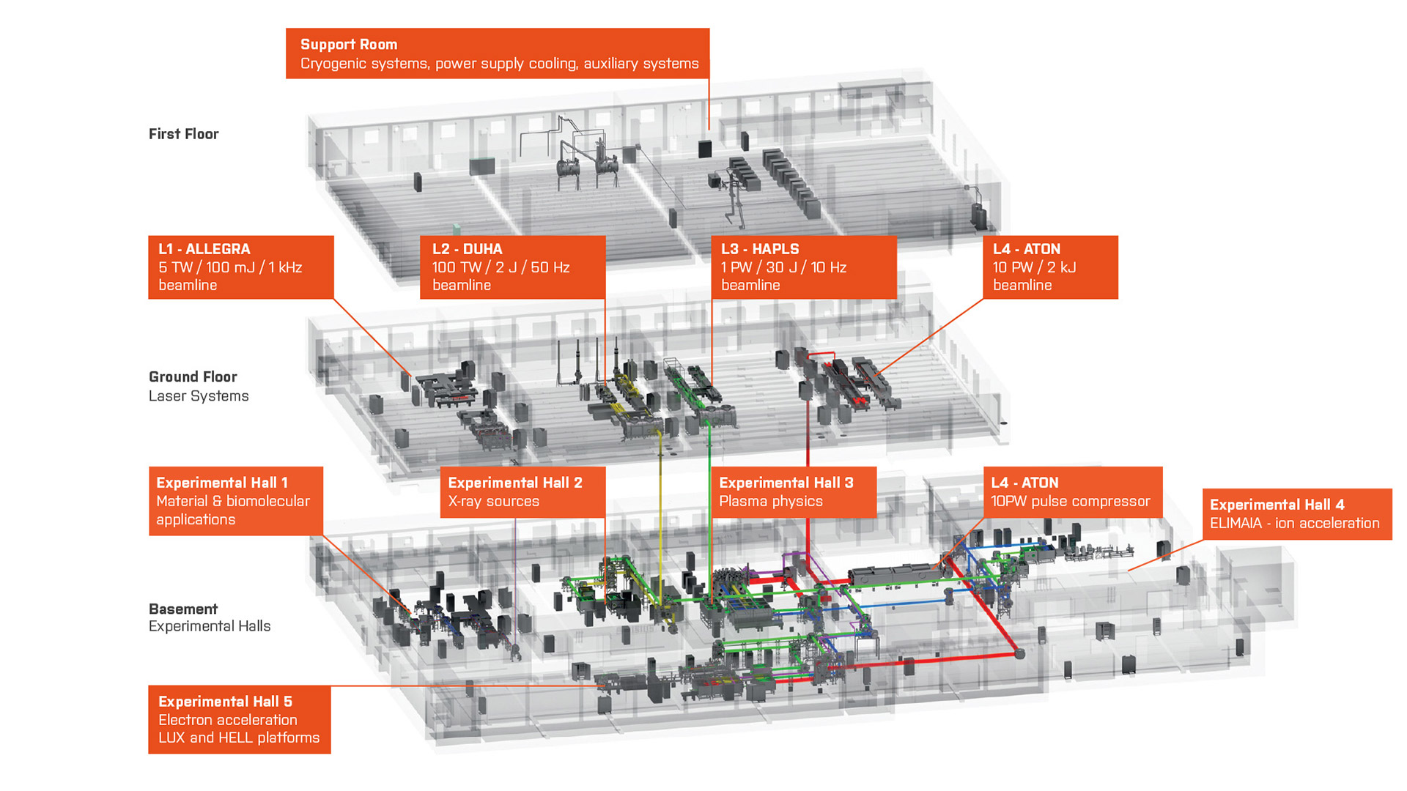
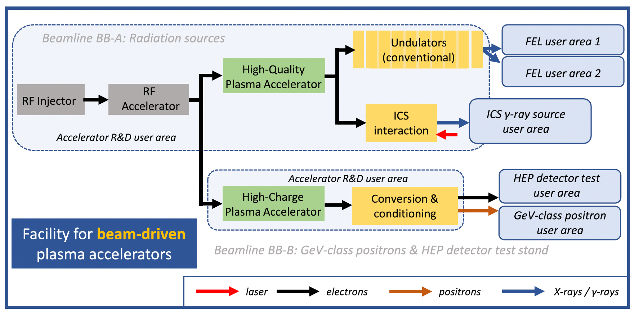
EuPRAXIA
EuPRAXIA is the first accelerator user facility based on plasma acceleration
Laser-driven site (ELI-BL, Czechia)
Beam-driven site (LNF, Italy)
TDR: https://www.openaccessrepository.it/doi/10.15161/oar.it/aye3c-2cx65
EuPRAXIA Conceptual Design Report: R. Assman et al., Eur. Phys. J. Special Topics 229, SUPPL 1 (2020)
Gianluca Sarri

Slide 12
A plasma-based positron source
Experimental proof-of-principle
Gianluca Sarri

Slide 13
Experimental proof-of-principle
First proof-of-principle of laser-driven high-energy positrons obtained with the Astra-Gemini laser at CLF (100 TW)
M. Streeter et al., Sci. Rep. (2025)
Gianluca Sarri

Slide 14
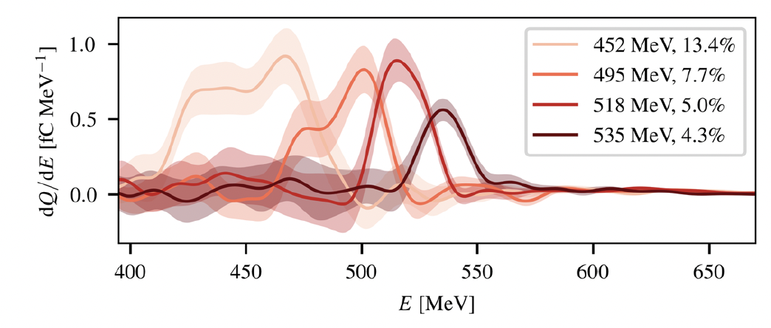
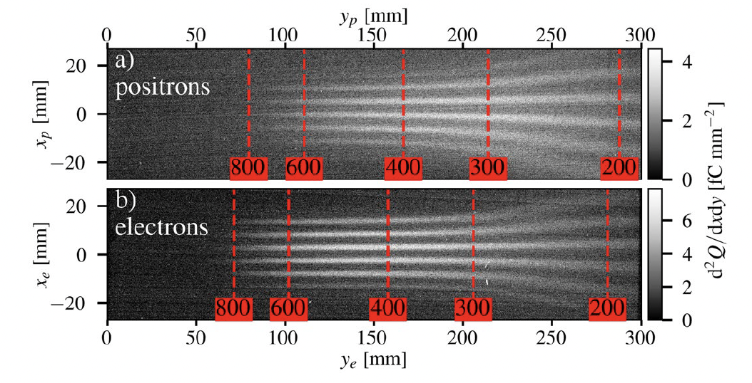
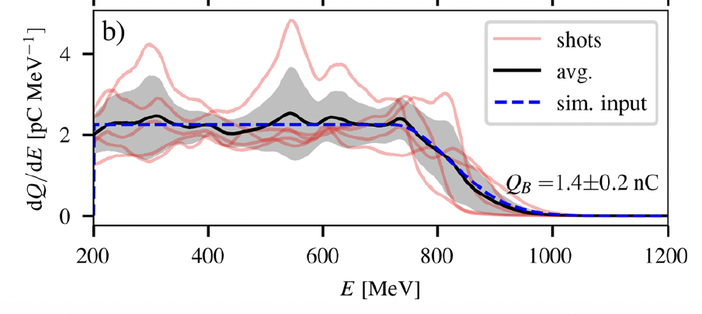
Experimental proof-of-principle
First proof-of-principle of laser-driven high-energy positrons obtained with the Astra-Gemini laser at CLF (100 TW)
M. Streeter et al., Sci. Rep. (2025)
G. Sarri et al., PPCF (2022)
Gianluca Sarri

Slide 15
Experimental proof-of-principle
First proof-of-principle of laser-driven high-energy positrons obtained with the Astra-Gemini laser at CLF (100 TW)
Obtained positron beam properties
Energy: 500 MeV
Bandwidth: ΔE/E ~ 5%
Charge: 0.2 pC
Norm. Emit.: 18 μm
Duration: < 50 fs
Results obtained with ~1.4 nC electron beams with maximum energy of ~ 900 MeV
Extending these results to a PW-scale laser indicates already the possibility of achieving GeV positron beams with > 10 pC charge in a few percent bandwidth and small transverse and longitudinal size
M. Streeter et al., Sci. Rep. (2025)
G. Sarri et al., PPCF (2022)
Gianluca Sarri

Slide 16
A plasma-based positron source
Numerical modelling
Gianluca Sarri

Slide 17
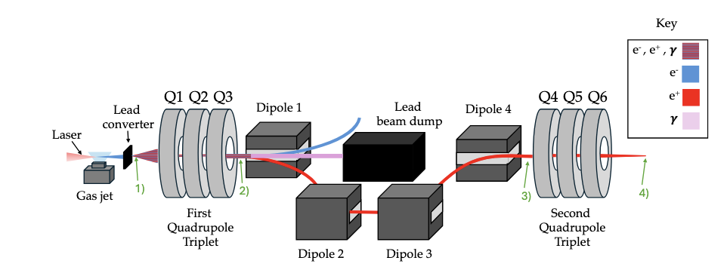
Experimental proof-of-principle
We can do much better than that though: 1) Higher electron beam charge, 2) Better conversion, 3) Better transport/conditioning
plasma lens
Plasma lens
simulations
FLUKA simulations
FBPIC with Bayesian optimization
Different laser powers (0.2 – 1 PW)
Beam transport simulations with
differential evolution algorithm
T. Foster et al., to be submitted (2026)
Gianluca Sarri

Slide 18
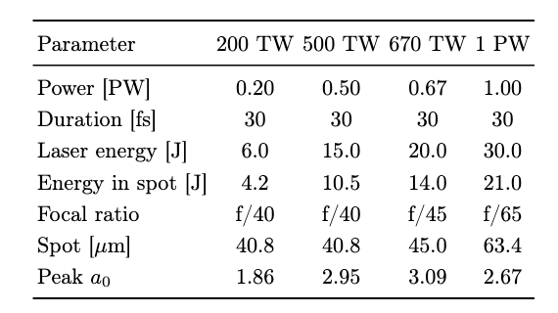
Experimental proof-of-principle
We assume 4 laser beam configurations
Simple ionization-injection setup
He gas with N₂ dopant (1 – 5 %)
25 mm plateau (20 mm for 200 TW)
1 mm cosine-squared ramps on either side
200 TW ➔ FLAME at LNF
500 TW ➔ FLAME at LNF (upgrade)
670 TW ➔ EPAC at CLF (conservative)
1 PW ➔ EPAC at CLF (optimum)
This is because, for positron generation, we have no real requirement on electron beam quality (i.e., small emittance or narrowband spectra)
T. Foster et al., to be submitted (2026)
Gianluca Sarri

Slide 19
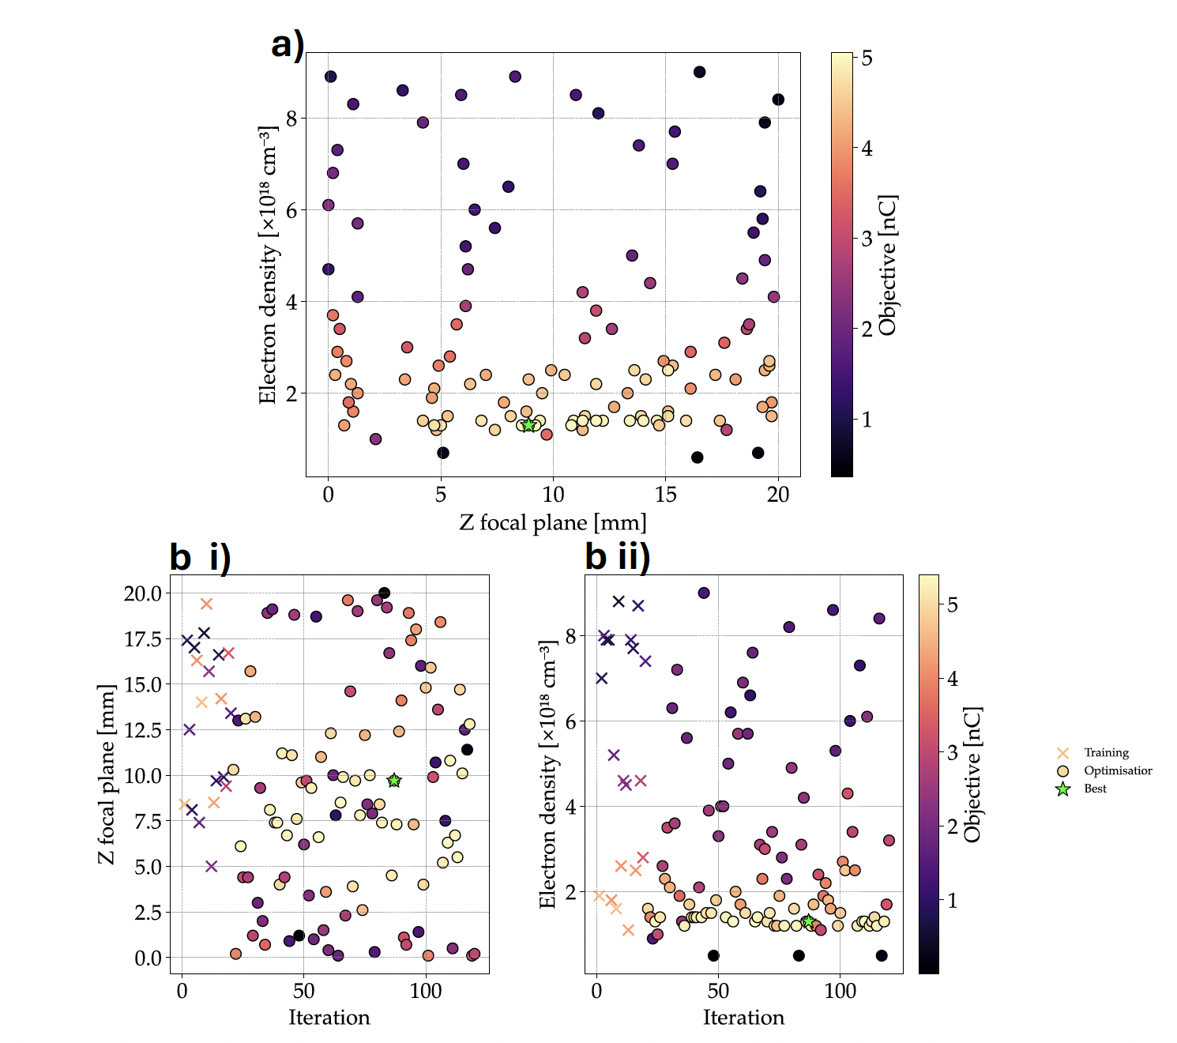
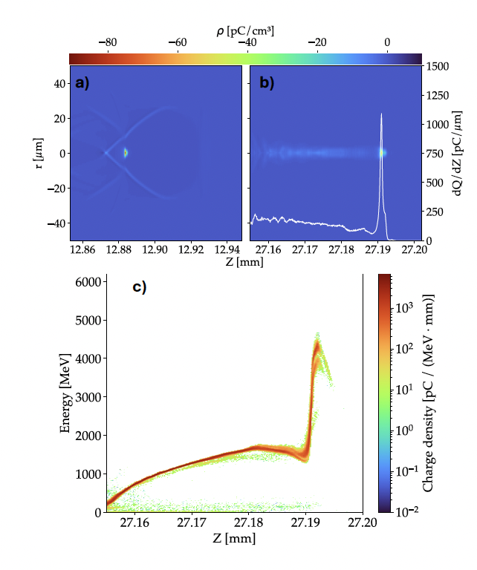
Electron beam optimisation
Bayesian optimization (maximum charge above 500 MeV)
T. Foster et al., to be submitted (2026)
Gianluca Sarri

Slide 20
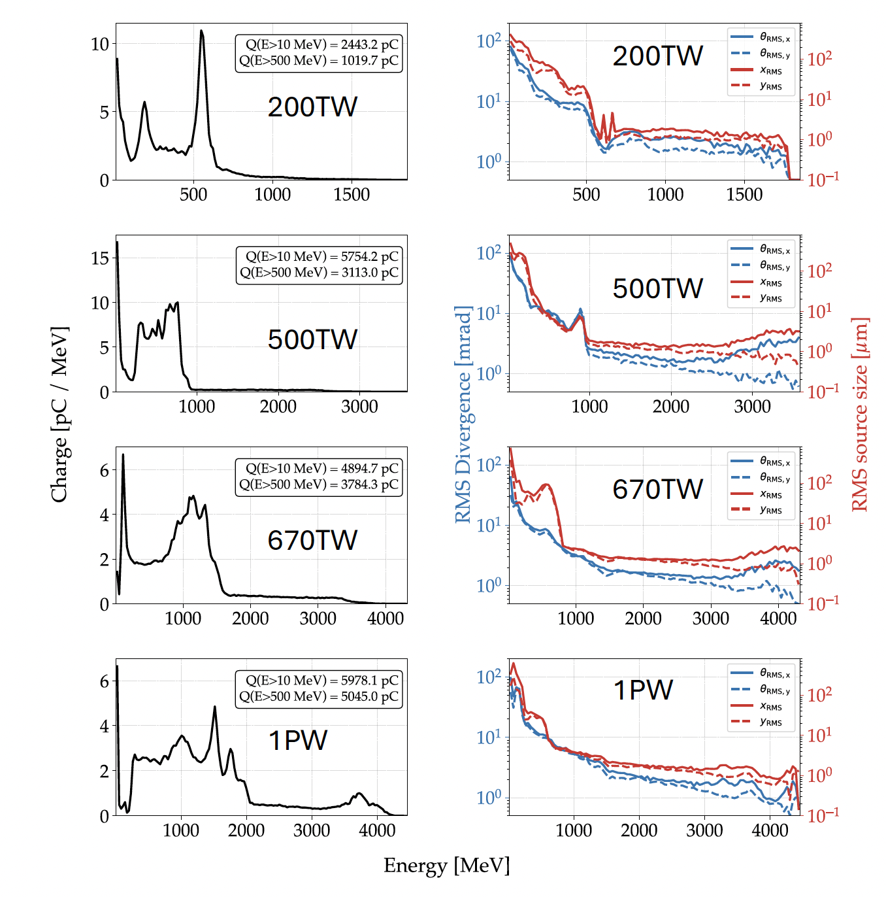
Electron beam optimisation
Bayesian optimization (maximum charge above 500 MeV)
Laser Power (TW) | 200 | 500 | 670 | 1000
Charge (nC) | 1.02 | 3.11 | 3.78 | 5.04
Energy (GeV) | 0.6 | 0.9 | 1.2 | 1.7
Positron beam virtually insensitive to spectral shape and spatial quality of the electron beam
Electron beam duration (> 1 GeV, for 1 PW) ~ 30 fs
T. Foster et al., to be submitted (2026)
Gianluca Sarri

Slide 21
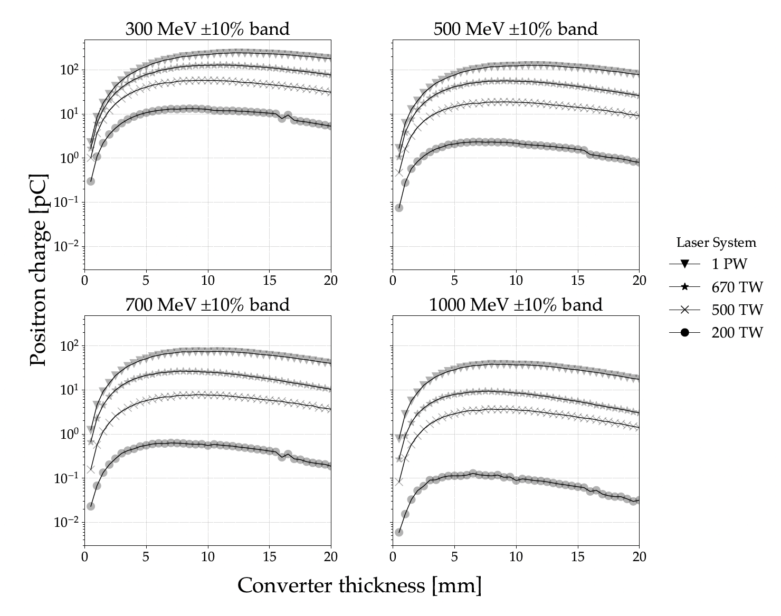
Positron source
Trade-off between positron yield and emittance
~ 80 pC
T. Foster et al., to be submitted (2026)
Gianluca Sarri

Slide 22
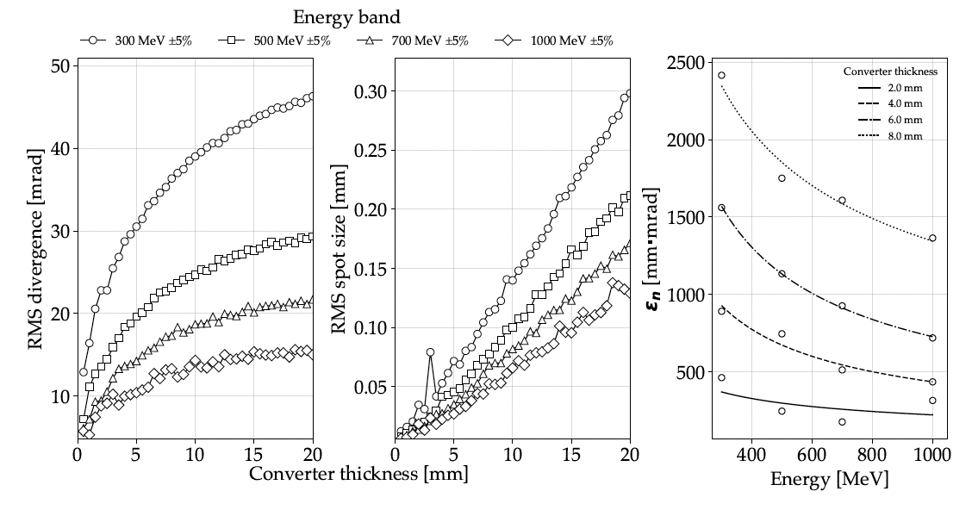
Positron source
Trade-off between positron yield and emittance
10²
10⁰
10⁻²
~ 80 pC
Charge = 80 pC
Divergence = 18 mrad
Source size = 40 μm
Energy = 500 ± 5% MeV
Norm. Emit. = 600 μm *
* Much better emittance obtainable for thin converters, but much lower charge…
T. Foster et al., to be submitted (2026)
Gianluca Sarri

Slide 23
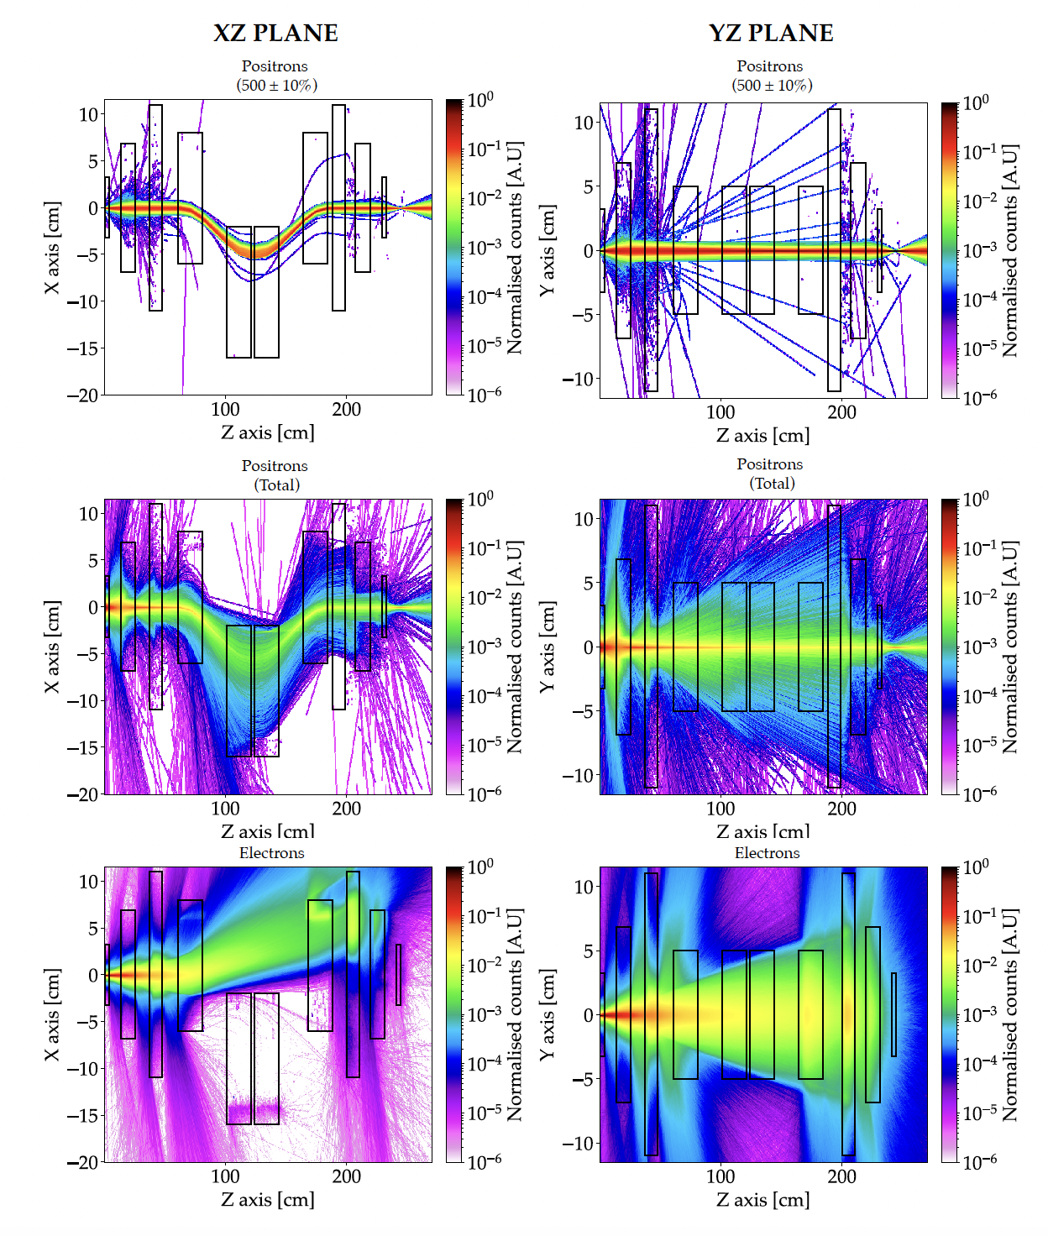
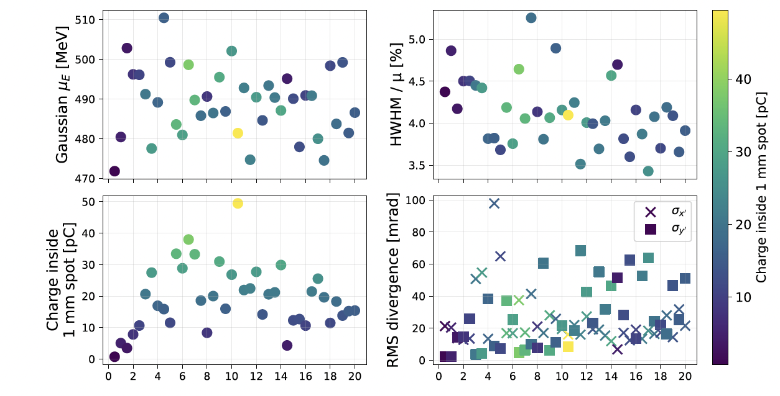
Positron transport
2 triplets and a chicane to separate positrons from electrons and photons
Differential evolution algorithm to optimise positron beam at focus
E = 482 MeV ΔE/E = 4%
Θ = 5 mrad σ_{x,y} = 1 mm
C = 50 pC σ_{z} = 10 μm
T. Foster et al., to be submitted (2026)
Gianluca Sarri

Slide 24

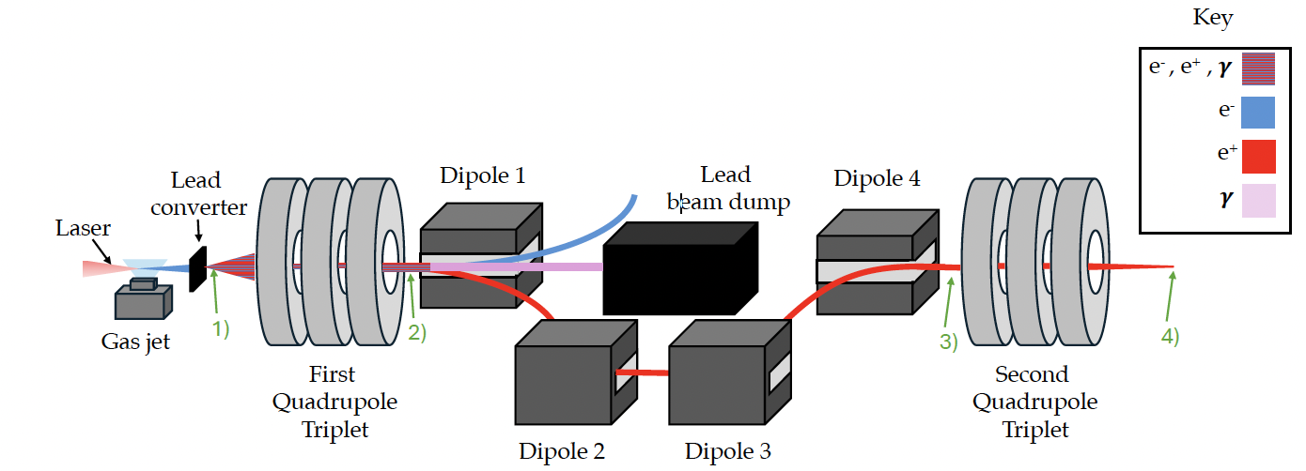
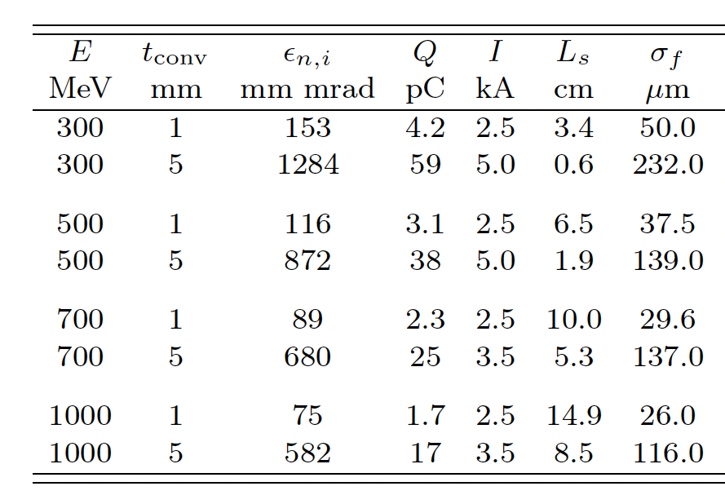
Plasma lens focussing
Start-to-end numerical modelling with Bayesian optimisation for 0.2 – 1 PW laser
Active plasma lens for final focussing
Example: 1PW laser
E ~ 500 MeV ± 4.4%
T_{put} ~ 80 %
Q ~ 1 - 40 pC
ε_{n} ~ 80 - 800 μm
indicative values, energy- and setup-dependent!
low-charge mode
high-charge mode
pC-scale, high quality
Courtesy of M. Galletti (LNF, INFN)
T. Foster et al., to be submitted (2026)
Gianluca Sarri

Slide 25
Implementation example
(LNF, 200 TW laser)
Gianluca Sarri

Slide 26
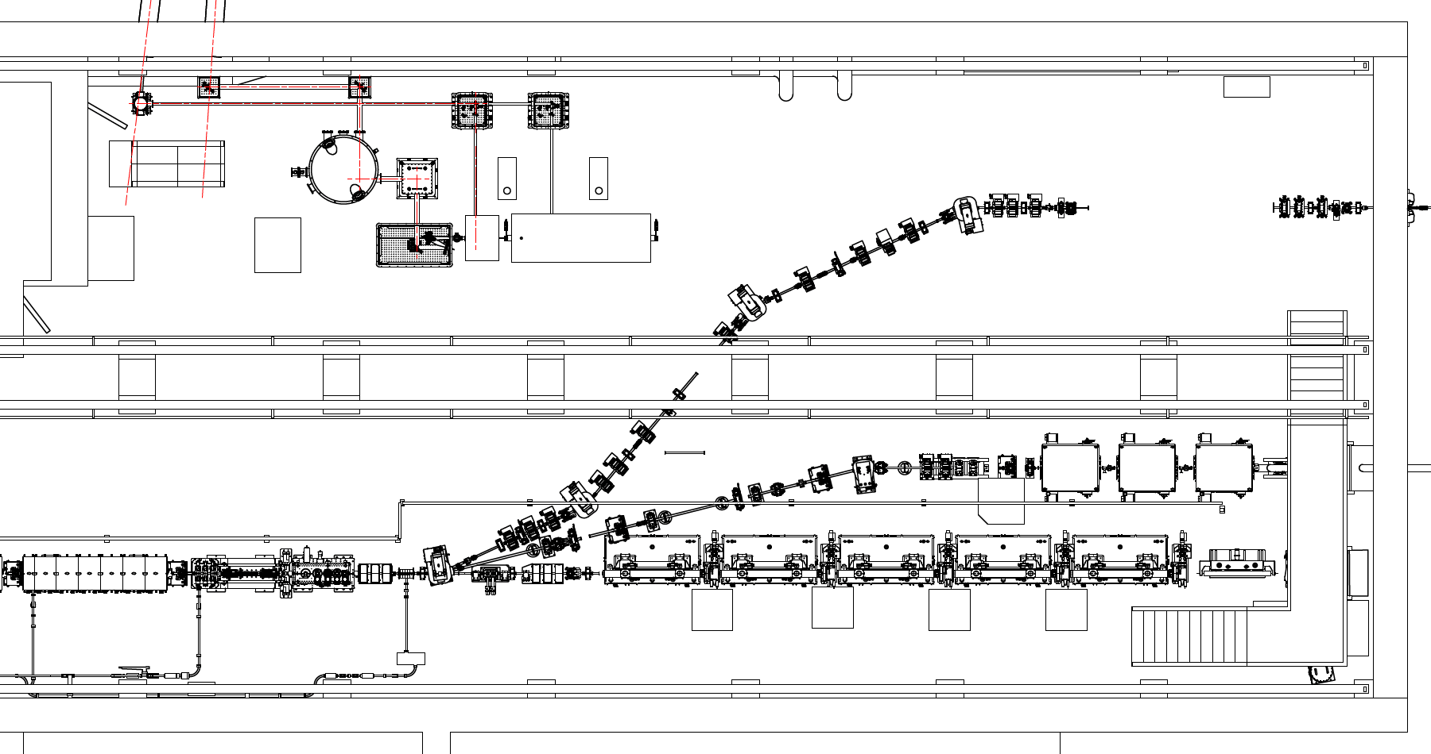
Area and capability
EuAPS
SPARC
Gianluca Sarri

Slide 27
Area and capability
EuAPS
SPARC
Gianluca Sarri

Slide 28
Area and capability
~10 m
Chicane + QMs
PM
Gascell
Diagnostics
Lens
Gasjet +
converter
F/40
F/15
90:10 BS
Delay
line
STEP 1: Generation of broadband GeV electron beams with nC total charge
STEP 2: Generation and characterization of the positron beam
STEP 3: Transport and energy selection: demonstration of 500 MeV ±10% 3 pC charge e+
STEP 4: First demonstration of laser-driven positron wakefield acceleration
STEP 5: Coupling of the positron beam (witness) with SPARC (driver)?
Gianluca Sarri

Slide 29
Conclusions
Gianluca Sarri

Slide 30

Conclusions
Wakefield accelerators present promising characteristics to reduce cost, footprint, and environmental impact of the next generation of particle colliders.
For the electron arm, their implementation is challenging but not impossible!
The positron arm is far more complicated and, while numerical proposals exist, progress in this area is hampered by a global lack of suitable experimental facilities.
EuPRAXIA aims to deliver ultra-short (σ_{z} ~ 10 μm), high-energy (E ~ 500 ± 5% MeV), and high charge (10s of pC) positron beam to study positron-wakefield acceleration
First numerical modelling of a simple beamline demonstrate that this is achievable in a small setup. pC beams within 10x30x30 micron volumes, up to 40 pC in larger beams
A lot of work is still required!
1) Optimize the beamline
2) Increase charge
3) Ensure high rep-rate operations
4) Achieve a high level of stability
5) Couple it with suitable drivers
Gianluca Sarri

Slide 31

Thanks for your attention!
Gianluca Sarri
g.sarri@qub.ac.uk

