Slide 1
DFCSR: A Fast Calculation of 2D Coherent Synchrotron Radiation in Relativistic Beams
Jingyi Tang
9/15, 2026

Slide 2
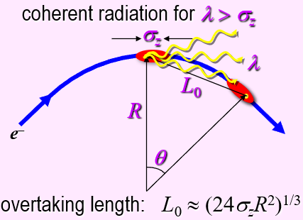
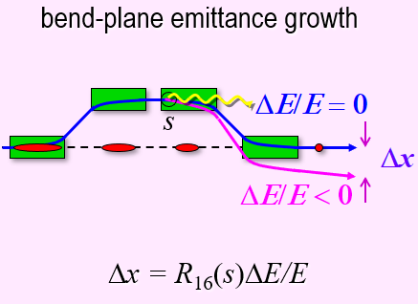
Introduction
When the trajectory of a relativistic beam is bent by magnetic field, the beam radiates electromagnetic field. It can radiate coherently for very short bunch if the wavelength of the synchrotron radiation exceeds the length of the bunch (CSR).
CSR can increase energy spread and transverse emittance. It is one of the most important limits to the brightness of the electron beam in storage rings, free electron lasers (FEL) and high-energy linear colliders
Paul Emma. “Acceleration and Compression of High Brightness Electron Beams in Linac-Based FELs”. 2015

Slide 3
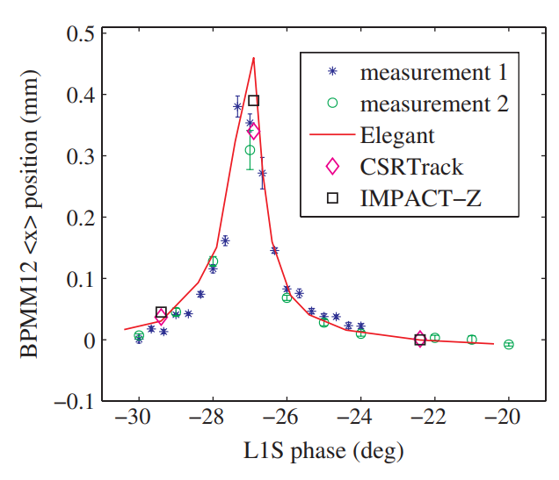
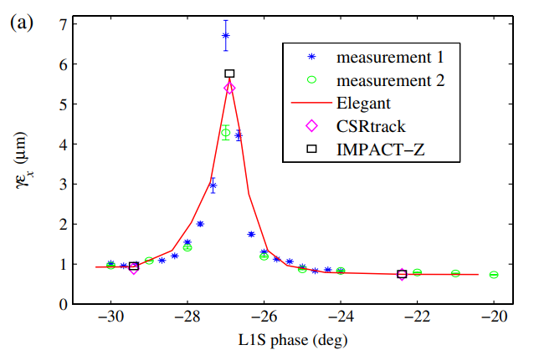
Introduction
There are well-established 1D models of the CSR wake. 1D models neglects transverse dimension of the beam, and they agree well with experimental results when the beam current is relatively low.
K.L.F. Bane et al. Phys. Rev. ST Accel. Beams, 12, 030704 (2009).

Slide 4

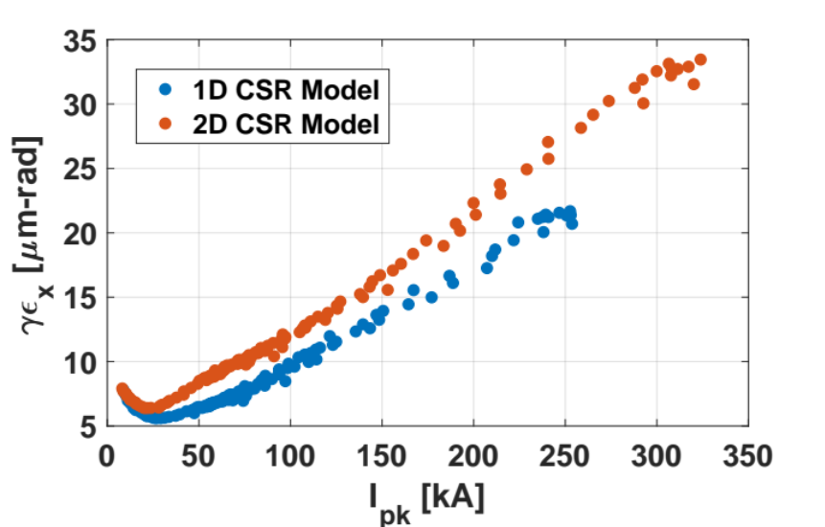
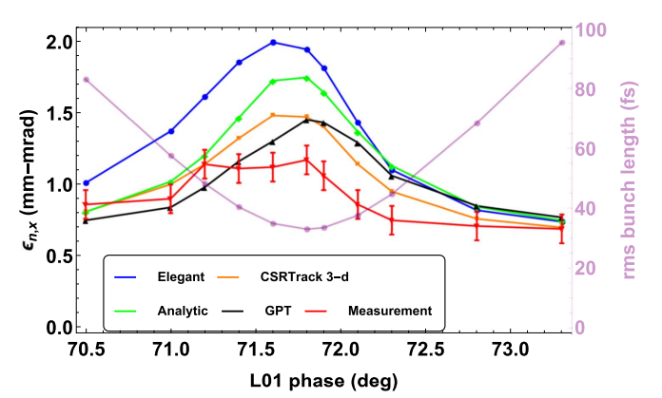
Introduction
1D models become invalid when Derbenev criterion is not satisfied, i.e. beam with large transverse extension and small bunch length.
The departure from 1D models have been explored both in simulation and experiment
G. White, FACET-II Science Workshop October 2017;
Brynes, A. D., et al. New Journal of Physics 20.7 (2018): 073035.
Generation of ultra-short, high-brightness electron bunches may lead to a parameter space that 1D CSR models fail to work.
A fast and reliable 2D/3D CSR model is required for the next generation of accelerators and light sources

Slide 5
Introduction
Difficulties in 2D/3D CSR computation
  history-dependent nature of CSR
  difficult 3D retardation conditions
  scaling of self-interactions in computation.
e-beam trajectory
radiation
2D/3D CSR codes being actively studied¹
CSRtrack/TraFiC4 (2005)
LW (2013)
GPT-CSR (2018)
PyCSR (2020)
Lucretia 2D CSR (2020)
CoSyR(2021)
DFCSR
a CSR code based on the history of density functions of electron beams.
Accurate and efficient computation of 2D/3D CSR
Open-sourced and user-friendly
1. Mayes, C. E. Journal of Instrumentation 16.10 (2021): P10010.

Slide 6
Outline
CSR Model and Algorithm
Benchmarks
  Dipole
  Berlin Benchmark Chicane
  FACET-II Benchmark Chicane
Computational Efficiency
An Example of Using Our Open-sourced Codes

Slide 7
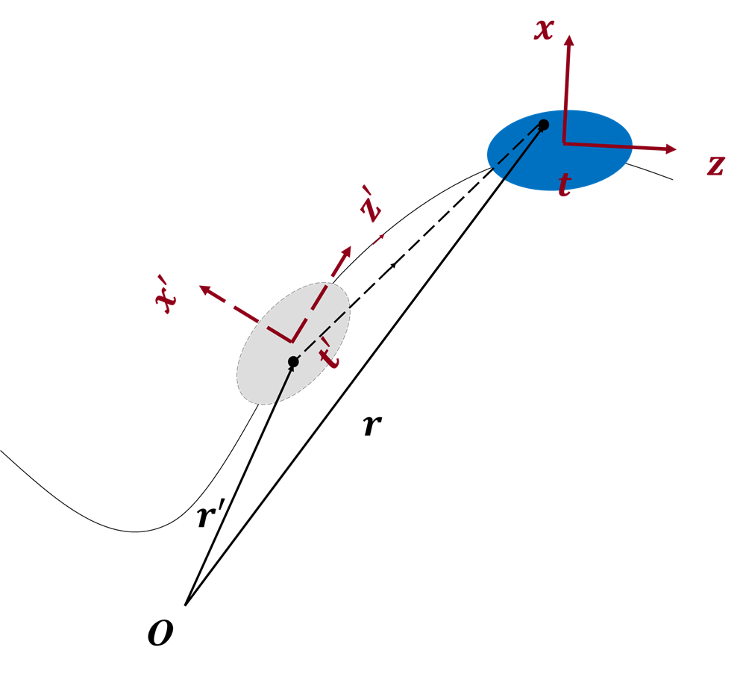
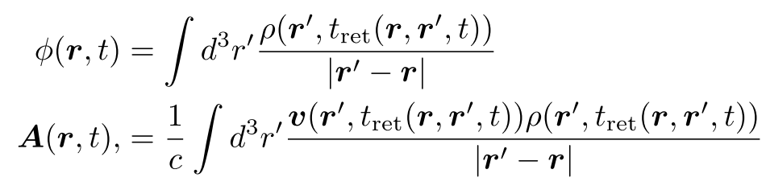
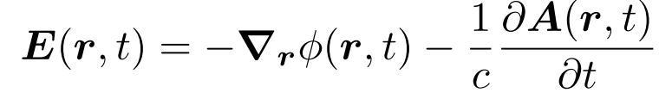


CSR Model and Algorithm
Electron beam is described by its time-dependent density functions of charge ρ(𝒓,𝑡) and velocity 𝒗(𝒓,𝑡) . Retard potentials are given by
Here $r^{′}$ is retarded space coordinates. $t_{ret}=t −|r−r′|/c$. The electric field can be expressed as
The instantaneous energy change per unit time and per unit charge (longitudinal force) is
The transverse force is given by
[1] Stupakov, G., & Tang, J. (2021). Physical Review Accelerators and Beams, 24(2), 020701.
[2] Stupakov, G. Physical Review Accelerators and Beams 25.1 (2022): 014401.

Slide 8
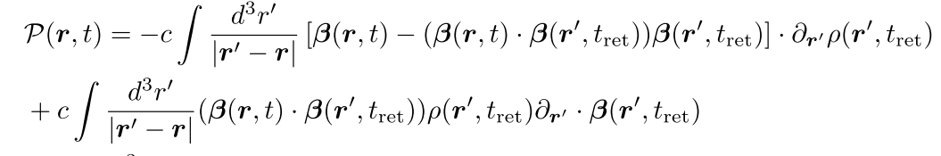
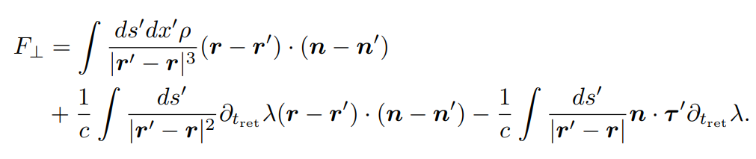
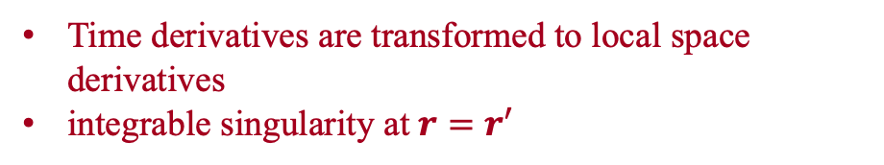
CSR Model and Algorithm
With further derivations described in [1], the longitudinal wakes can be expressed by
Time derivatives are transformed to local space derivatives
integrable singularity at $r=r′$
Similarly, we can get the transverse CSR wake [2]
$n$ and $τ$ are the normal and tangential vector of the reference trajectory.
[1] Stupakov, G., & Tang, J. (2021). Physical Review Accelerators and Beams, 24(2), 020701.
[2] Stupakov, G. Physical Review Accelerators and Beams 25.1 (2022): 014401.
8

Slide 9
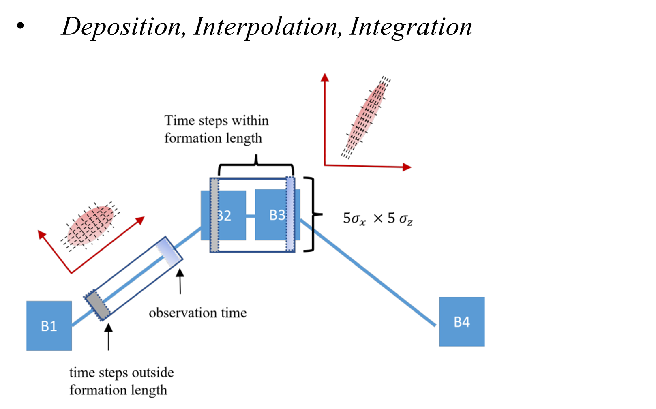
CSR Model and Algorithm
Input lattice · beam · config
Precompute trajectory, schedule
1. Track one step Bmad-X: drift / dipole / quad/…
2. Deposit ρ, ρ·v_x co-moving frame, cubic B-spline
3. Smooth & differentiate FFT filter, then ∂ρ, ∂v_x
snapshot
steps
4. Update history ring buffer; keep n·L_f
5. CSR wake on the mesh 3D interpolation; 2D retarded integral
kick steps
(far fewer)
6. Apply kick midpoint rule: ΔE/Δct, Δp_x
Output beam · wakes · statistics → HDF5

Slide 10
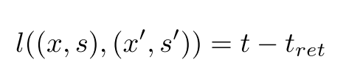
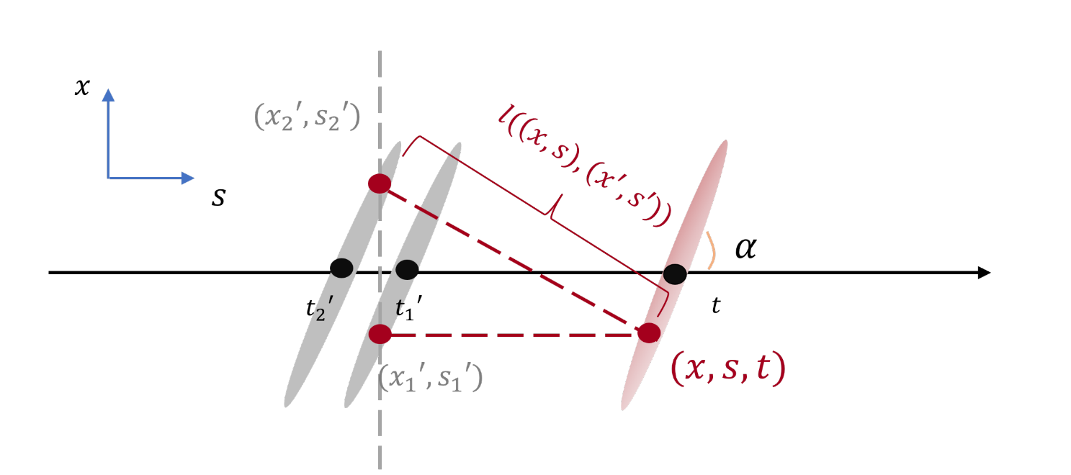
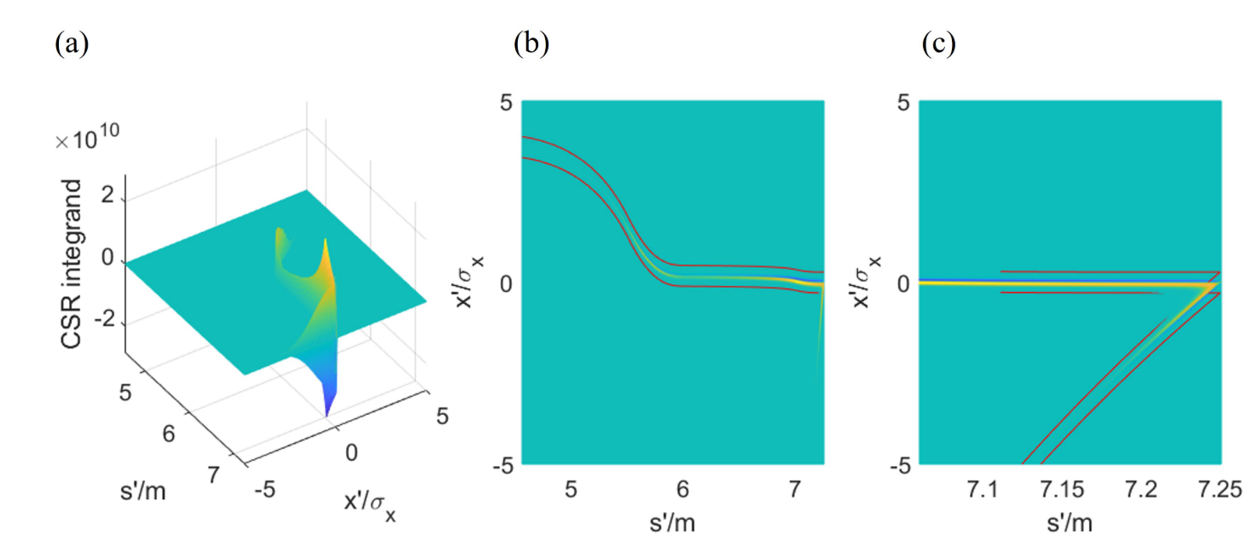
Localized CSR integrand

Slide 11
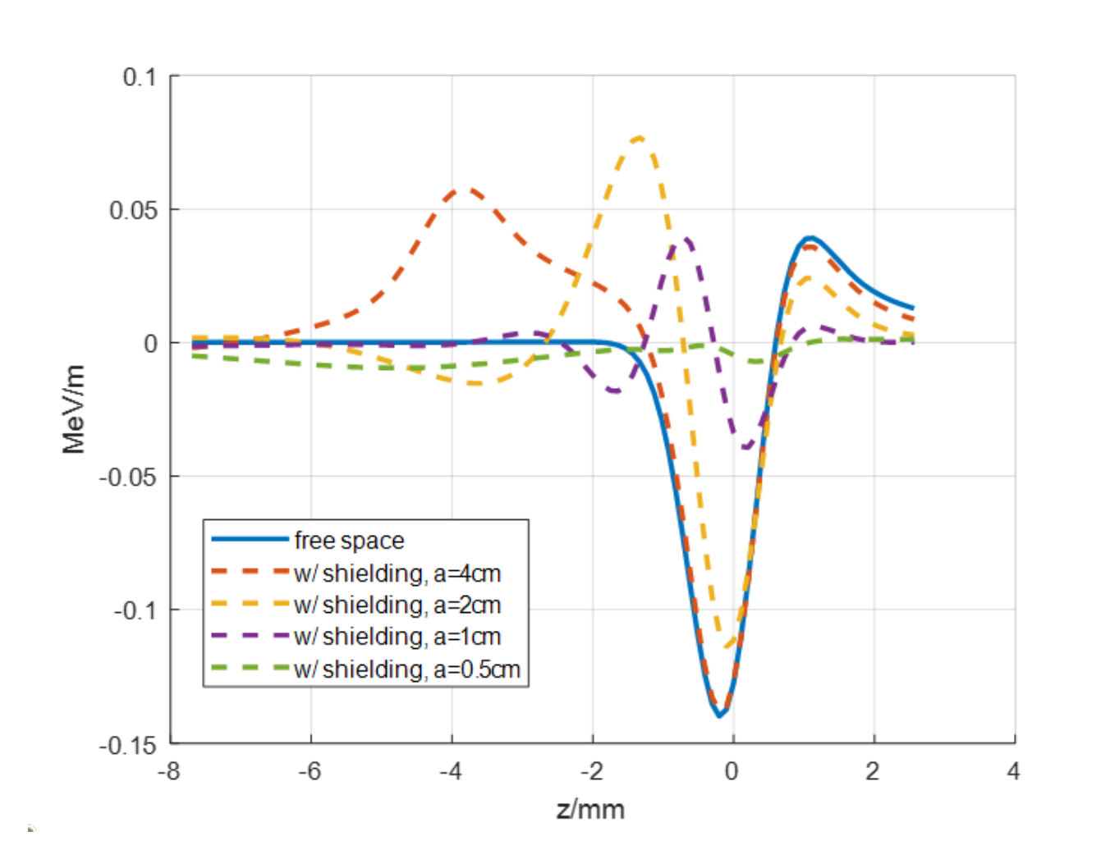

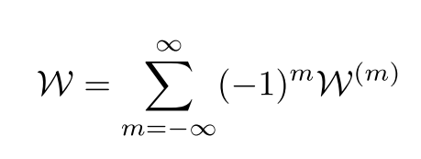
Shielding

Slide 12
Outline
CSR Model and Algorithm
Benchmarks
  Dipole
  Berlin Benchmark Chicane
  FACET-II Benchmark Chicane
Computational Efficiency
An Example of Using Our Open-sourced Codes

Slide 13
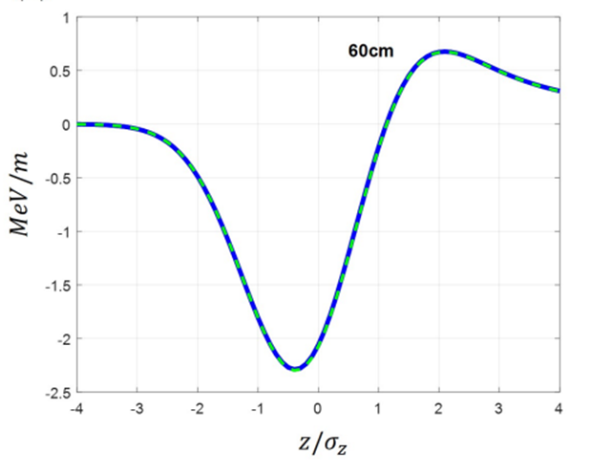
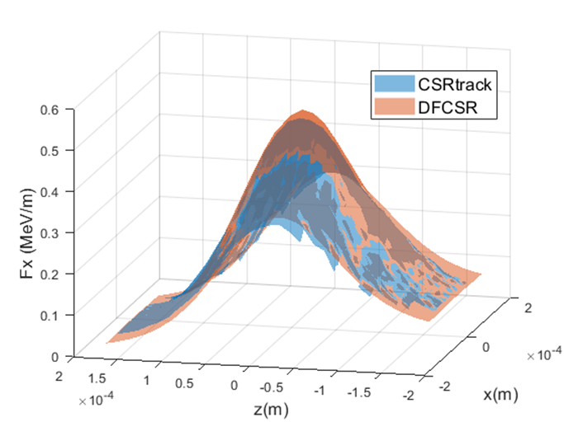
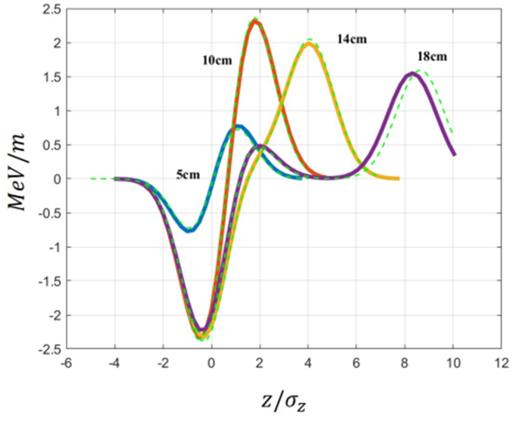
A Gaussian Beam in a Dipole
CSR wake of a Gaussian ebeam in a bending magnet, benchmarked with 1D CSR model and CSRtrack
$$σ_{x}=σ_{z}=50 μm, R=1.5m, E=5GeV$$
$$σ_{y}=1μm$$
1D model from: Saldin, Schneidmiller, Yurkov, NIMA, A398, 373, (1997); G. Stupakov and P. Emma, EPAC, p. 1479, (2002).

Slide 14
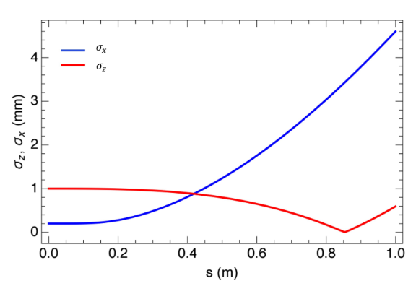
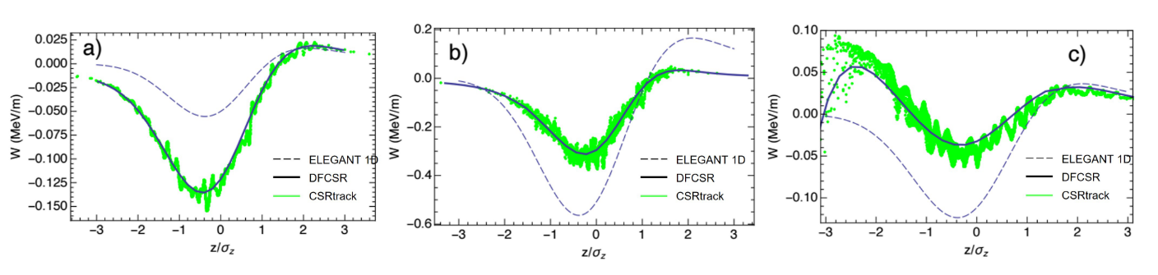
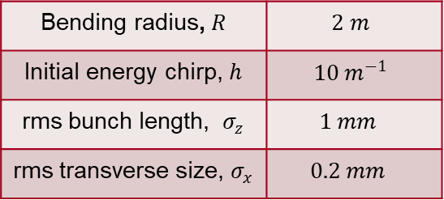
A Gaussian Beam in a Dipole
CSR wake of a Gaussian e-beam with an initial energy chirp in a bending magnet
Bending radius, $R$ | $$2 m$$
Initial energy chirp, $h$ | $$10 m^{−1}$$
rms bunch length, $σ_{z}$ | $$1 mm$$
rms transverse size, $σ_{x}$ | $$0.2 mm$$

Slide 15
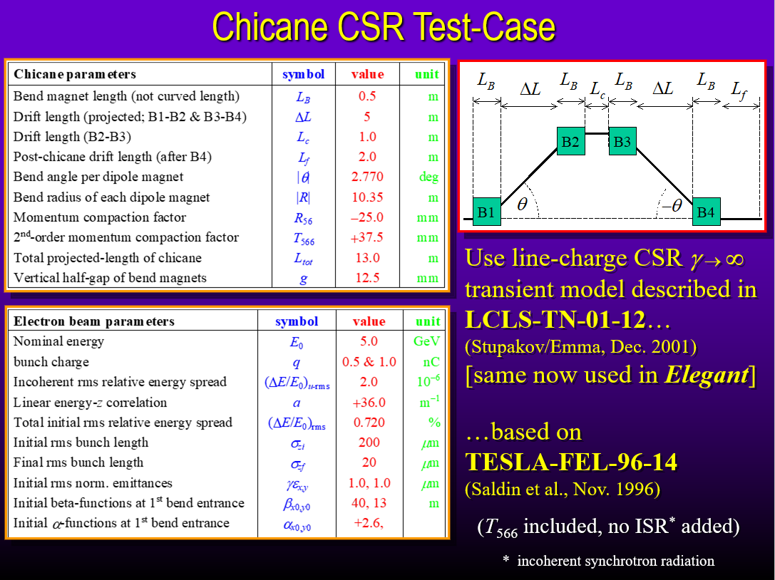
Berlin Benchmark Chicane
We benchmarked our code for a bunch compressor formulated at the CSR workshop at DESY-Zeuthen in 2002.

Slide 16
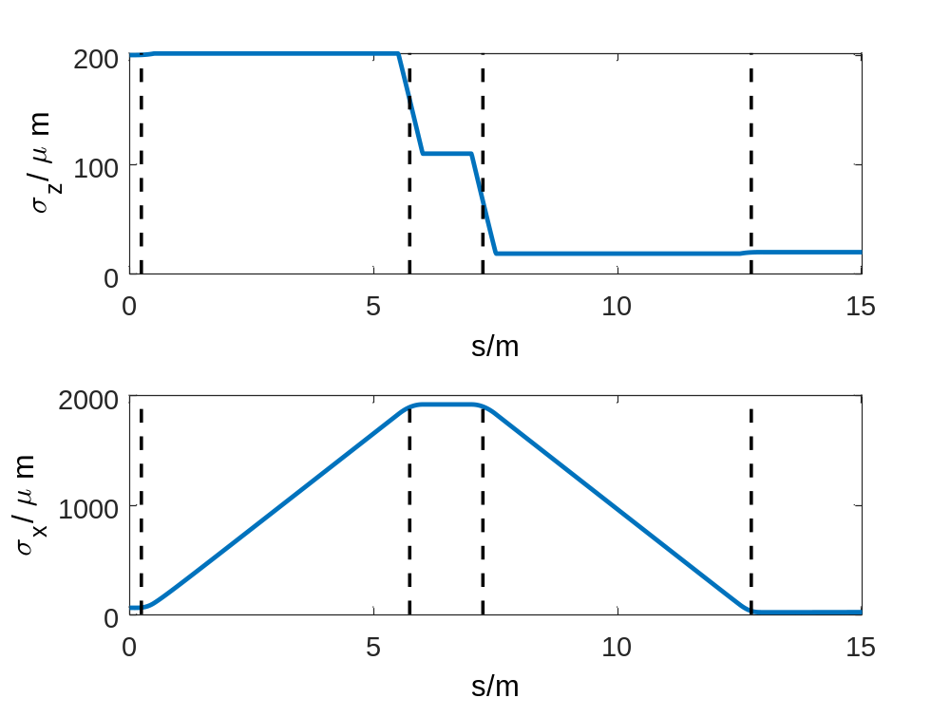
Berlin Benchmark Chicane
B2
B3
B1
B4
In the middle of the chicane (B2, B3), the transverse size of the bunch becomes much larger than the longitudinal one. We expect largest deviation from 1D model there.

Slide 17
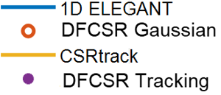
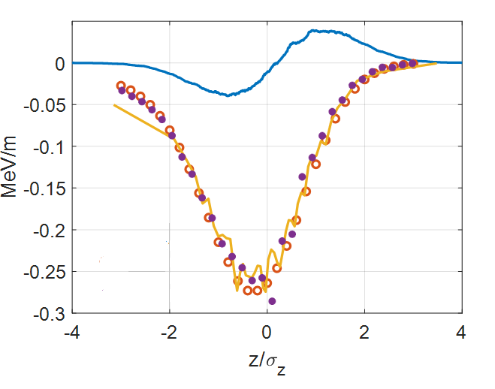
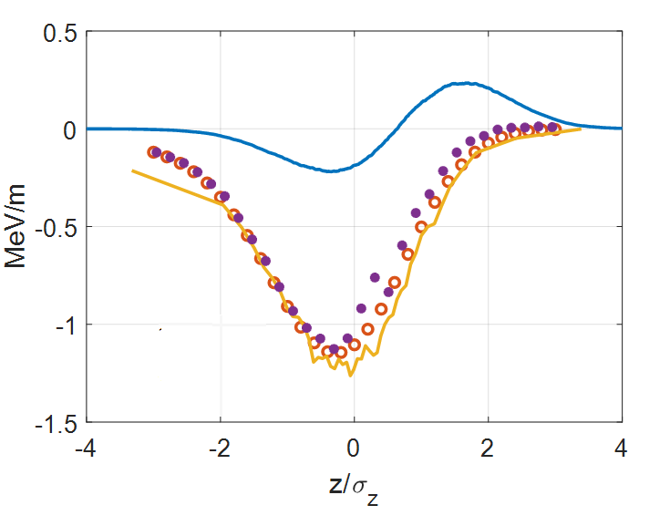
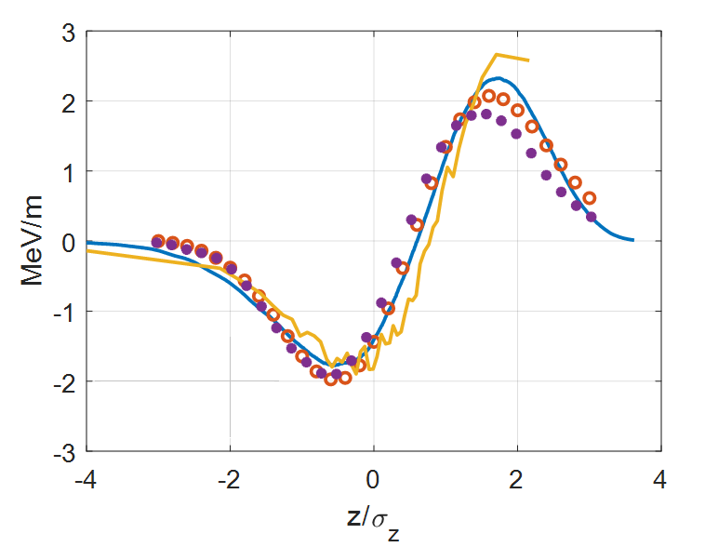
Berlin Benchmark Chicane
B2
B3
B1
B4
B2
B3
B4

Slide 18
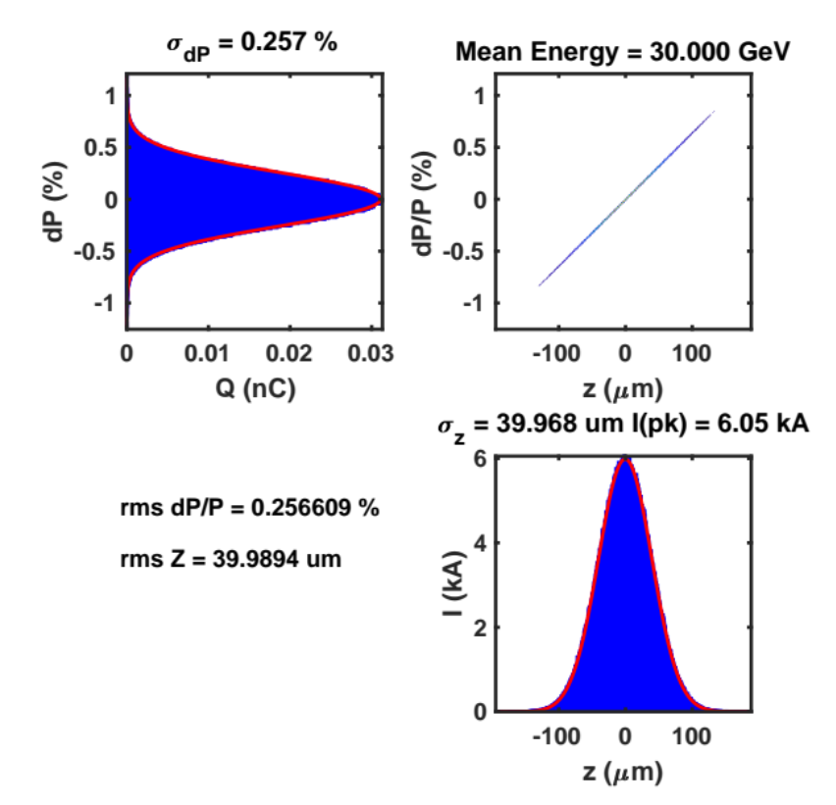
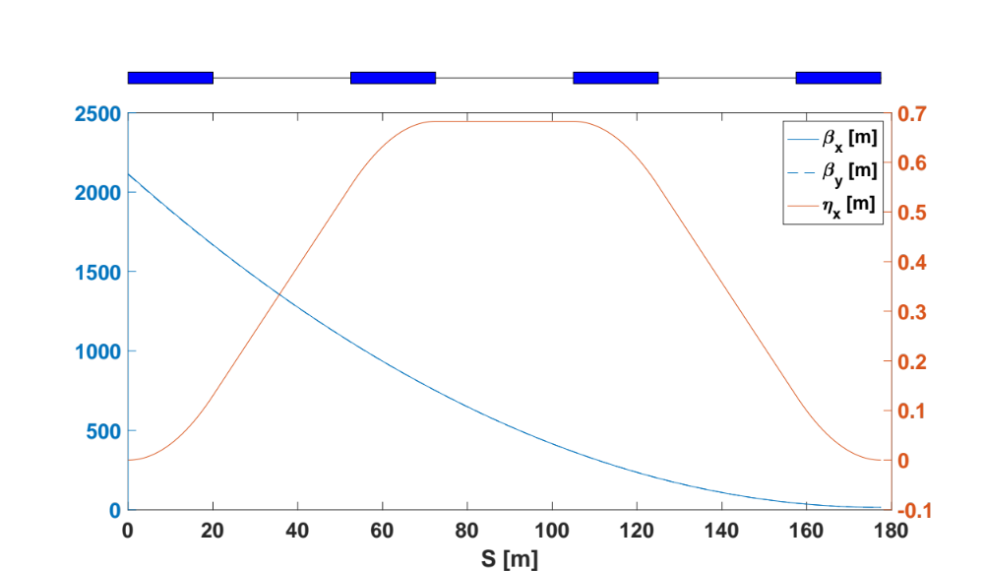
FACET-II Benchmark Chicane
Initial Longitudinal Profile
σ_{z} = 40 μm
σ_{z} = 0.5 μm
dE/dz chirp = 1925 (GeV/m)
Glen White. “Bunch Compressor Design and Tracking Simulations with CSR”. September 9, 2021

Slide 19
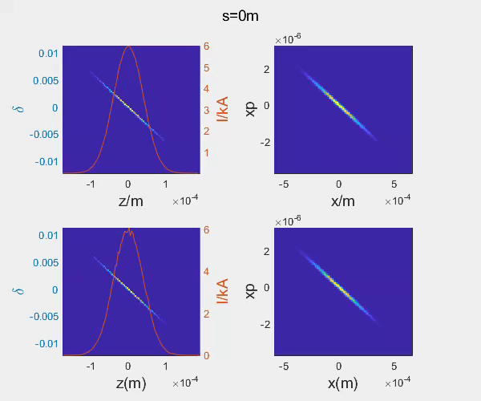
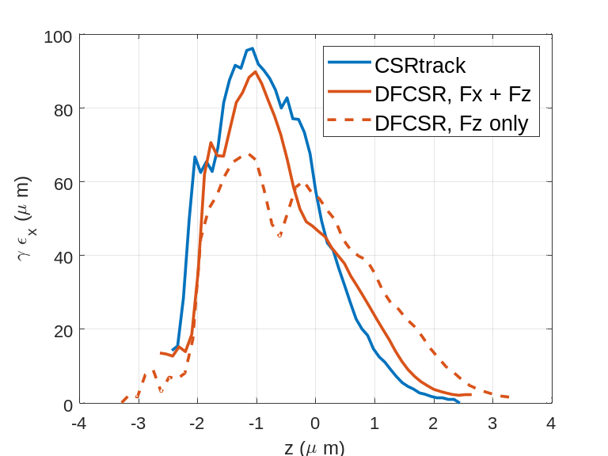
FACET-II Benchmark Chicane
DFCSR
CSRtrack

Slide 20
Outline
CSR Model and Algorithm
Benchmarks
  Dipole
  Berlin Benchmark Chicane
  FACET-II Benchmark Chicane
Computational Efficiency
An Example of Using Our Open-sourced Codes

Slide 21
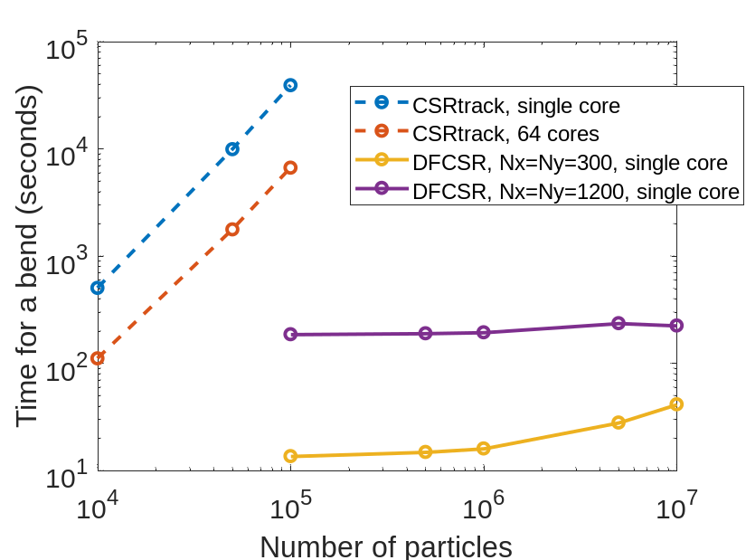
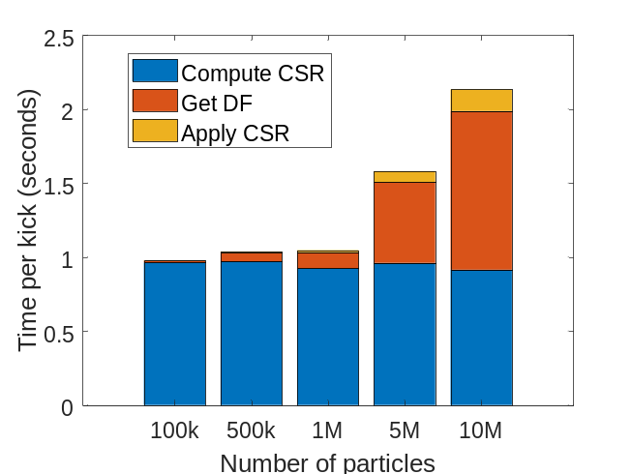
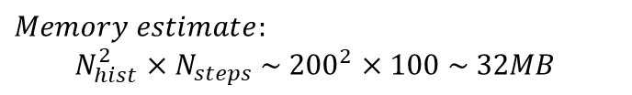
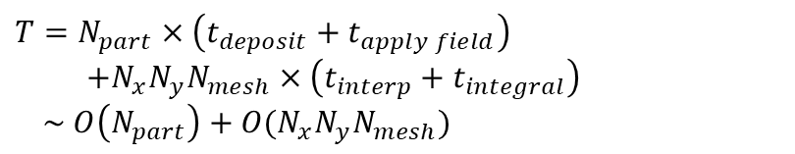
Computational Efficiency
$$T=N_{part}×\left(t_{deposit}+t_{apply field}\right)$$
$$+N_{x}N_{y}N_{mesh}×\left(t_{interp}+t_{integral}\right)$$
$\sim O\left(N_{part}\right)+O(N_{x}N_{y}N_{mesh})$
$$Memory estimate:$$
$$N_{hist}^{2}×N_{steps} \sim {200}^{2}×100 \sim 32MB$$

Slide 22
Outline
CSR Model and Algorithm
Benchmarks
  Dipole
  Berlin Benchmark Chicane
  FACET-II Benchmark Chicane
Computational Efficiency
An Example of Using Our Open-sourced Codes

Slide 23
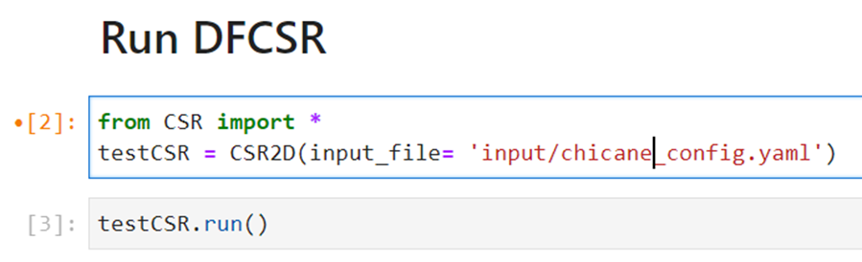
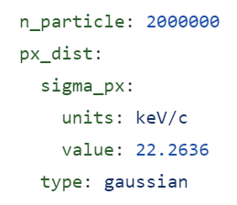
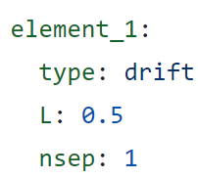
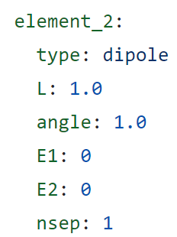
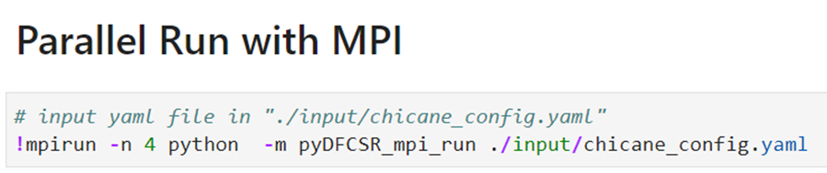
Open-sourced, user-friendly codes
Open-sourced codes in Python
https://github.com/slaclab/pyDFCSR
Input defined by human-readable yaml files
Single core or MPI parallel
input/init_beam.yaml
input/lattice.yaml
read from file or distgen

Slide 24
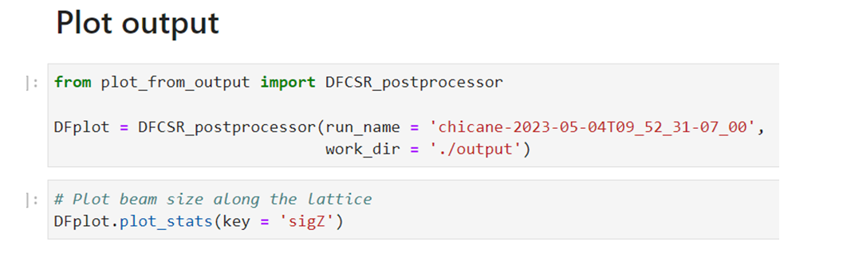
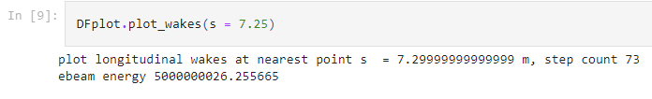

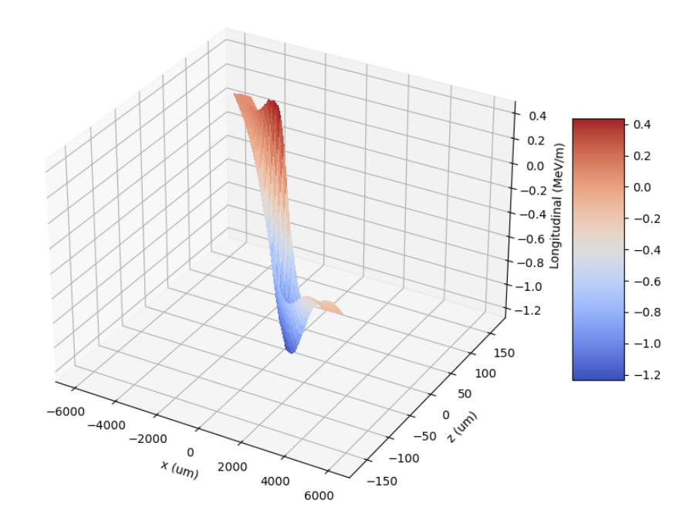
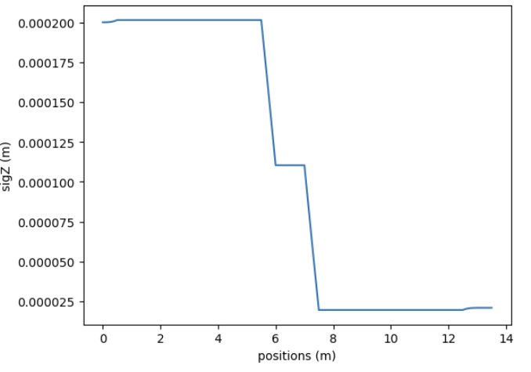
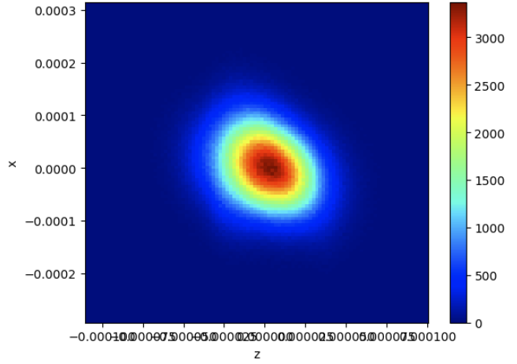
Open-sourced, user-friendly codes
Outputs in self-described hdf5 files
https://github.com/jy-tang/pyDFCSR/blob/main/pyDFCSR_2D/example.ipynb

Slide 25
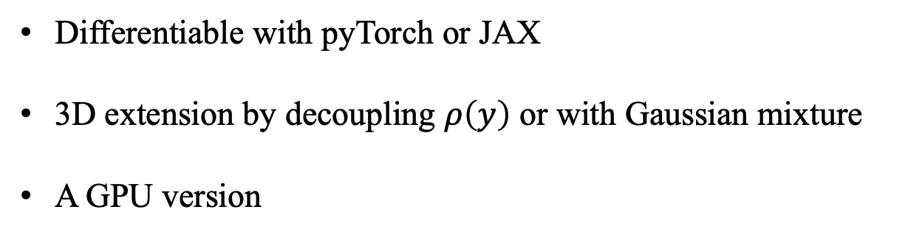
Future Work
Differentiable with pyTorch or JAX
3D extension by decoupling $ρ\left(y\right)$ or with Gaussian mixture
A GPU version

Slide 26
Thanks for your attention!

