Slide 2
Exotic Beams
David H. Dowell
SLAC
INJECTORS AND BEAM PHYSICS FOR FUTURE ACCELERATORS WORKSHOP
Sept. 14-15, 2026
Quantum Electron Beams
  It has been shown in electron microscopes and other high-quality electron sources that the electron’s wavefunction phase and amplitude can be manipulated to produce electrons with orbital angular momentum and modified internal structure. This involves altering the internal structure of the electron’s wave function itself rather than the distribution of a collection of electrons. These beams can potentially revolutionize FEL and UED science and applications. The challenge will be to generate these beams and preserve their properties while accelerating them to relativistic energy.

Slide 3
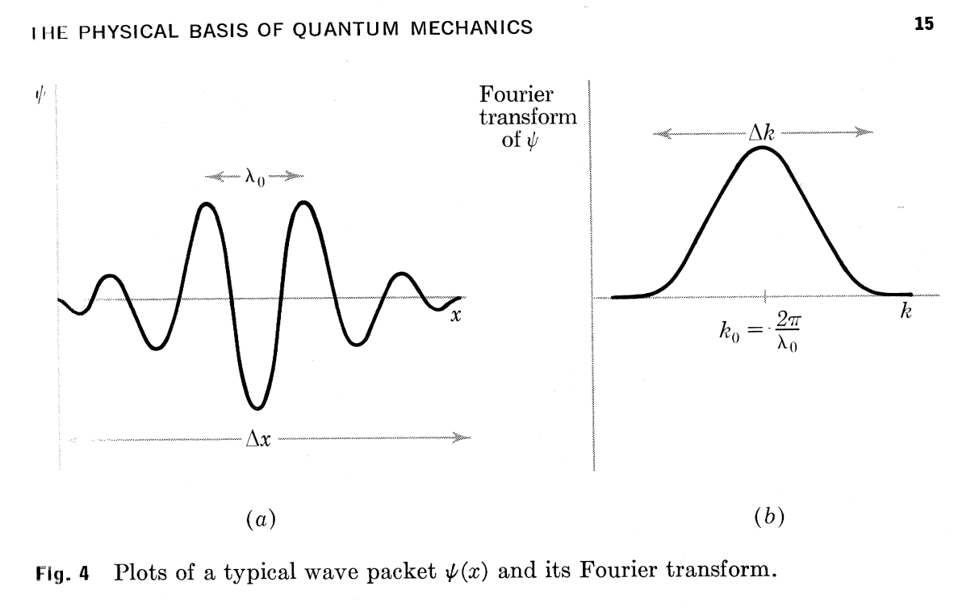
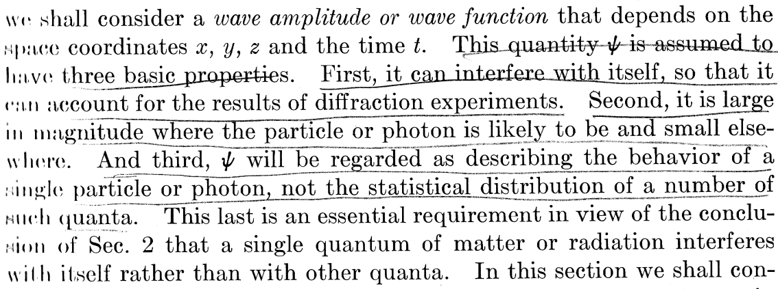
Basic Properties of the Quantum Wave Function
Quantum Mechanics, third ed., Leonard I. Schiff, McGraw-Hill, 1968

Slide 4
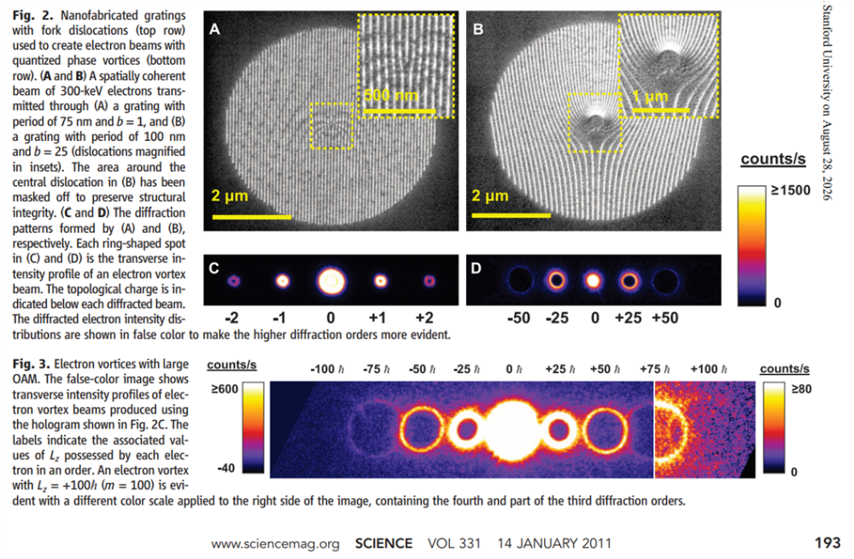
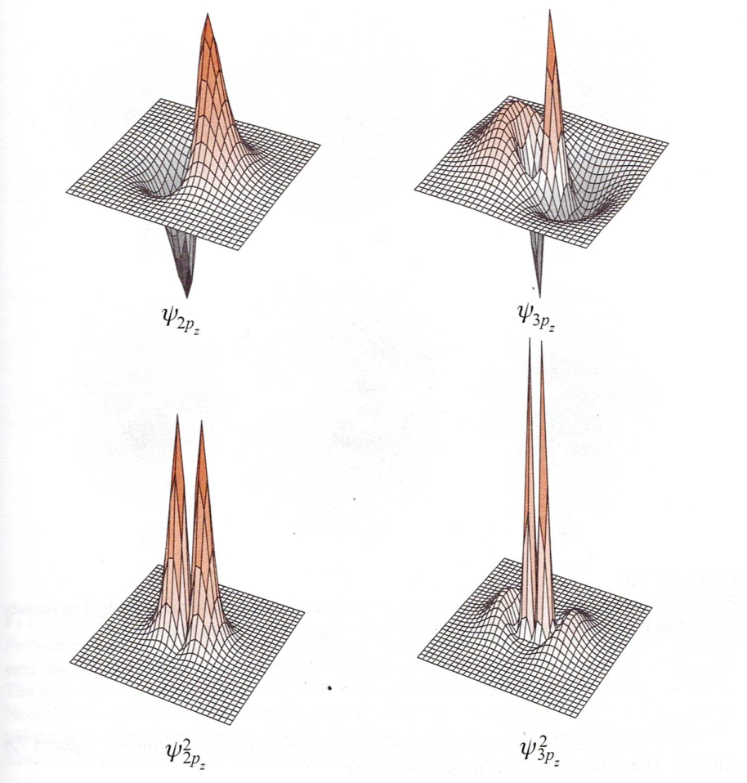
The shape of the electron’s wave function depends upon the type of the potential field interfering it.
Wave functions in Coulomb potential with electron bound to single proton of hydrogen atom
Free electron diffraction from ‘tuning-fork’ grating
wave function
(wave function)² = Probability function
(Quantum Chemistry by Donald A. McQuarrie,
University Science Books, 2007, p. 335)
(Electron vortex beams with high angular momentum, B.J. McMorran et al., Science vol 331, Jan 2011, p. 192.)

Slide 5
Producing, collimating and accelerating a pulse train of electron quanta with Orbital Angular Momentum (OAM)
Free electron diffraction from ‘tuning-fork’ grating
“Assuming a 1-nA, 300-keV electron beam with 0.3-eV energy spread, the longitudinal extent of an electrons wave packet along the optical axis is about 3 microns, whereas the average separation distance between consecutive electrons is 4 cm.” B.J. McMorran et al., ‘Electron Vortex Beams with High Quanta of Orbital Momentum’, Science Vol 331 (2011) p. 192.
Photoemission from rf gun is almost good enough for single electron if emission is from small laser spot (micron or less). Typical energy spread of photoelectrons is 0.1 to .2 eV and 0.025 eV for photo-thermal emission.
The problem will be reproducibility of each electron.
use a collimator to select the desired vortex orbital angular momentum
(Electron vortex beams with high angular momentum, B.J. McMorran et al., Science vol 331, Jan 2011, p. 192.)

Slide 6
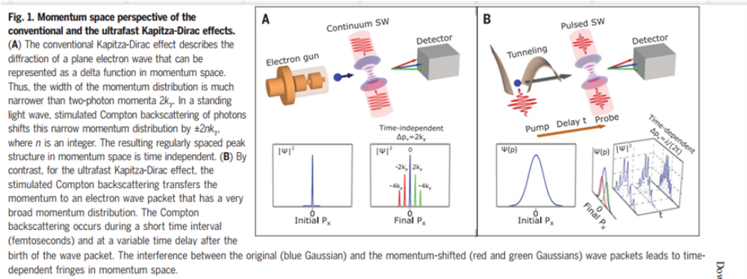
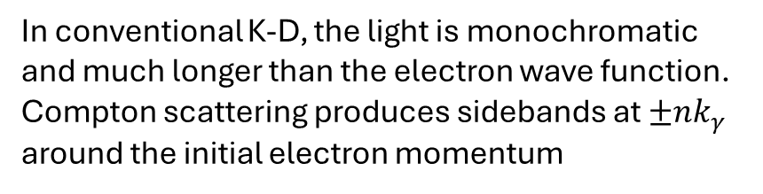
Comparison of conventional Kapitza-Dirac and ultrafast Kapitza-Dirac phenomena
Conventional Kapitza-Dirac effect: small momentum spread, long electron pulse
ultrafast Kapitza-Dirac effect: broadband (large momentum spread), short electron pulse
(K. Lin et al., Science Vol 383, Issue 6690, p. 1467)
In conventional K-D, the light is monochromatic and much longer than the electron wave function. Compton scattering produces sidebands at $±{nk}_{γ}$ around the initial electron momentum
In ultrafast K-D, the photon is short (large momentum spread)
compared to the electron wave function. Compton scattering momentum shifts the wave function which interferes with the original wave function. Resulting in time-dependent fringes in momentum space.

Slide 7
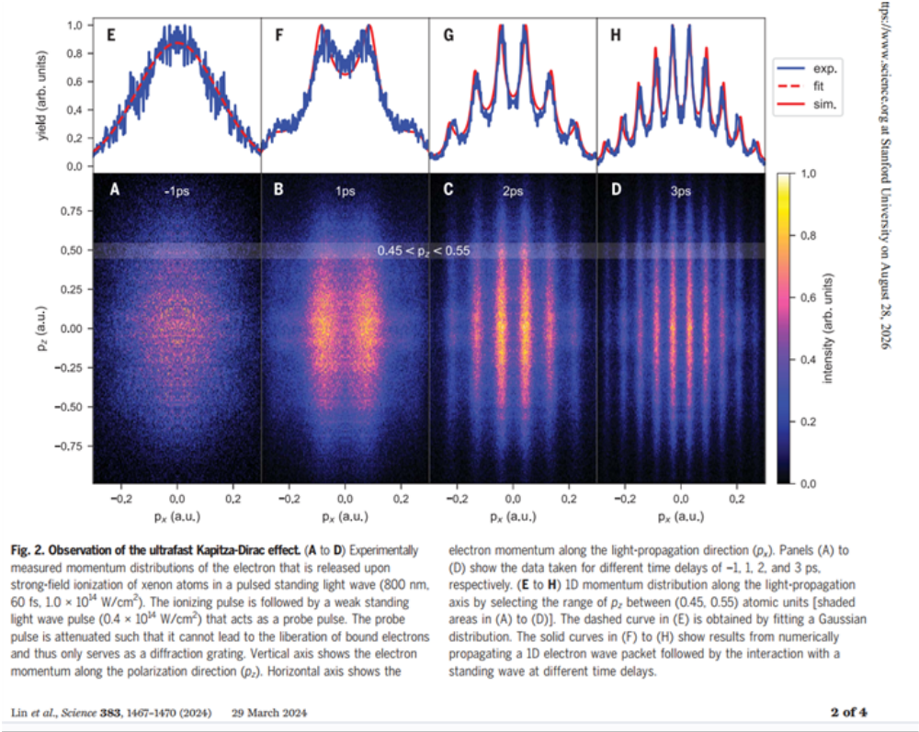
Demonstration of ultrafast Kapitza-Dirac effect
(K. Lin et al., Science Vol 383, Issue 6690, p. 1467)

Slide 8
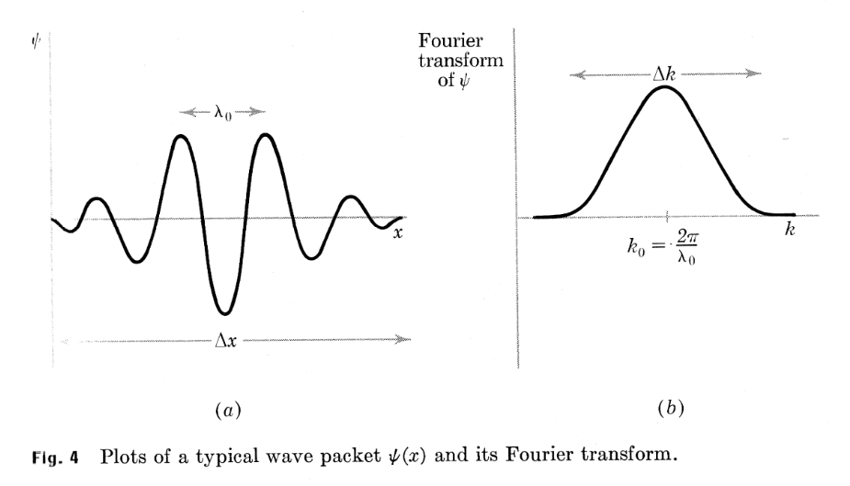
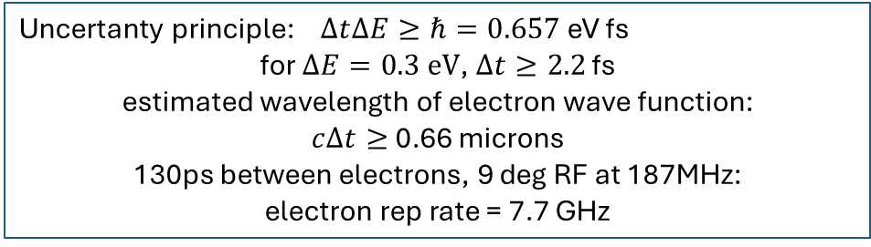
Making a beam with a pulse-train of wave functions
“Assuming a 1-nA, 300-keV electron beam with 0.3-eV energy spread, the longitudinal extent of an electrons wave packet along the optical axis is about 3 microns, whereas the average separation distance between consecutive electrons is 4 cm.” B.J. McMorran et al., ‘Electron Vortex Beams with High Quanta of Orbital Momentum’, Science Vol 331 (2011) p. 192.
Uncertanty principle: $∆t∆E≥ℏ=0.657$eV fs
for $∆E=0.3 eV$, $∆t≥2.2$ fs
estimated wavelength of electron wave function:
$c∆t≥$ 0.66 microns
130ps between electrons, 9 deg RF at 187MHz:
electron rep rate = 7.7 GHz
3-micron long electron wave function every 4 cm (~130ps) on average!
4 cm
The current can be increased by reducing the distance between electrons.
Will separate electron wave functions interfere as the spacing is decreased?
  Hartree-Fock theory for many-body Fermi systems.
  Theory of soliton scattering.

Slide 9
Possible Applications
UED spectroscopy
  Current pump-probe experiments are limited to states accessible with a photon (usually dipole) or to heating the sample and watching it cool with electron diffraction.
  In experiments using structured electrons with high orbital angular momenta (OAM), the structured electrons would be the pump, exciting the sample to a high spin state which would be probed (sampled) by either a second UED pulse or a photon.
Dependence of scattering cross section on angular momentum. Structured electrons would preferentially excite high spin states in the sample compared to mostly dipole transitions by photons.
Spontaneous and stimulated emission properties of high OAM structured electron wave functions. Revisit Madey’s and Bill Colson’s original theories.
Could this make a quantum fel? Contact Brian McNeil about Bonifacio’s quantum fel theory.
Studies of exotic beam generation and preservation with ultrafast lasers at FACET and future UED facility
  Demonstrate acceleration of quantum beams to high energy.
  Tests of diffraction electron beam diagnostics from 6 to 135 MeV.
  Shape electron beam at high energy. (A. Konecna et al., ‘Electron Beam Aberration Control Using Optical Near Fields’, Phys. Rev. Let. 125,030801 (2020)).
  FACET is already/easily connected to existing fels.
  Optimal UED facility would be to build NEXUS, the new MEV-UED source proposed by Theo Vecchione, at SLAC’s NLCTA facility. Opportunity to develop UED applications and exotic beams together, without disturbing the current SLAC UED program.

Slide 10
Responses to one-page questionnaire sent to attendees
Future of FELs is oscillators at wavelengths down to x-rays. There is also the possibility of SASE at ever high photon energies and shorter (zeptosecond, nuclear reaction time) pulse lengths.
The development of xFEL oscillators will require high-brightness and short bunches at high repetition rate.
The next great advancement in electron beams for UED and FEL’s will involve manipulating or structuring each electron’s wavefunction as well as the overall distribution of electrons in the beam.
Structuring electrons involves modifying the quantum wave function of the electron itself rather than the distribution of a collection of electrons. It’s important to understand how many of the structured electrons can be combined into a beam without destroying their structure.
A ‘tuning-fork’ phase mask diffracts electrons into orders of orbital angular momentum. The desired orbital angular momentum can be selected and accelerated to high energy. (Electron vortex beams with high angular momentum, B.J. McMorran et al., Science vol 331, Jan 2011, p. 192.)
It is now possible to use a ‘laser phase plate’ instead of the physical ‘tuning-fork’ mask. This opens the possibility of diffracting the electrons at high energy to preserve the beam quality.
What is the space charge field and spin-orbit forces like for a string of structured electrons with orbital angular momentum?
A very short (<60fs) laser pulse can modulate the time and space dependence of the wave function via the ultrafast Kapitza-Dirac effect. (K. Lin et al., Science Vol 383, Issue 6690, p. 1467).
Robust and fast temporal control of photoemission using a plasmonic metamaterial time crystal (Plasmonic metamaterial time crystal, T. Guo et al., Nature, Vol 656, (2026) p. 343).
Theoretical studies of structured electrons:
  How are structured electrons best applied to FELs and UED?
  Best means of producing and measuring an electron’s wave function
  Interaction of ensembles of structured electrons in a bunch
Investigate diffraction and interferometric diagnostics for emittance and coherence at FACET.
Challenges for FACET:
  Generate, preserve and accelerate bunches of structured electrons with long coherent lengths to high energy.
  Laser shaping and trimming of the electron bunch at high energy. (Transverse Electron-Beam Shaping with Light, M. Mihaila et al., Phys. Rev. X12, 031043 (2022)).
  Determine the coherent part of a photobeam from a rf gun.
  Combine incoherent and coherent diagnostics
    Coherent optical transition interferometry
Optimal UED facility would be to build NEXUS, the new MEV-UED source proposed by Theo Vecchione, at SLAC’s NLCTA facility. Opportunity to develop UED applications and exotic beams together, without disturbing the current SLAC UED program.

Slide 11
The End

