Slide 1
Laser pulse shaping
SLAC National Accelerator Laboratory
Donny Magana
09/14/2026

Slide 2
Motivation
Flexible shaping architecture — capable of synthesizing arbitrary temporal profiles (flat-top, ramped, ellipsoidal-approximation)
Fine, programmable control — ability to finetune the pulse shape to pre-compensate for nonlinear distortion through SHG/FHG
Sufficient conversion efficiency — end-to-end 1030 nm → 257.5 nm transformation delivers up to 100 nJ at the cathode

Slide 3
Requirements and Specifications for the laser shape
Requirement | Specification
Arbitrary temporal shaping | Synthesize programmable temporal profiles (flat-top, ramped, ellipsoidal-approx.)
Shape fine-tuning / resolution | Adjustable rise/fall time and ripple control to pre-compensate SHG/FHG distortion
UV energy at cathode | ≥ 100 nJ at 257.5 nm
Wavelength | 257.5 nm (4ω of 1030 nm)

Slide 4
Proposed design
Adapted from established Ti:Sapphire pulse-shaping architecture
Oscillator output from collimated and sent to the stretcher
Stretch the oscillator pulse → lowers peak intensity for safe amplification (CPA-style)
Gain Shape the temporal intensity profile with a liquid-crystal SLM + polarizer amplitude modulator
Pre-amplify the low-energy shaped pulse (100 pJ) → 1 nJ (low-gain stage)
Power-amplify → µJ level (high-gain stage)
Harmonic conversion 1030 → 515 → 257.5 nm (LBO SHG, BBO FHG)
Stretch/format to final ~15 ps at the cathode
Oscillator
Stretcher
Gain Shaping
Pre Amplifier
Pulse Stretch
FHG
SHG
Amplifier

Slide 5
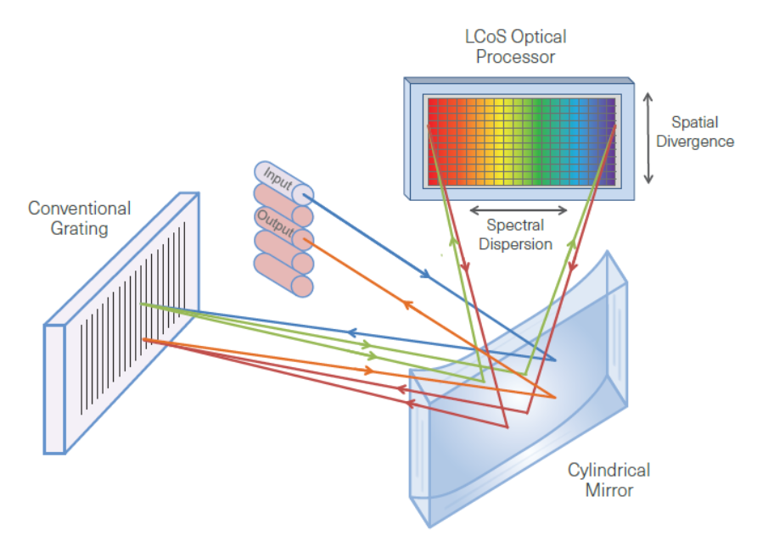
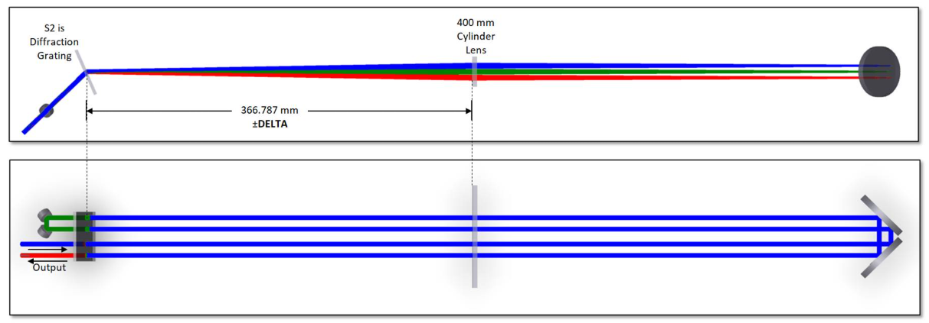
Pulse shaping the oscillator
Shaping must occur early, at low power, in the Fourier plane
Damage constraint: the LCoS (Liquid Crystal on Silicon ) SLM handles only low power — shaping must occur before amplification, or the device is damaged
Placement: the LCoS sits at the Fourier plane of the stretcher, where the spectrum is spatially dispersed
Mechanism: spatially-resolved amplitude modulation of the spectrum → synthesizes the desired temporal profile
Consequence: the oscillator/pre-amplifier stage is the only place (with current technology) to imprint an arbitrary shape
NEW WaveShaper instruments for the U- and Super C-bands | Starvoy Technologies

Slide 6
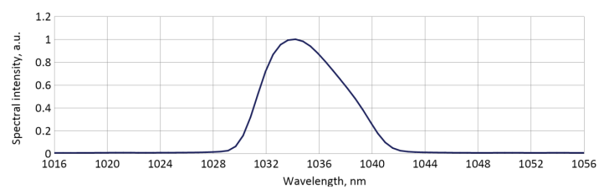
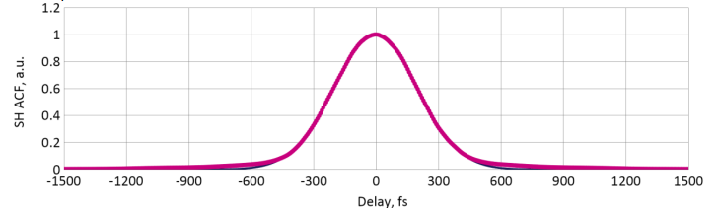
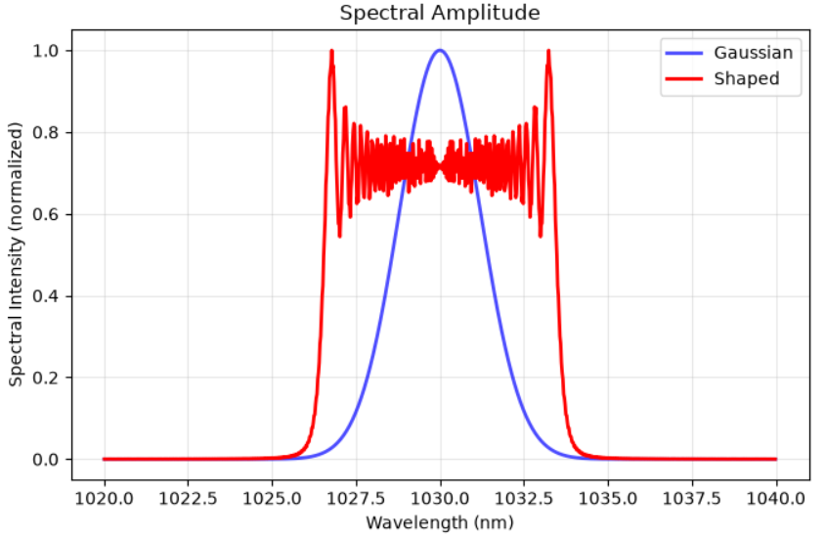
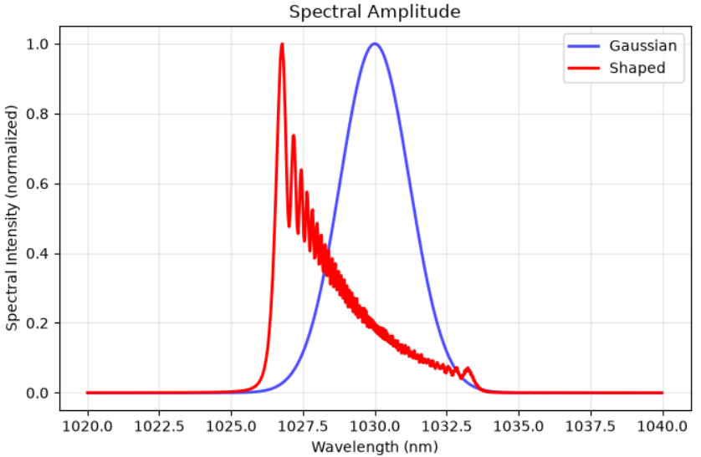
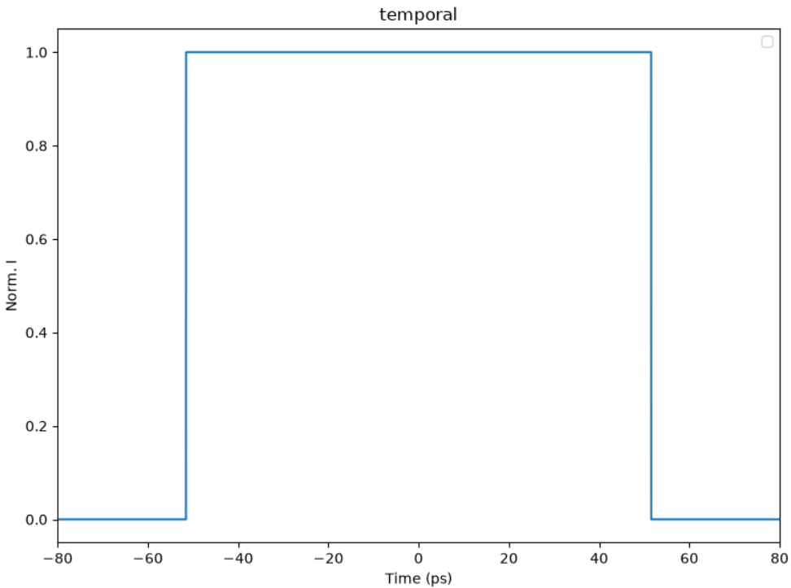
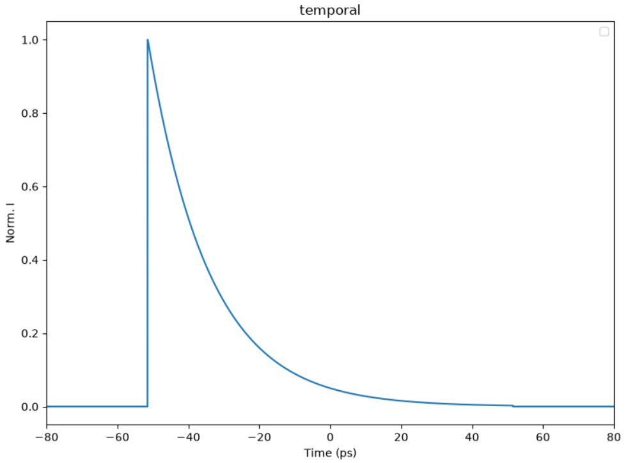
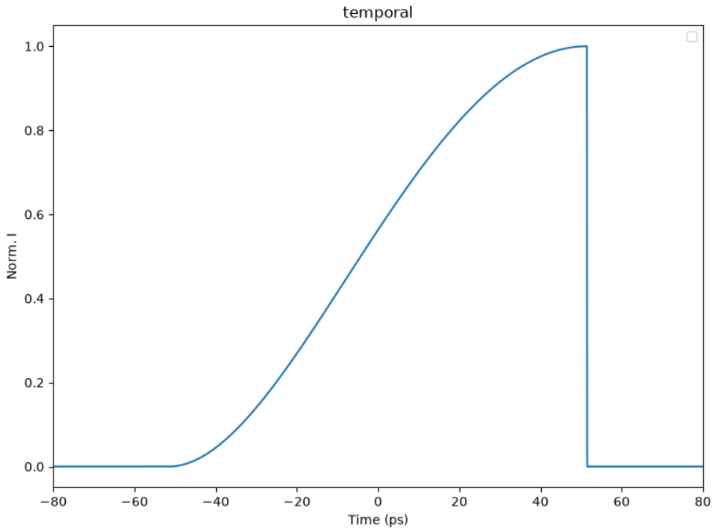
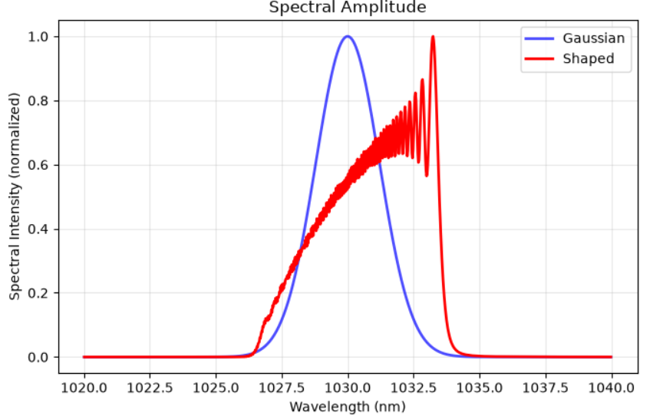
Laser model
Oscillator
Take the output from an oscillator and into the stretcher which stretches the pulse to prevent damage in the laser amplifier and shapes it to the desired shape, All the simulations are in the Infrared (fundamental wavelength

Slide 7
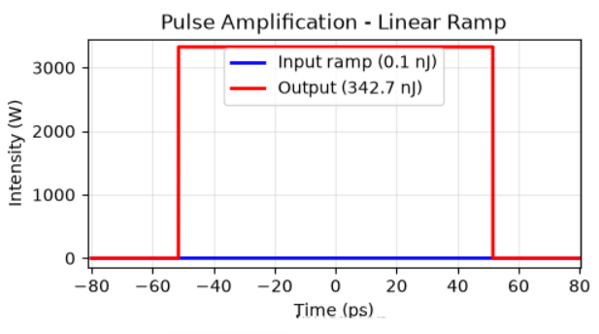
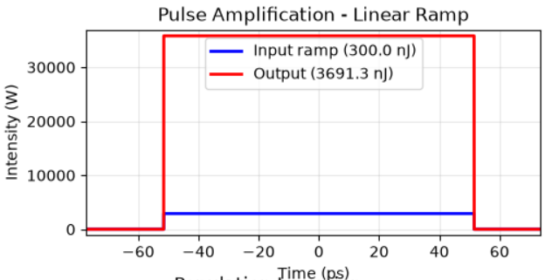
Pulse shape simulation
Model
Pulse after amplification
Mask generation and fiber amplification
Simulation includes:
The phase of the stretched pulse
Population rate equations
forward signal propagation, Gain, and pump propagation
Mask design: start from the oscillator's Gaussian spectrum as the baseline; apply an amplitude mask in the Fourier plane to sculpt it into the target profile
Stage 1 — Preamplifier: 30 µm core, 1.8 m Yb:fused-silica fiber (commercial) → amplify to > 300 nJ
Stage 2 — Power amplifier: 85 µm core large-mode-area fiber, multi-pass → amplify to target energy (µJ level)

Slide 8
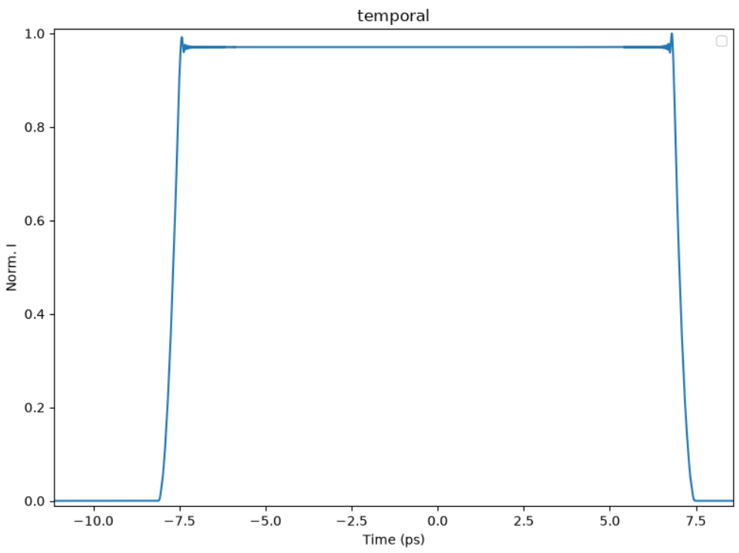
Second Harmonic generation
LBO second harmonic
Noncritical phase matching (NCPM) preserves the temporal and spatial profile
Broad acceptance bandwidth: NCPM (θ = 90°) gives a large spectral acceptance → the full pulse spectrum converts efficiently → temporal shape preserved
Zero (or minimal) spatial walk-off: fundamental and harmonic stay spatially overlapped → spatial profile preserved, no additional spatial shaping needed
Simulation coupling: output of the amplifier simulation (temporal profile + accumulated spectral phase) feeds directly as input to the harmonic-generation simulation
Simulation: uses a symmetric split-step with an RK45 integrator

Slide 9
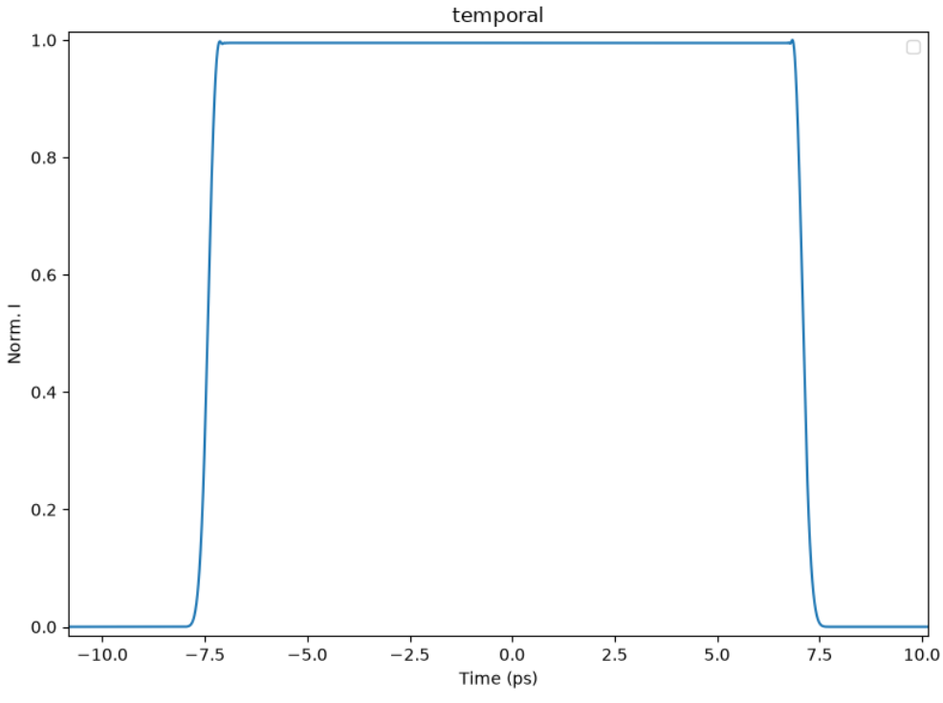
Fourth harmonic generation
Few choices for the crystal at this wavelength CLBO and BBO
Fourth harmonic generation: distortion is characterized and pre-compensated
FHG (BBO, 515 → 257.5 nm) applies the strongest nonlinear reshaping (∝ I⁴ relative to fundamental) → mask pre-compensation targets the final UV profile, not the IR
Simulation includes conversion nonlinearity, phase mismatch, and GVM/walk-off in the crystal
Conversion efficiency > 3% (normally get ~5%) (IR → 4ω), consistent with typical FHG efficiencies for this configuration
Result: shaped UV profile at 257.5 nm meets target within [tolerance] after pre-compensation

Slide 10
What is next
Laser
Harmonic generation
Several existing pulse shapers can be adapted to imprint the arbitrary stretched profile
Existing amplifier chains can be modified to accept and amplify the shaped input
Significant development effort still required to integrate shaping + amplification while preserving profile fidelity
Design reuses crystal lengths from current/proven configurations → low risk, leverages existing hardware
Need dedicated resources to work on this project

