Slide 1

FCC-ee linac design and synergies with FACET-II
S. Bettoni, A. Latina
WP1: A. Grudiev¹, S. Bettoni², P. Craievich², S. Doebert¹, A. Latina¹, J.-Y. Raguin², P. M. Reviriego¹, R. Zennaro²
SLAC collaboration contact person: B. O’Shea³
^{1 CERN}
^{2 Paul Scherrer Institute}
^{3 SLAC}
Injectors and Beam Physics for Future Accelerators, SLAC, 14th September 2026

Slide 2
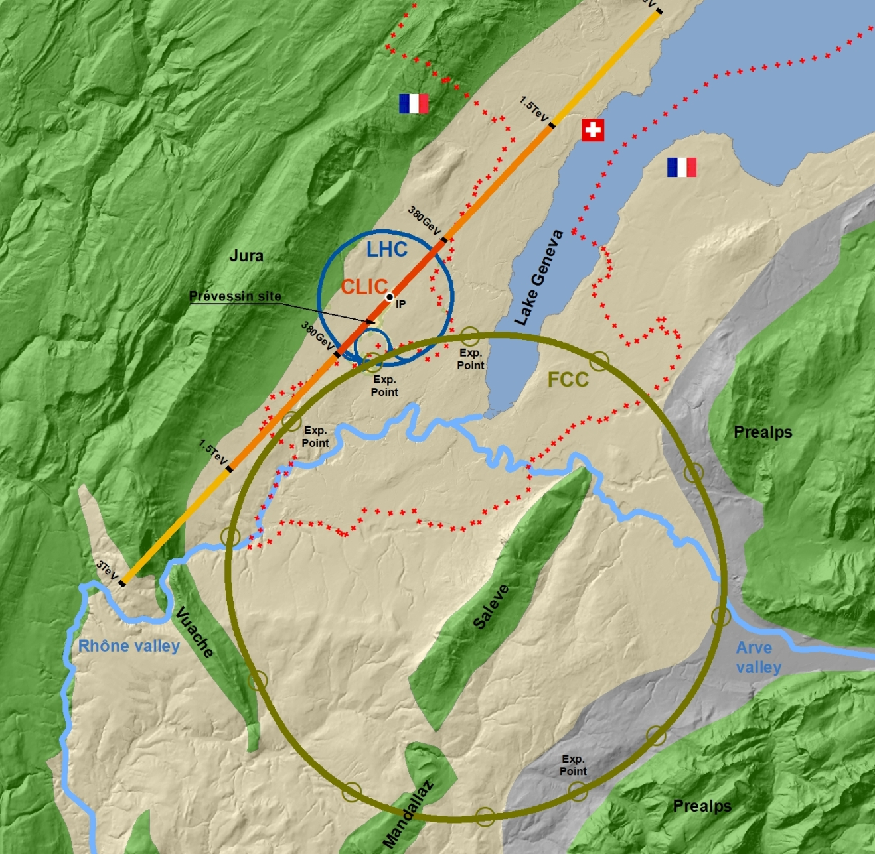
Outlook
FCCee injector: focus on the high energy linac
  Design strategy
  Results
Possible experiments at FACET-II:
  Done
  To be done
  Under investigation
Conclusions and outlook

Slide 3
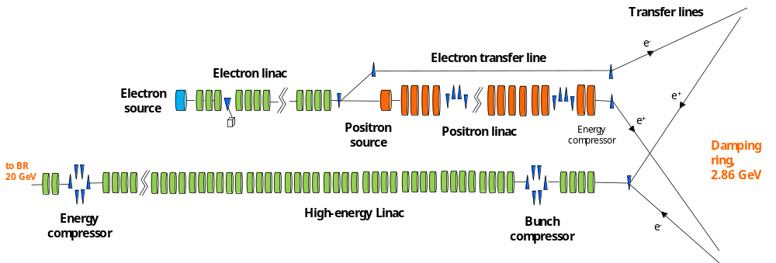
The FCCee injector layout: focus on the high energy linac
 | Initial (@ DR) | Final (@ TL to booster)
Normalized (ε_{x},ε_{y}) (mm.mrad) | (10,1) | <(20,2)
Energy spread (%) | 0.7 | 0.7→0.1
Bunch length (mm) | ~5-7 | 4
Jitter amplification (final) | -- | <2
Jitter amplification (along linac) | -- | <1.5
Special requirement | Vary the bunch charge from “0” nC to 5 nC

Slide 4
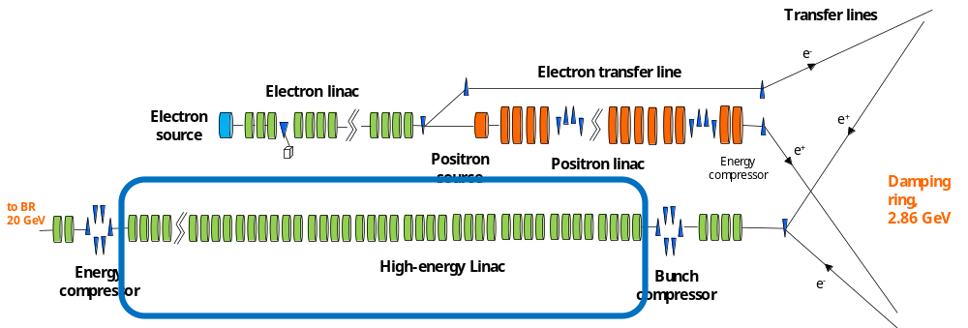
FODO sections

Slide 5
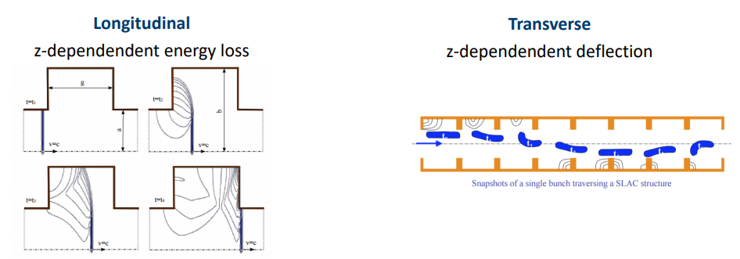
Wakefields along the linac
Wakefield
Longitudinal
Static
Emittance growth due to components alignment
Static
Dynamics
Amplification of angle/orbit jitter
Transverse
Impact on the energy spread
Short range wakefield → single bunch effects
Long-range wakefield → multi-bunch effects
Optimization/mitigation
Goals
Optics along the linac: kind of lattice, phase advance/cell, distance among quadrupoles
Beam parameters: bunch length
Machine components parameters: RF structures operating phase and length
Steering algorithms: one-2-one, DFS, WFS
Minimize the projected emittance growth
Maintain orbit stability
Maximize transport efficiency
Considered wakefield sources: RF structure and resistive wall

Slide 6
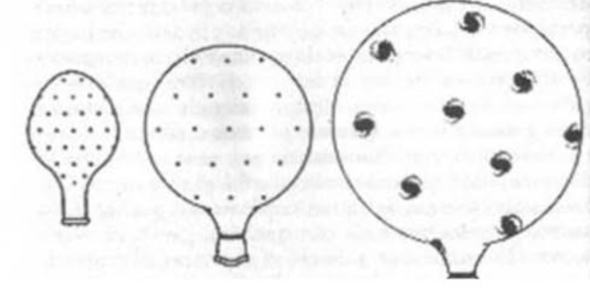
Static effects
Mitigation of the emittance growth

Slide 7
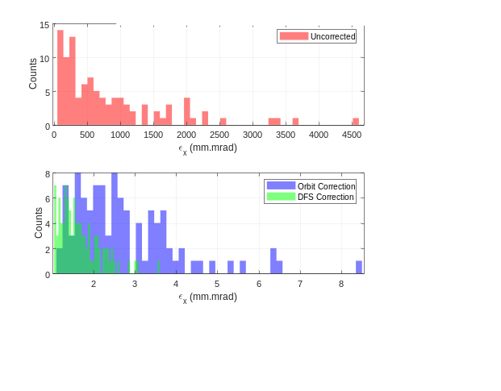
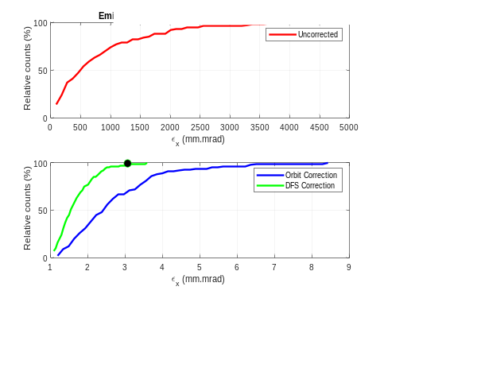

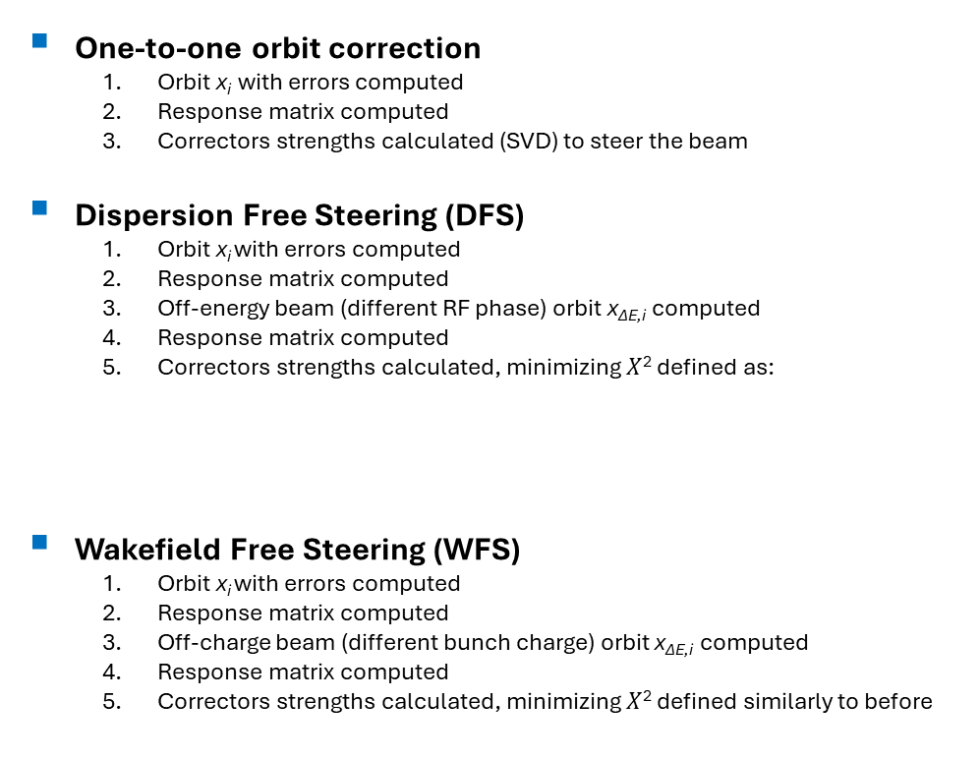
Static effects: assumptions and procedures
Imperfections
(expectations from SwissFEL)
Quadrupoles
Offset x, y = 100 μm rms
Gaussian distribution
RF cavities
Offset x, y = 100 μm rms
Gaussian distribution
BPM
Offset x, y = 30 μm rms
Resolution x, y = 10 μm
Gaussian distributions
Steering algorithms
  Taken emittance at 90% of the “good seeds”
One-to-one orbit correction
  Orbit x_{i} with errors computed
  Response matrix computed
  Correctors strengths calculated (SVD) to steer the beam
Dispersion Free Steering (DFS)
  Orbit x_{i} with errors computed
  Response matrix computed
  Off-energy beam (different RF phase) orbit x_{ΔE,i} computed
  Response matrix computed
  Correctors strengths calculated, minimizing $X$² defined as:
Wakefield Free Steering (WFS)
  Orbit x_{i} with errors computed
  Response matrix computed
  Off-charge beam (different bunch charge) orbit x_{ΔE,i} computed
  Response matrix computed
  Correctors strengths calculated, minimizing $X$² defined similarly to before
Distribution of the final emittances (100 seeds)
Cumulative sum distribution of the final emittance

Slide 8
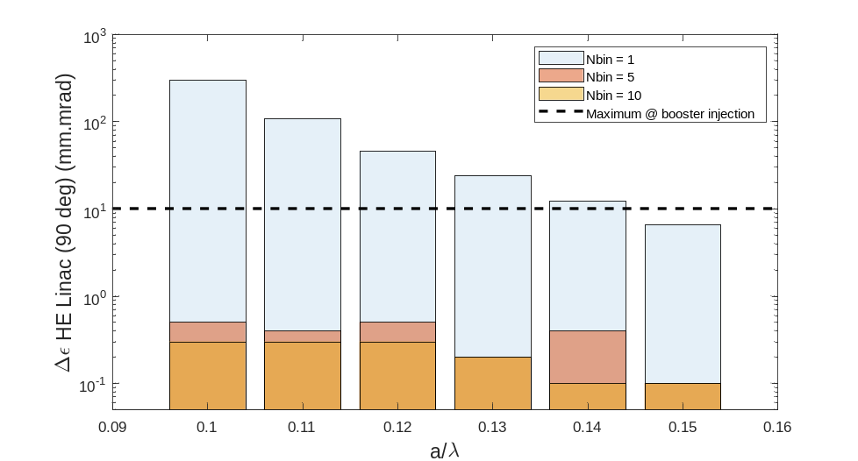
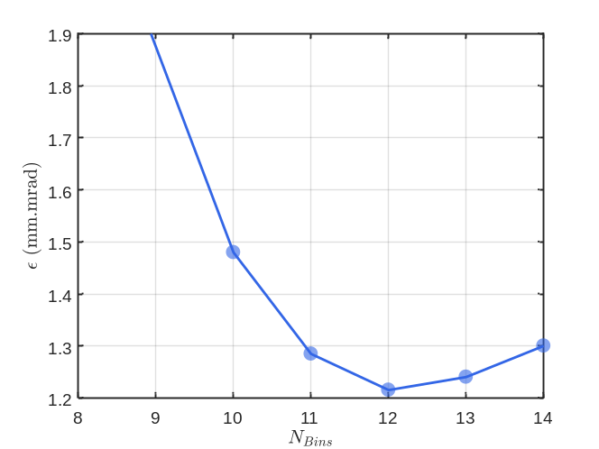
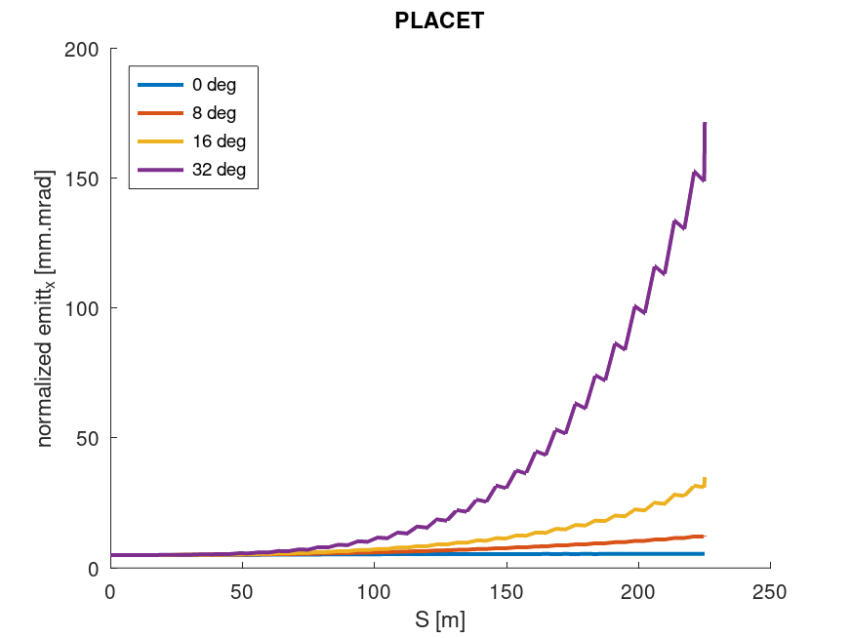
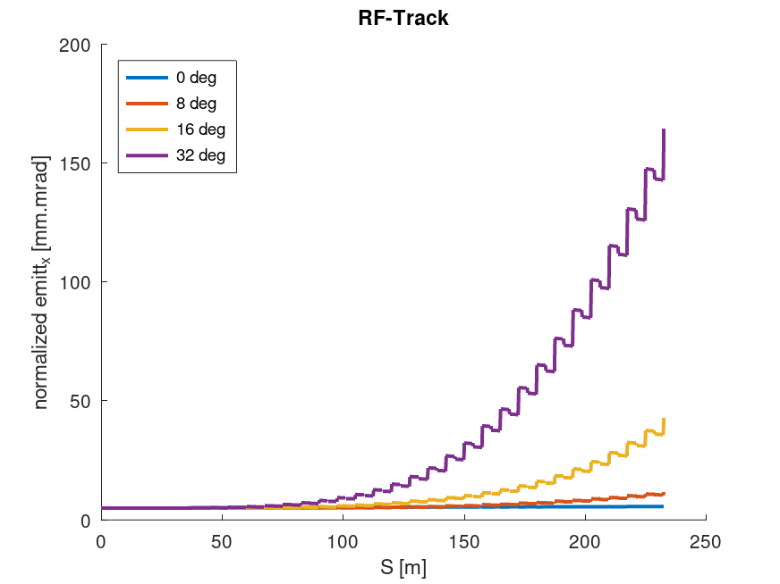
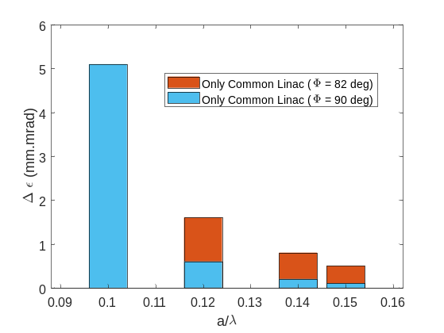
Heritage from the different designs
Investigated several designs → learning from one to the other one
Optimum splitting of the linac in sub-sections → better beam quality (avoid residual error propagation)
Linac “binning”
Best beam quality for on-crest operation
Chirp for the bunch decompression necessary for the downstream sections
(Maximum energy gain)
On-crest operation

Slide 9
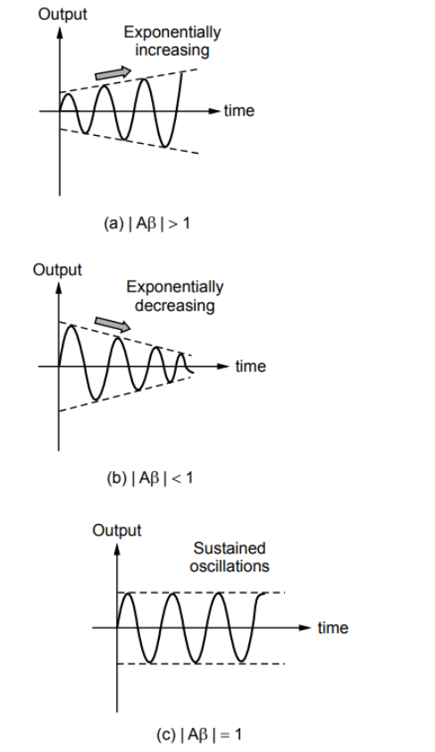
Amplification
Dynamic effects
Damping
Not amplify or even better damp any orbit jitter
Stability

Slide 10
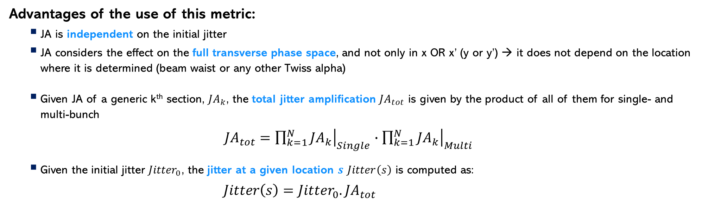
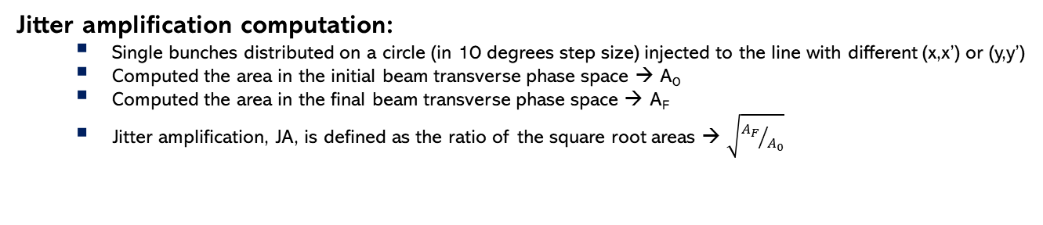
“Painting” of the transverse phase space and jitter
Bunch
x’
Approach already applied to the CLIC design
Jitter amplification computation:
  Single bunches distributed on a circle (in 10 degrees step size) injected to the line with different (x,x’) or (y,y’)
  Computed the area in the initial beam transverse phase space → A₀
  Computed the area in the final beam transverse phase space → A_{F}
  Jitter amplification, JA, is defined as the ratio of the square root areas → $\sqrt{{A_{F}}/{A_{0}}}$
x
Advantages of the use of this metric:
    JA is independent on the initial jitter
    JA considers the effect on the full transverse phase space, and not only in x OR x’ (y or y’) → it does not depend on the location where it is determined (beam waist or any other Twiss alpha)
    Given JA of a generic k^{th} section, ${JA}_{k}$, the total jitter amplification ${JA}_{tot}$ is given by the product of all of them for single- and multi-bunch
    ${JA}_{tot}={\left.\prod_{k=1}^{N}{{JA}_{k}}\right|}_{Single}∙{\left.\prod_{k=1}^{N}{{JA}_{k}}\right|}_{Multi}$
    Given the initial jitter ${Jitter}_{0}$, the jitter at a given location $s$ $Jitter\left(s\right)$ is computed as:
    $Jitter\left(s\right)={Jitter}_{0}.{JA}_{tot}$

Slide 11
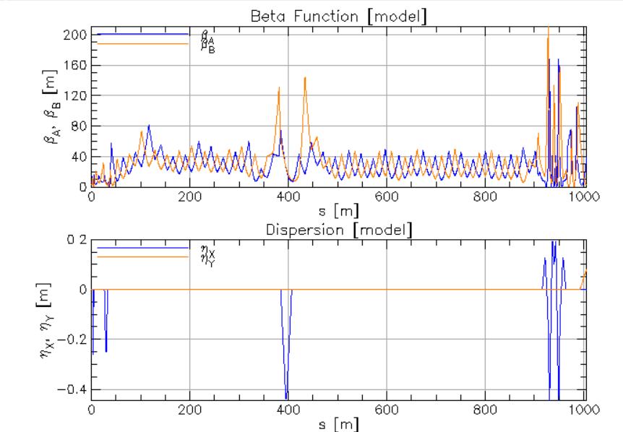
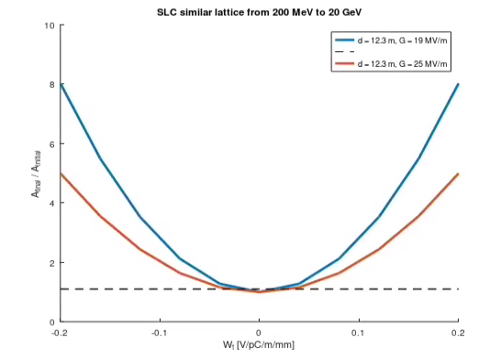
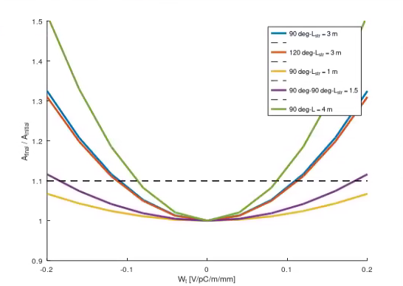
Dynamic: example of dependences
Save cost and simplify → less quadrupoles → more spacing among the quadrupoles
→ weaker for Beam Break Up instability
SLC design: several quadrupoles spacing along the different sections
Large quads separation lattice for FCCee HE linac
Closer quads lattice for FCCee HE linac
FACET lattice (former central sections of SLC)

Slide 12
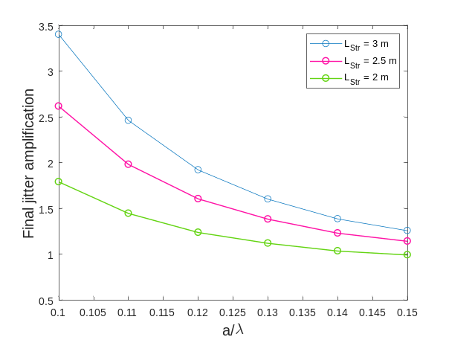
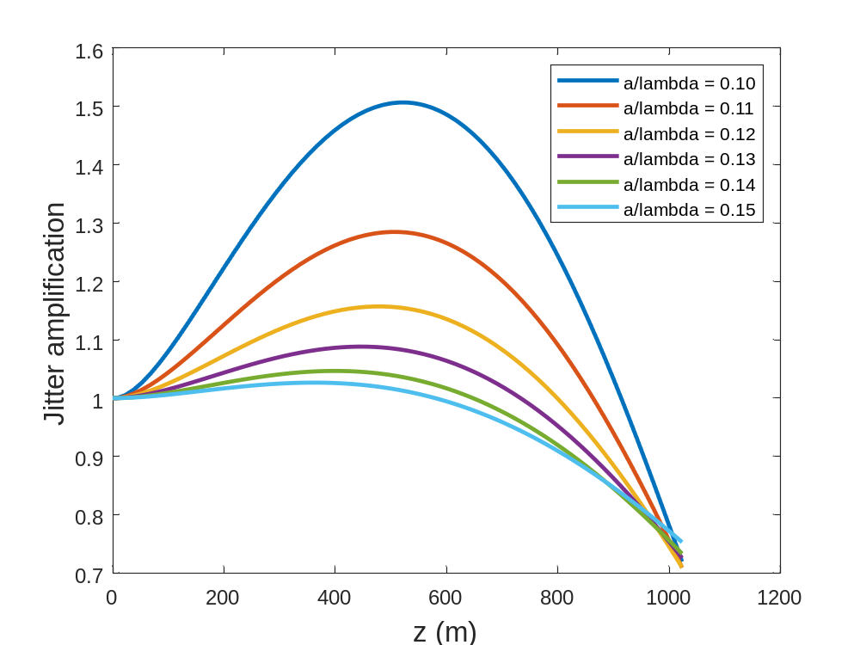
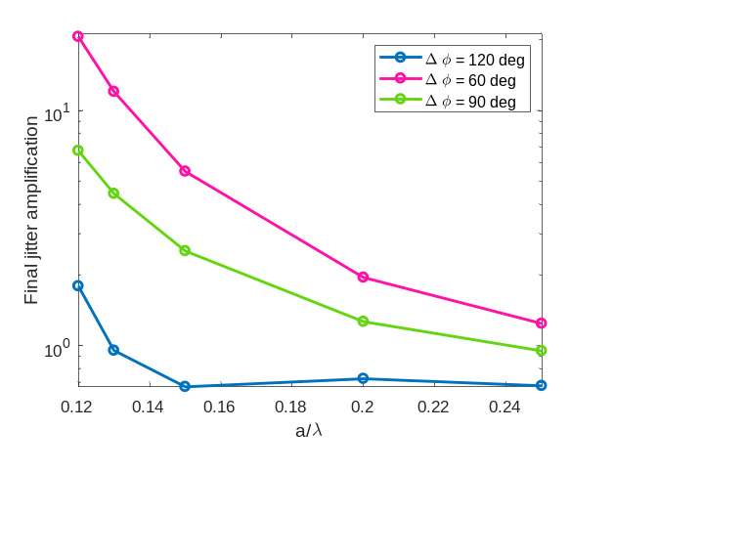
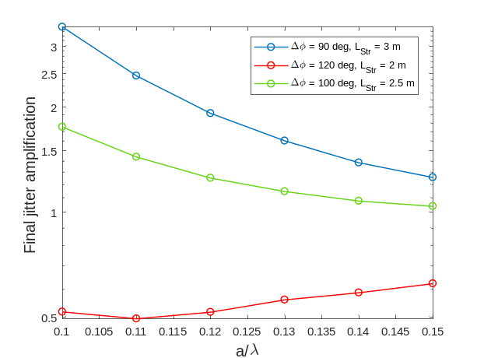
Dynamic: single-bunch
The HE linac is optimized to damp any incoming beam transverse jitter!
Amplification
Damping
Optimized parameters:
    “Kind” of lattice (number of quads/RF structure)
    Bunch length
    RF structure aperture and length
    Quadrupoles spacing
    Length of the RF structures
    Phase advance per cell
    Combination of the parameters
Essential to experimentally verify this effect
page 12

Slide 13
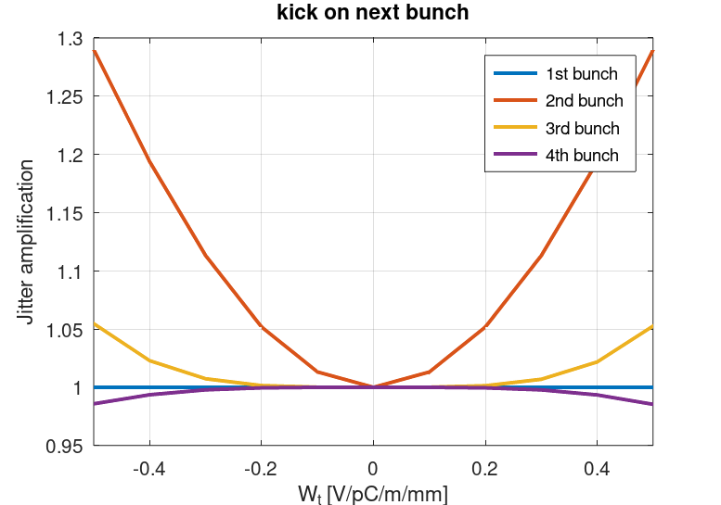
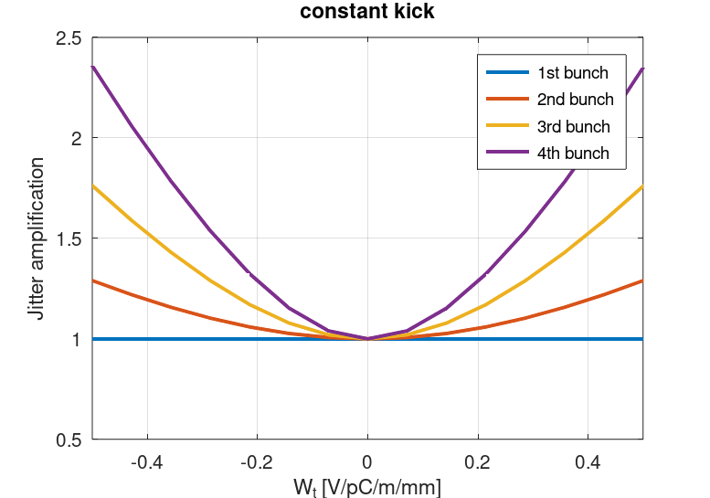
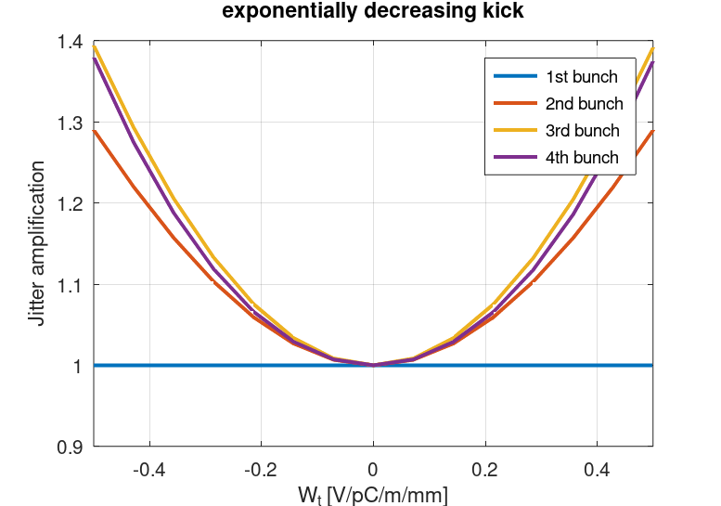
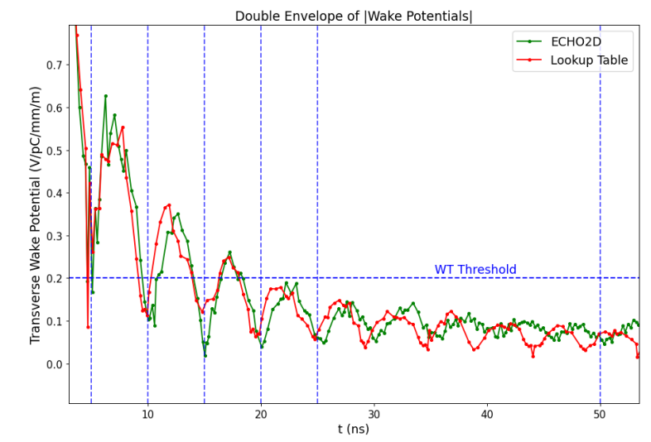
Dynamic: multi-bunch effects
Courtesy of A. Latina, A. Grudiev, A. Kurtulus
Considered three wakefield kick scenarios:
  Kick on the next bunch (simulates damping)
  Constant kick (pessimistic scenario)
  Exponentially decreasing kick (simulates detuning)
Detuning was chosen as a mitigation technique for the damping of HOMs and was found to be highly effective.
No multi-bunch limitation was found for bunch spacings of 25 ns with the baseline 3 GHz structure with iris aperture of a/λ = 0.12.
ECHO2D simulations show recoherence appearing at t ≥ 100 ns, which manifests as an increase in the jitter amplification for bunch spacings ≥ 30 ns.

Slide 14
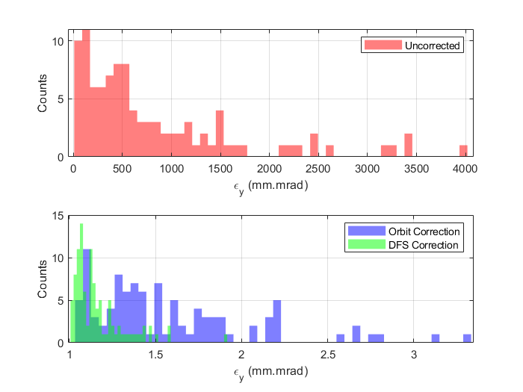
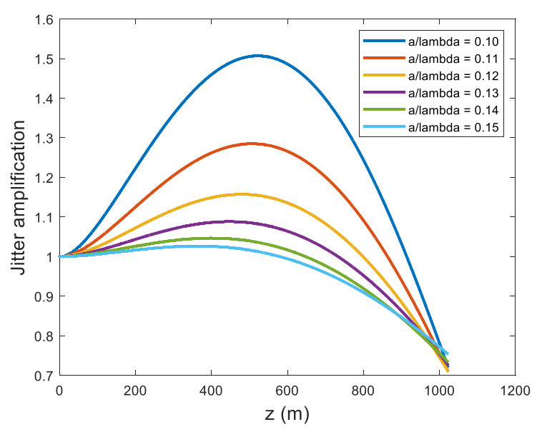
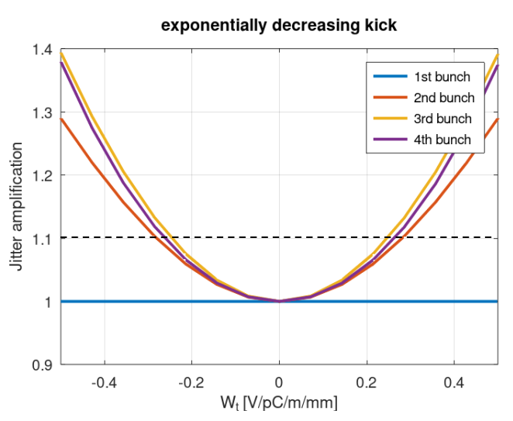
The zoo of the effects: optimize what by what?
Overall design: single bunch effects
Multi- bunch effects
Static effects: Emittance growth
Dynamic effects: Jitter amplification
Aperture and length of the RF structure, lattice
Wake suppression
Main results are based on RF-Track with some benchmarks with other codes

Slide 15
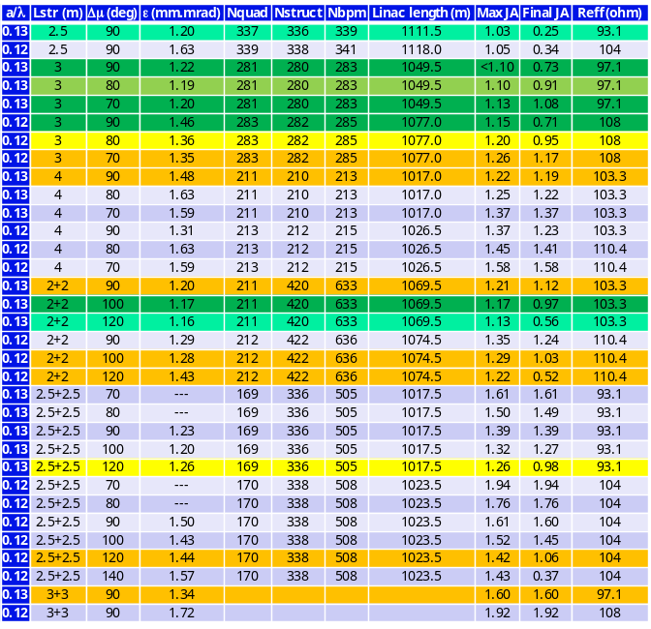
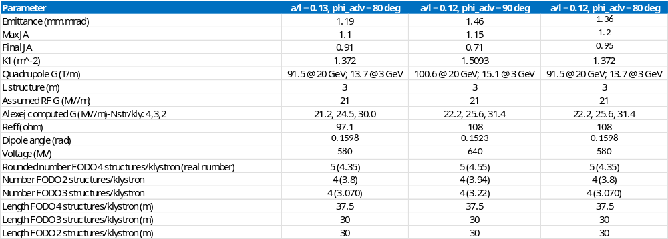
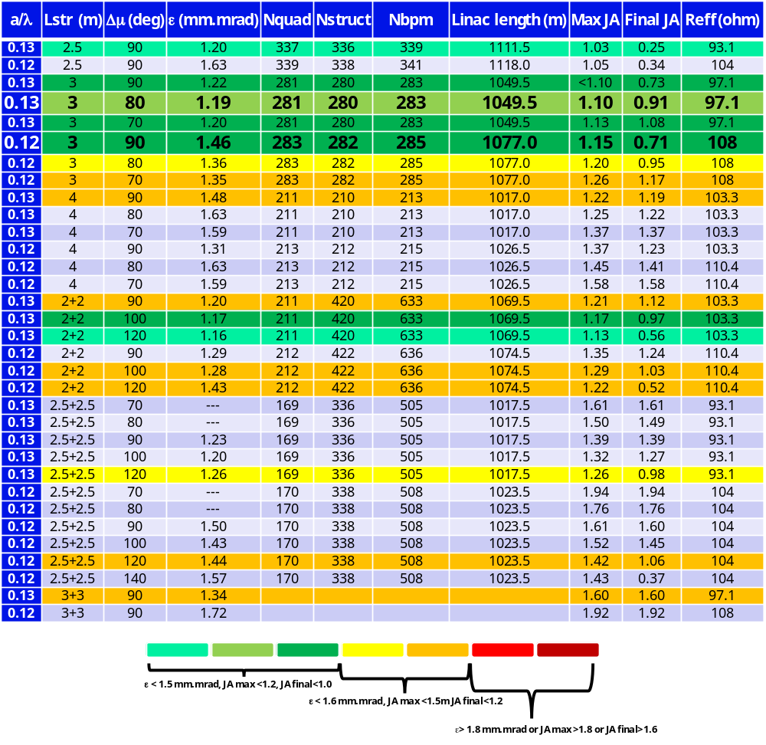



The winner configuration
Investigated space parameters
Correction algorithms
Criteria for selection
  RF frequency: 2-6 GHz
  RF aperture: 10-25 mm
  RF structure length: 2.5-4 m
  Optics (phase advance per cell): 70-140º
  Kind of lattice: 1Q2RF and 2Q2RF
  1-to-1 and DFS
  1-to-1, DFS and WFS
  WFS not included here (Δε ~-0.1 to -0.15 mm.mrad)
  Beam dynamics → beam parameters
  RF efficiency → Reff
  Cost → number of elements and footprint

Slide 16
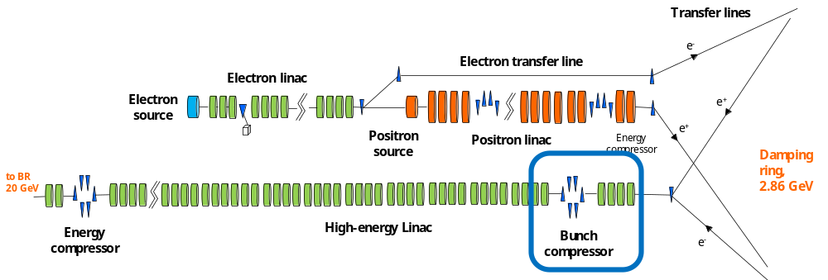
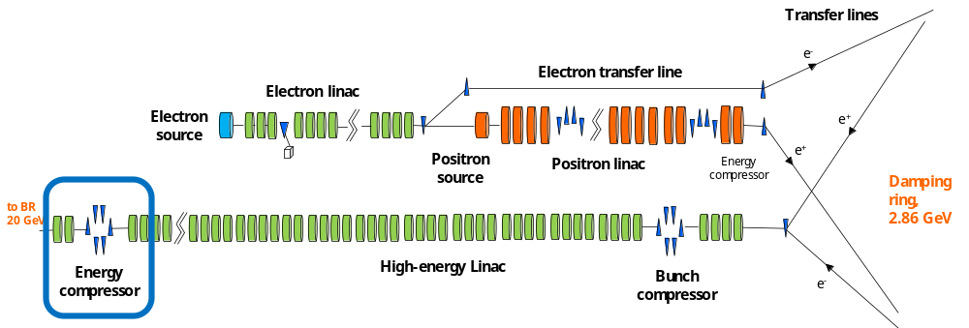
Compression, decompression and more

Slide 17
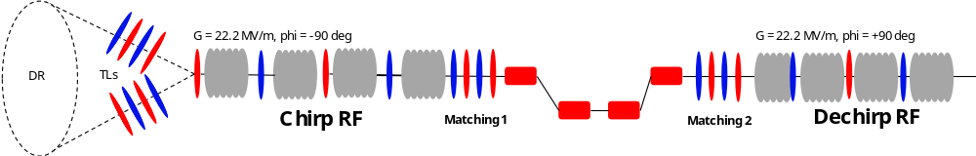
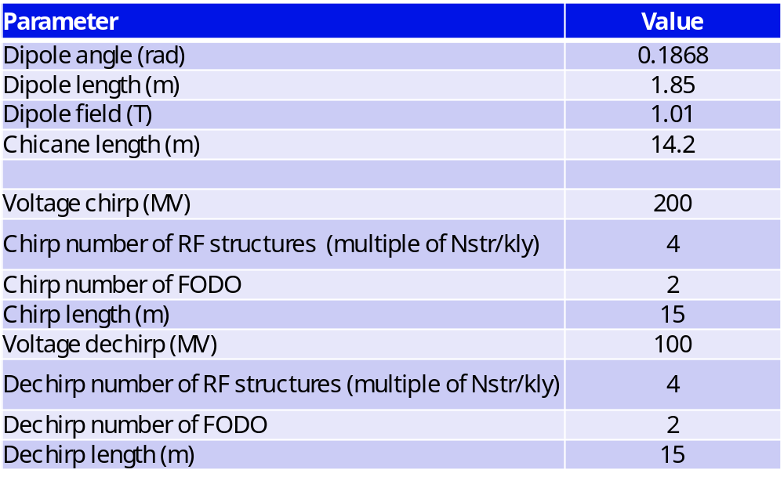
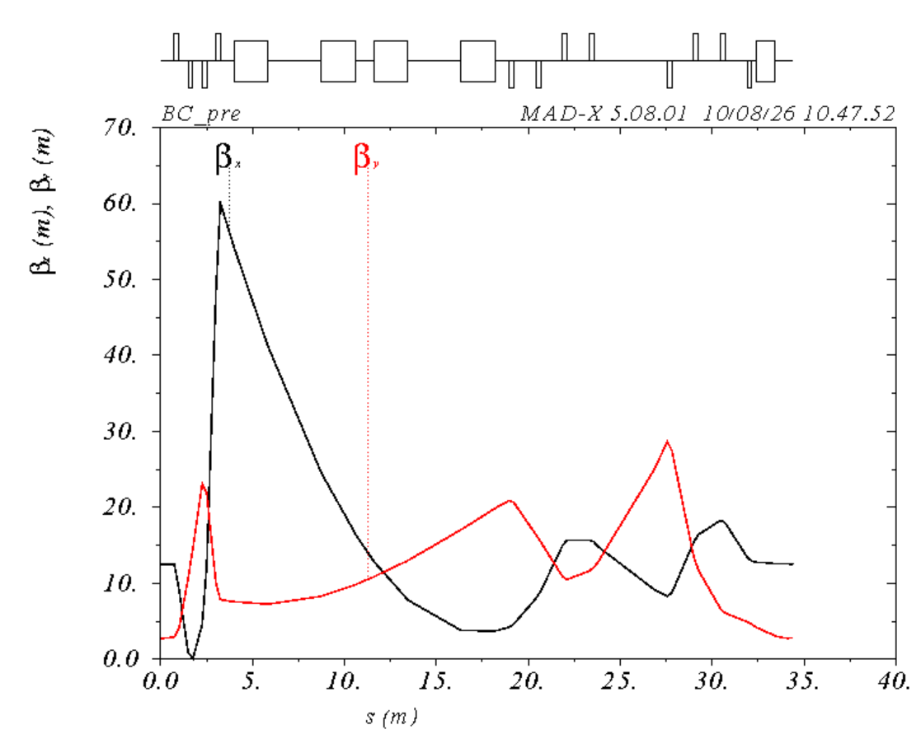
From the DR to the HE linac beam preparation: BC
Bunch from the DR too long to travel through the HE linac (@ GHz frequency) due to the energy spread cumulated (RF curvature)
Bunch length (rms): 5 mm → 0.8 mm
Chirp/dechirp in integer number of modules (1 module = 4 RF structures) → margin to compress differently, if necessary
Expected horizontal emittance growth~15% for the presently assumed bunch length coming from the damping ring

Slide 18
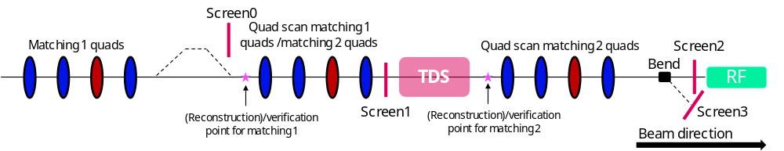
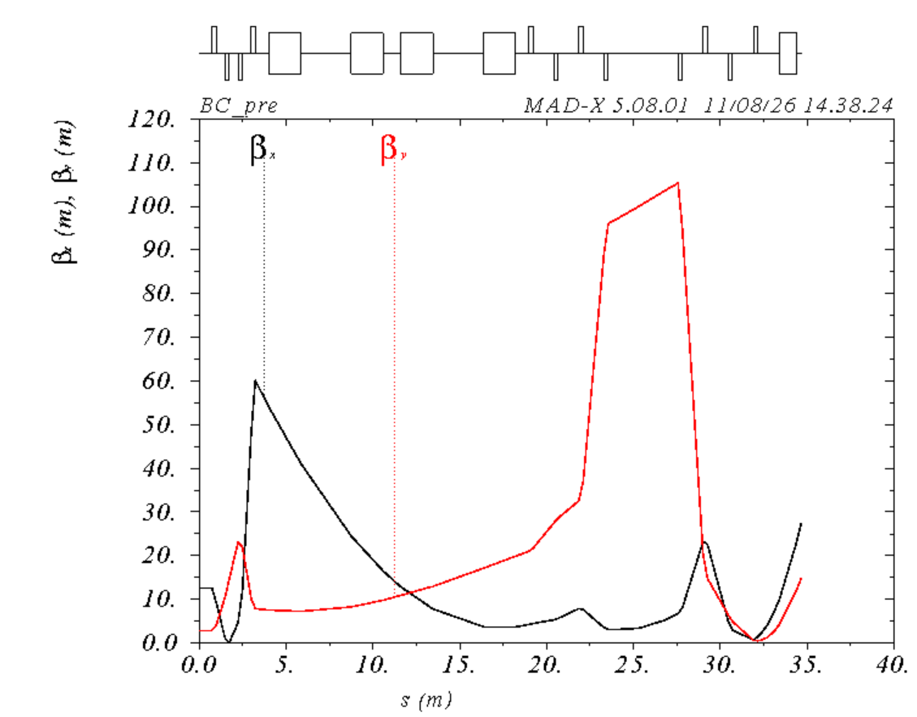
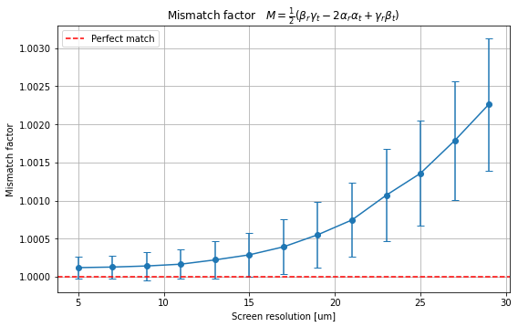
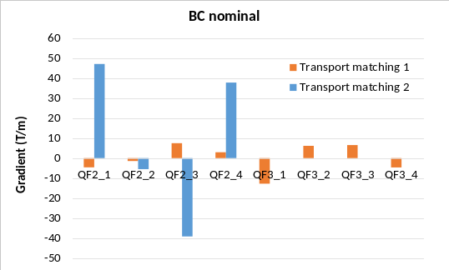
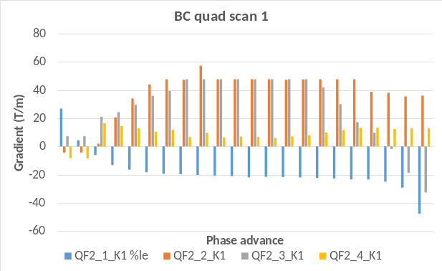
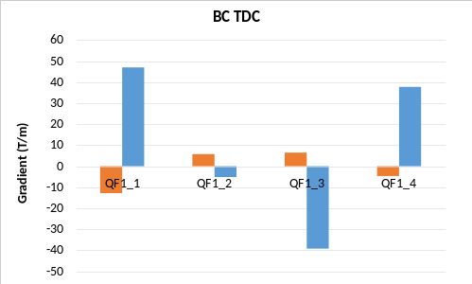
BC: full 6D beam characterization
Transport
Transverse phase space measurement
Longitudinal space measurement
Noise on beam size measurement = 1%
Control of the optics along and downstream of the chicane
Full characterization of the bunch in the (6D) space before going to the HE linac of the FODO section

Slide 19
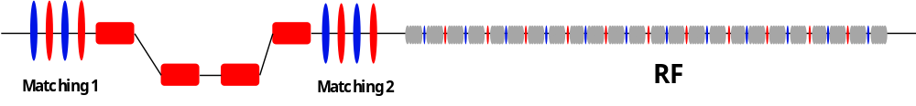
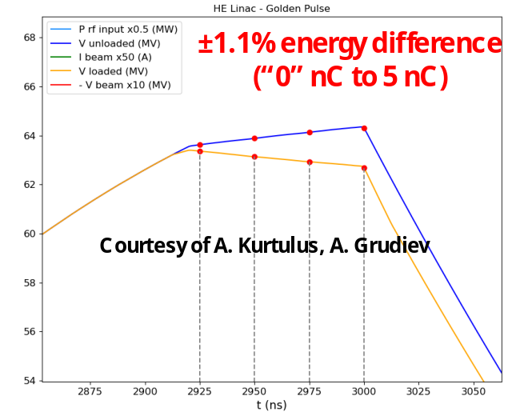
Energy compressor (EC)
Goal: manipulate and stabilize the bunch longitudinal phase space
f1
f2
T
DR
BC
HE
LINAC
R
RF EC
O
THE
56
BOOSTER
Δ
Target energy difference in the bunch (single bunch) and/or in between
Δ
Time
Energy
Δ
RF
phase
the bunches (multi
-
(intra/inter
bunch)
-
bunch)
The “golden pulse”
Bunch length (mm) | δp/p (%) | Δt (ps) | Δp/p (%)
4.02 | 0.11
4.04 | 0.11 | 5.1 | -0.02
4.06 | 0.10 | 9.7 | -0.04
4.08 | 0.09 | 15.3 | -0.07
Achievements:
Target bunch length: 4 mm
Target single-bunch energy spread (extra margin factor 3): 0.1%
Bunch-to-bunch energy offset<0.1%
Energy offset → time offset tolerable (booster group specs)
Advantages of using the EC:
  EC allows operating the HE linac on-crest: optimal for the beam quality and energy efficiency
  We need to decompress in any case the bunch before sending it to the booster (4 mm too long to travel through HE linac) → energy chirp and (chicane) necessary
  Improved the robustness of the machine to the bunch charge variation from “0” to 5 nC, and the energy stability in the downstream transfer line (dispersive line)
  Bunch length and energy spread can be independently set
Advantages of the EC located at the end of HE linac:
  Energy stabilization → impactful along a dispersive section like the several km downstream transfer line
  Not possible to install it at the TL end, because of the large R₅₆: out of the linear part of the RF and bunch-to-bunch time separation too large for the booster
  An intermediate location may be considered, but RF at 3 GHz must be brought underground → presently not the baseline, but possible from the BD point of view (see FCC week 2023)
page 19

Slide 20
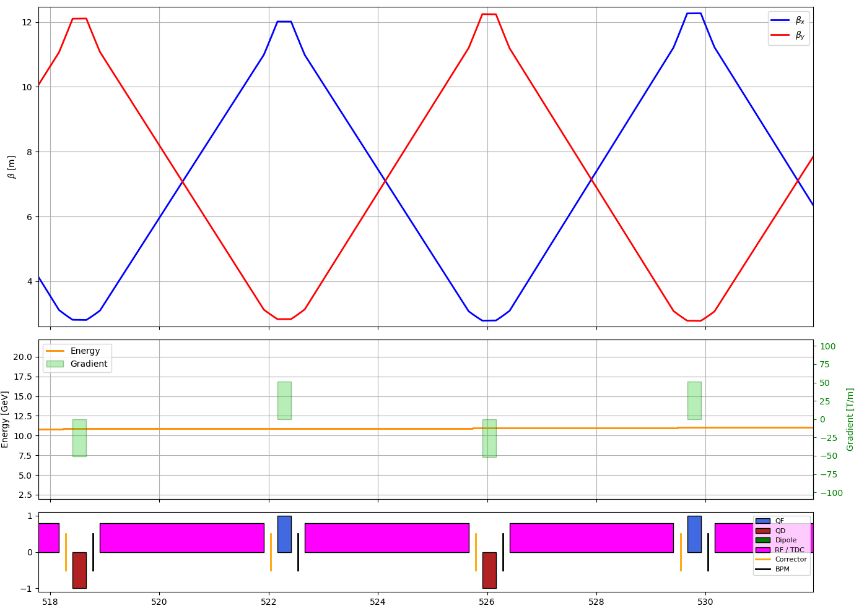
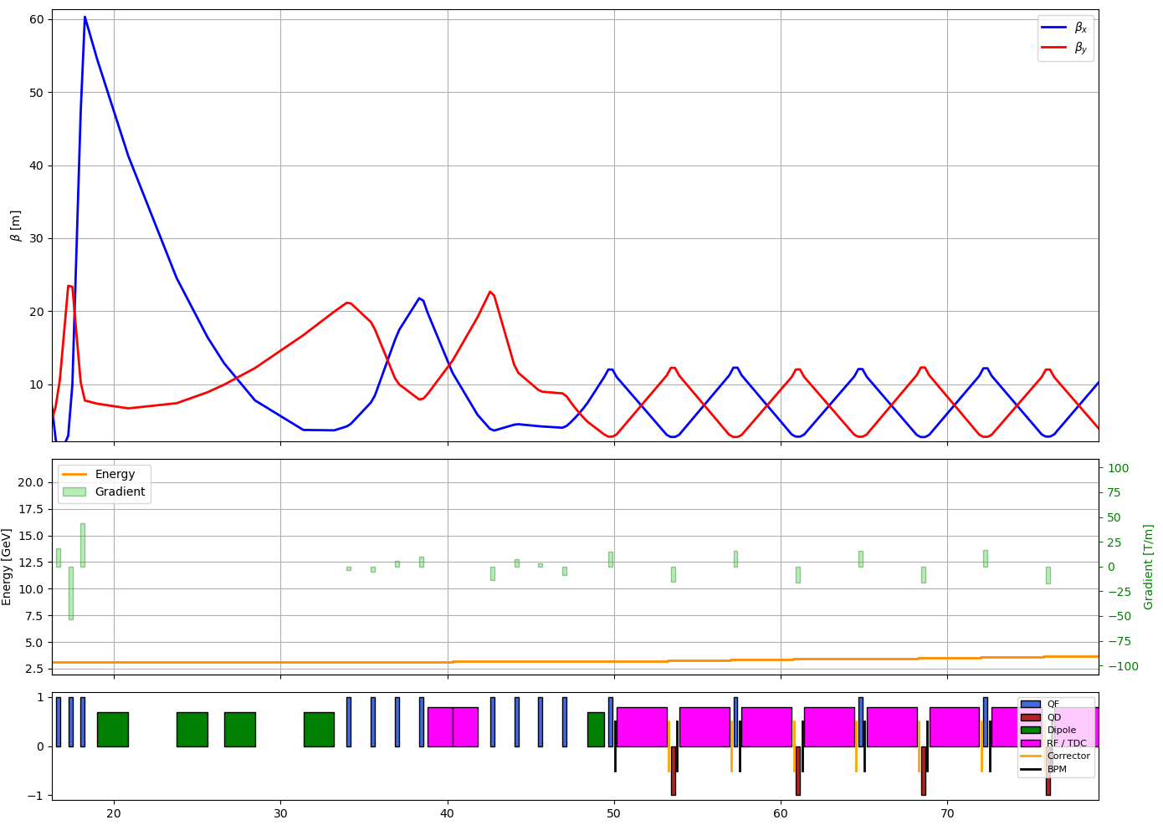
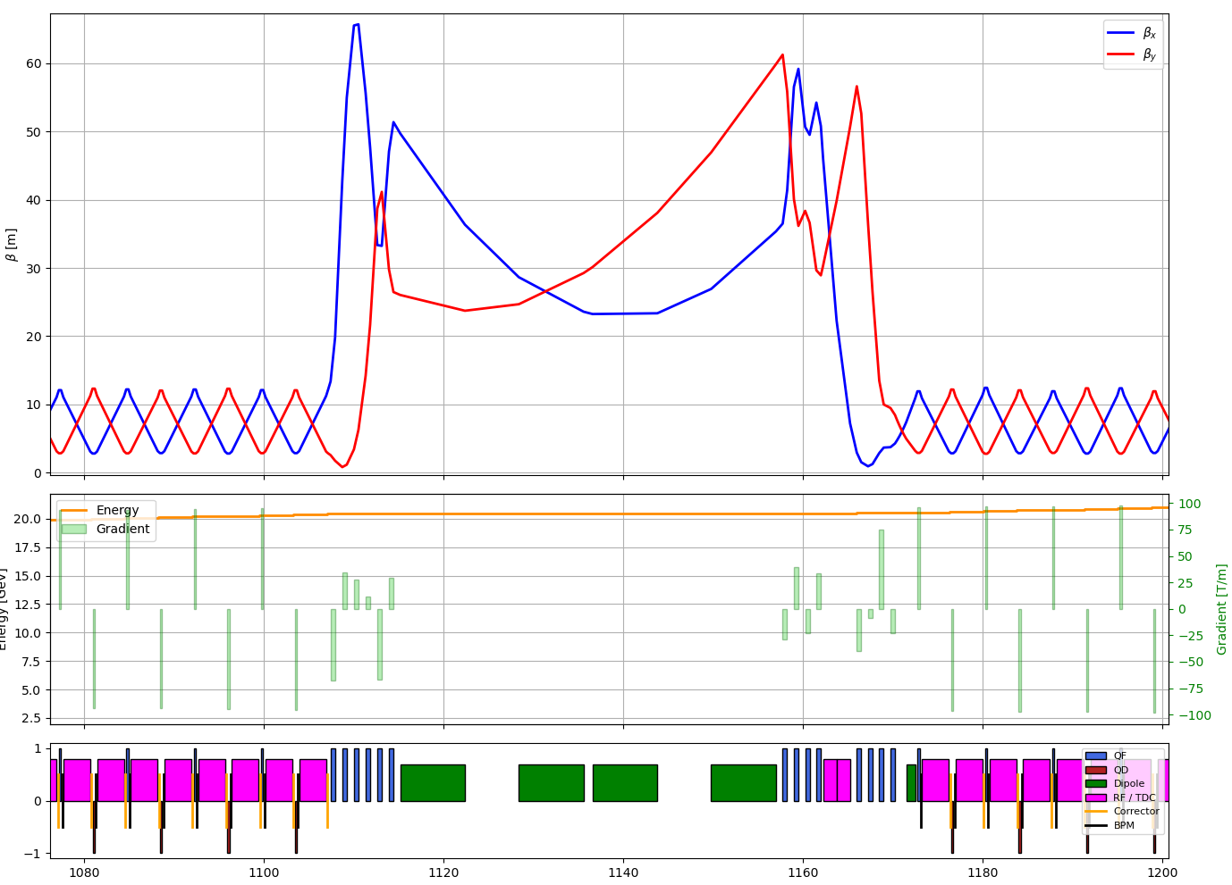
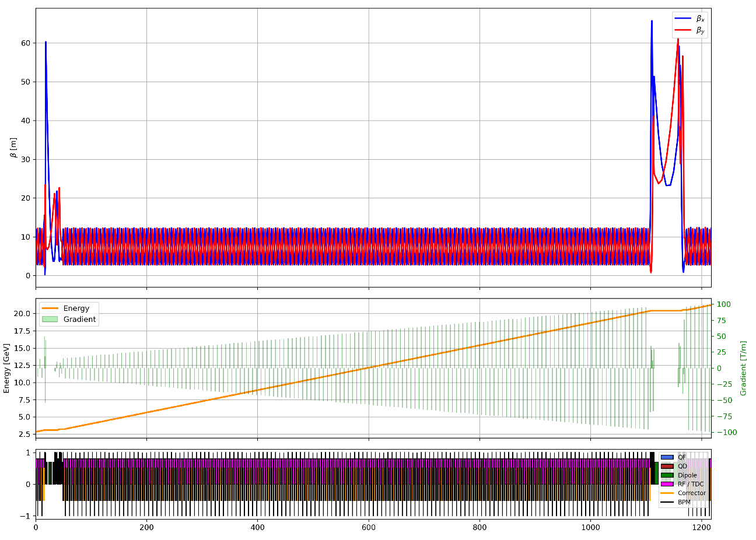




From the BD design to the technical design
FODO section
BC section
EC section
All the requirements fulfilled with the present design
(possible further improvements under considerations)
 | Initial (@ DR) | Final (@TL to booster) | Design final (@ booster)/along
Normalized (ε_{x},ε_{y}) (mm.mrad) | (10,1) | <(20,2) | (<15, 1.36)
Energy spread (%) | 0.7 | 0.7→0.1 | 0.1
Bunch length (mm) | ~5-7 | 4 | 4
Jitter amplification (final) | -- | <2 | 0.95
Jitter amplification (along linac) | -- | <1.5 | 1.20

Slide 21

Experimental tests at FACET-II
Experimentally verify what found in simulations

Slide 22



FCCee – SLAC collaboration at FACET-II
FCCee/SLAC ongoing collaboration on several topics (financed by CHART/CERN/Beam4US grant).
SLAC contact person: B. O’Shea.
page 22

Slide 23

FCC-ee injector complex layout
Aspects proposed for experimental verification mainly for electrons (ongoing):
  Bunch generation for top-up injection: charge scan from “0” nC to 5 nC
  Emittance versus bunch compression at nC charge
  Transverse jitter amplification and damping
  Test of the energy compressor
  Other methods to ease the setup of the FCCee linac in the shadow of other activities: impact of the RF focusing on the optics, fast RF phasing, …
Aspects proposed for experimental verification mainly for electrons (ongoing):
  Bunch generation for top-up injection: charge scan from “0” nC to 5 nC → see S. Doebert’s presentation
  Emittance versus bunch compression at nC charge → next to come
  Transverse jitter amplification and damping → done (see in few slides)
  Test of the energy compressor → postponed
  Other methods to ease the setup of the FCCee linac in the shadow of other activities: impact of the RF focusing on the optics, fast RF phasing, … → under preparation

Slide 24
FCC-ee injector complex layout
Aspects proposed for experimental verification mainly for electrons (ongoing):
  Bunch generation for top-up injection: charge scan from “0” nC to 5 nC
  Emittance versus bunch compression at nC charge
  Transverse jitter amplification and damping
  Test of the energy compressor
  Other methods to ease the setup of the FCCee linac: impact of the RF focusing on the optics, fast RF phasing, …

Slide 25





Bunch compression and emittance growth: reality
SwissFEL Test Facility (PSI)
Experimentally observed emittance growth for 200 pC bunch at moderate compression factor C/CF
More details in “S. Bettoni et al., PRAB, 19, 034402 (link)” and S. Bettoni et al., talk at the FEL conference 2015 (link)
page 25

Slide 26




Bunch compression and emittance growth: reality vs simulations
Elegant: no emittance growth (1D model)
CSRTrack 1D model → no emittance growth
CSRTrack “3D” model → qualitative but not quantitative agreement
Qualitative but not quantitative agreement between measurements and simulations found → a measurement campaign would be auspicable
More details in “S. Bettoni et al., PRAB, 19, 034402 (link)” and “S. Bettoni et al., talk at the FEL conference 2015 (link)”
page 26

Slide 27
FCC-ee injector complex layout
Aspects proposed for experimental verification mainly for electrons (ongoing):
  Bunch generation for top-up injection: charge scan from “0” nC to 5 nC
  Emittance versus bunch compression at nC charge
  Transverse jitter amplification and damping
  Test of the energy compressor
  Other methods to ease the setup of the FCCee linac: impact of the RF focusing on the optics, fast RF phasing, …

Slide 28



Beam transfer jitter damping: what is the mechanism?
Principle: use the same mechanism of the BNS damping but operating the RF structures on-crest
Advantages: best beam quality, energy efficiency
Tuning knobs: bunch properties, optics, kind of lattice, RF structure length
Head
RF
WF
Tail
More info in S. Bettoni, A. Latina, A. Grudiev, Phys. Rev. Accel. Beams 28, 061601 (2025): link
page 28

Slide 29








Experimental demonstration at FACET-II
Thanks to Brendan, Zack, Ryan and the excellent operation crews for the superb support!
What we simulated
What we observed
FACET-II L3 “configured” to represent the FCC-ee HE-linac dynamics
Balance between enough JA, damping and not too large JA (i.e. 5 nC, bunch length~1 mm)
Tuning knob: bunch length along L3 via L2 phase+BC14 → vary the energy spread along the bunch
Prediction: amplification → damping downstream of BC14
How we measured it
Experimental validation of the FCCee HE linac stabilization strategy
• Corrector scan (~90° phase advance)
• BPM trajectory measurements
• Normalized BPM-area observable $A_{BPM, norm}$
• Excellent signal-to-noise ratio for our purpose
Along the linac
Damping observed at 1.5 nC for longer bunch
For the same charge shorter bunch damping not observed
Damping begins downstream of BC14 (where the bunch is elongated-for wakefield it should amplify more)
30 consecutive shots
At a BPMs pair
First experimental evidence that RF curvature and longitudinal wakefields suppress beam transverse jitter.
page 29

Slide 30

Conclusions and outlook
    The FCCee injector design is in a good track:
      Beam parameters fulfill all the specifications with margin and flexibility for single- and multi-bunch effects
      Detailed design of the RF structures well advanced
      Definition of the specifications for the technical expert groups (diagnostics, magnets, …) to move from a BD to a real design
    FCCee and FACET-II possible synergies:
      FACET-II being a multi-GeV multi-nC machine is the perfect accelerator to experimentally verify the findings of the simulations before building FCCe
      Ongoing collaboration topics and more hopefully to come
We look forward to continuing this fruitful collaboration and exploring many more topics together, helping to make the FCC-ee injector design as realistic and robust as possible.

Slide 31


Acknowledgments…
…to you for your time,
to the entire WP1, the SLAC team, and to CHART*
*This work was done under the auspices of CHART (Swiss Accelerator Research and Technology) Collaboration
FCCIS: 'This project has received funding from the European Union's Horizon 2020 research and innovation programme under the European Union's Horizon 2020 research and innovation programme under grant agreement No 951754.'

Slide 32
Conclusions and outlook
    The FCCee injector design is in a good track:
      Beam parameters fulfill all the specifications with margin and flexibility for single- and multi-bunch effects
      Detailed design of the RF structures well advanced
      Definition of the specifications for the technical expert groups (diagnostics, magnets, …) to move from a BD to a real design
    FCCee and FACET-II possible synergies:
      FACET-II being a multi-GeV multi-nC machine is the perfect accelerator to experimentally verify the findings of the simulations before building FCCe
      Ongoing collaboration topics and more hopefully to come
We look forward to continuing this fruitful collaboration and exploring many more topics together, helping to make the FCC-ee injector design as realistic and robust as possible.

