Slide 1

Electron Source and pre-Injector for FCCee
FCCee injector overview
Frontend baseline and alternatives
CHART study and deliverables
Polarized electron Source
Possible experiments at SLAC
Steffen Doebert, Zdenek Vostrel, SY-RF
CHART FCCee-injector team

Slide 2
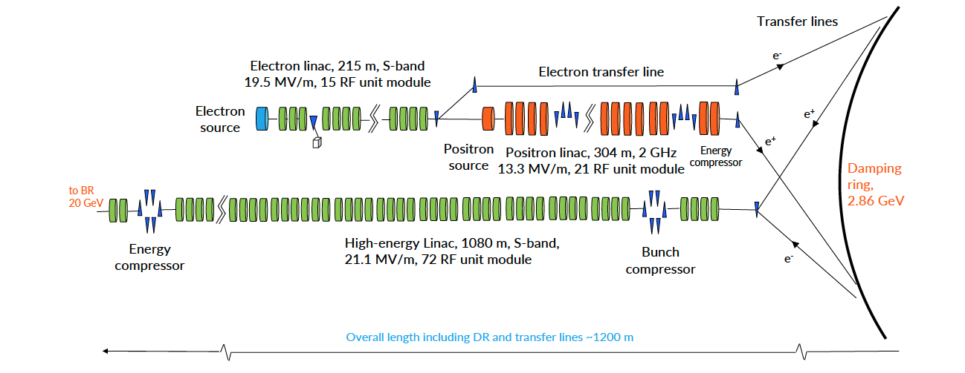
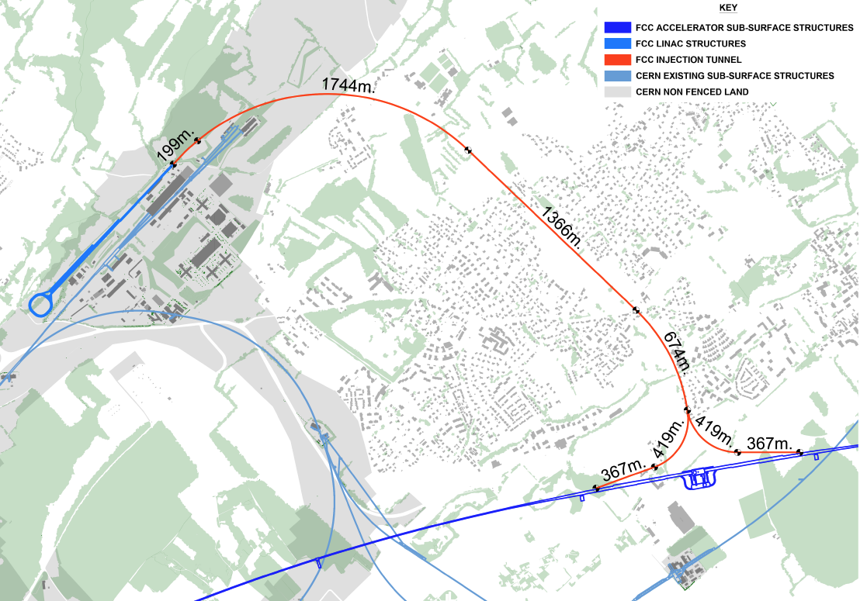

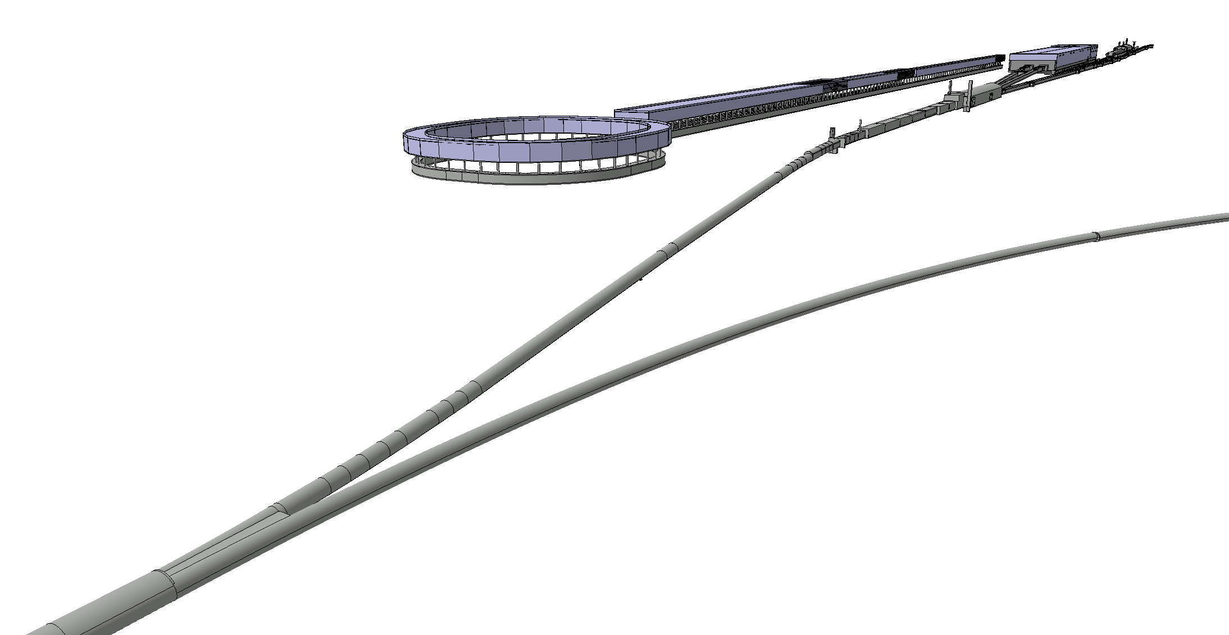
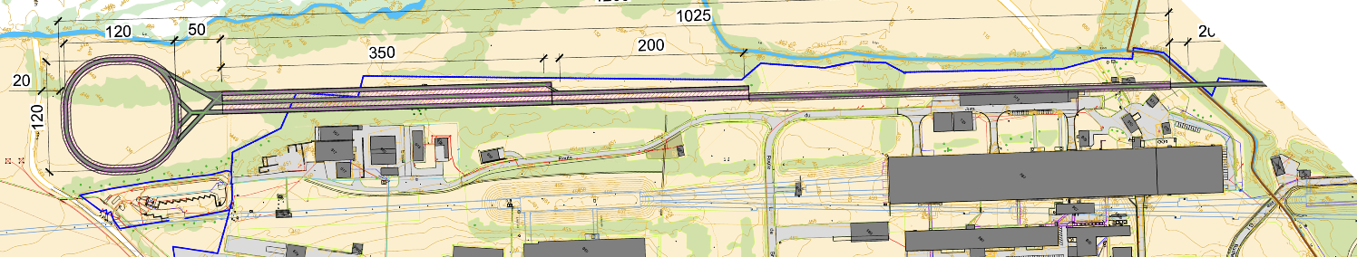
Injector complex definition – as of end of 2025
CERN site
Injector
Transfer line
FCC-ee booster and collider rings
Current Baseline as documented in the Feasibility Study Report : CERN-FCC-ACC-2025-0004
Injector complex made of 3 linacs, damping ring@ 2.86 GeV and transfer line to the Booster
Collaboration between PSI, CERN, IJCLab, INFN LNF
“Prevessin option”
NA
SPS
SPS slow extraction

Slide 3
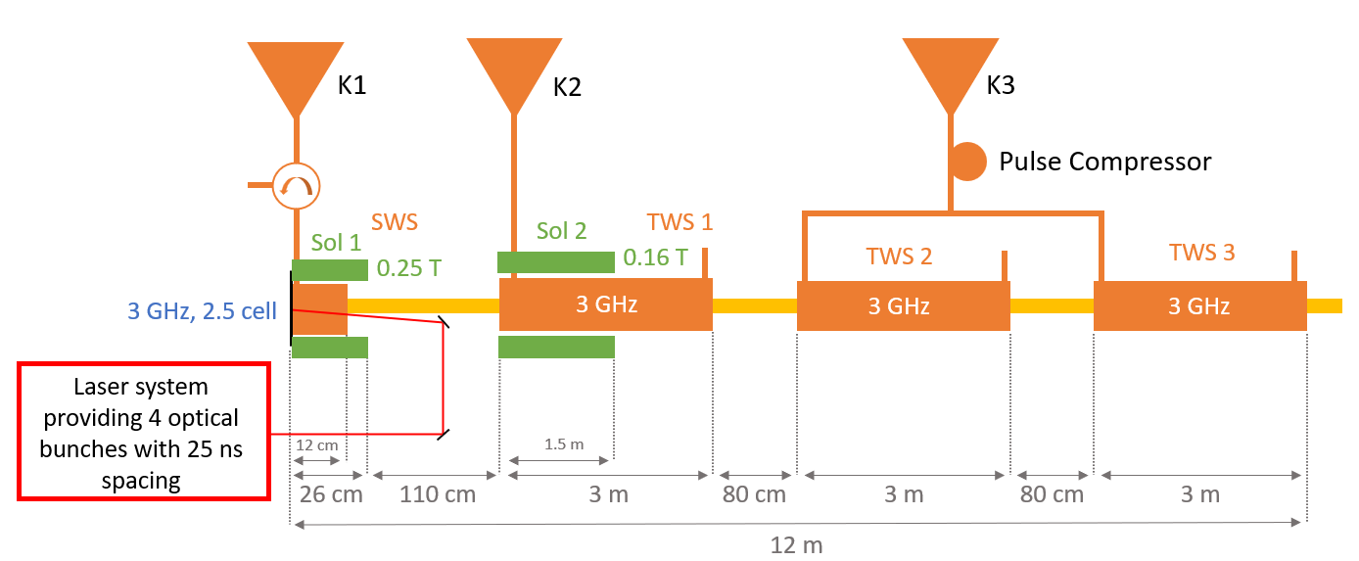
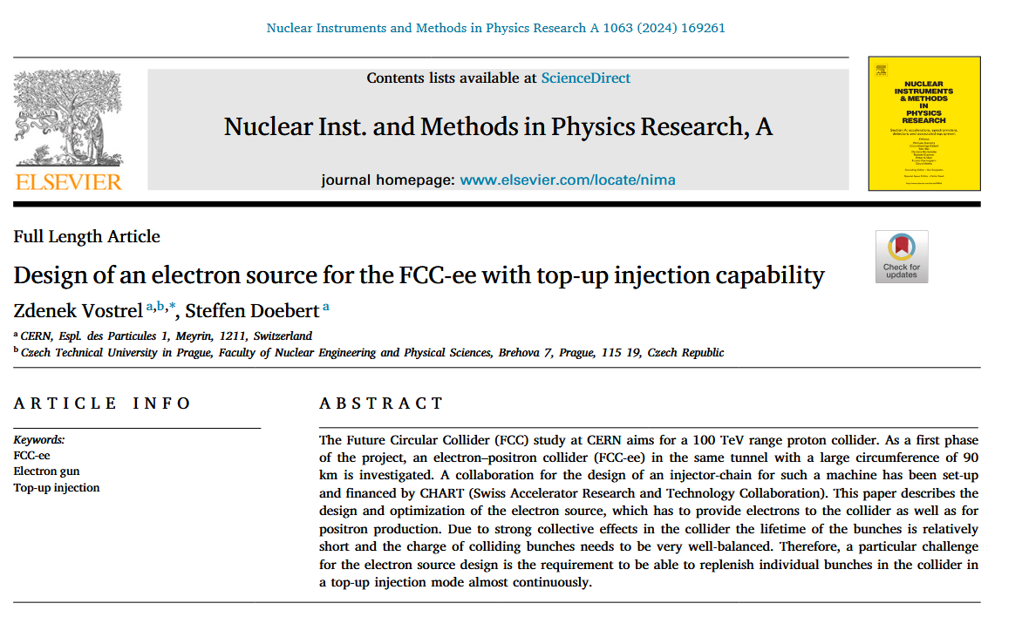
Proposed base line electron source
Inspired by the SwissFEL electron source
RF gun + 3 accelerating TWS structures @ ~ 3GHz
2 solenoids (no magnetic field at the cathode)
Laser system to provide 4 optical bunches with 25 ns spacing
with up to 5 nC per bunch
https://www.sciencedirect.com/science/article/pii/S0168900224001876

Slide 4
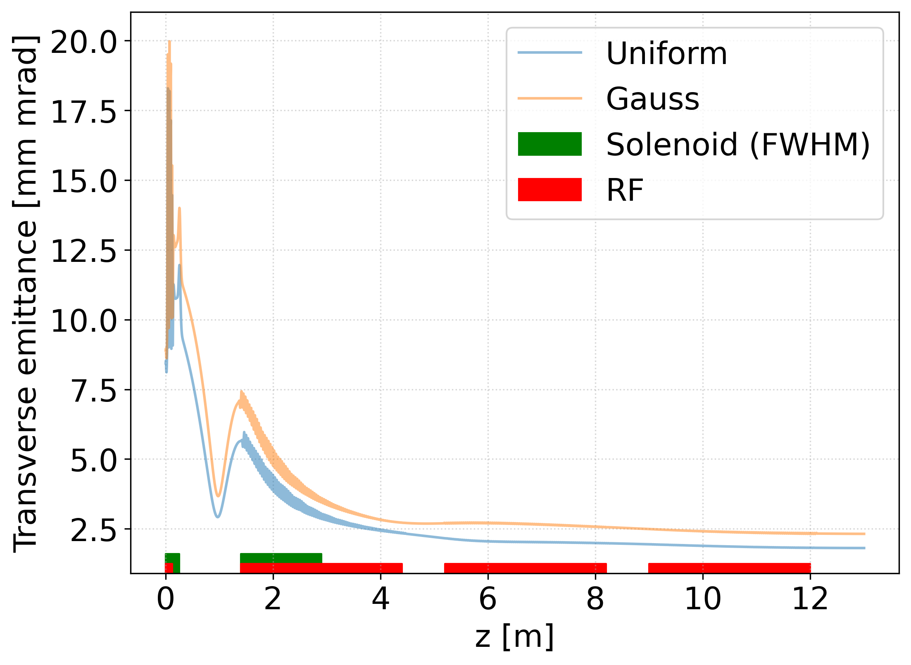
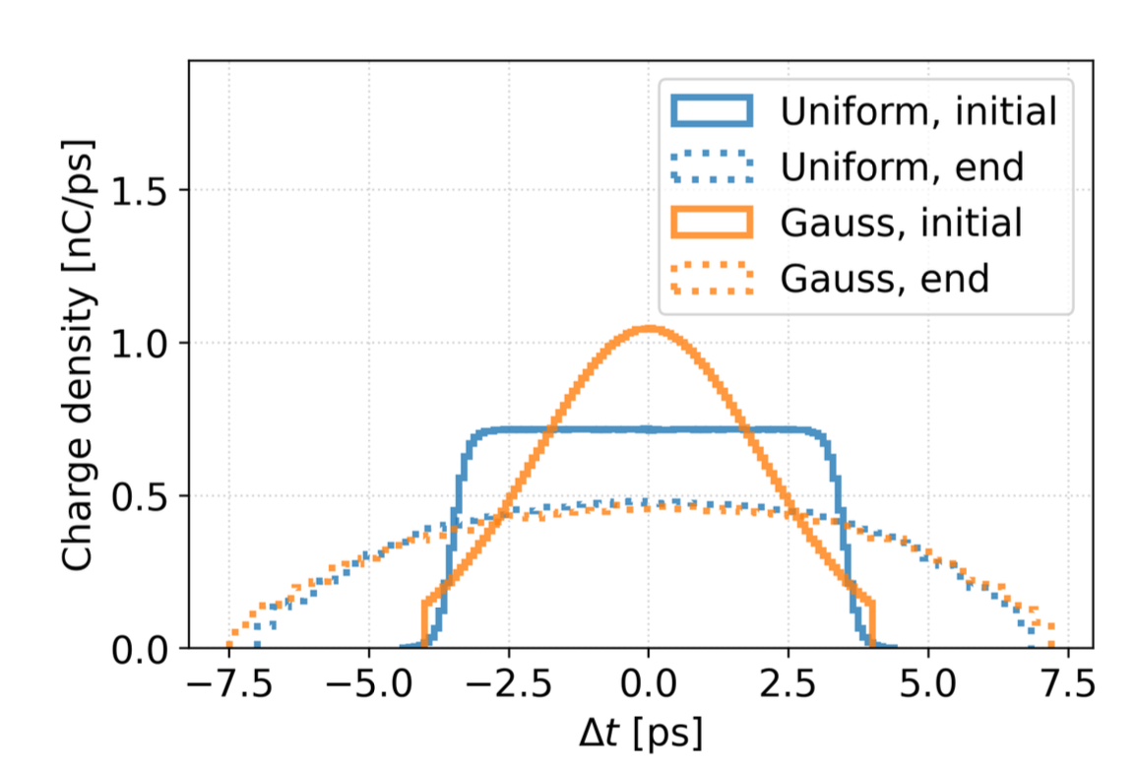
Performance
Bunch parameter | Limit | Achieved with Uniform | Achieved with Gaussian
Transverse emittance | < 4 mm mrad | 1.81 mm mrad | 2.39 mm mrad
Bunch length (rms) | ~ 1 mm or shorter | 1.01 mm | 1.06 mm
Energy | ~ 200 MeV | 168 MeV | 168 MeV
Energy spread | < 5 % | 0.21 % | 0.25 %
Simulations in ASTRA, large optimizations
My framework + genetic algorithms from INFN Milano

Slide 5
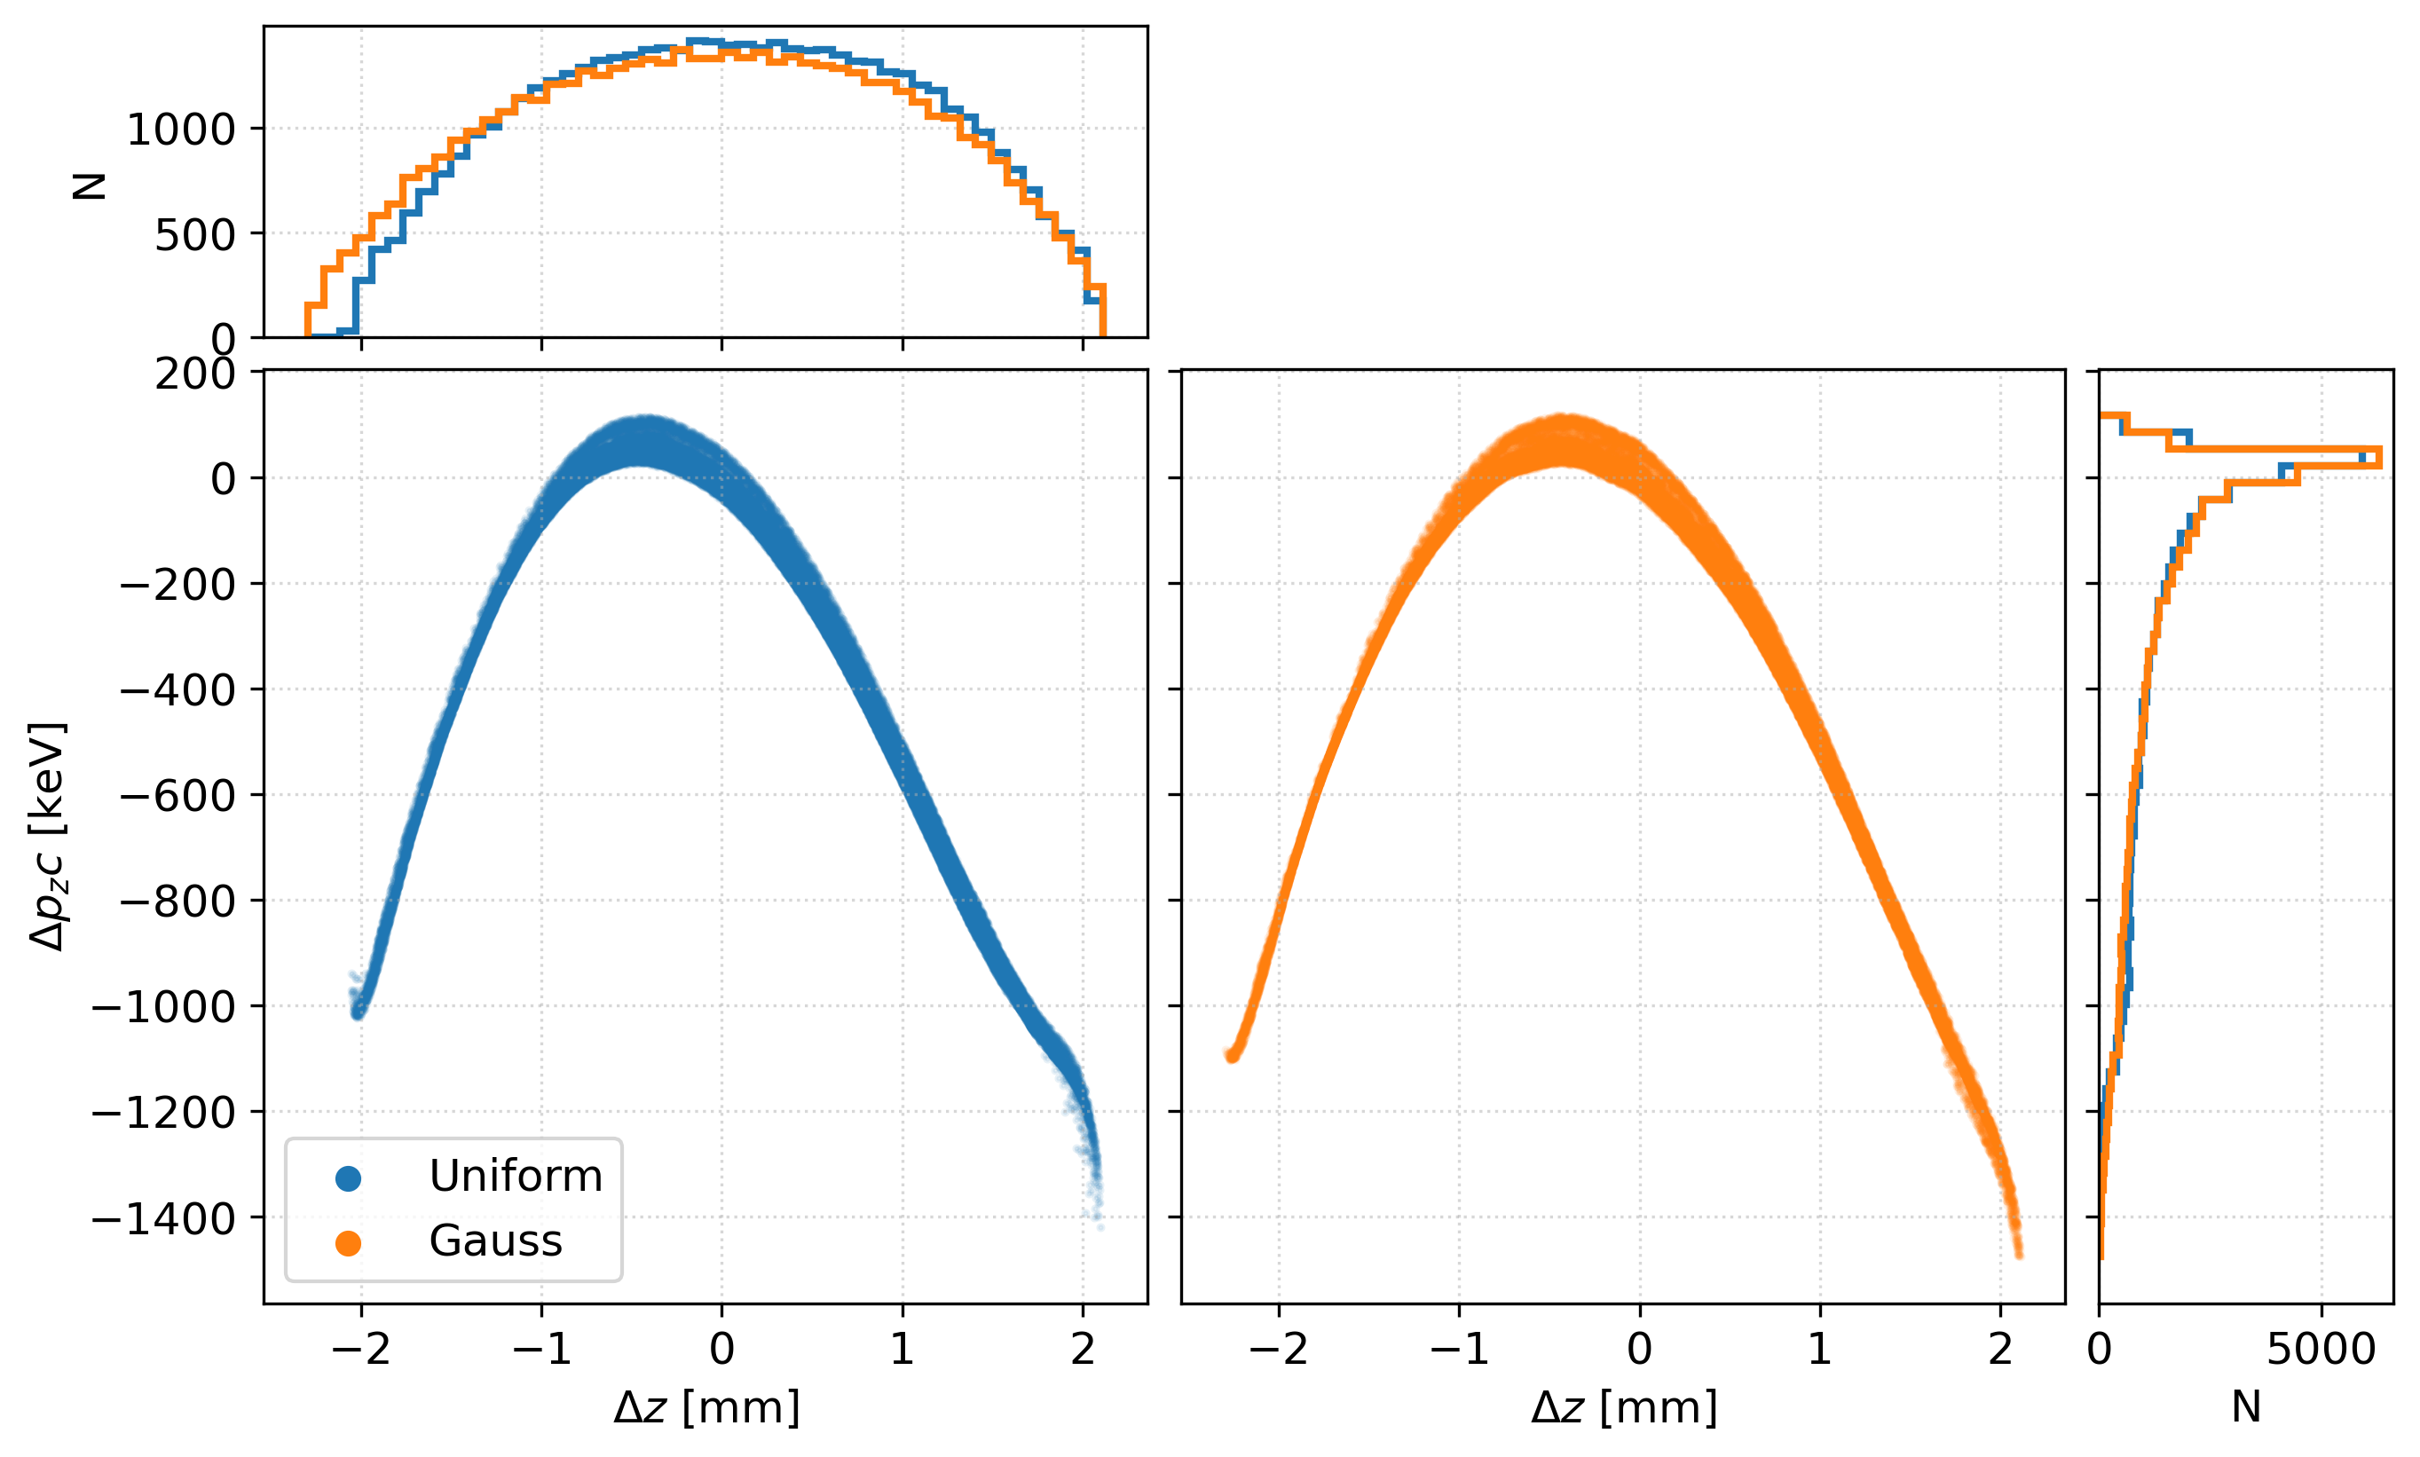
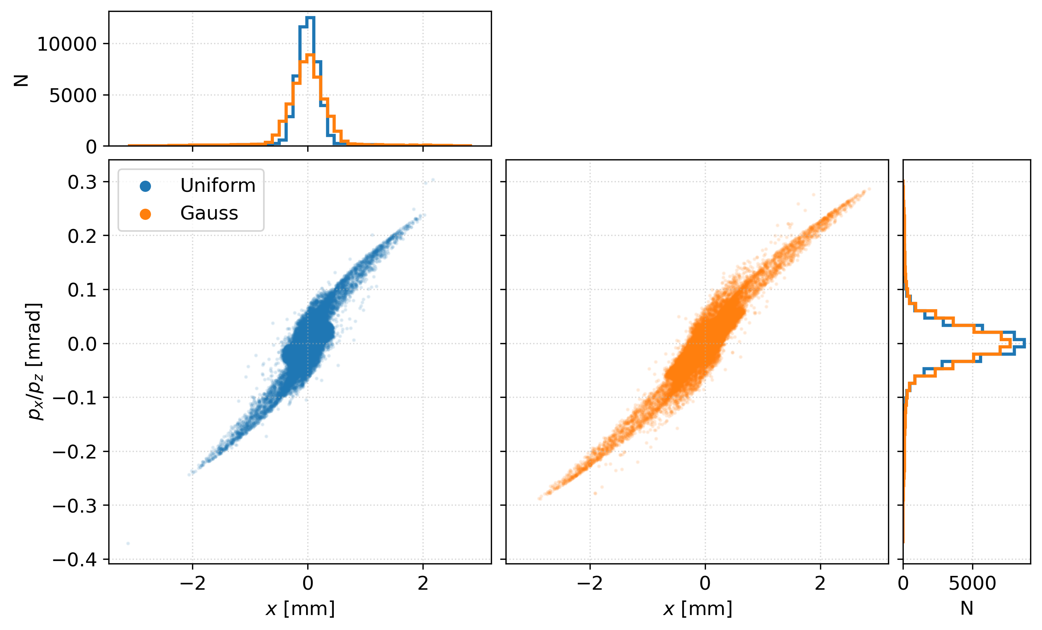
Performance
Longitudinal phase space
Transverse phase space

Slide 6
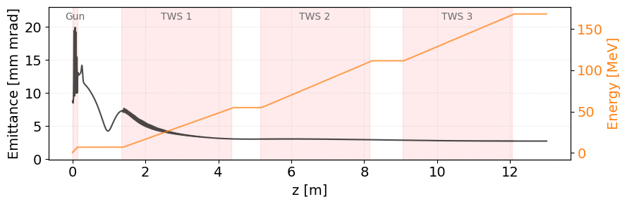
Charge variation scheme for photoemission
Electron source(s) studies
FCC WEEK 2026
Critical part for emittance minimization is the solenoid field in the low energy region, compensating the transverse space charge
Top-up injection and the electron source
Shot-to-shot charge variation
Arbitrary in the range 5 – 100 %, maximum charge 5 nC
Generating 4 bunches with 25 ns spacing at 100 Hz
→ fixed gun setup operating over large charge range
Schematic of the electron source layout
1.6 nC
4.1 nC
3.7 nC
5 nC
25 ns
25 ns
25 ns
Transverse emittance and energy evolution in the electron source complex at 5 nC

Slide 7


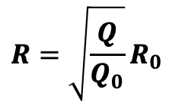




Charge variation scheme for photoemission
Electron source(s) studies
FCC WEEK 2026
Charge variation by changing the emission area proportionally to the desired charge
Charge variation proposal
Error study: solenoid field is critical parameter
Used to compensate space charge in low energy region
1.6 nC
4.1 nC
3.7 nC
5 nC
Preserve the transverse charge density, modulate by changing the transverse emission radius
25 ns
25 ns
25 ns
$$R_{3}$$
$$R_{2}$$
$$R_{1}$$
$$R_{0}$$
$$R=\sqrt{\frac{Q}{Q_{0}}}R_{0}$$
$$R, R_{0}$$
… emission radius
$$Q, Q_{0}$$
… bunch charge
Assuming uniform transverse charge density, setup optimized for 5 nC

Slide 8
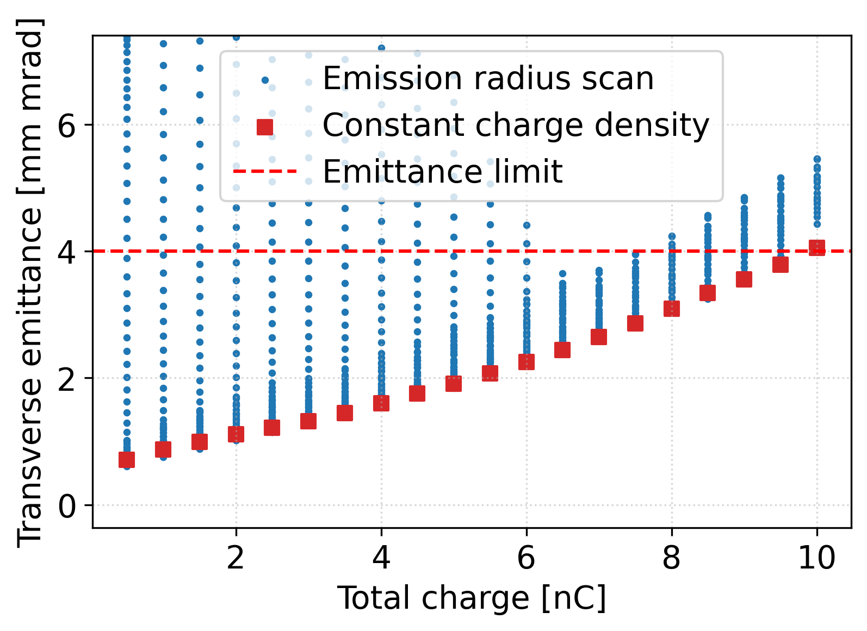
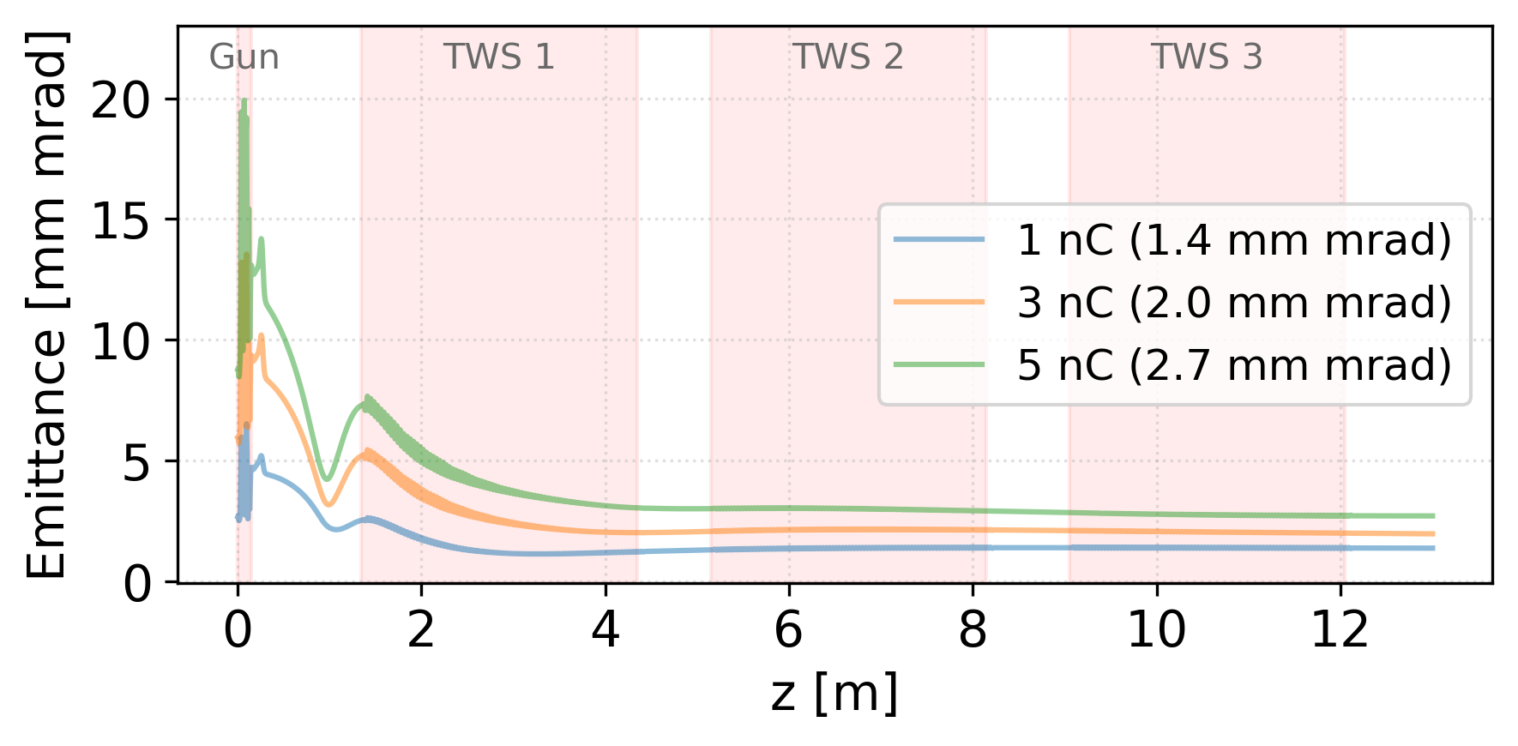
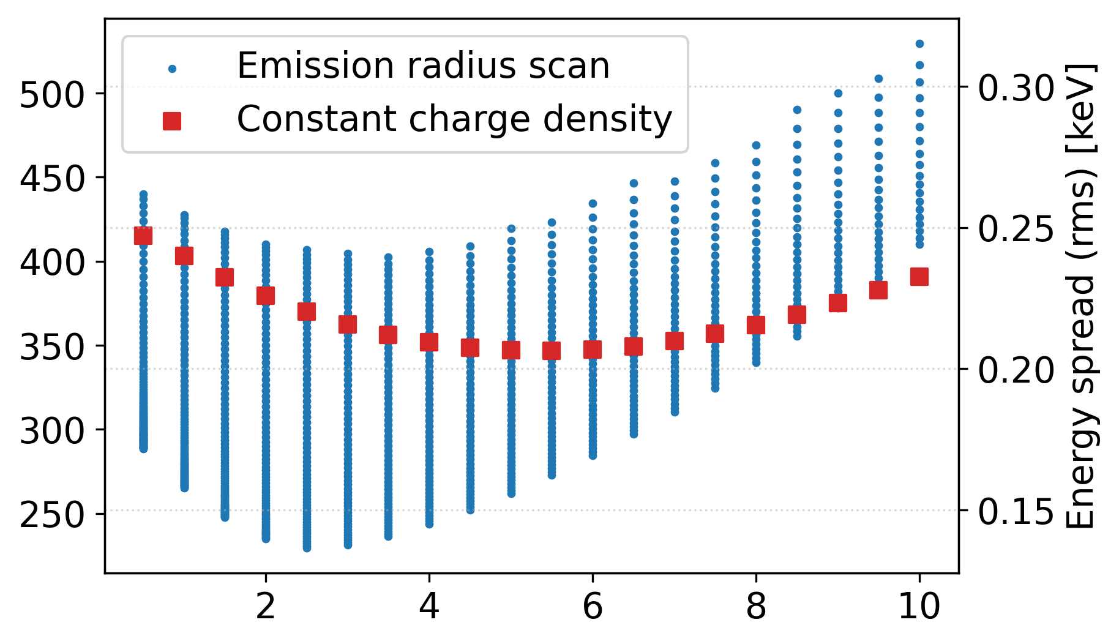
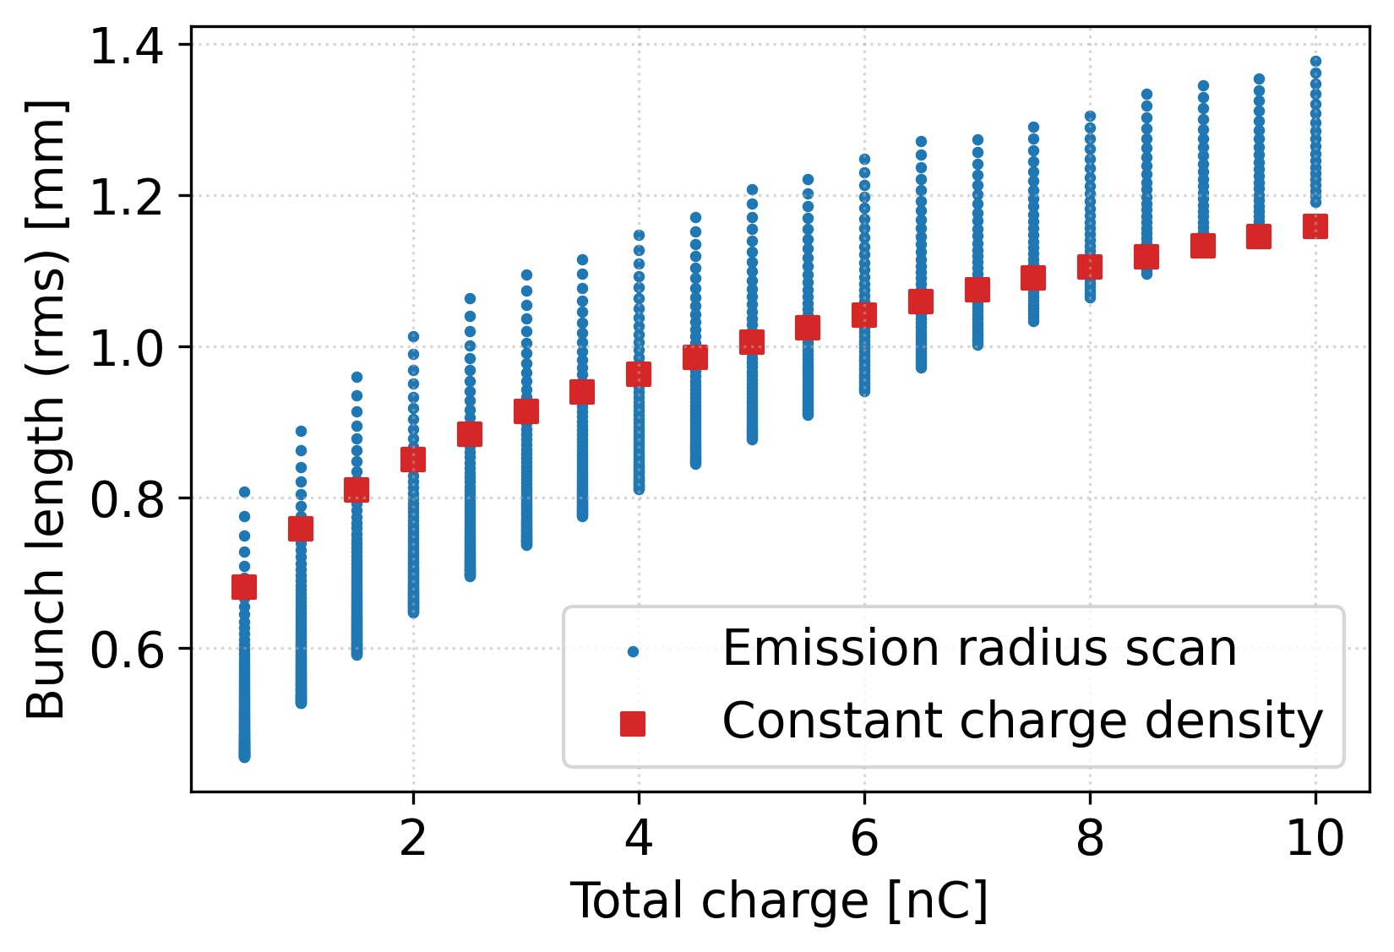
Charge variation scheme for photoemission
Electron source(s) studies
FCC WEEK 2026
Fixed setup provides compatible bunches across the charge range, proposed approach minimizes emittance for fixed setup
Squares: proposed variation
Dots: other charge-emission area combination
Presented method minimizes the emittance
Energy spread [keV]
Emittance evolution along the fixed source complex, plotted for different charges
Total charge [nC]
Assuming uniform transverse charge density, setup optimized for 5 nC

Slide 9
DC gun layout and design choices
Baseline:
  300 kV thermionic gun (space charge effect suppression),
  1 ns long emission (flat top),
  5 nC
  Charge variation capability by decreasing the length of the emission
30 cm
100 cm
100 cm
Thermionic gun
300 kV
1 ns emission
250 MHz buncher
1 MV/m
500 MHz buncher
1 MV/m
TWS
20 MV/m

Slide 10
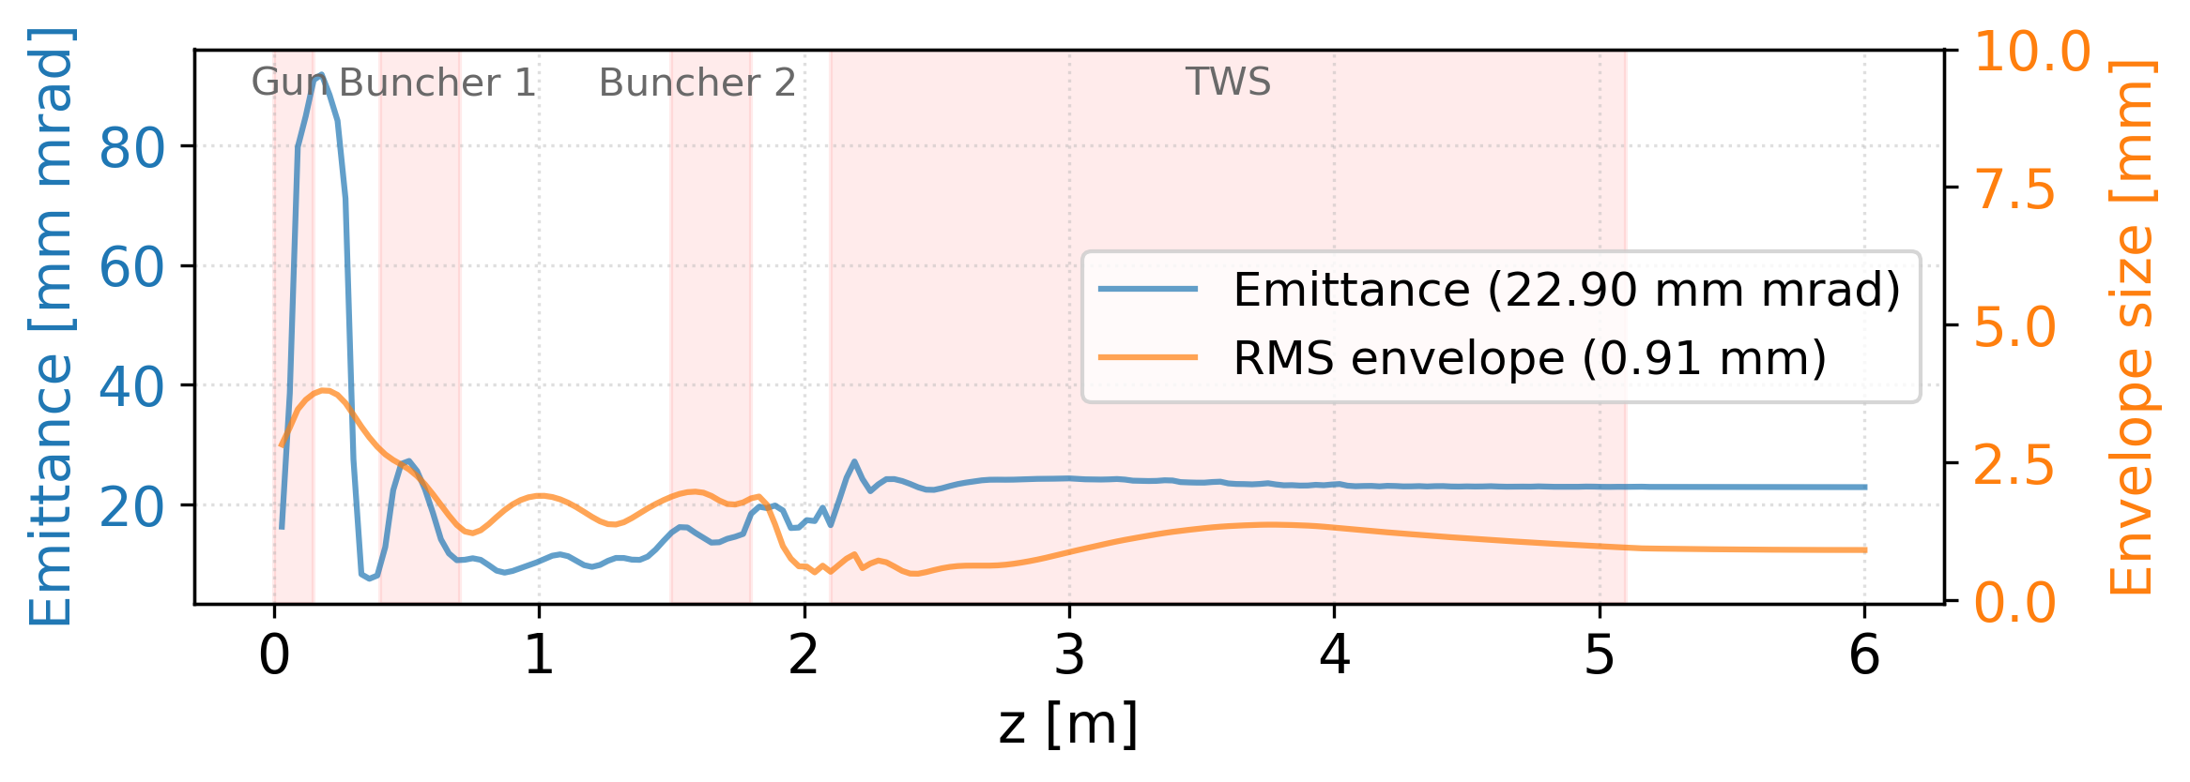
Thermionic gun – charge variation scheme
Electron source(s) studies
FCC WEEK 2026
Magnetic field designed to limit emittance growth during bunching, achievable emittance around 20 mm mrad at 5 nC
Focusing | Solenoid channel to maintain emittance at bunching section Focusing to waist at TWS entry to minimize RF kick
Iterative approach | Design bunching Update focusing Iterate…
Normalized emittance and envelope size evolution along the simulation

Slide 11
Thermionic gun – charge variation
Electron source(s) studies
FCC WEEK 2026
Changing the voltage of the grid positioned just in front of cathode (hundreds µm) can modulate extracted current and emission length
1.6 nC
4.1 nC
3.7 nC
5 nC
Fixed length
Changing current
Heater
Focusing electrode
Anode
1 ns
300 kV
25 ns
25 ns
25 ns
Electron beam
Changing length
Fixed current
4.1 nC
1 ns
Cathode
Control grid
25 ns
25 ns
25 ns
Schematic of the gridded thermionic DC gun
Changing length
Changing current
1 ns
25 ns
25 ns
25 ns

Slide 12
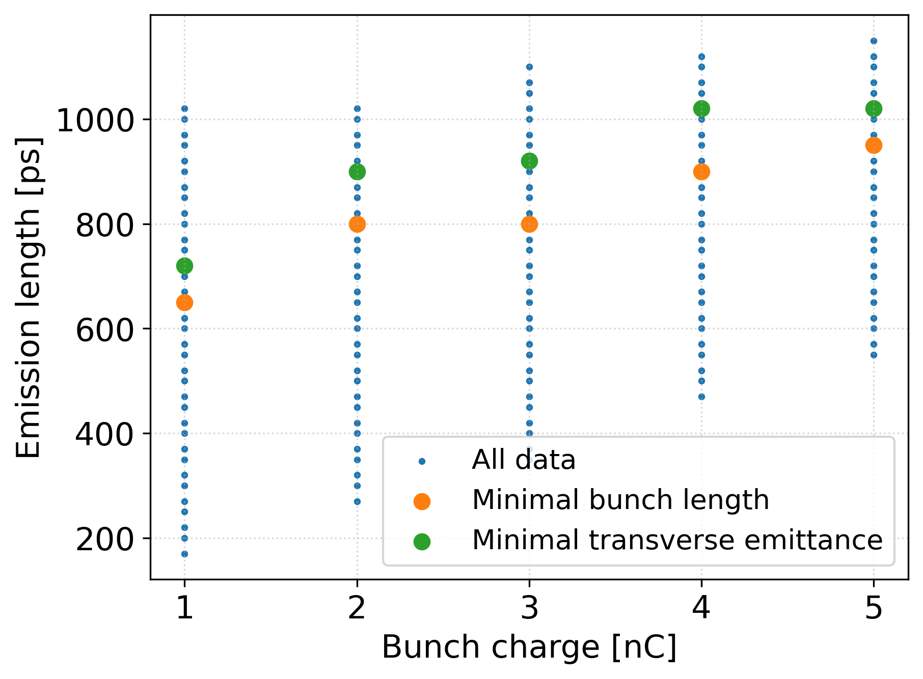
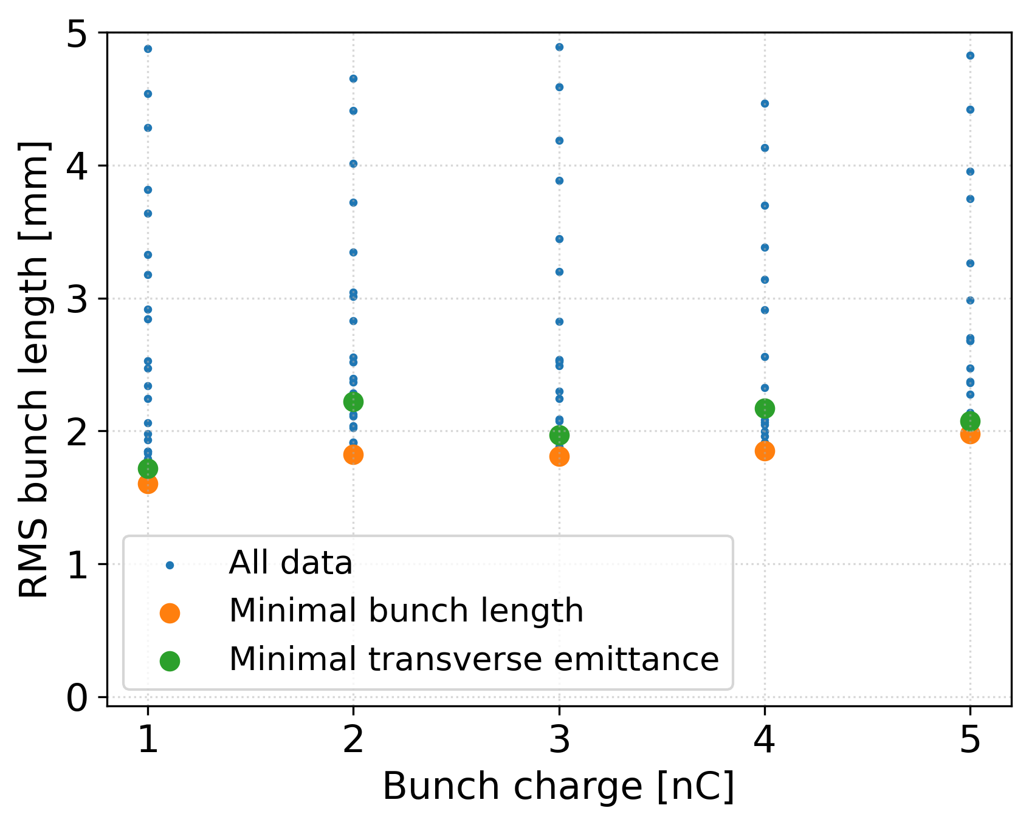
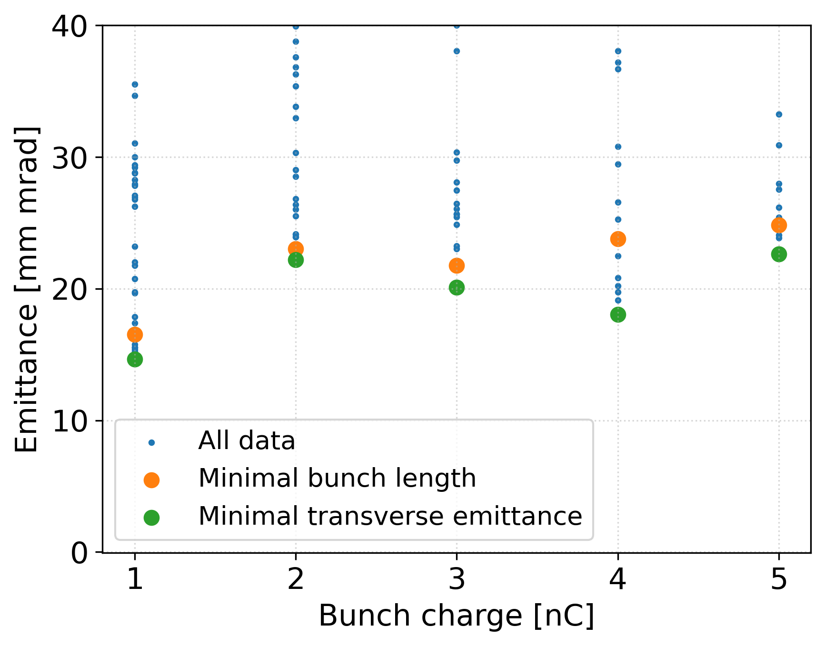
Thermionic gun – charge variation
Electron source(s) studies
FCC WEEK 2026
Possible combinations of total charge and emission length investigated and demonstrated that semi-constant bunch length and emittance is achievable with fixed gun setup
Thermionic gun with grid → modulating charge by manipulating emission length and/or current
Assuming fixed gun setup optimized for 5 nC
Preliminary results
Tested combinations of the emission length and total charge
Achievable RMS bunch length for different combinations of emission length and intensity
Achievable transverse normalized emittance for different combinations of emission length and intensity

Slide 13
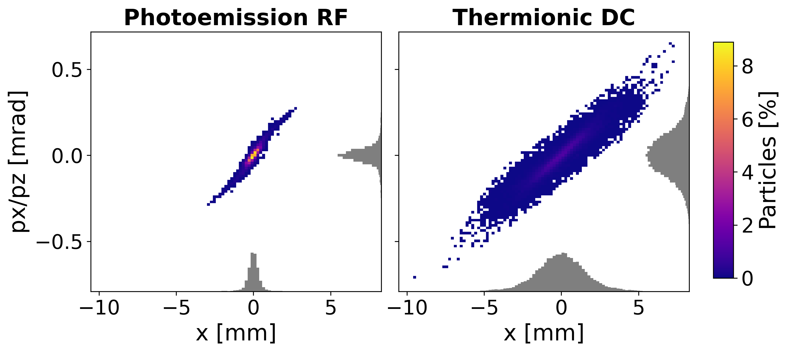
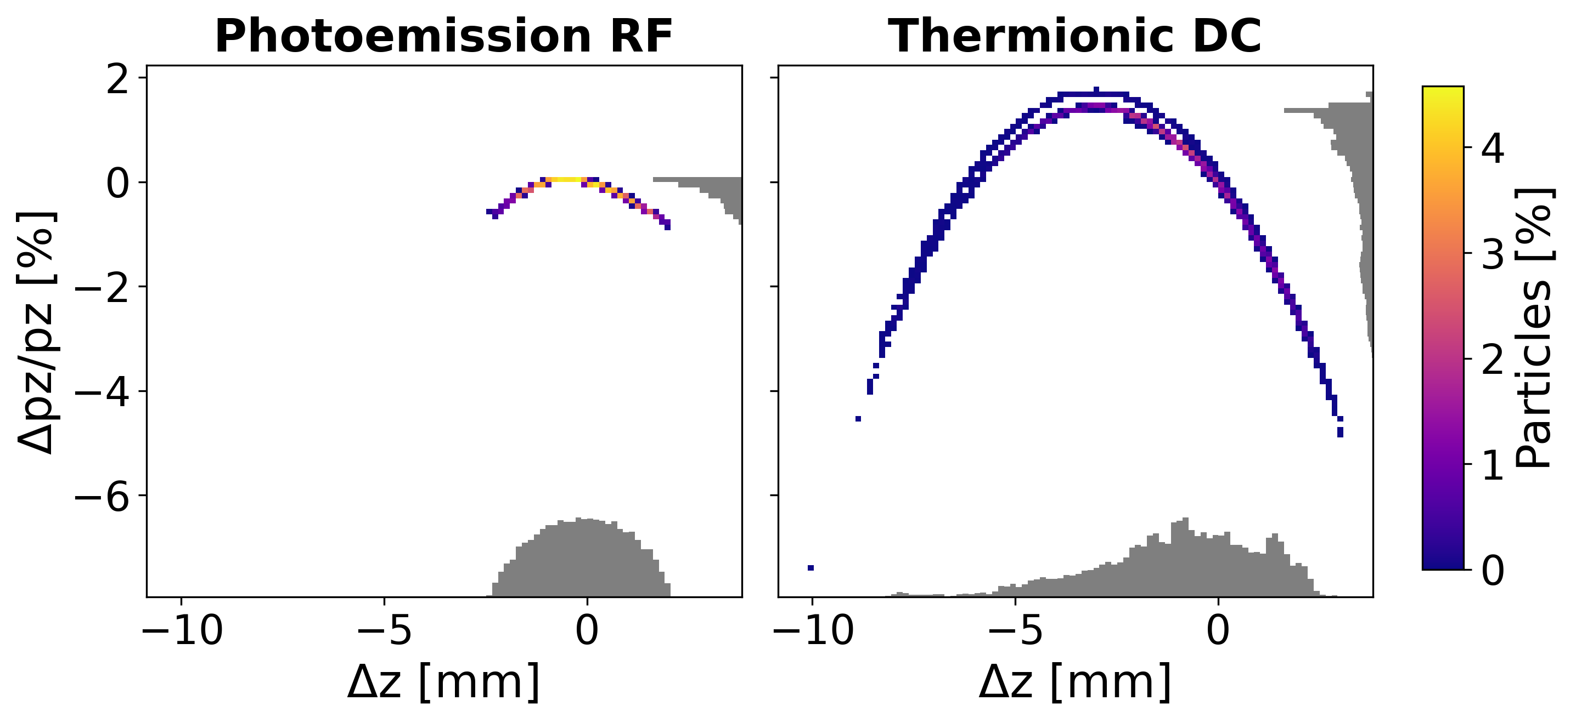
Comparison of phase spaces at 200 MeV / 5 nC
Electron source(s) studies
FCC WEEK 2026
Comparison of status of photoemission and thermionic gun bunches after acceleration to about 200 MeV, transverse phase space corresponds to higher emittance budget, longitudinally the thermionic bunch is longer by factor 2-3 with sparsely populated tail – optimization candidate
Transverse phase space
Longitudinal phase space

Slide 14








CHART; Work packages, milestones and deliverables
FCC-ee project
Injector linacs and sources
Coordination (WP0)
Collaborations
WP1
Electron and positron linacs
WP2
Electron source
WP3
Positron source and linac
WP4
Damping ring and transfer lines
WP5
Towards TDR
M1.1: working frequency
M2.1: Concept for
electron source
M3.1: working frequency
D4.1: Physics design
Damping ring and TLs
D5.1
Unified Global Requirement
M1.2, M1.3: RF prototypes
D2: demostration charge
modulation up to 5 nC
D3.1: TD and integration
target and capture system
D5.2
Physics Requirements Docs
e-, p- and HE-linac
M1.4: High power test, BDR
D3.2: P-cubed project:
positron production @SF
Functional Specifications Documents
D1.1: Industrialization
processfor RF structues
not in the CHART proposal
Eng. specifications docs
TDR chapers
Specifications
for CE and TI
Involvement of technical groups from CERN and PSI

Slide 15
Electron Source study within CHART
The baseline electron source as documented in the feasibility study was designed at CERN in the previous CHART 2 program dedicated to FCCee injectors
CHART 3; Alternative thermionic electron source design and comparison with the photo-injector baseline
Experimental verification of the baseline at PSI, photo injector with dynamic charge variation
First investigation of a polarized electron source
(not CHART but Zdenek’s PhD)
Accelerating structure prototype high-power testing
(FCCee test stand at CERN (CTF3 area))

Slide 16
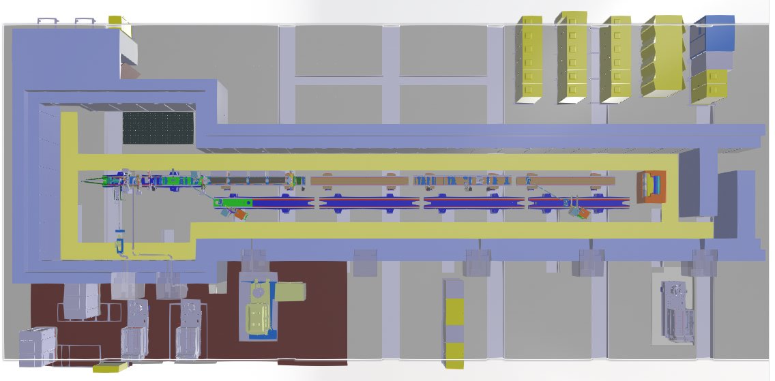
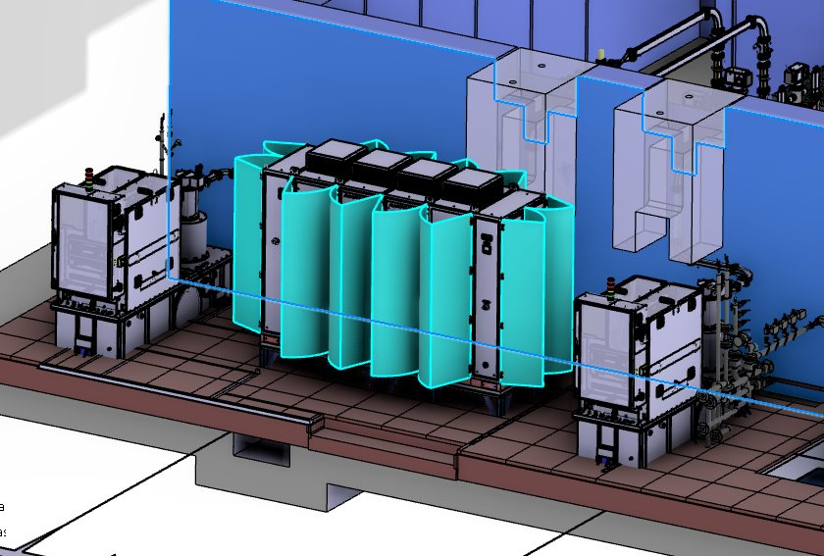
Electron Source Test Facility at PSI
Courtesy: Thomas Lucas
As the current electron source baseline for FCCee is a 2.5-cell RF photogun (SwissFEL-like), as part of Work Package 2 Task 2 we will test key concepts for FCCee at PSI.
We will:
  Commission the bunker and In-house designed PSI modulators will power the system.
  Install and commission spare SwissFEL RF Photogun.
  Install and commission photocathode laser.
Major challenges and demonstrations from the test stand:
  Pulse-to-pulse charge modulation and measurement with constant charge densities.
  Life-time of Cs₂Te with high charge.
Test Stand Layout
Electron source layout
PSI Built Modulators

Slide 17
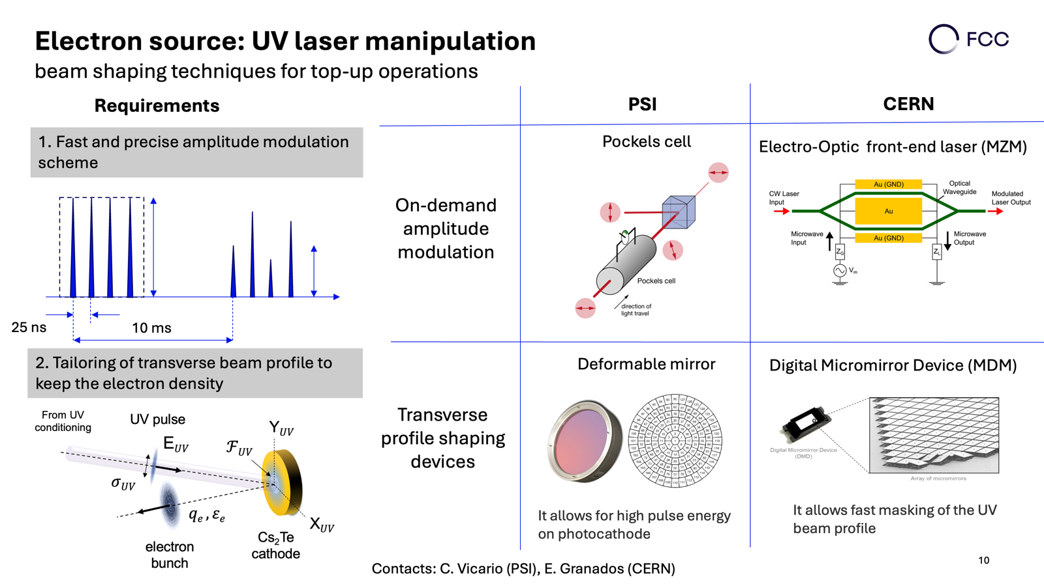

Slide 18
Polarized electron source
FCCee requires polarized electron and positron bunches for energy calibration in the collider ring. Typically, a number of buches , likely around 5 nC per bunch. Timing unclear for time being
Positron will be likely polarized in a dedicated ring withing the injector complex
Polarized electrons could be generated with a dedicated source and accelerated in the injector complex
Likely a DC photo emission source would be used
(the planed EIC source could be the ideal example )
From a high voltage and beam dynamics point of view quite similar to our thermionic unpolarized source
Polarized electrons
+ bunching
Other layouts are possible
Unpolarized electrons
+ bunching
Spin rotator ?
First accelerating structure
Alpha-magnet

Slide 19
Possible Collaboration Topics preliminary discussion with Brendan O’Shea at FCC week
Full beam characterization at the end of the injector for different laser spot size and charge
Static changes of laser parameters. Compare with simulations
Test of dynamic laser spot size changes with the laser only if equipment exists and alternative to plans at PSI
Systematic study of high charges with copper cathodes, which spot sizes are needed.
Use results as input for our simulations to understand potential/constraints of copper cathodes
Multi bunch effects ? Simulation effort (not FACET related)
Polarized electron source experience (not FACET related, maybe US-wide collaboration)

Slide 21
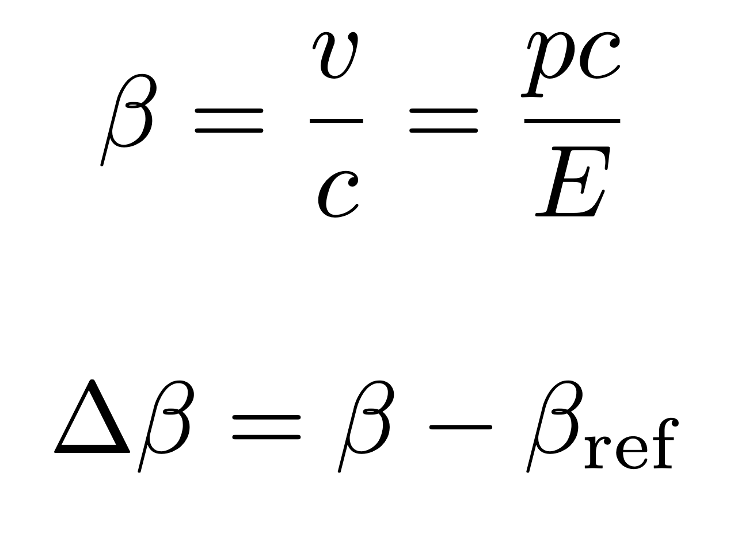
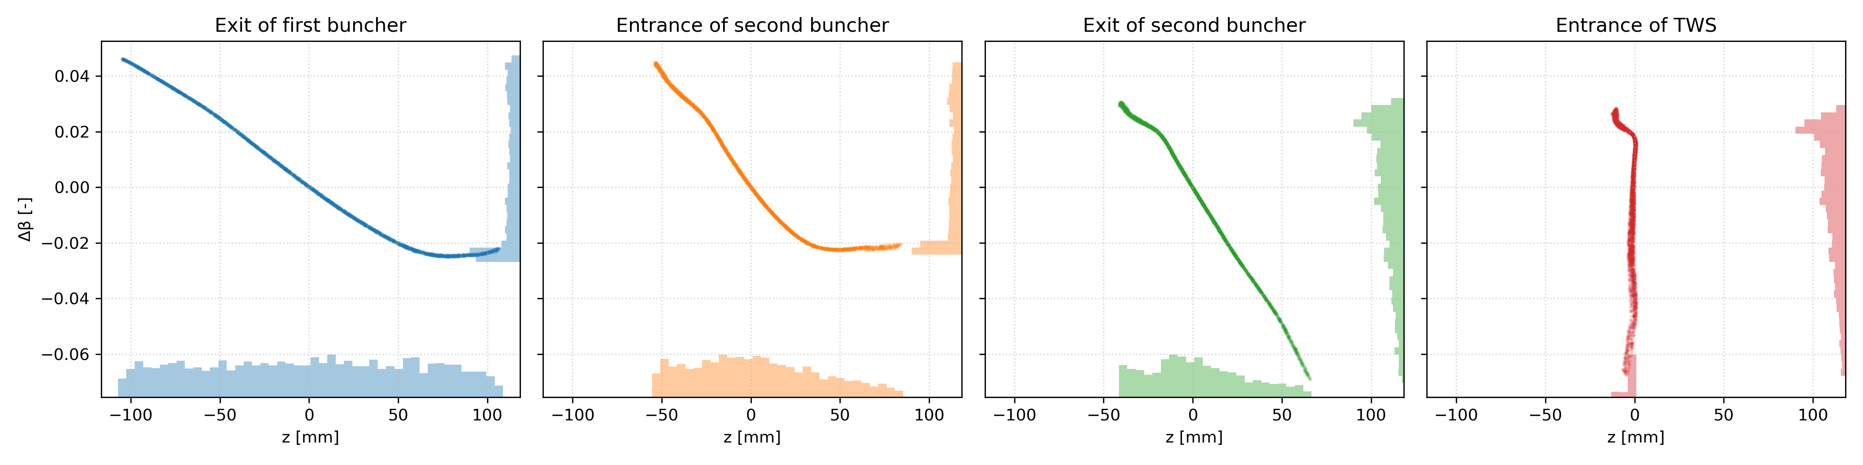
DC gun layout and design choices
30 cm
100 cm
100 cm
Thermionic gun
300 kV
1 ns emission
250 MHz buncher
1 MV/m
500 MHz buncher
1 MV/m
TWS
20 MV/m

Slide 22

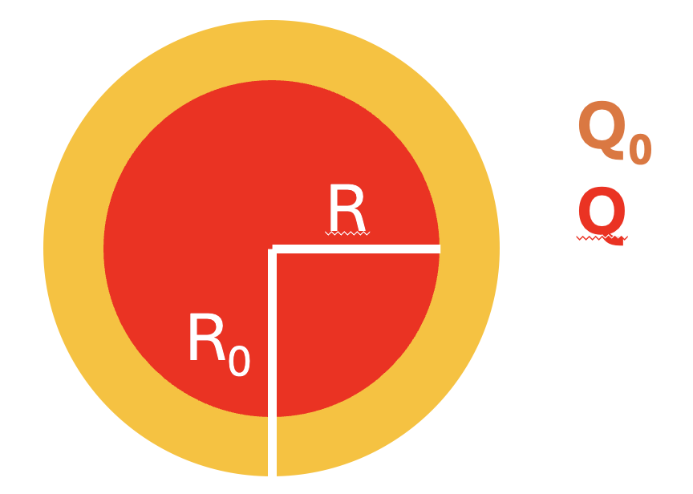
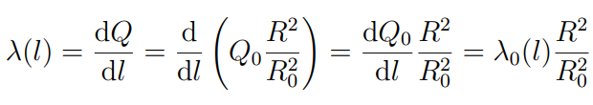
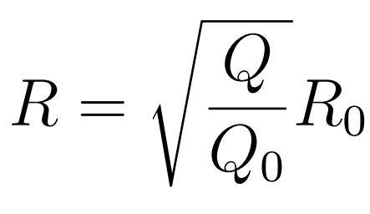
Top-up injection and beam dynamics
Gun setup cannot be optimized to each charge individually
From error study: solenoid focusing field is crucial
Our proposal: keep charge density fixed, decrease the charge by decreasing emission area (emission time fixed) → modulating the charge by modulating the emission size
Transverse space charge forces
Charge scaling with emission radius
(constant charge density)
Linear charge density
Q ... Wanted charge
$R$ ... Radius to obtain Q
$Q_{0, }R_{0}$ ... Peak charge and corresponding emissin radius
22

Slide 23
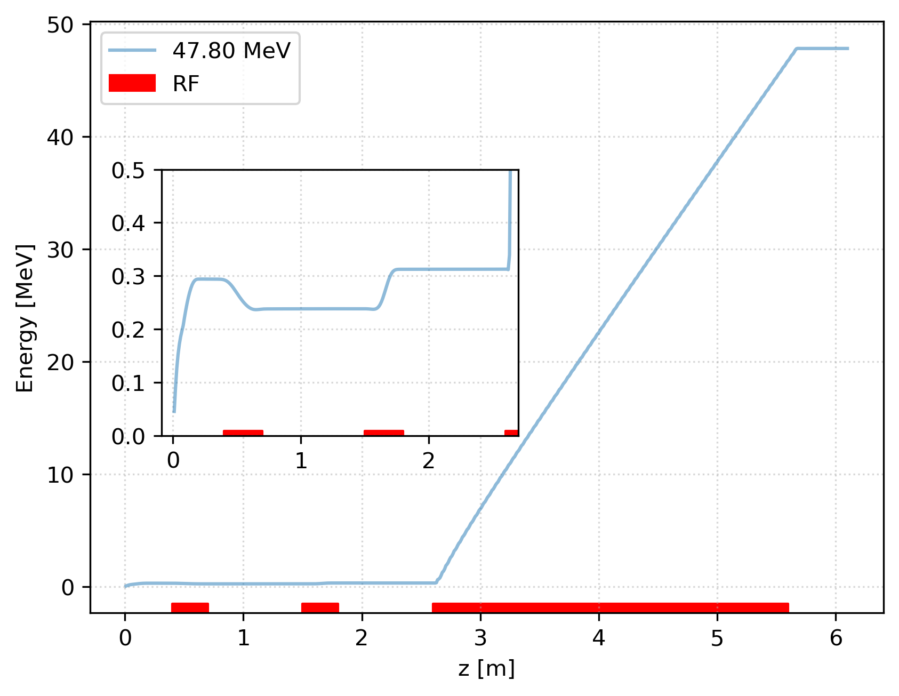
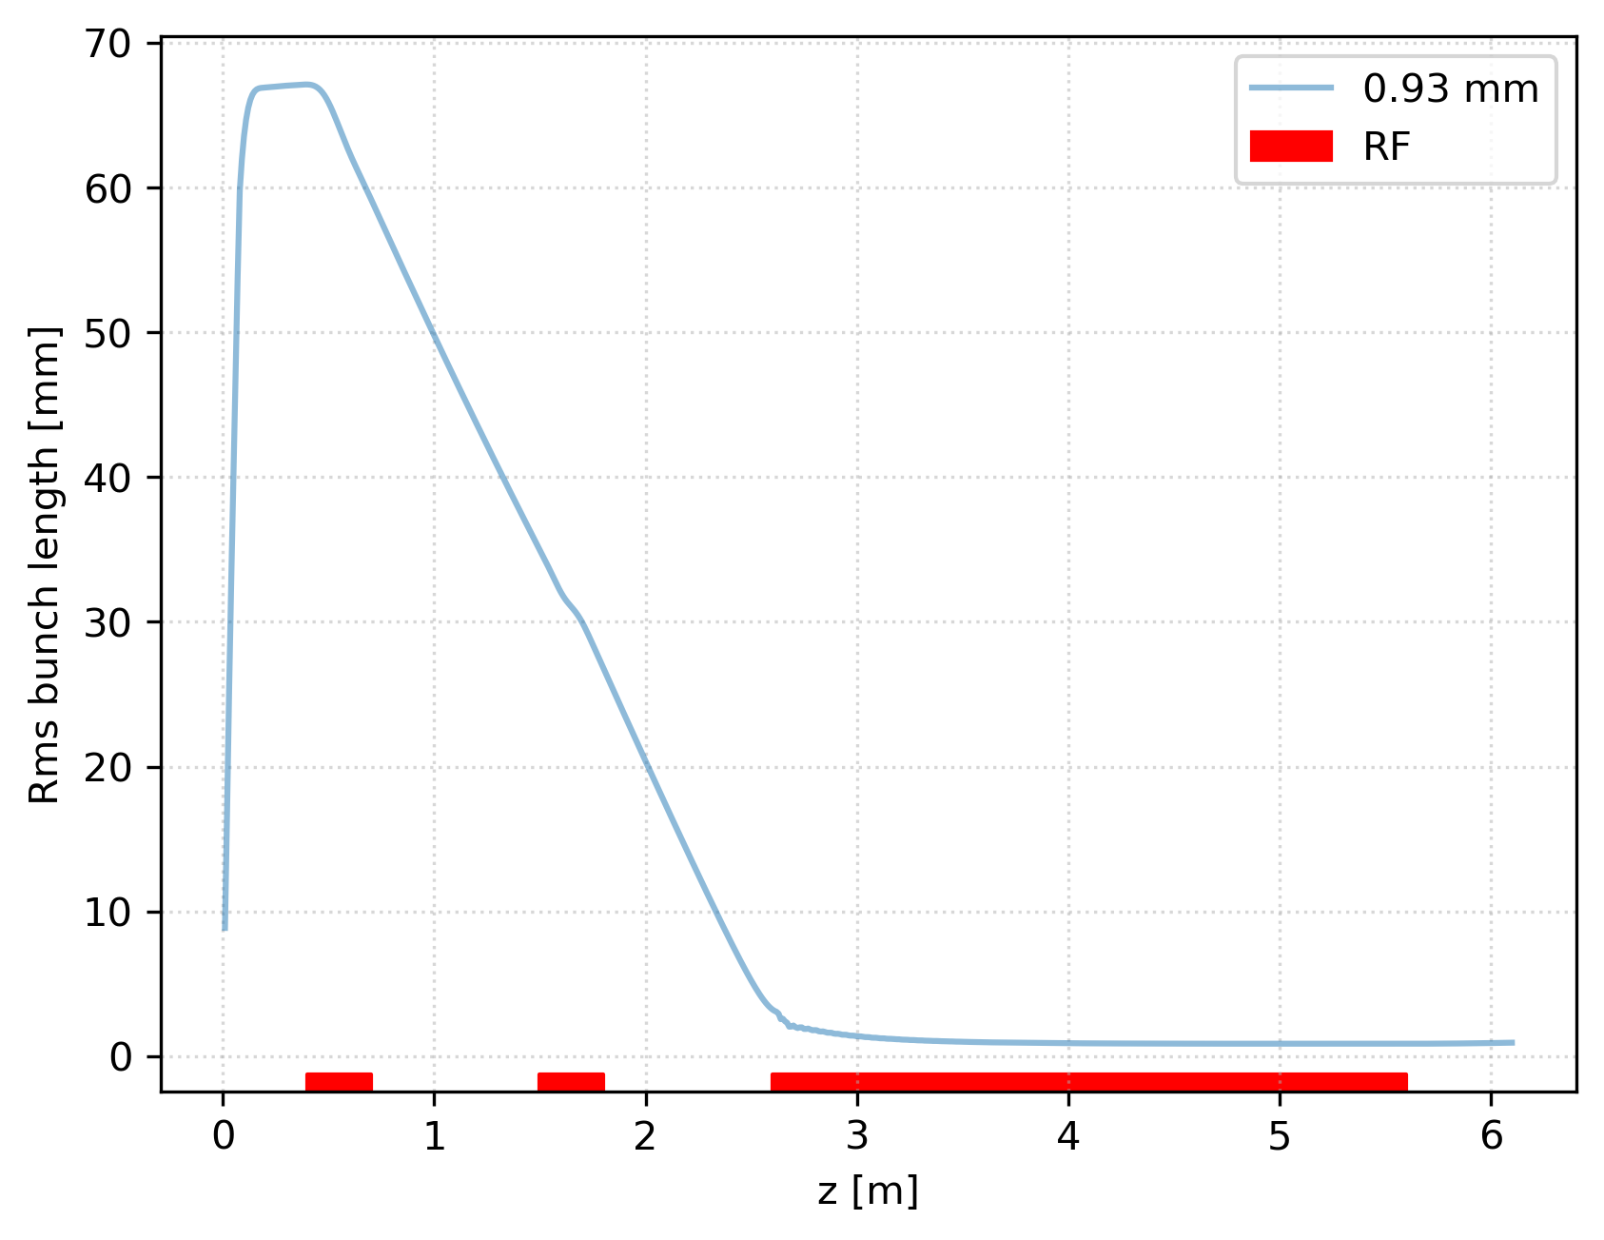
DC gun layout and design choices
Second buncher roughly at ½ of initial bunch length
No acceleration in the two bunchers: low velocity at TWS injection

