Slide 1
Dedicated AI/ML Accelerator Test Facility Workshop
July 15th-17th, 2026

Slide 2
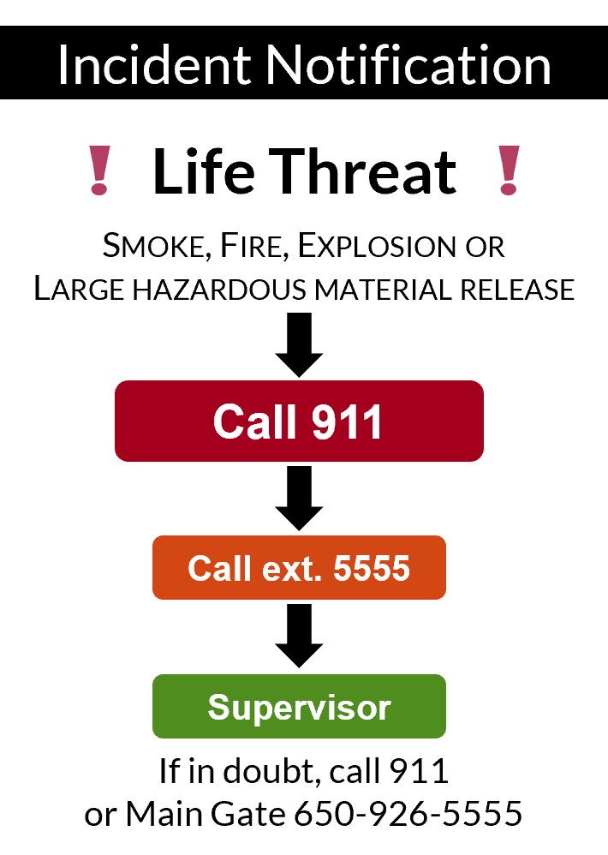
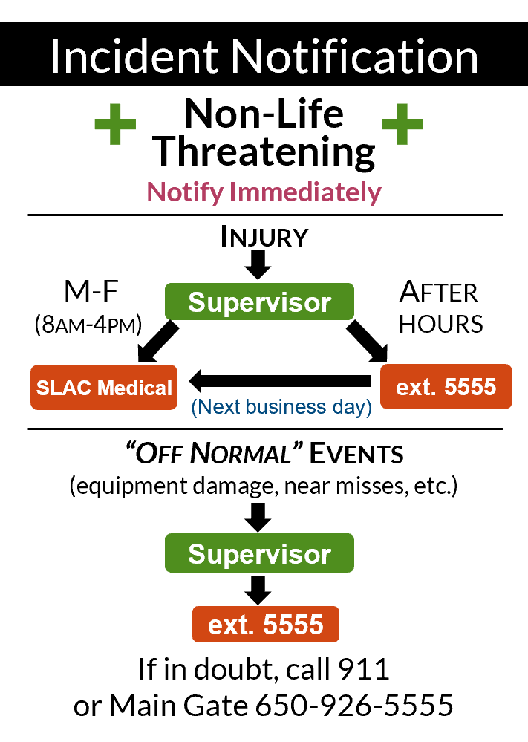
Emergency Information
Fire​
Evacuate - Be aware of building exits​
Follow building residents to the assembly area​
Do not leave until you are accounted for, and have been instructed to do so​
Earthquake​
Remain in building - duck, cover, and hold position​
When shaking stops, evacuate building via a safe route to the assembly area​
Do not leave until you are accounted for, and have been instructed to do so
Incident Notification
Dial 911 or 9-911 from any SLAC landline:
Connects you to dispatch center
Activates an alarm at SLAC Main Gate

Slide 3
Workshop Purpose
There is growing interest across the accelerator and AI/ML community in an accelerator facility purpose-built and dedicated to AI/ML testing and operations
Workshop brings together experts in AI/ML, accelerator-based science, and operations, with the aim to answer the following questions:
What would the benefit of such a facility be to the broader community?
What capabilities would be useful to test at such a facility? What current practical / science
challenges would a dedicated AIML test facility help overcome? What user science would be
enabled that cannot be done today?
What would be required to realize a fully AI/ML-integrated accelerator test facility?
What would the hardware, software, operating/governing principles, workforce / support, etc… look like? How can we enable transferability across facilities?
We will develop a public-facing white paper articulating the need, roadmap toward, and benefits of a fully AI/ML integrated test facility.
Report/roadmap are intended to be general: we expect that multiple AI/ML integrated test facilities will serve different science cases

Slide 4
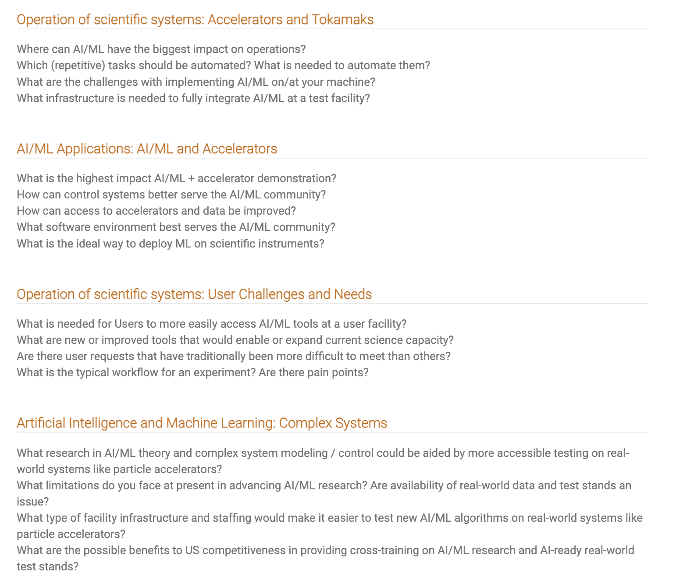
Workshop Themes / Sessions
Focus is on prospects around accelerator-based test facilities AND connections to other complex systems (e.g. tokamaks)
Heavy emphasis on discussion!
Example of questions to answer:
Several Sessions:
Operation of science facilities:
Accelerators and tokamaks
User challenges and needs
AI/ML Applications and Accelerators
AI/ML and Complex Systems Research

Slide 5
Venue and Workshop Details
When you join the Zoom connection, if you are in Redwood A/B/C/D (this room) do not join audio
  The menu can be tricky
The microphones in this room are remarkably sensitive. They pick up typing, wrappers and side conversations.
The workshop is in Redwood A/B
Food and coffee are in Redwood B/C
  If your registration says “in-person” there is lunch waiting for you.
  Ask Brendan, Auralee or Nadya how to check your registration

Slide 6
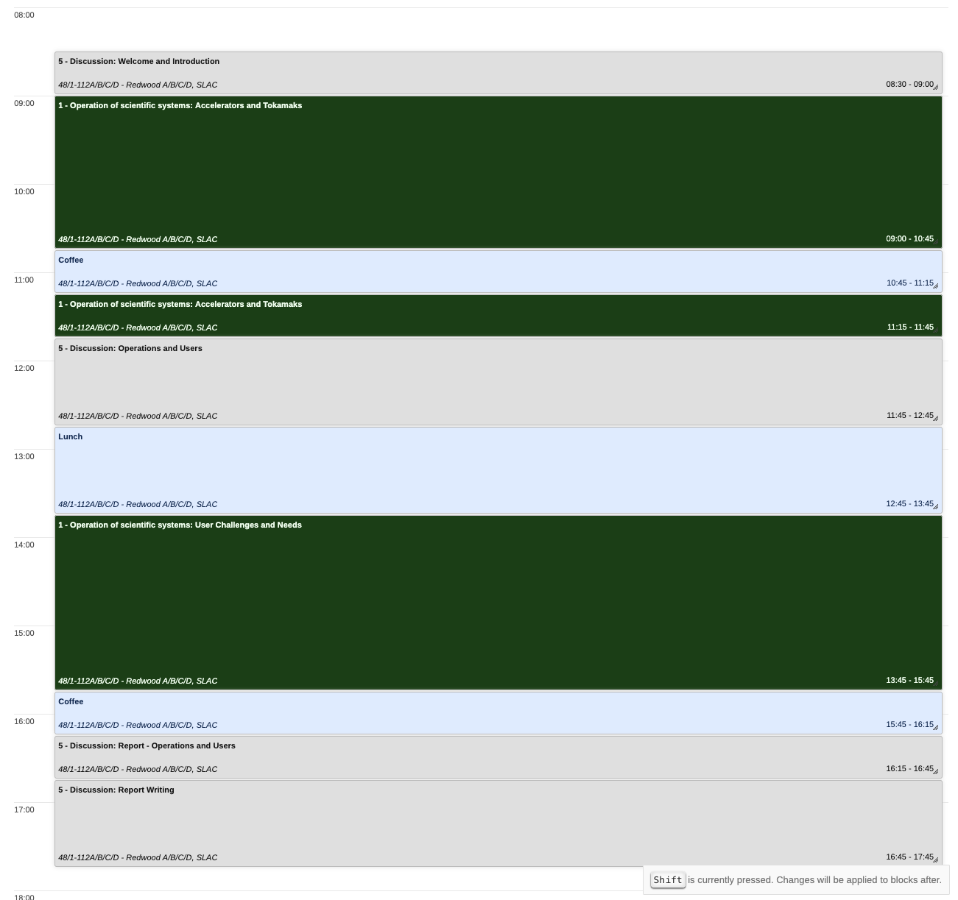
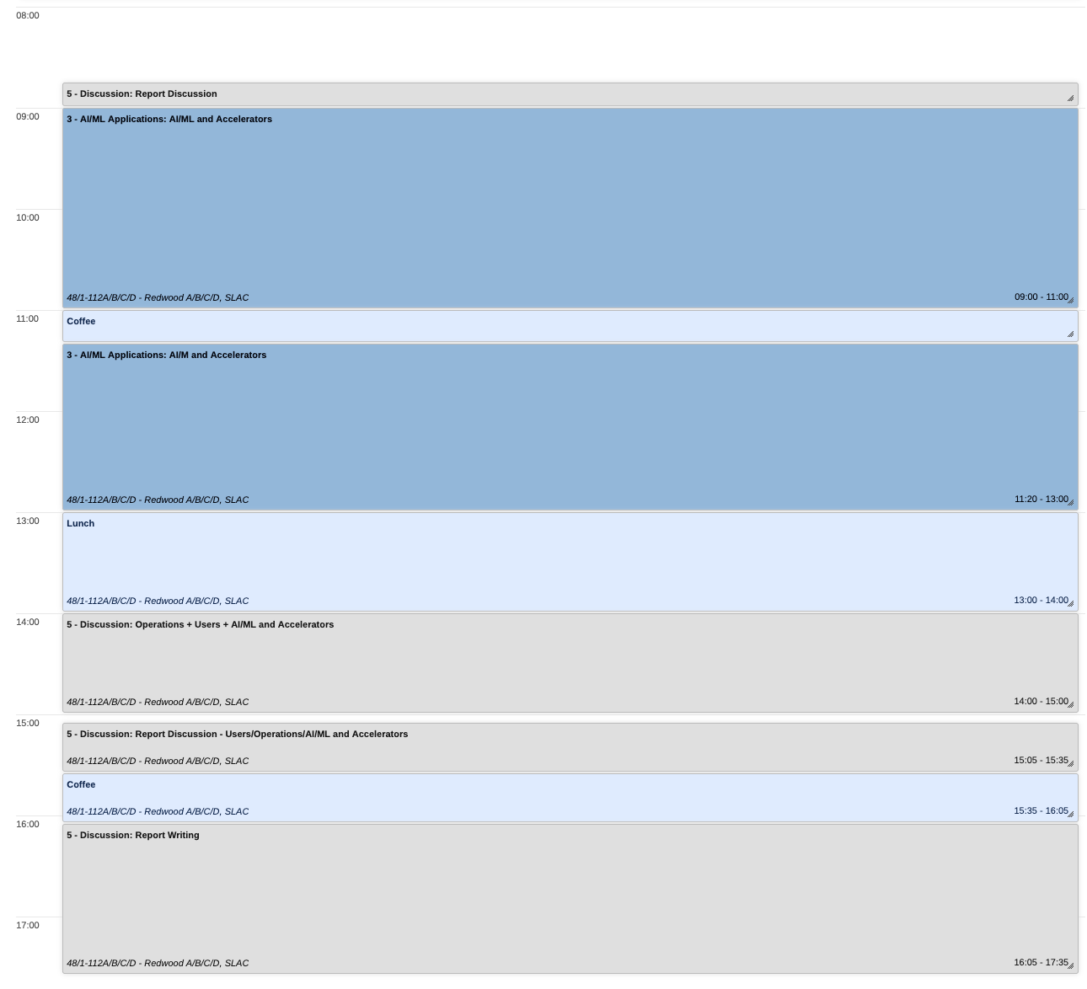
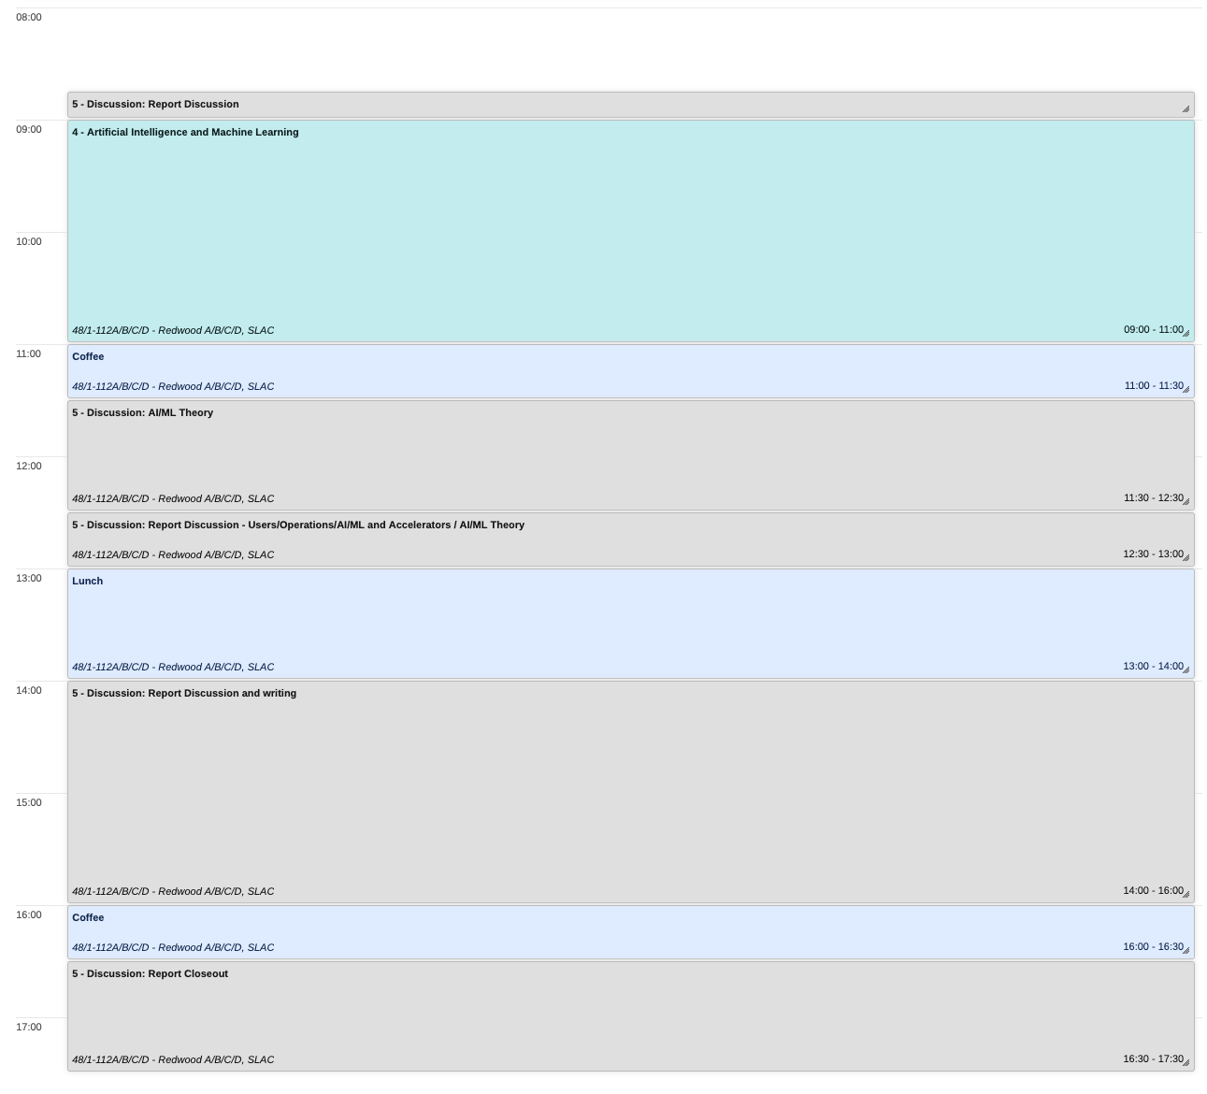
Schedule: talk sessions mixed with working / discussion sessions

Slide 7
Engagement Guidelines
Hybrid event - raise hand and we will call on you
Talks
  Purpose of the talks is to inform the broader discussions - we have a tight schedule and will keep exact time allotment for talks!
  Please post your slides as soon as possible or send to Brendan/Auralee
Critical / frank discussion is essential; please don’t be shy about speaking up
  Practical issues and barriers are just as important to discuss as AI/ML advances
  Anyone can contribute to notes documents (see email for link)
We will have brief discussion sessions each morning / throughout the workshop to address any arising topics
Wrap up after workshop: Please continue working with us to finalize the report. All contributions welcome, even from non-attendees.

Slide 8
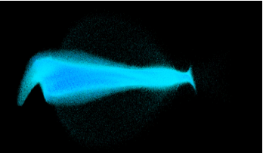
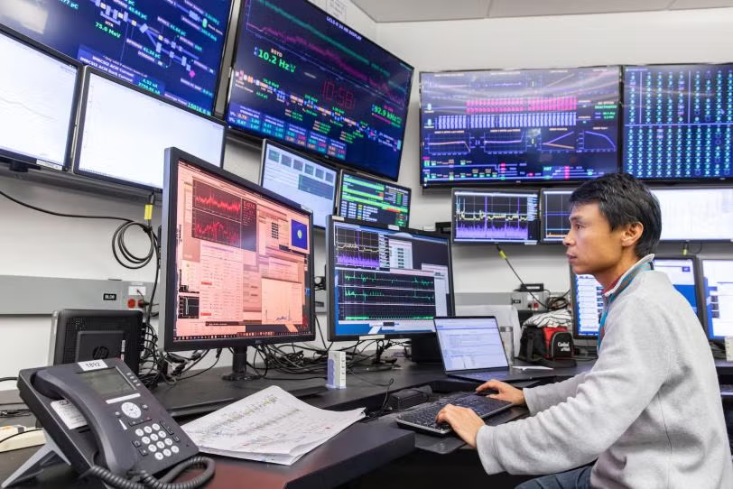

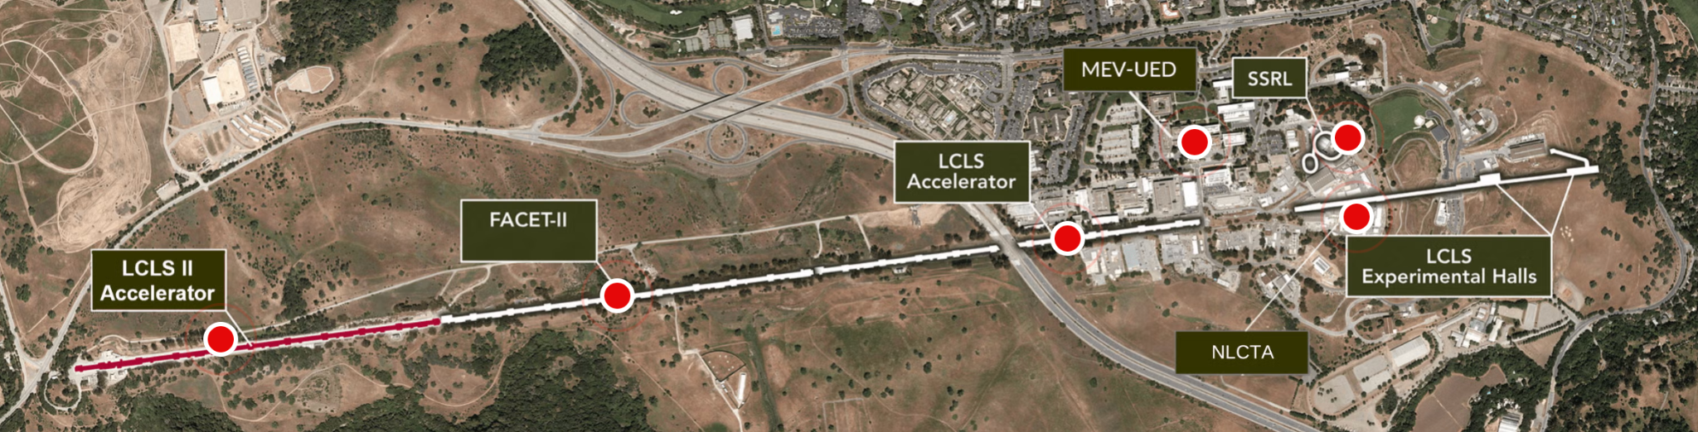
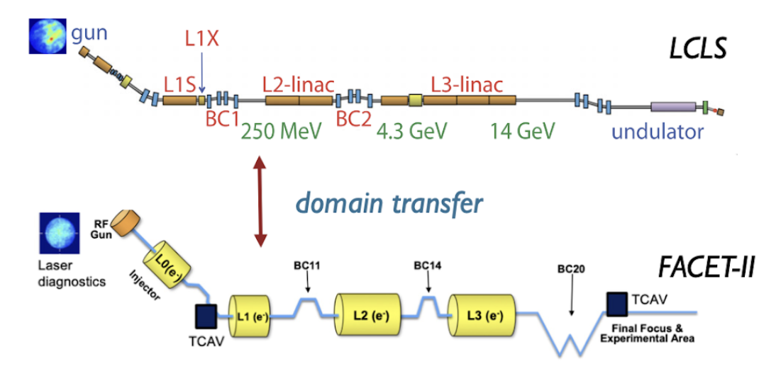
Particle Accelerators
Play a key role in science, industry, and medicine
  45 Nobel Prizes use accelerators
Wide range of science missions and characteristics
Accelerators are complex systems: millions of variables, multiple timescales, multiple output objectives for experiments, need for rapid reconfiguration, nonlinear beam behavior, incomplete diagnostic information
The beam itself is an interesting high-dimensional target: partially observable 6-D position-momentum phase space
For new science: increasingly challenging beam parameters and dynamic control are needed
Interesting test-bed for AI/ML techniques and software frameworks / ecosystems
  Complex system but can interact with directly and monitor comprehensively
  High-dimensional control, multi-modal representation learning, continual learning, physics-informed ML, edge-to-exascale workflows, agentic systems, human-centered AI, simulation based inference, inverse problems, etc …

Slide 9
Examples of practical challenges encountered over the years at SLAC in deploying AI/ML
Issue: need dynamic software environments on control system + continuous integration / deployment (CI/CD)
Current solution: nightly github actions workflow + container mimicking control system → custom conda env to prod. automatically
Issue: data synchronization and archiving, 1 Hz scalar archive not sufficient for complex beam behavior
Current solution: beam synchronous data archives (120Hz for LCLS, 10Hz for FACET etc) supplementing 1 Hz and including images (but still not unified across all variables)
Issue: numerous small “gotcha’s” in real-world testing; need to test realistic machine behavior, software stack, and algorithms
Current solution: physics + ML based virtual accelerators with 1-1 EPICS interface to real system, test in control system container
Issue: legacy compute on control system insufficient; need low-latency compute for heterogeneous compute tasks (CPU/GPU) and on-demand / quasi-real-time responsiveness (< 1 sec max)
Current solution: SLAC S3DF compute vcluster (CPU/GPU + kubernetes) and local GPU/CPU on control system
Issue: robust software systems needed, requiring sustained effort on building / maintaining / integrating new developments
Current solution: close partnership with SWE teams, cross-trained SWE/physics/AIML team members, dedicated funding
Issue: larger than ideal separation between accelerator operation and user needs; need more direct link between user science and accelerator requirements/operations; need to combine accelerator + user beamline control
Current solution: exploratory work in joint accelerator + user beamline tuning with direct joint funding support, exploratory efforts linking data acquisition more closely (make more user-side signals available in ACR and vice versa)

