Slide 1


Jean-Luc Vay
Advanced Modeling Program
Accelerator Technology &
Applied Physics Division
Overview of AI for accelerators
within the US DOE Genesis Mission
Dedicated AI/ML Accelerator Facility Workshop
SLAC - July 15-17, 2026

Slide 2
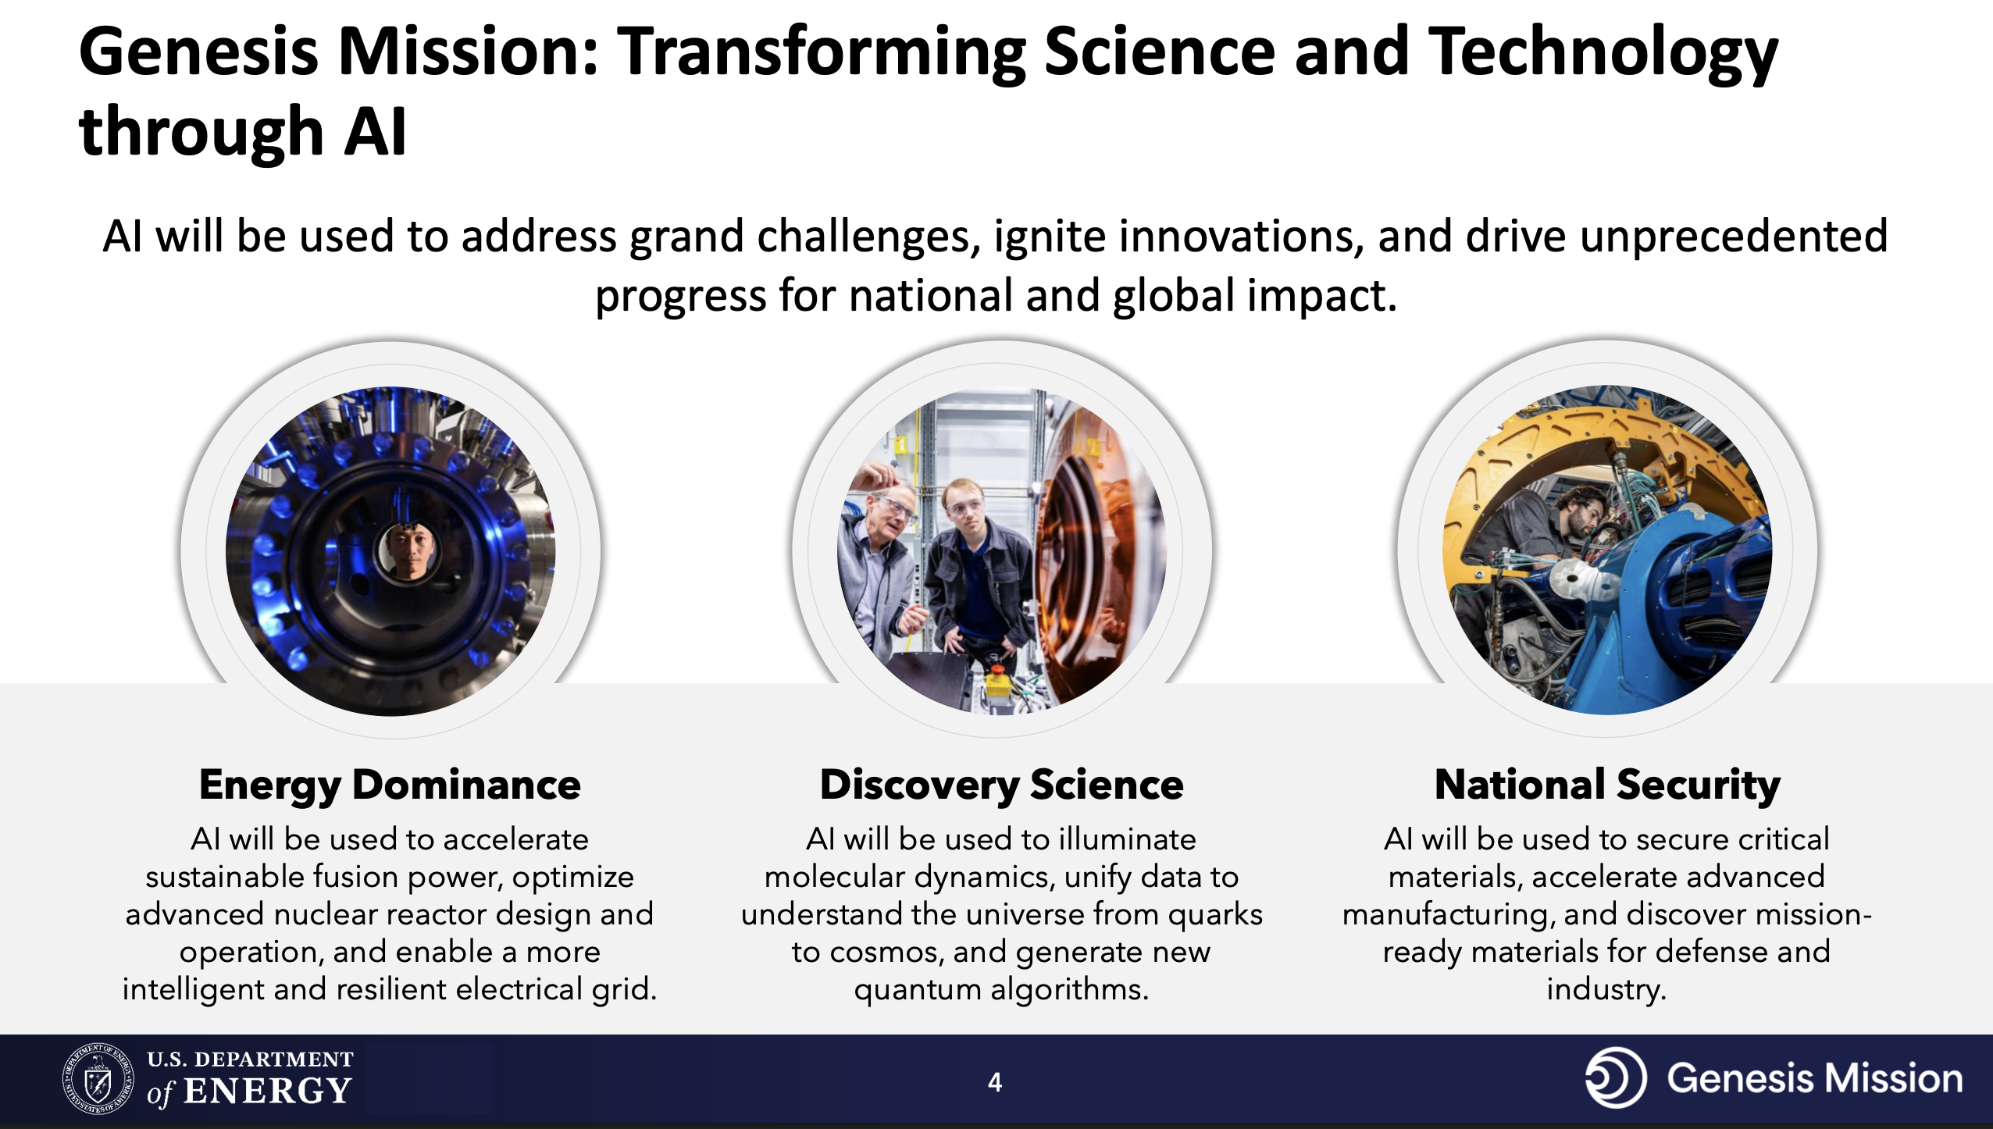
Genesis Mission: A National Mission to Accelerate Science Through AI
New applications require increasingly precise control and challenging-to-achieve beam characteristics
Fermilab
https://genesis.energy.gov
SNS
IOTA

Slide 3

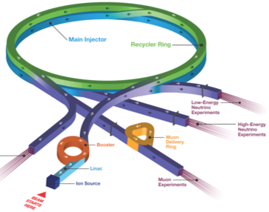
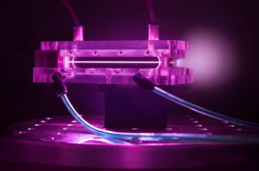




AI is Ideally Suited to Transform Accelerators and Applications
New applications require increasingly precise control and challenging-to-achieve beam characteristics
Long-term vision: AI becomes indispensable partner in accelerators
  Full lifecycle, from design to operation to R&D and workforce development
Many benefits expected to come from AI assistance and control, e.g.:
  Novel designs with integrated optimization
    Including end-to-end, detailed physics, cost, safety, etc
  Faster designs (spans years for largest accelerators, which are among the most complex machines)
  Higher efficiency and performance
  Unprecedented on-demand beam customization and beam quality
  Higher precision (control, pointing, etc)
  Automated failure prediction and prevention
  AI-assisted to fully autonomous operation
  …
  Better colliders, light sources & accelerators for many applications, e.g.:
  DOE accelerator-based science
  Nuclear waste transmutation
  Advanced reactor and fusion concepts
  EUV lithography
  Advanced manufacturing
  Ultracompact accelerators for medical and industrial use
Fermilab
LCLS
SNS
IOTA

Slide 4
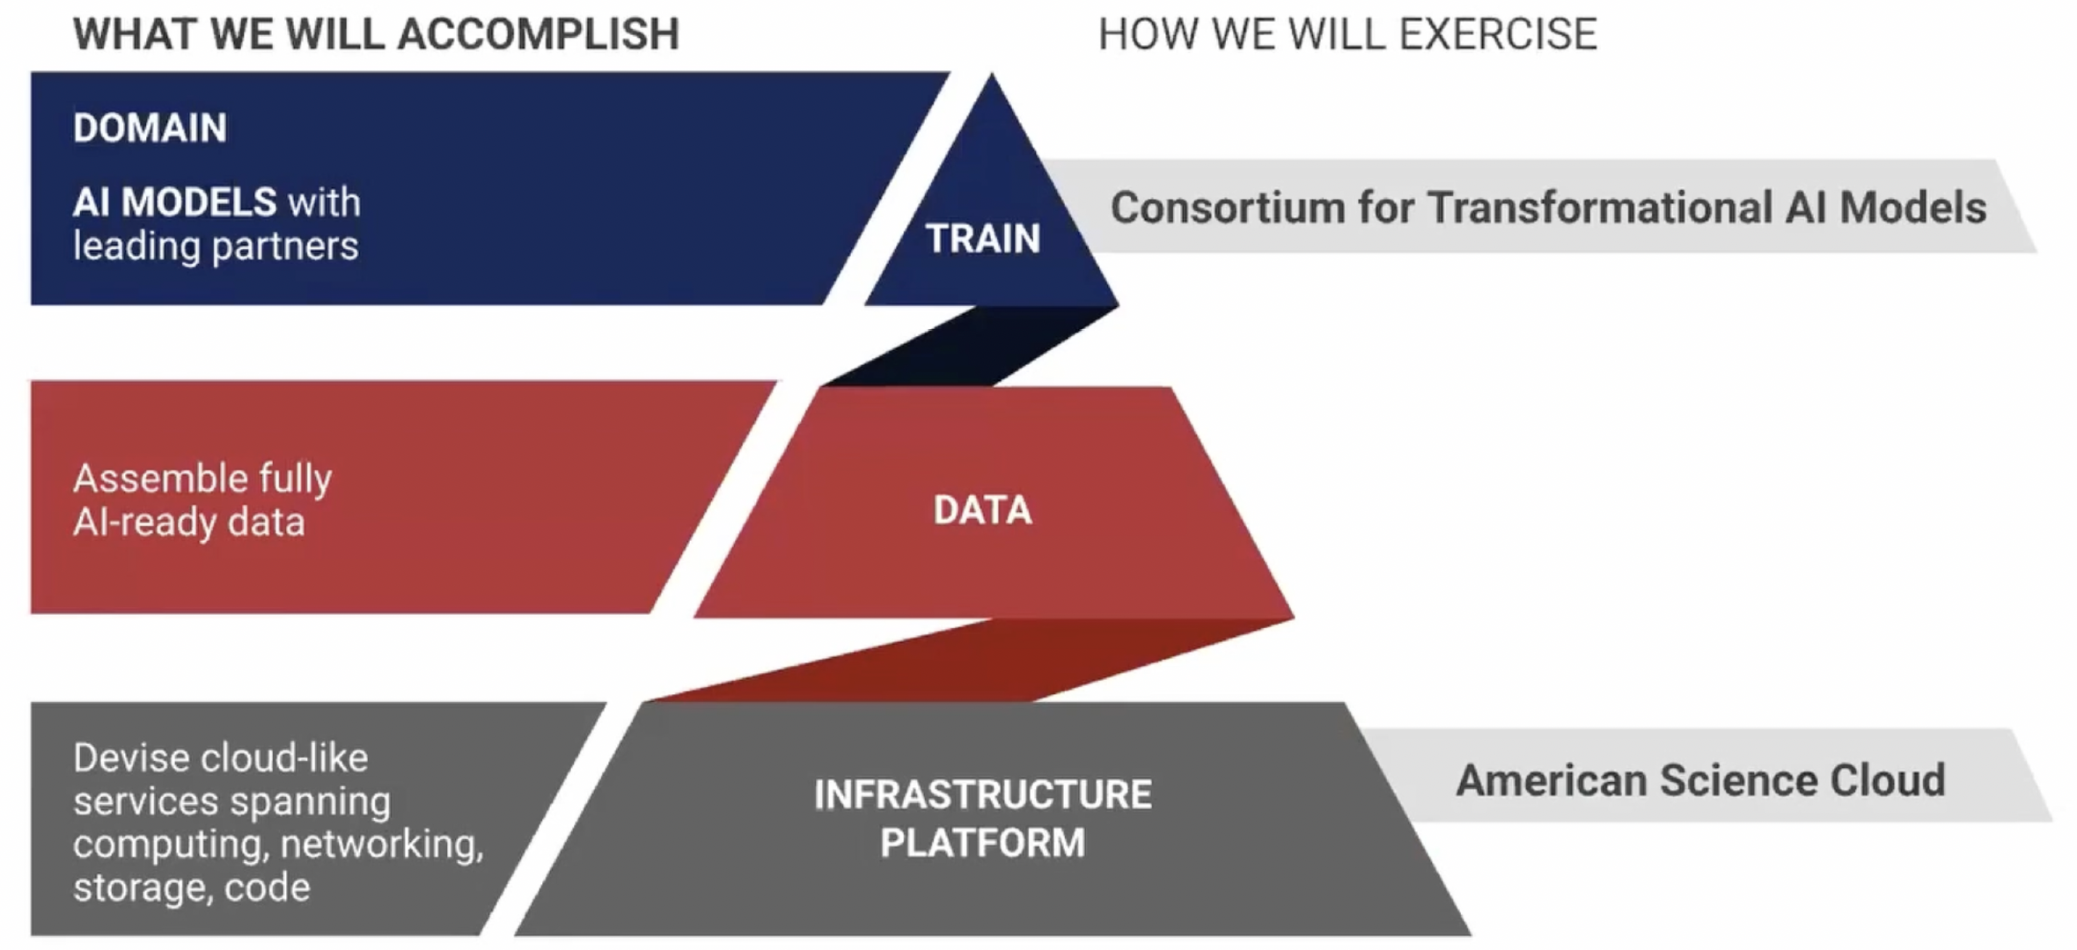
Genesis simplified structure*
(ModCon)
Standardization, AI-readiness
(DaPP)
(AmSC)
*From "Introduction to the American Science Cloud (AmSC) : Part One” – 11/13/2025
https://vimeo.com/1137699305

Slide 5
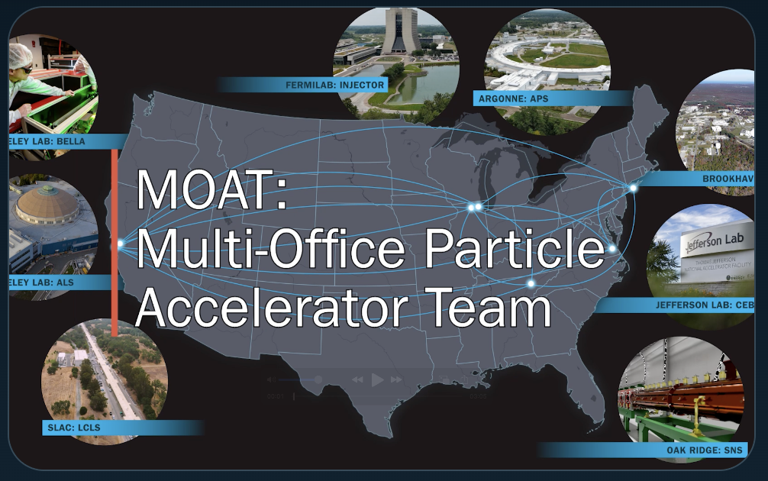
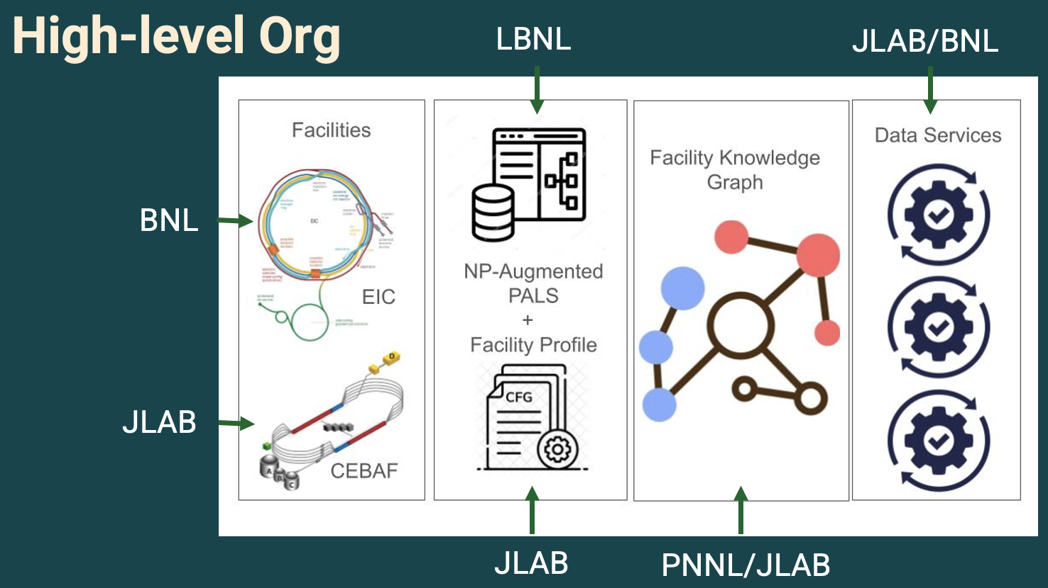
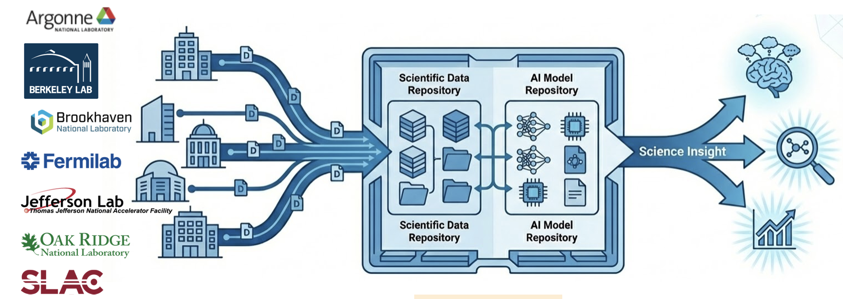
Initial accelerator projects embedded at all levels of Genesis
Multi-Office Accelerator Team (MOAT) seed
Oct. 2025-Jun.
2026
+?
7 nat. labs: LBNL, ANL, BNL, FNAL, JLAB, ORNL, SLAC (BES+HENP)
Deployment of shared accelerator agentic AI software across facilities (8 to date)
Deployment of digital twin prototypes across facilities (3 to date)
Nuclear Physics AI-Ready Accelerator Data (NARAD)
JLAB, BNL, LBNL, PNNL; (HE)NP-focused, but coordinating with all US accelerators
Augments the Particle Accelerator Language Standard (PALS) with facility‑specific profiles and a shared ontology; Delivers cross‑facility knowledge graph tools that supports subgraph extraction for diagnostics/optimization tasks
2025-2027
AmSC Scientific User Facility IP
7 nat. labs: LBNL, ANL, BNL, FNAL, JLAB, ORNL, SLAC (BES+HENP)
Establish Genesis as a shared platform to host and distribute AI models and scientific data for (mostly accelerator-based) BES, HEP, and NP Scientific User Facilities (SUFs), along with their industry and research partners
2025+

Slide 6
Focus on MOAT-seed

Slide 7
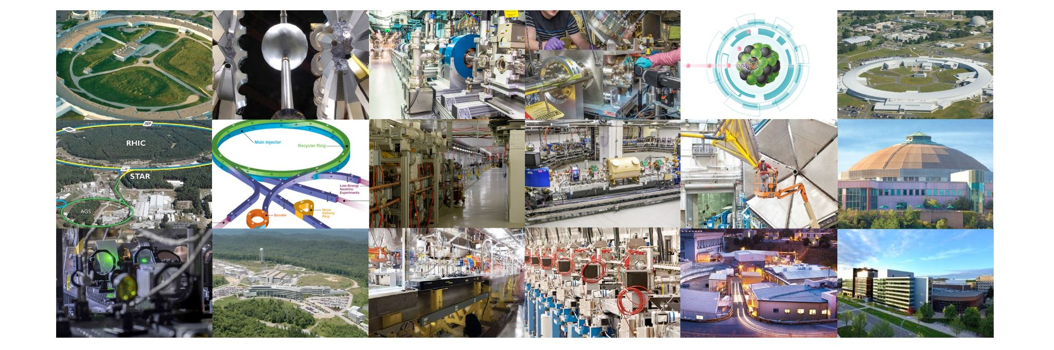
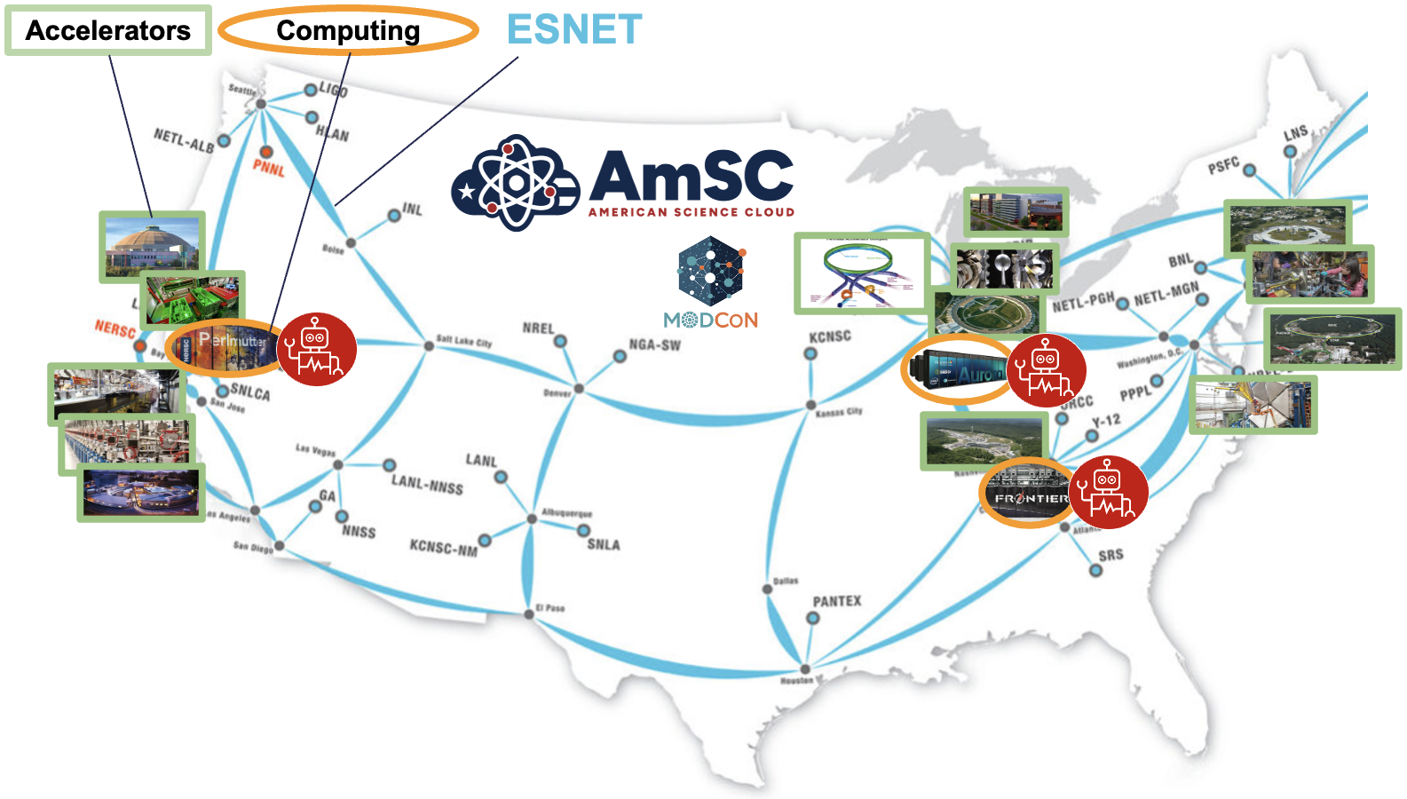


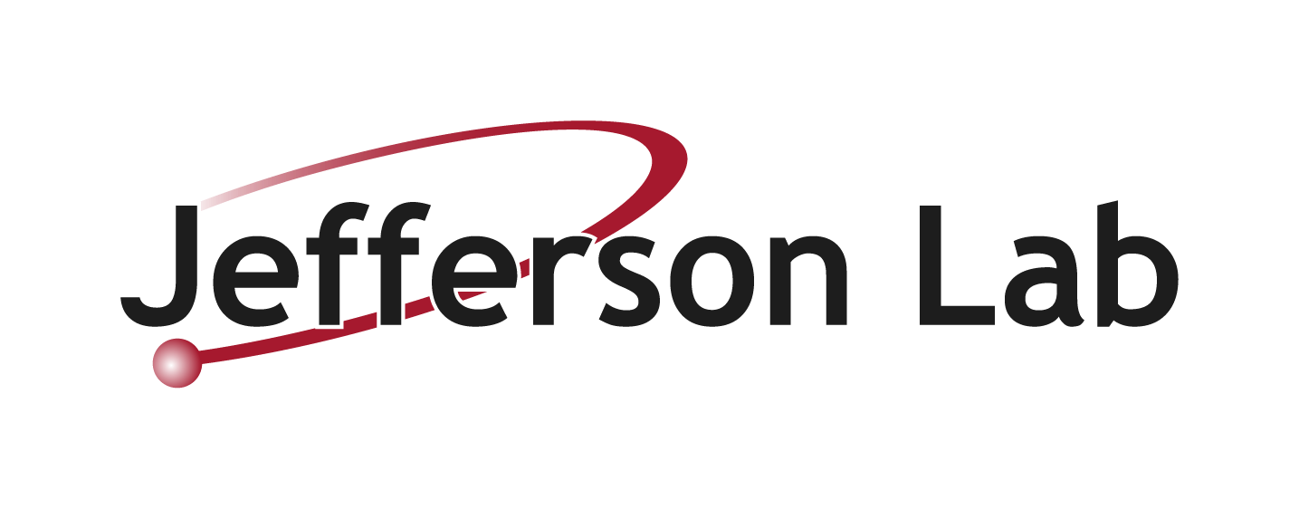



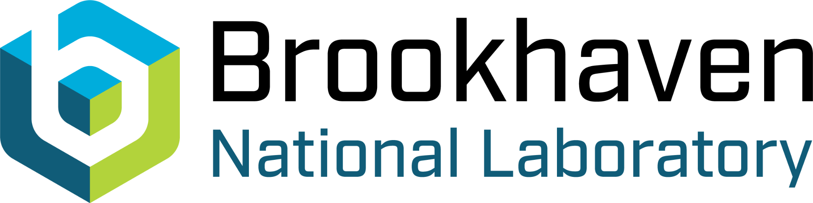
The Multi-Office Accelerator Team (MOAT-seed) project at a glance
Brings together DOE BES, HEP and NP
  7 national labs: LBNL+ANL+BNL+FNAL+JLAB+ORNL+SLAC
Vision: treat nation’s accelerator ecosystem as a single, intelligent system
  using AI to connect expertise across labs and offices
  views large accelerators as complex, dynamic socio-technical systems
    distributed teams of teams, thousands of physical components, vast stores of scientific knowledge, rigorous safety and management frameworks
The MOAT-seed project built initial foundations toward vision
  deployment of shared accelerator agentic AI software across facilities (8 to date)
  deployment of digital twin prototypes across facilities (3 to date)
  conceptualizing tools toward AI-assisted accelerator designs
Genesis Mission’s AmSC+ModCon provide the interconnecting tissue of computing + AI capabilities
IOTA

Slide 8
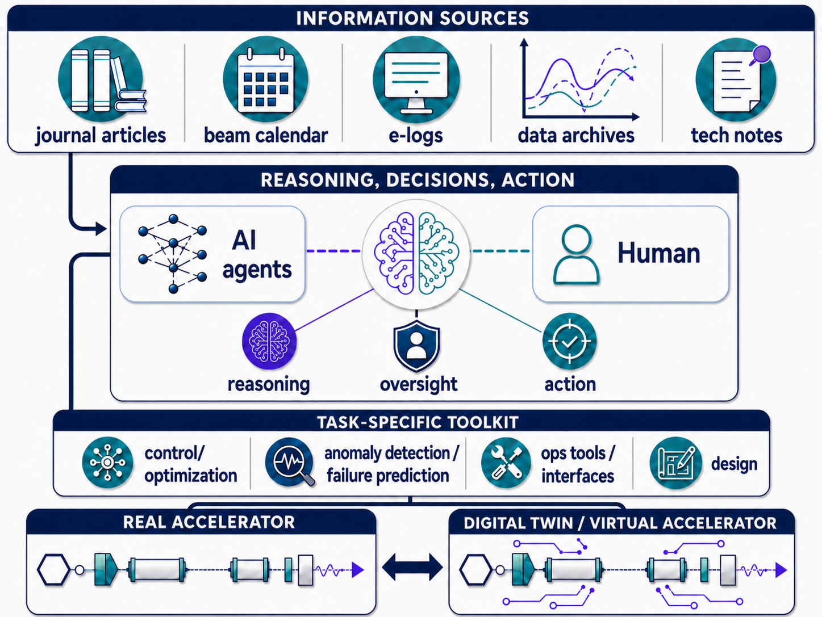
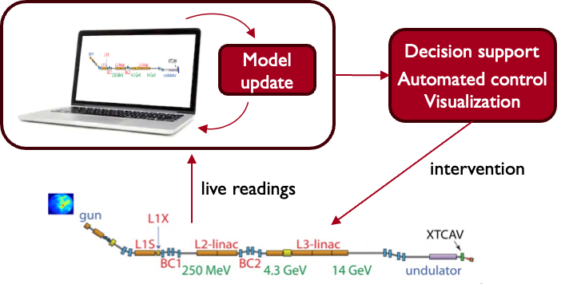
MOAT focus: develop AI framework around Agentic AI
Codes
source/doc
AI agents* use information sources and tools to assist accelerator activities:
design
tuning
anomaly detection & prevention
workforce development
…
The MOAT-seed project (Oct. 2025-Jun. 2026) developed foundations and demos
*Powered by the LBNL-led Osprey agentic framework https://github.com/als-apg/osprey

Slide 9
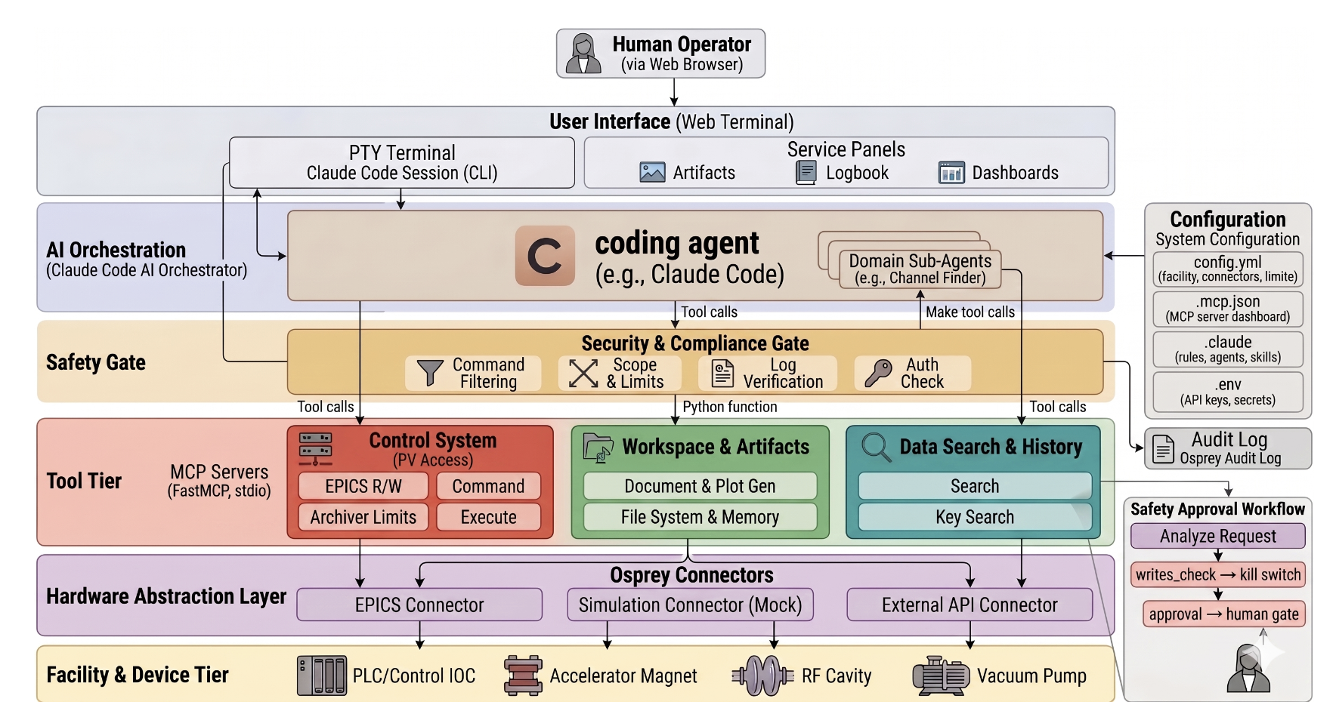
Osprey agentic AI architecture during the MOAT seed
T. Hellert, et al, “From Natural Language to Control Signals: A Conceptual Framework for Semantic Channel Finding in Complex Experimental Infrastructure,” https://arxiv.org/abs/2512.18779

Slide 10
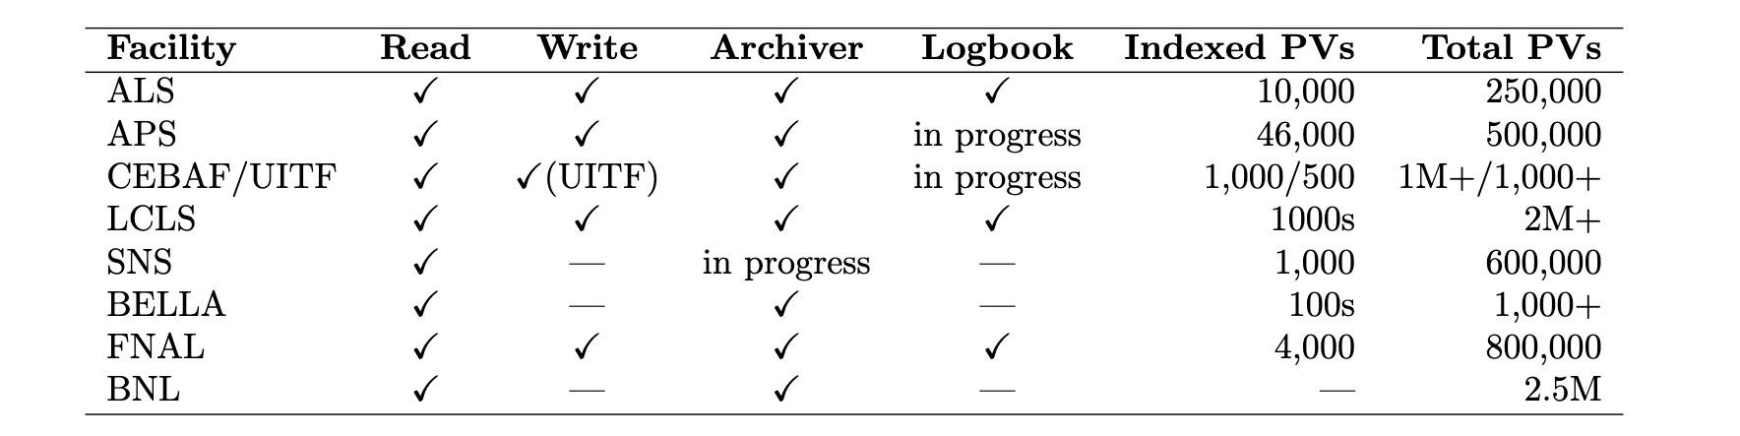
MOAT Seed Results Overview
Osprey AI agent deployed across > 10 DOE accelerator facilities to streamline operations
tasks and provide a natural language interface
Improved cross-coordination across DOE labs
in AI/ML for accelerators → substantial benefit to making progress on shared challenges and solutions
Osprey deployment as of May 2026. Same codebase runs at each site.
Demonstrated AI advantages across multiple aspects of accelerator design and operation, including:
  Reduced computational and time cost relative to present expert-driven operations and design workflows
  Improved quality and speed of beam delivery
  Improved breadth and speed of accelerator design-space exploration, leading to improvement in solution quality
  Increased levels of agent autonomy in complex operations and design tasks
  ⇒ All of the above can lead to faster time-to-science and improved science outcomes
Specific highlight examples in operation and design on next 3 slides

Slide 11
MOAT Seed Results: Operations (1/2)
Autonomous measurements and characterization
  At ALS (LBNL), Osprey autonomously executed a full insertion-device hysteresis measurement from a single natural-language prompt, ~100x faster relative to a human expert doing it manually
    The agent resolved candidate process variables (PVs) across ALS, retrieved archive data, generated a scan script, and executed it under operator approval, returning a publication-quality hysteresis plot.
  At APS (ANL), Osprey autonomously executed emittance measurement and analysis tasks that previously required human experts, reducing execution time by 2x while significantly improving accessibility, reproducibility, and frequency of beam-quality characterization and logging
  At JLAB, Osprey autonomously executed orbit response matrix measurements and emittance measurements, greatly improving accessibility and speed of conducting routine beam characterizations.
Autonomous optimization / control
  At LCLS (SLAC), Osprey was set up to launch complex optimization routines in the Badger tuning software from a simple natural language task description
    Resolving a long-standing barrier to AIML adoption in the control room
    Yielding 1.5x improvement in FEL pulse intensity 5x faster than it would take an operator to set up and run the software
    Used previous history of optimization runs to inform appropriate variables to use, setting ranges, algorithm, and objective/constraints for the particular task
These results demonstrate the potential of agentic AI to improve
the speed / quality accelerator tuning, measurement, and characterization

Slide 12
MOAT Seed Results: Operations (2/2)
Osprey was integrated with numerous laboratory control systems to complete various types of tasks in comprehensive information synthesis, analysis, and search
  At FNAL, Osprey acted as a first-of-a-kind AI cross-context auditor to enable nearly 200x faster downtime attribution
    Osprey detected extended no-beam intervals and cross-referenced them with elog records, identifying in minutes likely causes of downtime (vs. several hours for two to three operators)
    Enables faster downtime attribution, better use of operator expertise, and data-driven allocation of maintenance effort
New capabilities in operations workflows through natural language queries
  At ALS (LBNL), Osprey was linked to ten thousand PVs enabling natural-language querying, analysis, and visualization of machine behavior
    E.g., ``query the beam current over the past month, find the lowest dip occurrence, and plot it with an hour timeframe around''
  At APS (ANL), it interfaced with the elog enabling more thorough natural language search
  At RHIC (BNL), it was integrated with tools for parameter editing, live monitoring, and historical data visualization and used for automated retrieval and summarization of elog and parameter data from machine component databases
  At JLAB, Osprey was used to analyze and troubleshoot operational data, automatically flagging and returning statistics about anomalous BPM behavior
    E.g., fitting oscillations observed, identifying times where oscillations were occurring vs. flat
These results highlight the ability of agentic AI to improve
the speed and comprehensiveness of complex operations analysis tasks

Slide 13
MOAT Seed Results: Design
Greater simulation and search efficiency
  Nonlinear optics design for rings (SLAC)
    400x fewer physics simulations required for SSRL-X ring design
    50-80% improvement in solution quality on a resource-constrained task where previous methods failed
Design with a high degree of autonomy
  Optics design for PIP-II (LBNL)
    Asked agent to design a beam matching section of the PIP-II beamline entirely from scratch, providing the information needed to run simulations (github repo and documentation) and ability to run code on HPC
    Found similar quality solution in ~15 minutes with a high degree of autonomy
⇒ Speedup of > 50x compared to person-hours that would have been required
  Magnet design for rings (ANL)
    Demonstrated agent using Retrieval Augmented Generation (RAG) for domain-specific knowledge (manuals/procedures) and MCP to use simulations and external tools and successfully complete a magnet and optic design
These results show AI agents can accelerate design optimization, reduce simulation cost, broaden design-space exploration, and take over time-consuming accelerator-design tasks with a high degree of autonomy

Slide 14
Looking forward

Slide 15
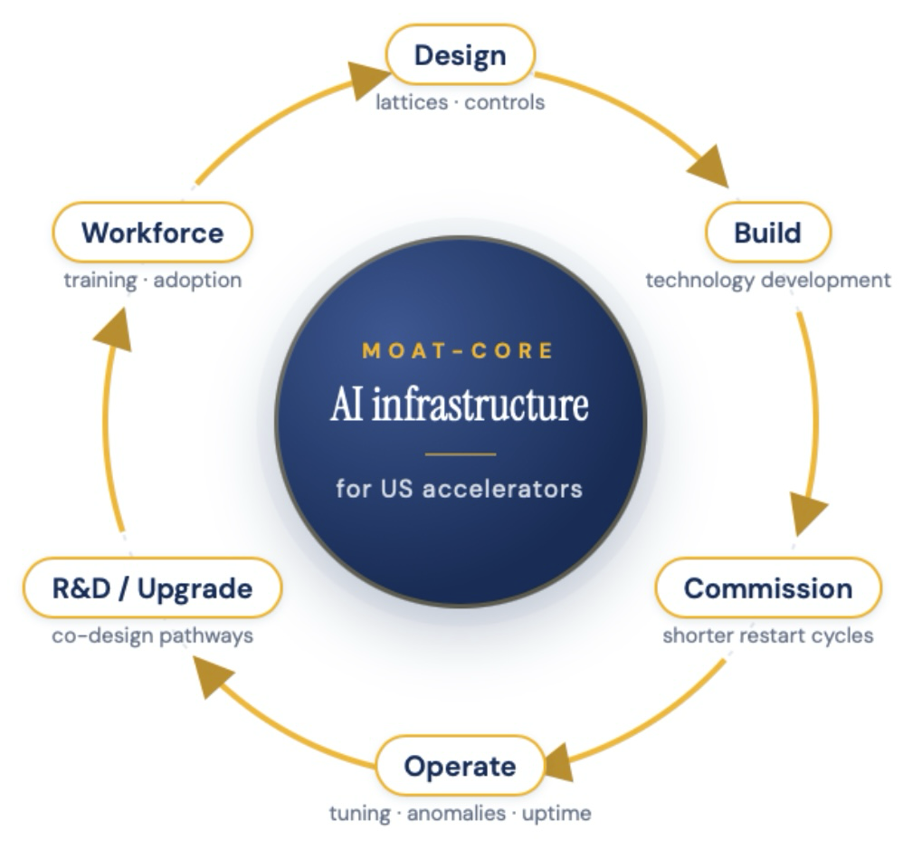
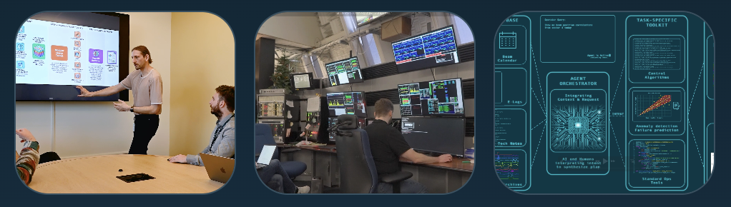

MOAT is expanding into a cross-projects, cross-facility collaboration extending to additional labs, universities and industry
The MOAT Collaboration
Focus on shared infrastructure
& coordination of AI-enabled accelerator work
MOAT connects institutions, workflows, tools, technical
knowledge so progress can be reused across facilities
More info: https://moat-ai.github.io
moat@lbl.gov

Slide 16
Thank You!

Slide 17
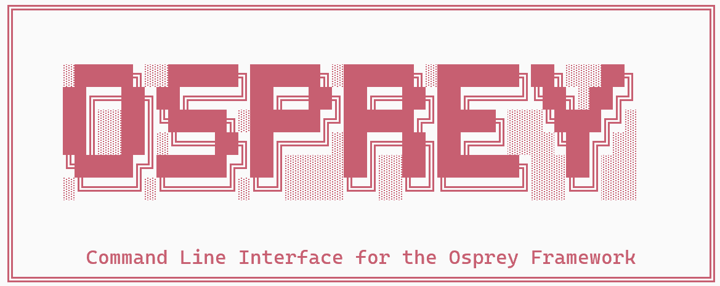


March Demo(s): MOAT in coordination with AmSC SUF
Deployment of agentic platform at 8 sites (MOAT), digital twins at 3 sites (MOAT+AmSC SUF IP)
Deployed agentic platform Osprey at multiple facilities
Supports accelerator operations @ LBNL (ALS, BELLA), FNAL (Accelerator Complex, FAST), ORNL (SNS), ANL, (APS), SLAC (LCLS), JLab (CEBAF, UITF), BNL (RHIC/EIC)
Uses MOAT’s Osprey framework (initially developed at LBNL/ALS)
⇒ outperform ad-hoc workflows based on fragmented institutional knowledge that operators currently rely on*
Operator query
Operator validates and executes
Agent retrieves and analyzes data (from archives, live control system, logbooks)
Agent proposes hypothesis or action
*”the preparation effort is reduced from what would typically take several hours of manual scripting and debugging to only a few minutes from a single natural language prompt—a speedup of 2 orders of magnitude.”
T. Hellert, PRR 8, L012017 (2026).
Digital twin demos at subset of facilities (collab. AmSC SUF IP)
HPC integration (e.g., IRI, Perlmutter@NERSC)
Deploying at LBNL (BELLA), FNAL (FAST), SLAC (LCLS)
Ongoing: ML model retraining (coord. w/ ModCon BASE SIM)
Ongoing: Linking digital twin to Osprey agents
17

Slide 18
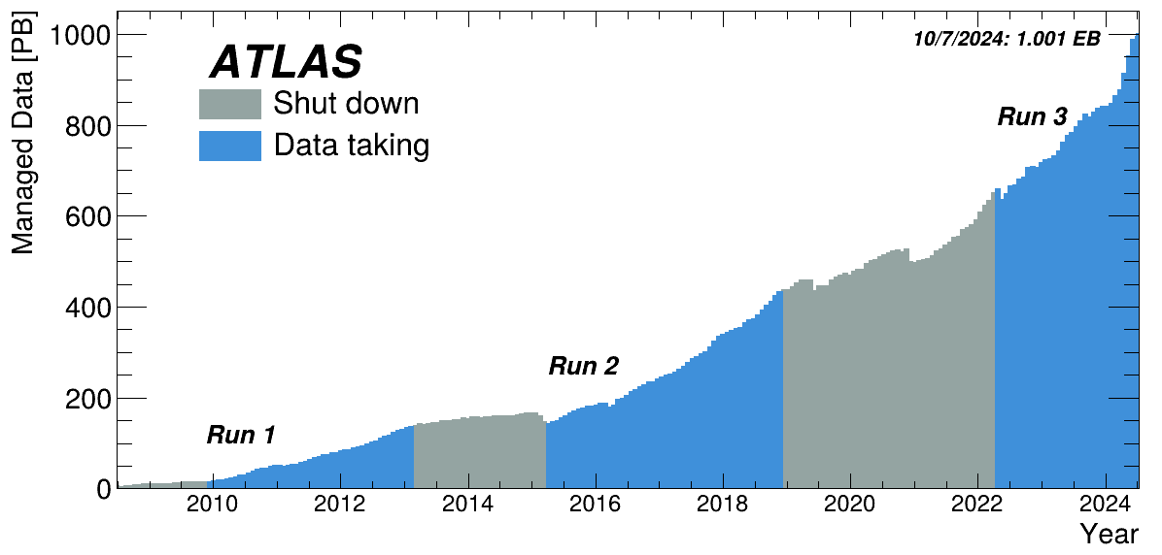
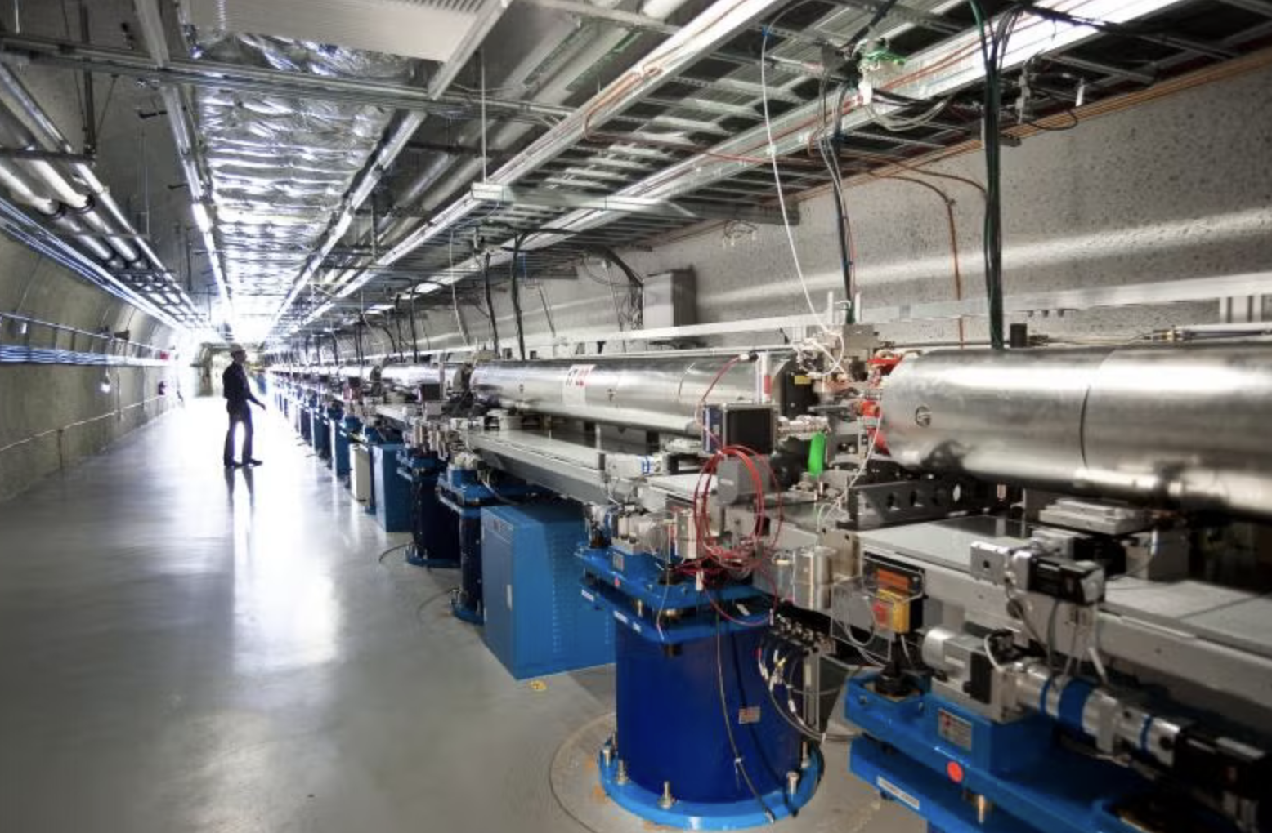


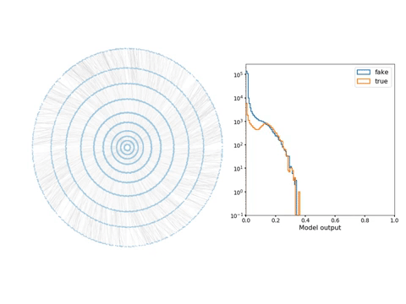
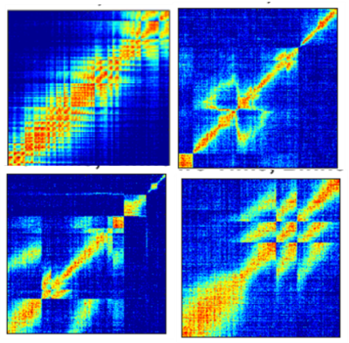
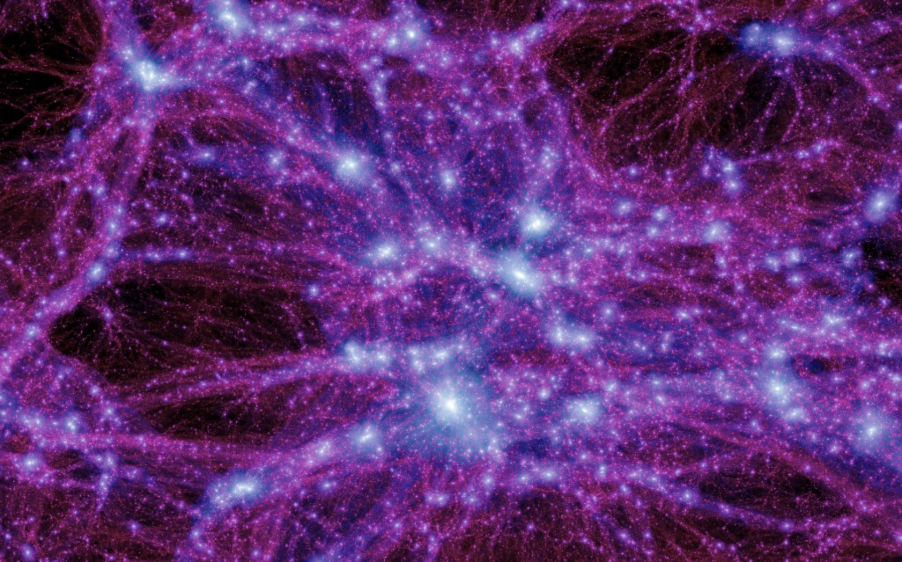

From Data to Insight: The AmSC-SUF Partnership
Our goal is to establish Genesis as a shared platform to host and distribute AI models and scientific data for the research communities of multiple accelerator-based BES, HEP, and NP Scientific User Facilities (SUFs), along with their industry and research partners.
Initial Representative Demonstrators
D1: Agentic Accelerator Controls
D2: Cross-Facility Data Ingestion
D3: Inference for HEP/NP Data
Exabytes of Data
High-quality scientific datasets
D4: Light & Neutron Sources
D5: OpenCosmo in AmSC
AI Models
Hundreds of production workflows
These demonstrator datasets and models provide the real-life requirements and benchmark solutions needed to design and validate AmSC Science Services with the Genesis Platform.

Slide 19
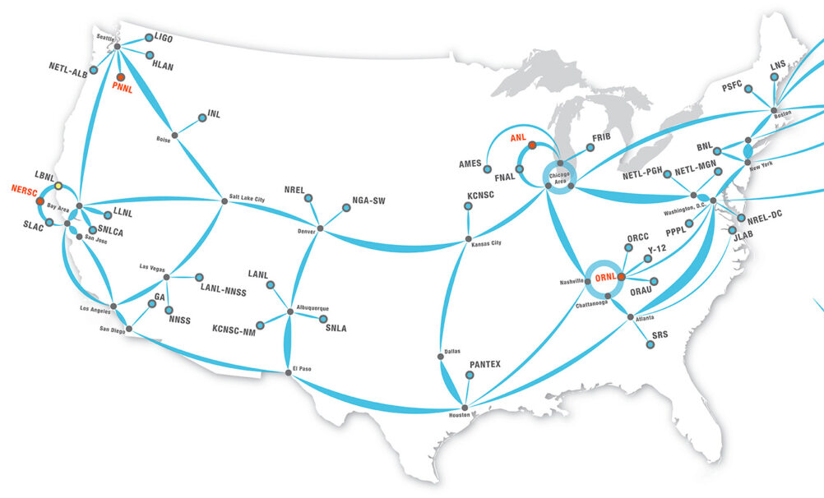

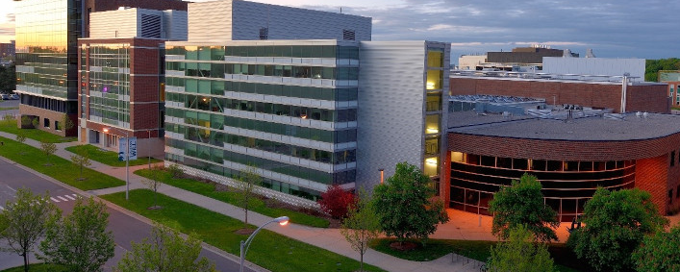
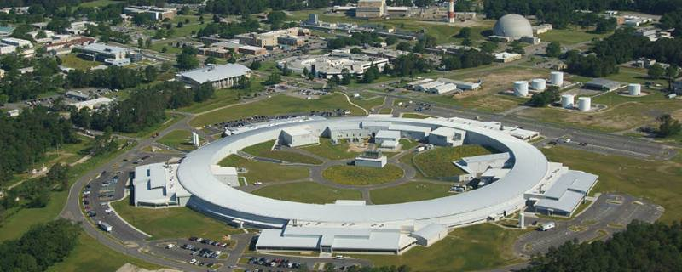
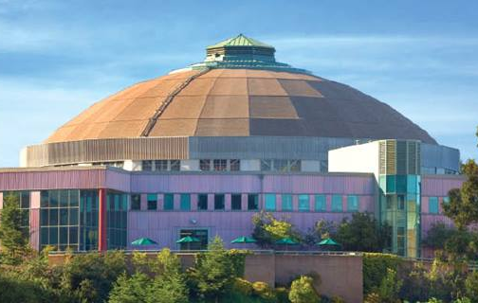

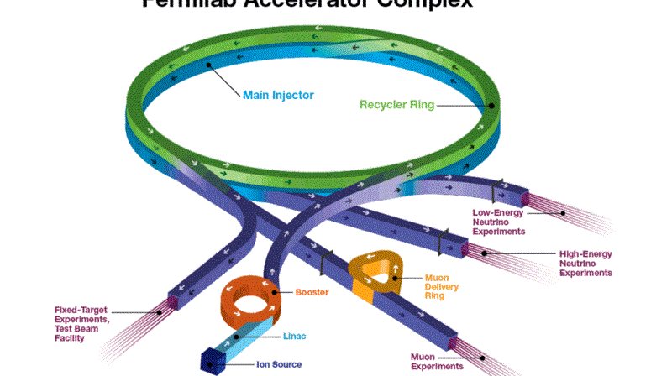
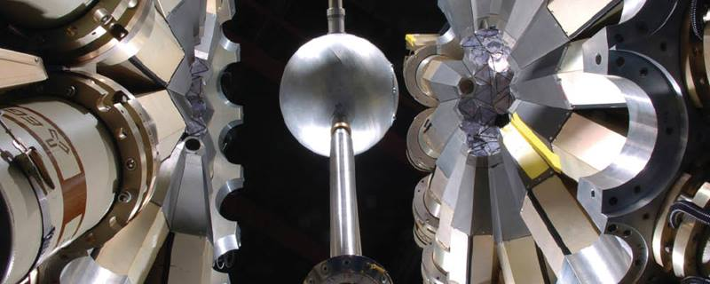
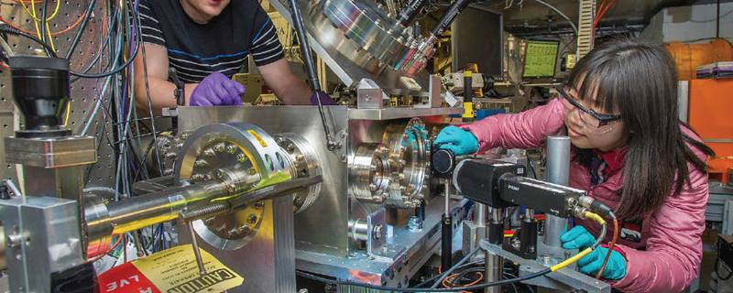
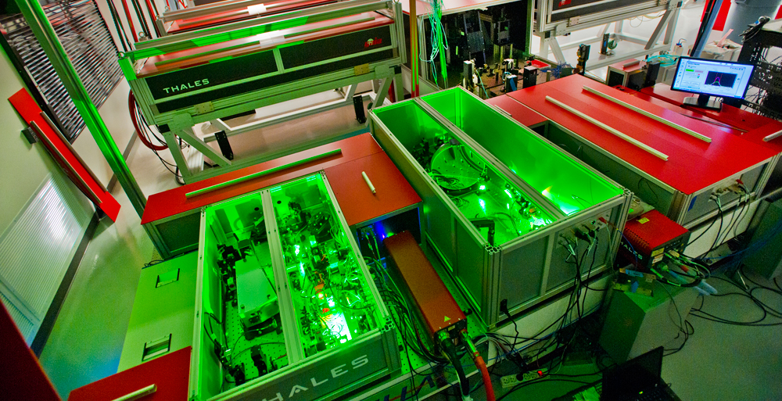
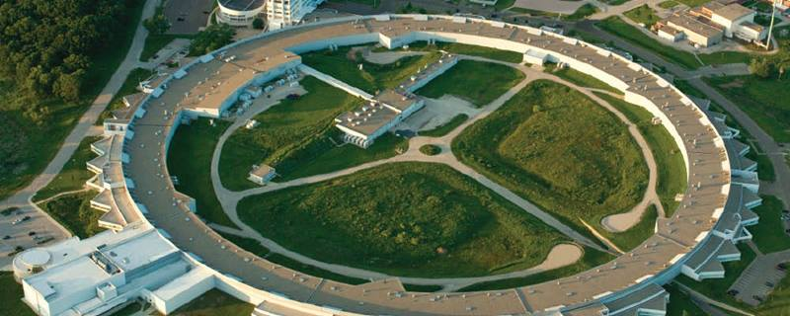
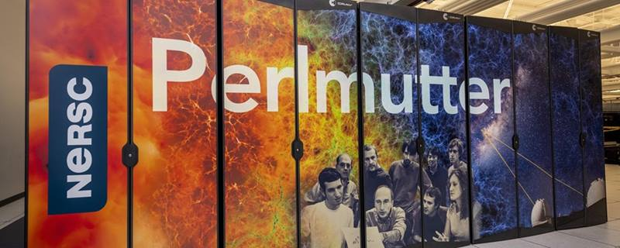

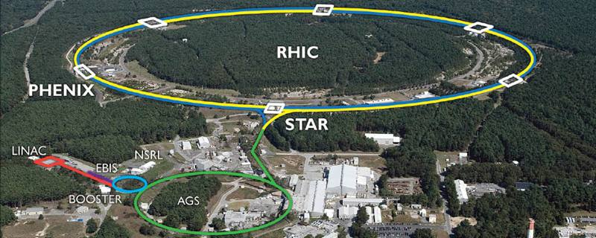
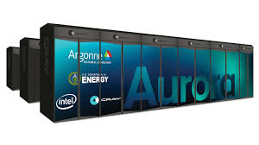
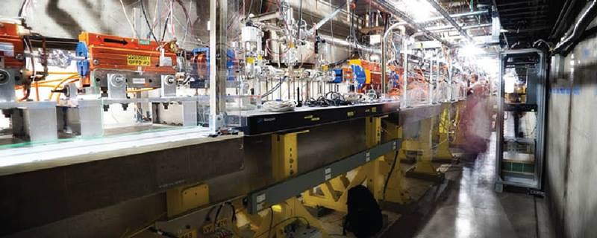
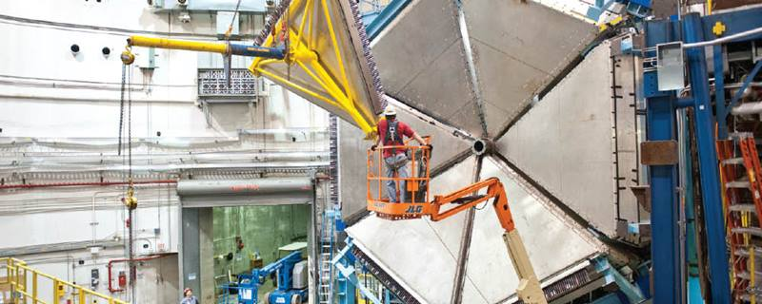
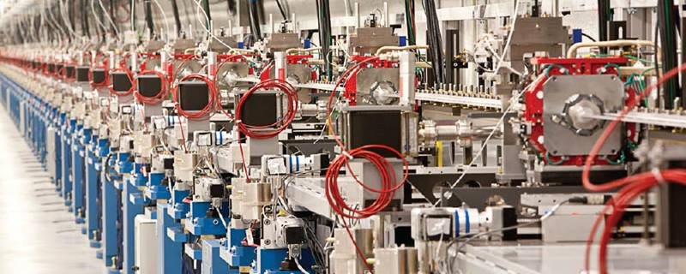
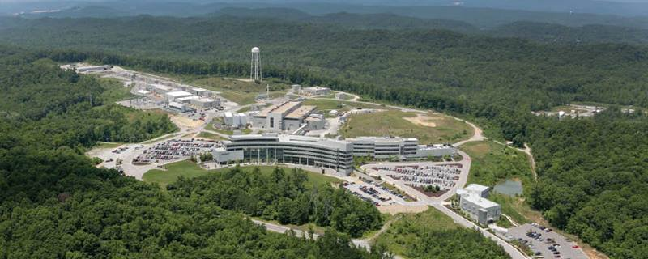
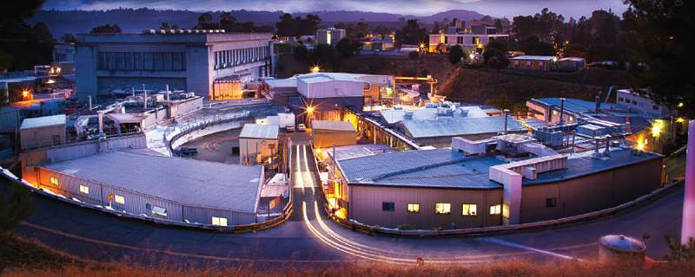
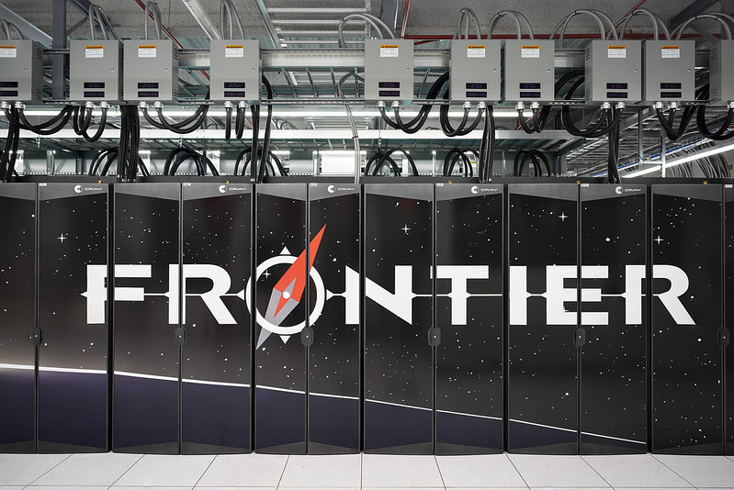
MOAT’s infrastructure web
ESNET
Accelerators
Computing
MOAT leverages AmSC & ModCon infrastructure & tools to connect DOE’s accelerator complex into a single, intelligent, accelerator ecosystem.
IOTA

