Slide 1
Outlook for AI/ML tools for the SNS accelerator
July 15, 2026
A. Zhukov, K. Ruisard
On behalf of SNS accelerator ML team: ORNL, JLab, PNNL and others

Slide 2
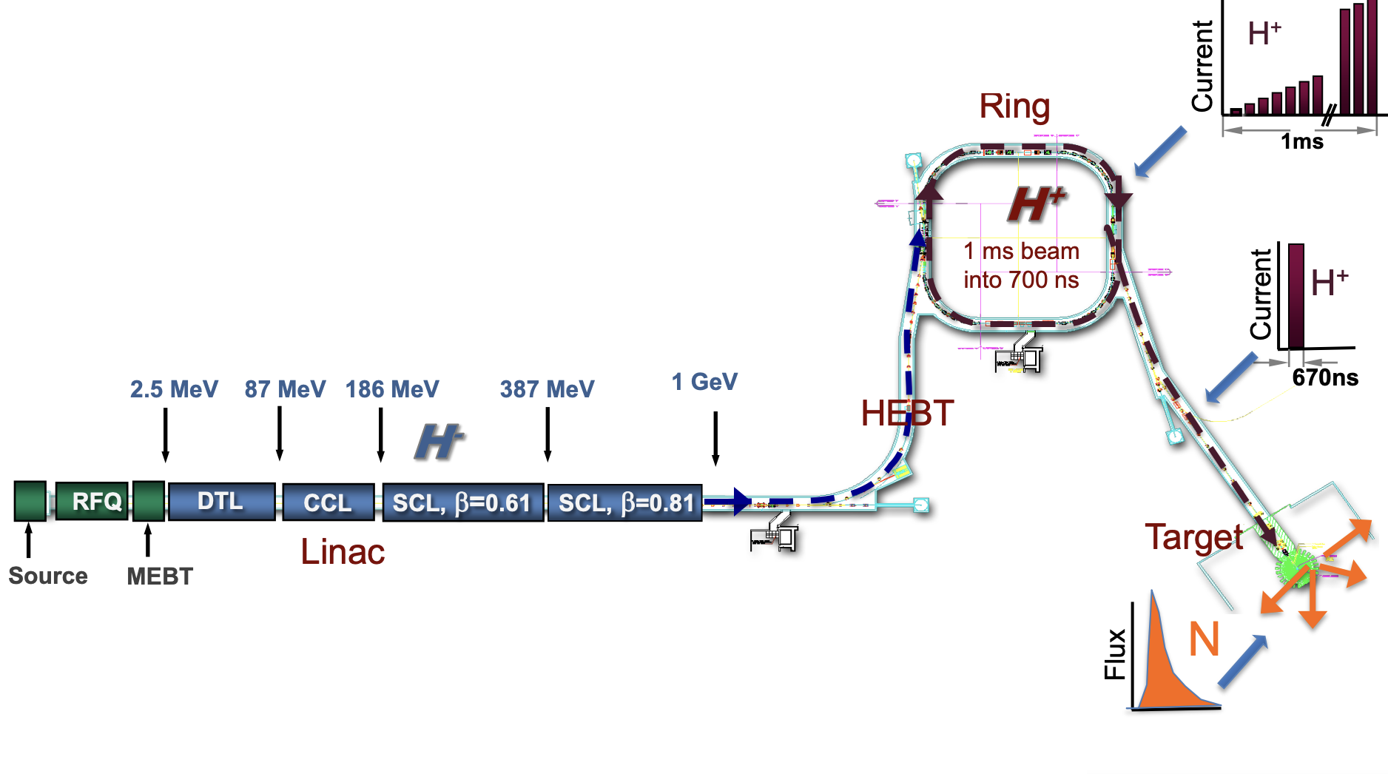
Spallation Neutron Source
Use-cases for AI/ML
  Anomaly detection
  Loss optimization
  Errant beam prevention
  Human interface with LLM/RAG
Notes:
H- accelerating to 1.3GeV
Charge exchange at the foil is the biggest issue

Slide 3
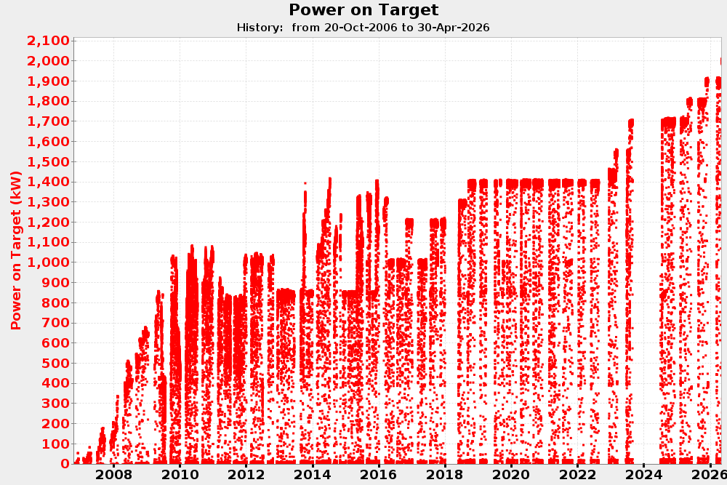
The SNS Linac is currently operating at 2.0 MW
(as of April 23, 2026)
The Proton Power Upgrade increased SNS beam power on target from 1.4 MW to 2.0 MW, mainly through 30% increase in beam energy (1 GeV → 1.3 GeV)
2.8 MW 10Hz equivalent
2 MW
Completed PPU installation
Cost of improved performance is tighter constraints on activation, unplanned downtime, maintenance schedules
Even a 20-year-old, relatively stable machine has a shifting “machine state”
1.4 MW baseline design
Notes:
Ee don’t understand our machine model very well. However, the SNS Linac is running really well
2 decades of operational experience
Smooth commissioning due to empirical understanding
-----------------------------
Beam loss outlook: we’re coming up on 2 years (and 3 shutdowns) of PPU beam
How did losses change? Activation levels went up…then down again. Losses are currently in-line with expectations.
ring activation is higher than expected (very localized spot ~1700 mrem/hr at a foot!)
PPU facts:
Commissioned in about 4 weeks in June/July 2024
Over 1 ms, 1000 pulses of negative hydrogen ions, each 700 ns long are accelerated to 1.3 GeV or 0.91c
Accumulated 700 ns long pulse of 1.5 E14 protons is extracted to target 60 times a second – roughly 32 kJ per pulse

Slide 4
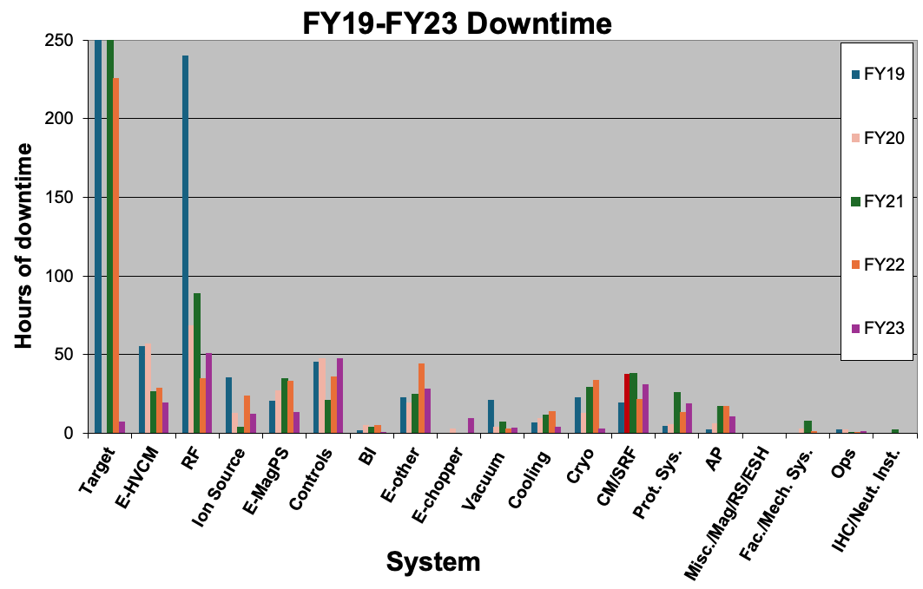
Challenges to SNS operations
(1) Maintenance! Our goal is to reduce activation and reduce failures
Predicting hardware failures on both long and short time scales gives us…
More lead-time to schedule maintenance or intervene
Fewer instances of spilled beam loss
(2) Beam physics in linac does not operate as designed; empirical intervention has been more successful than model-based interventions
SNS Systems downtime: interruptions in Neutron Production can lead to rescheduling of experiments
Notes:
Main causes for downtime Target and RF systems

Slide 5
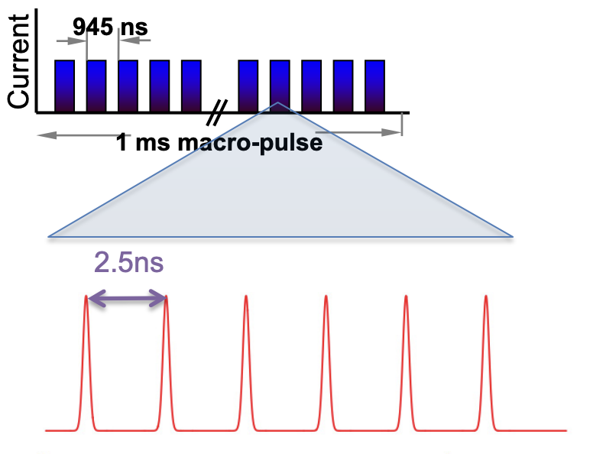
Pulse structure and timing
Time scale for use cases
  Anomaly detection in Target support loops (min/hr/days)
  Optimization of beam losses (sec/min/hr)
  Errant beam prevention (ms)
  Human interface with LLM/RAG (s)
16.67mS
Macro-pulses 60Hz
Empty RF only pulse
Mini-pulses (turns) 1MHz
The fastest optics change can be applied at ~ 2Hz
The only way we can affect current macro-pulse is MPS trip!
RF bunches 402.5MHz
AP physics model
works with one bunch
doesn’t have halo details

Slide 6



Target Anomaly Detection
A. Raj
Target systems
Archiver
> 30 interdependent systems
data
Archives relevant data
ML
data
Learns from archived data
Observes new data
Generates reports
Learns from feedback
data
data
Support personnel
STAR system
24/7 and long-term improvement
entry
Event tracking
anomaly report
report feedback
Credit D. Winder
Automatically detect anomalies
Flag anomalies using reconstruction (autoencoders, PCA) and tree-based (Isolation Forest) ML
STAR system (System Tracking And Reliability)
Notes:
○ Most developed use case
○ person -in -the loop example; if anomaly is flagged, target operators should have a look.
○ Look at temperature, pressure in mercury loop; predict anomalies based on time series.

Slide 7
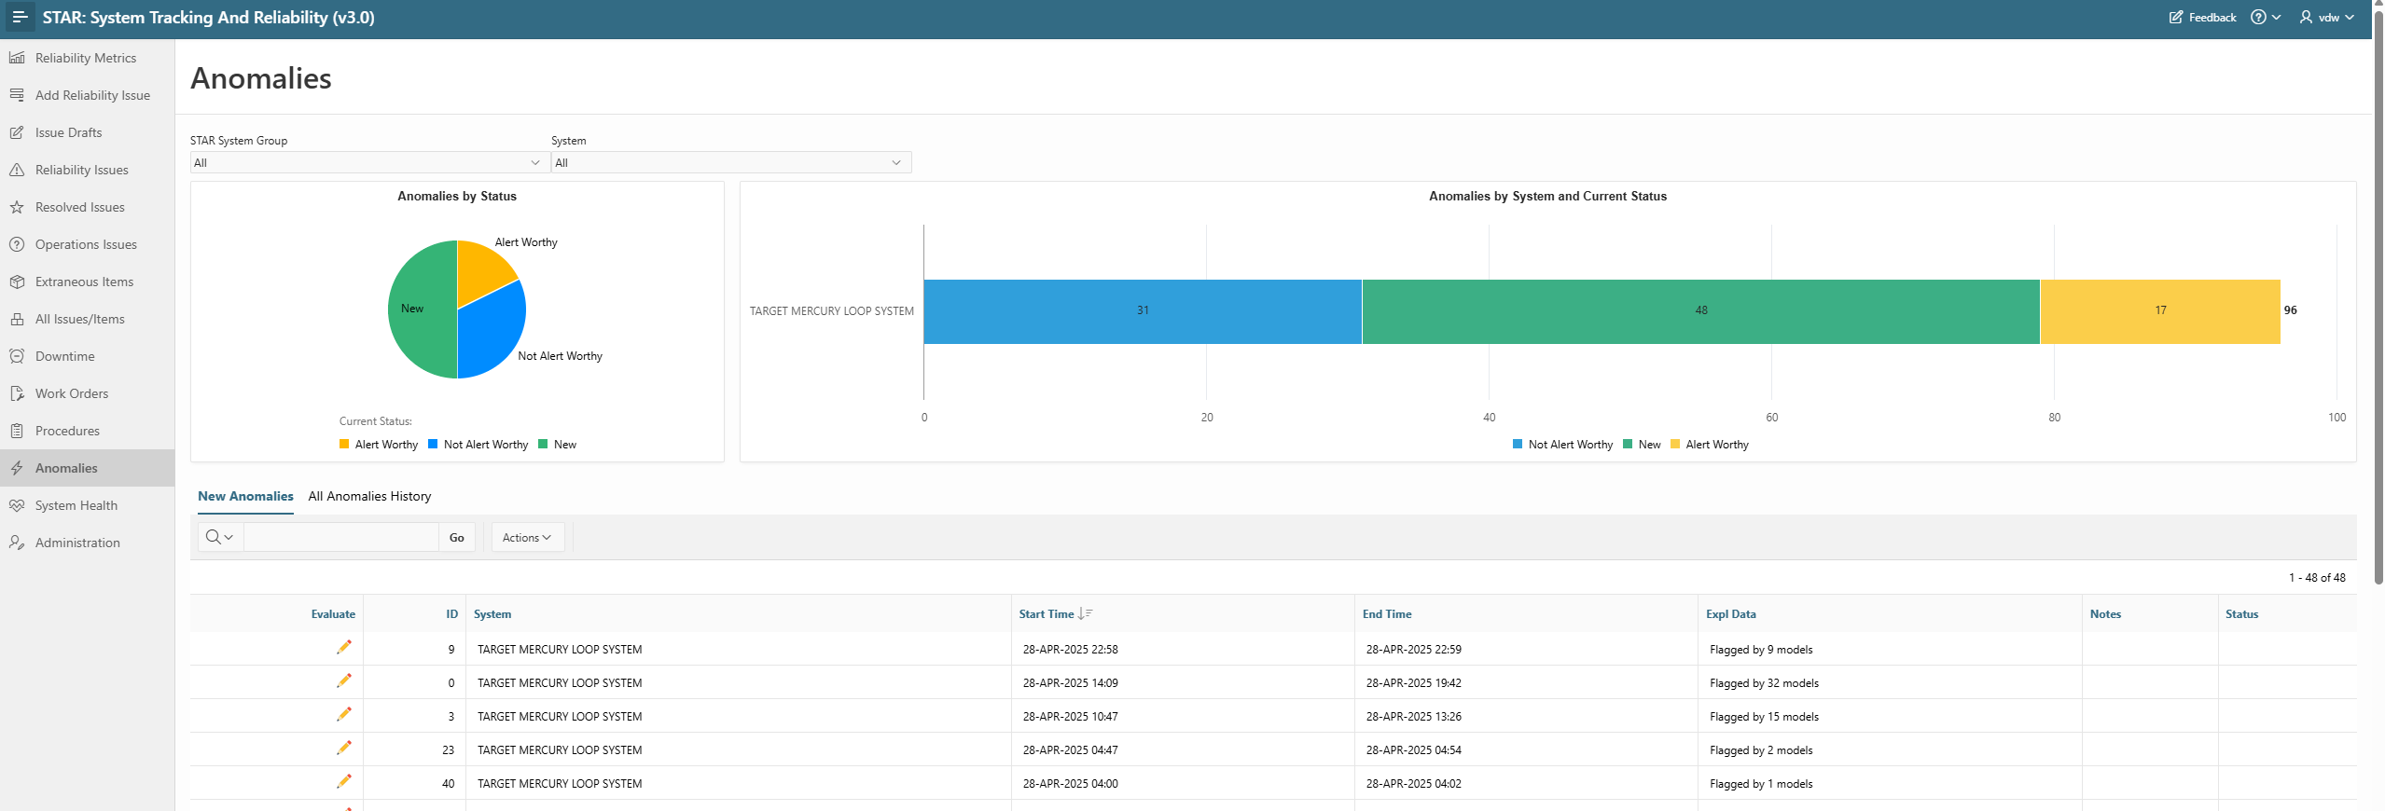
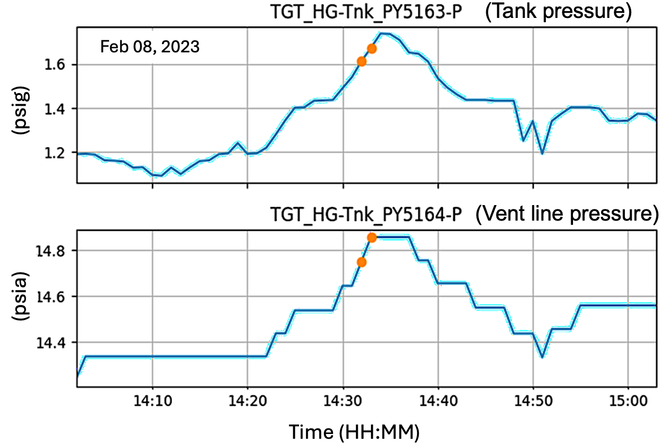
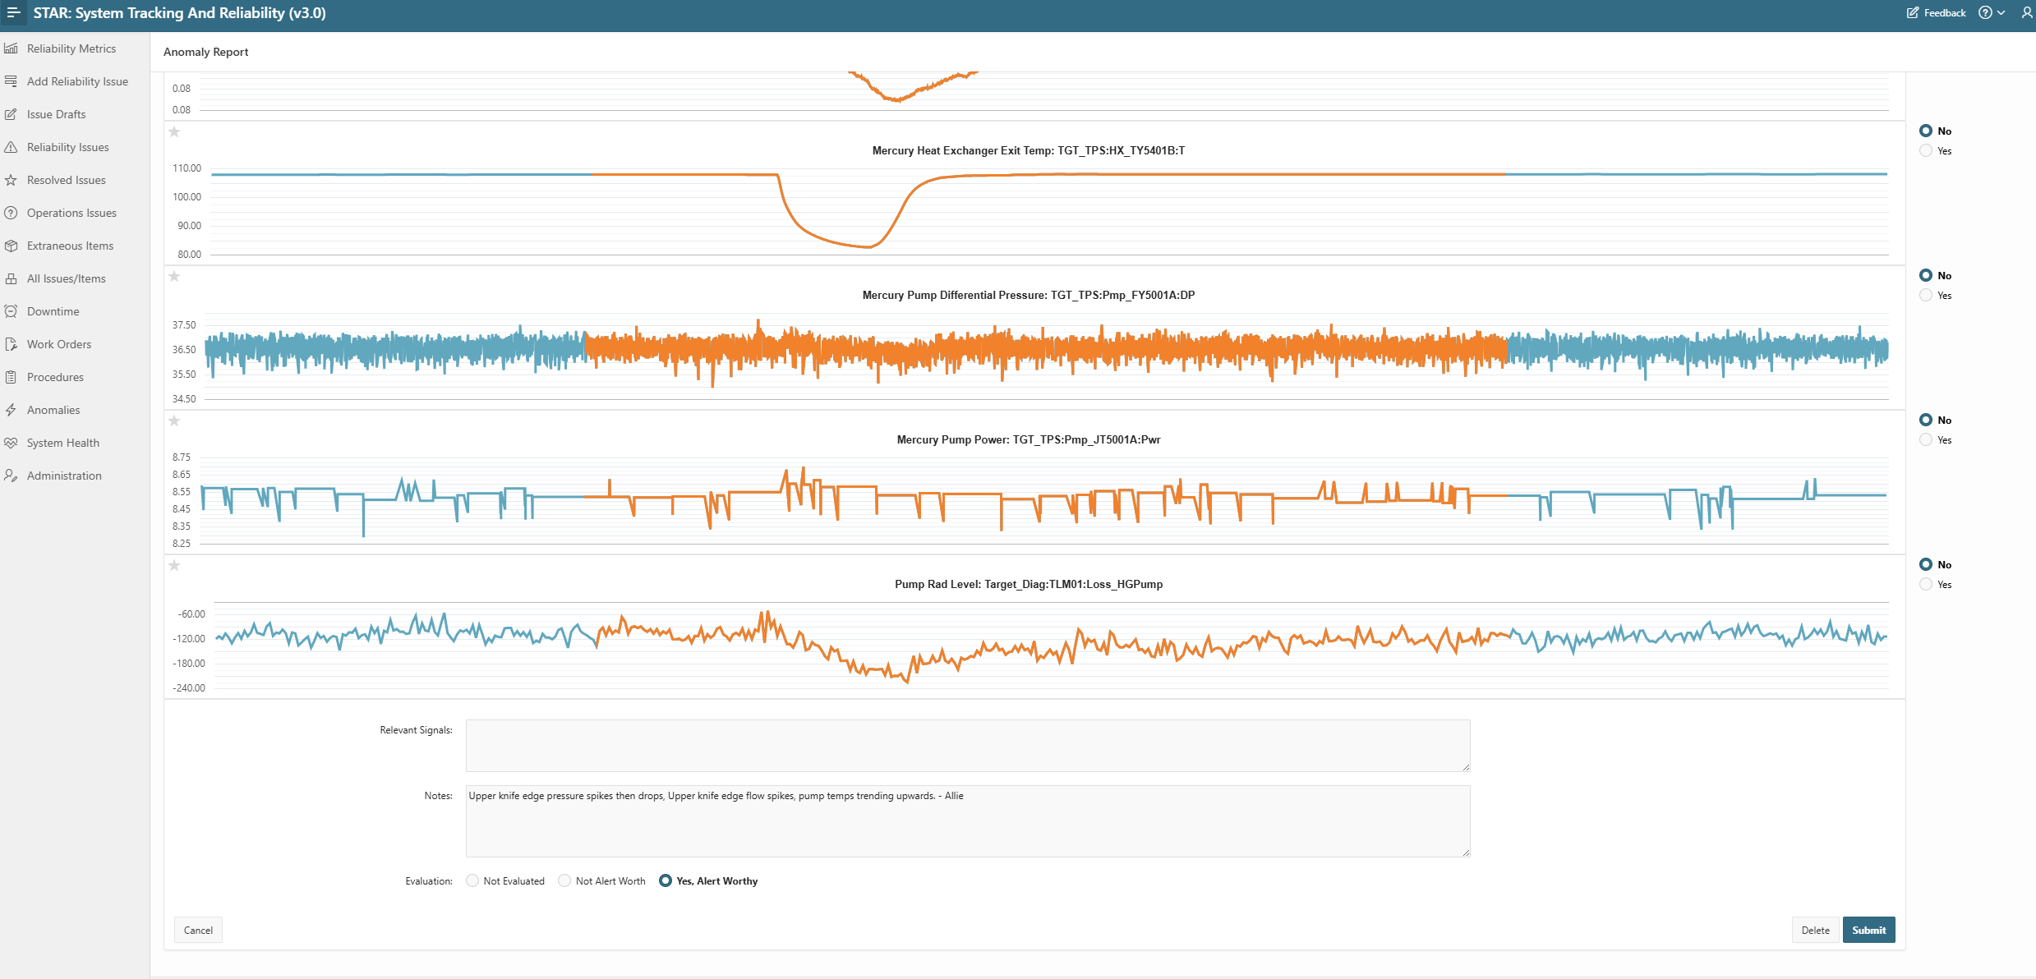
Target Anomaly Detection
Anomalies (•) It shows anomalous high increase in the pump tank and vent line pressures while the beam power ramped.
Integration with STAR system
Credit D. Winder, A. Raj
Results
Best model detected 13 previously unobserved anomalies with 11 being alert worthy
Physics model created for future physics informed ML
Running ML analysis only once a week, going to 10m: then we can prevent downtime
A. Raj, et al, “Automating Anomaly Detection for Target Systems at Spallation Neutron Source” NPIC June 2025 Chicago.

Slide 8
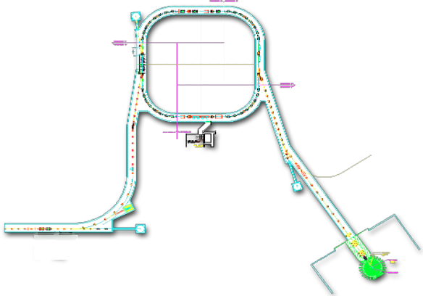
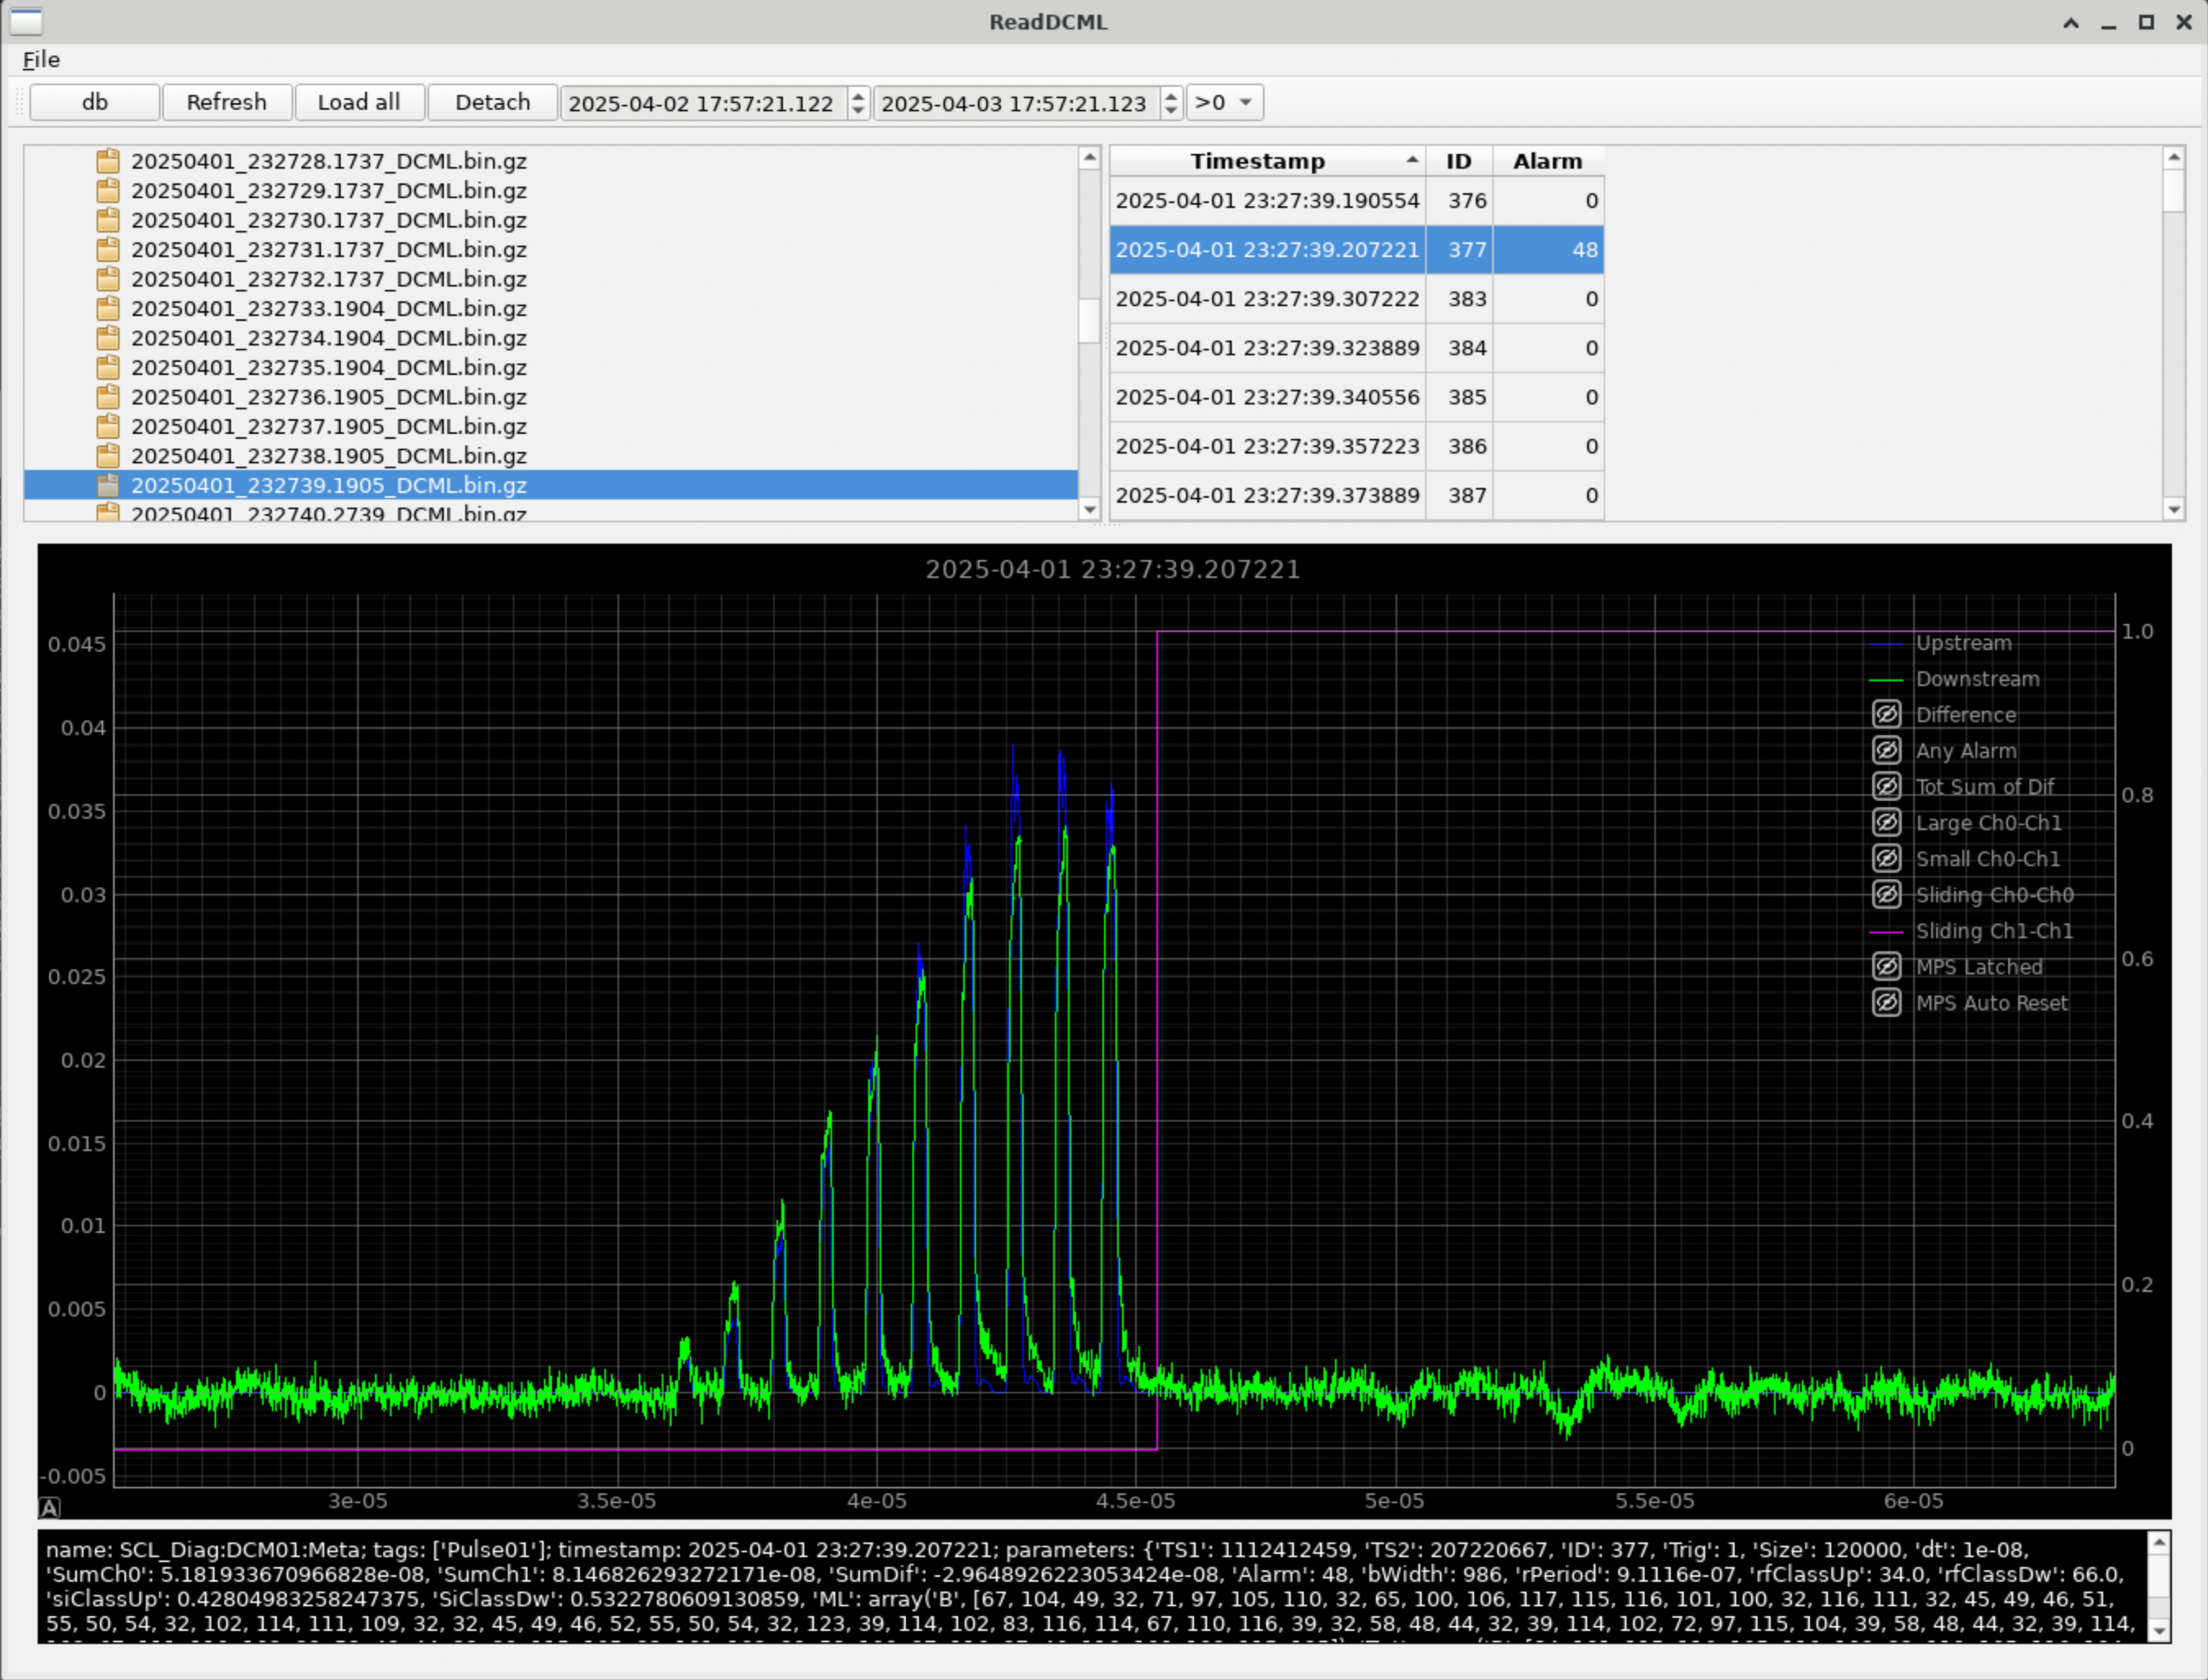
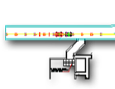

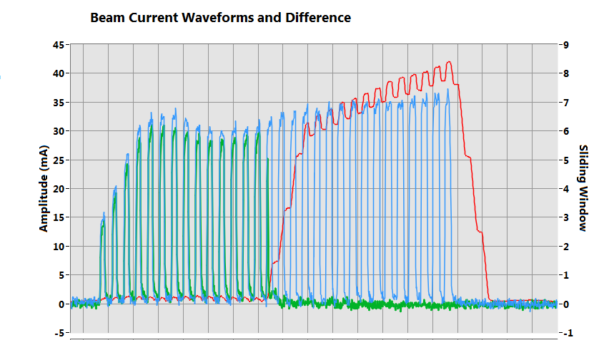
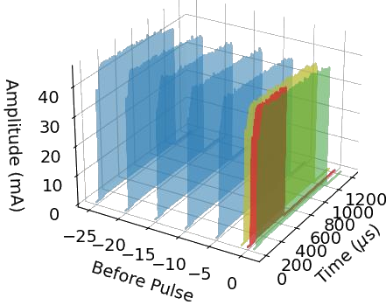
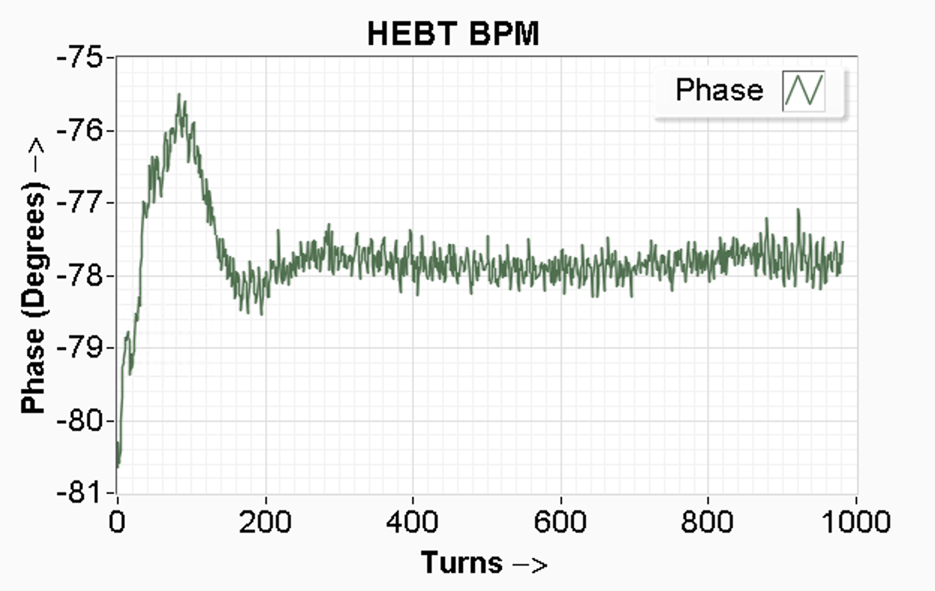
Errant Beam – beam is the best diagnostics tool?
Prevention of errant beam pulses
Errant beam pulse beam losses can result in lower SRF cavity performance and activated beam lines. Initially use the differential current monitor
H⁺
Ring
H⁻
Linac
MEBT
RFQ
DTL
CCL
SRF, β=0.61
SRF, β=0.81
Source
Target
2.5 MeV
186 MeV
1300 MeV
CCL102
HEBT01
HEBT01- HEBT06
Beam lost
Use pulse before as abnormal
Example errant beam
Beam current waveforms (~100MS/s)
Phase waveforms
(~1MS/s)
Notes:
DCM direct comparison of upstream and downstream
120k point per pulse at 60Hz
Inspector tool to look into faults or normal pulses

Slide 9
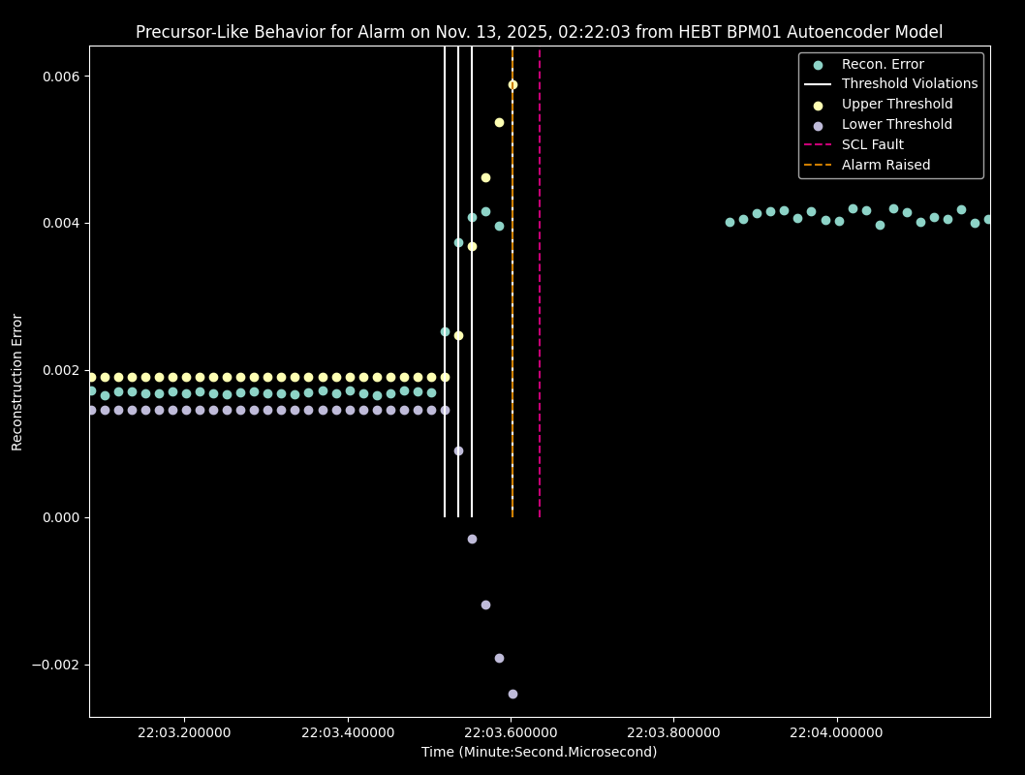
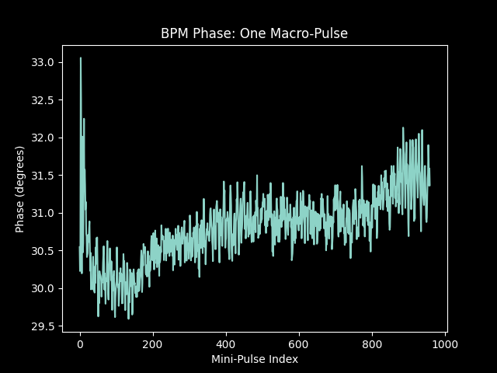
Errant Beam using phase data (from BPMs)
Time Range​ | Alarms Prevented​ | Pulses Aborted Per Day​
Nov. 13-20, 2025​ | 28​ | 2,429​
Nov. 20-27, 2025​ | 2​ | 2,128​
History of
leads to
T. Robertson
Phase data
Phase has a direct relationship with the acceleration
We have many Beam Position Monitors with phase data
Potentially immediately applicable to live machine
Notes:
BPM provides phase – bunch time of arrival
24 hours ~ 5M pulses
10^-3 false positive allowed. 5M pulses per day. Keep charge on target fixed

Slide 10
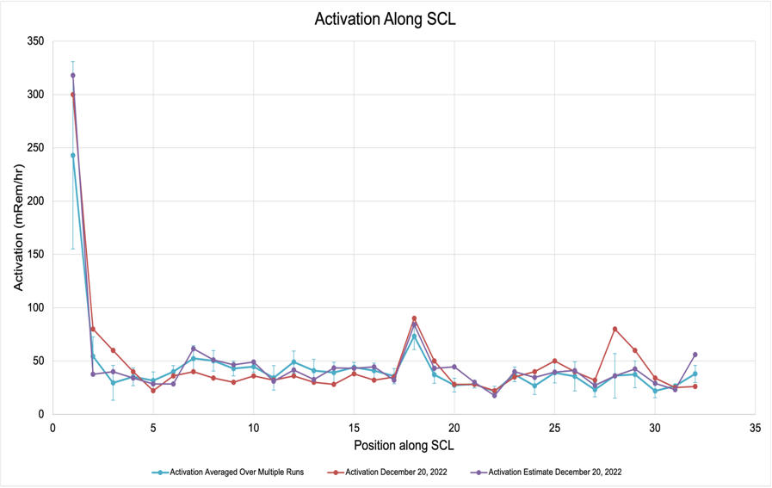
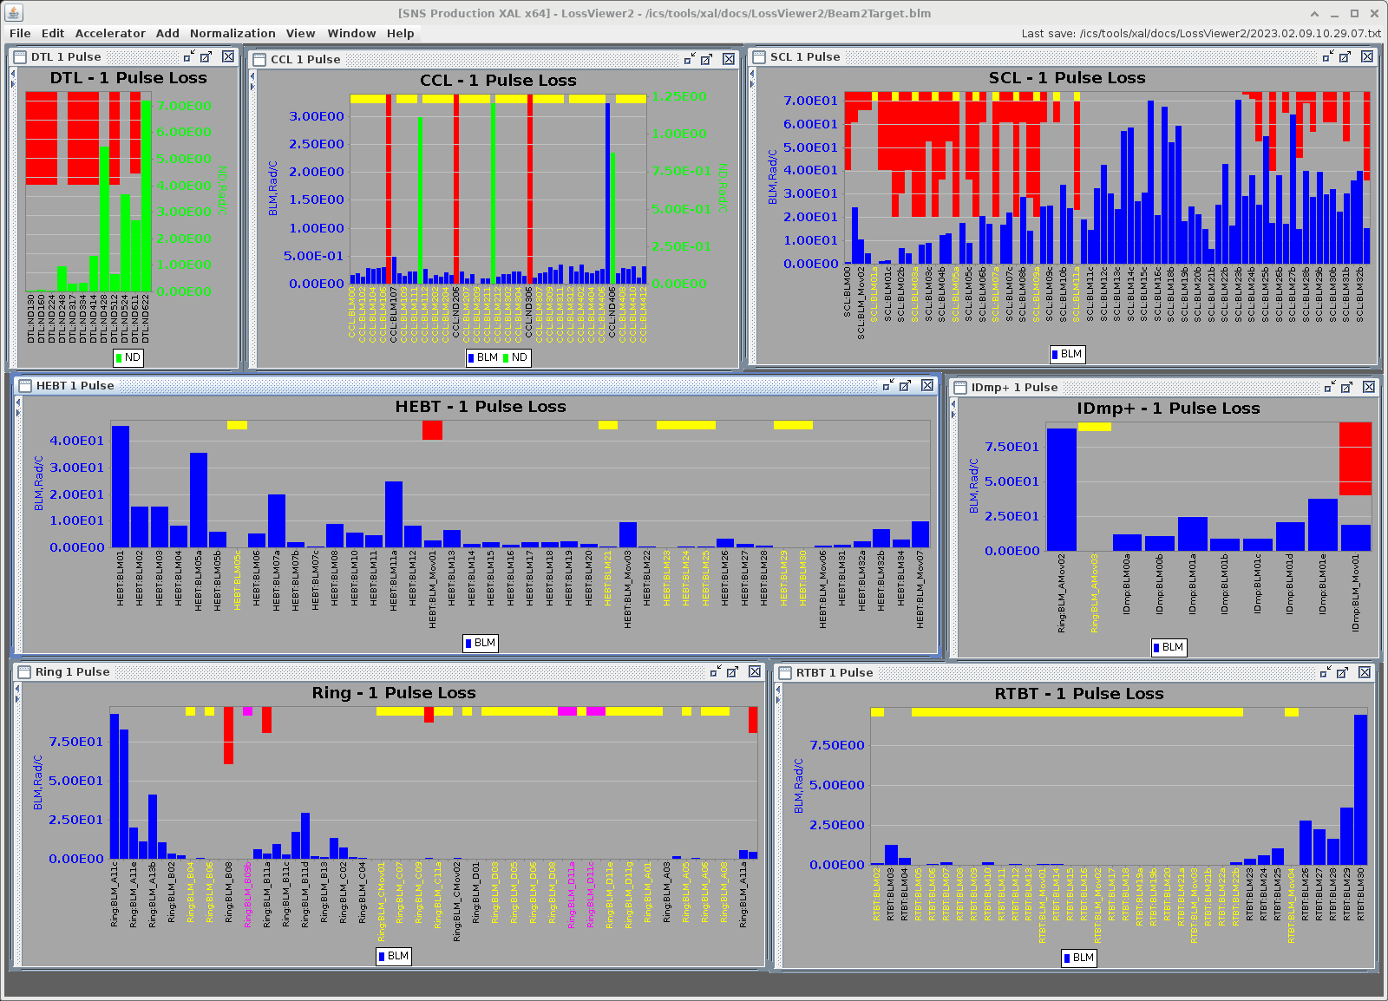
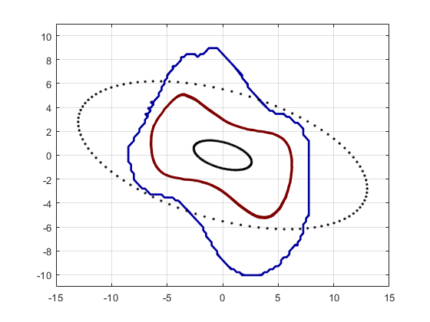
Beam Loss Optimization
Example of beamline activation due to losses
Measured beam losses lead to activation
Aleksandrov
1e-6 boundary
Shishlo
1e-2 level
x’[mrad]
1xRMS
5xRMS
X[mm]
Notes:
We don’t have a model for losses
Is it halo?
We know IBSt affects us
Large beam is bad, small beam is bad
We need to minimize losses to reduce activation
Operators perform a lot of time consuming
manual loss tuning by changing
Cavity phases (less amplitudes)
Quad gradients
Dipole correctors

Slide 11
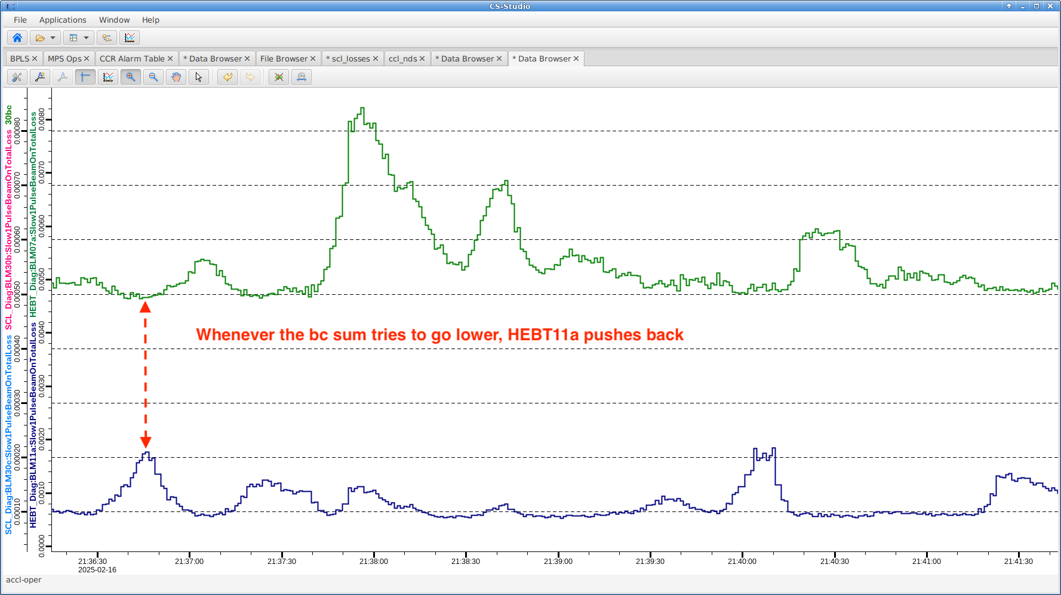

Beam Loss Optimization – RL or not RL ?
Proxy
Necessary to limit action to stay within operating envelope
  Splits large steps into smaller safe steps
  Aborts stepping if constraint violated
  Can redirect optimization
Losses in HEBT11a push back against lowering sum
Problems
  Short pulse doesn’t work, BLMs too noisy
  1Hz too slow due to RF cavity learning
  Needs production at 60Hz
  to start experimenting
Beam loss in SCL and HEBT, optimizing cavity phases
Accelerator Network
Optimization
Proxy server
Safeguard
Edge computer
Accelerator
Virtual Accelerator
Notes:
Any change on production machine requires authorization and potentially a configuration control approval
Let’s approve proxy once and then be absolutely flexible in agents without EPICS access
Test everything on virac

Slide 12
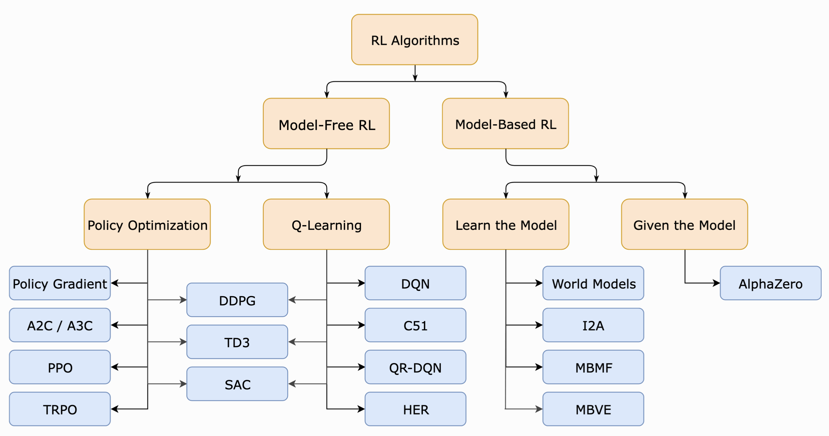
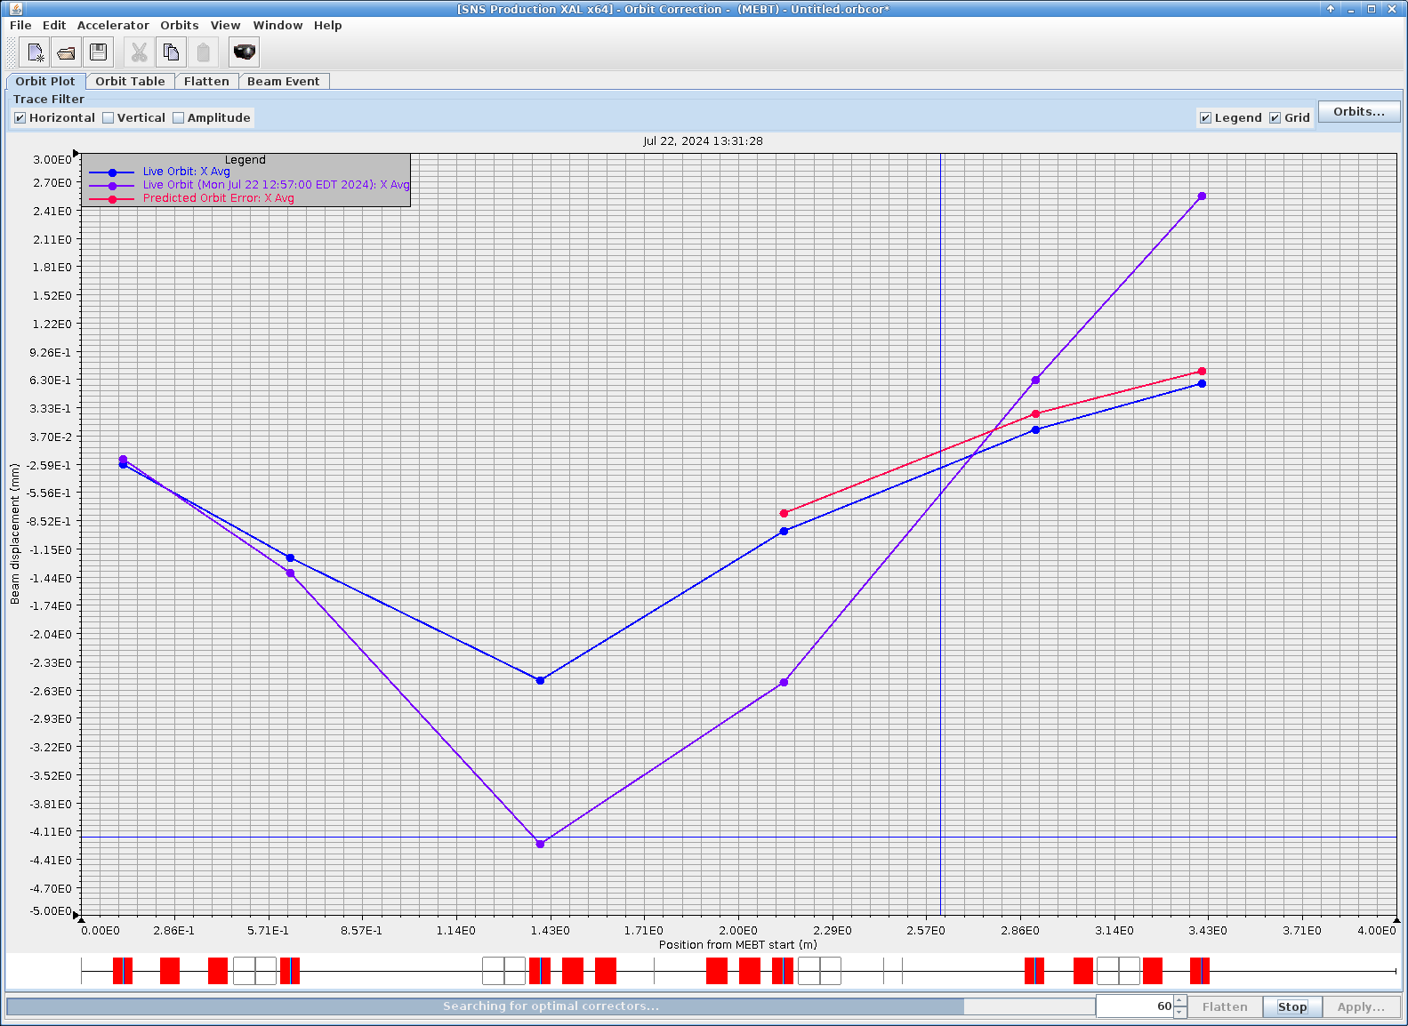


RL agents
Transverse displacement
physics model
DRL
Initial perturbed
Position along accelerator
Control policy
https://spinningup.openai.com/en/latest/spinningup/rl_intro2.html
SciOptControlToolkit
Two main approaches
  Model-Based RL: The agent can predict the reward for some action
  before performing it thereby planning what it should do.
  Model-Free RL: The agent needs to carry out the action to see what happens and learn from it.
Notes:
Tried Deep Reinforcment learning trained on virac
No physics in the agent
Physics is inside virac
Worked on real machine for orbit correction
If we have a model do we need RL?

Slide 13
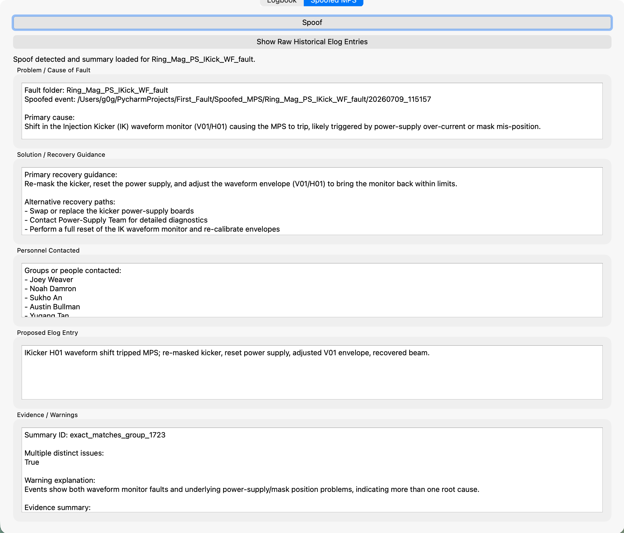
LLM usage for human interface and eLog analysis
G. Gallimore
MPS trips and generates a log of related events
Small test batch pre-processed
Find pre-processed entry that’s most similar to fault
Displays
  Fault
  Cause
  Recovery guidance
  Personnel contacted
  Proposed elog entry
  Warnings and evidence
  Button to grab raw elog entries from event

Slide 14
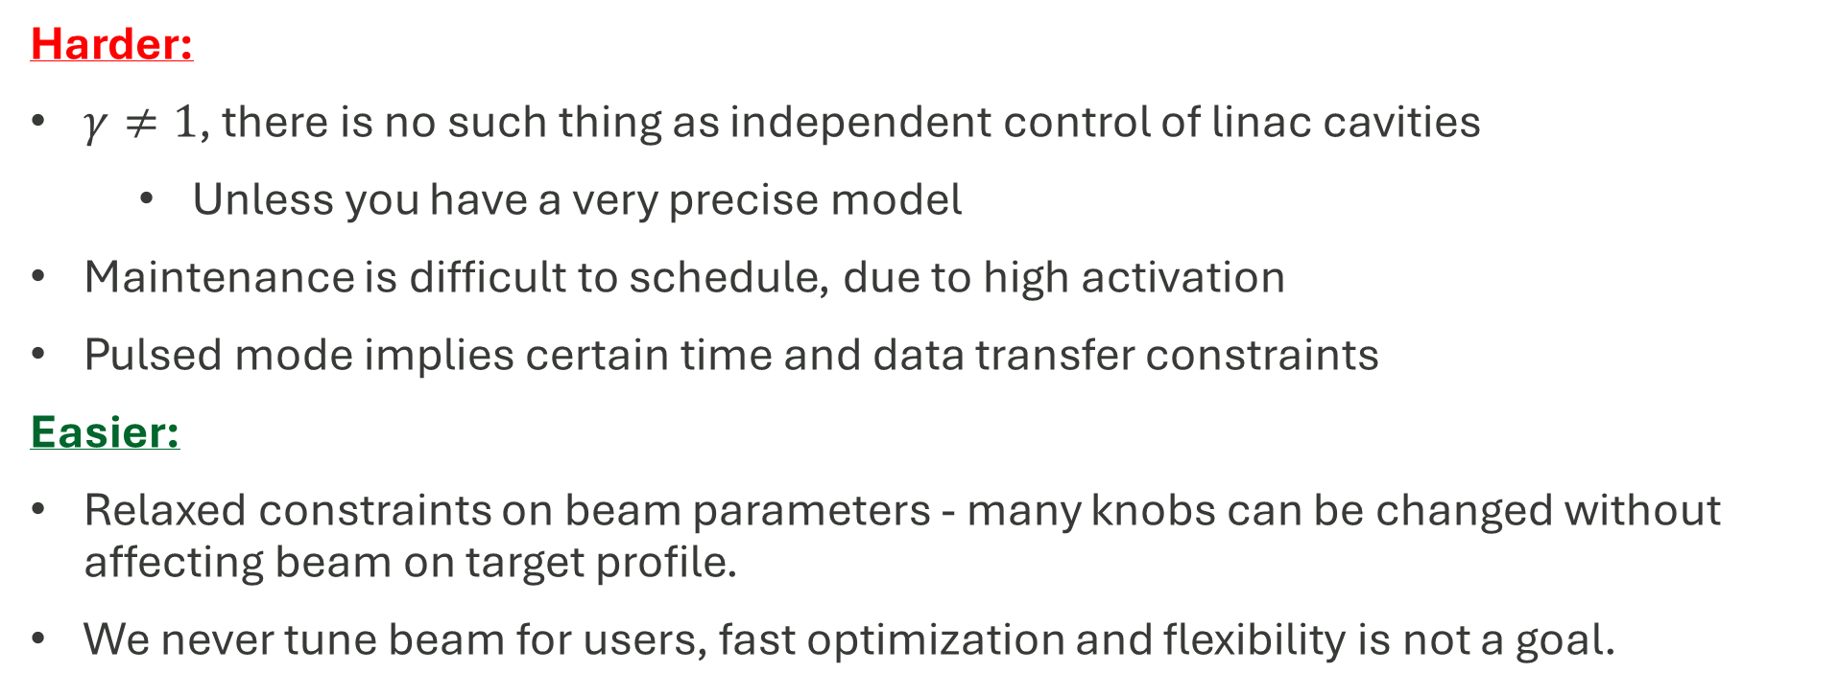
Specific needs of pulsed hadron machine
Harder:
$γ≠1$, there is no such thing as independent control of linac cavities
  Unless you have a very precise model
Maintenance is difficult to schedule, due to high activation
Pulsed mode implies certain time and data transfer constraints
Easier:
Relaxed constraints on beam parameters - many knobs can be changed without affecting beam on target profile.
We never tune beam for users, fast optimization and flexibility is not a goal.

Slide 15
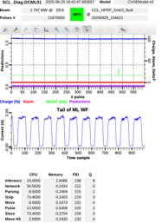
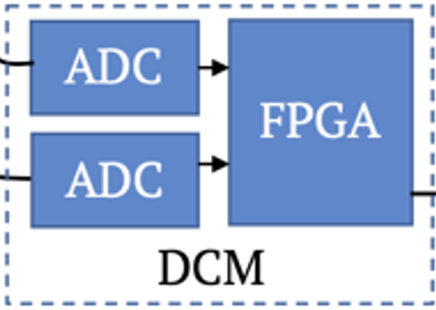
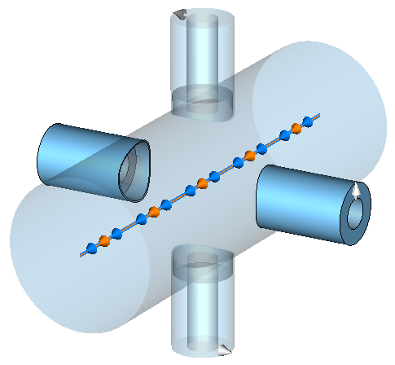

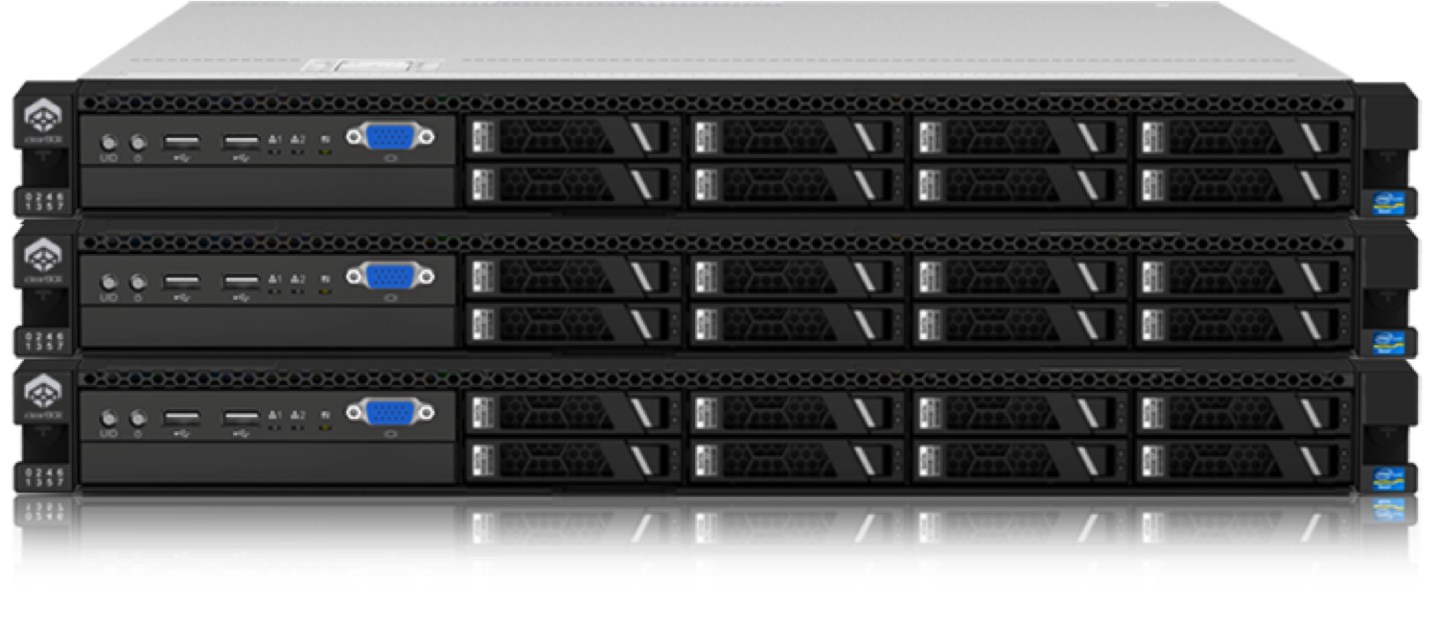



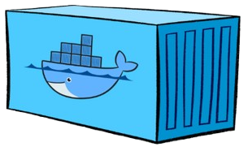






Errant Beam infrastructure
Operator view
A. Raj
Enterprise Network
Accelerator Network
Predictions
DCM
BPM
Edge Server
ML Model
Data Tagging
artifacts
1 PB
10 Gbps
user
External Storage
Container(s)
GitLab Runners
Storage
Icarus
Mindmeld Nvidia GPU Server
Notes:
Limitations of existing control network

Slide 16
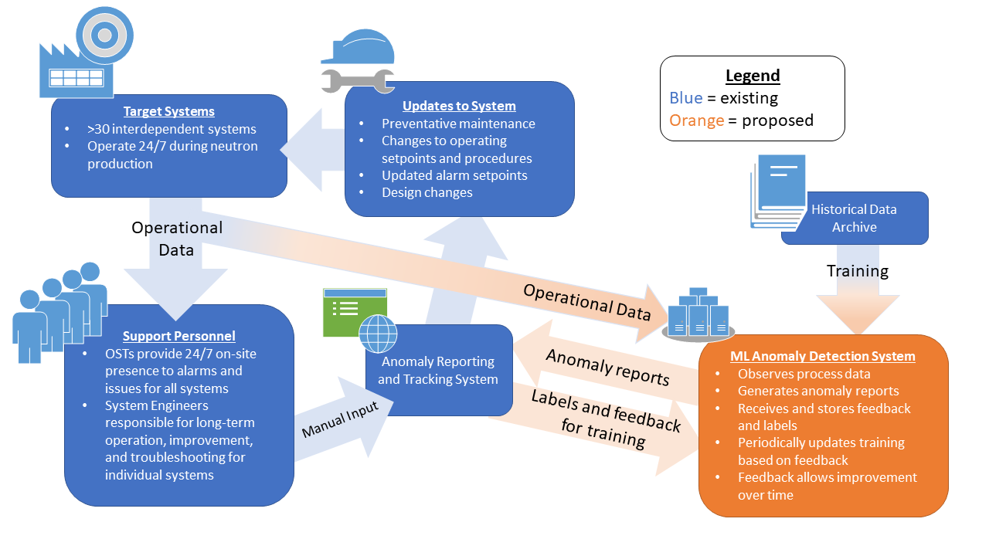
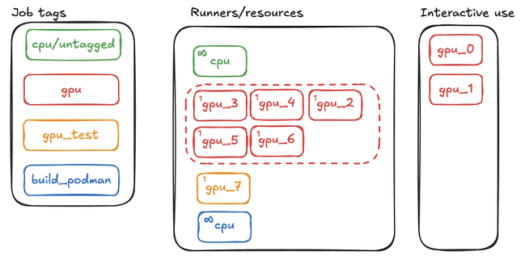
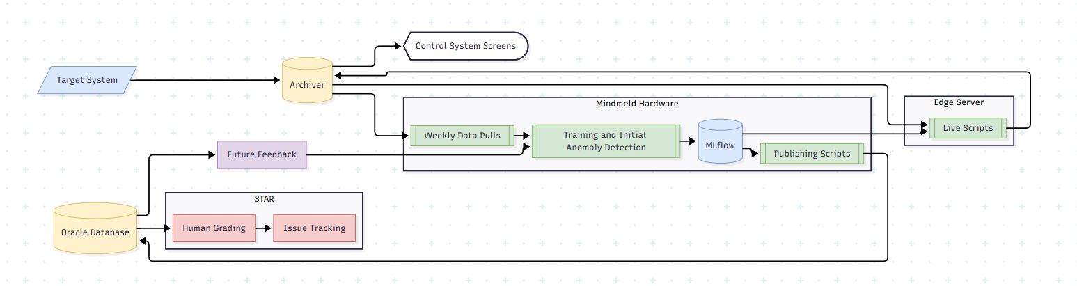
STAR
Weekly Anomaly Logging and Inference
A. Raj

Slide 17
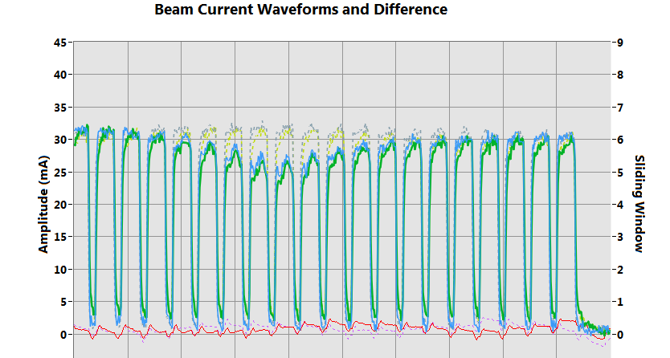
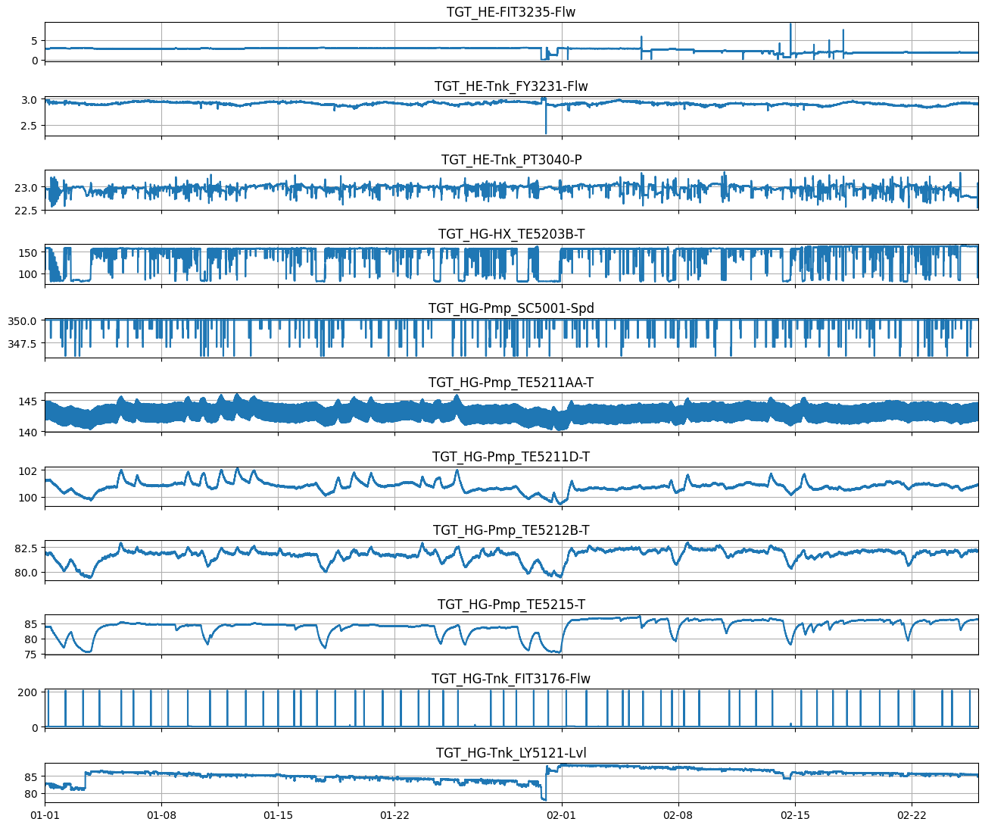
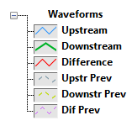
Data
Streaming not typical for SNS Accelerator
Waveforms ~1ms long, repeated at 60 Hz
Scalars at 60 S/s
Ring
H⁻
Linac
MEBT
RFQ
DTL
CCL
SRF, β=0.61
SRF, β=0.81
Source
Target
2.5 MeV
186 MeV
1300 MeV
Storage
(1 PB)
Beam current
Pressure, Temperature,
Flow, etc
Archiver
Losses,
Magnet Settings
Phase
4xWaveforms 100MS/s (~100MB/s)
350xScalars at 60S/s
(~20 kB/s)
8xWaveforms 1MS/s (~1MB/s)
40xScalars at 1S/s
(~200 B/s)
Each pulse
Each second

Slide 18
Desired infrastructure
We implemented ML infrastructure on top of existing Controls network
Heavily rely on one GPU server behind firewall – obviously, single point of failure (research mode)
Lacking network speed to connect diagnostics to training – various workarounds
Potential challenges/decisions for future AI-friendly accelerators
Separate dedicated network?
Edge inference or not?
Real time no-FPGA turnaround for inference ~ 10mS scale
Distributed storage (another network?) and/or distributed training?
Virtual accelerator should be there from the design stage

Slide 19
Dream capabilities
Multi-source anomaly detector – voting system?
Agentic operator - propose interventions depending on anomaly and based on historical experiences. Learn patterns from operators
Global optimization - slow optimization problem where large changes may be caused by variables outside controls problem
Continual learning
  When to re-train?
  How to forget irrelevant part while keeping important one
Robust digital twin infrastructure - where to put physics model?
  RL action
  Training only
Kishan’s talk

Slide 20
Anticipated headwinds for SNS
Cyber security
  live inference should be local
  training potentially
Data management and size of data
Over 1 year, errant beams project accrued 1 PByte from 6 Beam Position Monitors and 1 Differential Beam Current Monitor
Is RL an answer to 10+ dimensional optimization problems?
Conservative approach to operations
  How can you certify procedures that are not reproducible? Can they be benchmarked? Can we guarantee long-term stability?
  When something goes wrong with the agent, how do you track down the cause? How can you be sure you've fixed it?
  What expertise do you lose when outsourcing routine tasks to agent?

Slide 21
Questions?

