Slide 1
ML Applications and Experiences at BNL hadron injector complex
Weijian (Lucy) Lin
wlin1@bnl.gov
Dedicated AI/ML Accelerator Test Facility
July 15-17, 2026

Slide 2
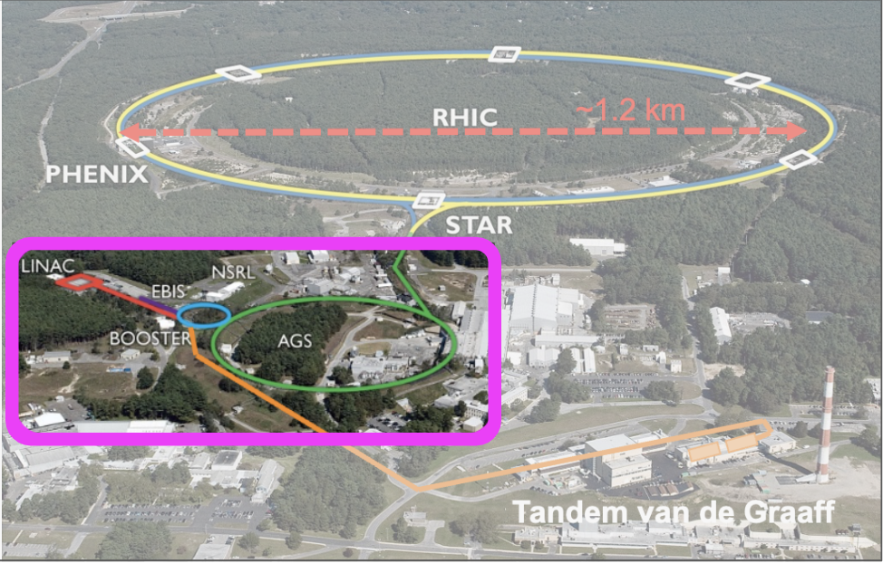
Hadron Injector Complex at BNL
Accelerator Rings
 | Circumference [m]
Booster | 201
AGS | 807
RHIC | 3833
Typical Top Energies [Total, GeV/N]
 | Au | Pol. Protons
Linac (H⁻) | -- | 1.1
Booster | 1 | 2.3
AGS | 10 | 23.8
RHIC | 100 | 255

Slide 3
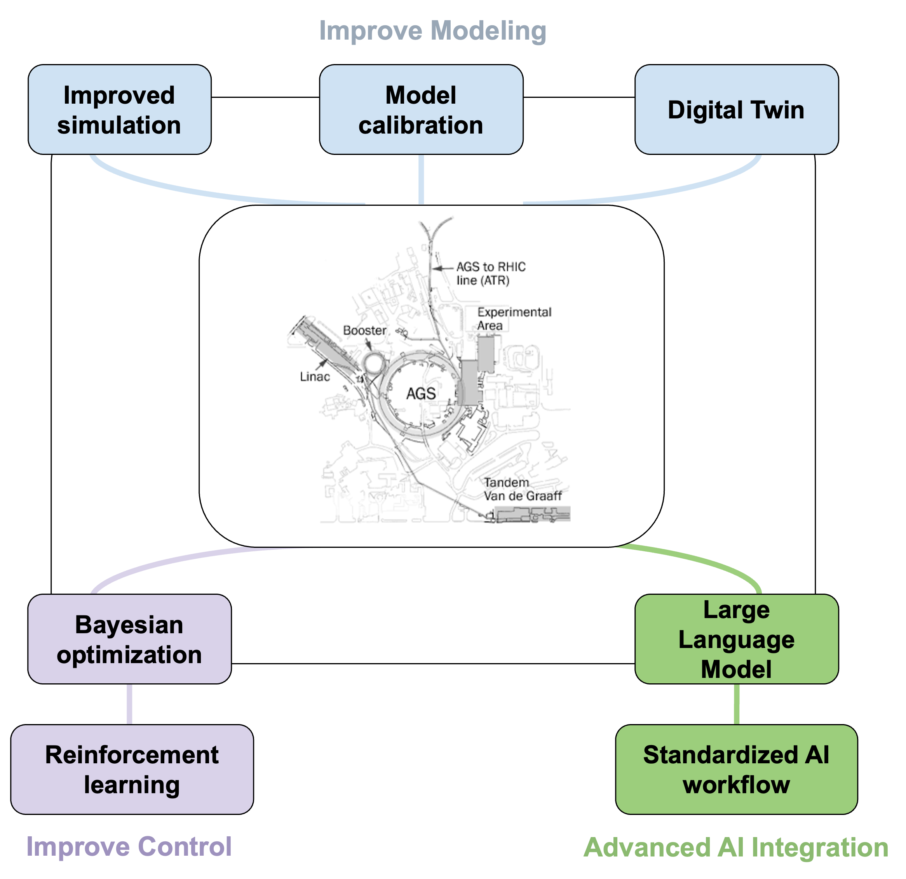
Machine Learning at BNL hadron injectors
Goal: Improve beam quality and operational efficiency.
This talk
Automated beam tuning
Operational Digital Twin
Data-driven model calibration
Fast adaptive control
AI-ready data standard development
Better models + better data + better optimization = more autonomous accelerator operation

Slide 4

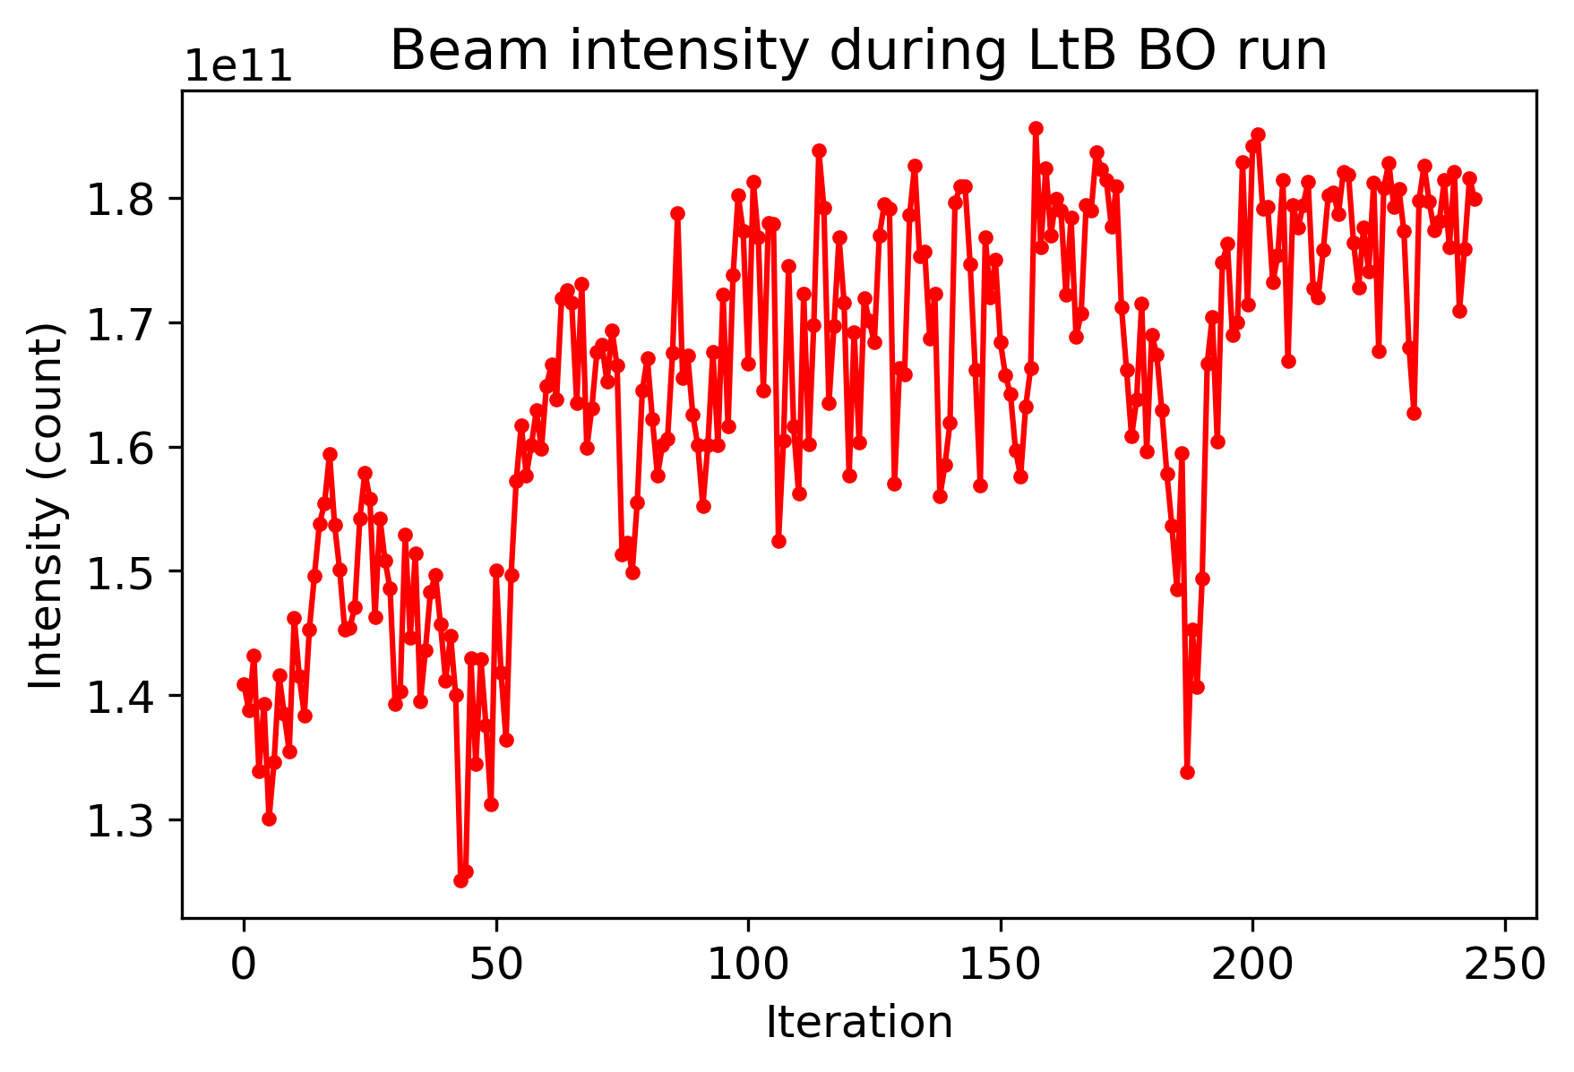
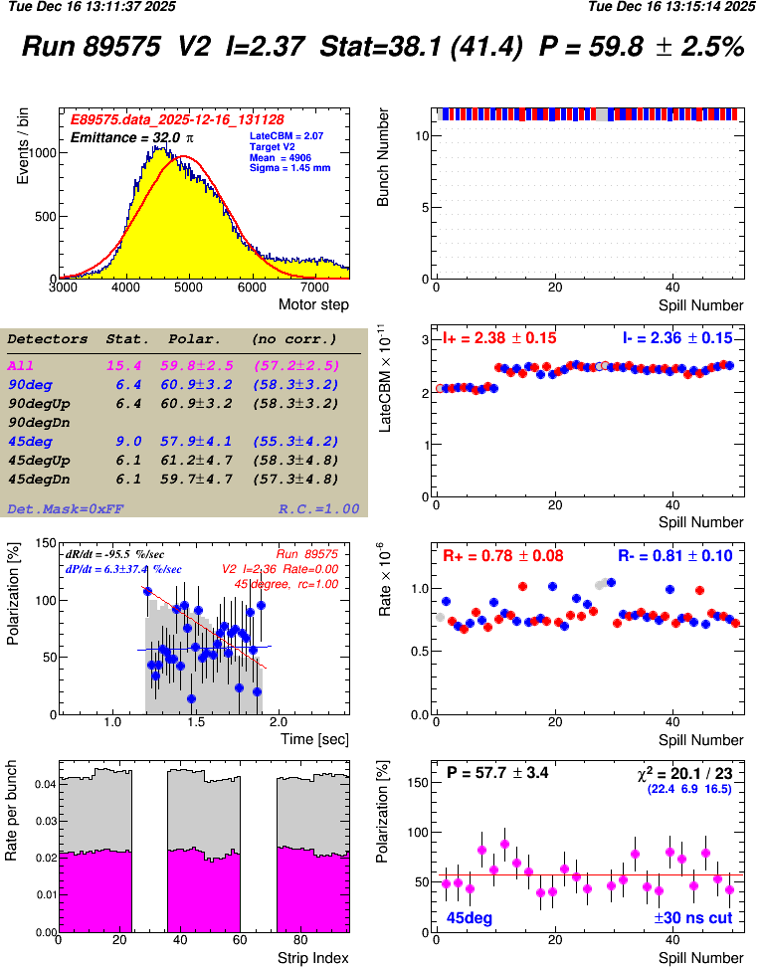
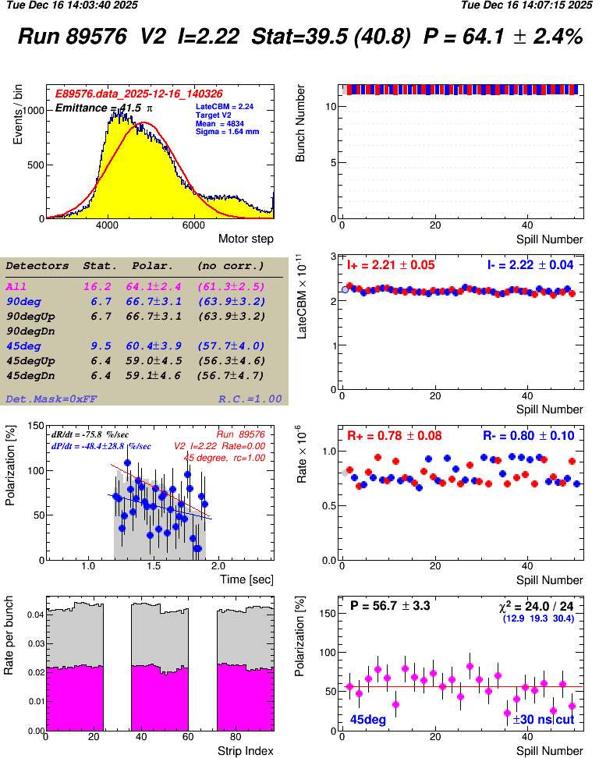
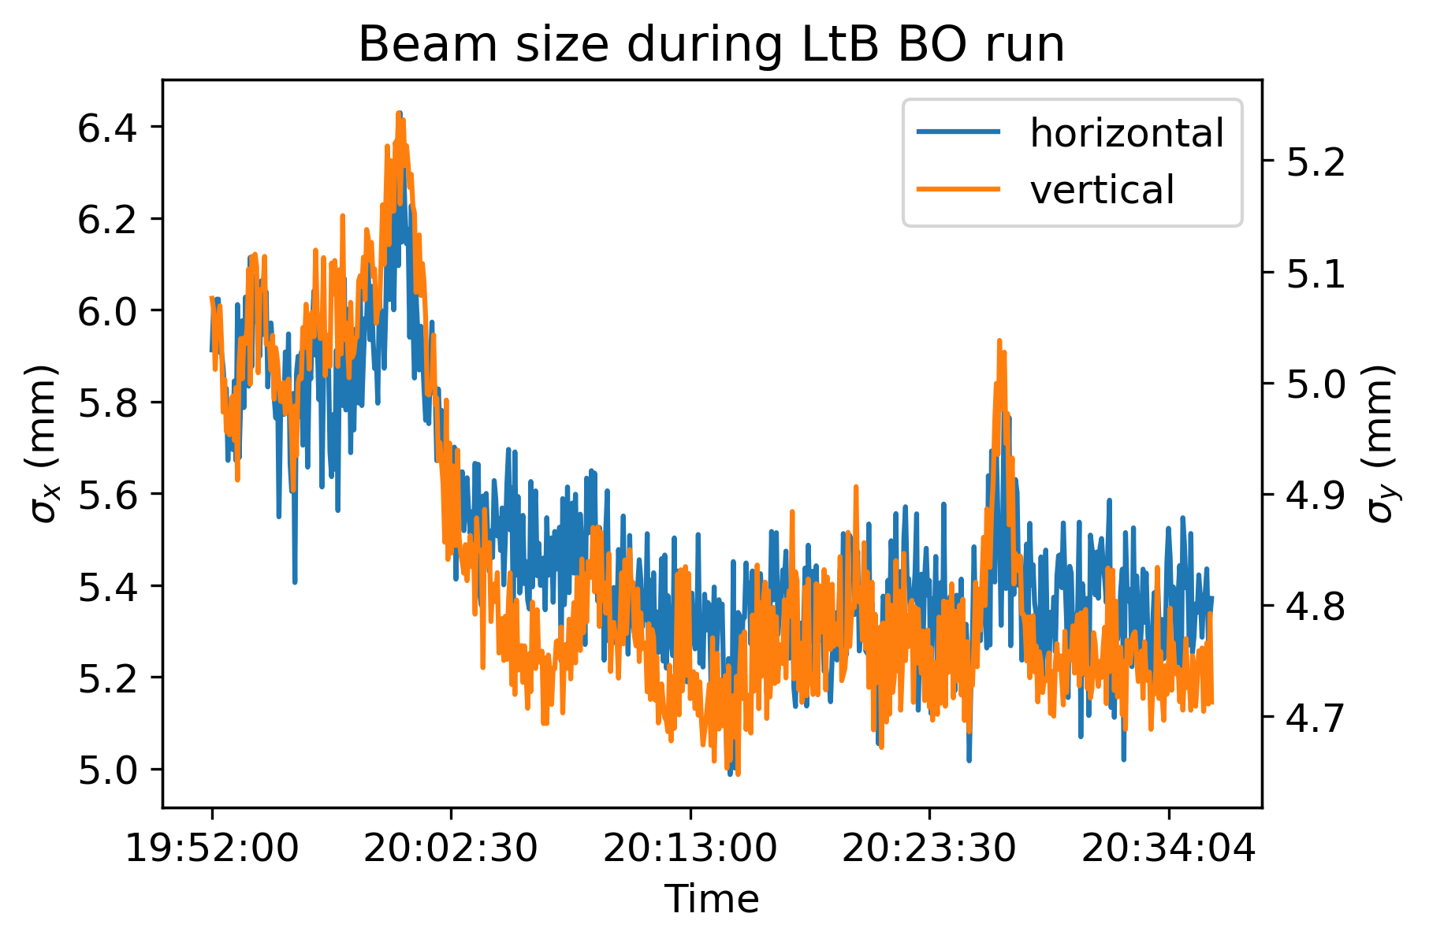
Injection Optimization with BO
LtB Injection Optimization
BO maximizes Booster beam intensity using LtB optics.
Beam size decrease in both planes during LtB optimization.
Polarization increase observed, but instrumentation limitation is significant.

Slide 5

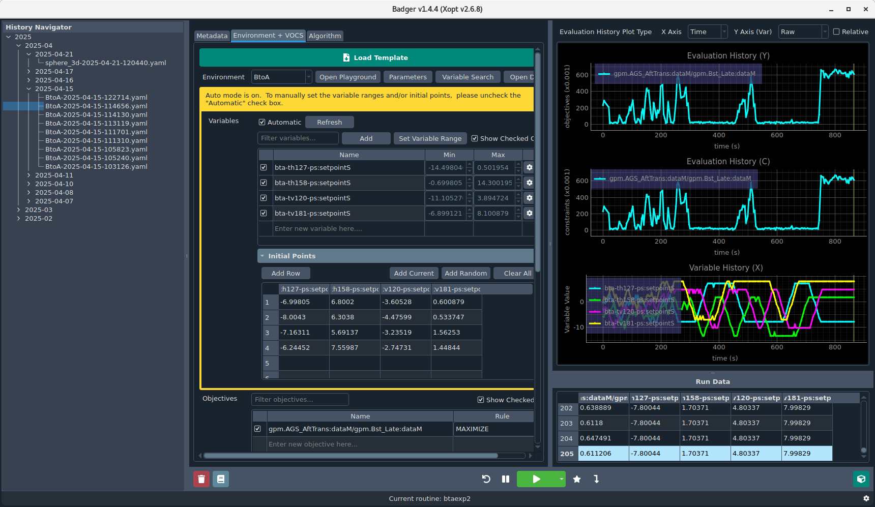
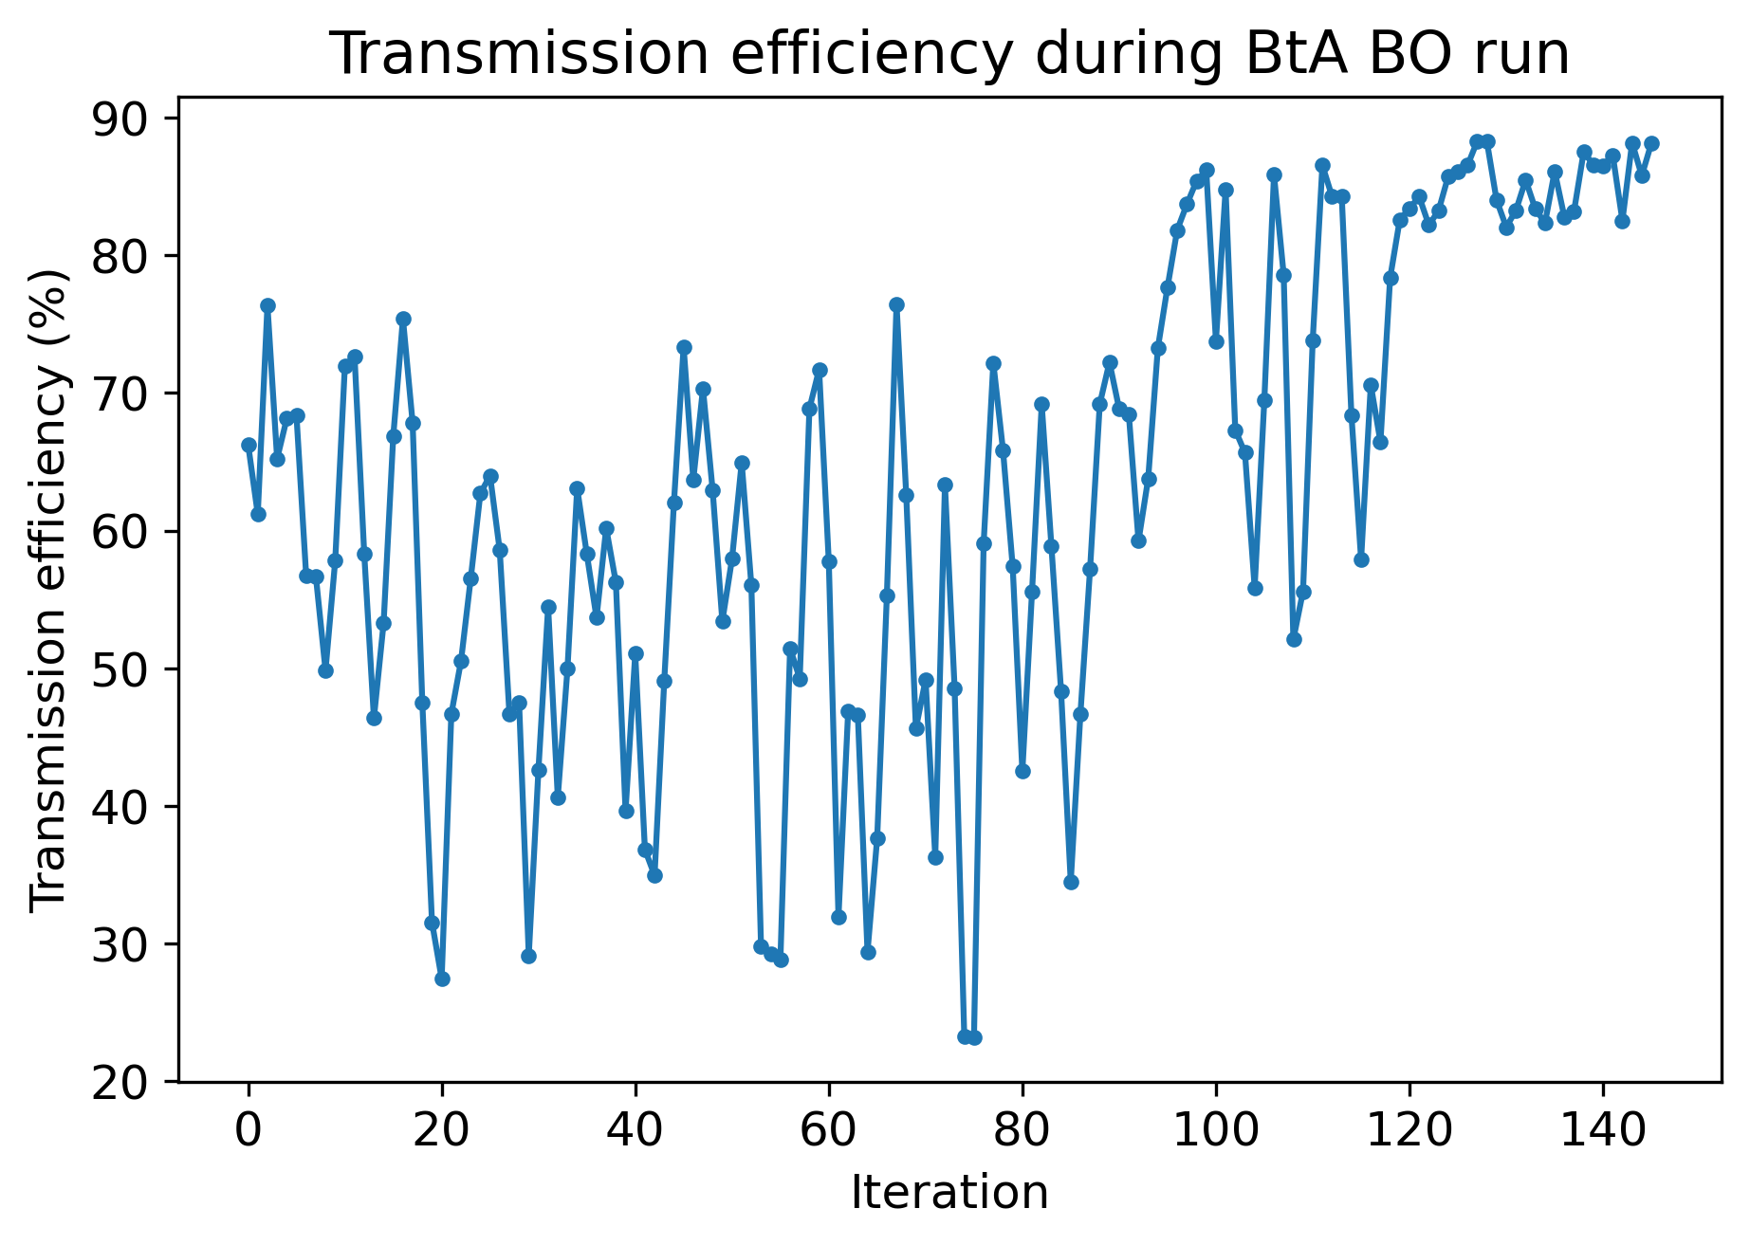
Injection Optimization with BO
BtA Injection Optimization
BO maximizes beam transmission efficiency using BtA optics.
20% improvement from operational settings.
Badger successfully deployed in the control room after customization for the BNL control system.
Emittance measurement from IPM is not reliable, no working BPM in BtA line.

Slide 6
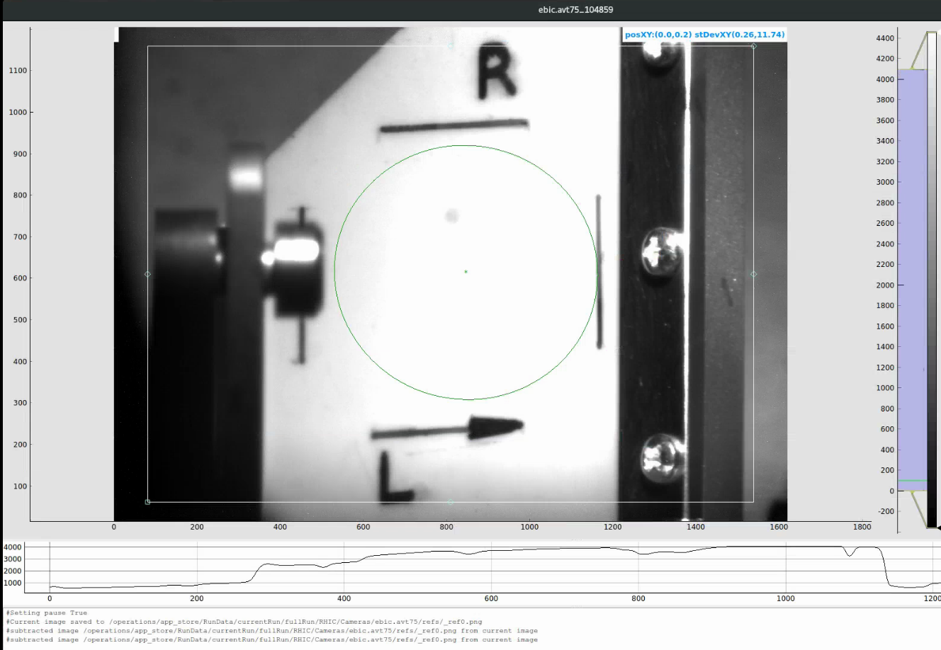
Digital Twin for Booster slow extraction bump
Operational DT GUI with bidirectional interaction between the physical and virtual machines.
Can expand to other scenarios (e.g. fast extraction bumps) with easier model-machine validation. BPM measurement unavailable during normal slow extraction process (RF off).
Diagnostics between thin (D3) and thick (D6) septa are sparse, difficult to reconstruct design bump. Camera was installed at thick septum for additional info, but no image processing in place.

Slide 7
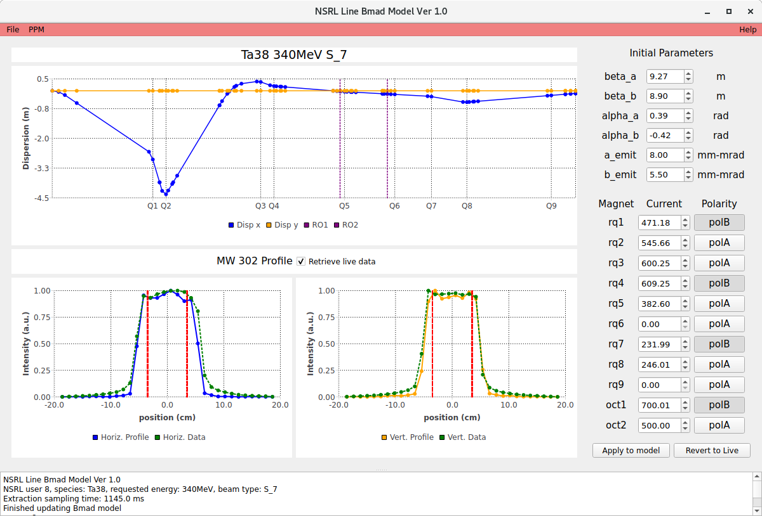
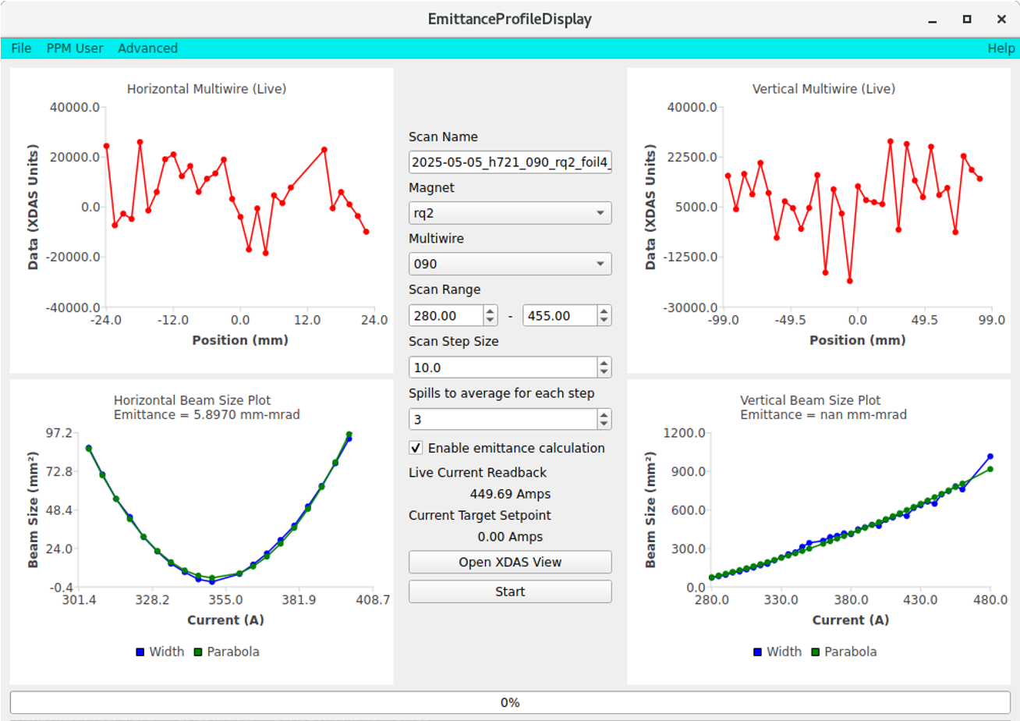
Digital Twin for NASA Space Radiation Laboratory
Operational DT GUI running in digital shadow mode.
Initial conditions after slow extraction hard to predict without dedicated measurements. Full slow extraction simulation is computationally prohibitive for online applications. Created automated quad scan GUI for initial parameter back-propagation, but horizontal is difficult due to dispersion.

Slide 8
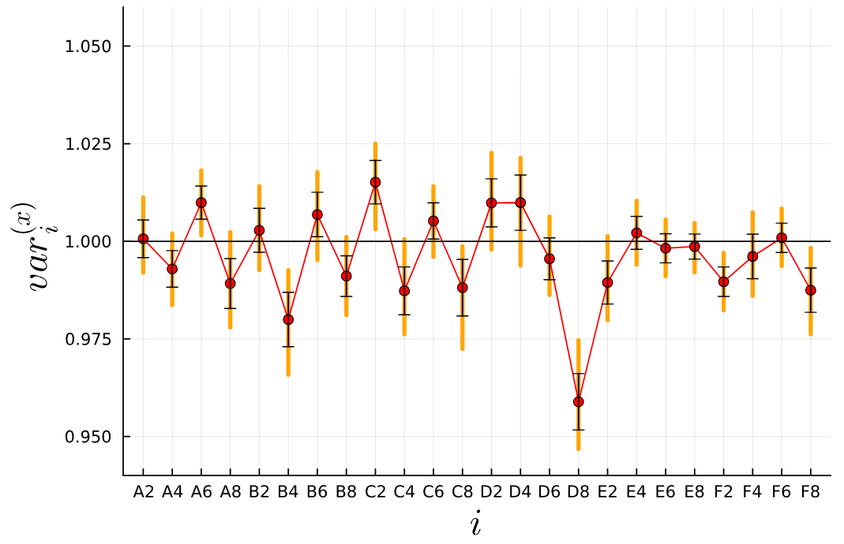
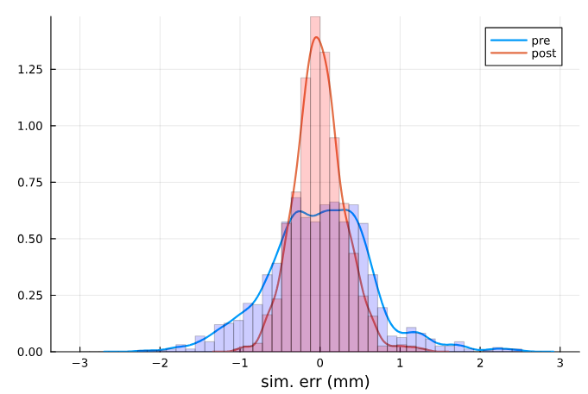
Uncertainty Quantification to Improve Booster Model
Use Bayesian Uncertainty Quantification (UQ) to characterize and reduce model-data mismatches, assisting Digital Twin development.
Bayesian UQ analyzes orbit response discrepancies.
Neural network surrogate model accelerates UQ process.
Bayesian UQ quantifies quadrupole field errors contributing to model discrepancies.
Incorporating UQ results improves agreement between simulation and measurement.
Anticipated turn-by-turn BPM upgrade will significantly improve the available data for UQ.

Slide 9
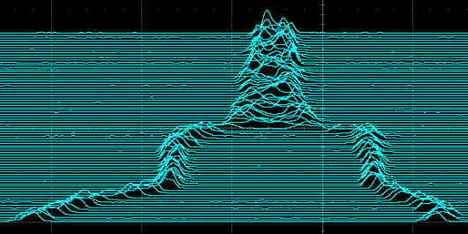
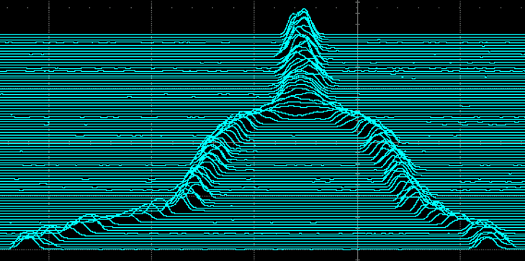
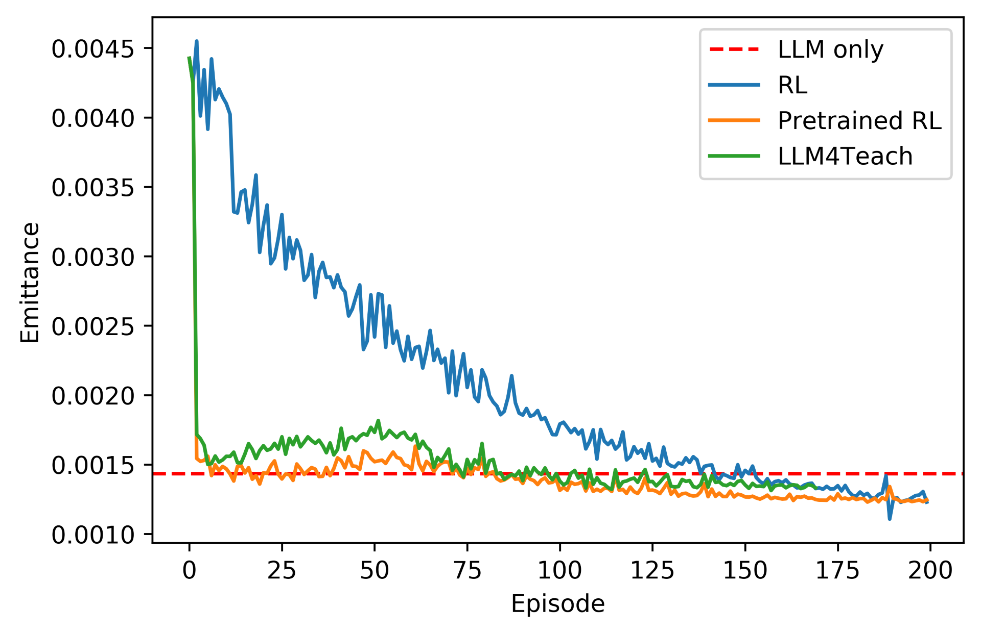
AGS Bunch Merging Optimization with RL
Initial bad merge
Obtain a good merged bunch profile – low emittance growth, no loss, centered and stable.
Longitudinal merge data had to be digitized and logged; operators tune by looking at remote scope signals.
RL optimized merge
RL Optimization
RL agent trained to minimize emittance growth.
Begins from poor merge conditions; rapidly converges to good RF settings.
Comparable performance to operational settings.
LLM-based policy teacher for RL agent in development, leads to faster convergence and better performance.

Slide 10
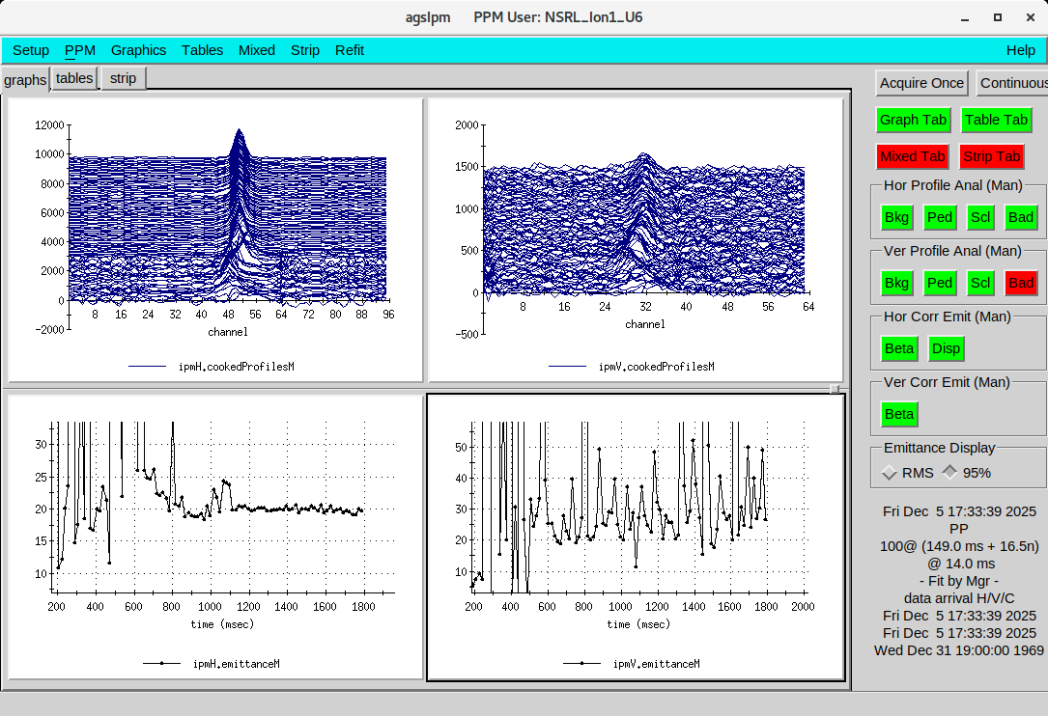
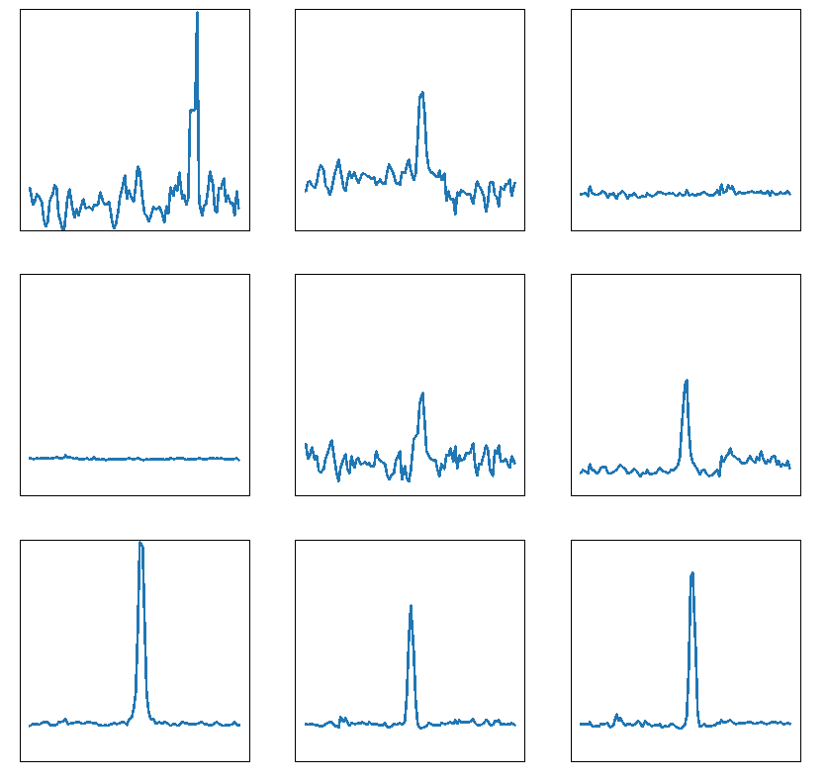
Improving AGS IPM Emittance Measurement with ML
Goal: Improve emittance reconstruction accuracy and robustness of AGS Ion Profile Monitor.
Approach: Gaussian process based surrogate model for fast IPM profile inference; unsupervised anomaly classifier to detect atypical IPM profiles.
Challenge: Limited availability of high-quality training data from both IPM and eIPM.
Classifier predictions on archive data
Anomalous
Normal

Slide 11
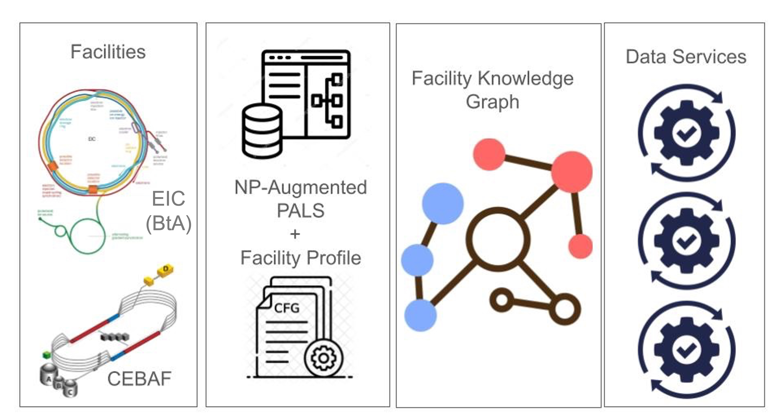
NP AI-Ready Accelerator Data (NARAD)
Goal: Develop FAIR, context-rich, AI-ready accelerator data and common ontology for cross-facility AI applications (BNL, JLab, LBNL, PNNL).
BNL BtA Experience
Legacy control systems are difficult to generalize: ADO vs. EPICS
Metadata / Context can be sparse or implicit: lattice configuration, device hierarchy, calibration, units, machine state etc.
Data correlation is nontrivial: asynchronous data streams (magnet settings, beam profiles, timestamps)
Standard Development Effort
PALS + LinkML + knowledge graphs: machine-readable accelerator semantics
Genesis Mission data card: toward community standards for AI-ready data curation, preprocessing, and quality assessment

Slide 12
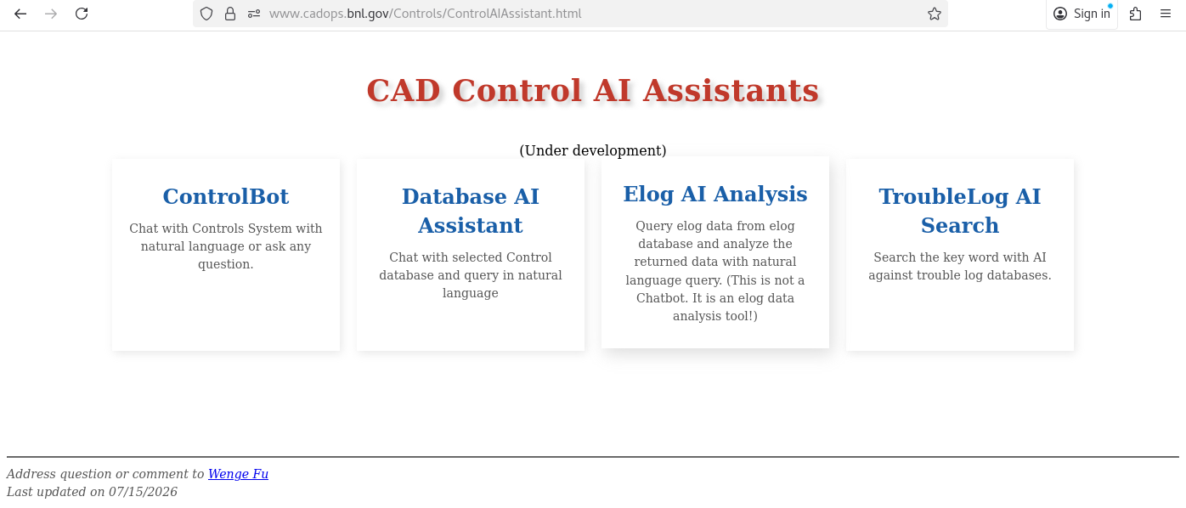
Agentic AI for Accelerator Operations
Current capabilities
Domain-specific RAG using GPT-OSS-120B over 300-400k documents (HTML, PDF, Wiki, etc.)
AI assistants for control system queries, database search, eLog analysis, and troubleshooting
Remaining challenges
Natural language query for ~2.7M ADO parameters, structured context from scattered documents
Secure agent interaction with control systems behind the firewall, local vs. commercial LLM
Building operator trust and encouraging routine use

Slide 13
ML Experience at BNL: Takeaways
AI works: Bayesian Optimization, Reinforcement Learning, surrogate models, and Digital Twins already provide measurable operational benefits.
Diagnostics are the bottleneck: Reliable measurements, metadata, and standardized data infrastructure are essential for scalable AI.
Physics + AI + Data Infrastructure: Future accelerator control will integrate first-principles models, machine learning, interoperable data standards, and intelligent agents.
Looking forward
Invest in next-generation diagnostics
Develop trustworthy Digital Twins with uncertainty quantification
Build standardized AI-ready data infrastructure through NARAD
Expand online Bayesian Optimization and Reinforcement Learning
Human-in-the-loop accelerator automation

Slide 14


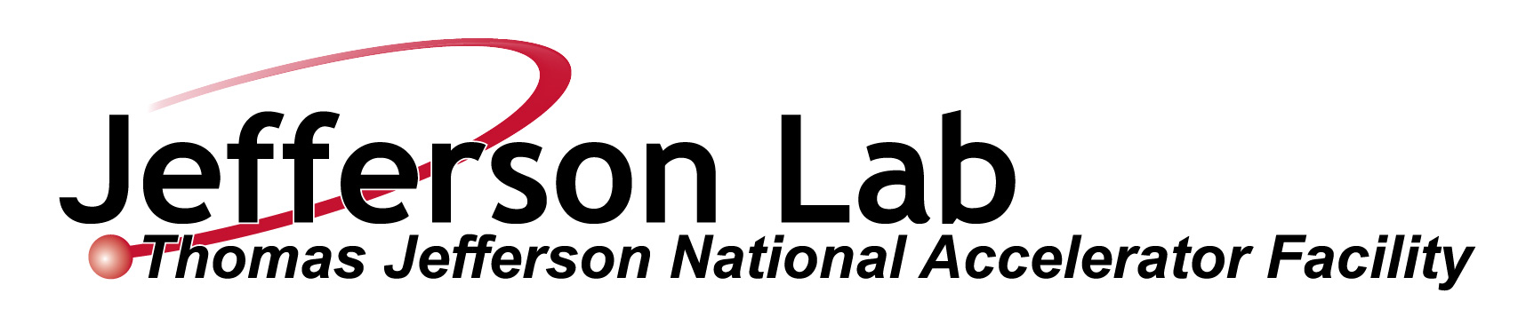






Acknowledgements: A Community Effort
EIC-Beam AI Working Group now organizes monthly meetings: https://indico.global/category/1612/

