Slide 1
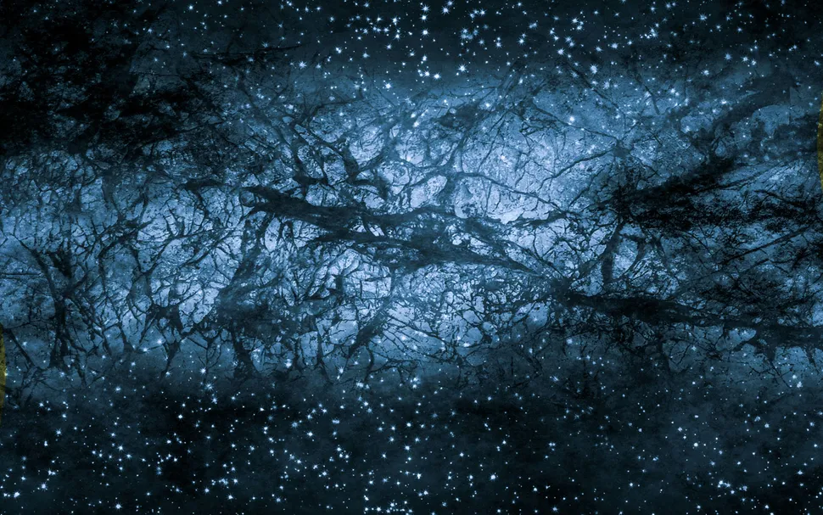
DM Direct Detection: From Particle Physics to Material Science
Bethany Suter | UC Berkeley
SLAC Seminar
April 1, 2026
IN collaboration with Y. Hochberg, B. Lehmann, R. Ovadia, S. Griffin, R. Yang, W. Zhao, P. Munbodh, S. Knapen, S. Gori, & T. Lin
Image credit: Shutterstock

Slide 2
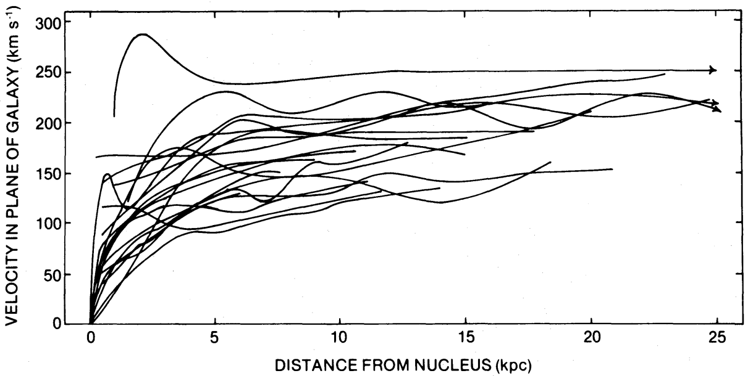
What is Dark Matter?
Dark, cold, collision-less, stable(ish) particle(s) making up 85% of matter in the universe
Evidence for DM is strong
  Galaxy rotation curves
  CMB
  Gravitational lensing
  The Bullet Cluster
  And many more
Astrophysics tells us a lot about DM, but one major unknown – DM’s mass
V. Rubin et al., 1980

Slide 3
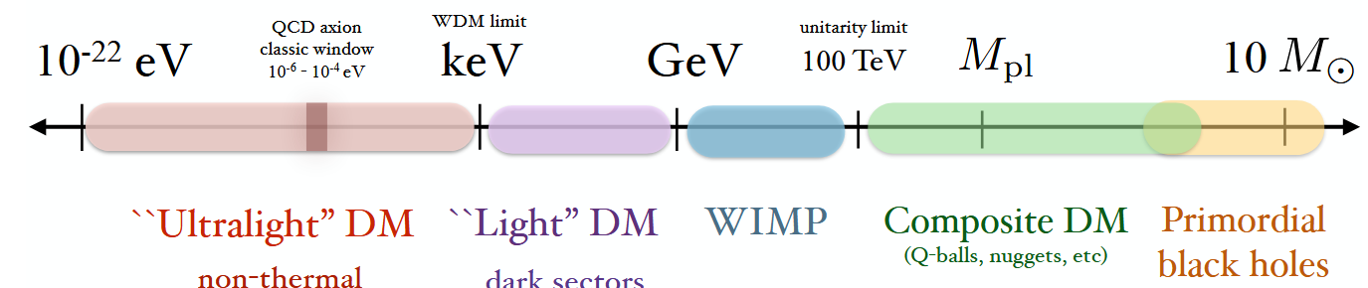
What I’ve worked on (and future work)
Mirror DM at a Muon Collider
arXiv:26XX.XXXXX
WIMP-like Asymmetric DM Model
arXiv:2107.03398
AMSB applied to chiral gauge theories
arXiv:2505.07931
arXiv:2503.08772
First High-Throughput Search for Dark Matter Detector Materials arXiv:2506.19905
Multiphonon Processes in Spin-Dependent Dark-Matter Scattering arXiv:2506.11191
A Bayesian statistical approach to supersymmetry
arXiv:26XX.XXXXX
Fig from: arXiv:1904.07915

Slide 4
What I’ve worked on (and future work)
Mirror DM at a Muon Collider
arXiv:26XX.XXXXX
WIMP-like Asymmetric DM Model
arXiv:2107.03398
AMSB applied to chiral gauge theories
arXiv:2505.07931
arXiv:2503.08772
First High-Throughput Search for Dark Matter Detector Materials arXiv:2506.19905
Multiphonon Processes in Spin-Dependent Dark-Matter Scattering arXiv:2506.11191
A Bayesian statistical approach to supersymmetry
arXiv:26XX.XXXXX
Fig from: arXiv:1904.07915

Slide 5
Why Light Dark Matter?
Well motivated theoretically
  Sterile neutrinos, asymmetric dark matter, axion-like particles, dark sectors, etc.
Well motivated experimentally
  Builds off WIMP searches
  Technology like SQUIDs and TES promise improved noise reduction and low energy thresholds
Many exciting methods to detect dark matter
  Scintillation, electron recoil, phonon excitations, the Migdal effect, etc.
Part 1
arXiv:2506.19905
Part 2 arXiv:2506.11191

Slide 6
First High-Throughput Search for Dark Matter Detector Materials
With Y. Hochberg, B. Lehmann, R. Ovadia, S. Griffin, R.X. Yang, & W. Zhao

Slide 7
Outline: Part 1
DM-Electron Scattering
Materials Project & Big Data
Results!

Slide 8
Outline: Part 1
DM-Electron Scattering
Materials Project & Big Data
Results!

Slide 9

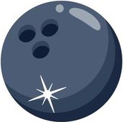

Kinematic Matching: Nuclear Recoil
Heavy DM
Nucleon

Slide 10

Kinematic Matching
Light DM
Nucleon

Slide 11

Kinematic Matching: Electron-DM
Light DM
Electron

Slide 12
Electronic Screening: DM
Light DM
Electron Gas

Slide 13
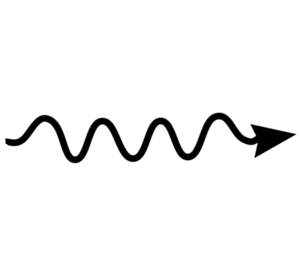
Electronic Screening: Dielectric Function
Photon
Electron Gas
Scattering

Slide 14
Electronic Screening: Dielectric Function
Photon
Electron Gas
Absorption

Slide 15
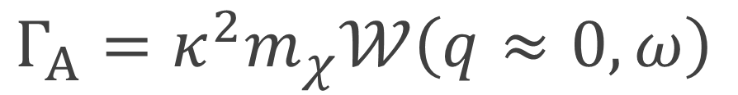
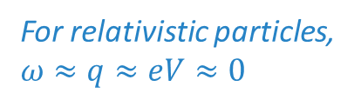
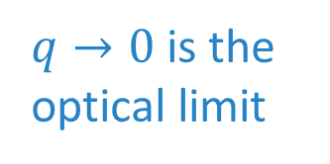
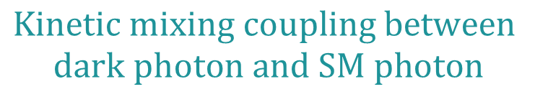
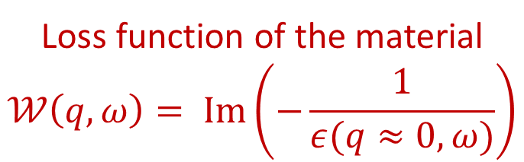
DM-Electron Absorption Rate
$$Kinetic mixing coupling between$$
$$dark photon and SM photon$$
Dark matter mass
$q→0$is the optical limit
$Γ_{A}=κ^{2}m_{χ}𝒲\left(q≈0,ω\right)$
For relativistic particles, $ω≈q≈eV≈0$
Dielectric Function:
Parametrizes a material’s response
to deposits of energy/momentum
Loss function of the material
$$𝒲\left(q, ω\right)= \text{Im}\left(−\frac{1}{ε(q≈0,ω)}\right)$$

Slide 16
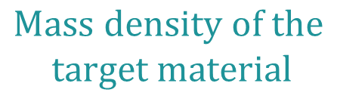
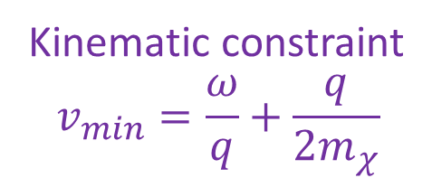
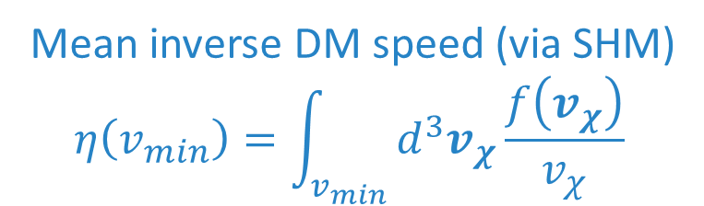
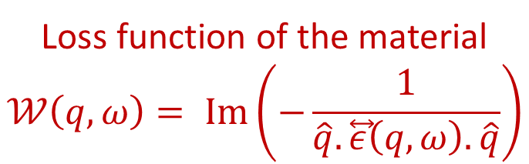
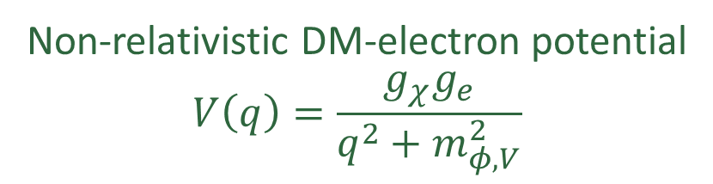
DM-Electron Scattering Rate
Mean inverse DM speed (via SHM)
$$η\left(v_{min}\right)=\int_{v_{min}}^{ }{d^{3}v_{χ}\frac{f\left(v_{χ}\right)}{v_{χ}}}$$
Non-relativistic DM-electron potential
$$V\left(q\right)=\frac{g_{χ}g_{e}}{q^{2}+m_{φ,V}^{2}}$$
$\frac{dR}{dω}=\frac{ρ_{χ}}{2π^{2}e^{2}ρ_{T}m_{χ}}∫dq q^{3}{\left|V\left(q\right)\right|}^{2}𝒲\left(q,ω\right)η(v_{min}\left(q, ω\right))$
$$Mass density of the$$
$$target material$$
Loss function of the material
$$𝒲\left(q, ω\right)= \text{Im}\left(−\frac{1}{\hat{q}.\overset{⃡}{ε}\left(q,ω\right).\hat{q}}\right)$$
Kinematic constraint
$$v_{min}=\frac{ω}{q}+\frac{q}{2m_{χ}}$$

Slide 17
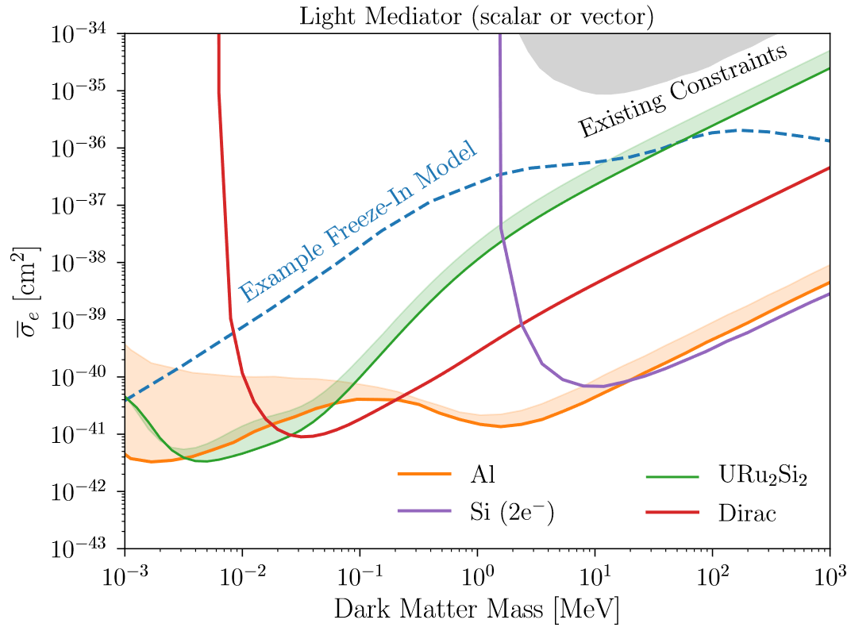
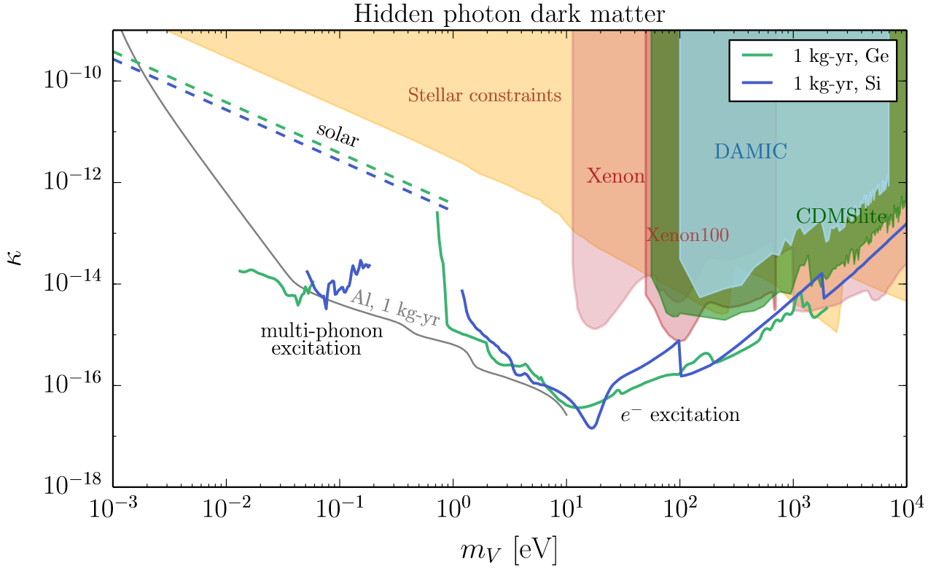
Current DM-Electron Absorption/Scattering
arXiv:1608.01994
arXiv:2101.08263

Slide 18
Outline: Part 1
DM-Electron Scattering
Materials Project & Big Data
Results!

Slide 19
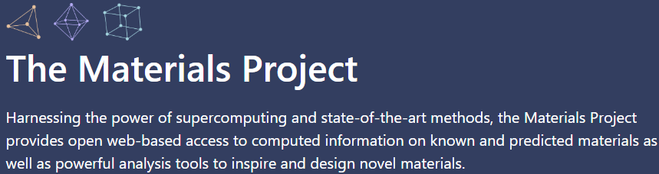

Slide 20
Our Dataset
1019 Materials with DFT computed, energy dependent, dielectric tensors
593 materials have anisotropic responses in at least 1 axis
  We can do both an isotropic and anisotropic scattering analysis
  Anisotropic scattering eliminates the background for a streaming DM signal, at the cost of requiring more DM interactions.
Calculated in the optical limit (transferred momentum q -> 0)
  Scattering rate calculation requires q ≠ 0 data 😞

Slide 21



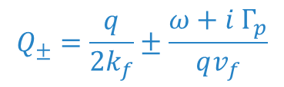
How to Extract Momentum Dependence
The Drude-Lindhard Dielectric Function has momentum dependence:
  Derived using perturbation theory and the Random Phase Approximation (RPA)
  Models materials with one plasmon peak very well
We can fit the $q→0$ limit to the Materials Project dielectric tensors and extract $ω_{p}$ and $Γ_{p}$:
$$ε_{RPA}\left(q, ω\right)=1+\frac{3ω_{p}^{2}}{q^{2}v_{F}^{2}}\left\{\frac{1}{2}+\frac{k_{F}}{4q}\left(1−Q_{−}^{2}\right)\text{Log}\left(\frac{Q_{−}+1}{Q_{−}−1}\right)+\frac{k_{F}}{4q}\left(1−Q_{+}^{2}\right)\text{Log}\left(\frac{Q_{+}+1}{Q_{+}−1}\right)\right\}$$
$$Q_{±}=\frac{q}{{2k}_{f}}±\frac{ω+i Γ_{p}}{qv_{f}}$$
$$ε_{RPA}\left(q→0,ω\right)=1+\frac{ω_{p}^{2}}{{\left(Γ_{p}−iω\right)}^{2}}$$
$k_{f}, v_{f}$ can be derived from $ω_{p}$

Slide 22
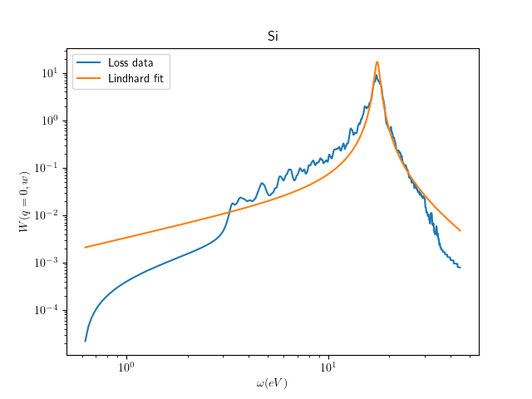
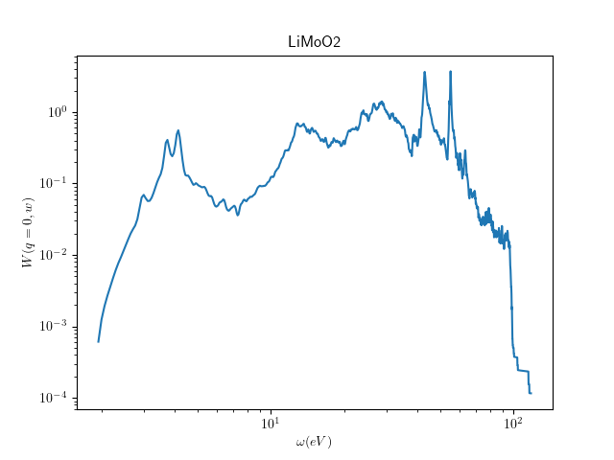
Fitting Difficult Dielectric Functions
?

Slide 23
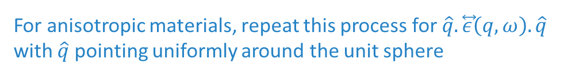

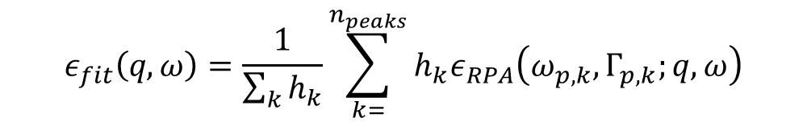
Full Pipeline
Locations of peaks, $ω_{p},$ are determined by zeros in Re($ϵ$)
We fit a sum of Lindhards at q=0:
We define $r\left(ω\right)=\frac{ε_{data}\left(ω\right)}{e_{fit}\left(q=0, ω\right)}$ and assume all features not described by Lindhard plasmons are independent of q
We calculate the scattering rate using
$$ε\left(q,ω\right)=r\left(ω\right) ε_{fit}\left(q,ω\right)$$
Oscillator Method
$$ε_{fit}\left(q,ω\right)=\frac{1}{\sum_{k}{h_{k}}}\sum_{k=}^{n_{peaks}}{h_{k}ε_{RPA}\left(ω_{p, k},Γ_{p,k};q, ω\right)}$$
This methodology is only a proxy for the true (unknown) q dependence. A more complete DFT or experimental analysis is required for any materials of interest
For anisotropic materials, repeat this process for $\hat{q}.\overset{⃡}{ε}\left(q,ω\right).\hat{q}$ with $\hat{q}$ pointing uniformly around the unit sphere

Slide 24
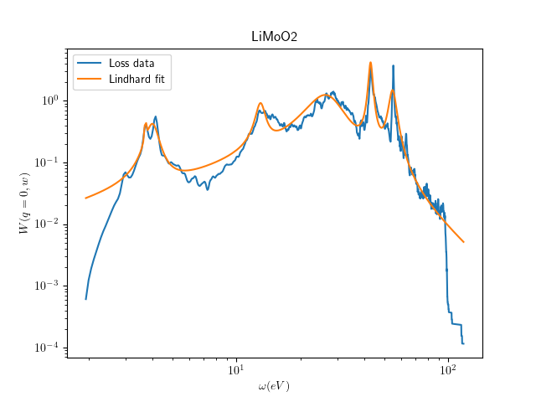
Fitting Difficult Dielectric Functions
?

Slide 25
Outline: Part 1
DM-Electron Scattering
Materials Project & Big Data
Results!

Slide 26
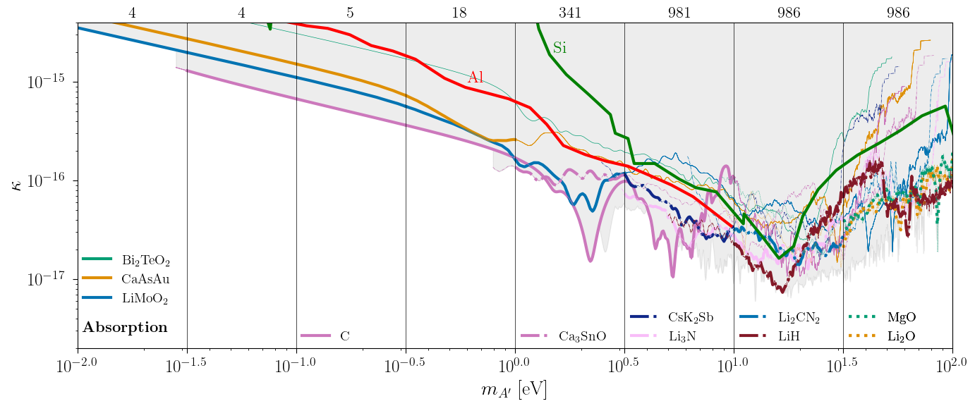
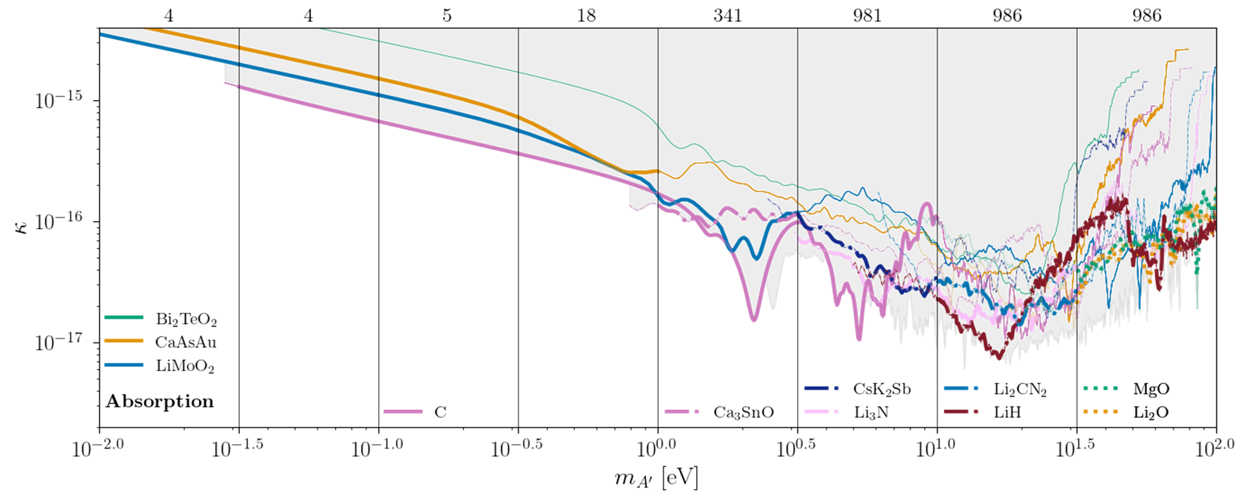
Absorption

Slide 27
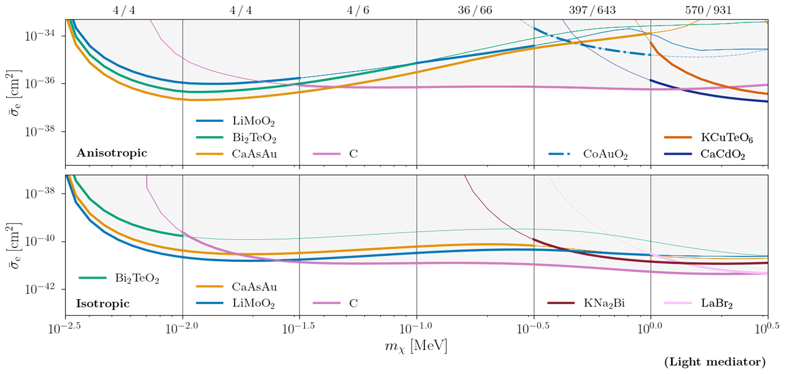
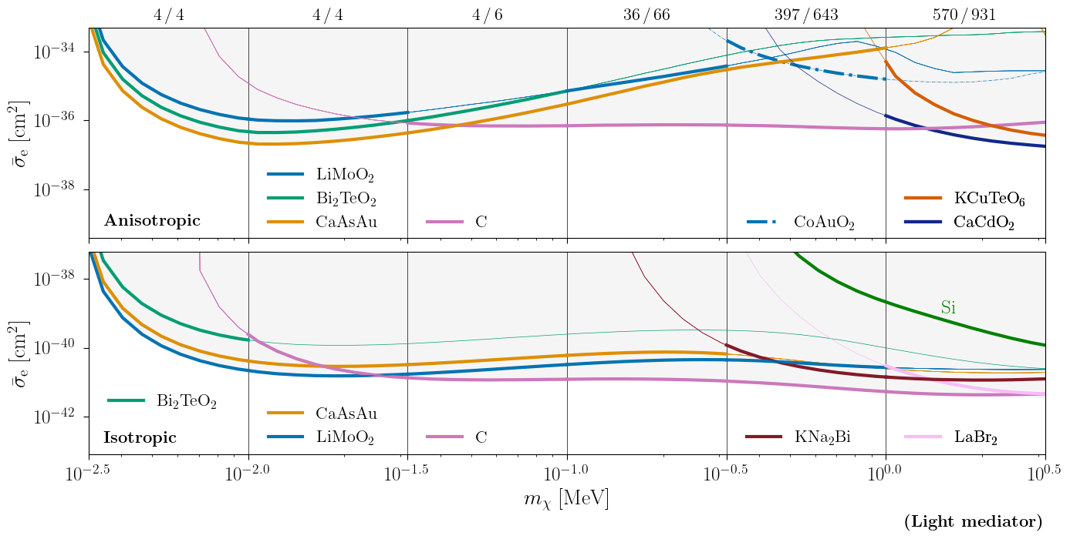

Light Mediator
$$E_{th}=10 meV$$

Slide 28
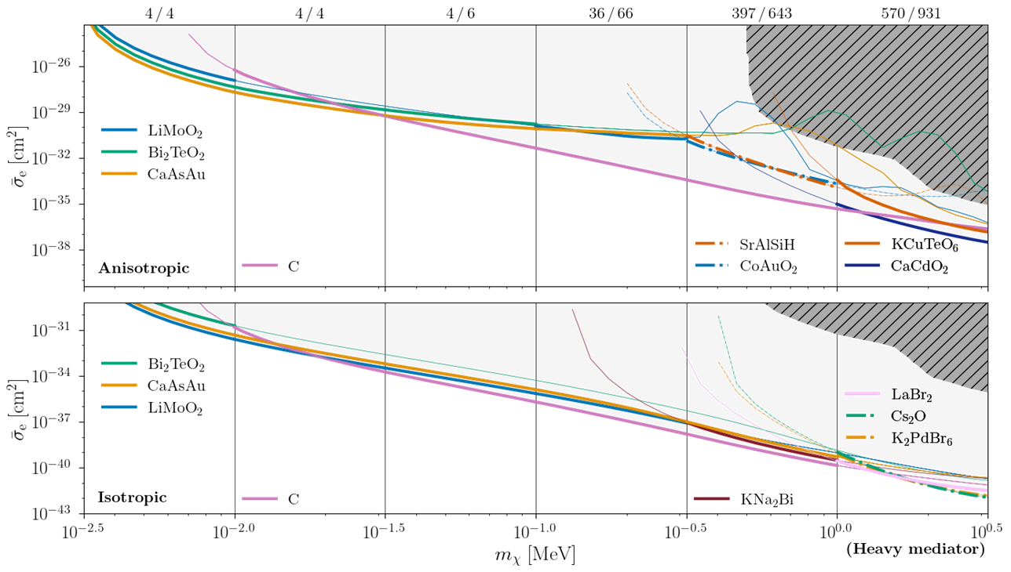
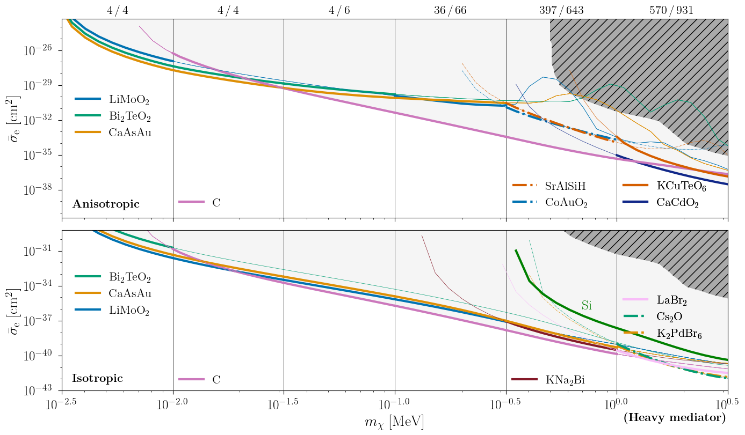

Heavy Mediator
$$E_{th}=10 meV$$

Slide 29
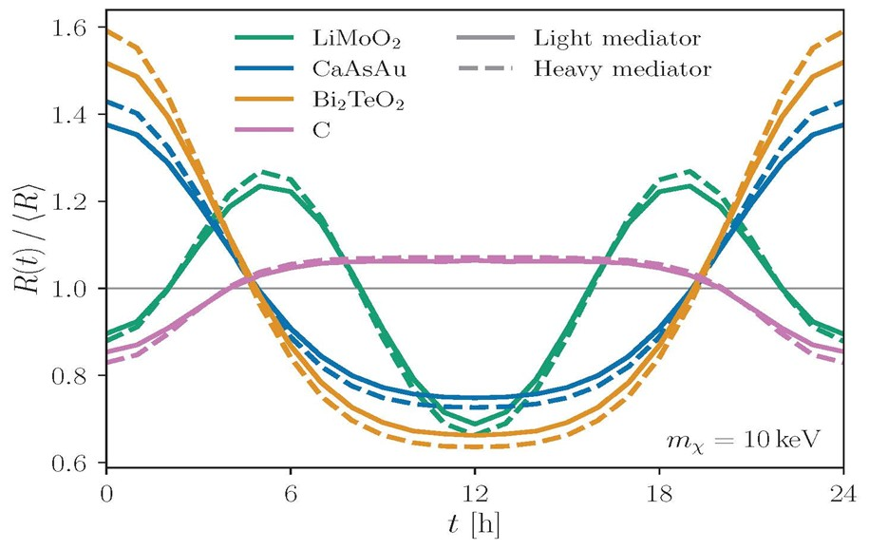
Daily Modulation

Slide 30
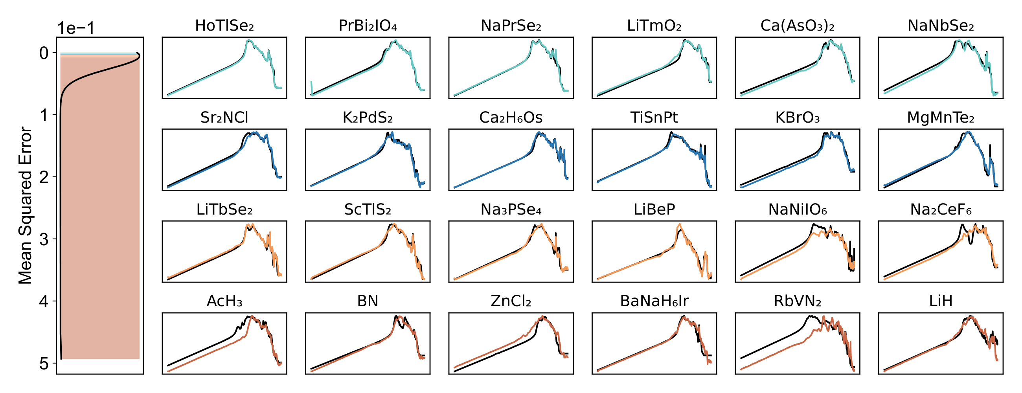


Sneak Peek: What can ML do?
Preliminary
$$W{\left(ω,q→0\right)}_{xx}$$
$$ω [eV]$$
https://doi.org/10.1002/adma.202409175

Slide 31
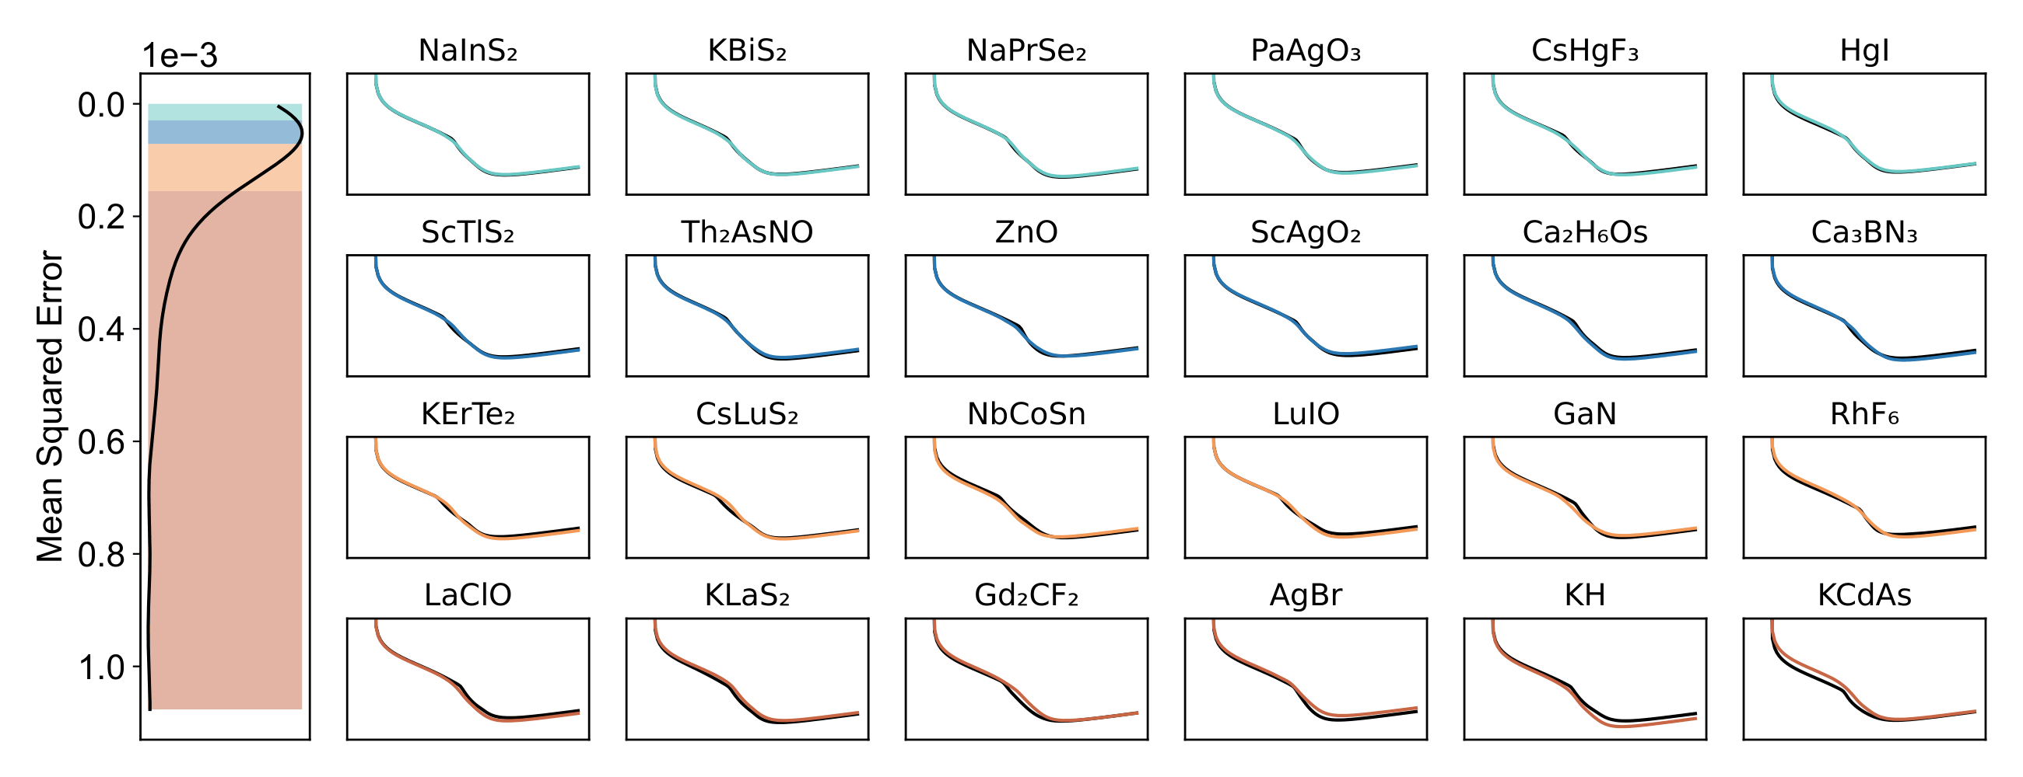


Sneak Peek: What can ML do?
Preliminary
$${\overline{σ}}_{e}[{cm}^{2}]$$
$$m_{χ} [MeV]$$
https://doi.org/10.1002/adma.202409175

Slide 32
Conclusions: Part 1
We’ve performed the first high-throughput materials search for dark matter direct detection based on the dielectric properties of the materials (material informatics)
We utilized a model of the electron – DM scattering rate which correctly accounts for electron screening and depends on the particular material’s dielectric tensor
We took dielectric tensor data from the Materials Project and modeled each material via a sum of Drude-Lindhard dielectric functions in order to approximate momentum dependence
We show the top three materials in many energy bands for absorption and scattering with both heavy and light mediators. We also show daily modulation for several exceptional materials.

Slide 33
Multiphonon Processes in Spin-Dependent Dark-Matter Scattering
With S. Gori , S. Knapen, T. Lin, & P. Munbodh

Slide 34
Outline: Part 2
Why phonons + DM
Derivation of multiphonon scattering
Results!

Slide 35
Outline: Part 2
Why phonons + DM
Derivation of multiphonon scattering
Results!

Slide 36
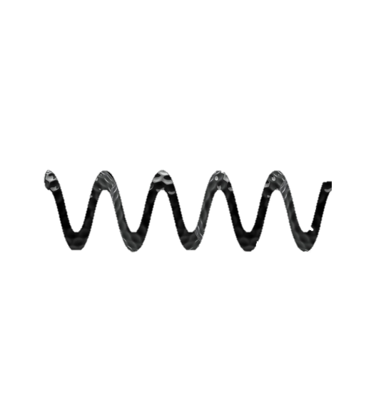
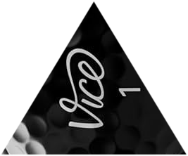
Kinematic Matching
Light DM
Nucleon

Slide 37

Nuclear Scattering: Phonons
Acoustic
Very complicated system of
coupled harmonic oscillators

Slide 38
Nuclear Scattering: Phonons
-
-
Optical
+
+
Very complicated system of
coupled harmonic oscillators
-
-
+
+
-
-
+
+

Slide 39
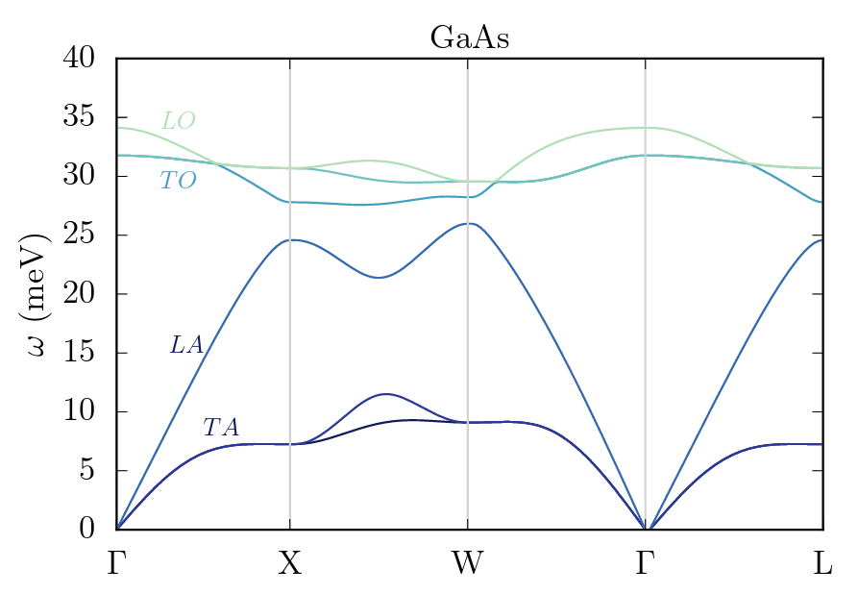
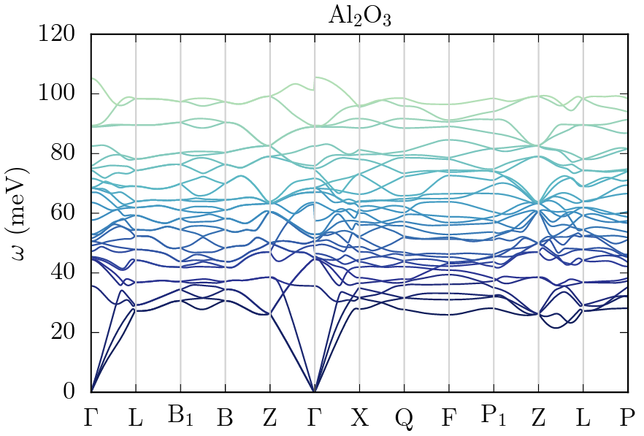

Acoustic vs Optical
As discussed in 1807.10291, low momentum transfer = only excite acoustic phonon in 1st Brillouin zone
$$ω=c_{s}\left|q\right| ≈2c_{s}vm_{X}∼7 meV× \frac{m_{X}}{100keV}$$
Best experimental threshold is in 10 – 100 meV range, so difficult or impossible to detect
Optical modes don’t have this scaling:
  $$ω \sim 30 meV as \left|q\right|→0$$
1807.10291
Notes:
Band structure plot

Slide 40
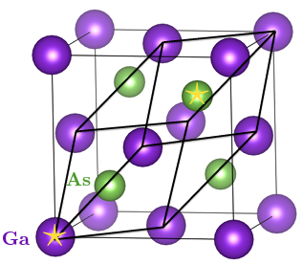
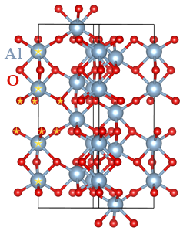



Polar Materials
$$GaAs$$
At least two different atoms with different effective charges
Each unit cell forms an electric dipole
E field or dark photon causes vibrations
  $→$Optical phonons
GaAs
  2 atoms in unit cell
  3 acoustic phonons, 3 optical phonons
Sapphire
  10 atoms in unit cell
  3 acoustic phonons, 27 optical phonons
${Al}_{2}O_{3}$ (Sapphire)
Primary crystal axis
1807.10291

Slide 41
Outline: Part 2
Why phonons + DM
Derivation of multiphonon scattering
Results!

Slide 42
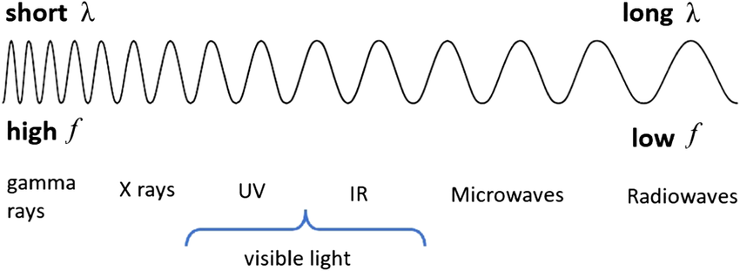
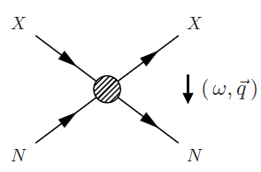
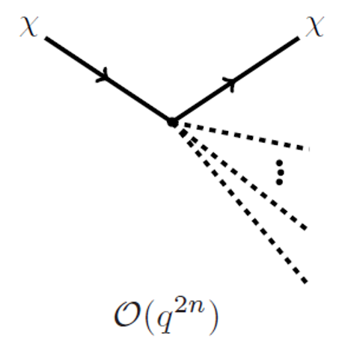
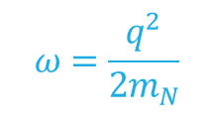
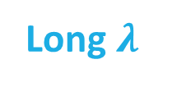
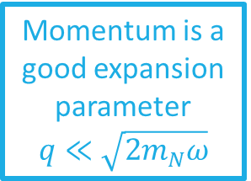

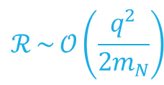
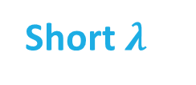
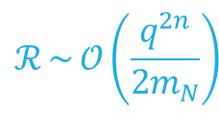

DM Multiphonon Expansion
arXiv:1712.06598
arXiv:1807.10291
arXiv:1911.03482
arXiv:2205.02250
Large $m_{χ}$ & q
Small $m_{χ}$ & q
Momentum is a good expansion parameter
$$q≪\sqrt{2m_{N}ω}$$
Short $λ$
Long $λ$
$$ω=\frac{q^{2}}{2m_{N}}$$
$$ℛ \sim 𝒪\left(\frac{q^{2n}}{2m_{N}}\right)$$
$$ℛ \sim 𝒪\left(\frac{q^{2}}{2m_{N}}\right)$$

Slide 43






Multiphonon Scattering Rate
$λ_{i} \& λ_{f}$ denote initial & final spin & phonon states
Fermi’s Golden Rule
$$\frac{dσ}{d^{3}qdω}\sim \sum_{i,f}{{\left|\sum_{d}^{N}{\left\langle λ_{f}\left|{𝒪(q)e}^{iq⋅r_{d}}\right|λ_{i}\right\rangle }\right|}^{2}δ(E_{f}−ω)}$$
$r_{d}$ is the position of each atom
$d$ labels each atom in the crystal
$𝒪(q)$ is some spin dependent operator
$𝒪(q)$ = 1 is spin independent (already been done: 2205.0225)

Slide 44
Spin Dependent Interactions
Nuclear Spin Polarized
Similar to spin independent case, with a form factor correction
Nuclear Spin Unpolarized
Cross section doesn’t average away:
$d =d′$ (incoherent) terms contribute $\sim ⟨S_{N}^{2}⟩$
Modify spin independent calculation!
Cross section doesn’t average away:
𝑑 =𝑑′ (incoherent) terms contribute ~ ⟨𝑆_𝑁^2⟩
Modify spin independent calculation!
(see T. Trickle et. al. 2009.13534)
Figures by S. Knapen

Slide 45
Approximations
Harmonic Approximation:
  Decompose into a sum of harmonic oscillators weighted by the phonon density of states
  Neglect anharmonic contributions to the crystal potential
Isotropic crystal
Unpolarized Spins
  Nuclei spins have equal probabilities of being pointed in any direction – no net B field

Slide 46





Multiphonon Rate
$s_{med}\left(q\right)$ is a spin factor depending on the EFT operator
$$\sim {1, q}^{2},q^{4}$$
Expansion order by order in $\frac{q^{2}}{2m_{d}}$
$n$ labels each phonon in the expansion
$$\frac{dσ}{d^{3}qdω} \sim \sum_{d}^{N}{s_{med}(q)e^{−2W_{d}(q)}}\sum_{n}{{\left(\frac{q^{2}}{2m_{d}}\right)}^{n}}\frac{1}{n!}\left(\prod_{i=1}^{n}{∫dω_{i}\frac{D_{d}\left(ω_{i}\right)}{ω_{i}}}\right)δ\left(\sum_{j}{ω_{j}−ω}\right)$$
$d$ labels each atom in the crystal
Same as in the spin independent calculation
Debye Waller factor
Partial density of states (from DFT)

Slide 47








Model Dependence:
EFT operators
$$χ$$
$$χ$$
q
$$p$$
$$p$$
Scalar mediator $φ$
Scalar mediator 𝜙
$ℒ_{ }⊃g_{χ}φ\overline{χ}χ+g_{p}φ\overline{N}γ^{5}N$
ℒ_ ⊃𝑔_𝜒 𝜙𝜒 ̅𝜒+𝑔_𝑝 𝜙𝑁 ̅𝛾^5 𝑁
Pseudoscalar mediator $a$
Pseudoscalar mediator 𝑎
$ℒ_{ }⊃g_{χ}a\overline{χ}γ^{5}χ+g_{p}a \overline{N}γ^{5}N$
ℒ_ ⊃𝑔_𝜒 𝑎𝜒 ̅𝛾^5 𝜒+𝑔_𝑝 𝑎 𝑁 ̅𝛾^5 𝑁
Pseudovector mediator $A_{μ}^{′}$
Pseudovector mediator A_𝜇^′
$ℒ_{ }⊃g_{χ}A_{μ}^{′}\overline{χ}{γ^{μ}γ}^{5}χ+g_{p}A_{μ}^{′} \overline{N}{γ^{μ}γ}^{5}N$
ℒ_ ⊃𝑔_𝜒 𝐴_𝜇^′ 𝜒 ̅〖𝛾^𝜇 𝛾〗^5 𝜒+𝑔_𝑝 𝐴_𝜇^′ 𝑁 ̅〖𝛾^𝜇 𝛾〗^5 𝑁
$ℒ_{NR} \sim \left(q⋅S_{N}\right)\left(q⋅S_{χ}\right)$
ℒ_𝑁𝑅 ~ (𝑞⋅𝑆_𝑁 )(𝑞⋅𝑆_𝜒 )
$ℒ_{NR} \sim \left(q⋅S_{N}\right)$
ℒ_𝑁𝑅 ~ (𝑞⋅𝑆_𝑁 )
$ℒ_{NR} \sim (S_{N}⋅S_{χ})$
ℒ_𝑁𝑅 ~ (𝑆_𝑁⋅𝑆_𝜒)
$${s_{φ}\sim }^{ }\frac{{ q}^{2}}{m_{N}^{2}}\left(\overline{f_{d}^{2}\left\langle S_{d}^{2}\right\rangle }\right)$$
$${s_{a}\sim }^{ }\frac{{ q}^{4}}{m_{N}^{2}m_{χ}^{2}}\left\langle S_{χ}^{2}\right\rangle \left(\overline{f_{d}^{2}\left\langle S_{d}^{2}\right\rangle }\right)$$
$${s_{A_{μ}^{′}}\sim }^{ }⟨S_{χ}^{2}⟩\left(\overline{f_{d}^{2}\left\langle S_{d}^{2}\right\rangle }\right)$$

Slide 48
Outline: Part 2
Why phonons + DM
Derivation of multiphonon scattering
Constraints & Results

Slide 49




Constraints on $g_{N}$
Valid for $m_{φ} \& m_{a}$

Slide 50



Constraints on $g_{χ}$
$$\frac{σ}{m_{χ}}\text{≲}\text{ 1.1 }{cm}^{2}/g$$
2006.12515

Slide 51


Results
Most optimistic reach curves: $φ$
$m_{φ}=10 m_{χ}v_{0}$
Cliff occurs at the constraint from HB stars
Left: SIDM constraints on $g_{χ};$ Right: $g_{χ}=1$
Cross sections needed for 3 events/kg-year rate for GaAs & sapphire using several threshold energies

Slide 52


Results
Potential reach for $a$ is always worse than $φ$ – momentum suppressed
$m_{a}=10 m_{χ}v_{0}$
Cliff occurs at the constraint from HB stars
Left: SIDM constraints on $g_{χ};$ Right: $g_{χ}=1$
Cross sections needed for 3 events/kg-year rate for GaAs & sapphire using several threshold energies

Slide 53


Constraints on $g_{N}$
The star denotes the optimal choice of mediator mass to reduce the constraint.
Valid for $m_{A′}$

Slide 54


Results
A’ – axial vector case; often considered the SD case
$m_{A′}=10 GeV$
$g_{N}∼g_{χ}$
  Theoretical consistency
  SIDM constraints are superseded
Cross sections needed for 3 events/kg-year rate for GaAs & sapphire using several threshold energies

Slide 55
Conclusions: Part 2
Multiphonon – DM interactions cover intermediate DM mass ranges between nuclear recoil and single phonon detection
Spin dependent multiphonon scattering utilizes similar methods as spin independent when crystal spins are randomly distributed
The reach of multiphonon experiments falls well short of current constraints on spin dependent DM interactions (SN, mesons, etc), except in a few possible cases

Slide 56
Conclusions
Part 1: arXiv:2506.19905
Current electron recoil experiments focus on limited, well-known materials
We can harness the ideas of Material Informatics and use a data-driven approach to find exceptional candidate materials for next-gen dark matter detectors
Anisotropic materials provide a big boost by eliminating backgrounds in detectors
Part 2: arXiv:2506.11191
We updated constraints on the spin-dependent DM-nucleon cross section for three representative operators
We project the zero-background reach for upcoming phonon detectors
Because of momentum suppression, and the strength of the constraints, very little parameter space remains open for these low DM masses.

Slide 57

Questions?

Slide 58
Backup Slides

Slide 59

Comparison between DFT (GPAW) and Mermin Oscillators
arXiv:2101.08275

Slide 60




Current Experimental Constraints and Projections
DM-$e^{−}$ Absorption
DM-$e^{−}$ Scattering
DM-$N$ Scattering
arXiv:2207.03764 arXiv:2303.14729
arXiv:2207.07640 arXiv:1702.07666
arXiv:1707.01632 arXiv:1611.01499
arXiv:1608.01994
arXiv:2101.08263

Slide 61

Benefits of Polar Materials
Gapped dispersion of optical phonons
  Single or multiphonon
Anisotropic crystal structures
  Daily modulation in rate
Low screening
  Required: few free electrons, high polarizability
  Gap for electronic excitations $\sim O\left(1−10 eV\right)$
  Kinetic mixing with dark photon couples to dipole moment
Easy to fabricate
S. Griffin, S. Knapen, T. Lin, M. Pyle, K. Zurek: 1807.10291

Slide 62



Approximations
Spin Independent
Spin Dependent
n-ph expansion
(no approximation)
$$ω=\frac{q^{2}}{2m_{d}}$$
Impulse approximation
DM phase space
$$→$$
B. Campbell-Deem, S. Knapen, T. Lin, E. Villarama: 2205.02250

Slide 63

Density of States
The peaks from each phonon are visible
The partial density of states are calculated using Density Effective Theory where data is not yet taken
Many materials’ density of states can be taken from the Material Project data
A. Jain, Et. Al. https://doi.org/10.1063/1.4812323

Slide 64


Spin Independent Results
Assumes a coupling $\sim A_{d}$
Isotropic approximation
Anharmonic corrections around $m_{χ} \sim 1−10 MeV$: 2309.10839
B. Campbell-Deem, S. Knapen, T. Lin, E. Villarama: 2205.02250

Slide 65
Where should we look?
Mirror DM at a Muon Collider
arXiv:26XX.XXXXX
A Bayesian statistical approach to supersymmetry
arXiv:25XX.XXXXX
AMSB applied to chiral gauge theories
arXiv:2505.07931
arXiv:2503.08772
WIMP-like Asymmetric DM Model
arXiv:2107.03398
Fig from: arXiv:1904.07915

Slide 66



Multiphonon Rate (SI)
$$\frac{dσ}{d^{3}qdω} \sim \sum_{d}^{N}{f_{d}^{2}e^{−2W_{d}(q)}}∑{\left(\frac{q^{2}}{2m_{d}}\right)}^{n}\frac{1}{n!}\left(\prod_{i=1}^{n}{∫dω_{i}\frac{D_{d}\left(ω_{i}\right)}{ω_{i}}}\right)δ\left(\sum_{j}{ω_{j}−ω}\right)$$
$$\frac{dσ}{d^{3}qdω} \sim \sum_{d}^{N}{f_{d}^{2}}\sqrt{\frac{2π}{Δ_{d}^{2}}}\exp\left(−\frac{{\left(ω−\frac{q^{2}}{2m_{d}}\right)}^{2}}{2Δ_{d}^{2}}\right)$$
$$\frac{dσ}{d^{3}qdω} \sim \sum_{d}^{N}{f_{d}^{2}}×δ\left(ω−\frac{q^{2}}{2m_{d}}\right)$$
$$q ≫\sqrt{2ωm_{d}}$$
Impulse Approximation
Partial density of States
Free nuclear recoil limit!
B. Campbell-Deem, S. Knapen, T. Lin, E. Villarama: 2205.02250

Slide 67


Spin Dependent Constraints
$m_{a}$ is not fixed
H. Ramani, G. Woolley arXiv:1905.04319

Slide 68


Phonon Detector: HeRALD
Calorimeters with TES readout
Quantum evaporation of He atoms
S. Hertel, A. Biekert, J.Lin, V.Velan, & D. McKinsey arXiv:1810.06283
Figures from J. Lin slides

Slide 69

Phonons
Very complicated system of coupled harmonic oscillators
Acoustic Phonons
Coherent motion of the lattice atoms
Wavelength $→$ 0 corresponds to displacement of the crystal
Wavelength → 0 corresponds to displacement of the crystal
Optical Phonons
Out of phase motion of the lattice atoms
If material is polar, couples to EM field
Figure from S. Knapen

Slide 70


Phonon Detector: SPICE
3’’ sapphire detector
Polar Materials: GaAs or Sapphire
Scintillation & phonons
  Background discrimination!
Low energy TES
  10 meV threshold
Figure from M. Pyle
Picture from TESSERACT Website

Slide 71


Transition Edge Sensors (TES)
Superconducting film acting at the phase “transition edge”
Large change in resistance with tiny shifts in temperature
Smaller band widths $→$ lower threshold energies

Slide 72
Kinematic Matching: Nuclear Recoil
Heavy DM
Nucleon

Slide 73


DM-Multiphonon Expansion
Nuclear Recoil:
$ω=\frac{q^{2}}{2m_{N}}$
Phonon Regime:
$q ≪\sqrt{2m_{N}ω}$
  Momentum is a good expansion parameter
  Single phonon vs multiphonon
S. Knapen, T. Lin, M. Pyle, K. Zurek: 1712.06598
S. Griffin, S. Knapen, T. Lin, M. Pyle, K. Zurek: 1807.10291
B. Campbell-Deem, P. Cox, S. Knapen, T. Lin, T. Melia: 1911.03482
B. Campbell-Deem, S. Knapen, T. Lin, E. Villarama: 2205.02250

