Slide 1

Relativistic Field Theories
for
Interacting Classical Higher-Spin Particles
Radu Roiban
ETH-ITS & Penn State
Based on work with: Mark Alaverdian, Zvi Bern, Dimitrios Kosmopoulos,
Andres Luna, Fei Teng, Trevor Scheopner, Chia-Hsien Shen, Justin Vines, Mao Zeng
Supported by
ITS Senior Fellowship
Notes:
Thanks. It’s great to be back at SLAC.
This talk is is based on a series of papers written with various subsets of these people. While the purpose of these papers was in the context of e/m and gravitational waves emitted by interacting massive bodies,
the methods and results used are perhaps of a broader interest.
Just to set the expectations – I will not attempt to solve the old problem of finding a consistent theory if HS particles. The FTs I’ll describe are valid in a very limited setting, which will hopefully be clear.

Slide 2
Some questions:
- Spinning bodies exist in nature; is there a relativistic field theory describing their interactions
with gravity?
- What about an effective field theory describing heavy classical spinning bodies at large distances?
- What defines the EFT that describes a Kerr black hole?
Is there a sense in which it is “the simplest” spinning body?
Notes:
Let me begin with a few questions:
….
For elementary particles of low spin is of course positive; and their spin is of the order of Plank’s constant. But what about particles or bodies with large/macroscopic spin. Pick a basketball and spin it, it has macroscopic spin, and from far away it looks pointlike.
Of course, such bodies are not exactly quantum mechanical; so a downgrade of this question asks about the existence of an effective field theory that describes such heavy classical spinning bodies. Such an EFT naturally has a piece describing pointline bodies, which is then systematicaliy corrected to account for finite size effects.
Among the classical spinning bodies there is a very special one – the Kerr black hole – because it has a certain degree of uniqueness. From a GR point of view it is described only by its mass and its spin.
What might it be from a QFT point of view? Schwarzschild BH is simple and it turns out that a minimally-coupled scalar field describes it. But a kerr BH – and in fact any spinning body – has spin-induced multipoles.
What singles out the Kerr black hole?

Slide 3
Why care about any of this?
- Classical spins are large in units of ; No-go theorems suggest difficulties with constructing
(Q)FT of higher-spin fields;
No analysis of their consequences to classical dynamics
- Classical spinning binaries have a GR description; we can leverage that information,
originally derived for gravitational-wave physics
- Classical spinning binaries are sources of gravitational waves
Data provides guidance/confirmation of theoretical constructions
(Q)FT yields predictions
- Look for structure and symmetries in relativistic spin-dependent observables
Notes:
The first question is a long-standing one;
Our original motivation to attempt to answer the latter two relates to gravitational wave physics, but they do have a life of their own.
There are no-go thm suggesting difficulties with a QFT for HS fields, and we’ll look into their modern incarnation, but their consequences to classical limit have not been analyzed yet so they might be looser – and we will see that they are.
Also, there is data that we can leverage in the classical limit, which comes from GR description of two-particle systems. These were originally derived for GW purpose.
Binaries produce GW, so whatever we construct, Nature will eventually confirm it or rule it out.
And last but not least, relativistic invariance allows us to look for structure and symmetries in spin-dependent observables – it does so in spinless systems.
I wont say much about this during the talk, but I am happy to discuss afterwards.

Slide 4
Some goal(s)
Theoretical: - understand the FT degrees of freedom that describe a classical spinning body
- construct a(n effective) field theory of finitely-many higher-spin fields that captures
long-distance gravitational interactions of massive spinning particles;
- find examples & understand what else this FT may describe
- understand (if possible) special GR cases and what singles them out
B. Practical:
1. Reorganize spinning scattering in General Relativity as a two-spinning-body Hamiltonian problem
generalize to include: - velocity dependence
- spin dependence
- dependence on Newton’s constant
2. Extract observables out of this Hamiltonian; generating function of observables?
3. Study if all degrees of freedom have observable consequences
Notes:
With this introduction, our gouls are 3 fold:
TH: -- Find an action with finitely many HS fields that captiures the long-distance gravitational in of massive spinning particles
2) Practical: reduce GR scattering of such particles to a problem in Hamiltonian dynamics for matter particles; That is, generalize Newton potential…
With this goals in mnd,

Slide 5
In this talk:
- Degrees of freedom of classical spinning particles
- QED & Gravity EFT of spinning objects, spin and extra states, decoupling
- An interpretation of the extra degrees of freedom
- Examples of systems exhibiting more than spin degrees of freedom
- Where is Kerr?
- Conclusions and outlook
Notes:
…in this talk we will ID dofs that describe interacting spinning particles. We will see that there are more DOFs or states than tose of a fixed spin particle
We’ll talk about the EM interactions of these DOFs, because it is simple, and then will port the results to GR
We’ll talk about the interpretation of the DOFs beyond spin, see some examples that exhibit them and then end up with a puzzle.

Slide 6
The regime we are focusing on:
i.e. classical limit in the sense of Bohr’s correspondence principle
- A field theory approach to spinning classical dynamics requires higher-spin particles
- Loop amplitudes contain classical parts ; soft region
Notes:
To spell out the setup in which the story shold hold – we will look at scattering in the small angle regime, i.e. masses and energies are much larger than the momentum exchanged by particles.
Moreover, the spin has this scaling with the exchanged momentum. This is a classical limit in the sense of corr., pp
Because ot his S is large in uniyts of hbar
And, even though we won’t see many loops today, loop-level S-matrox elements contain some classical parts.

Slide 7
Eight/Nine amplitudes-based approaches to (classical) higher-spin interactions
Arkani-Hamed, Huang, Huang
3-point ”minimal” amplitude for arbitrary-spin particles
building on Conde, Marzzola, Joung , Mkrtchyan
Naïve higher-point amplitudes with spurious poles at ; fixed
(2022) Chen, Chung, Huang, Kim
Exponentiated soft factors
Guevara, Ochirov, Vines
Same higher-point spurious pole issue as AHH at ; fixed
Heavy-particle EFT-like theory
Aoude, Haddad, Helset
Worldline QFT with spin
Jakobsen, Mogull, Plefka, Steinhoff;
Haddad, Jakobsen, Mogull, Plefka
Fixed order in spin from fixed quantum spin
Spin ½ and 1:
Holstein, Ross, Vaydia, Cachazo, Guevara, Bautista,
Damgaard, Haddad, Helset, …
Febres Cordero, Kraus, Lin, Ruf, Zeng;
spin 5/2: Chiodaroli, Johansson, Pichini
Chiral higher-spin gravity/massive higher-spin gauge symmetry
Cangemi, Chiodaroli, Johansson,
Ochirov, Pichini, Skvortsov
Extract (Compton/Raman) amplitudes from Teukolsky equation
Bautista, Huang, J-W Kim; Bautista,
Bonelli, Iossa, Tanzini, Zhou; Chen, Wang; Chen, Hsieh, Y-t Huang, J-W Kim
Background field calculations
Kosmopoulos, Solon; Cheung, Parra-Martinez, Rothstein, Shah, Wilson-Gerow
4d EFT for arbitrary-spin massive particles in classical limit
Bern, Luna, RR, Shen, Zeng; + Teng;
+ Kosmopoulos, Scheopner, Vines; + Alaverdian
Notes:
There are by now 8 or 9 current approaches to a relativistic description of spinning bodies w QFT techniques.
The minimal amplitiudes of Arkani-Hamed-Huang and Huang, building on earlier work of people here
Another closely related one involves exponentiated soft factors,
a heavy-particle EFT,
there is the wordline QFT, now upgraded to cover all powers of the spin,
fixed-spin calculations with spin-k determing all interactions up to spin^2k
There is chiral higher-spin gravity and massive higher-spin gauge symmetry that are used to fix the Compton amplitude
And last but not least there are a spin-dependent background field calculations and the Teukolsky equation as a source of
Compton or Raman amplitudes to be further sewn into two-body observables.
And last but not least, there is the 4d EFT that we will be discussing for the resft of the talk.
While by and large there is agreement between these various approaches through S^4, it is worth appreciating that, if one
is interested specifically in properties of Kell BHs, to some extent the first seven entries are conjectures.
At the moment the truth is provided by scattering of stuff off kerr BH and these various approaches should match that, and
some of them do.
One may wonder how these are consistent with the various no-go thms for interacting HS particles.

Slide 8
No-go arguments based on causality
- Higher-curvature terms require infinitely many massive higher-spin fields
Camanho, Edelstein,
Maldacena, Zhiboedov
(necessary interactions are graviton – graviton – S )
- Non-minimal interaction of massive higher-spin particles with gravity
breaks causality
Afkhami-Jeddi, Kundu, Tajdini
(interactions considered are graviton – S – S )
The argument: causality time delay due to propagation & scattering should be positive
related to eikonal/radial action:
Positivity order by order in and for all polarization tensors all nonminimal couplings vanish
(Possible) way around:
- Relax term by term positivity/impact parameter is large
- One state dominates in the classical limit
Long distance/low energy scattering should be consistent (i.e. is classically causal)

Slide 9
One higher-spin field or many higher-spin fields?
The physics bit:
Rotational invariance implies conservation of total angular momentum
Physically, dynamical (conservative) is not forbidden;
Should it happen? How?
Consider a Hamiltonian that depends only on the rest-frame spin vector
the magnitude of the spin vector is conserved
Hamiltonian: more operators bigger Hilbert space more d.o.f.-s of same mass/energy
QFT/EFT: fields with different spins and same mass, w/ allowed transitions between them
We will use Lorentz invariance to identify such fields/states/d.o.f.-s
Notes:
How many HS fields should we aim for? It depends on the physics we want to describe.
So we should aim for a theory of many HS fields

Slide 10
Classical asymptotic states: from fields to spin vectors
Standard description of integer higher-spin fields: symmetric traceless transverse rank-s tensors
They are needed to project onto spin-s representation of
Singh, Hagen
Notes:
Spin vector has 0 dispersion in the large spin limit

Slide 11
Classical asymptotic states: from fields to spin vectors
Standard description of integer higher-spin fields: symmetric traceless transverse rank-s tensors
They are needed to project onto spin-s representation of
Singh, Hagen
Classical limit – use spin coherent state
Klauder, Skagerstam
for general Lie groups see Perelomov
Spin tensor from Lorentz generators:
Factorization is a consequence of the classical limit
Transversality spin tensor is constrained (SSC):
Single spin spin magnitude is conserved by interactions
Notes:
Spin vector has 0 dispersion in the large spin limit

Slide 12
Classical asymptotic states – more general representations; relax transversality:
factorization
is convenient
but not necessary
For reps of Lorentz group:
Momentum dependence
via boost…
…
…
… of rest-frame
coherent-state spinors:
Rest-frame Lorentz sandwiches
vs.
covariant SSC:

Slide 13
Classical asymptotic states: coherent states to minimize dispersion of observables
factorization
is convenient
but not necessary
For reps of Lorentz group:
Rest-frame Lorentz sandwiches
vs
covariant SSC:
Transversality:
Transverse polarization tensors lead to spin tensors obeying covariant SSC:
Momentum-dependent
Lorentz sandwiches:
Study E/M field theories w/ various combinations of fields; straightforward extension to gravity
Notes:
This is all kinematics and representation theory.
To figure out the dynamics of these states, we’ll let them interact with EM fields. Extension to gravity is straightforwards, with one additional consistency check.

Slide 14
Three classical E/M-coupled HS FTs:
FT1:
FT2:
Singh, Hagen
e.g.
Chang
FT3:
The fields:
FT1: reps of Lorentz group
non-transverse
FT2 & FT3: reps of Lorentz group

Slide 15
FT1 – simple propagators
but not without issues:
External states contain lower-spin components:
Similar (coherent) states also
considered by Aoude, Ochirov
Transverse, traceless
Formally similar with continuous
higher-spin fields of Schuster, Toro
spins shifted by odd integers are ghosts
Notes:
Implementing them in a free Lagrangian requires s auxiliary fields, all of which will couple to gravity
Symmetry trivializes trace condition

Slide 16
FT1 – simple propagators
but not without issues:
External states contain lower-spin components:
Similar (coherent) states also
considered by Aoude, Ochirov
Transverse, traceless
Formally similar with continuous
higher-spin fields of Schuster, Toro
spins shifted by odd integers are ghosts
Will show that:
- Analytic continuation of non-minimal couplings yields amplitudes of FTx from FT1
- All lower-spin states can be decoupled by choosing non-minimal couplings
- Convenient to compute in FT1 & analytically continue at the end
Notes:
Implementing them in a free Lagrangian requires s auxiliary fields, all of which will couple to gravity
Symmetry trivializes trace condition

Slide 17
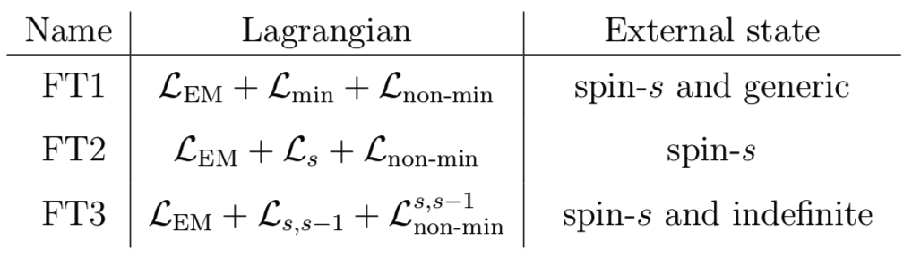
Non-minimal interactions:
… of a single field:
Spin operator:
+ …
… of two fields of different spins:
+ …
“Extra” Wilson coefficients appear at
“Tidal” operators appear at

Slide 18
A digression – standard scattering theory and amplitudes in FT3
little-group label
suppressed in
LSZ reduction: quantum amplitudes correlation functions of
Classically, there is no penalty to consider, e.g.
constrained by normalization
mass equality is important
for FT3:
1. spin-s
we will consider:
2. indefinite

Slide 19
Why these field theories and not others?
- Understand effect of extra states (FT2 vs. others)
- Understand consequences of the unphysical nature of the lower-spin states of FT1
(FT1 vs. FT3)
- Understand consequences of choice of external state (various choices of states in FT3)
FT1
spin-s
FT3 w/ spin-s state
FT1
generic
cSSC +
map of Wilson coef’s
cSSC
map of
Wilson coef’s
SSC & fix extra
Wilson coefficients
FT2
FT3 w/ special indefinite-spin external state
- FT1 w/ generic external state is related with a worldline theory with unconstrained spin tensor
Will find that the extra states/Wilson coefficients characterize change in |S| during evolution
Notes:
While a description of gravitational interactions has been known for more than 100 years, we are still working on understanding them, especially in regimes in which they are not weak, even at the classical level.
….
Many instances in which such a cycle led to a lot of progress, e.g. N=4 sYM theory, in the planar limit, N=8 supergravity, etc.

Slide 20
Amplitudes and relations between them
Three-point amplitudes:
The other FTs:
FT3 with special
indef.-spin external states:
i reflects the ghost nature of spin-(s-1) state in FT1
Extra Wilson coefficients
Interactions between states of different spin
Notes:
Calculations are straightforward; of course, to talk about 3-point amplitudes we need to think of momenta as complex, but that ‘s a minor inconvenience
Imposing transversality commutes with calculations
I is a reflection of the unphysical nature of the lower-spin states in FT1. Oddly, one can think of this as 2 bad things cancelling each other out: wrong sign kinetic terms and complex couplings.
This is 3 points; perhaps it’s too trivial. One may guess that if we glue 2 of these into a 2->2 matter amplitude the same shuld be true – and it is!

Slide 21
Two-body amplitudes; focus on spin-0 on spin-s to first order in spin -- /1PL
relations between three-point amplitudes relations between two-body amplitudes
FT1-generic
FT1
spin-s
FT2
FT3
spin-s &
indefinite
- Tree-level 2-body amplitudes of FT1-generic and FT3-indefinite can be mapped into each other
- Convenient to compute stuff in FT1-generic and continue to FT3-indefinite
- Continues to at least 1 loop order
Notes:
Same map of WC, as advertised. The more nontrivial part is that this relation continues also to the classical part of the 1-loop 2-body amplitude.
We didn’t look at higher orders, but expect that it will continue.

Slide 22
Compton amplitudes in the three field theories:
killed if SSC is imposed
Compton amplitude of FT1 with generic external state agrees to (up to contact terms) with a worldline theory with unconstrained spin tensor

Slide 23
Compton amplitudes in the three field theories:
killed if SSC is imposed
(computed by extrapolation)
FT1 generic FT2
Similar map at ; also removes
FT3 with fixed-spin external state:
FT1 w/ spin-s FT3 w/ spin-s
Consistent w/ 3-point map
Similar map at :
Notes:
While a description of gravitational interactions has been known for more than 100 years, we are still working on understanding them, especially in regimes in which they are not weak, even at the classical level.
….
Many instances in which such a cycle led to a lot of progress, e.g. N=4 sYM theory, in the planar limit, N=8 supergravity, etc.

Slide 24
A different comparison – expose K in FT1 Compton w/ generic external state…
…and pick the indefinite-spin external states in FT3:
FT1 Compton w/generic ext. state and FT3 Compton with indefinite-spin ext. state are related by:
Reflection of unphysical
nature of lower-spin states in FT1
Consistent with 3-point map!
Notes:
While a description of gravitational interactions has been known for more than 100 years, we are still working on understanding them, especially in regimes in which they are not weak, even at the classical level.
….
Many instances in which such a cycle led to a lot of progress, e.g. N=4 sYM theory, in the planar limit, N=8 supergravity, etc.

Slide 25
Main message: use FT1 because it’s easy and get desired theory by choosing coefficients
On to gravity… no conceptual changes
Equivalence principle constraint – spin determines the dipole interactions
Notes:
Replacing EM w gravity does not bring any further conceptual challenges; it does bring technical ones – because gravity is complicated.
There is one constraint though – we should expect that the boost part of the unconstrained spin tensor should not modify the splin-orbit coupling, which is governed by the minimal couping.

Slide 26
FT1 for gravity:
Alaverdian, Bern, Kosmopoulos, Luna, RR, Scheopner, Shen, Teng, Zeng
minimal
non-minimal
- Lower-spin ghost states -- same issues as in QED and same resolution
- Propagators is simple:
- Lorentz generators Clebsch-Gordon coefficients (same as in QED)
- Classical and large-spin limit are straightforward
- Employ EFT philosophy: “it’s required unless forbidden”
use S-matrix elements to identify the physical content of the various Lagrangian terms
Notes:
Implementing them in a free Lagrangian requires s auxiliary fields, all of which will couple to gravity
Symmetry trivializes trace condition

Slide 27
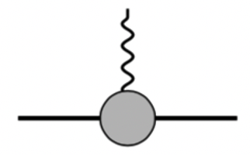
Graviton-matter amplitudes
Alaverdian, Bern, Kosmopoulos, Luna, RR, Sheopner, Teng
3-point amplitude/on-shell matter stress tensor
- does not modify the spin-induced dipole coupling; consistent w/ equivalence principle
- can be decoupled (at least through ) by choosing Wilson coefficients:
- Stress tensor sources space-time metric; adds to spin-induced multipoles
some can be absorbed into coordinate choices:
- present in: - standard worldline description of spinning extended particles
- for Kerr black hole (more later)
Porto;
Levi, Steinhoff
Vines
- Is this the stress tensor of anything known?
Notes:
Implementing them in a free Lagrangian requires s auxiliary fields, all of which will couple to gravity
Symmetry trivializes trace condition

Slide 28
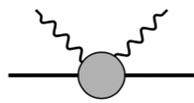
Graviton-matter amplitudes
Alaverdian, Bern, Kosmopoulos, Luna, RR, Sheopner, Teng
Compton amplitude
- does not generate a gravitational dipole response; consistent w/ equivalence principle
- generates dynamical quadrupole (governed by & ) and higher multipoles
- can be decoupled (at least through ) by choosing Wilson coefficients:
- present in: - standard worldline description of spinning extended particles
- for Kerr black hole (more later)
Porto;
Levi, Steinhoff
Notes:
The comments are exactly the same:

Slide 29
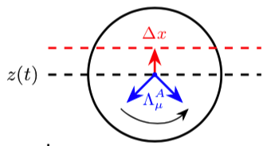
A worldline theory describing similar features:
Rigid spinning body -- Matisson-Papapetrou-Dixon formalism
constraints
spin connection
on-shell condition
dynamical mass function
- displacement between body’s COM and worldline
- If M is independent of , then can be removed from E.O.M. via
- Nonminimal interactions: one spin-induced multipole per order in spin
e.g.
Porto; Porto, Rothstein; Levi, Steinhoff;
Vines, Kunst, Steinhoff, Hinderer
+ higher orders in curvature
In general however, remains as a dynamical d.o.f.
Notes:
As much as I loke 4d QFT, it is a little opaque about the meaing of the extra DOFs. This is a lot more transparent in a worldline description of spinning bodies, based on a slight modification of the MPD formalism.
In its original form, the action is this, and there are 2 LMs imposing the SSc, here chosen to be the covariant one.
Even w/o constraint, if the dyn mass fct, which contains all nonminimal interactions, does not depend on the non-transverse part of S, then one can show that that part can be removed by a shoft of the trajectory z. This also
Explains why K does not affet the dipole interaactions.
In general however, K remains as as dynamical dof.

Slide 30
A worldline theory describing similar features:
Rigid spinning body -- Matisson-Papapetrou-Dixon formalism
spin connection
on-shell
condition
dynamical mass function
- Earlier discussions of WL theories with unconstrained spin tensor
D’Ambrosi, Kumar, van Holten
- Previous graviton-matter amplitudes can be obtained with
- Compton amplitude = incoming vs. outgoing wave:
- Matching requires analytic continuation:
Saketh, Vines
Notes:
With a suitably general choice of dyn mass fct, one can derive comtom amp and match the 4d QFT up to ann cont .
The computation is straight frward; one solves the EOM with an incoming plane wave for h and the amplitude is the coefficient ot the outgoing radial wave, just like in QM.

Slide 31
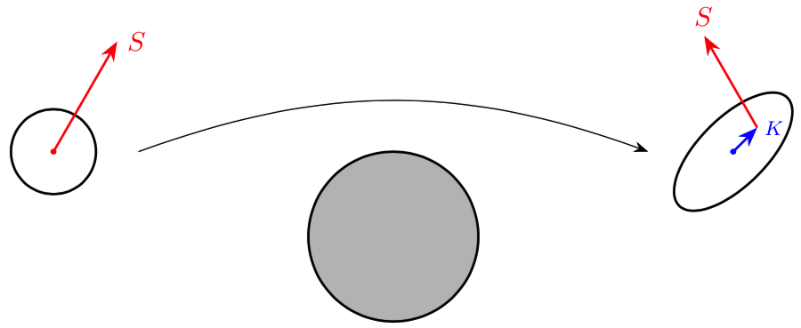
So… K is…
Alaverdian, Bern, Kosmopoulos, Luna, RR, Scheopner, RR, Teng
- A light/gapless conservative degree of freedom that characterizes asymptotic states
- Required by Lorentz invariance
- Describing change of spin magnitude
- Can be interpreted as dynamical multipole moments with specific dynamics
- It is part of the stress tensor, so it can source a space-time metric
Is there anything in the theoretical universe carrying such d.o.f.-s?
Notes:
So, to summarize… what are the extra DOFs on top of the spin?
…..

Slide 32
More amplitudes – probe HS particles by scattering spinless particles off of them
- More physical than 3-point amplitudes
EFT 3-point amplitude
- Systematic extension to higher orders (if necessary)
General structure of the amplitude:

Slide 33
Certain black holes exhibit ; e.g. EFT for the Rasheed-Larsen black hole
Metric:
nontrivial vector fields & dilaton
Kerr limit:
Two-body amplitude = from propagator of scalar field in background/scalar action on metric
Coordinate choice important: - choose coordinates to eliminate the mass dipole
- large gauge transformation; affects amplitudes
Notes:
Bena, Mayerson – paper discussing presence of absence of mass dipoles.

Slide 34




Certain black holes exhibit ; e.g. EFT for the Rasheed Larsen black hole
Metric:
Two-body amplitude = from propagator of scalar field in background/scalar action on metric
EFT
- Match continues through
- proportional to the electric/magnetic charges
- because of axial symmetry
- Axial symmetry of the RS solution some Wilson coefficients are degenerate
Notes:
What about our universe?
Not kerr BH, but random bodies wit some internal structure can have it.
To see this, consider the a newtonian bound state and a 3rd body scattering off of it.

Slide 35
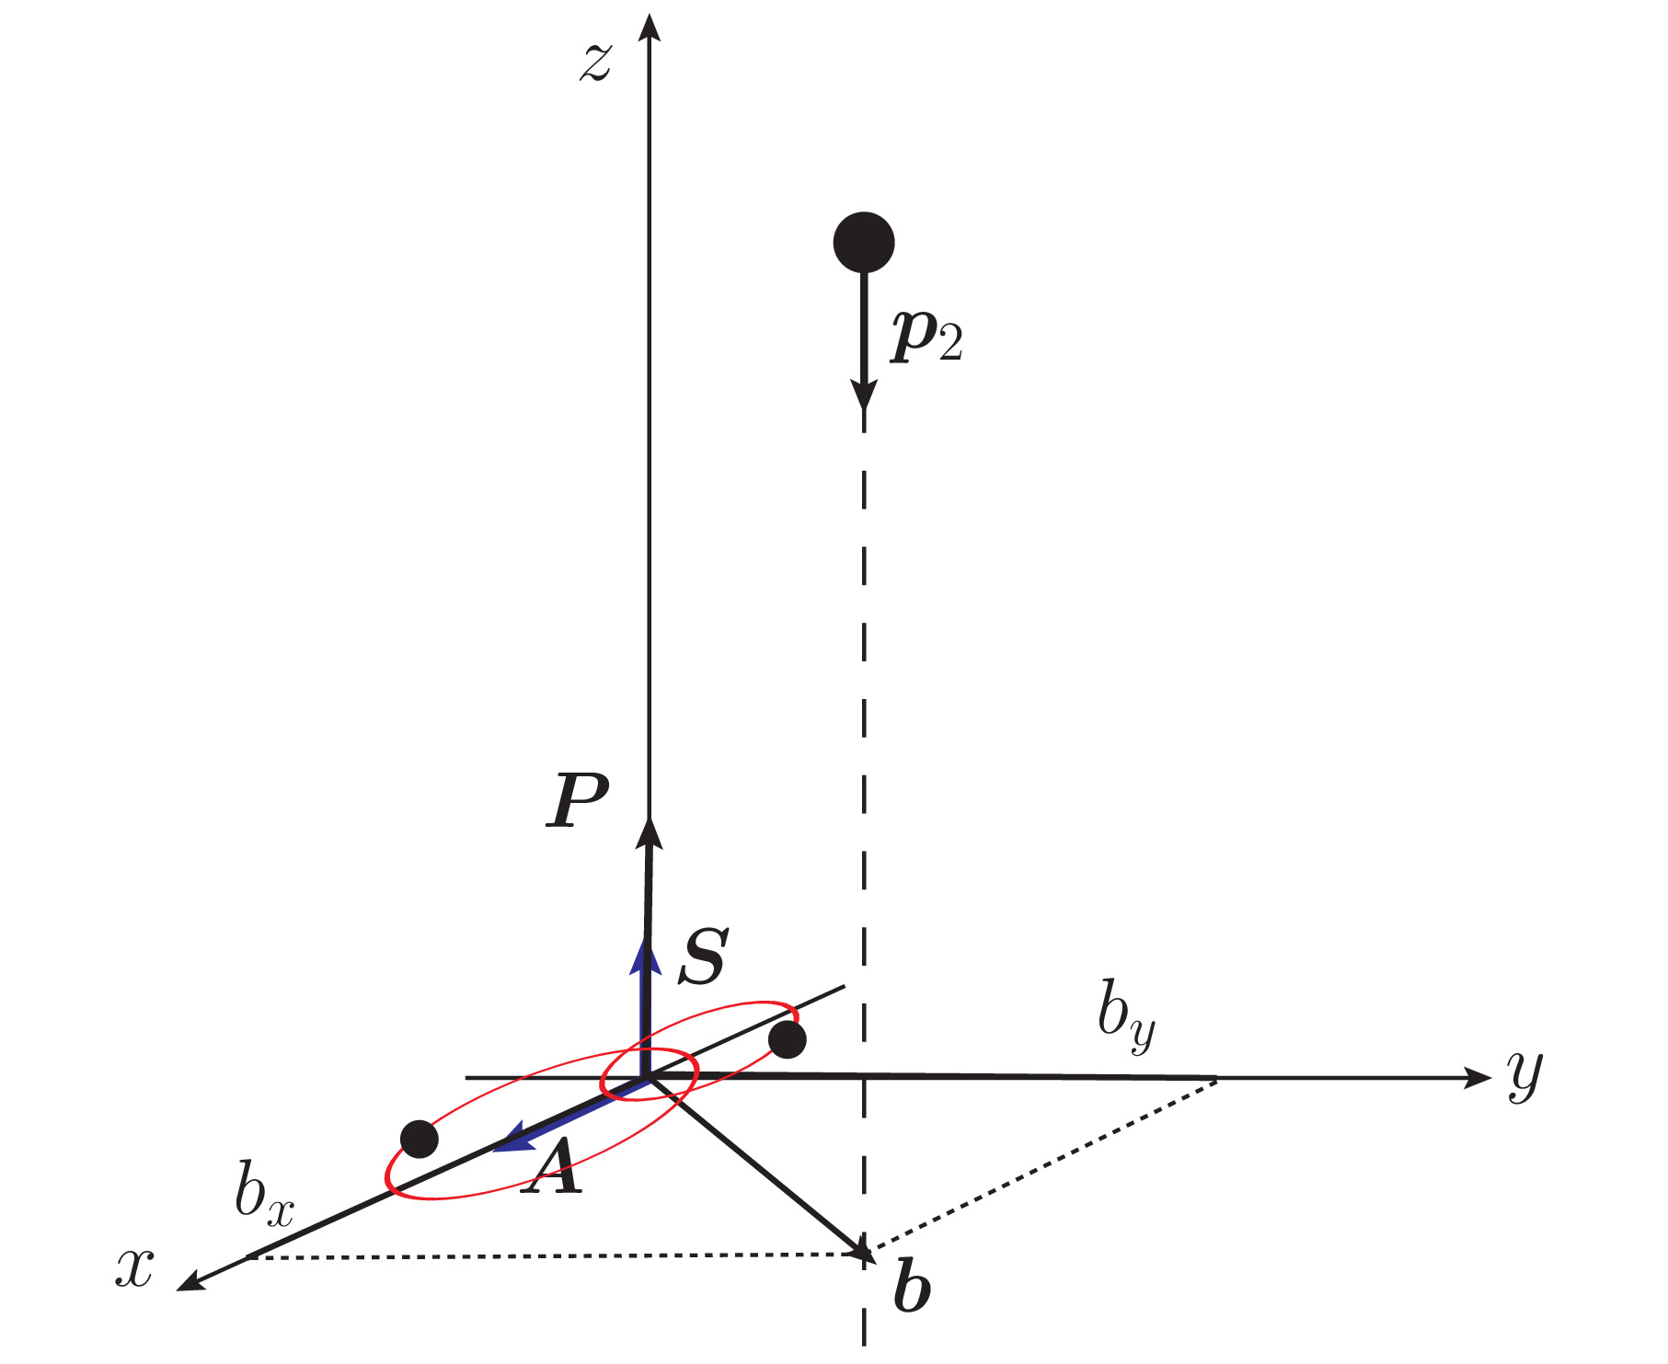
Example 2: EFT of a Newtonian bound state (Hamiltonian )
Probe bound state w/ a 3rd particle:
(bound Q)x(scattering Q)
- Spin = internal bound state angular momentum
- and Wilson coefficients from amplitude matching
+kinematics
constraints
- Straightforward to include relativistic scattering (relativistic bound state is unclear)
Notes:
This is a problem that that one may in principle assign as HW in a classical mechanics course. Here I’ll solve it in an unusual way and, to recall, the goal is to
Identify the EFT that describes the bound state as a point particle.
Assume bound state size << b ; this is a variant of the QFT constraint that separaton is large
Why Newtonian: velocities are much smaller than the scattering velocity; internal structure does not change much over typical scattering time.

Slide 36
Example 2: EFT of a Newtonian bound state (Hamiltonian )
Scattering amplitude from classical limit of NRQM transition amplitude
- Classical scattering trajectory:
- Classical limit of matrix element: use coherent state; minimize dispersion; energy
+ factorization
Bhaumik, Dutta-Roy, Ghosh
- Weak gravity/small perturbation/small angle scattering: ,
Notes:
Where A is the Runge-Lenz vector, aka the eccentricity of the bound state.

Slide 37
Example 2: EFT of a Newtonian bound state (Hamiltonian )
The matching calculation (nonrelativistic ignore all velocity dependence)
- eccentricity/Laplace-Runge-Lenz vector
- Choice of kinematics makes some terms inactive
- The one active Wilson coefficient is fixed as
- Higher orders work out similarly; higher Wilson coefficients determined
Notes:
Matching indicates that K is proportional to A – up to an I having to do with the unphysical nature of the DOFs.
Some terms cannot be accessed because I piched specific directsins for the spin and 3rd particle motion
We looked through 3rd order and things wotj out as expected.
So, to summarize, some garden variety systems exhibit these extra DOFs, and their dynamics is the one that cane out form our general discussion – essentially from Lorentz invariabnce.
This brings me to the last poit of my plan: what do we have to do to ID the Kerr BH in this EFT? The answer is I don’t know, but I’ll spend the last 5min talking about it.

Slide 38
“Observational
effects:”
Contribution to the memory from soft-limit of the 5-point amplitude

Slide 39
What is the QFT definition of the Kerr black hole (or what fixes the free coeff’s in Lagrangian)
Kerr stress tensor (defined as the r.h.s of Einstein’s eq after )
Vines
Covariant spin vector
V1. Fit the 3-point amplitude; ok through ; new 2-graviton gauge invariant op’s at
V2. Identify a special feature of the Kerr stress tensor and enforce it in the 2 2 amplitude:
is invariant under -- spin-shift symmetry
Bern, Kosmopoulos, Luna, RR, Teng
Conjecture: The scattering of 2 Kerr black holes:
1. is invariant under this symmetry at least through
2. all orders in Newton’s constant have the same high energy behavior
equivalent formulation by Aoude, Haddad, Helset
Both constraints are nontrivial
Notes:
An option is to fit as many of the GR-computed amplitudes to those of the EFT. This is all fine, but at some point it defies the purpose of the EFT -- to construct it we need to know everything we may want to know.
A second option is to constraim it using properties of Kerr. E.g. the stress tensot has this property. So we may impose it. Not only on the amplitudes from 3-point couplings but on all 2-body amps.
This fixes some but not all couplings. They can be fxed by also imposing that all orders in Newton’s constant have the same high energy behavior

Slide 40
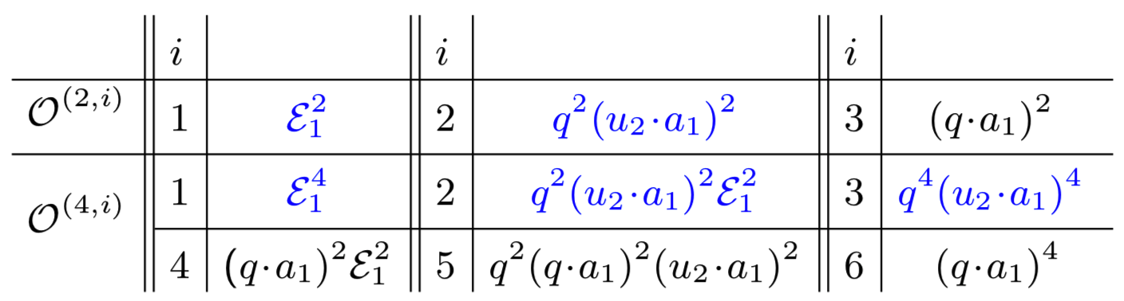
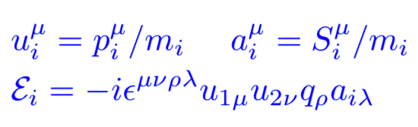
Some consequences:
Bern, Kosmopoulos, Luna, RR, Teng
Aoude, Haddad, Helset
- Some operators are forbidden, e.g. for through
All extra Wilson coefficients vanish; decouples
All S-dependent Wilson coefficients are fixed
Status:
- Appears to be present to all orders in the probe approximation
Akpinar, Febres Cordero,
Kraus, Smirnov, Zeng
- Suggested connection w/ integrability of geodesic motion
Akpinar, Brown, Gonzo, Zeng
- Teukolsky eq. suggests absence beyond probe approx.
Bautista, Guevara, Kavanagh, Vines
If conjecture is correct, Kerr cannot exhibit conservative change of its spin magnitude
Notes:
This leads to decoupking of K and determination of all WC, including those that could be added at least at S^
The status of this conjecture is unclear.
Though this refers to Compton amplitudes not to the 2-body amp wher ethe conjecture was formuoated.

Slide 41
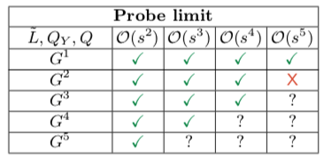
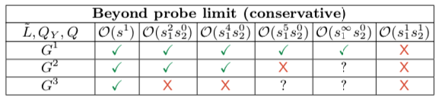
Other options to defining a QFT description of Kerr solution:
- Use the Carter constant and the Rüdiger invariant
preliminary: Akpinar, Brown, Gonzo, Zeng
: Killing-Yano tensor
- Identify EFT realization and enforce conservation
- Possible connection with integrability of geodesic motion (preserves spin-shift symmetry)
and nonlinear corrections
- Survey of conservation of and in existing fixed-spin results
Akpinar, Brown, Gonzo, Zeng
Notes:
Though this was not fully explored, other constraimts can come from other conserved quantities of the Kerr solution – the Carter constant and the Rudiger inv.
One may attempt to enforce their conservation and this way fix EFT couplings.
A preliminary analysis based on various available amplitudes, mainly based on fixed-spoin calculation, gave mixed results, with these not being conserved at various orders in spin or in G.
It would be interesting to have a systematic analysis, tryoing to relax prejudices on what the QFT description of Kerr might be.

Slide 42
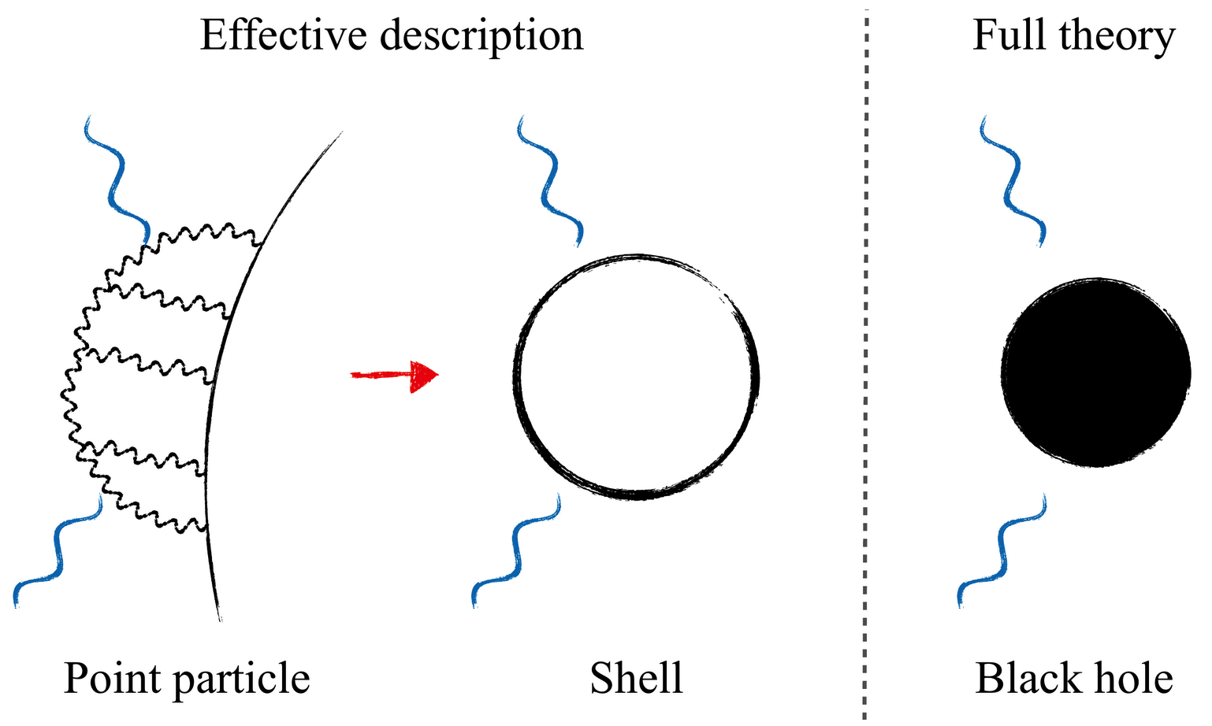
- Identify the EFT realization of static Love numbers & enforce that they vanish
- Connection w/ near-zone symmetries & matching of near and far zones
Hui, Joyce, Penco,
Santoni, Solomon
- Closer connection with worldline description of spinning particles
- More generally, construct EFT capturing properties of the Kerr black hole,
perhaps in the spirit of
membrane paradigm
for Schwarzschild & dynamical Love numbers:
Kosmopoulos, Peronne, Solon
- …

Slide 43
Summary & Outlook
- Field theories of higher-spin particles continue to be mysterious
- Coherent-state classical limit of generic massive HS representations of the Lorentz group
- Evade no-go arguments based on causality
- Exhibit further light d.o.f-s beyond just the spin
- They allow for dynamical conservative spin-magnitude change
- Both 4d and worldline descriptions; latter dynamical multipoles
- Can be decoupled by choosing Wilson coefficients/couplings
- There exist nontrivial examples exhibiting these new gapless modes
- Potential application to aspects of the 3-body problem
- Can in principle be observable
- Kerr black hole is hiding somewhere in this EFT
Identifying it remains an interesting and timely problem

