Slide 1


DArk Messenger Searches at an Accelerator, the DAMSA –Net
FPD Seminar
March 10, 2026
SLAC National Lab
Jaehoon Yu
University of Texas, Arlington

Slide 2
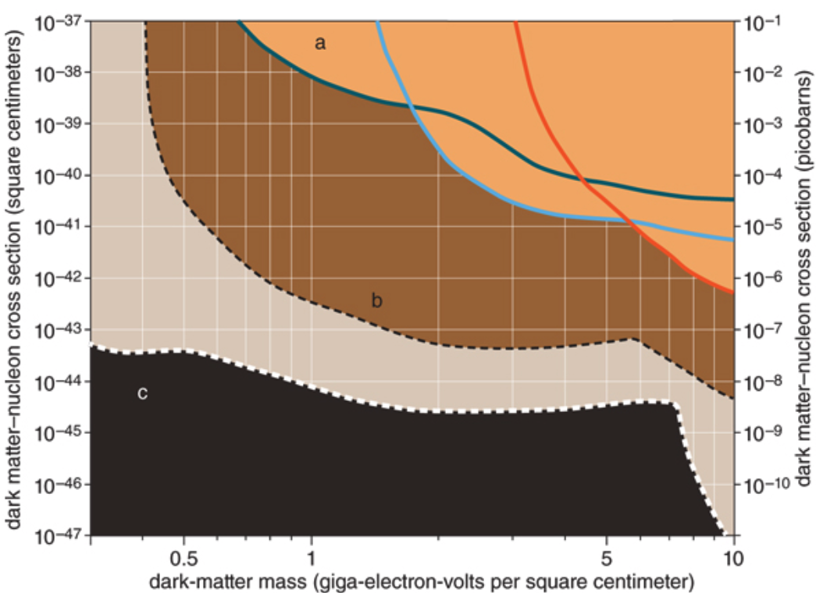
Physics Motivation For DSP
Direct searches have challenges in kinematic reach, leaving low mass range un-explored
Strategy:
Search for dark sector particles in unexplored kinematic regime
Make and discover DSPs in an accelerator
Establish the infra to better understand DM
No DM
Focus
here
Future: SuperCDMS SNOLAB
Solar Neutrino Background

Slide 3
What is DAMSA?
A very short baseline, table-top scale dark sector particle (DSP) search and discovery experiment at high intensity, yet capable beams
Stands for DAark Messenger Searches at an Accelerator (DAMSA, pronounced da-am-sa)
담사 (潭思) = 깊은생각 – Rumination or Reflection
J. Yu et al., PRD 107, L031901 (2023)
Conceptual Design Report, arxiv: 2601.15255 (2026)
Goal is to discover a portal particle to the Dark Matter World at a particle accelerator and provide crucial data for the fundamental theory in a controlled environment
DAMSA can be at any accl. facility, including CERN

Slide 4
Unique Opportunity on Dark Sector
Many DM search experiments in beams BUT
None of them at a super-short baseline (<1m)!
Yes, it presents a significant challenge
Very high radiation, including neutrons
This makes DAMSA unique!
DAMSA is a table-top size experiment with good physics cases and provides an excellent opportunity to enhance international collaboration
Takes advantage of the ceiling effect

Slide 5
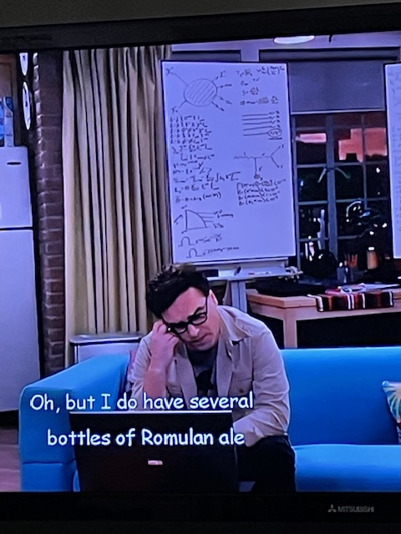
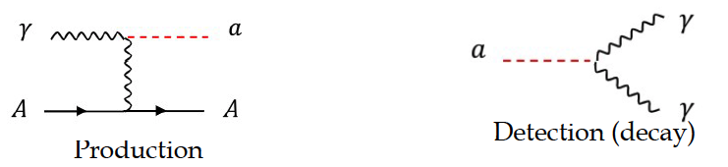
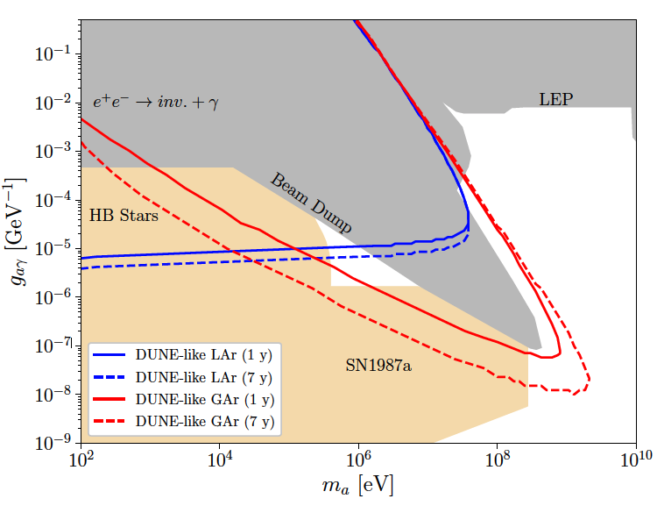
DAMSA Physics Strategy
Photons are the sources for dark sector particle production
Benchmark: Axion-like particles (ALP) in two-photon final state via the Primakoff process
Produce as many photons as possible from the beam
Capture as many ALPs in as wide a mass range as possible
Mitigate the backgrounds from neutral particles, using two EM particle final states
Place the detector very close to the beam
Brdar, JY, et al., PRL126, 201801 (2021)
What is the most peculiar feature of the DUNE sensitivity reach?
This edge limited (ceiling) by the distance from the source to the detector
Focus here

Slide 6
DAMSA Exp. Strategy
Inject and absorb as beam particles and produce as large number of γ in the dump/target as possible
Allow higher coupling ALP’s to decay in the vacuum w/ as small number of neutrons escaping the dump as possible
Place the detector as close to the dump as possible on axis to expand the mass reach to higher mass region
Vacuum Decay Volume
L=1m, R=1.1m
Detector
R=1.1m
Proton
W Dump
L=1m
R=0.5m
Absorber
Effective Detection Range
(~1m from the source)

Slide 7





The three key elements
The bad
The ugly
The good
The beam
The dump
The detector

Slide 8
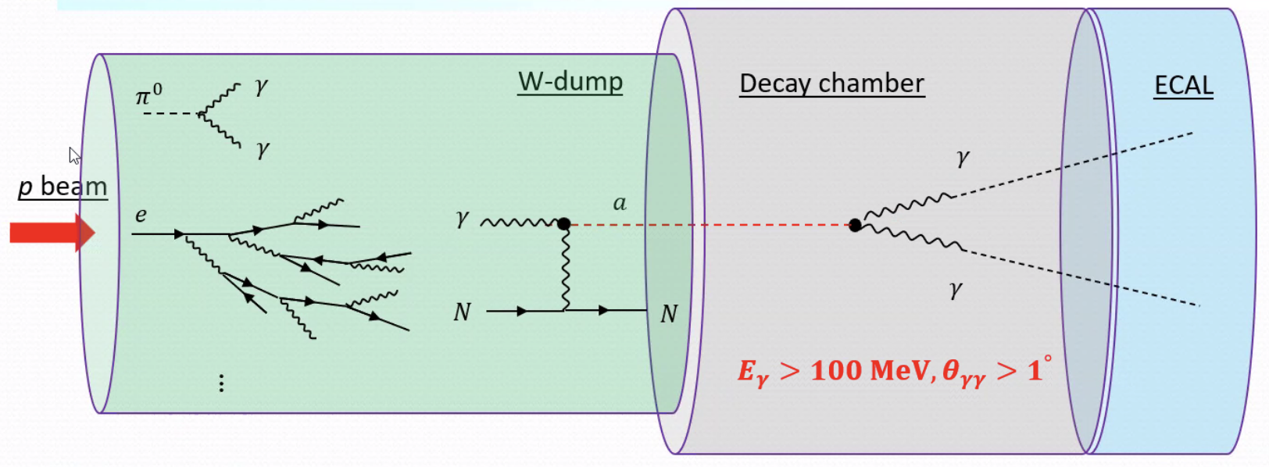
Detector Design Concept
NOT TO SCALE
2DST W-Scint
ECAL (~13 X₀)
Tail catcher
ECAL (~5 X₀)
Vacuum Decay Chamber
HD HG-ECAL - γ converter
(4 low X₀ layers ~3X₀)
D=10m, L = full containment
6 layers of Si trk
D=1m, L=1m
D=10m, L=10m
Magnet

Slide 9
Physics Driven DAMSA Detector
Discover dark sector particles beyond 2γ ALP, such as
Dark photon / ALP to e⁺e⁻, μ⁺μ⁻, τ⁺τ⁻?
HNL, Low mass dark matter, etc
Based on the signal and neutron background mitigation studies, using GEANT4 ➔ Detector requirements
Fine granularity for a superb shower position and angular resolutions for 2 EM particle vertex pointing & DCA precision better than 1cm in the vacuum decay volume
Fast timing capability at sub-ns level (~100ps) for two EM particle arrival time differences
Capability of measuring up to 500 MeV photons with as fine a mass resolution as accomplishable
Capability to distinguish charged particles from neutrals

Slide 10


More Realistic DAMSA & the ceiling
The question: Can we access the targeted parameter space with a dramatically smaller scale experiment (2401.09529)?
0. Concept Study: L_{dump}=1m, D_{vac}=10m, L_{vac}=10m, θ_{det}=0.5rad, N_{yr}=1yr
Smaller scale: L_{dump}=1m, D_{vac}=1m, L_{vac}=1m, θ_{det}=0.05rad, N_{yr}=3mo
Reduce the detector radius to 0.1m from 1.1m, same depth (10⁻²)
Reduce the vacuum chamber radius and length to 0.1m from 1m (10⁻³)
Reduce the W dump length to 0.5m (case 1) & 0.25m (case 2)
W Dump
L=0.5/0.25m
R=0.5m
Vacuum
L=0.1m,
R=0.1m
Proton
Detector
R=0.1m

Slide 11
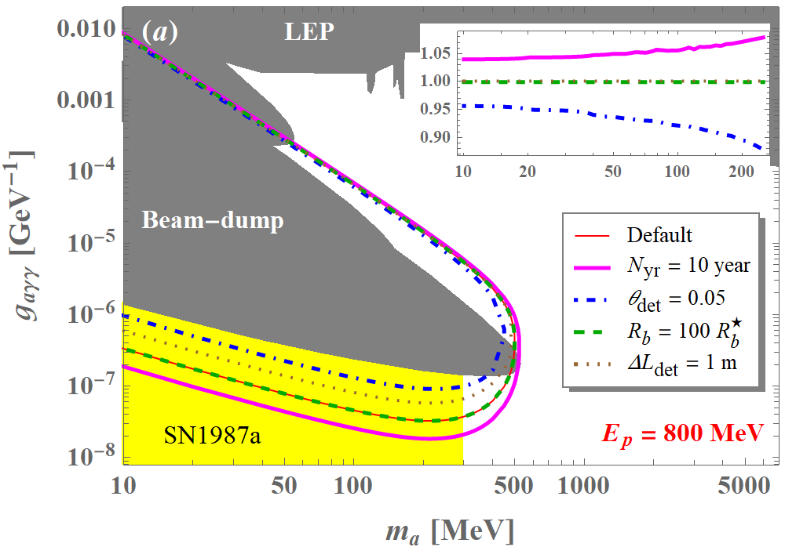
Impact of Exp. Param. to the Ceiling
For the given baseline, access to the ceiling affected little by the detector dimension or the stat.

Slide 12
DAMSA Pathfinder Strategy
Given the confidence of Little DAMSA sensitivity, DAMSA can be a very small detector ➔ DAMSA becomes more REAL!!
Primary goals are to demonstrate
Physics case feasibility ➔ can we access the target parameter space?
Background validation and handling ➔ did we make a mistake?
Physics before other p-beam dump facility (e.g. BDF@CERN) is ready
Produce physics, as the collaboration builds up the experiment and seek funds
Strategy for the pathfinder
Find a pathway to focus on physics case feasibility test
Need a facility that has as little neutron background from the dump as possible
Electron beams will do better job than hadron beams
Produce physics every phase

Slide 13
Beam Related Background Mitigation
Two beam related background components
Fast component : Particles exiting from the target/dump, immediately enter the experiment together with the signal
Slow component : Particles (primarily neutrons) lingering around after a beam interaction, entering the experiment at random times and affecting the subsequent beam interactions

Slide 14
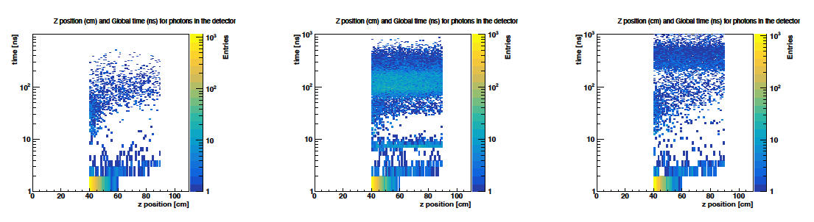
Critical Info on Little DAMSA –n bck
From detailed GEANT simulation study
The lingering neutron background impacts can be virtually eliminated by separating the beam more than 1μs, even with a hall of R=3m ➔ The low E EM particles can be captured by implementing a thin pre-shower layer with some absorber (what is the optimal X₀?)
Neutron flux from the given pulse and the pile up effect can be minimized by optimizing the pulse intensity and the separation
GEANT study shows: up to ~10⁷ e/pulse + >1μs separation good start
(No wall)
(R=1m)
(R=3m)
(t=1μs)
(t=5ns)

Slide 15
Beam Related Background Mitigation
Two beam related background components
Fast component : Particles exiting from the target/dump, immediately enter the experiment together with the signal
Slow component : Particles (primarily neutrons) lingering around after a beam interaction, entering the experiment at random times and affecting the subsequent beam interactions
Beam configurations could help mitigating and minimizing both the components
Adjusting the number of particles in each beam pulse for fast components
Adjusting the beam pulse separation (or the repetition rate) for slow components, allowing slow neutrons to be absorbed by the water in atmosphere before the next pulse
Beat the remaining background using detector capability

Slide 16
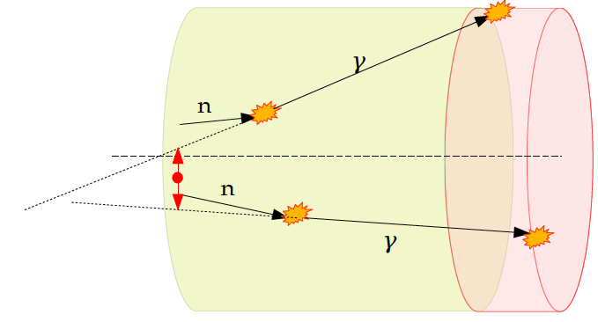
DAMSA Detector – The γ pair traceback
Require two photon track trace back position be inside the dump perimeter
2x10⁻² of γ pairs remain
Before cut
in unit of m
After cut
in unit of cm
100 cm

Slide 17
DAMSA Detector Study E_{γ} Cut
Geometry implemented in GEANT4
10⁸ 600MeV protons injected to dump
260k neutrons enter the decay chamber
2.6x10⁻³ n/p
1.6x10⁶ γ produced from n
3.2x10³ γ with E>5MeV ➔ ~1k enter the detector fiducial volume
5.1x10⁵ γ−pair combination possible
All photons
E_{γ}>5MeV

Slide 18
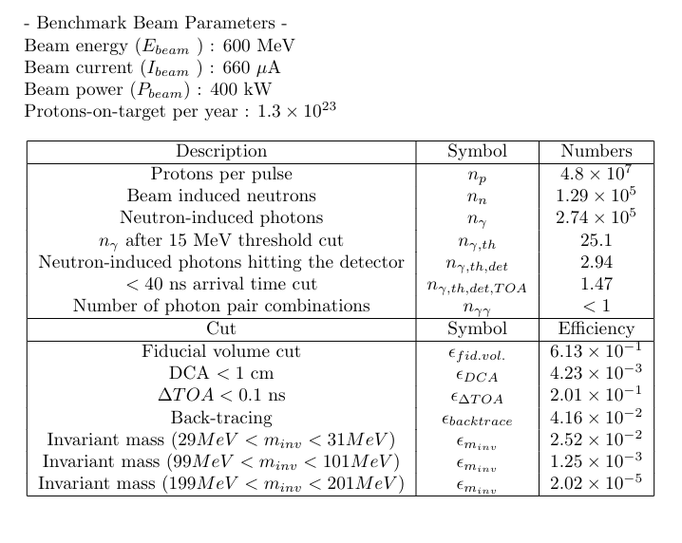
Neutron Background Reduction Summary
neutron-induced photons are reduced by (1 / 2.74e-5) = 3.6e-6
Overall rejection factors 1.92e-7 9.51e-9 1.54e-10
1.46

Slide 19
DAMSA Detector Requirements
Physics driven requirements to accomplish
Sub-ns timing difference resolution
Good vertex pointing resolution for γγ and e⁺e⁻
Low E threshold identification of e⁺e⁻
Charge identification to help further background mitigation
As fine an energy resolution as reasonably accomplishable
A proposed configuration – from up to down stream
20cm(D)x30cm(L) vacuum chamber
~6 rad-hard Si-tracking layers under B field for charge ID
44cm depth (24.5X₀) of highly granular CsI total absorption ECAL

Slide 20
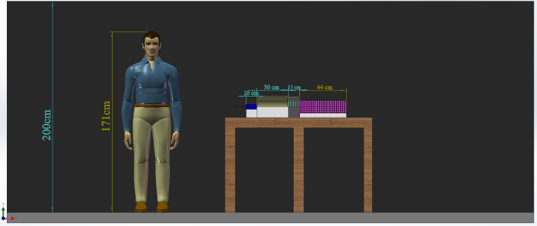
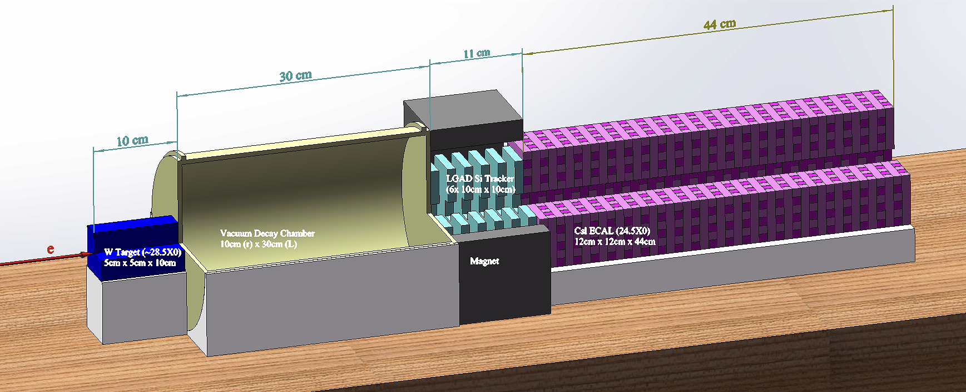
The DAMSA Pathfinder Experiment
The goal: Mount and complete a physics pathfinder in the next 3 yrs
Beam: 8GeV e-beams at SLAC’s LESA ➔ greatly reduced neutron backgrounds, compared to proton beams, provides flexibility
Target: 5cm x 5cm x 15cm W target (~43X₀)
Vacuum decay chamber : 10cm (r) x 30cm (L)
Enable the two EM particles from the vertex in vacuum to be separated
Detector: 6 layers of 10cmx10cm Si tracker under B=1T permanent magnet + 44 layers of 12x12x1cm³ 4D CsI total absorption Ecal (24.5X₀)

Slide 21
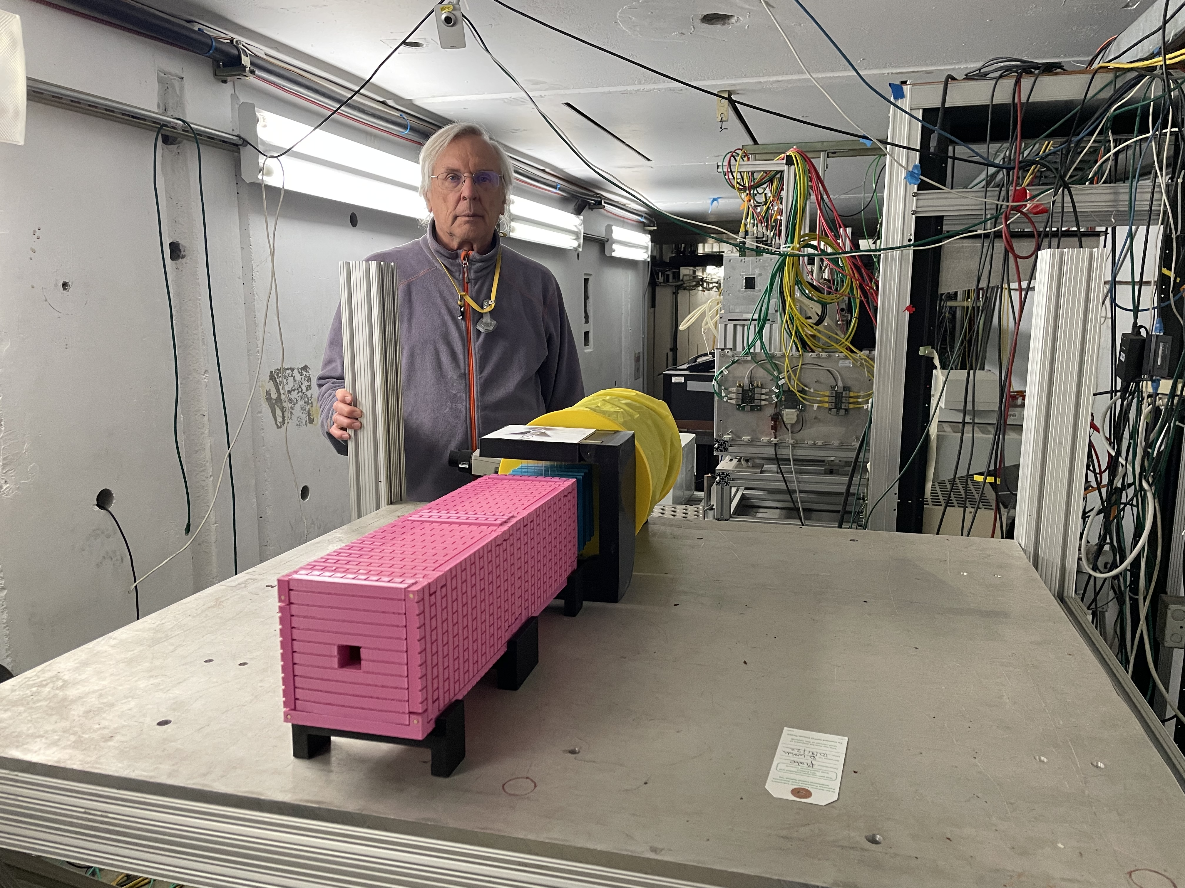
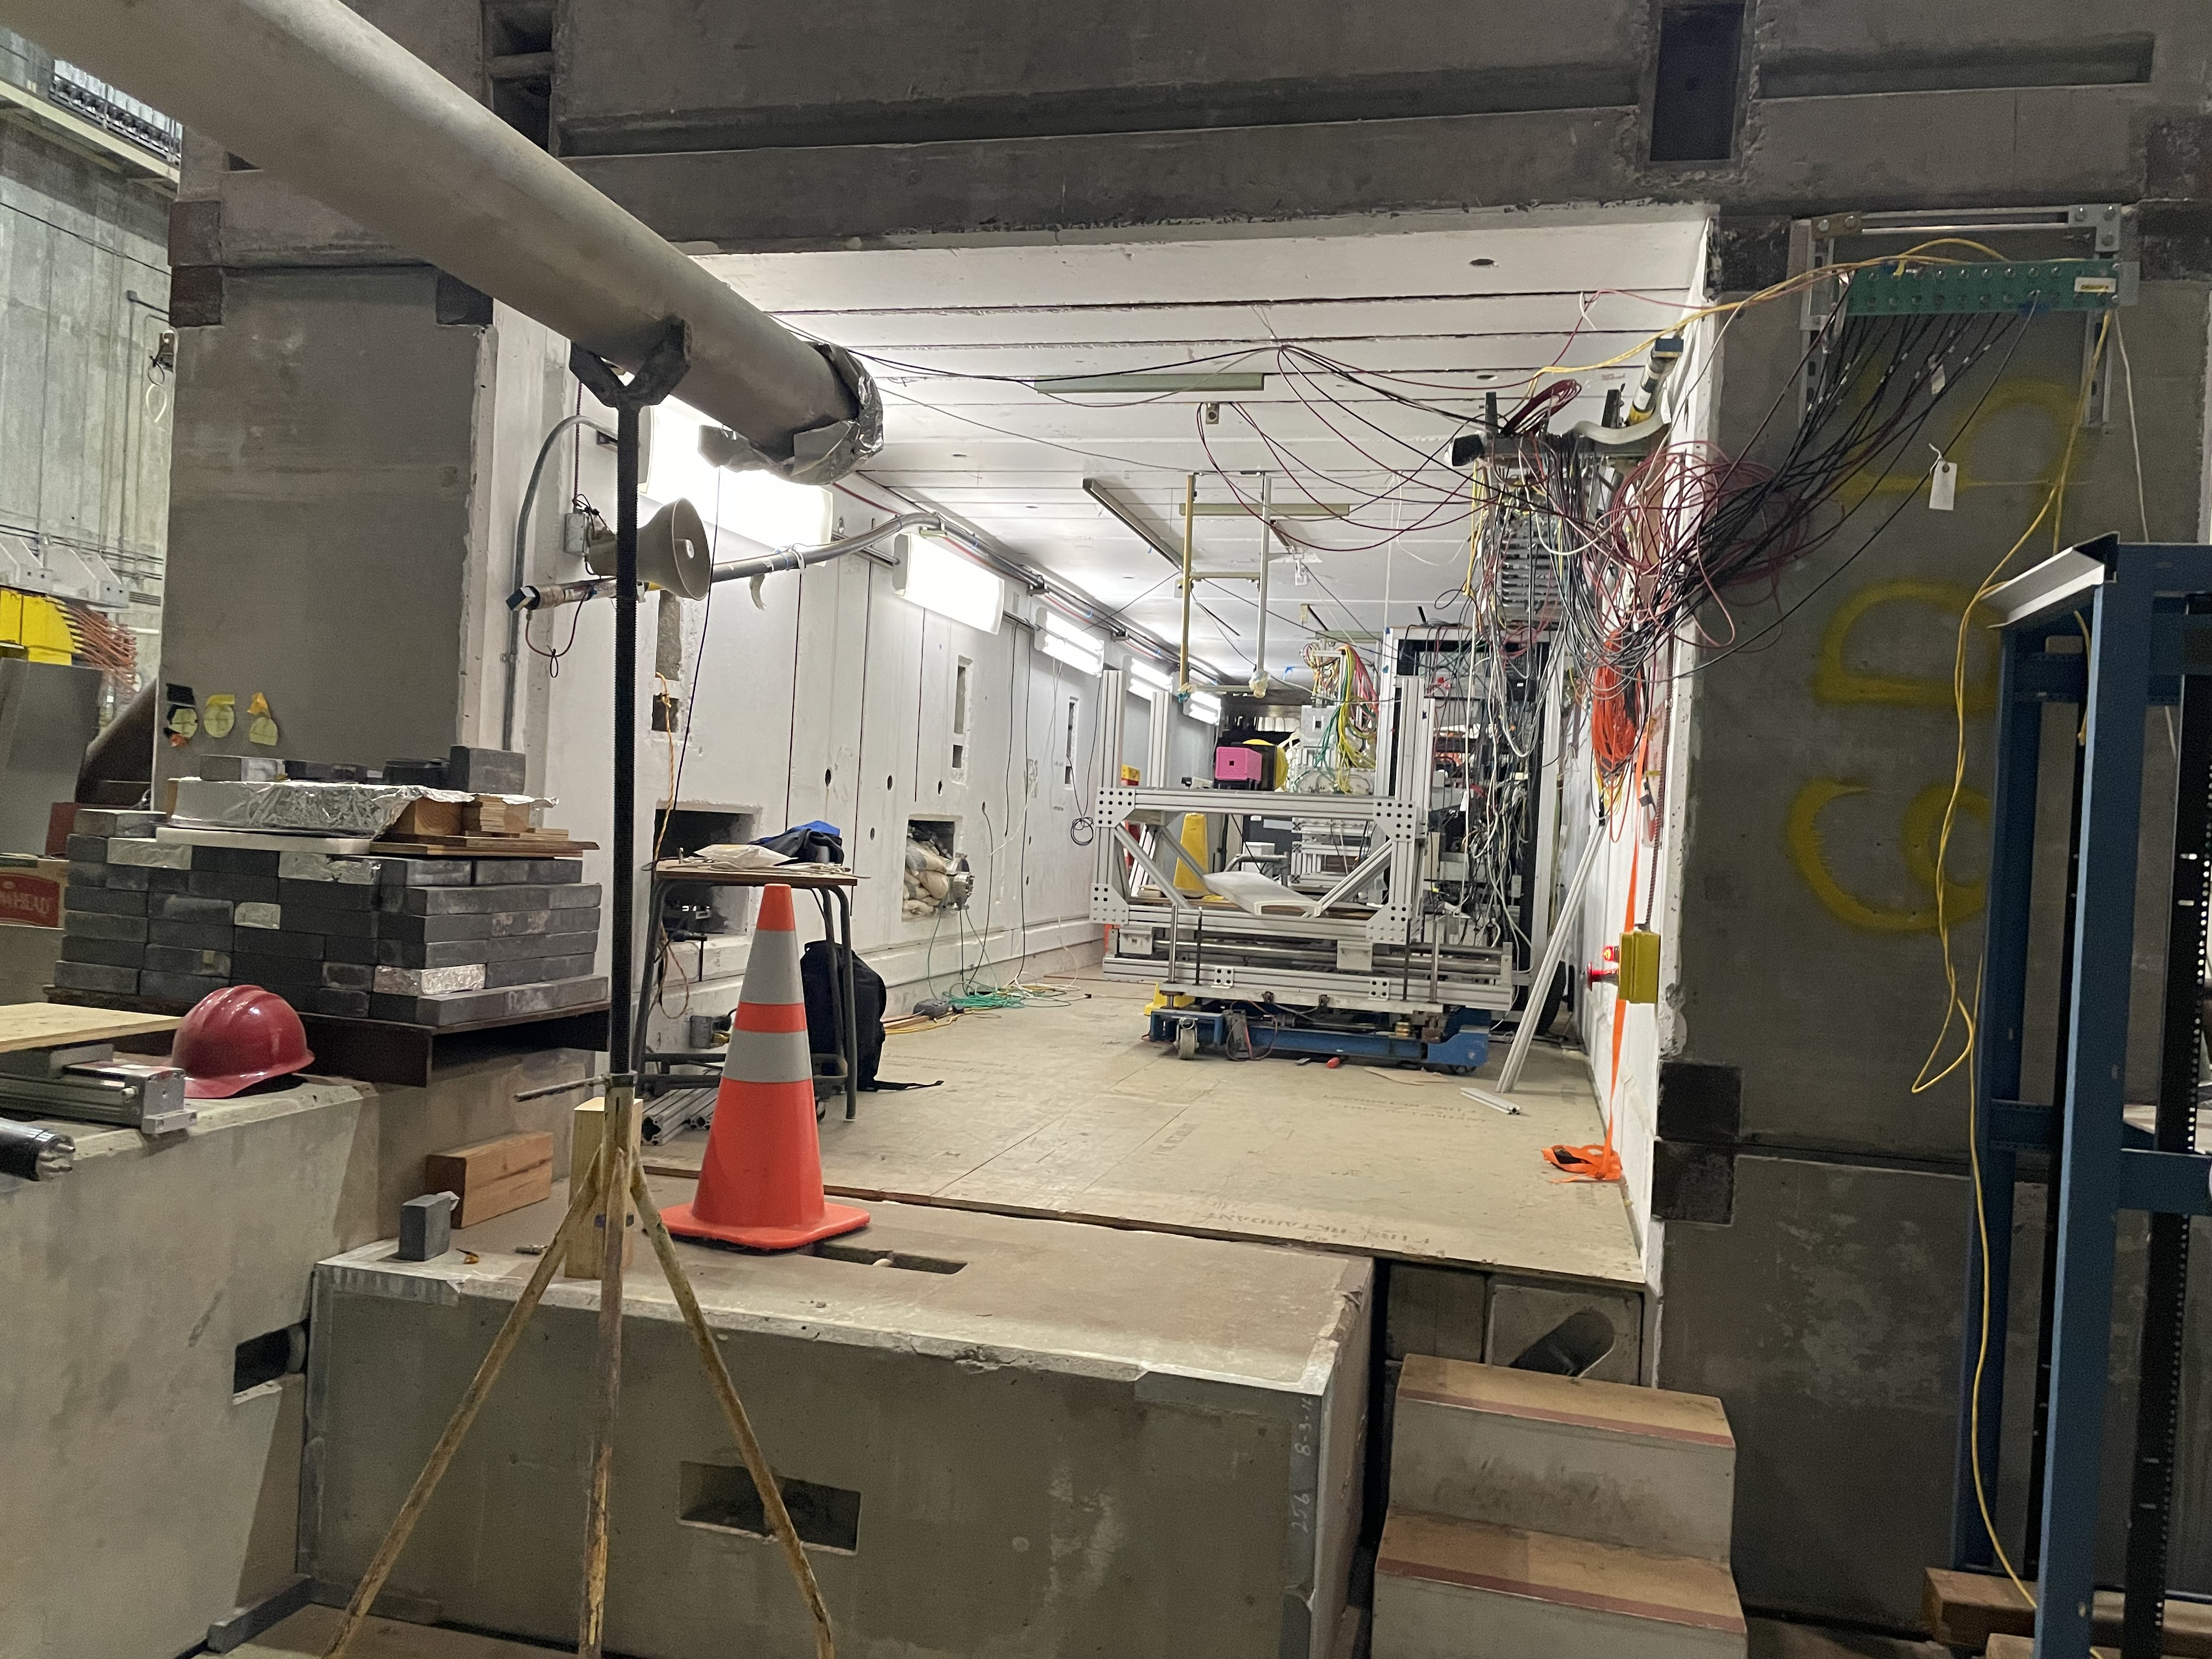
DAMSA in ESA?

Slide 22
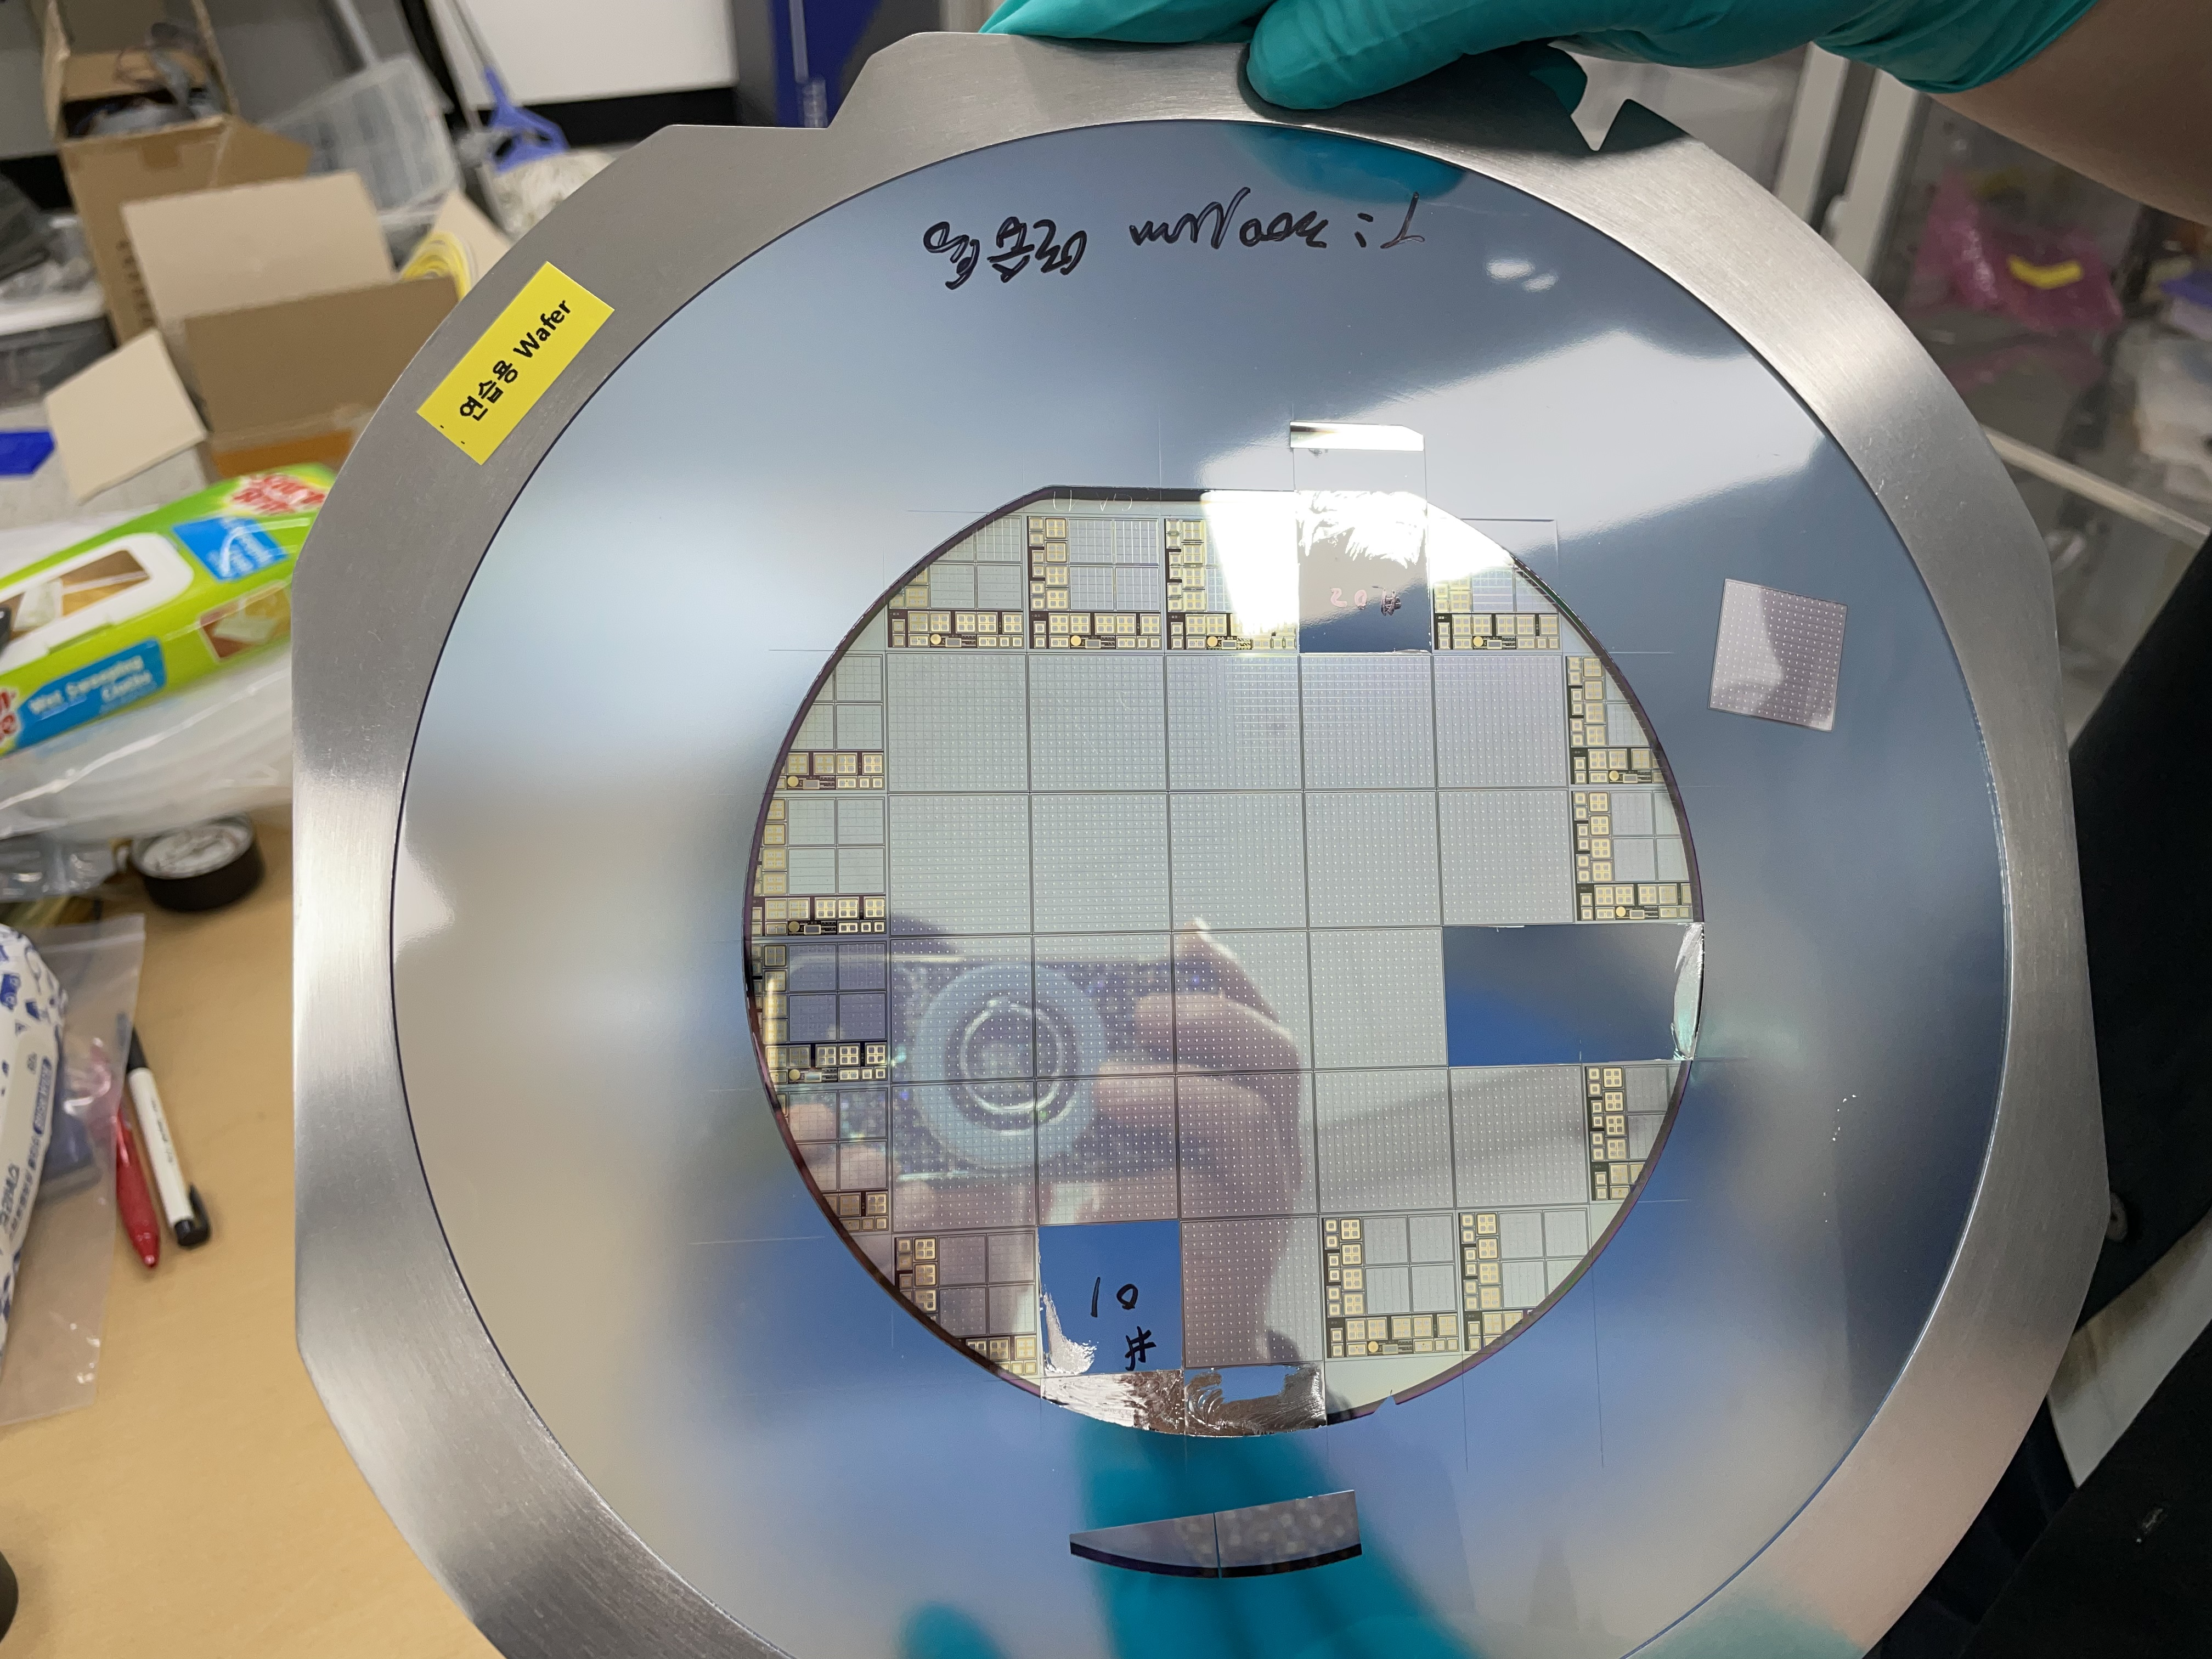
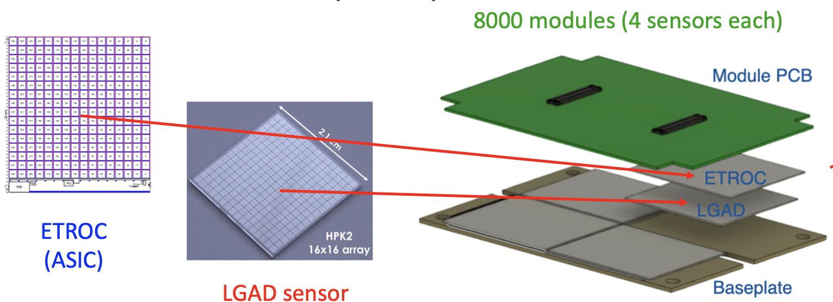
DAMSA – The Tracker
KNU in SK responsible for CMS forward LGAD detector
The Low Gain Avalanche Diode (LGAD) consists of 16x16 pixels of 1.3x1.3mm²
Position resolution of 35 – 50 μm
Timing resolution per track <35ps (single hit resolution <50ps)
High radiation tolerance ➔ DAMSA can be a testing ground

Slide 23
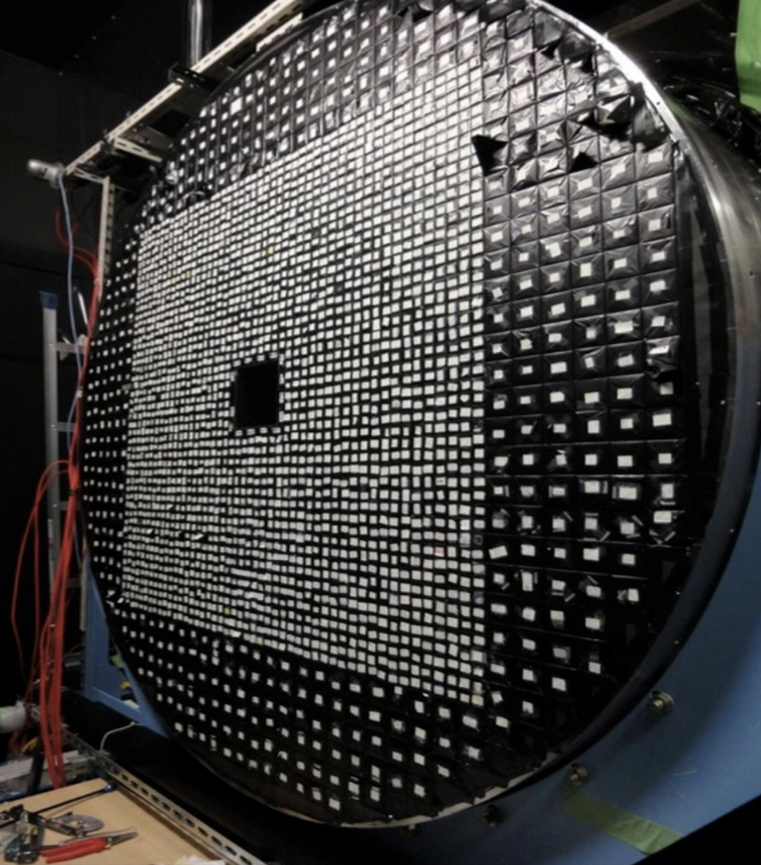
DAMSA – The ECAL
U. of Chicago built CsI ECAL for K-TeV experiment at Fermilab and the KOTO experiment at KEK
Timing resolution of 200ps accomplished
Has 16 of 5x5x50cm³ undoped CsI crystal blocks in hand
Each of these can be cut into 80 or so 1x1x12cm³ bars, read out by 2 SiPM’s mounted on either end ➔ could provide ~mm level shower position resolution
These bars need to be cut, polished, wrapped and SiPM mounted ➔ worked with the Ukrainian company, ISMa (Institute for Scintillation Materials) for initial evaluation of UC Crystals and the performance of the cut pieces

Slide 24
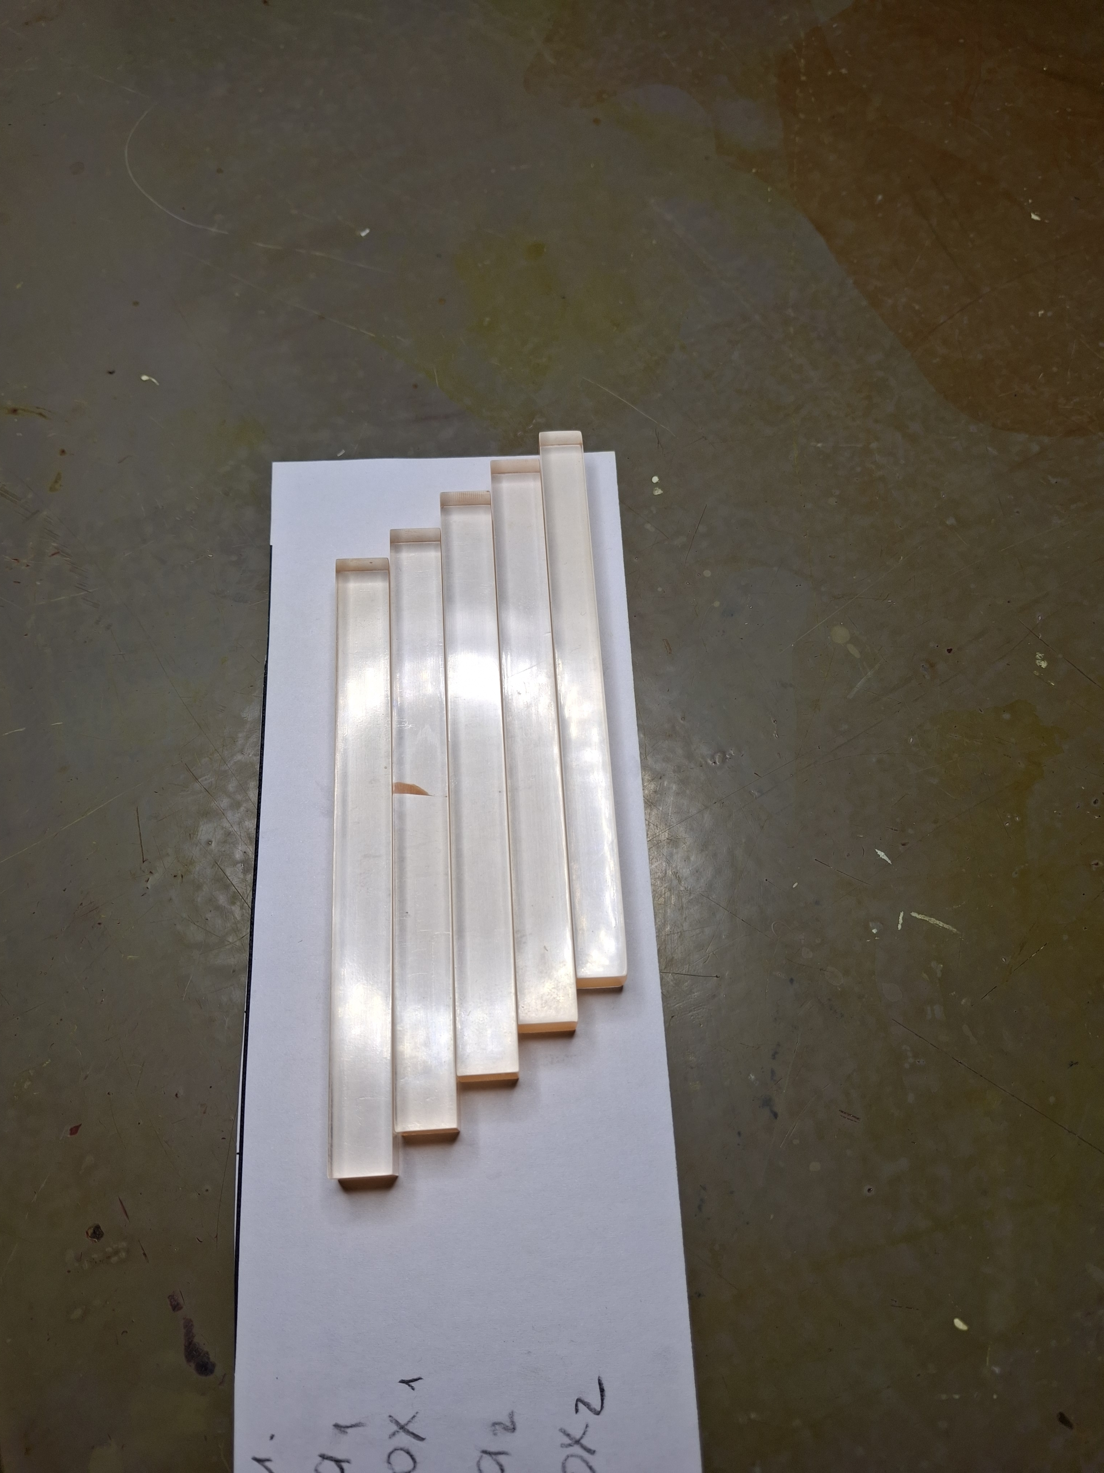
Progress On ECAL Crystal Bars
Ukrainian ISMa has been very helpful with DAMSA at no costs
Produced 50 crystal bars of 1x1x12cm³ using one 5x5x50cm³ U. Chicago CsI crystal block
Bars are cut, polished, FTPE reflector wrapped & QCed
All 50 bars have been distributed to five collaborating institutions
SNU, KNU, BNL, UCR and FNAL
ISMa engineers claim that they can produce as small as 0.3x0.3x6cm³ fully processed bars and as small as 0.1x0.1x6cm³ unprocessed bars
ISMa provided cost estimates for producing fully processed crystal bars with SiPM mounted
DOE suggested two other companies as backup
Working with another company, UK, RMD who provided cost estimate

Slide 25
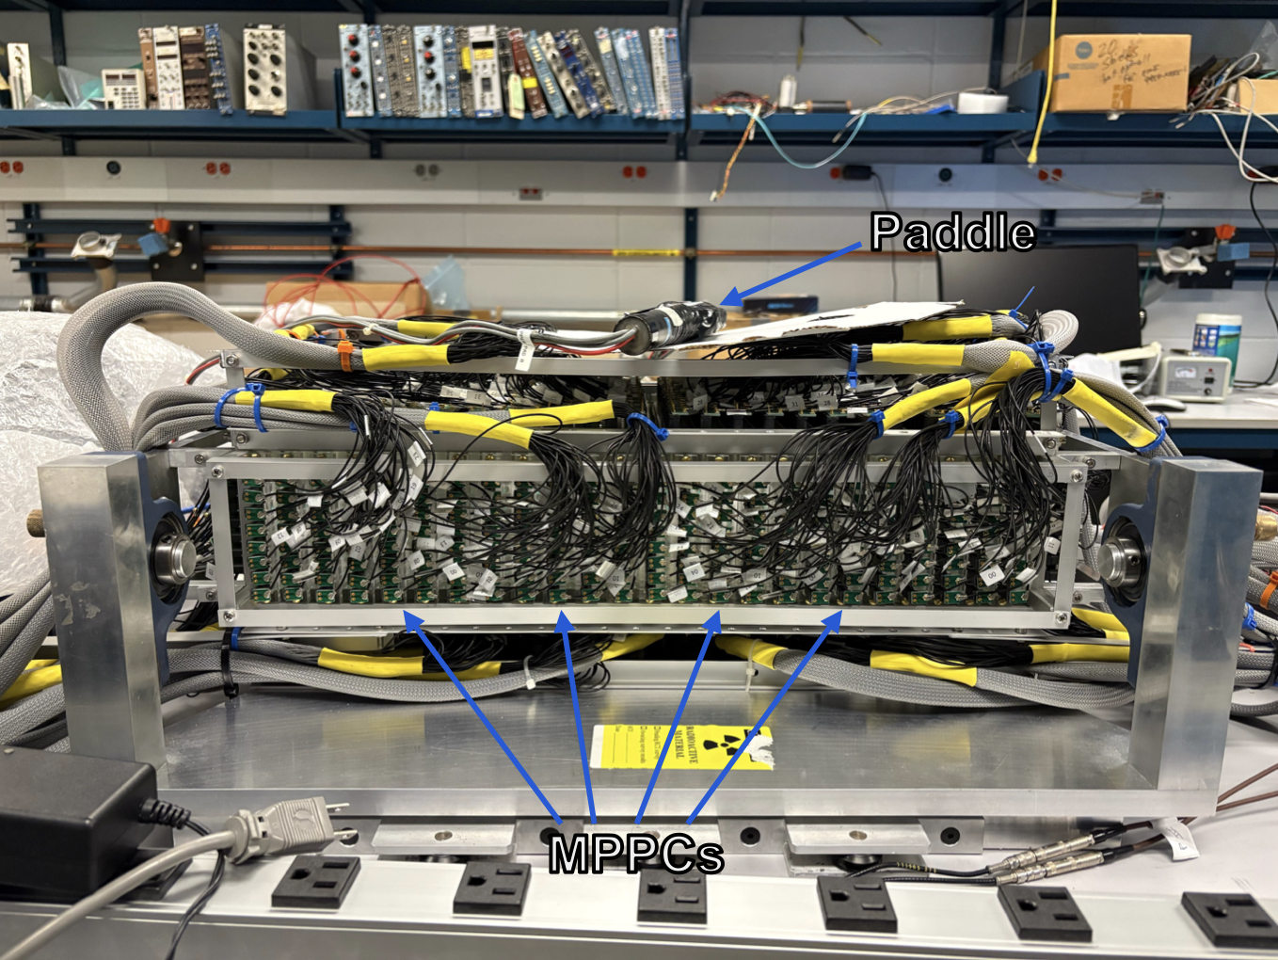
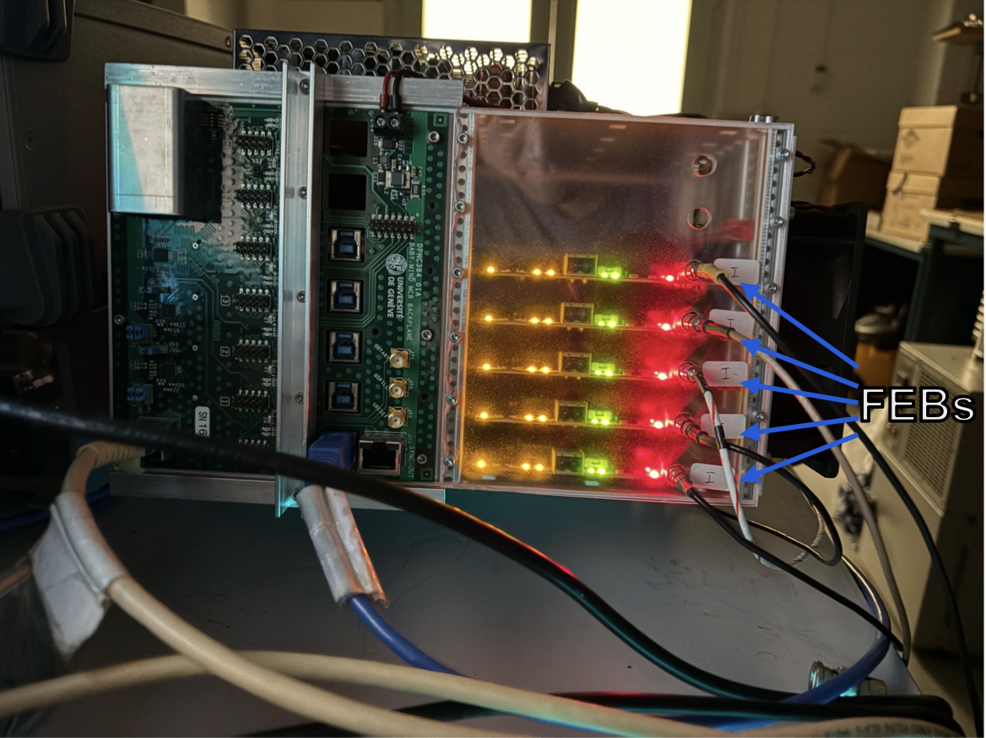
DAMSA – A Phased Approach
Phase 0 ➔ e-beam background validator
Measure and validate background MC & test a prototype at 300MeV e-beam at Fermilab’s FAST ➔ may be able to test physics, as well
BNL has two prototype detectors of the fine granular calorimeter using the 3DST (1x1x1cm³ scint. Cubes)technology, being used in ND280 ➔ fully equipped with the DAQ system with many spare channels

Slide 26
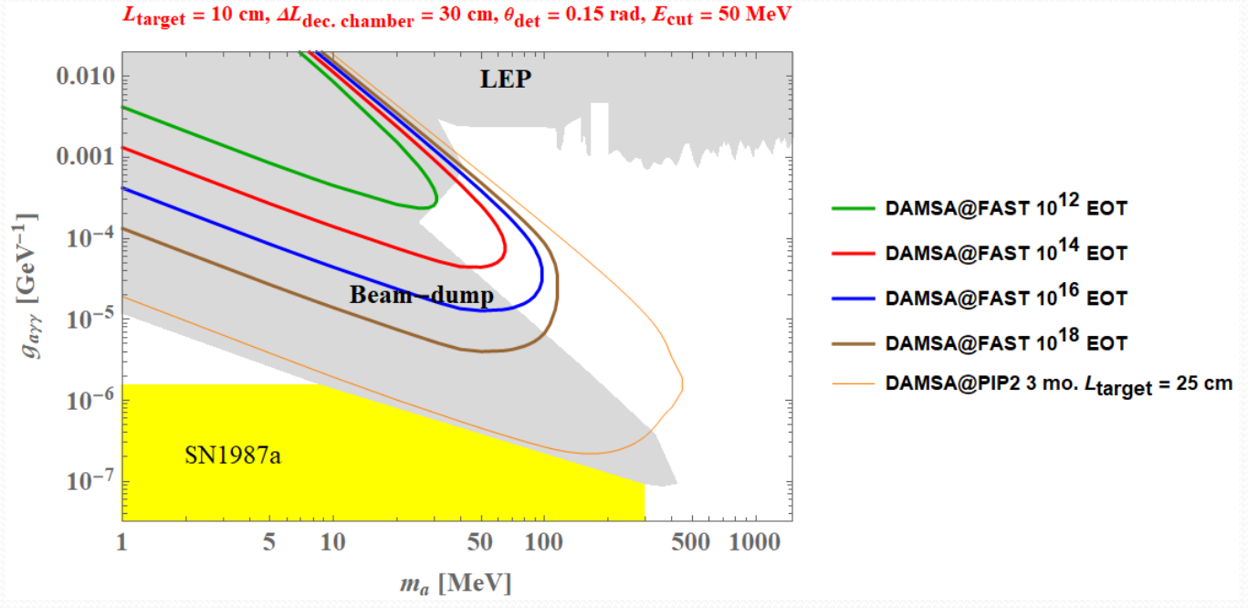
DAMSA Path-Finder Expectation
Even w/ 10¹⁴ EOT could already help accessing the target parameter space!

Slide 27
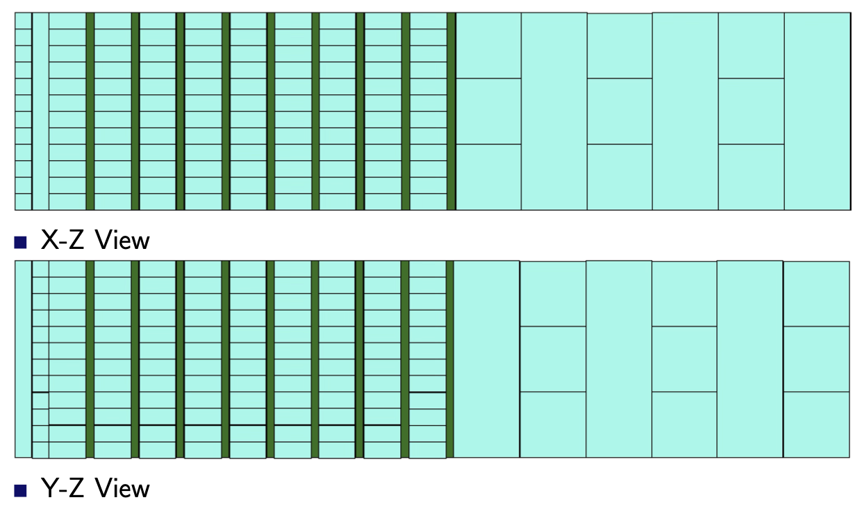
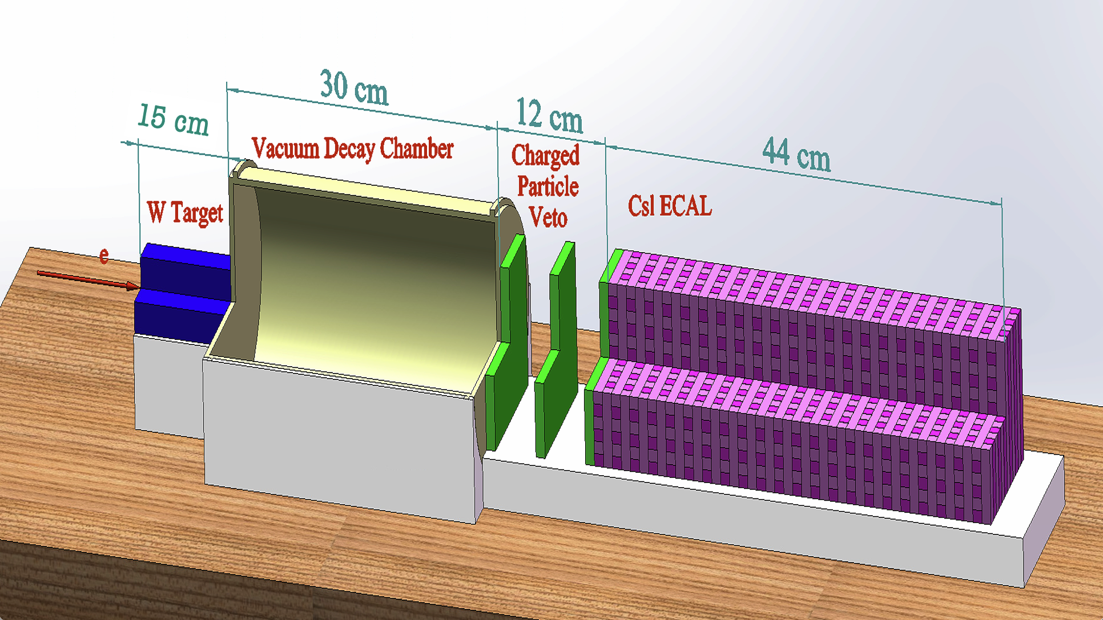
Phase 1 Detector & ECAL Geom.
Phase 1 ➔ The a2γ demonstrator @ LESA 8 GeV e
Build a pathfinder with only W target, vacuum decay chamber and an ECAL + charged particle veto counters which occupy the same location and space as the tracker
ECAL baseline geometry to control the fast background occupancy
Potential Baseline ECAL Geometry

Slide 28
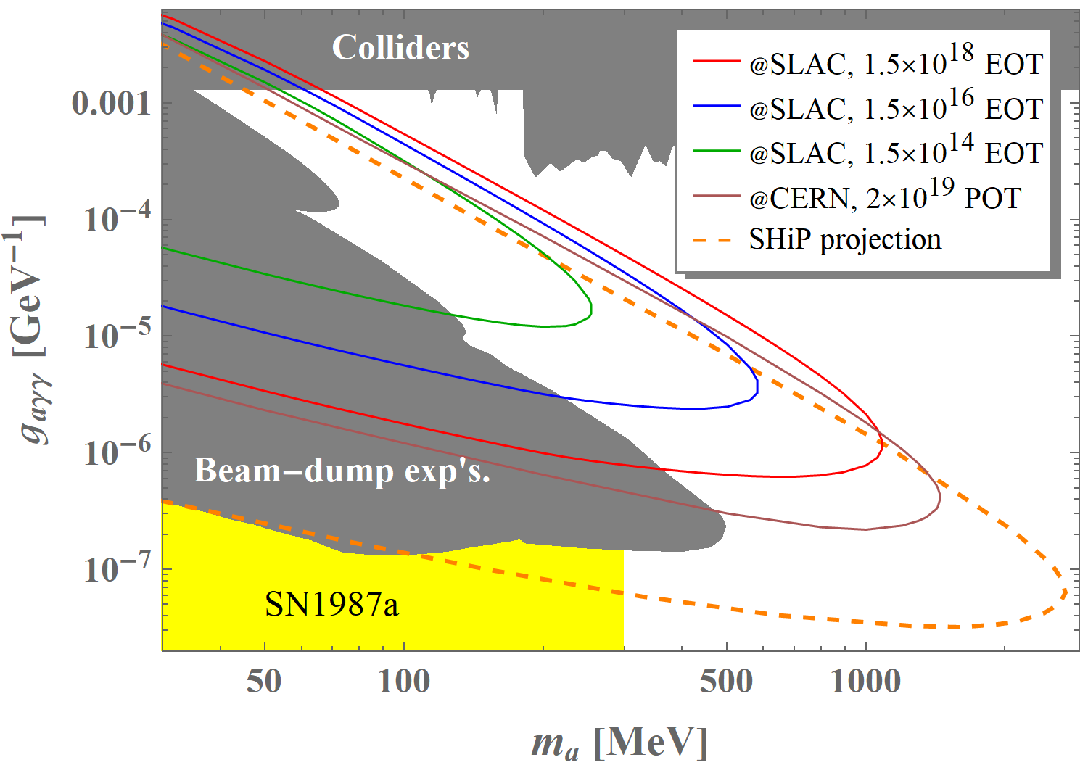
DAMSA Sensitivity @SLAC 8GeV e

Slide 29
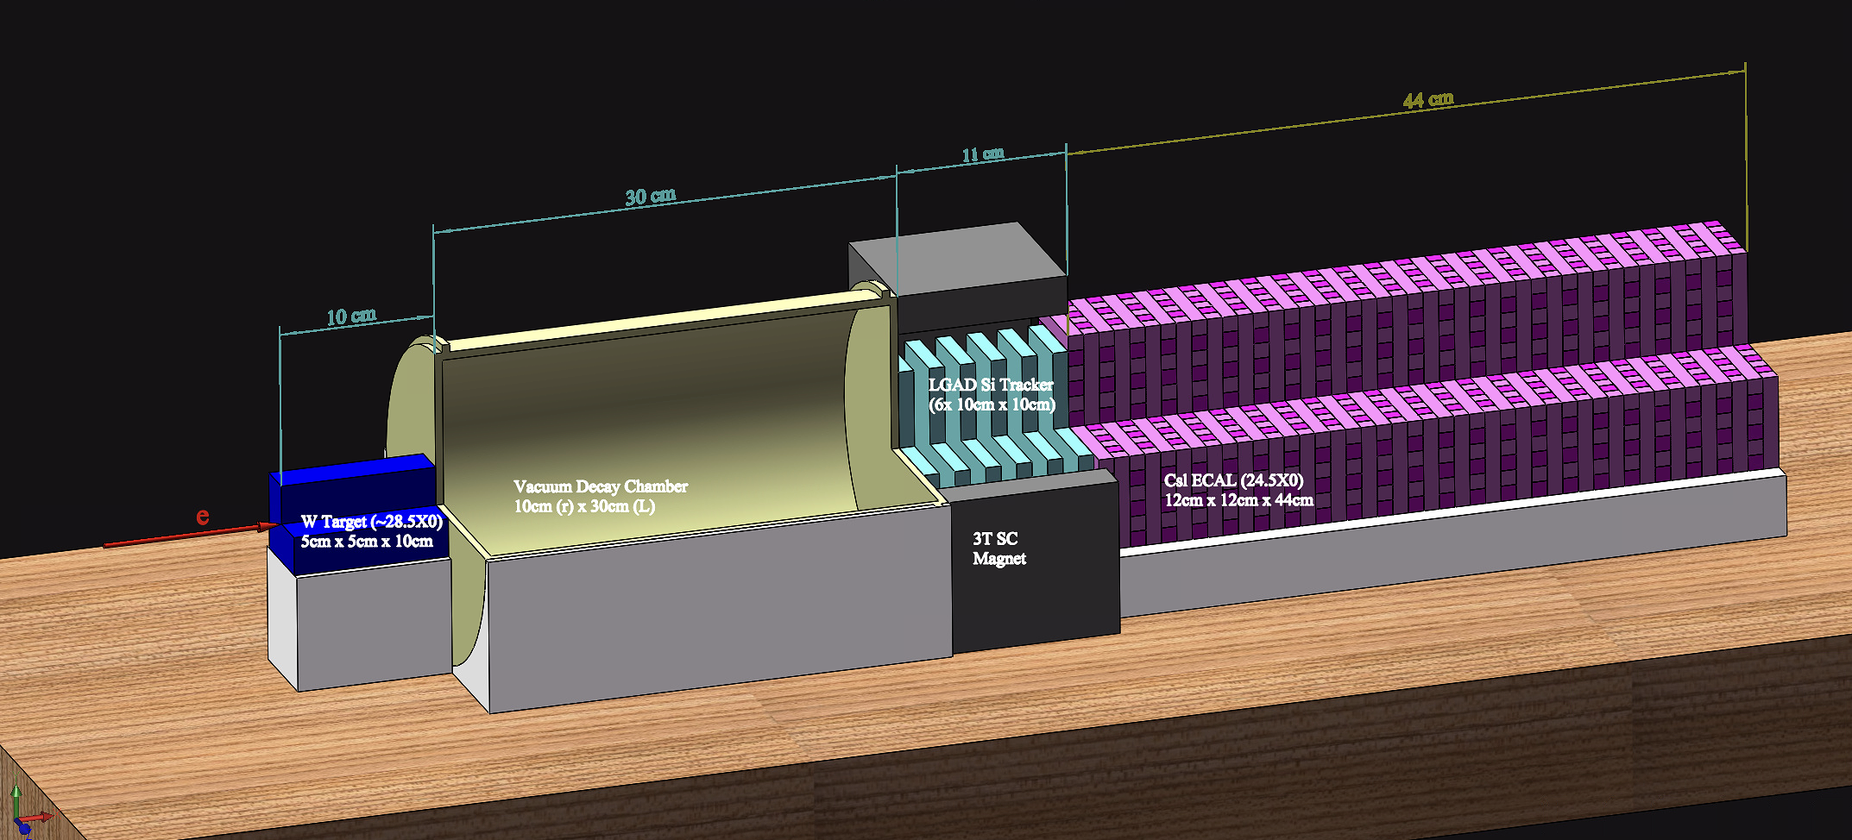

DAMSA – Phased Approach
Phase 0 ➔ e-beam background validator
Measure and validate the MC neutron and photon bck counts
Phase 1 ➔ The a2γ demonstrator @ LESA 8GeV e-beam
Build a path finder with only W target, vacuum decay chamber and an ECAL + charged particle veto counters which occupy the same location and space as the tracker
Phase 2 ➔ The a2e demonstrator @ e-beam
Complete and insert the tracker and the magnet
Phase 3 ➔ The full scale DAMSA @ p-beams
DAMSA Physics Expander (Phases 2 and 3)
DAMSA Path-Finder (DPF, Stages 0 and 1)
DAMSA Physics Expander (Phases 2 and 3)

Slide 30
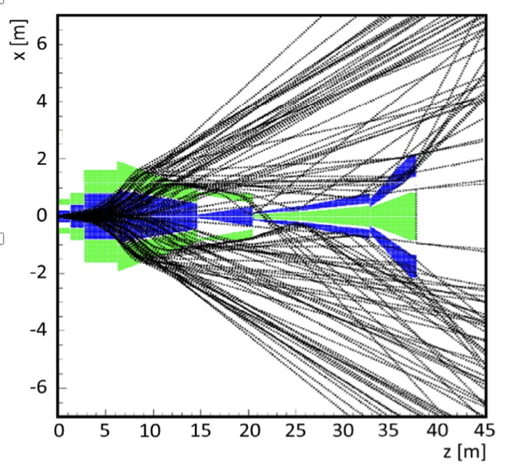
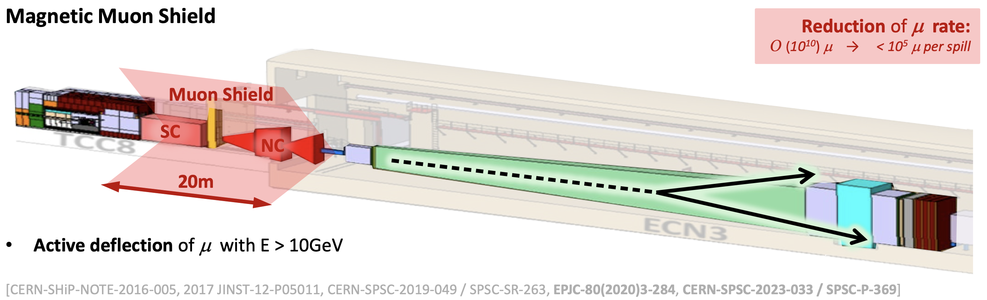
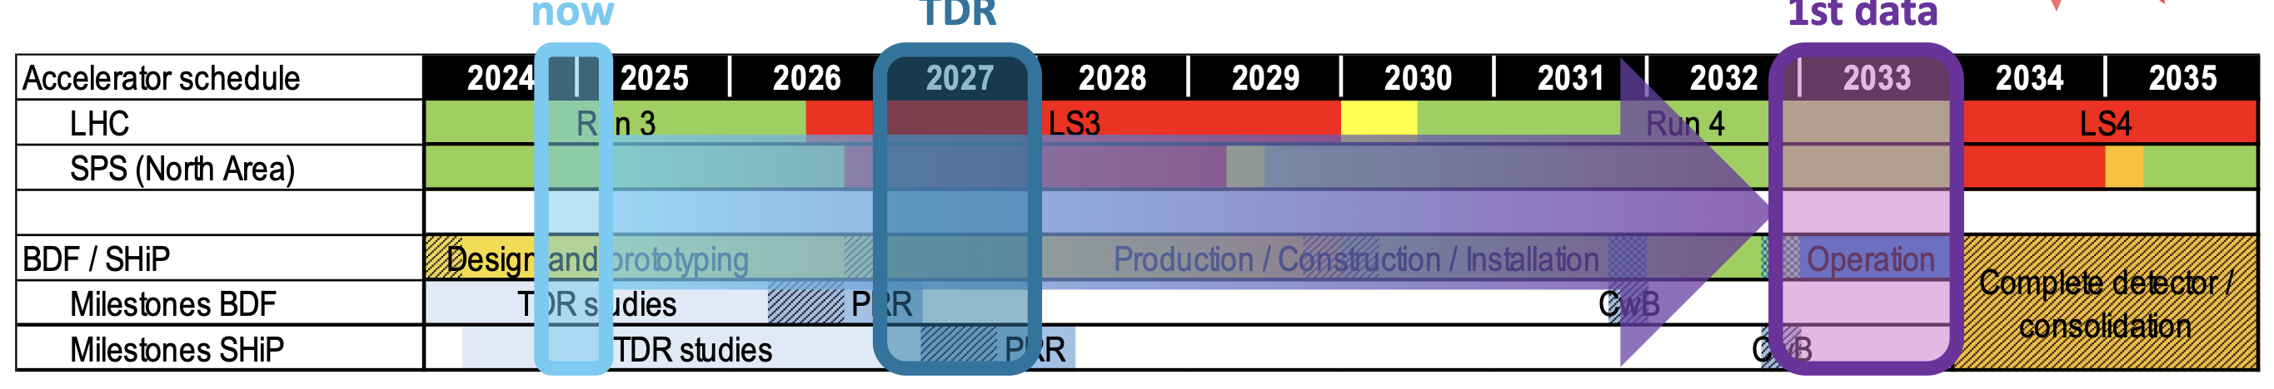
DAMSA@CERN BDF (2504.02923)
SHiP approved at CERN SPS ECN3 experimental area
Plan on completing the construction and begin experiment commissioning in 2032 with 1 year data taking in 2033
DAMSA can be placed in front of SHiP, behind the shield in 2032

Slide 31
Timelines for Some Beam Facilities
Many accelerator facilities shut down through early 2030s
Fermilab accelerator complex will go into LBNF switch-over prep 2027
LBNF beam to be ready in 2031
FAST 300MeV e-beam available through the shutdown period
CERN LHC High Lum upgrade prep
LHC shutdown July 2026
Beams return early 2030 for commissioning
CERN PDF facility & SHiP to commission in ~2032 (experiment in 2033)
SK PAL’s new 10GeV e-beam facility potentially available in early 2030s
But existing electron beams for light source will continue operating
J-PARC beam to return in 2028 with 1MW power
SLAC LCLS-II 8GeV upgrade: beam available in late 2027
Potential for DAMSA at 12GeV e beams at Jefferson Lab in discussion

Slide 32
Staged DAMSA Timeline
Stage 0 @ FNAL FAST
Det. R&D and Bck Validation
FNAL-FAST
Stage 1 – ALP→γ γ
8GeV e beams @ SLAC LESA
w/o Si Tracking System
SLAC-LESA
Stage 2 – ALP→γ γ + e⁺e⁻
8GeV e beams @ SLAC LESA
Si Tracking System + Magnet
Stage 3 – ALP→γ γ + ee + μμ
400GeV p beams @ CERN BDF
Stage 2 + muon tagging system
CERN-BDF
Yr 0 2026
Yr 1 2027
Yr 2 2028
Yr 3 2029
Yr 4 2030
Yr 5 2031
Yr 6 2032
Yr 7 2033

Slide 33
Where is the DAMSA experiment?
DAMSA has been introduced to the community in the past >4 years, more intensely since 2023
Multiple presentations made at conferences, workshops and seminars in the U.S., SK, EU and CERN since 2023
US funding agencies and facilities (FNAL, SLAC, PAL & CERN) informed
DAMSA Proto-collaboration established
Lead Investigators: J.Yu (UTA), J. Estrada (BNL), UK Yang (SNU)
14 US + 11 SK institutions on DAMSA (still have room for more)
A healthy mixture of theorists and experimentalists
Funding applications being submitted (some success in SK)
Collaborators work on crystal characterization & ECAL R&D

Slide 34
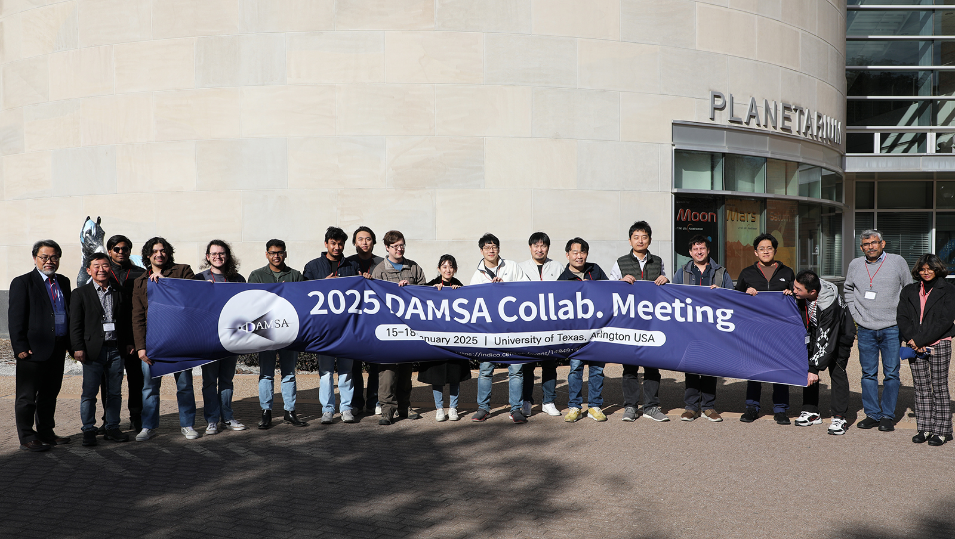
Conclusions
DAMSA is a table-top DSP search and discovery exp.
DAMSA has been making steady and serious progress
Aim to take data before the end of this decade, before DUNE
First neutron background validation measurement performed!
Conceptual Design Report release to archive (2601.15255)
DAMSA proto-collaboration established
A proof-of-concept Pathfinder experiment is being developed for SLAC LESA facility
Crystal processing has been exercised ➔ Costs better known
DAMSA presents an excellent opportunity to lead in DSP production & discovery in beams, through the strong partnership with international HEP community

Slide 35
Extras

Slide 36
Estimated Exp. Costs & Responsible
Experiment System | Costs ($k) | Responsible
Target | 10 | US
Vac. Decay Chamber | 100 | US
Motion Table | 80 | US
Permanent Magnet (1T) | 240 | SK
Si Tracker | 400 | SK
Ecal | 440 | US
Trigger | 100 | US+SK
Computing | 200 | US+SK
Experiment Effort | 670 | US+SK
Total | 2240 | (IDC on M&S uncounted)
SK contributions amount to ~ 50%

Slide 37
Yearly cost w/ human resources
Tasks per year | Human Resources (HR - loaded) |  | US ($k) |  |  | SK ($k) |  |  | Grand Total
 | PD | GRA | HR | Det. | Total | HR | Det. | Total
Yr 1 - design R&D + start of construction | 2 | 4 | 220 | 190 | 320 | 176 | 100 | 276 | 686
Yr 2 - Complete construction + commissioning | 3 | 6 | 330 | 475 | 805 | 264 | 100 | 364 | 1169
Yr 3 - Stage 2 - Trk+magnet + data taking, analysis | 3 | 6 | 330 | 250 | 580 | 264 | 580 | 844 | 1424
Yr 4 - Stage 2 data taking, Stage 3+4 det | 3 | 6 | 330 | 200 | 530 | 264 | 345 | 609 | 1139
Yr 5 - Stage 3 and 4 data taking & analyses | 3 | 6 | 330 |  | 330 | 264 |  | 264 | 594
Total |  |  | 1540 | 1115 | 2655 | 1232 | 1125 | 2357 | 5012
*HR cost is loaded (SK at 0.85*US)

