Slide 1
COLD update
S.Liuzzo, on behalf of the EBS COLD project team and the international collaboration: SLAC, INFN, CERN, PSI, CORNELL
30th April 2026

Slide 2
C-band Linac ~150-300 MeV pre-injector: OBJECTIVES
Accelerating Gradient
Breakdowns (10⁻⁷ /pulse /meter).
Acceleration in presence of a breakdown
Dark currents
Compact
Reliable, maintainable
alignment
Possible lower temperature reach
(need dedicated structure design)
WP9
WP2
Radiation safety
Ytterbium laser
Radiation safety
Radiation safety
Radiation safety
HIGH CHARGE
Low emittance
7MeV
150MeV
Radiation safety
HIGH GRADIENT
CRYOMODULE
300MeV
Beam charge
Beam energy
WP4
Solenoid
Beam charge
Beam position
GUN
Beam position
Quadrupole
steerer
steerer
Vacuum valve
Vacuum valve
RF deflector
Dipole
Vacuum valve
3xQuadrupole
WP1
Beam position
Beam position
Beam charge
WP1
Cryomodule 3.3m
Cryomodule 2.7m
WP10
WP10
WP4
WP3
WP2
WP2
WP1
Shot – shot reproducibility
Energy, Emittance
Bunch length, charge
ALIGNMENT
S-band
WP8
BEAM PROPERTIES
35MW
Vacuum valves
Legend
50MW
4μs
4Hz
Vacuum valves
OBJECTIVES
WP1
PC
C-band
Low Level RF
Control system
WP7
Diagnostics
Safety
WP1
WP1
PULSE COMPRESSION
Vacuum valves
Hardware interlocks
WP7
RF
Magnets
Laser
RF CONTROL
LONG PULSE
WP3
Infrastructure
Control
Safety interlocks
WP9

Slide 3
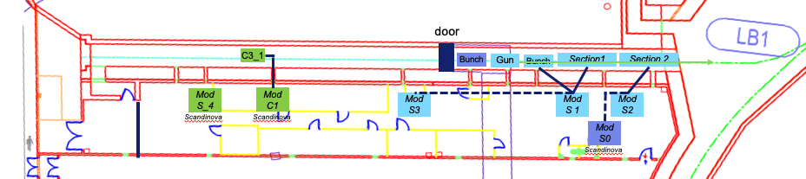
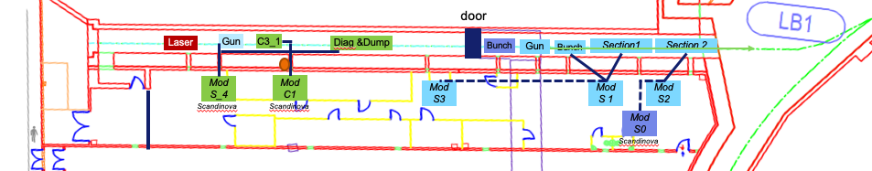
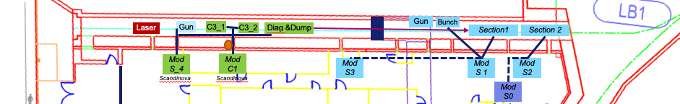
Timeline for the COLD projecT
Date | Instrument added to the installation | Beam achievements | project
2026-Aug SD | Grounding, holes in tunnel wall, cable trays |  | Phase 0
2026-Oct SD | Handling, air extraction (LN2 leaks), water (temp) |  | Phase 0
2026-Dec SD | ModS4- RF-unit (SAT) |  | Phase 0
2027-May SD | First C-band RF-unit |  | Phase 0
2027-Aug SD | First C-band Acc. Struct. |  | Phase 0
2028-May SD | Infrastructures installation |  | Phase 1
2028-May SD | Diagnostics and beam dump |  | Phase 1
2029-Jan SD | S-band photo-gun + laser | 7MeV photogun beam | Phase 1
2029-May SD | Beam in Acc. Struct. | 150MeV beam (expected 150) | Phase 1
2030-May SD | RF deflector | 2ps bunch length | Phase 1
2029-Dec SD | Second C-band RF-unit (if needed) and new injector design acc.struct |  | Phase 2*
2030-Sep |  | 300MeV beam (expected 300) | Phase 2*
2031-Aug SD | TL1upgrade and inject in booster | 300MeV beam to booster | Phase 3*
new
new
Delivery Jan 2026
CFT April 2026
SAFETY authorization for Phase 0, 1, 2, 3
EIC grant proposal for Phase 0, 1, 2
Budget and planning for Phase 0, 1
* No planning or budget at the time being

Slide 4
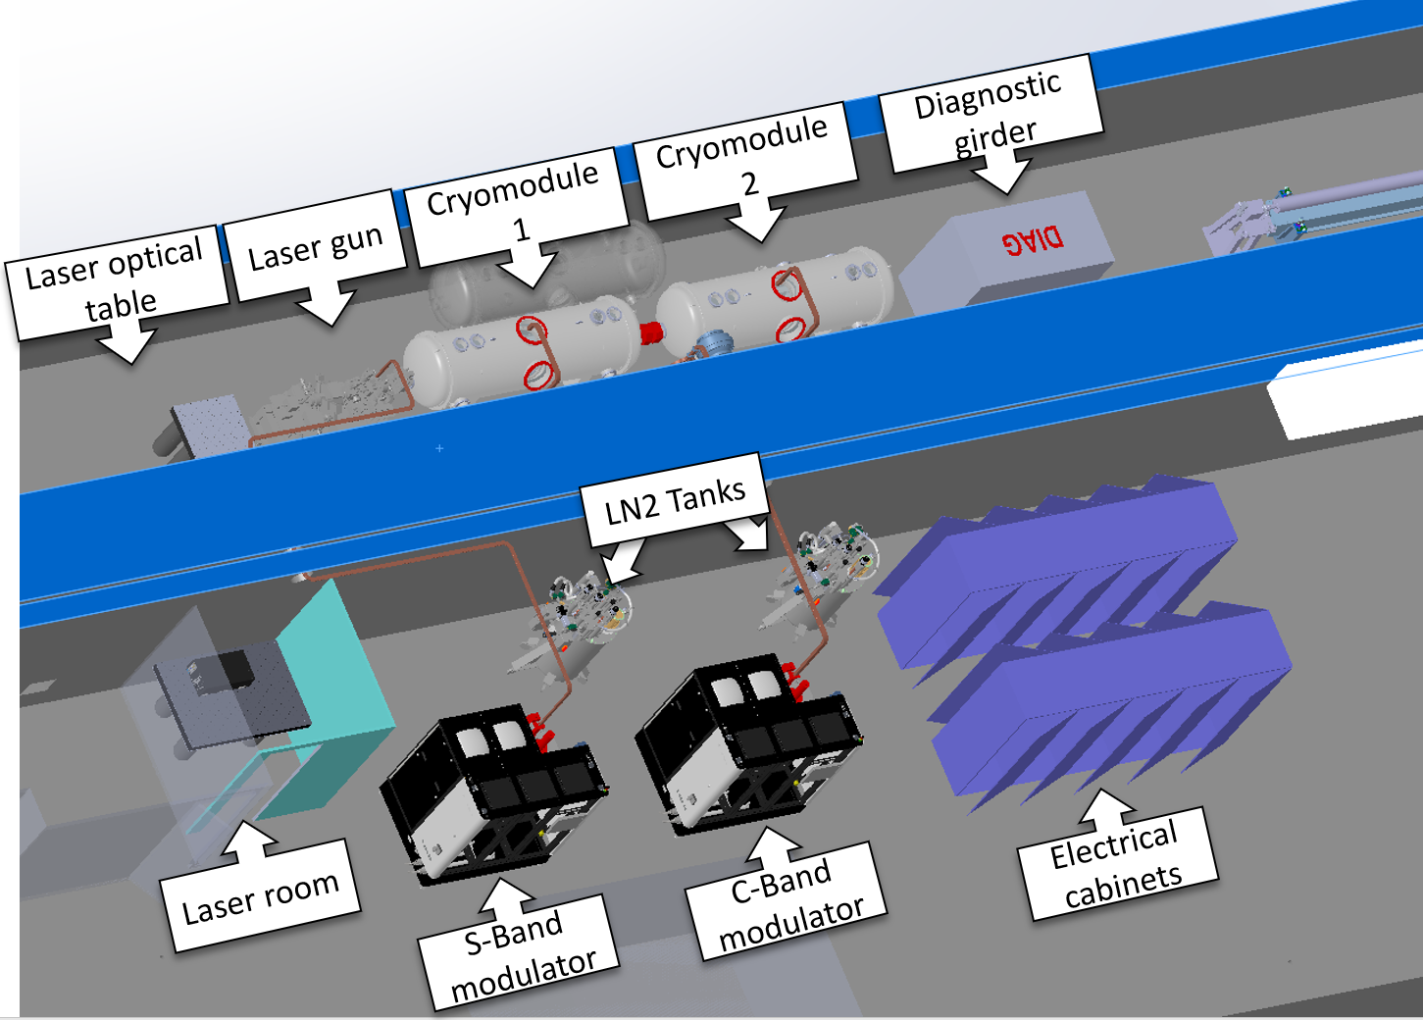
Layout in LINAC bunker

Slide 5

WP-01 RF
Definition of the RF power distribution, pulse compression studies, etc..
S-Band RF-unit purchased for photo-gun.
Fully compatible (identical) to the new RF-Units purchased for the present linac refurbishment.
In case COLD project is delayed, this equipment can be used for USM operation.
First component of COLD project purchased in 2025
C-band RF unit to be purchased in 2026 (needed July 2027)
Used Unit from PSI
New unit (Call for Tender)
Possibility of Buy-back proposed by Scandinova
→ CFT for new RF-unit + buy back option request.
new
Second component of COLD project CFT lunched in April 2026

Slide 6
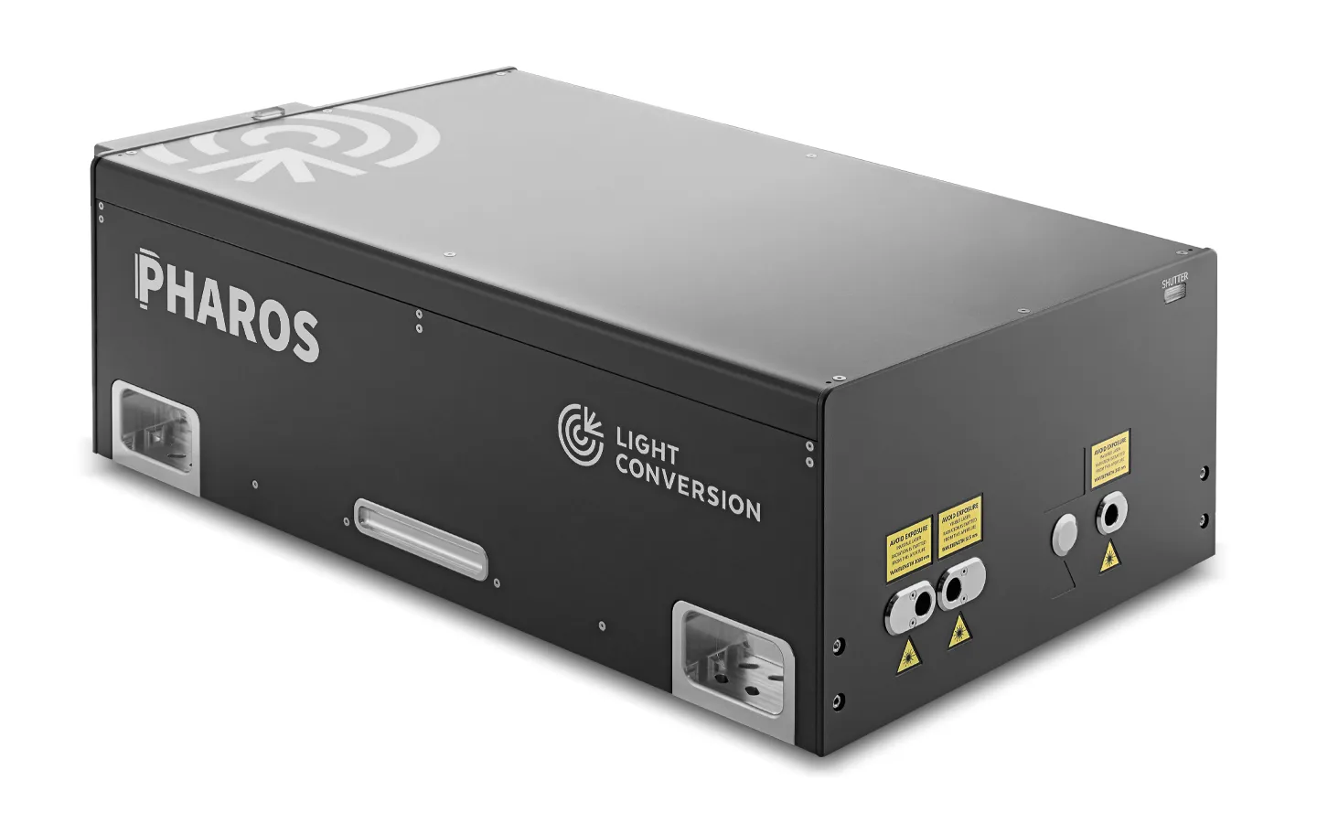
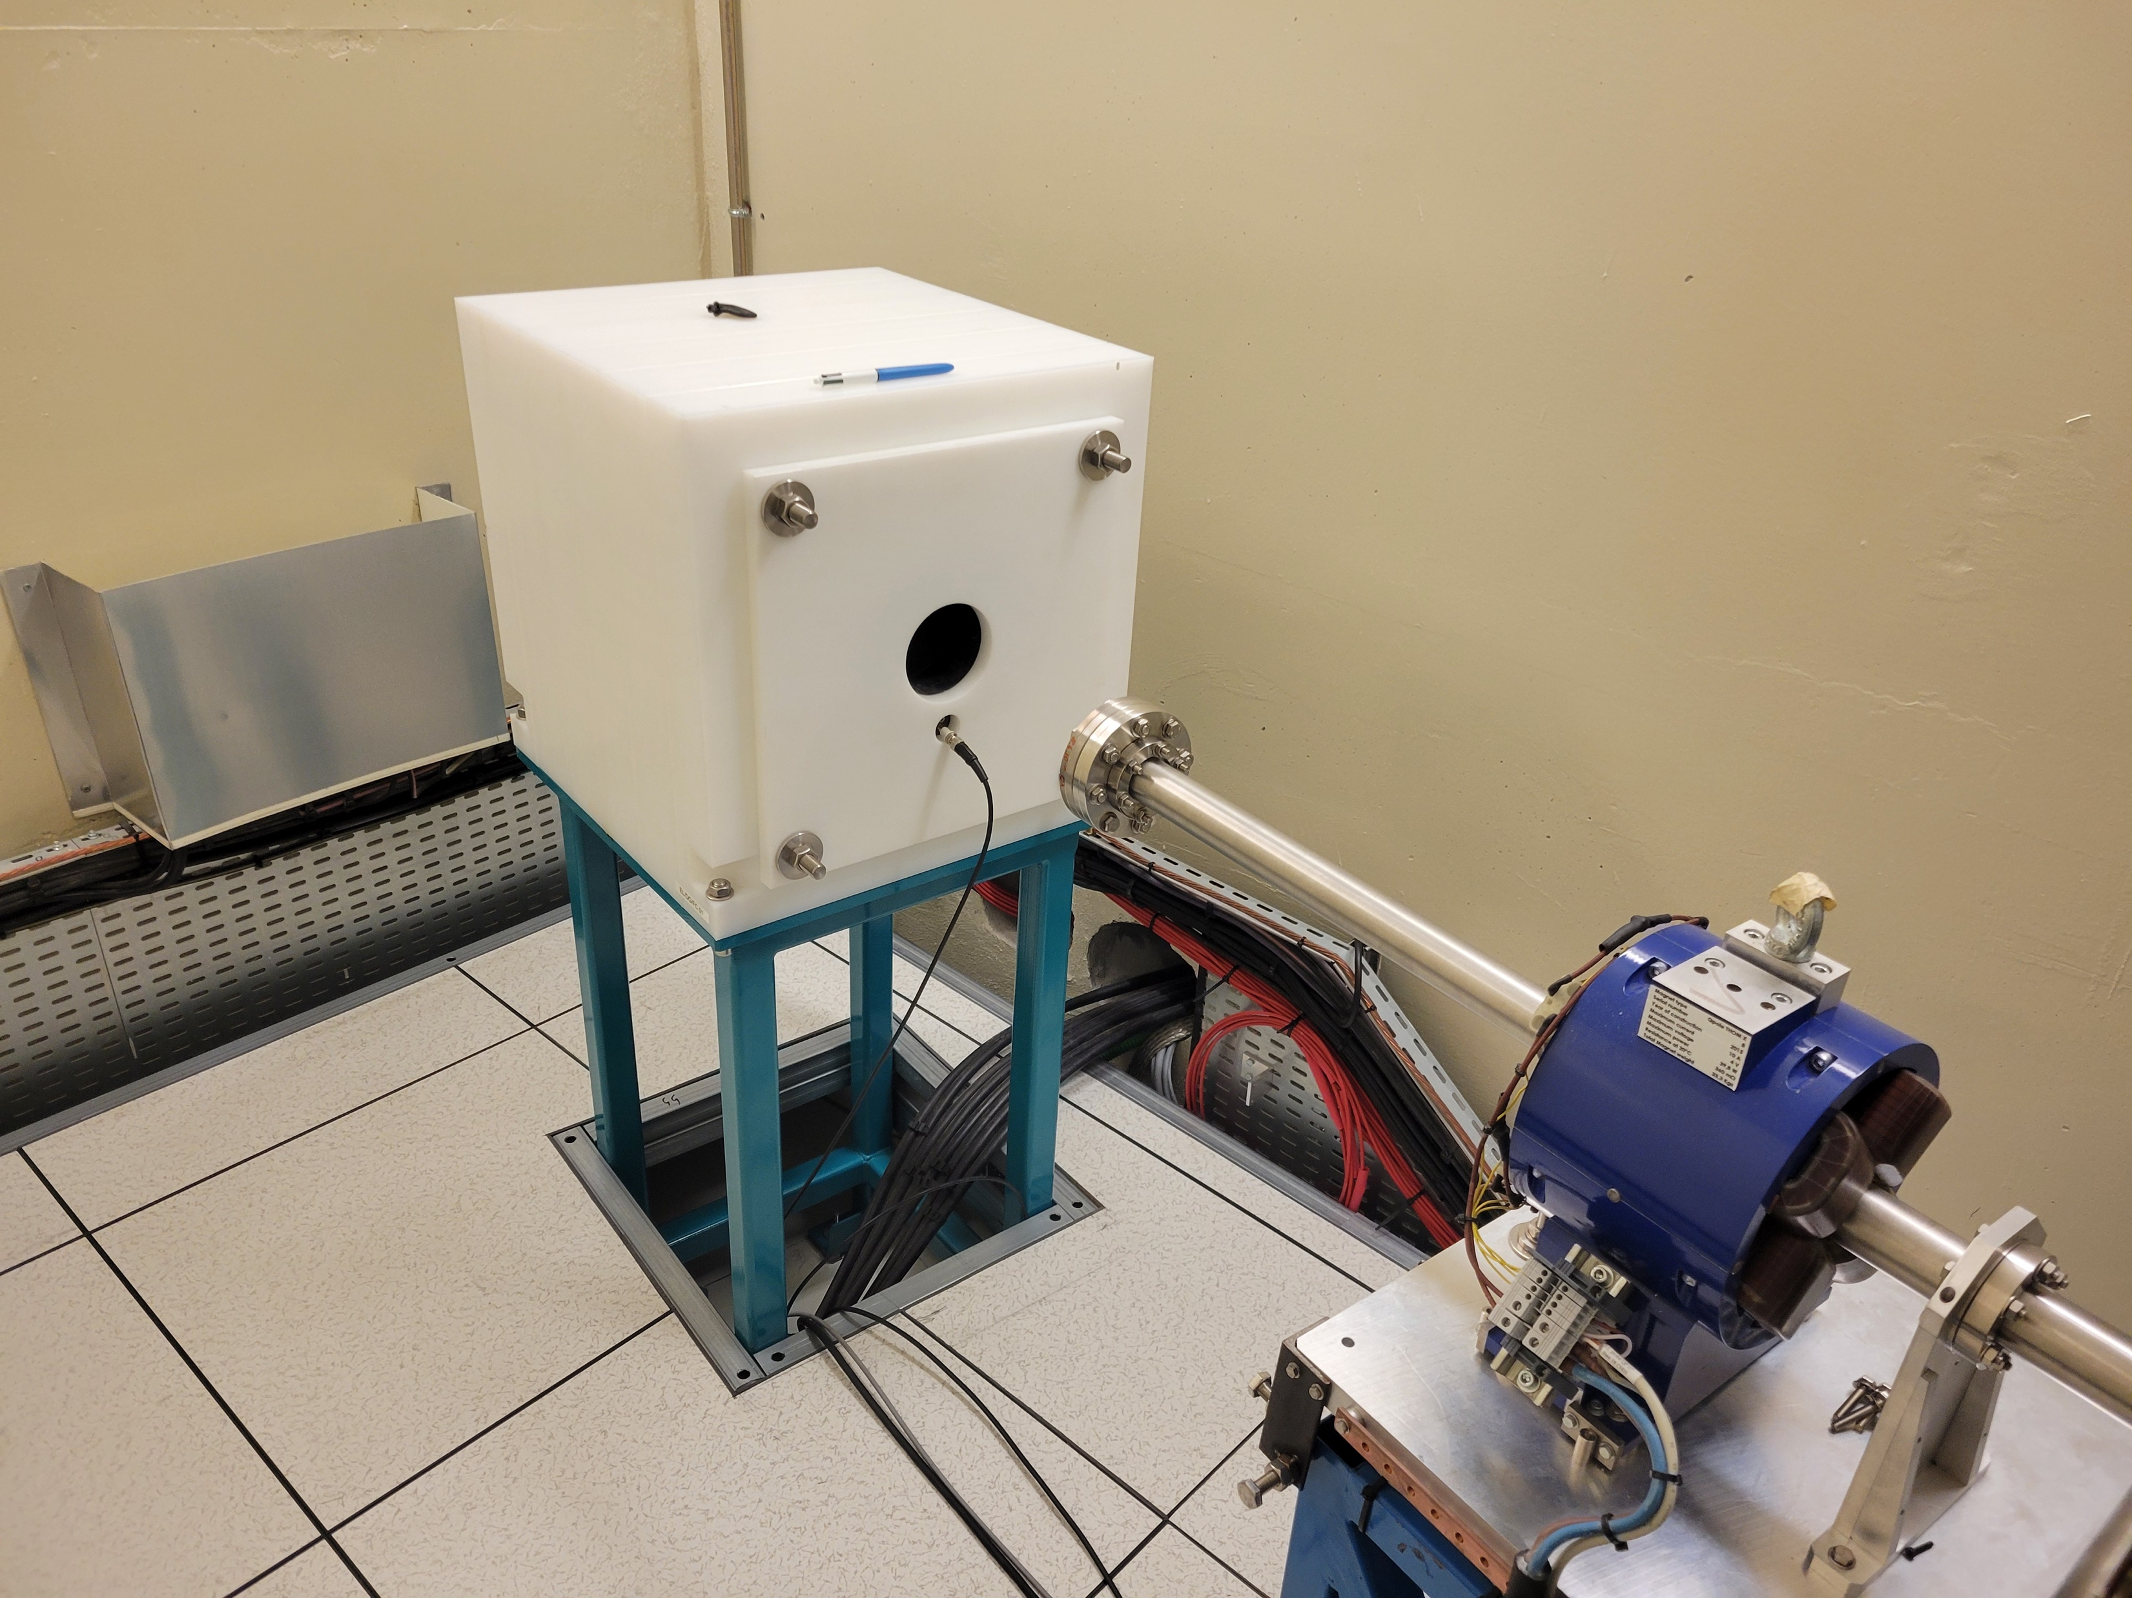
WP-02 diagnostics: Pharos 2H-4H from Light Conversion
Ideal solution: Pharos 2H-4H from Light Conversion
Diode pumped Yb-crystal laser (λ = 1030 nm) with integrated 4th harmonics generation:
150 MeV beam dump (ThomX) designed by P.Berkvens.
Will design for COLD a similar one for 350MeV. Works as Faraday cup as well.
492 cm
827 cm
25 cm
190 fs
= 257 nm
E = 100 - 200 uJ / pulse depends on model
Single shot – 100kHz
Synchronisation to SSRF/4 (88 MHz)
Compact
This laser is already used as UV-photon source for at
DESY (S-band photoinjector at SINBAD-ARES)
CERN CLEAR/CTF2 photoinjector
Photoinjector of CXFEL (Arizona State University)
Positive feedbacks on performance and service (beam quality, stability, long term reliability,…)

Slide 7
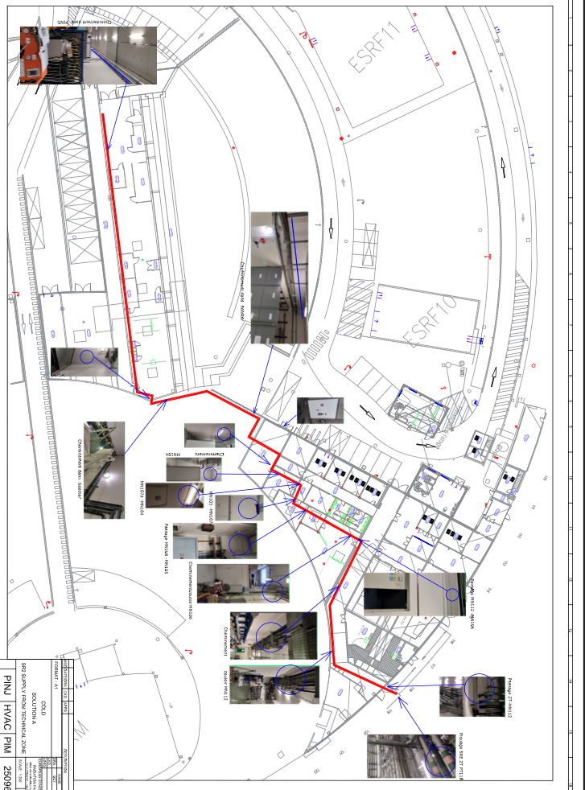
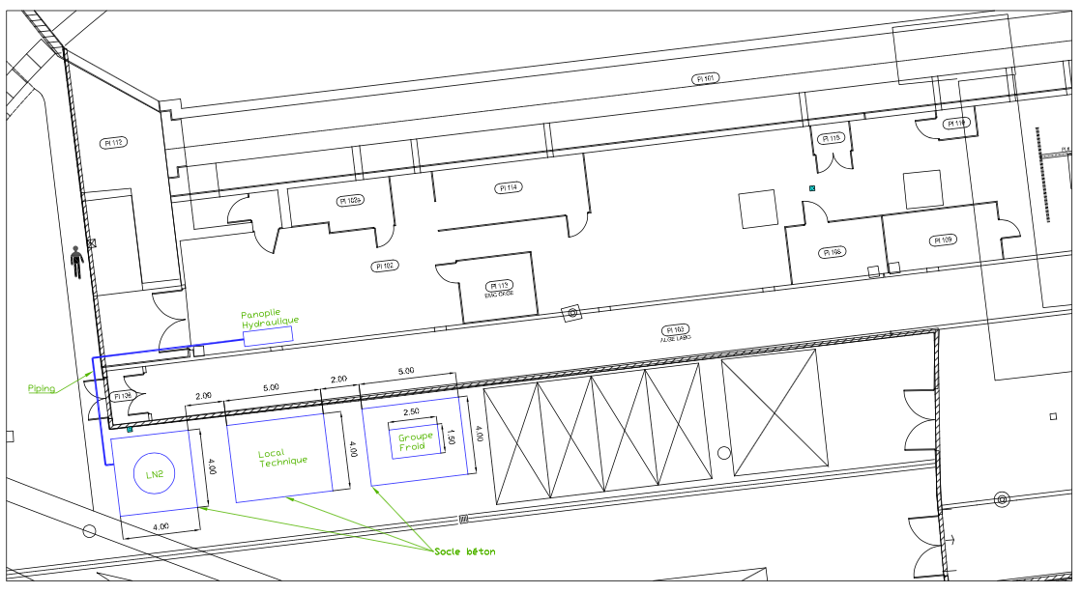
WP-05 infrastructure
Water cooling
new
2-300 kEuro
High quality
High reliability
Possible impact on Facility operation
3-400 kEuro
High Quality
Independent from main facility
Additional maintenance needed
Limited to 2 RF-units.
Potential for future use, Phase 3
SELECTED

Slide 8
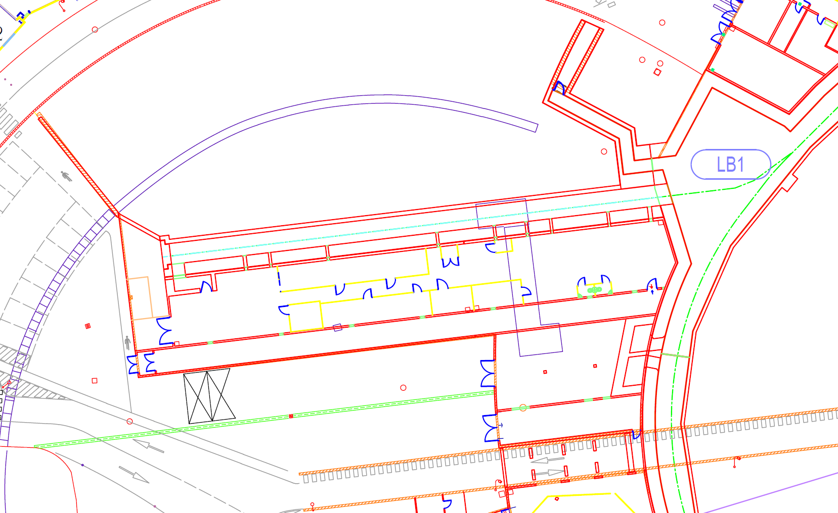

WP-06 Operation
Installation procedure: what enters and when.
Space for storage and handling solutions
Space availability in the PINJ modulator hall
Door separations
new
2026 August and October Shutdowns
The modulator hall is getting more and more free to make space for COLD project
325 MeV
Laser
Gun
C3_1
C3_2
Diag &Optics
Gun
Bunch
Section1
Section 2
325 MeV
Overhead crane ? → NO
Mod S_4
PC
Mod C1
Mod S3
Mod S 1
Mod S2
Scandinova
Scandinova
Mod S0
Scandinova

Slide 9
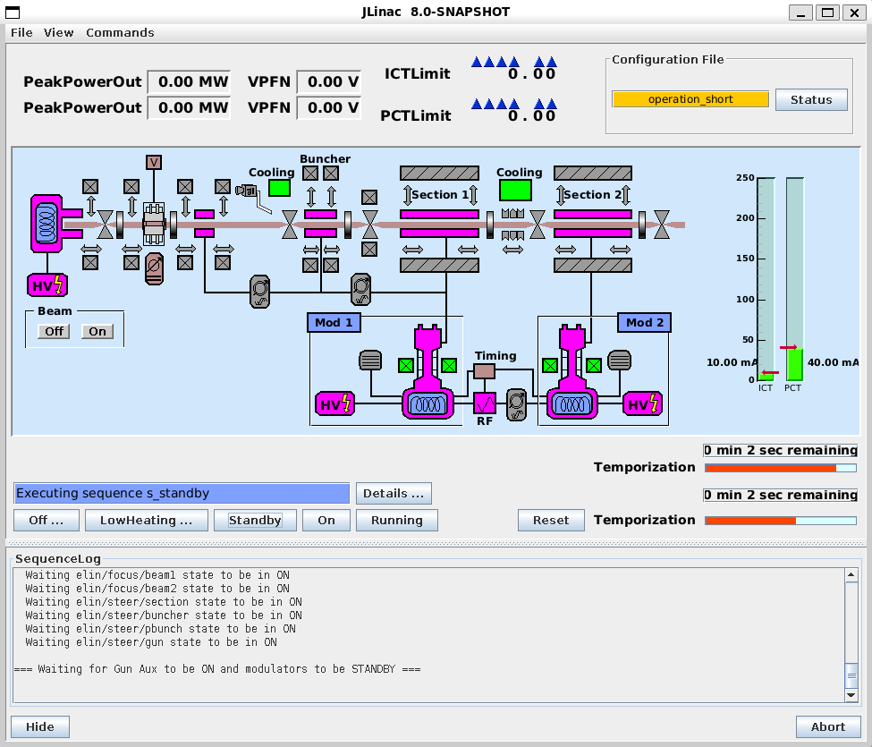
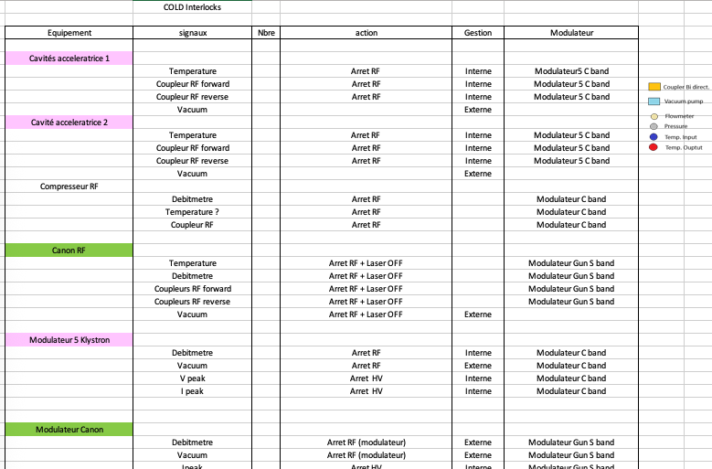
WP-07 Controls
We could consider the preparation of a digital twin based on RF-Track simulations as the one of the EBS-SR to start creation of Device Servers and applications for control of COLD.
new
PRESENT LINAC
Interlocks: several WP involved RF, safety, operation, control, etc…

Slide 10
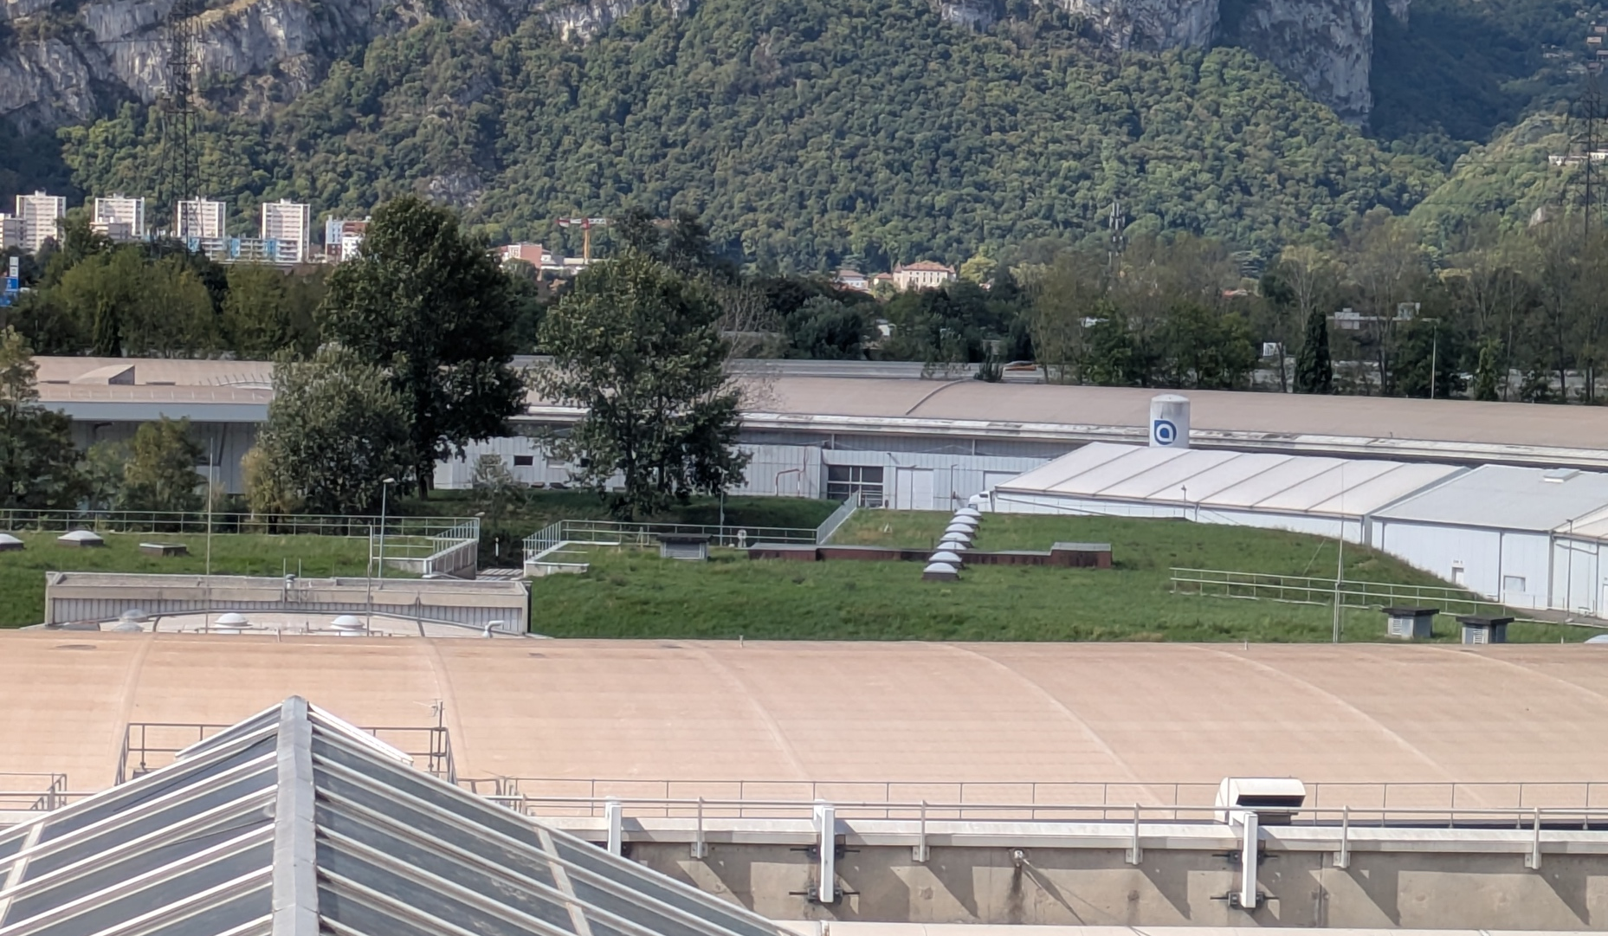
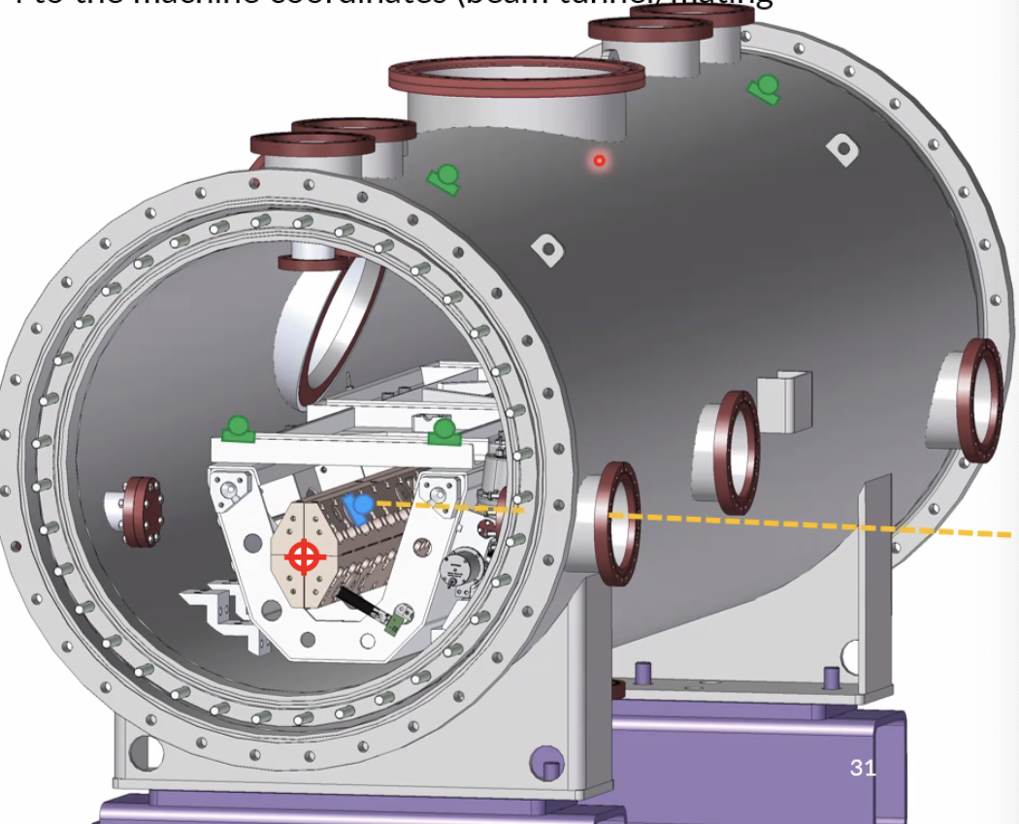
WP-08 Alignment
Measurement of the earth embankment that covers the linac tunnel for SAFETY approval request to ASNR.
COMPLETED on 24th September 2025
Modulators
hall
Linac
grass-covered earth mound
March 2026 → 3D Laser Survey of the Tunnel interior. Next shutdown (May) installation of HLS in linac tunnel.
new

Slide 11
WP-09 SAFETY
The procedure to obtain L'Autorité de sûreté nucléaire et de radioprotection (ASNR) approval requires drawings, simulations and a CDR document.
~2 years to obtain permission for beam. We are on schedule and started preparing the documentation.
6GeV Linac Injectors upgrade project is the ultimate justification for ASNR to approve COLD project
ASNR approval deadlines:
Prepare → 6month → Submit → 1 year → Obtain (accelerators)
Submit → 6 month (or less) → Obtain (klystrons)
1st Dec 2025: Prepare Drawings and beam information for Linac refurbishment (DONE)
Submit authorization for S-band RF unit (Klystron) (DONE, BUT NOT OBTAINED YET)
1st July 2026: Submit authorization request to use RI structure as spare (sent)
Obtain authorization for S-BAND RF units (klystron)
2nd July 2026: Prepare Drawings and beam information for Phase 1-2-3-… Linac parameters 1000 part 6D beam at linac end
Submit authorization for C-band RF unit (Klystron) Phase 0
1st Jan. 2027: Submit authorization request for Phase 1-2-3
Obtain Authorization for C-band RF unit Phase 0
1st July 2027 : Obtain Authorization for linac refurbishement beam
1st Jan. 2028 : Obtain Authorization for beam and RF Phase 1-2-3-…
COLD authorization starts right after Linac Refurbishment
new

Slide 12
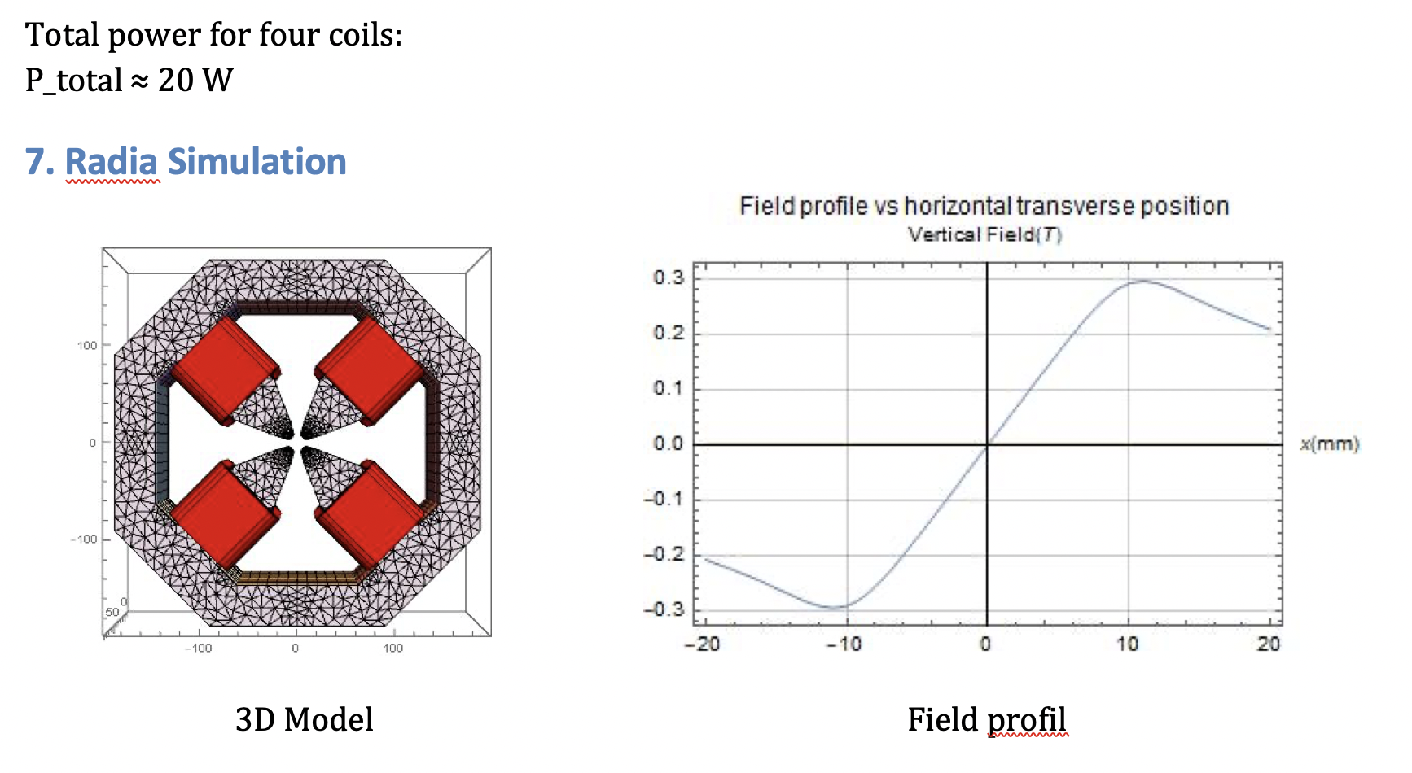
WP-10 Magnets and Power supplies
More correctors needed (2) and quadrupole to be installed on mover or with integrated H/V correction coils
Included in the list of participants to the project also Power Supply Group.
2 H/V correctors (similar to the ones of TL1), 2028
1 quadrupole (similar to the ones of TL1), July 2027
1 dipole (similar to the ones of TL1), 2028
1 solenoid (the PS will likely be part of the photo-gun purchase), 2028
Low Power consumption, AIR COOLED magnets.
new

Slide 13
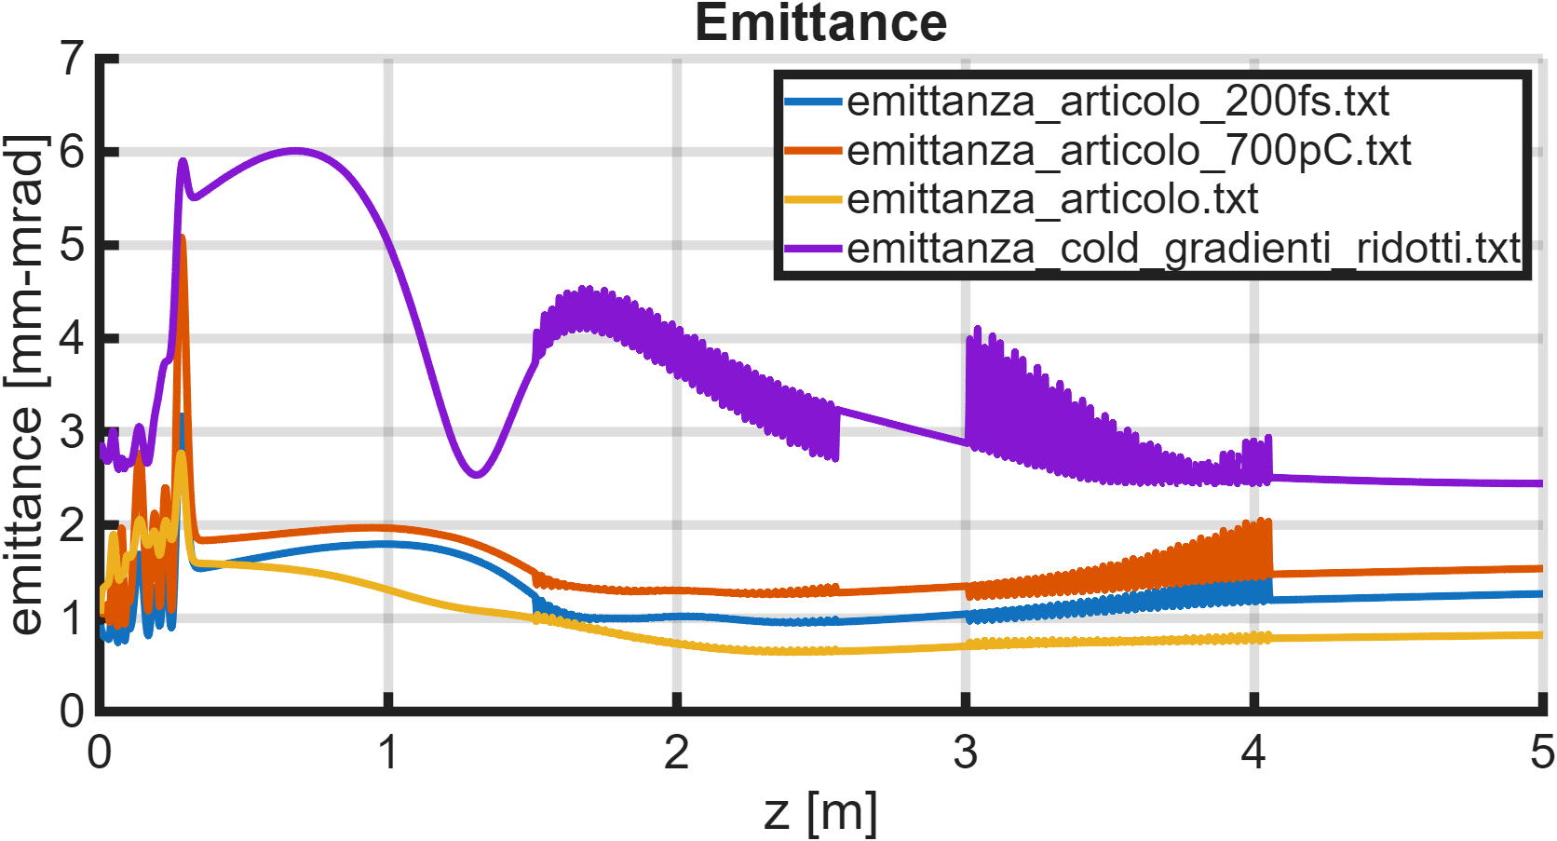
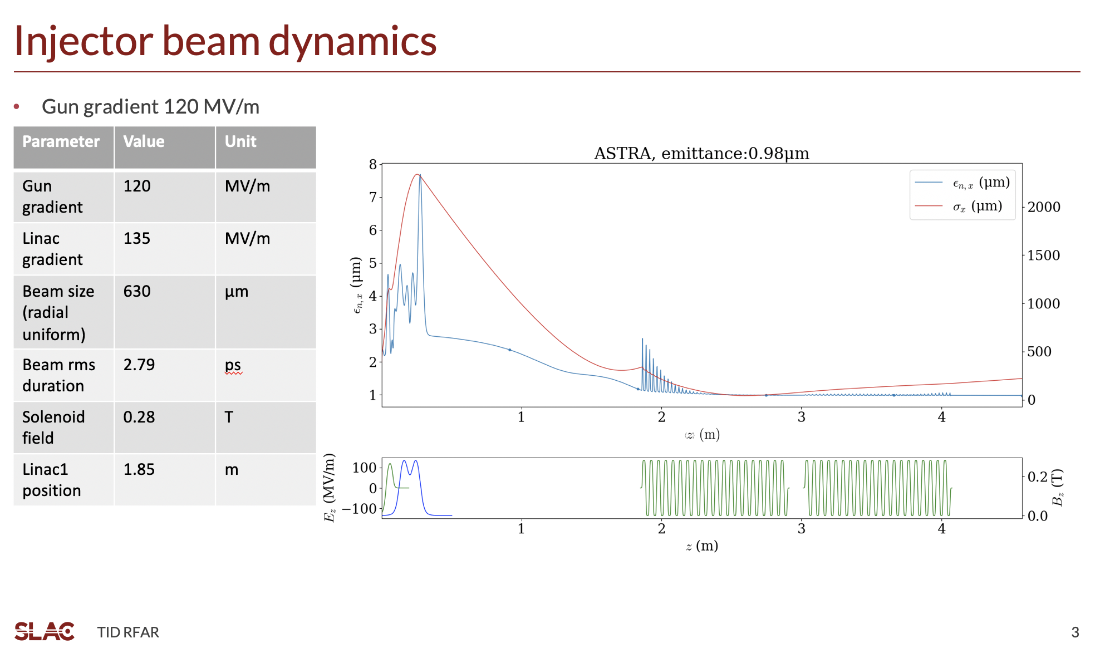
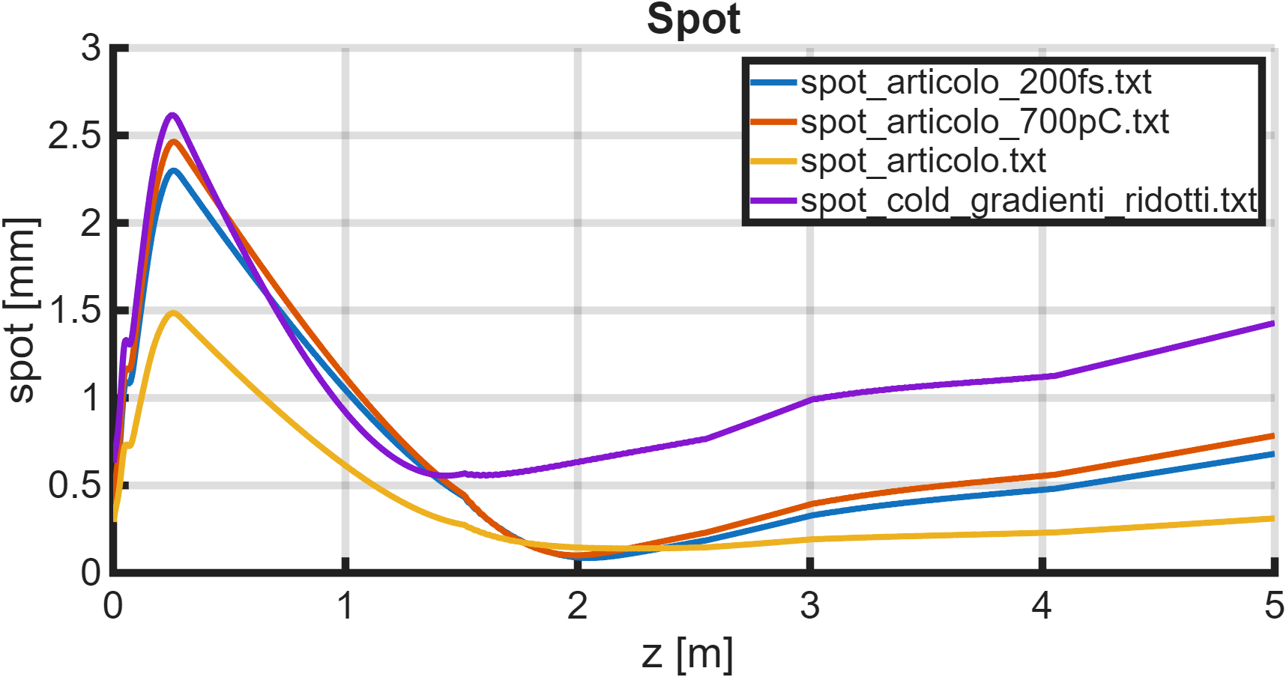
Collaboration working on emittance simulations differences RF-Track - ASTRA
In ASTRA simulations, emittance is ~ 1 mm mrad
SITF
700pC
SITF
SITF
200ps
G.J.Silvi, INFN
Wei-Hou Tan, SLAC

Slide 14
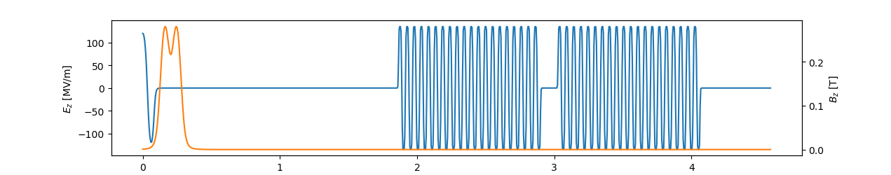
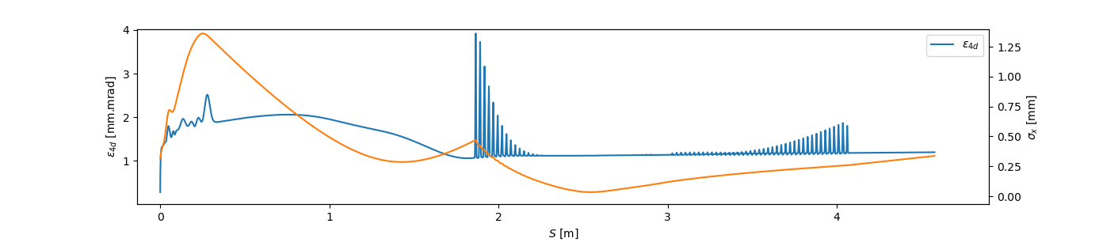
RF-Track simulations
new
A.Latina, CERN
Final 4d emittance at linac start = 1.05 mm.mrad; at linac end 1.08 mm.mrad
1) interpolate 1D fieldmaps on a regular 1D mesh, 2) smoothing function similar to that used in Astra 3) fund a better working point using Bayesian optimisation in Xopt to get a small emittance at the entrance of the first linac structure using the gun phase and the solenoid field as degrees of freedom.
σ_{r} = 0.3 mm (gaussian)
σ_{t} = 2.79ps (gaussian)
0.289795 T
Different optimal parameters.
0.823 m gun←→linac

Slide 15
WP-12 Timing
NO
GO!
NO
NO
This WP is recently added to the project.
142.8MHz
X 21
X 40
Wait for coincidence within a given limit.
GUN
Accelerating structures
Storage Ring
2998.8 MHz
5712.0MHz
352.372174 MHz
EU S-BAND
C-BAND
COMPATIBLE WITH PRESENT LINAC
MAX-IV propose their solution to generate the S-band and C-band signals from the laser.

Slide 16
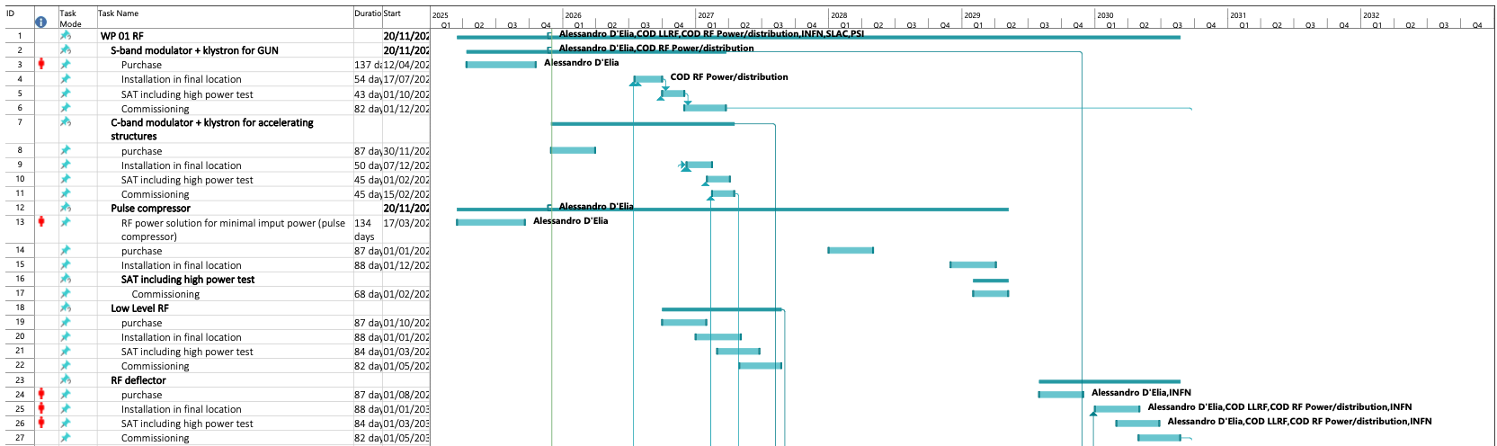
Planning, HR and WP organization @ ESRF
Management:
Q.Qin, P.Borowiec, S.White, J.-L.Revol
Human resources:
3-years contract for cryomodule design
3 years contract for diagnostics/laser
3 years contract for RF accelerating structures design for Phase 2 (could be a PhD)
3 years contract for mechanical engineering
Resources for Safety and Infrastructure (to be defined)
Needed:
WP-01 RF
A.D’Elia
WP-02 Diagnostics and Laser
F.Ewald
WP-03 Vacuum
H.Pedroso Marques
WP-04 Mechanical Engineering
T. Brochard
WP-05 Infrastructure
Y. Gouez
Hiring:
1 COD selection in progress for LLRF (3 years)
1 PhD open for Beam Dynamics (6GeV linac)
1 COD to be opened for high power RF (3 years)
WP-06 Operation
J.-L. Revol
new
WP-07 Controls
R. Bourtembourg
WP-08 Alignment
C. Gonzalez Torres
WP-09 Safety
P.Colomp
~200 tasks
30 people
WP-10 magnets
and power supplies
C. Benabderrahmane
P. Falaise
WP-11 beam dynamics
S.M.Liuzzo*
Including resources and following an almost flat financial profile is set up with the available tools (excel mainly).
WP-12 Timing
Not. Available
* project coordination

Slide 17
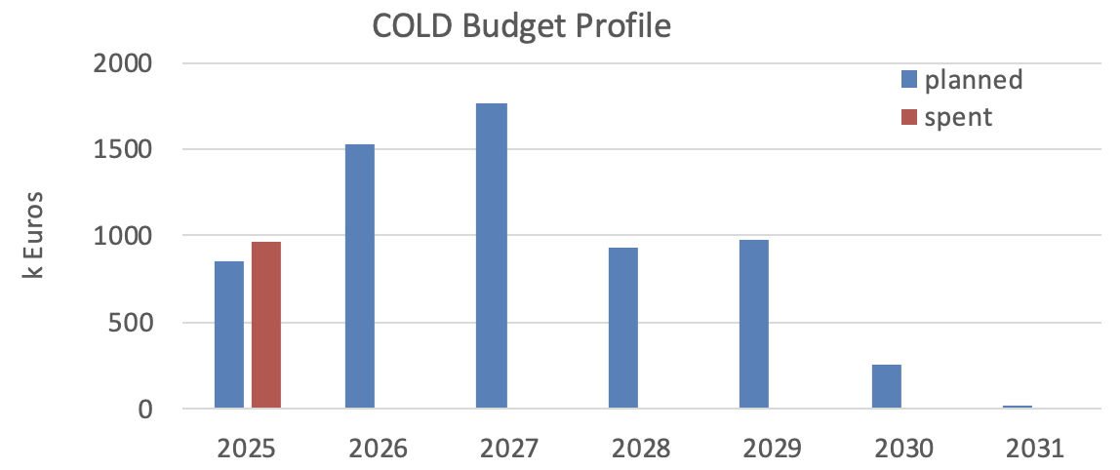
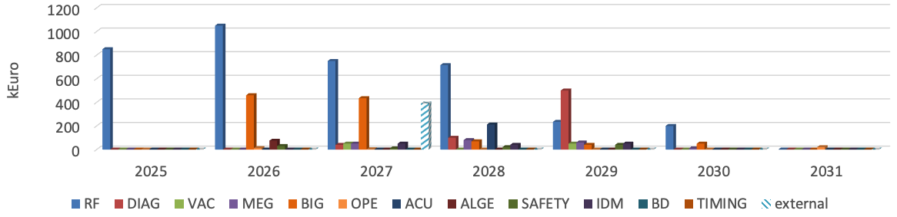
BUDGET
Financial profile and budget codes are set up
High power RF measurements
BUDGET EVOLUTION:
April 2025: ~5M€
June 2025: ~6.0M€
October 2025: ~6.5M€
+ Detailed inputs from all WPs
Beam
+ Infrastructure, RF-deflector
+100K
+ updated costs
6.5MEuros total to reach Phase 1:
- 250 k€ refilling QCM with 300l dewars
- 250 k€ if we can leave without RF-deflector
Photo gun,
Pulse compressor
RF deflector
Diagnostics, waveguides, laser, acc. structures
C-band RF unit,
infrastructure
S-band RF unit
infra
RF
DIAG

Slide 18
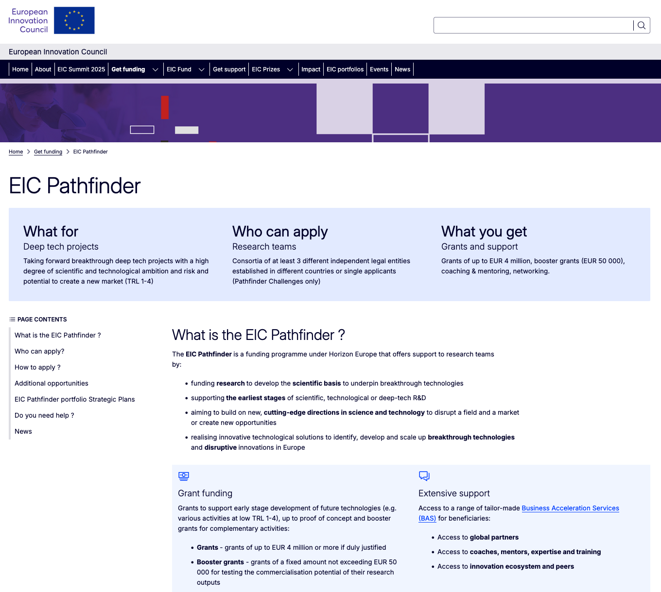
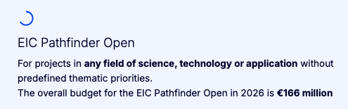
European commission EIC grant application
Deadline for submission 12th May 2026 (open 5th February ‘26)
High risk - high gain project
Bring technology to no more than TRL4 (Technology validated in lab)
22 pages to be filled in: Excellence, Impact ( applications other than basic science, could be medicine, industry), Quality, budget.
Lump sum payments, budget pre-approved, advance payments and residual at WP finalization.
2.1% success rate last year (likely will need to resubmit next year)
4-5 labs, 5-7 WPs, SLAC can be an associated partner
For people-travel-consumables not for hardware
4 millions over 60 months
ESRF
INFN
CERN
SCANDINOVA
Instrumentation Technologies
SLAC (Associated, no budget)
We are applying to EIC Pathfinder Open
Submission
7th May 2026

Slide 19
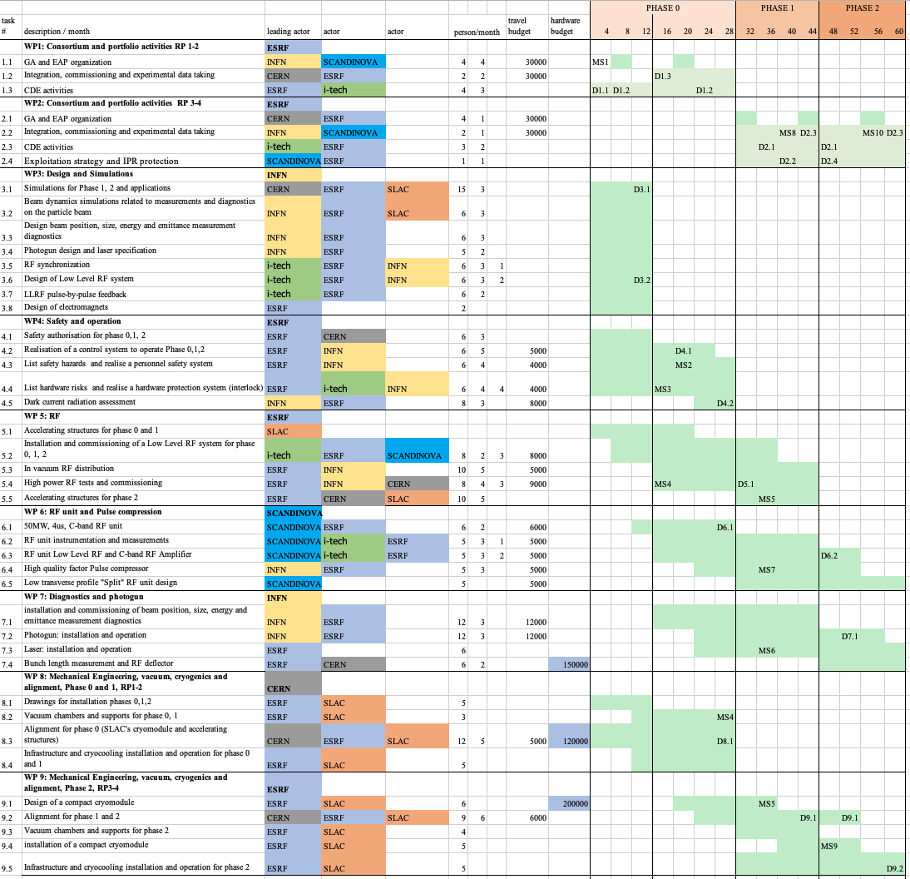
rough draft timeline f0r EIC proposal
T₀ could be October 2026
2% success rate in 2025
Lump sum = payment at each WP conclusion → WP must be staggered
Tasks and Budget FROZEN.
Only editing phase.
3 person/month spent to prepare this proposal
BENKEI company hired for 2x project review. Last review will take place in 24th April.
Includes: Alignment dummy cryomodule
Phase 2 cryomodule
planning linked to COLD project master planning
Could finance 4 additional HR for: Cryogenics, Laser, RF, Mechanical Engineering (phase 2 cryomodule)
T0=2026
Tend=2031

Slide 20
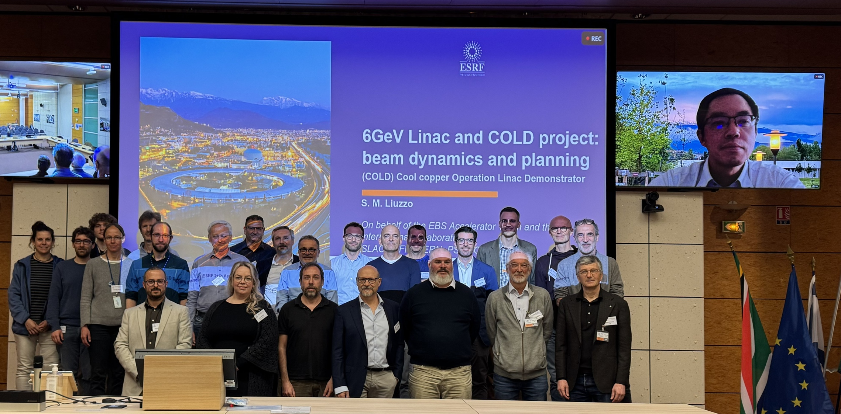
Review Panel 21st April
INFN, CORNELL
PSI
Partners, from remote
SLAC partners
CERN partners
Panel members: CERN, DESY, MAXIV, CEA

Slide 21
Feedback from Review Panel 21st April → aVAILABLE to MAC
Key recommendations (highlights):
Keep open for alternative 6GeV linac solutions (PWA, X-band, etc..)
Avoid placing too much effort on emittance optimization, no top-hat laser distribution
The development of a dummy cryomodule to test different systems to control the alignment at cold is essential for the project.
Establish strong partnerships with other laboratories that have that expertise. A key question that also has to be addressed is continued support and resources from the US partner lab.
Having a plan B for the delivery of the SLAC cryomodule should be secured in case funding changes occur for the US funded program, or in case of technical issues with the proposed four-quadrant assembly.
Properly vet the phase 0&1 project to ensure that the full budget is allocated.
Ensure that COLD diagnostics are capable of accurately measuring and characterizing the potentially shorter bunches then design (to control charge per bunch)
Explore energy tuning through adjustment of the pulse compressor fill timing
The proposed RF deflector for bunch length measurements seems excessive for the storage ring injection application. A simpler diagnostic setup based on a bending magnet and screen should be sufficient to characterize the longitudinal properties of beam.

Slide 22
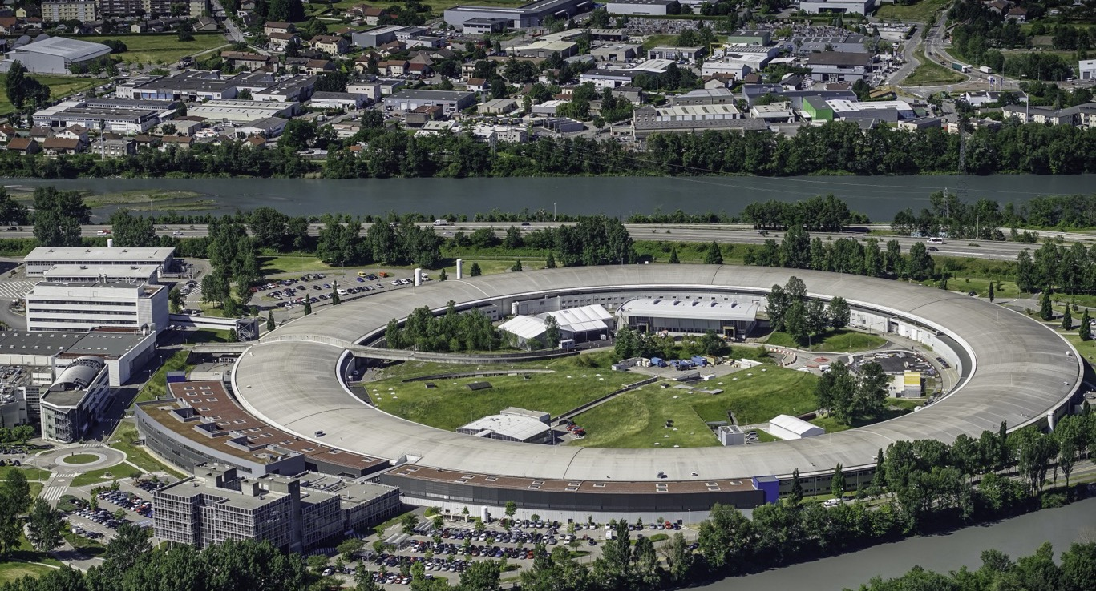
Many thanks for your attention
S.Liuzzo on behalf of the COLD project team:
A.D’Elia, P.Borowiec, V.Serriere, M.Dubrulle, M.Morati, S.White, F. Ewald, N.Benoist, K.Scheidt, B.Roche, C.Benabderrahmane, G. Le Bec, R.Bourtenbourg, J.-L. Pons, D. Martin, B. Pelissier, L.Eybert, T.Brochard, C.Maccarrone, J.-L. Revol, B.Joly, Y.Gouez, H. Pedroso Marques, P.Colomp, A.Dely, F.Falaise, David Frichet, Q.Qin
International collaborators
E.Nanni, A.Dhar, W.-H. Tan, G.Aymar (SLAC),
A.Latina (CERN),
D.Alesini, F.Cardelli, A.Giribono, C.Vaccarezza, G.Silvi (INFN-LNF),
M.Andorf, J.Maxson (Cornell),
P.Craievich, R.Zennaro (PSI)
6GeV Linac injector
Thank you for your attention!

