Slide 1

QCM Accelerator Structure
30 April 2026
Galen Aymar, Emilio Nanni, Andy Haase, Zenghai Li

Slide 2
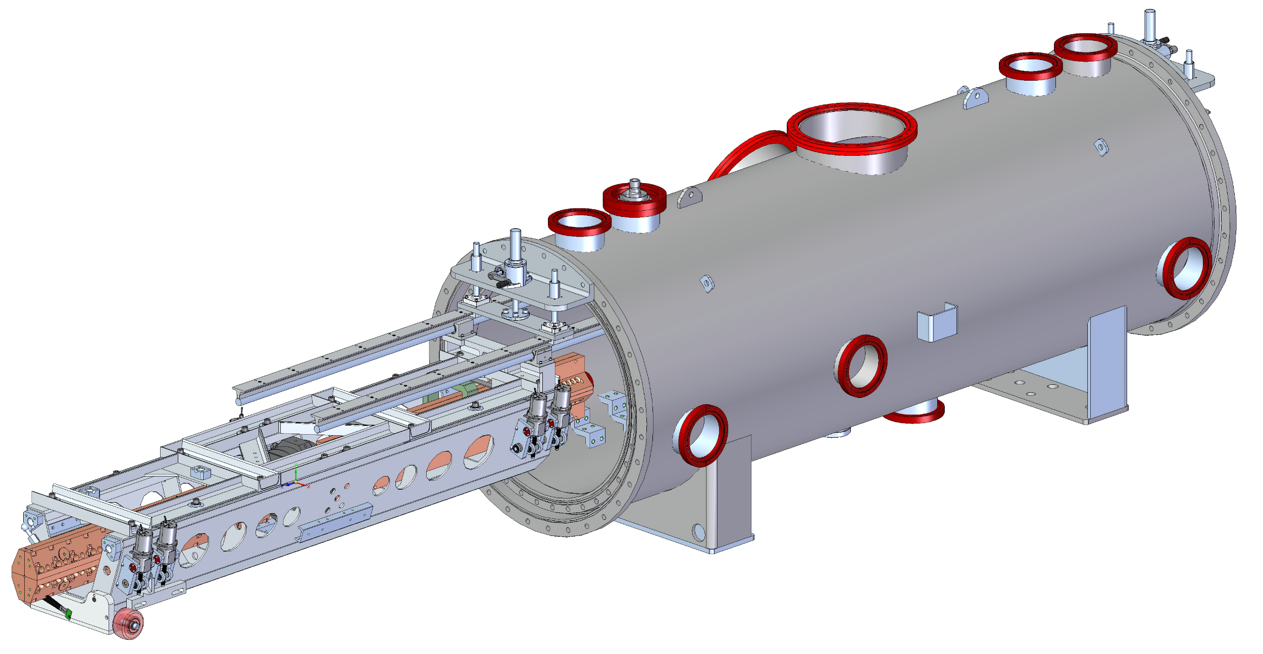
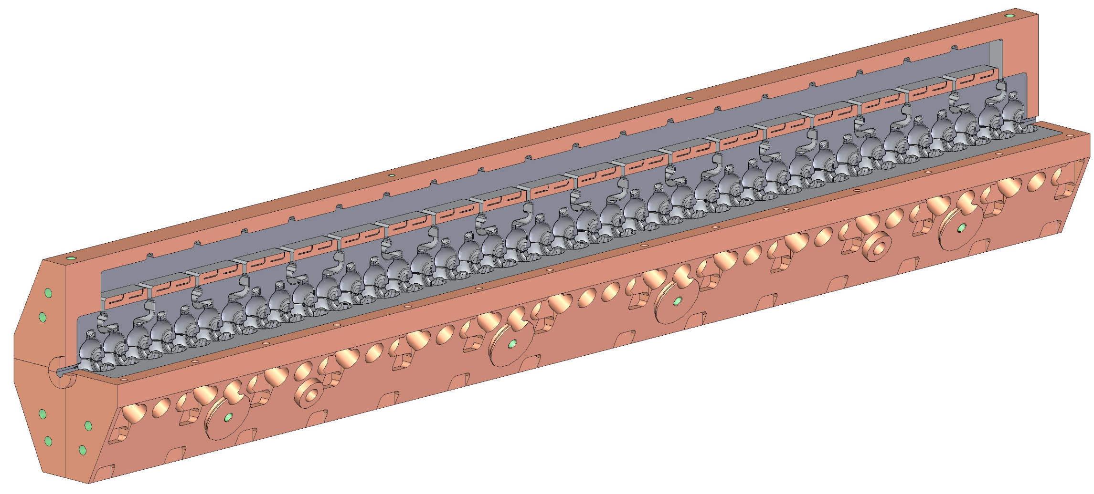
QCM Overview
VESSEL
QUADRUPOLE
ACCELERATOR STRUCTURE
INSTALLATION HARDWARE
RAFT
MOUNTS

Slide 3
Proposed Schedule
Mechanical assembly of the QCM to start by Nov 2026, allowing testing before shipment to ESRF by July 2027

Slide 4
Procurement Status
Long Lead Items
Accelerator Structure
Request for Proposal process completed via Sam.gov website – received 8 bids
A vendor has been identified and awarded the contract – waiting on their approval/signature (within days)
Lead time for the first set of parts is 28 weeks and for the complete two sets of parts is 34 weeks.
Receive at SLAC in November 2026
Cryomodule
Received at SLAC in 2025

Slide 5
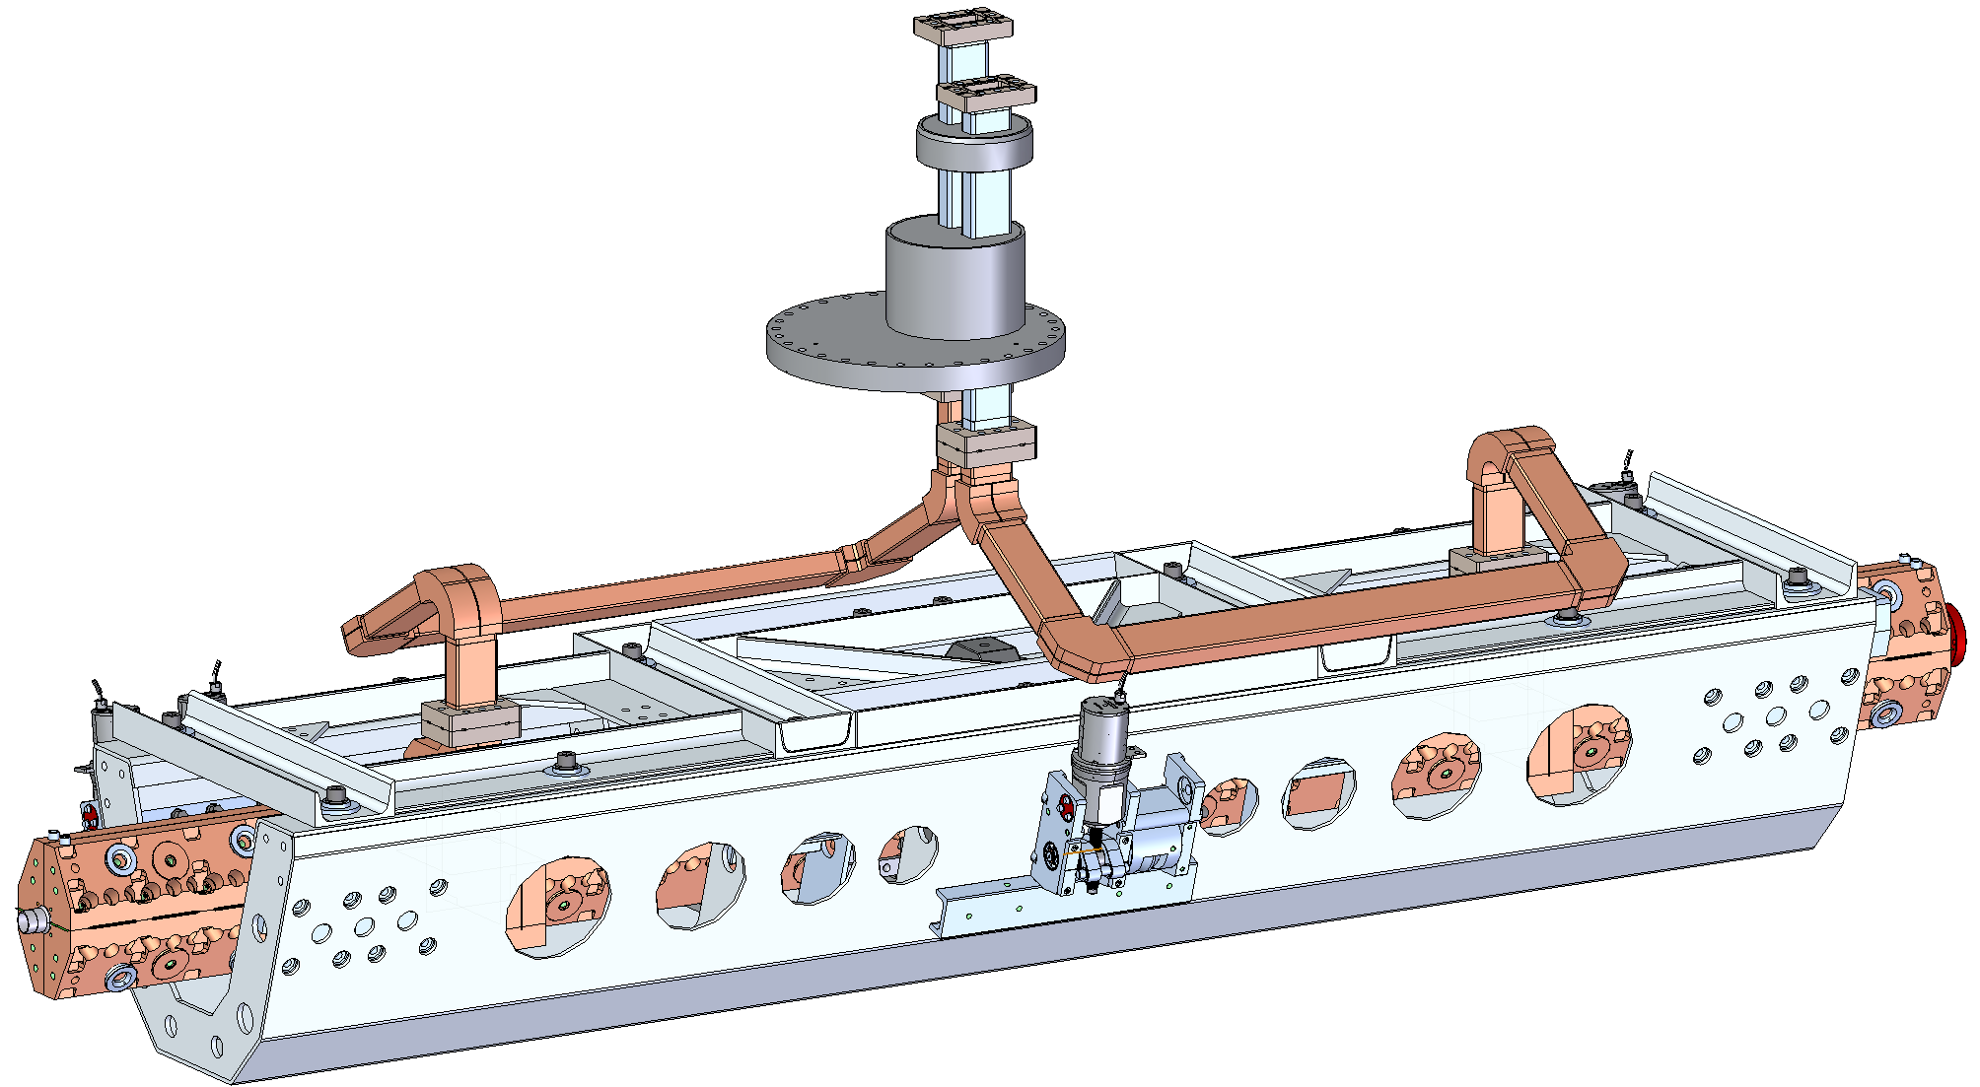
Design and Build Status – HPRF Waveguide
Feedthrough into the QCM is via stainless steel waveguides bolted externally and internally.
Internal waveguides are of copper and have an elongated path to make them flexible, allowing for mm-scale adjustments of the raft and accelerator while the feedthrough is fixed.

Slide 6
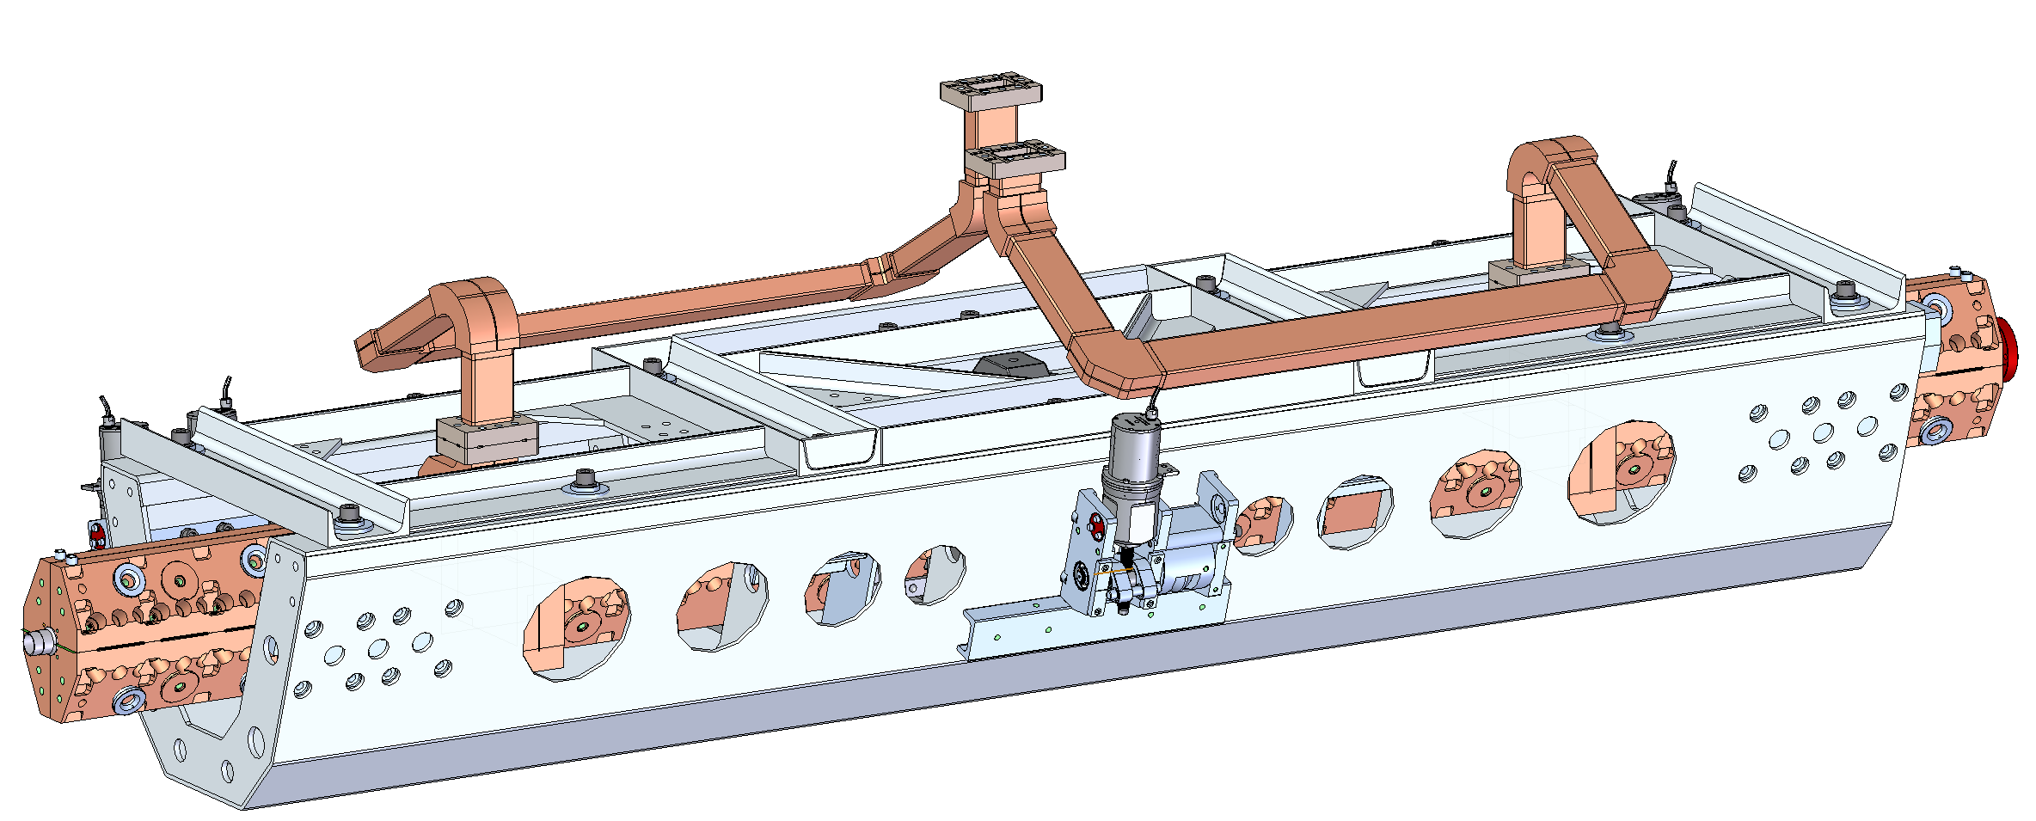
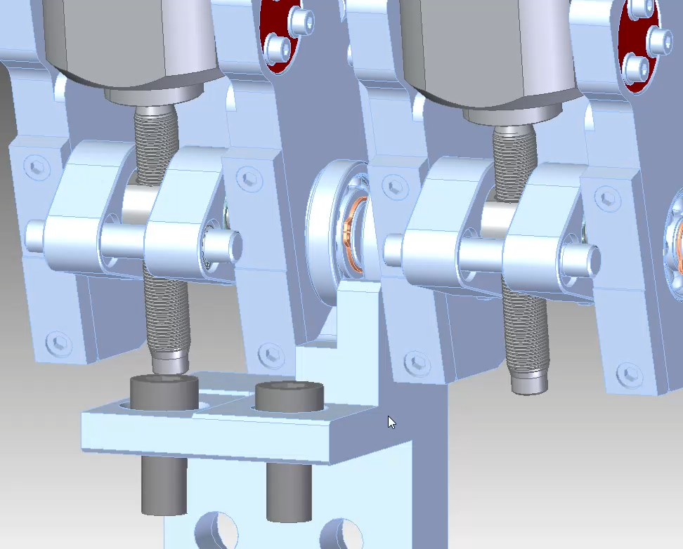
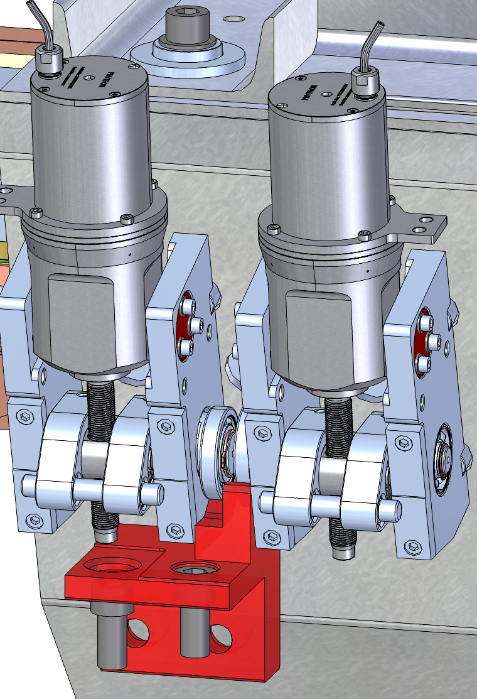
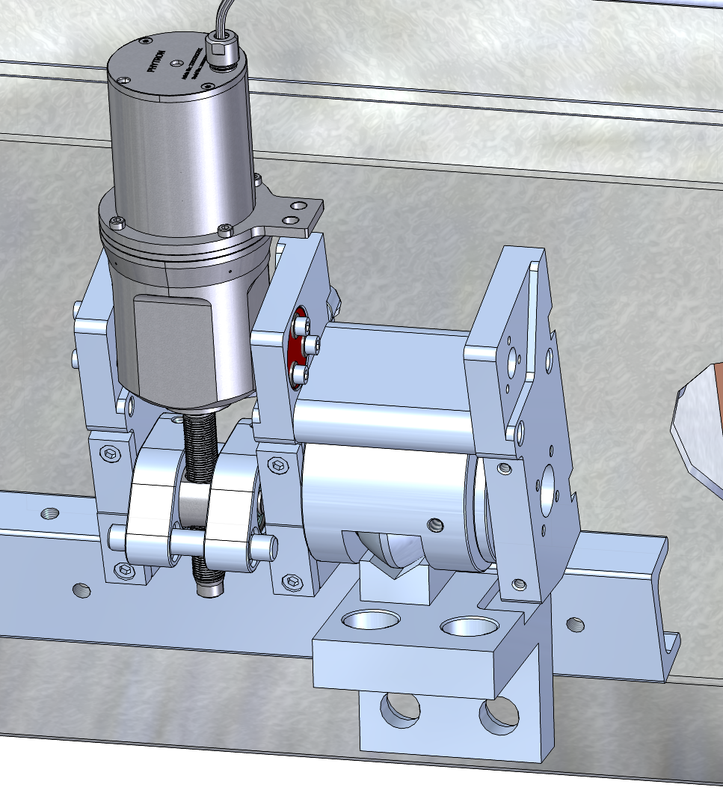
Design and Build Status – Mounts/Movers/Loaders
5 adjustable mounts for 5 degrees of freedom
Adjustable range is mm-scale, with the exact limits to be agreed upon with ESRF and then set by SLAC.
3
4
1
2
5
Animation showing various movements for one pair of movers

Slide 7
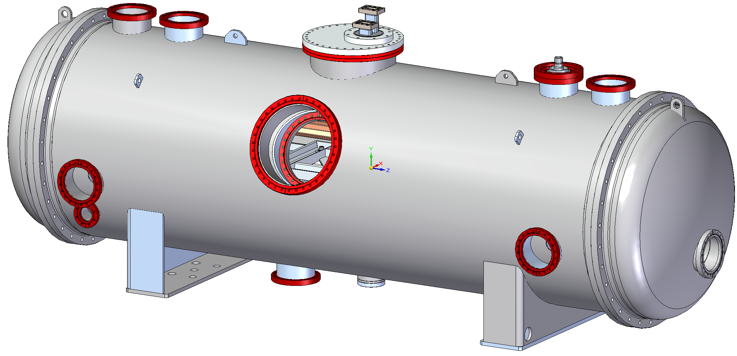
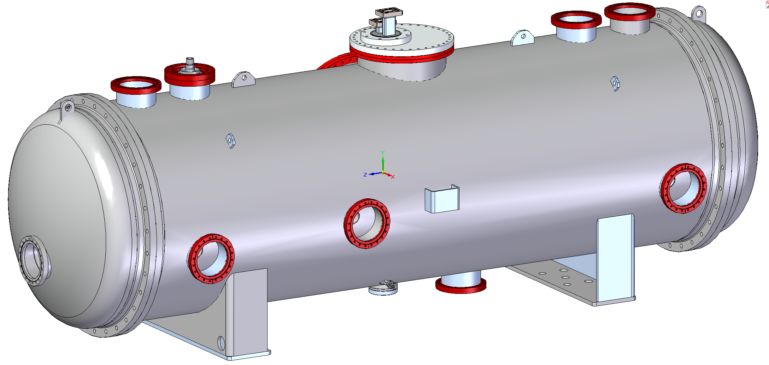
Design and Build Status - Feedthroughs
Proposed feedthrough locations
Instrumentation and N2 gas out
HPRF & Instrumentation
LN2 In
Service Hatch
Vacuum
Alignment/ unused
Alignment/ unused
Beamline
LN2 Drain
Mechanical Centering Pin

Slide 8
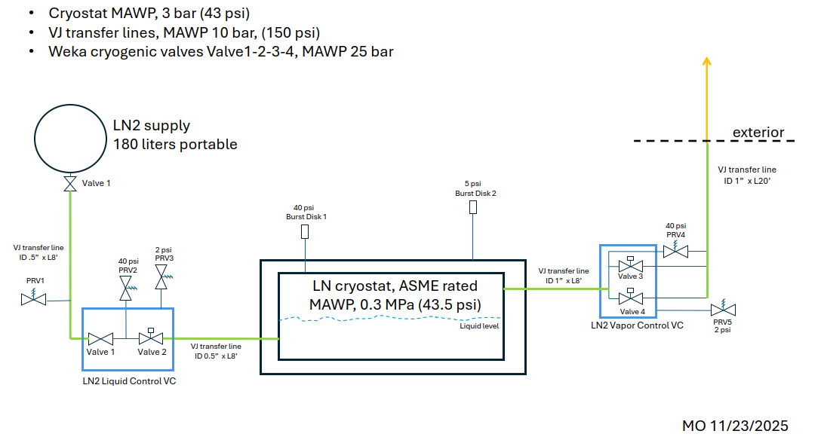
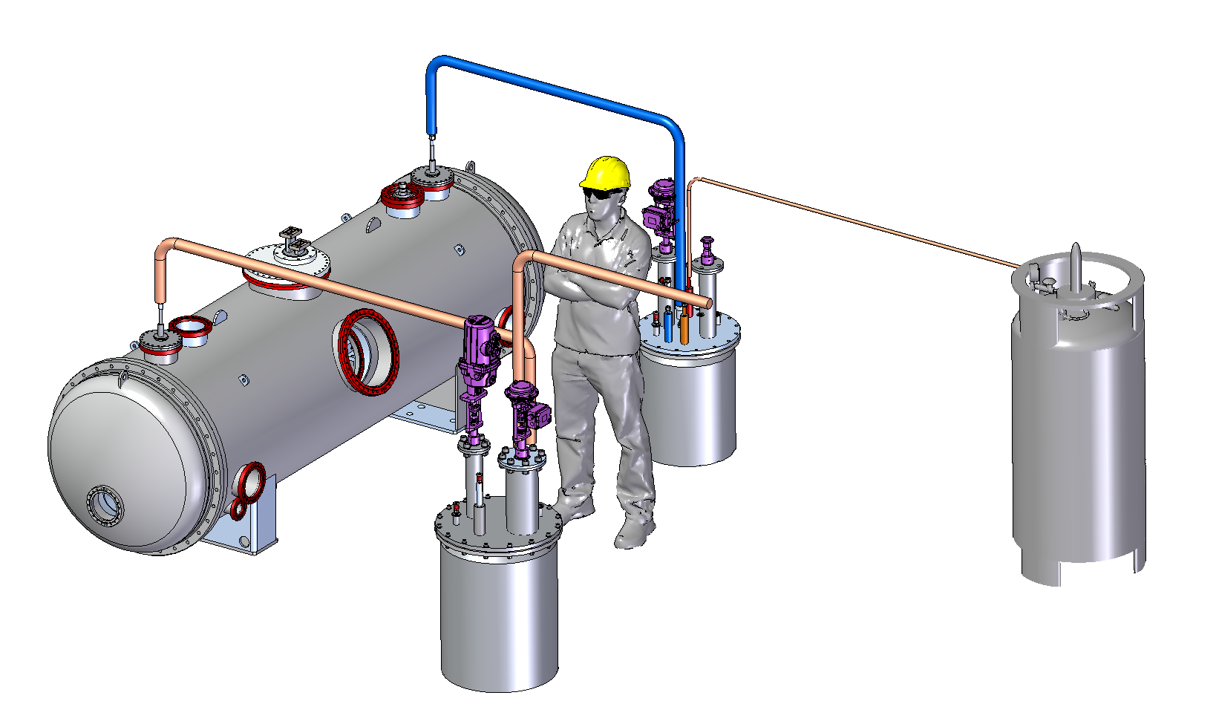
Design and Build Status – Cold Box/Fill Lines
Cold boxes designed to enable controlled filling/venting of cryomodule.
P&ID agreed upon with SLAC pressure vessel safety team.
Valves are already received at SLAC.
Half of the transfer lines and bayonets are received at SLAC, but will require additional components or modification.
Boxes and lids are still in design.

Slide 9
Conclusion

