Slide 1


Beam-Beam Activities at SLAC and LBNL
HFCC meeting, SLAC
Peter Kicsinyª, A. Formenti^{b}, S. Gessnerª, R. Lehe^{b}, C. Muntingª, J. Parkª, J.-L. Vay^{b}
February 12, 2026
ªSLAC National Accelerator Laboratory & Stanford University
^{b}Lawrence Berkeley National Laboratory (LBNL)

Slide 2
Near-term goals (1 year or sooner)
Develop & benchmark FCC-ee relevant beam-beam features in WarpX
  Create tutorials
  Aim for rollout to HEP community ahead of US FCC Meeting at SLAC in September
Couple WarpX with:
  Beam dynamics codes for multi-turn particle tracking (Xsuite, ImpactX)
  Detector modeling to understand the effects of beam-induced-backgrounds

Slide 3
WarpX development
Crossing angle & Lorentz boost
Achieve high luminosity
Crab waist scheme
Get stable beams in multiturn tracking, potentially impacts beam background distribution
Beamstrahlung
Defines equilibrium dynamics, background for detectors, IR and detector design, heat load
Radiative Bhabha
Dominates beam lifetime, beam loss studies in arc
Elastic Bhabha
Used for luminosity calibration & measurement, beam loss studies in arc, IR and detector design
Incoherent pair creation
Background for detectors, IR and detector design
all features implemented, benchmarking in progress

Slide 4
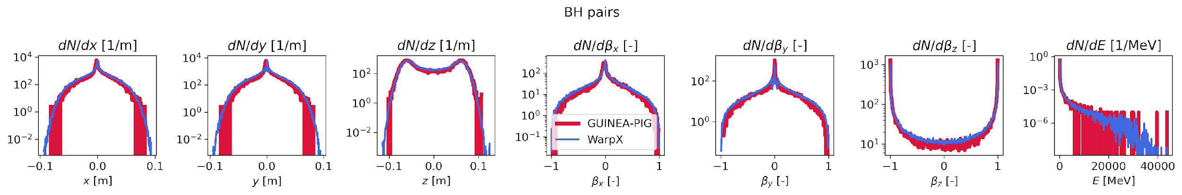
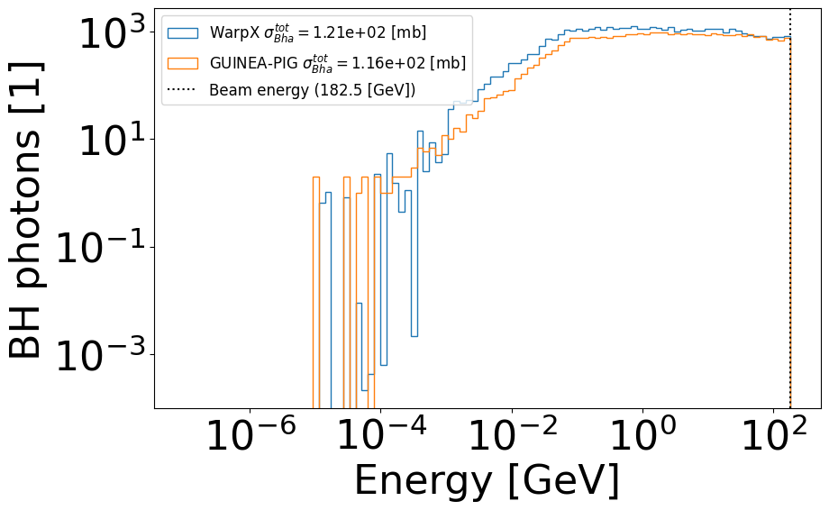
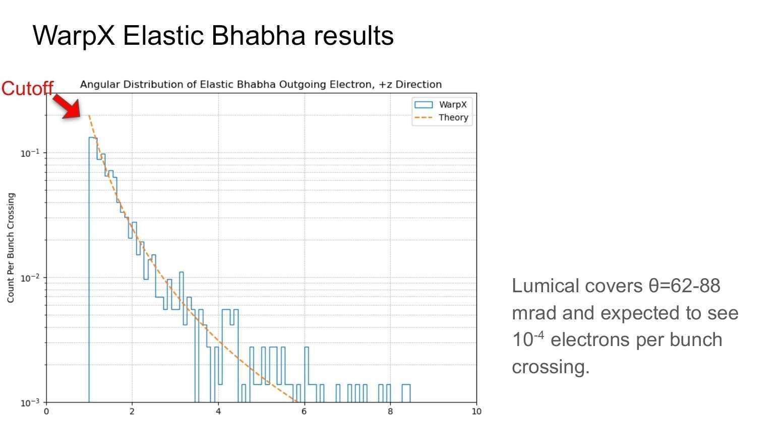
WarpX benchmarks / beam-beam backgrounds
Radiative Bhabha photons
Incoherent pairs
by A. Formenti
FCC-ee t
FCC-ee Z
Progress presented at:
      70th CERN MDI meeting
      https://indico.cern.ch/event/1600079/#3-beam-beam-simulations-in-war
9th FCC Physics Workshop
https://indico.cern.ch/event/1588696/timetable/?view=standard#48-warpx-a-massively-parallel
FCC-ee Z
by J. Park

Slide 5
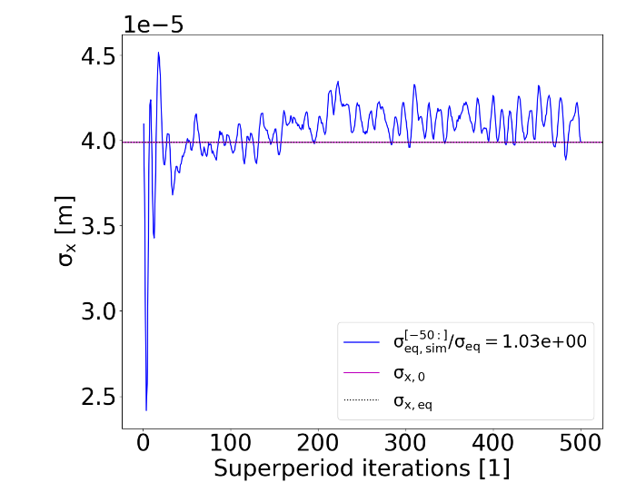
Coupling WarpX with beam dynamics codes
Xsuite (multiturn tracking): first workflow set up, optimization in progress
Usecase e.g.: https://proceedings.jacow.org/ipac2025/pdf/MOPM043.pdf
  Tutorials for users planned (priority)
ImpactX (multiturn tracking): considered
Detector codes (e.g. FLUKA, GEANT4): considered
Usecase e.g.: https://indico.jacow.org/event/75/contributions/7021/
WarpX IP + Xsuite arc

Slide 6
Mid-term goals (1-3 years)
Widespread community adoption (replace GUINEA-PIG and CAIN)
Improve WarpX physics models e.g. beam size effect
Beam-beam studies (MDI, beam dynamics, lumical design)
Explore advanced algorithms (surrogates, autodifferentiable tracking)
WarpX benchmarks against LEP data

Slide 7
Summary
WarpX is on a promising way to become a fast & well documented alternative to GUINEA-PIG
FCC-ee beam-beam specific features implemented
Work in progress to set up first WarpX – Xsuite workflow, WarpX – ImpactX & WarpX - detector workflows are considered
Monthly beam-beam meetings for updates: https://conferences.lbl.gov/category/137
Mailing list:
https://groups.google.com/a/lbl.gov/g/warpx-beam-beam

Slide 8
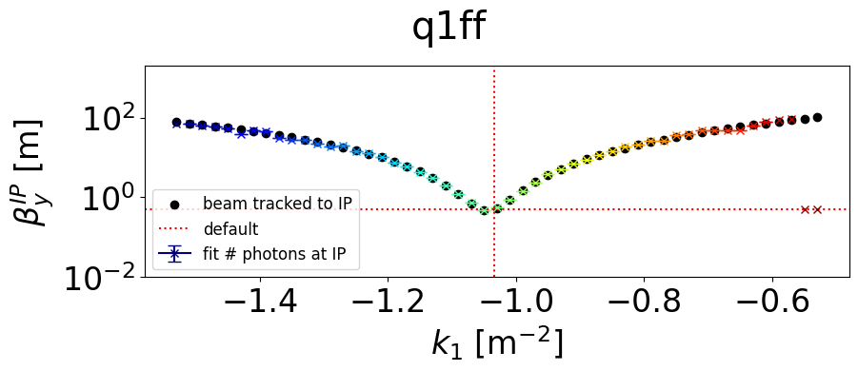
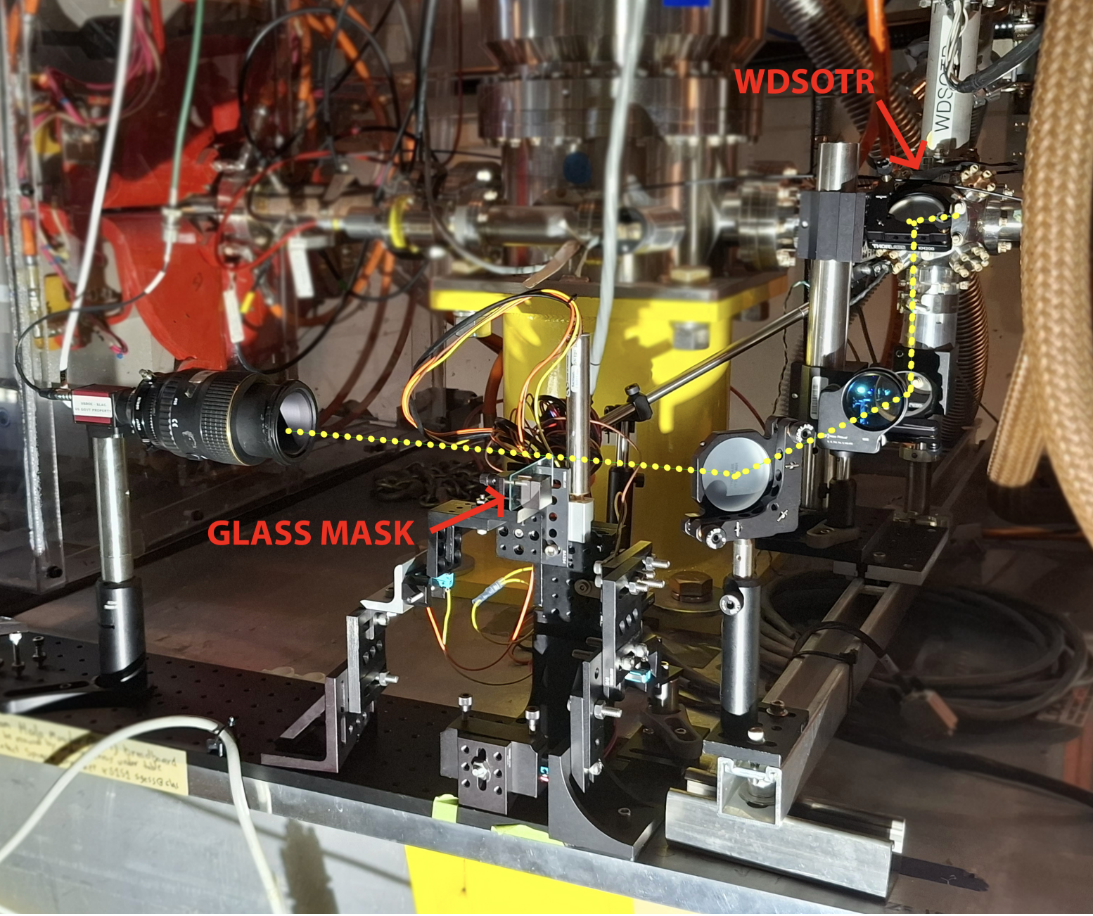
3. FACET-II as FCC-ee demonstrator
Laser control for bunch charge
https://proceedings.jacow.org/ipac2025/pdf/MOPM047.pdf
  Goal: high intensity bunch size measurement &
  population control through laser Compton scattering
  Simulations performed:
  scattered photons good proxy for bunch size
  Optics tuning measurements done &
  planned in coming months
Hollow laser beam collimation
https://arxiv.org/pdf/2601.19865
  Goal: collimate high intensity beams with laser
  Optics setup in progress (beam halo monitor)
  Measurements planned in coming months
Xsuite + CAIN simulation

