Slide 1

QCM Accelerator Update
10 February 2026
Galen Aymar

Slide 2
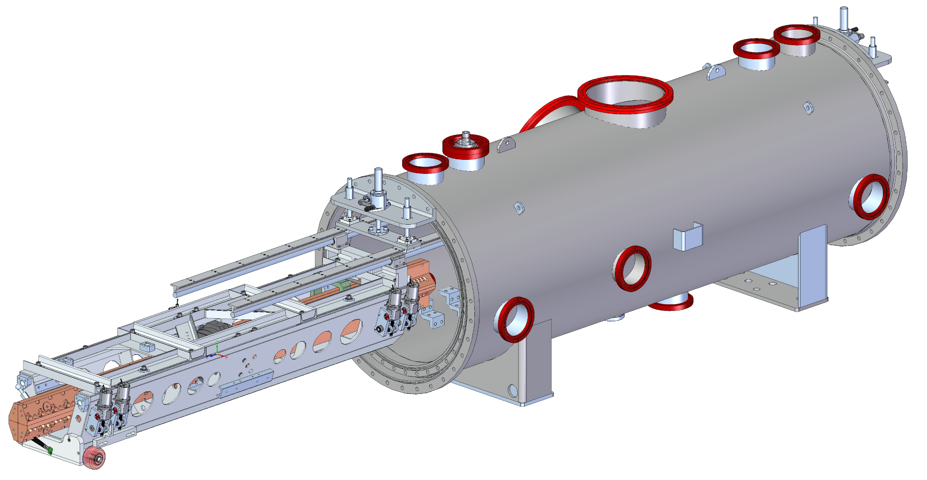
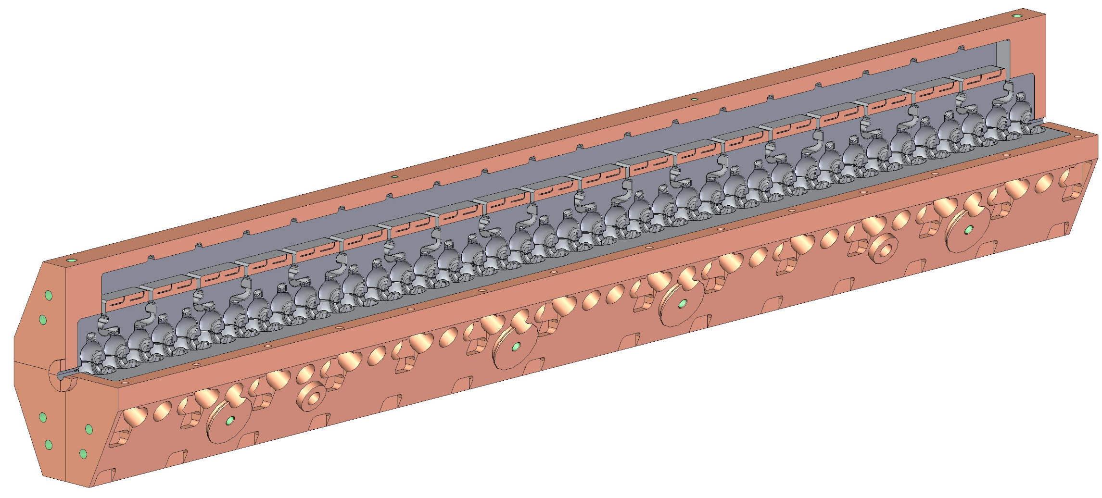
QCM Overview
Original goal: demonstrator for C³
Additional goal: provide QCM to ESRF for their linac upgrade
  The full C³ design works for ESRF, but ESRF has less stringent requirements
  ESRF’s schedule is to receive this QCM in June 2027
VESSEL
QUADRUPOLE
ACCELERATOR STRUCTURE
INSTALLATION HARDWARE
RAFT
MOUNTS

Slide 3
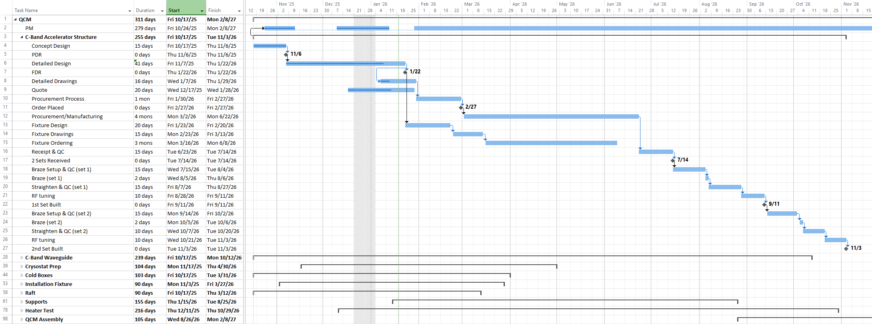
Proposed Schedule
Mechanical assembly of the QCM to start by Nov 2026, allowing testing before shipment to ESRF by June 2027

Slide 4
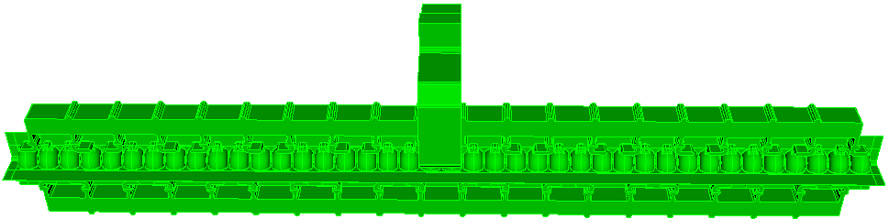
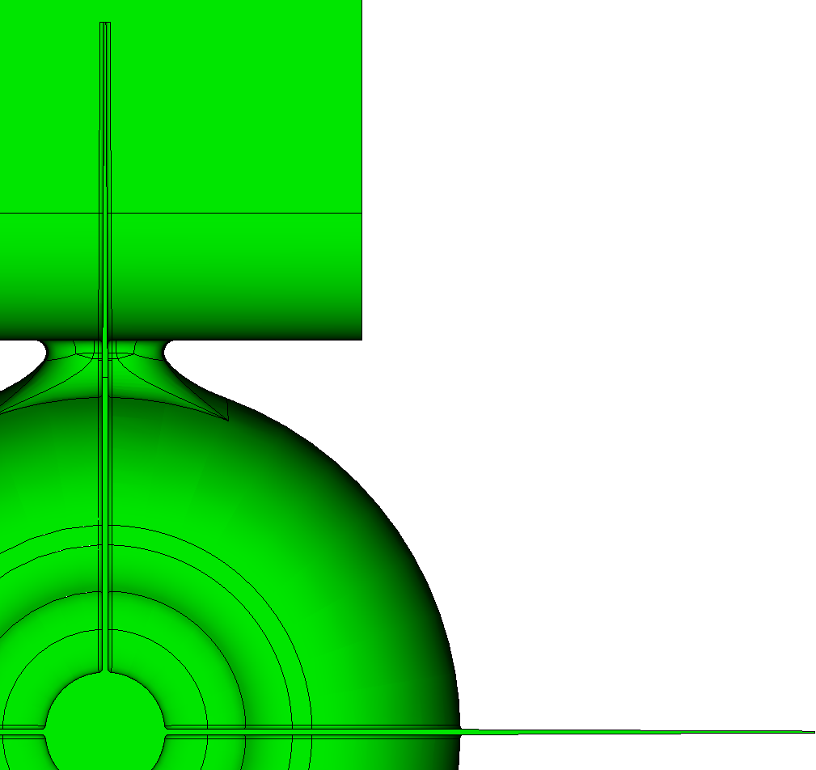
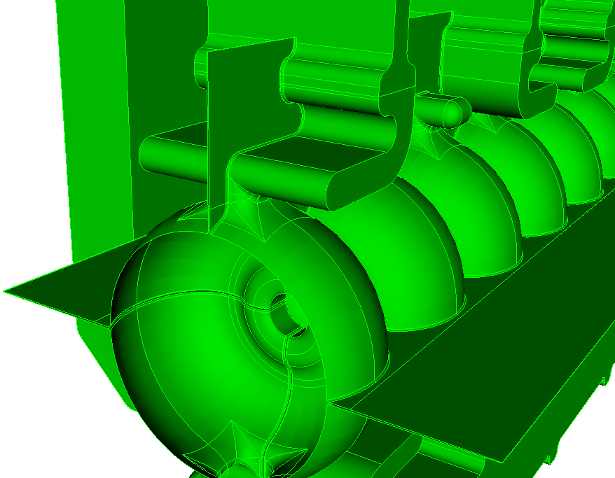
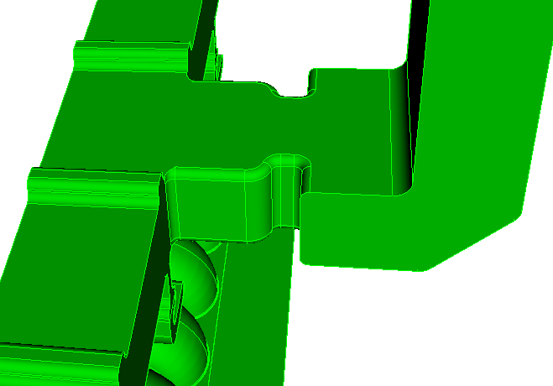
Final RF Geometry
Features
  40 cells with pair wise side to side distributed coupling
  Cell Balancing features
  4 damping slots extending to the beam center line (4 part open cells and iris)
  Structures to be spaced so that cell center to center distance is (N+.5)*26.242 at operating temperature
1-m structure: 40-cell with damping slots
0.3mm
0.1mm
R2mm
21.010 mm
0.25 mm rounding
42.020 mm
Damping slot
Waveguide corner rounding

Slide 5
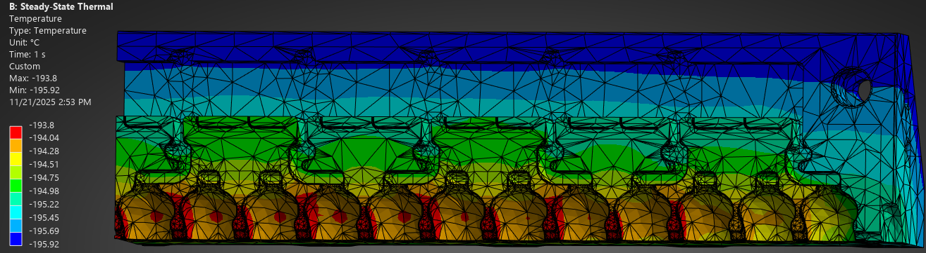
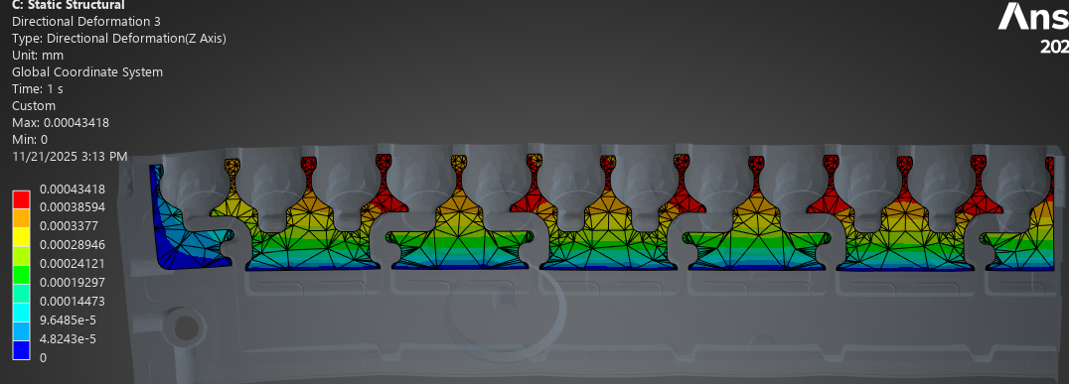
FEA: Pool Boiling Temperatures & Thermal Expansion
Case with no cooling at the tuner surfaces indicates inside temperatures at approximately 4° above the LN bulk temperature.
As this is “well below” the film transition temperature of ~10°, no modification of the tuning features is thought essential.
Distortion from RF heating and 3 atm pressure (Tref is cold)
Case without any tuner surface heat transfer
Displacement of less than .5µm is acceptable
Some tuning offsets to compensate for end effects may be incorporated.

Slide 6
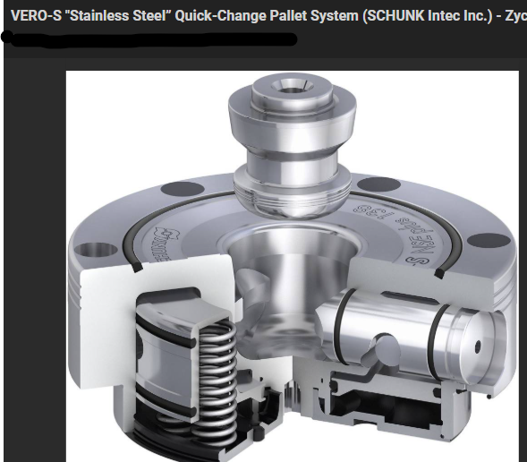
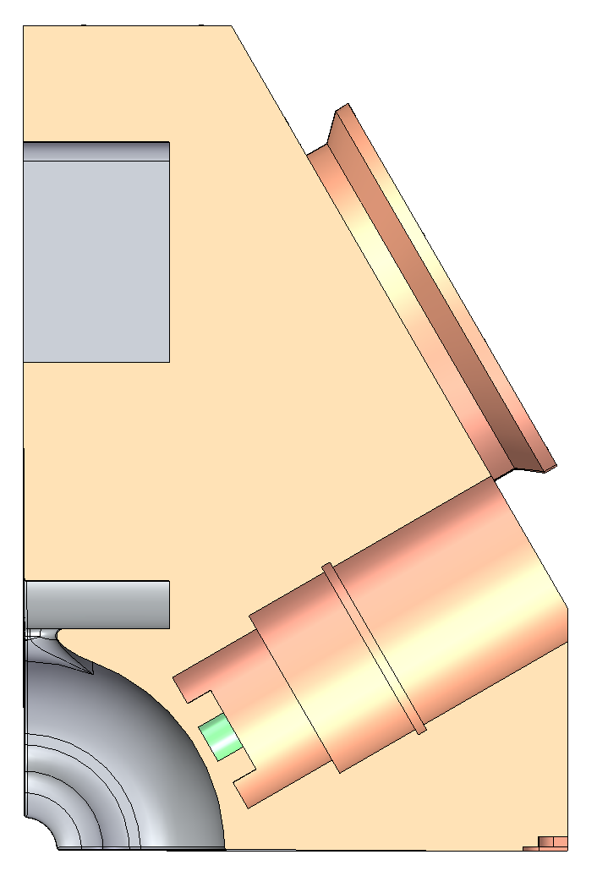
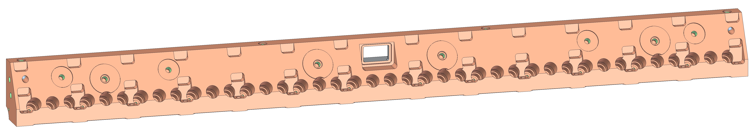
Mechanical Features - External
Mounts for Rasnik or laser nests
Alignment surfaces to be machined in one pass at the final step, checked/recorded
Part handling feature for machining – TBD by vendor
Mounts for struts to support raft
Cell tuners
Thru-holes for bolt clamping at braze
Braze clamping pads

Slide 7
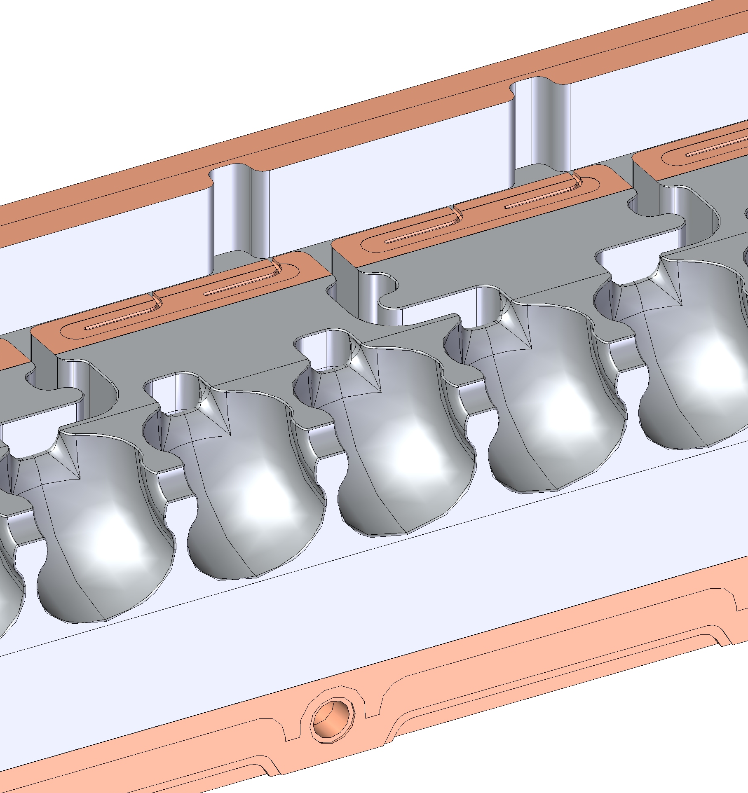
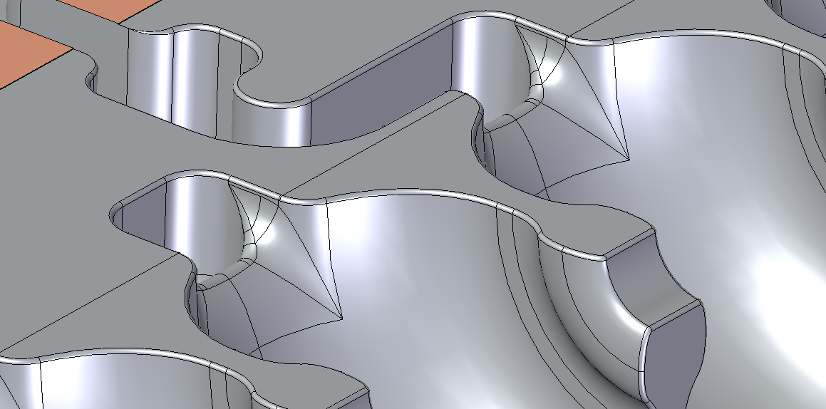
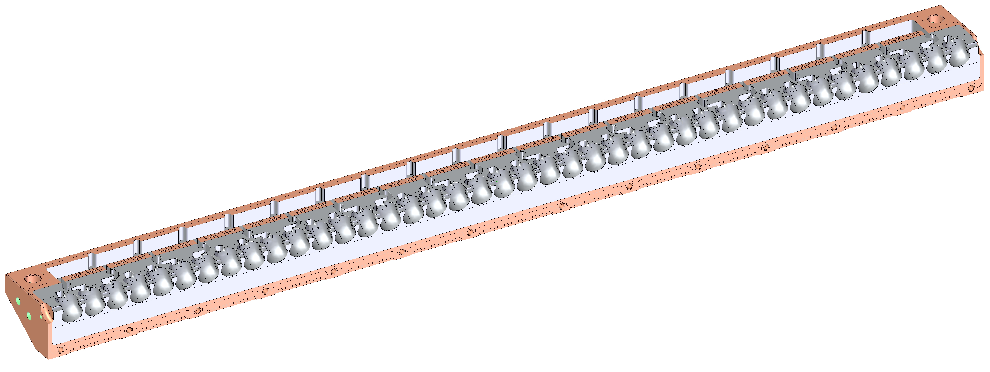
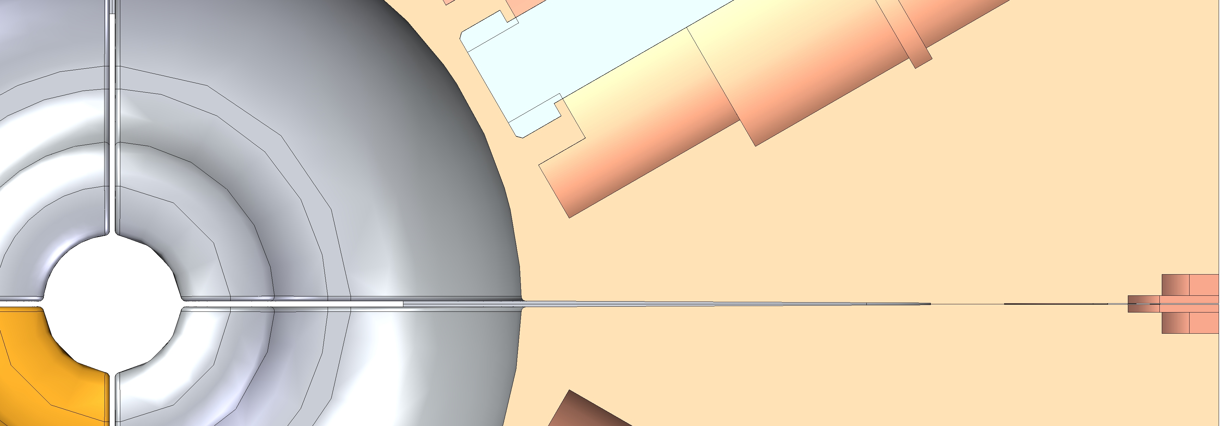
Mechanical Features - Internal
Damping slots
Internal radii around cells at split face
Waveguide feed
Braze surfaces
Cells and irises
R_{damping slot}
R_{cell}
R_{iris}

Slide 8
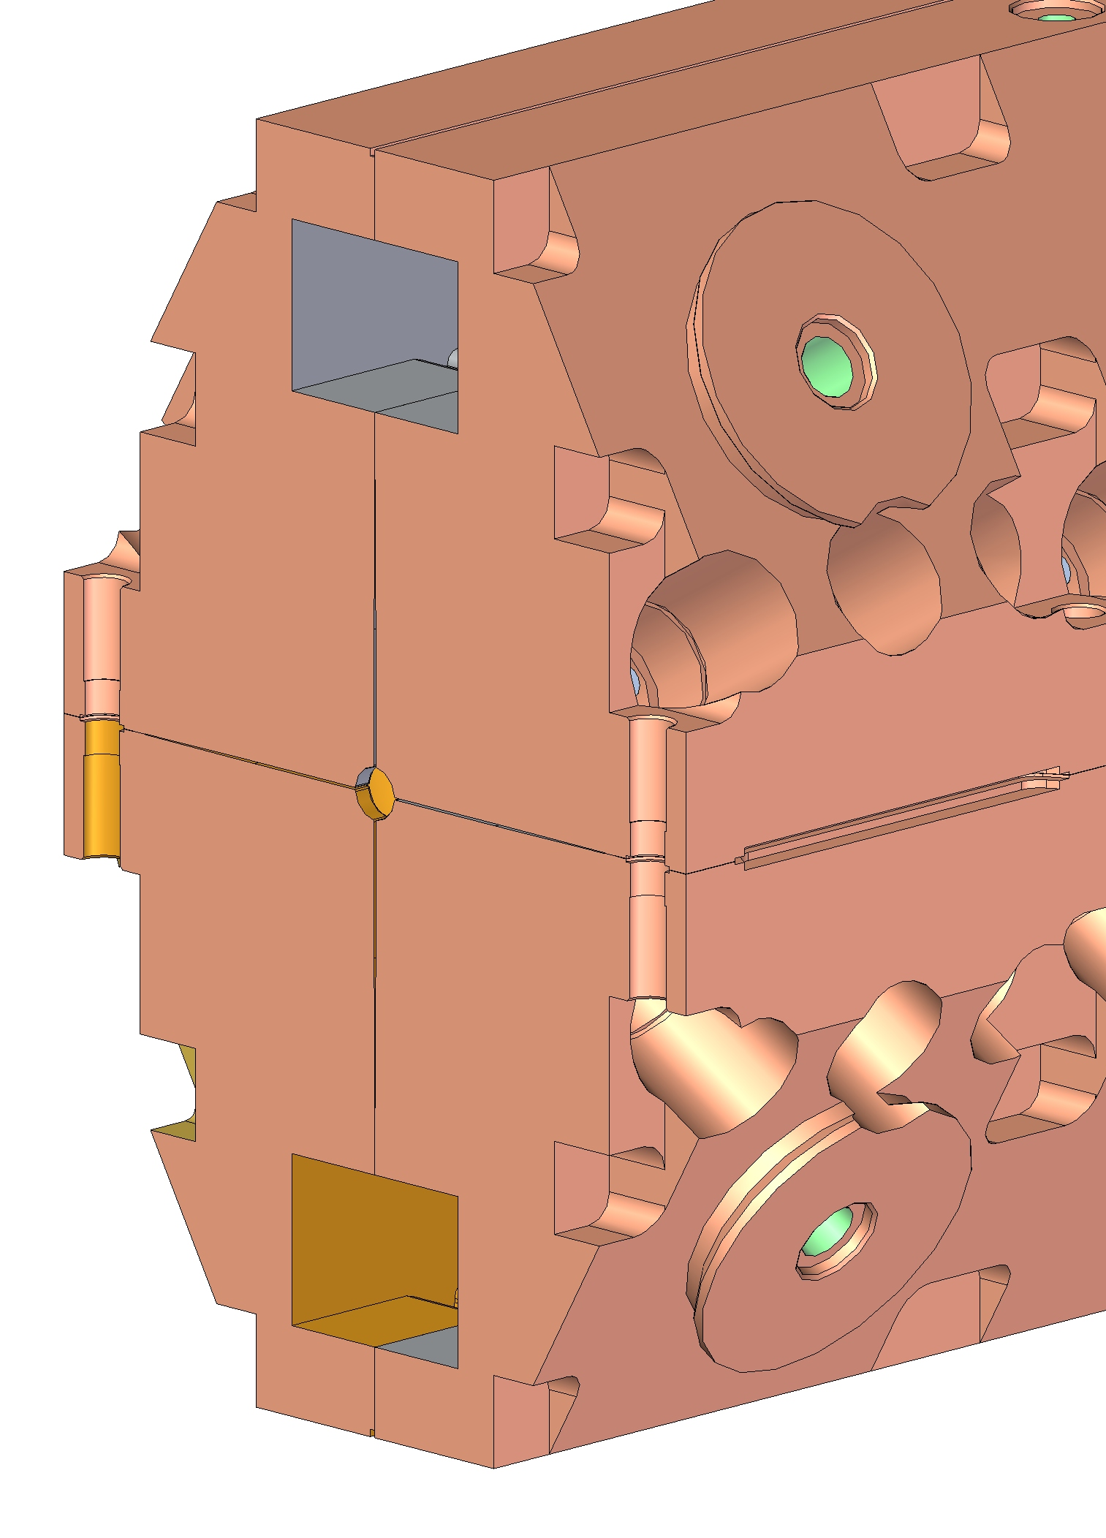
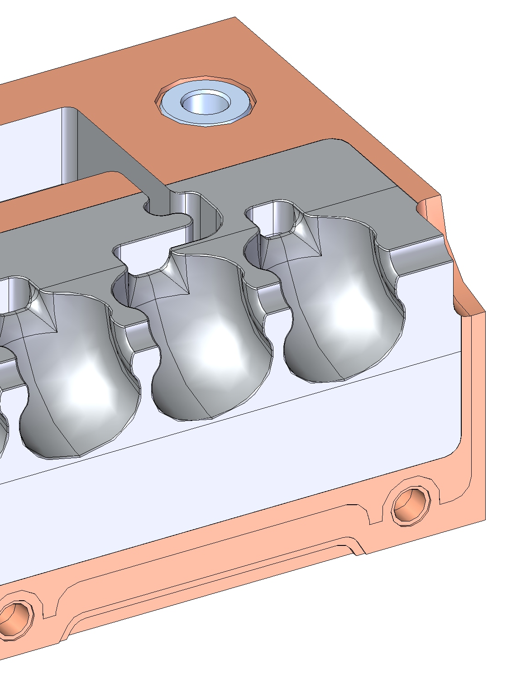
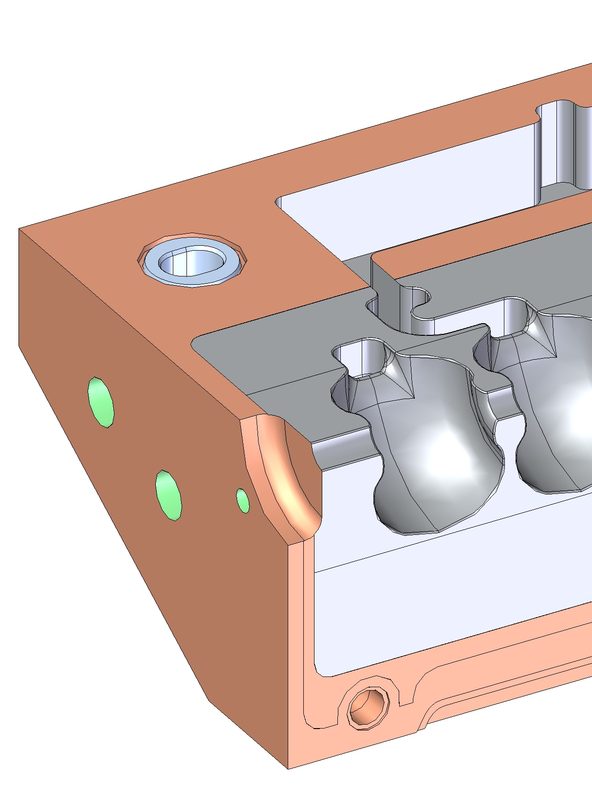
Braze Steps and Features
3 critical “perimeter” joints (2 vacuum, 1 mechanical)
During braze, the braze joints are held by external clamps and compression bolts.
At assembly, alignment is achieved with a pin and slot arrangement, using stainless steel inserts to prevent deformation of the hole and slot (Exterior flat surfaces may also be used)

Slide 9
Procurement
17 potential vendors have been contacted about manufacturing the machined copper quadrants.
9 have expressed a strong interest in the project.
A SLAC-internal procurement requisition is currently being routed for approvals and is expected to be posted to sam.gov for bidding in the coming weeks.

Slide 10
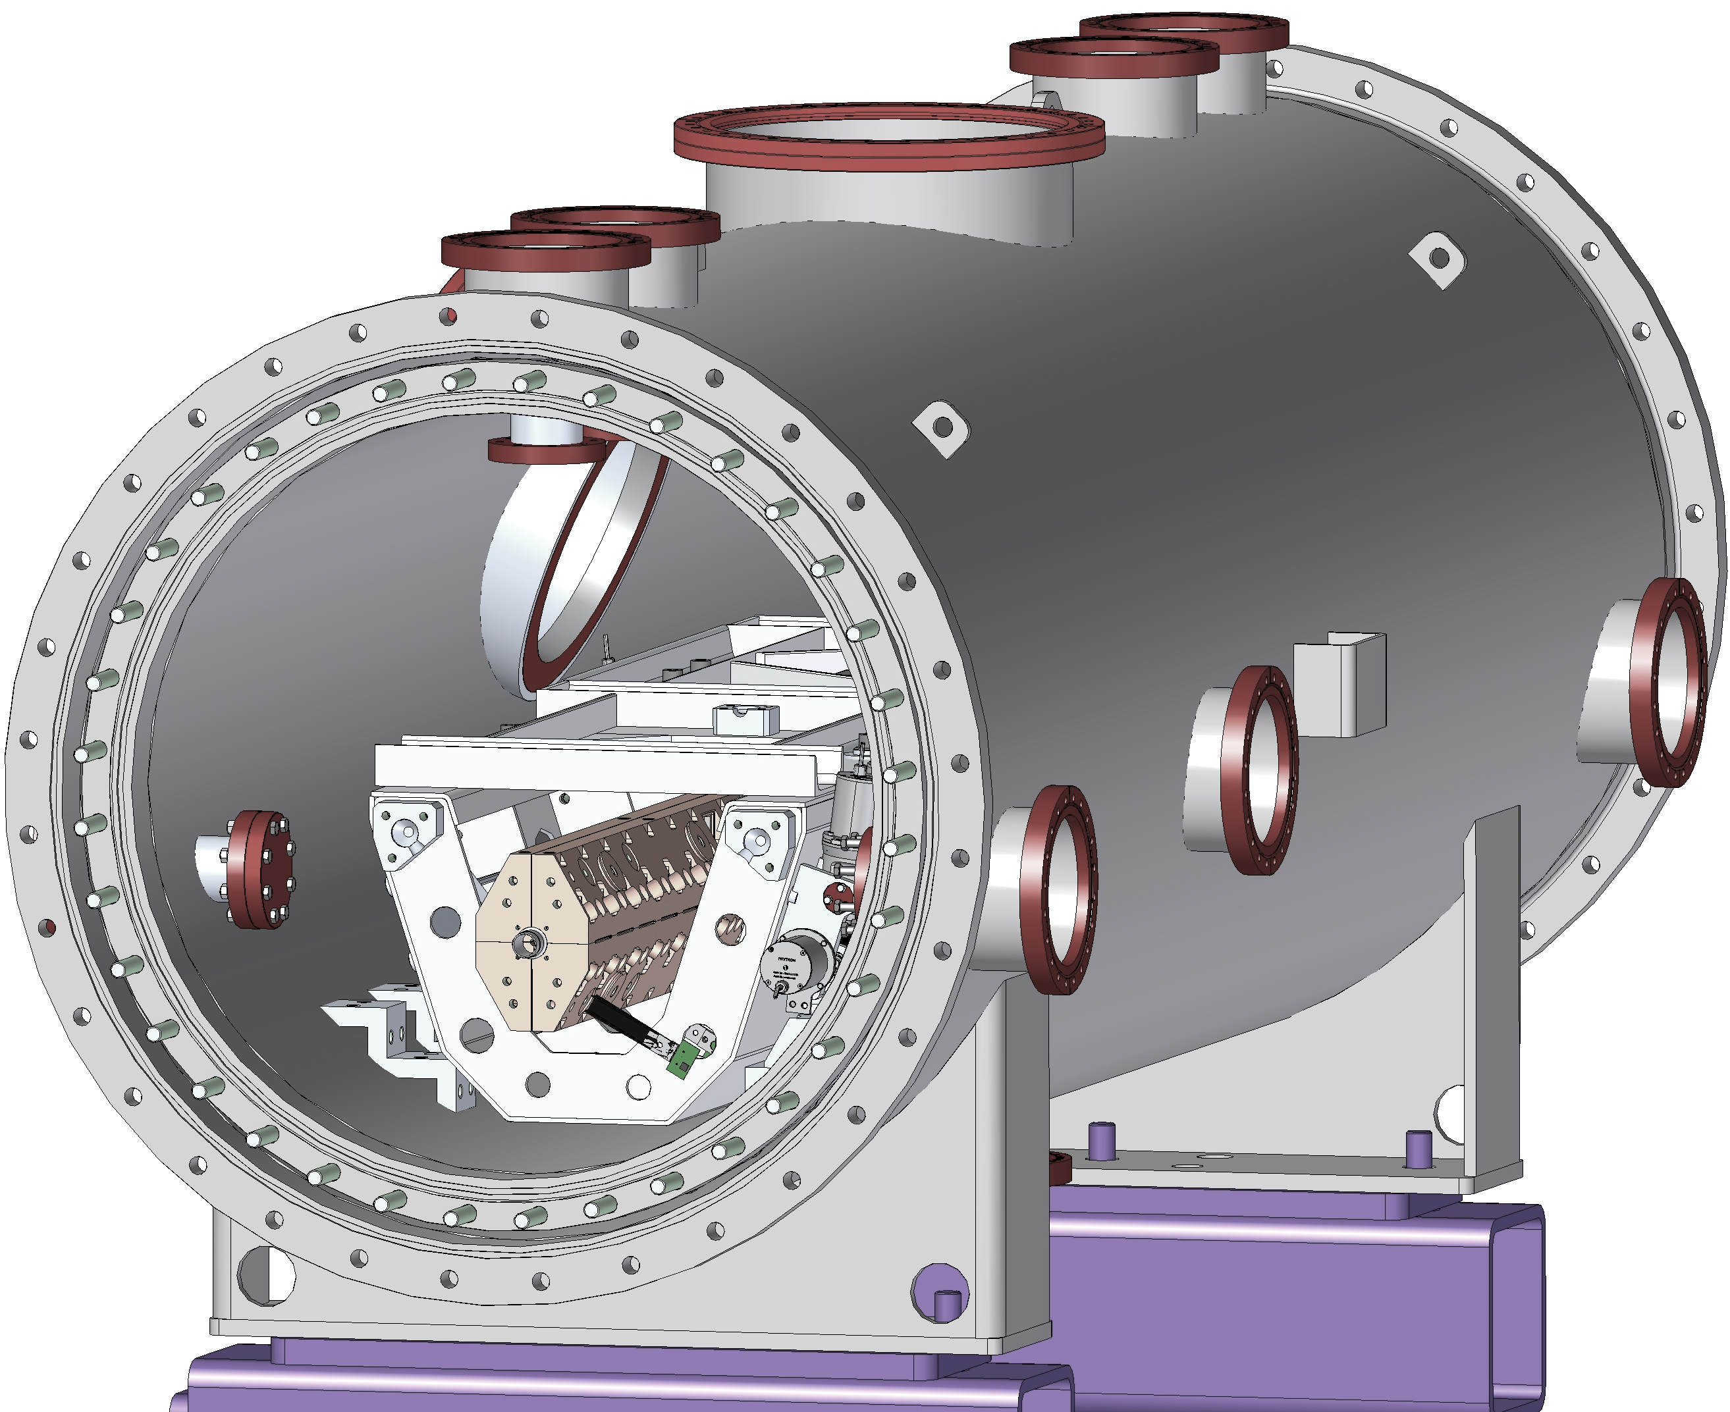
Mechanical Features – Alignment and Fiducials
C3 requires: Very high precision structures, quad on piezo 5 DOF stage, raft with 5 DOF stepper adjustment, Rasnik alignment feedback, beam position monitor.
ESRF needs: Precision alignment of the structures in the QCM to the machine coordinates (beam tunnel/mating components) and a means of verification/adjustment.
Option 1:
  CMM alignment of accelerators to laser nests on the raft
  Laser alignment of laser nests on the raft to laser nests on the QCM external face
  Survey QCM external lasers nests for alignment at ESRF
Option 2:
  CMM alignment of beam tunnel to laser nests on the structure (visible through view ports)
  Calibration of laser nests on structure through windows and LN2 (discuss with SLAC/ESRF alignment teams)
  Survey laser nests on structure to do alignment at ESRF

Slide 11
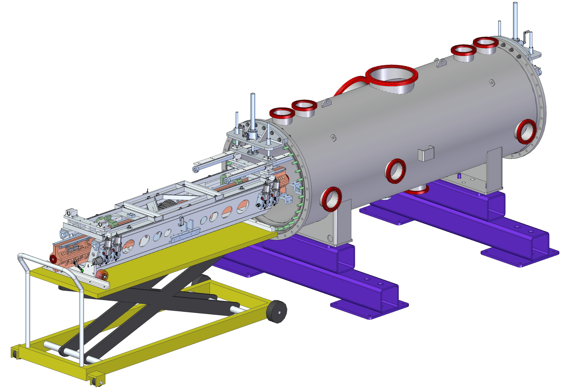
QCM Accelerator Installation Fixture
Entire structure (raft with two accelerator structures) is installed into the QCM from one end riding on vertically adjustable shafts.

