Slide 1
Introduction to the projects
SLAC Summer Institute
August 2026
Chelsea Bartram, Jenny Smith, Zoe Smith, Caitlyn Stone-Whitehead

Slide 2
Three projects over the course of the week!
Project #1:
Develop a better understanding of Josephson junctions as a building block of quantum circuits
Use simulation software to build quantum circuits and understand their properties
Project #2:
Simulating phonon propagation and quasiparticle response, and analyzing the results using G4CMP.
Project #3:
SMuRF demo, mult-device measurements using real fridge measurements

Slide 3
Project software

Slide 4
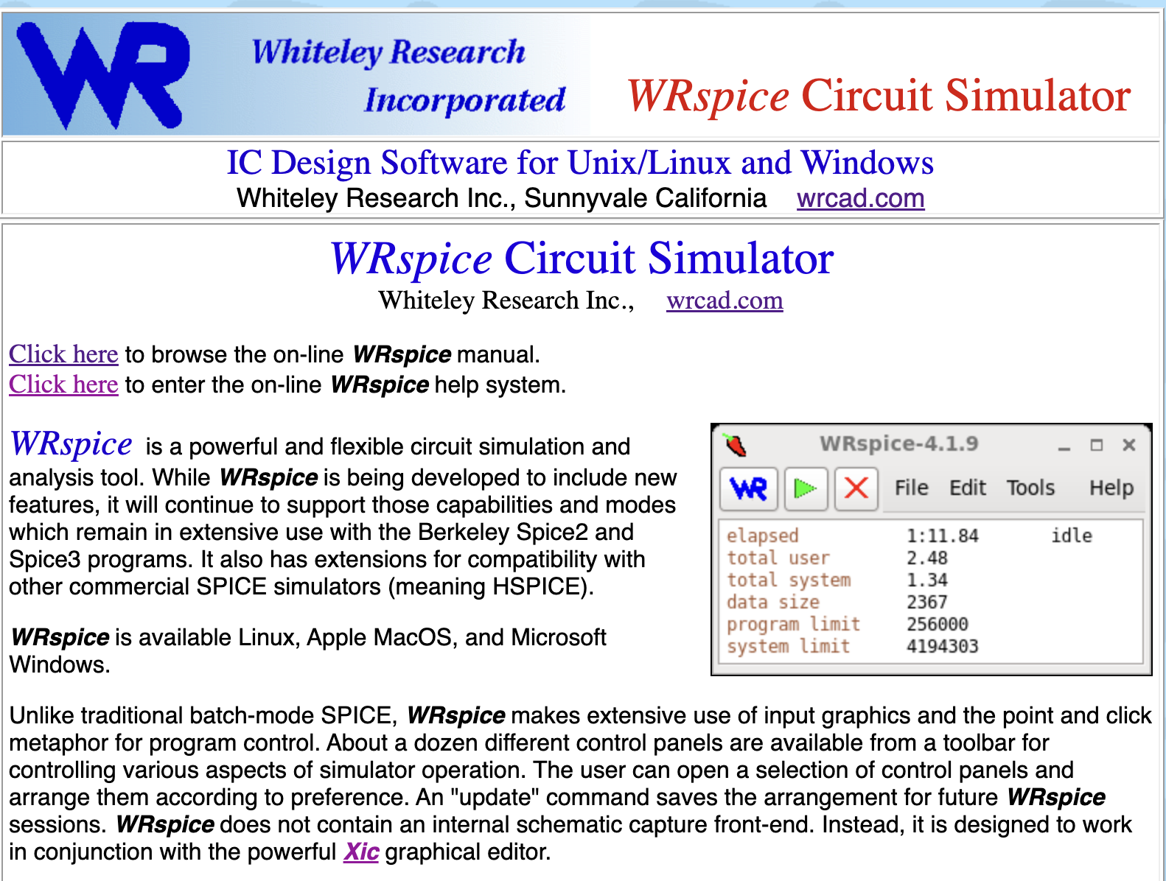
Project 1: WRSPICE Tutorial
Used for time domain or frequency simulations of quantum circuits
Specific capability to simulate Josephson junctions
Similar to SPICE
Good at simulating continuous wave amplifiers…SQUIDs, JPAs, TWPAs, etc

Slide 5
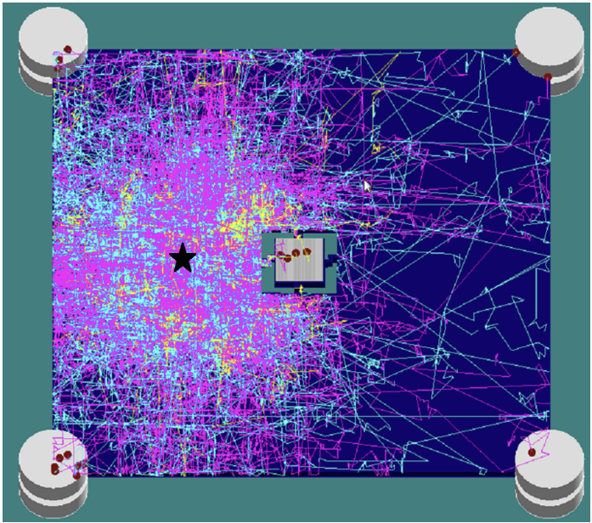

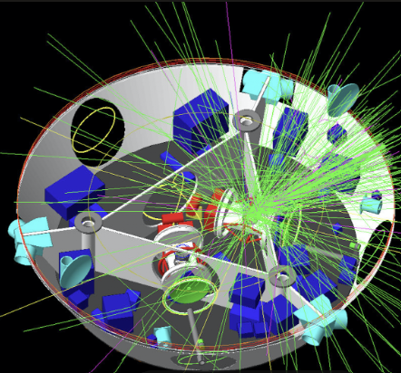

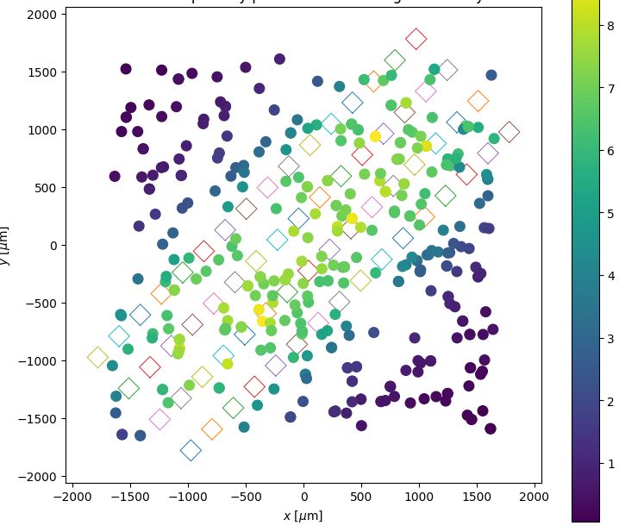
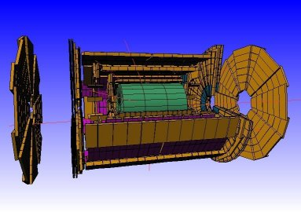
Project 2: G4CMP Tutorial
Phonon Mitigation
Shielding Studies
+
G4CMP: Condensed Matter Physics Simulation Using the Geant4 Toolkit
The reference C++ toolkit for HEP
Handles particle interactions with matter
Highly customizable for different geometries, sources and processes
Energy deposition excites phonons and charges OR phonons and quasiparticles
Phonons/QP/charges applicable processes
Applicable to < 1K temperatures
Collection Efficiency
Picture Gallery | geant4.web.cern.ch
ATLAS
Picture Gallery | geant4.web.cern.ch
Recent Developments in Geant4, J. Allison et al., Nucl. Instrum. Meth. A 835 (2016) 186-225
Geant4 Developments and Applications, J. Allison et al., IEEE Trans. Nucl. Sci. 53 (2006) 270-278
Geant4 - A Simulation Toolkit, S. Agostinelli et al., Nucl. Instrum. Meth. A 506 (2003) 250-303

Slide 6
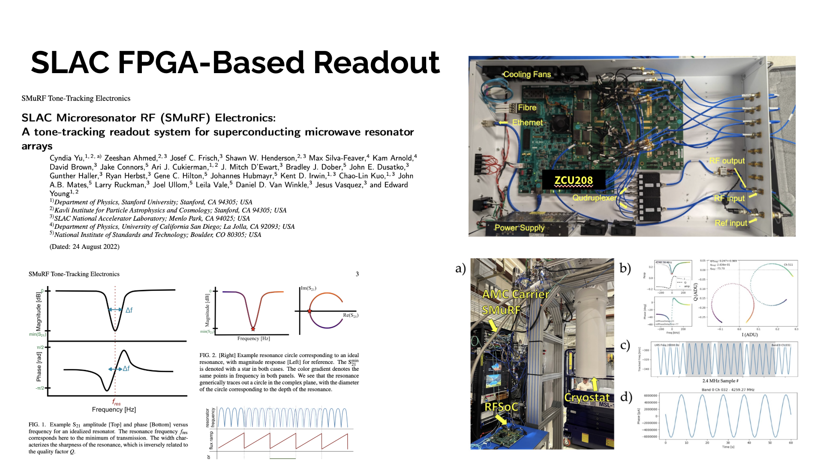
Project 3: SMURF
Picture Gallery | geant4.web.cern.ch

Slide 7
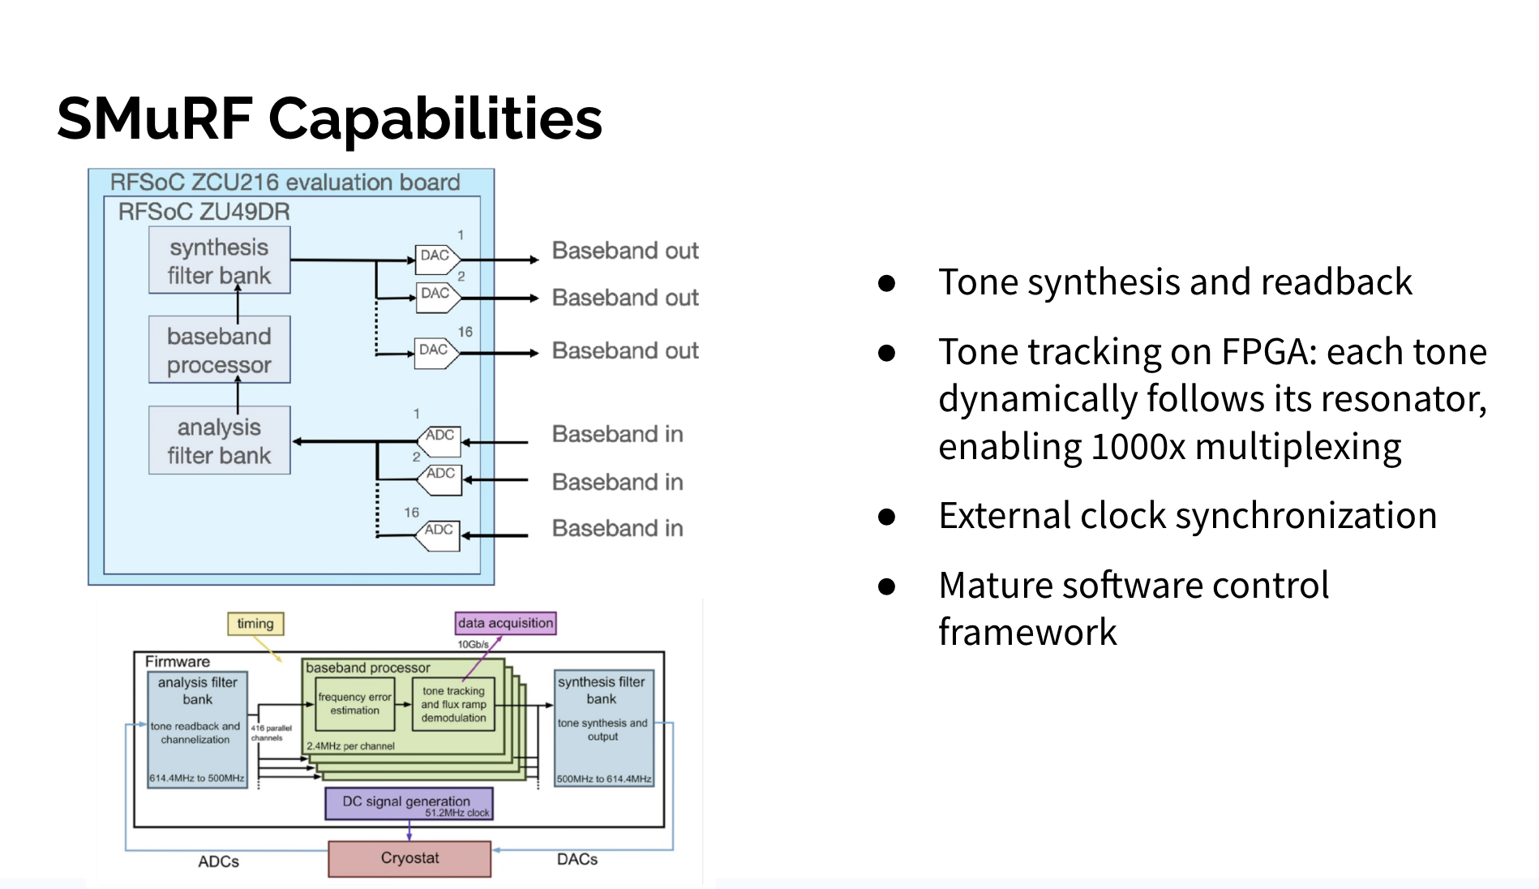
Project 3: SMURF
Picture Gallery | geant4.web.cern.ch

Slide 8
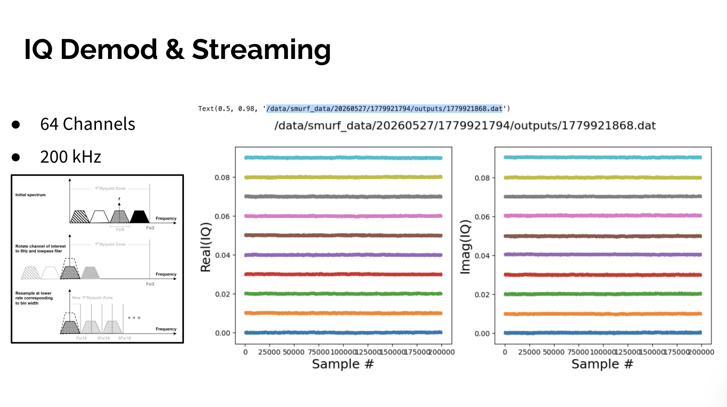
Project 3: SMURF

Slide 9
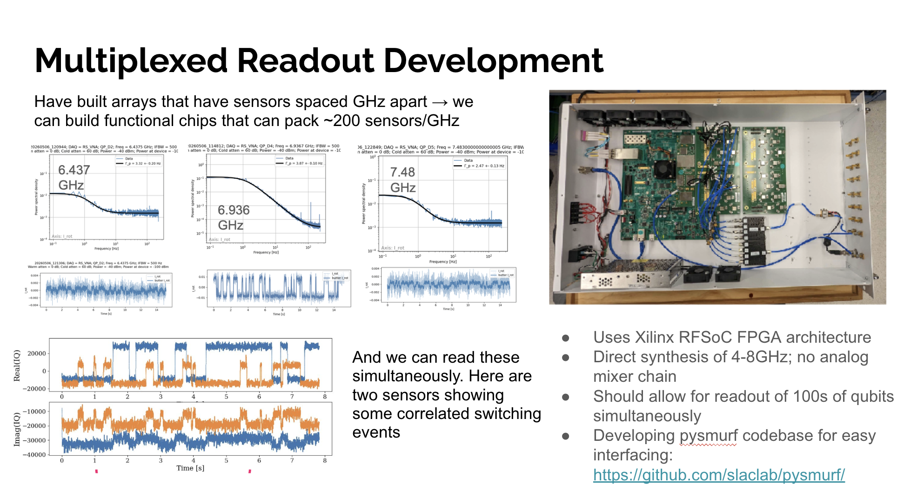
Project 3: SMURF

Slide 10
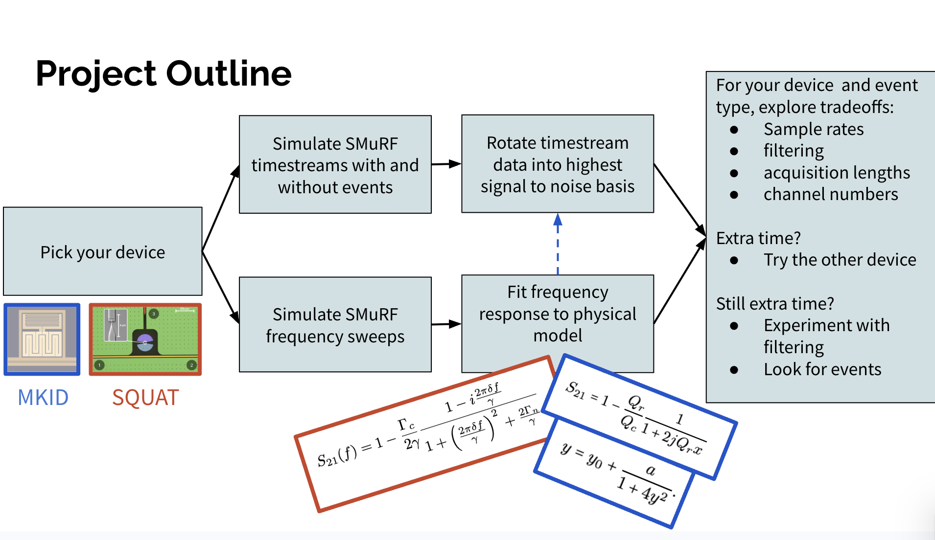
Project 3: SMURF

Slide 11
Introduction to Josephson Junctions
SLAC Summer Institute
August 2026
Chelsea Bartram, Andrew Yi, Stephen Kuenstner, Pam Stark

Slide 12
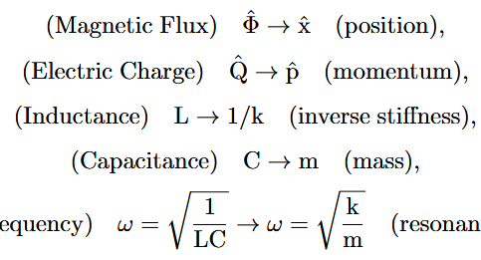
The Harmonic Oscillator
Motivation: we can use intuition from a simple harmonic oscillator to understand the behavior of LC circuits
A sprung mass oscillates by exchanging energy between kinetic and potential energy.
Adding Josephson junctions to LC circuits makes them anharmonic, tunable, and generally more interesting and useful.
Analogous quantities:

Slide 13
Circuit elements: the inductor
An inductor stores energy by creating a magnetic field when currents flow through it.
This will be our potential energy.
The potential is quadratic in the magnetic flux threading the inductor.
The inductance sets how much energy is stored per unit flux, just as the spring constant sets how much energy is stored per unit displacement
small inductor = stiff spring
large inductor = soft spring

Slide 14
Circuit elements: the capacitor
A capacitor stores energy by creating an electric field when it is charged.
In our LC circuit, the charge stored is proportional to the time derivative of the magnetic flux, so it can store kinetic energy.
The capacitance sets the inertia of the mass.
large capacitor = heavy mass
small capacitor = light mass

Slide 15
Circuit elements: the resistor
Resistors and other sources of dissipation play the role of friction, allowing energy to leak out of the circuit.
Resistors are typically undesirable, as they introduce noise and decoherence.
small resistor = less friction
large resistor = more friction

Slide 16
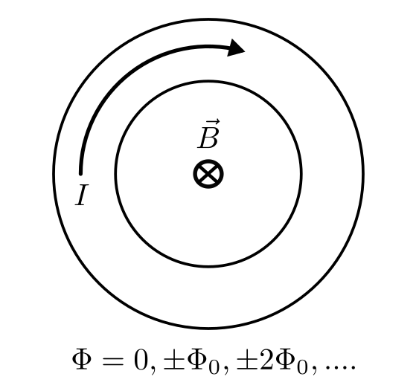
Superconductivity
Loop of superconducting material
Total phase around loop is 0 (mod 2π)
In a superconductor electrons pair up into Cooper pairs and become bosons.
The bosons condense into a macroscopically occupied state, which is described by an “order parameter”
This is essentially a quantum wavefunction, whose magnitude gives the Cooper pair density.
The order parameter has a phase which must be continuous around any superconducting loop, leading to quantization of magnetic flux!
Magnetic flux threading loop is quantized

Slide 17
The Josephson junction (finally)
Just like any quantum particle, Cooper pairs can tunnel through barriers where they would be classically forbidden.
A superconducting wire interrupted by a barrier is known as a Josephson junction (JJ).
The potential energy stored in a Josephson junction is a sinusoidal function of the phase difference across the barrier.
The behavior of a physical junction is well described by the resistively and capacitively shunted junction (RCSJ) model.
Magnetic flux quantum sets periodicity
Junction critical current sets tunneling energy

Slide 18
JJ use case #1: anharmonic oscillator
The potential wells in the washboard potential are strongly anharmonic: in addition to a parabolic term, they contain quartic and higher terms.
Thus, any circuit containing JJs is nonlinear.
This is useful because the energy levels of an anharmonic oscillator are not evenly spaced, which allows specific energy levels to be addressed.
Superconducting qubits use this principle to act as “artificial atoms”.
harmonic potential = linear inductance
true potential contains quartic and higher terms

Slide 19
JJ use case #2: tunable inductance
We can also use a Josephson junction with a tunable phase across them to act as tunable inductances.
Adding a phase offset changes the curvature, and thus the effective inductance, of the junction.
This can allow us to create frequency tunable circuits, e.g. rf SQUIDs.
Bottom of well: minimum inductance
Between wells: inductance diverges

Slide 20
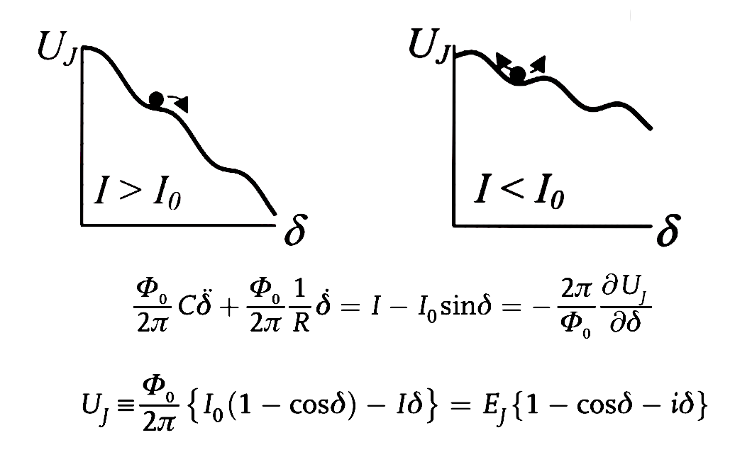
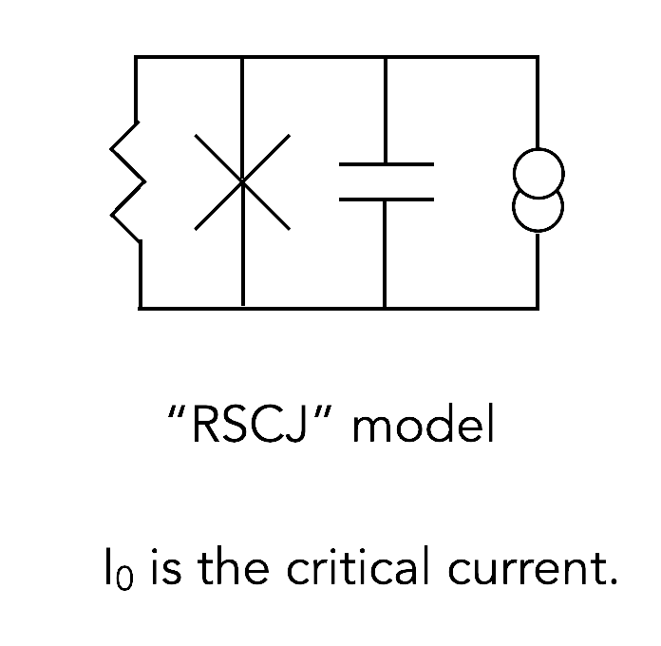
Josephson junction: summary
Washboard potential: critical current determines tilt

Slide 21
Continuous wave amplification

Slide 22
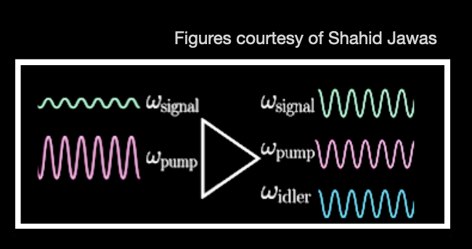
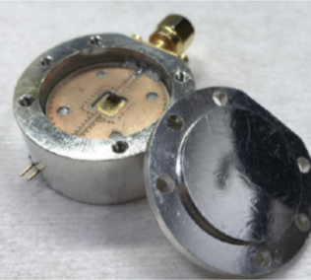

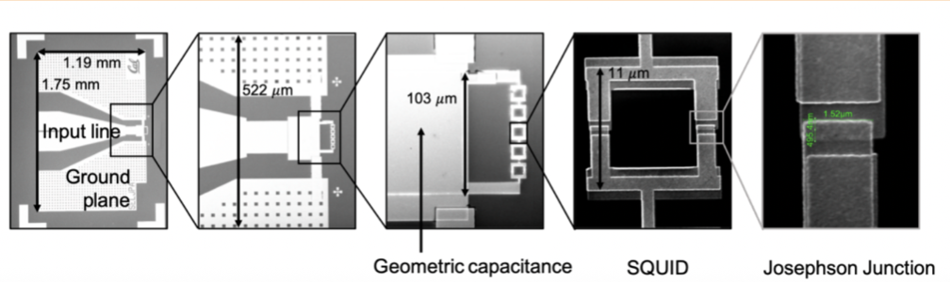
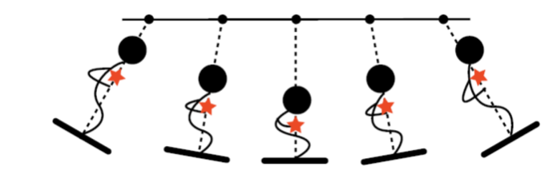
Josephson parametric amplifiers

Slide 23
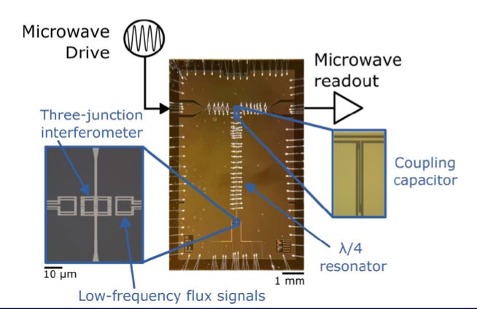
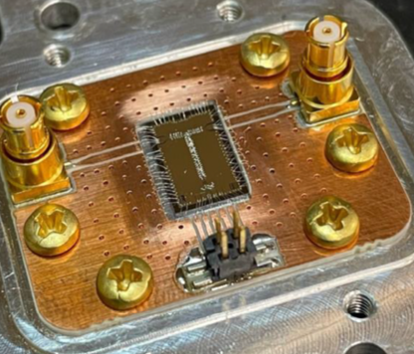
SQUIDs and RF Quantum Upconverters
RF Upconverters courtesy of Kent Irwin’s group

Slide 24
Suggested reading
Clarke, John, and Alex I. Braginski. The SQUID handbook: fundamentals and technology of SQUIDs and SQUID systems. John Wiley & Sons, 2006.
Girvin, Steven M. "Circuit QED: superconducting qubits coupled to microwave photons." Quantum machines: measurement and control of engineered quantum systems 96 (2014).
Blais, Alexandre, et al. "Quantum-information processing with circuit quantum electrodynamics." Physical Review A—Atomic, Molecular, and Optical Physics 75.3 (2007).

Slide 25
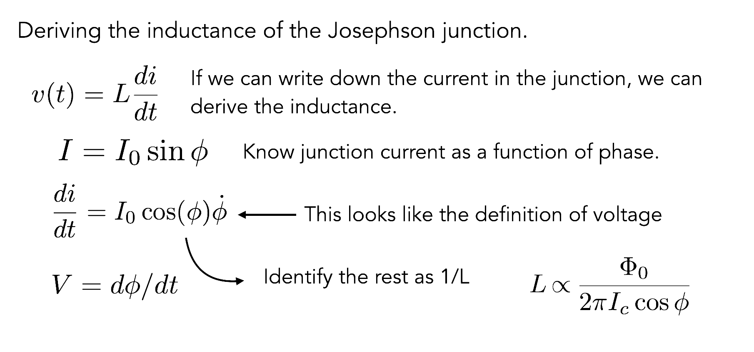
Non-linearity of the Josephson junction
The non-linear inductance of the Josephson junction is a very important feature!
Most Josephson-junction-based amplifiers leverage this non-linearity for parametric amplification

Slide 26
Derive the inductance of a single junction
We know that the V = –L dI/dt.
Use the constitutive equations to derive L, the inductance, for a single junction of critical current I_{c}.
Use the same equations to derive L, the inductance, for two junctions in parallel with critical currents I_{c1} and I_{c2}, and phases φ₁ and φ₂ respectively. What happens when I_{c1}=I_{c2}?
Use the same equations to derive L, the inductance, for two junctions in series, with critical currents I_{c1} and I_{c2}, and phases φ₁ and φ₂ respectively. What happens when I_{c1}=I_{c2}?

Slide 27
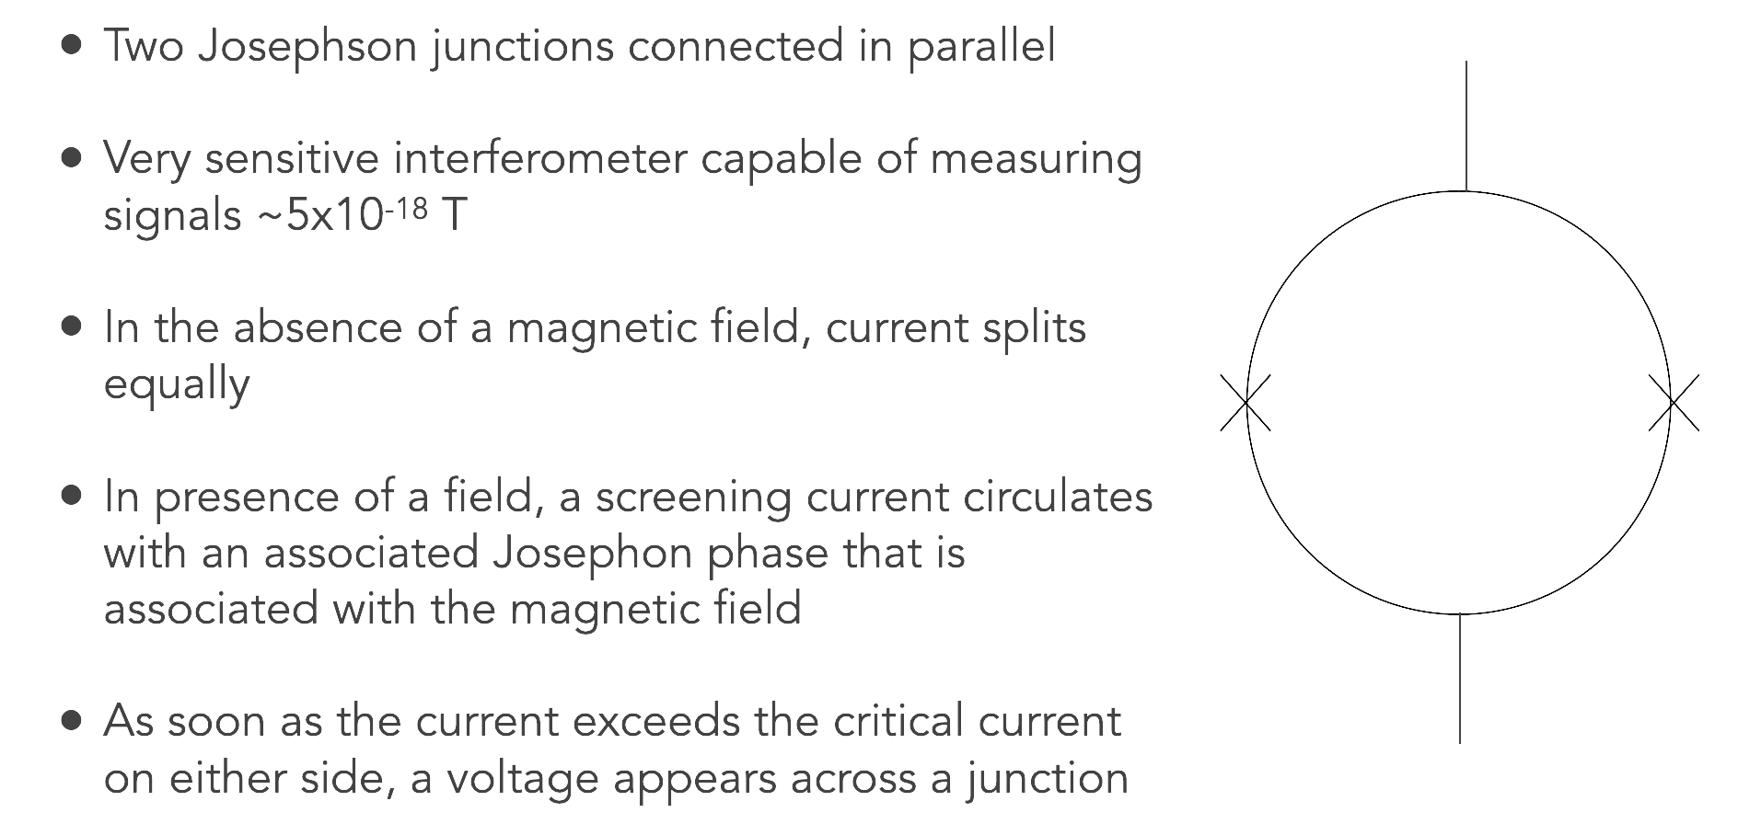
Building a SQUID

Slide 28
Project #1: Simulating Josephson junctions with WRSpice
SPICE is a well-known circuit simulation tool. The original SPICE allows modeling of standard circuit components.
Standard inputs: circuit design file
Standard outputs: currents and voltages throughout the circuit
WRSPICE is open source code for modeling circuits with Josephson junctions. It includes modeling capabilities for all the standard SPICE components plus the ability to model Josephson junctions.
The biggest difference between SPICE and WRSPICE is it has to track this new circuit parameter, which is the phase of the waveform.

Slide 29
Project #1: Getting started
First, navigate to website: http://wrcad.com/wrspice.html. Read the short description of the software on that main page.
This site has the documentation for wrspice, including a comprehensive manual. Click on the link to the manual and you will find a long table of contents page.
In the table of contents, navigate to http://wrcad.com/manual/wrsmanual/node142.html
This is the page on Josephson junctions. Take some time to peruse this. The “Josephson junction description” is particularly interesting. Take some notes; write some ”fun facts” down to share with the larger group.

Slide 30
Project #1: Open the terminal
Now go to your desktop and navigate to the search bar.
Type “Msys”. You should see several options pop up.
Select the one that says Msys2 Mingw64. It should be a blue color.
This terminal environment emulates a linux environment. You can now issue standard linux commands.
Navigate to the wrspice example folder with
cd /usr/local/xictools/wrspice/examples
Execute an example using the wrspice command followed by the circuit file
wrspice jjac.cir

Slide 31
Project #1: Some examples to test
Now go to your desktop and navigate to the search bar.
Type “Msys”. You should see several options pop up.
Select the one that says Msys2 Mingw64. It should be a blue color.
This terminal environment emulates a linux environment. You can now issue standard linux commands.
Navigate to the wrspice example folder with
cd /usr/local/xictools/wrspice/examples/JJexamples
Execute an example using the wrspice command followed by the circuit file
wrspice jjac.cir

Slide 32
Project #1: Study the examples
Try running the following examples and take some notes on the output:
  jjIV.cir: This generates an IV curve for a Josephson junction. What do you notice?
  jjac.cir:
  jjdc.cir:
If there is time, explore the other circuit files and write down some notes on your favorite.

Slide 33
Project #1: Now let’s build something more challenging
Can we build a SQUID out of Josephson junctions in WRSPICE?
In the terminal, navigate to your home directory
Navigate to the directory SSI_QIS
Type ‘jupyter notebook’ to open a notebook in the browser tab.
In the browser tab, you should see a notebook called ‘squid_demo’. Click on it.
The code writes a circuit file to represent a SQUID. Look at the circuit file and translate it into a drawing of a circuit diagram, with labels.
Run the notebook. The final plot should take about 5 minutes to generate. It should save the last plot as a PDF.

Slide 34
Project #1: What is the code doing?
The code is looping over circuit file parameters. Write down which circuit file parameters are being changed each time wrspice is called.
What type of WRSPICE analysis is it doing?
What does the final plot show?
Trying changing:
  the values of the different circuit parameters
  the range over which you loop
Note the effects of these changes; save the plots as separate files and/or screenshots and write down what you observe.

Slide 35
Project #1: We just learned of a WRSPICE alternative!
Challenges of WRSPICE: Complex circuits with large numbers of Josephson junctions means many more parameters to track. WRSPICE has some parallel capabilities but not a lot.
Alternative option courtesy of Kevin O’Brien, that can be 10,000x as fast: https://github.com/kpobrien/JosephsonCircuits.jl
Try a git clone in the home directory?

Slide 36
G4CMP Tutorial
For tomorrow, since there is less time to get started…

Slide 37
G4CMP Tutorial
Getting started
  How to build an application, visualize and plot data
Making modifications
  Changing sensor properties and device geometries
Adding more physics
  Adding custom physics for interactions with primaries such as gammas, neutrons, etc.

Slide 38
G4CMP Tutorial
How to use your own computer to run the tutorial:
Install Docker desktop
$Docker pull cstonewhitehead/slac-summer-institute:tutorial
Install vcxsvr (X server for visualization)
  VcXsrv Windows X Server download | SourceForge.net
Start the X server with XLaunch application
$Docker run –it –p 8888:8888 cstonewhitehead/slac-summer-institute:tutorial

Slide 39


