Slide 1
Spin-2 Mediated Freeze-In Dark Matter at the LHC
James Junzhe Liu, Alfredo Gurrola
Vanderbilt University

Slide 2
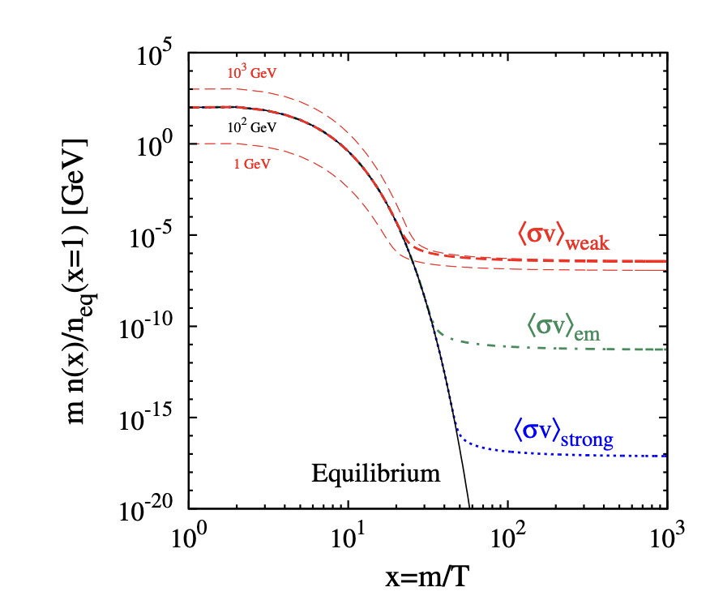
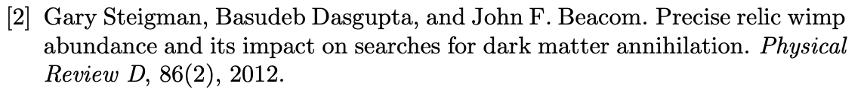
Freeze-Out Dark Matter
- SM couplings strong enough to thermalize
Thermal equilibrium in early universe
Cooling — production drops, annihilation dominates
Freeze-out — annihilation stops, relic density locked in

Slide 3
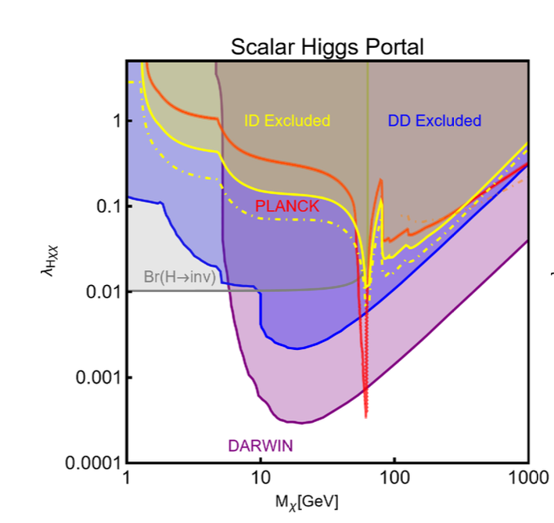
Freeze-out is cornered
Simple Higgs portal model
Red line = the freeze-out prediction to match relic density
Completely excluded by existing searches
Arcadi et al., "The Waning of the WIMP: Endgame?", EPJC 2024, arXiv 2403.15860

Slide 4
Motivation: Beyond WIMPs
Feebly Interacting DM (freeze in) – couplings orders of magnitude smaller than WIMP
  weak interaction -> no thermal equilibrium
  Slow production, no annihilation
  Relic density slowly built up

Slide 5
Our Model: Spin-2 mediated production
Heavy spin-2 mediators in many BSM theories (e.g., extra dimensions, Randall–Sundrum scenarios)
Natural starting point — now repurposed as a DM portal
DM: real scalar singlet, stabilized by a Z₂ symmetry
Coupling considerations:
  Dijet + Mono-jet: constrains g, q coupling
  Dilepton: constrains lepton coupling
  Photon/EW fusion production: open
  We consider photon-only coupling as a minimal baseline unconstrained by existing searches

Slide 6
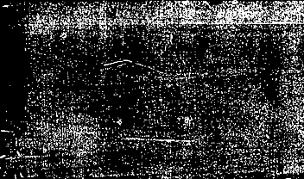
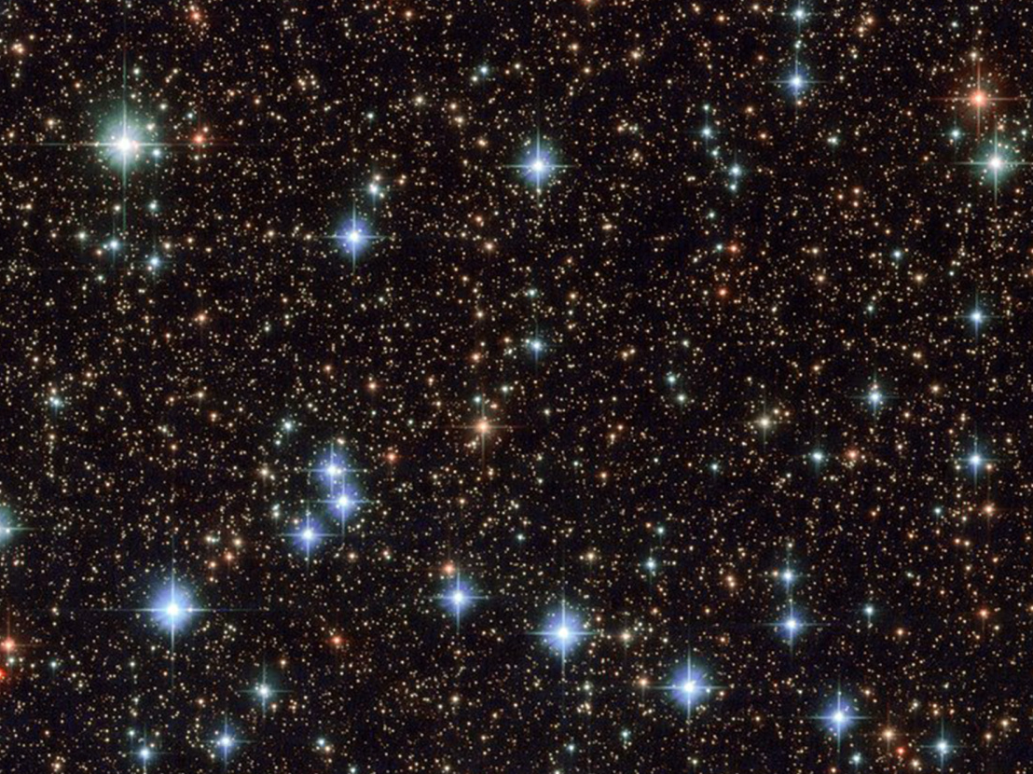
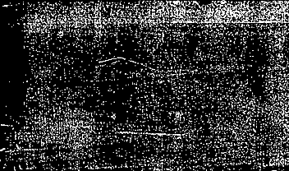

Part 1: Cosmological constraints

Slide 7
Freeze-in Constraint
Γ < H, universe expands faster than DM could annihilate
Simplifications
  Resonance: TR ~ mG (mediator thermally accessible → on-mass-shell production)
  Off-resonance: TR << mG (mediator too heavy → virtual exchange only)
  Both translate to lower bounds on Λ

Slide 8

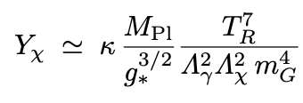
Relic Density Constraint
Want our result to contribute less than the observed Ωχh²=0.12
Lower bound on Λ
Off-resonance assumption simplifies Boltzmann integral

Slide 9
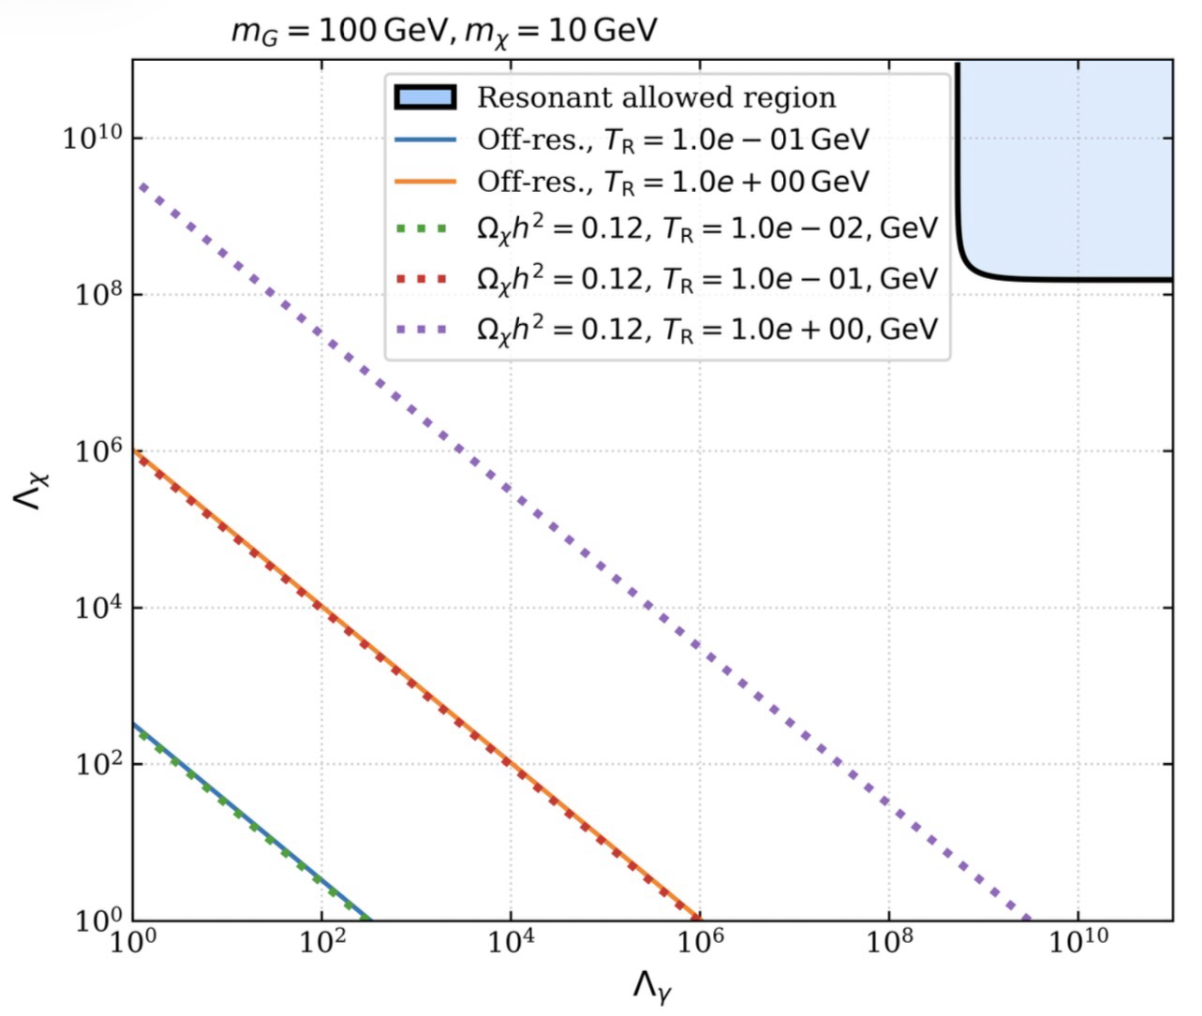
Cosmological Parameter Space
Feasible region = low TR, off-resonance production
Target for collider searches
Notes:
"The resonant region sits at very high Λ because when the mediator is thermally accessible, on-shell production is efficient. To prevent the DM from equilibrating with the bath — which would violate the freeze-in requirement — both couplings must be very weak, meaning both Λ_γ and Λ_χ must be large. That pushes the allowed region to the upper-right corner."

Slide 10
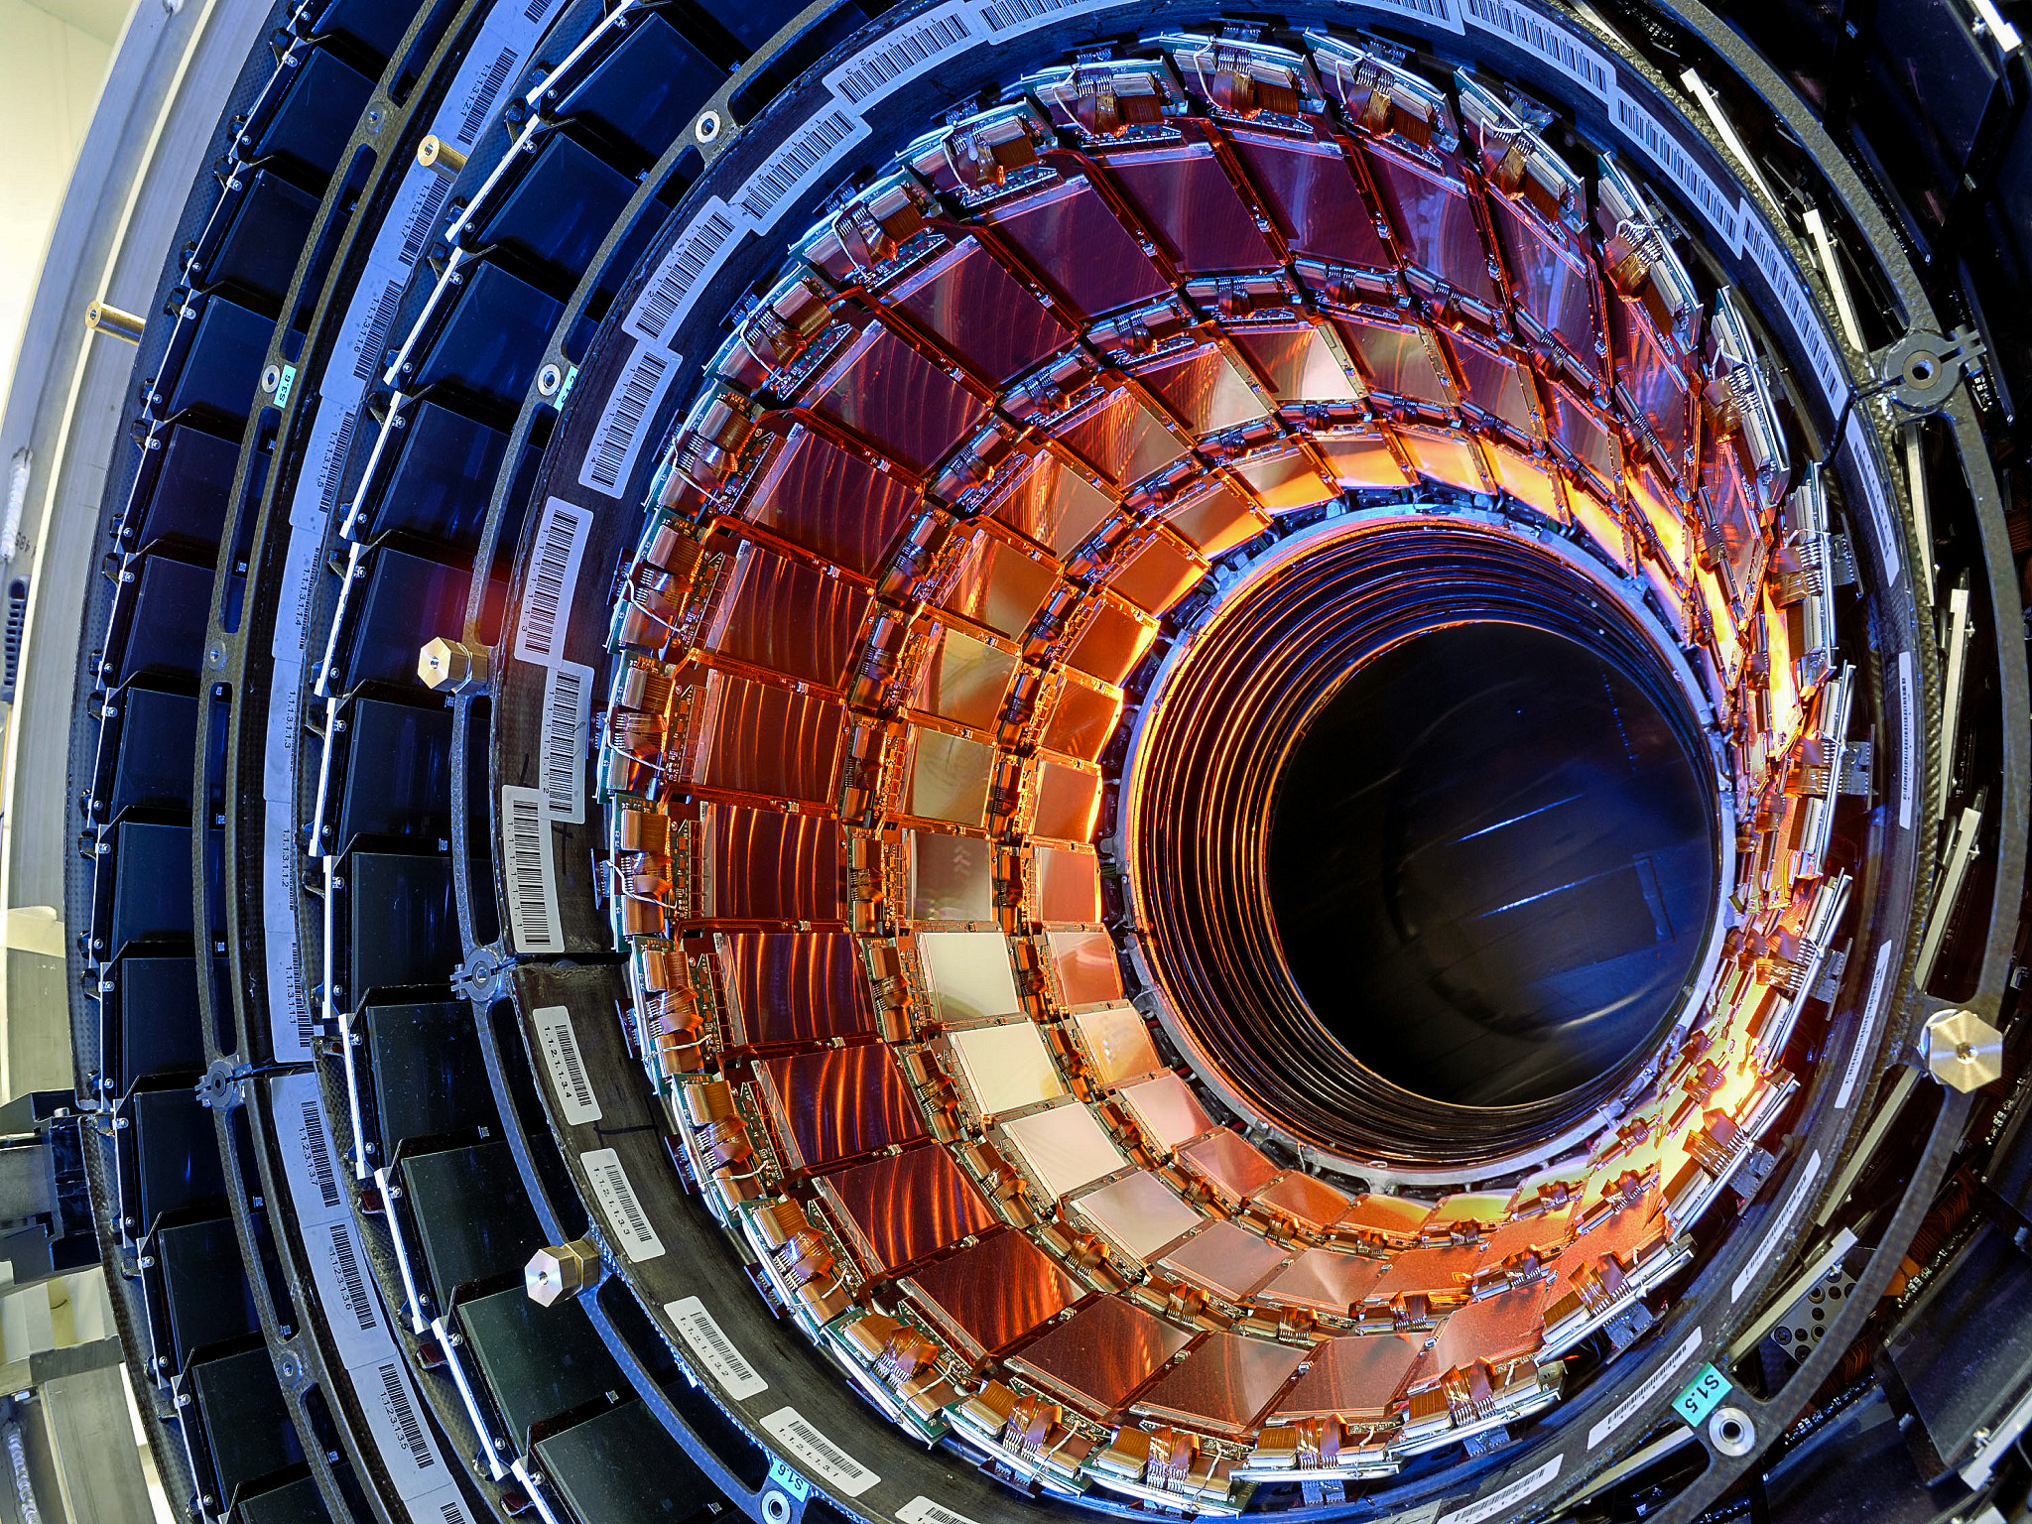
Part 2:
LHC phenomenology studies

Slide 11
Simulation Methodology
Event Generation (MadGraph5)
  Signal: 1M events for each mG mass, mDM = 10 GeV, mG ∈ [50, 1000] GeV
  Background: 10M SM events
Parton Shower & Hadronization: Pythia 8 + MLM matching
Detector Simulation: Delphes 3.4.1
HL-LHC Pileup
  ~140 simultaneous interactions per bunch crossing
  Degrades lepton, jet, and b-tag reconstruction → conservative efficiencies applied

Slide 12
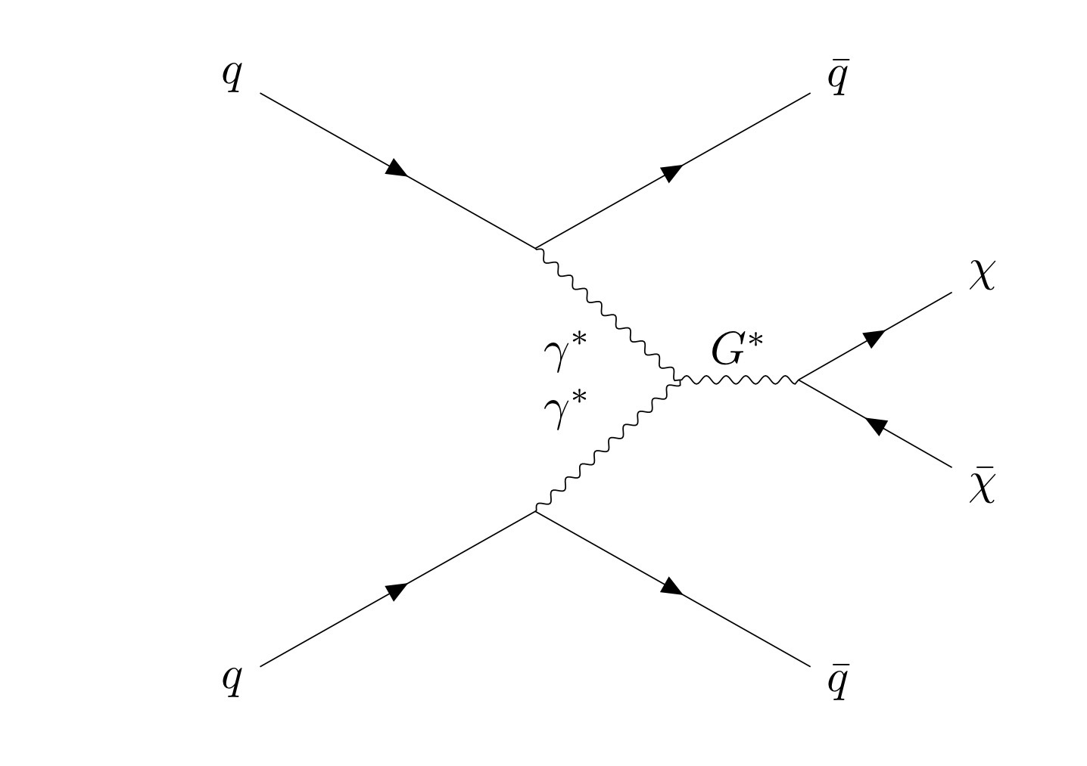
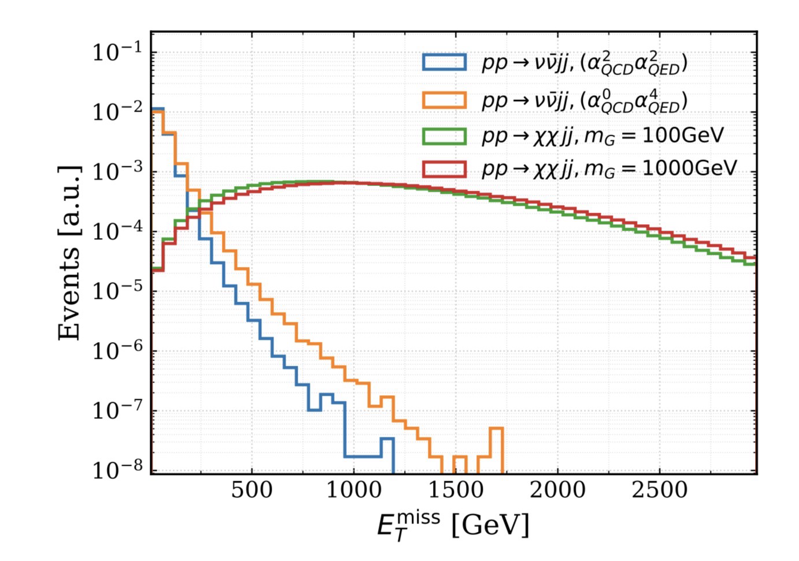
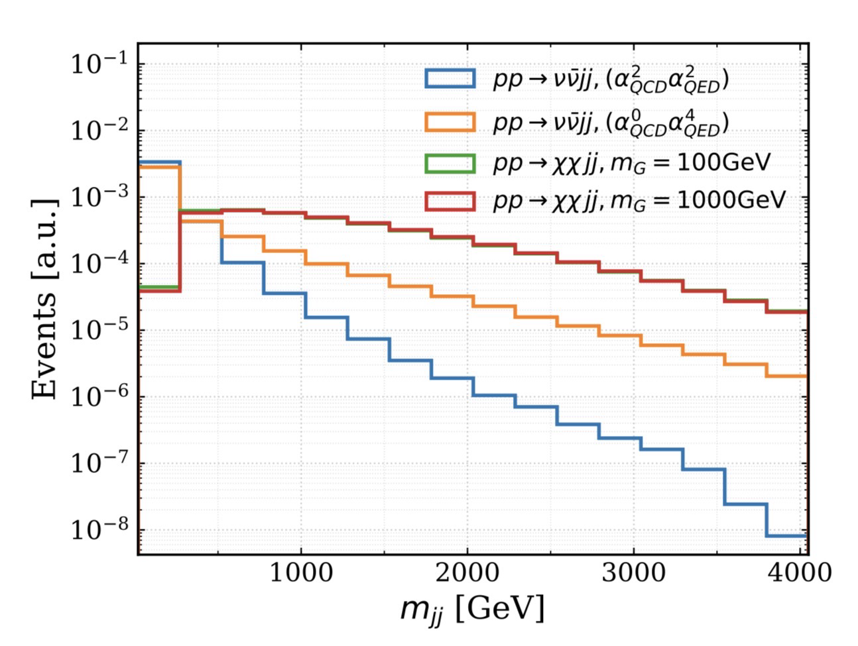
Kinematic Features
VBF = rare but distinctive
Signal: high mjj, high MET
Background: p p -> vl vl + jets process

Slide 13
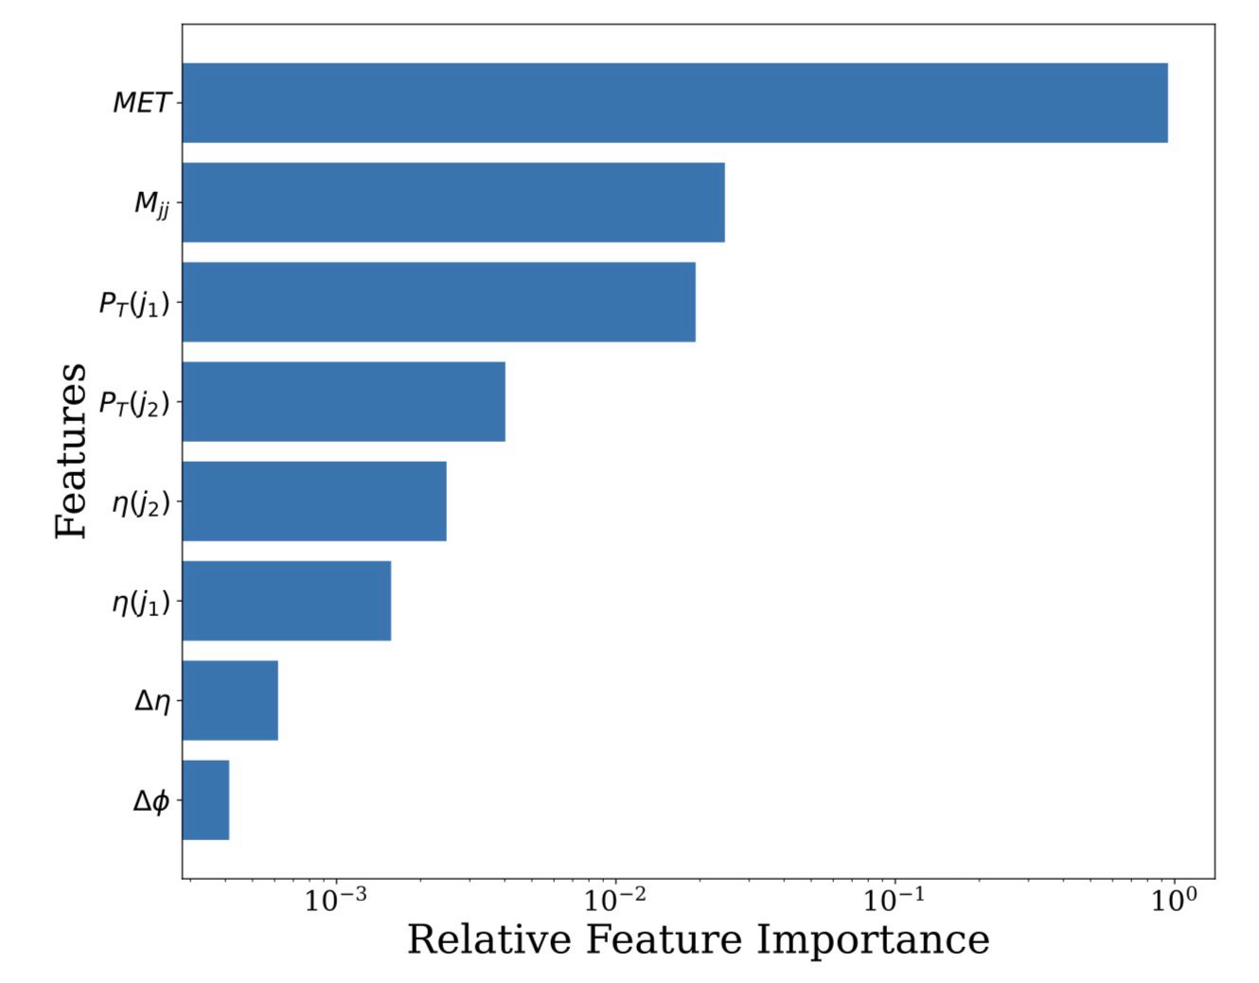
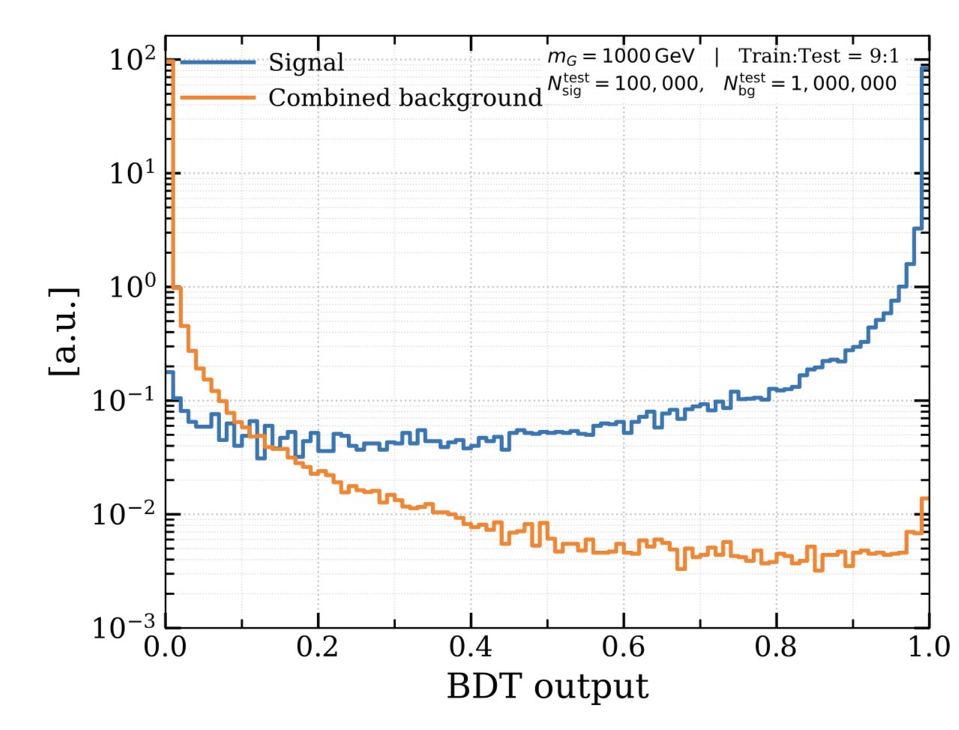
Machine Learning Performance
BDT using kinematic observables
Use correlation to improves discrimination
Strong separation

Slide 14
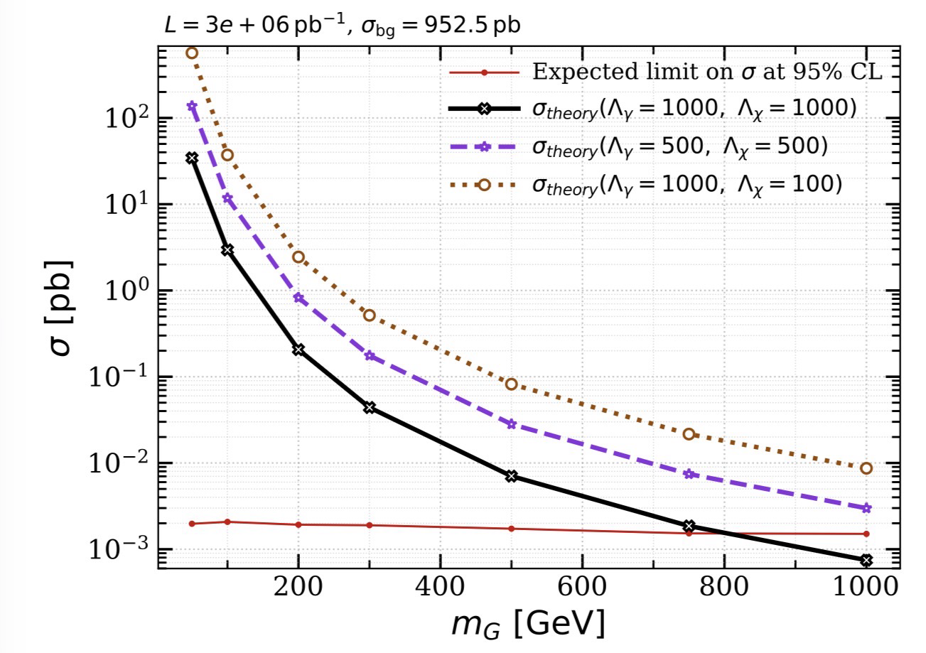
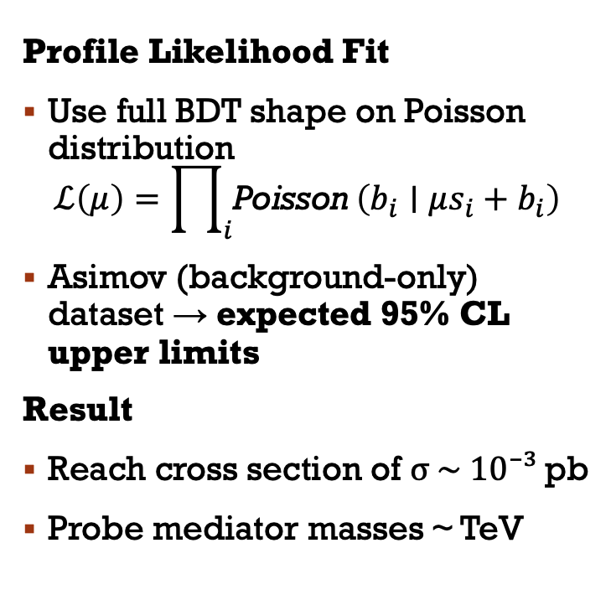
HL-LHC Sensitivity
Profile Likelihood Fit
Use full BDT shape on Poisson distribution
$$ℒ\left(μ\right)=\prod_{i}{\text{Poisson}}\left(b_{i}∣μs_{i}+b_{i}\right)$$
Asimov (background-only) dataset → expected 95% CL upper limits
Result
Reach cross section of σ ~ 10⁻³ pb
Probe mediator masses ~ TeV
Notes:
Profile Likelihood Fit — Speaker Notes
The likelihood:
"We build a Poisson likelihood across the bins of the BDT output. In each bin, the expected count is μ times signal plus background, where μ is the signal strength — the parameter we're fitting for. μ = 0 means no signal, μ = 1 means our nominal predicted cross section. The full likelihood is the product of Poisson probabilities across every bin."
Why shape-based:
"Using the full shape rather than a single cut means every bin contributes — signal-rich bins drive the sensitivity, signal-poor bins constrain the background."
Asimov dataset:
"Since HL-LHC data doesn't exist yet, we need pseudo-data to fit against. The Asimov dataset is just the background-only expectation used as fake observed data. So we're asking: 'if the universe handed us exactly the background prediction, how large could the signal strength get before being inconsistent at 95% CL?' That bound is our expected upper limit."
Result:
"Running this fit across the mediator mass scan, we project sensitivity to cross sections down to about 10⁻³ picobarns, probing mediator masses up to the TeV scale."

Slide 15
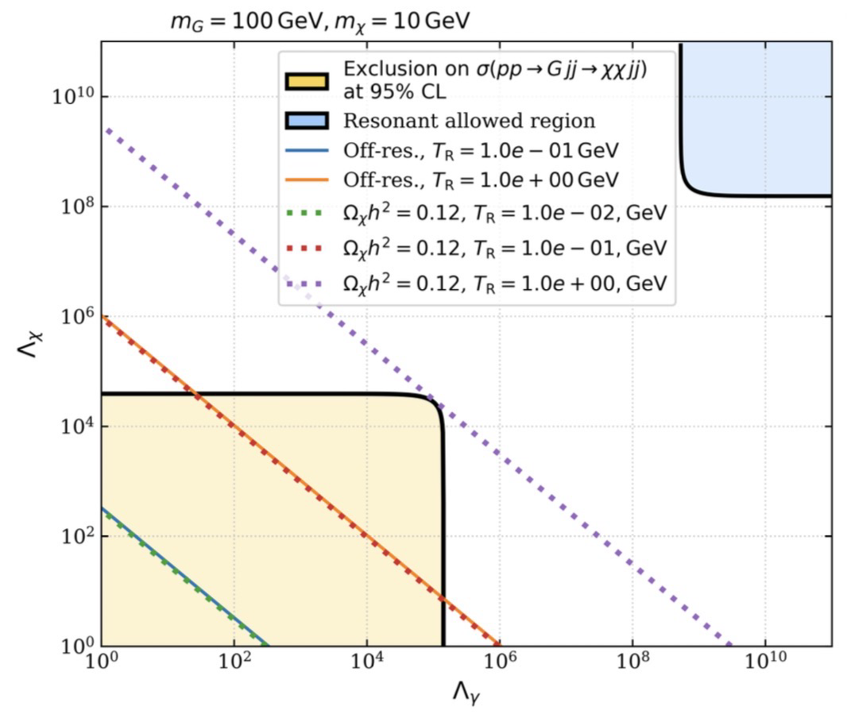
Cosmology vs Collider
Overlay constraints
Partial overlap of viable + observable
LHC probes freeze-in DM at MeV scale reheating temperature

Slide 16
Conclusion
Freeze-in DM naturally evades traditional searches
VBF + ML provides new sensitivity regime
HL-LHC can probe a large section of cosmology–consistent parameter space
Future Studies:
  Extend to full EW portals
  Path toward ATLAS/CMS implementation

Slide 17
Thank you!

