Slide 1
MKID Bolometer
Jack Bargemann
SLAC SSI 2026
jack.bargemann@pnnl.gov

Slide 2
Radiation in a Qubit Substrate
Ionizing radiation is a problem for qubits
Different types of radiation have different origins, produce different spectra, and require different shielding
muon
hadron / alpha
gamma
muon
gamma

Slide 3



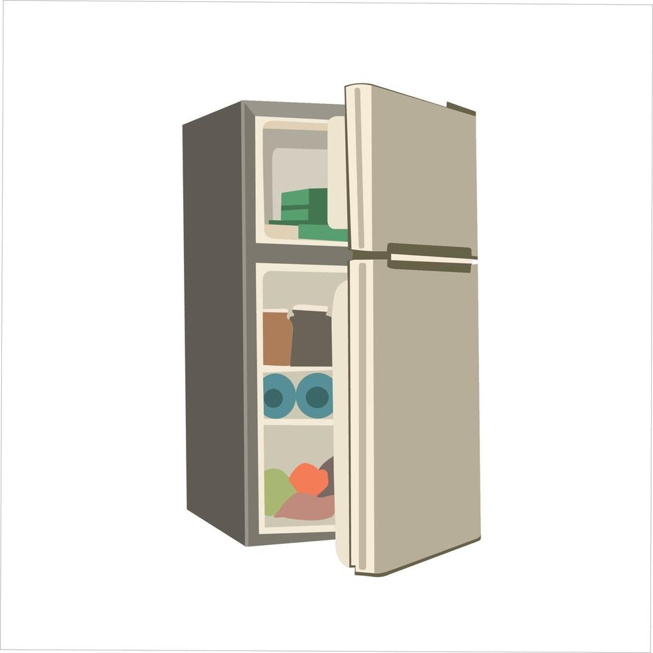
A shallow underground lab
muon
hadron
muon

Slide 4
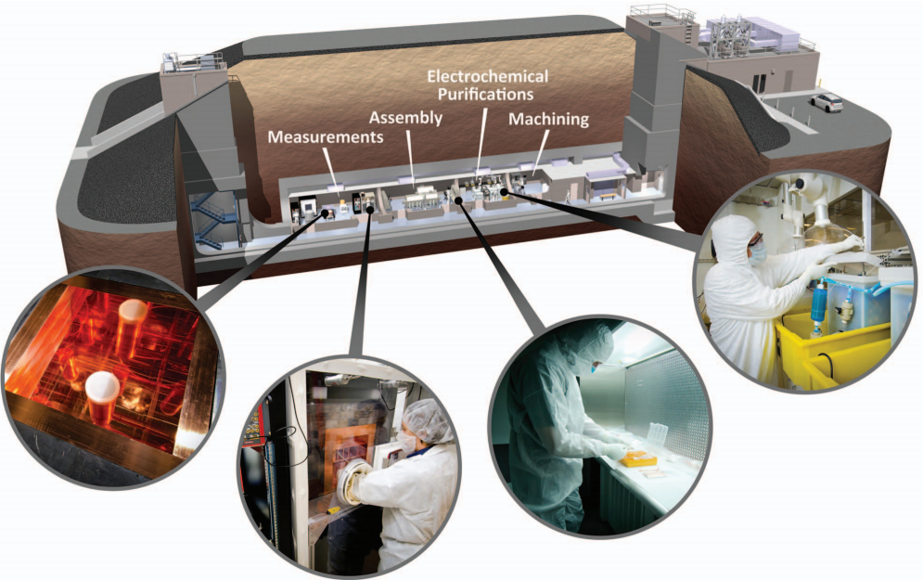
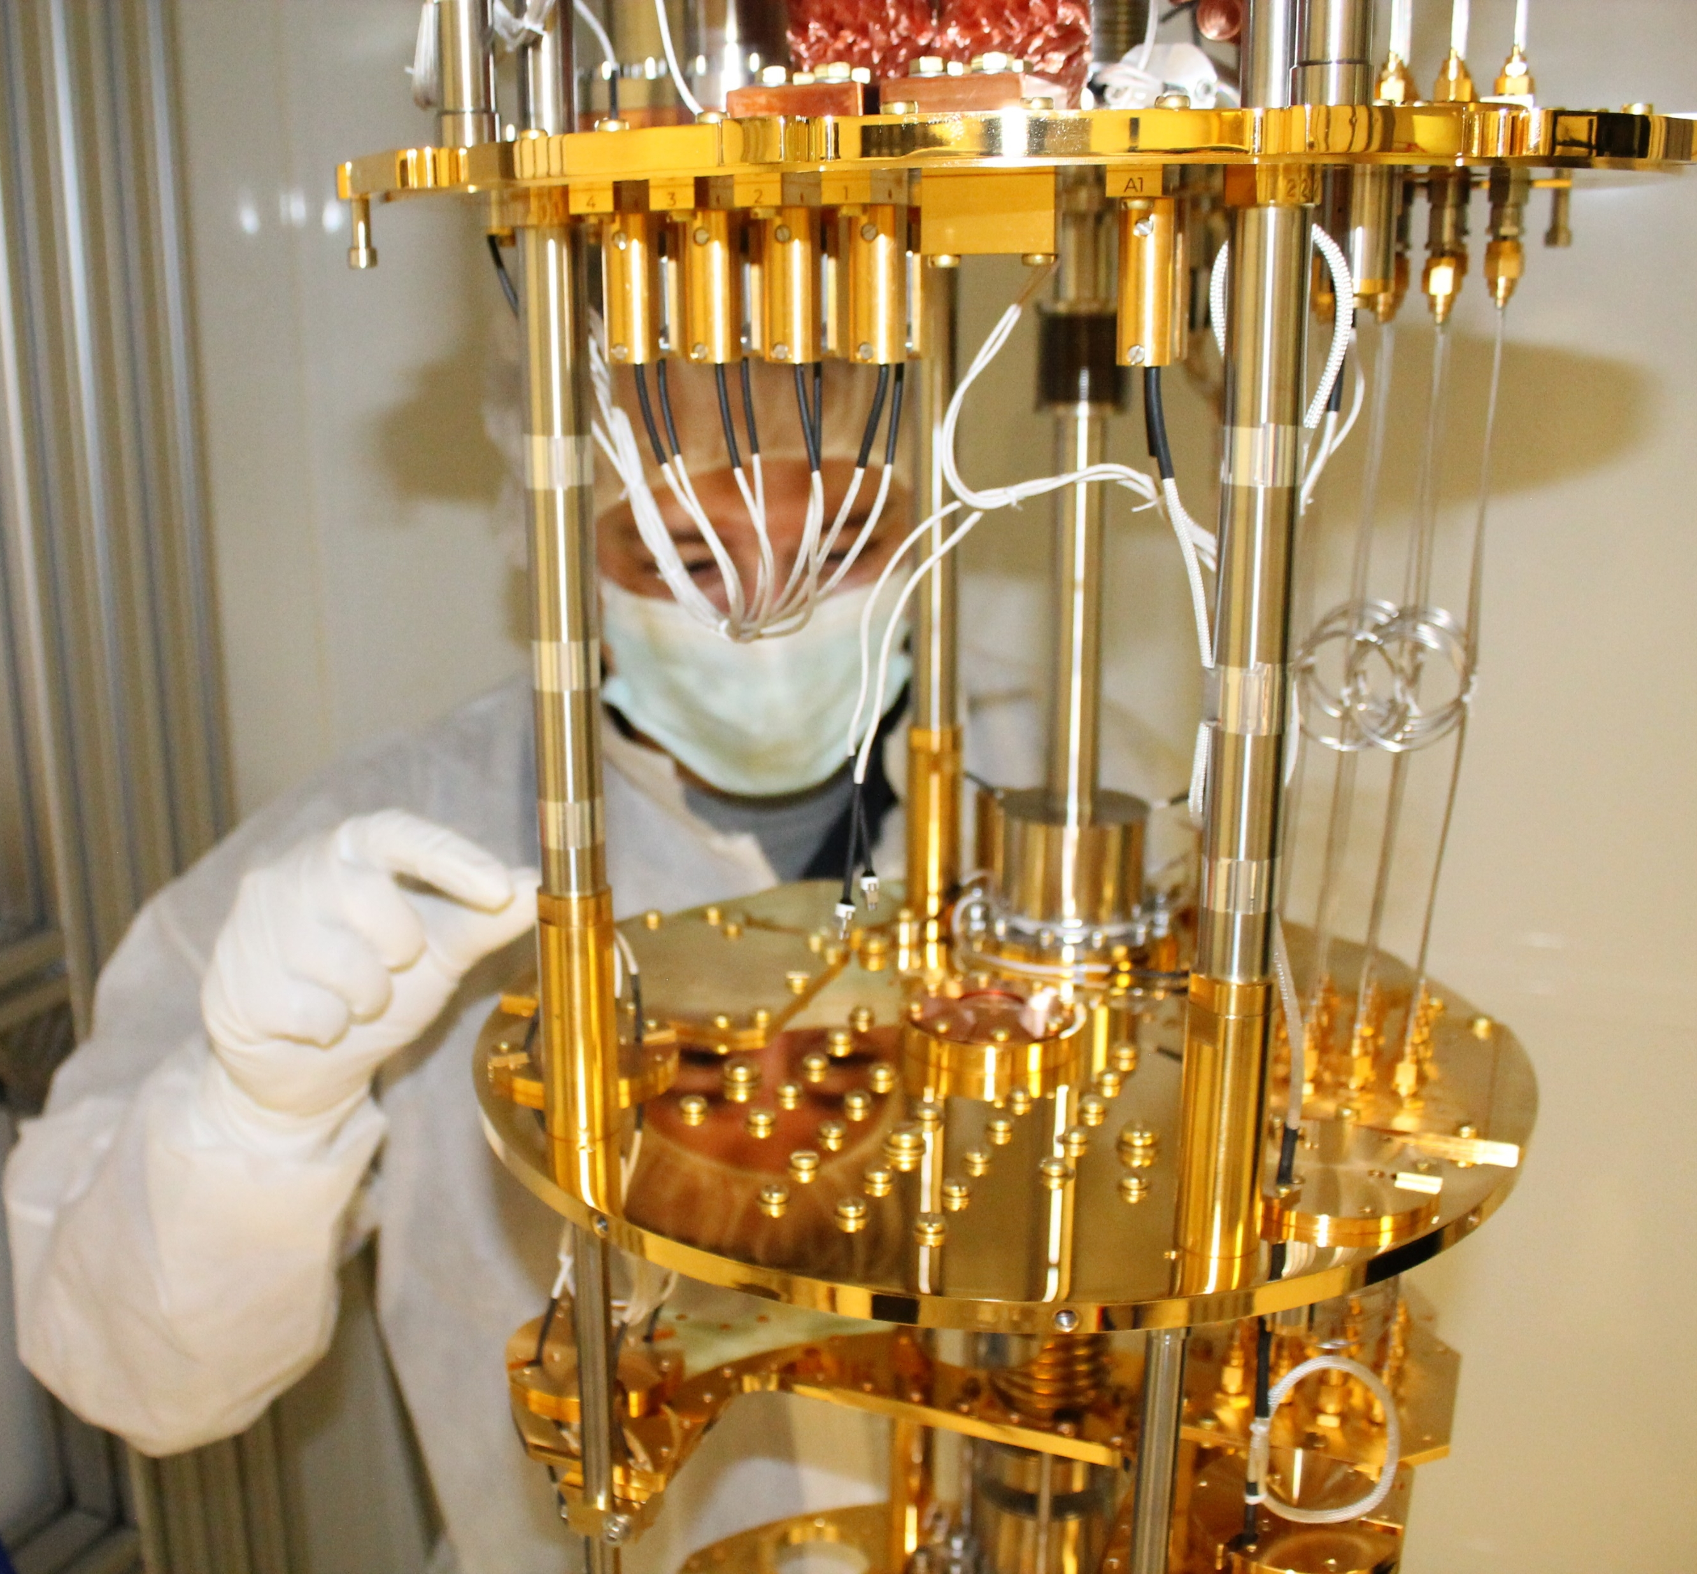
PNNL Shallow Underground Laboratory and
Low Background Cryogenic Facility (LBCF)
SUL houses clean rooms (class 10,000 and 1,000) , world-leading ultra-pure material growth and characterization capability
19 m overburden reduces muon flux by 6X, neutron and proton flux by >100X
Bluefors LD-400 dilution fridge with external gamma shield
Dilution
Refrigerator

Slide 5
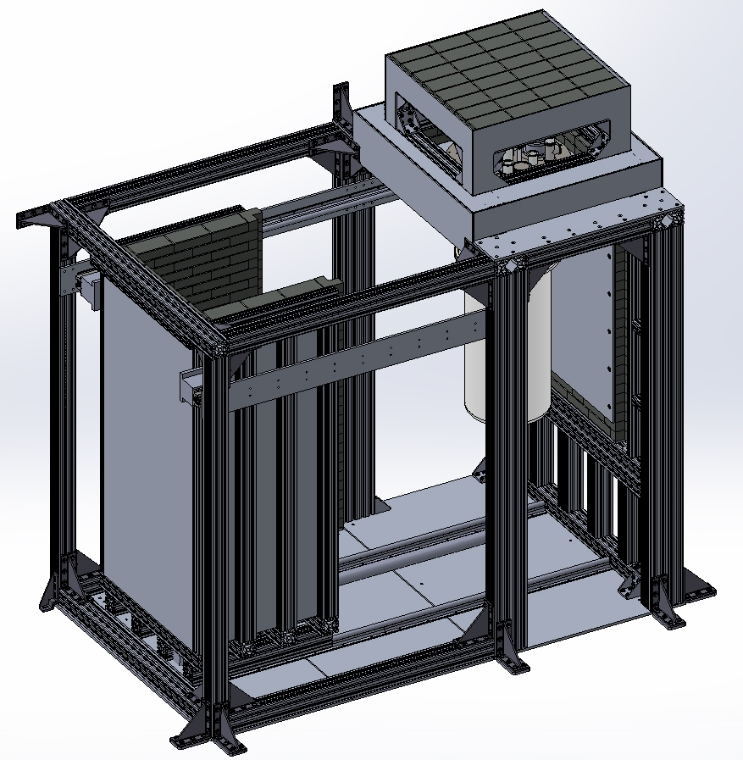
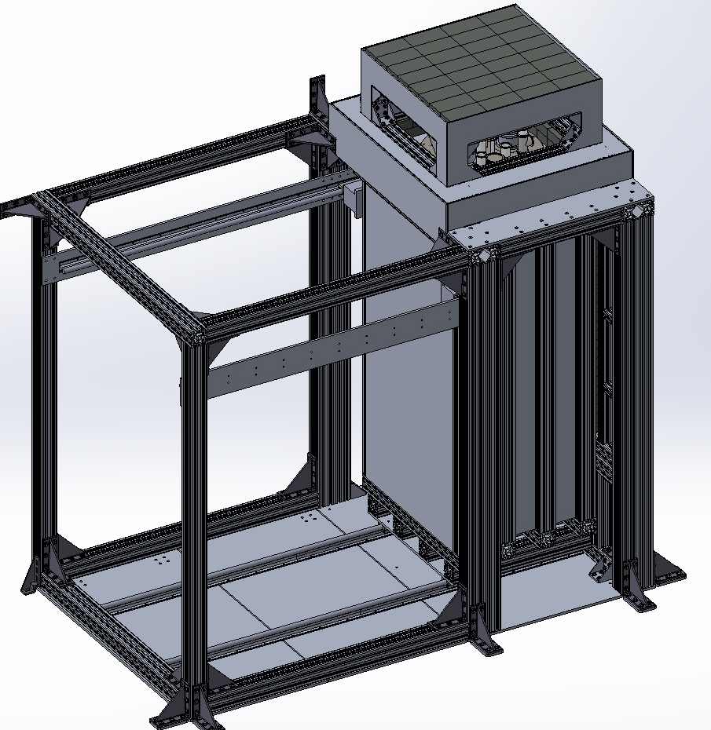
LBCF Shield
Reduces gamma rate from surrounding earth and building material

Slide 6
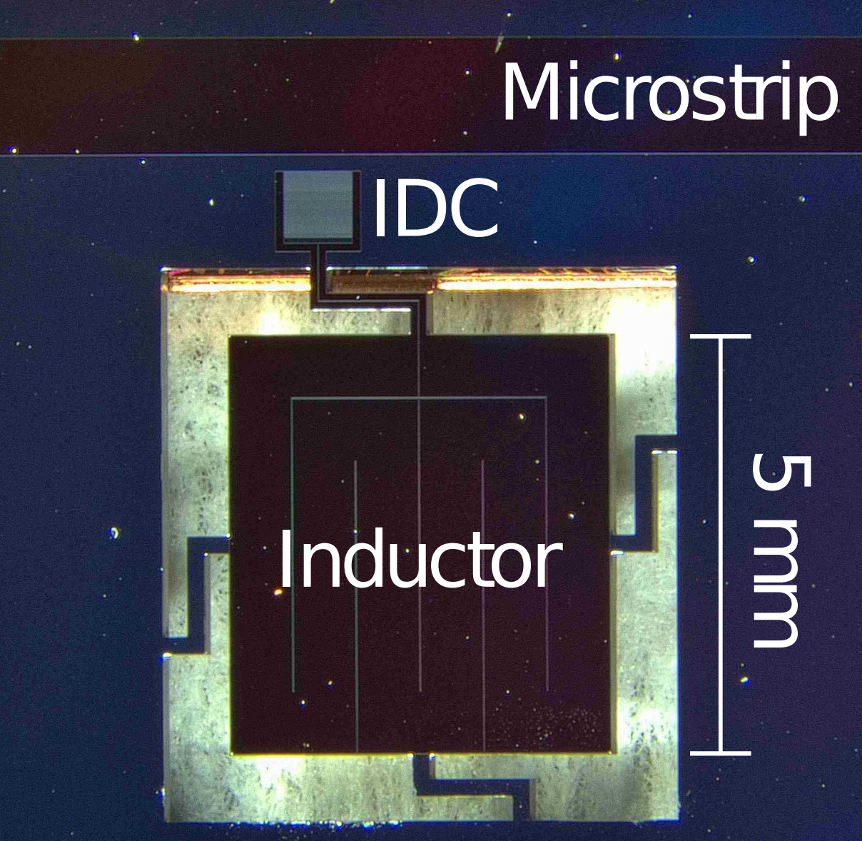
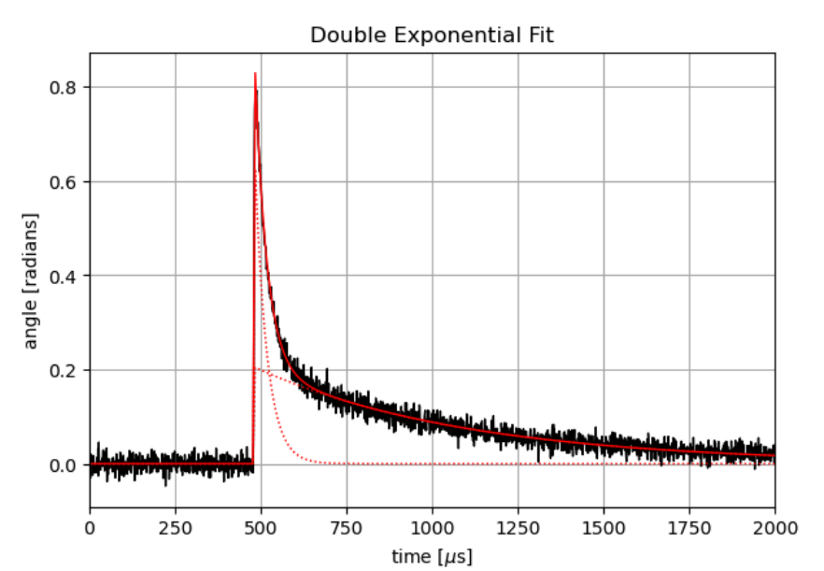
NIST Thermal Kinetic Inductance Detector
Energy-resolving qubit proxy

Slide 7
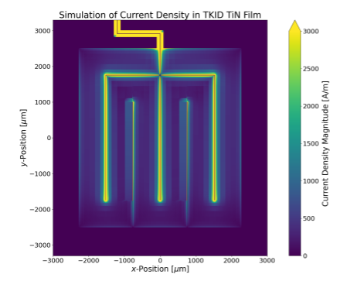
Why use a thermal KID?
Reduced position-dependence!
A study of the position-dependent response of thermal kinetic inductance detectors through the use of cryogenic beam steering, Flogarty et. al.
With thanks to the SLAC DMQIS group for providing the steerable MEMS mirror

Slide 8
NIST Thermal Kinetic Inductance Detector
Energy-resolving qubit proxy
Fast athermal signal
Slow thermal signal

Slide 9
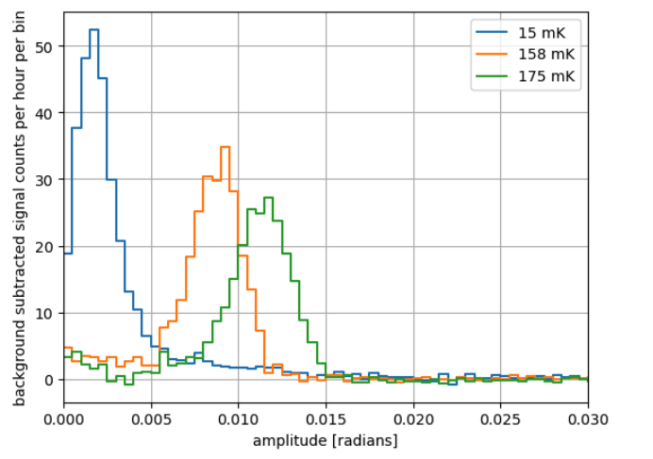
NIST Thermal Kinetic Inductance Detector
Energy-resolving qubit proxy
60 keV ²⁴¹Am

Slide 10
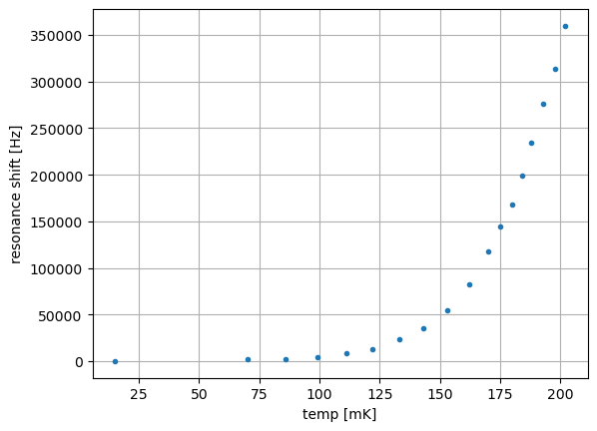
NIST Thermal Kinetic Inductance Detector
Energy-resolving qubit proxy
60 keV ²⁴¹Am

Slide 11
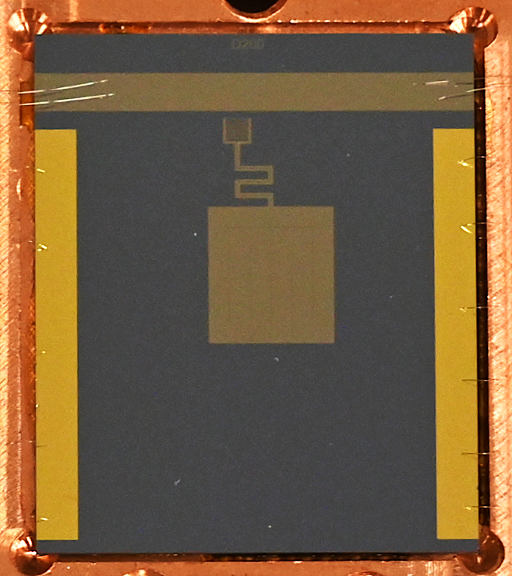
Do we really need to micromachine?

Slide 12
Thermally Isolating the entire chip
nylon screw
silicon substrate
copper housing
solder wire thermal standoff

Slide 13
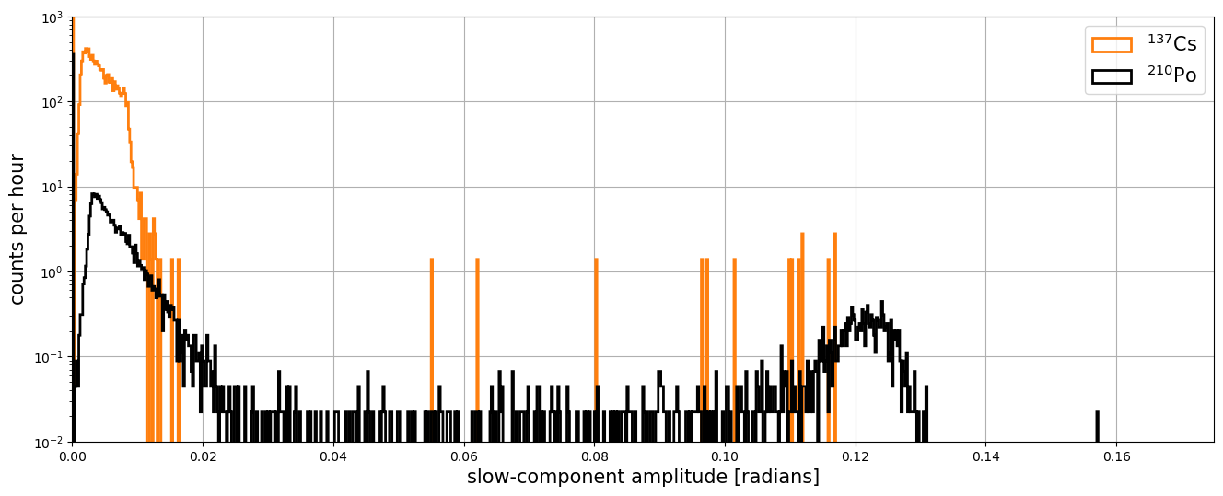
Results – it works!

Slide 14
Results – it works!
477 keV Compton shoulder
5.3 keV ²¹⁰Po alphas

Slide 15
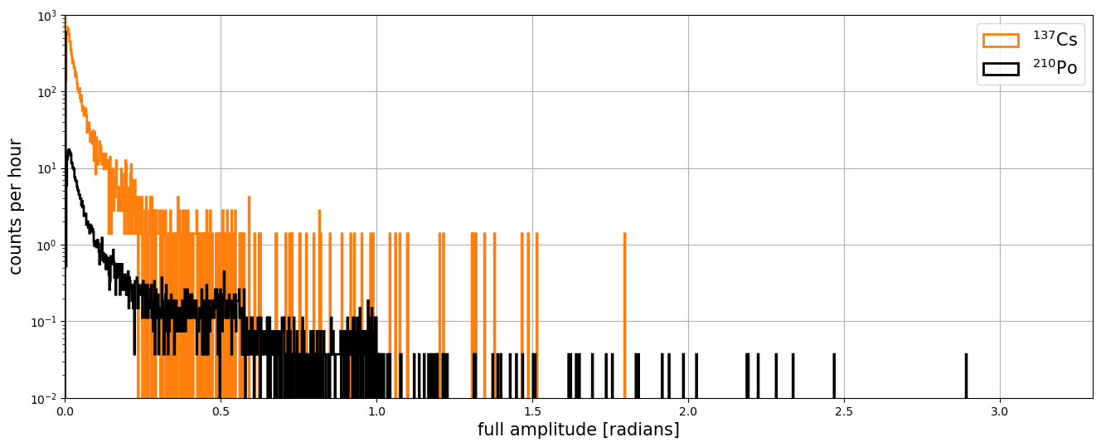
Results – it works!

Slide 16
Fixing ²¹⁰Po alpha backgrounds
nylon screw
silicon substrate
copper housing
solder wire thermal standoff

Slide 17
Fixing ²¹⁰Po alpha backgrounds
nylon screw
silicon substrate
copper housing
solder wire aluminum spheres

Slide 18
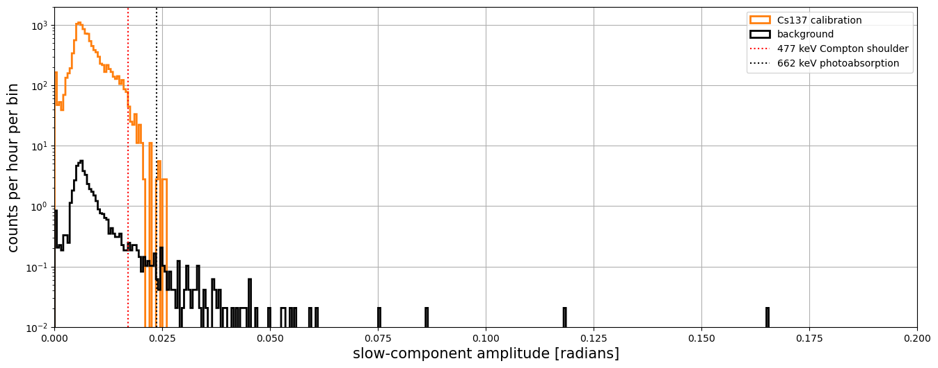
Low-background MKID bolometer
PRELIMINARY

Slide 19
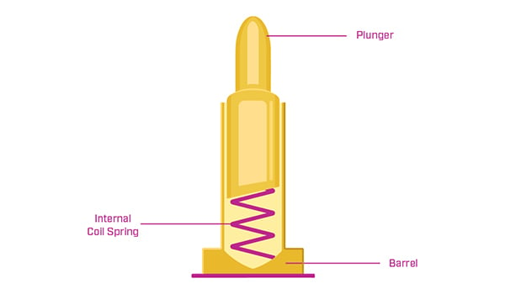
Future directions
Background measurement with 𝒪(several) gram-days of exposure
  (very) near future
Mount and operate low-volume-high-sensitivity MKIDs as bolometers
  With a well-optimized MKID, what energy and temperature sensitivity is achievable?
Improved chip mounting
  Nylon clamp screw was a stopgap
  Clips or pogo pins would allow reproducible clamping force
MKID arrays
  Arrays of MKID resonators should see a coherent thermal signal
    √n improvement in signal-to-noise when channels are summed
  Athermal signal can be used for position reconstruction, triggering

Slide 20
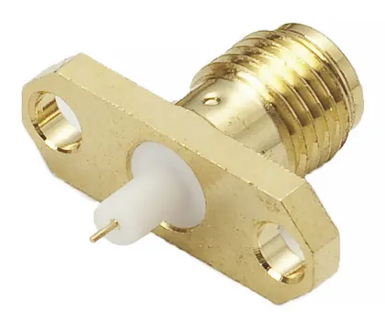
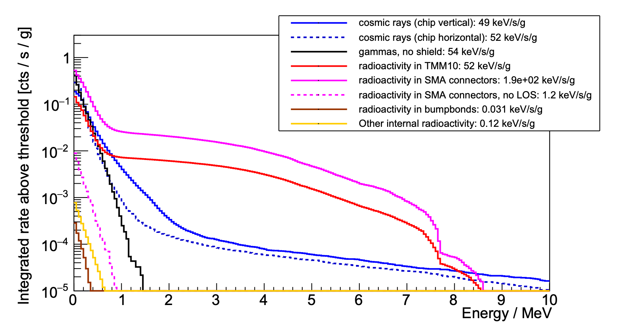

Alphas and Radiopurity
Alphas can only reach qubit substrates by line-of-sight
Significant sources of alphas:
  Beryllium-copper pins on SMA connectors
  Radioactivity in interposer circuit boards
Abatement of ionizing radiation for superconducting quantum devices

Slide 21
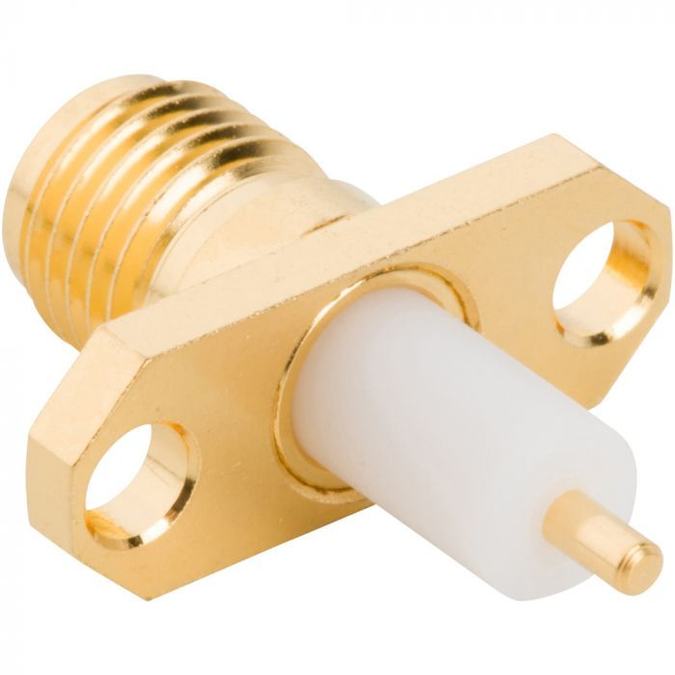
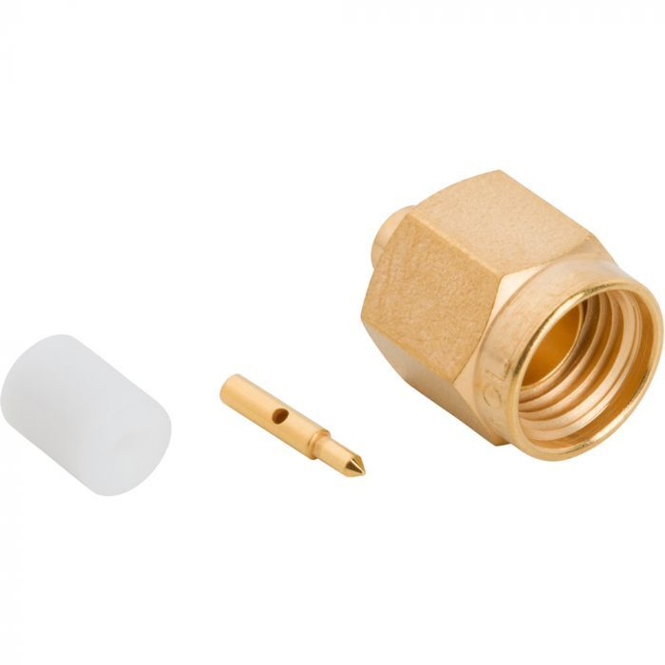
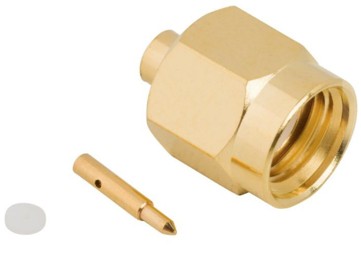
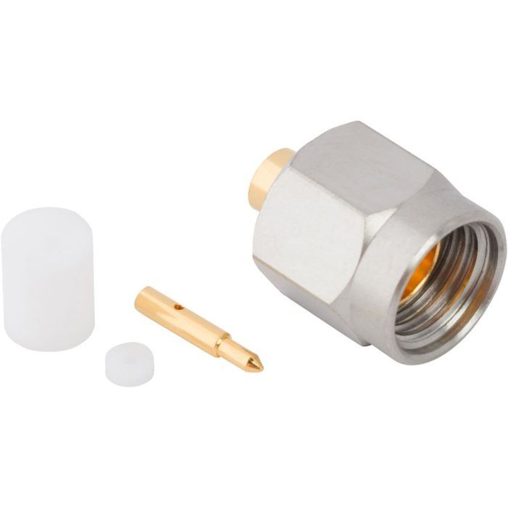
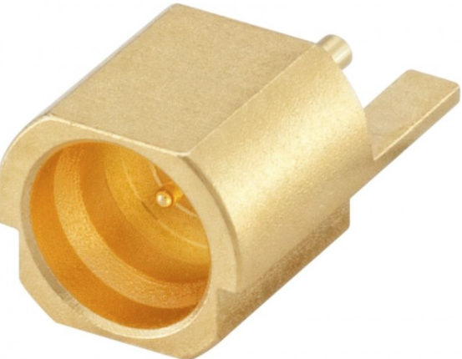
SMA Connectors
 |  |  | ²³²Th |  | ²³⁸U
Product No. | Material | Rep# | pg/g | +/-sd | pg/g | +/-sd
132147-29 | All dissolved (sans PTFE) | rep1 | 3100 | 200 | 24300 | 400
132147-29 | All dissolved (sans PTFE) | rep2 | 1400 | 200 | 1510 | 90
132147-29 | All dissolved (sans PTFE) | rep3 | 1070 | 90 | 1170 | 80
901-9201-2A | Nut Portion w/CuBe | rep1 | 14800 | 500 | 16200 | 8000
901-9201-2A | Nut Portion w/CuBe | rep2 | 14870 | 700 | 13100 | 2000
901-9201-2A | Nut Portion w/CuBe | rep3 | 15000 | 1500 | 15200 | 4000
901-9201-2A | CuBe Pin | rep1 | 230000 | 15000 | 2400000 | 18000
901-9201-2A | CuBe Pin | rep2 | 270000 | 13000 | 2500000 | 10000
901-9201-2A | CuBe Pin | rep3 | 250000 | 15000 | 2500000 | 40000
132101 | Brass Nut Portion | rep1 | 11 | 3 | 51 | 4
132101 | Brass Nut Portion | rep2 | 8 | 6 | 39 | 8
132101 | Brass Nut Portion | rep3 | <3 | - | 28 | 4
132101 | Brass Pin | rep1 | 28 | 10 | 5 | 5
132101 | Brass Pin | rep2 | 7 | 4 | 4 | 7
132101 | Brass Pin | rep3 | 9 | 2 | <1.2 | -
132248 | Steel Nut Portion | rep1 | 330 | 40 | 60 | 4
132248 | Steel Nut Portion | rep2 | 540 | 150 | 290 | 130
132248 | Steel Nut Portion | rep3 | 320 | 50 | 68 | 1
132248 | CuBe Pin | rep1 | 60 | 10 | 250 | 30
132248 | CuBe Pin | rep2 | 39 | 5 | 230 | 40
132248 | CuBe Pin | rep3 | 37 | 12 | 170 | 30
19S202-40ML5 | All (no CuBe) | rep1 | 4 | 6 | 3 | 5
19S202-40ML5 | All (no CuBe) | rep2 | <3 | - | <0.8 | -

Slide 22
SMA Connectors
 |  |  | ²³²Th |  | ²³⁸U
Product No. | Material | Rep# | pg/g | +/-sd | pg/g | +/-sd
132147-29 | All dissolved (sans PTFE) | rep1 | 3100 | 200 | 24300 | 400
132147-29 | All dissolved (sans PTFE) | rep2 | 1400 | 200 | 1510 | 90
132147-29 | All dissolved (sans PTFE) | rep3 | 1070 | 90 | 1170 | 80
901-9201-2A | Nut Portion w/CuBe | rep1 | 14800 | 500 | 16200 | 8000
901-9201-2A | Nut Portion w/CuBe | rep2 | 14870 | 700 | 13100 | 2000
901-9201-2A | Nut Portion w/CuBe | rep3 | 15000 | 1500 | 15200 | 4000
901-9201-2A | CuBe Pin | rep1 | 230000 | 15000 | 2400000 | 18000
901-9201-2A | CuBe Pin | rep2 | 270000 | 13000 | 2500000 | 10000
901-9201-2A | CuBe Pin | rep3 | 250000 | 15000 | 2500000 | 40000
132101 | Brass Nut Portion | rep1 | 11 | 3 | 51 | 4
132101 | Brass Nut Portion | rep2 | 8 | 6 | 39 | 8
132101 | Brass Nut Portion | rep3 | <3 | - | 28 | 4
132101 | Brass Pin | rep1 | 28 | 10 | 5 | 5
132101 | Brass Pin | rep2 | 7 | 4 | 4 | 7
132101 | Brass Pin | rep3 | 9 | 2 | <1.2 | -
132248 | Steel Nut Portion | rep1 | 330 | 40 | 60 | 4
132248 | Steel Nut Portion | rep2 | 540 | 150 | 290 | 130
132248 | Steel Nut Portion | rep3 | 320 | 50 | 68 | 1
132248 | CuBe Pin | rep1 | 60 | 10 | 250 | 30
132248 | CuBe Pin | rep2 | 39 | 5 | 230 | 40
132248 | CuBe Pin | rep3 | 37 | 12 | 170 | 30
19S202-40ML5 | All (no CuBe) | rep1 | 4 | 6 | 3 | 5
19S202-40ML5 | All (no CuBe) | rep2 | <3 | - | <0.8 | -

Slide 24
