Slide 1

The Stimulated Emission and Detection of Gravitational Waves via the use of Dissimilar Superconducting Josephson Junctions
Gary V Stephenson
Seculine Gravitics
54th SLAC Summer Institute (SSI 2026)
August 10th - 14th, 2026
(as presented, August 12th)

Slide 2
Presentation Outline
1964 Halpern & Laurent
1982 Ford – Quantum GW
2012 Fontana – spin 2 transitions
Fontana – the S-wave to D-wave SC junction
Fontana – emission power estimate
The curved GASER
AC Josephson Effect
8. 150, 200, 300 mm Wafer Scale Emitters / Detector (WSE / WSD) designs
9. GW generation / detection lab setup
10. Output power predictions
11. Detection sensitivity
12. Conclusion / Next Steps
13. Nomenclature
14. References

Slide 3
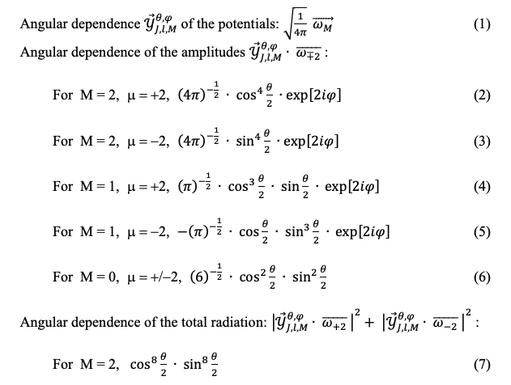
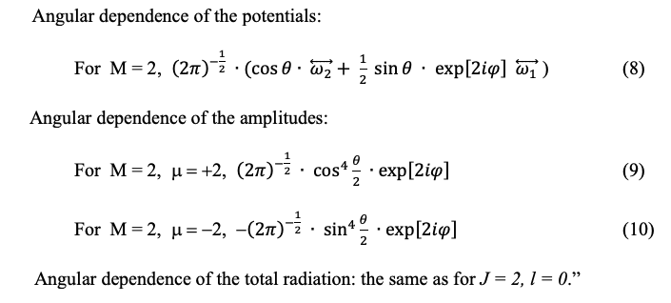
1. 1964 Halpern & Laurent - the Gravitational Radiation of Microscopic Systems
1.1, Gravitational radiation for J = 2, l = 0
1.2, Gravitational radiation for J = 2, l = 1
Spinor coupled spherical harmonic tensors were used by Halpern & Laurent to predict the angular distribution of the lowest orders of gravitational radiation from spin 2 transitions

Slide 4

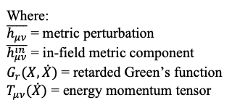
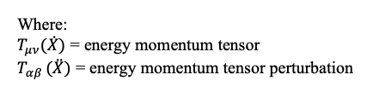


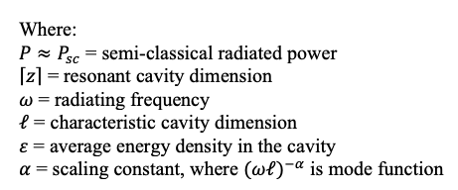

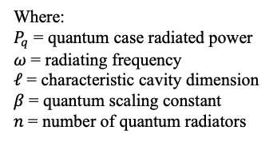
2. 1982 Ford– Gravitational Radiation by Quantum Systems
  2.1 Semi-classical metric perturbation
  2.2 Setting semi-classical & quantum approaches equal
  2.3 Radiated gravitational wave power in semi-classical theory
  2.4 Radiated gravitational wave power
  from quantum theory

Slide 5
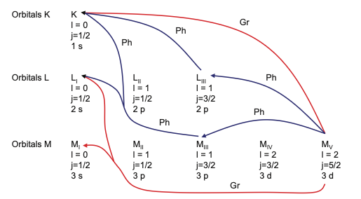
3. 2012 Fontana – spin 2 transitions
  Examples of photon and graviton transitions [3]
  (reprinted with permission)

Slide 6
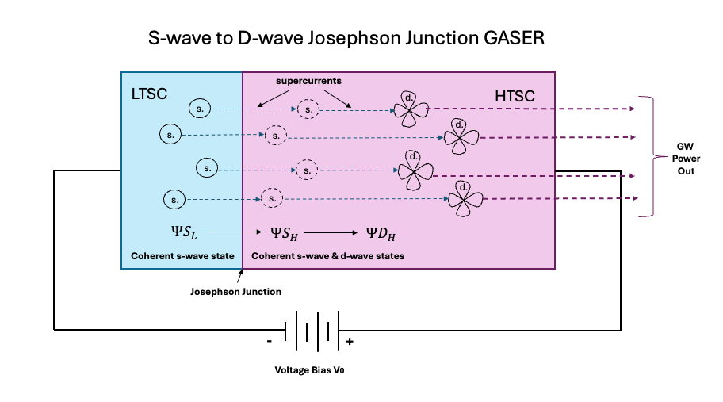
4. Fontana – the S-wave to D-wave SC junction
Graviton emissions at an s-wave to d-wave junction, adapted from [3]
(Here the "s-states" and "d-states" refer to orbital angular momentum symmetries in the superconducting order parameter, not the band structure)

Slide 7


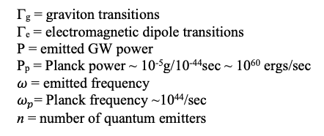
5. Fontana – emission power estimate
  5.1 Spontaneous graviton transitions versus photon transitions
  5.2 Macroscopic power versus Planckian scale
  5.3 Where the following nomenclature applies:

Slide 8
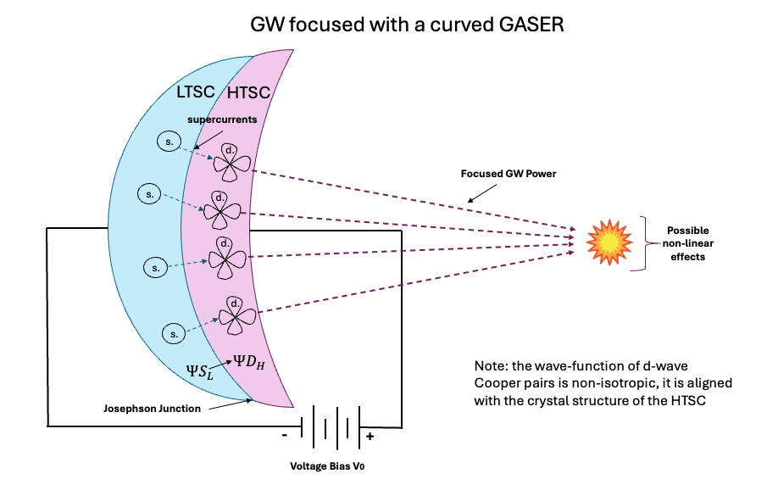
6. The curved GASER
A curved GASER to create an HFGW focal point, adapted from [3], [7]

Slide 9
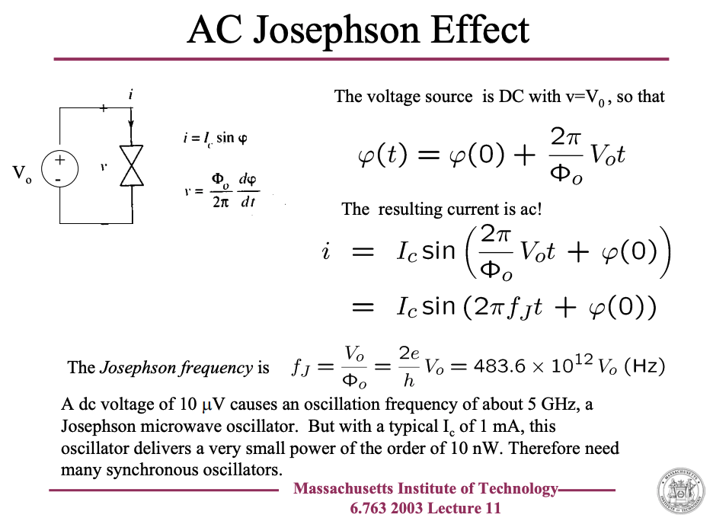
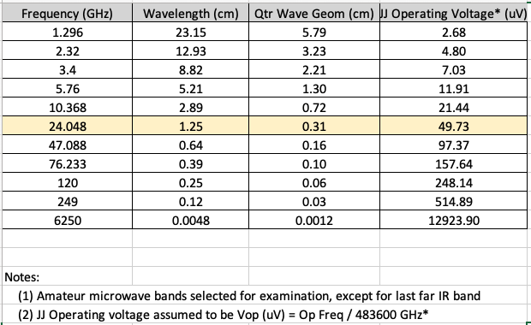
7. Operating Frequency & Voltage
(in concert with the AC Josephson Effect)
Operating voltage determines operating frequency in the AC Josephson effect
Reference slide 14: https://web.mit.edu/6.763/www/FT03/Lectures/Lecture11.pdf

Slide 10
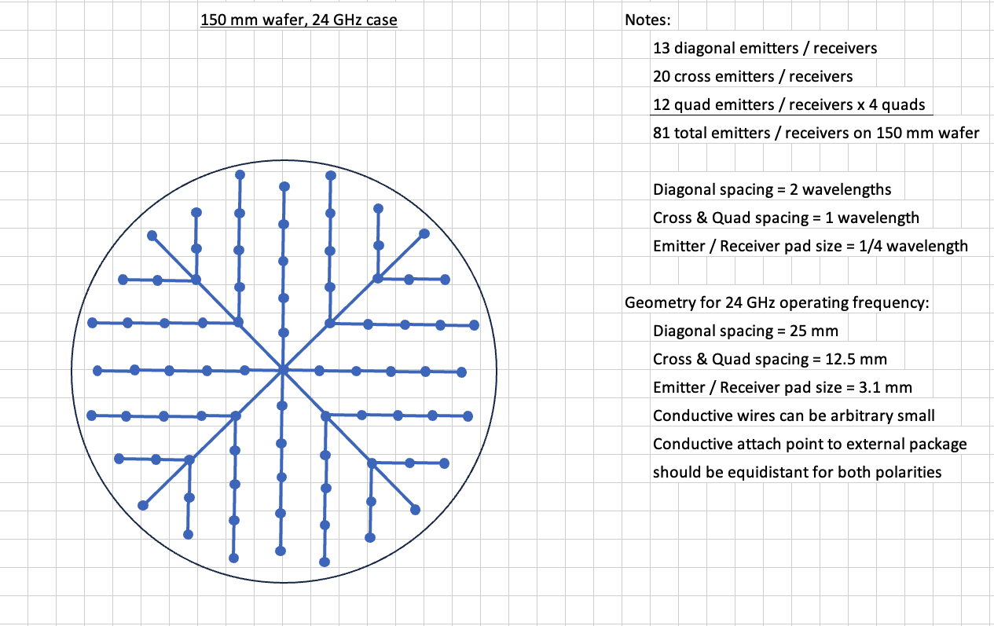
8.1 Wafer Scale Emitters & Detectors
(WSE & WDE, 150 mm case)
  Phased Array Layout Example for 150 mm (6”) Wafer Scale Emitter / Detector

Slide 11
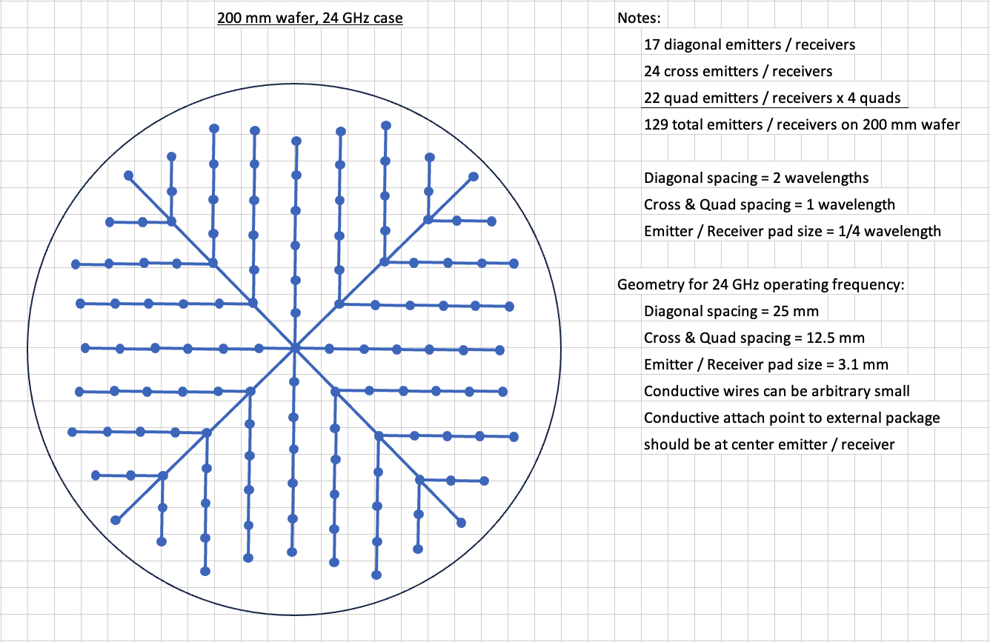
8.2 Wafer Scale Emitters & Detectors
(WSE & WDE, 200 mm case)
  Phased Array Layout Example for 200 mm (8”) Wafer Scale Emitter / Detector

Slide 12
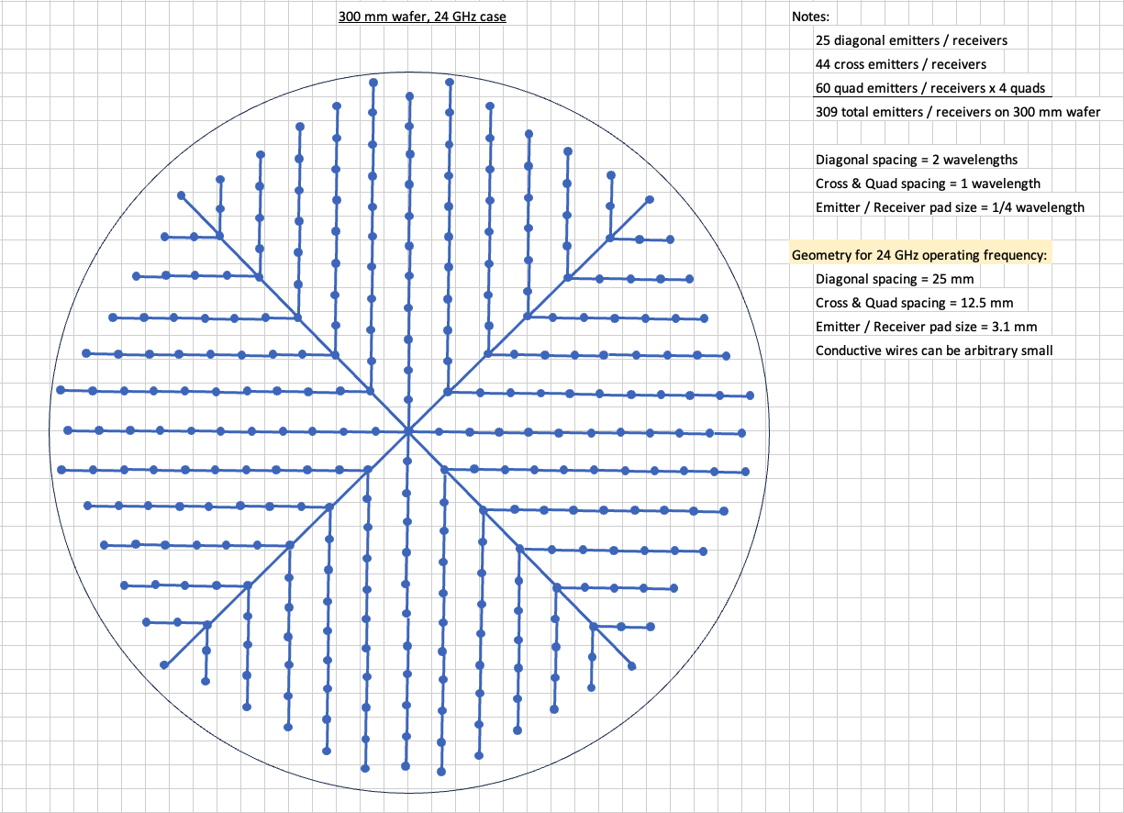
8.3 Wafer Scale Emitters & Detectors
(WSE & WDE, 300 mm case)
  Phased Array Layout Example for 300 mm (11.8”) Wafer Scale Emitter / Detector

Slide 13
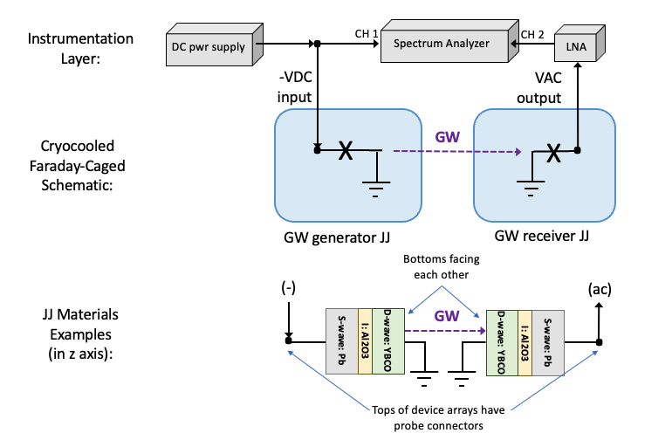
9. GW generation / detection lab setup
  Josephson Junction GW Generation and Detection Lab Setup

Slide 14
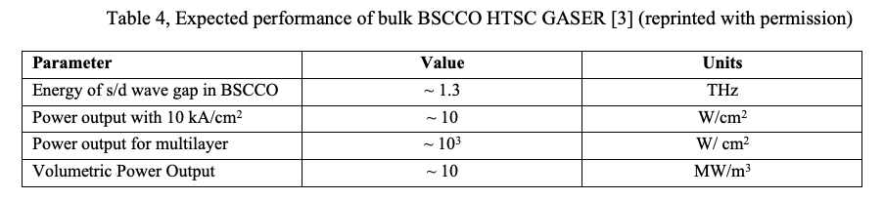
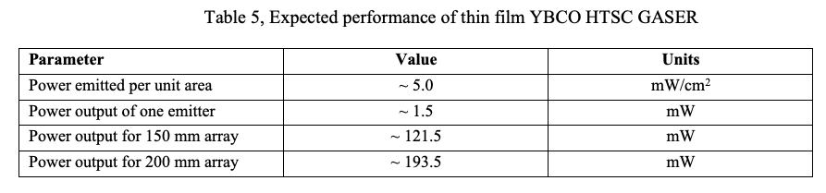

10. Output power predictions
10.1 Fontana’s original estimate for a bulk BSCCO HTSC device
10.2 Expected performance of thin film YBCO/Pb DJJ arrays
10.3 for a per emitter resistance estimate of:

Slide 15
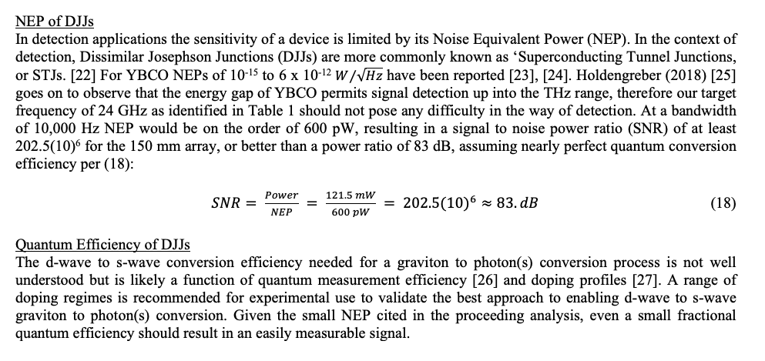
11. Detection sensitivity

Slide 16
12. Conclusions / Next Steps
Conclusions
  12.1 Initial application of GW-JJs would be in GW Com (transmit and receive)
  12.2 Receive only GW-JJ detectors could have value in gravitational astronomy
  12.3 Receive only GW-JJ detectors may also hold value in SETI (Search for Extraterrestrial Intelligence) efforts
Next Steps
  12.4 Theoretically estimate D-wave to S-wave quantum efficiency
  12.5 Explore the Atanasov JJ configuration (versus Fontana’s)
  12.6 Build and test Fontana configuration as described on chart 9.

Slide 17
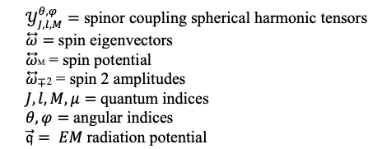
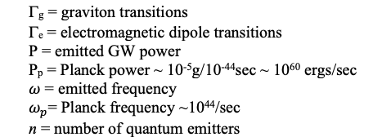
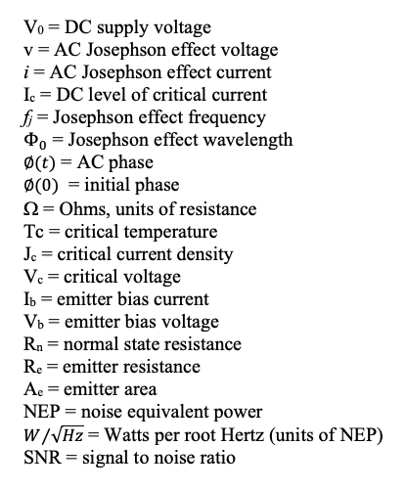
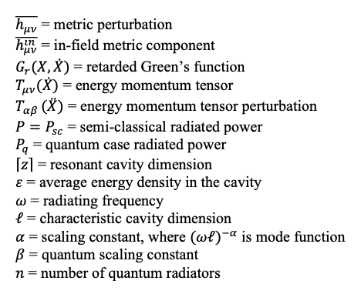
13. Nomenclature
  13.1 Halpern & Laurent Nomenclature
  13.2 Ford Nomenclature
  13.3 Fontana Nomenclature
  13.4 Experiment Design Nomenclature

Slide 18
14. Technical References
[1] Overduin and Plendl (2006), Leopold Ernst Halpern and the Generalization of General Relativity, https://arxiv.org/pdf/gr-qc/0608129, accessed 12/11/2025.
[2] Halpern and Laurent (1964), On the Gravitational Radiation of Microspoic Systems. Il Nouvo Cimento, 33, N. 3.
[3] Fontana, Giorgio (2012), High Temperature Superconductors as Quantum Sources of Gravitational
Waves: The HTSC GASER, Gravity-Superconductors Interactions: Theory and Experiment, Gravity-Superconductors Interactions: Theory and Experiment, 2012, 58-73.
[4] Ford, L.H., (1982), Gravitational Radiation by Quantum Systems. Annals of Physics, 144, 238-248.
[5] L. P. Grishchuck and M. V. Sazhin, Zh. Eksp. Teor. Fiz. 65 (1973), 441 Sov. Phys. JETP 38
(1974), 215; Zh. Eksp. Teor. Fiz. 68 (1974).
[6] C. Kiefer (2025), Quantum Gravity (4th ed.). Oxford: Oxford University Press.
[7] G. Fontana (2007), The HTSC GASER, Proceedings of the 2nd Intl. HFGW W.G., 2007.
[8] N.T. Bishop, et al., The interaction of gravitational waves with matter, arXiv:2405.07743v2 [gr-qc]
[9] Massachusetts Institute of Technology 6.763 2003 Lecture 11, AC Josephson Effect, https://web.mit.edu/6.763/www/FT03/Lectures/Lecture11.pdf, accessed 12/23/2025.
[10] Amateur bands reference: https://rrra.org/post/2017/08/05/an-inexpensive-introduction-to-10ghz-microwave/#footnotes, accessed 12/28/2025.
[11] Wafer Electronics Sizes, https://en.wikipedia.org/wiki/Wafer_(electronics)#cite_note-f450c-13, accessed 12/23/2025.
[12] M. Moßle and R Kleinerm (1999), c-axis Josephson tunneling between Bi2Sr2CaCu2O8 x and Pb, PRB 59, 4486-4496.
[13] Horng, et al. (2000), Superconducting Pairing Symmetry in YBa2Cu3O7ix from a Study of Josephson Tunnel Junctions, Chinese Journal of Physics, 38, (2-II), 262-267.
[14] Physics Today, 04/01/2005, High-Temperature Cuprate Superconductors Get to Work, https://physicstoday.aip.org/features/high-temperature-cuprate-superconductors-get-to-work, accessed 12/28/2025
[15] J.L. MacManus-Driscoll, and S.C. Wimbush (2011), IEEE Transactions on Applied Superconductivity 21, (3), 2495-2500.
[16] T. Shen et al. (2022), White Paper on High Temperature Superconducting Bi-2212 Magnets for Energy Frontier Circular Colliders, Proceedings of the US Community Study on the Future of Particle Physics (Snowmass 2021)
[17] Wikipedia, List of Superconductors (element portion) https://en.wikipedia.org/wiki/List_of_superconductors, accessed 12/23/2025.
[18] M. Lyatti, et al., (2024), Quantum size effects in ultra-thin YBCO films, Scientific Reports, www.nature.com
[19] K. A. Kouznetsov (1997), C-axis Josephson Tunneling Between YBa2Cu3O7-δ and Pb: Direct Evidence for
Mixed Order Parameter Symmetry in a High-Tc Superconductor, https://arxiv.org/pdf/cond-mat/9705283, accessed 12/23/2025.
[20] Gu, et al., (2019), Directly visualizing the sign change of d-wave superconducting gap in BSCCO by phase-referenced quasiparticle interference, Nature Communications, https://www.nature.com/articles/s41467-019-09340-5, accessed 1/10/2026.
[21] M. Ohkubo, et al. (2022), Standard measurement method for normal state resistance and critical current of resistively shunted Josephson junctions, Supercond. Sci. Technol. 35 045002.
[22] ESA website ‘Superconducting Tunnel Junction (STJ),’ last updated 9/01/2019, https://sci.esa.int/s/wxDBYEw, accessed 12/23/2025.
[23] Rogalski and Sizov (2011), Terahertz detectors and focal plane arrays, Opto−Electron. Rev., 19, no. 3, 2011
[24] C. C. Grimes et al. (1968), Josephson-Effect Far-Infrared Detector, Journal of Applied Physics, 39, No. 8.
[25] E. Holdengreber, A. G. Moshe, M. Mizrahi, V. Khavkin, S. E. Schacham & E. Farber (2018): High sensitivity high Tc superconducting Josephson junction antenna for 200 GHz detection, Journal of Electromagnetic Waves and Applications, https://www.tandfonline.com/doi/full/10.1080/09205071.2018.1535333
[26] Macklin, et al. (2024), A near–quantum-limited Josephson traveling-wave parametric amplifier, Science, 350, (6258), 307-310.
[27] J. Tahir-Kheli, et al. (2023), Potential Major Improvement in Superconductors for High-Field Magnets, https://arxiv.org/abs/2304.06171, accessed 12/23/2025
[28] G.V. Stephenson, et al. (2019), Extended Cases of Laboratory Generated Gravitomagnetic Field Measurement Devices, Journal of High Energy Physics, Gravitation and Cosmology, 5, 375-394.
[29] G.V. Stephenson (2021), High Index SMES Device for Gravitomagnetic Field Generation, Journal of High Energy Physics, Gravitation and Cosmology, 7, 367-376.
[30] Gorlik, et al., (2018), Generation and detection of high frequency gravitational waves at intensive electromagnetic excitation, IOP Conf. Series: Journal of Physics: Conf. Series, 1051, 012001.
[31] V. Atanasov (2019), Gravitational wave emission from quadrupole Josephson junction device, https://arxiv.org/pdf/1909.01732, accessed 12/23/2025
[32] V. Atanasov and A. Saxena (2023), Rapid mass oscillations for gravitational wave emission: superconducting junctions, https://arxiv.org/abs/2307.00503, accessed 12/23/2025
[33] J. Tahir-Kheli, et al. (2023), Potential Major Improvement in Superconductors for High-Field Magnets, https://arxiv.org/abs/2304.06171, accessed 1/03/2026
[34] Yung-Yeh Chang, et al. (2025), A mechanism for quantum-critical Planckian metal phase in high-temperature cuprate superconductors, Rep. Prog. Phys. 88 048001
[35] G. Fontana (2012), Directions for gravitational wave propulsion, Journal of Space Exploration, https://www.tsijournals.com/articles/directions-for-gravitational--wave-propulsion.pdf, accessed 1/03/2026

