Slide 1
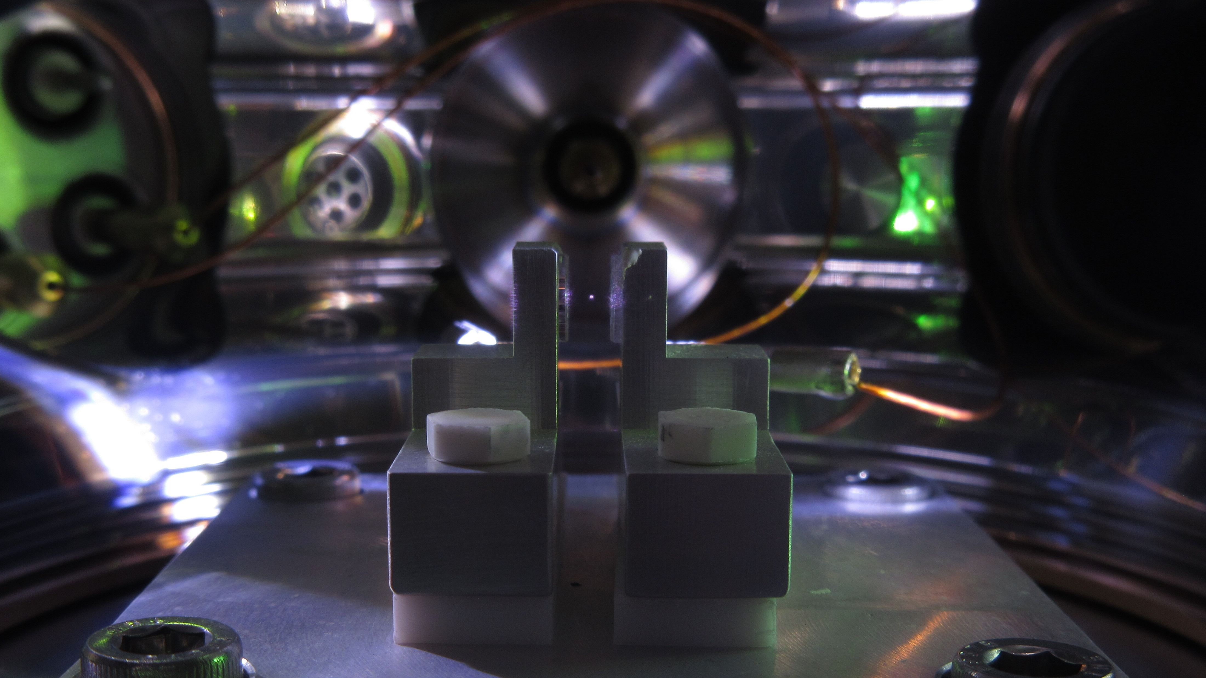


Optomechanical sensors for fundamental physics
David Moore, Yale
SLAC Summer Institute
August 11, 2026

Slide 2
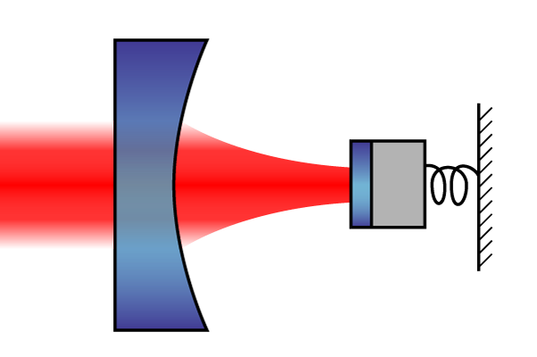
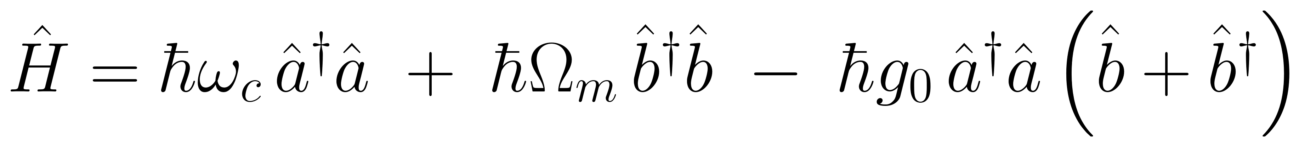
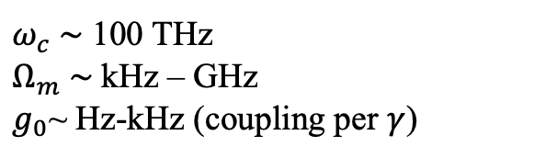
Optomechanics primer
An optomechanical system is a mass whose motion is controlled and read out through light
The canonical system is an optical cavity where one mirror is free to move:
Two coupled harmonic oscillators (light and mechanical motion)
  Each photon exerts a tiny force on the mirror, and mirror’s motion imprints phase on light
As we’ll see in a minute, many other systems that at first appear very different in geometry have this same basic quantum description
Energy per phonon
Phonon number (mechanical resonator)
Mirror displacement
Energy per photon
Photon number (optical cavity)
Optomechanical coupling
$ω_{c} \sim$ 100 THz
$Ω_{m} \sim$kHz – GHz
$g_{0}$~ Hz-kHz (coupling per $γ$)
D. Moore, Yale

Slide 3
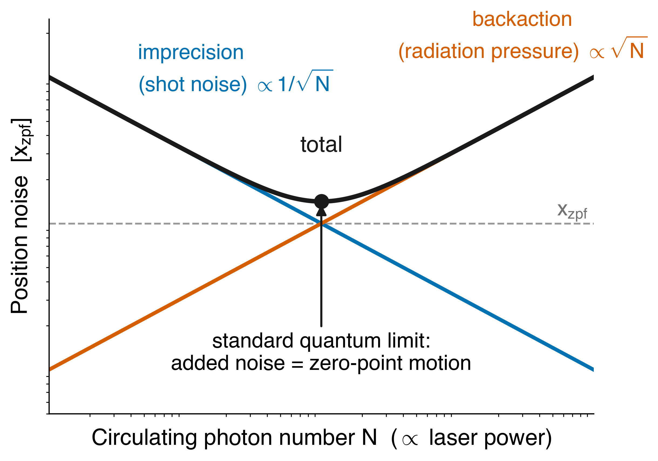
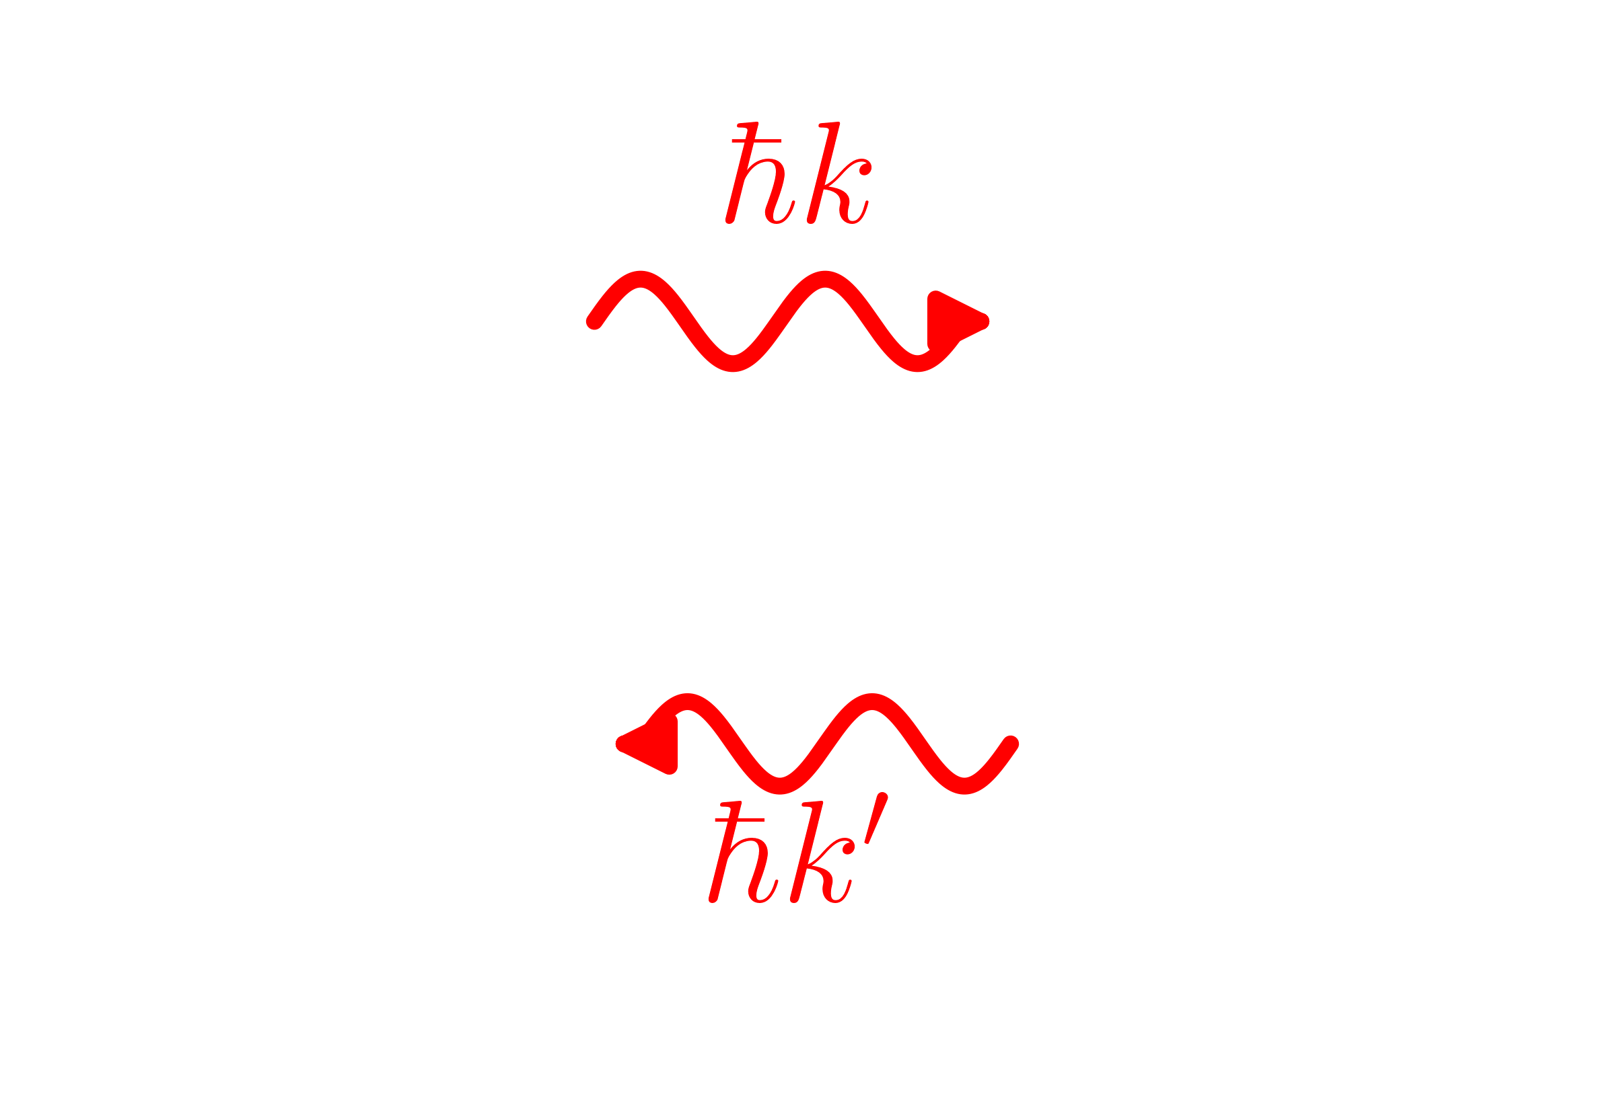
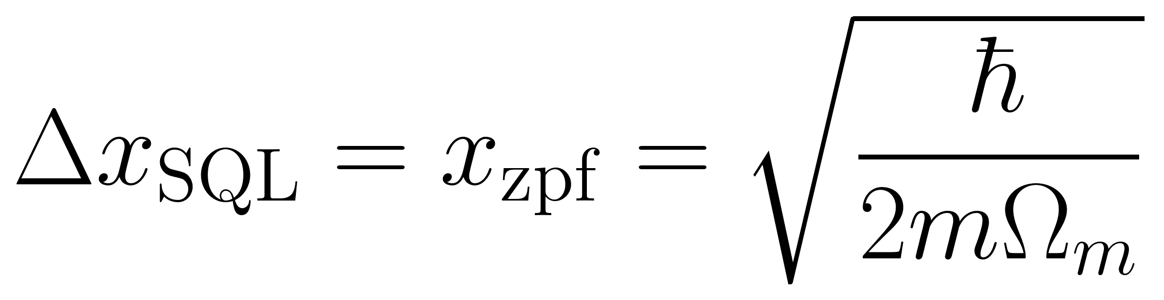
How well can you measure a mass this way?
The phase of the light leaving the cavity encodes the mirror’s position
If we get rid of all sources of noise other than the measurement itself (thermal noise, noisy electronics, …), we are still limited by quantum noise:
Cartoon of imprecision and backaction:
  Imprecision: Uncertainty in mirror position due to shot noise fluctuations in measured phase
  Backaction: Fluctuations in mirror position due to shot noise in radiation pressure
Backaction
Imprecision
Noise added by measurement at SQL:
D. Moore, Yale

Slide 4

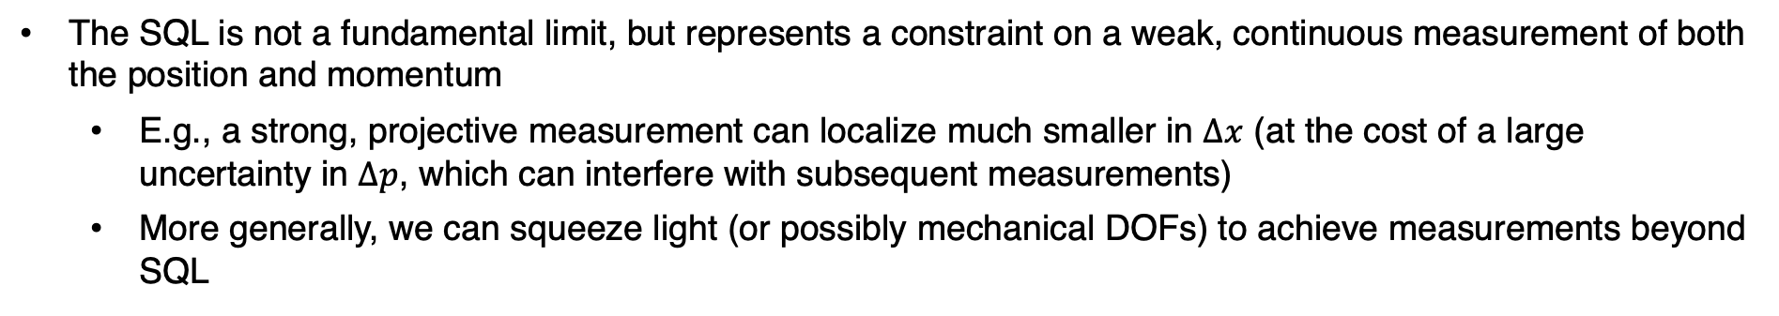

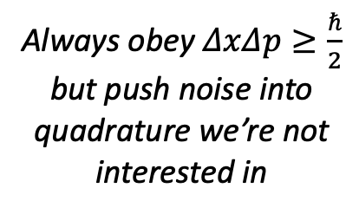






Beyond the SQL
The SQL is not a fundamental limit, but represents a constraint on a weak, continuous measurement of both the position and momentum
  E.g., a strong, projective measurement can localize much smaller in $Δx$ (at the cost of a large uncertainty in $Δp$, which can interfere with subsequent measurements)
  More generally, we can squeeze light (or possibly mechanical DOFs) to achieve measurements beyond SQL
Cartoon of squeezed position measurement:
Unsqueezed
Squeezed
$$\hat{p}$$
$$\hat{p}$$
$$d$$
Always obey $ΔxΔp≥\frac{ℏ}{2}$ but push noise into quadrature we’re not interested in
$$d$$
$$\hat{x}$$
$$\hat{x}$$
$Δ$x
$Δ$x
D. Moore, Yale

Slide 5
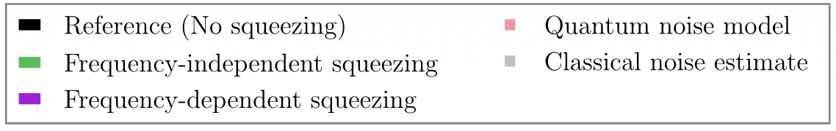
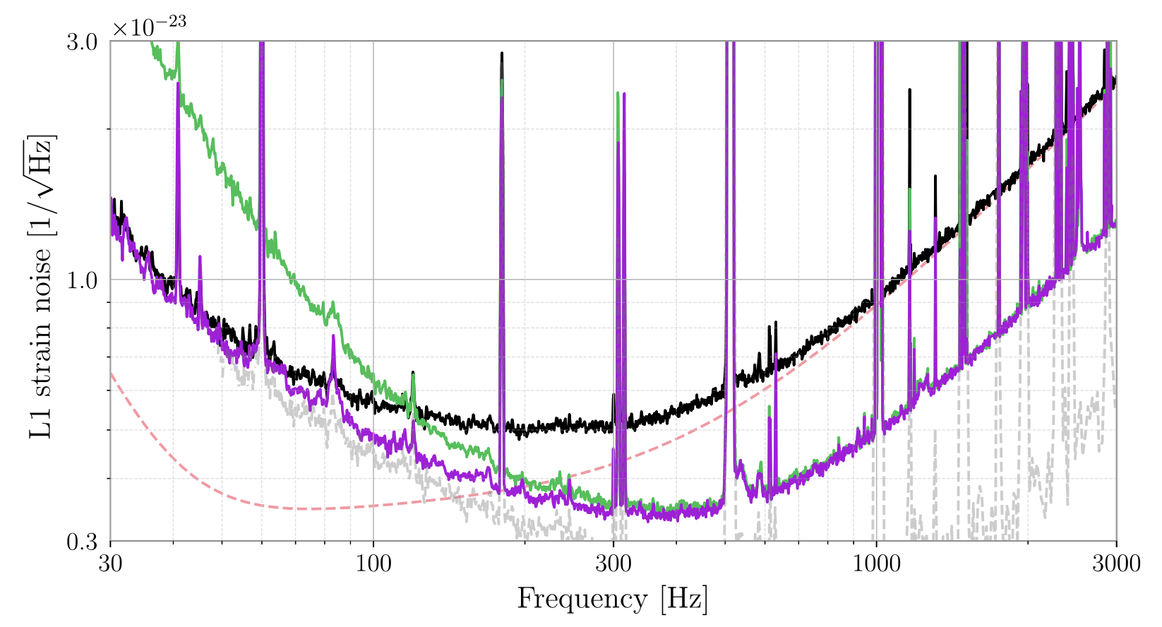
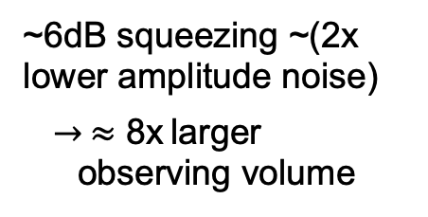
Squeezing in LIGO
Gravitational wave detectors have pioneered many of these techniques, and are now using squeezing to enhance sensitivity
  Notably, first exhausted “classical” sensitivity improvements at high frequency (e.g. more laser power)
LIGO Livingston strain spectrum (ASD):
~6dB squeezing ~(2x lower amplitude noise)
$→ ≈$ 8x larger observing volume
D. Moore, Yale
LIGO O4 Collaboration, PRX 13, 041021 (2023)

Slide 6
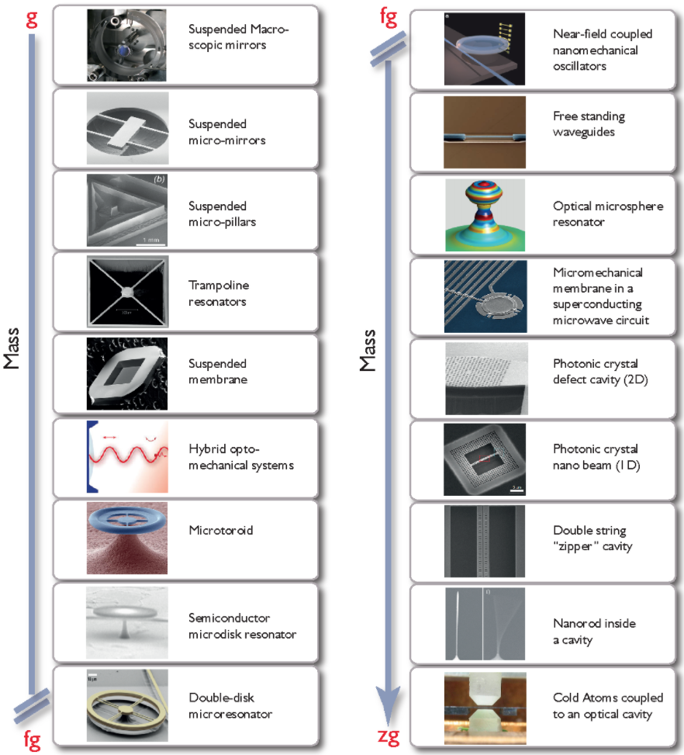
LIGO, VIRGO, KAGRA
Other optomechanical systems
A wide variety of optomechanical systems are revolutionizing how we measure tiny forces
Many types of systems are reaching quantum regime following pioneering work by the gravitational wave community
These sensors are can detect extremely tiny forces or accelerations
  In the large mass range, excellent accelerometers (e.g. gravity, dark matter, …)
  In the sub-ng range, reaching sensitivity to the forces imparted by single sub-atomic particles
For more details see, e.g.:
  “Snowmass 2021: Quantum Sensors for HEP Science,” arXiv:2203.07250.
  "Mechanical Quantum Sensing in the Search for Dark Matter,” Quant. Sci. Tech. 6 024002 (2021), arXiv:2008.06074
  “Searching for new physics using optically levitated sensors,” Quant. Sci. Tech. 6 014008 (2021), arXiv:2008.13197
  “Quantum sensing for particle physics,” Nature Reviews Physics 6, 329 (2024)
  …
Aspelmeyer et al., Rev. Mod. Phys. 86, 1391 (2014)
D. Moore, Yale

Slide 7
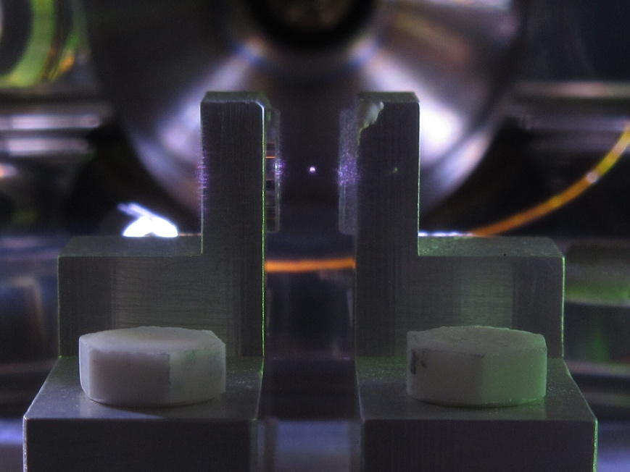
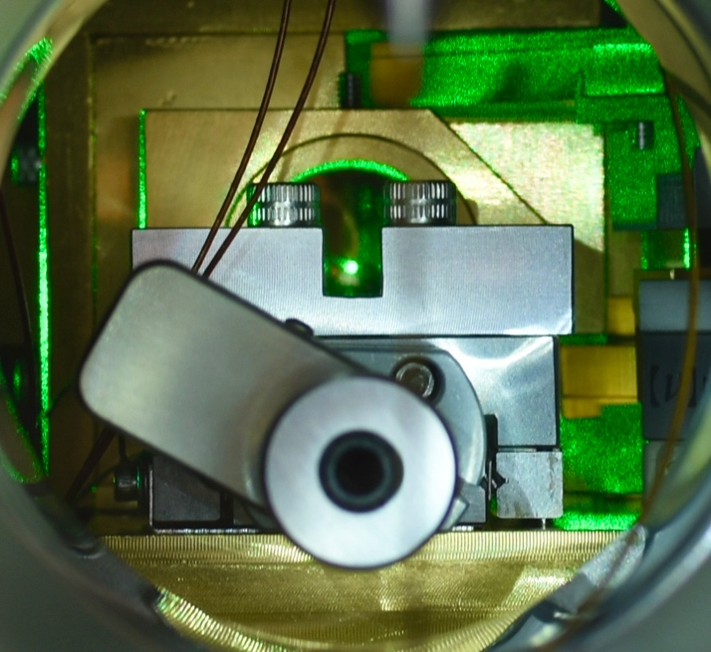
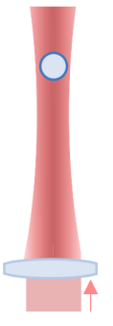
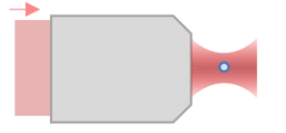
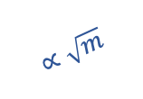

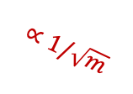


Photographs of trapped nano/micro particles at Yale:
Levitated optomechanics
Nano- to micro-sized dielectric masses can be optically trapped with ~100 mW of laser power
Levitated masses are isolated both electrically and thermally
  Ultra-low decoherence allows quantum control of motional degrees of freedom
  Force sensitivities at the zN level, with acceleration sensitivities near a nano-g
Levitation trap
(~1 – 30 𝜇m):
Highly focused tweezers (~0.1 – 1𝜇m):
~1 pg – 30 ng
~1 fg – 1 pg
Force and acceleration sensitivity vs particle mass:
10⁻¹⁸
$$∝\sqrt{m}$$
10⁻⁵
10⁻¹⁹
10⁻⁶
Force sensitivity [N/$\sqrt{Hz}$]
Accel. sensitivity [g/$\sqrt{Hz}$]
10⁻²⁰
10⁻⁷
$$∝1/\sqrt{m}$$
10⁻²¹
10⁻⁸
$$\vec{g}$$
fg
pg
ng
Particle mass
Moore and Geraci, Quantum Sci. Technol. 6 014008 (2021)
D. Moore, Yale

Slide 8
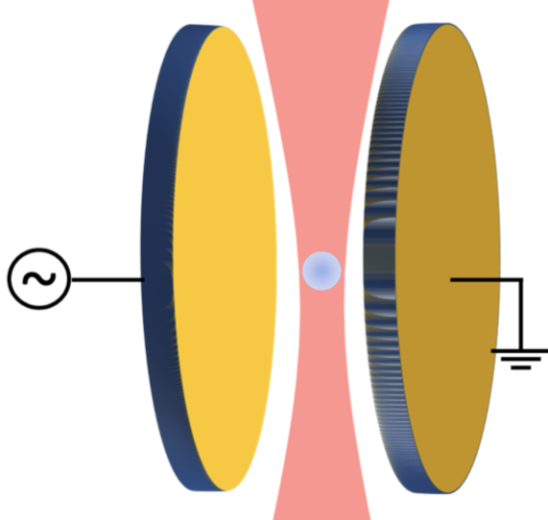
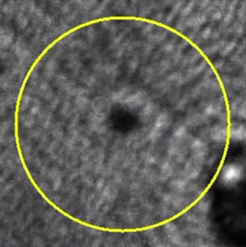
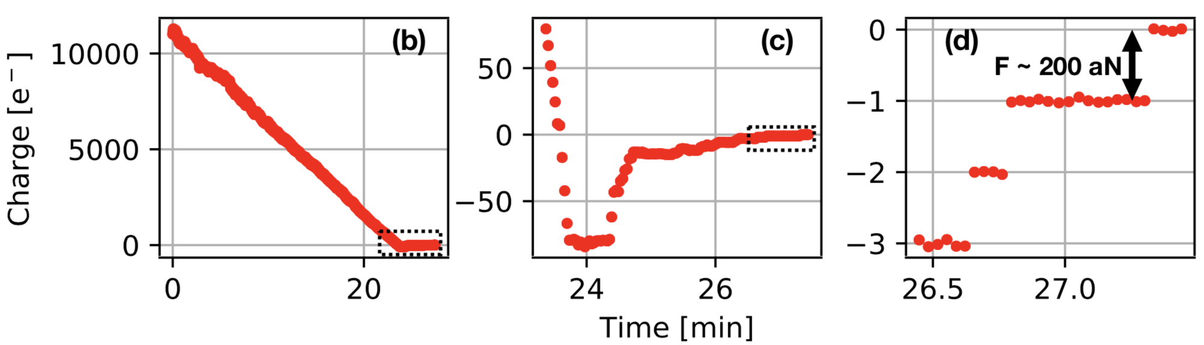
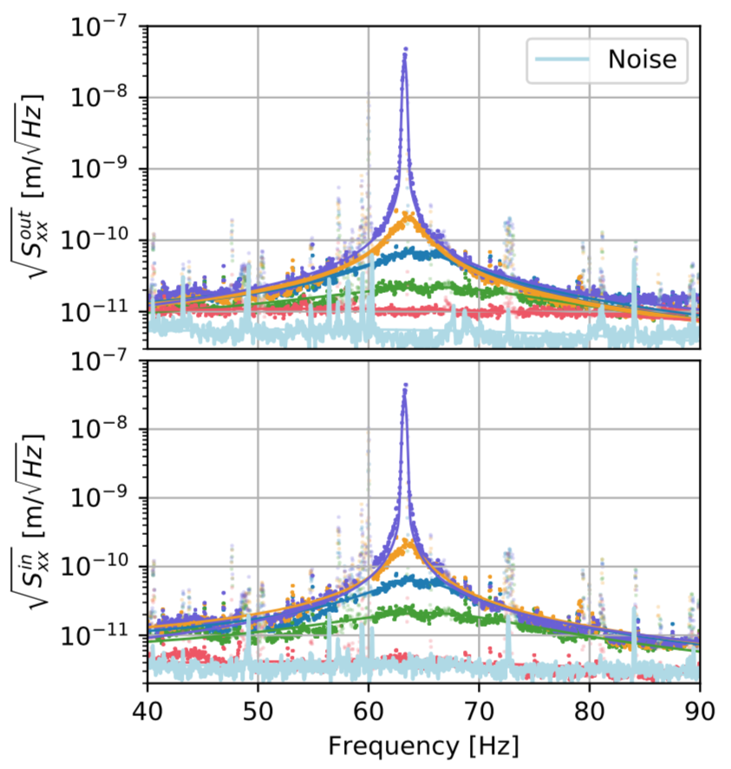
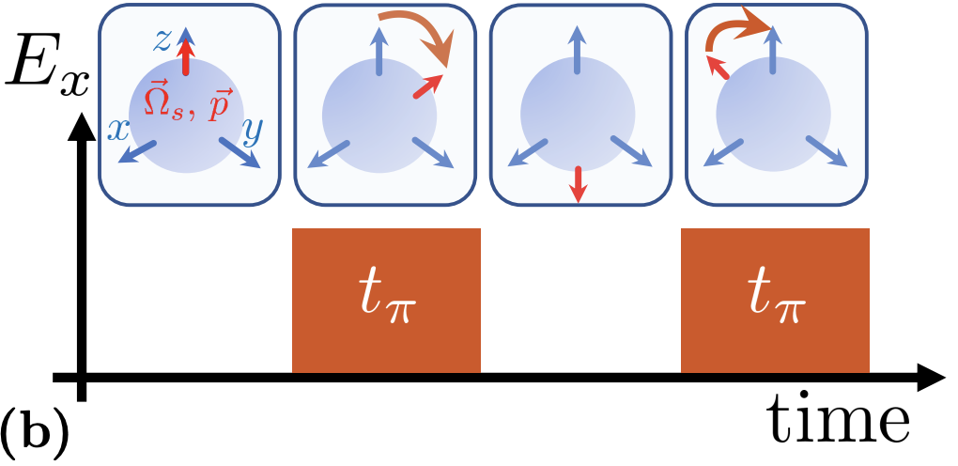

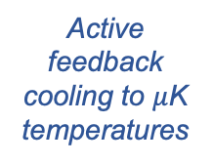


Experimental sequence (>ng spheres)
25 mm
Step 1: Trap sphere (~1 mbar)
Step 2: Electrically neutralize
q_{init} >10⁴ e⁻
~1-10 mm
Pump to $≲$10⁻⁷ mbar
E ~ 1 V/mm
Piezo stack
Monteiro et al., PRA 101, 053835, arXiv:2001.10931(2020)
Monteiro et al., PRA 101, 053835, arXiv:2001.10931(2020)
Step 4: Cool center-of-mass mode
Step 5: Orient electric dipole moment
Step 3: Stabilize spin
Optically spin to >MHz frequency
$$ω\sim MHz$$
Active feedback cooling to $μ$K temperatures
Out-of-loop sensor
Apply electric field (if desired)
$50±22 μ$K
p₀
Afek et al., PRA 104, 053512, arXiv:2108.04406 (2021)
Monteiro et al., PRA 97, 051802(R), arXiv:1803.04297 (2018)
Monteiro et al., PRA 101, 053835, arXiv:2001.10931(2020)
Monteiro et al., PRA 96, 063841, arXiv:1711.04675 (2017)

Slide 9
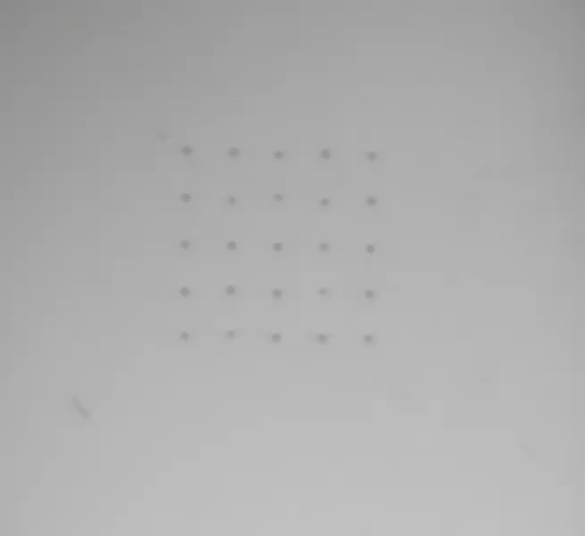
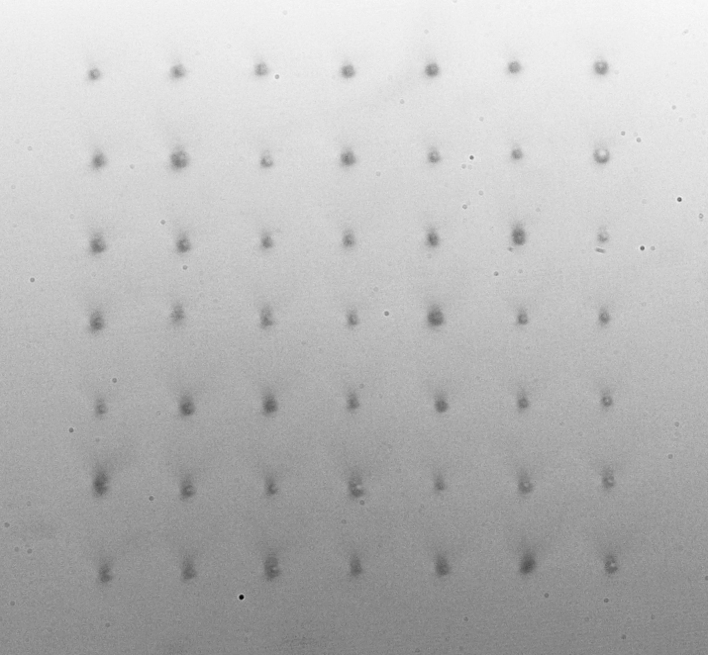

Microsphere arrays (Yale)
Also upgraded our system with high power laser (100 W) to demonstrate first microparticle arrays up to ~10 x 10 in vacuum
Similar technology to tweezer arrays for neutral atom quantum computing
  Additionally require closed loop feedback on trap positions
25 spheres = 10¹⁵ atoms!
7x7 array of spheres in vacuum:
Simplified schematic:
~500 $μ$m
Played at 8x speed
D. Moore, Yale
9
Siegel et al. PRA 111, 033514 (2025)

Slide 10
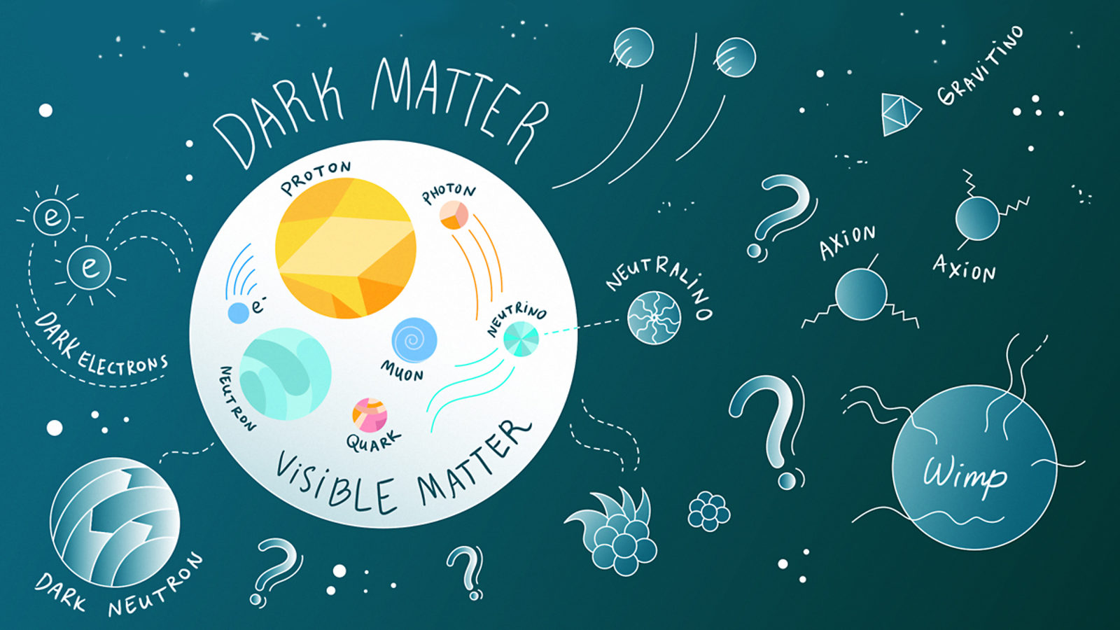
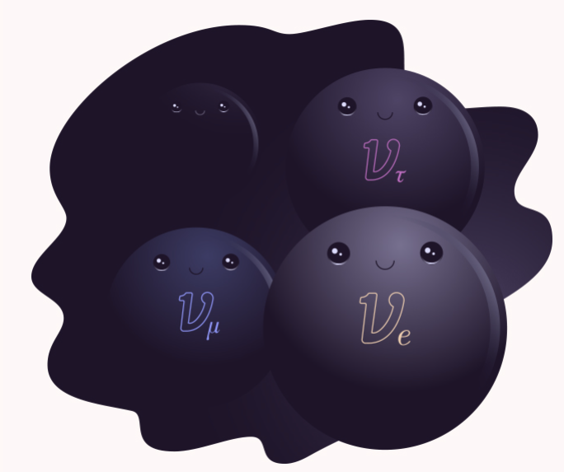
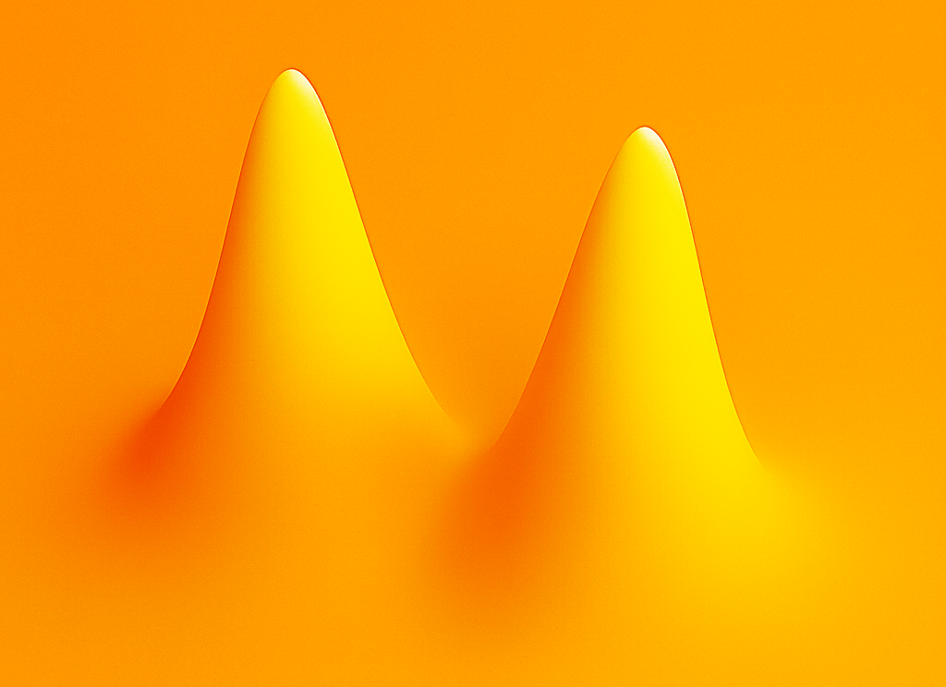
Optomechanical sensors for the “invisible” Universe
Dark matter
Neutrinos
Gravity
https://www.symmetrymagazine.org/article/december-2013/four-things-you-might-not-know-about-dark-matter
https://www.symmetrymagazine.org/article/the-hidden-neutrino
What is the gravitational field sourced by a massive, delocalized particle?
Are there BSM sources of high frequency gravitational waves?
What is the nature of dark matter?
Can we detect forces imparted by dark matter interactions in the lab?
Are there heavy, right-handed neutrinos that haven’t been observed?
What are the masses of the light neutrinos?
These questions remain unanswered largely due to the extremely weak interactions of interest
  Quantum measurement/control of much larger masses than single atoms/ions may allow new tools to prove these phenomena
Optomechanical systems are ideal for searching for new interactions that couple to massive objects (compare e.g. to sensors for couplings to E&M fields [talk by D. Speller])
D. Moore, Yale

Slide 11
Dark matter
https://www.symmetrymagazine.org/article/december-2013/four-things-you-might-not-know-about-dark-matter
D. Moore, Yale

Slide 12
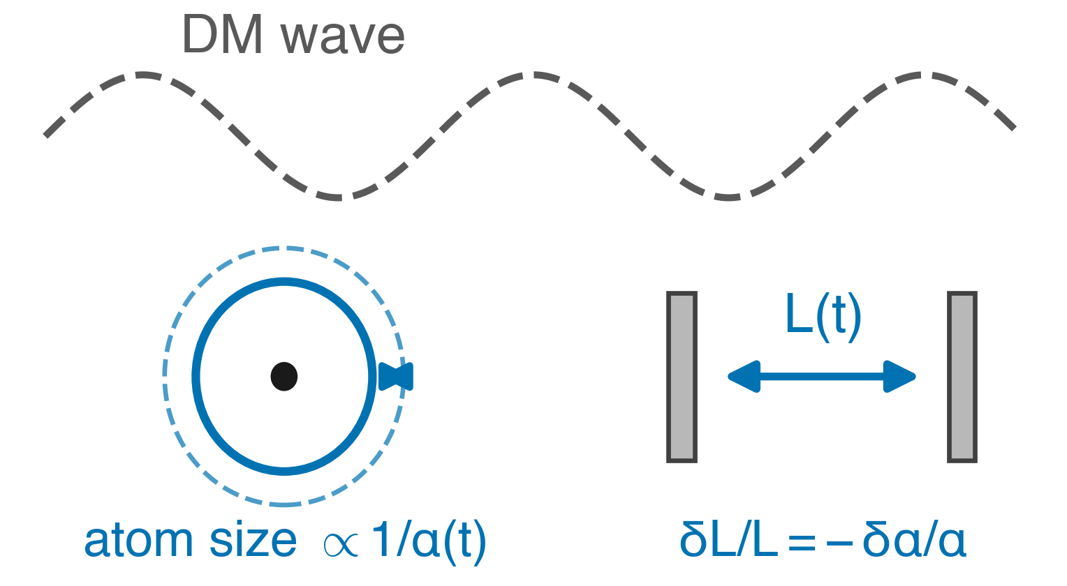
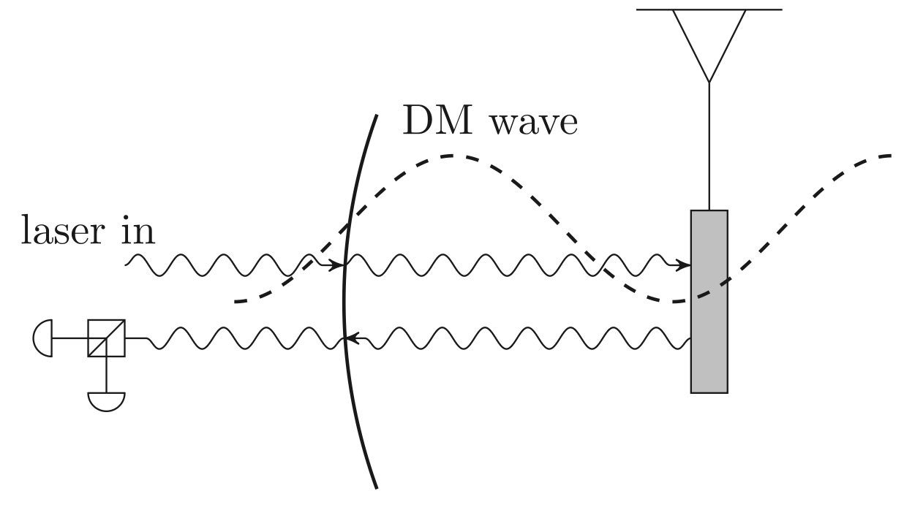
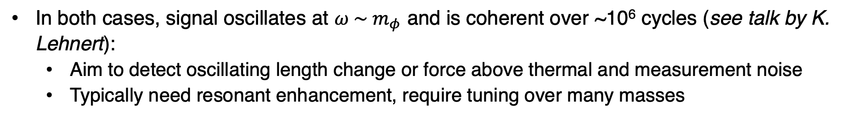
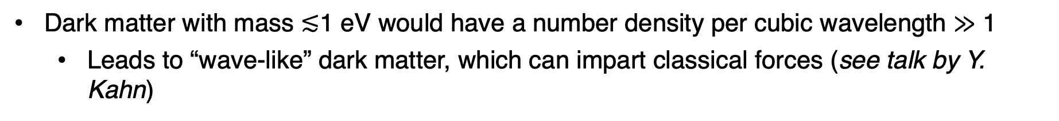
Ultralight dark matter
Dark matter with mass $≲$1 eV would have a number density per cubic wavelength $≫$ 1
  Leads to “wave-like” dark matter, which can impart classical forces (see talk by Y. Kahn)
Scalar (search for oscillating constants):
Vector (search for oscillating force on mass):
Carney et al., New J. Phys. 23 023041 (2021)
Can use clocks, optical cavites, etc. (see talk by V. Xu)
E.g., coupling to B-L pushes on neutrons:
a ≲ 10⁻¹¹ m/s² at 10 kHz [i.e., 10⁻²⁰ N on a μg mass]
In both cases, signal oscillates at $ω \sim m_{φ}$ and is coherent over ~10⁶ cycles (see talk by K. Lehnert):
  Aim to detect oscillating length change or force above thermal and measurement noise
  Typically need resonant enhancement, require tuning over many masses
D. Moore, Yale

Slide 13
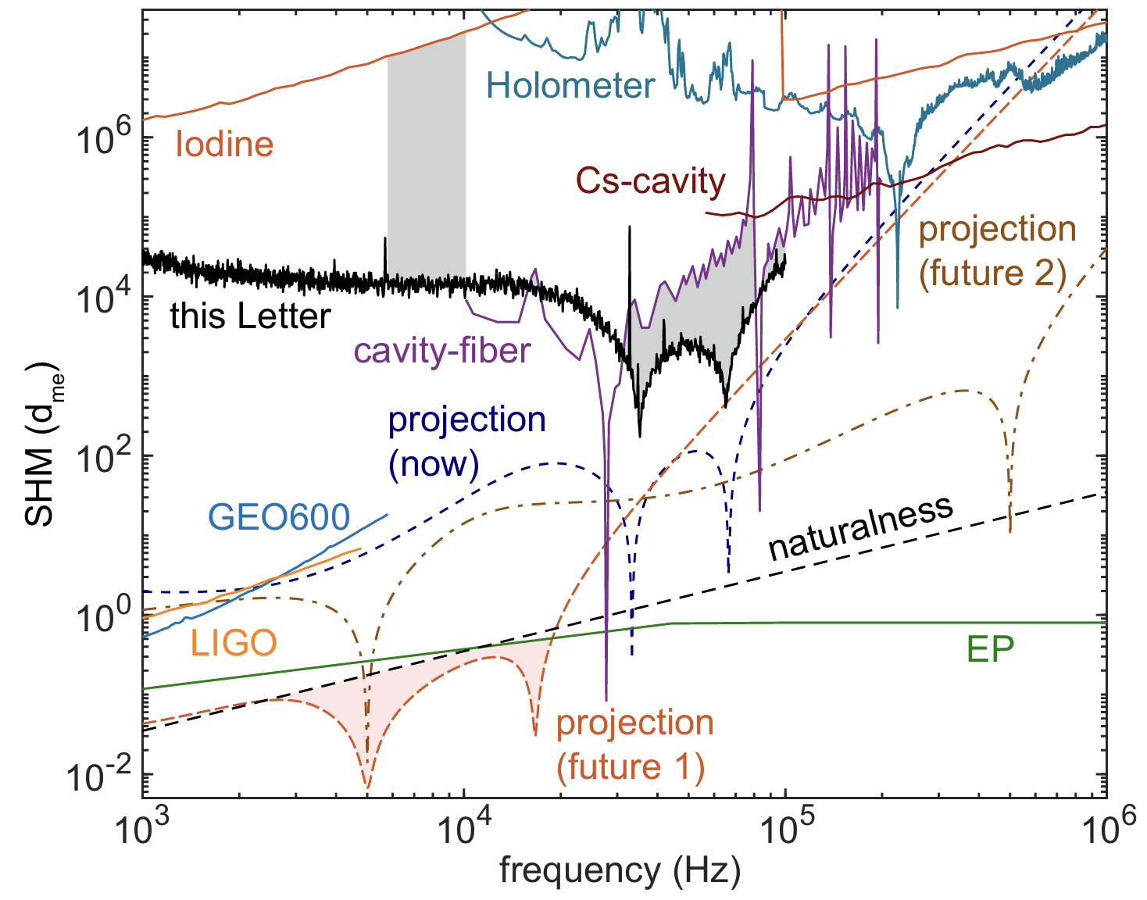
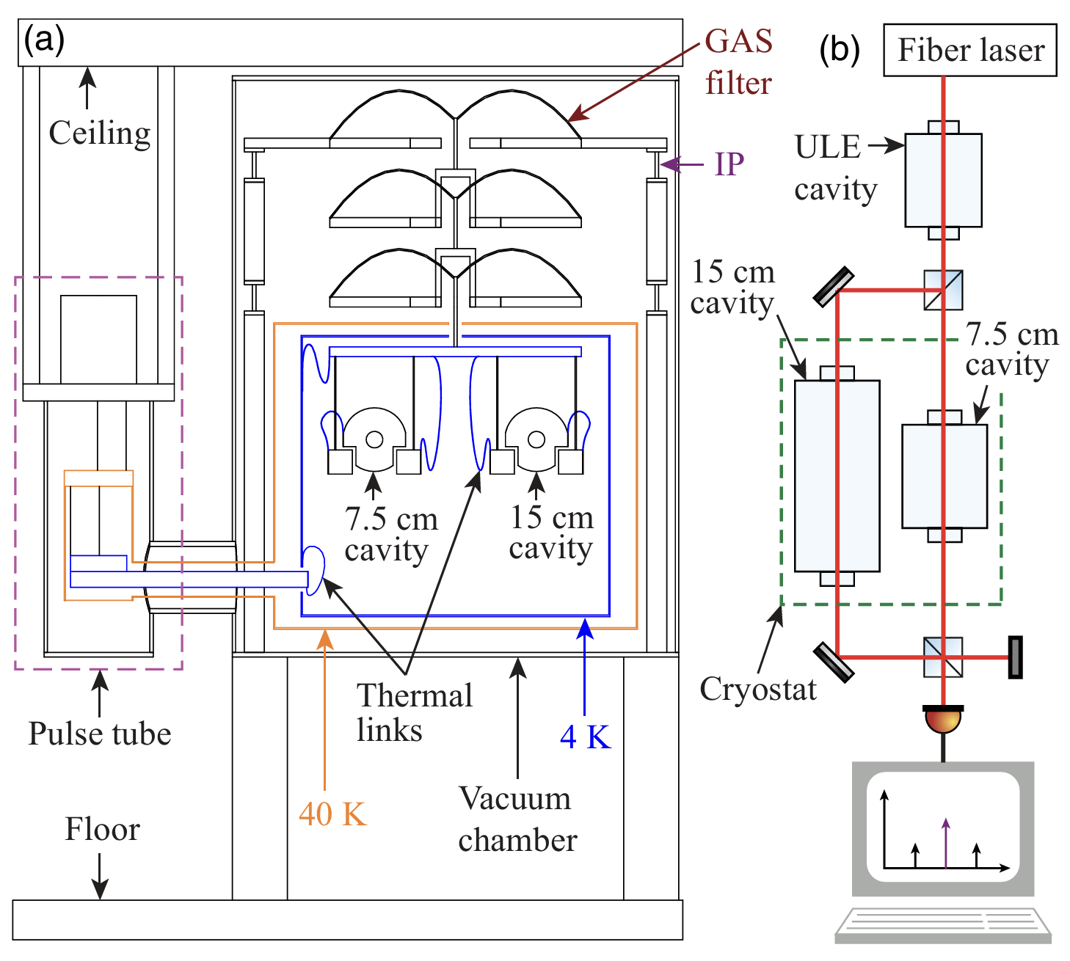
Ultralight dark matter (Optical cavities)
Several experiments are now pursuing these models
  Optical cavity comparisons (Northwestern):
Current and projected sensitivity:
Comparison of two cryogenic cavities:
D. Moore, Yale
Deshpande et al., PRL 135, 261001 (2025)

Slide 14
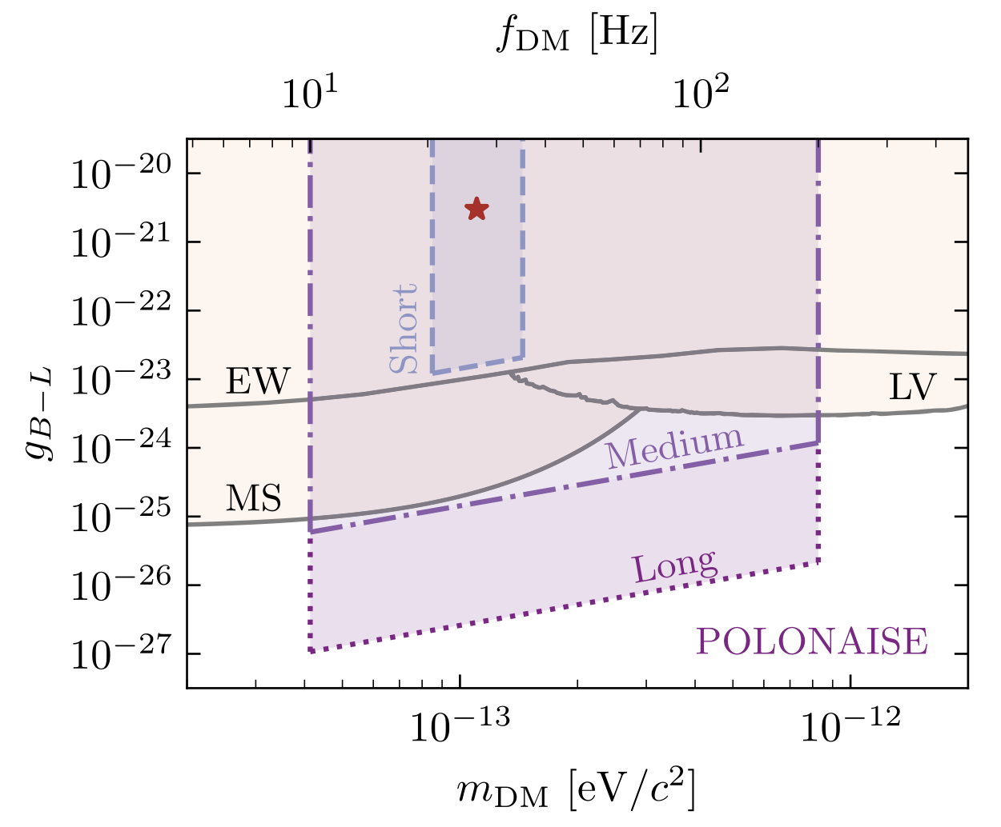
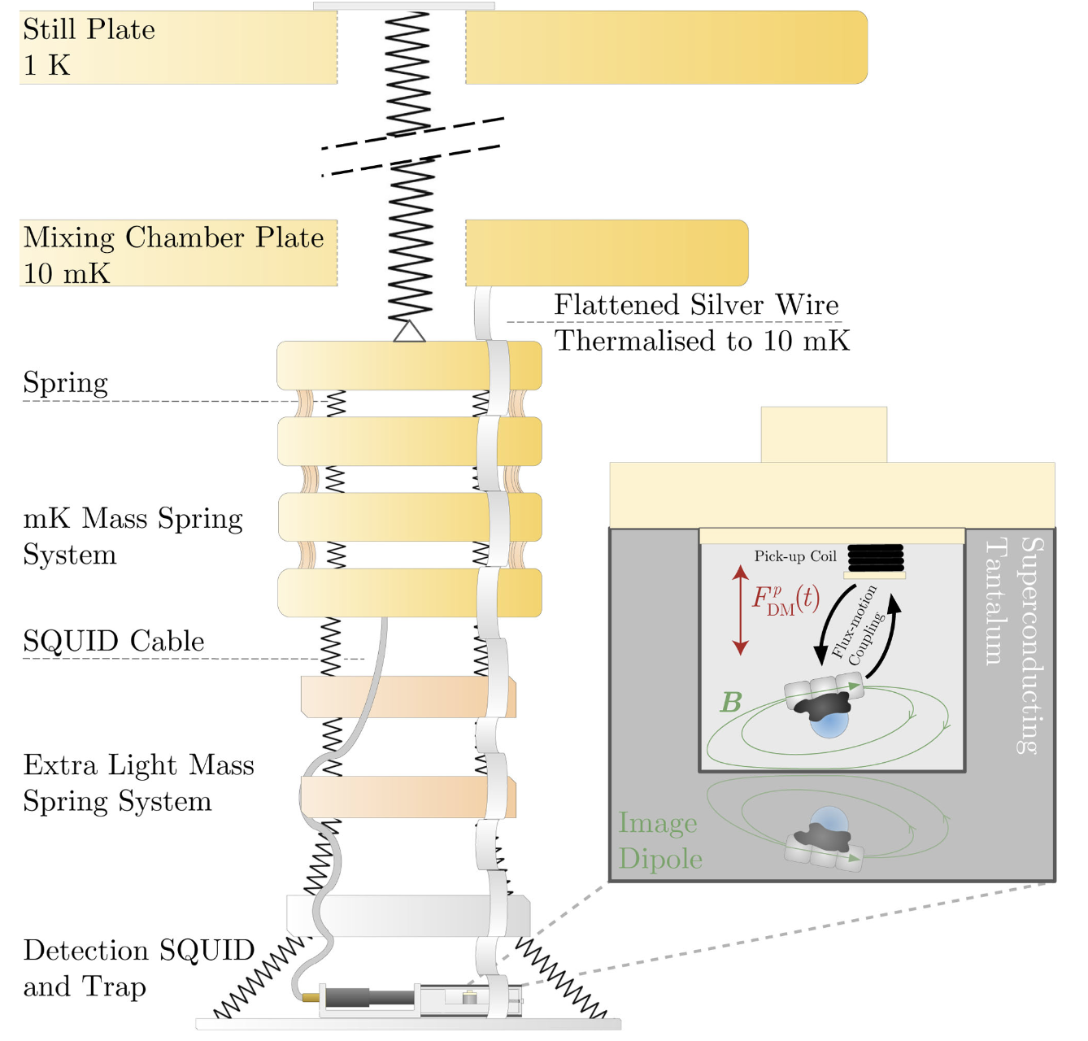
Ultralight dark matter (POLONAISE)
  POLONAISE:
Current and projected sensitivity:
Magnetically levitated 400 ug mass:
2025 result
D. Moore, Yale
Amaral et al., PRL 134, 251001 (2025)

Slide 15
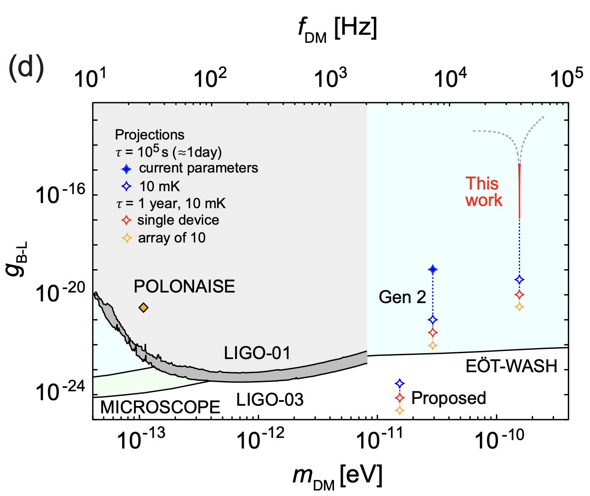
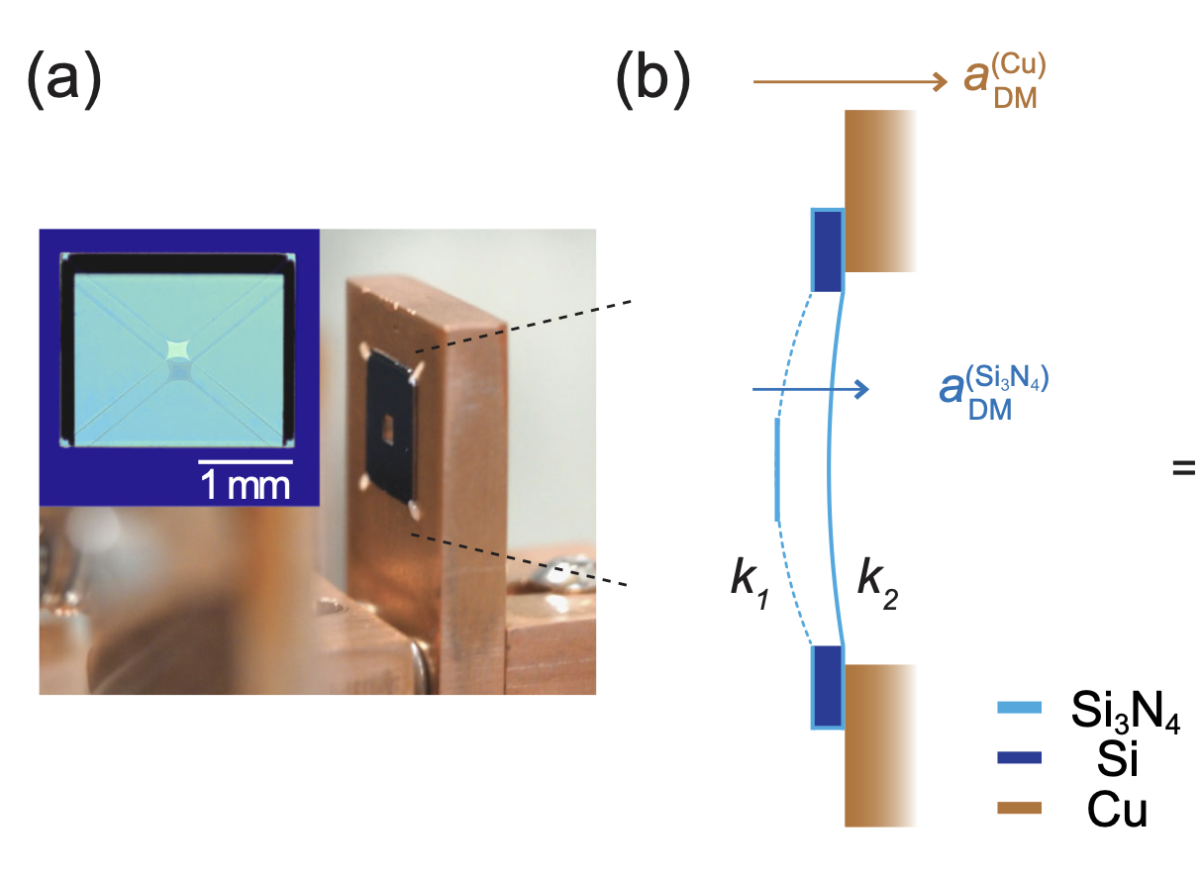
Ultralight dark matter (Trampoline oscillators)
Membrane oscillators (U Arizona/NIST):
Current and projected sensitivity:
Tethered trampoline membrane oscillator:
D. Moore, Yale
Chowdhury et al, PRD 113, L121303 (2026)

Slide 16
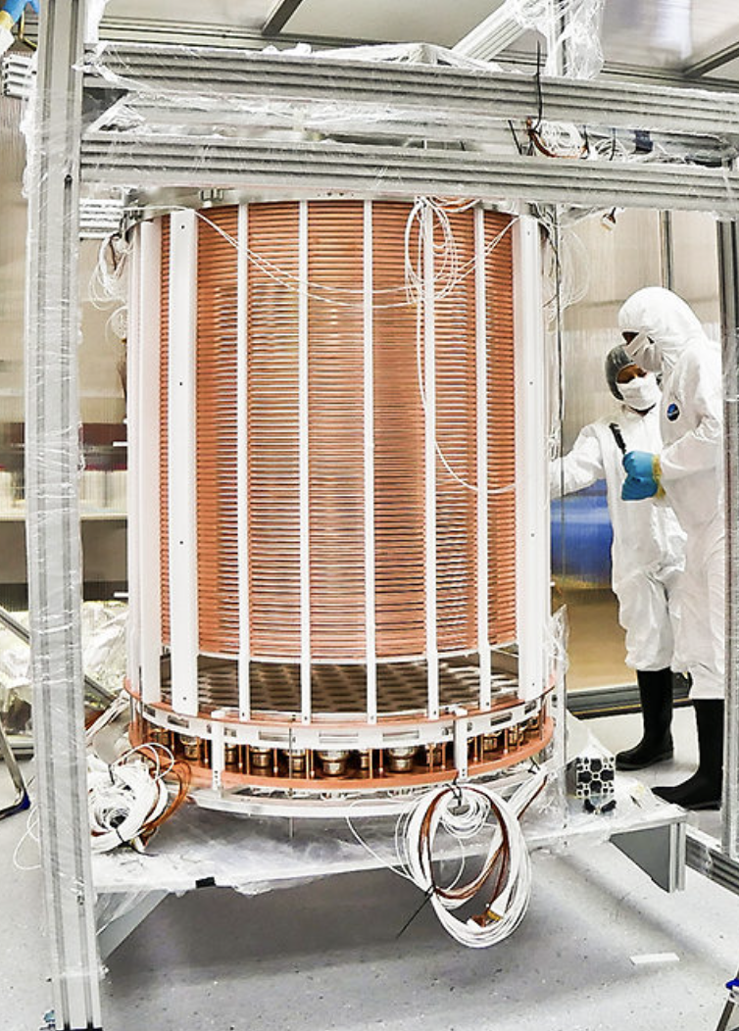
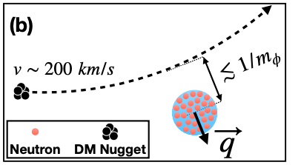
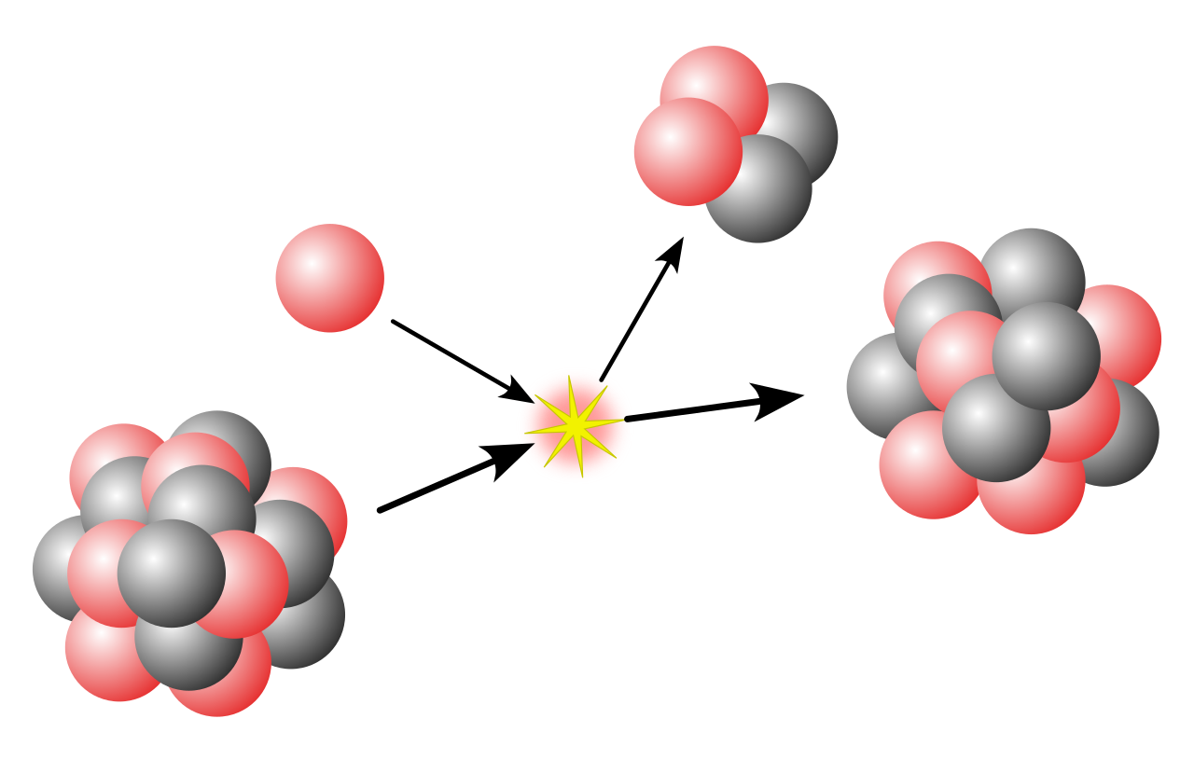
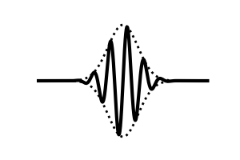

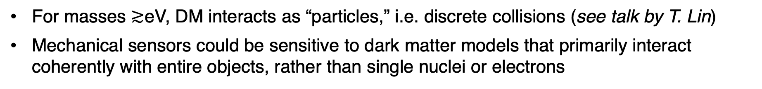
Kinematic detection of (particle) dark matter
For masses $≳$eV, DM interacts as “particles,” i.e. discrete collisions (see talk by T. Lin)
Mechanical sensors could be sensitive to dark matter models that primarily interact coherently with entire objects, rather than single nuclei or electrons
Ton-scale WIMP detectors (e.g. LZ, XENONnT,…):
fg-ng scale trapped objects:
Long range force:
Low momentum transfer:
Xe (A~100)
$$χ$$
$$χ$$
q⁻¹ ~ 10 nm
q⁻¹ ~ 10 fm
Monteiro et al., PRL 125, 181102 (2020), arXiv:2007.12067
Afek et al., PRL 128, 101301 (2022), arXiv:2111.03597
Coherence over an entire nano- or micro-sized object:
Coherence only over a single nucleus:
Rate $∝$ (N_{T})²$σn$
Rate $∝$ N_{T} A² $σn$
Can rival Avogadro’s number!
~ (10⁹)² to (10¹⁴)²
D. Moore, Yale
$≫$10²³
~10⁴

Slide 17
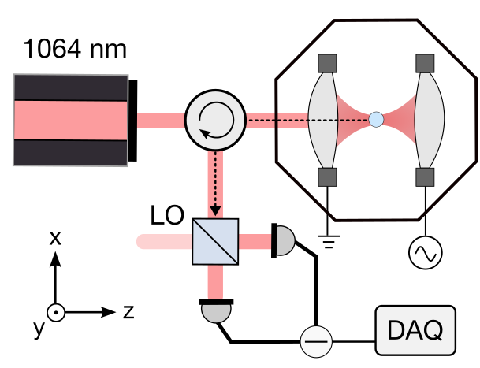
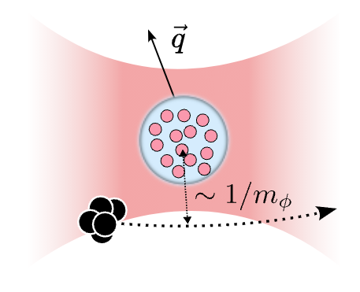
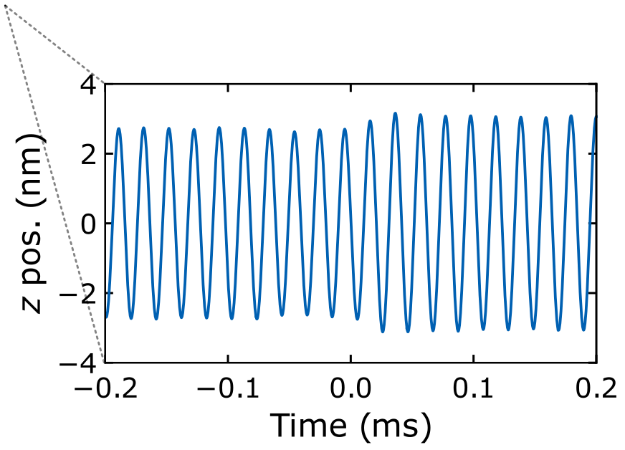

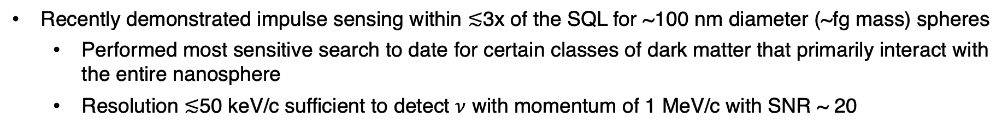
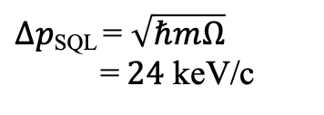
Impulses with nanospheres (Yale)
Recently demonstrated impulse sensing within $≲$3x of the SQL for ~100 nm diameter (~fg mass) spheres
  Performed most sensitive search to date for certain classes of dark matter that primarily interact with the entire nanosphere
  Resolution $≲$50 keV/c sufficient to detect $ν$ with momentum of 1 MeV/c with SNR ~ 20
Schematic of impulse measurement:
Measured force noise, 5 fg particle:
Backaction
$Δpmeas \text{= 65}±9$ keV/c
$Δp\text{SQL}\text{ = }\sqrt{ℏmΩ} \text{=} 24$ keV/c
Imprecision
PRX Quantum 6, 040367 (2025), arXiv:2508.00815
D. Moore, Yale

Slide 18




Natural directionality → any detection would be definitive!
Dark matter search (nanospheres)
Event rate vs sidereal time:
Performed search for dark matter with two nanospheres (total exposure ~5 fg x month)
  Tail of events above Gaussian noise background observed
  Conservatively set new limits on dark matter-neutron coupling, assuming events could either be dark matter or unidentified backgrounds
Measured recoil spectrum:
Limits on dark matter/neutron coupling:
Sphere 2
Sphere 1
D. Moore, Yale
PRX Quantum 6, 040367 (2025), arXiv:2508.00815

Slide 19
Neutrinos
https://www.symmetrymagazine.org/article/the-hidden-neutrino
D. Moore, Yale

Slide 20













Nuclear decays in mechanical sensors
Levitated sensors are now reaching sufficient sensitivity to detect the miniscule forces imparted by single sub-atomic particles
  For weak decays, allows the momentum of each neutrino to be reconstructed on an event-by-event basis
Phase space trajectory:
Example force measurements for nuclear decay:
$α$ decay
$β/$EC decay
$$α$$
$$\vec{p}α$$
$$\vec{p}sph$$
Auger e⁻
x-rays
$$\vec{p}ν$$
$$ν_{e}$$
$$\vec{p}sph$$
10 $μ$m sphere
$σ=$10 MeV/c = 5x10⁻²¹Ns
100 nm sphere
$σ=$10 keV/c = 5x10⁻²⁴ Ns
D. Carney, K. Leach, and DCM, “Searches for massive neutrinos with mechanical quantum sensors,” PRX Quantum 4, 010315 (2023) arXiv:2207.05883
J. Wang et al., “Mechanical detection of nuclear decays,” Phys. Rev. Lett. 133, 023602 (2024), arXiv:2402.13257
See, e.g.:
Magrini et al., Nature 595, 373 (2021)
Tebbenjohanns et al., Nature 595, 378 (2021)
D. Moore, Yale

Slide 21


Nuclear decays in mechanical sensors
Levitated sensors are now reaching sufficient sensitivity to detect the miniscule forces imparted by single sub-atomic particles
  For weak decays, allows the momentum of each neutrino to be reconstructed on an event-by-event basis
Phase space trajectory:
Example force measurements for nuclear decay:
$α$ decay
$β/$EC decay
$$α$$
$$\vec{p}α$$
$$\vec{p}sph$$
Auger e⁻
x-rays
$$\vec{p}ν$$
$$ν_{e}$$
$$\vec{p}sph$$
10 $μ$m sphere
$σ=$10 MeV/c = 5x10⁻²¹Ns
100 nm sphere
$σ=$10 keV/c = 5x10⁻²⁴ Ns
D. Carney, K. Leach, and DCM, “Searches for massive neutrinos with mechanical quantum sensors,” PRX Quantum 4, 010315 (2023) arXiv:2207.05883
J. Wang et al., “Mechanical detection of nuclear decays,” Phys. Rev. Lett. 133, 023602 (2024), arXiv:2402.13257
$${\left(Δp\right)}^{SQL}=\sqrt{ℏmω0}$$
See, e.g.:
Magrini et al., Nature 595, 373 (2021)
Tebbenjohanns et al., Nature 595, 378 (2021)
D. Moore, Yale

Slide 22


Proof-of-principle (gas collisions)
Sensitivity needed to see single room temperature gas molecules collide with the particle similar to 𝜈
  Injected trace levels of heavy gases (Kr, Xe, SF₆) and reconstructed the momentum transfers from individual collisions
Example measured gas collision:
Collision spectrum vs. pressure:
Increasing p
D. Moore, Yale
arXiv:2604.18371

Slide 23





Radioisotope loading ($α$ decays)
As a proof-of-principle, we have detected single 𝛼 decays with >$μ$m sized spheres
  Momentum is ~200 MeV/c (compared to 0.1-1 MeV/c for typical $ν, γ$)
Have demonstrated loading of small quantities of ²¹²Pb into trapped microspheres
Rn-220 decay chain:
Schematic of loading scheme:
²²⁰Rn
²¹⁶Po⁺
Drift in E-field
~100 nm
²¹²Pb
T_{1/2} = 56 s
T_{1/2} = 0.14 s
T_{1/2} = 10.6 h
3 $μ$m diameter SiO₂ sphere
PRL133, 023602 (2024), arXiv:2402.13257
D. Moore, Yale

Slide 24

Detection of single nuclear decays (charge)
Can detect single nuclear decays through the change in net charge of the particle
Example of measured charge changes vs. time:
Auto-discharge
$α/β$ decays
PRL133, 023602 (2024), arXiv:2402.13257

Slide 25
Detection of single nuclear decays (recoil)
Reconstruct recoil of the entire particle correlated with the decay time
Recoil coincident with charge change:
Zoom to decay time:
Signal to noise = 13
PRL133, 023602 (2024), arXiv:2402.13257

Slide 26
Gravity
D. Moore, Yale

Slide 27


High frequency gravitational waves
By incorporating levitated particle in Michelson interferometer, can use high Qs to potentially resonantly enhance high frequency GW signals (10s - 100s of kHz)
Currently under development by Levitated Sensor Detector (LSD) collaboration
LSD Concept:
Projected sensitivity:
Aggarwal et al., PRL 128, 111101 (2022)
D. Moore, Yale

Slide 28
See also talk by D. Carney
Is gravity “quantum”?
Can we experimentally probe fundamental questions about gravity with micron-scale particles:
Gravitational field sourced by classical mass:
Spatial superposition:
?
What is the gravitational field sourced by a spatial superposition?
D. Moore, Yale
Figures from A. Markowitz

Slide 29
See also talk by D. Carney
Is gravity “quantum”?
Can we experimentally probe fundamental questions about gravity with micron-scale particles:
Semiclassical View:
Quantum View:
No entanglement, classical potential
Potential depends on wavefunction, masses entangled
Semiclassical gravity review: Miki et al., PRD 111, 104084 (2025)
Weak field gravity quantized by Bronstein (1936):
Physikalische Zeitschrift der Sowjetunion, 9, 2–3, p140–157 (1936)
D. Moore, Yale
Figures from A. Markowitz

Slide 30



Canonical thought experiment
As more and more massive systems allow us to control them in quantum states, can we imagine testing this?
  Long history of considering these sorts of questions, going back at least to the 1957 Chapel Hill Conference
Feynman’s thought experiment:
Decoherence! (and backgrounds)
D. Moore, Yale

Slide 31
Key figures of merit
Massive objects in quantum states
Small decoherence
Small electromagnetic interactions
Gravitational
potential
Tidal coupling
Gravitational entanglement rate
D. Moore, Yale
Slide from A. Markowitz

Slide 32



Which massive system should we use?
Pedalino, S., … Gerlich, S. Nature 649, 866–870 (2026).
Bild, M., … Yang, Y. Science 380, 274-278 (2023)
macromolecules,
metallic clusters
Solid state acoustics
Whittle, C… Zweizig, J. Science (2021)
T. Kovachy e.a. Nature 528, 530-533 (2015)
Rossi, M., …, Novotny, L. PRL 135, 083601 (2025)
Gravitational Wave Observatories
atoms
levitated nanoparticles
$$Δx$$
0.5 m
1e-7 m
1.2e-10 m
1e-18 m
1e-19 m
delocalization
1e-12
1e-19
1e-22
1e-18
1e-11
Fig of merit
$$m$$
9e-26 kg
2.8e-22 kg
1e-18 kg
2e-8 kg
10 kg
mass
D. Moore, Yale
Slide from A. Markowitz

Slide 33











MAST-QG:
Microdiamond concept
(Macroscopic Superpositions Towards Witnessing the Quantum nature of Gravity)
Several recent proposals to realize this type of concept, typically with levitated objects*
NV spin: $\left|→\right\rangle +\left|←\right\rangle$
Gravitational interaction of two superpositions:
$$∇ \vec{B}$$
Initial concept:
Stern-Gerlach interferometer using single nitrogen-vacancy center in a nanodiamond
Non-gravitational interactions shielded by conducting sheet
Conceptual experimental parameters:
  Particle mass $≈$ 10 pg ($μ$m diameter)
  Superposition size $≈$ 50 $μ$m
  Particle separation $≈$ 30 $μ$m
Anupam Mazumdar, University of Groningen
Bose et al. https://journals.aps.org/prl/abstract/10.1103/PhysRevLett.119.240401 (2017)
Marletto and Vedral, https://journals.aps.org/prl/abstract/10.1103/PhysRevLett.119.240402 (2017)
*Also some proposals with tethered ~mm sized masses (MIT, ISTA Austria)
D. Moore, Yale

Slide 34

Summary
Optomechanical systems are revolutionizing how we measure tiny forces and accelerations acting on masses in the lab
Many weakly interacting phenomena of interest in fundamental physics may produce such forces
A wide variety of new systems are currently under development, with applications to weakly interacting phenomena such as dark matter, neutrinos, and gravity
D. Moore, Yale

Slide 35



Diamagnetic trap for microdiamonds
Have developed hybrid magnetic/optical trap for nano- and micro-diamonds based on design by Brian D’Urso’s group (MSU)
Diamagnetic trapping with optical readout and control, allowing multiple diamonds to be co-trapped
Photo of trapping chamber:
Zoom to trap:
Feedback cooling to sub-K temperatures:
~44 Hz, x-resonance
Increasing feedback damping
Front view:
Cooling center of mass
1 mm
N
S
Side view:
Reinjecting sensing noise
Trap design based on: Sci Rep 6, 30125 (2016), [B. D’Urso group]
S
N
D. Moore, Yale
35
Plots and figures from A. Markowitz

Slide 36





Experimental limits on sterile 𝜈 mixing with 𝜈_{e}:
Sterile 𝜈
Search for keV-MeV steriles by reconstructing recoil momentum in weak decays
If sterile mixes with $ν_{e}$, would observe “wrong momentum” in fraction ${\left|U_{e4}\right|}^{2}$ of decays
Surround array of spheres with position sensitive detectors to reconstruct $β$ momentum
Mixing with $ν_{e}$, $|U_{e4}|2$
“Minimal” DM candidate?
Detector concept:
Nanosphere array
Nanospheres
Sterile $ν$ mass, $m4$ [GeV]
Bolton et al., JHEP 2020, 170 (2020), arXiv:1912.03058
Masses:
m₁
m₂
m₃
m₄
D. Moore, Yale
Scintillator + SiPM arrays

Slide 37
Projected sensitivity
If a keV – MeV mass sterile 𝜈 mixes with the light 𝜈, then expect small fraction of decays to emit a heavy 𝜈
Possibility to probe many orders of magnitude beyond best existing experiments with mechanical sensors
Example electron capture decay (³⁷Ar):
Projected sensitivity versus livetime:
100 nm sphere
1 month
$m_{4}$ = 750 keV
1 sphere month
10 sphere years
1000 sphere years
D. Moore, Yale
PRX Q 4, 010315 (2023) arXiv:2207.05883

