Slide 1
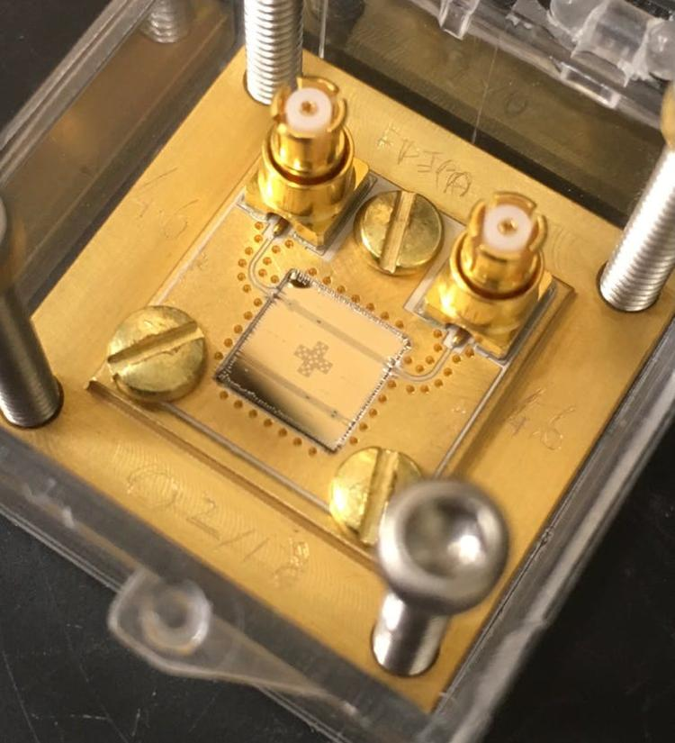
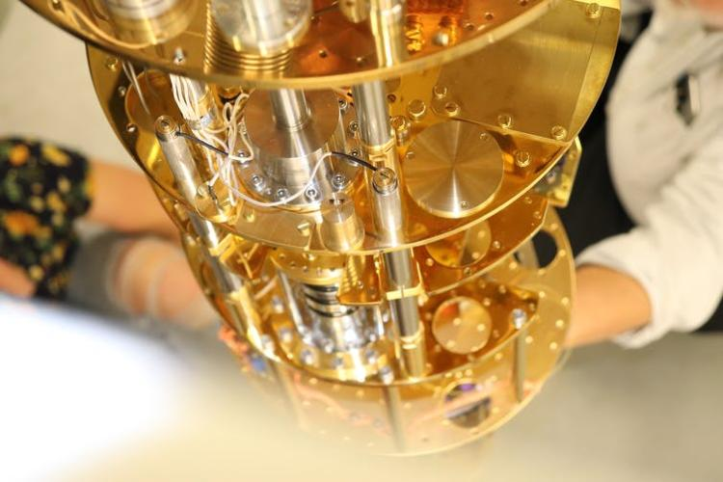
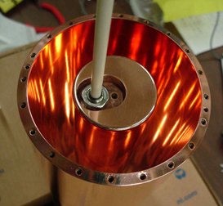


Quantum information for high-energy and nuclear particle physics
Konrad W. Lehnert
SLAC Summer institute 2026
Palo Alto, California
The Haloscope At Yale Sensitive To Axion CDM
Notes:
Well hello, my name is Dan Palken; I work for Konrad, and I’ll be giving my Comps III talk on how I plan to enhance the primary figure of merit – the scan rate – of a dark matter detector called an axion haloscope.
I’ll be achieving this scan rate enhancement with two distinct innovations: quantum squeezing, which will rid our system of much of its vacuum noise, and then a statistical analysis that takes a leap forward from what has been being done in this field for the past 30 years.

Slide 2
What can Quantum info do for high-energy and nuclear particle physics?
many things, but I will discuss the example I know best
quantum enhanced sensing of classical fields
hypothetical ultralight dark matter, especially the QCD axion (this lecture)
gravitational wave detection

Slide 3
Summary
quantum enhanced sensing: engineering design choice, not magic
reduces time or money needed to detect a signal
primary benefit is an increase in sensor bandwidth
useful if easier to lower noise than to increase signal
https://doi.org/10.48550/arXiv.2110.04912

Slide 4
Outline
theory of quantum squeezing to enhance classical field sensing
squeezing deployed in a search for axionic dark matter
strategies for more quantum enhancement

Slide 5
Classical fields: large amplitude but weak coupling to a sensor
hypothetical field
decoherence
possible sensor
resonant circuit (DM Radio)
microwave cavity (ADMX/HAYSTAC)
spin ensemble (CASPER)
mechanical resonator (Windchime)
high-Q
resonator
distinguish evolution under
null hypothesis
field hypothesis
Notes:
Points to make here. Work as hard as you can to make coupling rate strong, it’s always weaker than decoherence rate. At tiny fraction of the energy stored in the field may enter the sensor to be detected but there is essentially no hope to detecting the energy in the cavity decaying into the field.

Slide 6
If signal is an oscillatory “force” of unknown frequency
rotating frame removes simple harmonic evolution
quadrature variables
null hypothesis
dark matter hypothesis
amplifiers measure cavity quadratures X₁ and X₂
Notes:
key point to make: on resonance defined by how long you’re willing to wait.

Slide 7
Quantum noise pollutes inference of classical force
coherent state limit (CSL) also “SQL”
prepare in ground state, measure X or Y
null hypothesis
field hypothesis
amplifiers measure cavity quadratures X₁ and X₂
displaced ground state
ground state

Slide 8
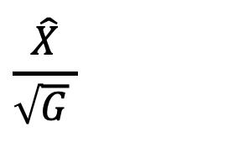


Squeezed states approximate quadrature eigenstates
$$\left[\hat{X}/\sqrt{G},\hat{Y}\sqrt{G}\right]=i$$
$$\hat{Y}\sqrt{G}$$
$$\frac{\hat{X}}{\sqrt{G} }$$
phase space volume conserved
commutator preserved
no added noise

Slide 9
Squeezing and noiseless measurement circumvent quantum limit
‘beat’ the CSL:
prepare in X squeezed state, measure X noiselessly
null hypothesis
field hypothesis
amplifiers measure cavity quadratures X₁ and X₂
displaced squeezed state
squeezed state

Slide 10
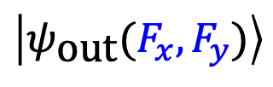



Quantum state preparation and measurement access quantum metrology
$$\left|ψ_{0}\right\rangle$$
prepare
$$\left|ψ_{\text{in}}\right\rangle$$
evolve
$$\left|ψ_{\text{out}}(F_{x},F_{y})\right\rangle$$
measure
$$P(l|F_{x},F_{y})$$
classical statistics
amplifiers measure cavity quadratures X₁ and X₂
optimize estimation of parameters over:
initial state preparation
measured quantity

Slide 11
Frequently asked questions
Does the quantum advantage disappear when considering decoherence?
Do you need to know the phase of the signal to benefit from squeezing?
Can you measure both quadratures of the signal better than the CSL?

Slide 12
Impact of loss and decoherence on squeezing and signal
time evolution with decoherence from loss
in a characteristic decoherence time
squeezing is lost
displacement reaches steady-state value

Slide 13
Squeezing improves sensor bandwidth
measure after decoherence time
squeeze and measure fast
preserve SNR when detuned

Slide 14
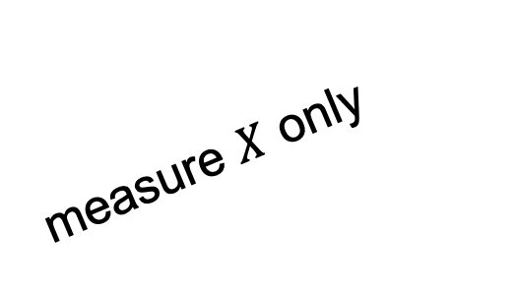




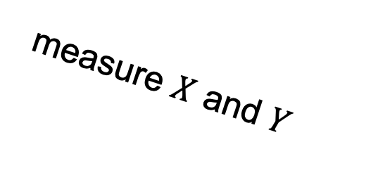

Measuring both quadratures doubles the signal and noise power
marginal of Wigner function
$$P(X|F_{X})$$
Wigner function
measure $X$ only
$$X$$
Huisimi – Q function
$$P(Y)$$
$$P(X,Y|F_{X},F_{Y})$$
measure $X$ and $Y$
$$P(X)$$

Slide 15
Two-mode squeezing operation is unitary
correlations reveal entanglement
resonator 1
resonator 2

Slide 16

Quantum enhanced measurement of both quadratures
resonator coupled to hypothetical field
$$\left[{\hat{X}}_{1},{\hat{Y}}_{2}\right]=0$$
evolve
unentangle
two-mode
squeezed & entangled state
ancillary resonator
Notes:
These ultralight dark matter searches are laboratory scale experiments. As such they complement facility scale searches that use accelerators or large underground detectors, to search for much more massive particles. They test a different class of models and by using entangled quantum sensors even small experiments can have large reach.
Because the dark-matter field is highly occupied but weakly coupled it creates a tiny but classical signal on the laboratory detector apparatus, which is usually some kind of tunable high-quality harmonic oscillator. The oscillator can be an ensemble of atomic or molecular spins , an inductor-capacitor resonant circuit, or a microwave cavity.
Whatever the nature of the oscillator, represented in a phase space picture
[animate], an experiment proceeds by preparing the oscillator in its ground state and measuring, about one coherence time later, where it ended up, thus resolving the presence of a dark matter force.
If one is technically perfect, only the zero-point motion of the oscillator
[animate] limits how precisely it can be prepared and only the non-commutation of the phase space variables limit how precisely it can be measured.
This point of technical perfection defines a quantum limited search rate for a particular apparatus.

Slide 17
Squeezing in an axion dark matter search

Slide 18

Ultralight dark matter must be bosonic
dark matter (ΛCDM)
“cold:” gravitationally bound to us
mean density: ~ 0.4 GeV/cm³
weakly interacting
implications for particles with rest mass
quantum degenerate Bose gas
more “field-like” than “particle-like”
persistent, large amplitude, weakly coupled field

Slide 19
Hypothetical QCD axion: a light particle that is cold and dense enough to contribute to dark matter
mechanism to resolve strong-CP problem (Peccei and Quinn)
associated particle (axion) is dark matter candidate
mass range
as a frequency
*post-inflation scenario

Slide 20
Axion field couples (weakly) to electromagnetism
modified QCD Lagrangian
γ
A
γ
linearize coupling around static -field
A
γ
dark matter axions create microwave photons

Slide 21
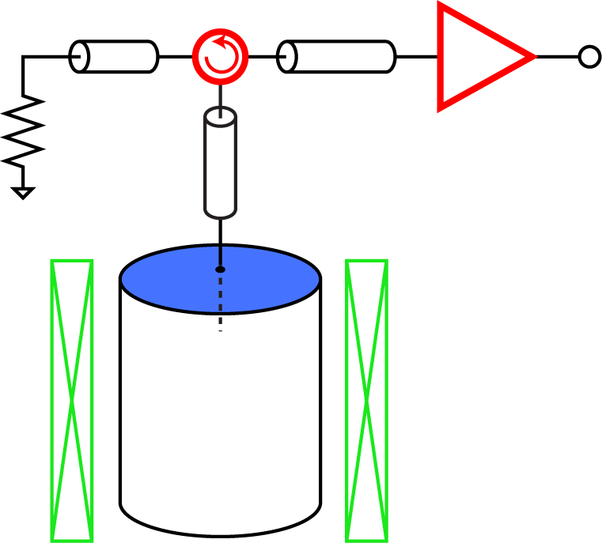
Scan narrowband cavity to search for resonant axion to photon conversion: haloscope (Sikivie 1983)
Johnson-Nyquist and amplifier noise
amp
spectrum analyzer
solenoid
tunable cavity
axion field more coherent than cavity
tune → wait and integrate → tune
resolve variance with 10⁻³ precision
⇨10⁶ realizations of random process

Slide 22
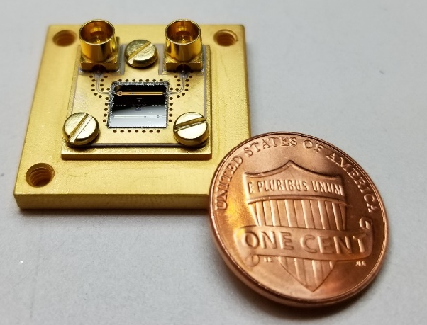
Cool cavity and measure with noiseless amplifier to reach CSL
solenoid
1 L volume
Q = 10⁴
tunable cavity
Josephson parametric amplifier (JPA)
measure noiselessly
haloscope near the CSL (HAYSTAC 2017)

Slide 23
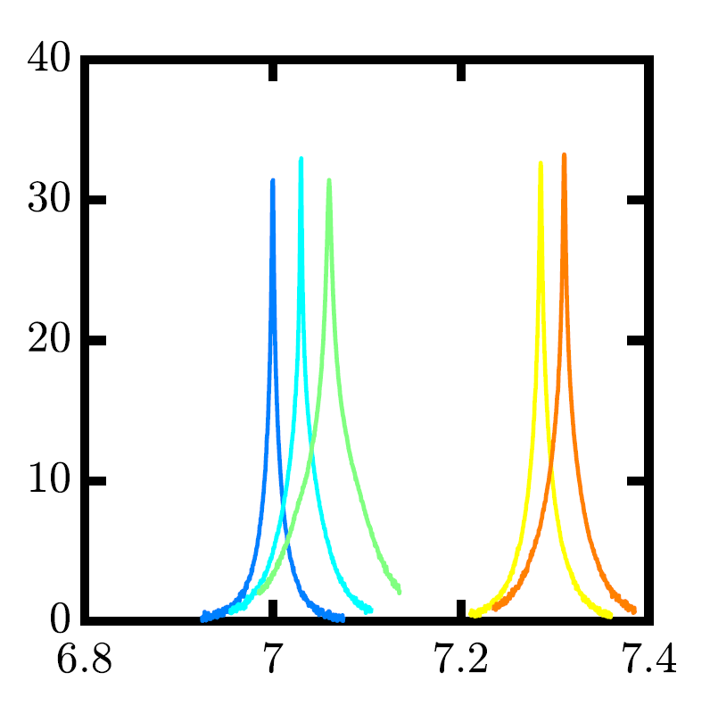


Low noise amplification with Josephson parametric amplifiers
capacitor
100 μm
port 1:
signal
port 2:
pump
SQUID array
coil
tuned
$G (dB)$
flux line
$f (GHz)$
tunable over 1.5 GHz
gain > 30 dB
coil

Slide 24
Phase sensitive amplifier measures one quadrature noiselessly
pump
phase sensitive mode:
half-pump resonant with cavity
in
out
cavity band
JPA

Slide 25
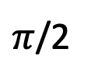
JPA noiselessly transforms ground state into squeezed state
pump
$π$/2
JPA
squeezed quadrature: quantum noise suppressed
use JPA to prepare cavity in squeezed state

Slide 26

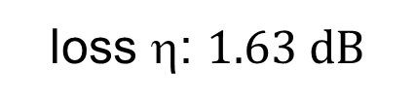
Demonstration of squeezing and determination of loss: second JPA analyzes squeezed state created by first
pump
JPA
JPA
SQ
AMP
squeeze
measure
var(X) (dB)
CSL
phase chooses measured quadrature relative to squeezed quadrature
loss η: $1.63 dB$

Slide 27
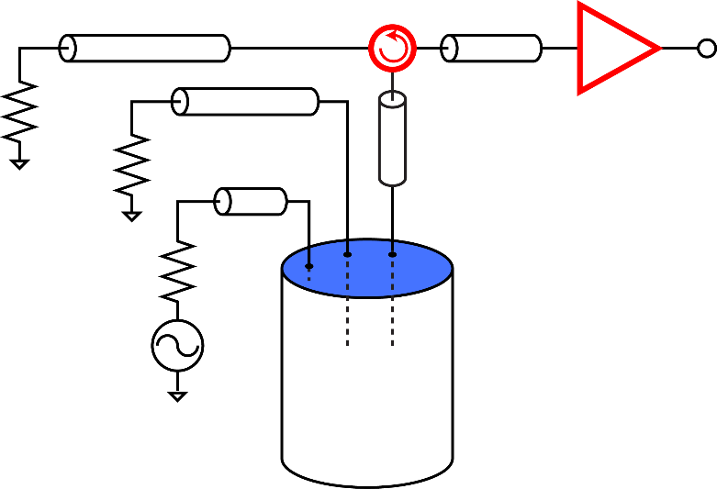
Squeezing achieves best sensitivity over a wider bandwidth
pump
measurement
loss
suppress measurement port noise
resonant signal and critically coupled
axion field
overcoupled cavity with squeezing

Slide 28
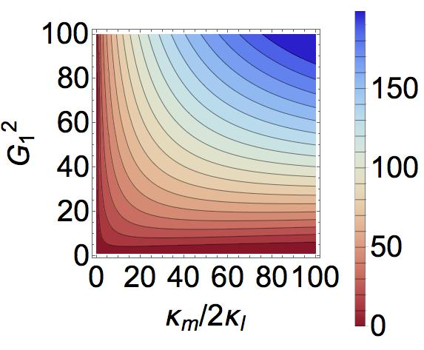
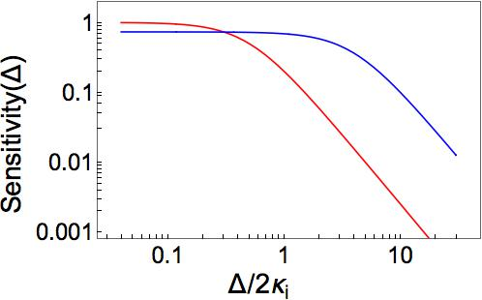

Scan rate enhancement, perfect efficiency
squeezing
scan rate enhancement
Sensitivity
no squeezing
slight reduction in sensitivity
much larger bandwidth

Slide 29
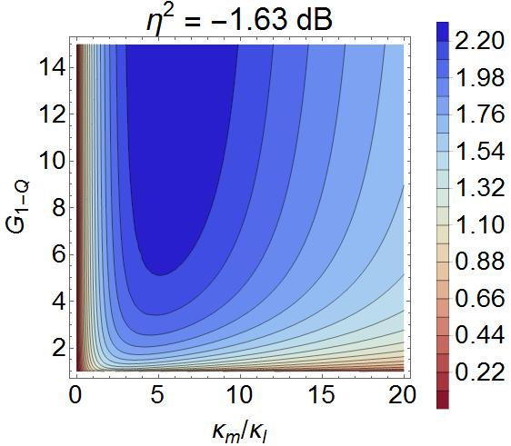
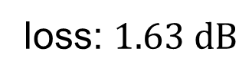
Effect of propagation losses on the scan rate
transmission loss diminishes benefit
loss: $1.63 dB$
Is doubling the search rate meaningful?
saves 10,000 years or 600 M$
dramatic improvement with reduced loss
scan rate enhancement

Slide 30
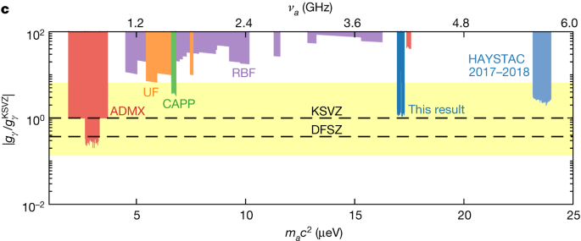
Quantum enhanced sensing is now routine in HAYSTAC
double the quantum limited scan rate
A quantum enhanced search for dark matter axions
K.M. Backes, D.A. Palken, et al., Nature 590, 238–242 (2021).
M. J. Jewell et al. (HAYSTAC Collaboration) Phys. Rev. D 107, 072007 (2023).
X. Bai et al. (HAYSTAC Collaboration)
Phys. Rev. Lett. 134, 151006 (2025).

Slide 31
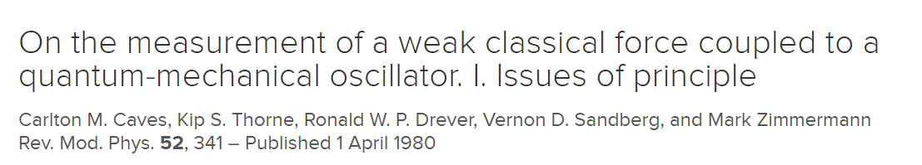
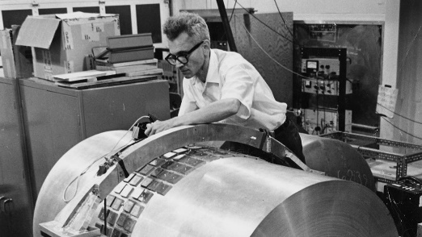
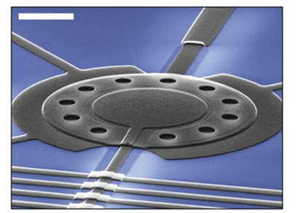
The coherent state limit is hard to beat in a search for fundamental fields
hard to beat CSL
coupling to fundamental fields: big objects
quantum control and measurement: small systems
near technical perfection required
5 μm

Slide 32
strategy for more quantum enhancement

Slide 33
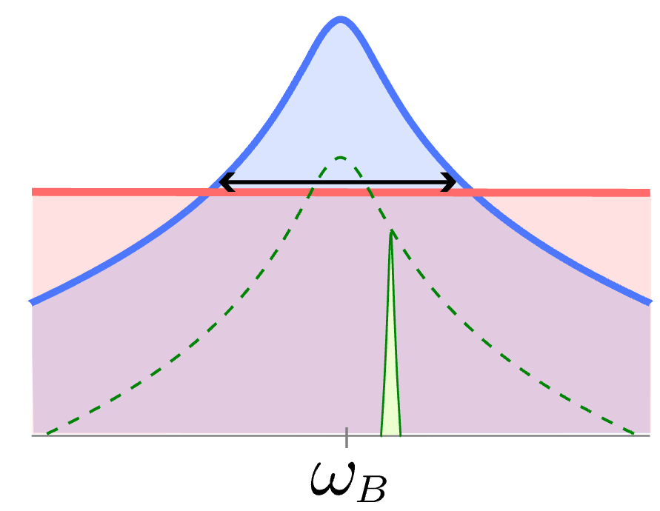
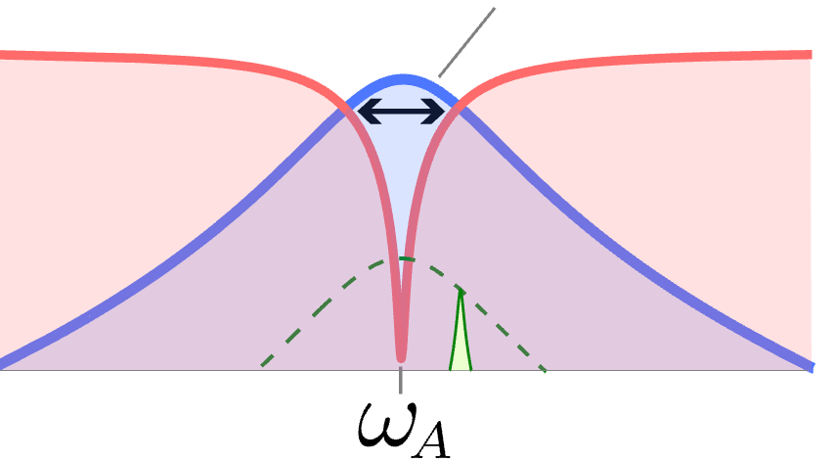
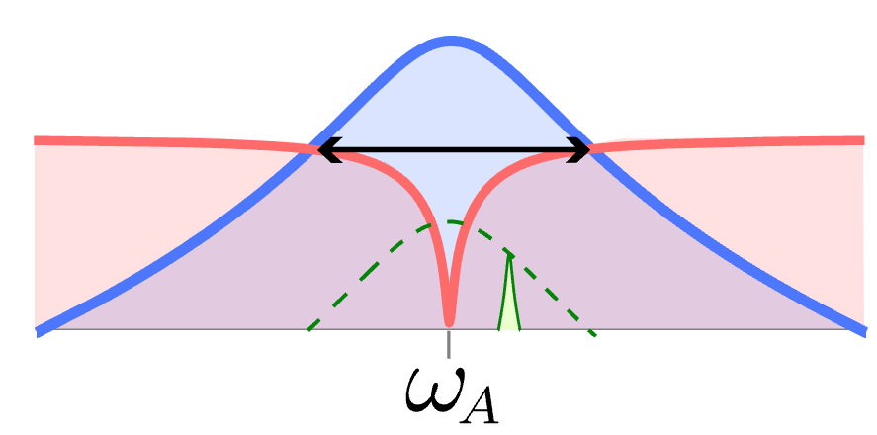


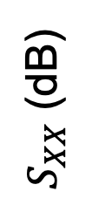

Amplify signal before encountering measurement port noise
$B_{w}$
vacuum
$S_{XX}$ (dB)
standard quantum limit
$$×2$$
$$×8.2$$
squeezing
HAYSTAC apparatus
cavity entanglement
“CEASEFIRE” Demo
Y. Jiang, E.P. Ruddy, K.O. Quinlan, M. Malnou, N.E. Frattini, KWL, PRX Quantum 4, 020302 (2023)
K. Wurtz, Benjamin Brubaker, Y. Jiang, E. Ruddy, Daniel Palken, KWL, PRX Quantum 2, 040350 (2021)
Notes:
So far we have introduced what’s the quantum limited searches, and squeezing the measurement noise enables 2 times SRE. In the last topic of this talk, I will spend my time in telling you an alternative method, by amplifying the cavity noise and axion signal together but keep measurement noise unamplified, an alternative way to increase the sensitivity bw, we are able to search 6 times faster by the balanced interactions. And by slightly imbalance the interaction rates using the same method, we can accelerate the searches by 8 times compared to quantum-limited case.

Slide 34
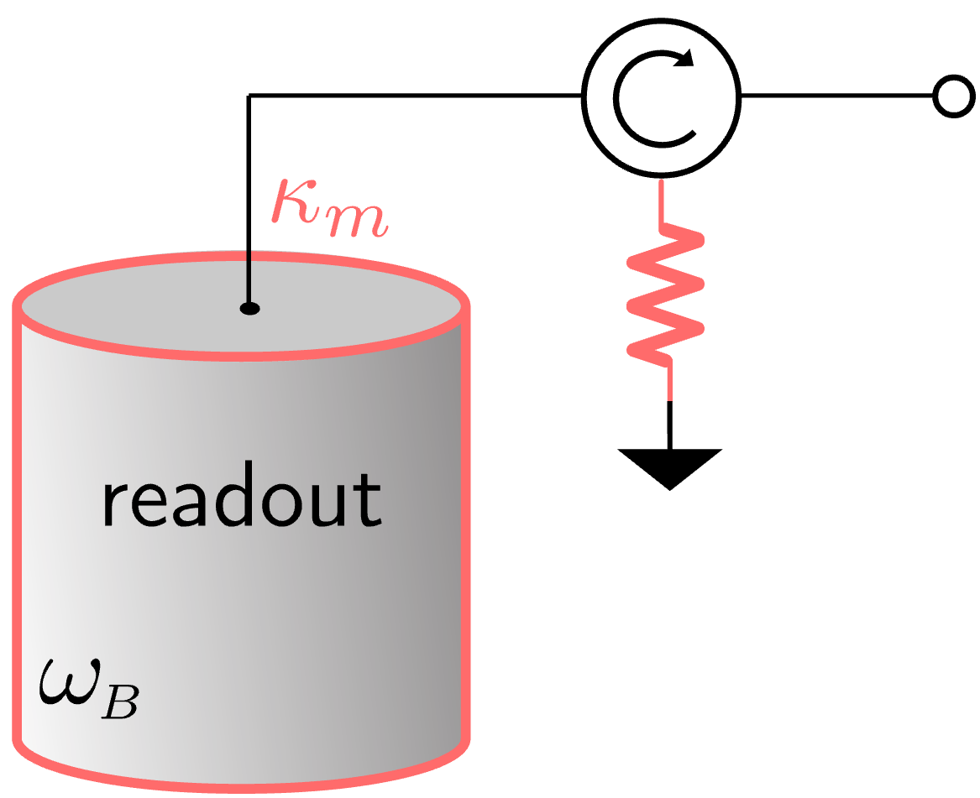
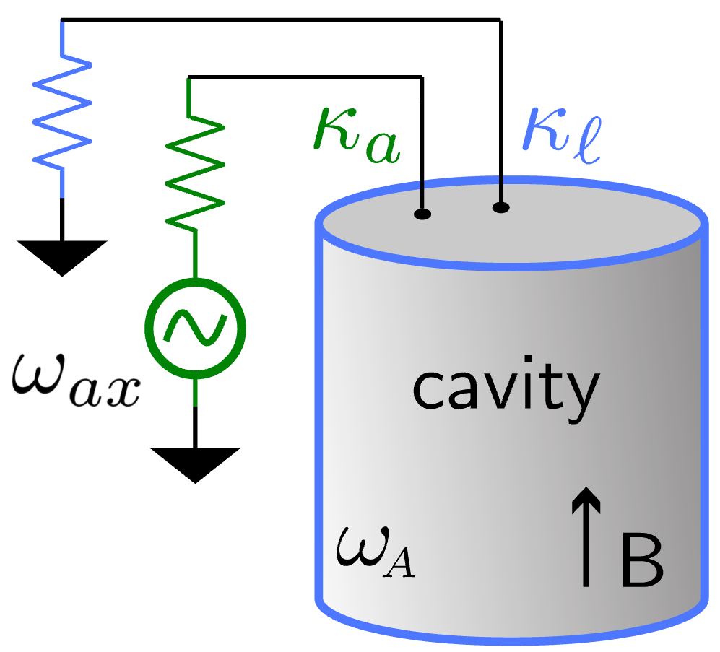

Dynamically couple axion cavity and readout mode by 3-wave mixing
3WM
A
B
P
axion-sensitive cavity
auxiliary readout mode
$${\hat{H}}_{3WM}∝\left(\hat{A}+{\hat{A}}^{†}\right)\left(\hat{B}+{\hat{B}}^{†}\right)\left(\hat{P}+{\hat{P}}^{†}\right)$$

Slide 35





State swapping (C) interaction swaps states between two modes
3WM
A
B
P
$$ω_{Δ}$$
$$ω_{Δ}=\left|ω_{B}−ω_{A}\right|$$
axion-sensitive cavity
auxiliary readout mode
$${\hat{H}}_{3WM}∝\left(\hat{A}+{\hat{A}}^{†}\right)\left(\hat{B}+{\hat{B}}^{†}\right)\left(\hat{P}+{\hat{P}}^{†}\right)$$
$$\hat{P}→g_{C}e^{−iω_{Δ}t}+\text{c}\text{.}\text{c}\text{.}$$
$$→g_{C}\left(\hat{A}{\hat{B}}^{†}+{\hat{A}}^{†}\hat{B}\right)$$
state-swapping
Notes:
The first interaction we want to build is the state swapping interaction between two modes, by pump C mode at the diff frequency of A,B mode, we can continuously swap the states of two modes at rate g_C, as represented by the beam splitter Hamiltonian here.

Slide 36




Two-mode squeezing (G) induces amplification and entanglement
3WM
A
B
P
$$ω_{Σ}$$
$$ω_{Σ}=ω_{B}+ω_{A}$$
axion-sensitive cavity
auxiliary readout mode
$${\hat{H}}_{3WM}∝\left(\hat{A}+{\hat{A}}^{†}\right)\left(\hat{B}+{\hat{B}}^{†}\right)\left(\hat{P}+{\hat{P}}^{†}\right)$$
$$\hat{P}→g_{G}e^{−iω_{Σ}t}+\text{c}\text{.}\text{c}\text{.}$$
$$→g_{G}\left({\hat{A}}^{†}{\hat{B}}^{†}+\hat{A}\hat{B}\right)$$
two-mode squeezing
Notes:
The 2nd type of interaction is the two-mode squeezing interaction, by pumping at the sum frequency of the A, B mode, each mode contains the amplified cavity noise and signal from A mode and amplified meas noise from mode B, as represented by the amplified purple bulb here. Two-mode squeezing interaction allows amplification at rate g_G as shown in Hamiltonian, it also builds up the quadrature correlations between two modes.

Slide 37
Two-mode squeezing (G) induces amplification and entanglement
3WM
A
B
P
$$ω_{Σ}$$
$$ω_{Σ}=ω_{B}+ω_{A}$$
axion-sensitive cavity
auxiliary readout mode
$${\hat{H}}_{3WM}∝\left(\hat{A}+{\hat{A}}^{†}\right)\left(\hat{B}+{\hat{B}}^{†}\right)\left(\hat{P}+{\hat{P}}^{†}\right)$$
$$\hat{P}→g_{G}e^{−iω_{Σ}t}+\text{c}\text{.}\text{c}\text{.}$$
$$→g_{G}\left({\hat{A}}^{†}{\hat{B}}^{†}+\hat{A}\hat{B}\right)$$
two-mode squeezing
Notes:
The 2nd type of interaction is the two-mode squeezing interaction, by pumping at the sum frequency of the A, B mode, each mode contains the amplified cavity noise and signal from A mode and amplified meas noise from mode B, as represented by the amplified purple bulb here. Two-mode squeezing interaction allows amplification at rate g_G as shown in Hamiltonian, it also builds up the quadrature correlations between two modes.

Slide 38
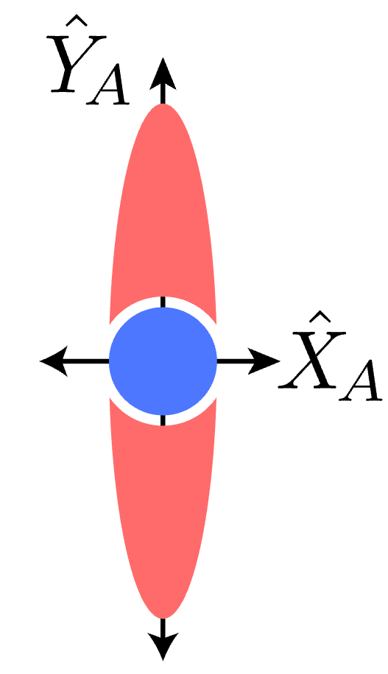
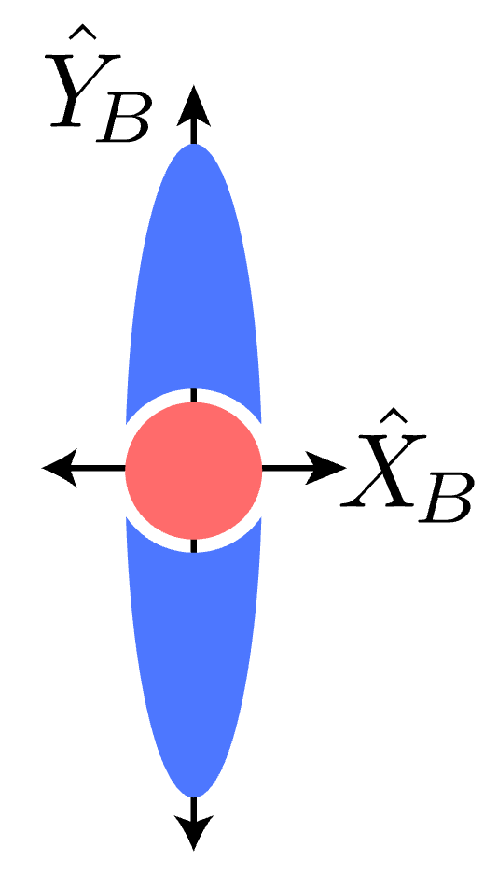
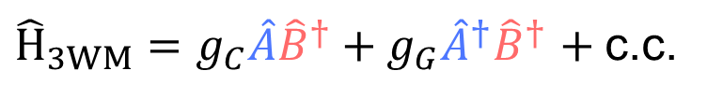


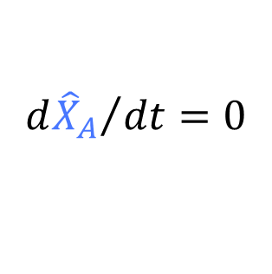
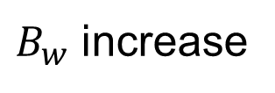
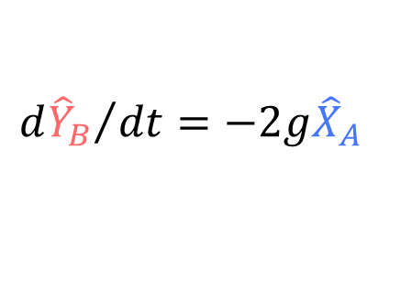

Quantum non-demolition interaction yields bandwidth increase
3WM
A
B
P
$$ω_{Δ}$$
$$ω_{Σ}$$
readout
${\hat{H}}_{3WM}=g_{C}\hat{A}{\hat{B}}^{†}+g_{G}{\hat{A}}^{†}{\hat{B}}^{†}$ $+$c.c.
$$\underset{→}{QND} 2g{\hat{X}}_{A}{\hat{X}}_{B}$$
$B_{w}$ increase
$${d{\hat{Y}}_{B}}/{dt}=−2g{\hat{X}}_{A}$$
$${d{\hat{X}}_{A}}/{dt}=0$$
amplification
QND
Metelmann, A. and Clerk, A.A., Physical Review X 5.2 (2015): 021025.
Chien, T-C., et al. Physical Review A 101.4 (2020): 042336.
Notes:
When these two interactions are applied simultaneously, and at equal interaction rates, this manifests as QND Hamiltonian. We can write down the Hamiltonian in quadrature basis as shown here, where quadrature variables X_A,B are the linear combination of annihilation and creation operators A and B. This Hamiltonian is a quantum non-demolition Hamiltonian as revealed in the Heisenberg equations of motion. EoMs tell that the signal and cavity noise contained in XA will be amplified at YB, while leaving the original quadrature unchanged, representing the QND. As shown in the phase space picture.
Now if we readout along the amplified quadrature, we get amplified signal and cavity noise, and unity measurement noise. Through this amplification, we realize the sensitivity bandwidth increase, therefore increase the search rate.

Slide 39


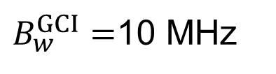






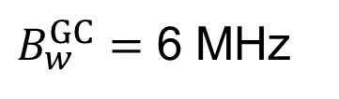


Imbalanced GC operation for further scan rate enhancement
SNR² norm.
$B_{w}^{GC}=$ 6 MHz
$$B_{w}^{GC}$$
$$×5.6$$
$$g_{c}=g_{G}$$
$$B_{w}^{GC}$$
$$B_{w}^{GCI}$$
$$B_{w}^{GCI}$$
$B_{w}^{GCI}=$10 MHz
$$B_{w}^{QL}$$
$$×8.2$$
$$g_{c}>g_{G}$$
Y Jiang, et, al., PRX Quantum 4 (2), 020302. (2023)
Notes:
In real experiment, one of the practical limitation comes from the balanced state swapping and two-mode squeezing interaction is the stability. If there are some ambient flux noise that shifts the mode frequency, the imbalanced interaction rates, especially if the TMS rate is larger than state swapping rate, that would lead the system to be unstable, which limits the ultimate achievable interaction rates. To overcome this challenge, we make the slightly imbalance of the GC interaction, causing swap rate to be larger than two-mode squeezing rate, this operation would solve the instability problem, and moreover, this imbalanced operation itself would also widen the visibility bandwidth. In this experiment, the main benefit from this operation is that is allows the increased interaction rates from 7.6 MHz to 12 MHz, which results in a SRE of 8 times.
As a summary for the 2nd type of quantum-enhanced sensing technique, plotted here is the SNR^2 over the detuning wrt axion mode freq, for quantum limited case in orange, balanced GC/QND interaction in purple, and slightly imbalanced GC interaction in teal. The area under the curve from the purple and teal wrt to the quantum limited case gives the SRE of 5.6 and 8.2, respectively. So we increase the SRE by increasing the bandwidth that the detector is sensitive to axion signal. Moreover, another benefit comes from the increase of peak visibility, which is because of the GC interaction causes amplification before any lossy element which adds a fixed amount of noise, this amplification reduce the relative size from the pollution of the noise from the lossy element, therefore giving a higher peak visibility than the quantum-limited case, where part of our scan rate enhancement is benefit from the peak visibility increase.
Just to mention, in the first type of receiver, preparing a squeezed state, then transport it through a lossy circulator to the cavity, the SRE is ultimately limited by the added noise from the lossy element. In the 2nd method, we amplify the signal before sending it to the lossy circulator, which allows this method to have robust reaction to the added noise from the circulator, even further benefit from the peak visibility increase than the quantum limited case.

Slide 40

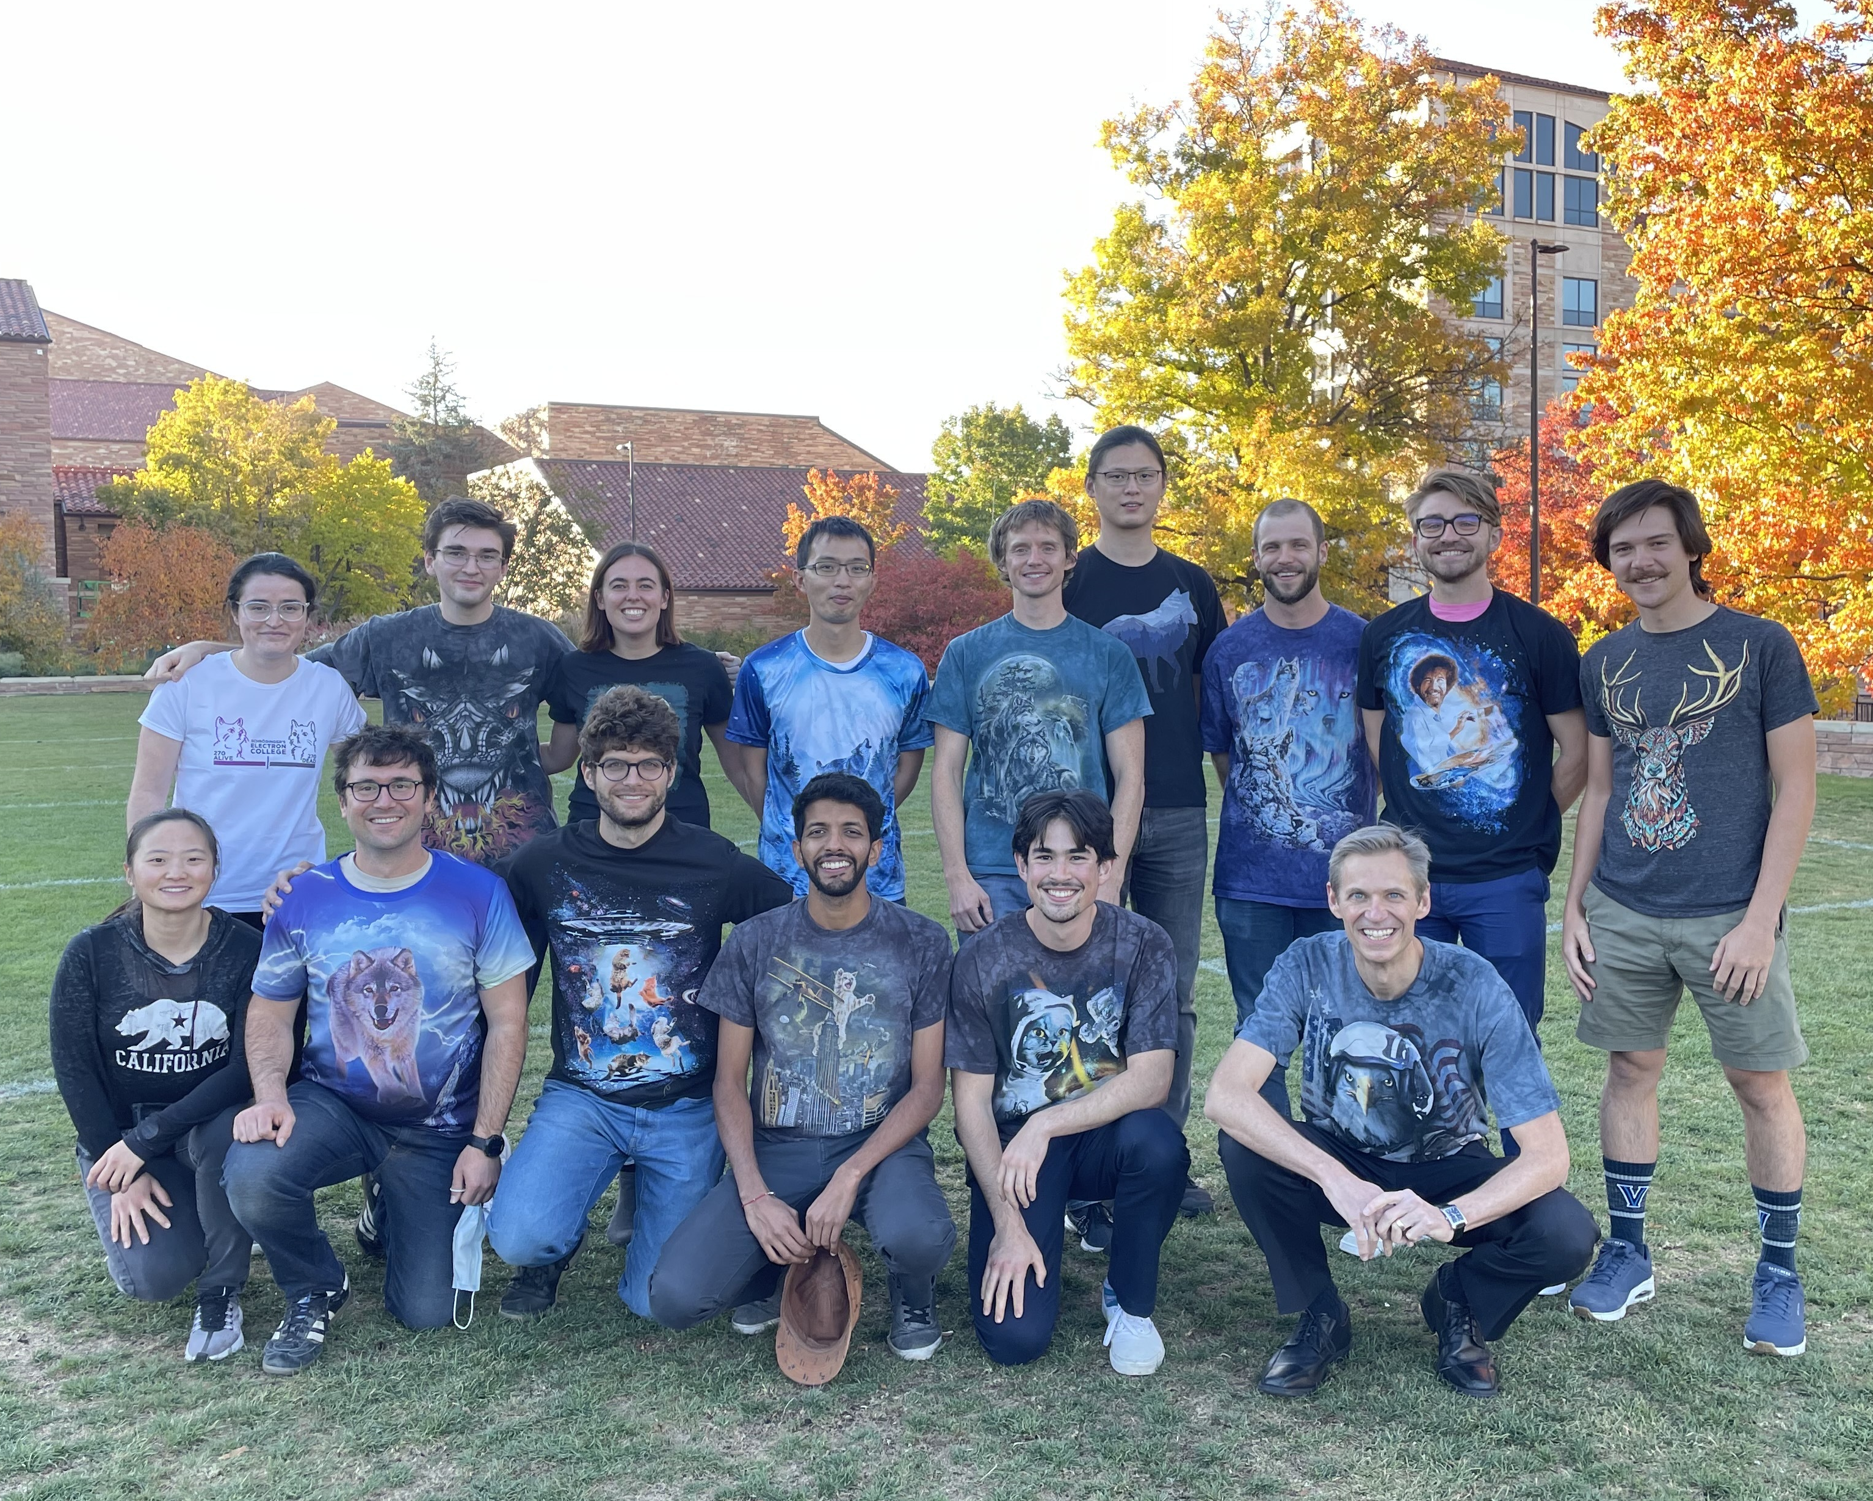
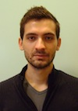





Acknowledgements for CEASEFIRE data
Yale/JILA
Liz Ruddy
Yue (Joyce) Jiang
Kyle Quinlan
Nick Frattini
Konrad Lehnert
NIST Maxime Malnou
HAYSTAC collaborators
Yale
Berkeley
Johns Hopkins
Kyle
Liz
The Haloscope At Yale Sensitive To Axion CDM
Max
Joyce
Konrad
fall 2021

