Slide 1

E304: Plan for FY26
Chaojie Zhang
(E300 collaboration)
Feb 2, 2026
Work supported by DOE-HEP

Slide 2
FY’26 plan for E304
We have published the “plasma wakefield transformer” paper, which reports a “regular downramp injection” experiment.
Plan for FY26:
Modulated downramp injection experiment to generate bunched electrons
Plasma source: a new 15-cm slit nozzle (to get GeV e- beams)— Done
Plasma density modulation: plasma grating — Technique developed
Numerical modeling: PIC simulations — Done
Experimental setup/execution: Feb-July 2026
Post-compression of downramp-injected bunches to generate attosecond beams
Simple calculations

Slide 3
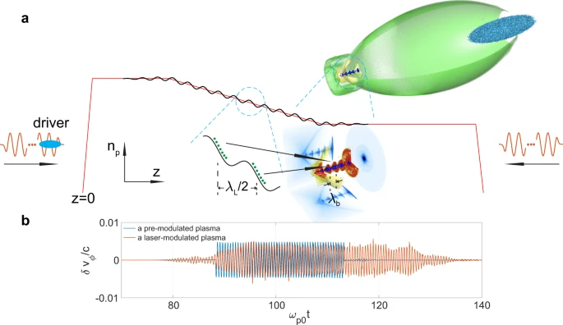
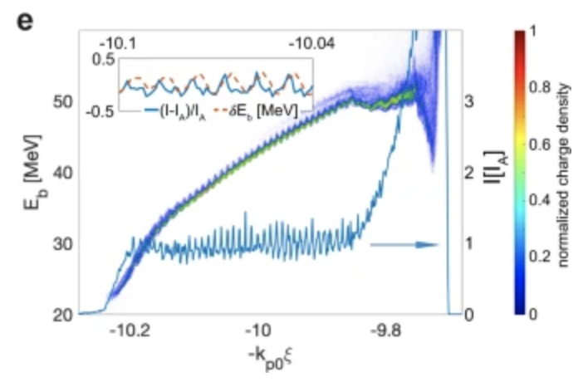
Modulated downramp injection: the concept
Xu, Xinlu, et al. "Generation of ultrahigh-brightness pre-bunched beams from a plasma cathode for X-ray free-electron lasers." Nature communications 13.1 (2022): 3364.

Slide 4
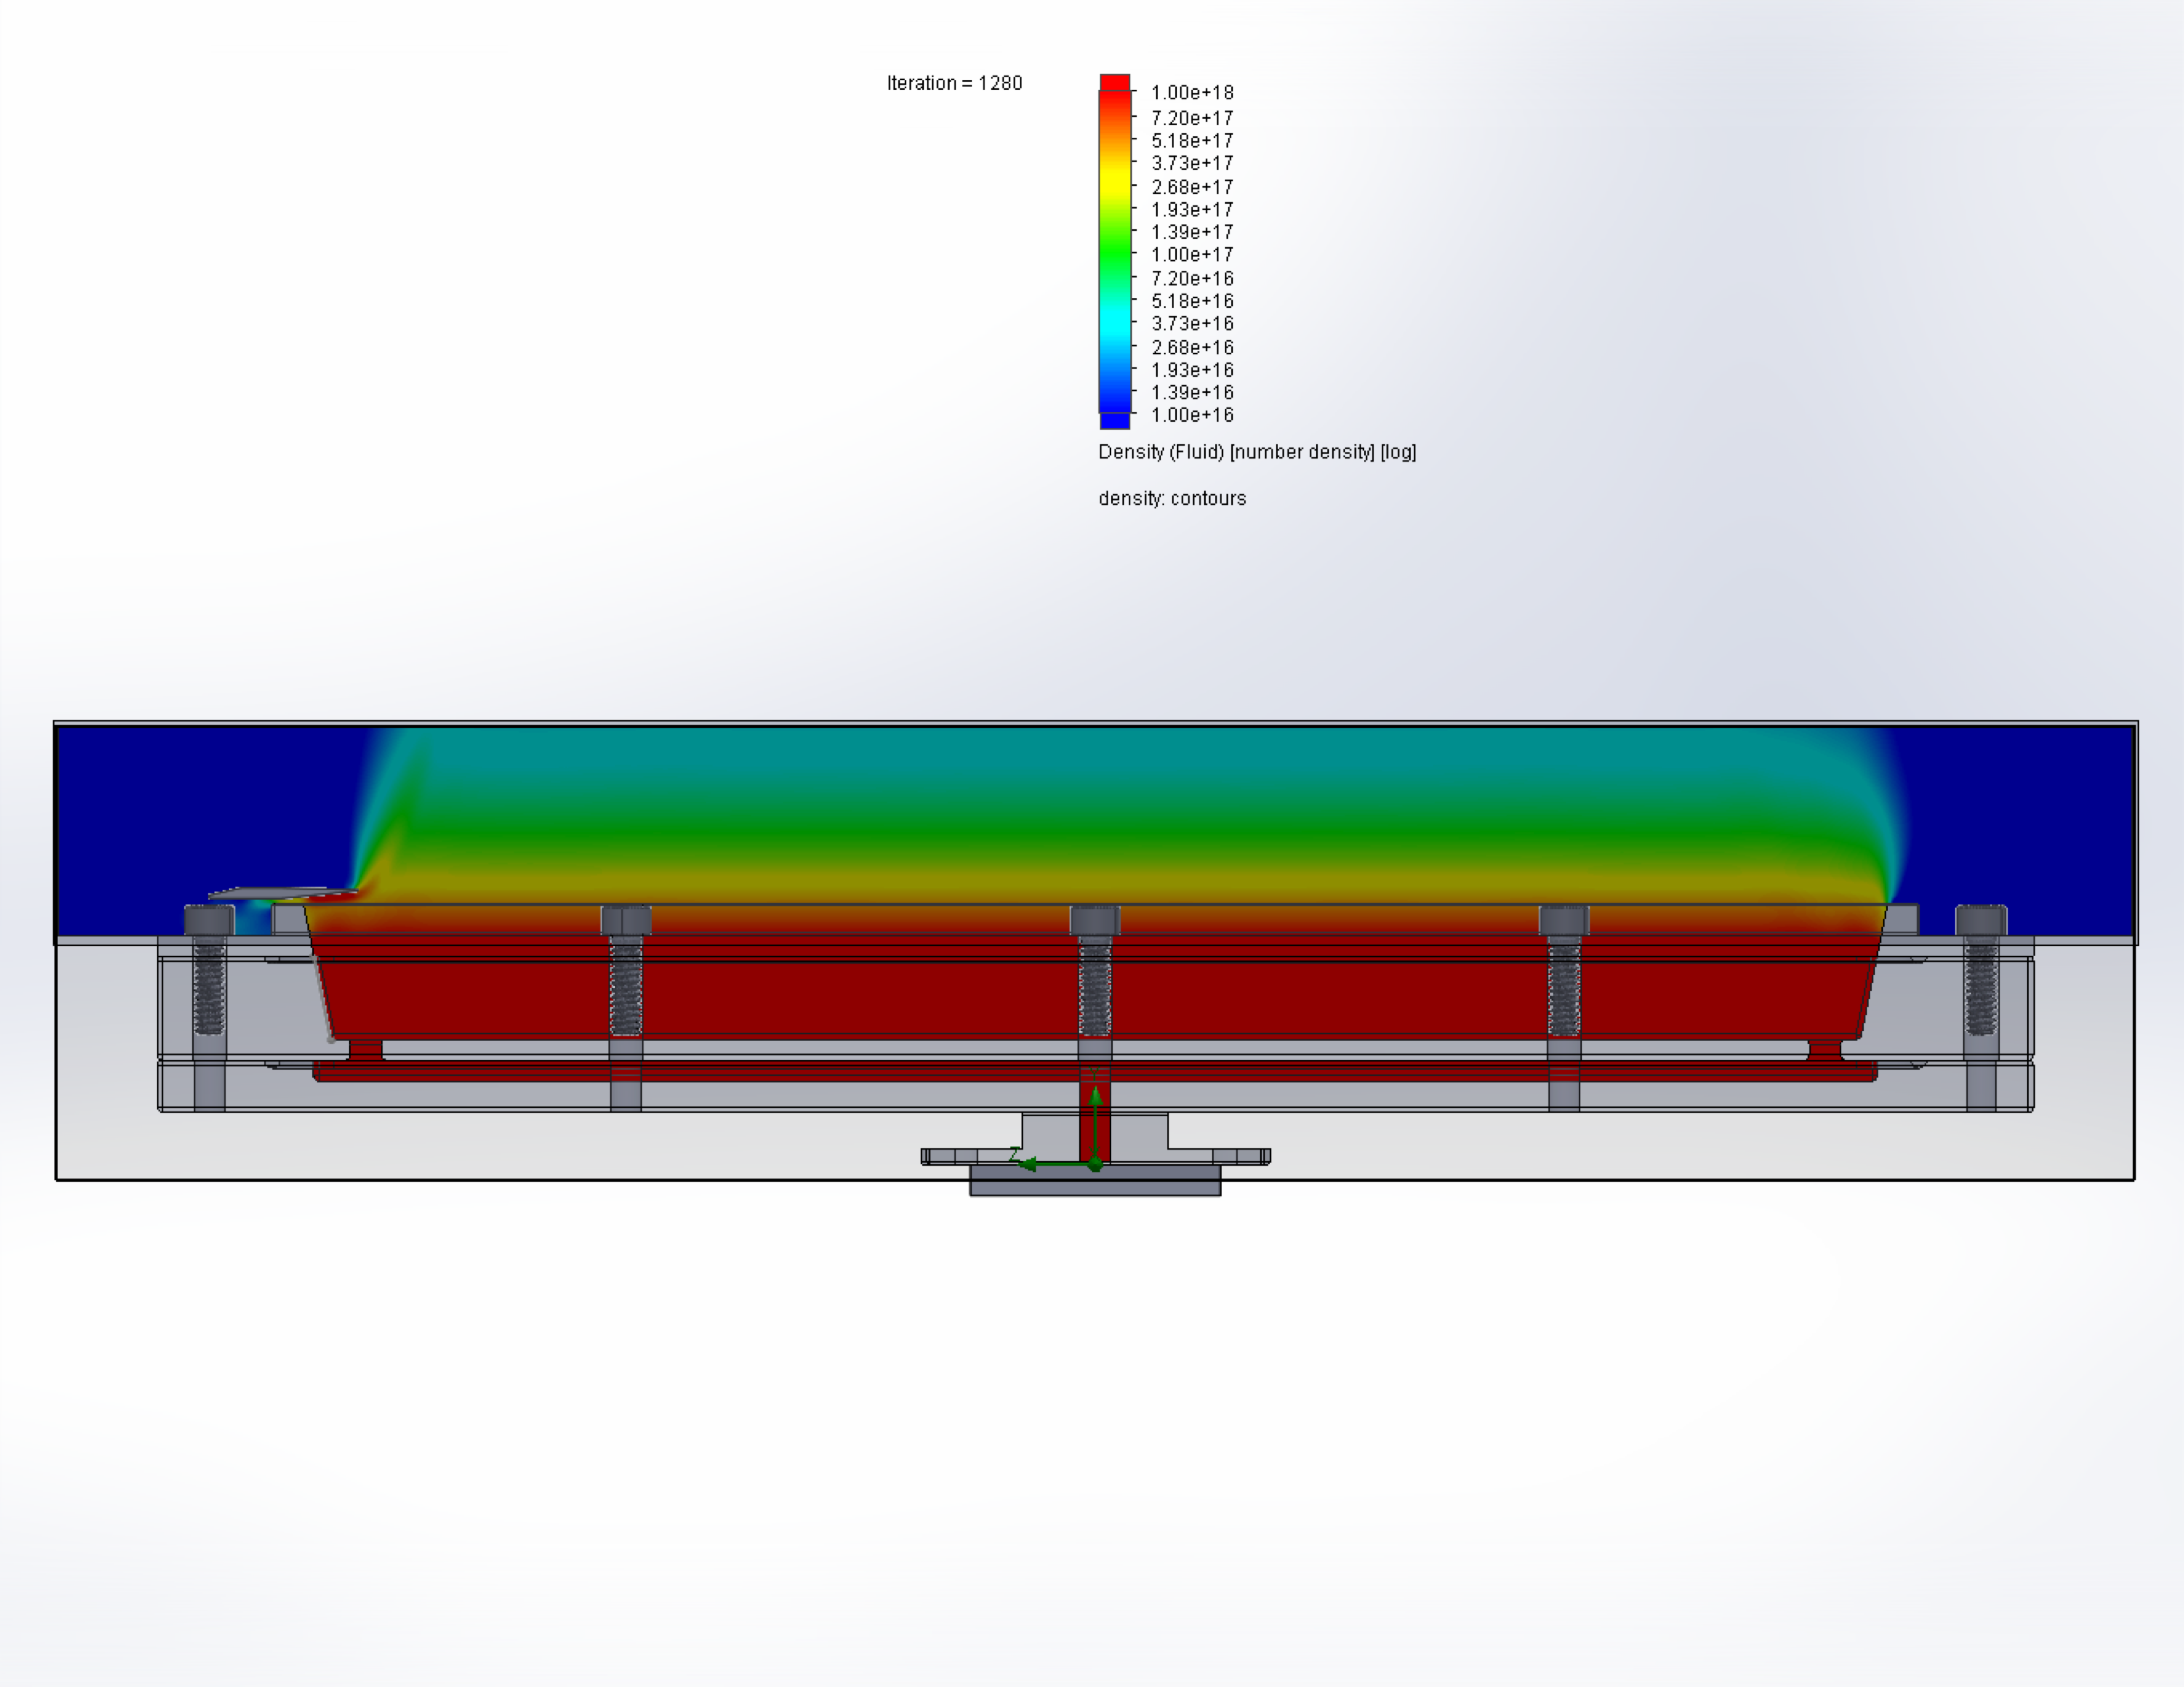
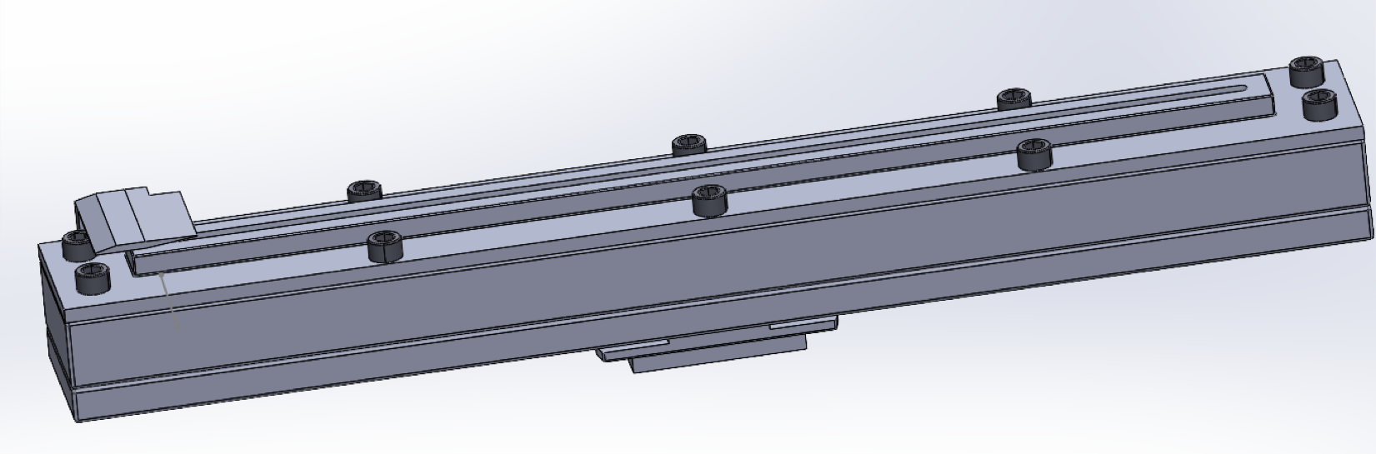
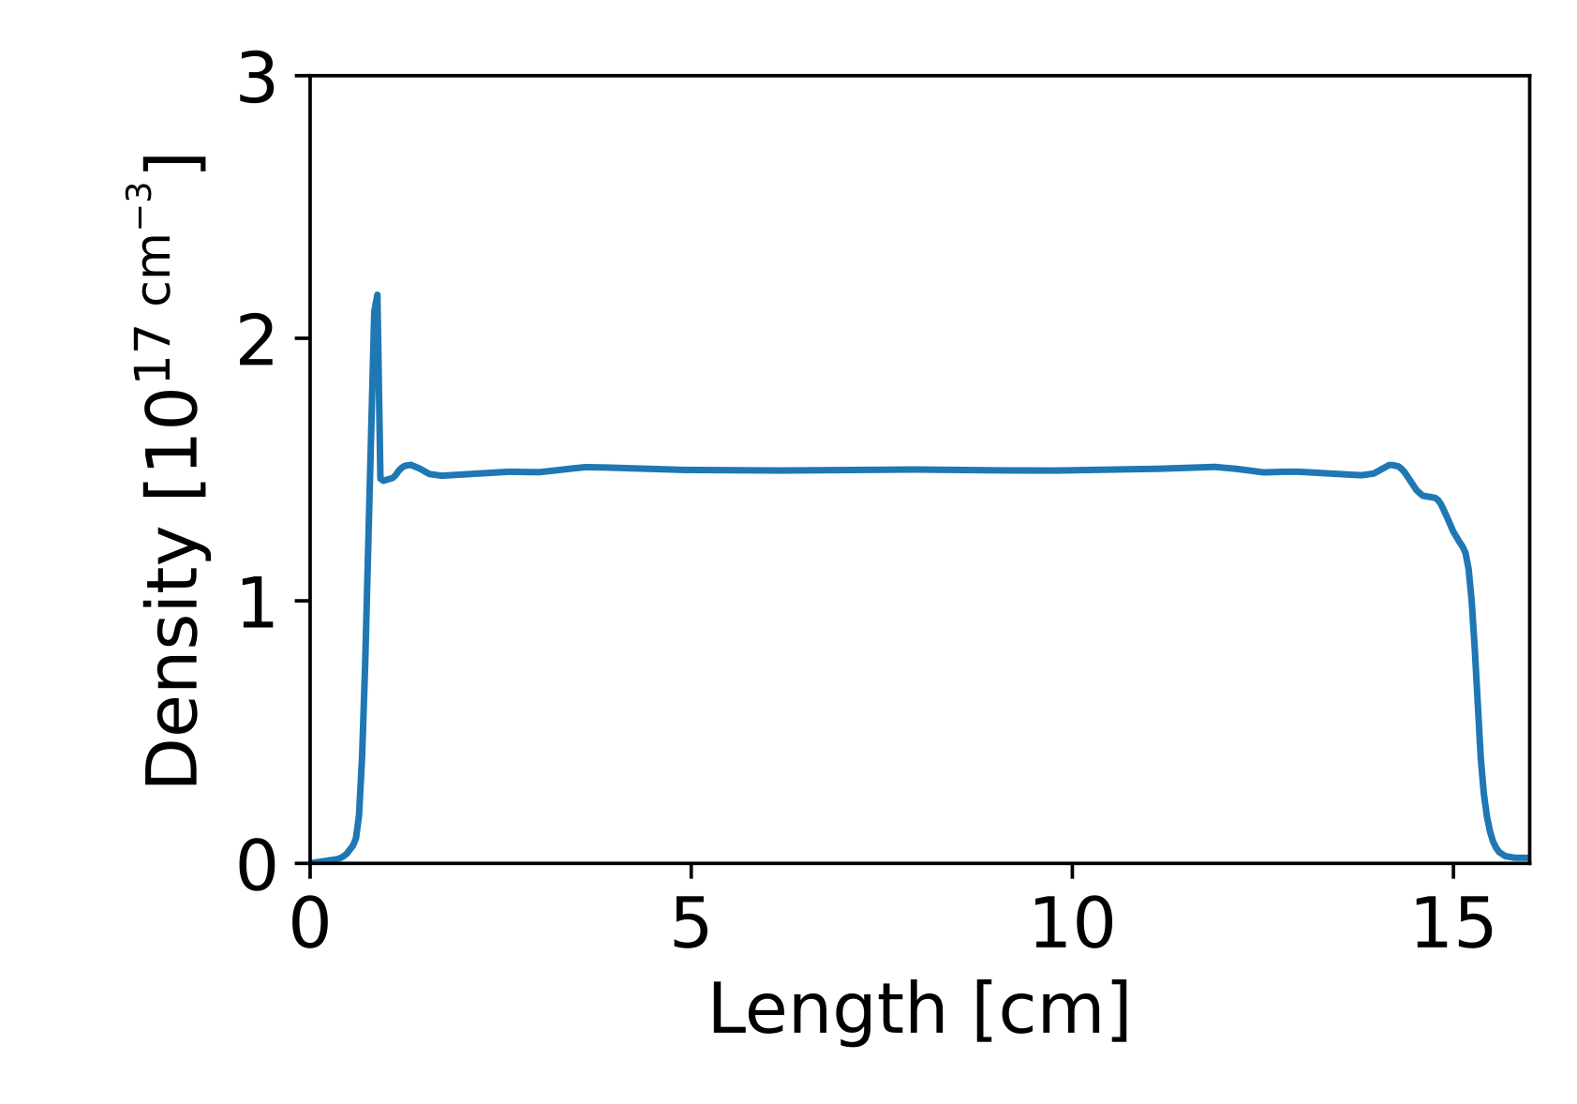
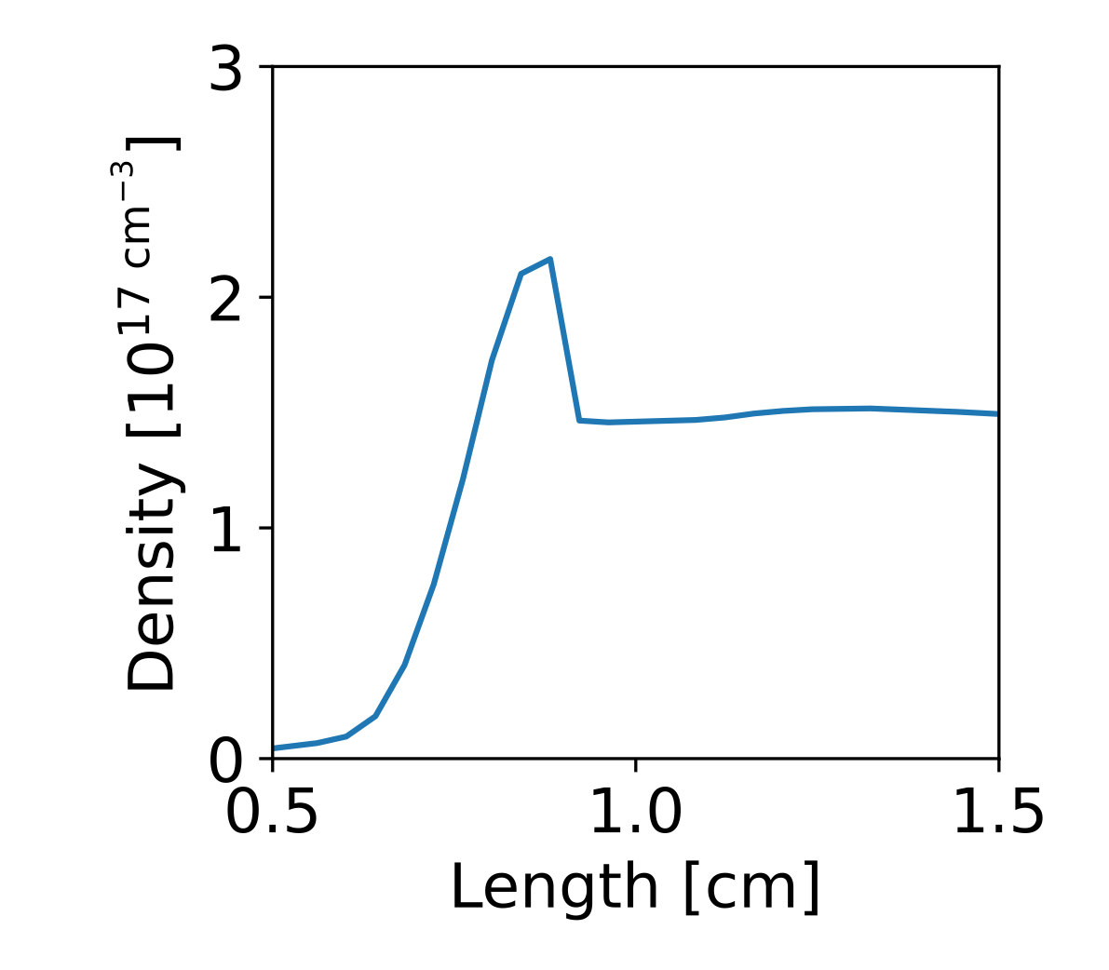
The new plasma source
Shock
15-cm slit nozzle, manufactured
a blade for creating the downramp
blade
drive beam axis
backing pressure 50 psi
2.1e17 cm⁻³
1.5e17 cm⁻³
ramp: 400 µm
(29 $c/{ω_{p}}$)

Slide 5
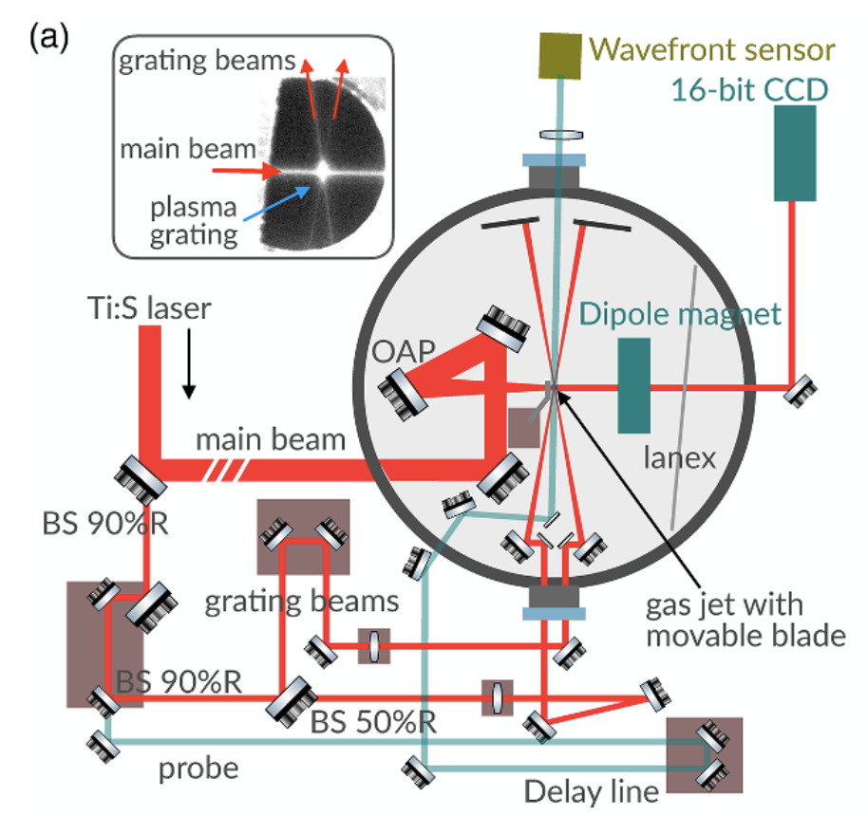
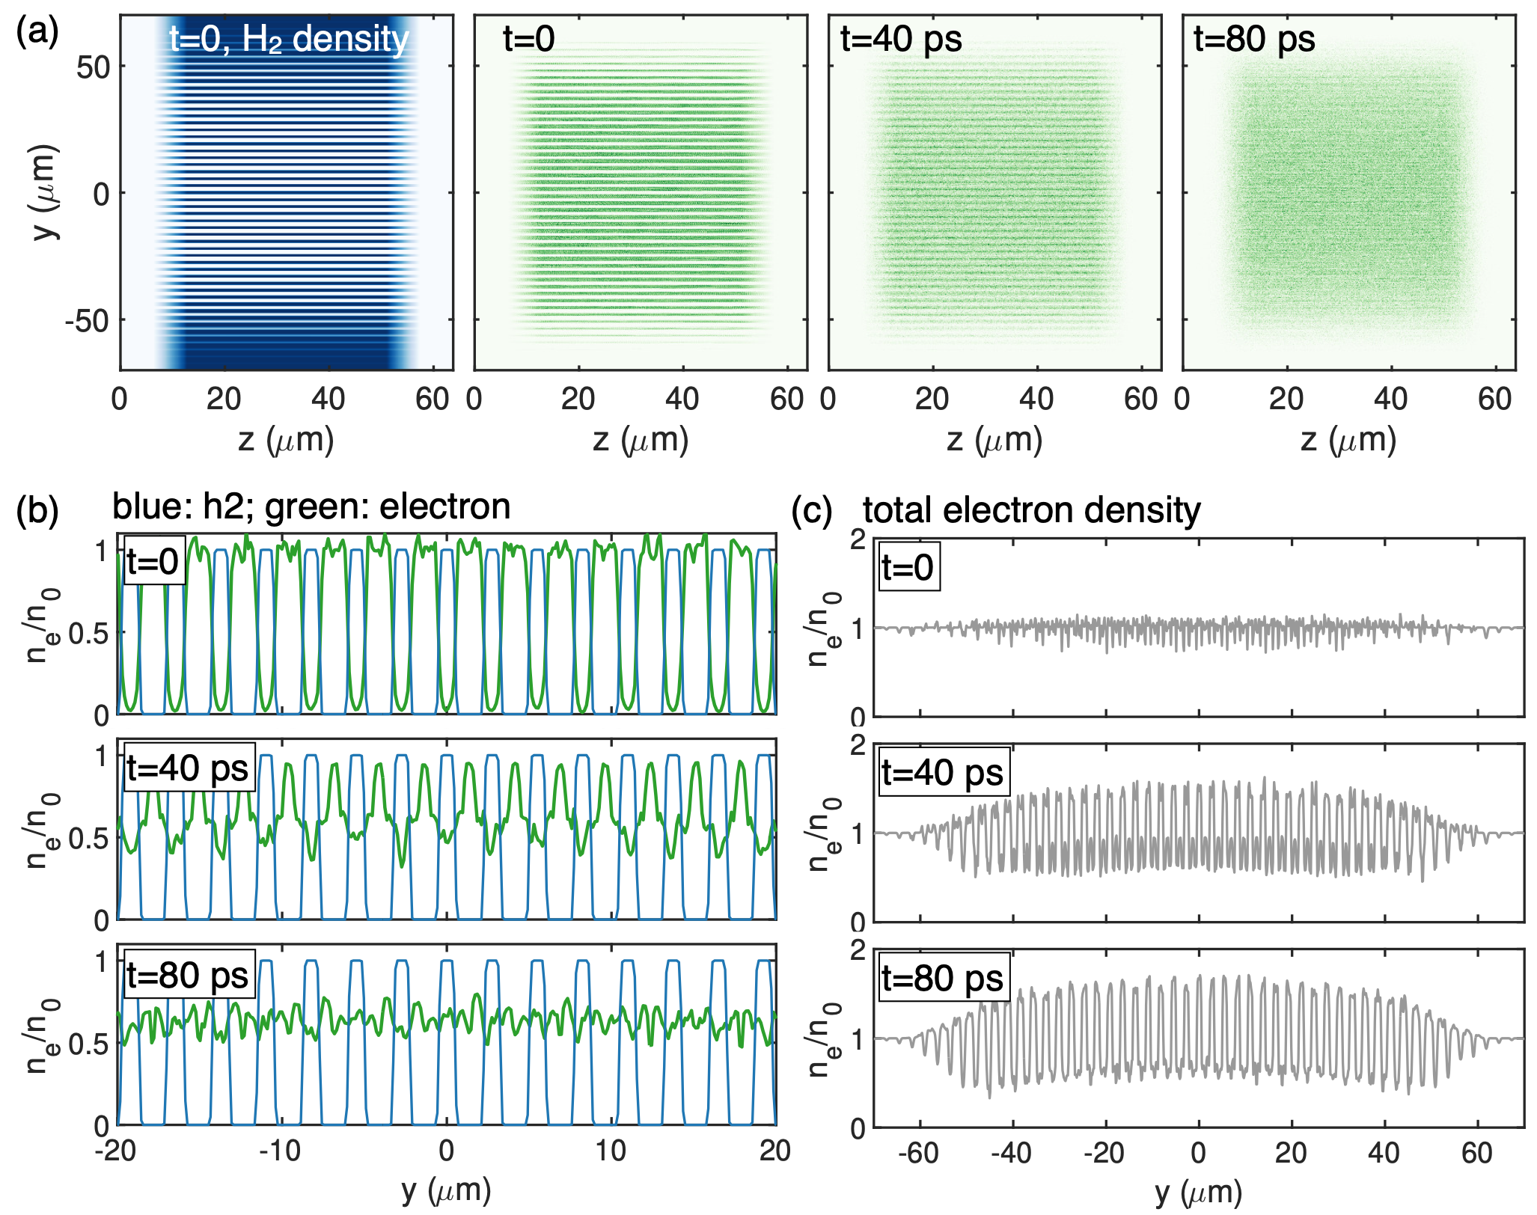
Create a modulated downramp using plasma grating
C Zhang, et al. PPCF (2021); PPCF (2026)

Slide 6
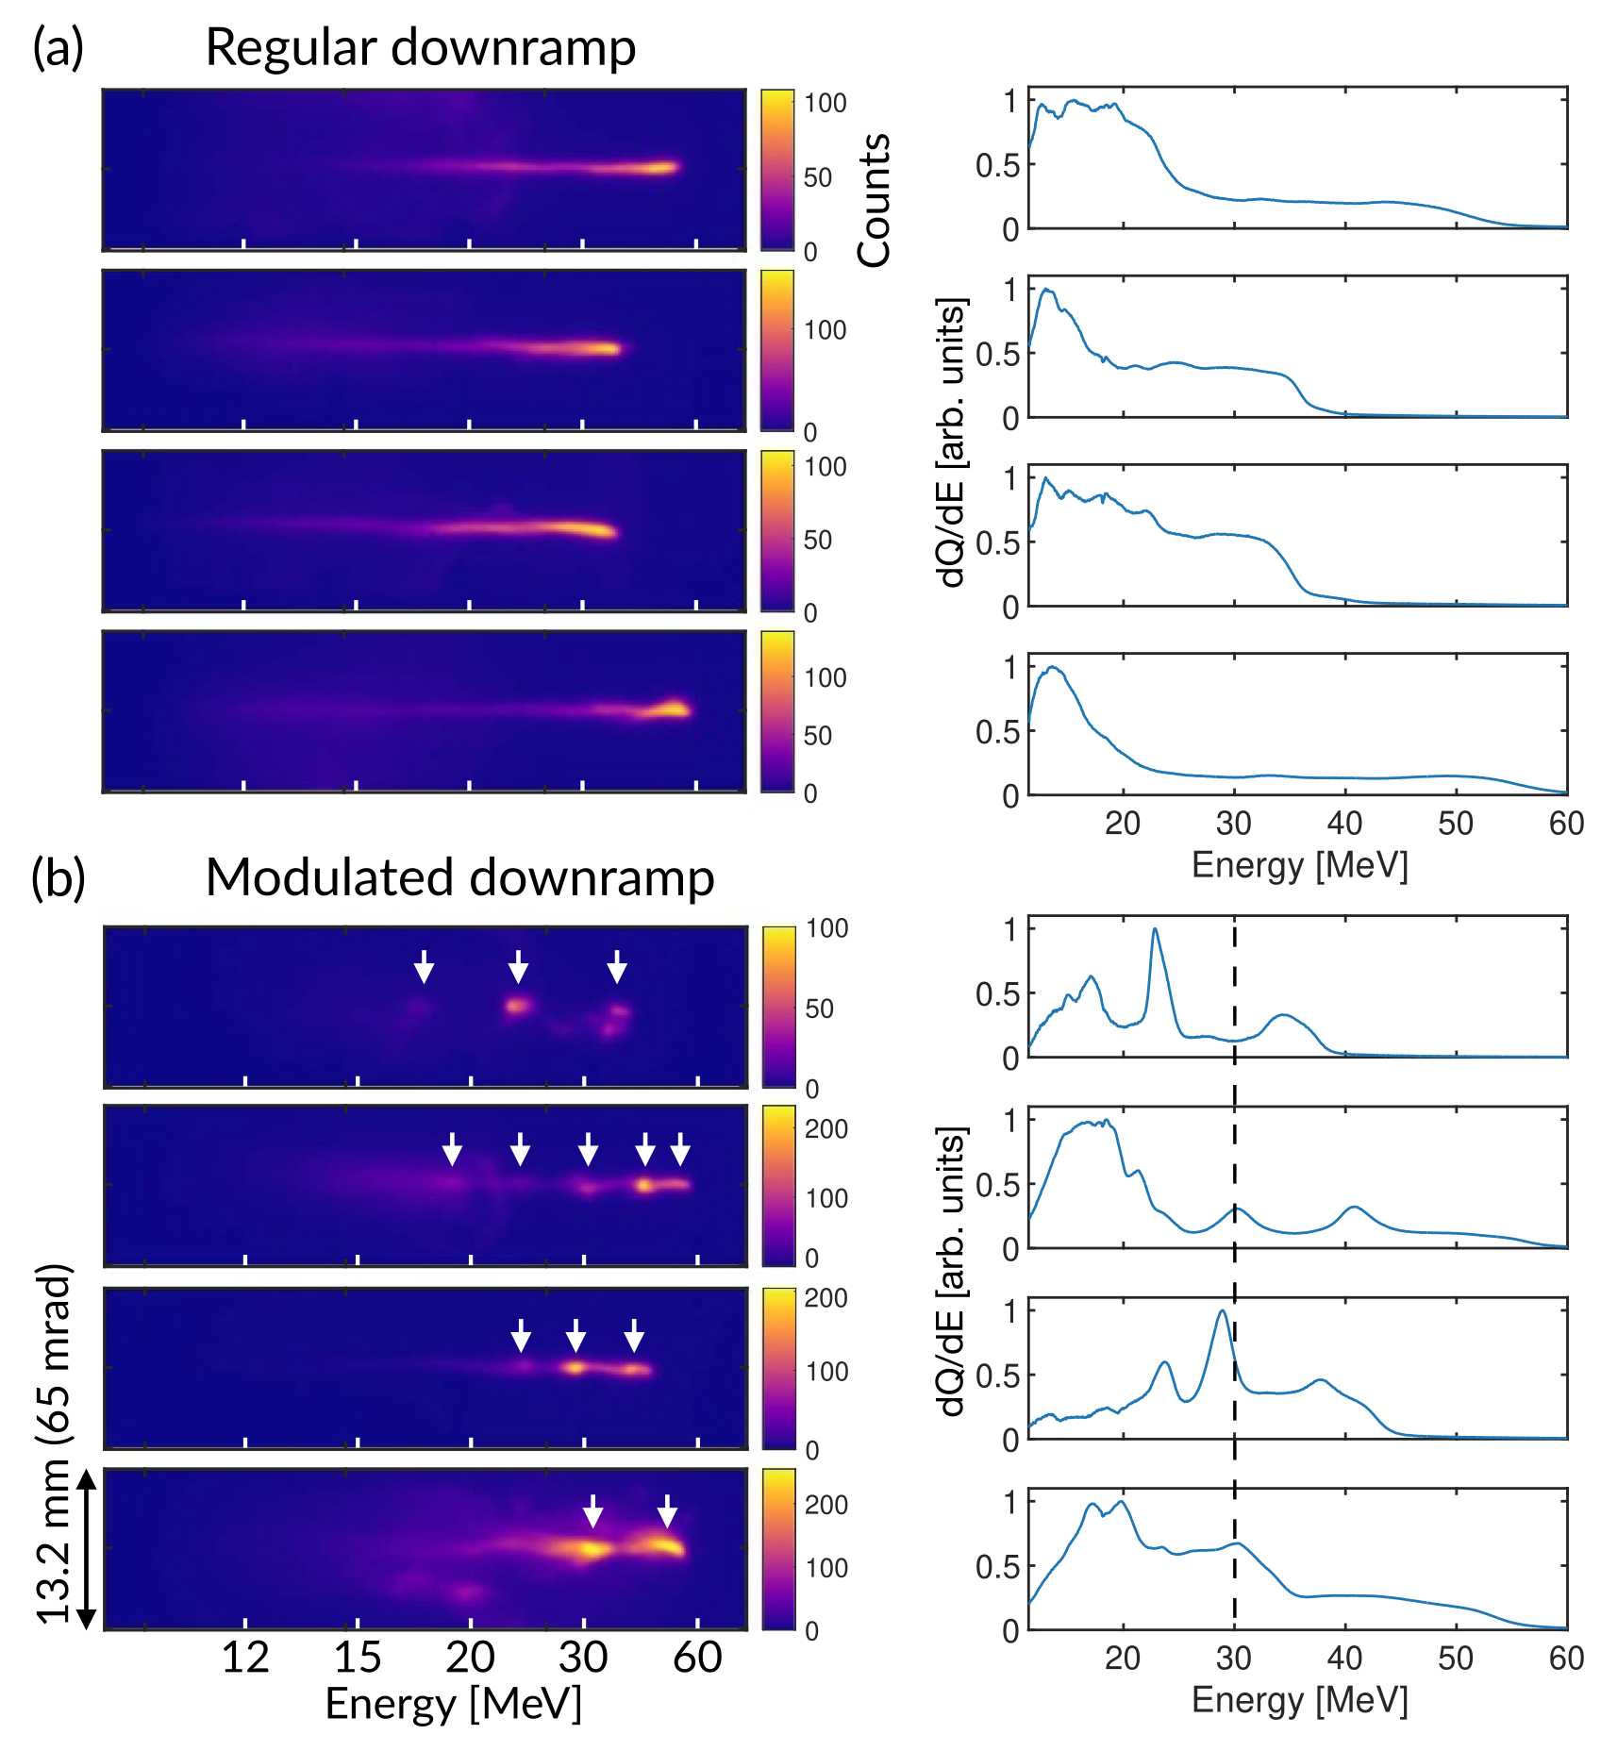
Evidence of microbunching in LWFA at UCLA
C Zhang, et al. PPCF (2026);

Slide 7
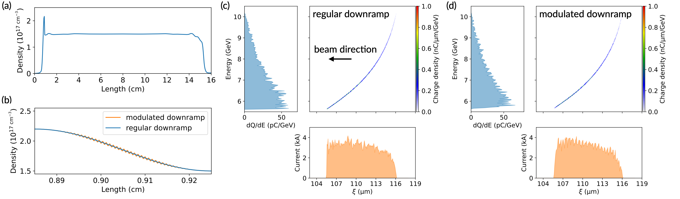
Modulated downramp to generate bunched beams
laser beams intersecting angle: 0.1 rad
downramp modulation period: 8 µm
injected beam bunches at ~500 nm (makes diagnostic easier)

Slide 8
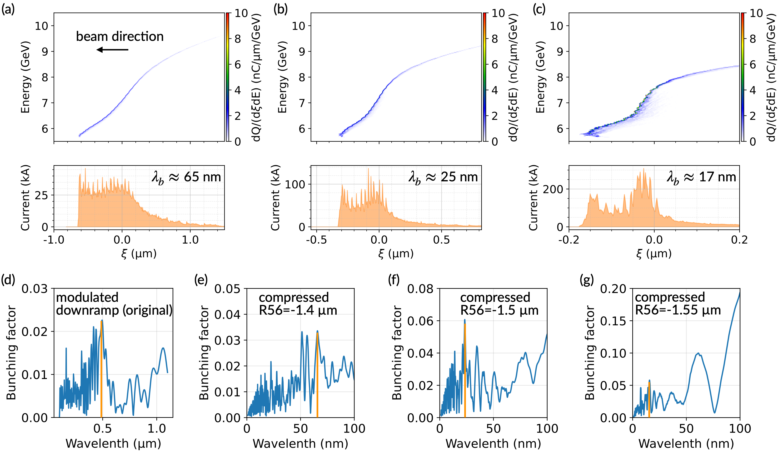
Post-compression

Slide 9
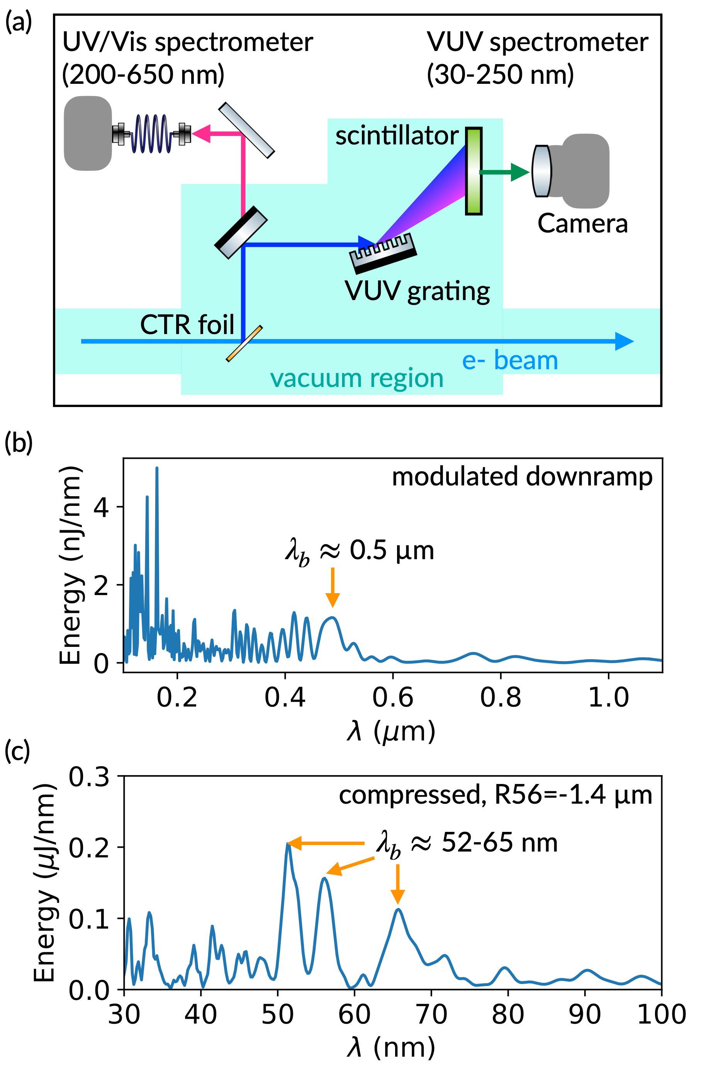
Diagnostics
modulated energy spectrum directly
CTR spectrum

