Slide 1

Potential Use of EOS-BPM in PWFA Experiments
FACET-II PWFA Meeting
February 2, 2026
Michael Litos
Notes:
Done

Slide 2

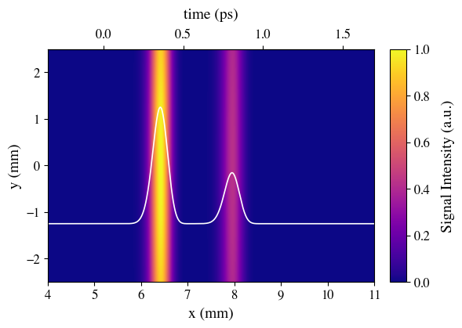
EO Cross Polarization Scheme
Image on camera
e⁻ beam
k
γ
Drive
Laser
Witness
Polarizer
Horizontally polarized
Polarizer
Vertically Polarized
CMOS Camera

Slide 3
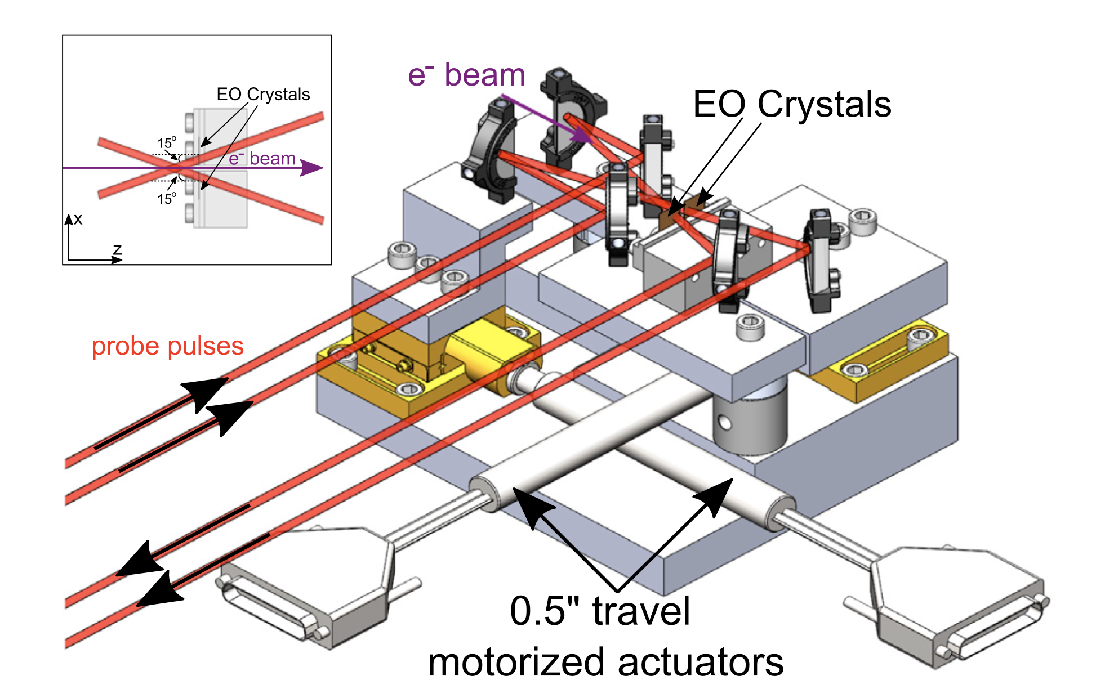
EOS-BPM Mk. 1
EOS BPM Mk.1
EO Crystal
e⁻ beam
EO Crystal
Laser
Leverages correlation between strength of phase retardation and location of e⁻ beam with respect to crystal².

Slide 4
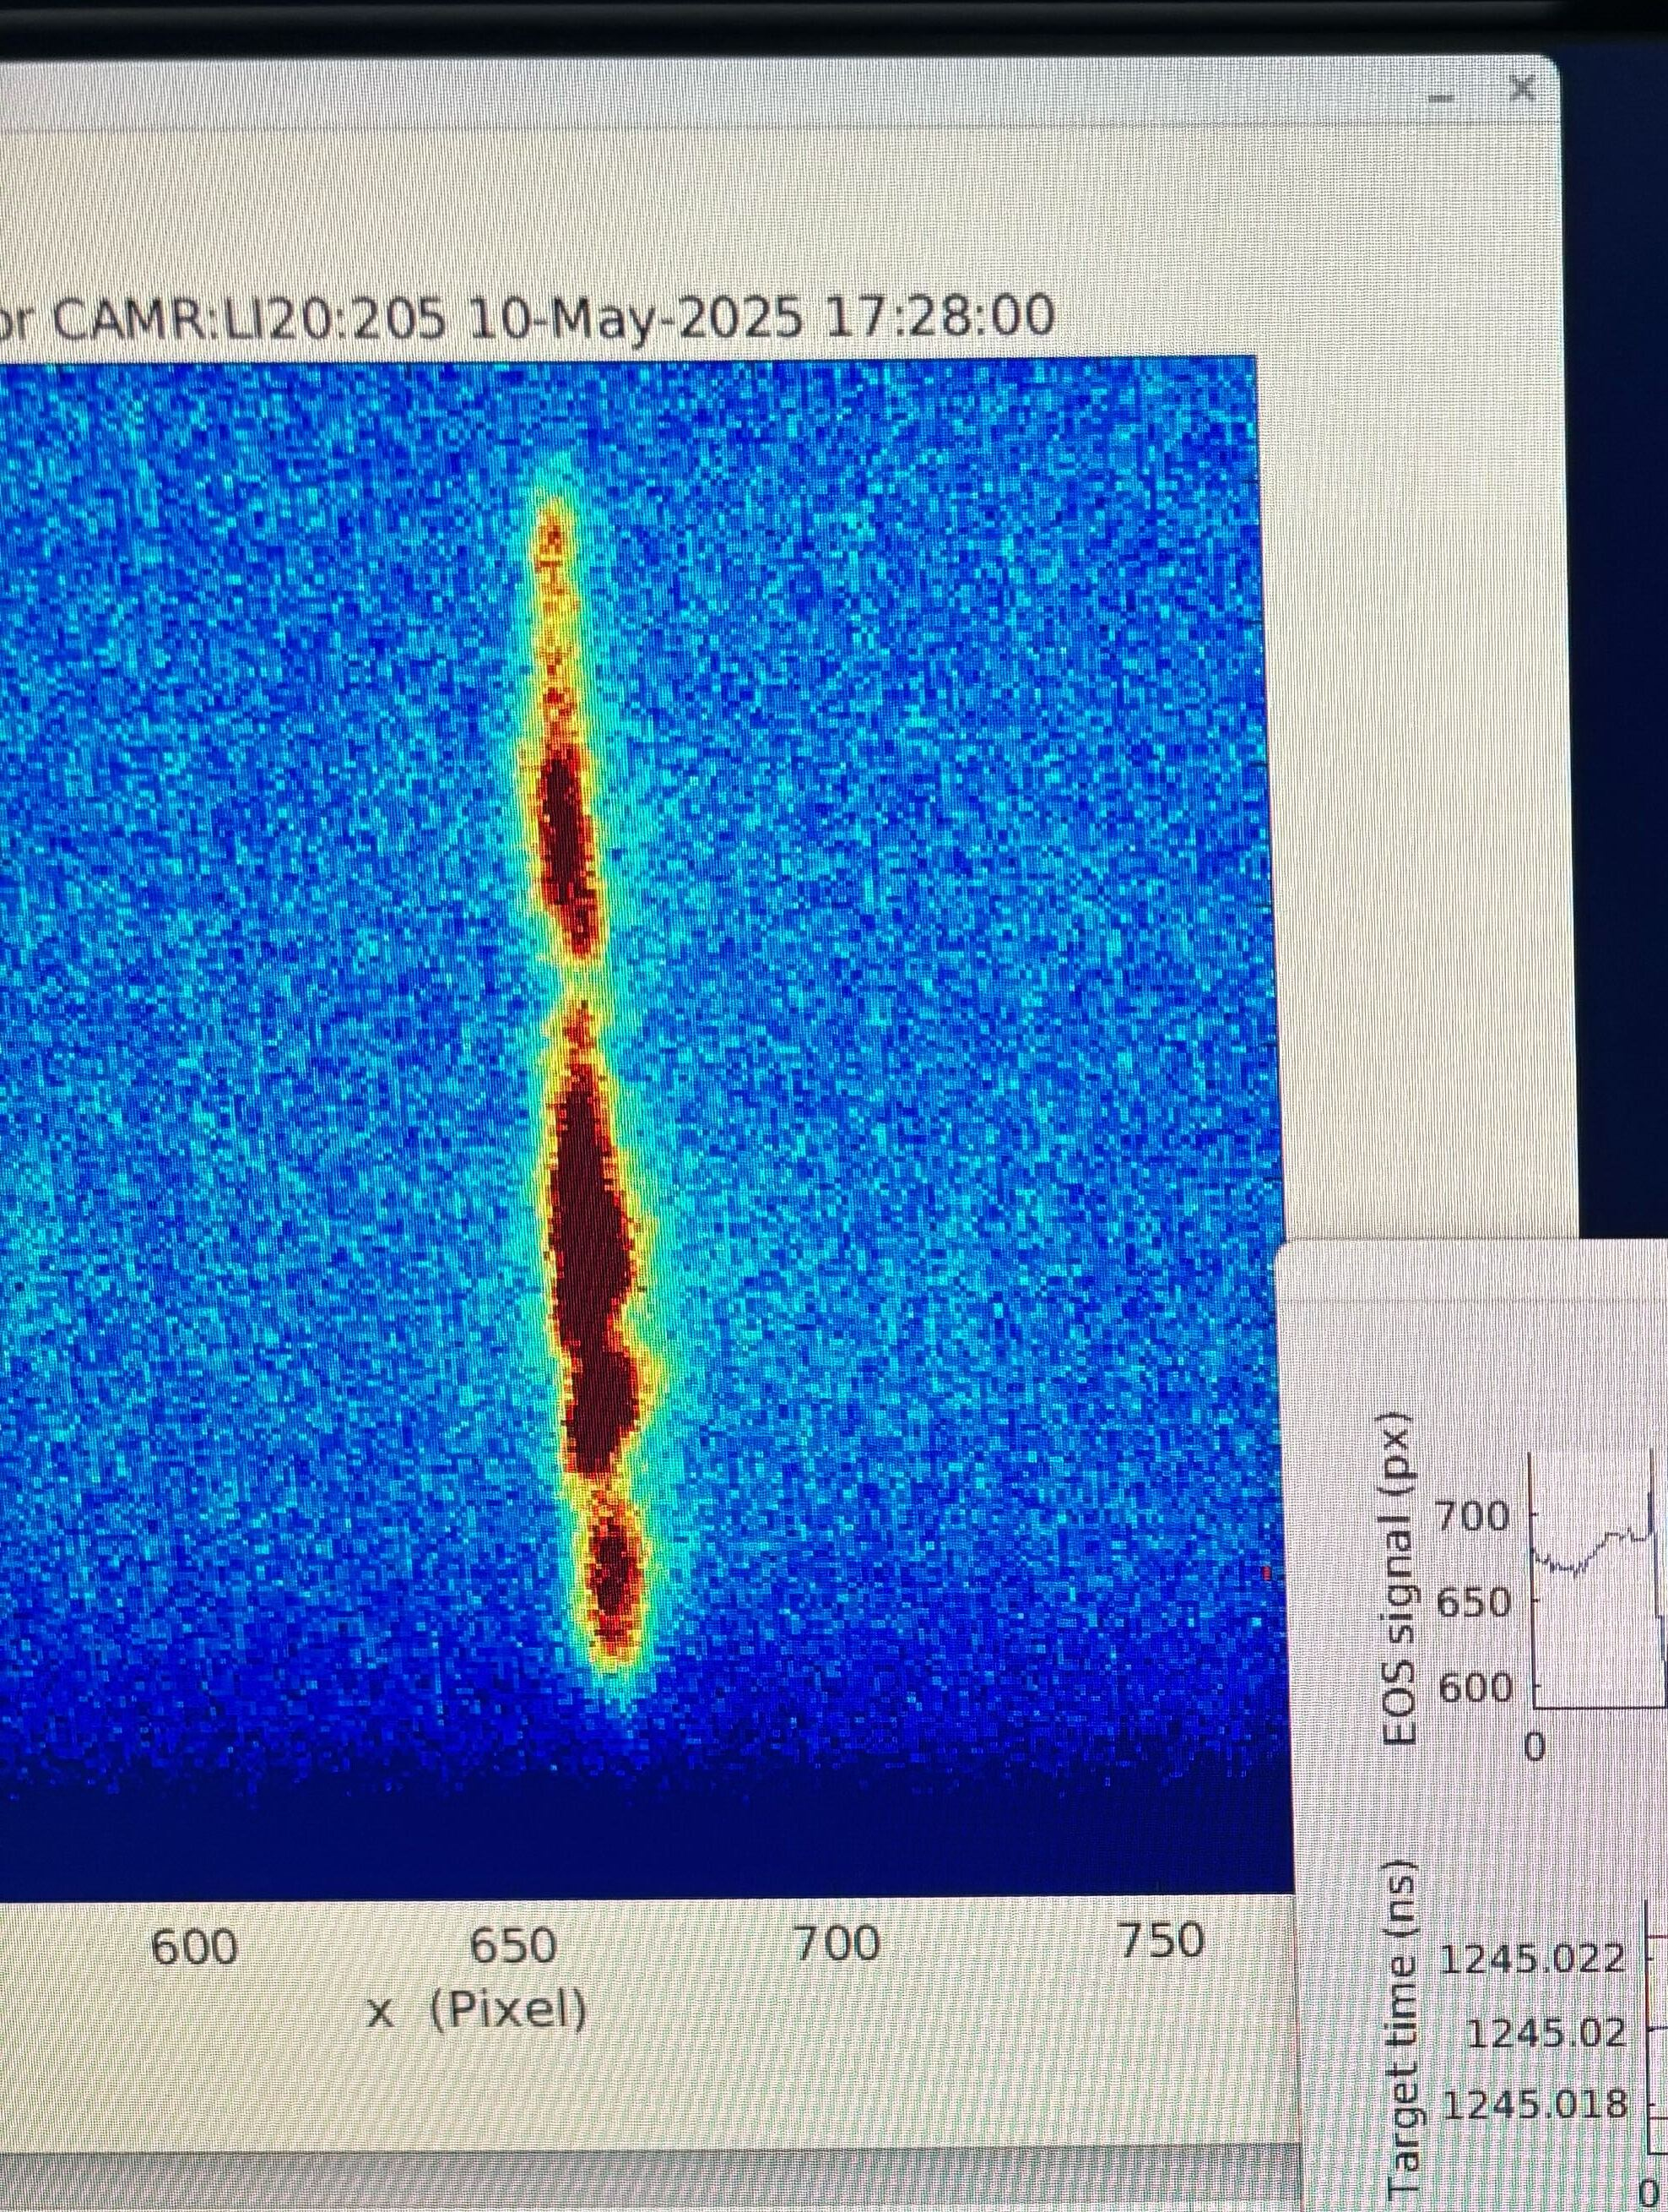
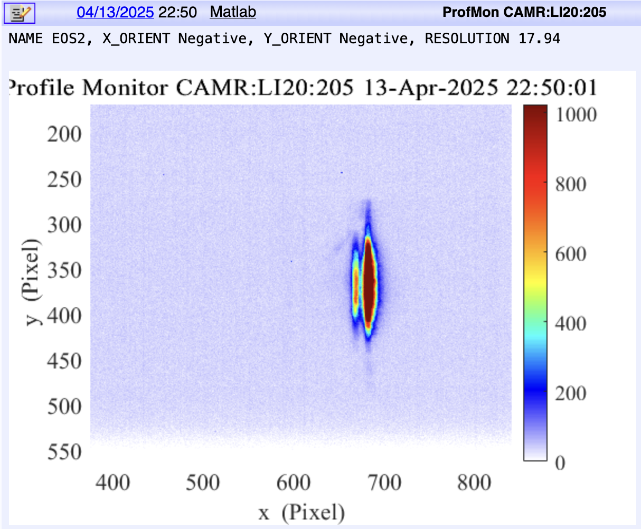
EOS-BPM Mk. 1 - Signal
Unapertured: Significant clipping on optics → strong diffraction; However, stronger signal/noise won out.
Apertured: Laser was reduced in size to avoid clipping, but signal/noise suffered as a result.

Slide 5
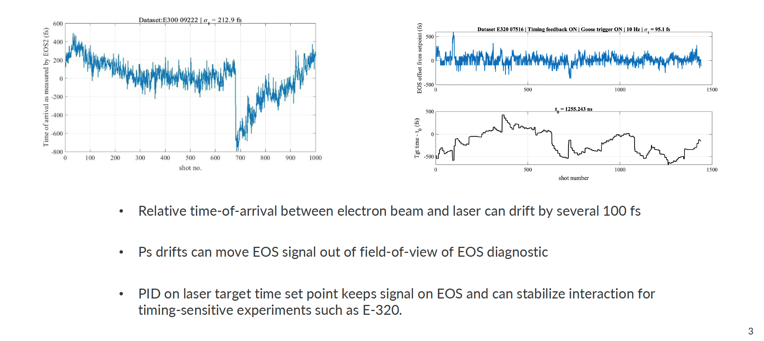
EOS-BPM Mk. 1 – Laser Timing Stabilization

Slide 6
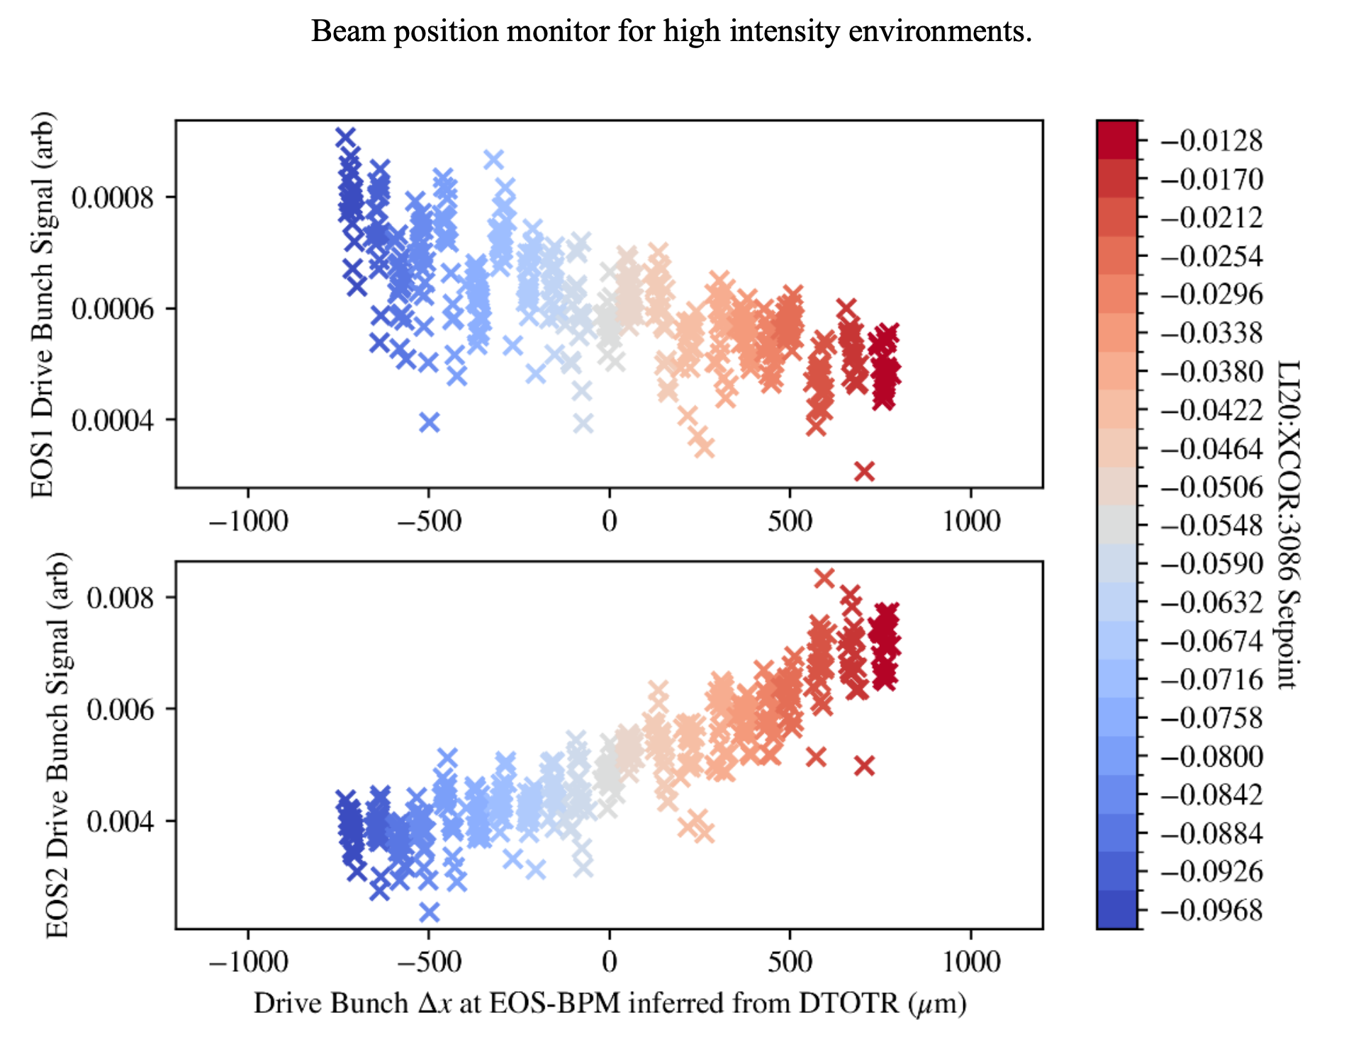
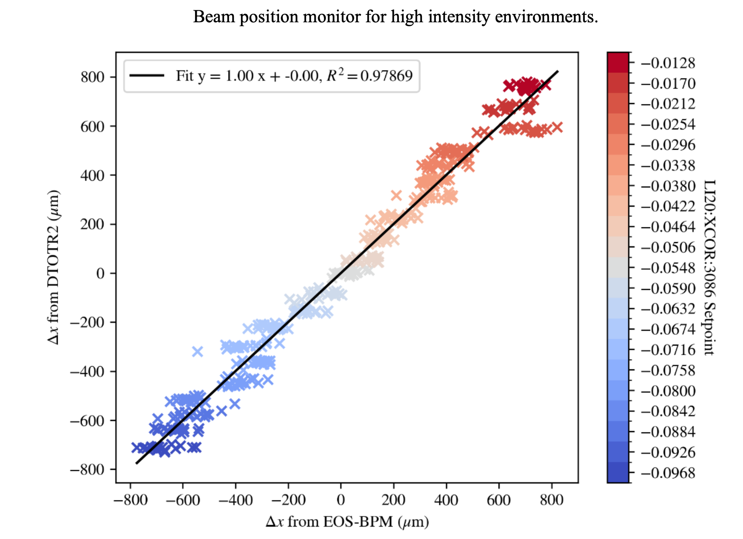
EOS BPM Mk.1 – FY25 Experimental Data
Claire Hansel
Beam position monitor for high intensity environments
EOS1
EOS1 Signal Strength (arb)
Δx measured at OTR (μm)
EOS2
EOS2 Signal Strength (arb)
Δx from EOS-BPM (μm)
Δx measured at OTR (μm)
65 μm Resolution!

Slide 7
EOS BPM Mk.2 Design
Axicon creates circular donut
4 crystals around e⁻ beam axis
Easier alignment more uniform laser intensity
More complete azimuthal coverage allows for position measurement in x and y.
Enhanced signal to noise leads to better temporal and transverse resolution.
EO Crystal
k
e⁻ beam
k
4 Crystal Design
Tilted Pulse Front
5º angle of incidence (θ)
3 ps temporal window
θ
4 10mm x 10mm 100μm thick GaP wafers
Axicon

Slide 8
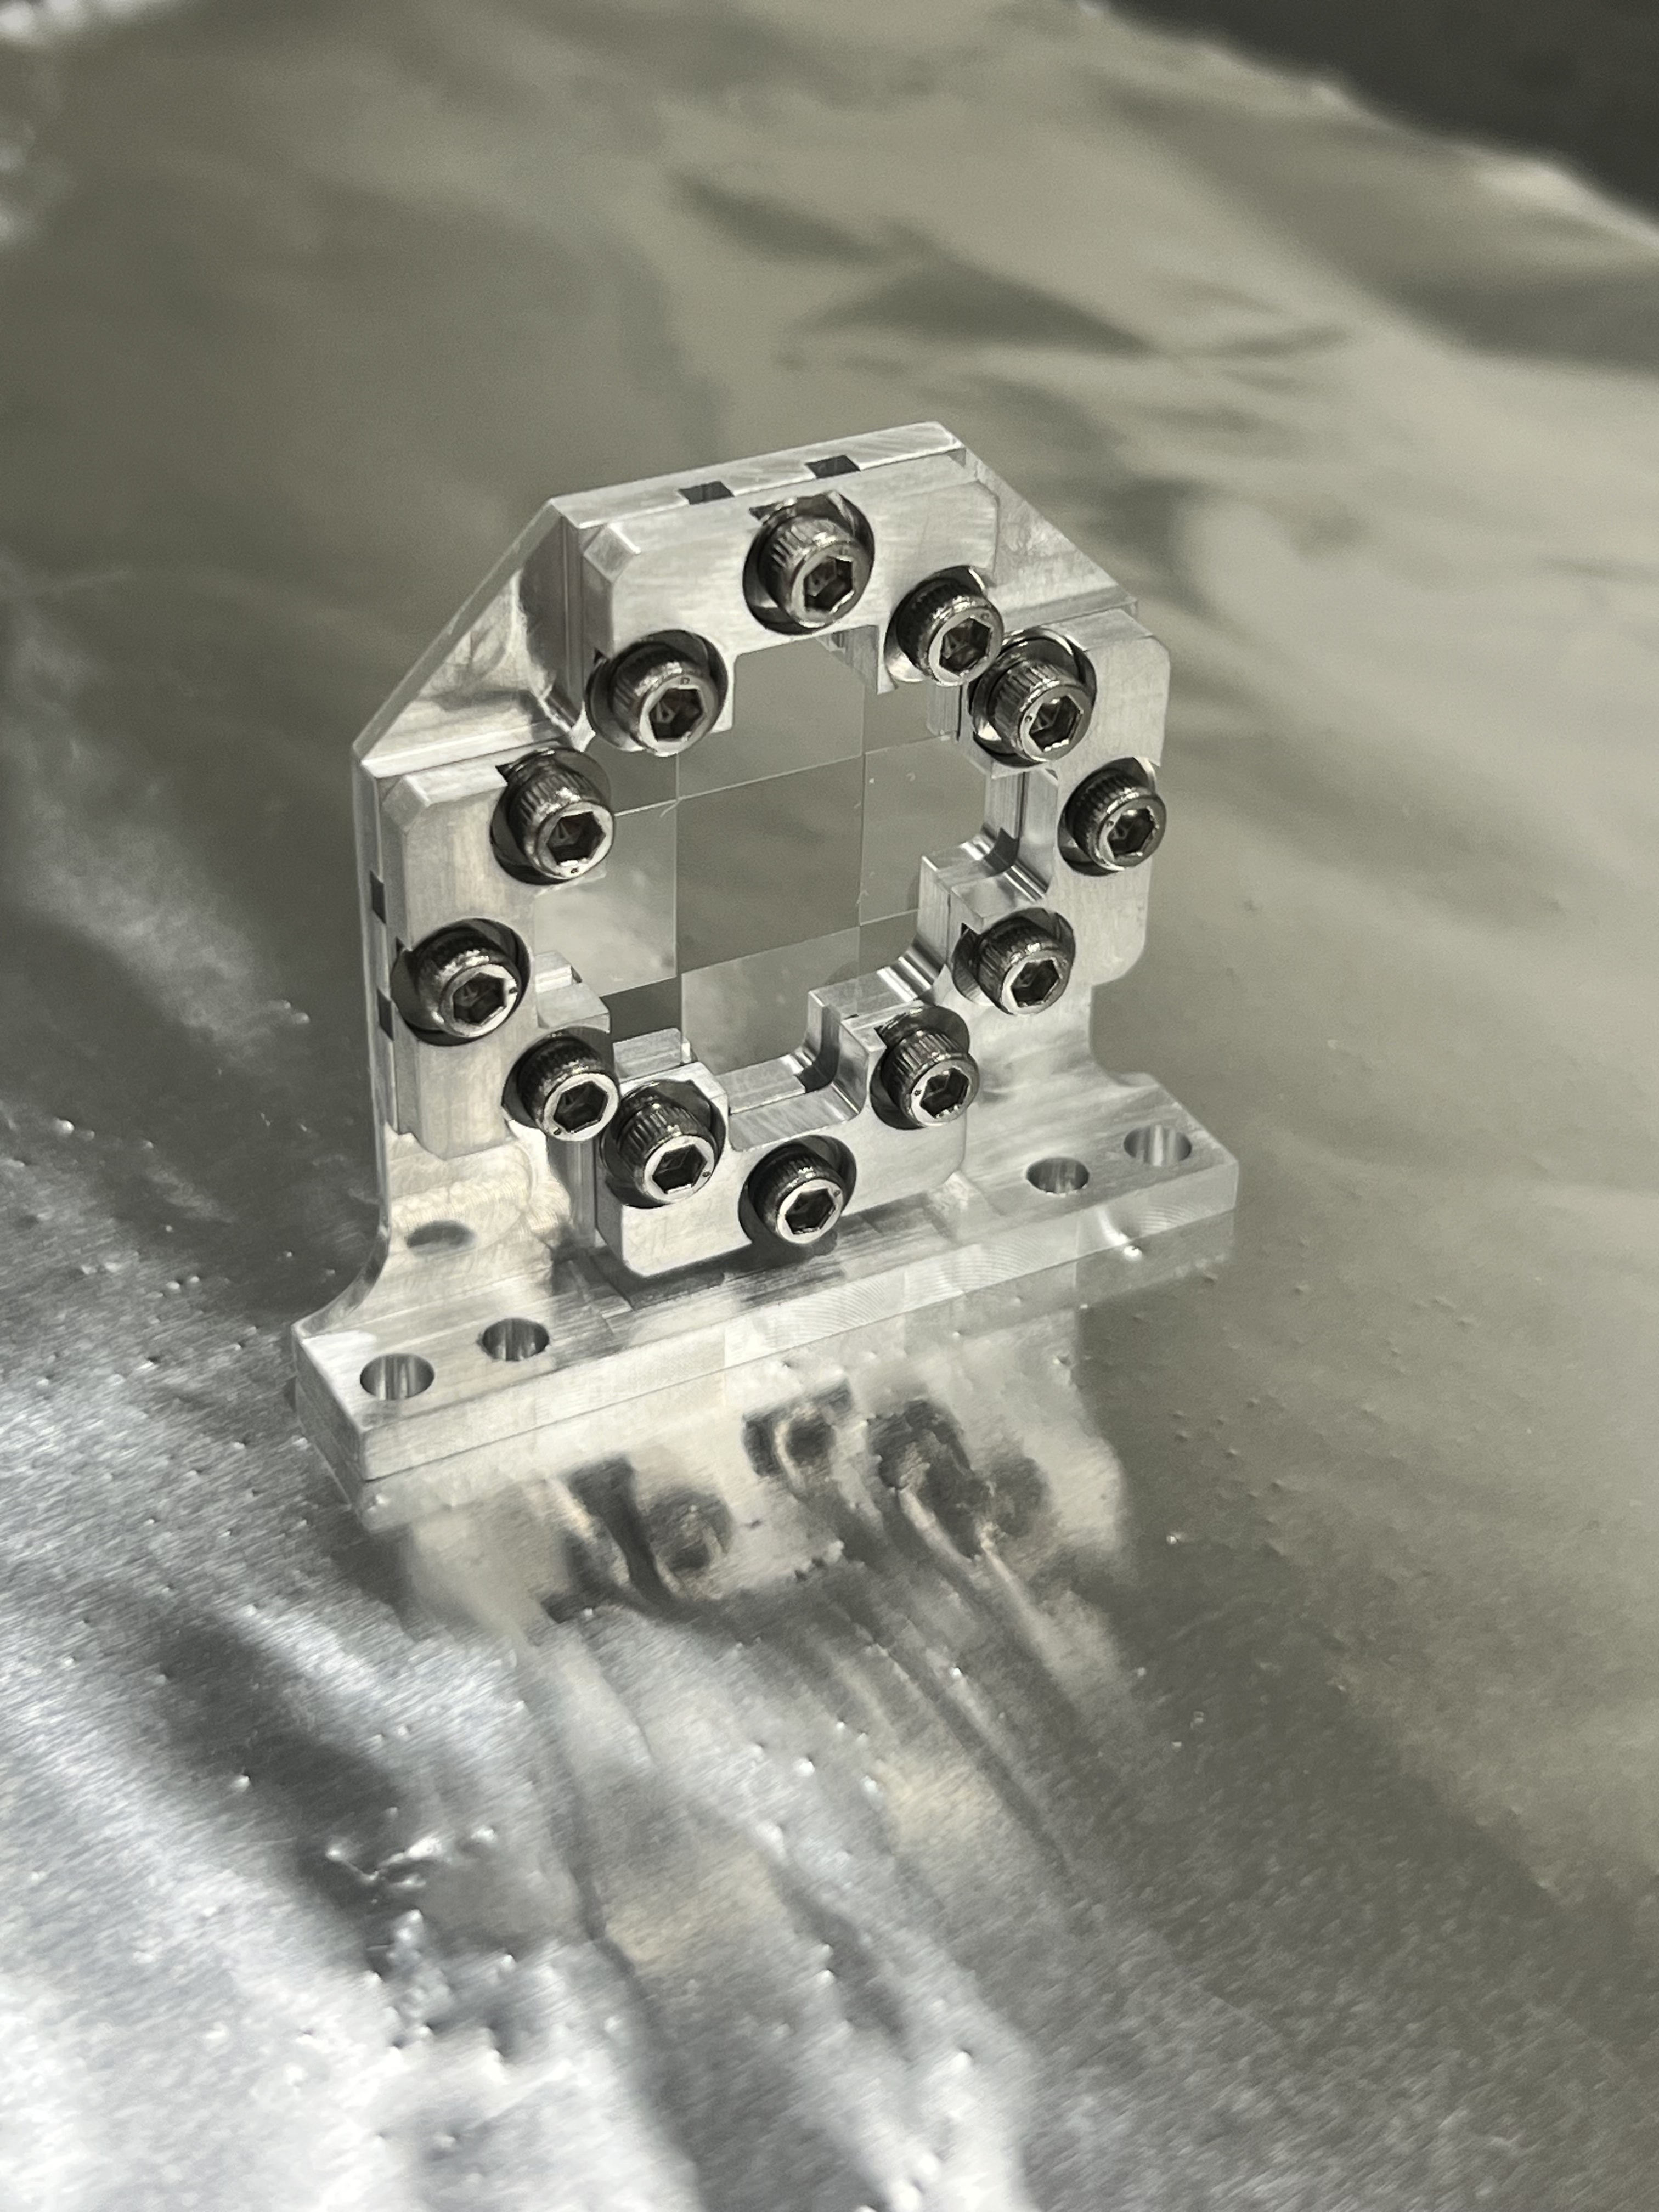
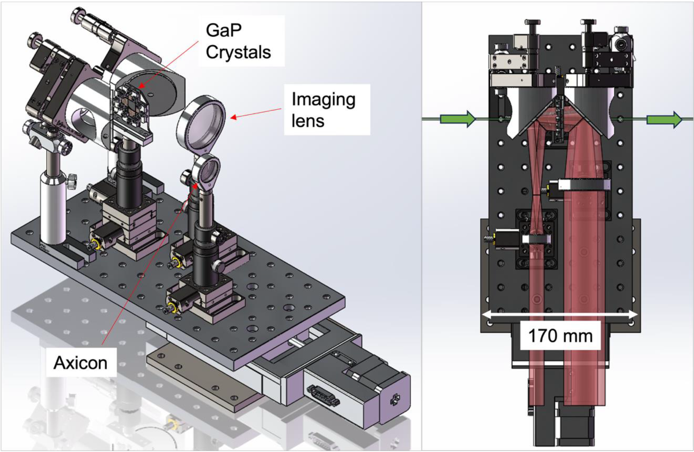
EOS-BPM Mk. 2 CAD Model/Pictures
e⁻ beam
Mounted 100μm Glass Wafers in EOS BPM Mk.2 Crystal Holder

Slide 9
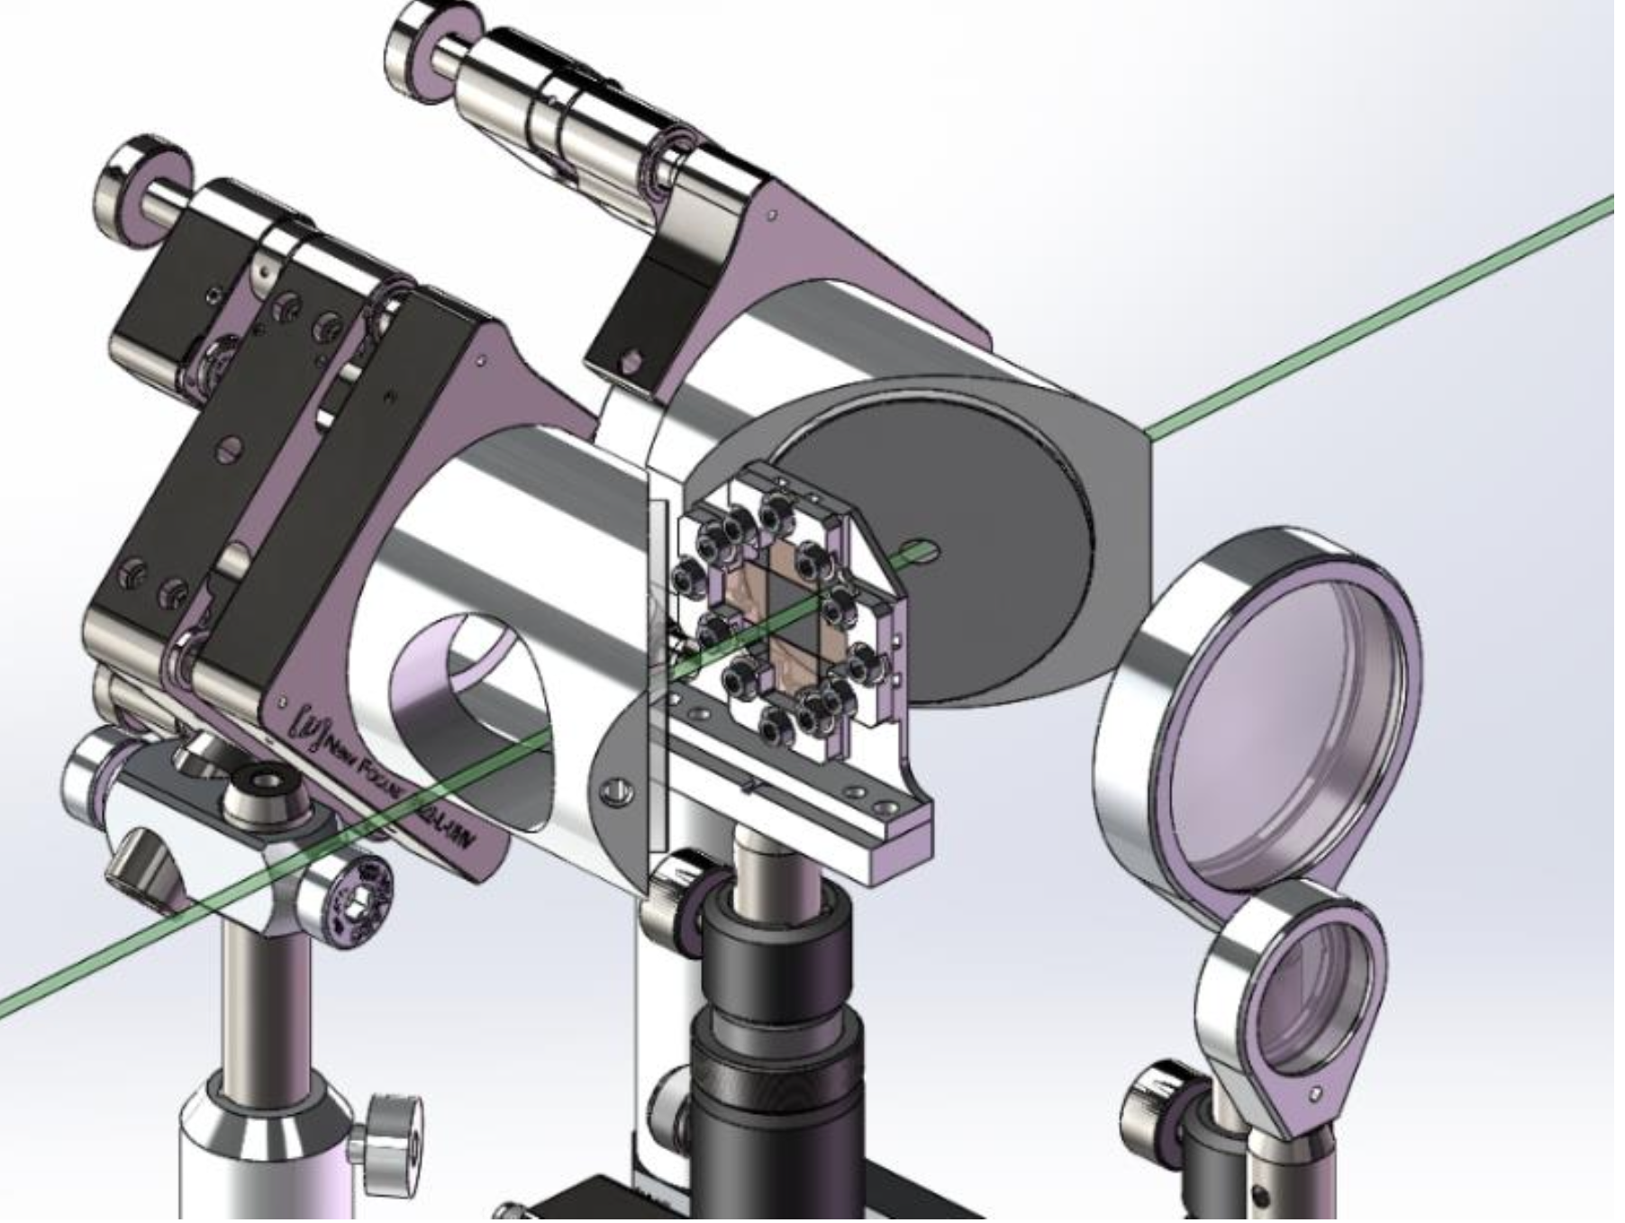
Limiting Aperture
Mirrors have 4 mm hole diameter and are 6.7 mm thick.
- Crystal minimum aperture is 1 cm

Slide 10
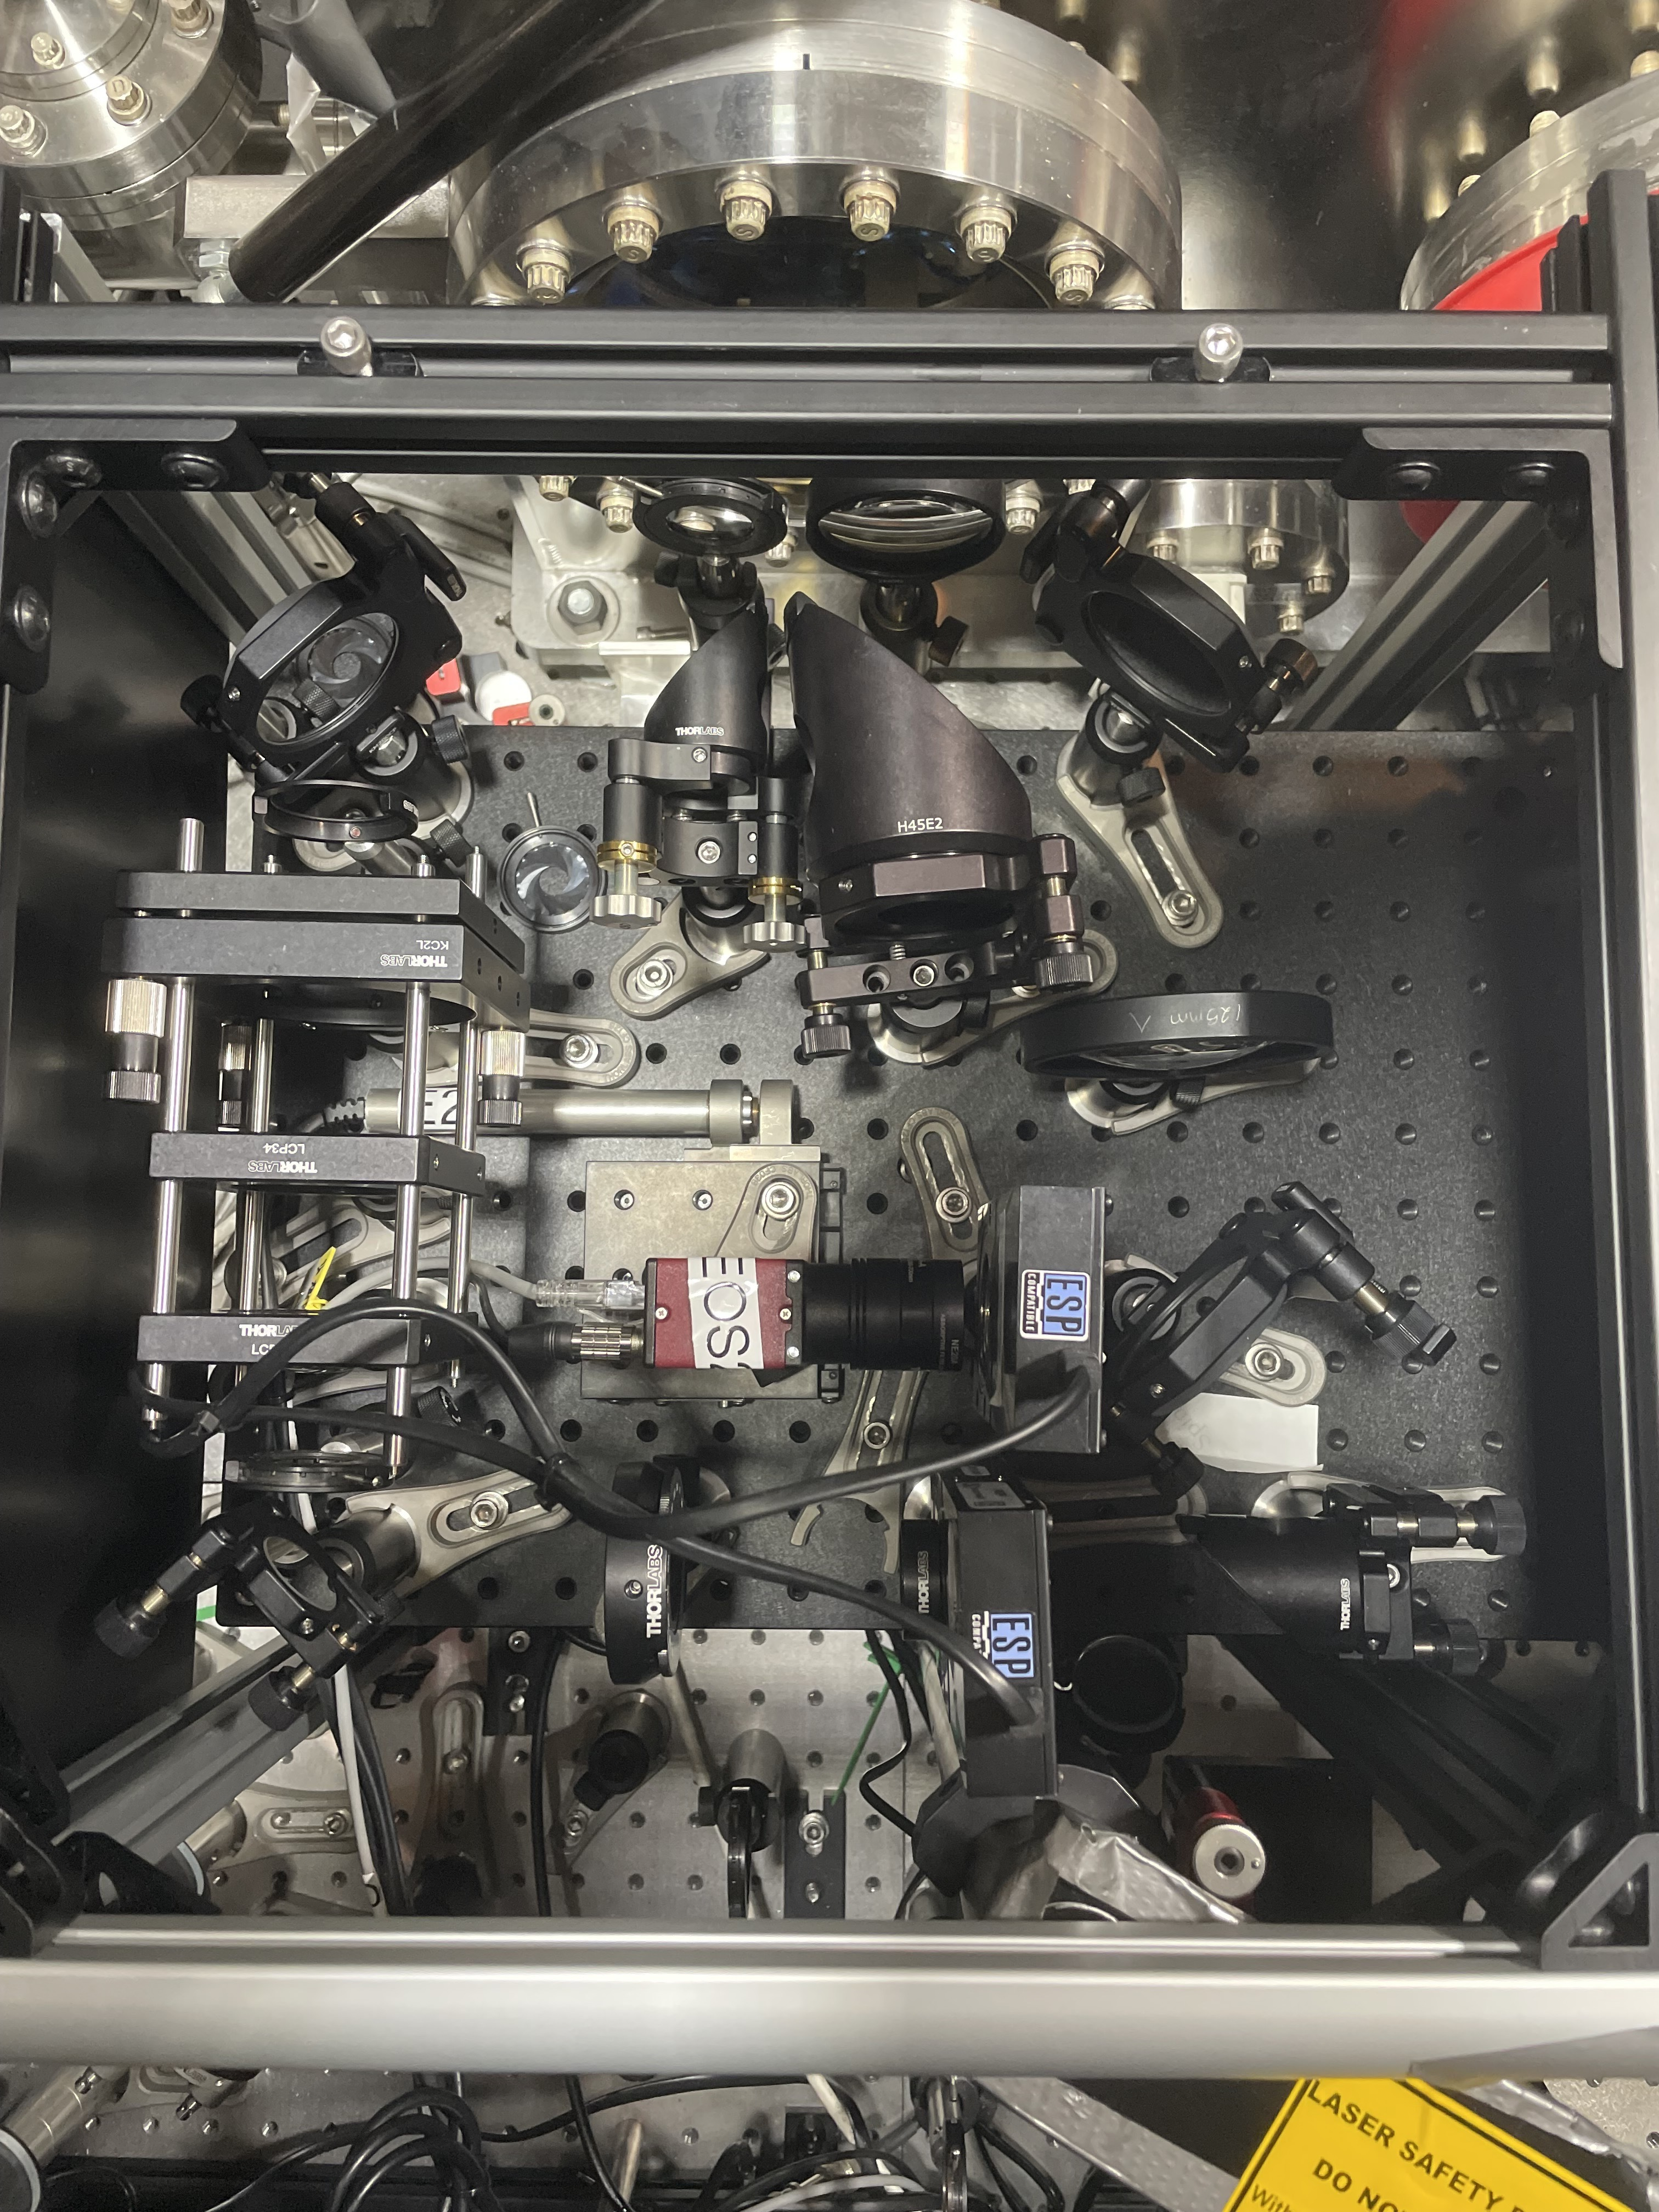
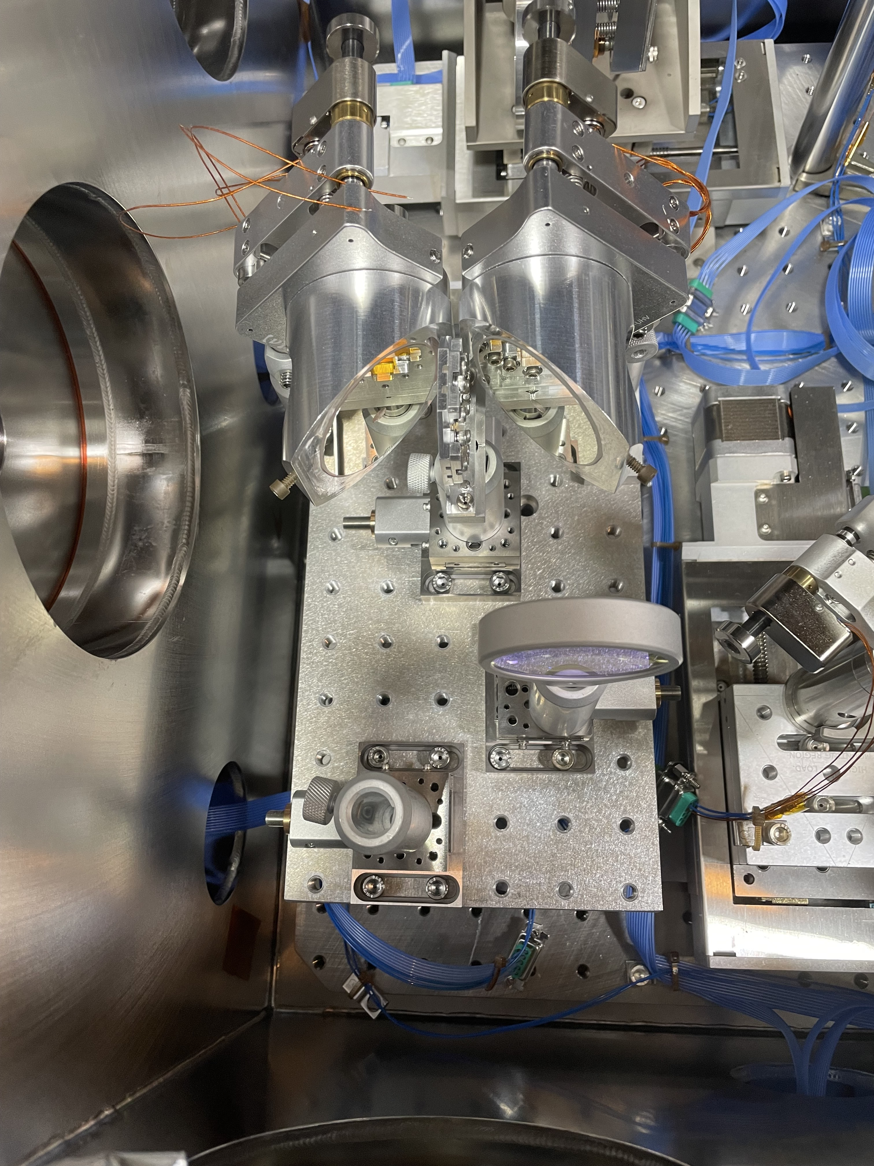
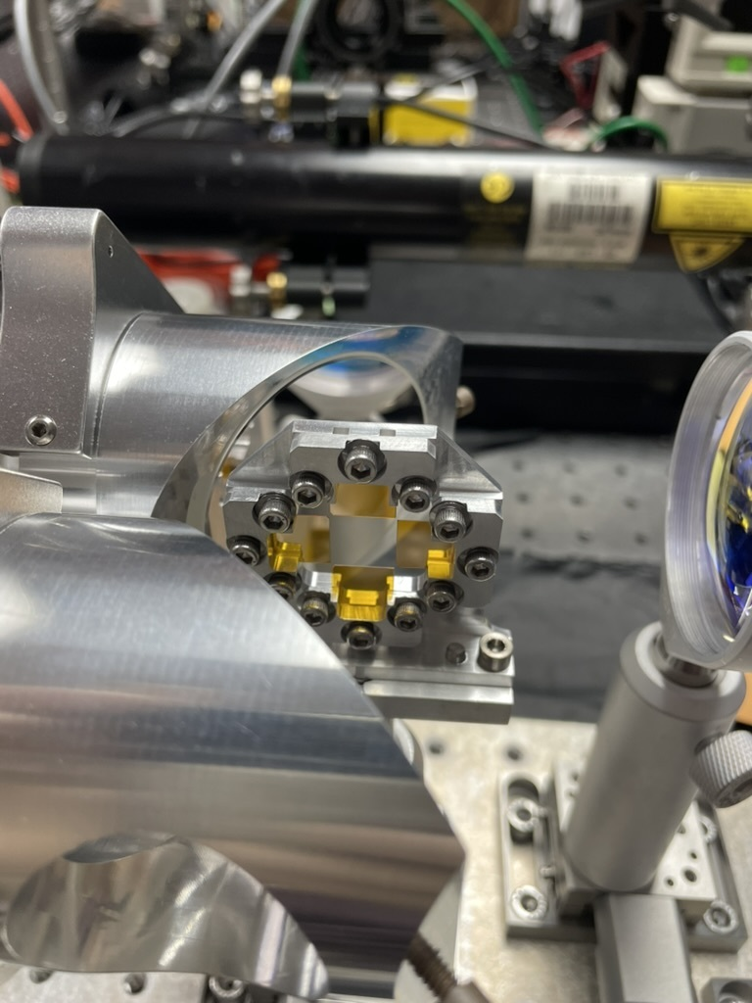
EOS-BPM Mk. 2 Photos
Outside PB
Inside PB
EO Crystals

Slide 11
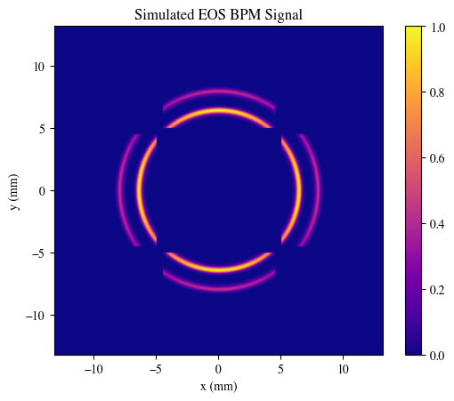
EOS BPM Mk.2 Simulation
Parameter | Value | Unit
Laser Wavelength | 800 | nm
Laser Angle | 5 | degree
GaP Wafer Thickness | 100 | μm
Drive Beam Charge | 1000 | pC
Witness Beam Charge | 800 | pC
Time Delay btw. Beams | 450/135 | fs/μm
Transverse Beam Offset Drive | ~10 | μm
Transverse Beam Offset Witness | ~10 | μm
Bunch Length (Both) | 50/15 | fs/μm
t
Witness
Drive

Slide 12
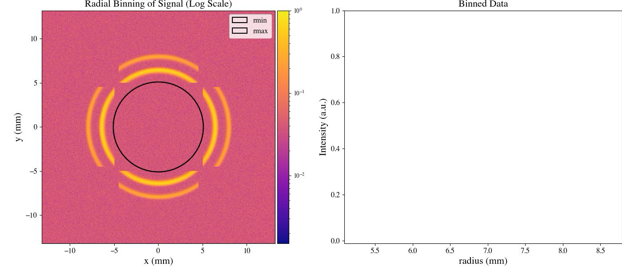
EOS BPM Mk.2 Time of Arrival Analysis

Slide 13
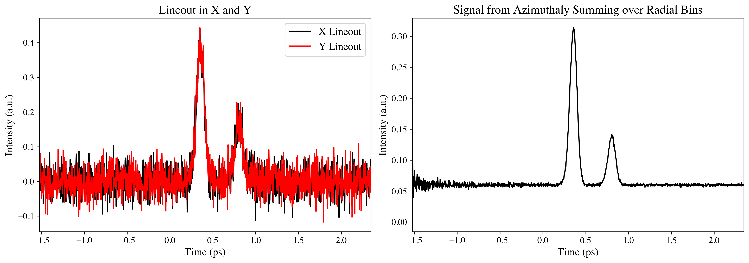
EOS BPM Mk.2 Time of Arrival
SNR Drive Beam: 2.20
SNR Witness Beam: 0.92
SNR Drive Beam: 73.1
SNR Witness Beam: 50.4

Slide 14

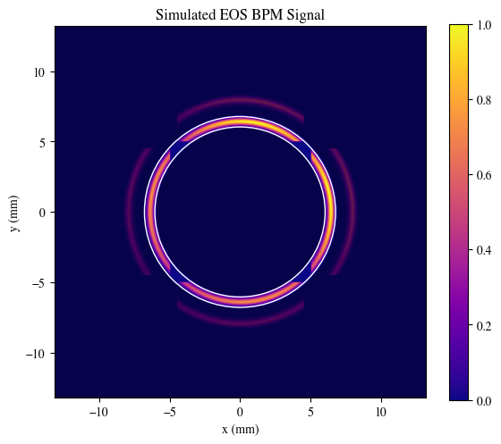
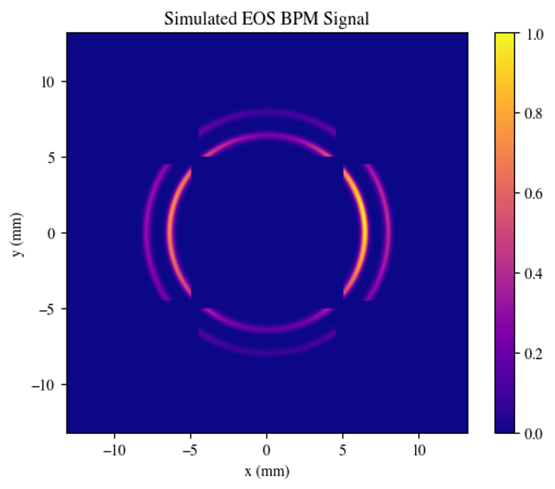


EOS BPM Analysis Algorithm
Crystal rotated 90º
Expected Signal
b
b
$$I_{a}\left(α,r\right)=A_{1}{Sin}^{2}\left(\frac{A_{2}}{r}\sqrt{1+3\cos^{2}\left(α \right)}\right)$$
$$I_{b}\left(α,r\right)=A_{1}{Sin}^{2}\left(\frac{A_{2}}{r}\sqrt{1+3\sin^{2}\left(α \right)}\right)$$
a
α₁
a
a
α₁
a
α
α₁ = α +π/2
α
α
Mask to get 1 ring
Piecewise fit to model
Extract r and α to find bunch position
Repeat for 2nd ring
e⁻beam
b
b

Slide 15
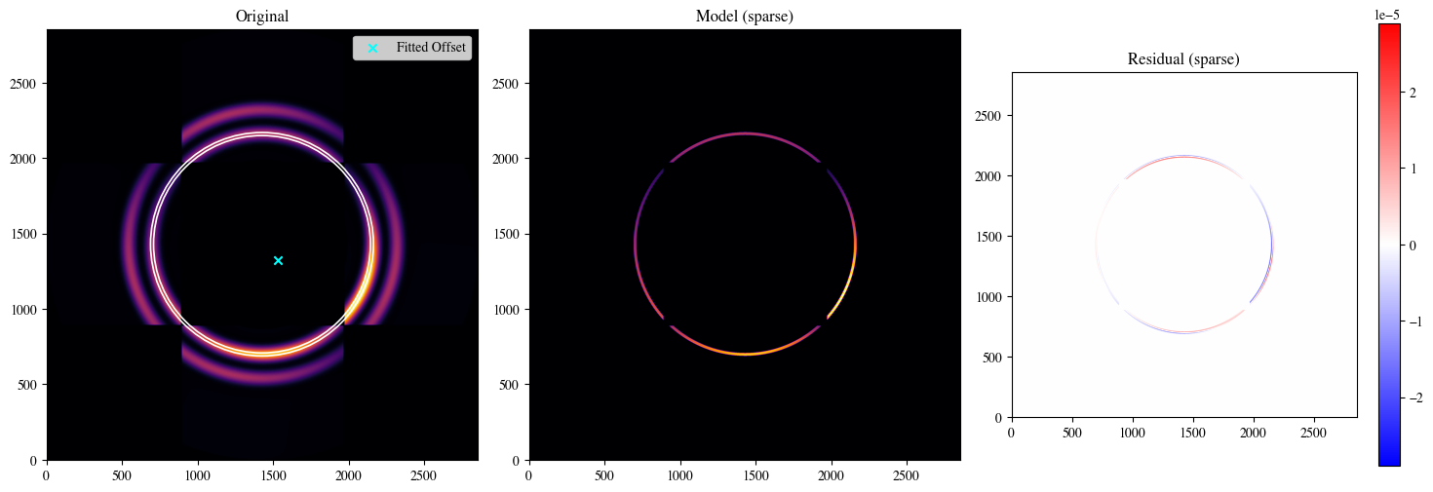
Drive Beam Position Reconstruction
(996 um, -999 um)
Pixels = (2856, 2856)

Slide 16
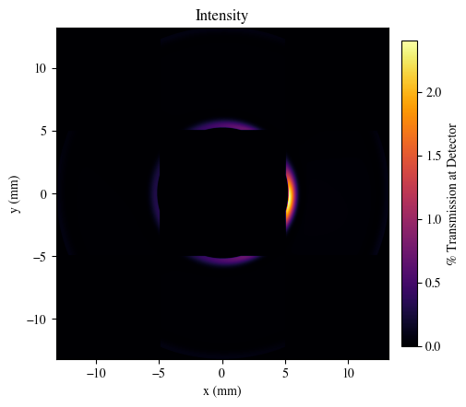
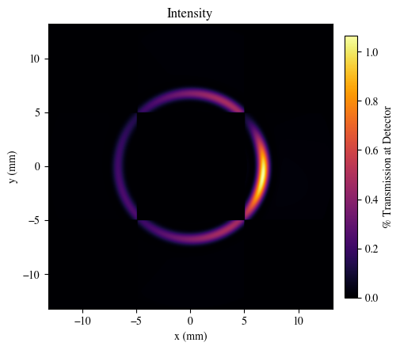
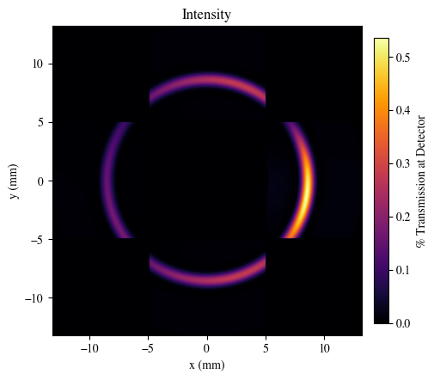
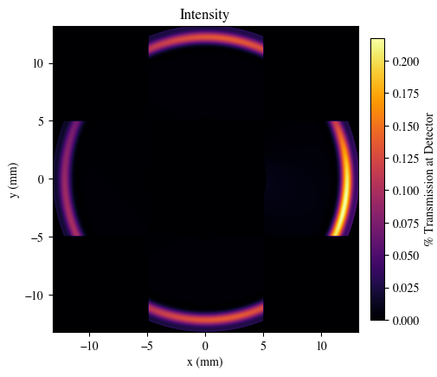
Offset Bunch with Different TOAs
Δt: 0.1 ps
T: 2.4 %
Δt: 0.5 ps
T: 1.1%
Parameters:
1.6 nC
40 um long
Δt: 1 ps
T: 0.53%
Δt: 2 ps
T: 0.21%

Slide 17
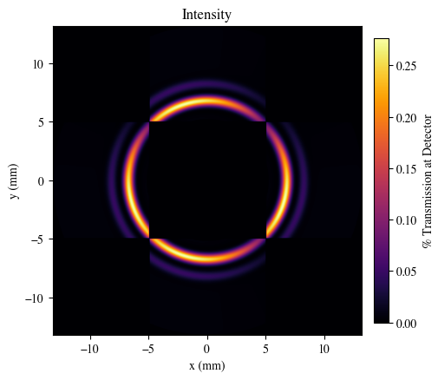
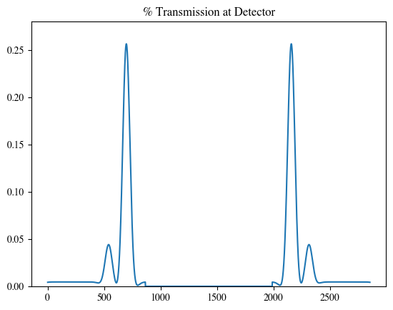
On-Axis Two-Bunch Simulation
Lineout Through Center
Parameters:
Drive: 1 nC , Witness: 0.5 nC
30 um bunch length, 400 fs seperation
Δt (laser & ebeam): 0.5 ps
* This assumes t= 0 is the inner edge of the donut beam

Slide 18
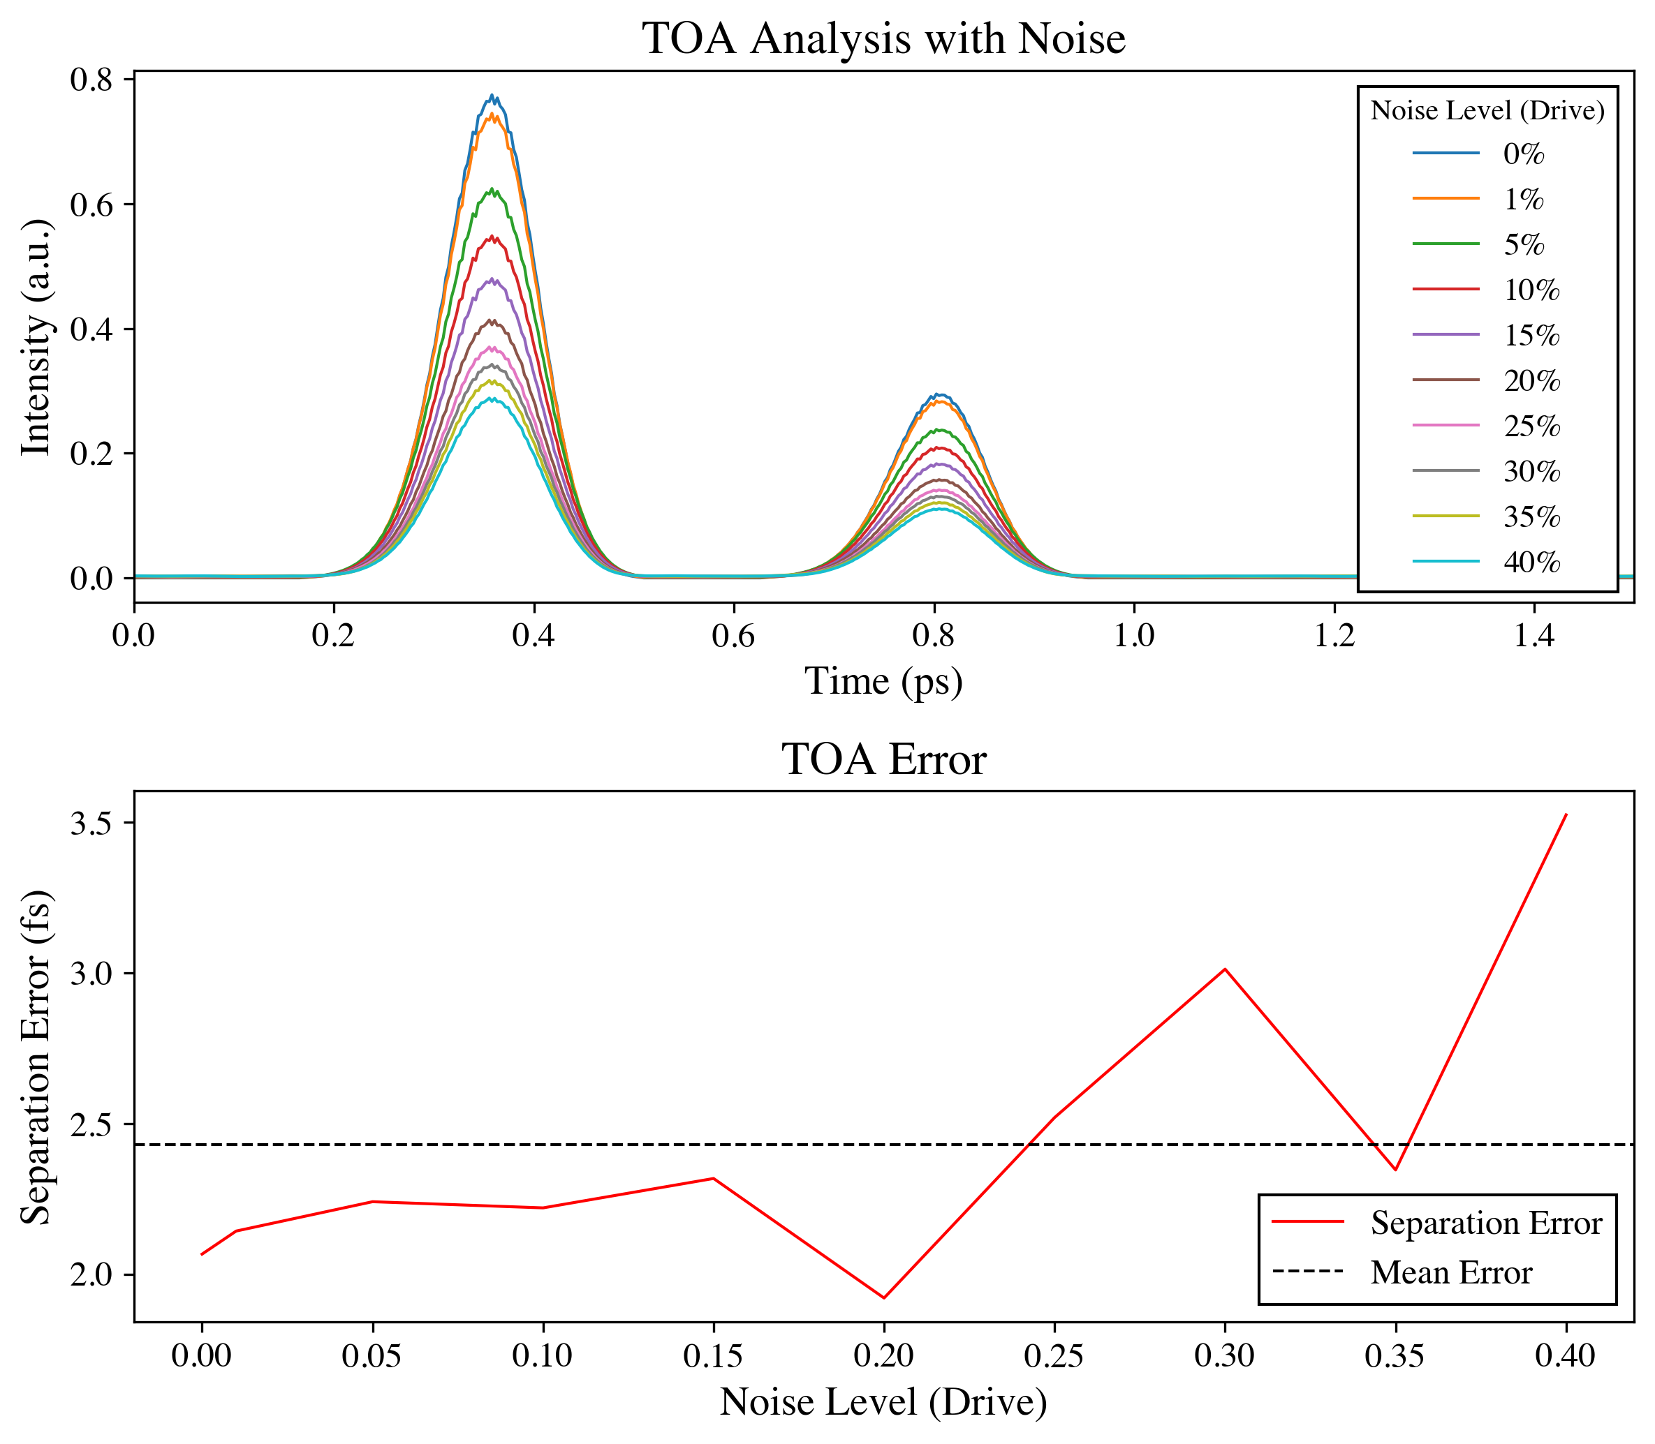
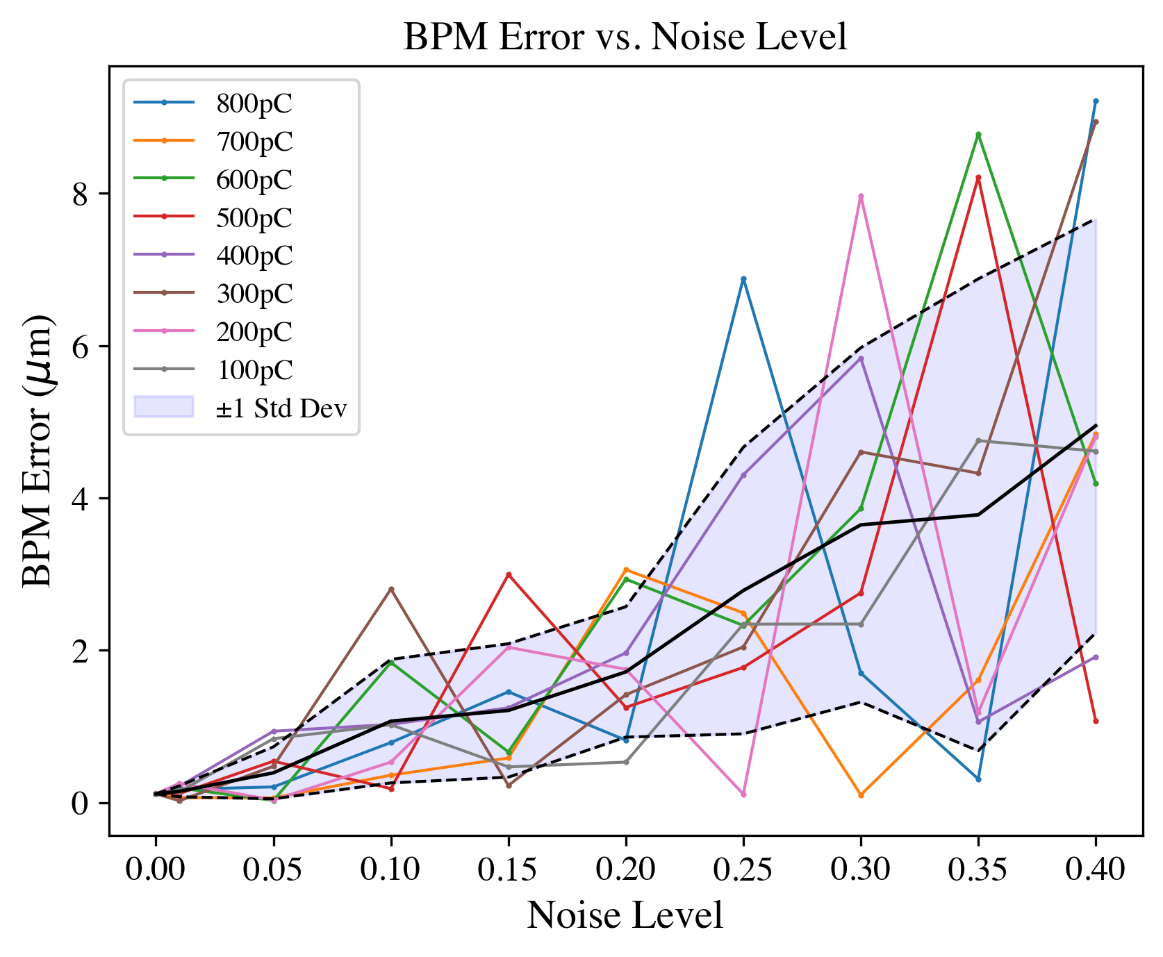
EOS BPM Mk.2 BPM and TOA Results
3 fs relative TOA resolution
<5 μm transverse resolution

Slide 19
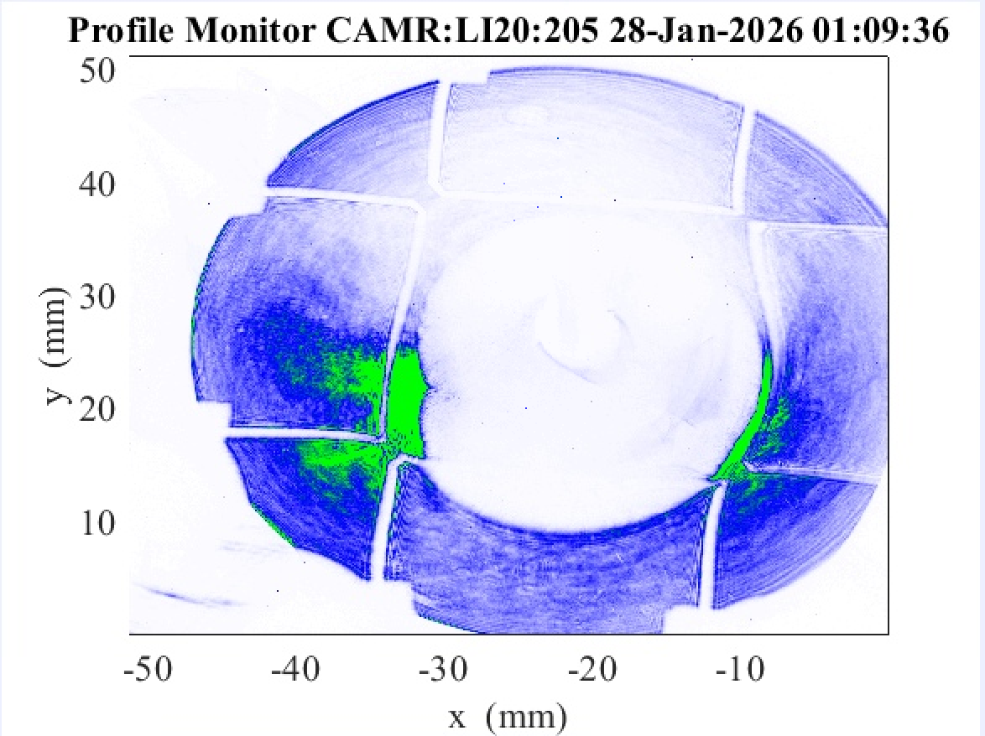
Current Laser Donut Profile
Good enough for commissioning
Need alignment improvement
Apparent spherical aberration
→ can be corrected in analysis
→ still want to improve!
Prefer more uniform intensity
→ background camera coming

Slide 20
EOS-BPM Summary
EOS-BPM Mk. 1 pretty promising results
EOS-BPM Mk. 2 installed
  Initial configuration strangled signal (too much ND, bad polarization)
  Signal search this week with improved setup
  Science shifts in mid-Feb.
Hope for ~fs TOA and <5 µm BPM capability
  Often >1m upstream of e-beam waist → ~µm effective BPM resolution at waist
Goal: live analysis tool
  Longitudinal bunch separation
  Transverse alignment
  Use in ML algorithms?
Importance to PWFA
  Chromatic emittance growth from transverse offset
  Hosing instability

