Slide 1

Plans for E-301
FACET-II PWFA Meeting
February 2, 2026
Michael Litos
Notes:
Done

Slide 2
Publications from Last Year
Methods, Techniques, and Design Considerations:
V. Lee, “Experimental parameters for plasma wakefield acceleration in a narrow plasma column”, Journal of Physics: Conference Series 3124, 012009 (2025) [EAAC 2023 Proc.]
R. Ariniello, “Demonstration of a tandem lens for producing shaped laser-ionized plasmas for plasma wakefield acceleration”, Optics Express 33, 52019 (2025)
V. Lee, “Precision alignment and tolerance of a plasma wakefield accelerator in a laser-ionized plasma source”, arXiv:2508.16864 (2025, PRAB)
PWFA Experimental Results:
R. Ariniello, “Drive beam depletion with multi-Joule energy transfer in a plasma wakefield accelerator”, arXiv:2511.15143 (2025, PRAB)
V. Lee, Two-bunch PWFA results: high charge-capture efficiency, in progress
V. Lee, Narrow-channel PWFA results (E333), in progress

Slide 3
Key Results from Last Run
Developed fast, semi-automated alignment technique
Single bunch drive depletion similar to E300
Two-bunch PWFA with high charge capture efficiency, similar energetics to E300

Slide 4
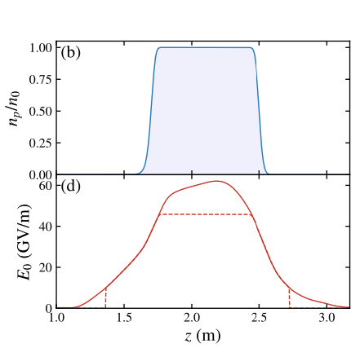
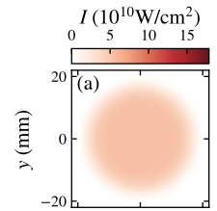

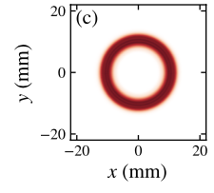

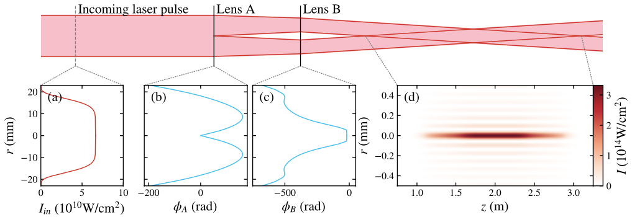
Tandem Lens Focusing of Ionization Laser
A pair of diffractive optics acts in tandem to shape the laser intensity profile.
Lens A controls initial intensity profile at Lens B.
Lens B produces axicon-like Bessel focusing.
Shape of donut profile at Lens B determines axial intensity profile downstream.
Plasma refraction helps to broaden plasma filament.
R. Ariniello, V. Lee, M. Litos, “Demonstration of a tandem lens for producing shaped laser-ionized plasmas for plasma wakefield acceleration”, arXiv:2509.01747 (2025)

Slide 5
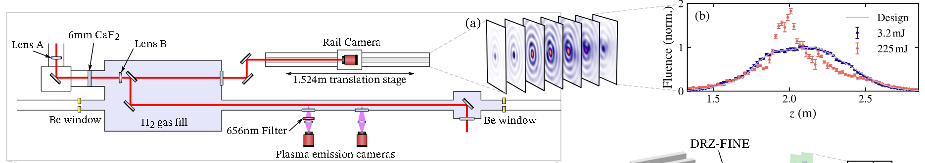
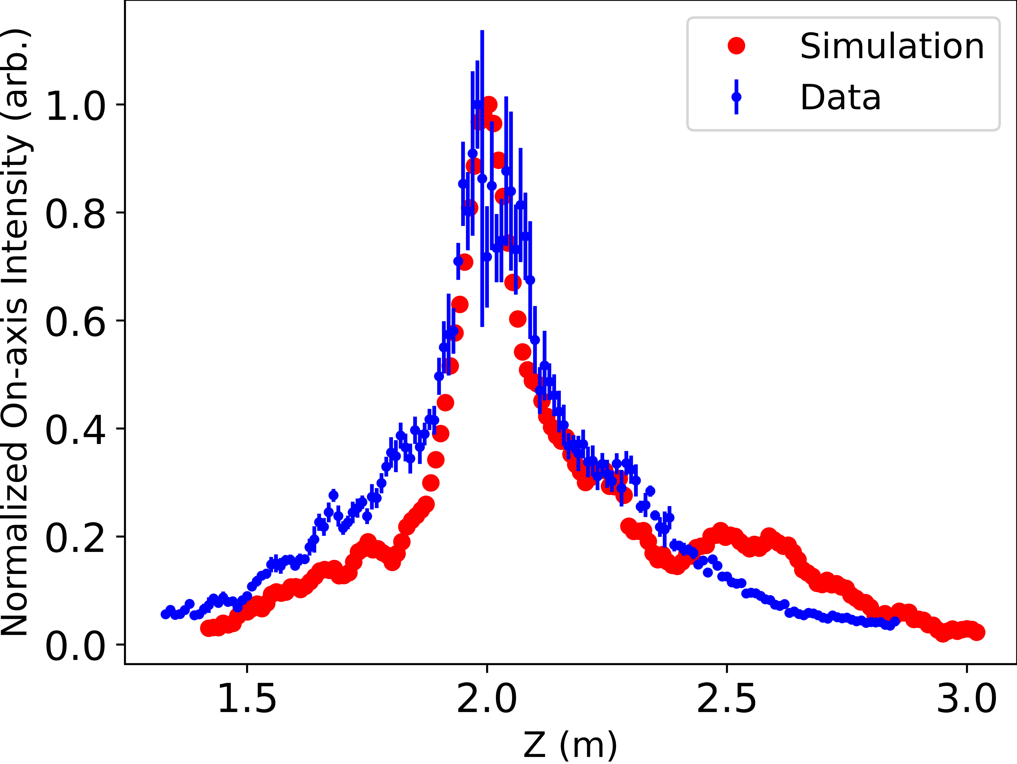
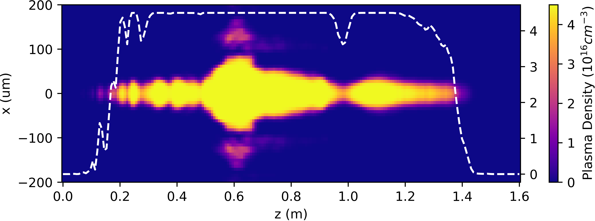
Laser-ionized Plasma Source – Plasma
Understand the plasma source through simulations:
Verify on-axis laser intensity against data (Includes diffraction, GVD, Kerr effect, self phase modulation, and broadband chromatic effect)
Simulate ionization with the ADK model
Contact Valentina at valentina.lee@colorado.edu if you are interested in using this GPU enabled laser plasma code.

Slide 6
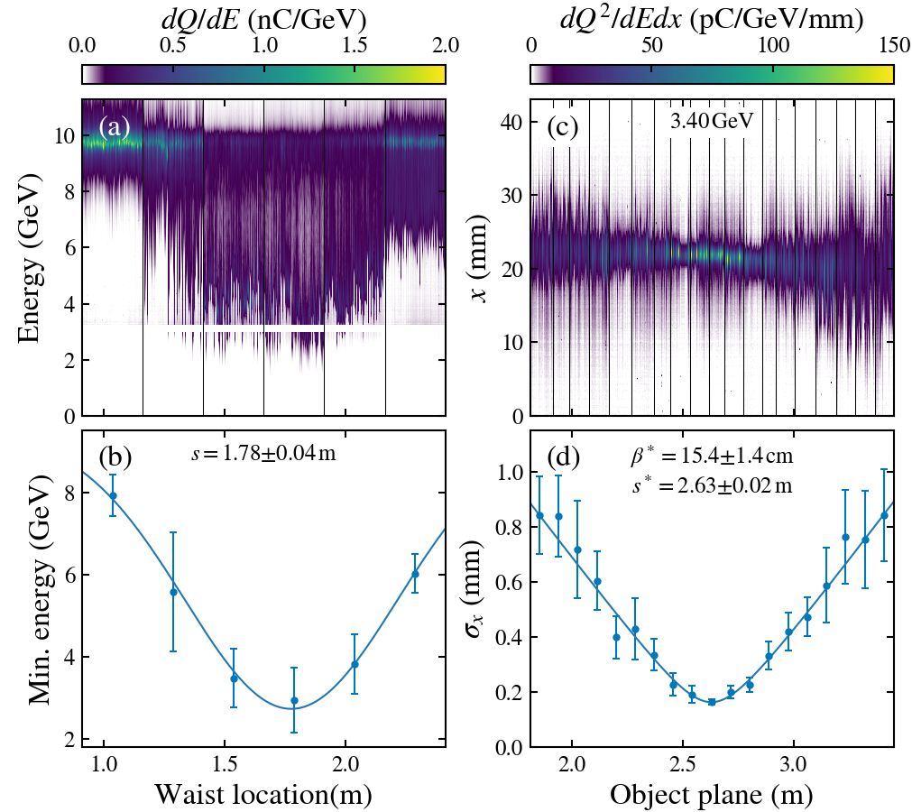
Laser-ionized Plasma Source – Plasma
Verify the plasma source experiments:
Plasma entrance measurement through e-beam waist scan
Plasma exit measurement through object plane scan
By comparing the data with our simulation, the laser-ionized plasma source is well understood.
Ariniello, R., V. Lee, et. al., "Drive beam depletion with multi-Joule energy transfer in a plasma wakefield accelerator" submitting to PRAB, arXiv: XXXX.XXXX (2025).

Slide 7
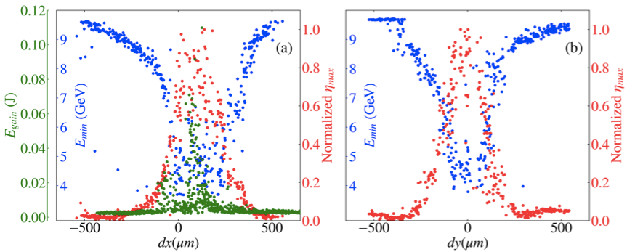
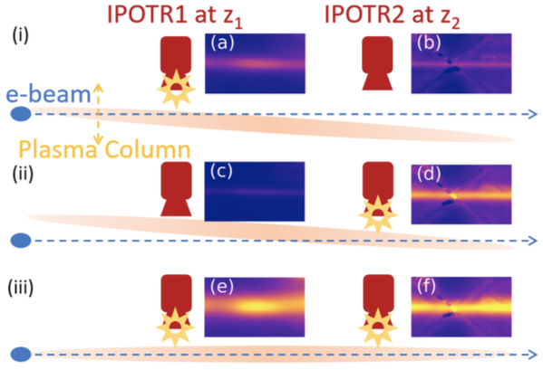
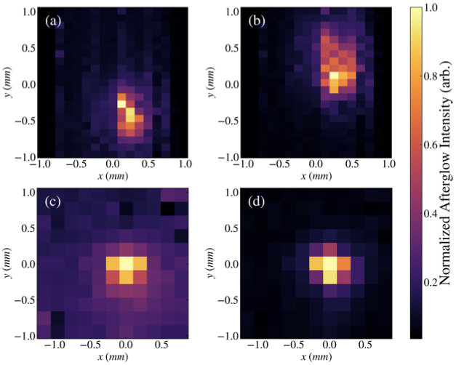
Alignment of Plasma Source to e-Beam
A method was developed for rapid alignment of plasma source to e-beam.
Initial coarse alignment achieved using OTR foils.
Fine alignment achieved using plasma glow after interaction with e-beam. Brighter light = better alignment.
Measurement of drive and witness beam interaction confirmed simple geometric alignment constraint:
Δr: radial offset, Δθ: angular offset
L: length of plasma, R_{p}: radius of plasma, R_{b} radius of blowout
misaligned
aligned

Slide 8
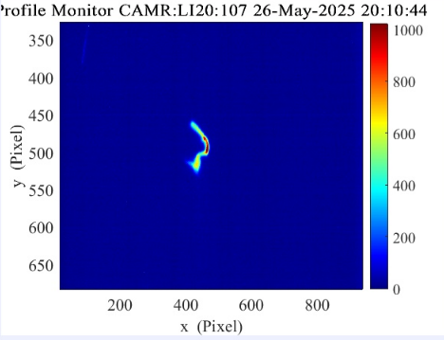
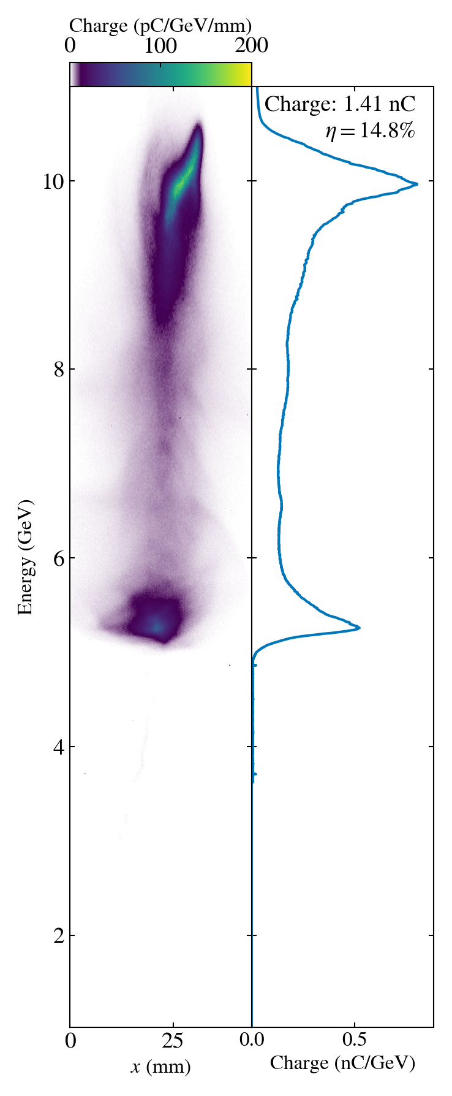
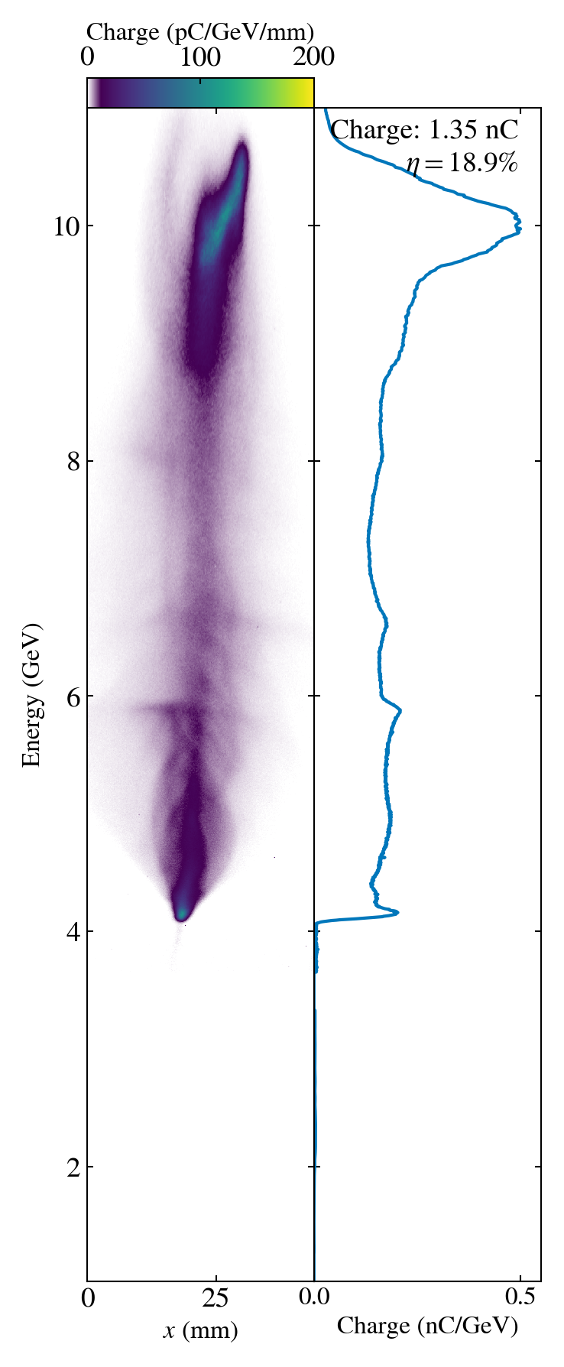
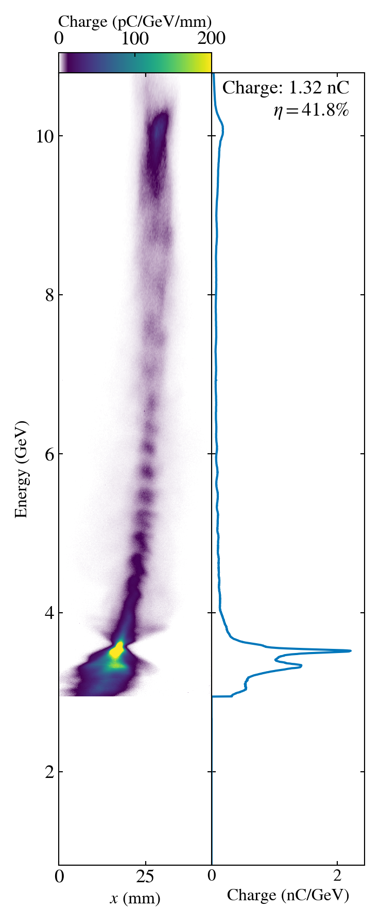
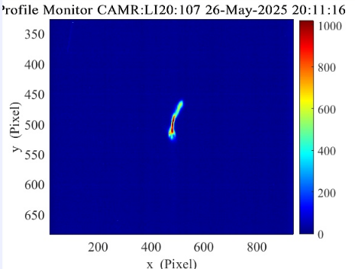
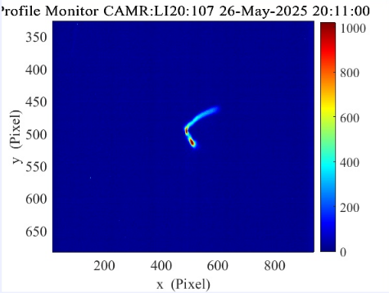
Plasma Interaction Optimization Process
Step 1: Overlap drive and witness in time – both will lose energy driving wake
Step 2: Send into plasma and observe energy loss
Step 3: optimize longitudinal waist location
Step 4: Optimize sextupole tuning to minimize dispersion
TCAV: -90º
TCAV Off
TCAV: +90º
time

Slide 9
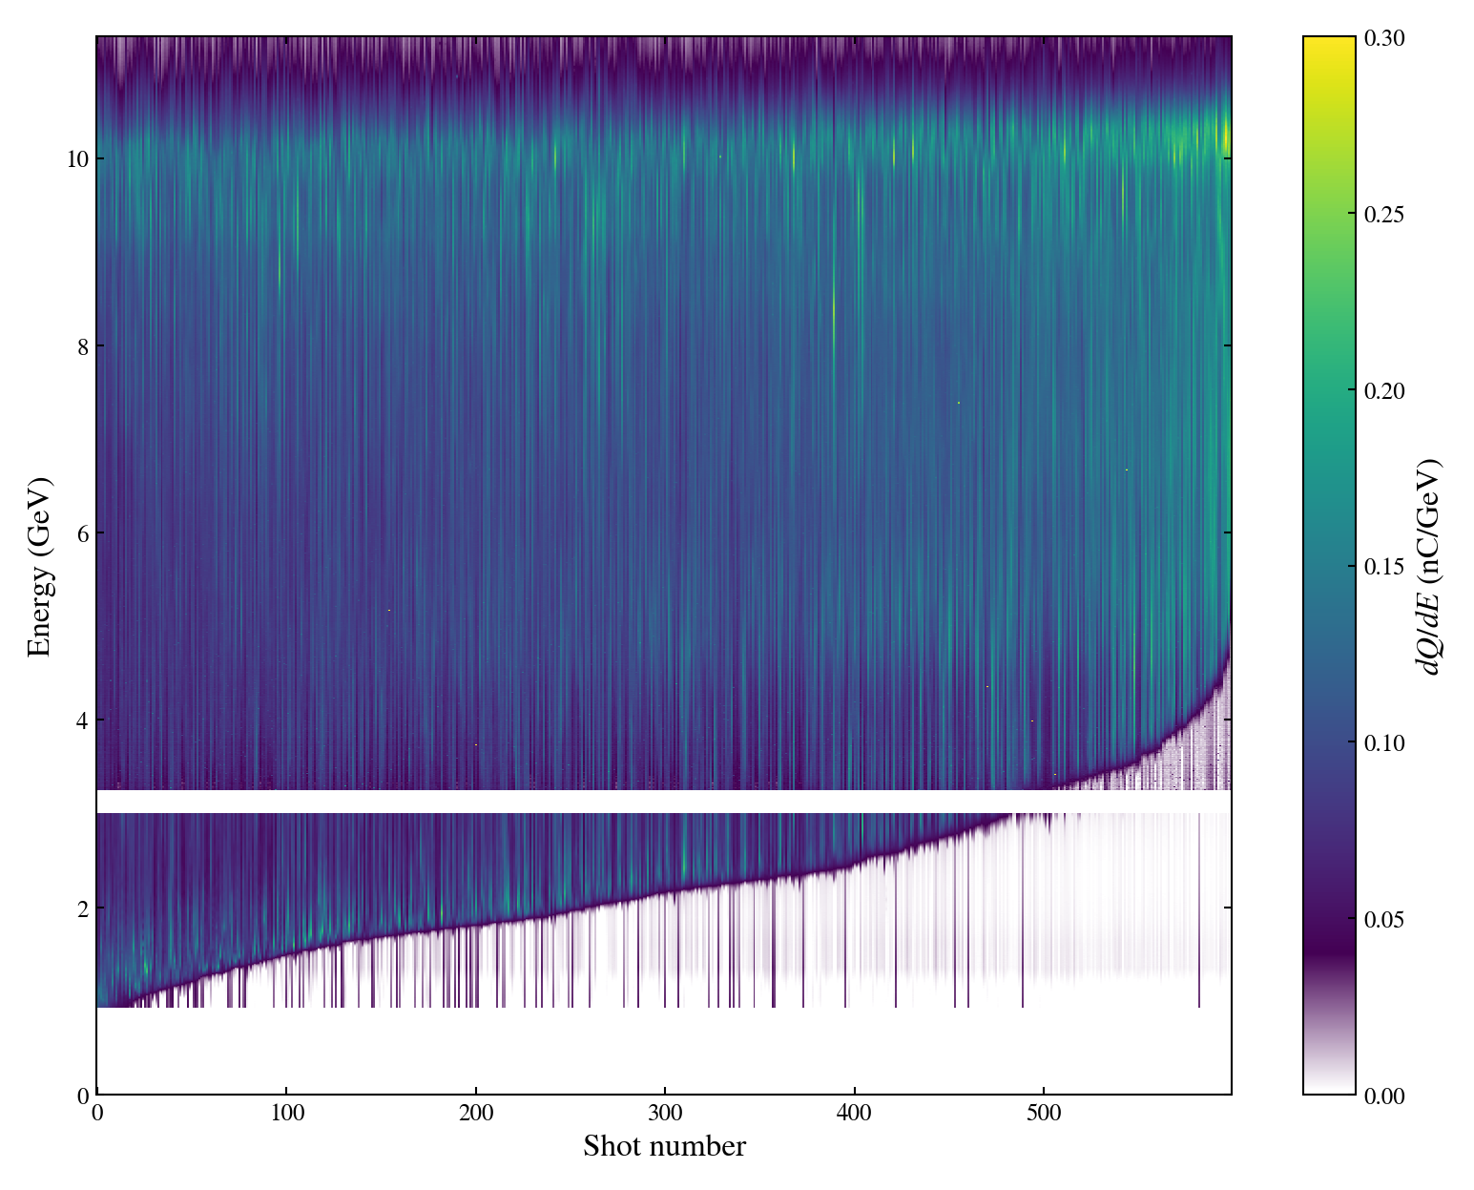
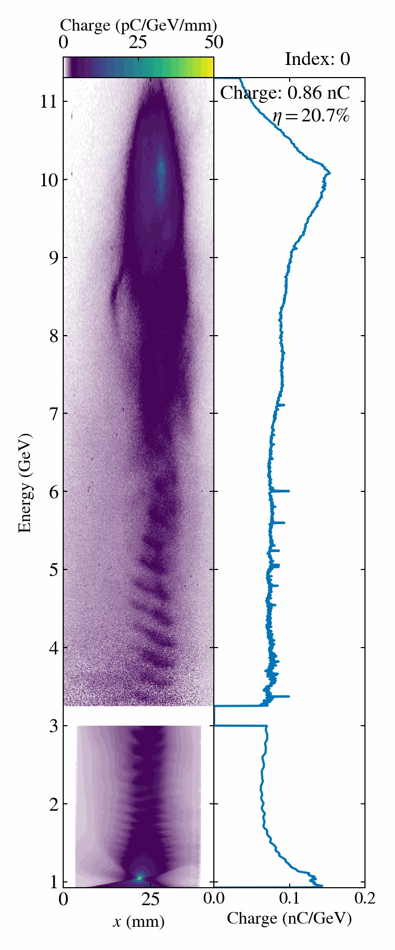
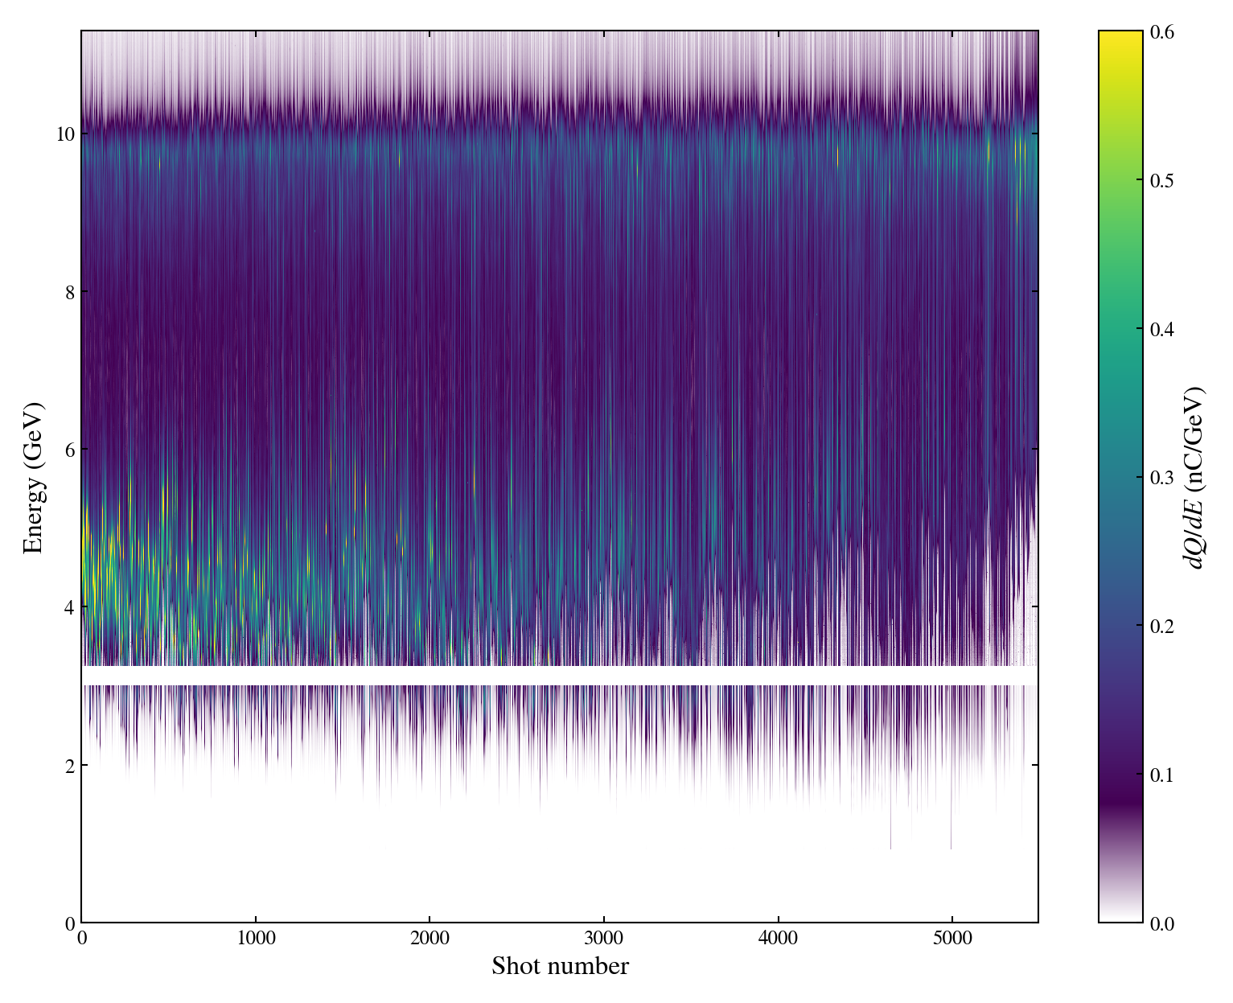
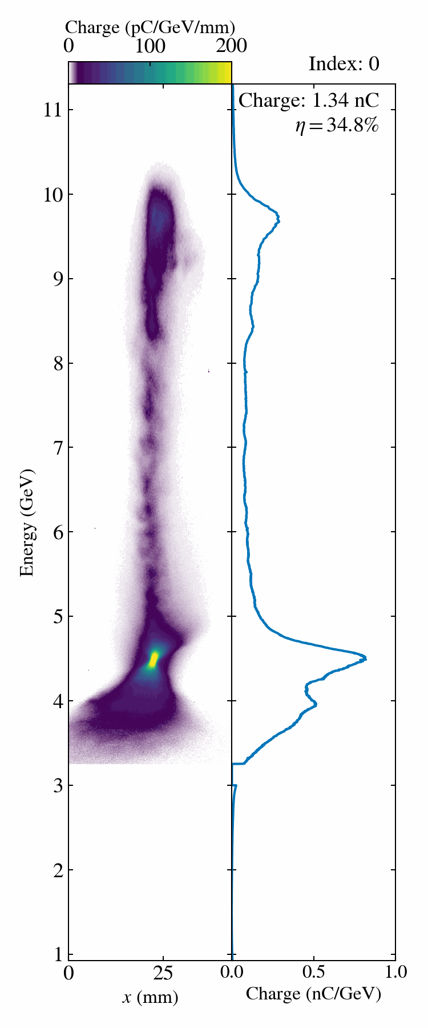
E-301: Drive Bunch Depletion and High Efficiency
Drive Beam Depletion
Spectrometer was set to image charge at ≤1 GeV
Many shots show deceleration below 1 GeV
In this data, >200 pC did not participate strongly in the beam-plasma interaction.
High Drive-to-Wake Efficiency
Spectrometer set to image charge at 3.5 GeV
>30% of drive beam energy transferred plasma wake
Best shot achieving 37% → 5.6 Joules of energy deposited in the plasma.

Slide 10
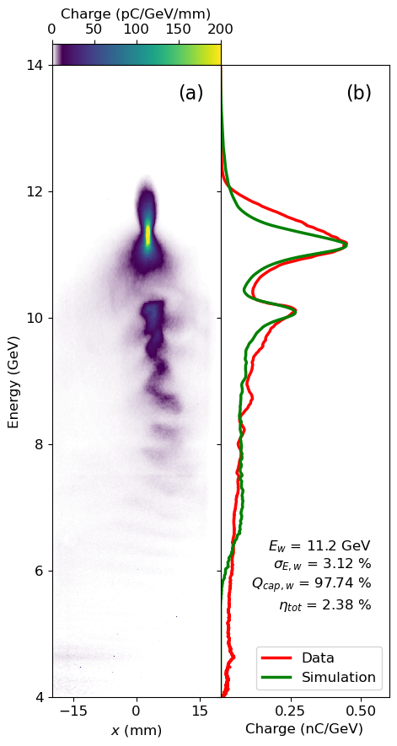
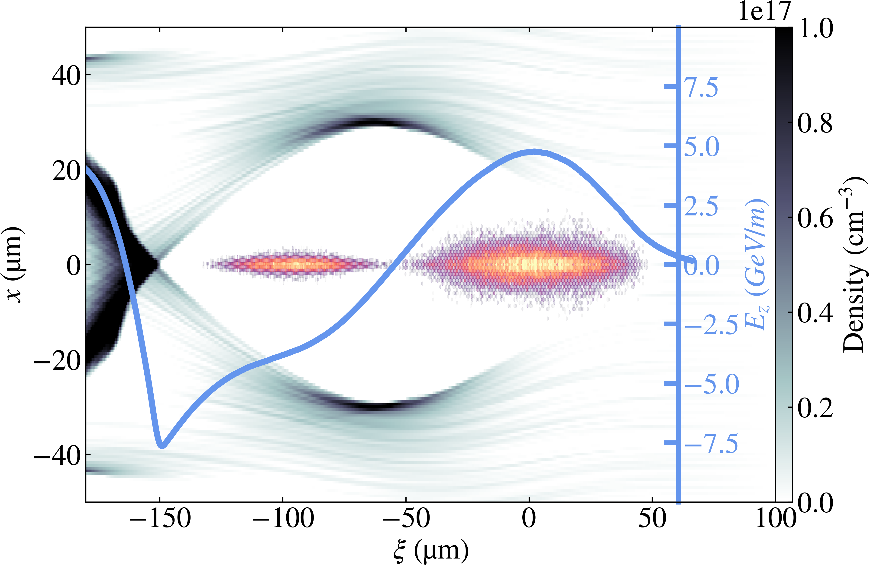
High-Energy, High-Efficiency PWFA
Parameters | FACET-II
Energy gain | 1 GeV
Driver charge | 1.6 nC
Driver energy | 10 GeV
Energy deposits to plasma | 5.9 J
Total Energy transfer | 432 mJ
Drive to wake efficiency | 37%
Total efficiency (η) | 2.7%

Slide 11
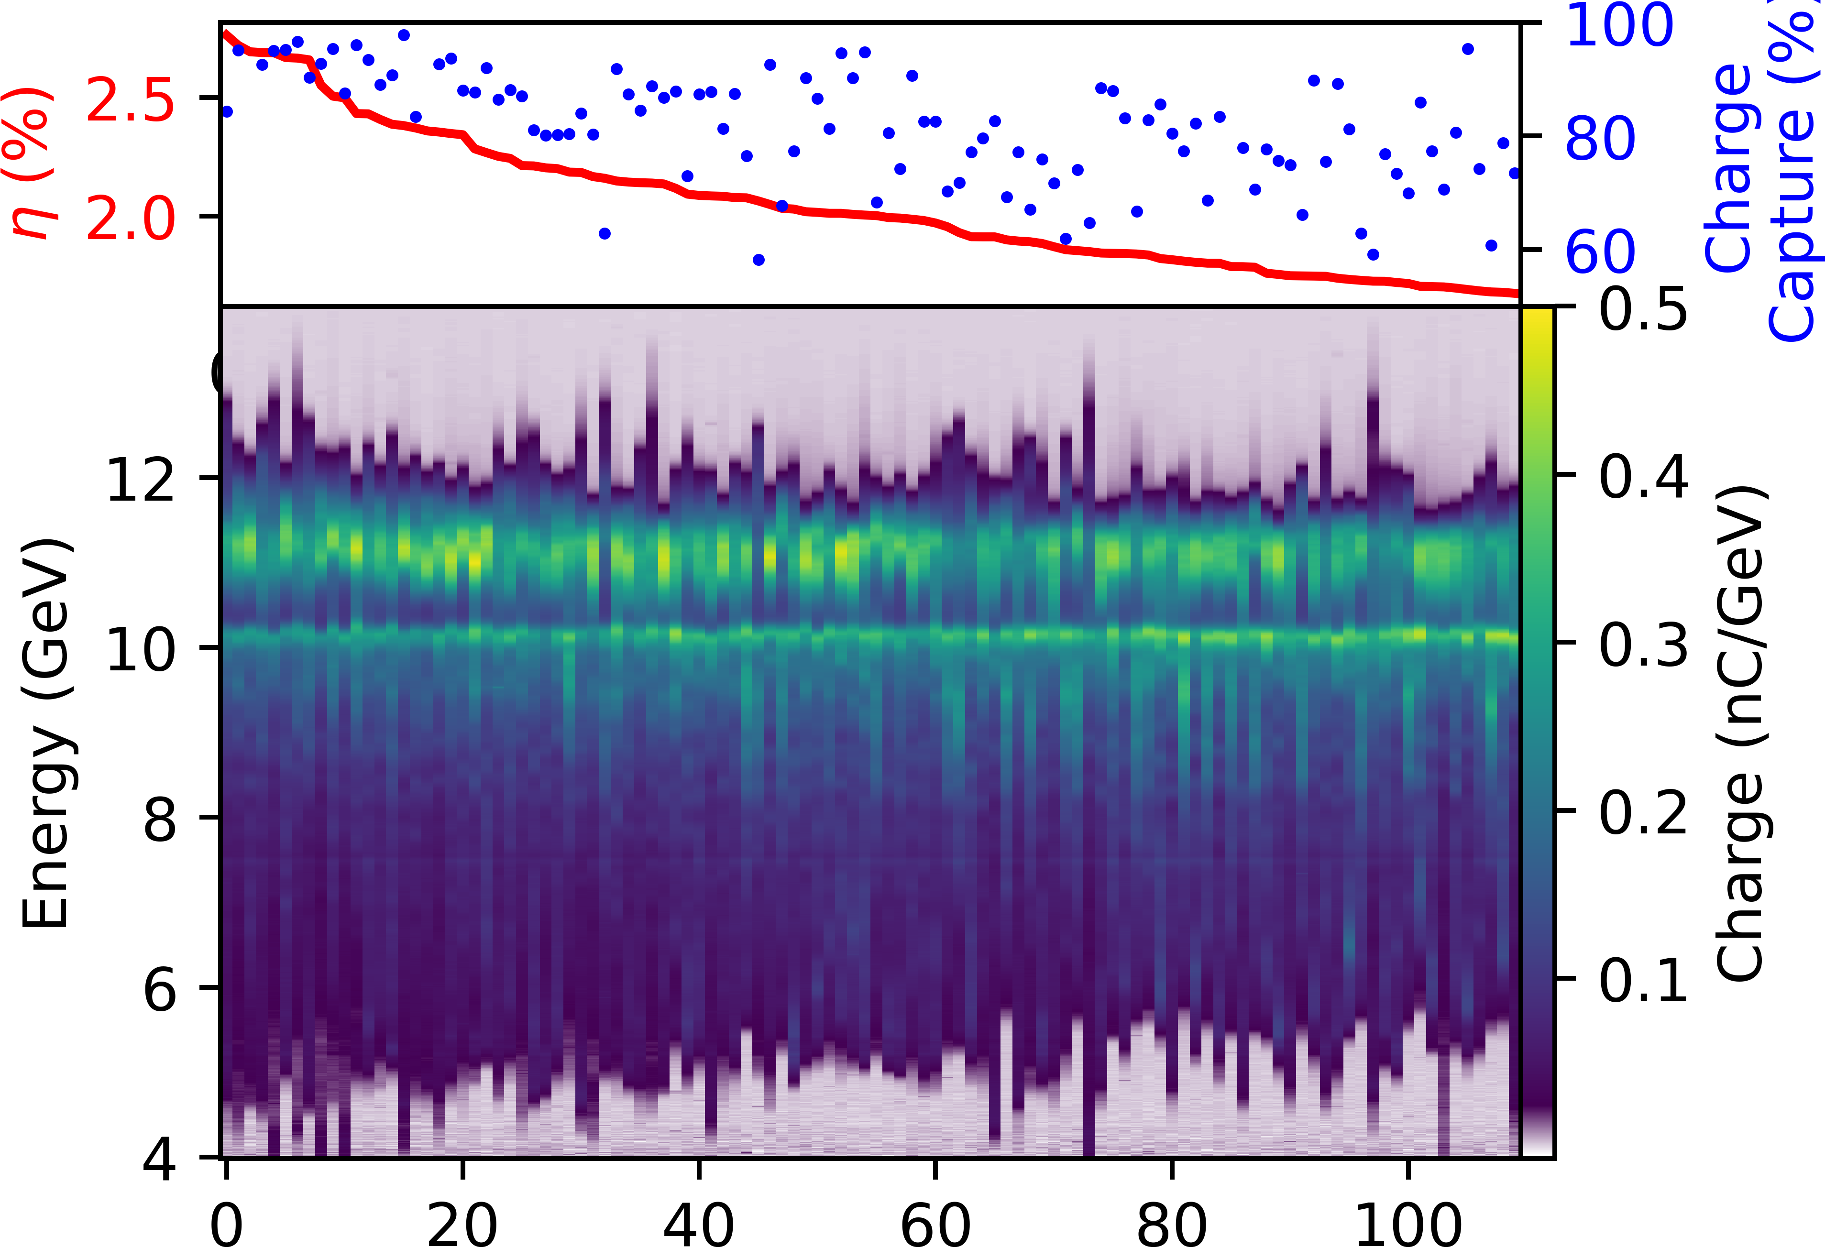
High-Energy, High-Efficiency PWFA
Parameters | FACET-II | DESY | HALHF
Energy gain per stage | 1 GeV | 0.045 GeV | 7.8 GeV
Driver charge | 1.6 nC | 0.49 nC | 8 nC
Driver energy | 10 GeV | 1 GeV | 4 GeV
Energy deposits to plasma | 5.9 J | 0.2 J | 25.6 J
Total Energy transfer | 432 mJ | 4 mJ | 12.8 J
Drive to wake efficiency | 37% | 30-50% | 80%
Total efficiency (η) | 2.7% | 0.9% | 40%
First demonstration of multi-hundred mJ, high total efficiency PWFA with complete charge capture.

Slide 12
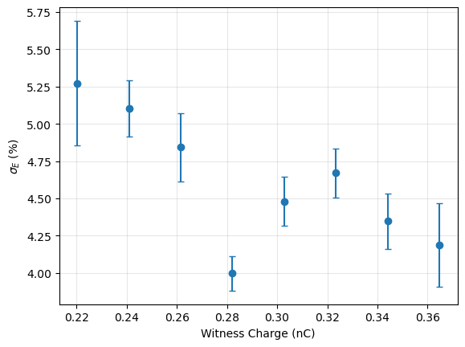
E-301 FY25 – PWFA Energy Spread
Ongoing analysis points toward underloading of wake

Slide 13
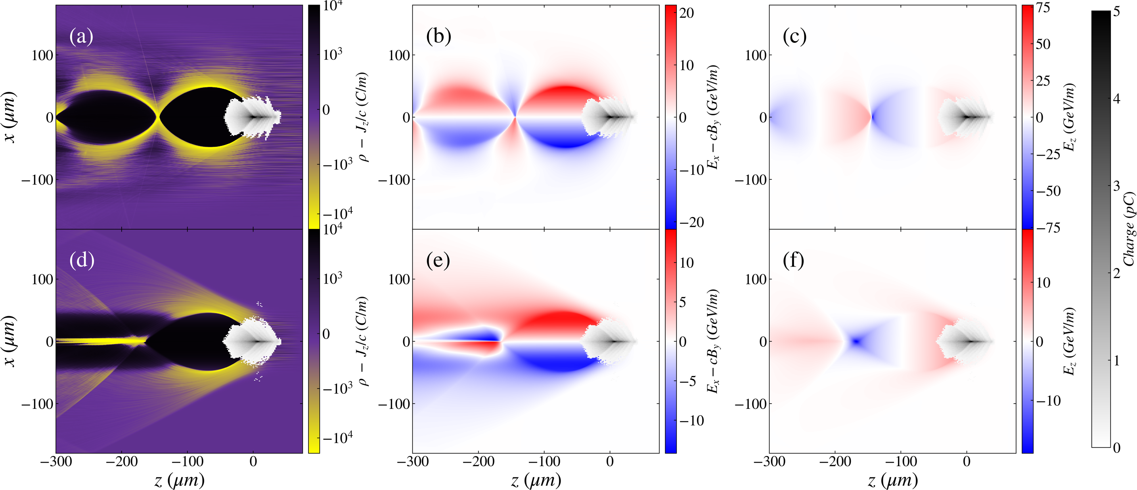
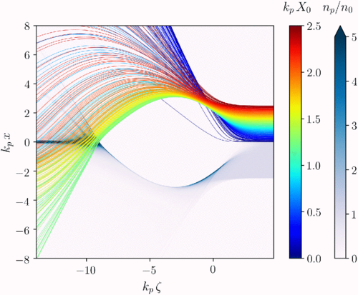
E-333: Narrow-Channel PWFA
PWFA in a narrow plasma channel → toward positron PWFA
S. Diederichs, et al., Phys. Rev. Accel. Beams 22, 081301 (2019)
e⁻ driver
Wide Channel
e⁺ goes here
Narrow Channel
Science Goals:
Demonstrate ability to control plasma channel radius
Measure PWFA response to narrowing of plasma channel
Guiding of e-beams along channel
Elongation of plasma wake bubble
Focusing for Positrons
Accelerating for Positrons

Slide 14
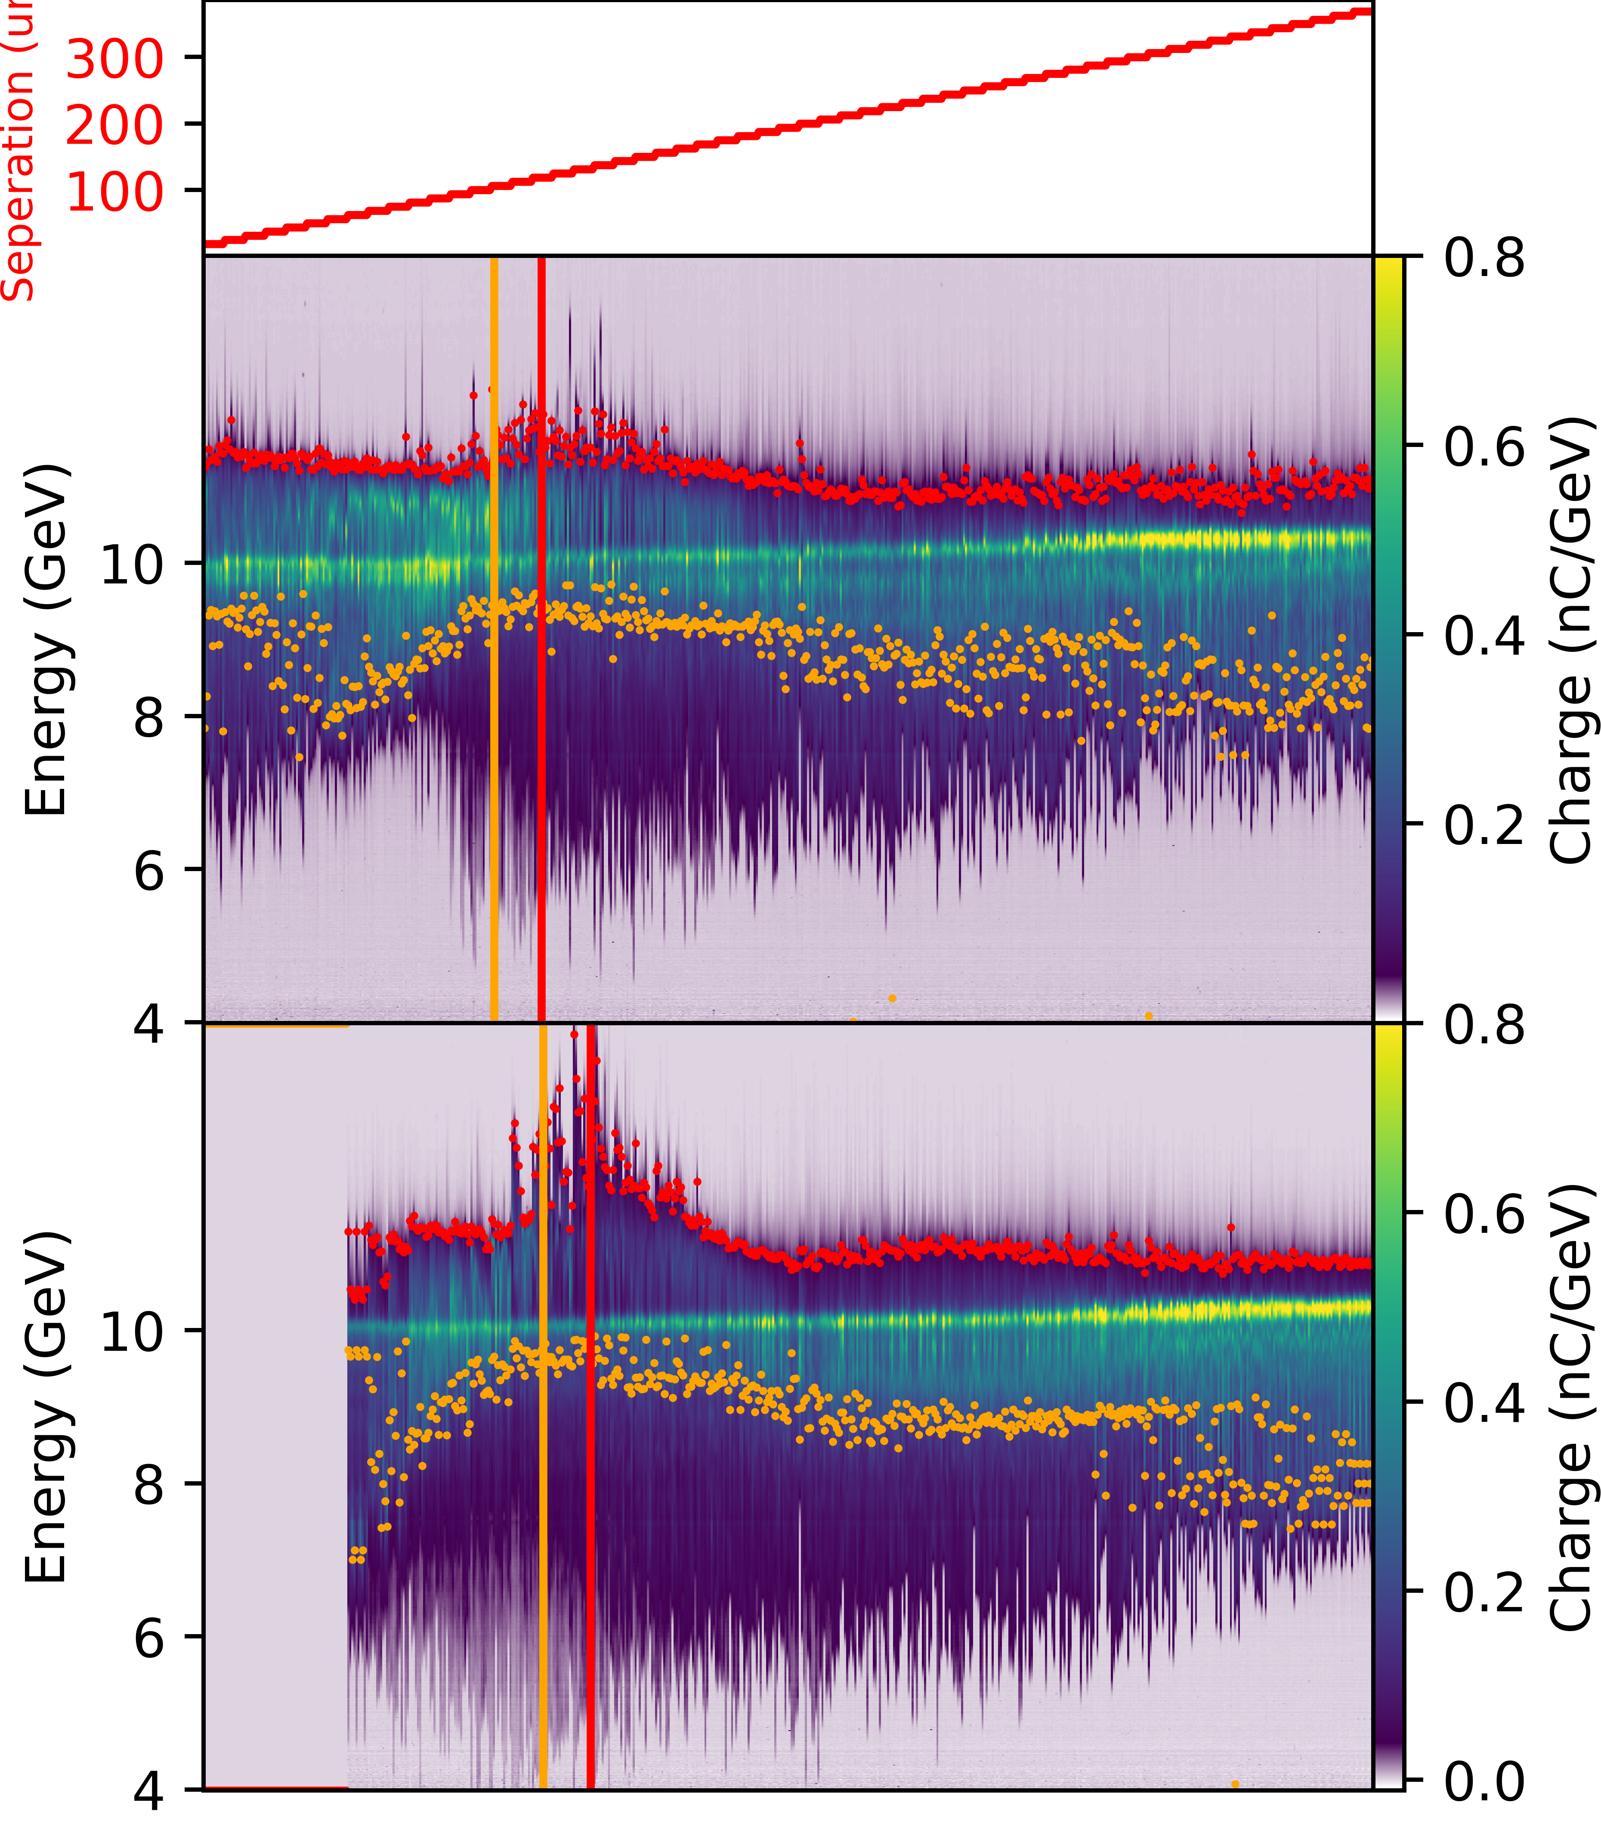
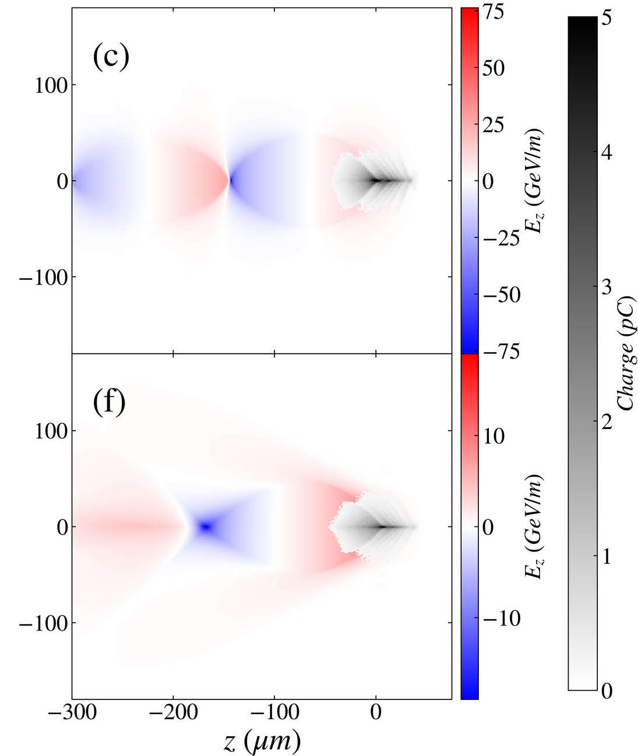
E-333: Elongated Wake Measurement
Drive-Witness Separation Scan
Reduced plasma width by reducing laser energy
Scanned drive/witness separation from 0 to 400 µm
Observed shift of max acceleration and min deceleration location by ~20 µm in narrow plasma
Qualitative agreement with expectations
Detailed simulation campaign ongoing
Wide Channel
Narrow Channel
[no data]
orange: min. decel.
red: max accel.

Slide 15
Challenges During Last Run
Laser far from ideal
General laser quality had drifted significantly from optimum
Compressor window caused very detrimental nonlinearities
Plasma barely wide enough for PWFA
Would be true even under ideal conditions
Difficult to maintain alignment while tuning e-beam
E-beam far from ideal
lots of dispersion and dispersion’ – difficulty correcting for both simultaneously
current profile not great – overlap of drive beam tail and witness beam

Slide 16
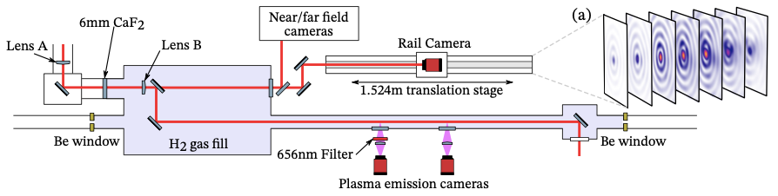
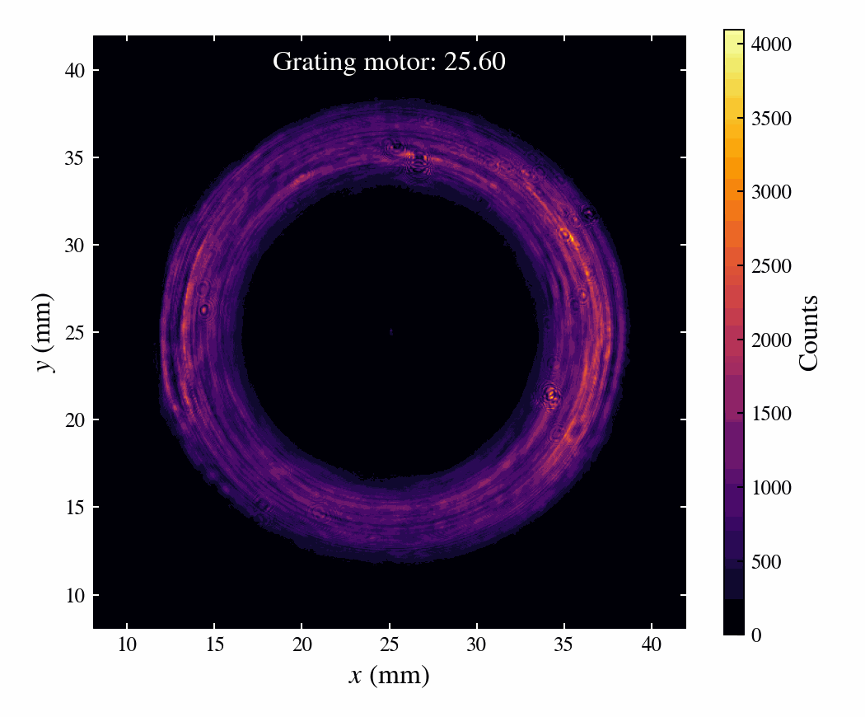
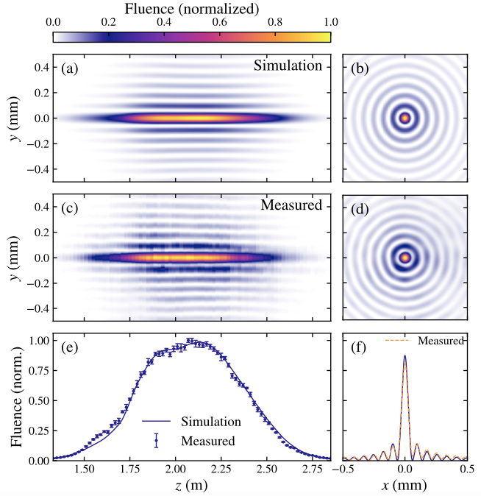
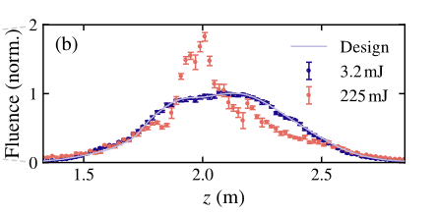
FY25 Axial Intensity Profile
Left: At low intensity, laser profile matches prediction with excellent accuracy.
Right: At high intensity, nonlinear effects in a window between Lens A and Lens B produce aberrations in the wave front leading to distortion of the axial intensity profile.
~85 cm x 250 µm, 4x10¹⁶ cm⁻³ plasma filament.
Not ideal, but useable.
Window has been removed for upcoming run.

Slide 17
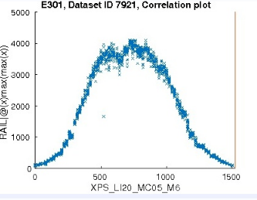
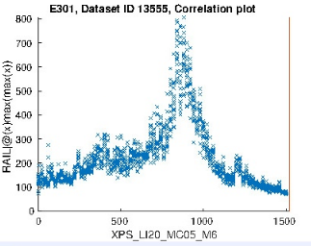
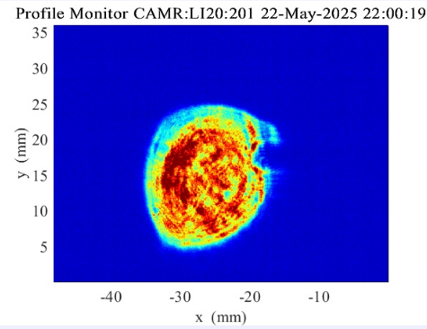
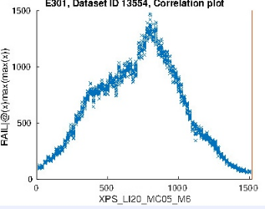
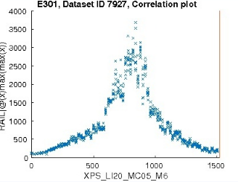
FY25 Laser Quality
Low power
High power
Intensity profile very non-uniform
Uncertain wavefront quality
Uncertain compression quality
FY24
FY25

Slide 18
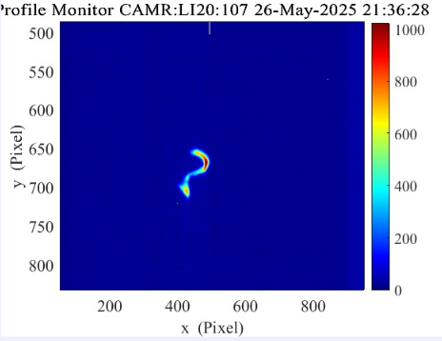
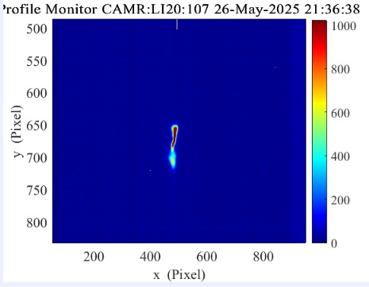
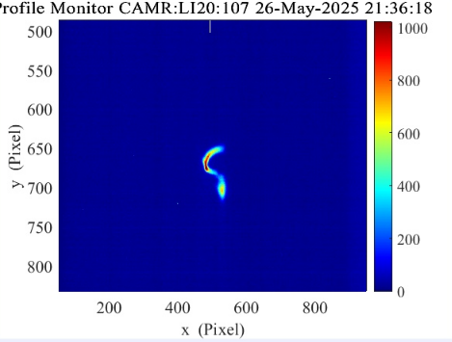
FY25 e-Beam Quality
High energy part of the drive was aligned with witness in time
TCAV: -90º
TCAV: Off
TCAV: +90º
TCAV Scan 1
TCAV: -90º
TCAV: Off
TCAV: +90º
TCAV Scan 2

Slide 19
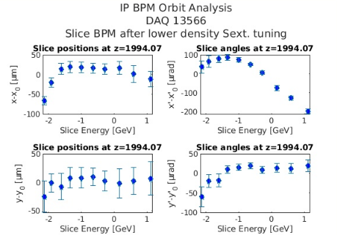
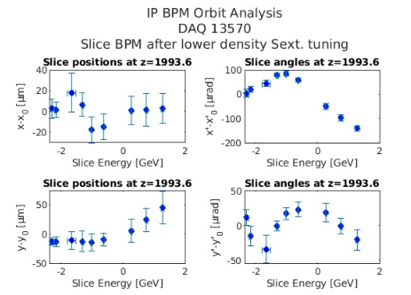
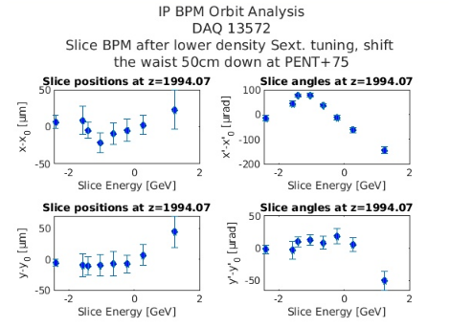
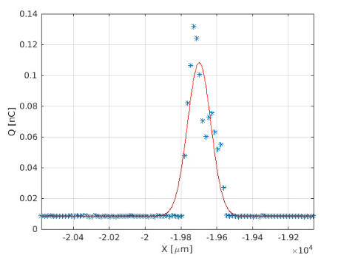
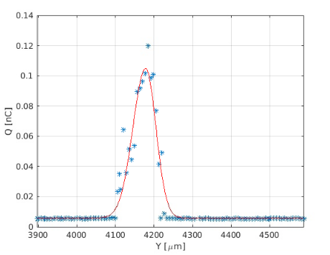
FY25 Dispersion and Dispersion’

Slide 20
What’s New This Run?
Compressor window removable – more ideal plasma source
Will try to use plasma expansion – successful technique demonstrated in E308
EOS-BPM to provide transverse drive-witness separation
Utilize improved e-beam tuning and diagnostic methods

Slide 21
Science Goals for This Run
Collider-level energetics with 100% charge capture
Few hundred pC, >5 GeV gain, <1% E-spread, >10% total efficiency
Begin studying transverse dynamics
Emittance growth as a function of vacuum waist, witness alignment, plasma profile
In a nutshell: same goals as E-300. So why bother with E-301? Opens several doors...
Long ramps → matching at smaller emittance
Parametric scans of plasma parameters
Enables many injections schemes
Path to high rep. rate
Compatible with plasma lens

