Slide 1
E300 FY26 Plans
E300 Collaboration Meeting
Doug Storey | AARD
2/2/2026

Slide 2
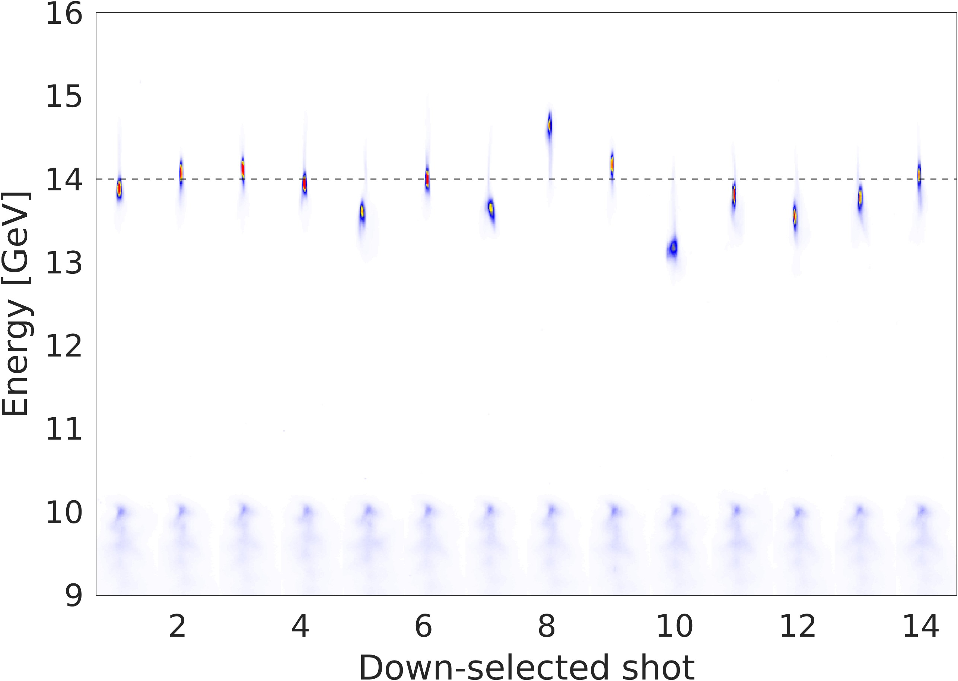
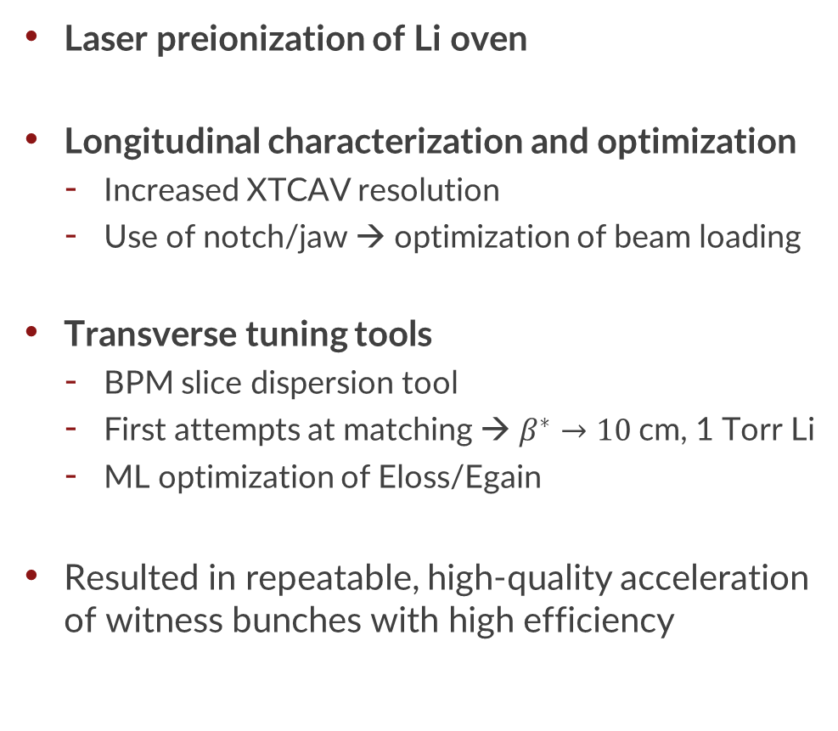
What did we do in FY25
Laser preionization of Li oven
Longitudinal characterization and optimization
Increased XTCAV resolution
Use of notch/jaw → optimization of beam loading
Transverse tuning tools
BPM slice dispersion tool
First attempts at matching → $β^{∗}→10$cm, 1 Torr Li
ML optimization of Eloss/Egain
Resulted in repeatable, high-quality acceleration of witness bunches with high efficiency
High-quality acceleration of witness bunches

Slide 3
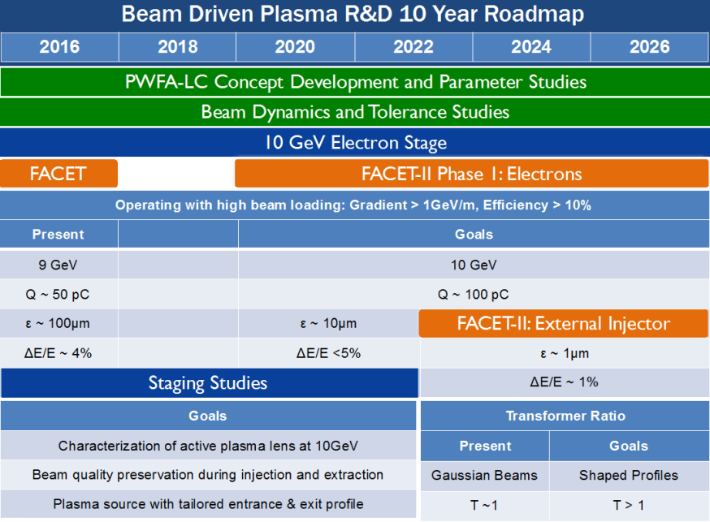
Progress on PWFA in FACET-II so far
Parameter |  | FY24 Results | FY25 Results | 2016 AAC Goal
Emittance | µm | >200 | ~200* | 10
Energy Spread | % | 4 | < 1 | < 5
Energy Gain | GeV | 1.5 | 4 | 10
Charge Accelerated | pC | ~100 | ~200 | ~100
Total Efficiency | % | 4 | ~6 | > 10
Overall state:
Energy gain and energy spread is ok with this oven length
Efficiency and charge capture needs improvement
Lots of work towards emittance preservation

Slide 4
PWFA goals for FY26
Parameter |  | FY24 Results | FY25 Results | 2016 AAC Goal
Emittance | µm | >200 | ~200 | 10
Energy Spread | % | 4 | < 1 | < 5
Energy Gain | GeV | 1.5 | 4 | 10
Charge Accelerated | pC | ~100 | ~200 | ~100
Total Efficiency | % | 4 | ~6 | > 10
FY26 Goals
~10’s
< 1
~5
>100 pC (100%)
10
How do we do better? Better longitudinal and transverse control
Stable longitudinal working point → Fine tuning of drive/witness current profile and notch/jaw to optimize charge capture, beam loading
Matching into the plasma → emittance preservation, improved charge capture, efficiency

Slide 5
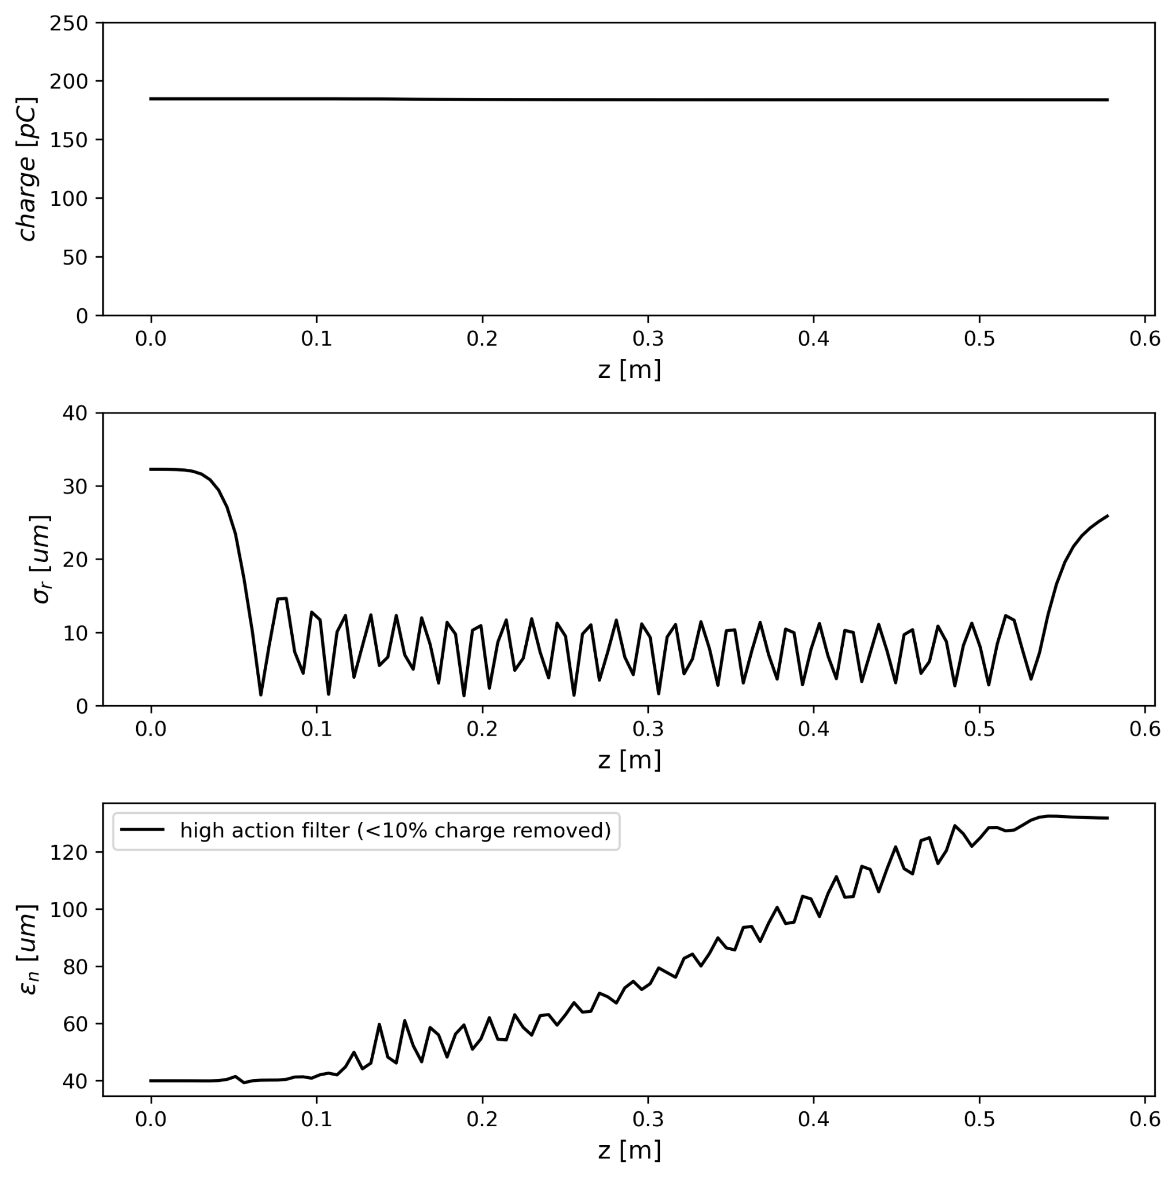
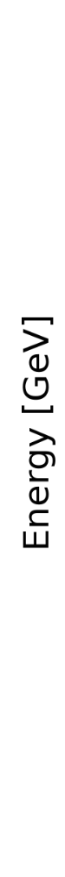
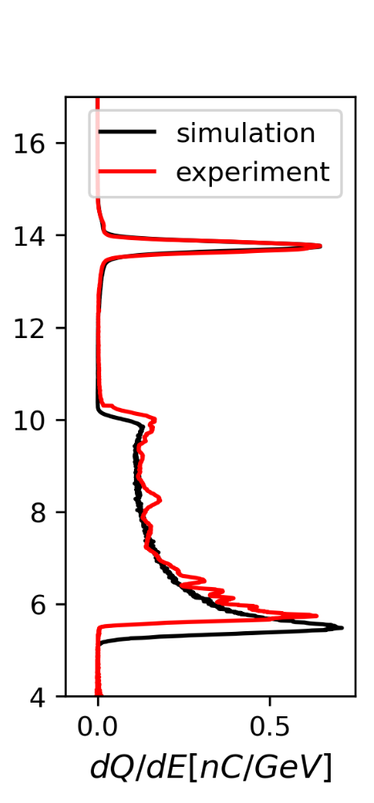
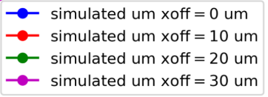
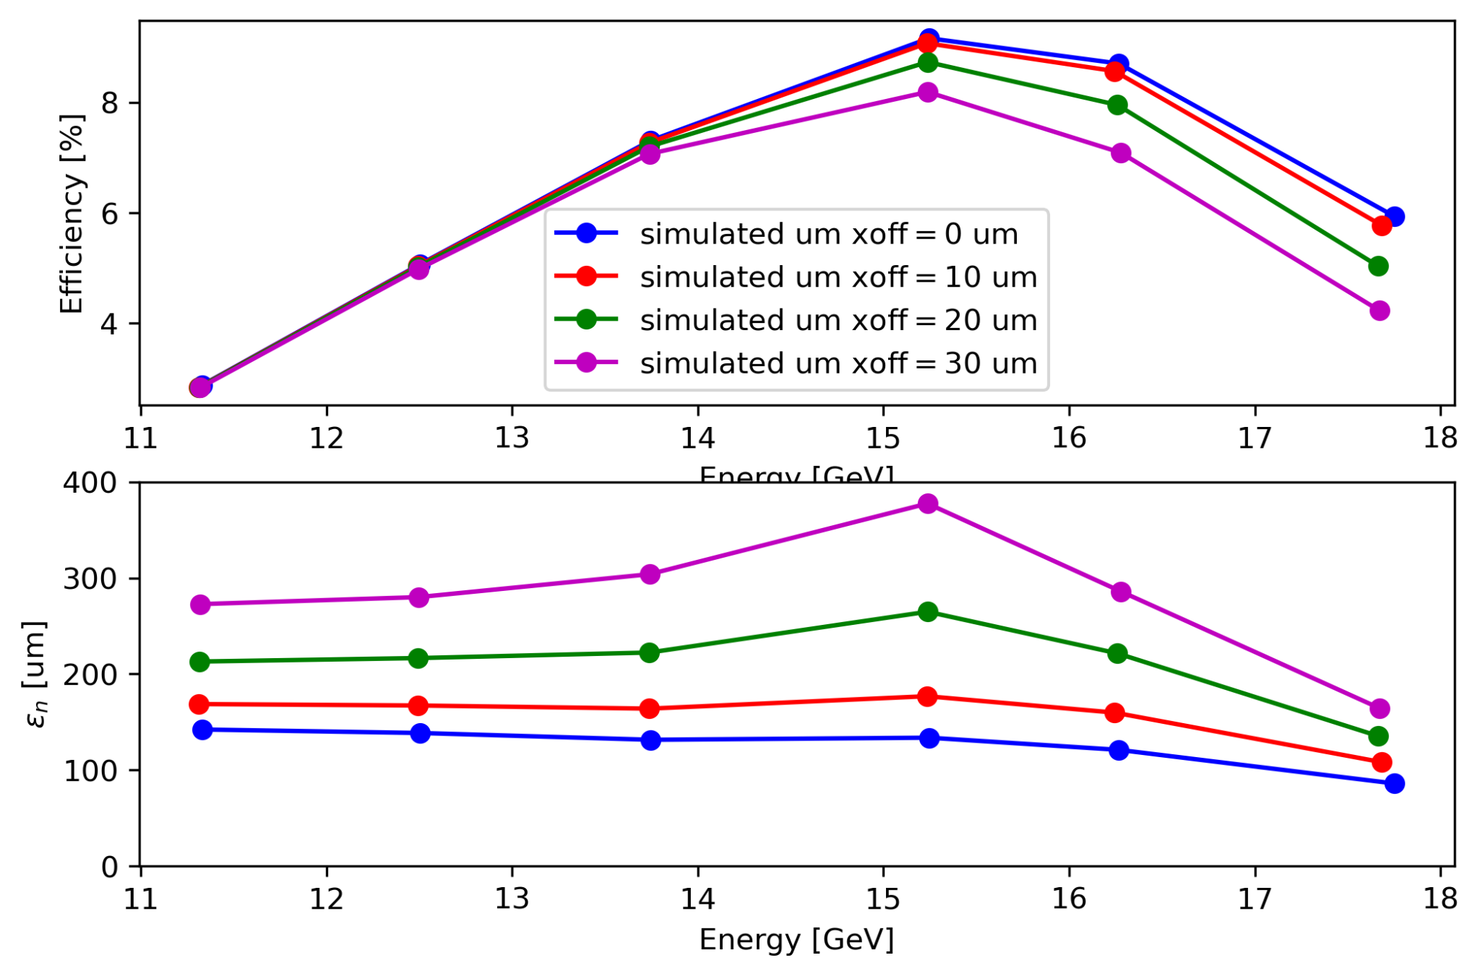
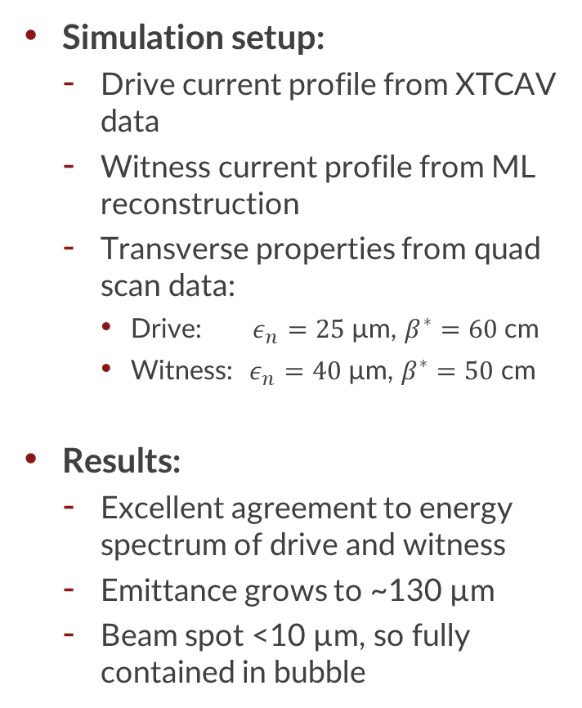
Guidance from simulation studies
Witness evolution through the plasma
Simulation setup:
Drive current profile from XTCAV data
Witness current profile from ML reconstruction
Transverse properties from quad scan data:
Drive: $ε_{n}=25$µm, $β^{∗}=60$cm
Witness: $ε_{n}=40$µm, $β^{∗}=50$cm
Results:
Excellent agreement to energy spectrum of drive and witness
Emittance grows to ~130 µm
Beam spot <10 µm, so fully contained in bubble
Energy Spectrum
Simulations by T. Dalichaouch

Slide 6
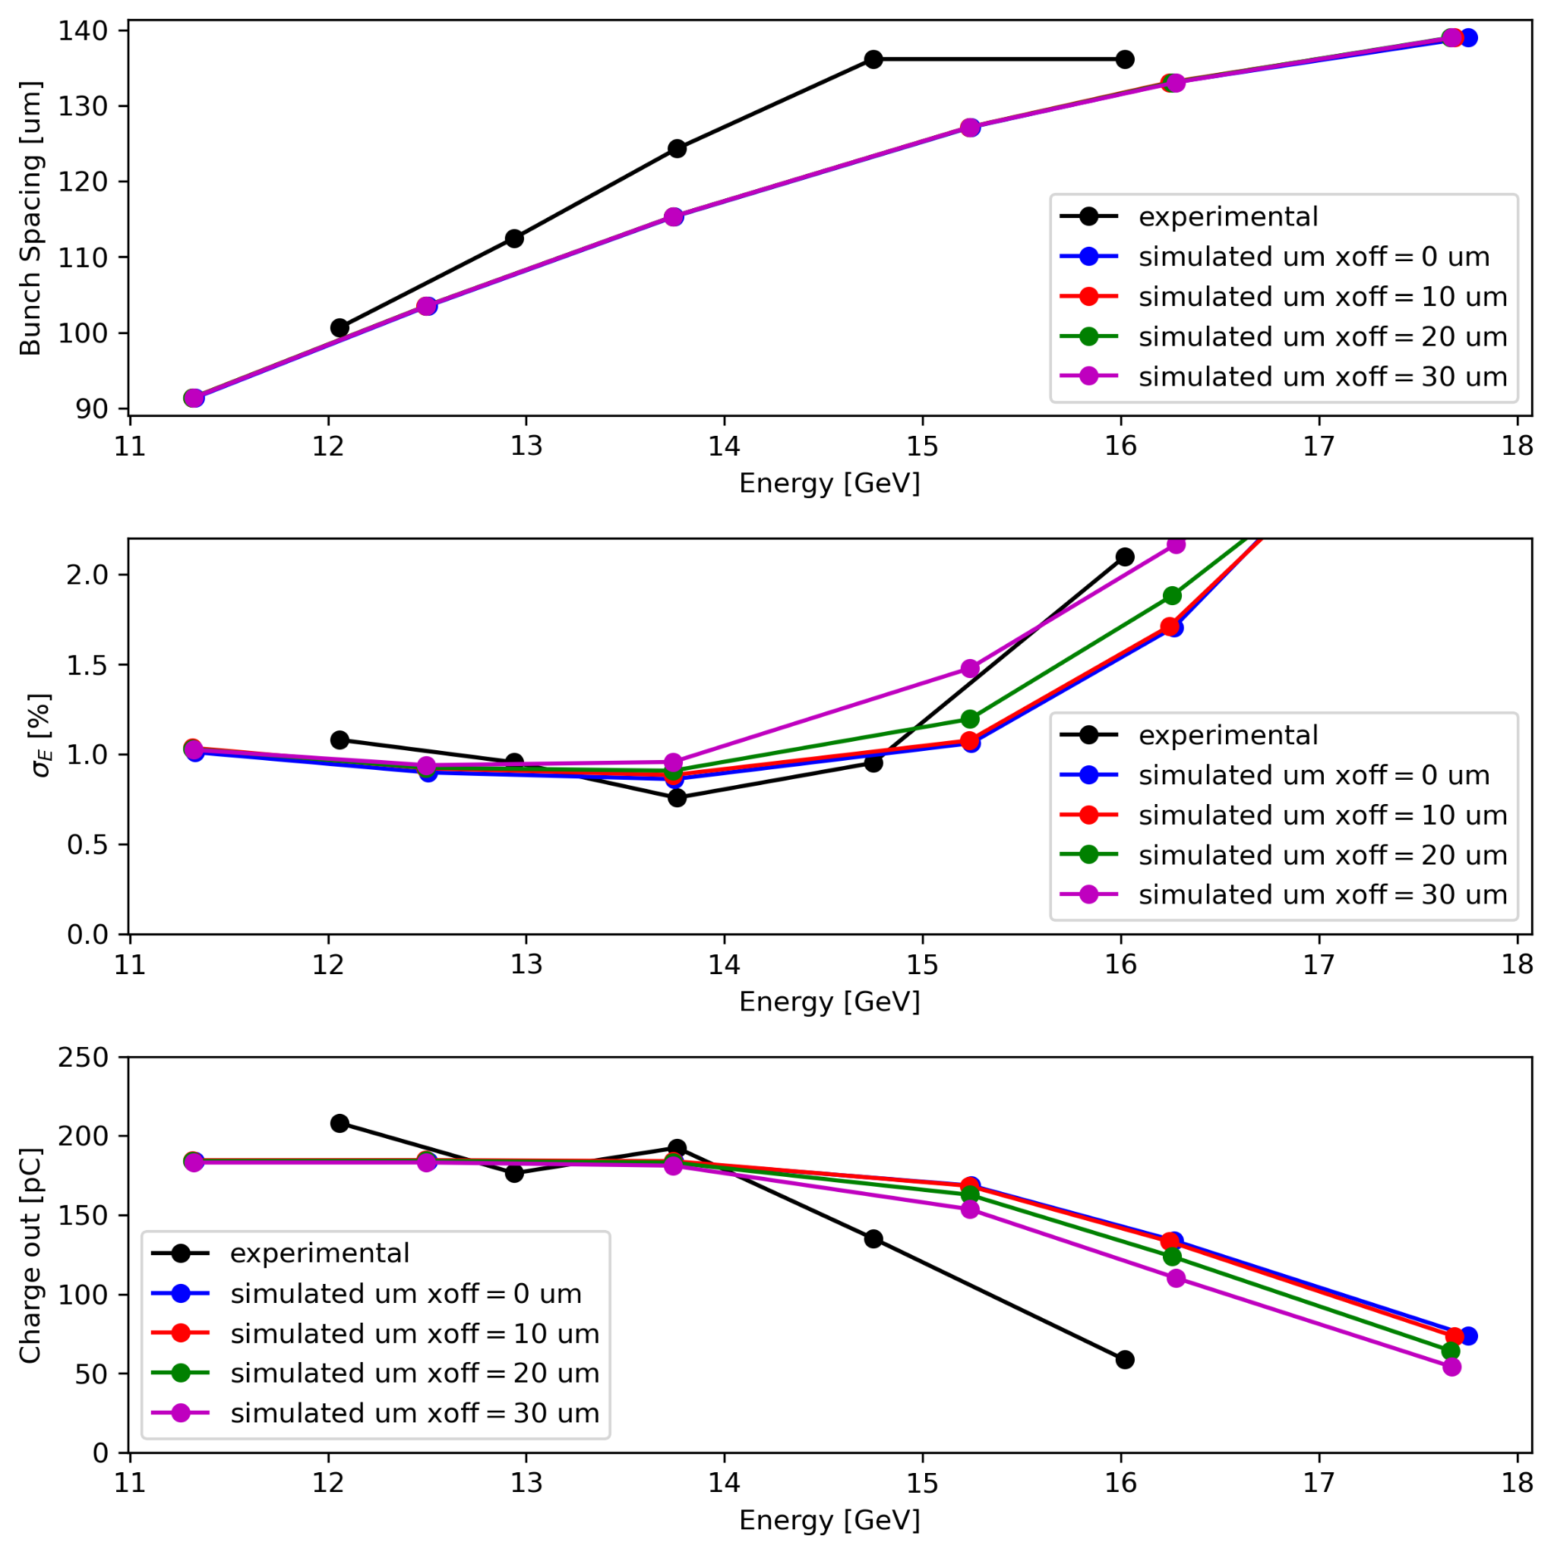
Path to higher energy transfer efficiency
Optimization of bunch separation alone will not get us from ~5% → 10%
Charge capture/transport:
Starting to study transverse offsets in simulation
We think there is an additional aperture in the beamline that is limiting charge transport
Solutions: 1) smaller outgoing divergence, 2) improve aperture
Need to better optimize:
Drive current profile
Drive participating charge
Witness “charge participation” / charge transport
Matching/witness offset
Simulations by T. Dalichaouch

Slide 7
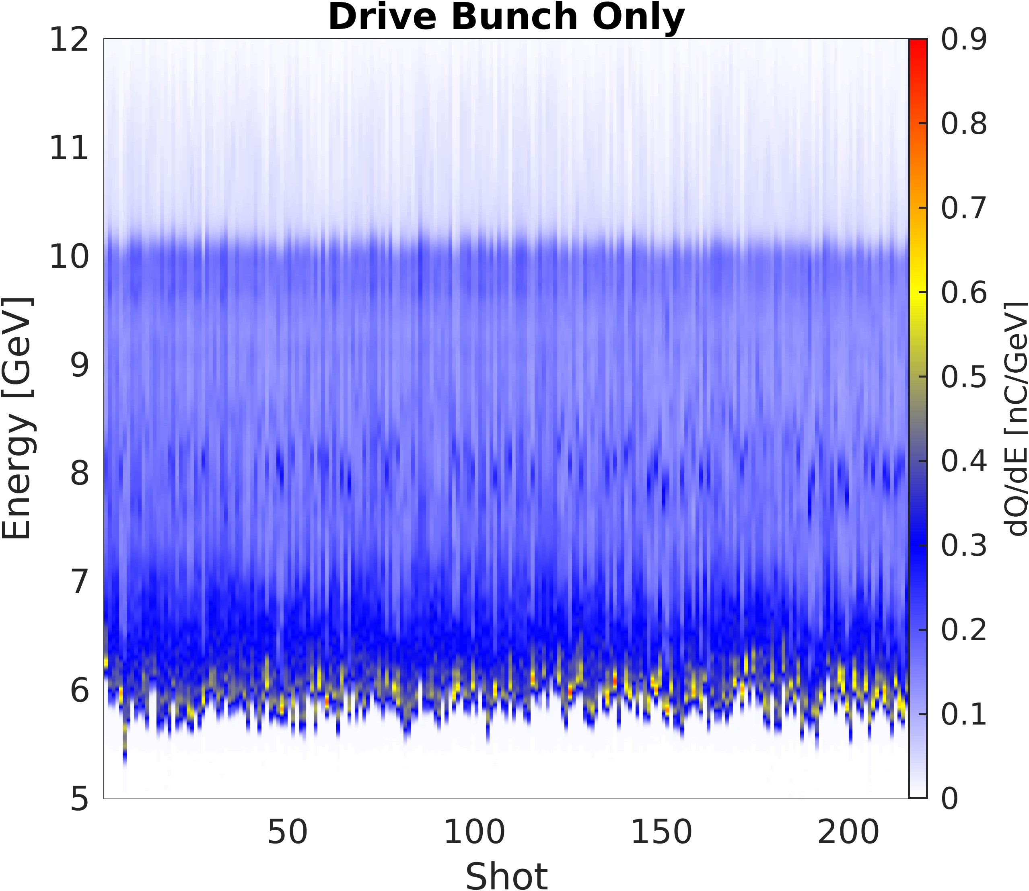
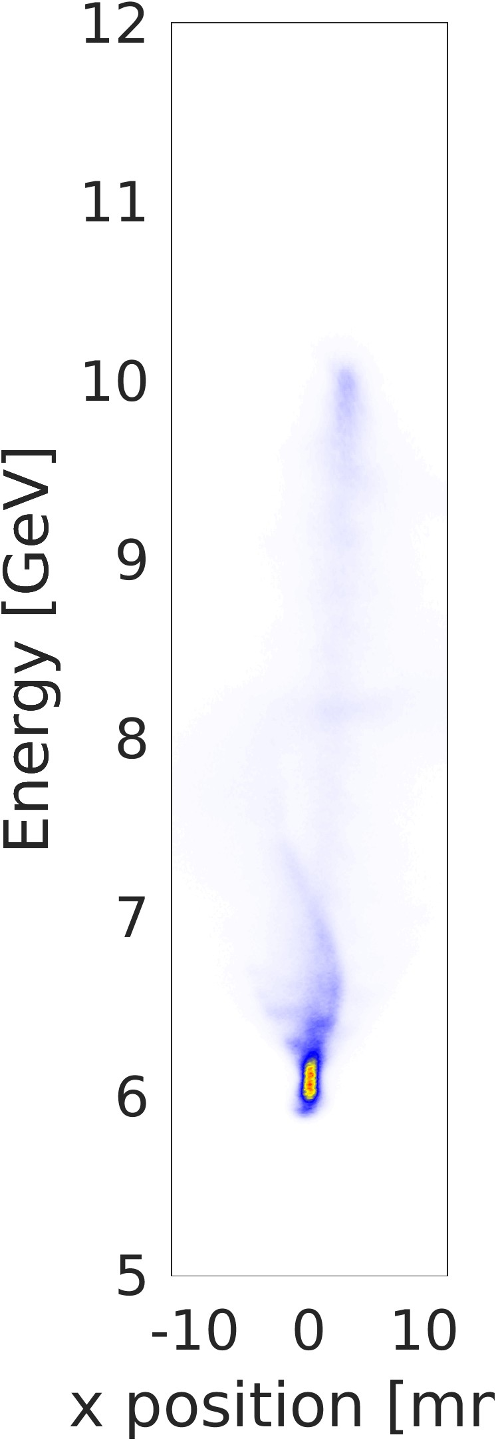
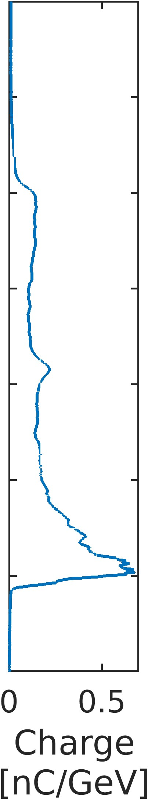
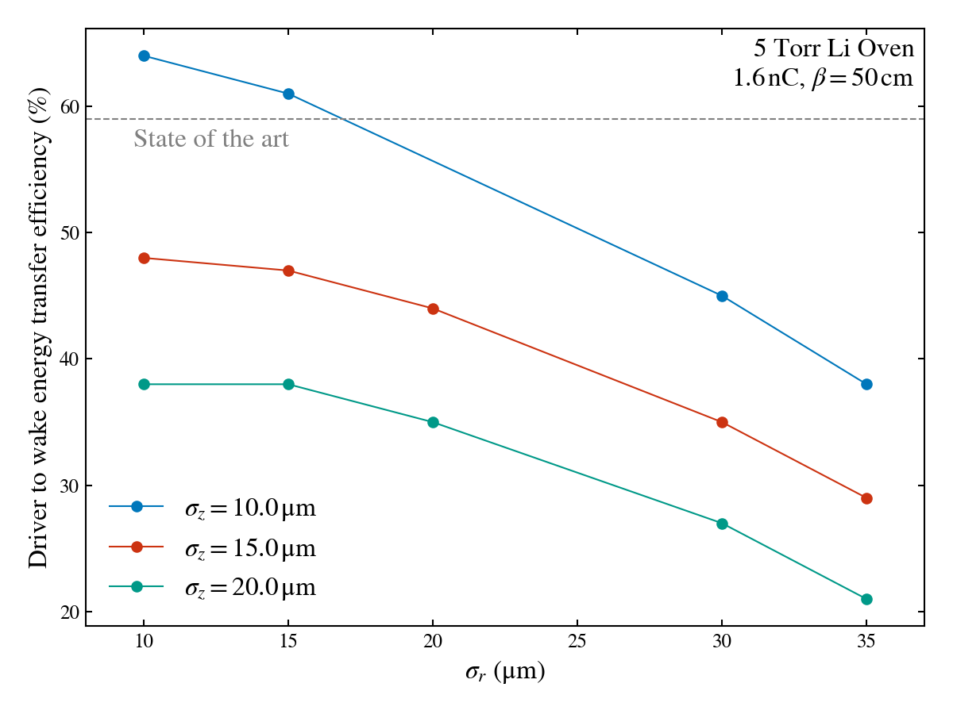
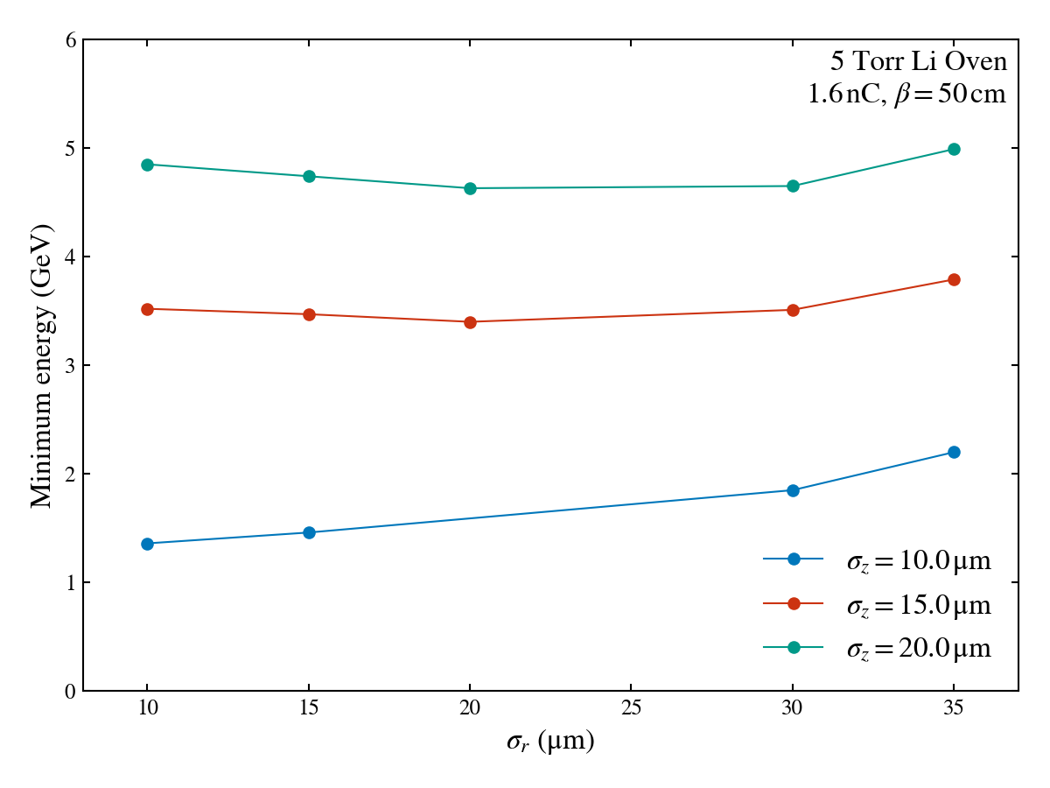
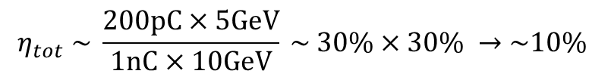

1) Improve Drive-to-Wake energy transfer
FY25 Results - $η\sim 23\%$
Need to extract at least 30% energy from the drive bunch
Need a minimum of 20 µm bunch length x 20 µm spot size
$$η_{tot} \sim \frac{200pC×5GeV}{1nC×10GeV} \sim 30\%×30\% →\sim 10\%$$
FY25
FY26
FY26
FY25
Simulations by C. Zhang

Slide 8
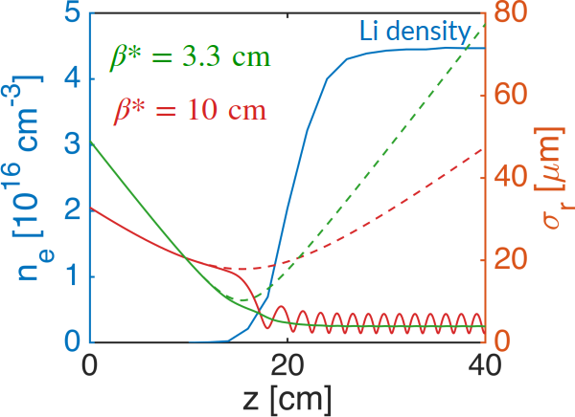
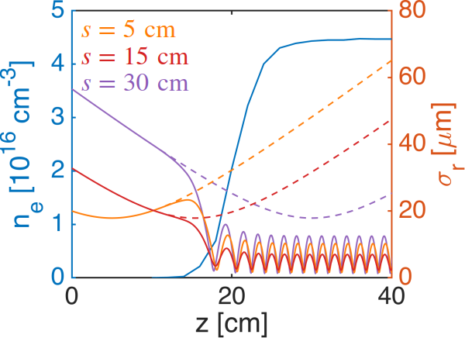
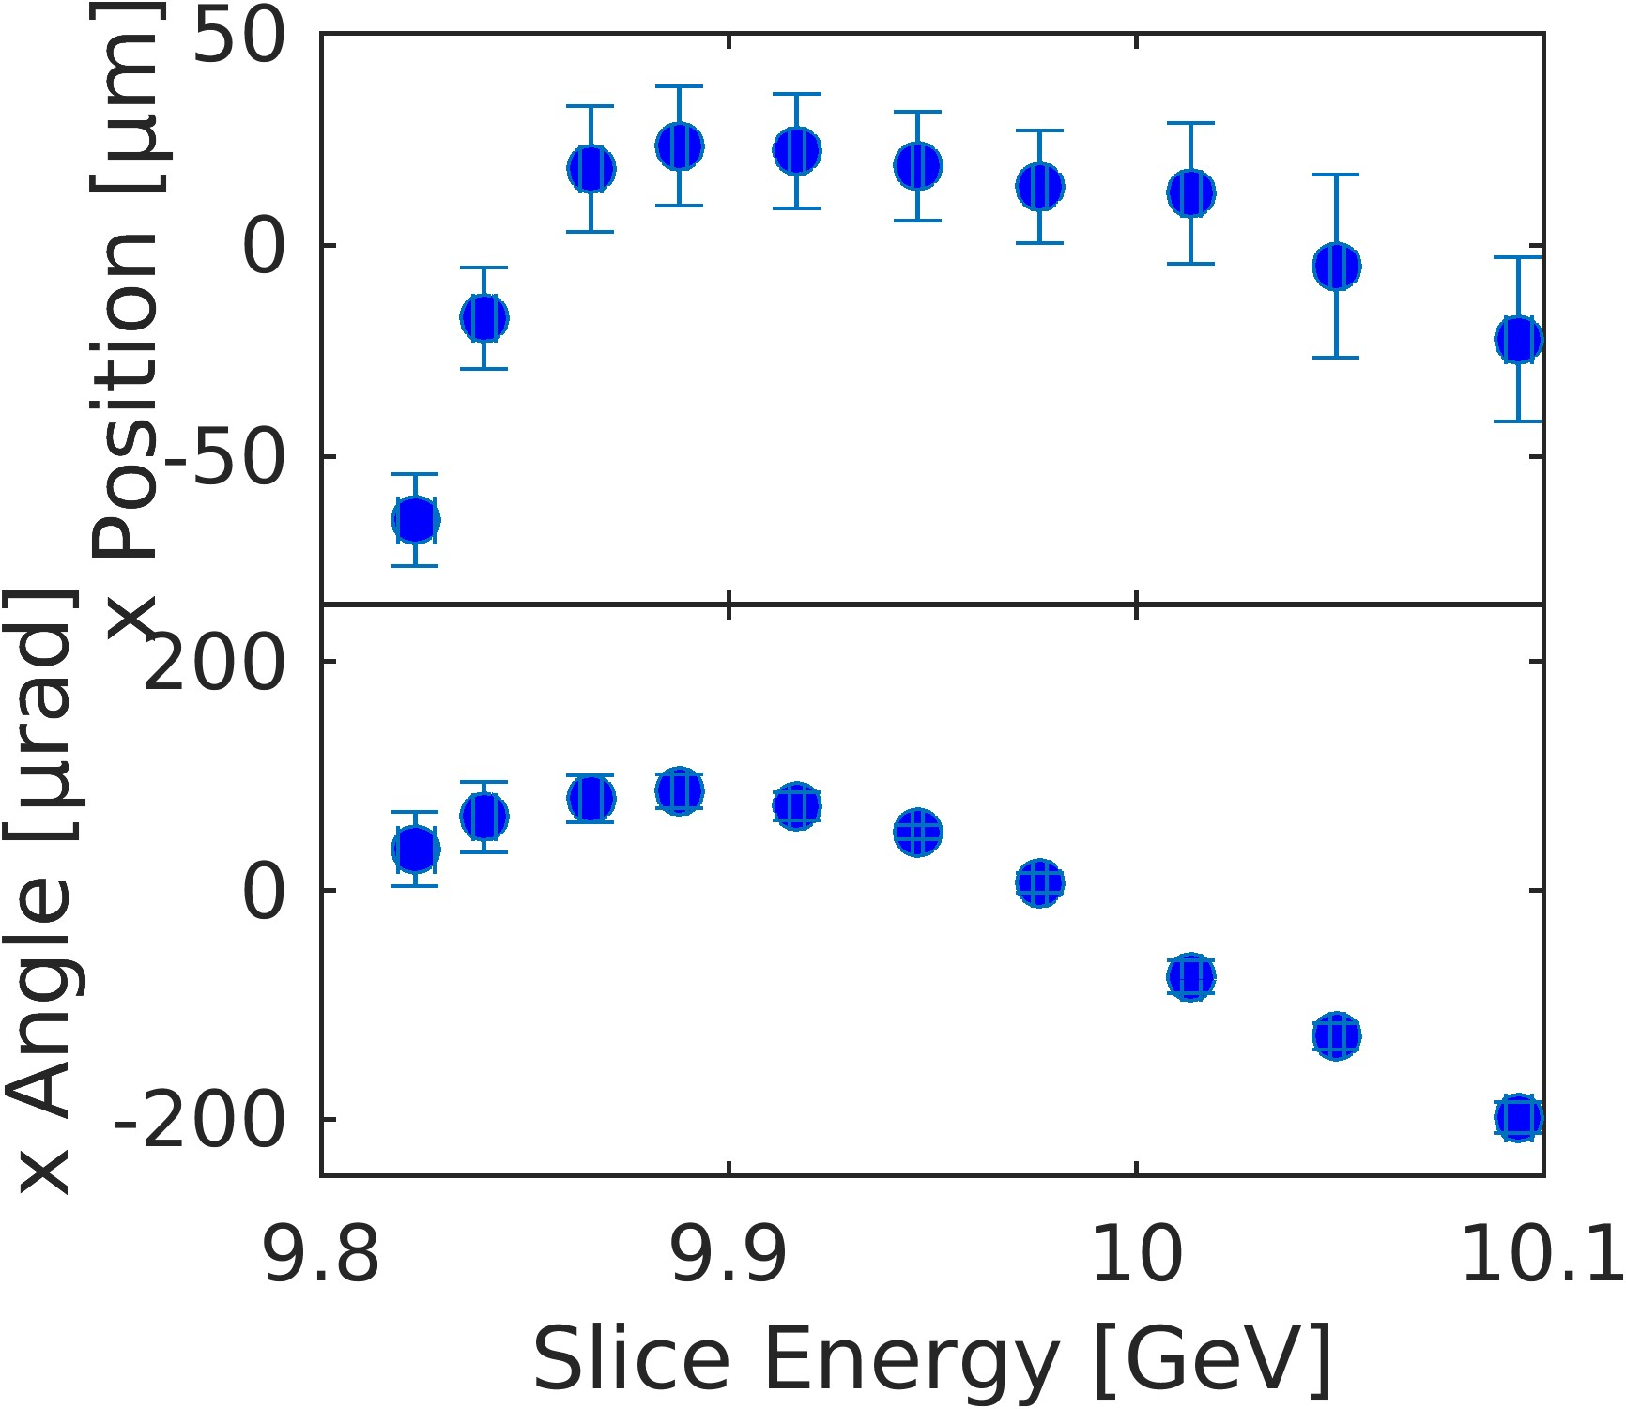
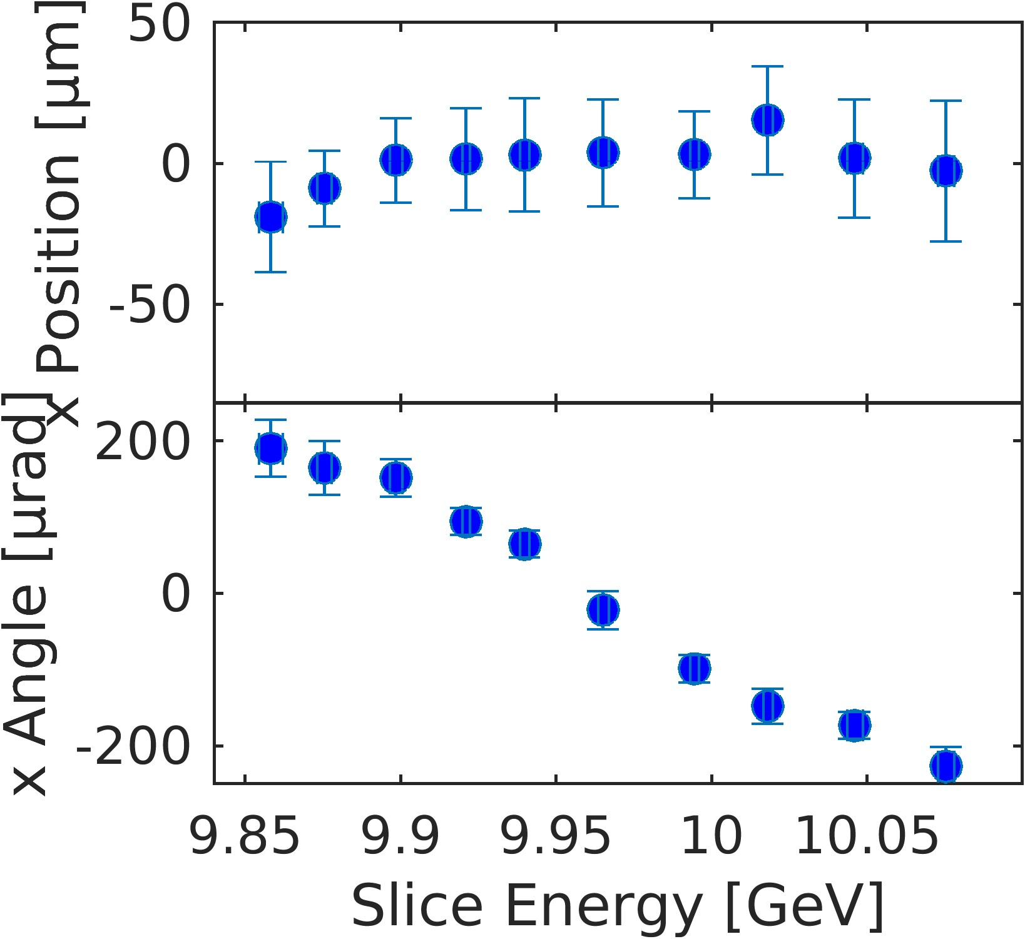
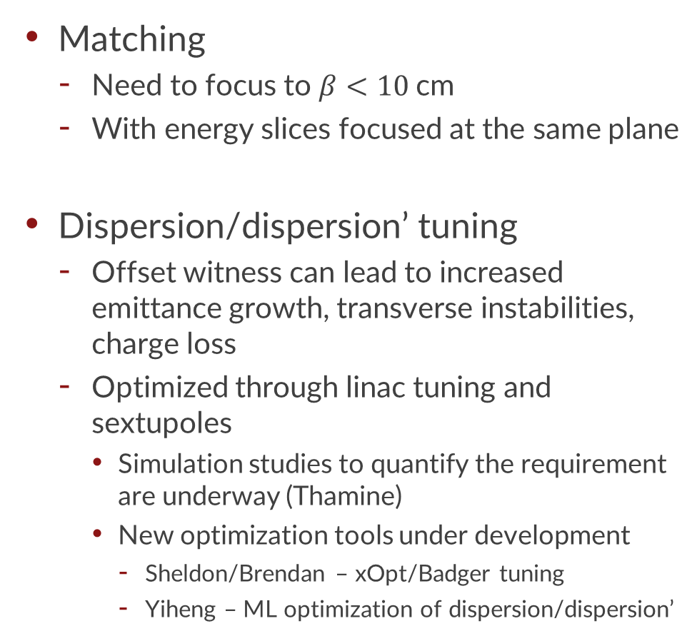
2) Improved transverse performance
Plots by C. Zhang
Matching
Need to focus to $β<10$cm
With energy slices focused at the same plane
Dispersion/dispersion’ tuning
Offset witness can lead to increased emittance growth, transverse instabilities, charge loss
Optimized through linac tuning and sextupoles
Simulation studies to quantify the requirement are underway (Thamine)
New optimization tools under development
Sheldon/Brendan – xOpt/Badger tuning
Yiheng – ML optimization of dispersion/dispersion’
Witness
Drive
Drive
Witness
Drive
Plasma
Drive
Plasma
Witness
Witness

Slide 9
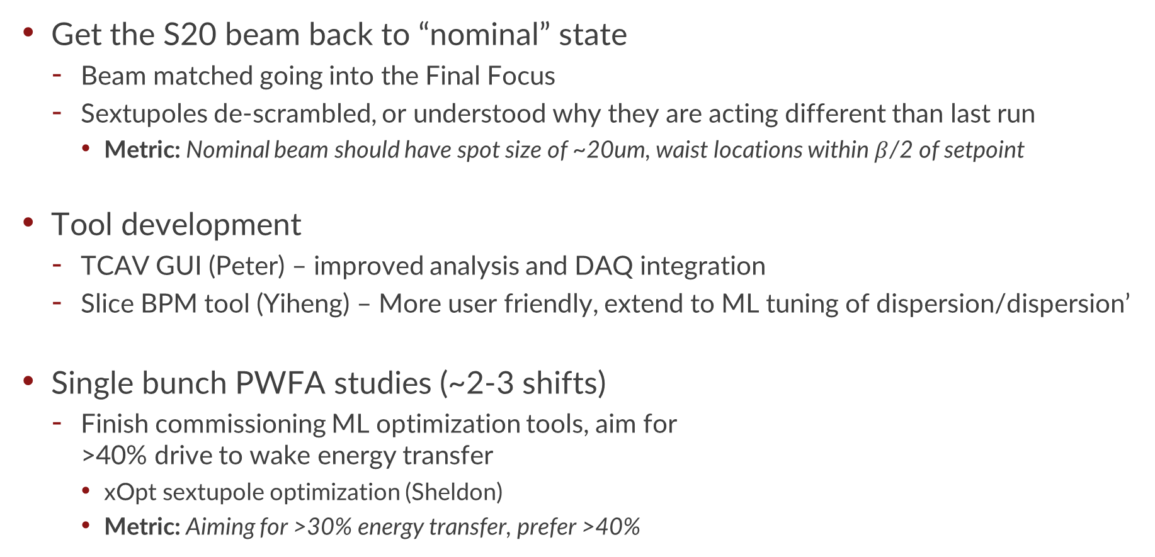
Shift plan/ideas for Jan. to July 2026
Get the S20 beam back to “nominal” state
Beam matched going into the Final Focus
Sextupoles de-scrambled, or understood why they are acting different than last run
Metric: Nominal beam should have spot size of ~20um, waist locations within $β$/2 of setpoint
Tool development
TCAV GUI (Peter) – improved analysis and DAQ integration
Slice BPM tool (Yiheng) – More user friendly, extend to ML tuning of dispersion/dispersion’
Single bunch PWFA studies (~2-3 shifts)
Finish commissioning ML optimization tools, aim for >40% drive to wake energy transfer
xOpt sextupole optimization (Sheldon)
Metric: Aiming for >30% energy transfer, prefer >40%

Slide 10
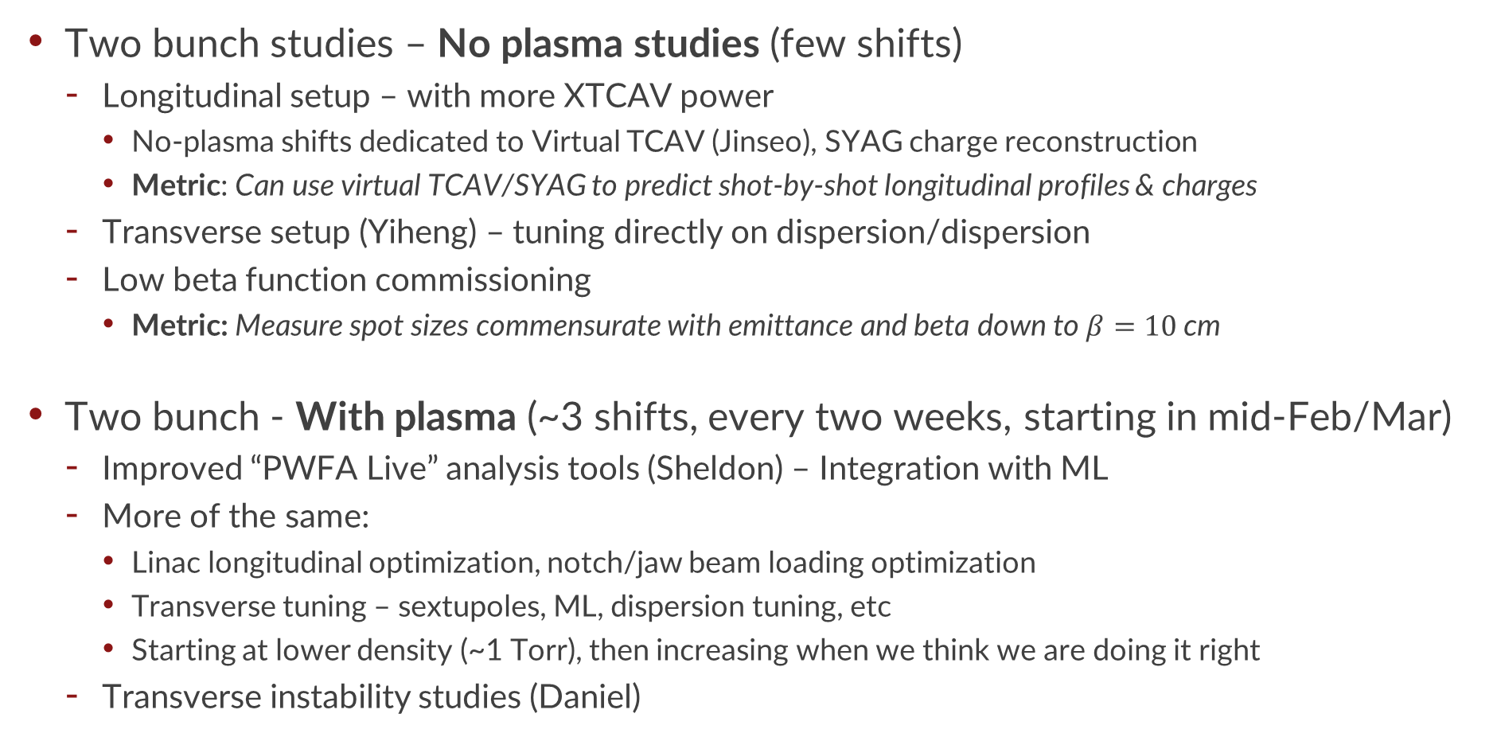
Shift plan/ideas for Jan. to July 2026, continued
Two bunch studies – No plasma studies (few shifts)
Longitudinal setup – with more XTCAV power
No-plasma shifts dedicated to Virtual TCAV (Jinseo), SYAG charge reconstruction
Metric: Can use virtual TCAV/SYAG to predict shot-by-shot longitudinal profiles & charges
Transverse setup (Yiheng) – tuning directly on dispersion/dispersion
Low beta function commissioning
Metric: Measure spot sizes commensurate with emittance and beta down to $β=10$cm
Two bunch - With plasma (~3 shifts, every two weeks, starting in mid-Feb/Mar)
Improved “PWFA Live” analysis tools (Sheldon) – Integration with ML
More of the same:
Linac longitudinal optimization, notch/jaw beam loading optimization
Transverse tuning – sextupoles, ML, dispersion tuning, etc
Starting at lower density (~1 Torr), then increasing when we think we are doing it right
Transverse instability studies (Daniel)

Slide 11
Person requirements for FY26 E300
Last spring we ran E300 for 30 days in total (25 with the oven on)
How should we do it this year?
Li oven operators: oven startup/shutdown, on shift heat management, on-call for issues
Ivan, Kelly, Daniel, Yiheng, ??
Laser operators: Laser startup, EOS setup/monitoring, Laser alignment and on-shift management
Alex, Junzhi, Claire, Sheldon (Mar-May), ???
2 bunch specialists: Assist with daytime beam setup/tuning, understanding of machine setup
Zack, New-Nathan??
On-shift specialists, data analyzers, visitors, well-wishers, distant relations, very old friends

Slide 12
Summary
What do we need to do to do better?
Get the S20 beam back to “nominal” state
Be better at both longitudinal and transverse tuning, at the same time, every time (or at least 10% of the time)

Slide 14
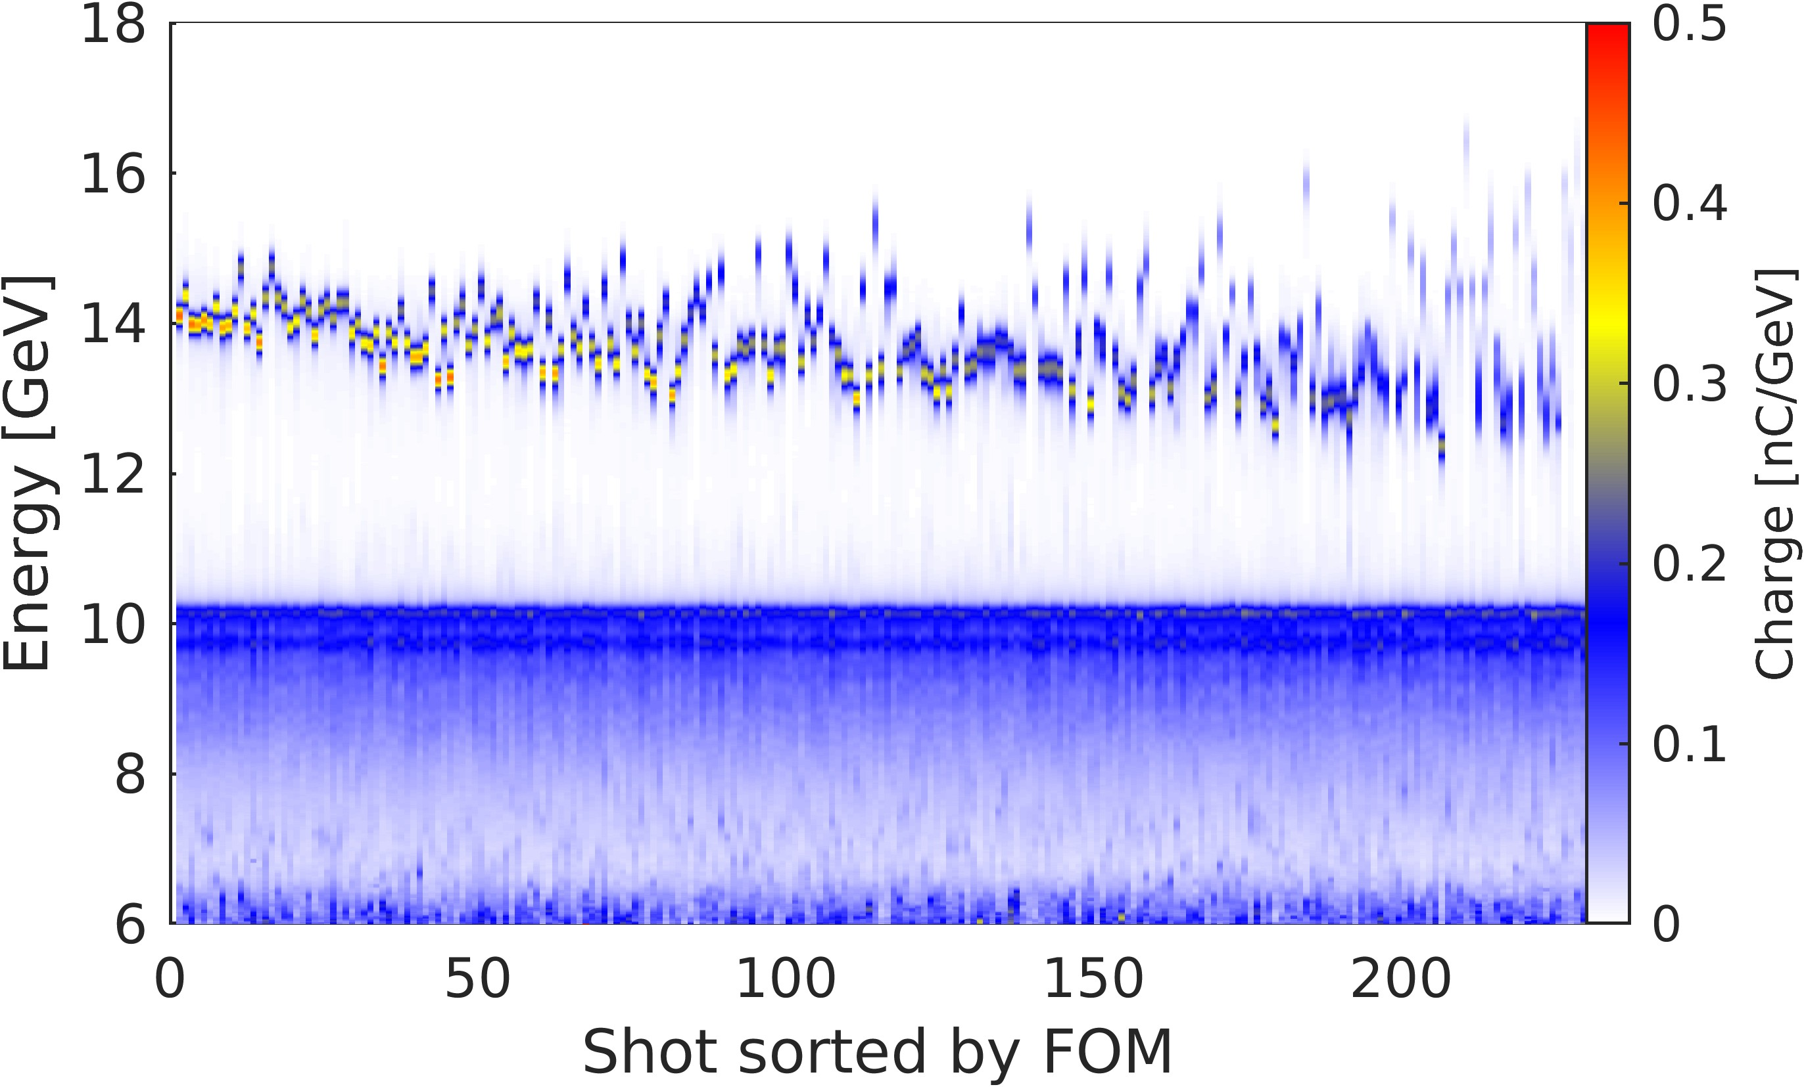
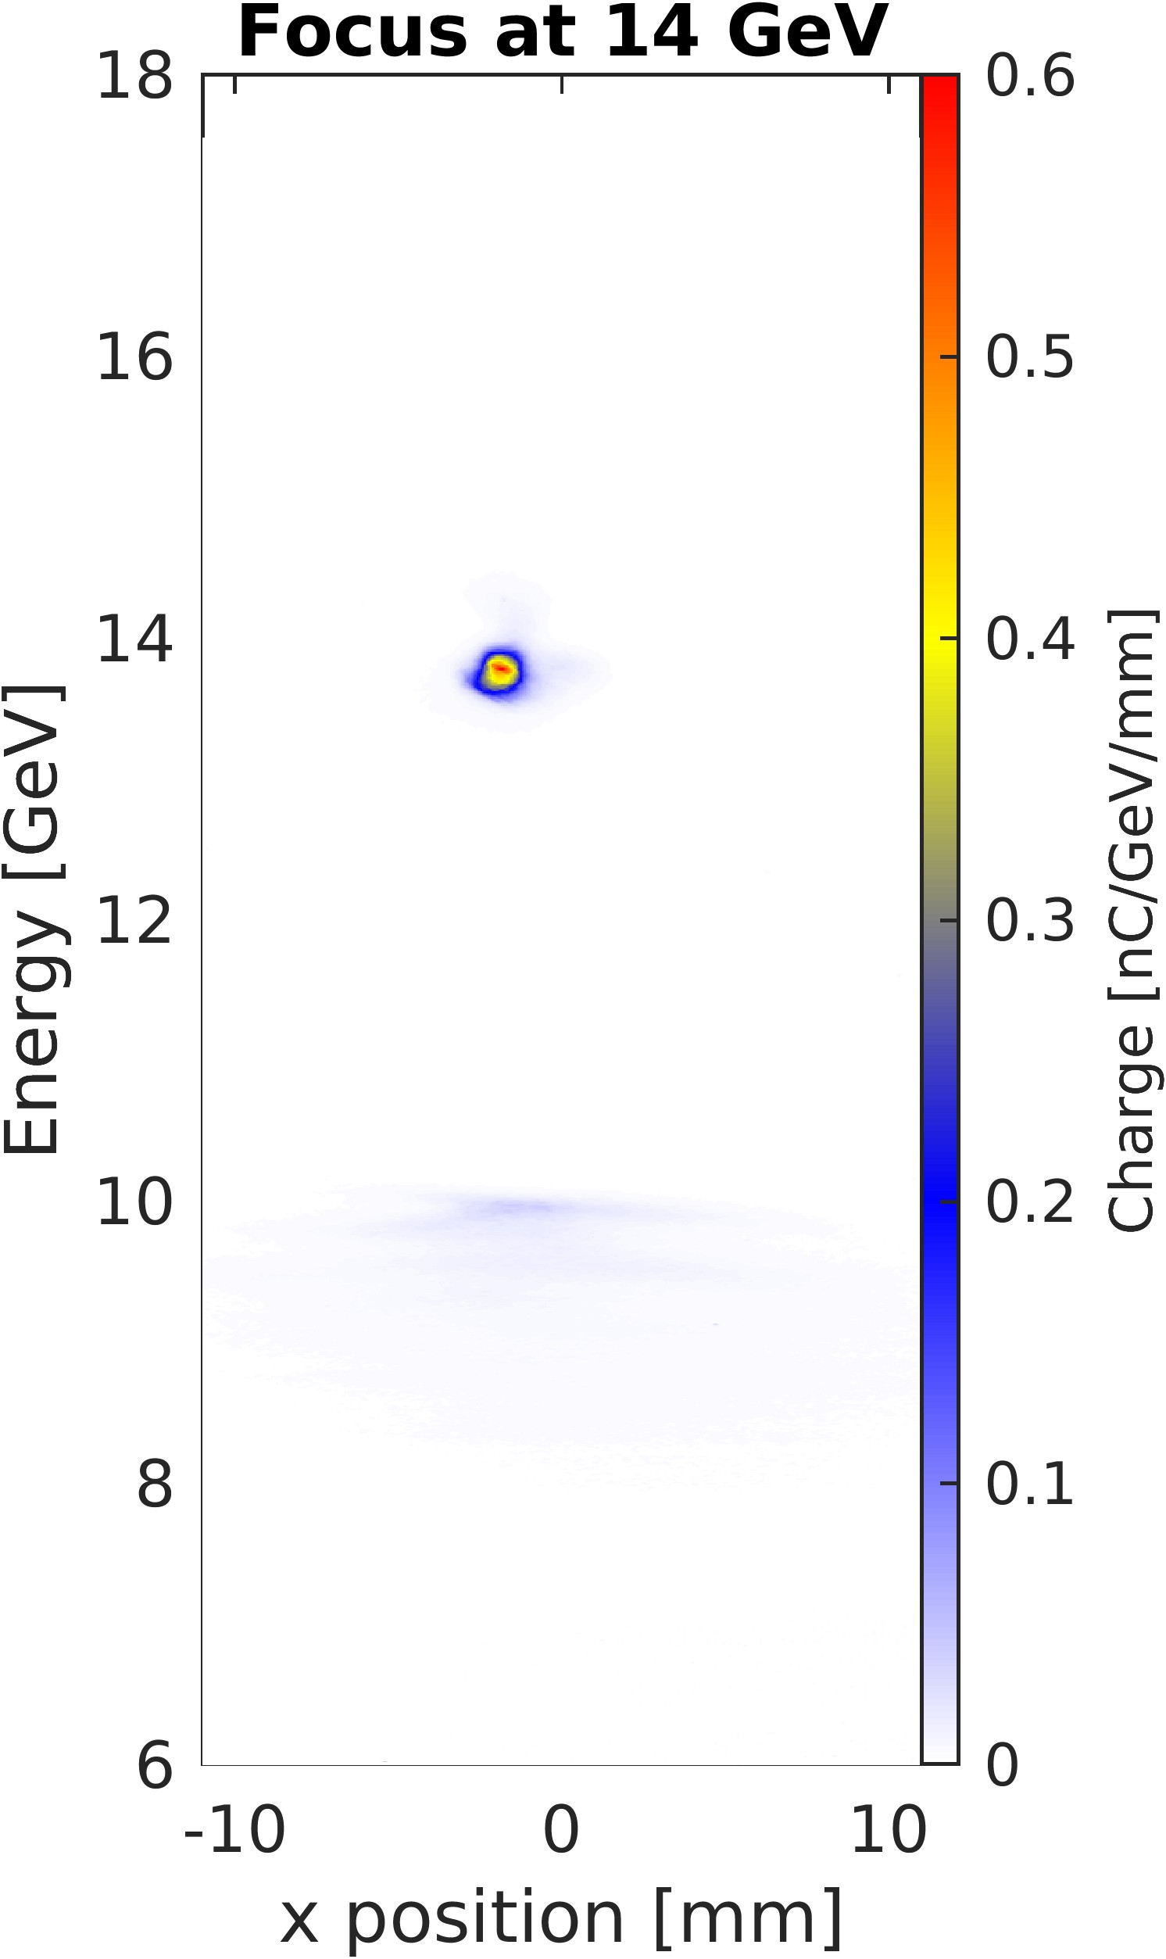
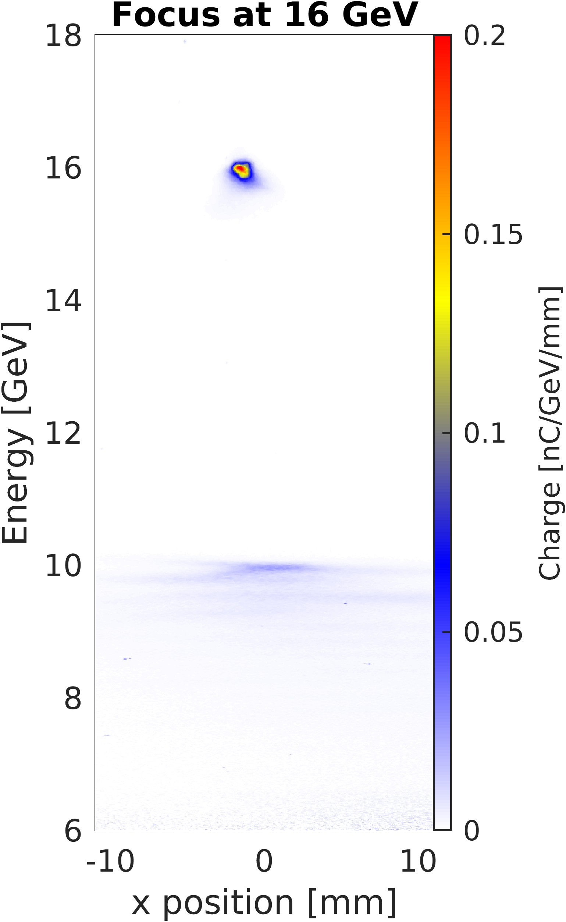
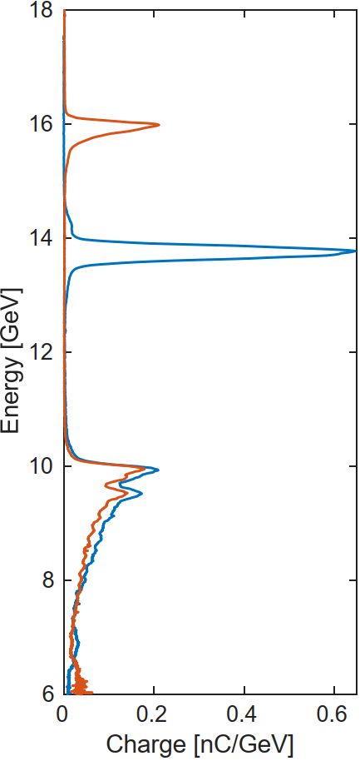
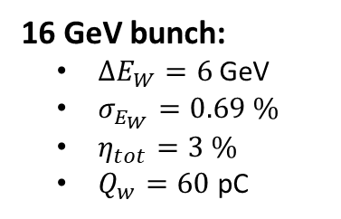

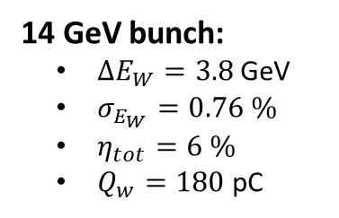
Characterizing the nominal working point
Full dataset (laser pre-ionized)
Two-bunch from cathode, with collimators
Driver: ~1.2 nC, 6-8 kA
Witness: 150-250 pC incoming charge
Plasma: 40cm long lithium plasma, 4e16 cm⁻³
Sorted by figure of merit:
$$Ω=\frac{\left(\frac{σ_{E_{W}}}{ΔE_{W}}\right)}{η_{tot}\left(\frac{ΔE_{W}}{10 GeV}\right)}$$
14 GeV bunch:
$ΔE_{W}=3.8$ GeV
$σ_{E_{W}}=0.76 \%$
$η_{tot}=6 \%$
$Q_{w}=180$ pC
16 GeV bunch:
$ΔE_{W}=6$ GeV
$σ_{E_{W}}=0.69 \%$
$η_{tot}=3 \%$
$Q_{w}=60$ pC

Slide 15
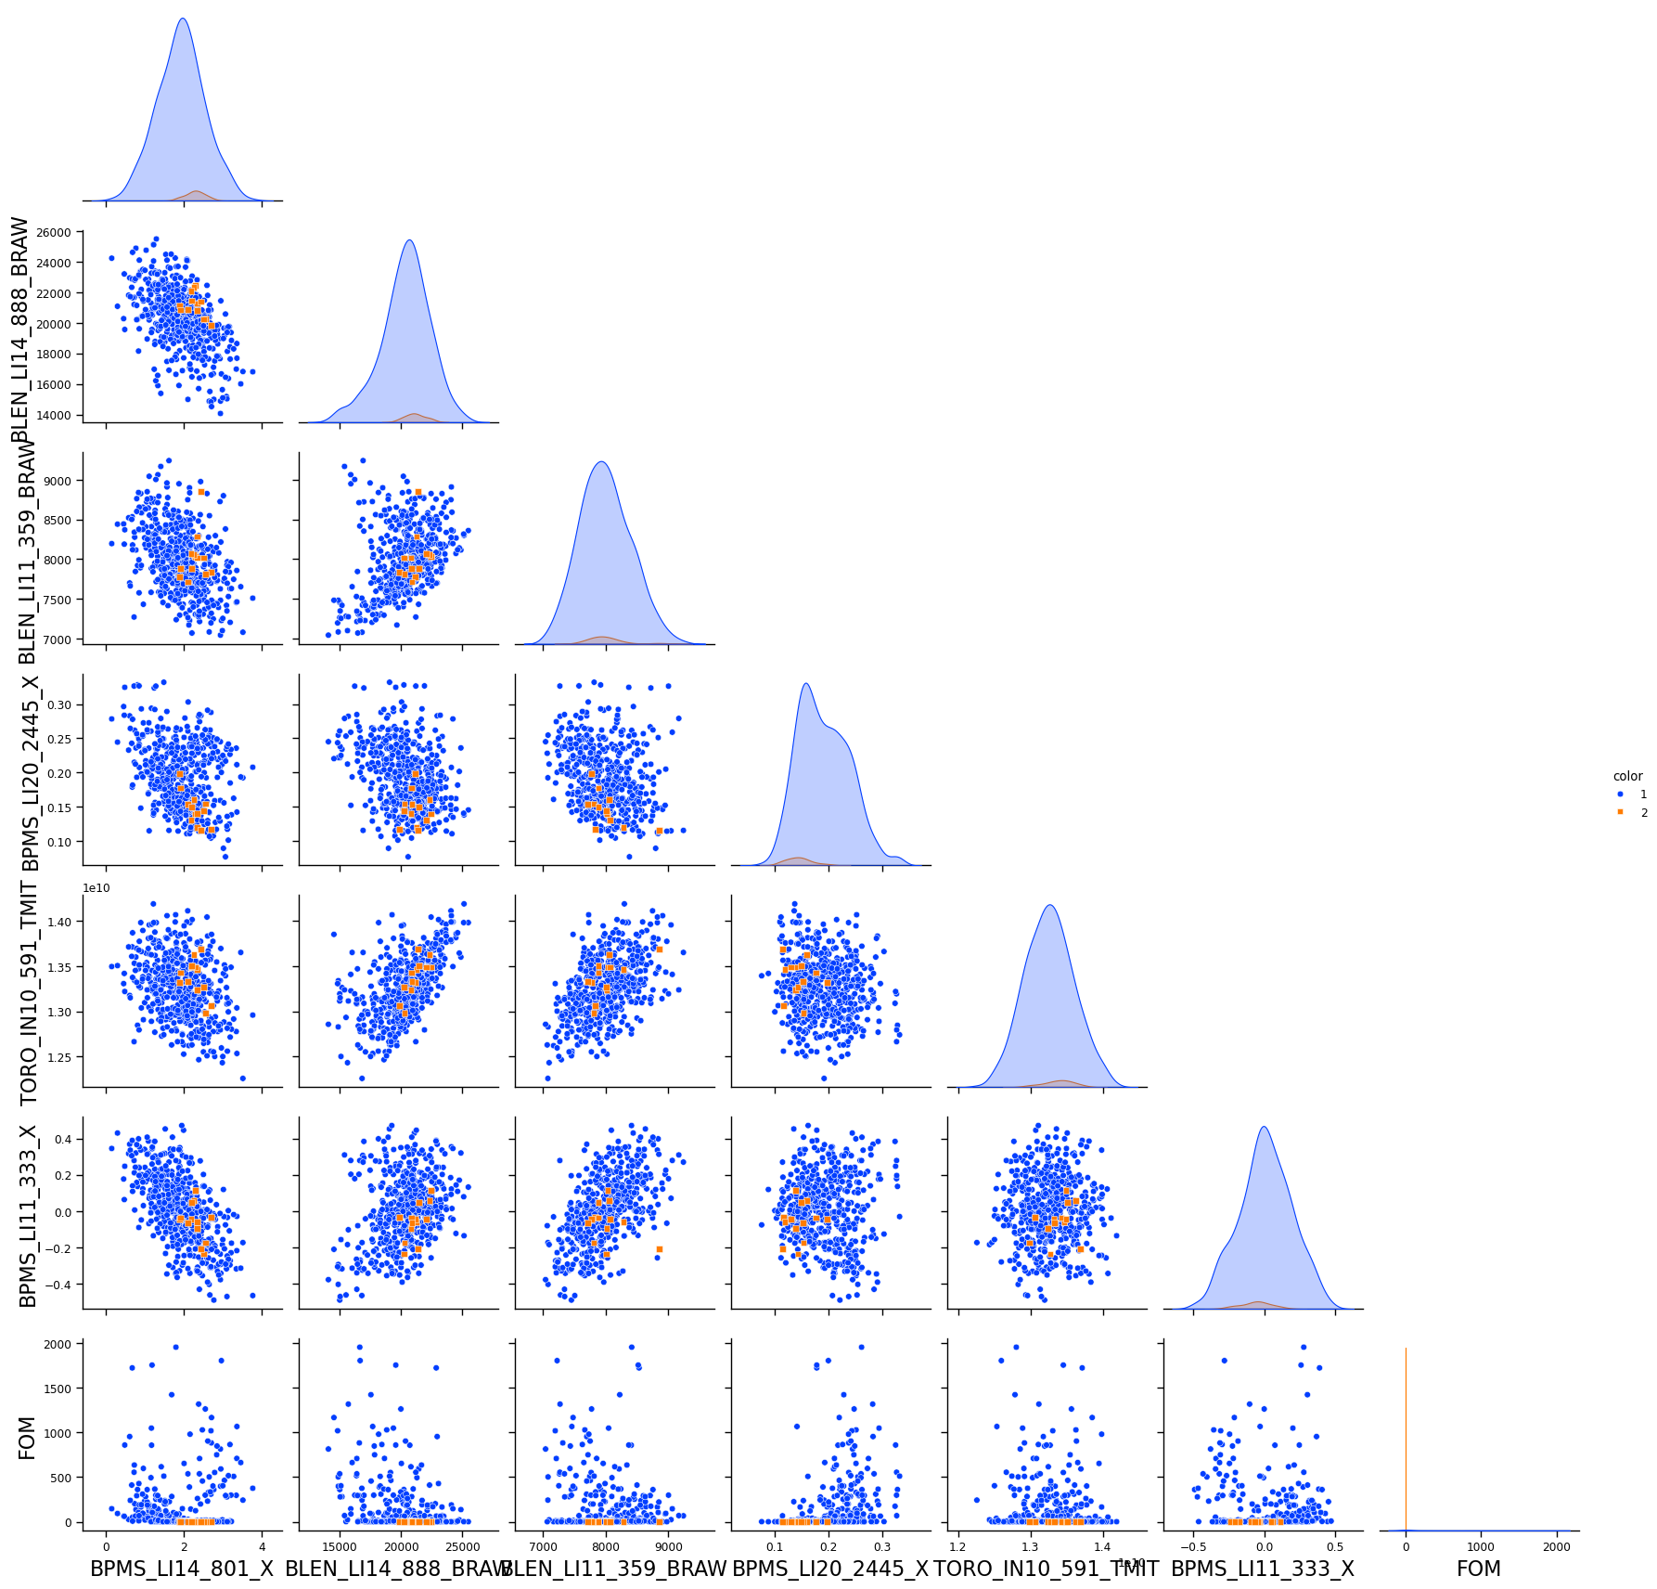
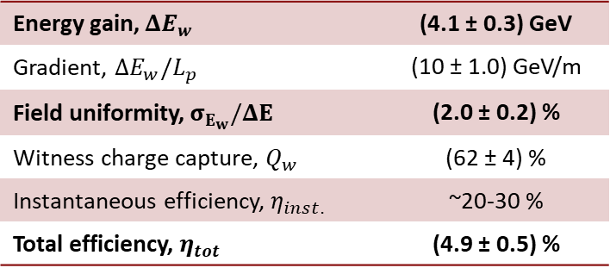
Can we predict what shots are going to be higher quality?
Only shots with similar incoming PV’s
Brendan’s analysis: linear regression coupled with feature importance permutation
- Finds a list PV’s with high correlation with FOM
Further analysis to determine optimal range of these PV’s that minimizes FOM
Filter data by PVs
BPM 333 X
BPM 511 X
BPM 801 X
BPM 2445 X
BPM 3156 X
BC11 BLEN
BC14 BLEN
Energy gain, $ΔE_{w}$ | (4.1 ± 0.3) GeV
Gradient, $ΔE_{w}/L_{p}$ | (10 ± 1.0) GeV/m
Field uniformity, $σ_{E_{w}}/ΔE$ | (2.0 ± 0.2) %
Witness charge capture, $Q_{w}$ | (62 ± 4) %
Instantaneous efficiency, $η_{inst.}$ | ~20-30 %
Total efficiency, $η_{tot}$ | (4.9 ± 0.5) %

Slide 16
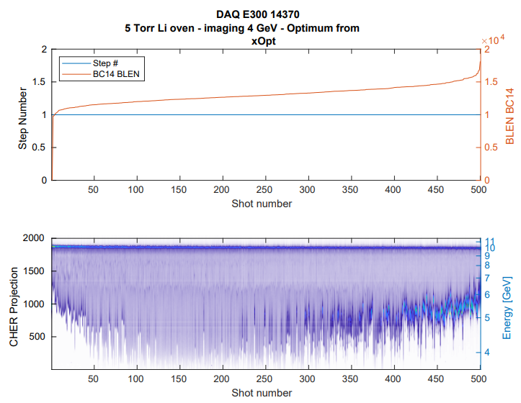
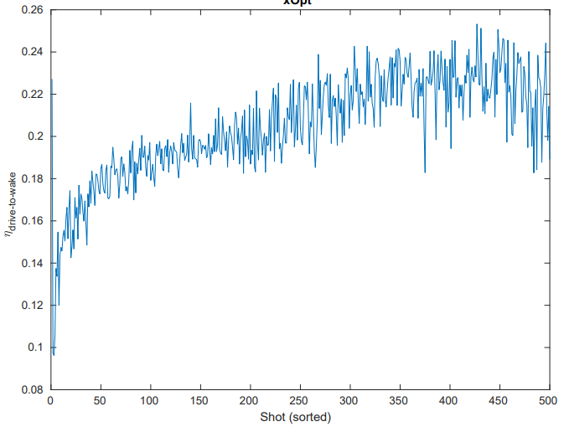
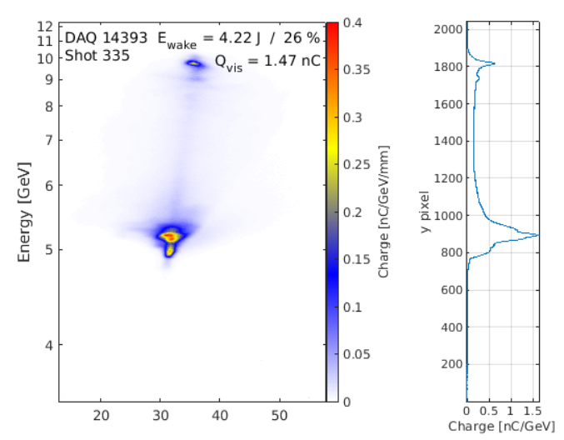
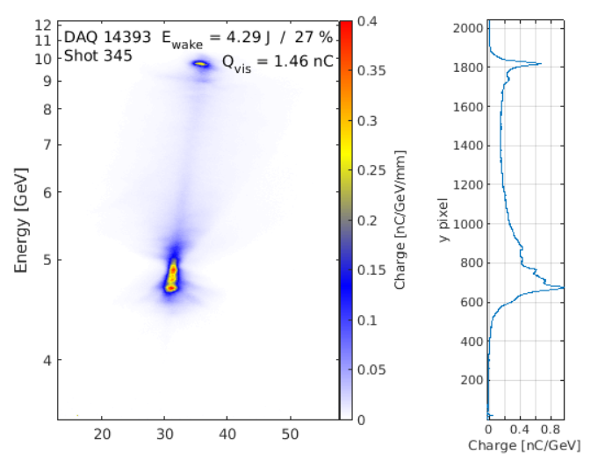
FY26 fall run - xOpt Optimization of Drive-to-Wake Transfer Efficiency
Challenges:
Ensuring BSA acquisition of camera and scalar data
xOpt setup (Thanks Ryan Roussel)
Optimum found with ~25% drive-to-wake efficiency
Comparable to best performance
(43% efficiency, but with a much longer oven)
Minimum energy particles down to <4 GeV

Slide 17
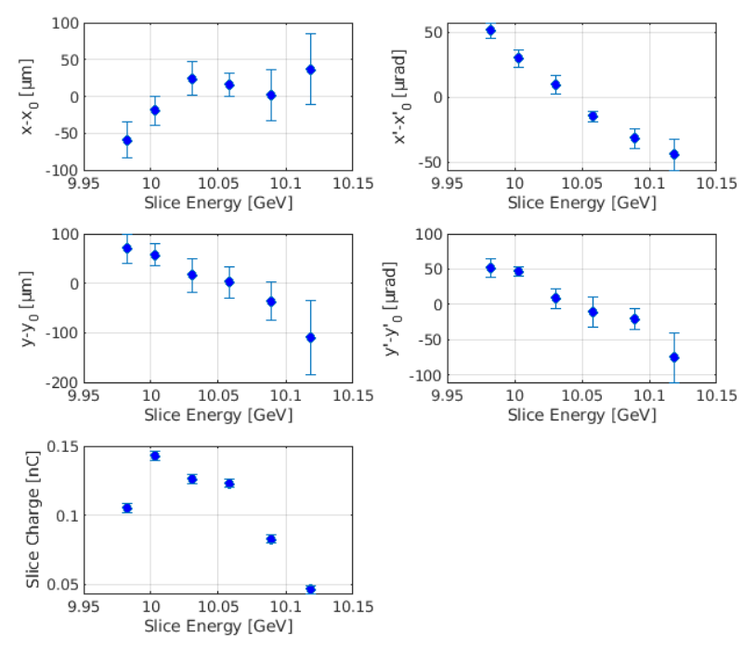
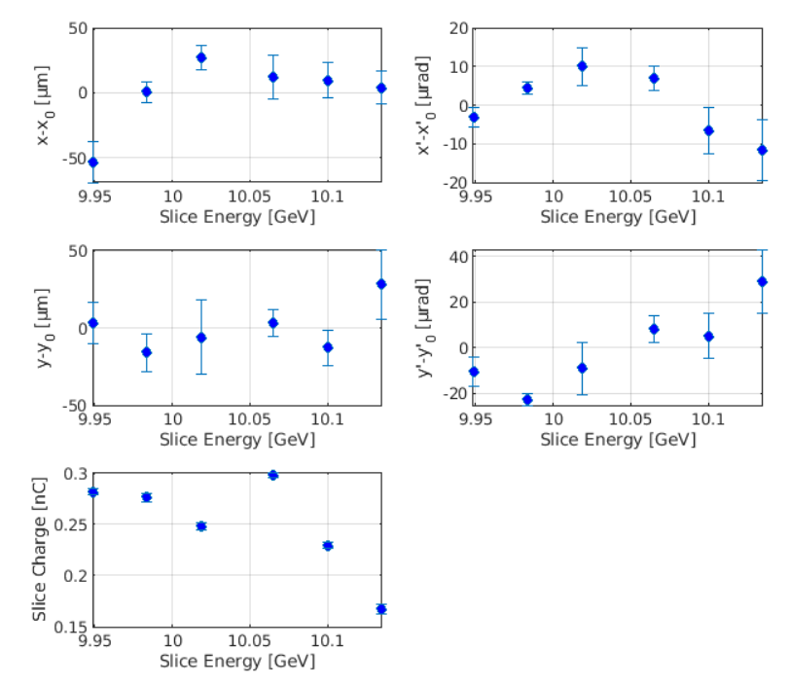
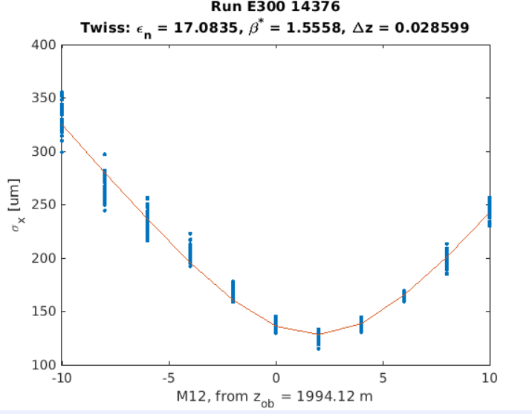
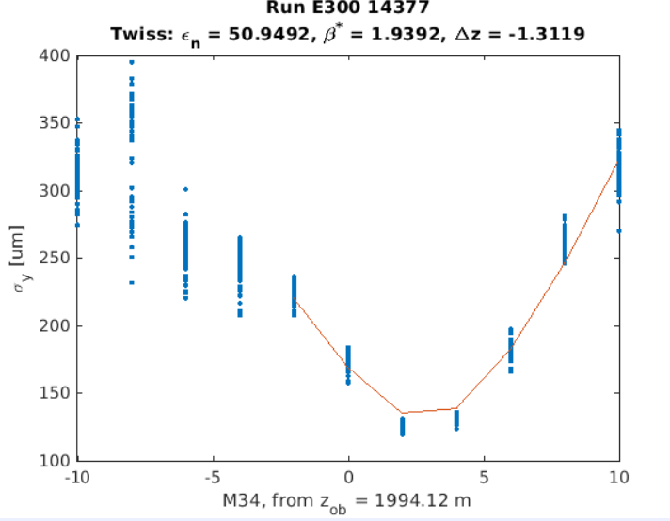
FY26 fall run - Post-optimization characterization
Slice Dispersion Plots - Before
Slice Dispersion Plots – After xOpt
Quad scans after xOpt
Slice dispersion and dispersion’ much improved by optimization
Offset in x and y waist positions persists after optimization

Slide 18
Additional thoughts
Witness transport: Is there an aperture that is limiting witness transport
Data – save more data!
Do the CMOS IOCs allow for smaller images to be saved??

Slide 19
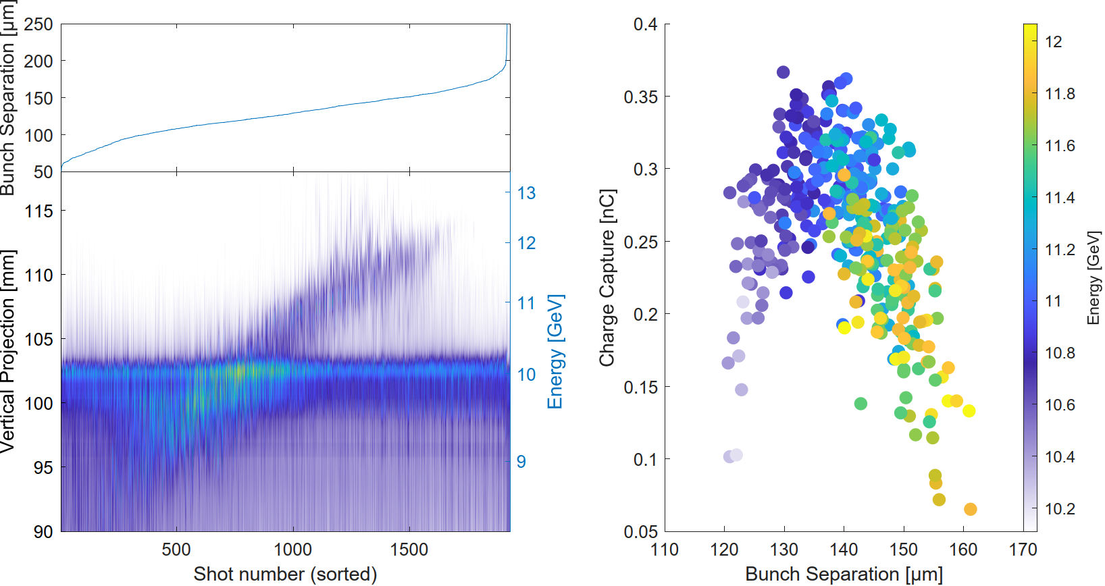
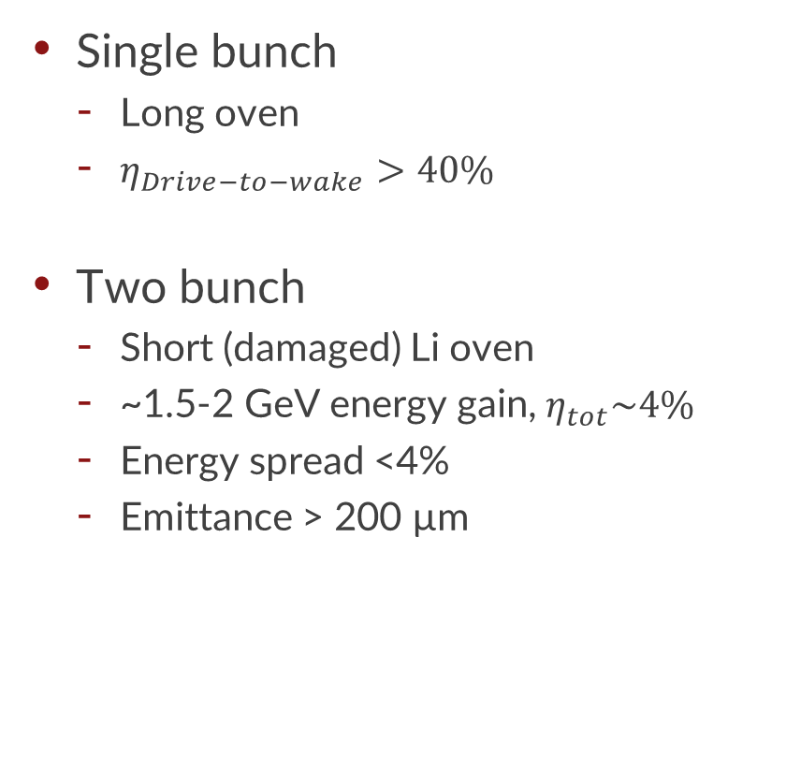
Main results from FY24 run
Single bunch
Long oven
$η_{Drive−to−wake}>40\%$
Two bunch
Short (damaged) Li oven
~1.5-2 GeV energy gain, $η_{tot}\sim 4\%$
Energy spread <4%
Emittance > 200 µm

Slide 20
Progress this past fall – Single E300 oven run
Shift goals:
Use xOpt with BSA-acquisition to optimize PWFA
Goal: Maximum drive-to-wake energy transfer
Actuator: 8 sextupole mover positions
Compare optimization performance to Nelder-Mead optimizer
Use the new slice dispersion measurement GUI and quad scans to measure the beam
Support E324

