Slide 1
Beam Synchronous ML for E300
Sheldon Rego
E300 collaboration meeting
2/2/26

Slide 2
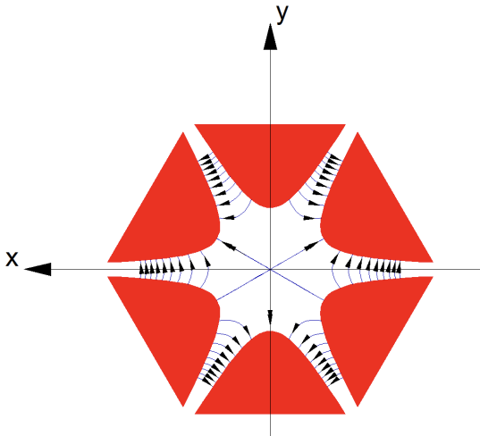
Sextupole optimization
Sextupole magnets tune higher order momentum dispersion and handle precise shaping of the particle beam.
PWFA performance is very sensitive to sextupole settings
4 sextupoles at FACET-II x [X, Y]→ 8 degrees of freedom
Enormous parameter space to search by hand….ML!
However, the ML optimizer needs to ignore bad shots caused by shot-to-shot machine jitter rather than sub-optimal sextupole settings.
Bad shot filtering is done by filtering on S14 BLEN.
Sextupole magnet field lines.
Credit: Andy Wolski, U. of Liverpool, Linear dynamics, Lecture 3
Thus, we need a program that beam synchronously matches scalar diagnostics with the spectrometer cameras in real time to provide inputs to the optimizer.

Slide 3
Objectives
Project goal: Build PWFA spectrometer tool that interfaces with:
ML optimizer
Live display GUI
Main challenge: Acquisition needs to be beam synchronous (BSA)
Notes:
PWFA?

Slide 4
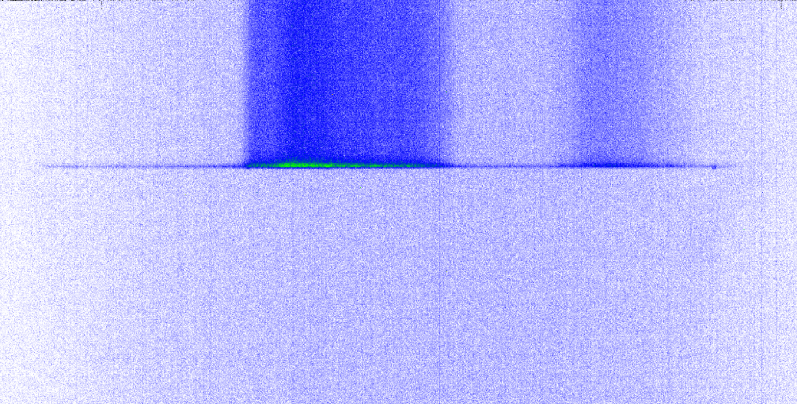
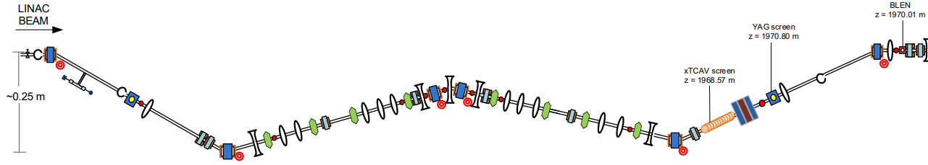
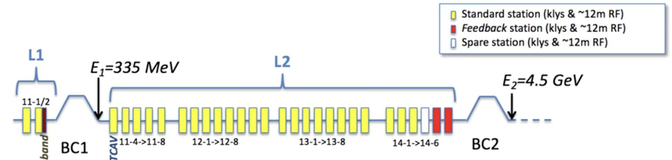
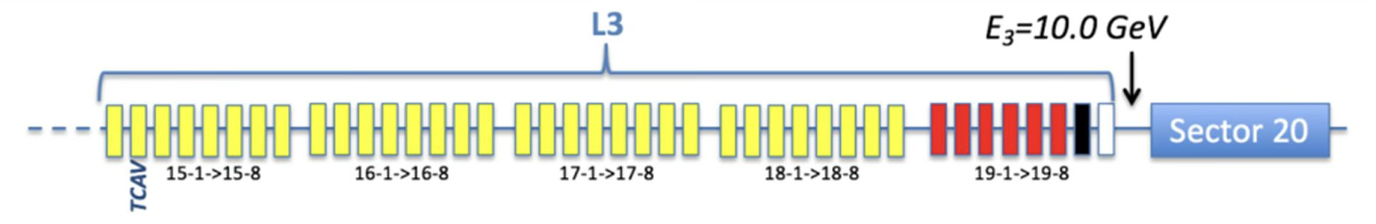
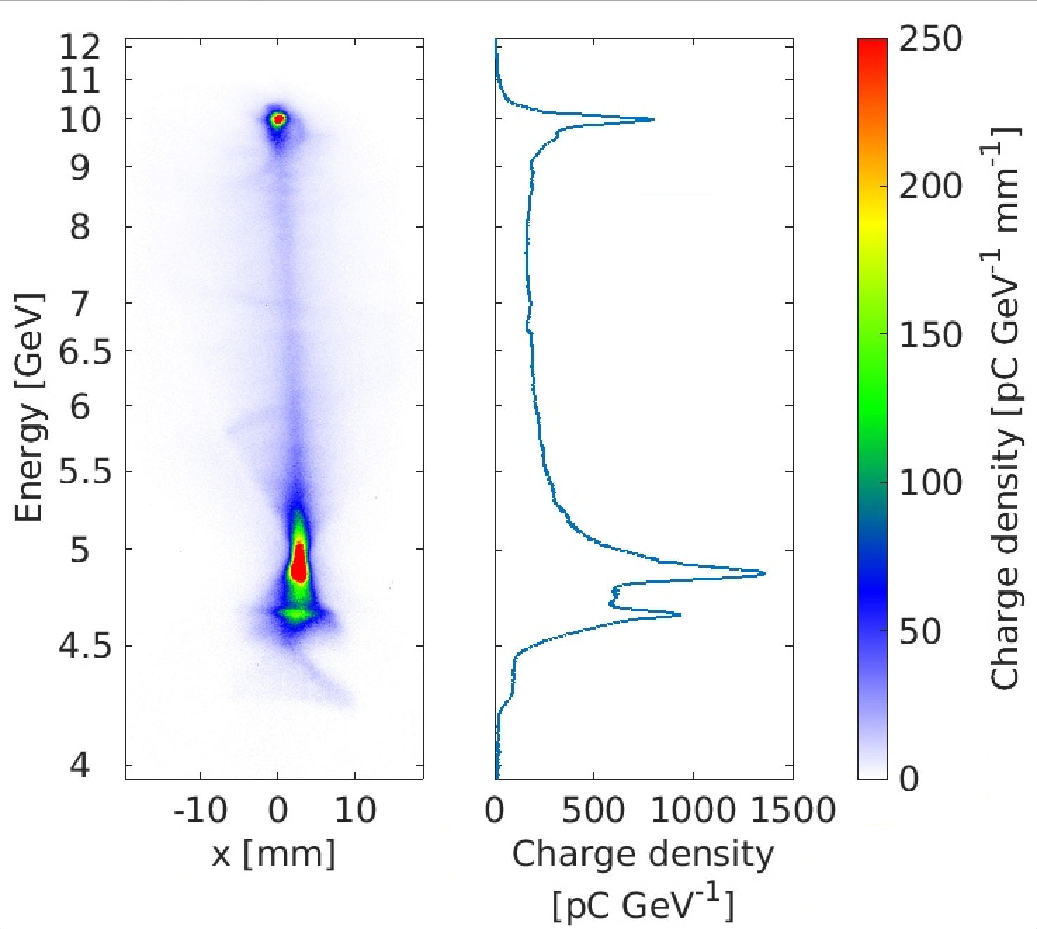
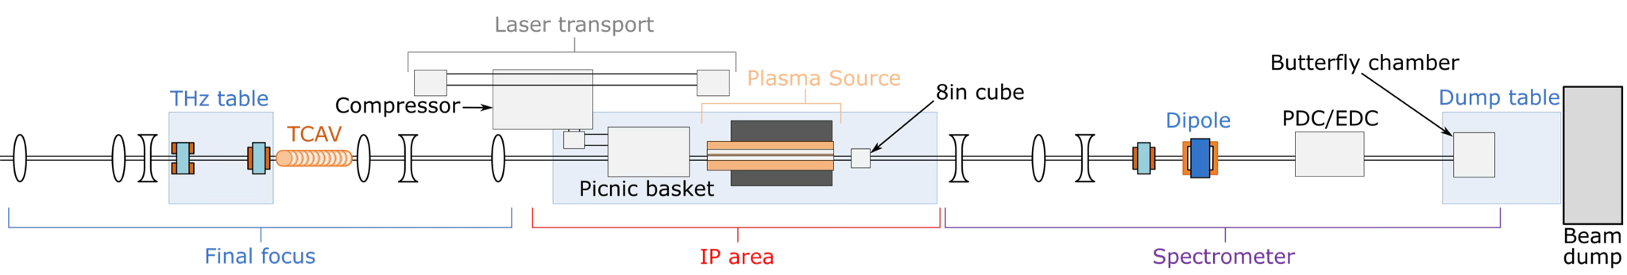
Optimization goals
Sextupoles
SYAG
Energy
S14 BLEN
IP TORO
CHER

Slide 5

BSA ML optimizer workflow
No
Collect measurements
PWFA Spec. calculation
Machine
Learning Optimizer
BLEN within range?
Yes
Scalars
BLEN
TORO
Eloss: Total energy lost by drive bunch (below 10 GeV)
Egain: Total energy gained by trailing bunch (above 10 GeV)
Qaccel: Total charge accelerated above 10 GeV
Eta_tot: Total drive to trailing energy transfer efficiency
Cameras
CHER
SYAG
Try new sextupole position
Notes:
Speed through 5, 6, 7

Slide 6
BSA acquisition: Single bunch configuration
buffer.dat
acquisition.py
Controls system
w+
Buffer name | Stored data
CHER Image Array | .. | .. | .. | …
CHER Pulse ID | .. | .. | .. | …
SYAG Image Array | .. | .. | .. | …
SYAG Pulse ID | .. | .. | .. | …
CHER PID PV
Read CHER Image Array and CHER Pulse ID PV, write to buffer, tell matching.py to start matching
Calc. PVs
SYAG PID PV
w+
Read SYAG Image Array and SYAG Pulse ID PV, write to buffer
r
matching.py
10 Hz Scalar Buffer
Search for SYAG and Scalar PID match for given CHER PID
Buffer name | Stored data
Scalar Pulse ID | .. | .. | .. | …
BLEN | .. | .. | .. | …
TORO | .. | .. | .. | …
Current status:
Full process takes ~0.3s
→ 1/3rd of all shots are acquired, matched and calculated at 10 Hz beam repetition rate
Calculate Eloss
ML optimizer
read/write to np.memmap
caget/caput with EPICS PV
PySide6 signal/slot

Slide 7
BSA acquisition: Final design
buffer.dat
acquisition.py
Controls system
w+
Buffer name | Stored data
CHER Image Array | .. | .. | .. | …
CHER Pulse ID | .. | .. | .. | …
SYAG Image Array | .. | .. | .. | …
SYAG Pulse ID | .. | .. | .. | …
CHER PID PV
Read CHER Image Array and CHER Pulse ID, write to buffer, tell matching.py to start matching
Calc. PVs
SYAG PID PV
w+
Read SYAG Image Array and SYAG Pulse ID, write to buffer
r
main.py
matching.py
10 Hz Scalar Buffer
Update front end graphics
Search for Pulse ID match across buffers
Buffer name | Stored data
BLEN | .. | .. | .. | …
TORO | .. | .. | .. | …
GUI push buttons and edit fields
Calculate everything
ML optimizer
read/write to np.memmap
caget/caput with EPICS PV
Front end GUI
PySide6 signal/slot
GUI front
end update
Notes:
Show overlay of what is needed for xopt and Live Spectrometer (not the same) [ also shut off waterfall when xopt is running to save computation]

Slide 8
ML optimization workflow
buffer.dat
acquisition.py
Controls system
w+
Buffer name | Stored data
CHER Image Array | .. | .. | .. | …
CHER Pulse ID | .. | .. | .. | …
SYAG Image Array | .. | .. | .. | …
SYAG Pulse ID | .. | .. | .. | …
CHER PID PV
Read CHER Image Array and CHER Pulse ID, write to buffer, tell matching.py to start matching
Calc. PVs
SYAG PID PV
w+
Read SYAG Image Array and SYAG Pulse ID, write to buffer
r
main.py
matching.py
10 Hz Scalar Buffer
Update front end graphics
Search for Pulse ID match across buffers
Buffer name | Stored data
BLEN | .. | .. | .. | …
TORO | .. | .. | .. | …
GUI push buttons and edit fields
Calculate everything
ML optimizer
read/write to np.memmap
caget/caput with EPICS PV
Front end GUI
PySide6 signal/slot
GUI front
end update
Notes:
Show overlay of what is needed for xopt and Live Spectrometer (not the same) [ also shut off waterfall when xopt is running to save computation]

Slide 9
PWFA spectrometer GUI workflow
buffer.dat
acquisition.py
Controls system
w+
Buffer name | Stored data
CHER Image Array | .. | .. | .. | …
CHER Pulse ID | .. | .. | .. | …
SYAG Image Array | .. | .. | .. | …
SYAG Pulse ID | .. | .. | .. | …
CHER PID PV
Read CHER Image Array and CHER Pulse ID, write to buffer, tell matching.py to start matching
Calc. PVs
SYAG PID PV
w+
Read SYAG Image Array and SYAG Pulse ID, write to buffer
r
main.py
matching.py
10 Hz Scalar Buffer
Update front end graphics
Search for Pulse ID match across buffers
Buffer name | Stored data
BLEN | .. | .. | .. | …
TORO | .. | .. | .. | …
GUI push buttons and edit fields
Calculate everything
ML optimizer
read/write to np.memmap
caget/caput with EPICS PV
Front end GUI
PySide6 signal/slot
GUI front
end update
Notes:
Show overlay of what is needed for xopt and Live Spectrometer (not the same) [ also shut off waterfall when xopt is running to save computation]

Slide 10
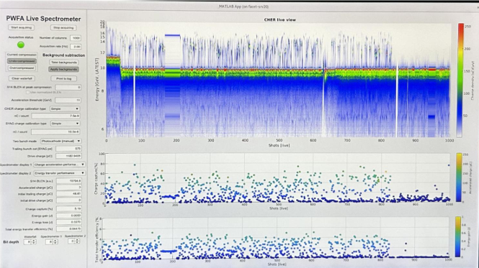
User interface: old design (Matlab)

Slide 11
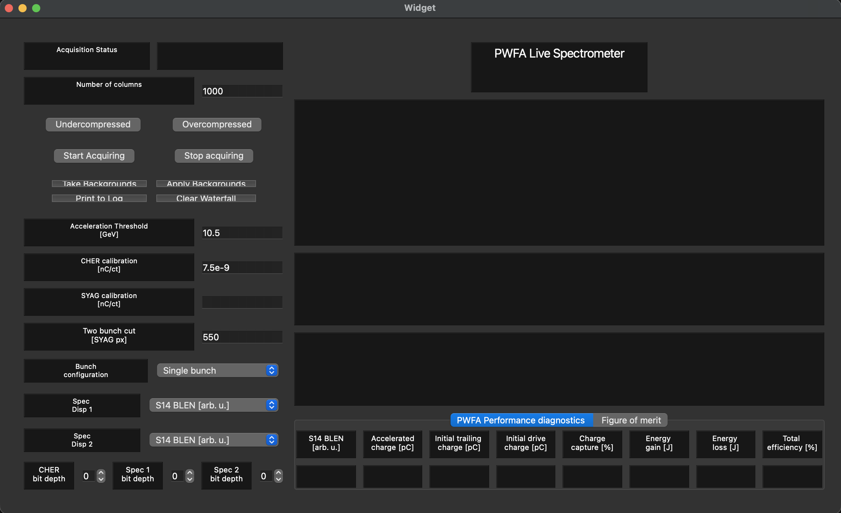
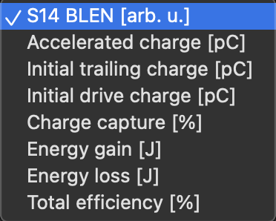
User interface: Qt Creator
Start/stop
Electron Spectrum waterfall plot display window [charge density vs shot number]
Set configuration and global calculation variables
2 independent Spectrometer Display windows
Spectrometer diagnostics for most recent shot

Slide 12
User interface
Graphics plotting does not work right now…goal for upcoming E300 run
Start/stop
Electron Spectrum waterfall plot display window [charge density vs shot number]
Set configuration and global calculation variables
2 independent Spectrometer Display windows
Spectrometer diagnostics for most recent shot

Slide 13
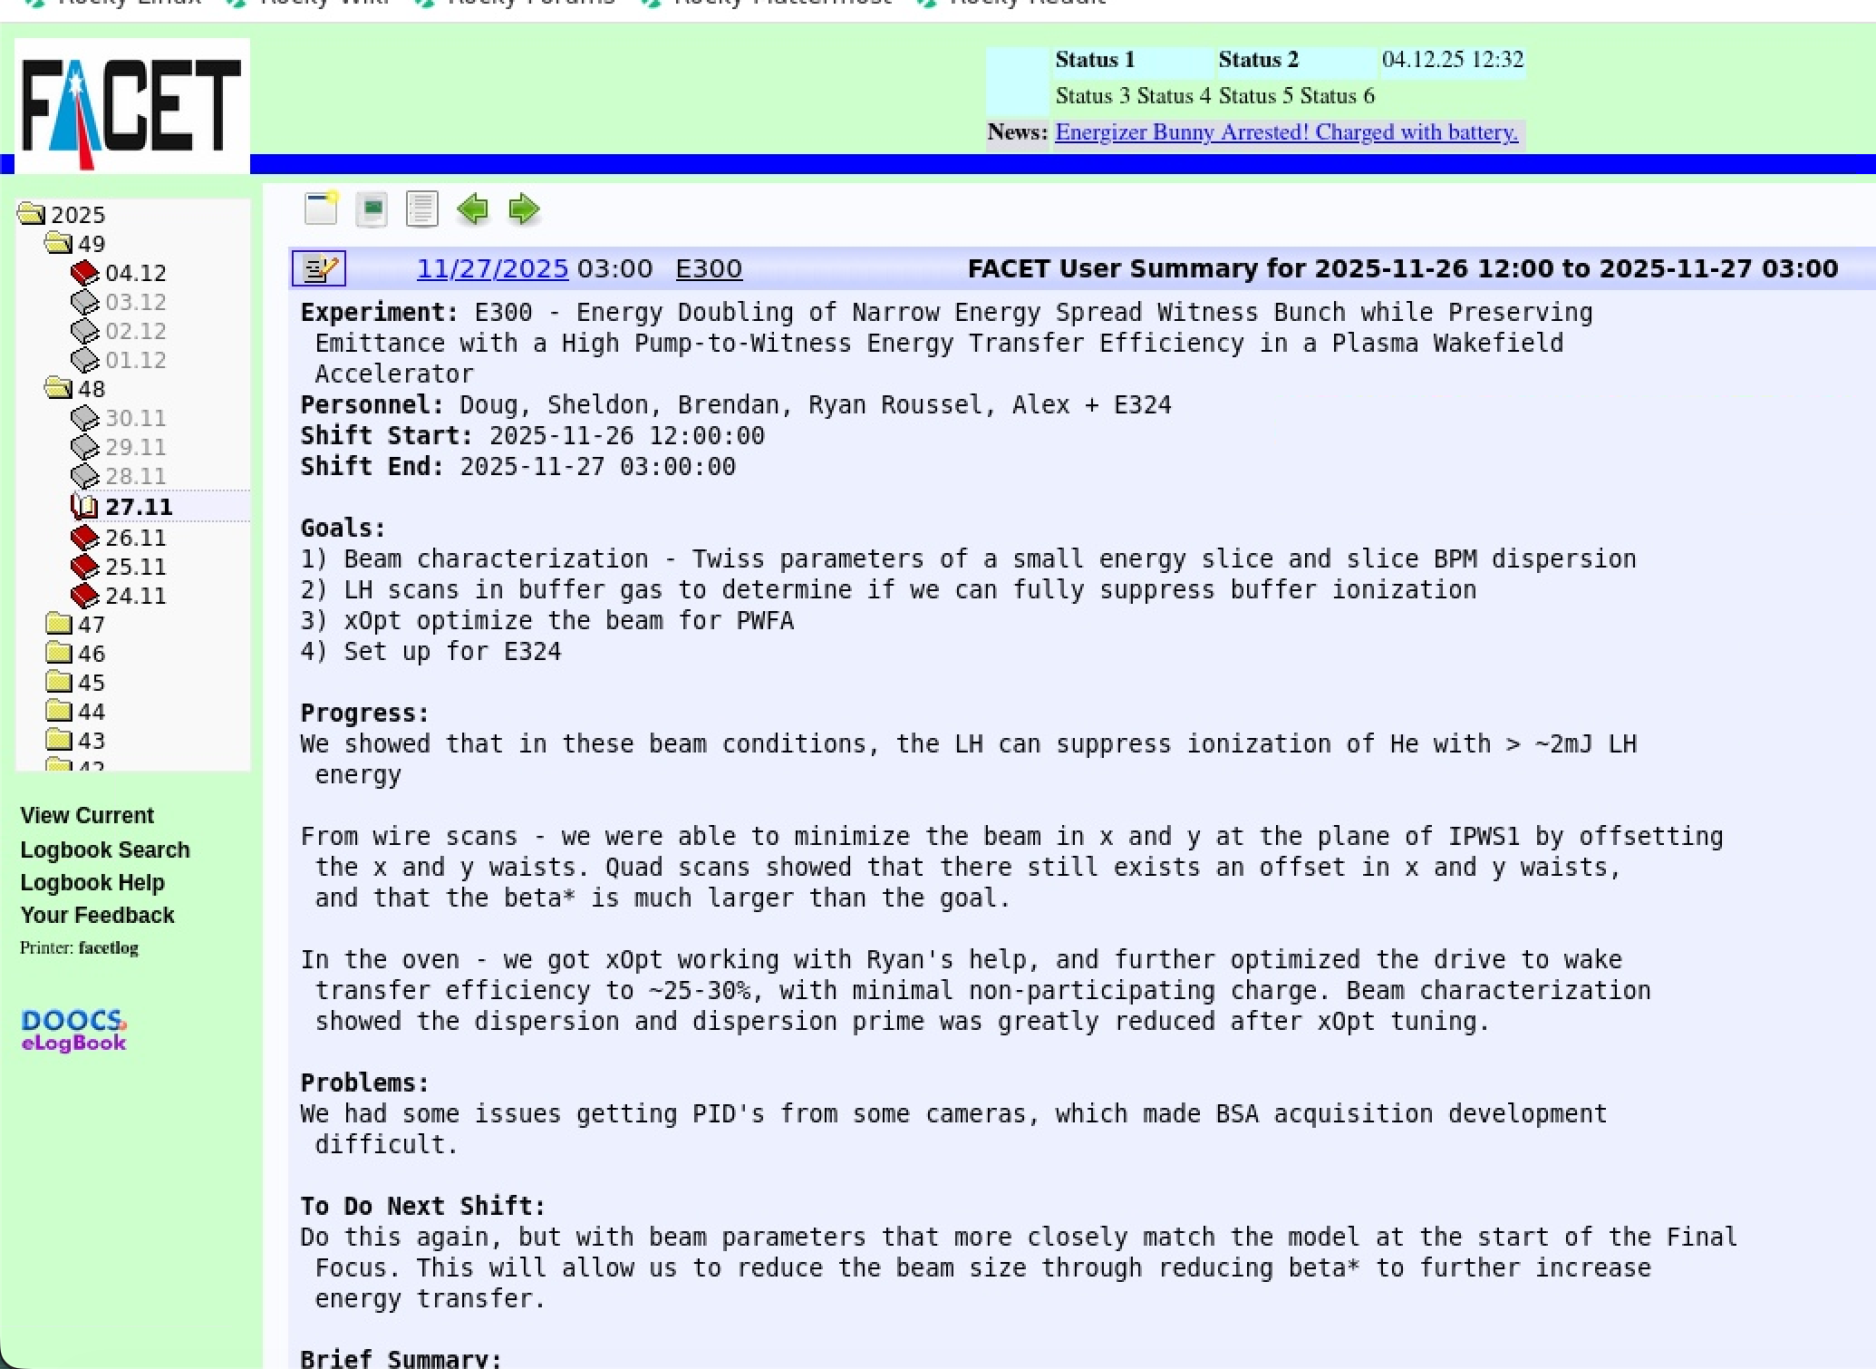
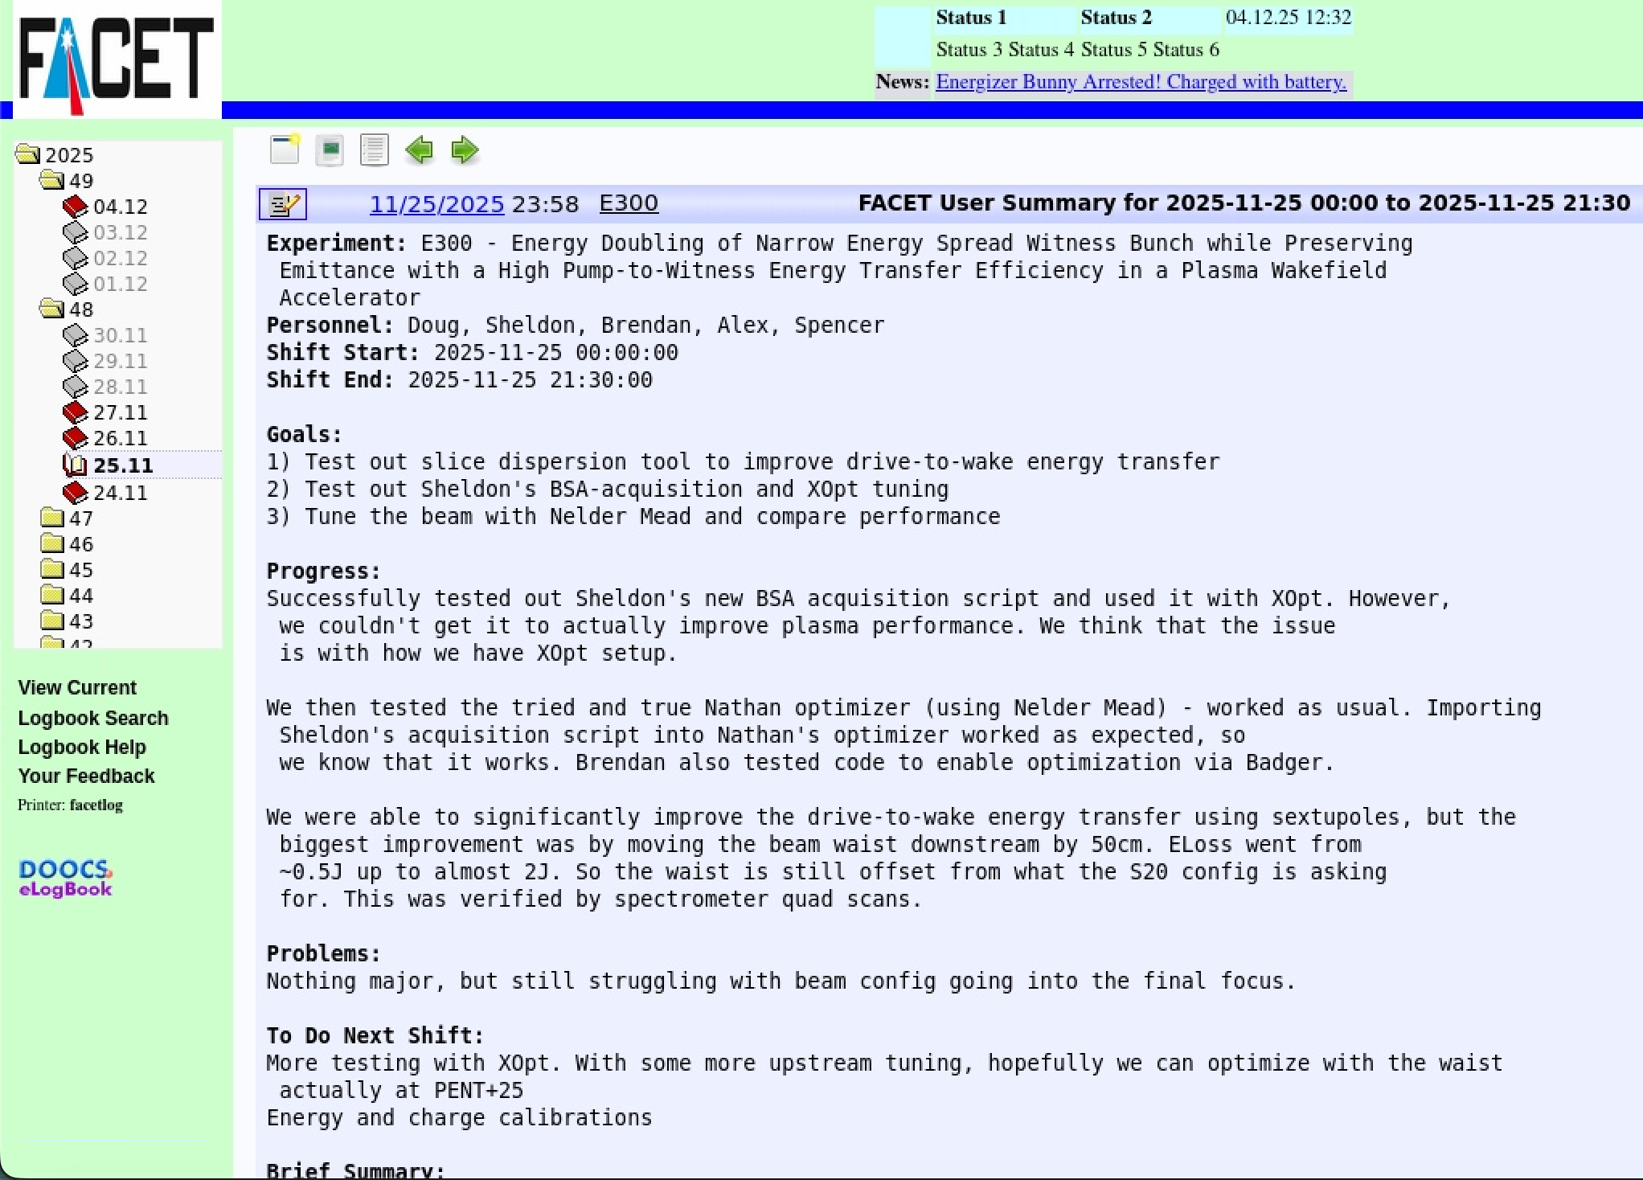
Summary of E300 25/11-26/11 shift
Tested BSA acquisition script over 2 shifts in late November
Day 1
Day 2

Slide 14
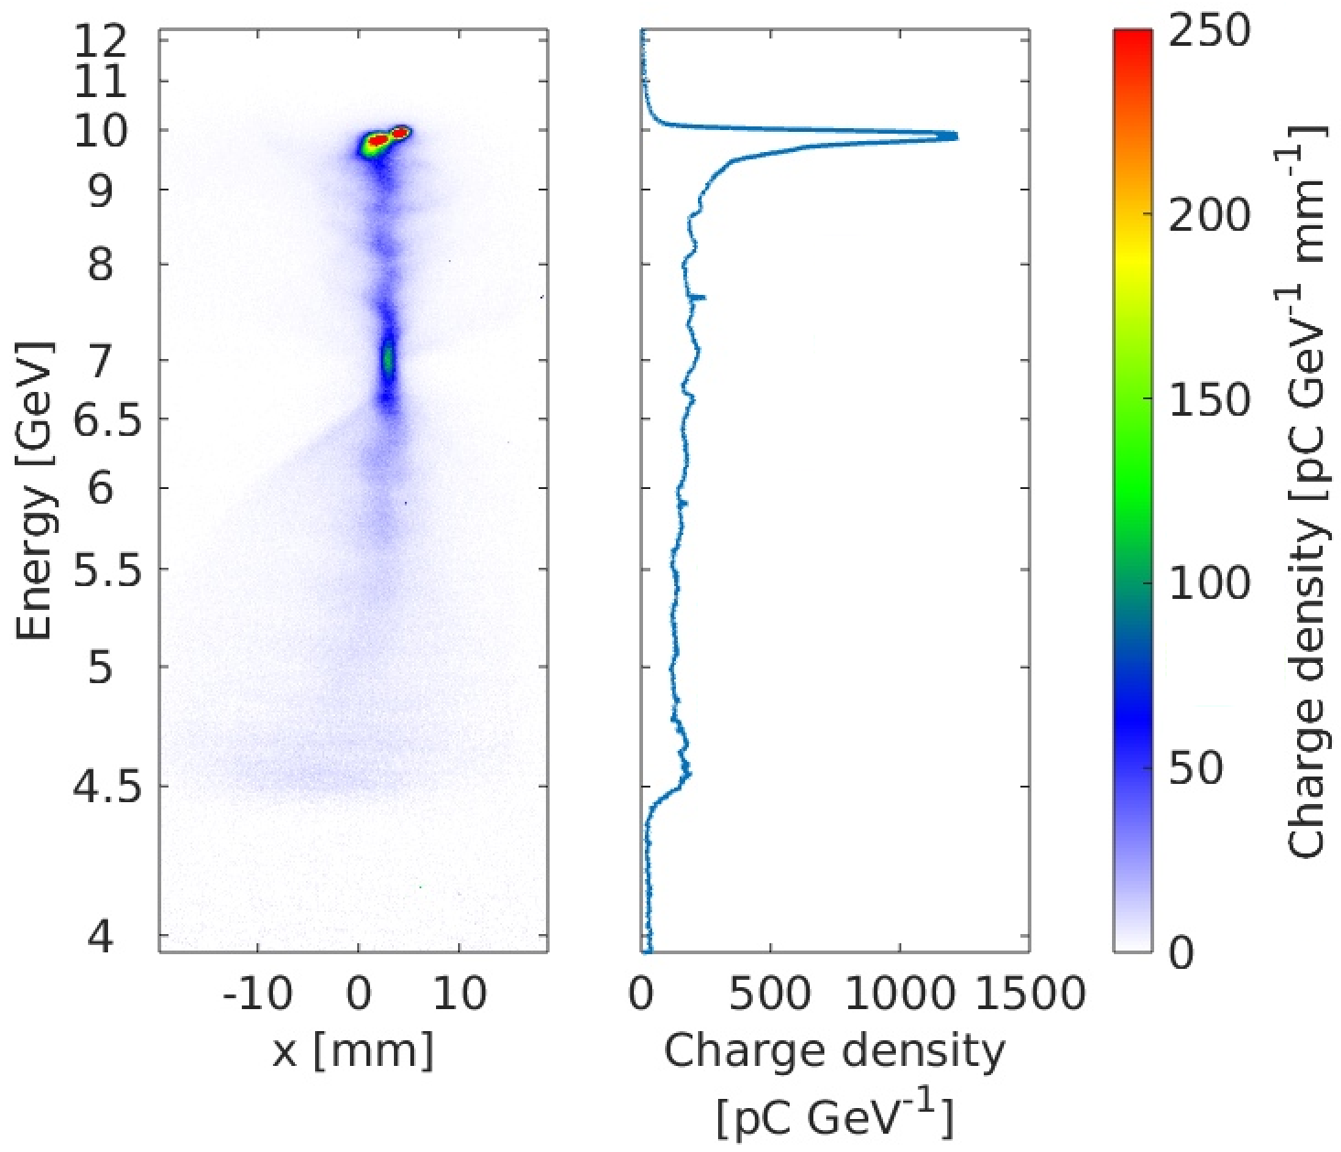
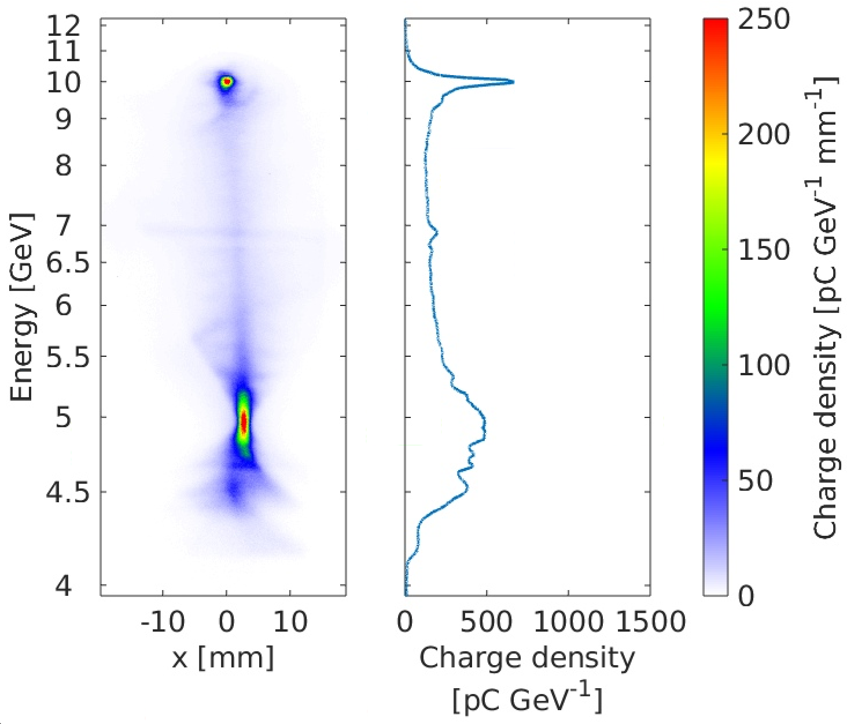
Summary of E300 25/11-26/11 shift
Energy loss - Before
Energy loss - After
Sextupole tuning
Initial energy loss = 3.26 J
Initial drive to wake transfer efficiency ~18%
Final energy loss = 3.89 J
Final drive to wake transfer efficiency ~24.3%

Slide 15
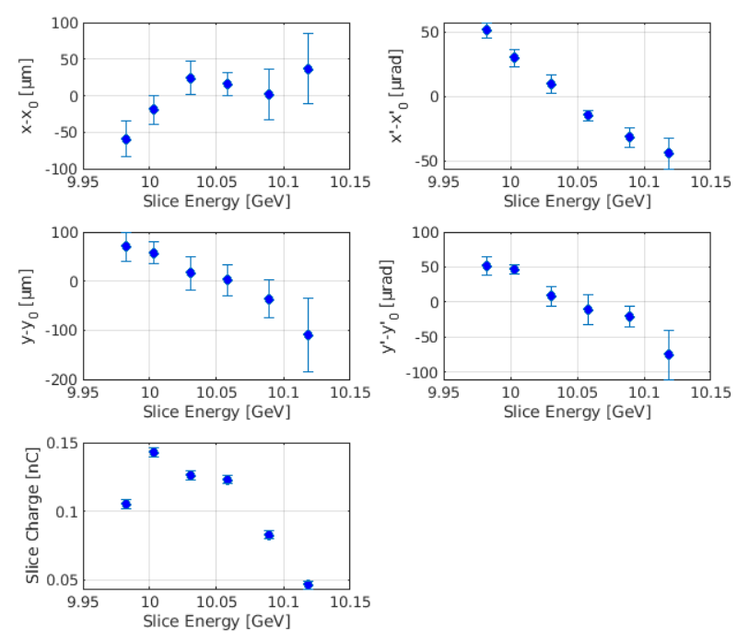
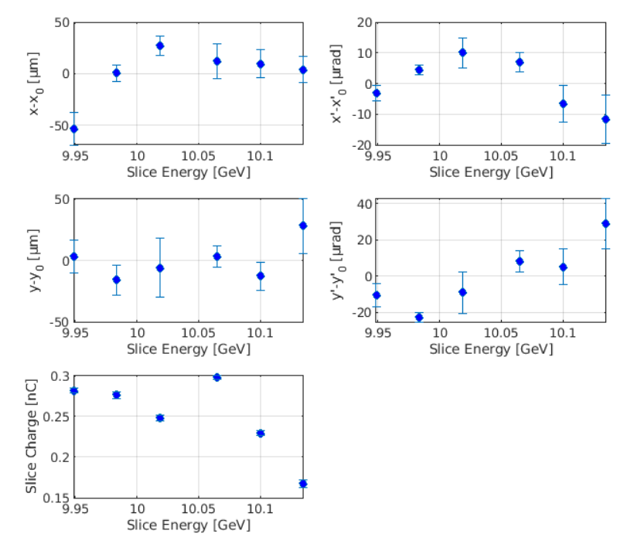
Slice Dispersion
Credit: Doug Storey
Slice Dispersion Plots - Before
Slice Dispersion Plots – After xOpt
~100 μrad
~100 μm
~40 μm
~20 μrad
Sextupole tuning
~40 μm
~50 μrad
~180 μm
~125 μrad
Sextupole tuning significantly improved the shaping of the electron beam – smaller x and y size and angular dispersion after ML optimization!

Slide 16
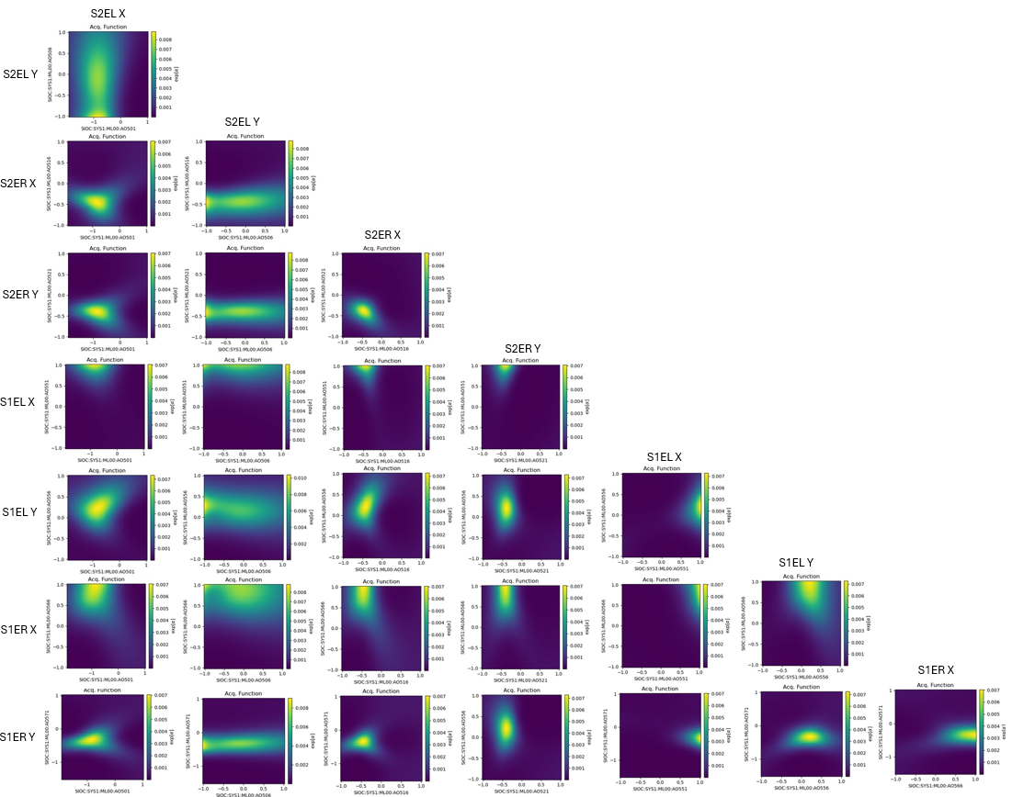
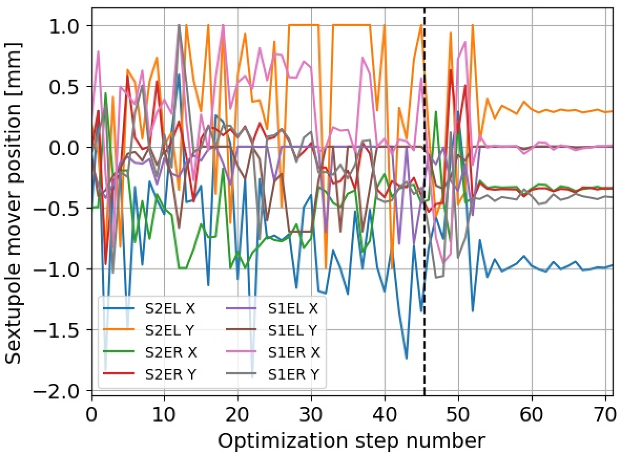
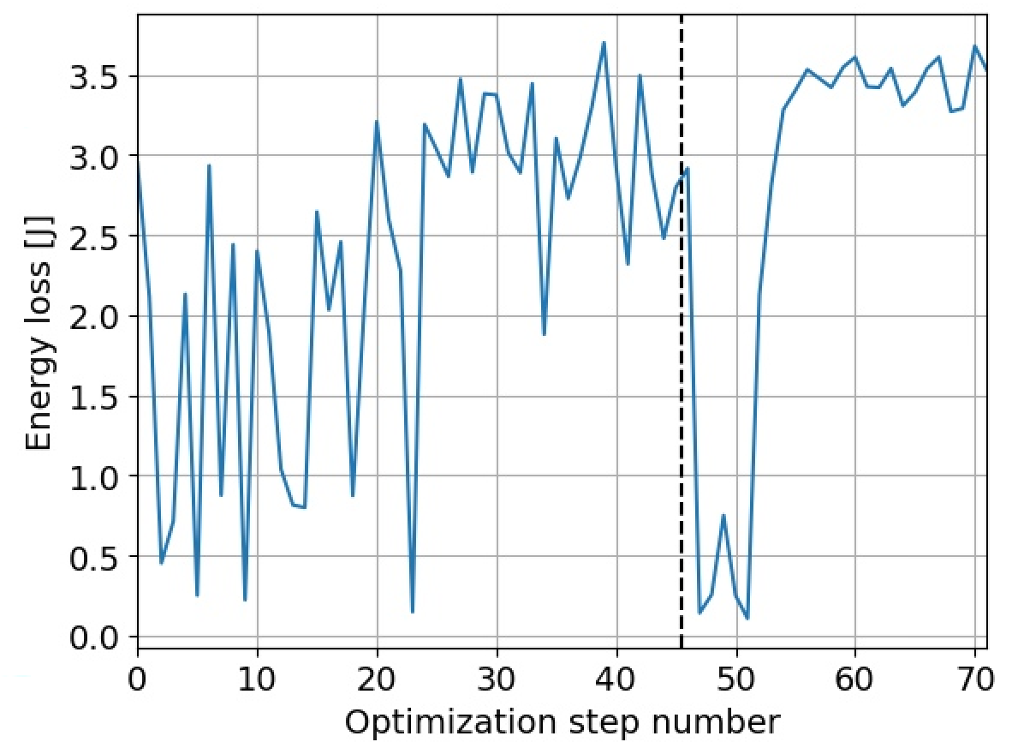
ML optimizer
Bayesian optimizer surrogate function: “how sensitive is the optimum w.r.t. sextupole moves?”
(*) set optimizer to TURBO mode at step 45, ie. force converge in narrow region around best point till step 45
Credit: Doug Storey
(*)
Set acceptable BLEN range to accept shot
For each sextupole configuration, Eloss was the average of 20 good shots
(*)

Slide 17
Beam Synchronous Acquisition…. or is it?
Current program assumes that if we acquire a sensor/camera and its Pulse ID on the next line of code, then they are synchronized
Small chance that the Pulse ID update (at 10 Hz) occurs between these two lines ⟶ we occasionally have a misaligned shot
Not a dealbreaker (optimizer still improves PWFA performance), but not the optimal solution
Most rigorous method is to synchronize with the timestamp metadata sent by the server
Works for some cameras but not others

Slide 18
Progress Summary
Completed:
Designed backend for acquisition, matching and calculation program for single bunch configuration
Prepared preliminary framework for full program
ML optimizer successfully improves drive bunch energy loss, dispersion and dispersion’
To prepare for upcoming run:
Complete and commission all tools (acquisition, matching, calculation, GUI) for single and two bunch configuration
Test ML optimization with various figures of merit
Implement timestamp based BSA matching
Impact for E300:
Need >30% drive to wake transfer efficiency to achieve total efficiency goals of FACET-II – rigorous ML optimization needed
Improvements in slice dispersion measurements are promising

Slide 19
Thank you
Questions?

