Slide 1
E300 FY25 Results and Papers
E300 Collaboration Meeting
Doug Storey | AARD
2/2/2026

Slide 2
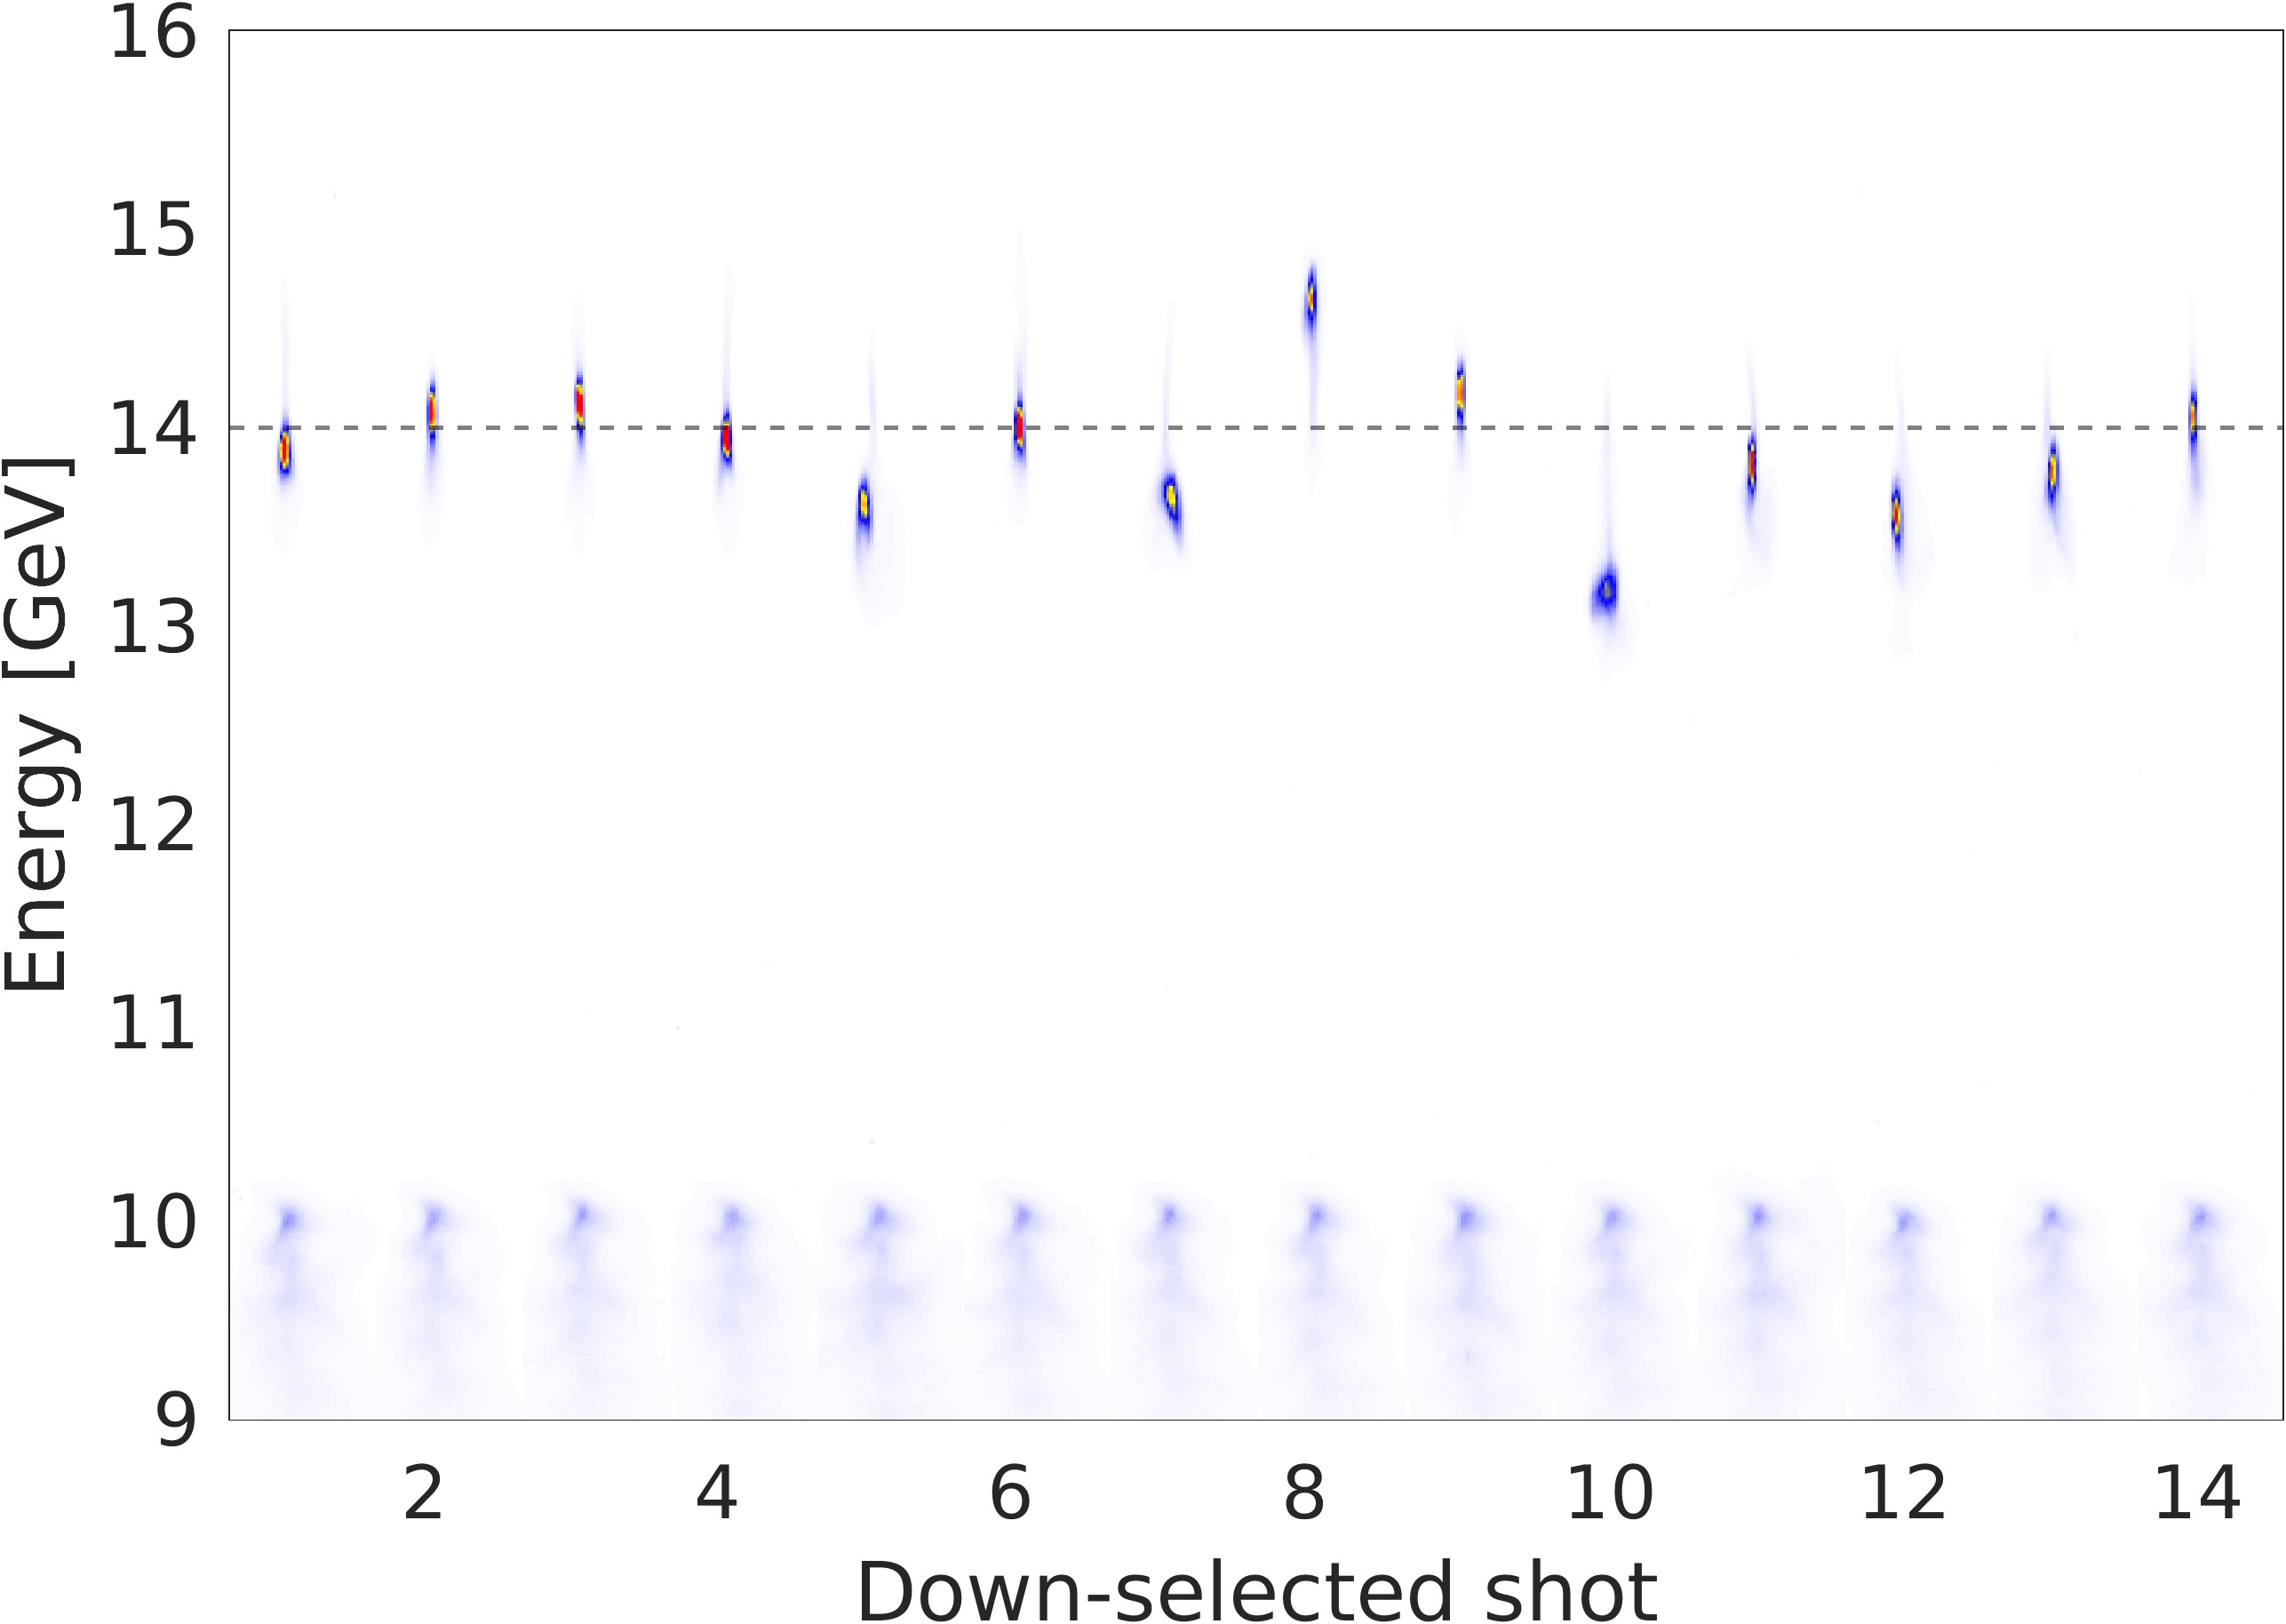
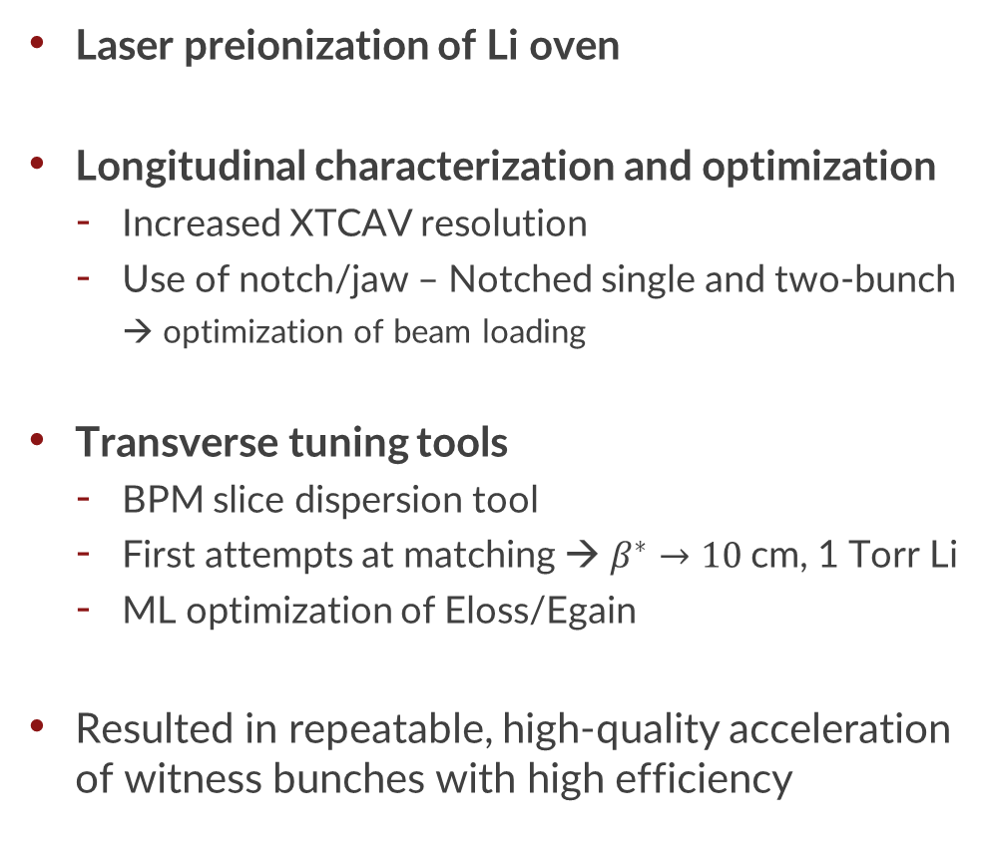
What did we do in FY25
Laser preionization of Li oven
Longitudinal characterization and optimization
  Increased XTCAV resolution
  Use of notch/jaw – Notched single and two-bunch
    → optimization of beam loading
Transverse tuning tools
  BPM slice dispersion tool
  First attempts at matching → $β^{∗}→10$cm, 1 Torr Li
  ML optimization of Eloss/Egain
Resulted in repeatable, high-quality acceleration of witness bunches with high efficiency
High-quality acceleration of witness bunches

Slide 3
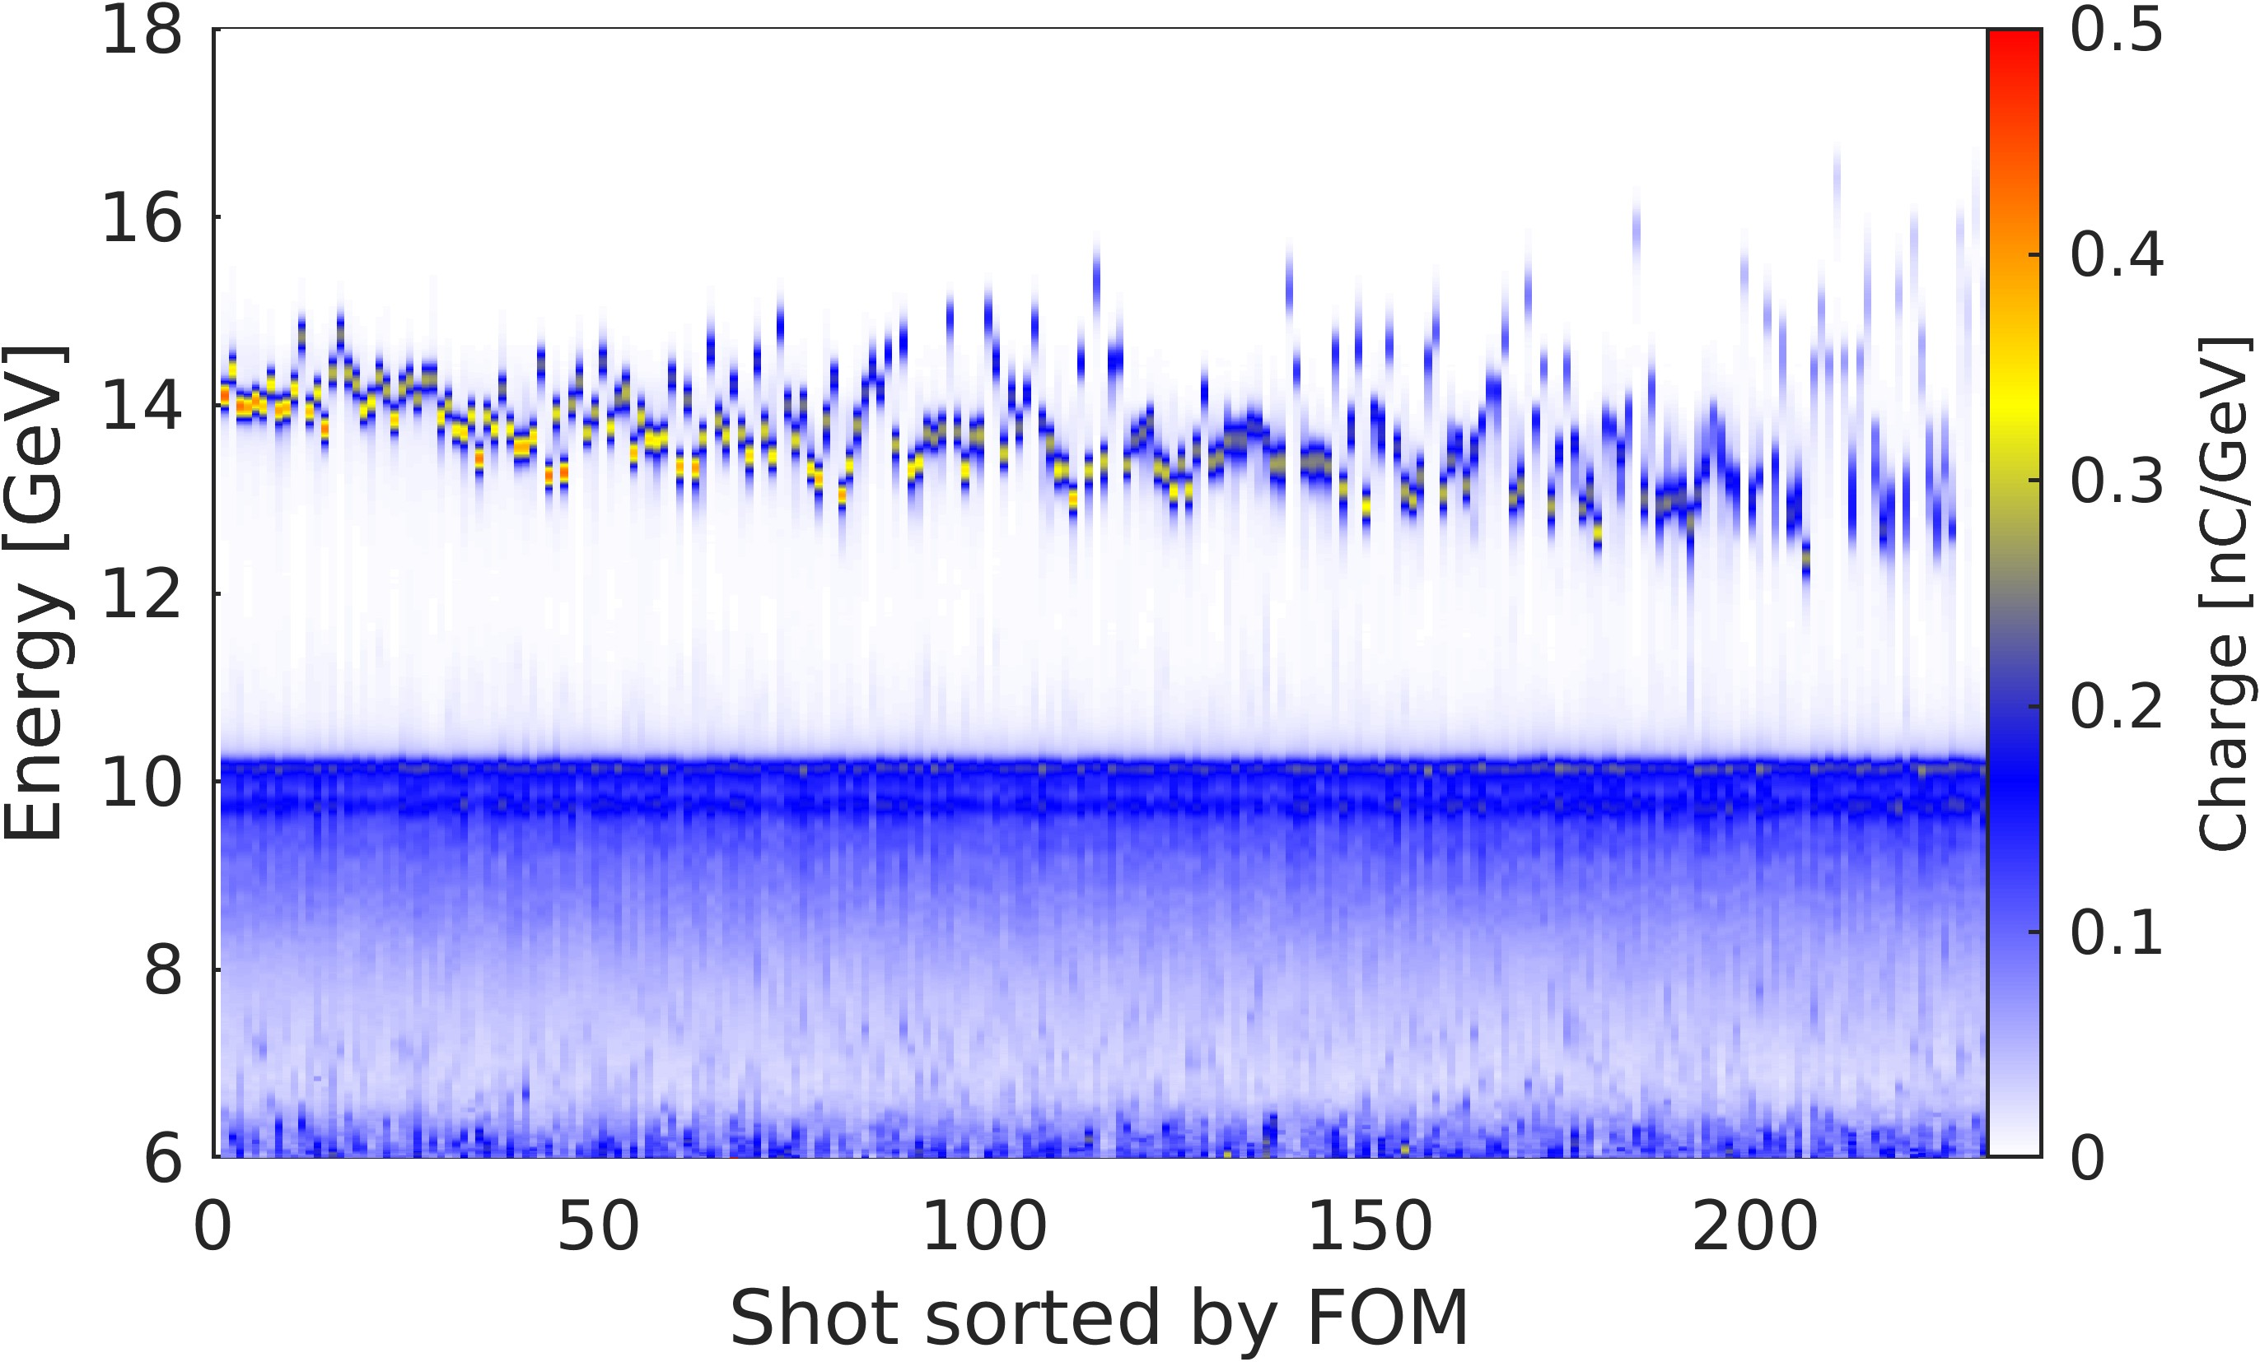
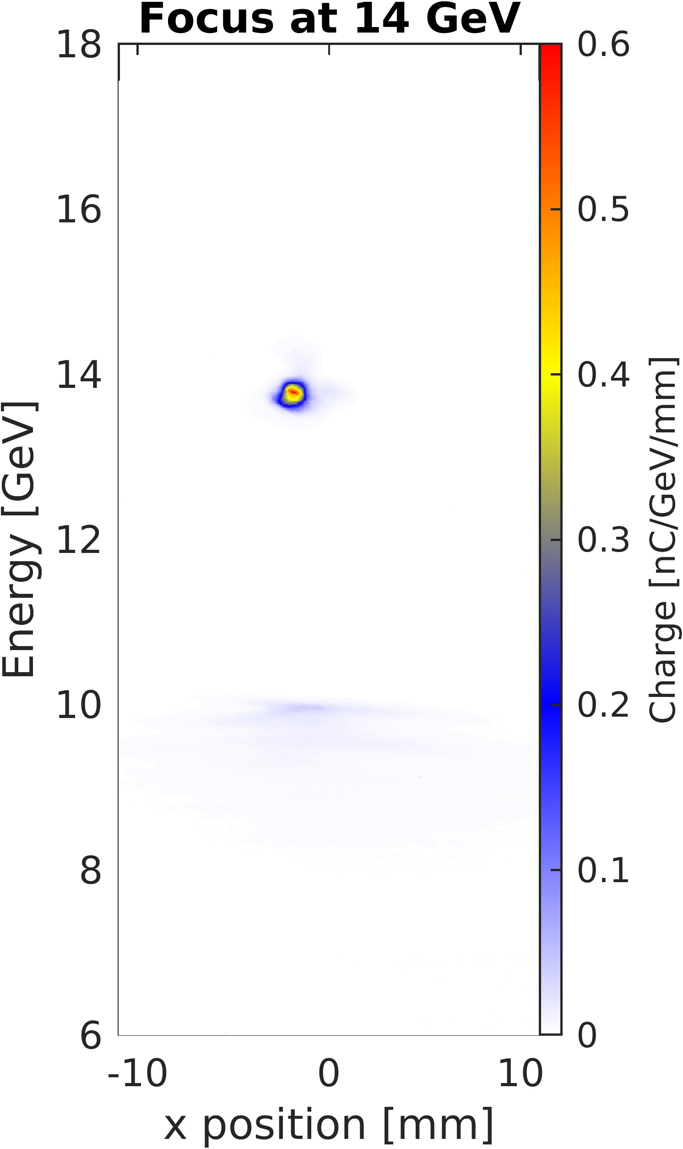
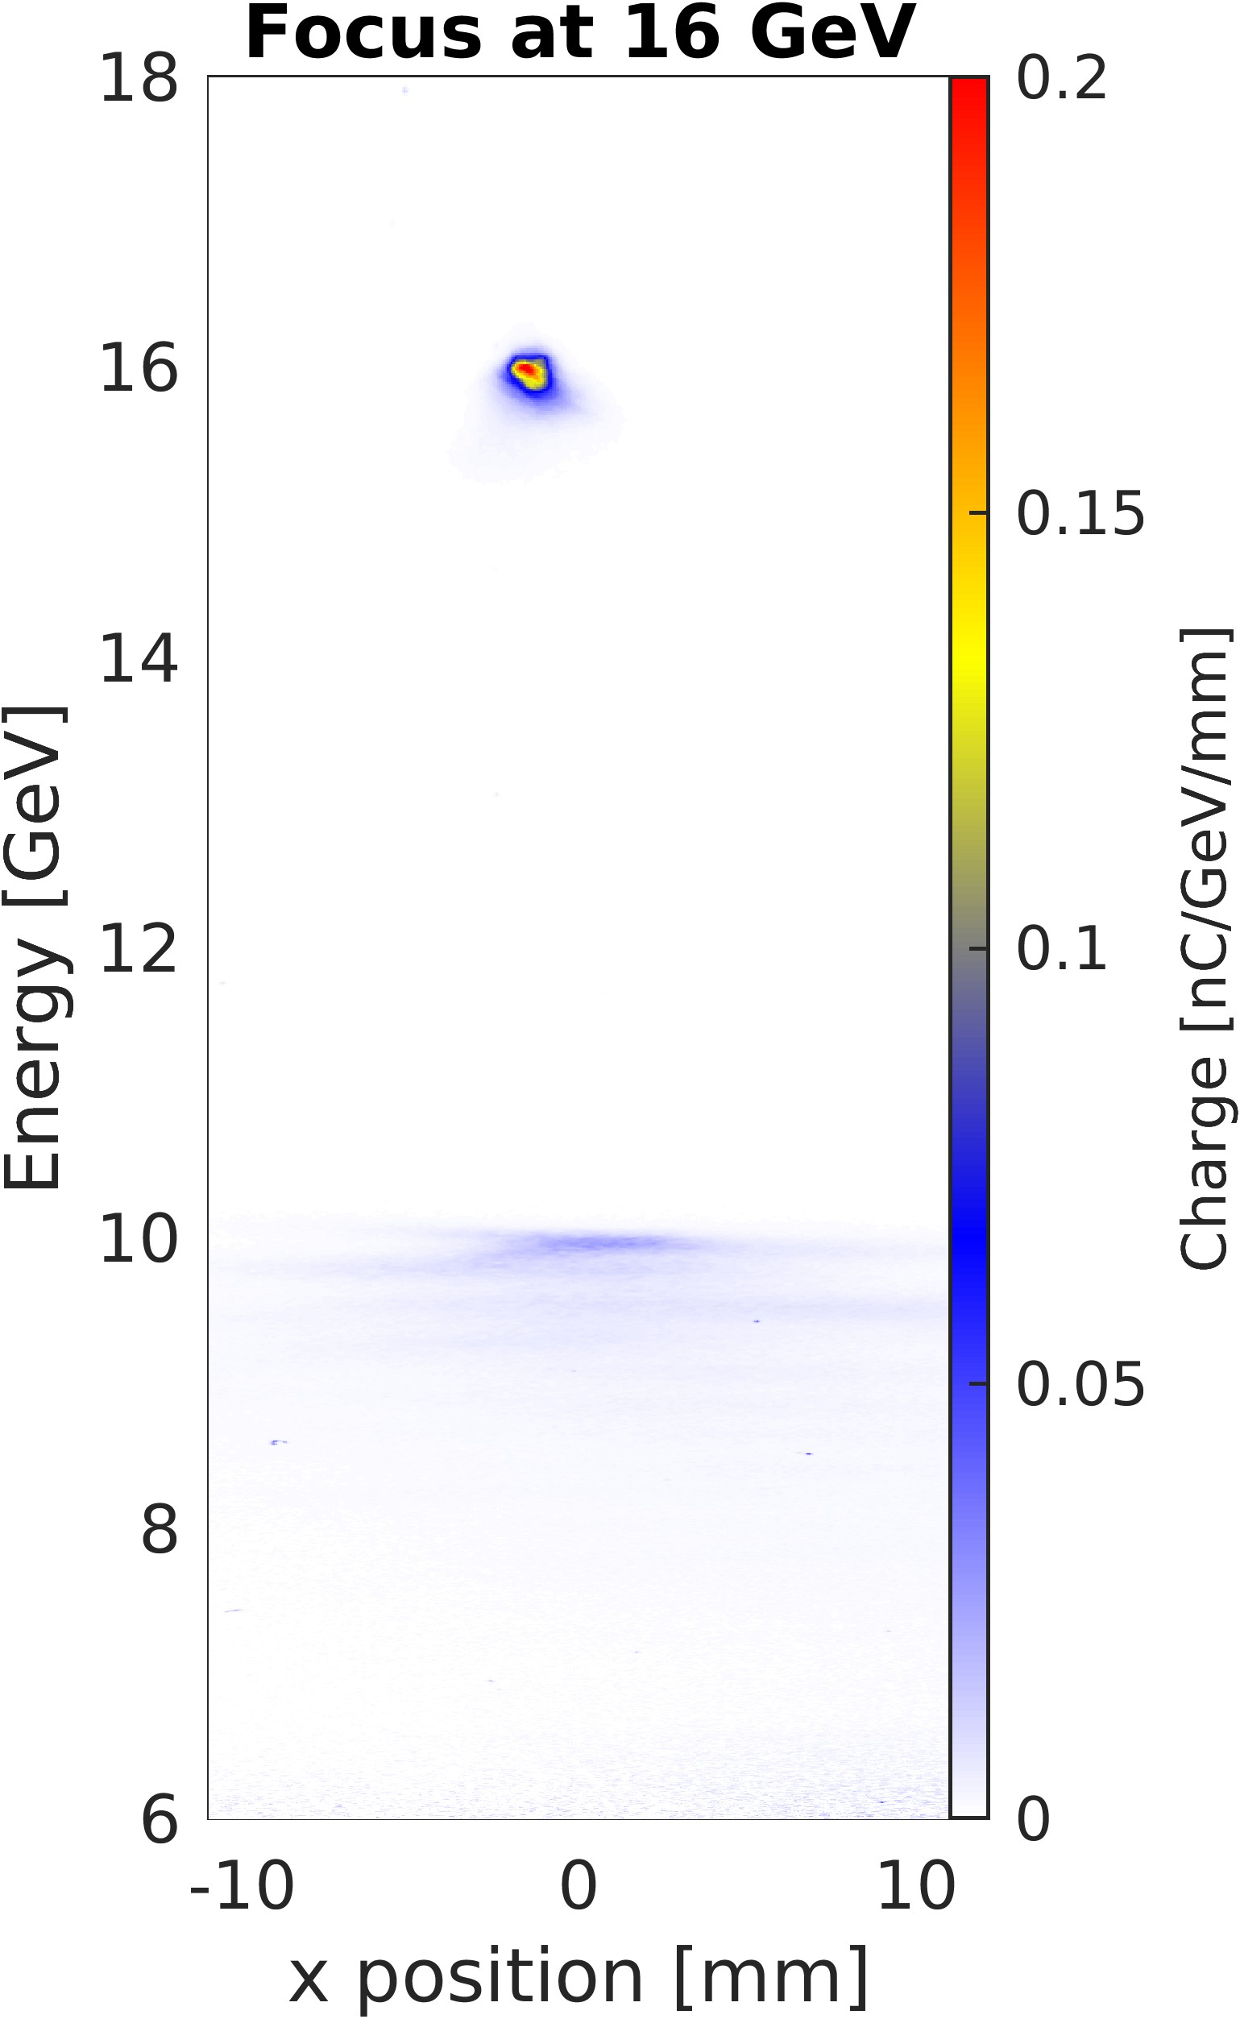
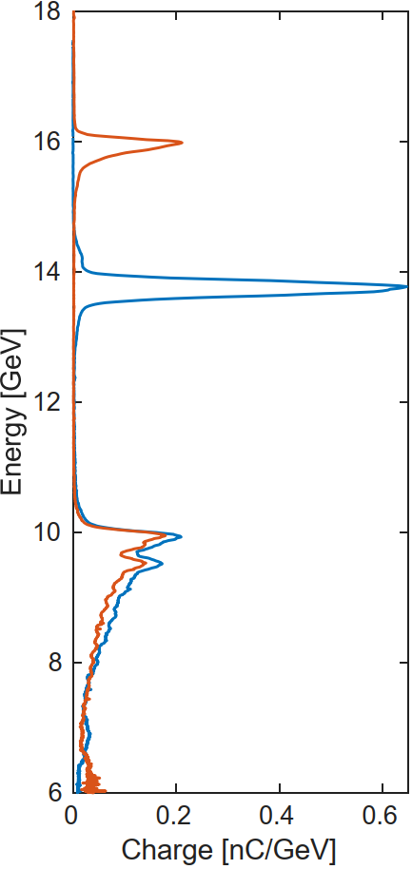
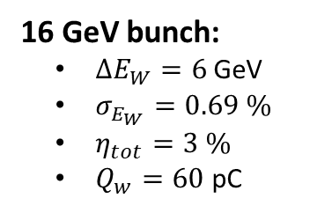
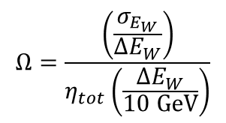
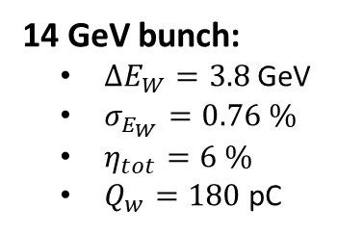
Characterizing the nominal working point
Full dataset (laser pre-ionized)
Two-bunch from cathode, with collimators
  Driver: ~1.2 nC, 6-8 kA
  Witness: 150-250 pC incoming charge
  Plasma: 40cm long lithium plasma, 4e16 cm⁻³
Sorted by figure of merit:
$$Ω=\frac{\left(\frac{σ_{E_{W}}}{ΔE_{W}}\right)}{η_{tot}\left(\frac{ΔE_{W}}{10 GeV}\right)}$$
14 GeV bunch:
$ΔE_{W}=3.8$ GeV
$σ_{E_{W}}=0.76 \%$
$η_{tot}=6 \%$
$Q_{w}=180$ pC
16 GeV bunch:
$ΔE_{W}=6$ GeV
$σ_{E_{W}}=0.69 \%$
$η_{tot}=3 \%$
$Q_{w}=60$ pC

Slide 4
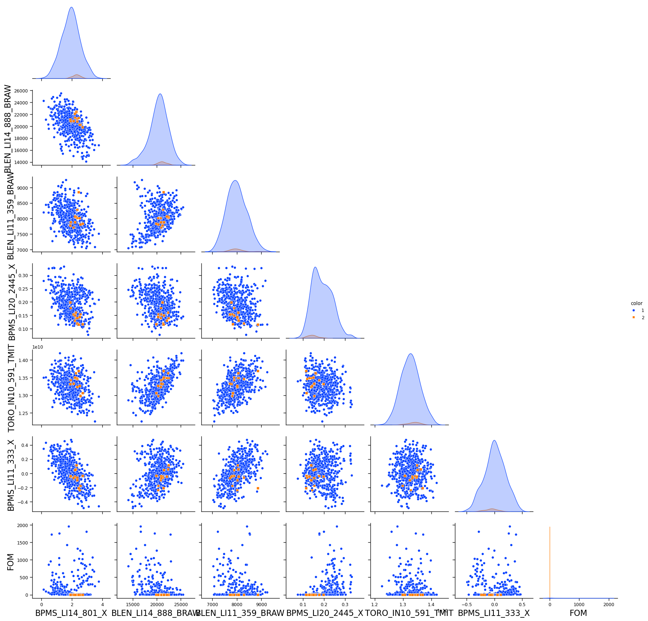
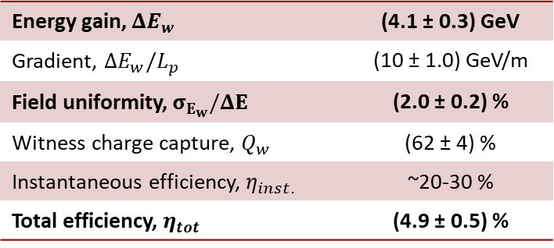
Can we predict what shots are going to be higher quality?
Only shots with similar incoming PV’s
Brendan’s analysis: linear regression coupled with feature importance permutation
- Finds a list PV’s with high correlation with FOM
Further analysis to determine optimal range of these PV’s that minimizes FOM
Filter data by PVs
BPM 333 X
BPM 511 X
BPM 801 X
BPM 2445 X
BPM 3156 X
BC11 BLEN
BC14 BLEN
Energy gain, $ΔE_{w}$ | (4.1 ± 0.3) GeV
Gradient, $ΔE_{w}/L_{p}$ | (10 ± 1.0) GeV/m
Field uniformity, $σ_{E_{w}}/ΔE$ | (2.0 ± 0.2) %
Witness charge capture, $Q_{w}$ | (62 ± 4) %
Instantaneous efficiency, $η_{inst.}$ | ~20-30 %
Total efficiency, $η_{tot}$ | (4.9 ± 0.5) %

Slide 5
Planned publications
1) PRL – High quality plasma wakefield acceleration at collider relevant energies
  Results from two-bunch config:
    Multi-GeV energy gain
    ~2% field uniformity
    ~5% efficiency
2) Deeper dive into beam loading – PRAB, PRX, etc
  We have extensive data in notched two-bunch config
  Different LPS to get overload, underloaded, optimal loading
  Achieved ~3% field uniformity with ~2 GeV energy gain

Slide 6
Multi-GeV Acceleration with High Field-Uniformity and Efficiency in a Plasma-Wakefield Accelerator
What is the story?
Precision PWFA with high field uniformity, at a scale that is required for collider and light source
  Precision: Wakefield parameter comparable to FlashForward results
  Scale: Multi-GeV acceleration
    Joule-scale energy gain of witness bunch
    For colliders you need ~nC charge, accelerated by multi-GeV = Order(10 J)
  Efficiency: Up to ~6%

Slide 7
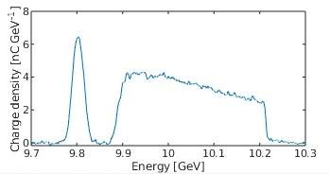
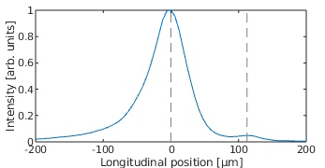
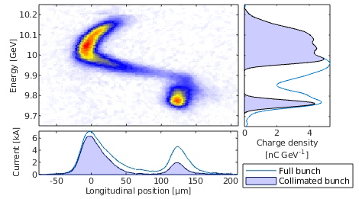
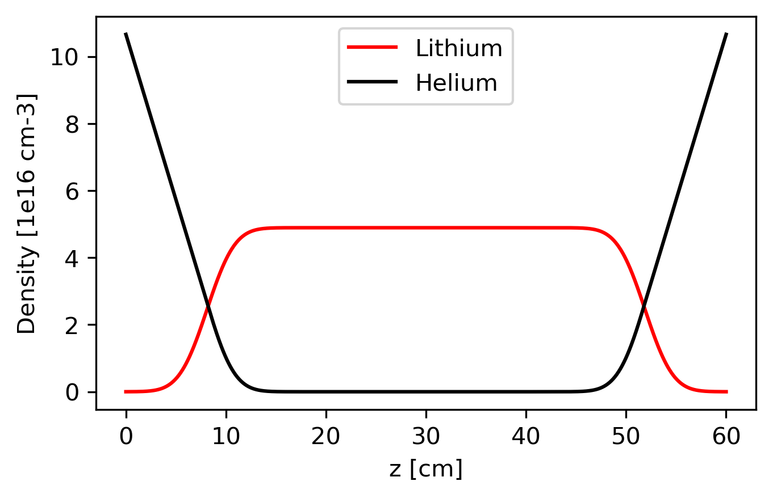
Figure 1 – Schematic and diagnostics
(a)
(b)
(d)
No plasma image
(d)
Collimators
YAG
screen
Final focus quadrupoles
Spectrometer quadrupoles
Magnetic chicane
Spectrometer dipole
Transverse deflecting cavity
EOS
YAG
screen
(e)
(f)
Li oven
plasma source
(retractable)
(h)
Cherenkov spectrometer
(g)
FIG. 1. Experimental setup. Two co-accelerated bunches – drive and witness, at full energy from the linac enter the final bunch compressor. A set of collimators in the first dispersive section are used to block different energy slices to modify the bunch current profile. The a) energy distribution and b) bunch separation are viewed non-destructively on every shot. A destructive measurement of the full longitudinal phase space (e-g) may be imaged using a transverse deflecting cavity. A set of final focus quads are used to focus the beam into the laser-preionized lithium plasma oven (h). Additional diagnostics on the beam entering into the plasma are toroids and BPMs. Post plasma – a set of imaging quadrupoles and vertical deflecting dipole make up the spectrometer beamline to measure energy spectra on both (c) high resolution and (d) large field of view beam spectrometers.

Slide 8
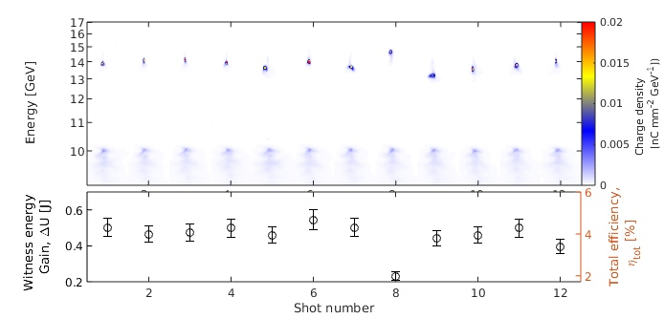
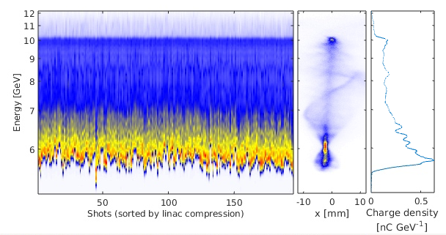
Figure 2: Scale – J level energy gain, and approaching energy depletion
(a)
FIG. 2. Post-plasma energy spectra measured by the electron spectrometer.
(a) Drive and witness energy profiles for shots selected solely by incoming beam parameters, specifically measured parameters related to the longitudinal ___ of the beam. All shots are shown to have similar PWFA performance… The spectrometer was set to image particles at an energy of 14 GeV here.
(b) The energy gained by the witness bunch and total energy transfer efficiency for these shots.
(c-e) The energy spectra of the drive beam, with the witness beam blocked by the collimators, and the spectrometer imaging 6 GeV.
(d and e) show the profile for a single shot, with the same incoming beam parameters as (a).
In text – talk about filtering by PVs, drive-to-wake ~23%
(b)
(c)
(d)
(e)

Slide 9
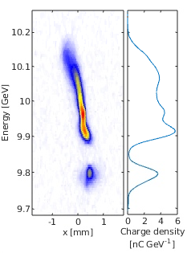
Figure 3: Precision – approaching the energy precision required for applications
FIG. 3. (a-b) Energy spectra of the drive and witness bunch measured without the plasma, and (c) after plasma acceleration for particles accelerated by 2, 4, and 6 GeV. In (d), the projected relative energy spectra, divided by the energy gained by the witness. Comment of field uniformity.
In text – discuss field uniformity. Increase in energy spread sets the upper limit on the variation in the field across the witness bunch
(a)
(b)
energy profile of good 2, 4, and 6 GeV shots
Projections of energy profile
In progress
Plot 1 – energy profile of incoming witness
- with E spread
Plot 2 – energy profile of good 2, 4, and 6 GeV shots
- with E spread
Plot 3 - field uniformity of acc. shots
- Rel. energy over E gain for these shots

Slide 10
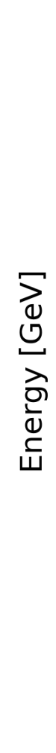
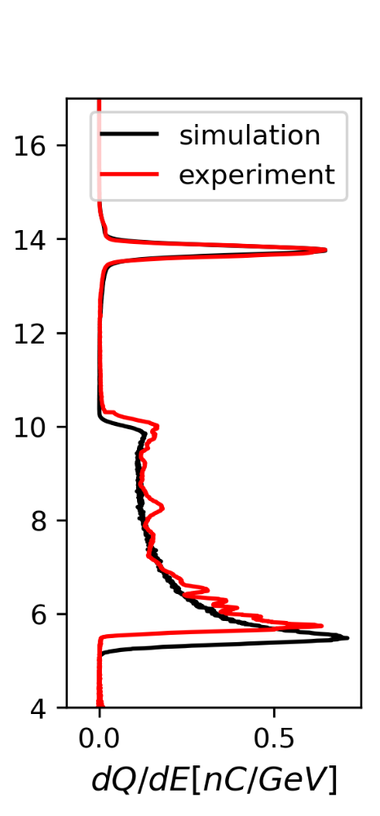
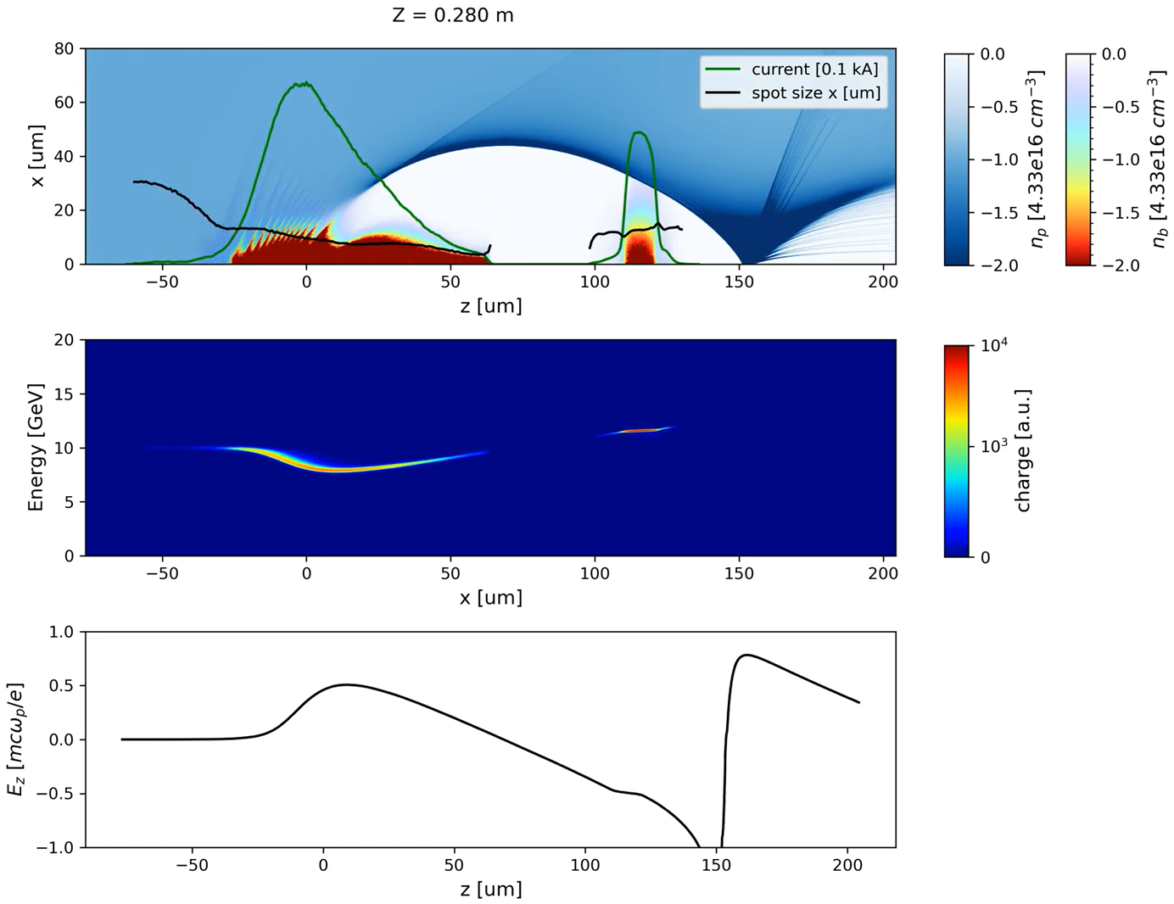
Figure 4 – Simulation results
FIG. 3. Simulation results. (a) snapshot of the simulation halfway through the plasma, and (b) the longitudinal electric field, showing the wake is flattened across the witness bunch through optimal loading
(c) The resulting energy spectra of the drive and witness bunches from simulation overlaid with experimental data.
In text: The drive current profile was taken directly from LPS measurement from the TCAV. The resolution was insufficient resolution to determine the precise current profile of the witness bunch, so this was estimated through ML reconstruction.
Will discuss the requirement to reach optimal beam loading here

Slide 11
Supplemental Materials
Full dataset
Sorting by FOM (Wakefield parameter)
PV filtering
Demonstrate how for every shot that has the same incoming beam parameters, we get roughly the same PWFA performance.
Plots of energy PVs
Downselected dataset

Slide 12
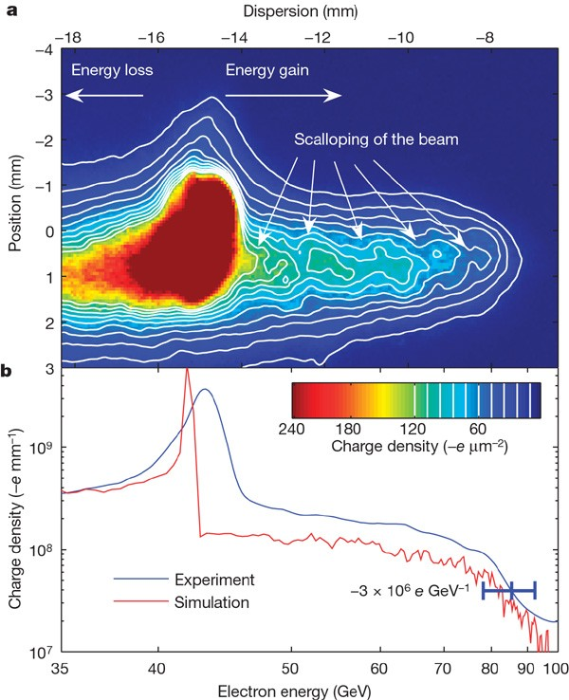
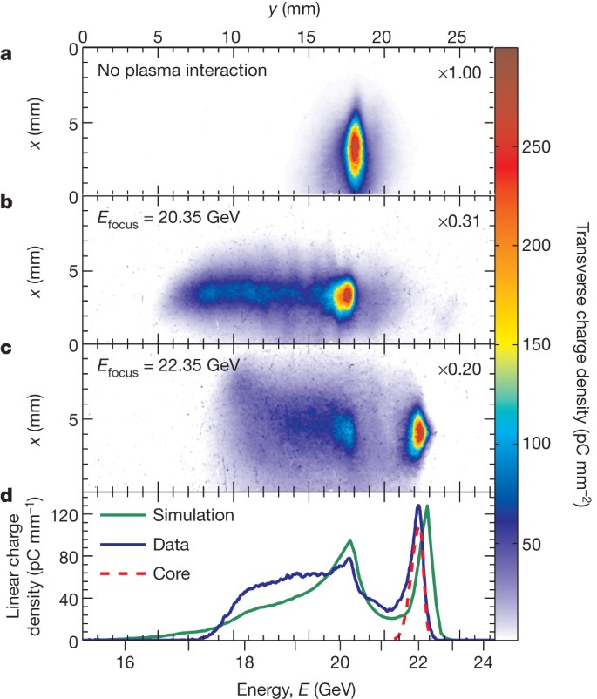
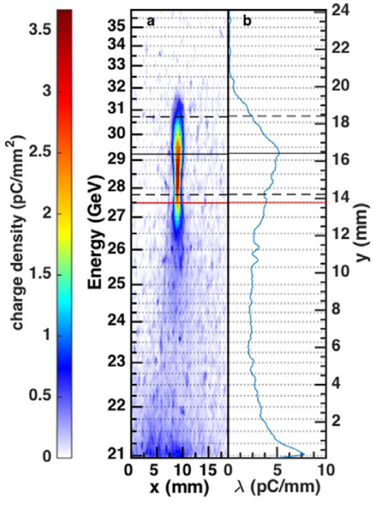
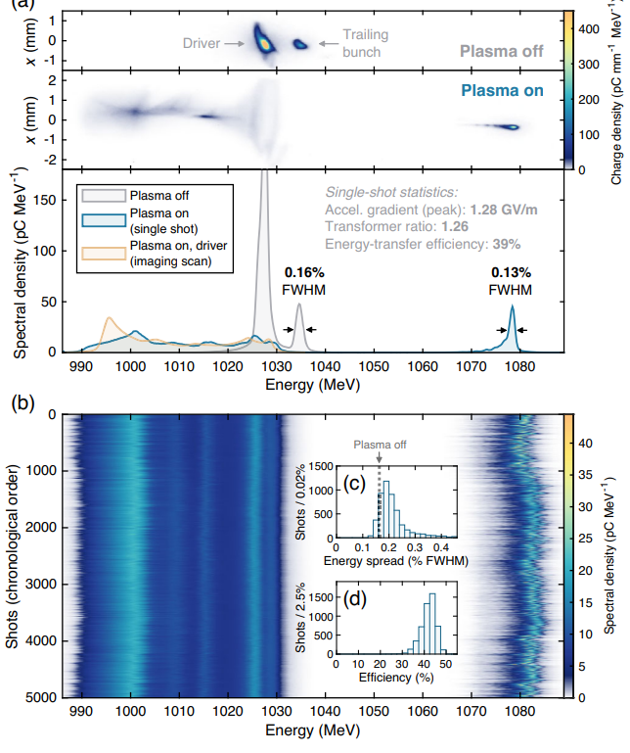
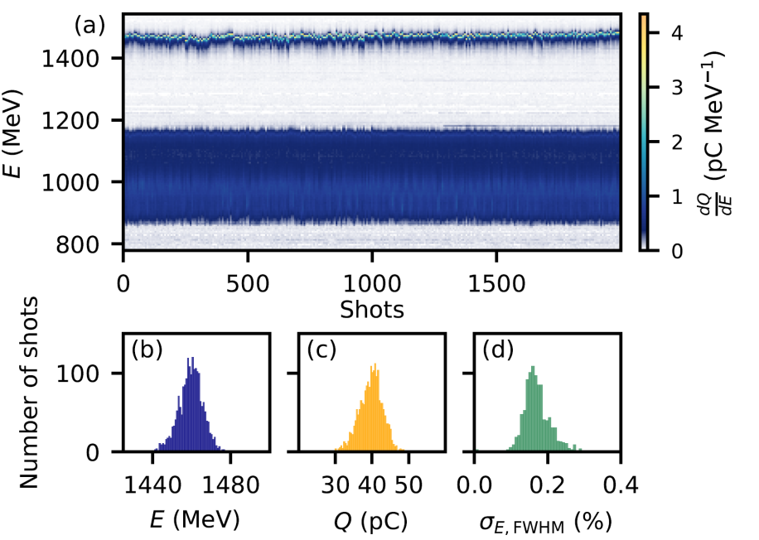
Overview of past beam driven PWFA results
Parameter | Blumenfeld Nature 2007 | Litos Nature 2014 | Litos PPCF 2016 | Lindstrøm PRL 2021 | Wood IPAC Proc. 2024 | Present work 14 GeV shots
Energy Gain, GeV | 42 | 1.6 | 5.3 / 9 | 0.045 | 0.252 ± 0.006 | 4.1 ± 0.3
Gradient, GeV/m | 52 | 4.4 | 4.0 / 6.9 | 1.3 | 1.3 | 10.0 ± 1.0
Energy spread over energy gain | ~100% | 9.6% | 25% / | 2.8% | 1.0% | 2.0 ± 0.2
Total efficiency** |  | 0.6% | 5% / 2% | 1% | 3.6 ± 0.3% | 4.9 ± 0.5
Charge accelerated, pC |  | 74 | 115 / 28 | 100 | 40 ± 3 | ~150-200 (62%)
Energy gain, J |  | 0.1 | 0.6 / .25 | 0.0045 | 0.01 | 0.72

Slide 13
Where do we need to be for a collider application?
HALHF (375 GeV e-)
Energy gain per stage: ~10+ GeV 7.8 GeV
  Gradient, can be relatively low 1 GeV/m x 48 stages
Final energy spread: sub % 0.15%
  Field uniformity must be better than sub % in a stage
Charge: nC’s 1.6 nC
Total efficiency: ~40% 40%
Energy gained by witness: 10+ J 12.5 J
Parameter | Blumenfeld Nature 2007 | Litos Nature 2014 | Litos PPCF 2016 | Lindstrøm PRL 2021 | Wood IPAC Proc. 2024 | Present work 14 GeV shots
Energy Gain, GeV | 42 | 1.6 | 5.3 / 9 | 0.045 | 0.252 ± 0.006 | 4.1 ± 0.3
Gradient, GeV/m | 52 | 4.4 | 4.0 / 6.9 | 1.3 | 1.3 | 10.0 ± 1.0
Energy spread over energy gain | ~100% | 9.6% | 25% / | 2.8% | 1.0% | 2.0 ± 0.2
Total efficiency** |  | 0.6% | 5% / 2% | 1% | 3.6 ± 0.3% | 4.9 ± 0.5
Charge accelerated, pC |  | 74 | 115 / 28 | 100 | 40 ± 3 | ~150-200 (62%)
Energy gain, J |  | 0.1 | 0.6 / .25 | 0.0045 | 0.01 | 0.72

