Slide 1
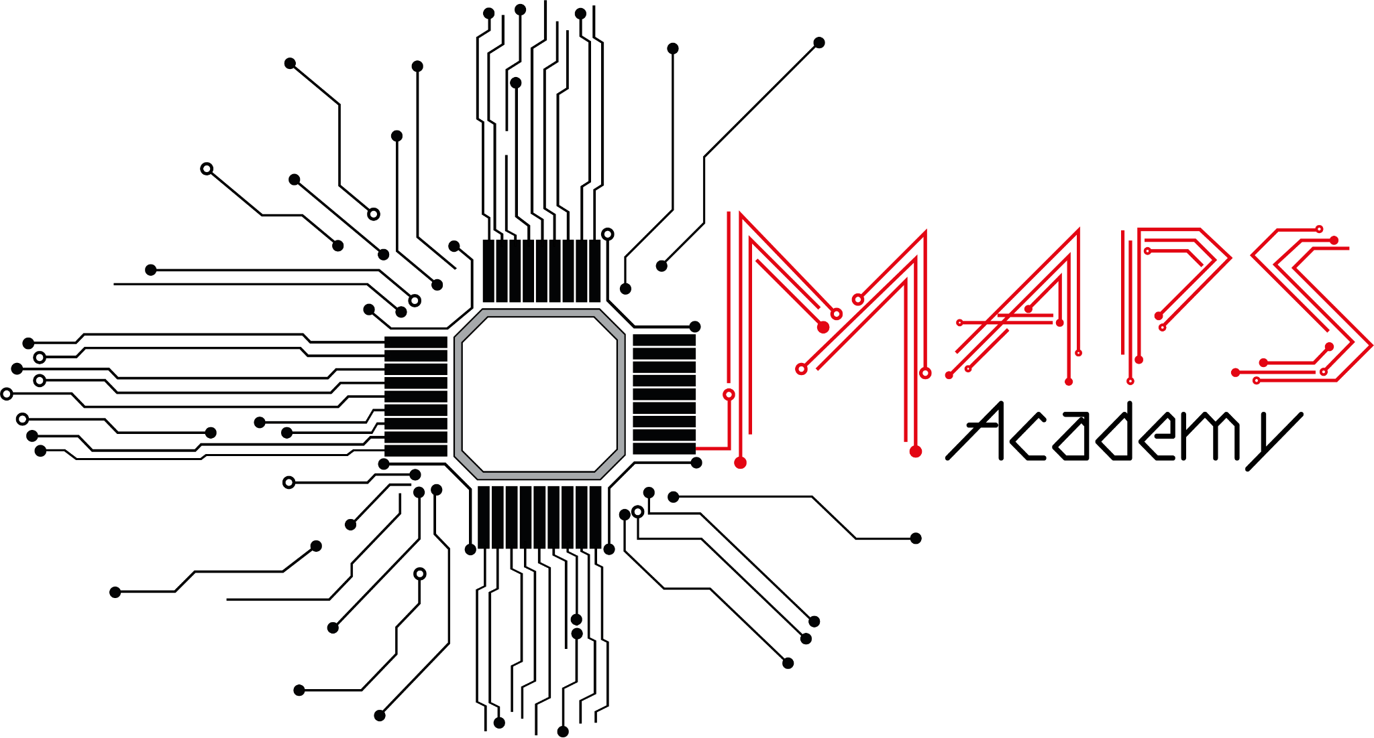

TCAD+ALLPIX Simulation of the Operations Hands-On
2
The OG Cartographers
Pierce, Vito (aka Yuto), Penri (aka Punit)

Slide 2
Who are we?
(non-existential version)

Slide 3

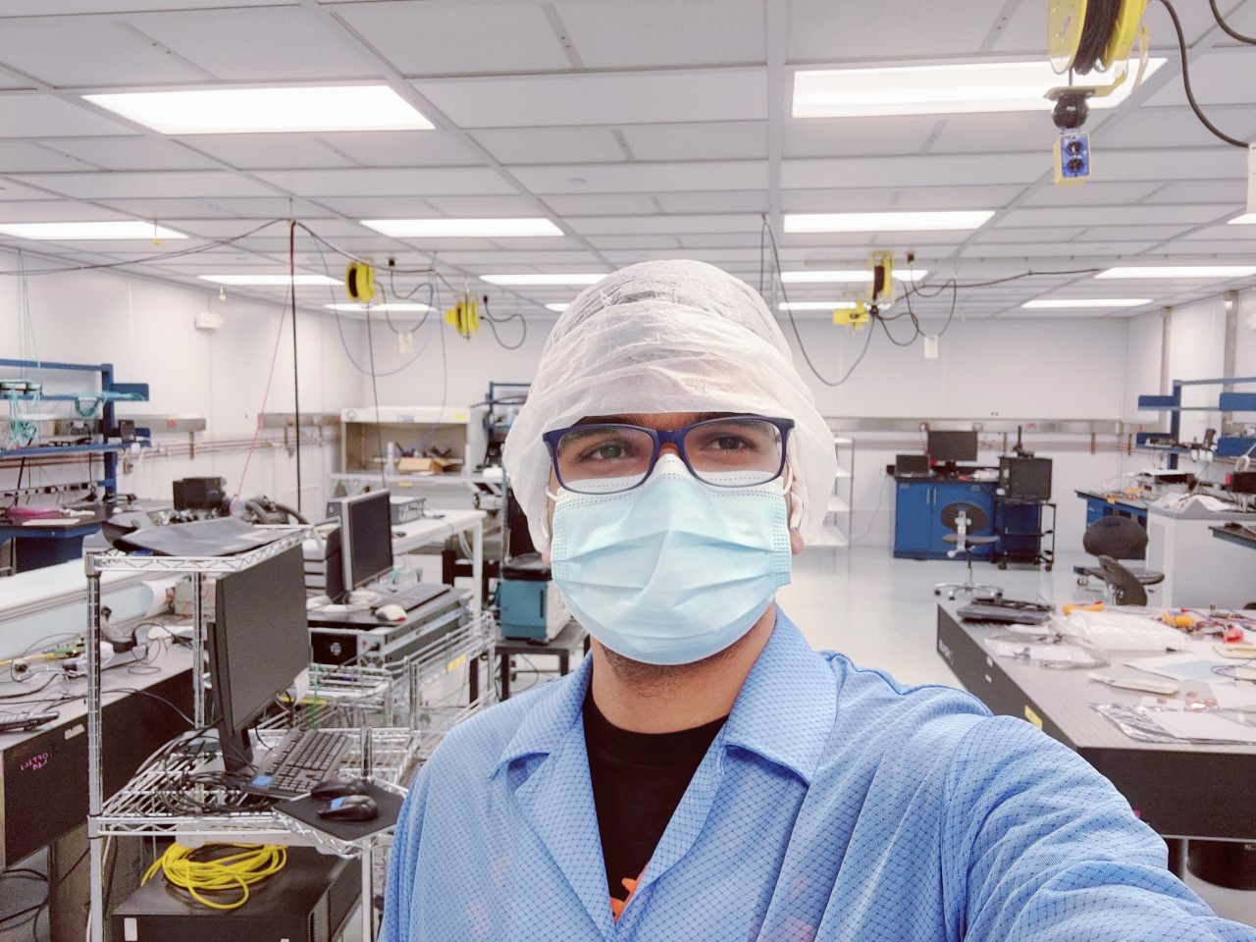
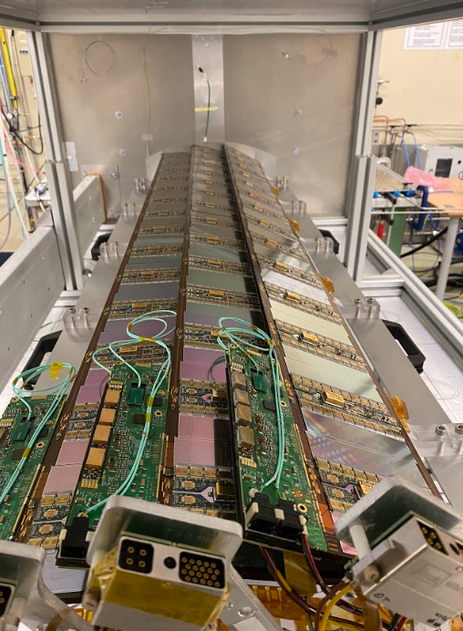
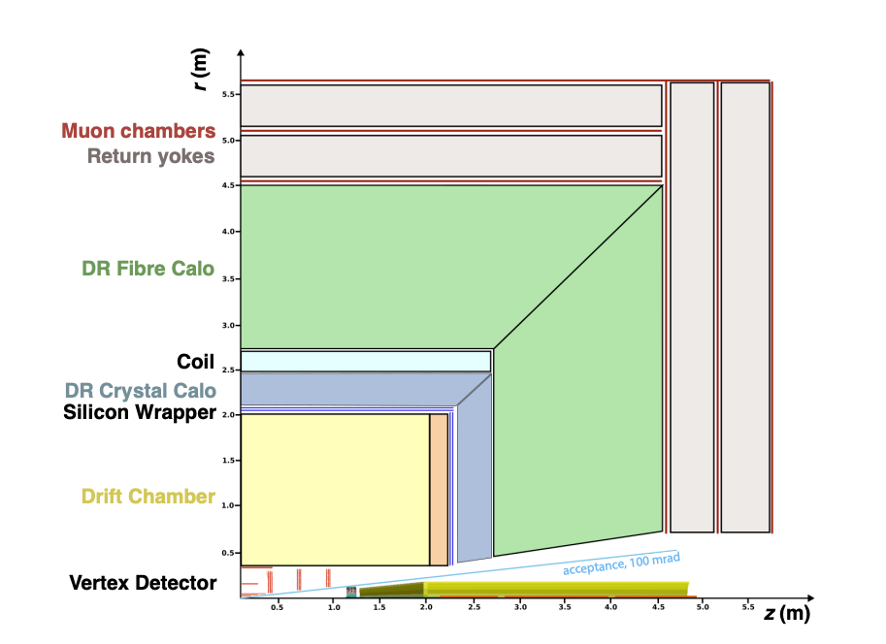
Punit Sharma
Post Doc at BNL
Working with the ATLAS collaboration mainly working on Higgs physics and tracking/vertexing/trigger.
Worked on the ATLAS upgrade project primarily on tracker and trigger upgrades.
Looking into MAPS for the FCC detector concepts.
FCC Detector concept example

Slide 4

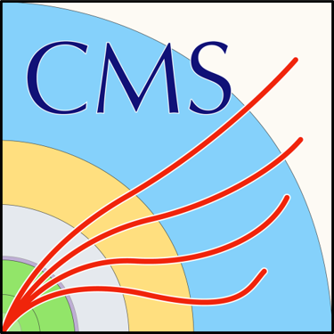

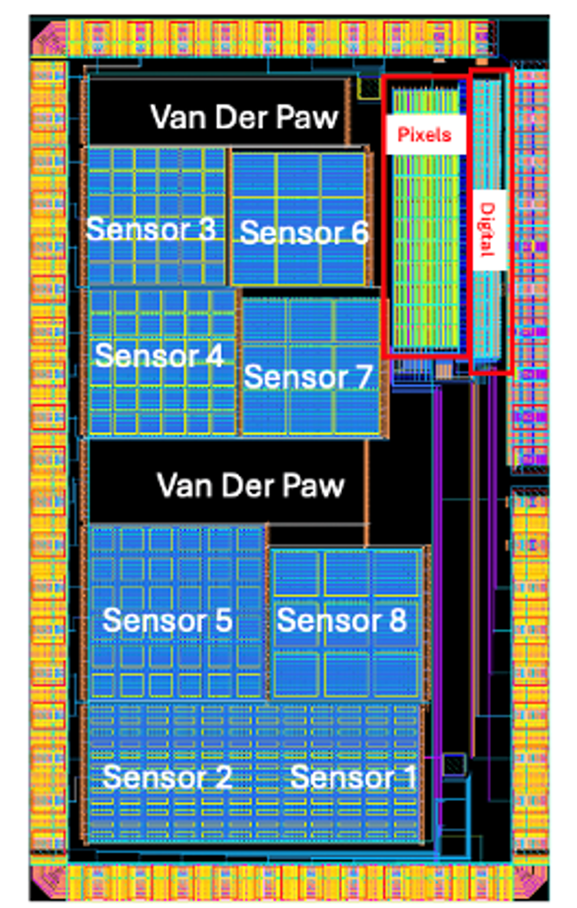

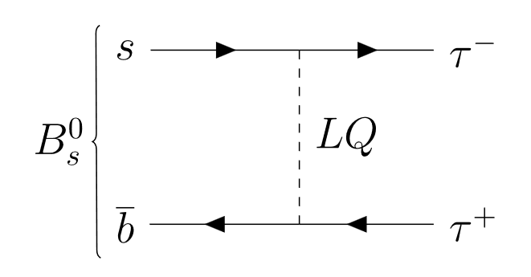

Pierce Affleck
PhD student at →
Searching for new physics with
from with CMS
Characterization of “Blue sky” MAPS from Fermilab
🤞Muon collider 🤞

Slide 5



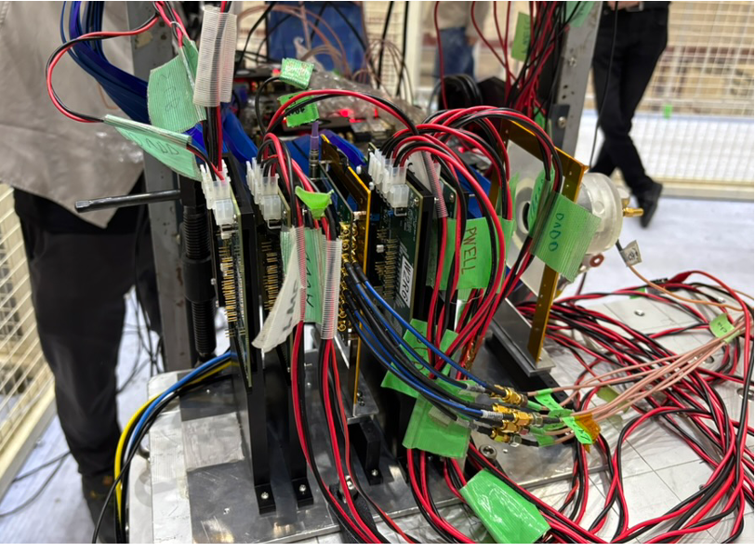
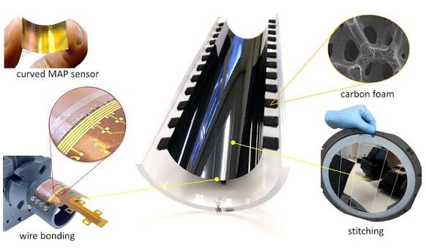
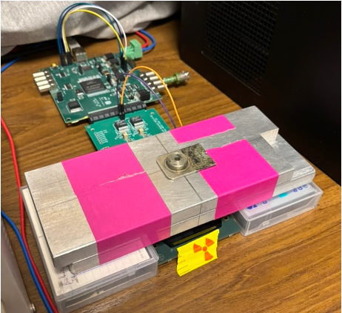
Yuto Hama
Master student at Univ. of Tsukuba
KEK MALTA2 Telescope project
ALICE ITS3
Telescope for detector R&D such as MAPS.
Mainly working on the Trigger logic System
Upgrade project for Run 4, HL-LHC
Working on the sensor characterization of the MAPS prototypes for ITS up-grade.

Slide 6
Why are we (up) here?
Motivation
Possibly existential

Slide 7
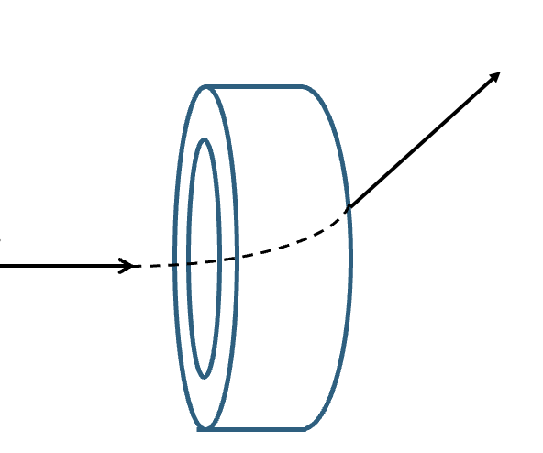

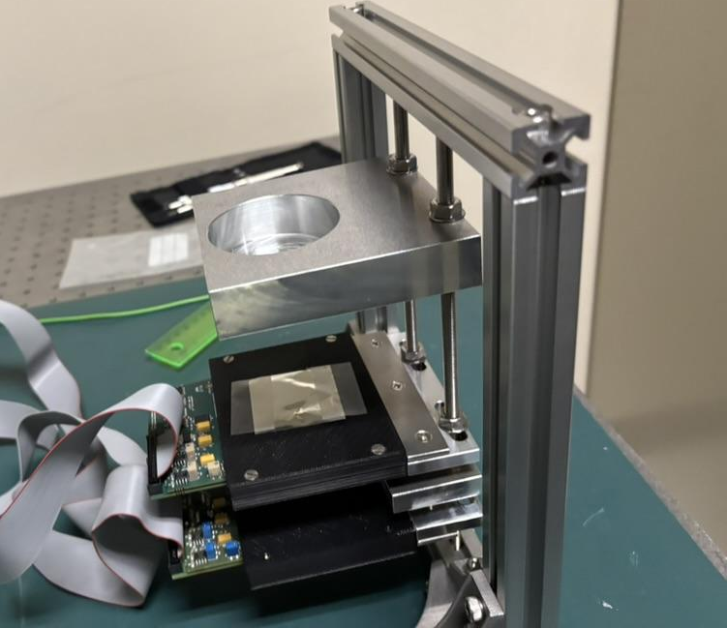
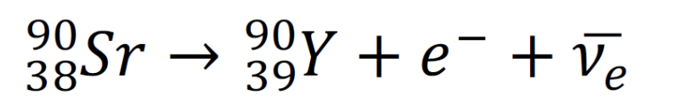
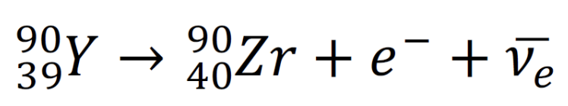
Operation of MIMOSA-28
Learned how to operate MAPS sensor
Our attempt ：
  Detect the radiation from Sr-90 decay
  Observe the deflection by the magnet
Put the source here
MIMOSA-28 specification
Active area: 2 cm × 2 cm
Pixel size：20.7 μm Thickness of epitaxial layer: 14 μm
Sr -90 is put above the sensor top
β-decay
Emax = 0.546 MeV, T1/2 = 28.74 years
Emax = MeV, T1/2 = 64 hours

Slide 8
TCAD and Allpix^2
TCAD
  Simulation software for modeling the semiconductor devices.
    Optimization of the sensor structure (e.g. implant structure,..)
    Simulation of the internal sensor characteristics (e.g. I-V, electric field, doping concentration, radiation damage,..)
Allpix Squared
  Simulate the sensor response to the particles.
    Imports the TCAD data for simulating the charge collection.
    Charge deposition (Geant4) → charge collection → digitization

Slide 9
Our group topic
Simulation of the operation setup with TCAD and Allpix^2
1st topic
2nd topic
Operation of MIMOSA-28
TCAD and Allpix^2 simulation
Comprehensive application of what we learned.
We can compare the results. ← Very practical experience.

Slide 10

How did we do it?
Setup Overview

Slide 11
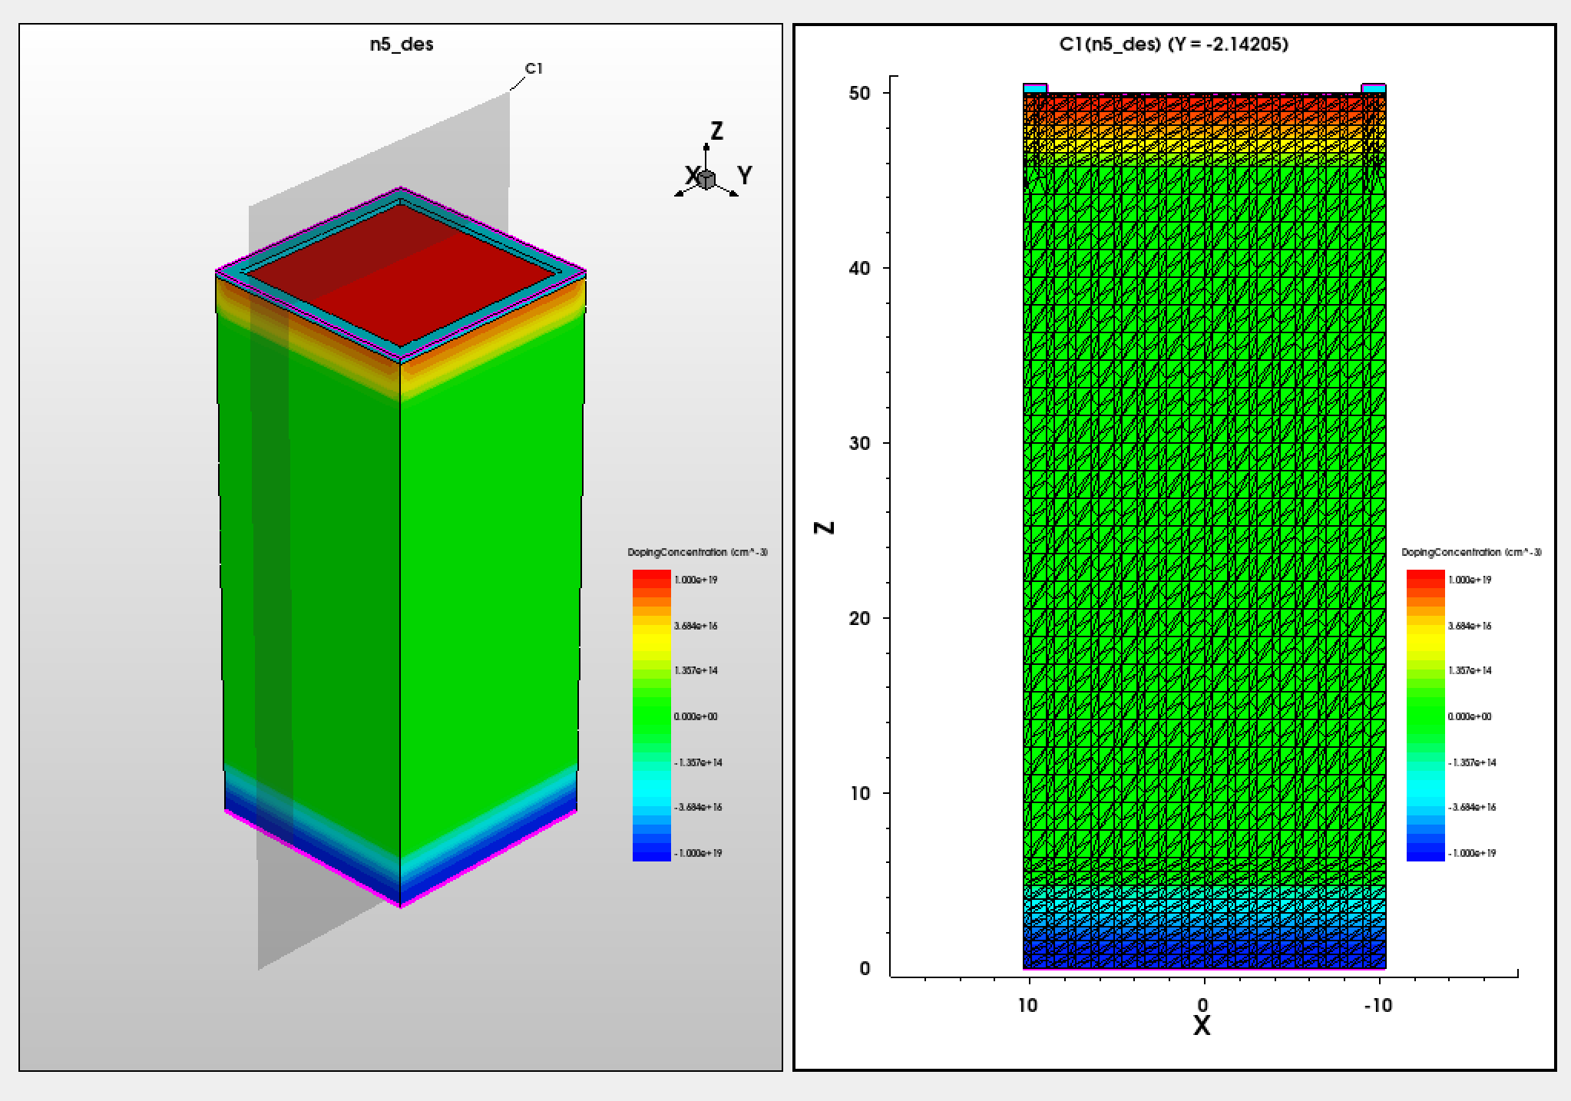
TCAD
Modeled Miomsa28 Pixel in Sentaurus TCAD
Simple 3D diode with 20.7 μm pitch and 50 μm depth
Applied 10V and exported electric field to allpix2

Slide 12


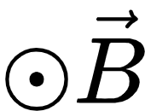
2
ALLPIX
Mimosa28: 928 x 960 pixel sensor; used 3x3 sensors per plane (to see full beam spot)
Pixel size = 20.7um x 20.7um
sensor_thickness = 50um
Modeled the setup similar to the operations lab:
4 sensors in telescope configuration
  2 double-layers of sensors 5mm apart
12mm from uniform 0.3T magnetic field
  r = 5mm, h = 10mm
⁹⁰Sr (⁹⁰Y) source 5mm from top
  particle_type = "ion/39/90/0/0eV/true"
source_energy = 0eV
source_type = "point"

Slide 13
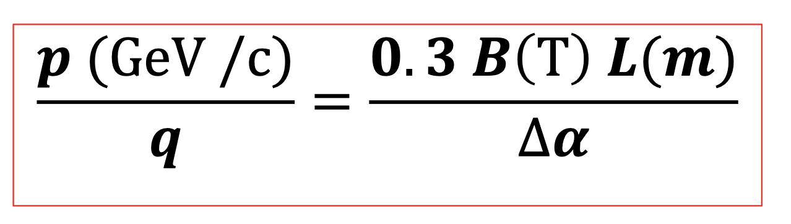
2MeV electron beam
BEAM
Calculation
Δα: refraction angle
electron path
Deviated distance
10 mm
Δα
12 mm
drift deviated length (L)
Deviated distance
Δr = L tan(Δα）
20 mm

Slide 14
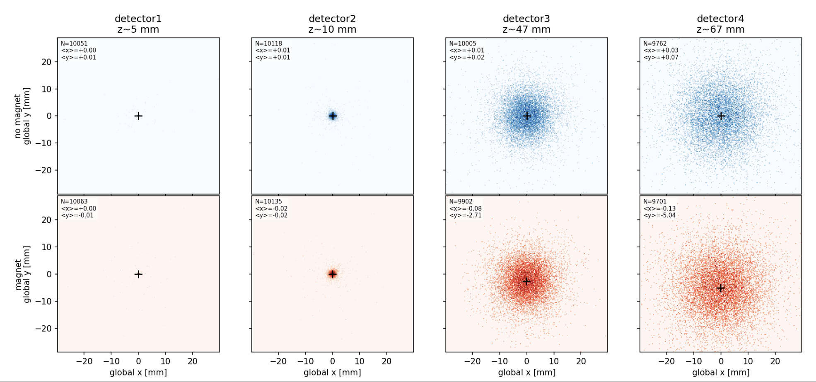
2MeV electron beam, 0.1 T
In Calculation
Y = - 4.5 mm (approx)
Simulation
Y = -5.0 (approx)
BEAM
10 mm
12 mm
20 mm

Slide 15
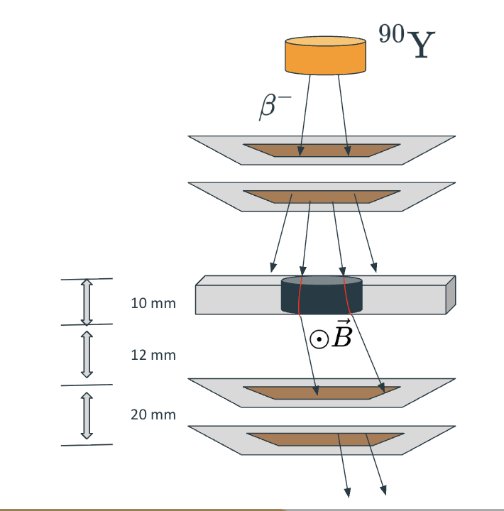
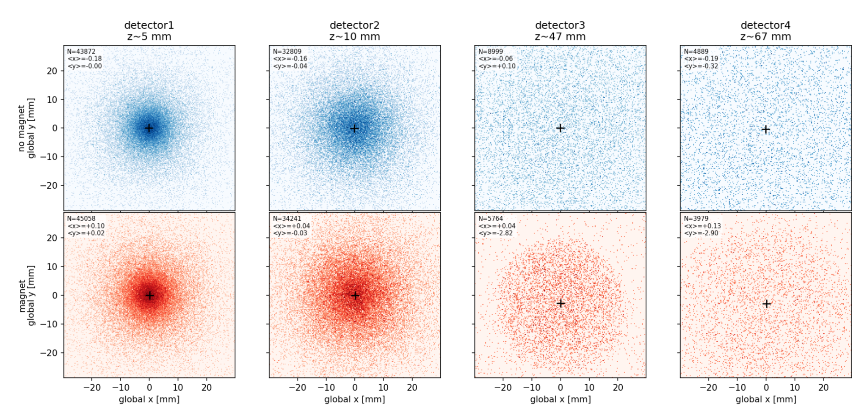
Y90 Source, 0.1T Field

Slide 16
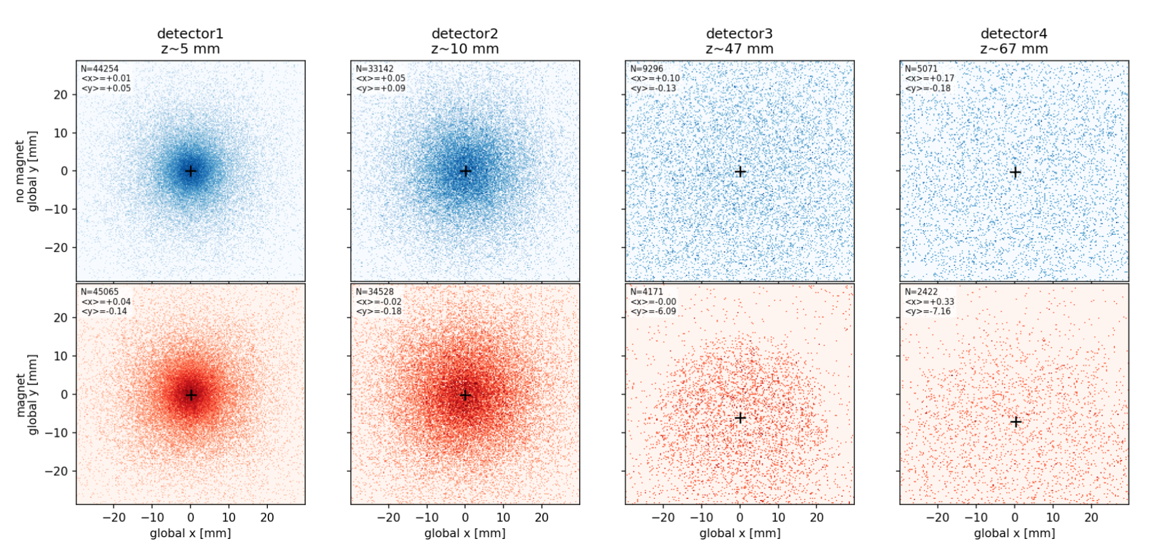
Y90 Source, 0.3T Field

Slide 17
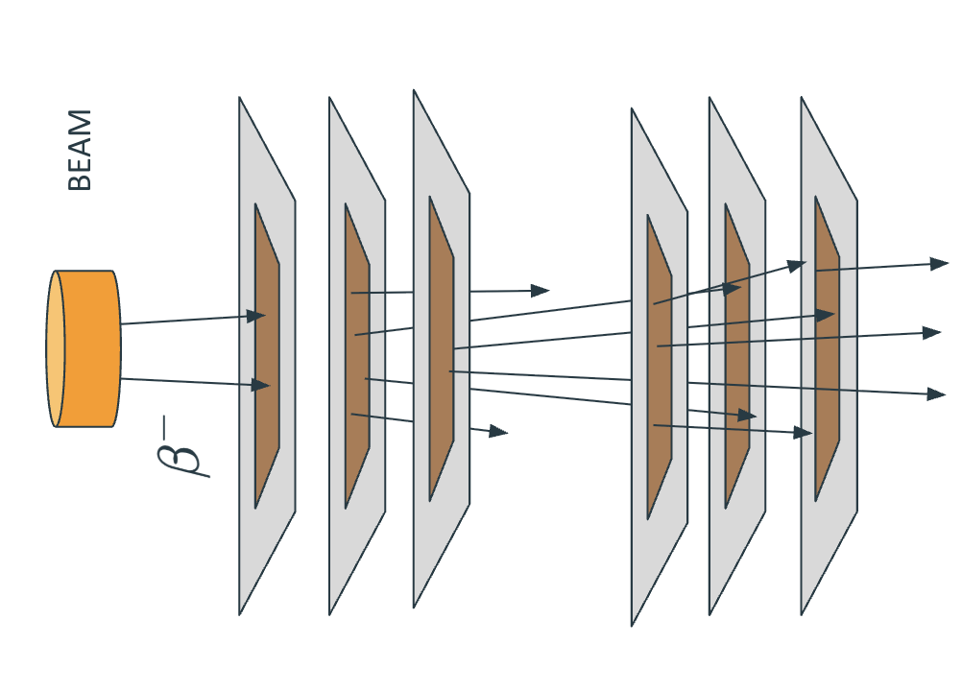
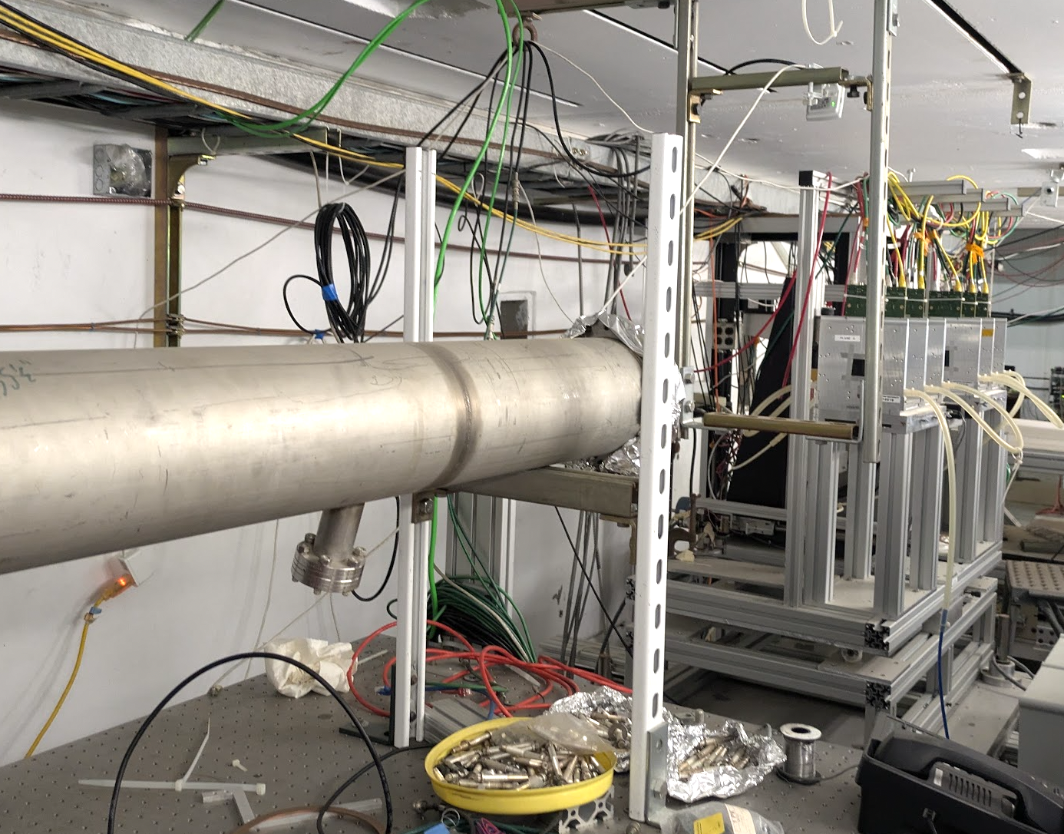
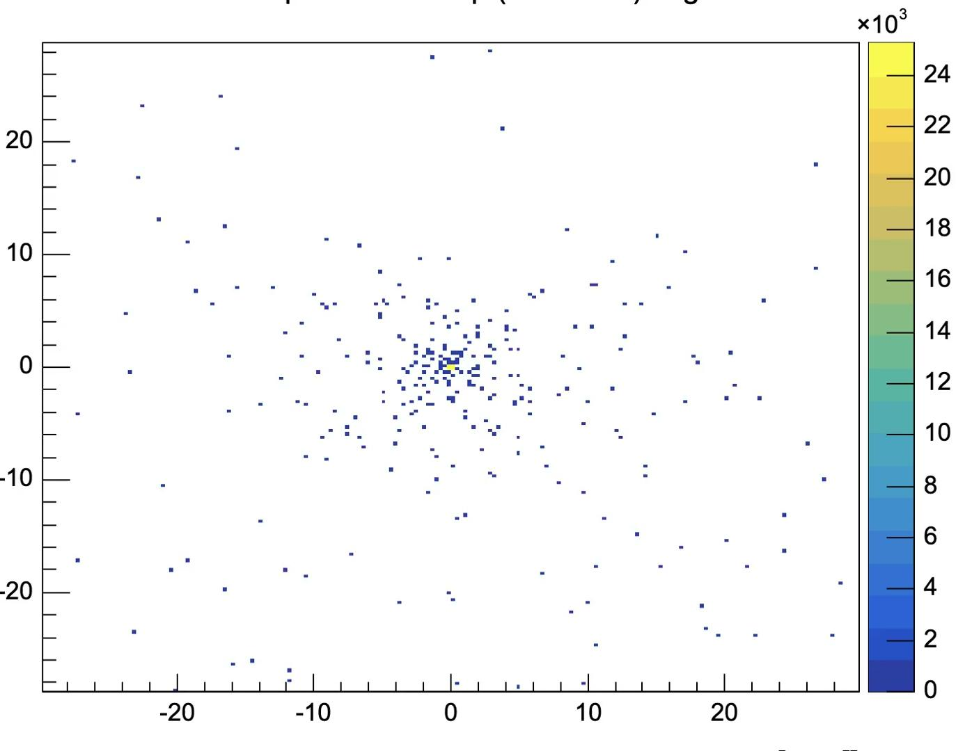
From the visit to the test beam facility
Evolution of a 2 GeV beam through our silicon sensors

Slide 18
Conclusions
Takeaways
  Now aware (and got a taste) of the tools being used to design MAPS
  Documentations are really helpful; especially Allpix2.
Likes and dislikes
  Liked how most of the time was spent hands-on. Kept the mind engaged
  Last two sessions felt rushed because of the presentations
  Got the full in-lab experience, bugs and all (maybe troubleshoot a little more before hand?)
Which achievement you are proud of.
  Can proudly tell our bosses we have the ability to (one day) design our own MAPS!

Slide 19
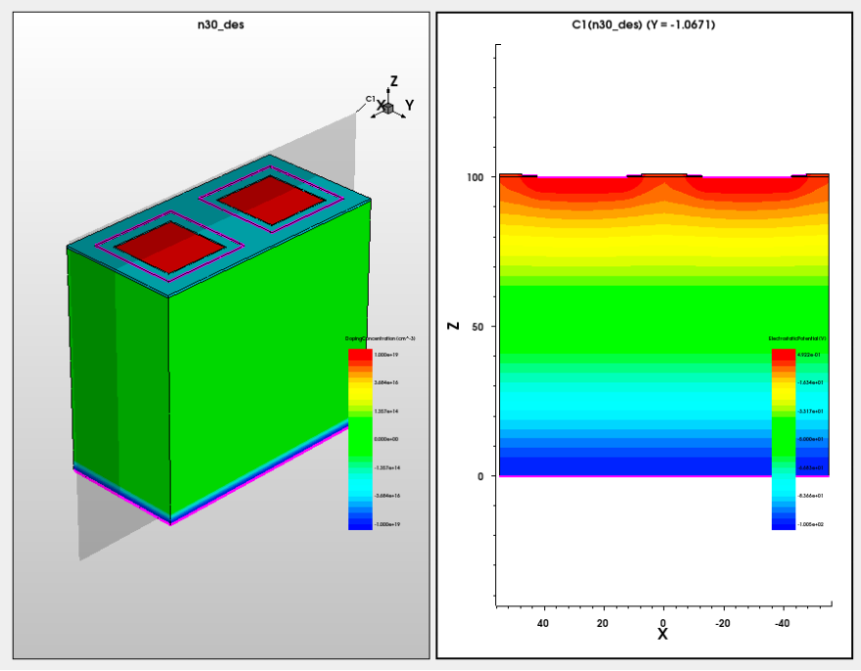
Extra Fun Stuff

Slide 20
Thank you very much
Punit Sharma
Brookhaven National Laboratory
punit.sharma@cern.ch
Pierce Affleck
University of Florida
pierceaffleck@ufl.edu
Yuto Hama
University of Tsukuba
yuto.hama@cern.ch

