Slide 1

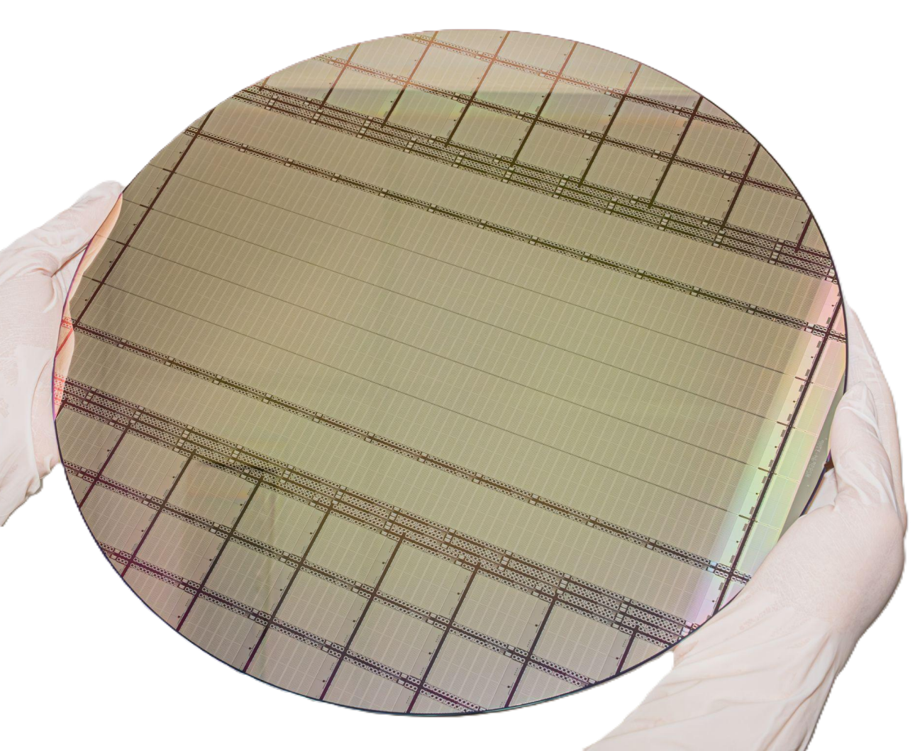




Hands-on B: pixESL
Tucker Hwang¹
Hinata Nakamura²
Giovanni Vecil³
SLAC, California - August 3, 2026
¹University of California, Berkeley
²Hiroshima University
³University and INFN Trieste
The most beautiful MAPS ever (source: an unbiased personal opinion)

Slide 2
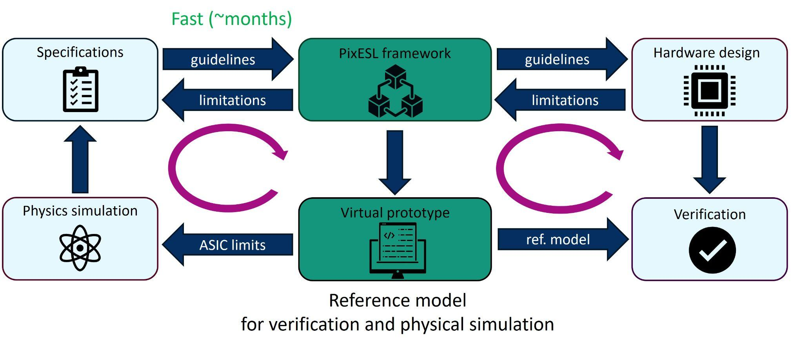




Why is pixESL relevant in MAPS development?
A framework for the virtual prototyping of pixel detectors at a high level of abstraction
  Rapid design space exploration and reference model verification/simulation
Developed in C++/SystemC by CERN EP-ESE-ME since 2023
  → Speed-up the design process for future MAPS projects
Notes:
Hinata

Slide 3
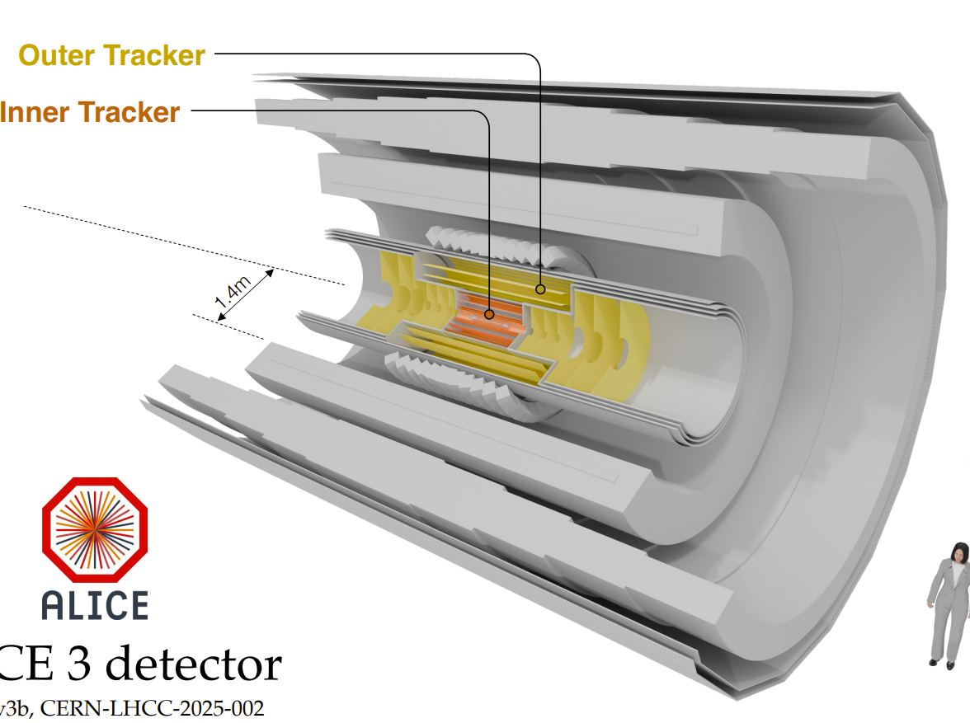
Why pixESL is relevant to us: the ALMIRA project
ALMIRA (ALICE 3 Monolithic Integrated Tracker ASICs) is developing the MAPS sensors for the ALICE 3 tracker
  different requirements in terms of spatial resolution, radiation tolerance, readout and powering architecture, readout speed, power consumption…
  + the final requirements from the physics community are still not set!
pixESL is crucial in the initial prototyping phase in collaboration with the physics community
The most beautiful barrell MAPS detector among the ones planned for LHC Run 5
See for example (restricted access):
https://indico.cern.ch/event/1664656/contributions/7070380/attachments/3268440/5838041/ALMIRA_architecture.pdf
Notes:
Giovanni

Slide 4
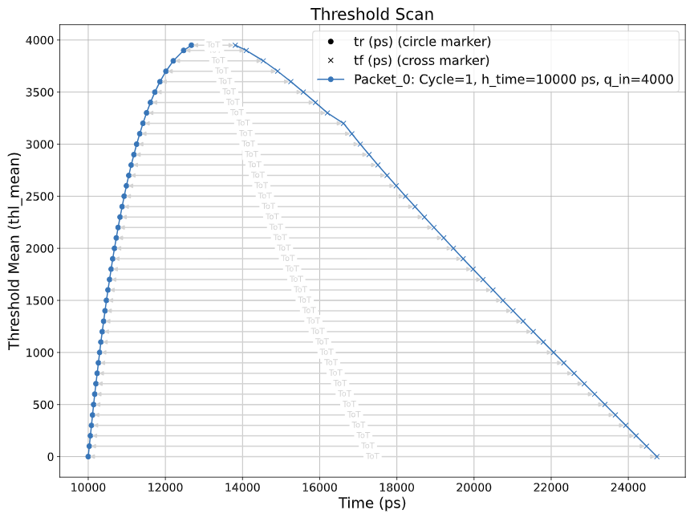
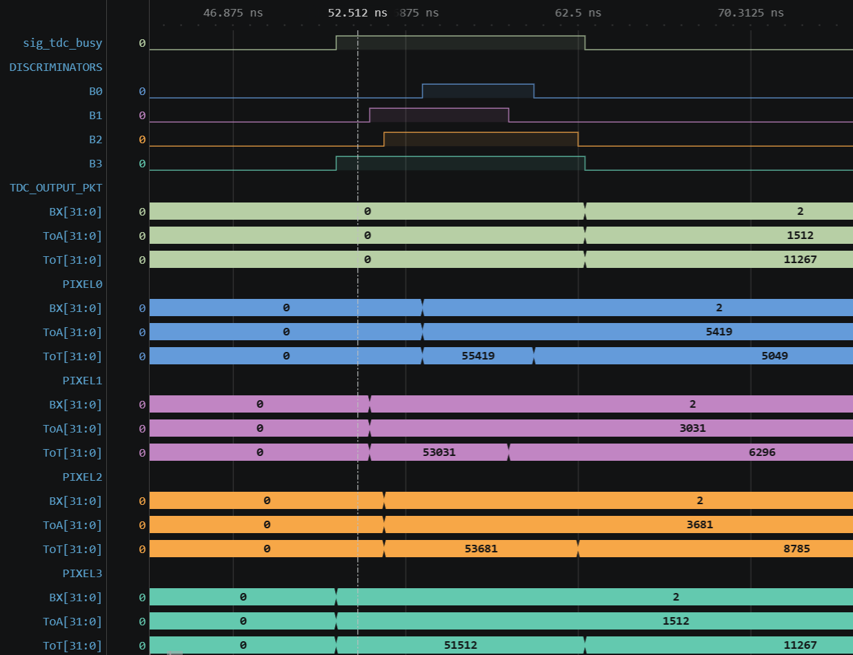
Hands-on session overview: front-end
The Analog Front-End (AFE) is divided into
  AFE Core: implementation of amplifier, shaper and digitizer in C++
  AFE Node: implementation of pixel wrappers and TDC (if present) in SystemC → temporal progression
The AFE can simulate the signal quantities of interest
  From signal amplitude and time → rise time, fall time, ToA, ToT, number of lost events…
Threshold scan on the output from a realistic front-end model
Temporal distribution of TDC output signals from four pixels
Notes:
Tucker

Slide 5
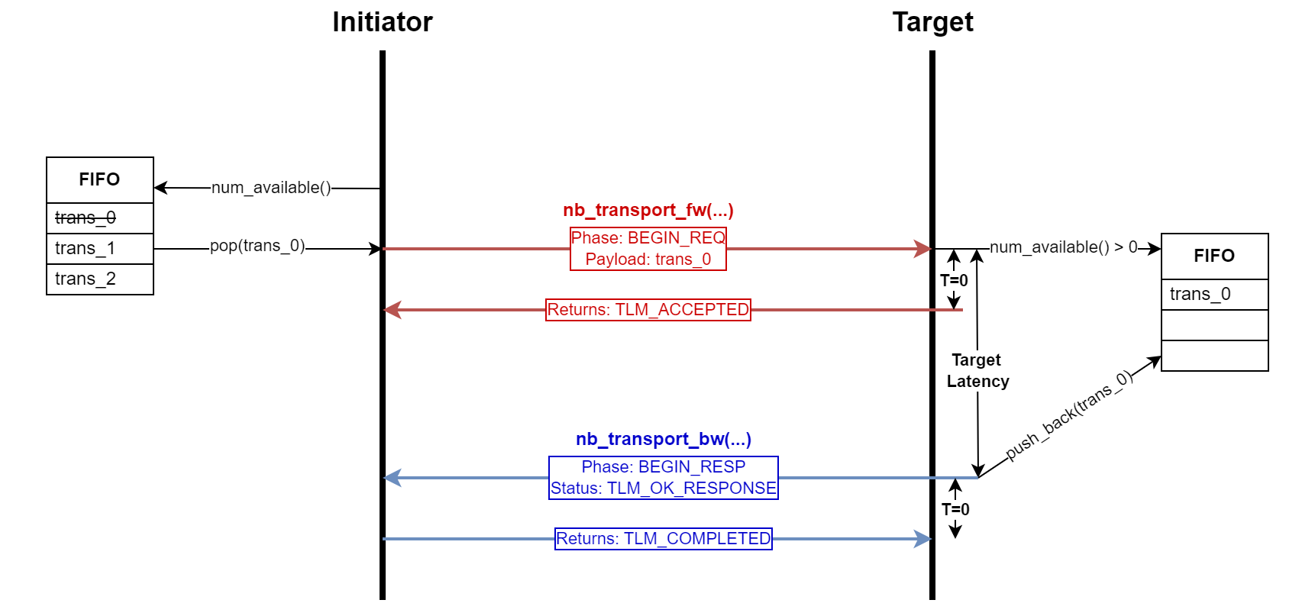
Hands-on session overview: TLM
Transaction-Level Modeling (TLM) implements an abstract data communication model between nodes → e.g. interconnection of front-end and readout nodes
  pixESL implements the SystemC TLM 2.0 library where the ports connect different FIFOs and data flow between them is event-driven
Notes:
Giovanni

Slide 6
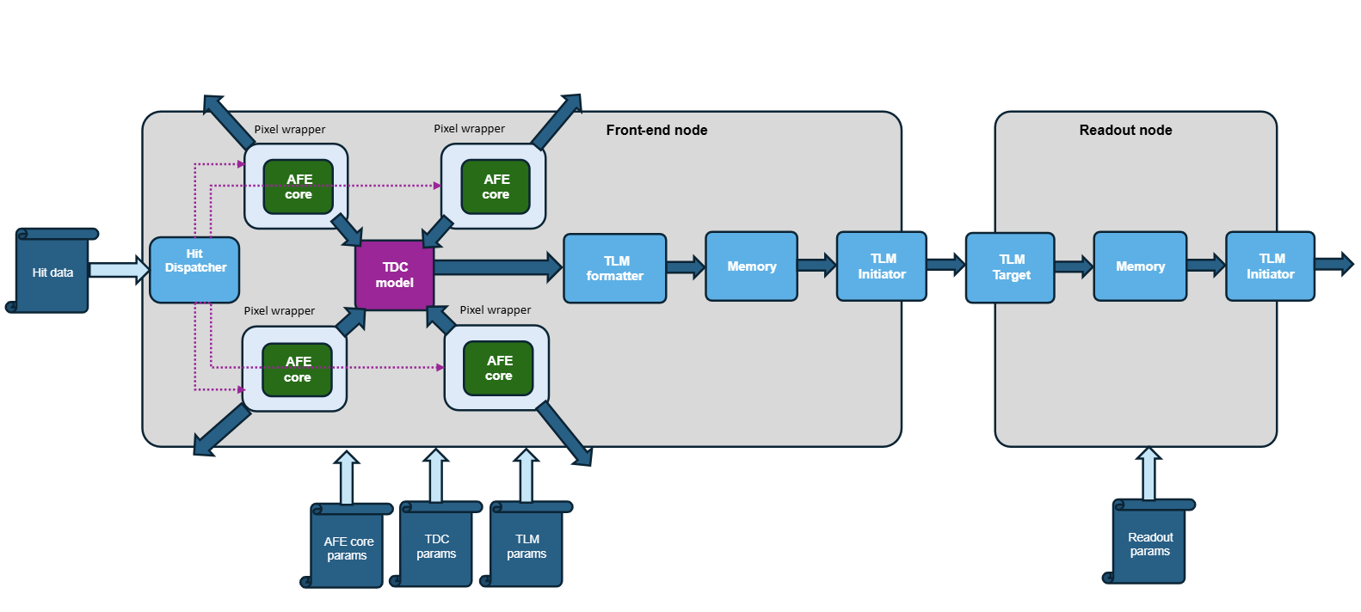
Hands-on session overview: TLM
Transaction-Level Modeling (TLM) implements an abstract data communication model between nodes → e.g. interconnection of front-end and readout nodes
  pixESL implements the SystemC TLM 2.0 library where the ports connect different FIFOs and data flow between them is event-driven
Notes:
Giovanni

Slide 7
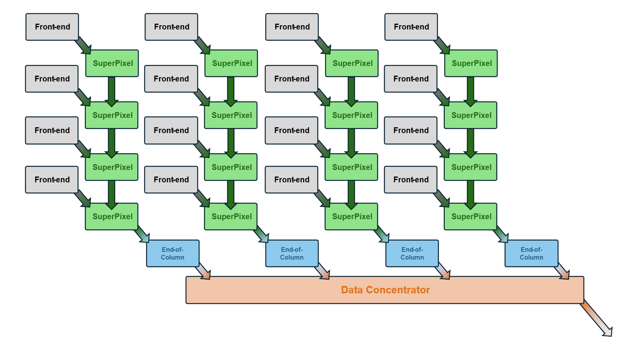
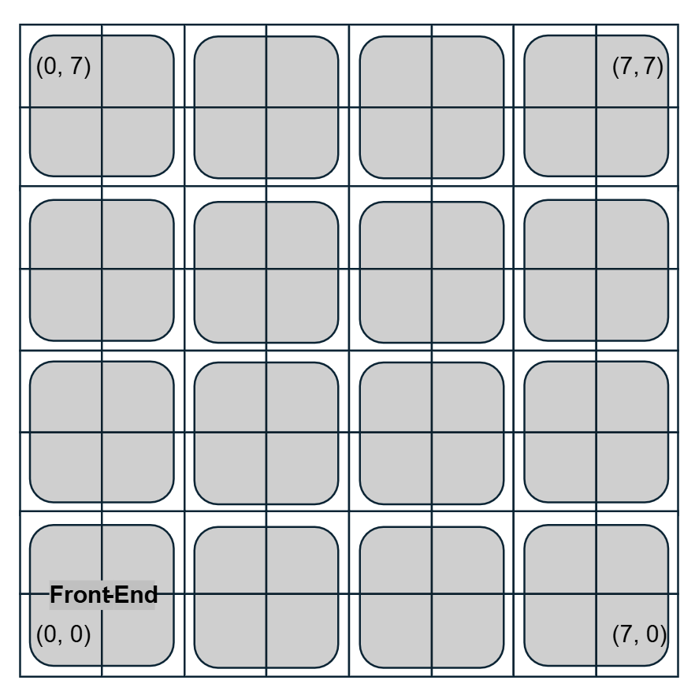
Hands-on overview: data network
The data network architecture is the aggregation of front-end nodes and different levels of readout nodes that forms a hierarchical architecture with multiple stacked readout layers
  Pixel front-ends, super pixels/pixel macros, end-of-column blocks, data aggregators,...
pixel
Simulated data network architecture: 8x8 pixels, 4x4 front-end and super pixels, 4x1 EoC blocks, data concentrator
Notes:
Hinata

Slide 8
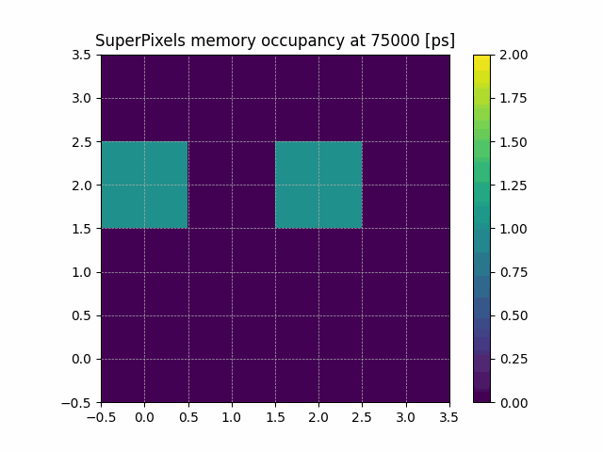
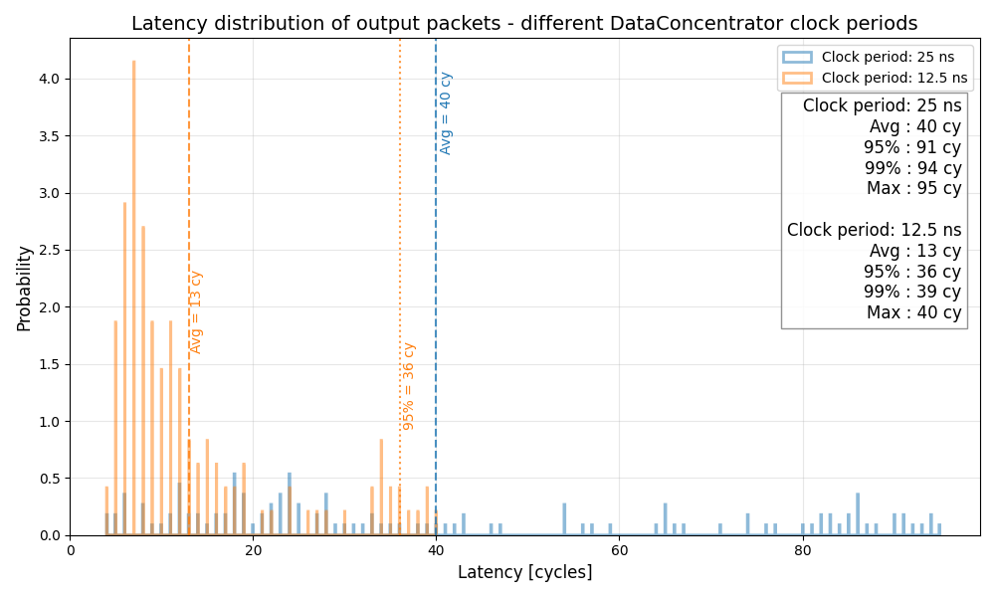
Hands-on overview: metrics analysis
Metrics (via pixESL’s Metrics Analyzer) are quantitative measures of: the inputs given, the outputs generated, and the general performance of the network
  Injection patterns, hitmaps, packets per cycle, dropped packets, logs, efficiency, latency, …
Clock period: 25 ns
Clock period: 12.5 ns
Clock period | Readout eff. | Avg. latency
25 ns | 89% | 40 cy.
12.5 ns | 97% | 13 cy.
Notes:
Giovanni

Slide 9
What did we learn here at the MAPS Academy?
We are all in physics (no engineers), in the same collaboration (ALICE), with generally the same experience (pixel characterization)...
MAPS design is not a linear, disconnected chain, but rather a complex, interconnected web!
  Requires communication and feedback throughout the process between different groups
  It’s important to know the capabilities and limitations of other parts of the process, even those that you may not be directly involved with
A more holistic, quasi-bird’s-eye view is always helpful to expand your viewpoint and understanding
  → lectures vs. hands-on
Notes:
Tucker

Slide 10
Feedback
Pros
  Strong documentation for exercises
  Very helpful instructors and insightful tours
  Really enjoyed learning about new tools
  Good food and snacks (coffee break!)
Future suggestions
  Longer Academy? (e.g. two full days for each hands-on)
  Different concept for presentations?
Notes:
Tucker

