Slide 1
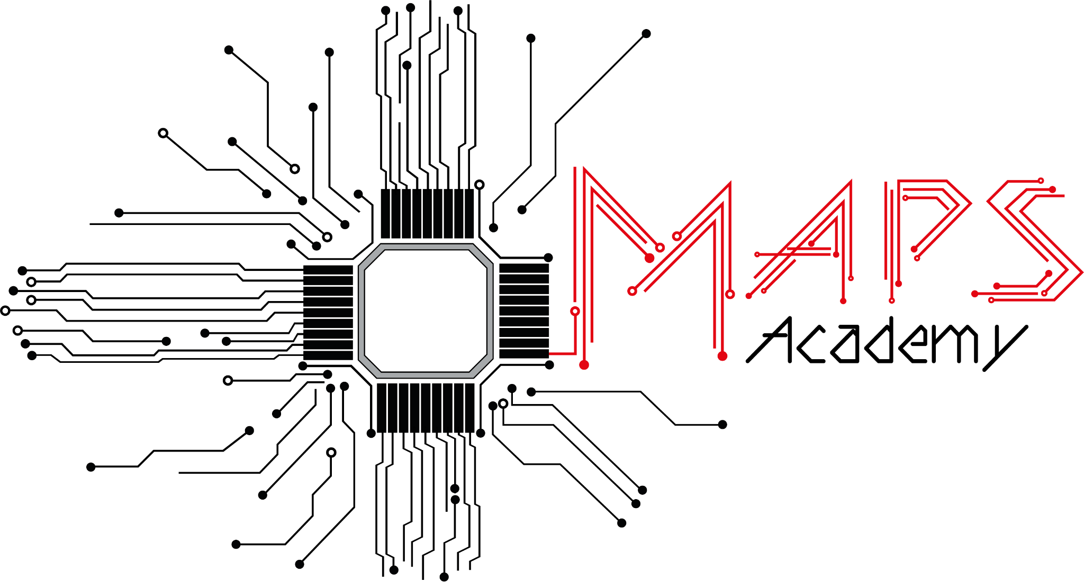
TCAD
MAPS Academy 2026
Ana Sofia Calle & Tao Yang
Notes:
Recommended presentation outline:
motivation and target of the hands-on,
Overview of the work performed,
focused point from your experience,
Comments to future participants (and preparation team).
We want to hear about:
what the hands-on helped you understand about MAPS or tools,
what you liked and also disliked,
which achievement you are proud of.

Slide 2
TABLE OF CONTENTS
04
01
05
02
06
Sofi’s TCAD experience + comments
Motivation and target
Tao’s TCAD experience
2D Diode sim & analysis
Technique for simulation

Slide 3
Motivation and target
Provide an introduction of the TCAD Software and learn the basic process of designing, simulating, and analyzing semiconductor devices.
Overview of the workbench environment.
Hands-on 2D and 3D examples where we became familiar with the main tools such as SDE and SDEVICE.
Notes:
The goal of these introductory exercises was to become familiar with the TCAD workflow. We started by learning how the Workbench organizes simulations and how the different tools interact. Then, through simple 2D and 3D examples, we created device structures, generated meshes, ran electrical simulations in SDevice, and analyzed the results. These exercises provided the foundation for understanding more advanced semiconductor device simulations.
Structure Editor): device geometry and mesh creation.

Slide 4
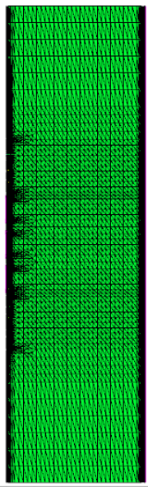
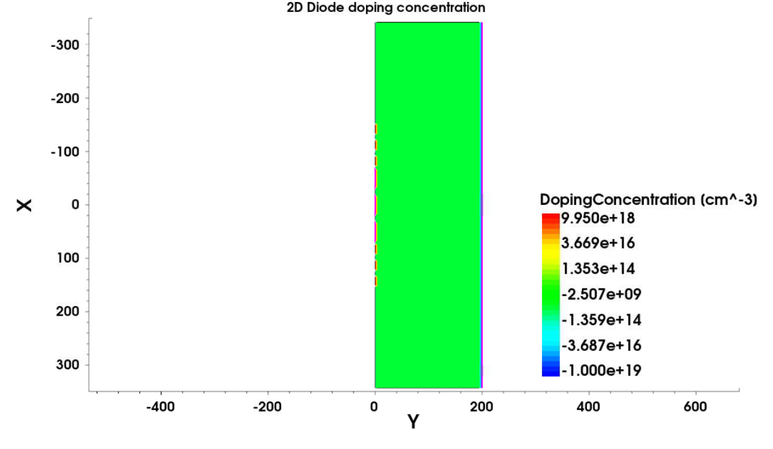
2D Diode simulation
(um)
2D silicon diode with SiO₂ surface passivation.
PN junction that enables current flow in one direction.
200 um width.
Adaptive mesh refinement for accurate device simulation.
(um)
Notes:
We started with a 2D PN diode because it is one of the simplest and most fundamental semiconductor devices. A PN diode consists of a p-type and an n-type region that form a junction, allowing current to flow mainly in one direction. In TCAD, this example is ideal for learning the simulation workflow while visualizing key physical phenomena such as the depletion region, electric field, carrier concentrations, and the resulting I–V characteristics. Understanding this device provides the foundation for simulating more advanced semiconductor structures.

Slide 5
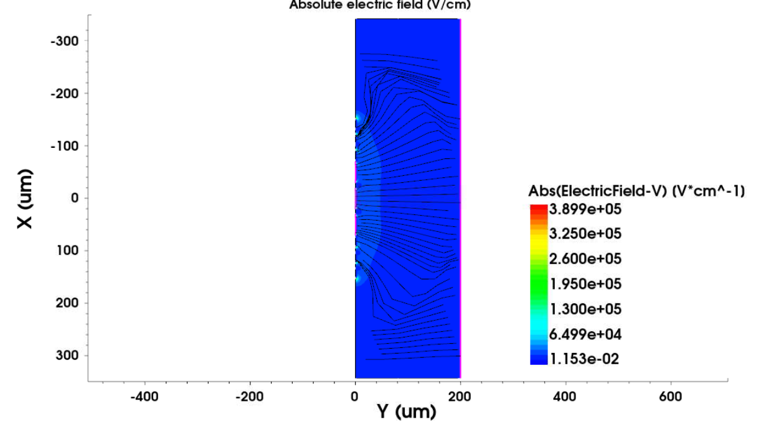
2D Diode simulation
Notes:
We started with a 2D PN diode because it is one of the simplest and most fundamental semiconductor devices. A PN diode consists of a p-type and an n-type region that form a junction, allowing current to flow mainly in one direction. In TCAD, this example is ideal for learning the simulation workflow while visualizing key physical phenomena such as the depletion region, electric field, carrier concentrations, and the resulting I–V characteristics. Understanding this device provides the foundation for simulating more advanced semiconductor structures.

Slide 6
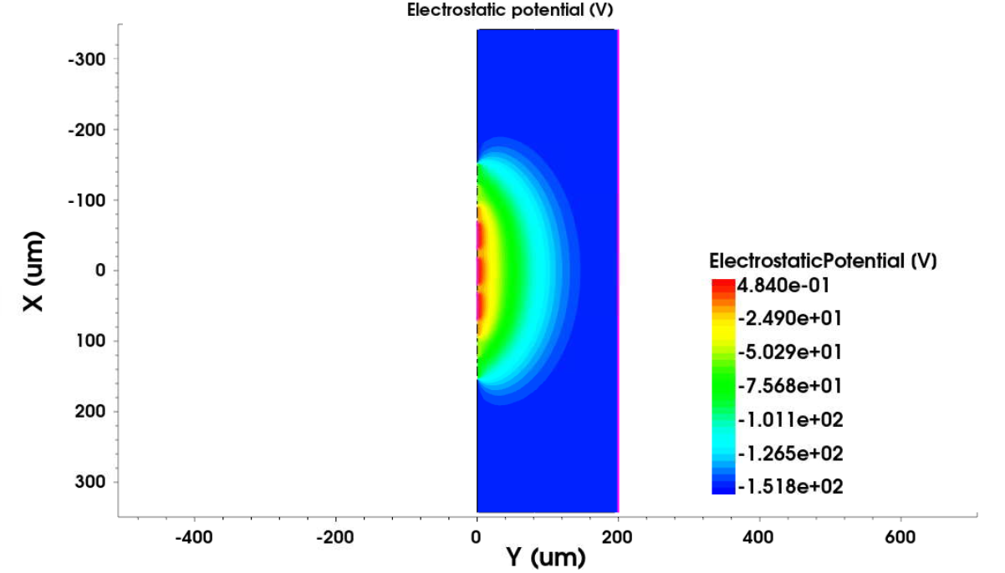
2D Diode simulation
Notes:
We started with a 2D PN diode because it is one of the simplest and most fundamental semiconductor devices. A PN diode consists of a p-type and an n-type region that form a junction, allowing current to flow mainly in one direction. In TCAD, this example is ideal for learning the simulation workflow while visualizing key physical phenomena such as the depletion region, electric field, carrier concentrations, and the resulting I–V characteristics. Understanding this device provides the foundation for simulating more advanced semiconductor structures.

Slide 7
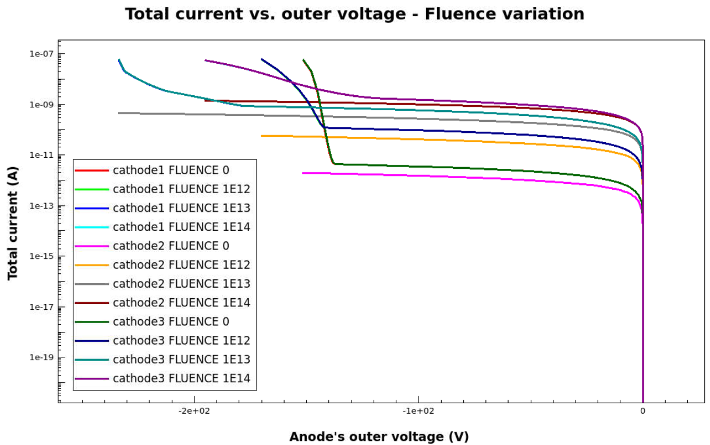
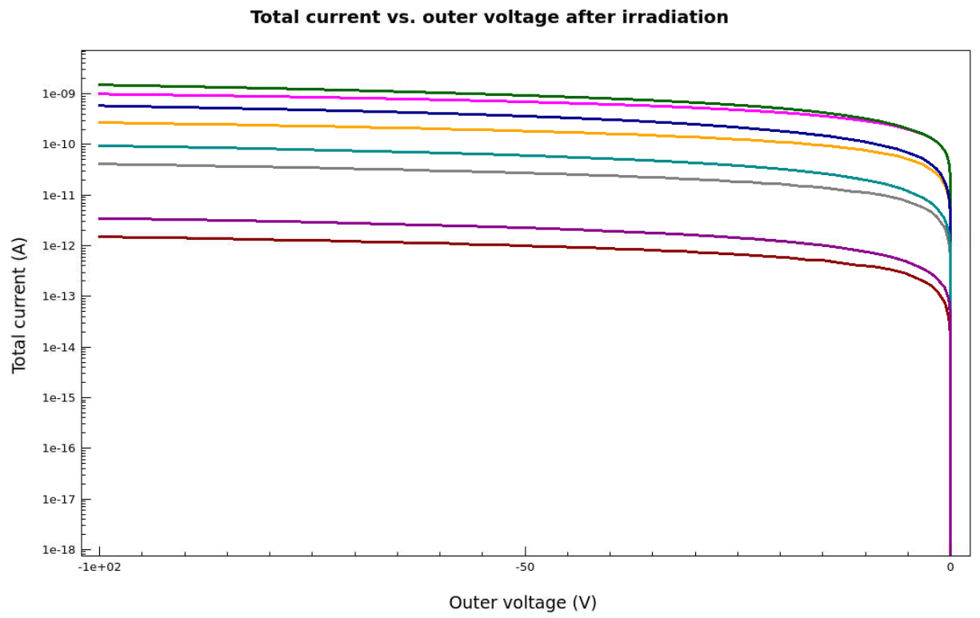
2D Diode analysis
Fluence [n_eq/cm^2]
0, 1e12, 1e13, 1e14
Before irradiation
After irradiation
Higher fluences produce higher currents + breakdown
Irradiation terminates voltage earlier and decreases the total current.
Notes:
Higher fluence means more particles have crossed the detector, creating more defects (traps) in the silicon. These defects degrade the detector's performance by increasing leakage current, trapping charge carriers, and changing the electric field.
UNITS 1 MeV neutron equivalent per square centimeter

Slide 8
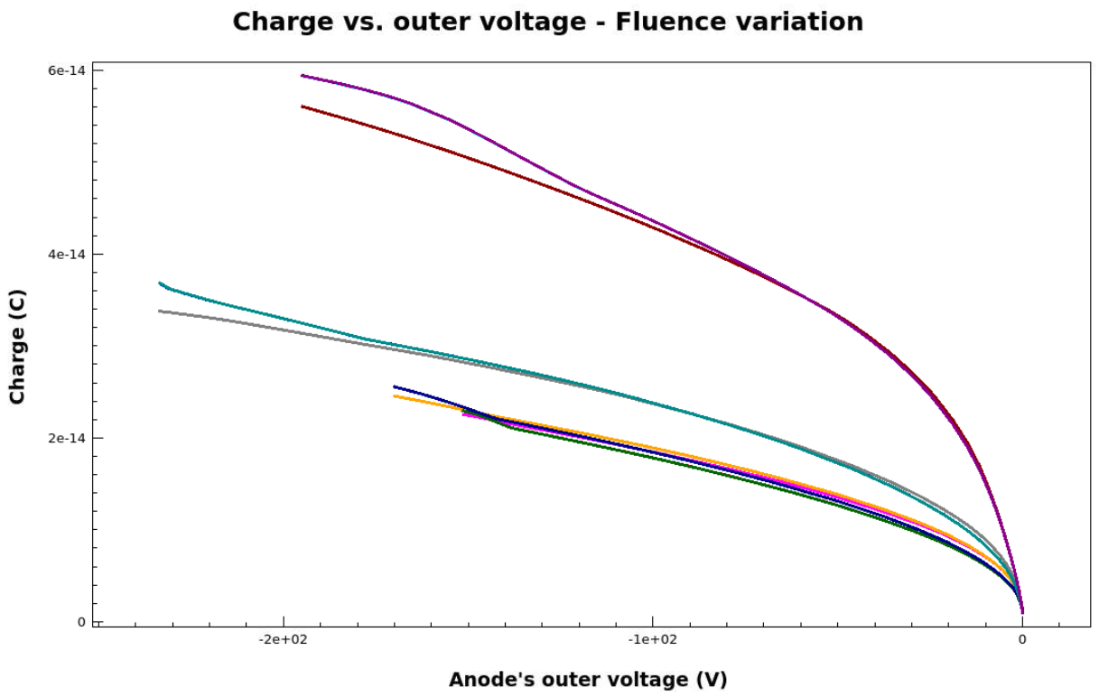
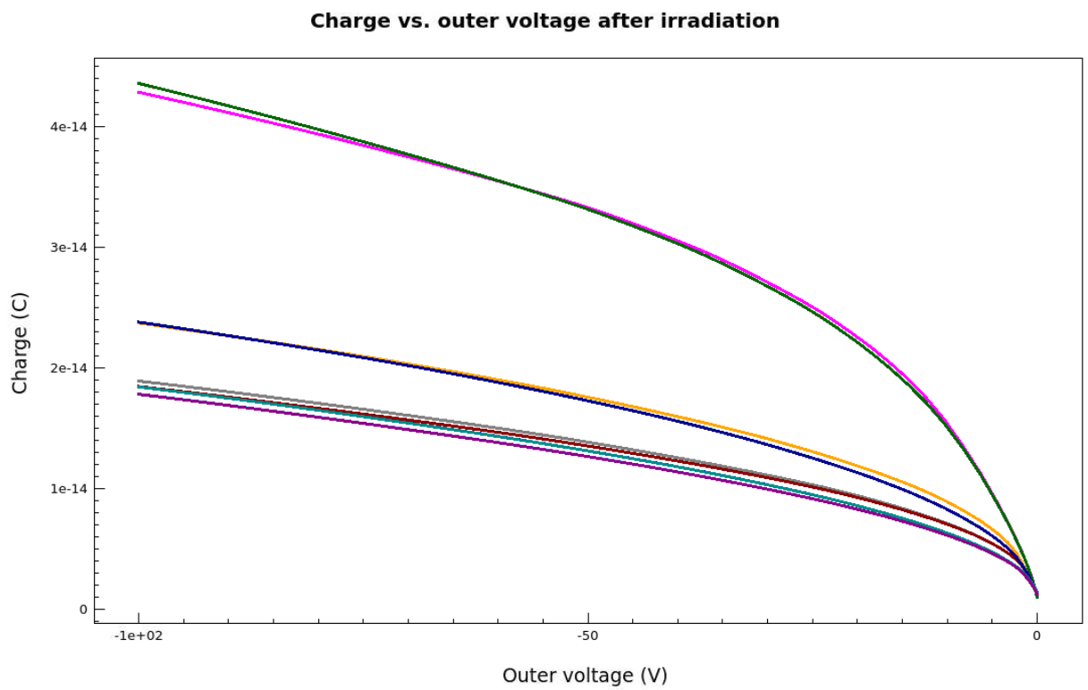
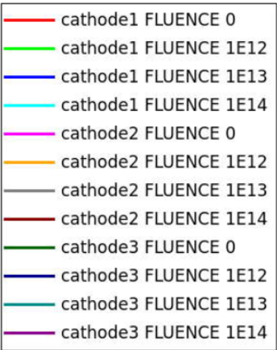
2D Diode analysis
Fluence [n_eq/cm^2]
0, 1e12, 1e13, 1e14
Before irradiation
After irradiation
Higher fluences enable higher charge collection.
Irradiance decreases collected charge and outer voltage

Slide 9
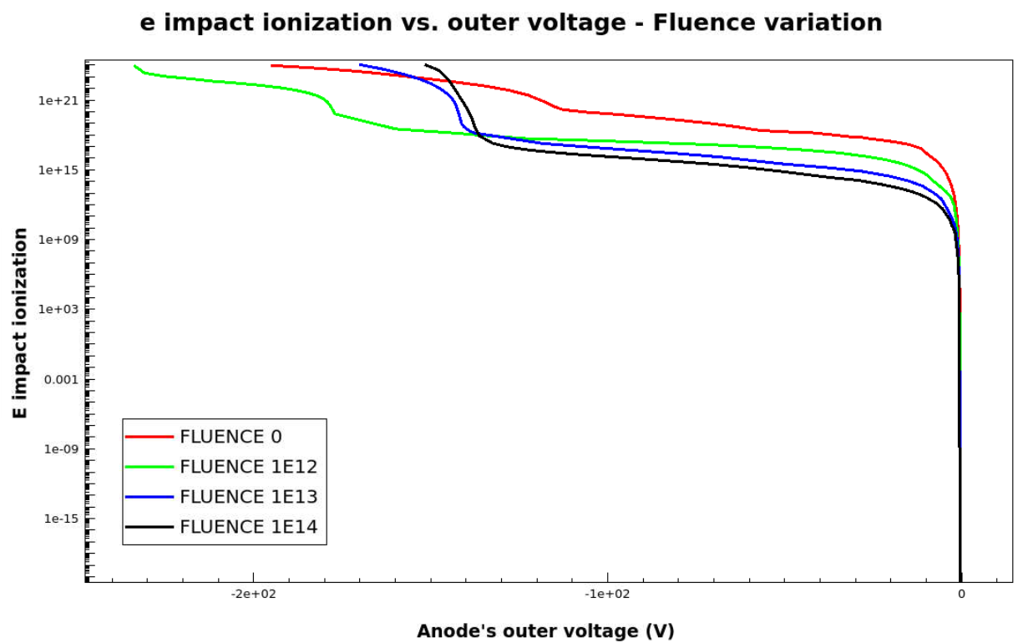
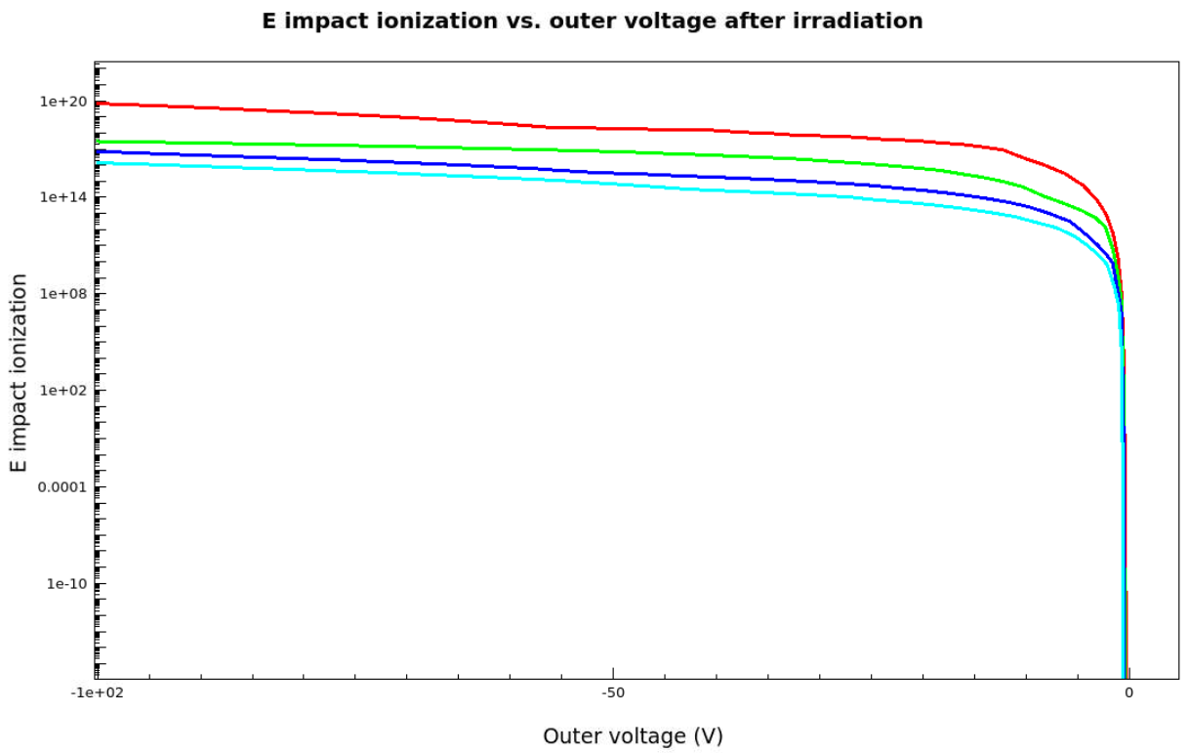
2D Diode analysis
Fluence [n_eq/cm^2]
0, 1e12, 1e13, 1e14
Before irradiation
After irradiation
Lower fluence enhances impact ionization/avalanche in your device
Higher fluence destabilizes avalanche at earlier stages of biasing.

Slide 10
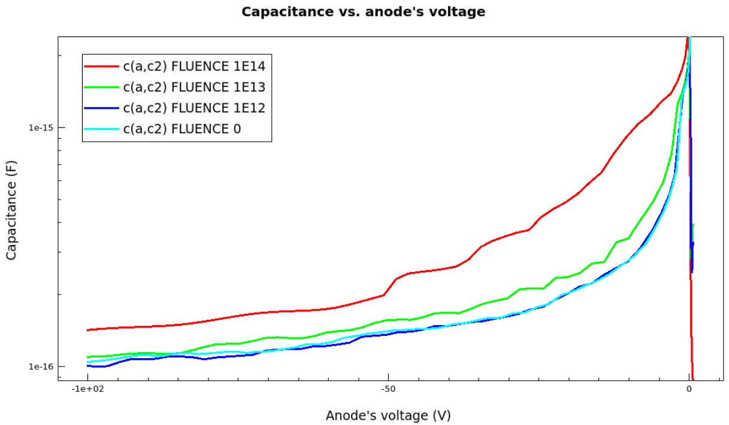
2D Diode analysis
Fluence [n_eq/cm^2]
0, 1e12, 1e13, 1e14
Higher capacitance values for high fluence values

Slide 11
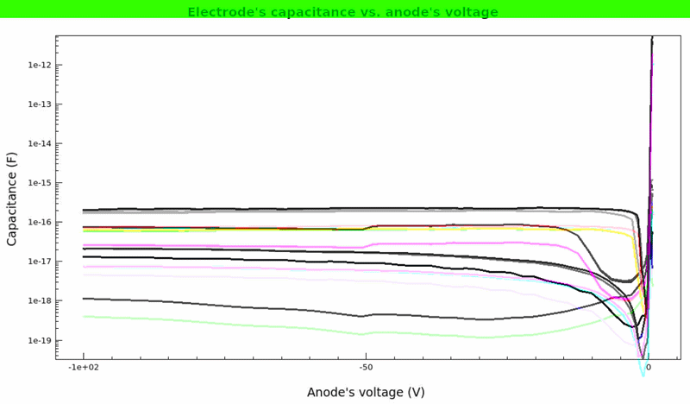
2D Diode analysis
Fluence [n_eq/cm^2]
0, 1e12, 1e13, 1e14
Electrode capacitance vs. anode voltage

Slide 12
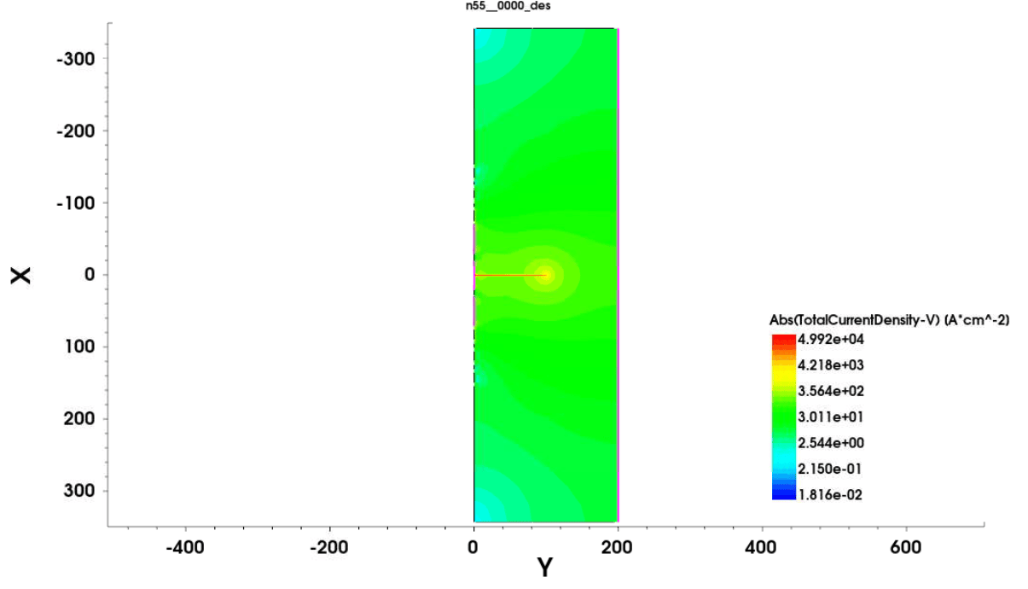
2D Diode analysis

Slide 13
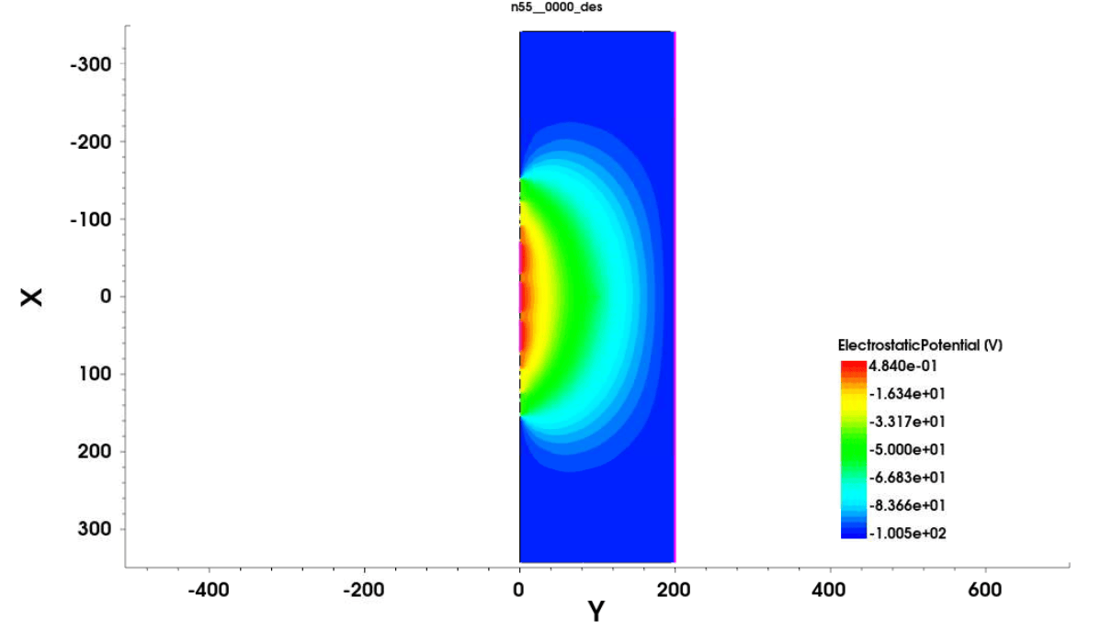
2D Diode analysis

Slide 14
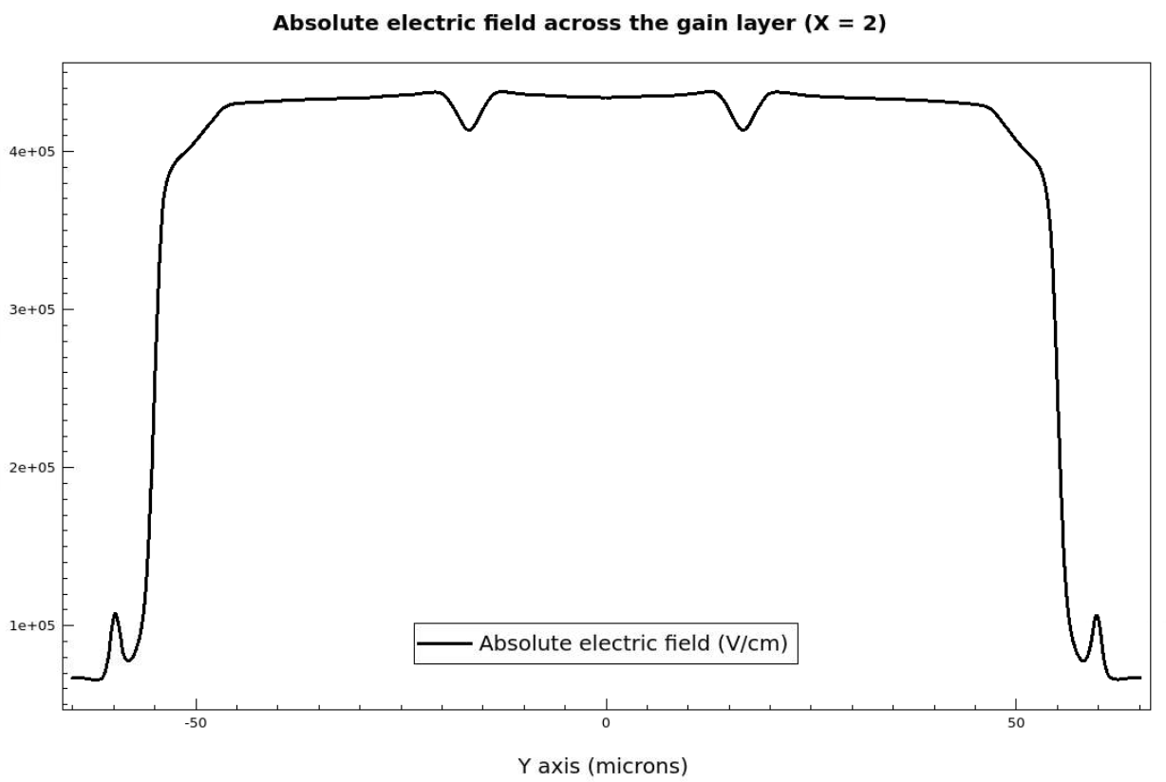
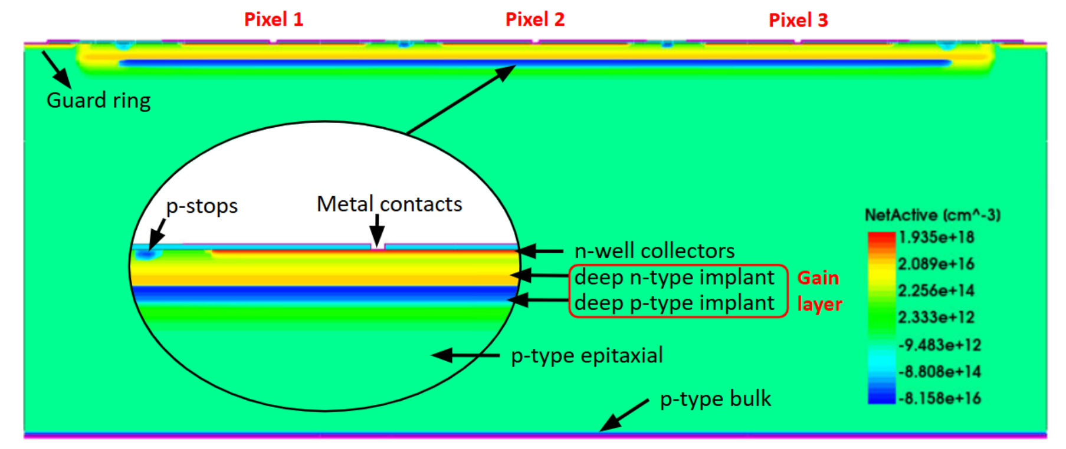

Sofi’s TCAD experience + comments
Inter-pixel regions
Abs electric field (V/cm)
Simulated a Buried-layer LGAD and optimized the inter-pixel electric-field located in the gain layer.
Implemented implantation dose & energy variations, additional implants and geometries.
Obtained a design with 80% increased inter-pixel charge collection, < 0.3% field degradation, preserved central gain.

Slide 15
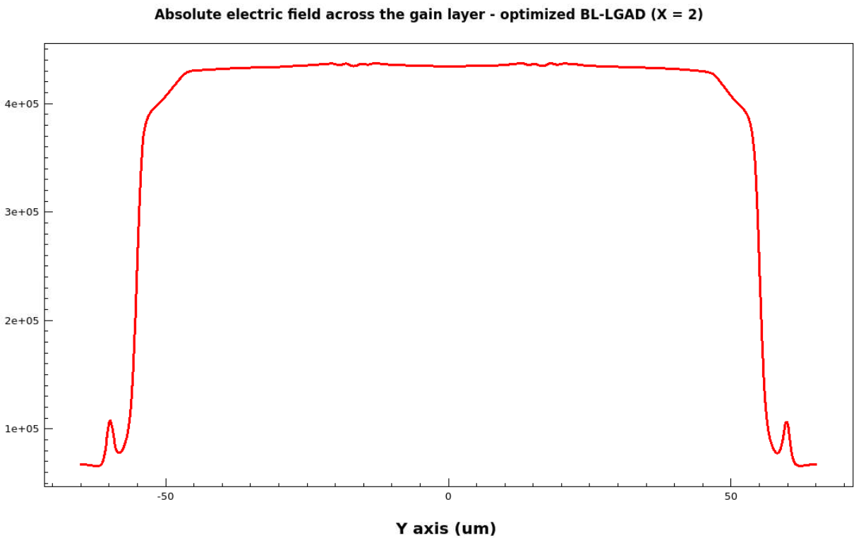
Sofi’s TCAD experience + comments
Inter-pixel regions
Inter-pixel regions
Abs electric field (V/cm)
Abs electric field (V/cm)
Simulated a Buried-layer LGAD and optimized the inter-pixel electric-field located in the gain layer.
Implemented implantation dose & energy variations, additional implants and geometries.
Obtained a design with 80% increased inter-pixel charge collection, < 0.3% field degradation, preserved central gain.

Slide 16
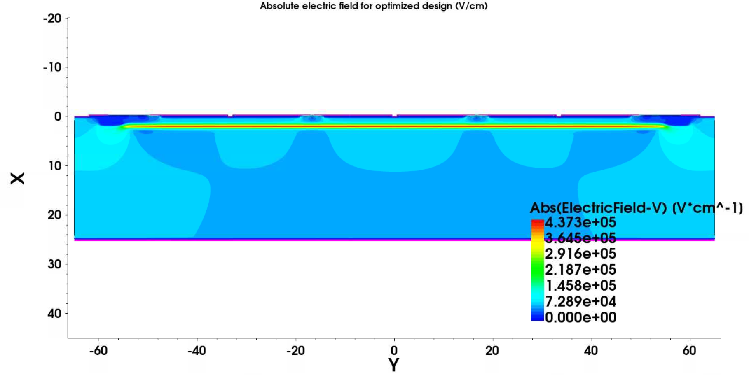
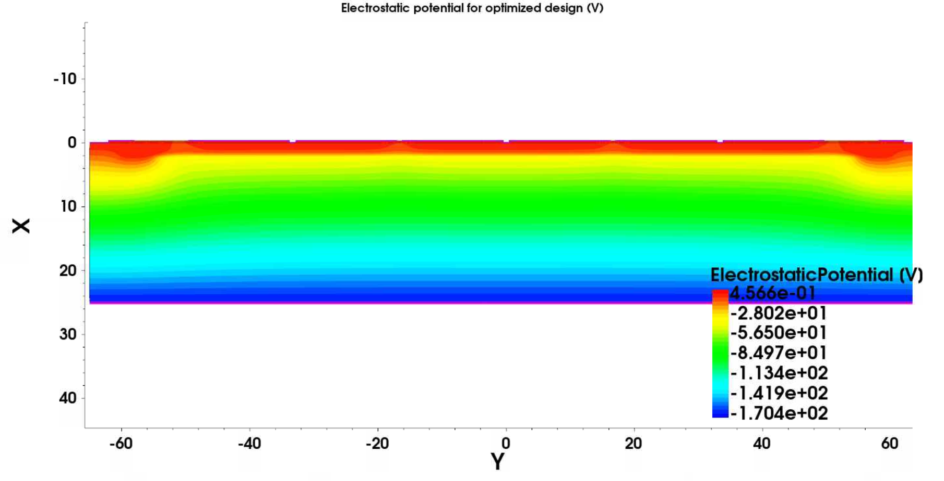
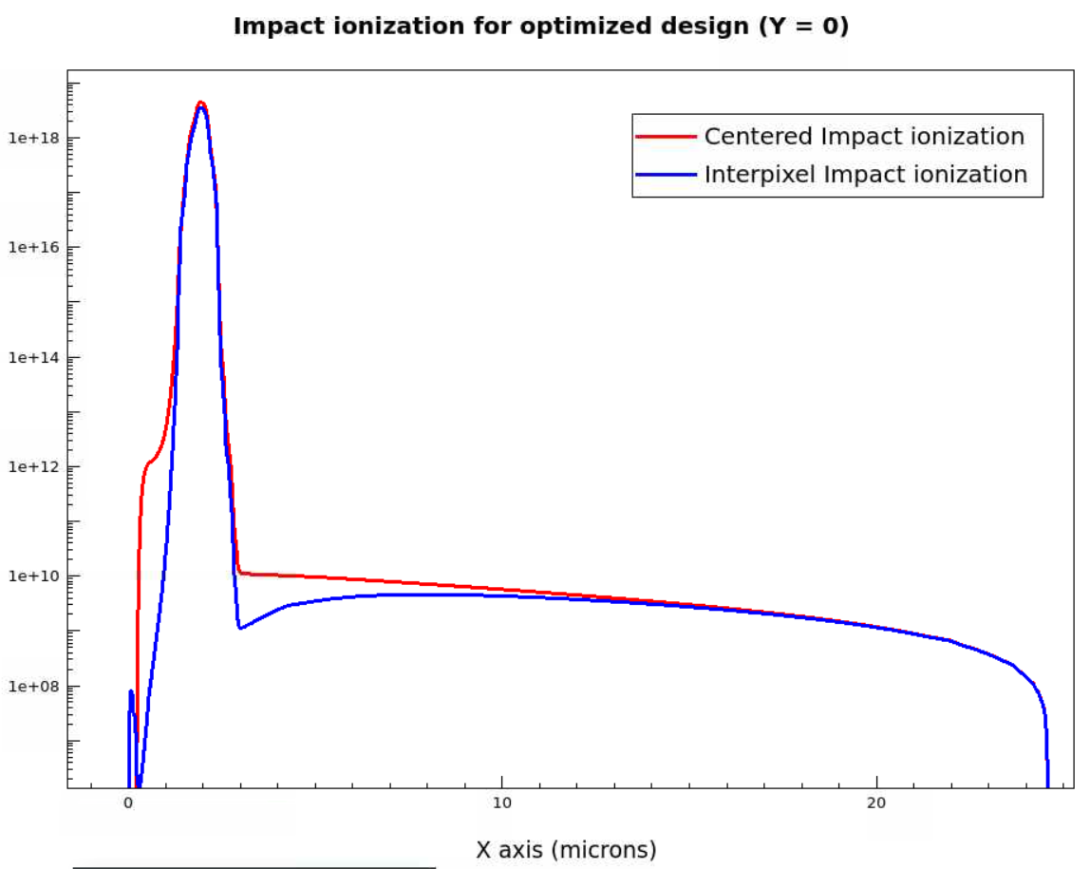
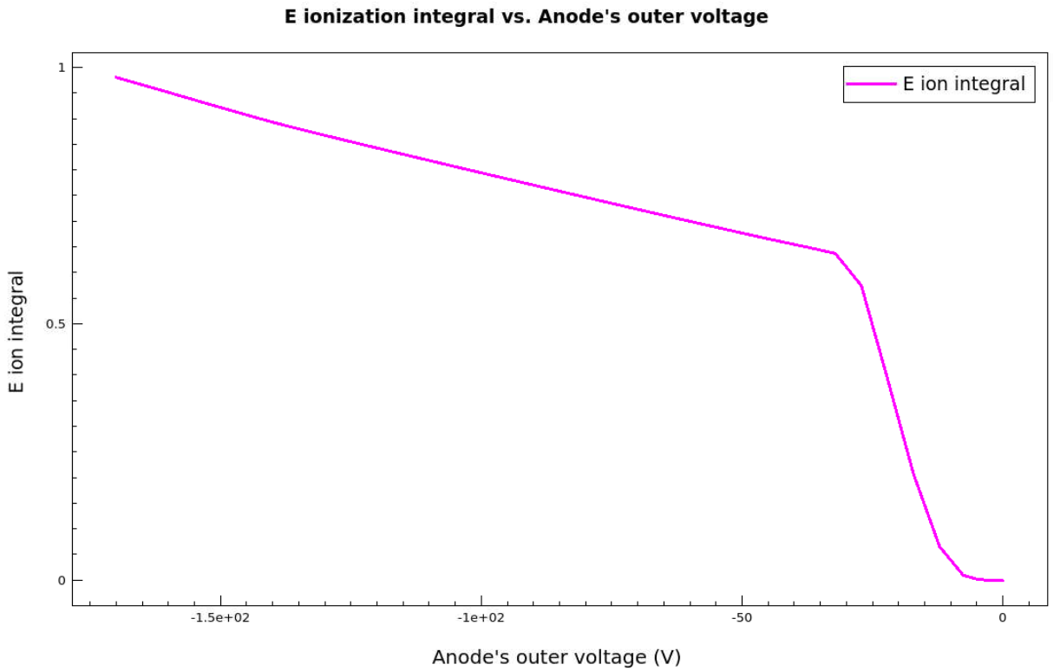
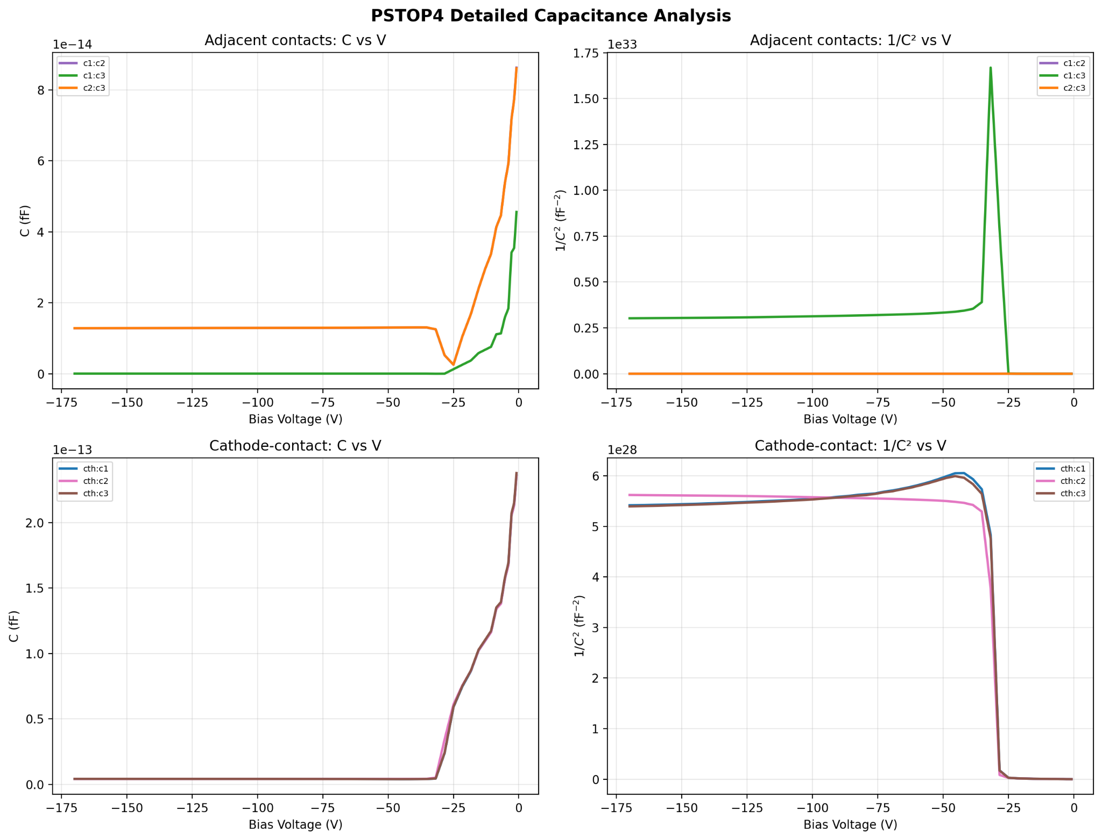
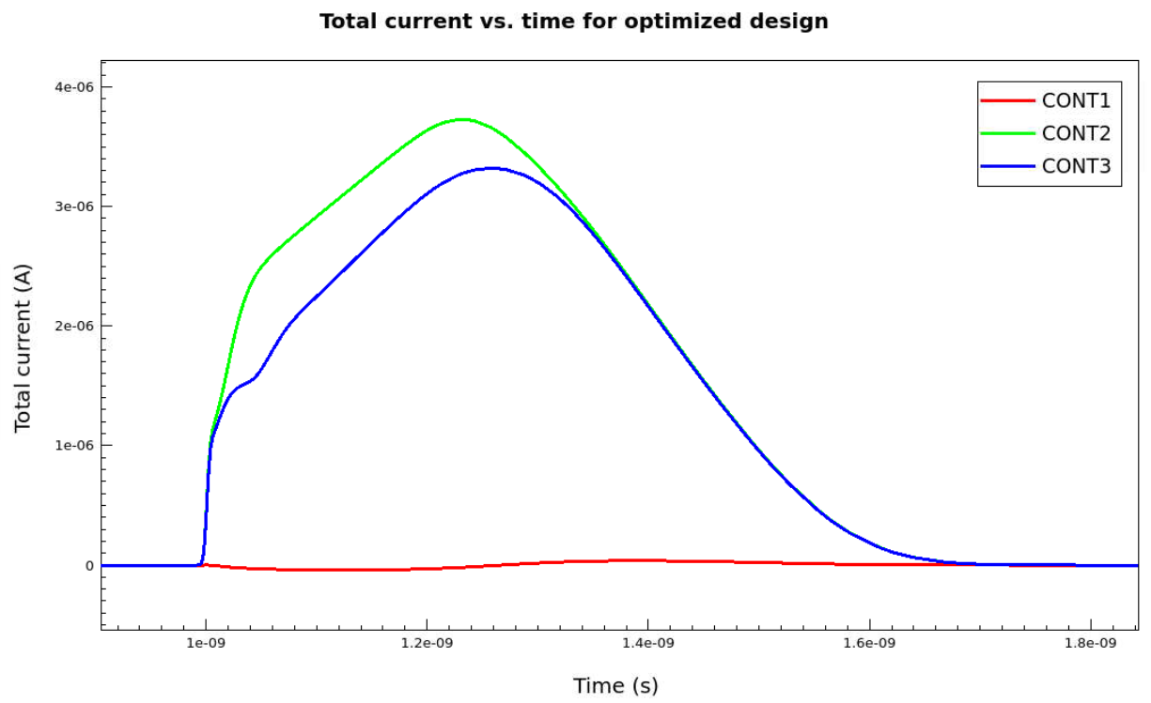
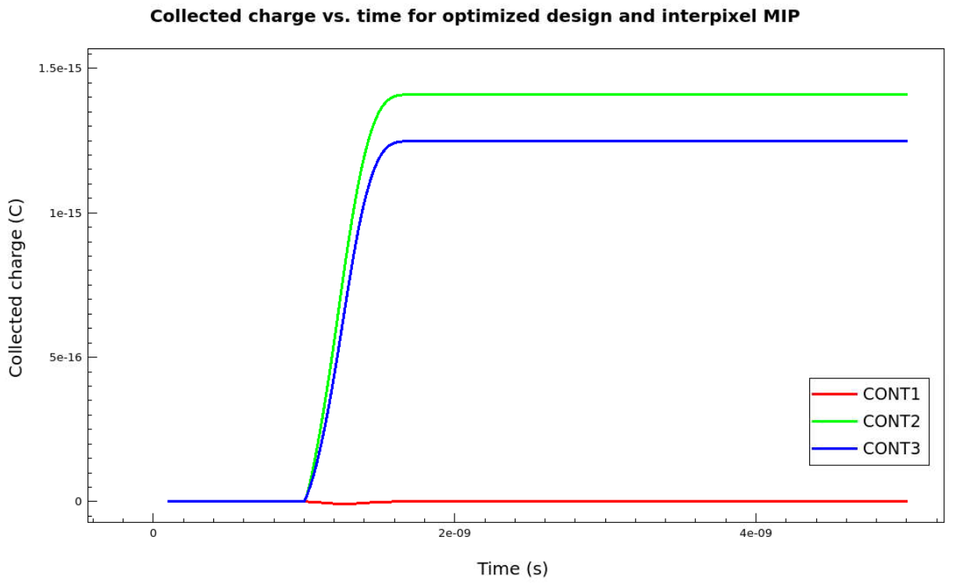
Sofi’s TCAD experience + comments
Overall had an incredible experience and learned how to use several tools I did not understand previously.

Slide 17
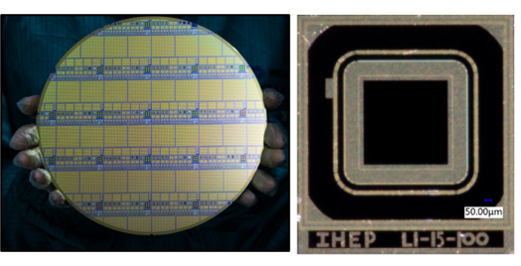
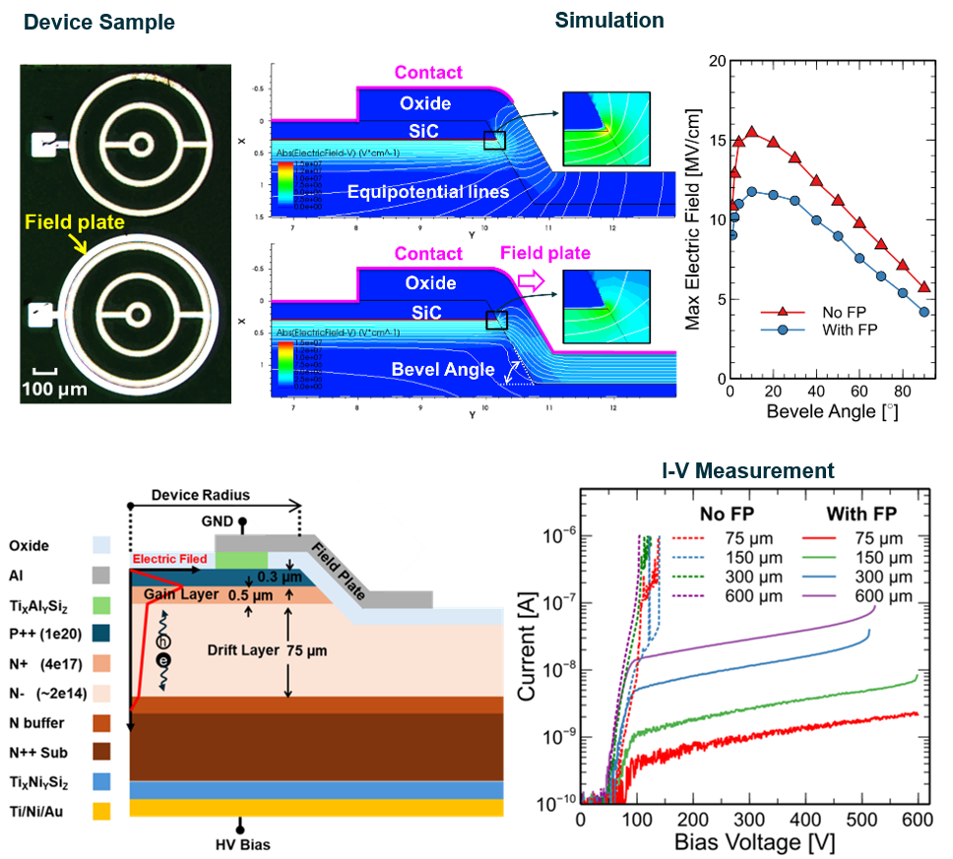
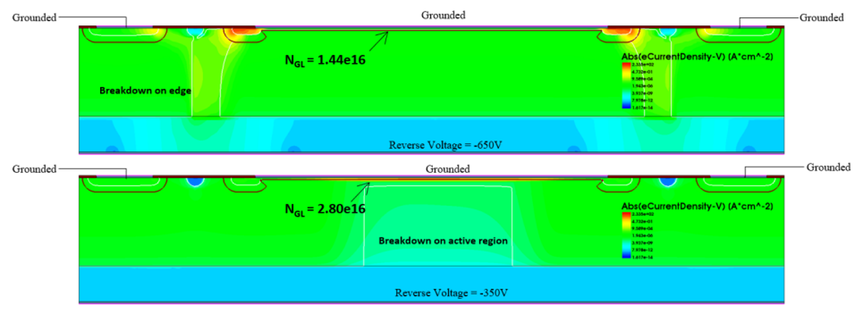
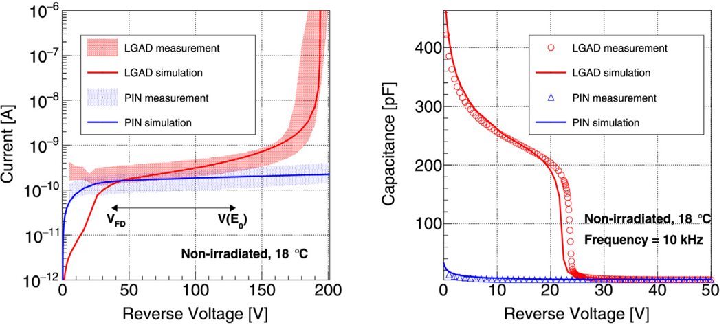
Tao’s TCAD experience
I've been using Sentaurus TCAD for 8 years now …
Si LGAD for ATLAS HGTD
SiC LGAD R&D for future collider

Slide 18
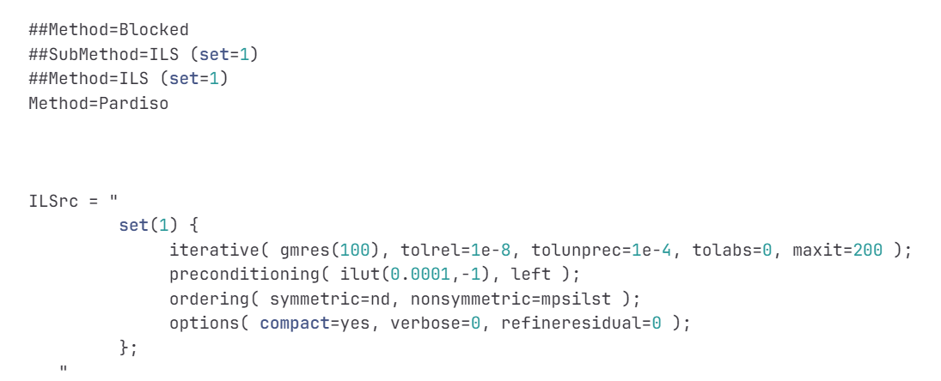
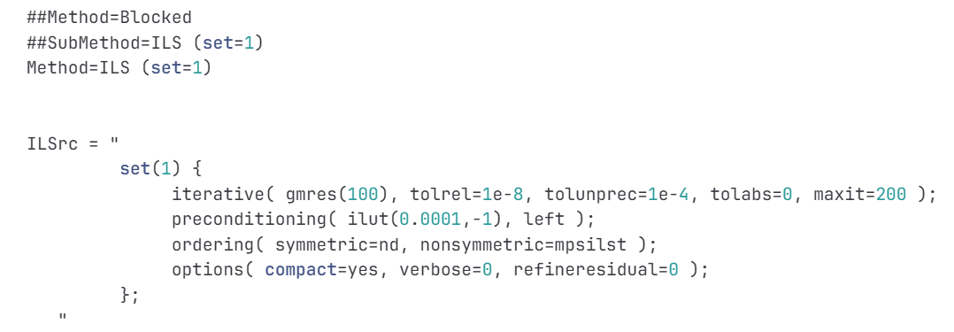
Techniques 1 for simulation
How to choose solver in Sentaurus TCAD simulation?
Solver | Parallel | Speed | Memory | Mesh Size
SUPER | No | Fast | High | <10k nodes
PARDISO | Yes | Moderate | High | 10k–50k
ILS | Yes | Relatively slow | Low | >50k
Diode_2D IV_des.cmd
Pardiso
Diode_3D IV_des.cmd
ILS
*SUPER does not support parallel solving, but simulation performance can be improved by increasing the number of assembly threads.

Slide 19
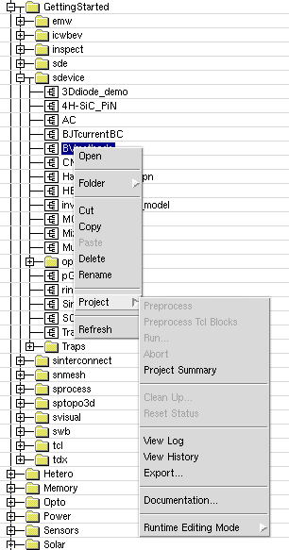
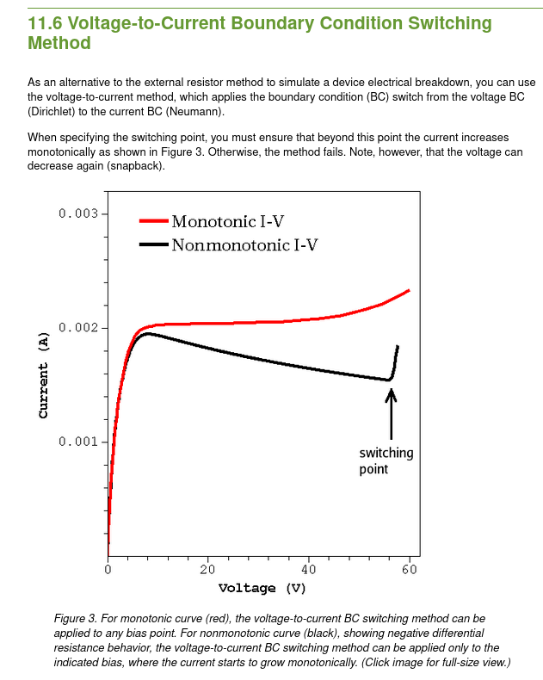
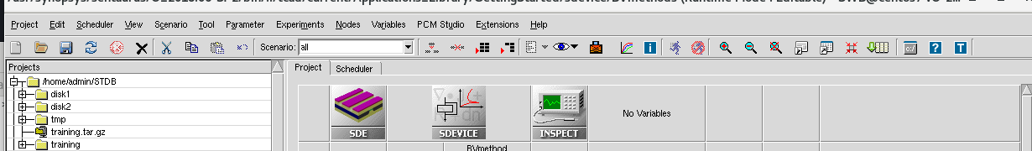

Technique 2 for simulation
Every official example comes with detailed documentation tucked away in a really deep spot.
The official training documentation is here
A very useful example related to breakdown voltage simulation.
GettingStarted/sdevice/BVmethods

Slide 20
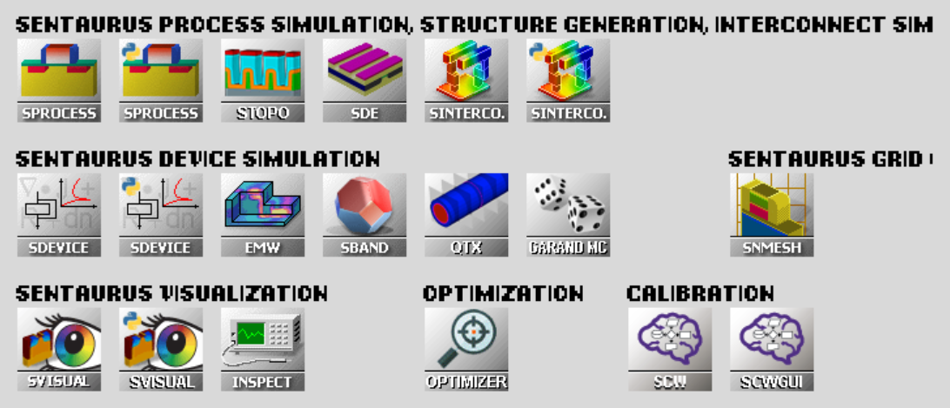
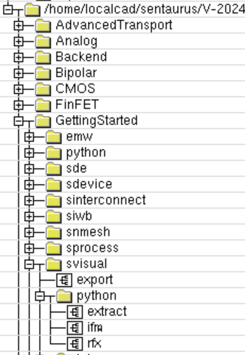
Technique 3 for simulation
Some of Sentaurus tools now support Python
(The Python interpreter built into Sentaurus: gpythonsh).
🙂
If you want to the AI agent to help you with simulation, Python is undoubtedly the best choice.
Please select the tools with the Python label.
Official example

Slide 21
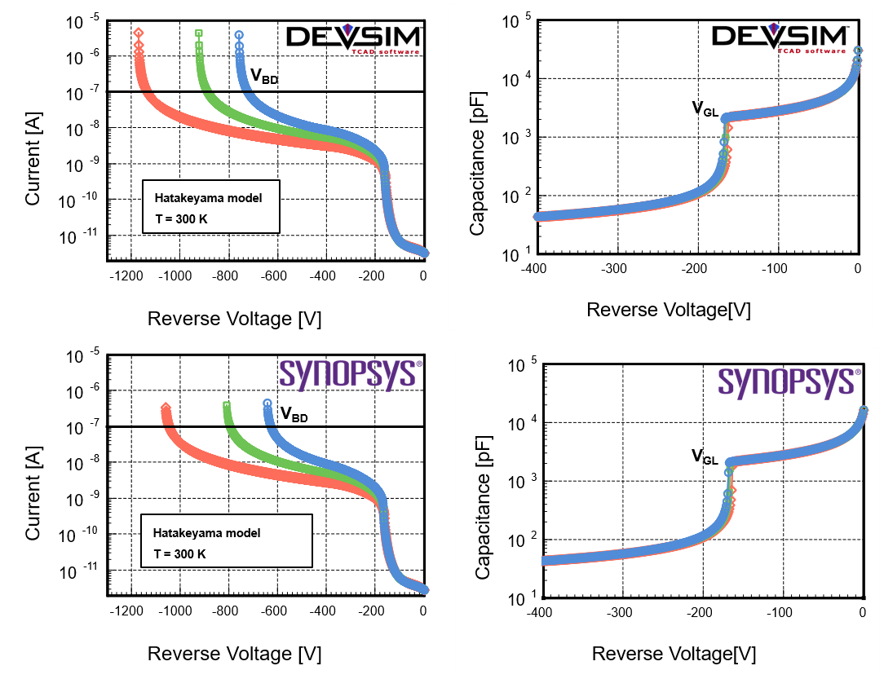
Technique 4 for simulation
😐
If you don't have licenses of Sentaurus and Silvaco …
SiC LGAD Simulation by DEVSIM & Sentaurus
DEVSIM is a open source semiconductor device simulation software based on Python:
DEVSIM TCAD Semiconductor Device Simulator
You (codex or claude) need a deep understanding of TCAD, along with enough math and physics to build the equations and simulation programs in DEVSIM.

Slide 22

Technique 5 for simulation
Don't become a "TCAD Monkey"

Slide 23
Thank you!
Ana Sofia Calle
University of Illinois Chicago
ascall@uic.edu
Tao Yang
Lawrence Berkeley National Laboratory
tao.yang@lbl.gov

