Slide 1

Hands-on Projects presentation
Exercise Session A: TCAD (and AllPIX²)
Aliki Sofia Rotelli (aliki.rotelli@physics.ox.ac.uk)
University of Oxford
Paul Martin Sander (pasander@phys.ethz.ch)
ETH Zürich, Paul Scherrer Institute Villigen
SLAC, Stanford, US
August 3rd 2026

Slide 2
What are we working on

Slide 3
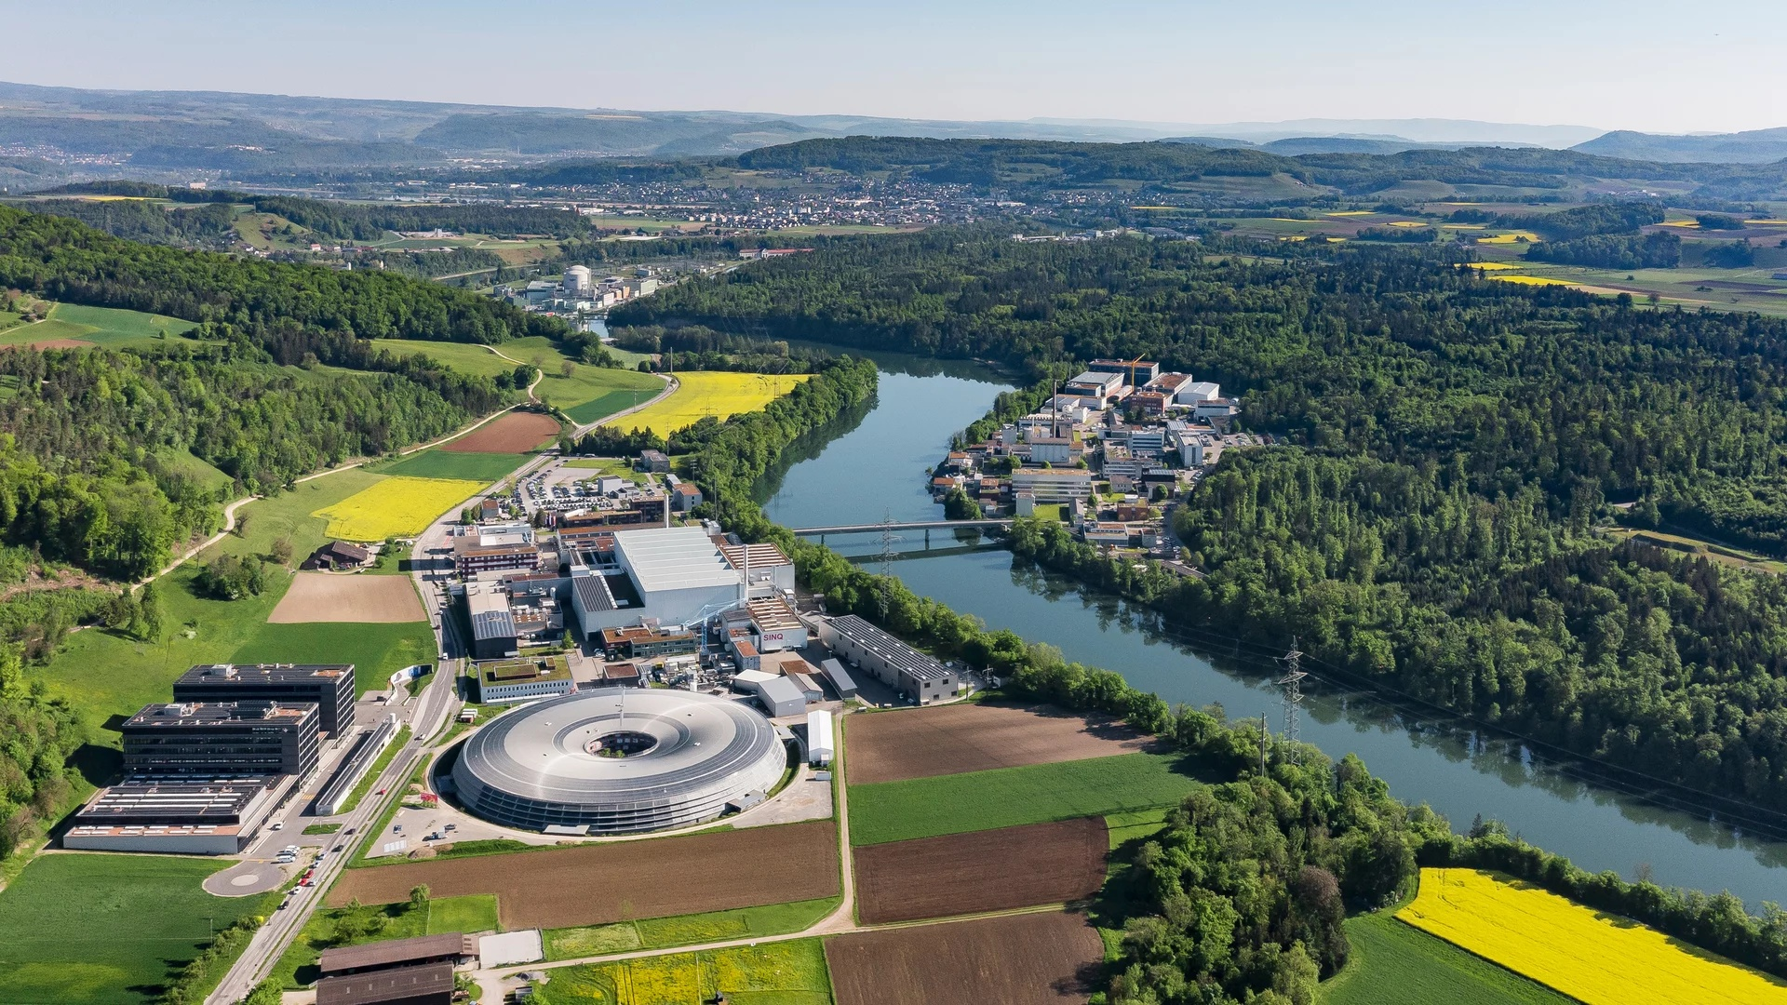
Where we can be found (currently)
CNM
Mu3e

Slide 4

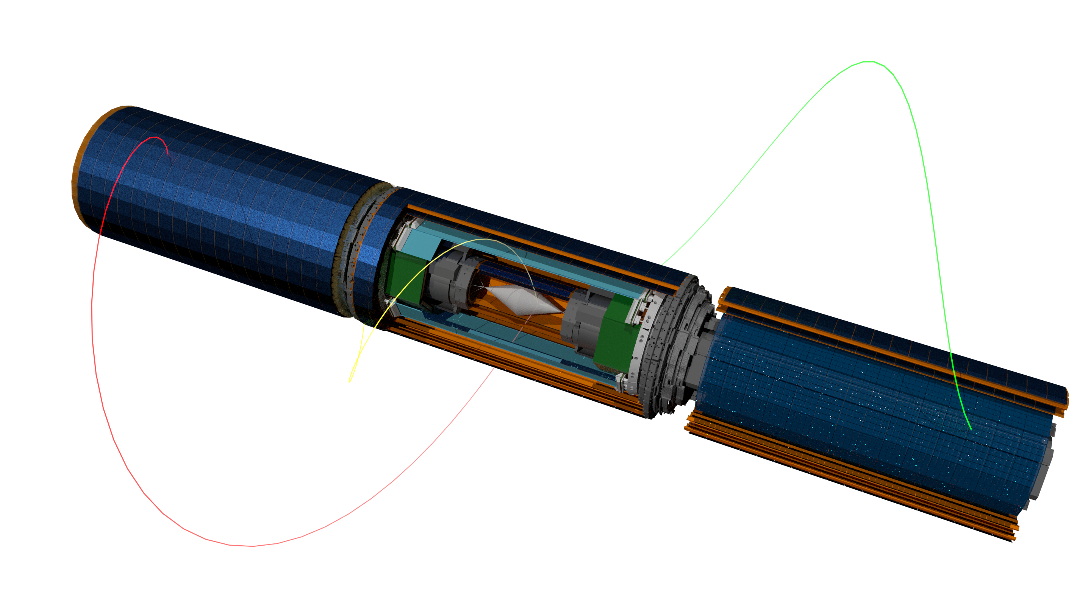

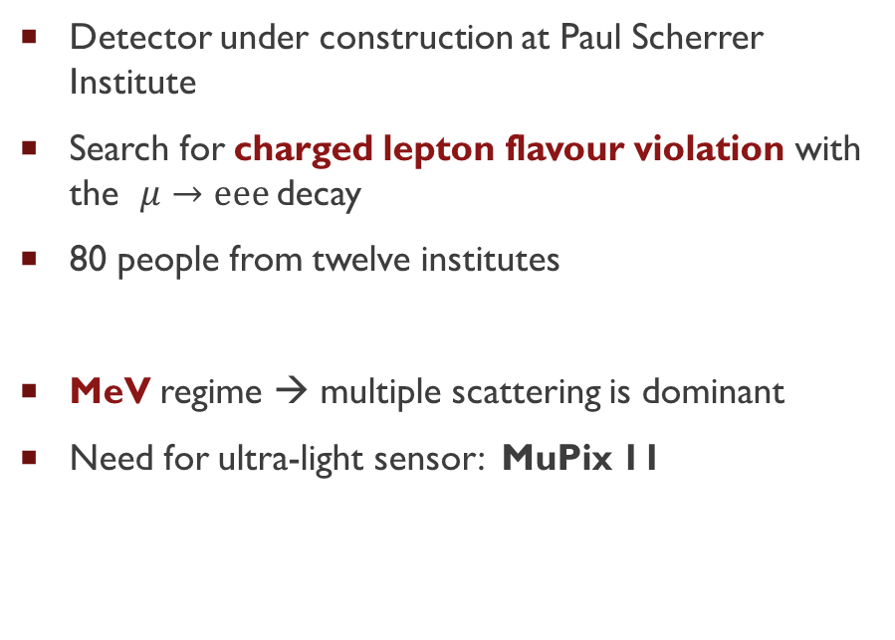
Mu3e
Detector under construction at Paul Scherrer Institute
Search for charged lepton flavour violation with the $μ→eee$decay
80 people from twelve institutes
MeV regime → multiple scattering is dominant
Need for ultra-light sensor: MuPix 11
Target
μ decay at rest
!
110 cm
1T B-field
particles recurl

Slide 5
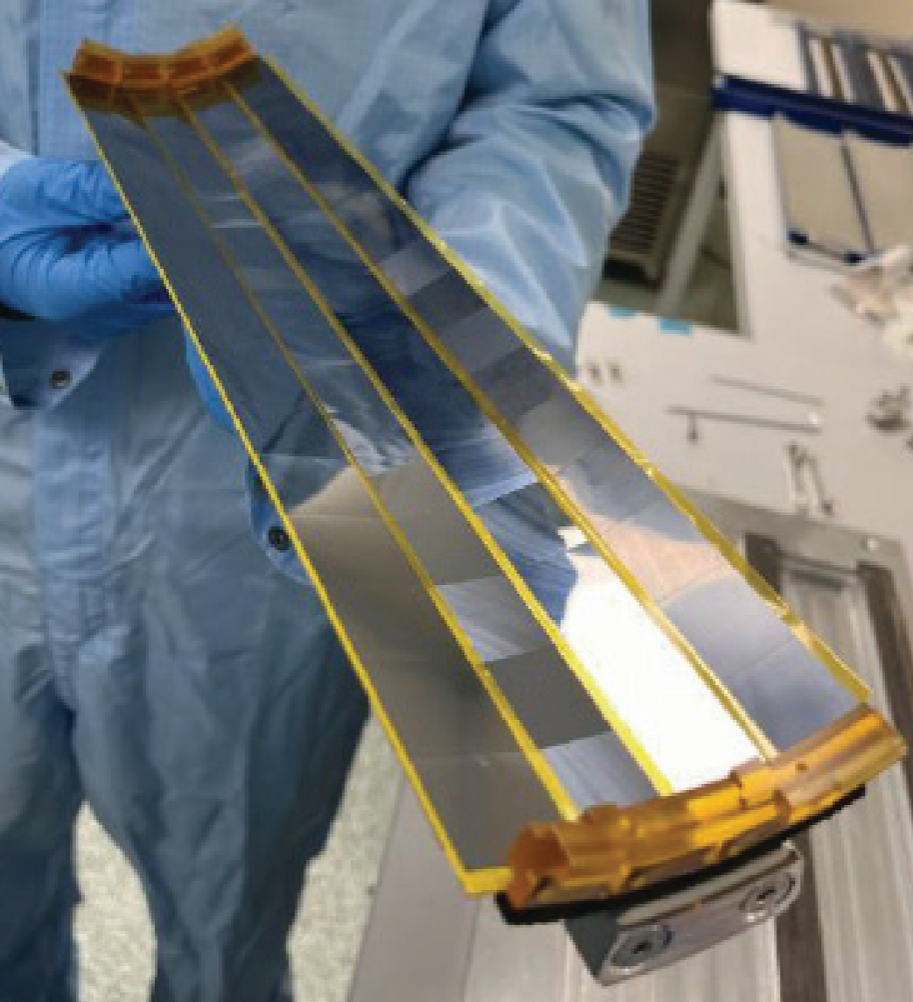
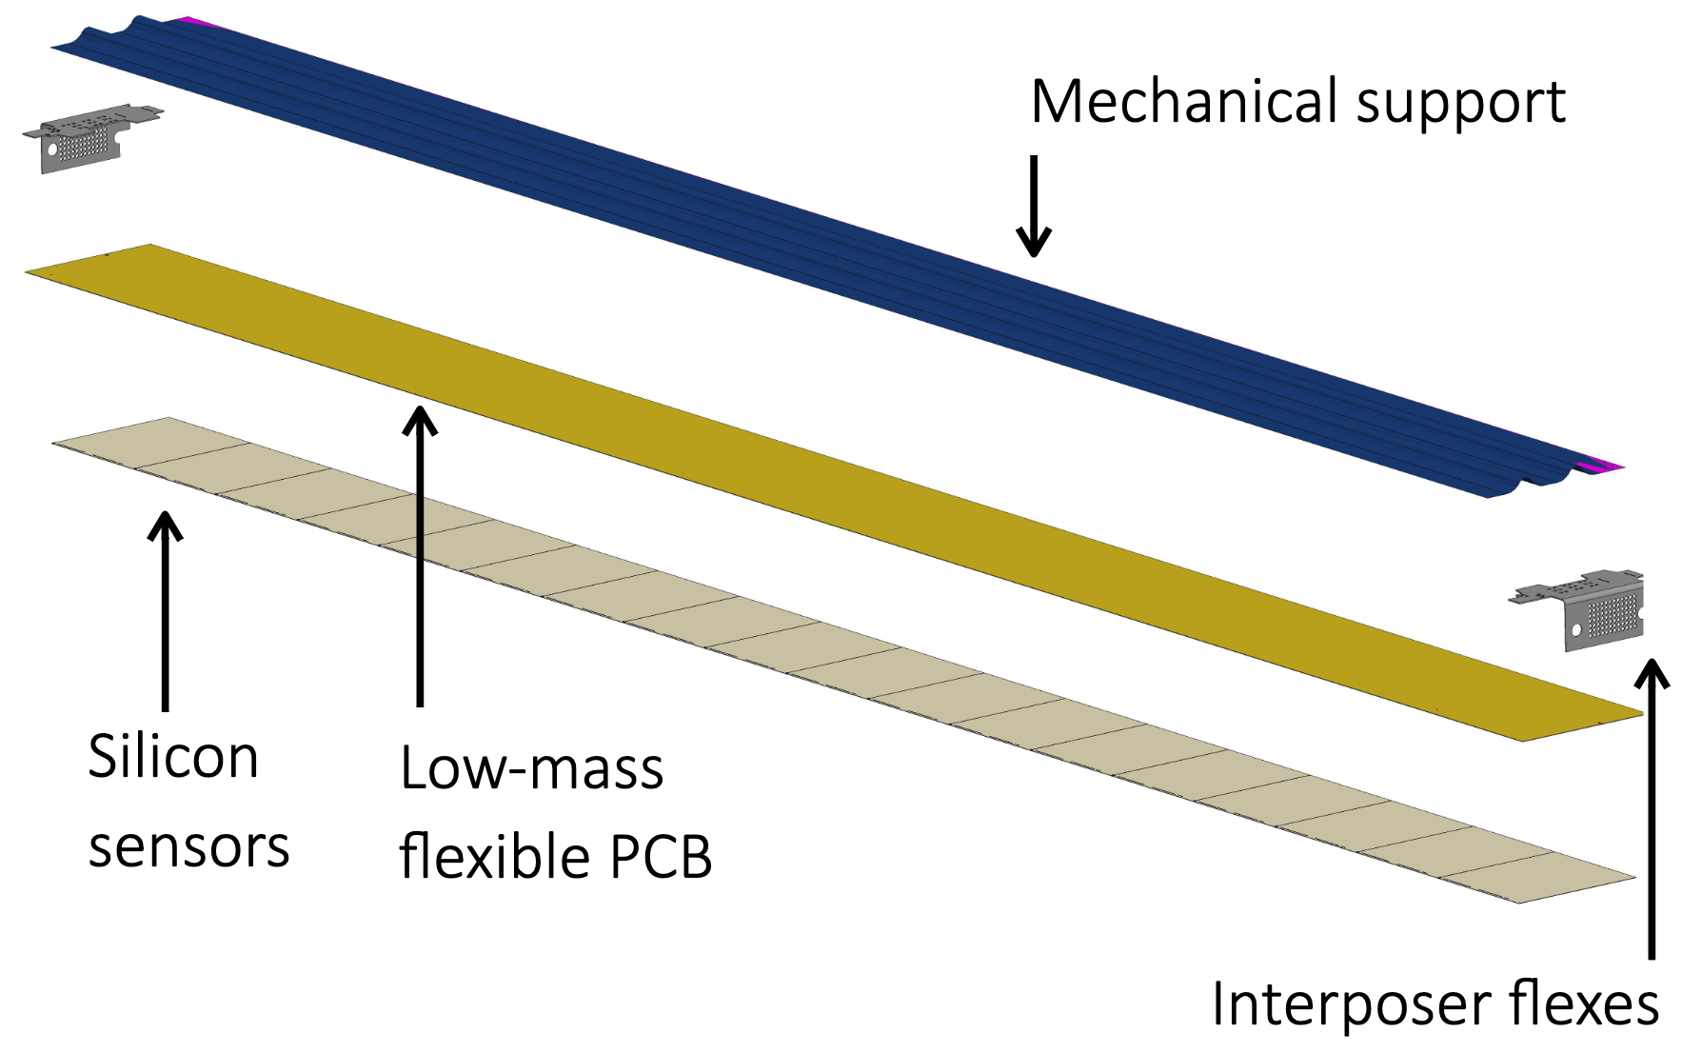
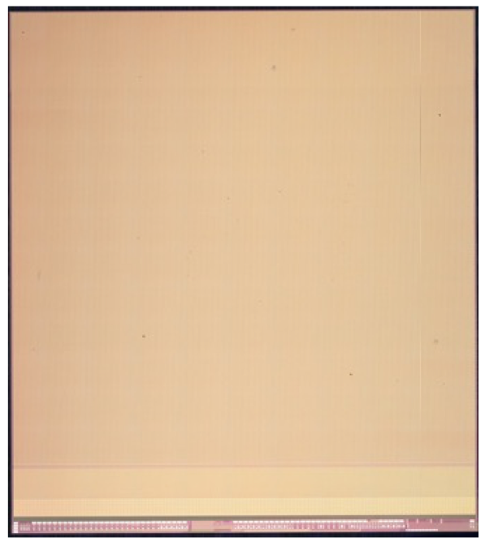
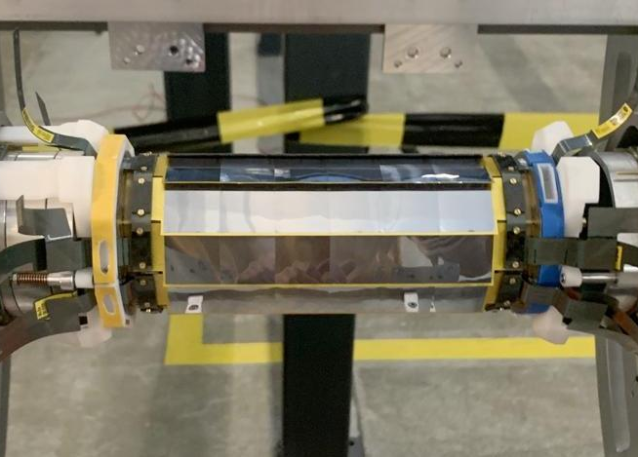
MuPix11 (HV-MAPS)
25µm thick carbon fibre support
Thinned to 50-70µm
80µm pixel pitch
< 20ns time resolution
> 99% efficiency
Vertex:108 MuPix11
Outer Pixel: 2736 MuPix11 with >1m² silicon
0.001 X₀ / X, 36cm long, weight ~2g

Slide 6
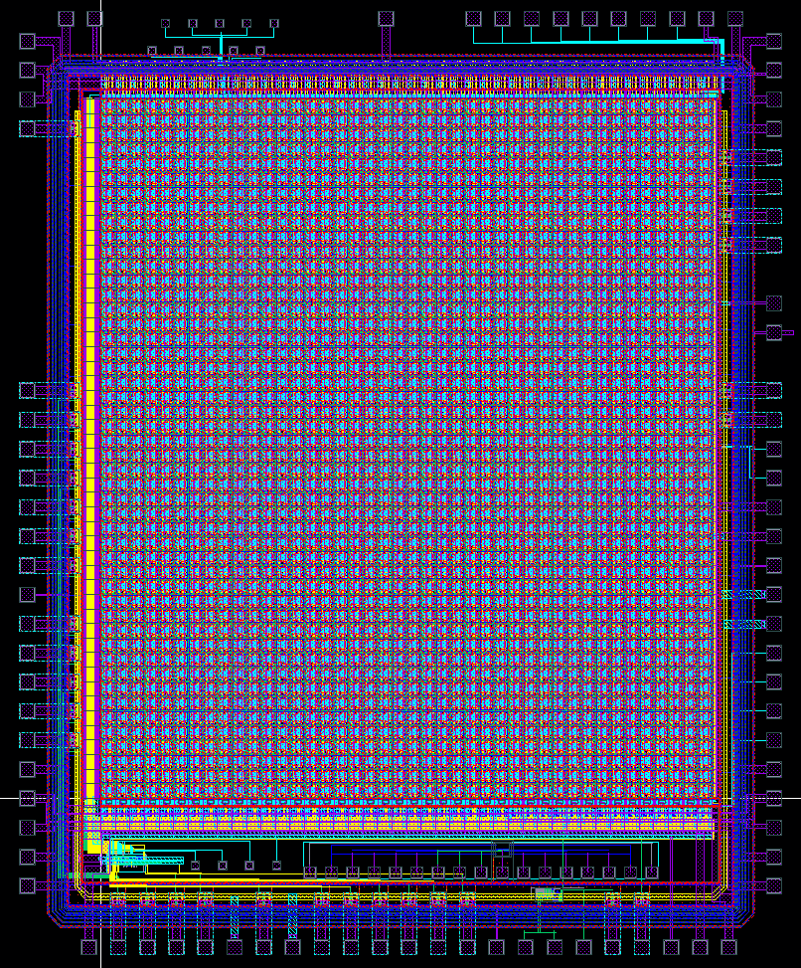
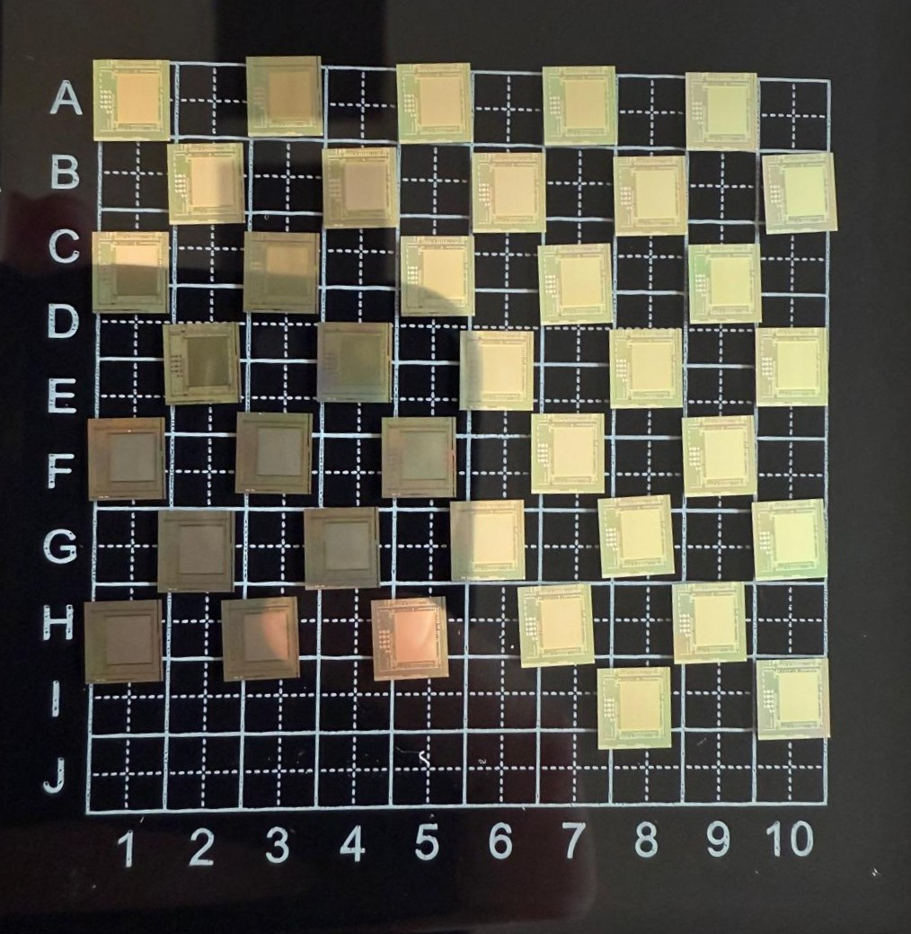
PANTHER 1 (HV-MAPS)
Generic R&D on MAPS to achieve < 100ps timing by the CNM at Paul Scherrer Institute
LFoundry 150nm, large fill factor and backside implant
Features of version 1 (2024) :
  75µm x 75µm in 42 columns with 48 rows
  Three different front ends, pulse recorded per pixel
  TDC with tens of picosecond resolution per column
My work: Characterization, measurements, simulation and design for version 2 and 3

Slide 7
Hands-on exercise A: TCAD and Allpix²

Slide 8
What are sentaurus TCAD and allpix2
Geometric considerations
Sentaurus TCAD
Allpix²
Pixel size
Doping/Implants
…
Model device
Meshing
Solve system
Apply voltage
Extract charge densities
Extract electric fields
Guard rings
Fill factor
Simulate particle interaction
Propagate charge carriers
Create electric signal

Slide 9
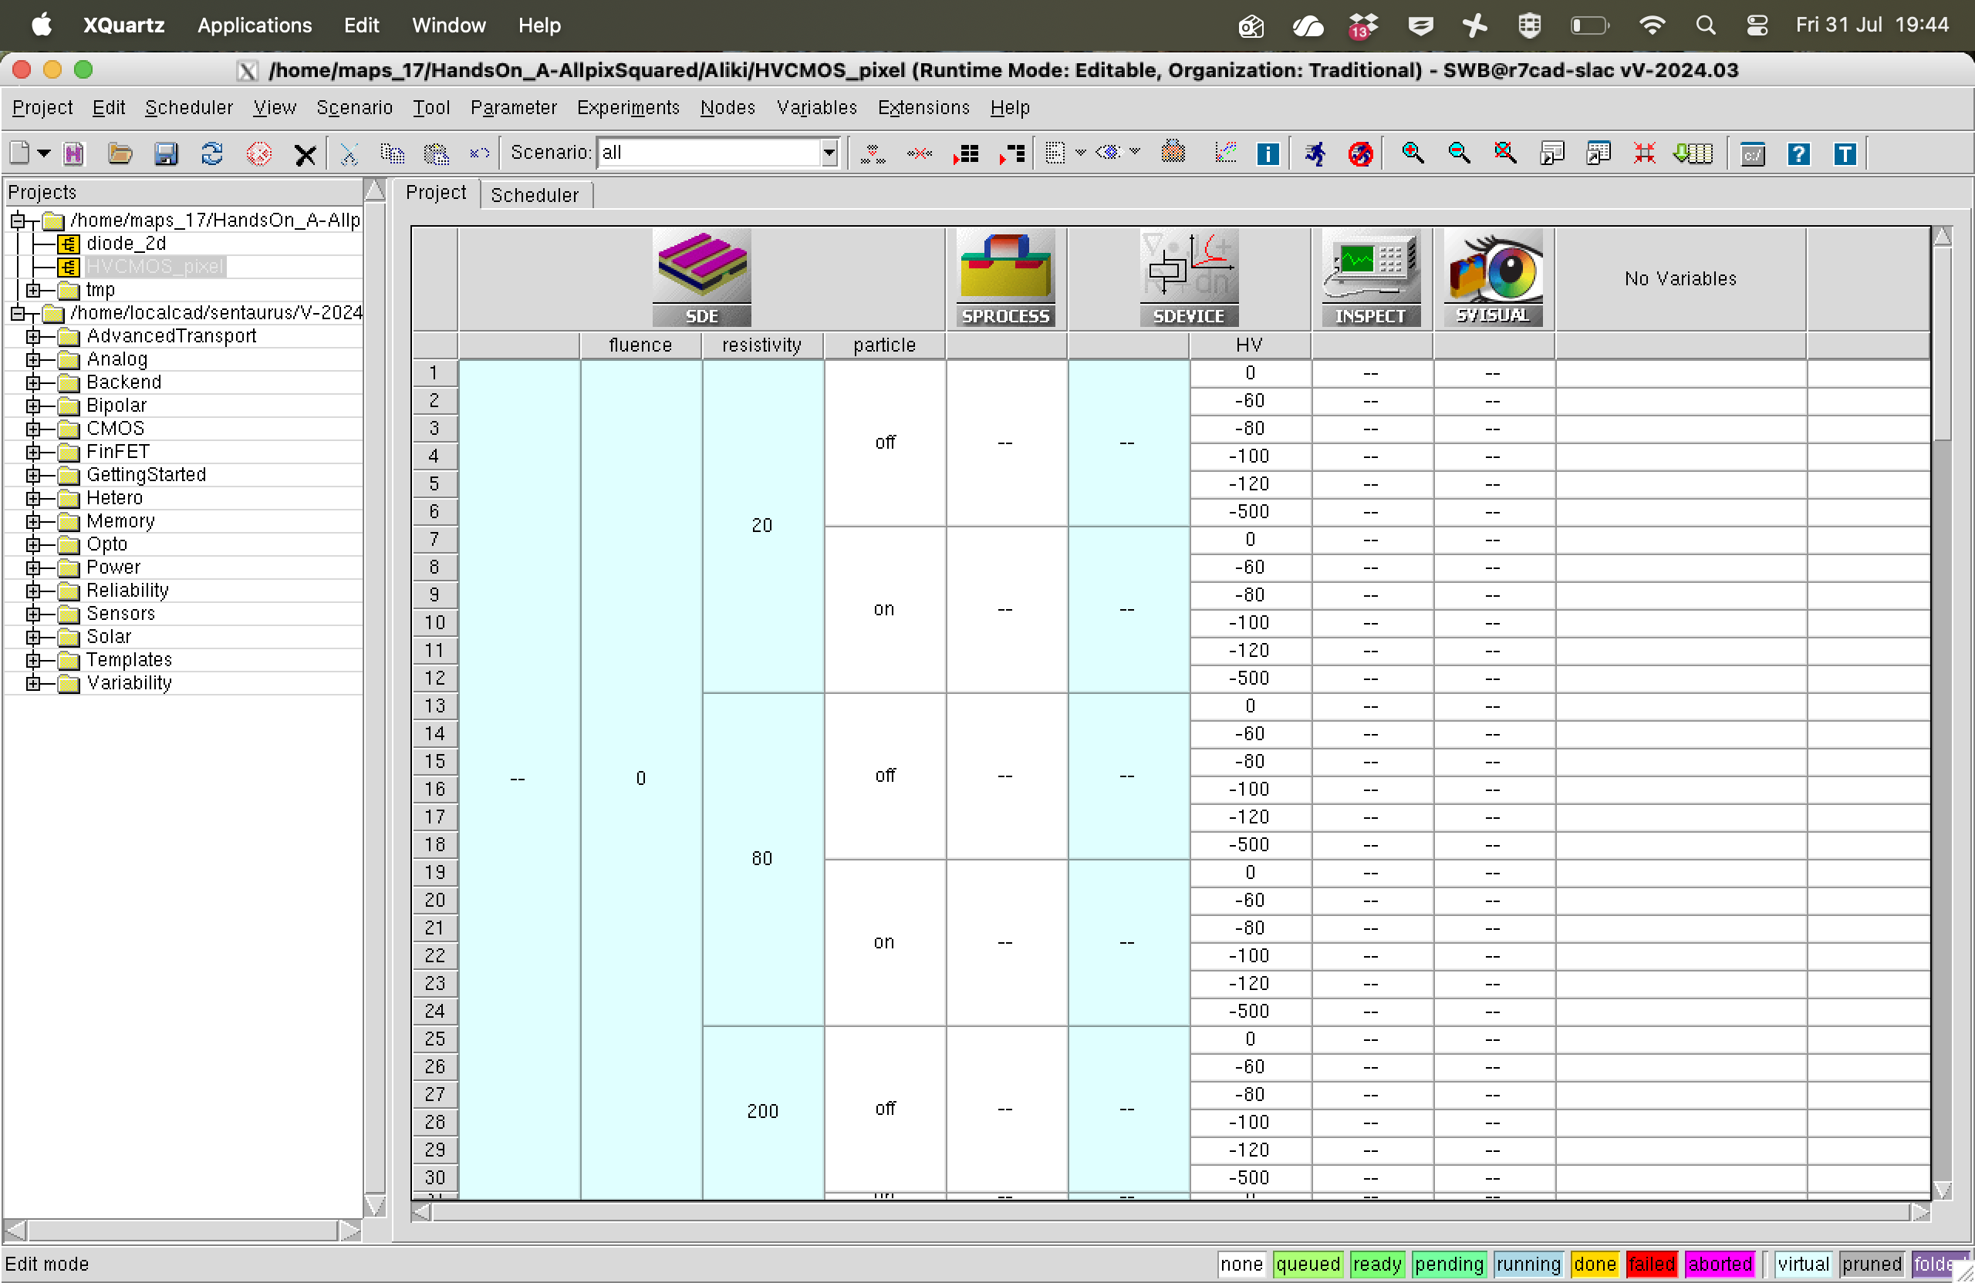
The tcad interface
Tools
Project directory
Simulation Tree
Node

Slide 10
The tcad interface
Tools
Project Directory
Simulation Tree
Node

Slide 11
The tcad interface
Tools
Project directory
Simulation Tree
Node

Slide 12
The tcad interface
Tools
Project directory
Simulation Tree
Node

Slide 13
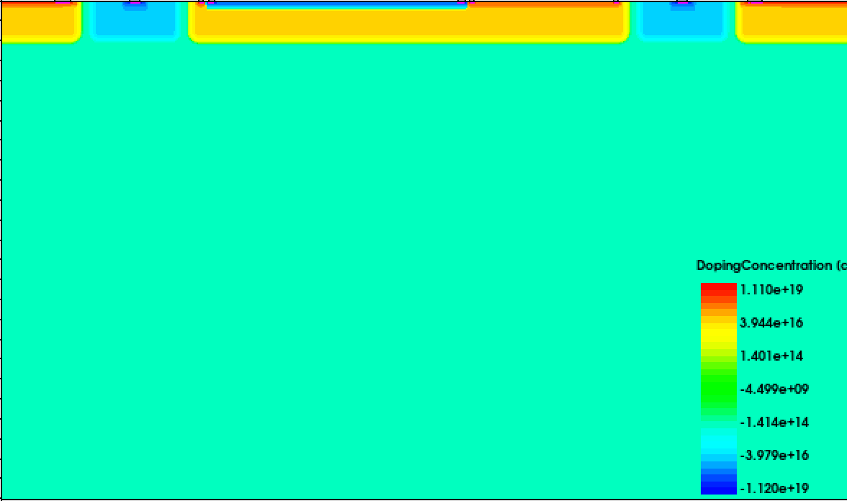
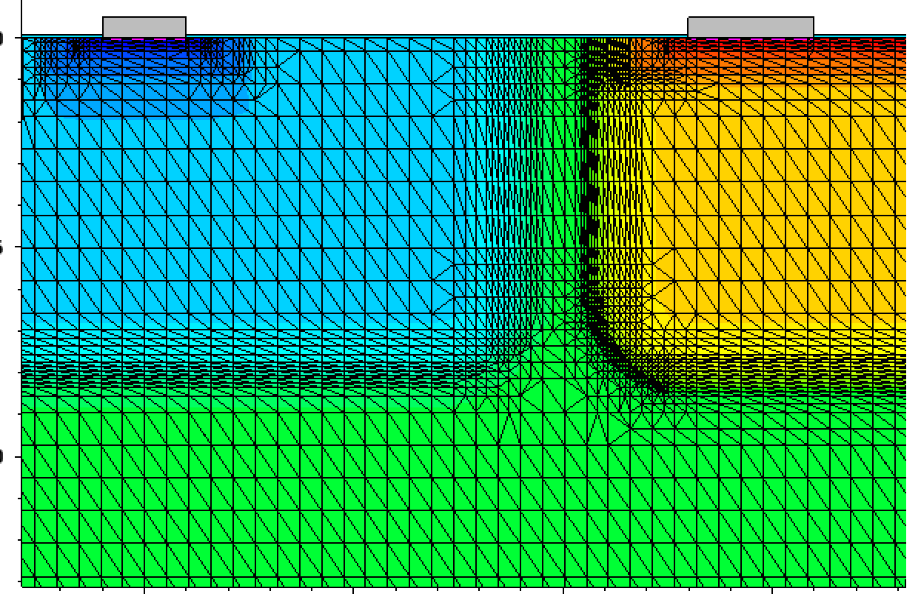
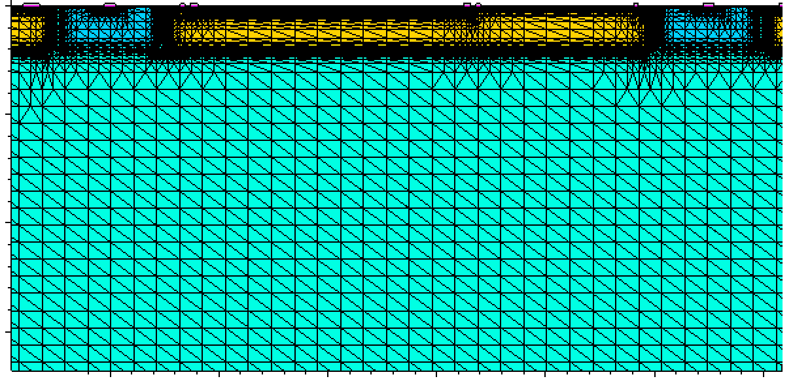
Device definition
Use of Synopsis Device Editor (SDE)
Define device geometry
Set physical parameters such as material, resistivity and doping concentration
Assign electrical contacts
Generate a mesh for the simulation. This divides the device into smaller volumes to linearize the problem.
Where the doping changes a lot, the mesh needs to be fine to adapt to the expected change in field

Slide 14
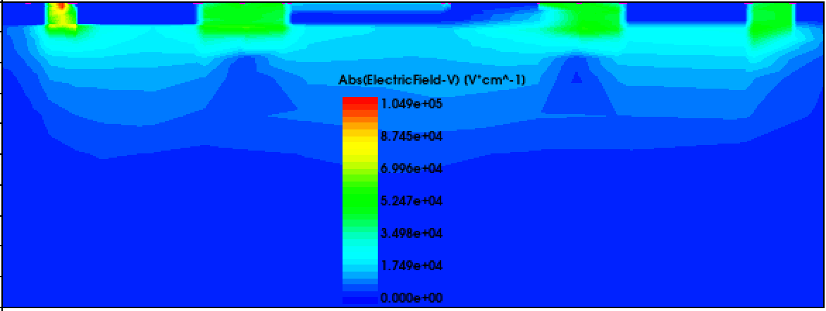
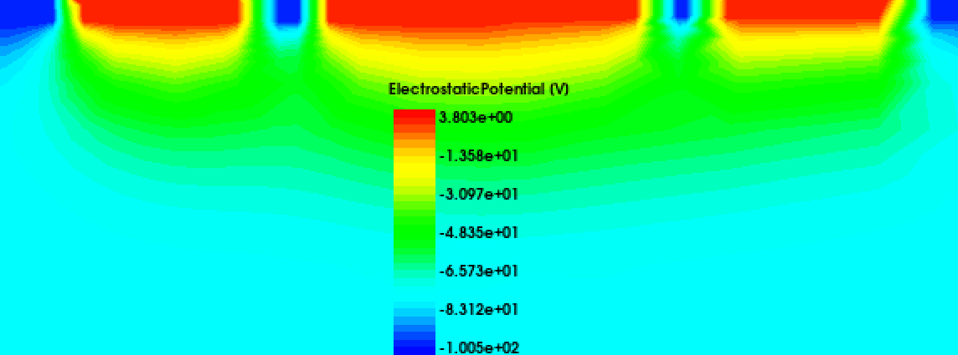
DEVICE simulation
Use of Synopsis Device Simulation
Tries to solve the partial differential equations for the potential, field and charge distribution
Starts with solving the equations independently, then combining them together where the previous result works as the starting point for the next simulation.
Applies voltages to the contacts and slowly increase towards the final voltage while solving the Poisson equation for each intermediate step.
Converge towards a solution with the potentials fully applied.

Slide 15
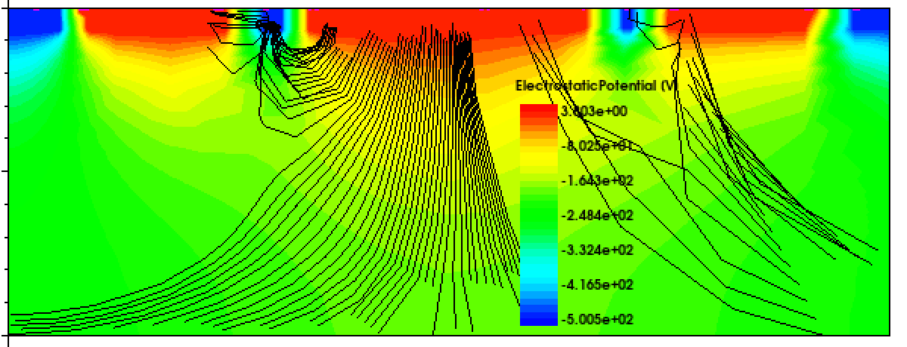
Extraction of the electric fields
The electric field is interpolated through the mesh
It can be used as a starting point to place particles in the electric field to simulate an interaction in the sensor.
It can be extracted from TCAD and then utilized in allpix² to systematically generate simulation.

Slide 16
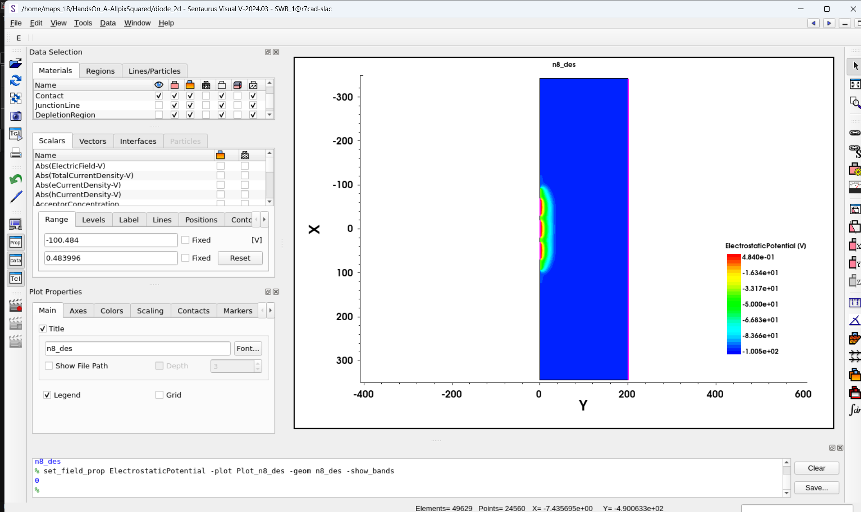
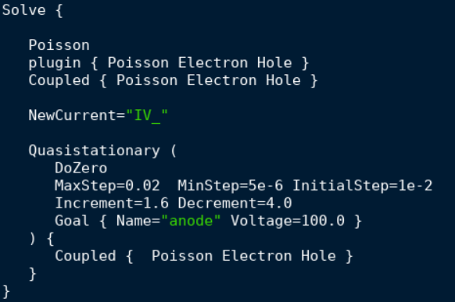
How did the hands on improve our understanding of maps
How to start up the software, navigate the interface and run already prepared simulations.
How a simulation is performed and which steps are taken during to reach a solution.
How to prepare our own setups and simulations.
How to understand and visualize the results.
We can simulate before we go to a testbeam to better understand our devices.
Sanity check for lab measurements e.g. IV, CV …

Slide 17
Feedback
Extensive and detailed introduction
Explanations with examples and anecdotes
Provide material beforehand
Dedicated time for working on the project for the presentation

Slide 18
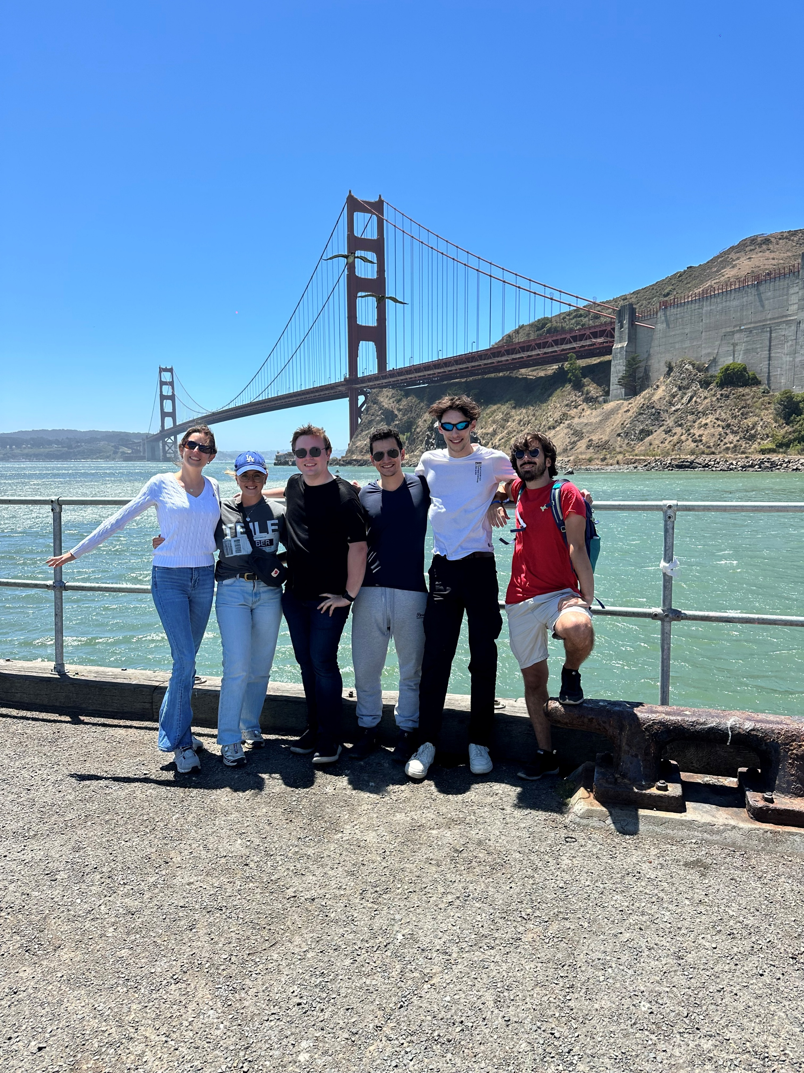
Thank you for your attention

