Slide 1
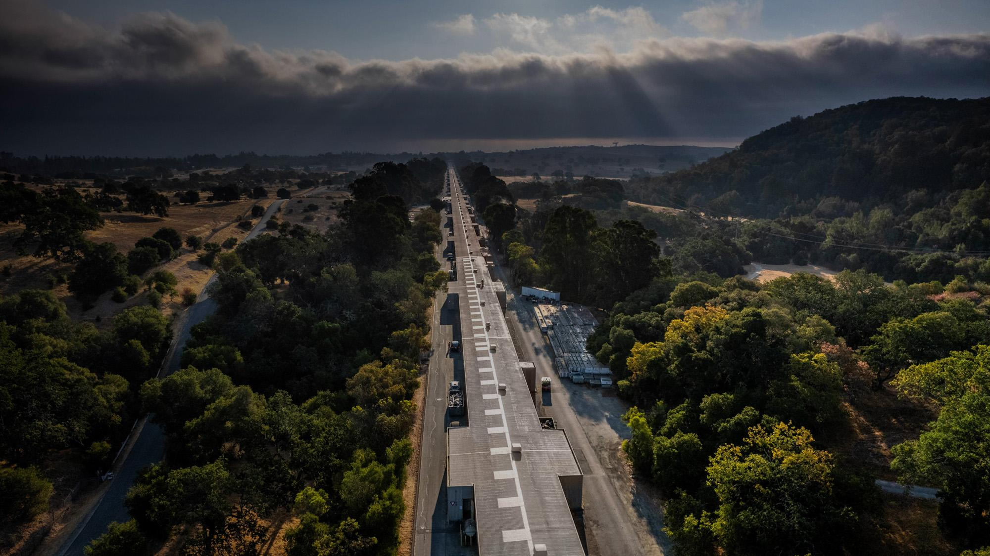



Close out
Caterina and Yuji
August 4, 2026

Slide 2
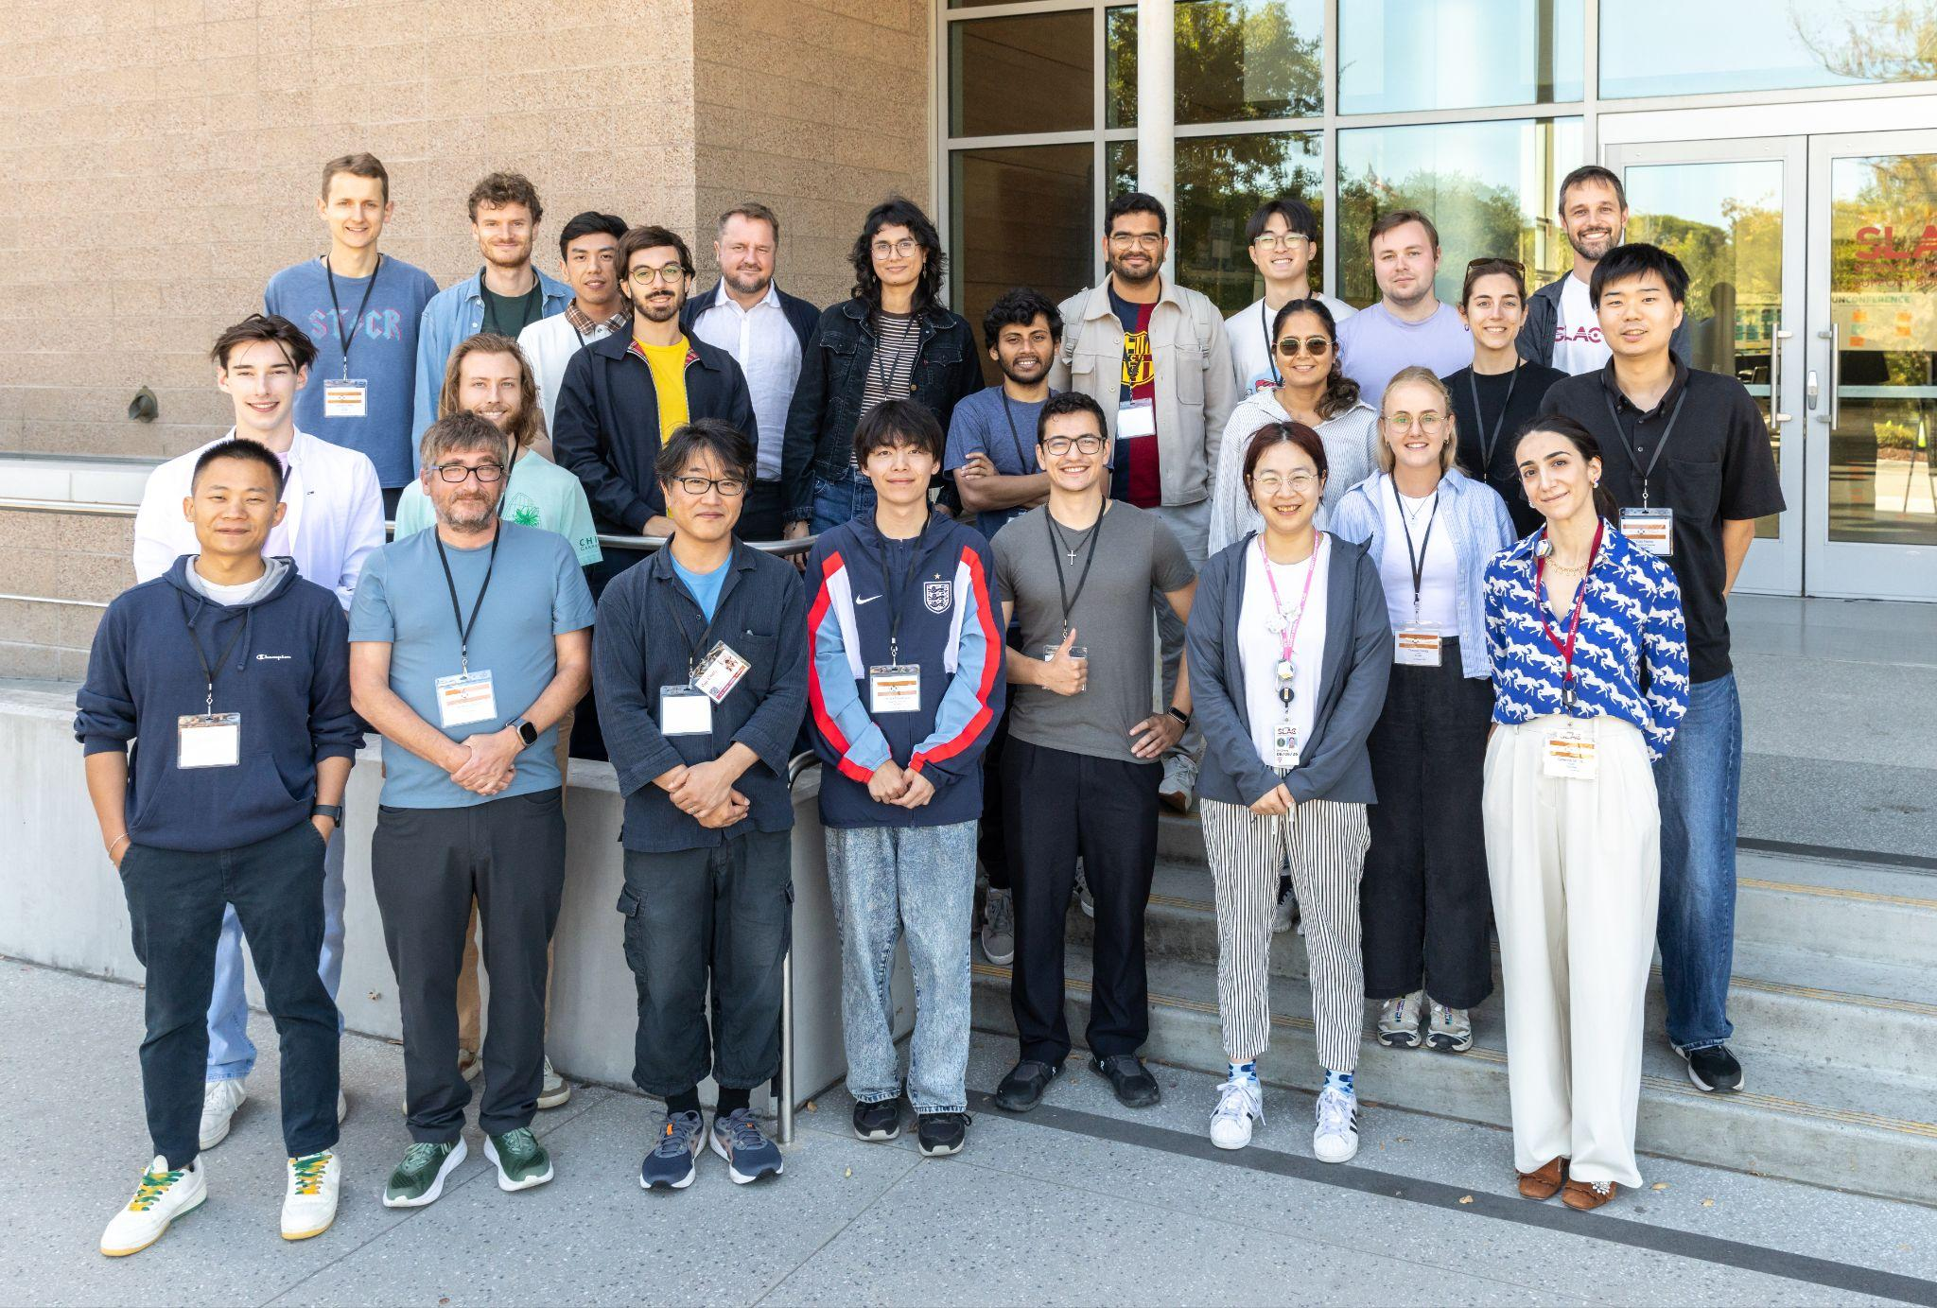
Thank you!
LOC

Slide 3
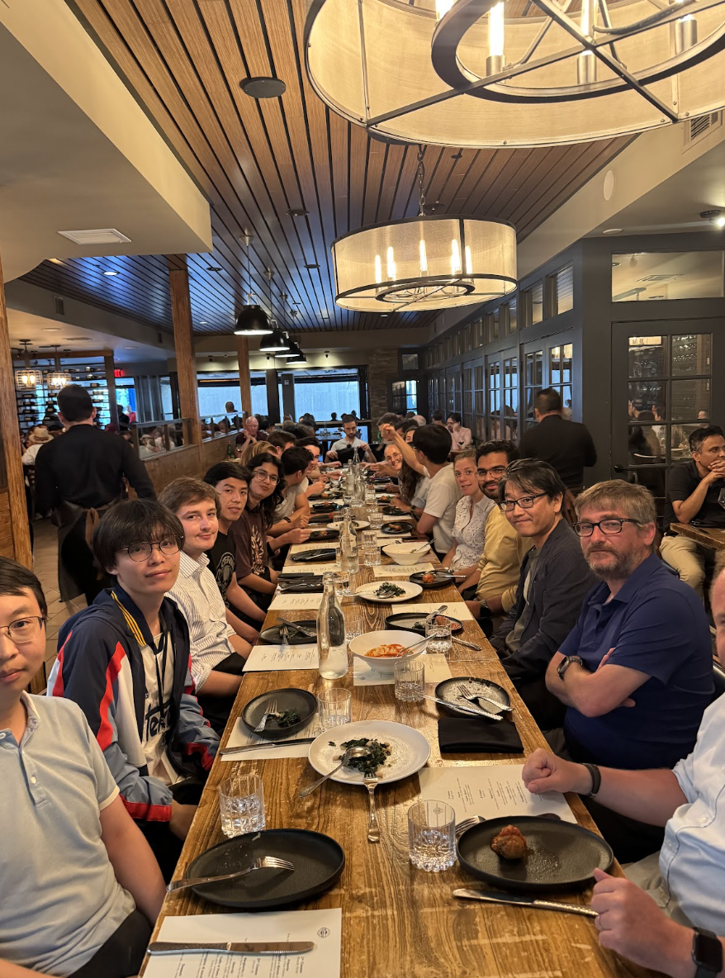
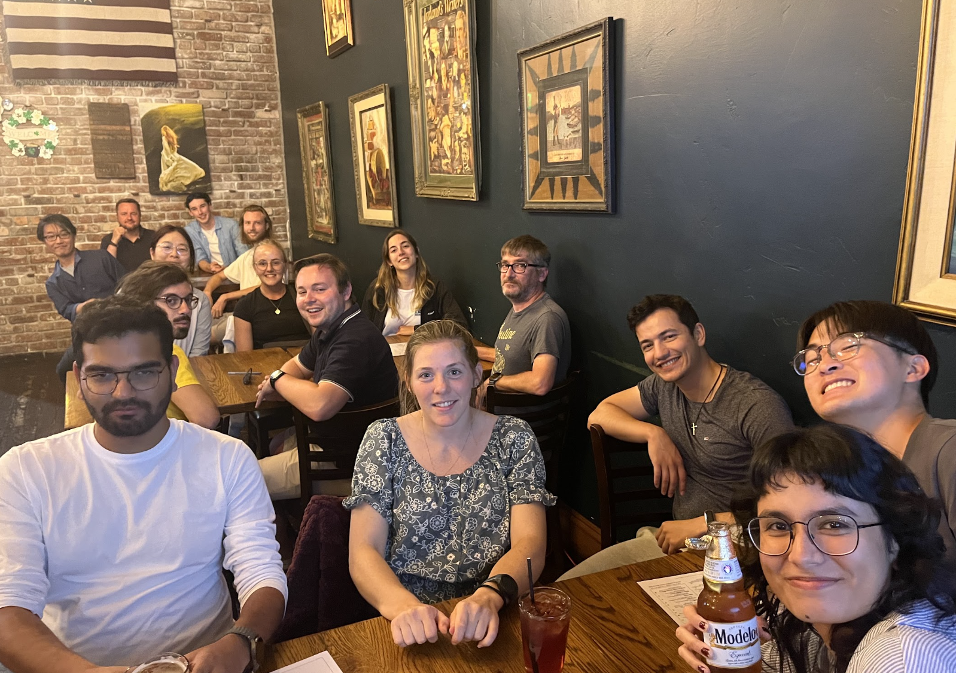
Trivia night, a true american experience!
thanks Mirella!

Slide 4
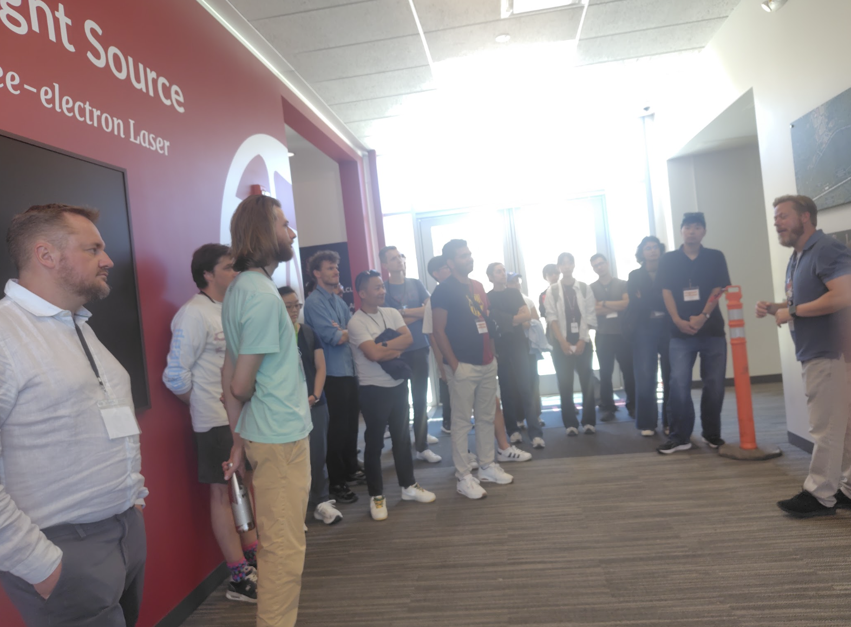
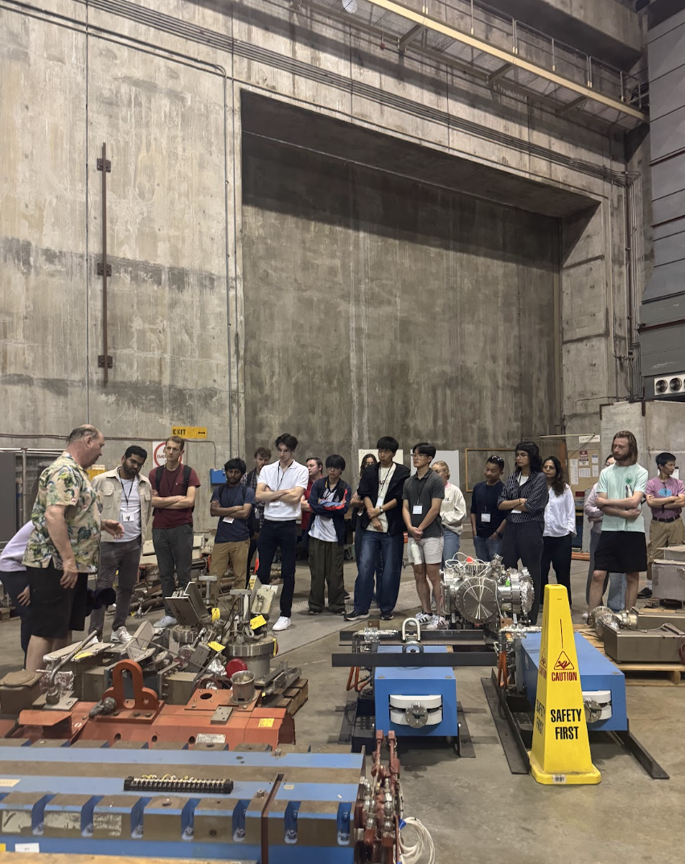
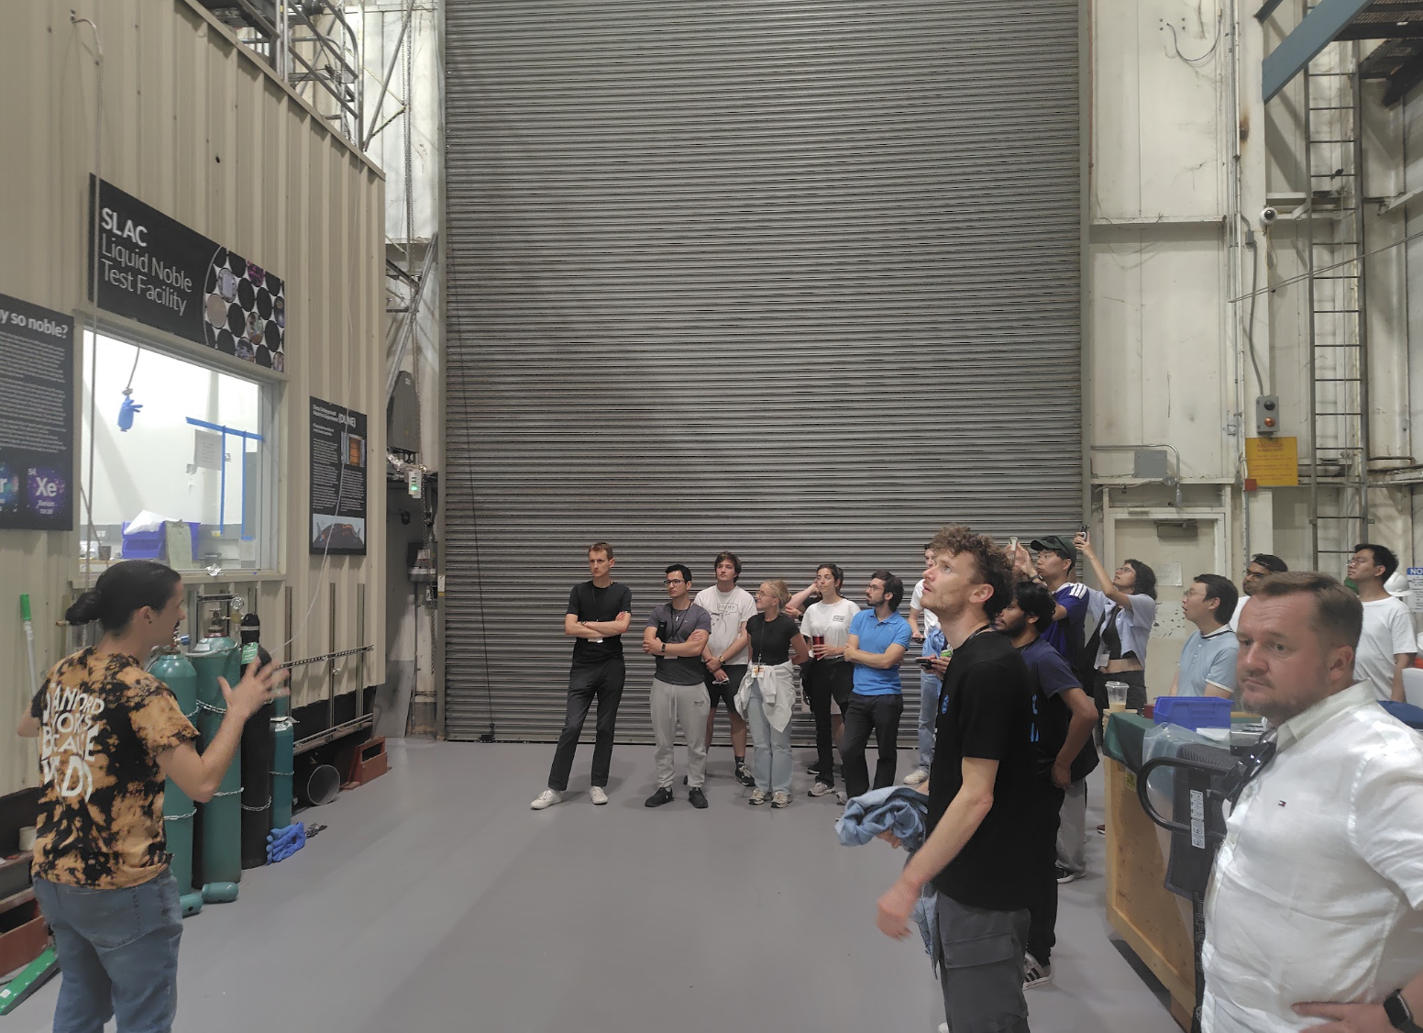
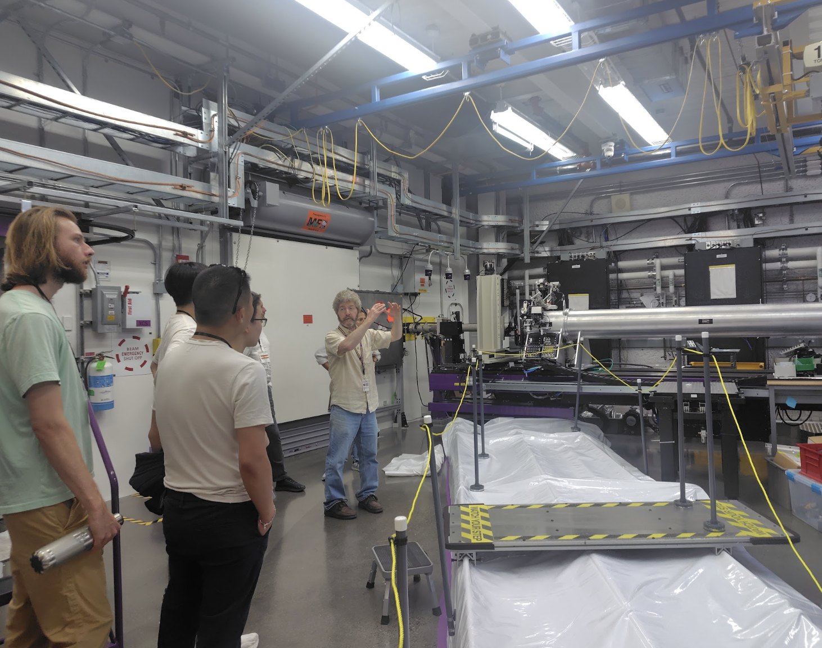
Where quarks were discovered!

Slide 5
Safe trips!!!
Before you go ….
Advertise this Academy in your institute and with your collaborators and peers
Give us (more) feedback to improve the school in future iterations.
https://forms.gle/1JLy9VhqTog5G1zL6

