Slide 1
July 28 – Aug 04, 2026
MAPS Academy 2026
Welcome - Detector R&D at SLAC
A. Dragone,
Program Director Detector R&D and Applied Microelectronics
Notes:
Good morning, everyone, and welcome to SLAC.It is a pleasure to have you here for MAPS Academy 2026. I would like to thank the organizers, instructors, and everyone who has worked to make this academy possible. In particular, organizing a program with a substantial hands-on component requires much more effort than organizing a traditional sequence of lectures.I have been asked to begin by giving you some context for detector research and development at SLAC—why we consider it important, how we organize it, and where MAPS fits within the broader program.I will not attempt to give you a complete overview of all our detector activities. In ten minutes, that would be neither possible nor particularly useful. Instead, I would like to leave you with three ideas:First, detectors define what science we are able to measure.Second, developing modern detectors requires a complete system-level approach.And third, MAPS is a very good example of why this multidisciplinary approach is necessary.

Slide 2
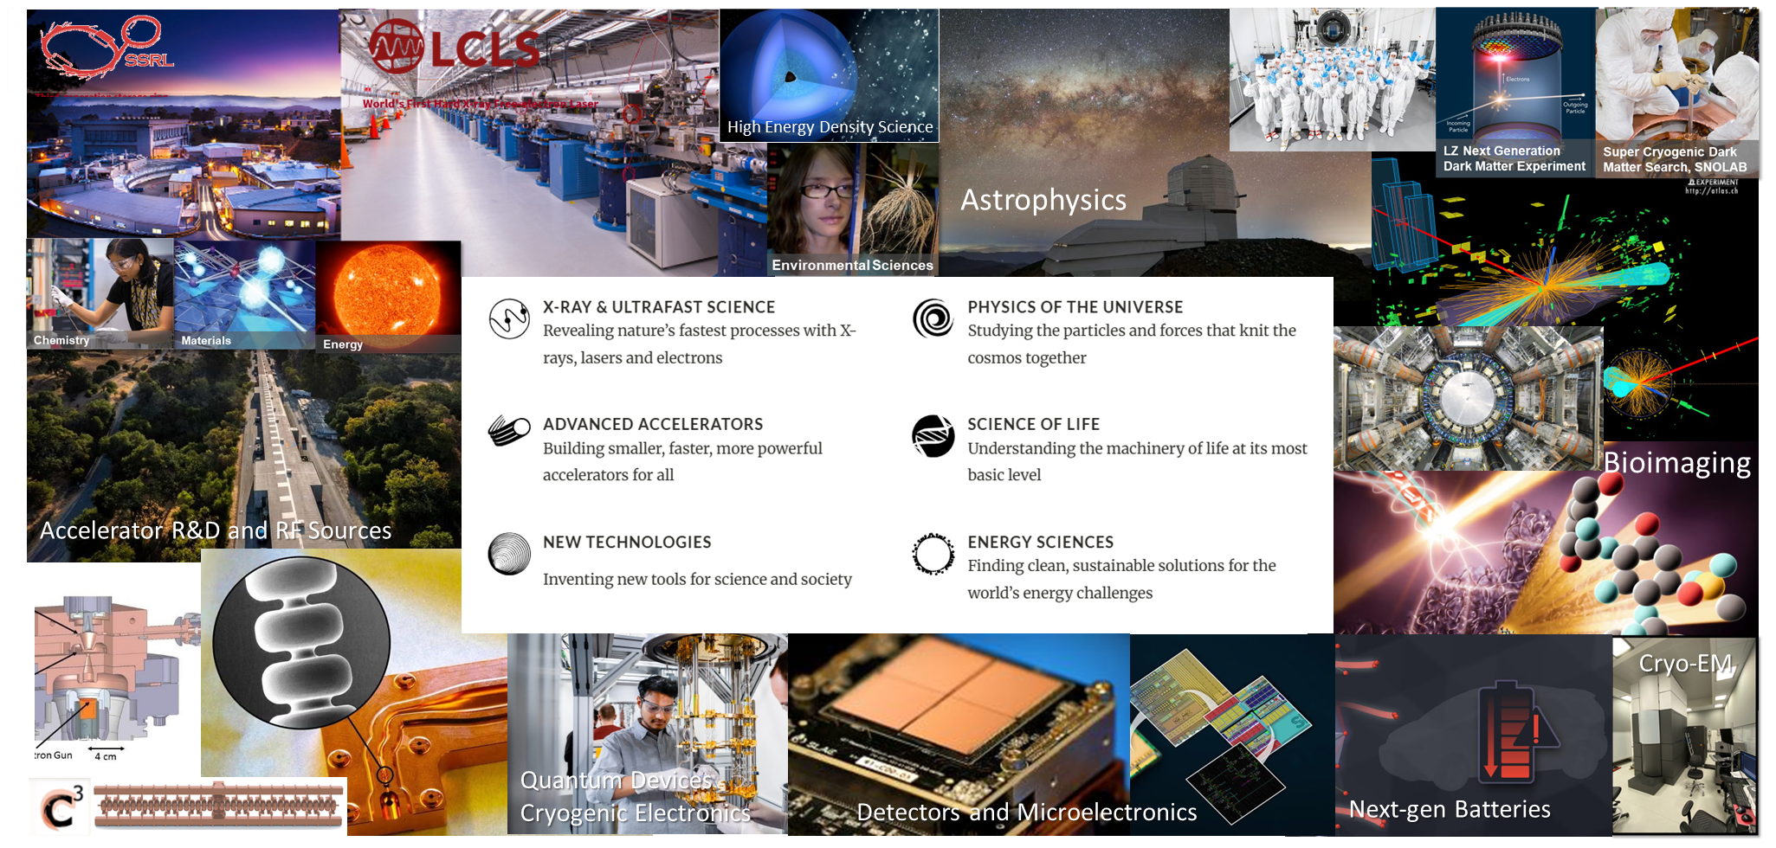
SLAC’s Unique Scientific Environment

Slide 3
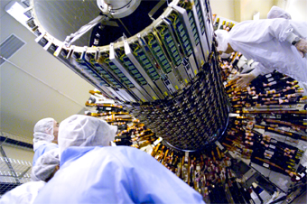
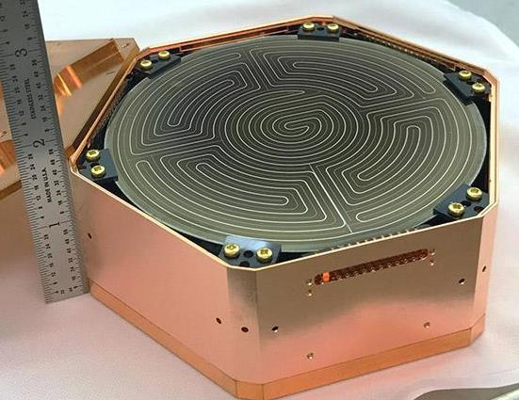
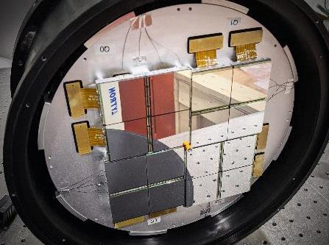
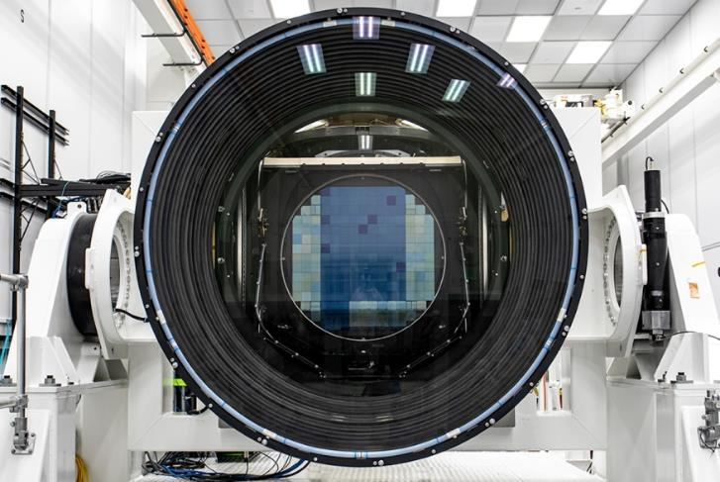
Detectors at DOE Labs: Building the Eyes for Scientific Experiments
ATLAS
Particle Detector
Whether designed for detecting particles in high-energy physics experiments, images from light-matter interactions in photon science facilities, or visible light in astrophysics telescopes, detectors are built to see ultra-small, ultra-fast phenomena and produce data from which science can be extracted.
ePix10k
2MPix X-ray Detector
LSST
3.2 Gpix CCD Camera
SuperCDMS cryogenic (15mK) Dark Matter TES based Ge Sensor
Notes:
We often describe detectors as the eyes of scientific experiments.
As you can see from the examples on this slide, the word “detector” covers an extraordinarily broad range of instruments.
ATLAS detects the products of particle collisions and allows us to study the fundamental constituents of matter.
SuperCDMS uses cryogenic detectors operating at temperatures of approximately 15 millikelvin to search for extremely rare interactions associated with dark matter.
The ePix10k camera measures X-rays at LCLS, capturing patterns produced by the interaction of intense X-ray pulses with matter.
And the LSST camera—now part of the Vera C. Rubin Observatory—uses a 3.2-gigapixel focal plane to observe the visible universe.
These instruments differ enormously in physical scale, operating environment, sensor technology, data rate, and scientific purpose. But they all perform the same fundamental function.
They convert a physical interaction that we cannot observe directly into an electrical signal, and then into numerical data from which scientific information can be extracted.
The analogy with an eye is therefore useful, but incomplete. A scientific detector does not simply take a picture. It must measure the quantities relevant to the experiment: position, time, energy, intensity, momentum, or some combination of them. Its performance determines whether two events can be separated, whether a weak signal can be distinguished from noise, whether a fast process can be resolved, and whether a rare event can be recognized.
The detector therefore establishes the boundary between what an experiment can imagine and what it can actually measure. That is why detector development cannot simply begin after the experiment has already been designed. The scientific question, the instrument, the detector, the electronics, and the data-processing system must be developed together. As facilities become faster and more capable, that relationship becomes even more important. Better sources do not automatically produce better science. Their capabilities can be fully exploited only if the instrumentation can measure what they produce.

Slide 4

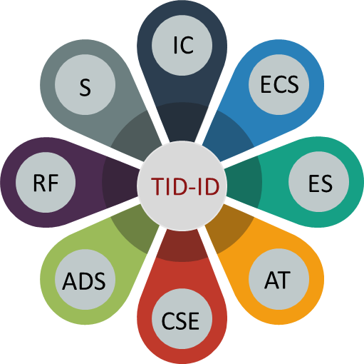
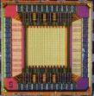
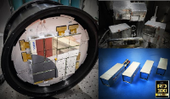
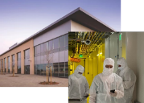

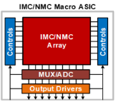
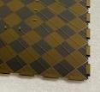
How Detector R&D Works at SLAC
Sensors (S)
Electronic Systems (ES)
Integrated Circuits (IC)
Assembly & Test (AT)
Edge Computing Systems (ECS)
Algorithmic Data Systems (ADS)
Mixed-Signal ASICs in Extreme Conditions Design and Characterization
PDK modeling for extreme environments
RadHard ASIC design in nodes from 130nm down to 22nm
Cryo-CMOS down to 4K
Cryogenic Waveform digitizing System-on-Chip
RF & Analog Systems (RF)
Control Software Engineering (CSE)
Novel Sensors Design and Characterization
Low noise Monolithic Active Pixel Sensors
Ultra low noise CMOS sensors
Sensors with built in amplification (LGADs)
High QE low energies entrance windows
Identifies common needs across the lab, acting as a use-Inspired R&D hub on Instrumentation Systems
State-of-the-art infrastructure for design, characterization and calibration of Instrumentation from proof of principles to full systems “ready for science”
Scaling and small production capabilities
Maintains critical mass required to keep up on latest technologies and practices.
Broad perspective reinforces system design skills and co-design approach across the lab.
Vet and guides design practices, reinforcing reuse and consistency.
Provides mentorship for young staff , creating a diverse pool of talent (12 Stanford students over 3 years through EE214B and HEPIC Traineeship program)
Intelligent Sensing Network Architectures
High frame rate pixel array detectors
Precision energy resolution and timing,
Trainable data–driven adaptive architectures
System Integration, small production and calibration
Low-power Monolithic Active Pixel Sensors (MAPS) with ns timing
Ultra high rate X-ray detector systems for photon science applications
Quantum and Superconducting Device Design, Fabrication and Characterization
New superconducting foundry under construction
Toolset dedicated to superconducting quantum bits and sensors
Ex-fab facilities for dicing, packaging & cryo-test
Edge Computing / ML
Fast AI featurization processing
Beyond Von Neumann computation: in-memory computing, natural algorithms on CMOS, for energy efficient intelligent systems
DMF 5,500 ft2 class-100 superconducting fab for qubits, detectors and advanced quantum devices.
Advanced Packaging and Interconnections
Ultra fine pitch bump bonding for pixel
Wrap-around interconnections
Flexible substrates integration
Development of in-/near-memory architectures for efficient ML-based distributed data processing.
Wrap-around aluminum traces on edges of glass chip
Notes:
This brings me to how detector and instrumentation R&D is organized at SLAC.
The diagram on this slide shows the range of capabilities brought together within the Technology Innovation Directorate’s Instrumentation Division.
They include sensor development, integrated circuits, RF and analog systems, electronic systems, assembly and testing, edge computing, algorithmic data systems, and controls software.
The main point is not the individual names of the groups. The important point is that all these capabilities must work together.
A modern detector is not only a sensor.
It is a sensor connected to front-end electronics. Those electronics require integrated circuits, power, communication, timing and control. The sensor and electronics must be packaged and cooled. Their data must be collected, calibrated, processed and delivered to the scientific application. The complete system must also be reliable, maintainable, and capable of operating in a real experimental environment.
No single person—and increasingly no single traditional discipline—can develop the complete instrument.
Our role is therefore to maintain a laboratory-wide, system-level capability that connects these elements.
We identify instrumentation needs that appear across different scientific programs and use them to drive use-inspired research and development.
We maintain the infrastructure needed for design, fabrication, characterization, calibration and system integration.
We support the progression from an initial proof of principle to an instrument that is ready to produce science.
This last step is particularly important. There is a large difference between demonstrating that a device works once in a laboratory and delivering an instrument that scientists can depend on during an experiment.
That transition requires engineering, packaging, firmware, software, calibration, quality assurance, production capability and operational support. It also requires close interaction with the scientists who will use the instrument.
Another important aspect of the program is the development of common technologies and reusable building blocks.
It would be inefficient—and often impossible—to begin every new detector from zero. Common interfaces, design blocks, electronics, firmware, software and test infrastructure reduce development time and technical risk.
At the same time, each new scientific application pushes those common capabilities forward. A solution developed for one project can become the starting point for the next.
Maintaining this breadth also creates the critical mass needed to follow new technologies, preserve specialized knowledge, and train the next generation of detector developers.
Students and early-career researchers are essential to this process. They bring new ideas and new tools, but they also need opportunities to work on complete systems and understand how decisions made in one part of a detector affect every other part.
This is one reason an academy such as this one is so valuable.

Slide 5
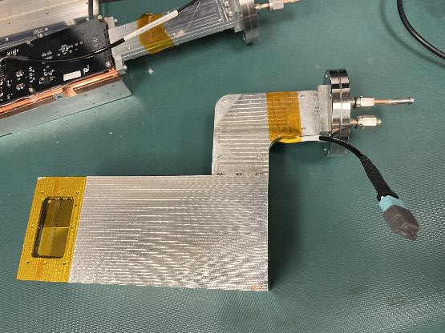
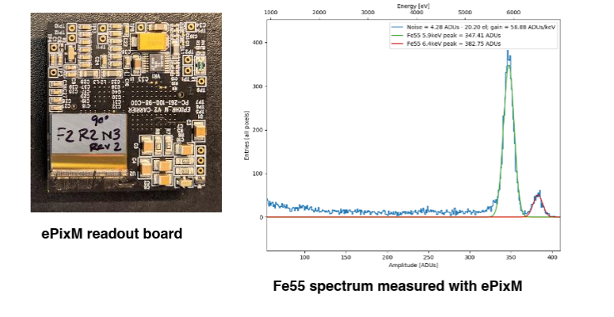
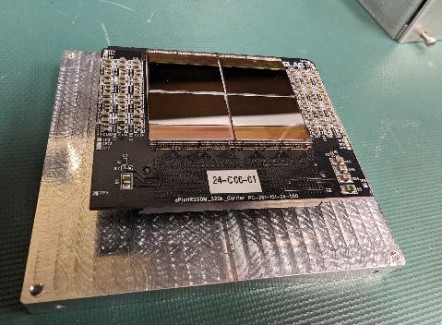
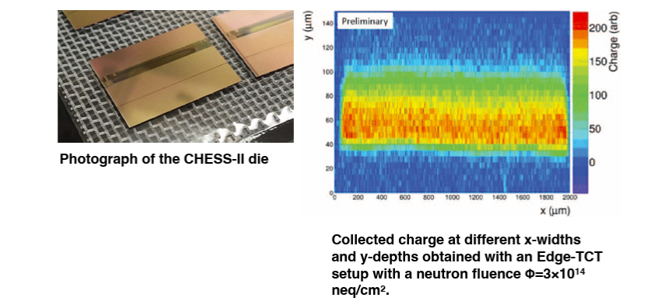
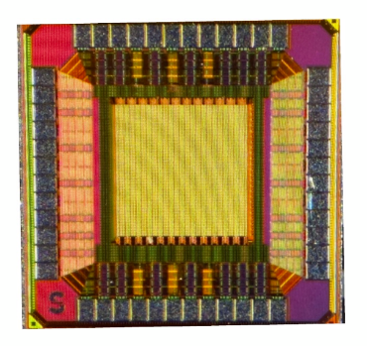
MAPS at SLAC
A common technology platform addressing very different scientific requirements
ePixM
Soft-X-ray MAPS detector for LCLS-II - From monolithic sensor to an operating scientific instrument
NAPA – MAPS with ns timing for future colliders
New monolithic pixel architecture
Exploring the next generation of integrated sensing and readout
CHESS-II
Monolithic sensor prototype for ATLAS
Initial studies on Radiation tolerance, charge collection and tracking applications
Notes:
The examples on this slide illustrate how MAPS activities fit into this broader program.
At the top is ePixM, a monolithic soft-X-ray detector developed for LCLS-II.
Here, the detector must combine sensitivity to relatively low-energy X-rays with low noise, useful dynamic range, high acquisition rate and integration into a complete camera system.
The images show both the detector hardware and a measured iron-55 spectrum. That progression—from device, to assembly, to measurement—is important. The objective is not simply to fabricate a chip. The objective is to create an instrument that produces reliable scientific data.
At the lower left is CHESS-II, developed in a different process and for a very different application: a prototype monolithic strip detector associated with the ATLAS program.
Here the requirements include charge collection after irradiation and operation in the environment of a high-energy physics experiment. The plot illustrates the study of charge collection within an irradiated device—connecting device structure, radiation effects and detector performance.
On the right is the NAPA prototype, representing another exploration of monolithic pixel architectures.
These examples are not intended as a complete catalog. They demonstrate that MAPS is not one detector and not one fixed architecture.
It is a technological approach that can be adapted to very different scientific requirements.
That adaptability is also what makes MAPS challenging.
The sensor and the readout electronics occupy the same semiconductor structure. The electric field, charge generation and charge transport affect the analog front end. The front-end architecture affects noise, timing, power and pixel dimensions. The digital logic affects data rate and communication. The fabrication process constrains all of them.
Decisions cannot be made independently.
This is why the sequence of activities in this academy is so appropriate. You will work across sensor simulation, system-level modeling, circuit design and the operation of real devices.
Those are not separate subjects placed together for convenience. They are different views of the same detector-design problem.

Slide 6
and so….
We are very pleased to have you here.
Welcome to SLAC, and welcome to MAPS Academy 2026.
Notes:
I would therefore encourage you to use this academy not only to learn particular tools, but also to understand the connections between them.
When you simulate a sensor, ask how its behavior will affect the front-end circuit.
When you design a circuit, ask what assumptions you are making about charge collection, fabrication and calibration.
When you look at a measured device, ask which design decisions produced the behavior you observe—and which parts of the complete system may be influencing the result.
And most importantly, ask questions outside your immediate area of expertise.
The next generation of detectors will be created by people who can communicate across device physics, integrated-circuit design, system engineering, computing and scientific applications.
The most valuable outcome of this academy will not simply be that you learn to use several new tools. It will be that you begin to see the detector as a complete scientific instrument and become part of the community that will design the next generation of those instruments.
We are very pleased to have you here.
Welcome to SLAC, and welcome to MAPS Academy 2026.

