Slide 1

PixESL at MAPS 2026
Francesco E. Brambilla
SLAC, Stanford, USA
27-4 Jul-Aug 2026
francesco.enrico.brambilla@cern.ch

Slide 2
Introduction
Overview
ESL design
Electronic design flow
PixESL in simulation flow

Slide 3
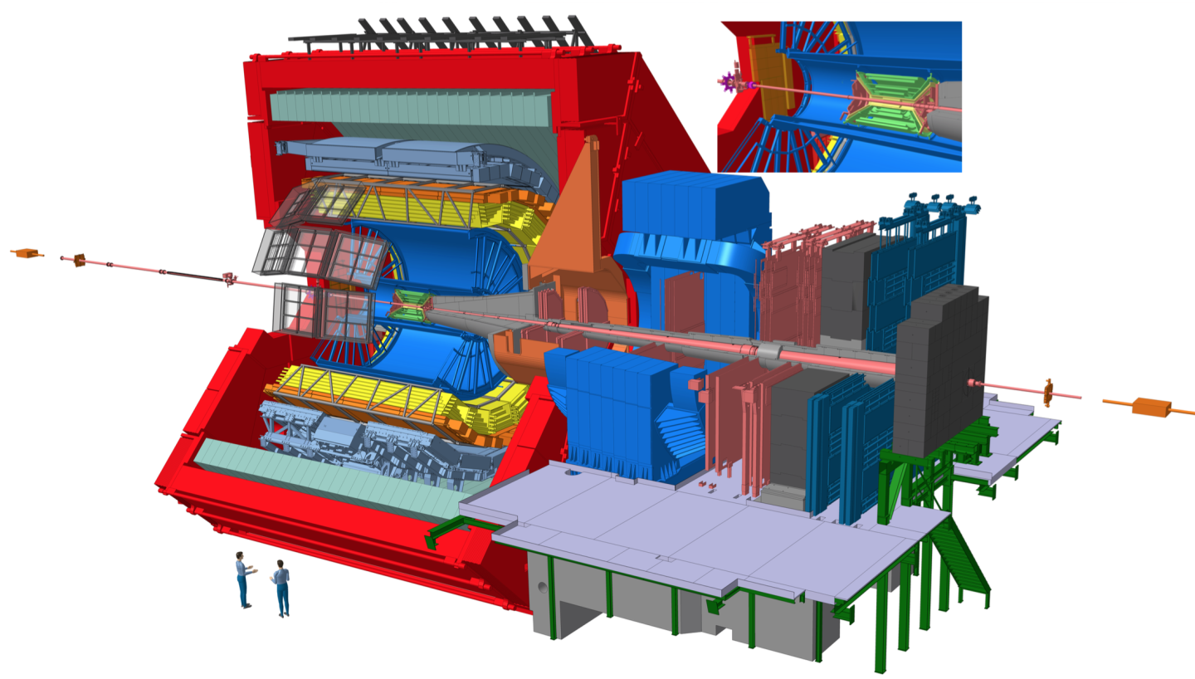
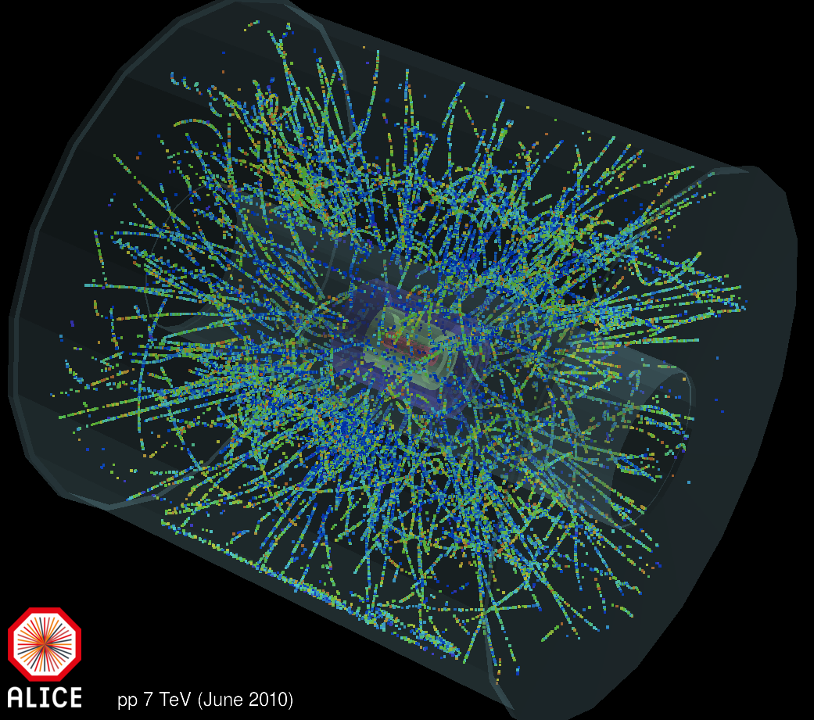
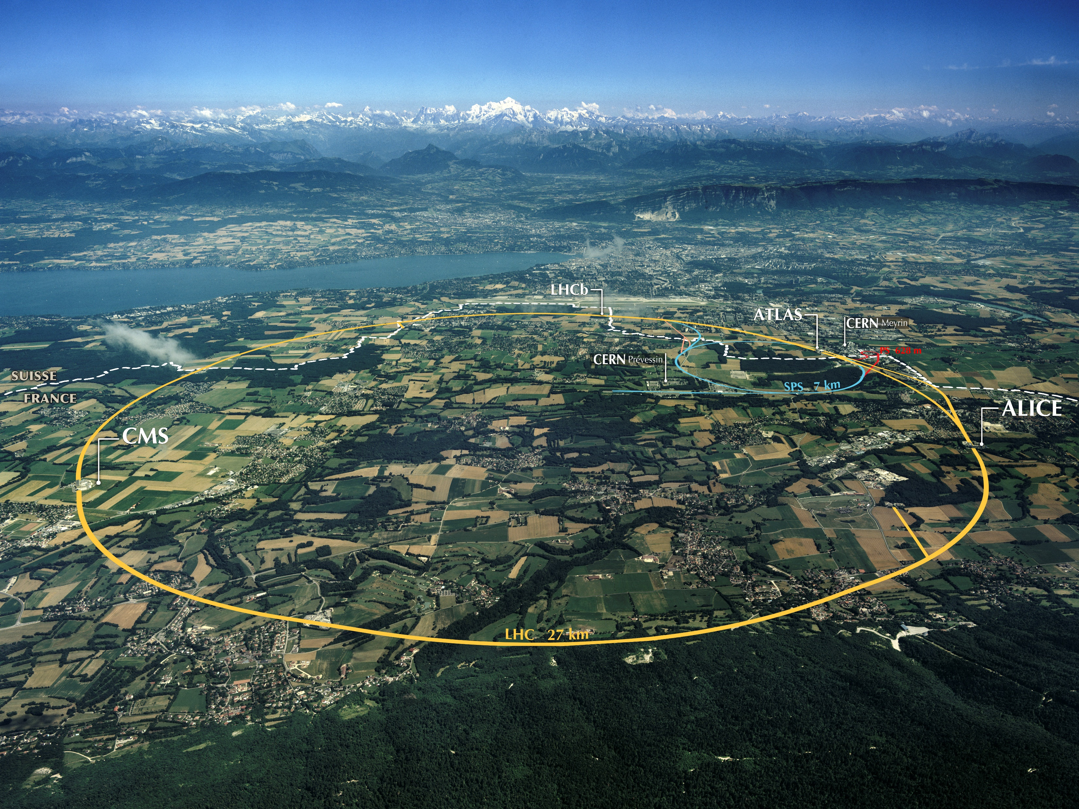
Overview
CERN
  The world’s largest laboratory in particle physics
  LHC is a 27km-long circular particle accelerator in Geneva, Switzerland.
  4 main experiments to investigate particles produced by collisions in the accelerator.
  Site of the discovery of the Higgs boson particle in 2012
  Pioneered the World Wide Web in 1989
Notes:
Add DVCON paper link?

Slide 4
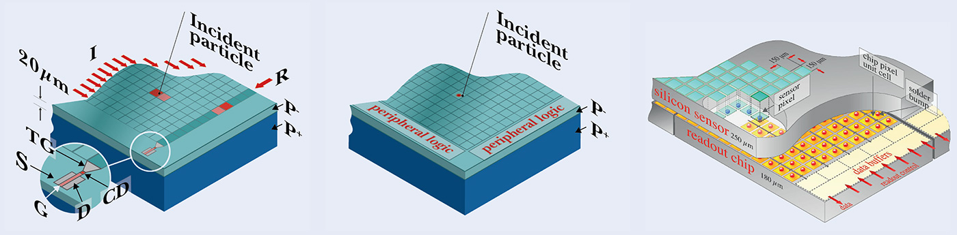
Overview – Pixel detectors
Pixel detectors measure the position and charge of the particle interactions
Various types:
  Charge-coupled devices: charge is collected on pixels and then shifted to the periphery.
  Monolithic Active Pixel Sensors: per-pixel amplification and measurement.
  Hybrid detectors: sensing substrate bonded to readout chip.
CCD
MAPS
Hybrid

Slide 5
Overview – Detector Specifications & Prototyping
The latest generations of pixel detectors push towards higher performance in:
  Pixel pitch and count, sustainable particle rate, charge and timestamping resolution…
The performance targets are defined by the physics applications:
  How can we draw a set of specifications matching that performance?
  How do we validate those specifications against the application?
Electronic System-Level (ESL) modeling can guide us to write an abstract model of the detector to prototype and study its performance in the early design phase.

Slide 6
Overview - PixESL
Project
  PixESL: Pixel detector virtual Electronic System-Level prototyping framework
  GitLab repositories: PixESL core & PixESL4school
Context
  EP R&D Programme on Technologies for Future Experiments: IC Technology Work-Package (WP5)
  Used to prototype MAPS and hybrids detectors at CERN.
Publications
  [2024] Paper: Virtual Prototyping Framework for Pixel Detector Electronics in High Energy Physics
  [2024] Paper: SystemC framework for architecture modelling of electronic systems in future particle detectors
Notes:
Add DVCON paper link?

Slide 7
Electronic System Level – ESL design
ESL is a methodology for modelling and simulating complex electronic systems.
Key points:
Abstraction
System-level perspective
Simulation and analysis
Design space exploration
Validation
PixESL
Pixel detectors virtual Electronic System-Level prototyping framework
Notes:
We want to build a framework called PixESL to introduce the Electronic System Level design for the first time in the High Energy Physics environment.
ESL is a design methodology which proposes a higher level of abstraction to see the design from a system-system perspective through models.
And this allows faster design analysis and design space exploration.
The idea is to include all these key point in a single framework.

Slide 8
Electronics design flow
Time-consuming
(~years)
Specifications
guidelines
Hardware design
limitations
Time-consuming
(~years)
Physics simulation
Verification
NO structured feedback
Notes:
Why are we introducing this problem? Because across time we noticed that going from specs to hardware design takes a lot of time and there is no structured feedback… and you have to do it through meetings/presentations between physicists and engineers.

Slide 9

Electronics design flow with ESL prototype
Specifications
guidelines
PixESL framework
guidelines
Hardware design
limitations
limitations
Physics simulation
Virtual prototype
Verification
ASIC limits
ref. model
Reference model
Notes:
So, with the PixESL framework we are proposing to add the ESL design as an additional step.
PixESL is a framework where you design the virtual prototype to describe an electronic system, and it allows for both validation and verification
In this way the flow is split into two phases:
the validation of the specifications with a faster turn around time;
And a verification part which profits from the virtual prototype using it as a reference model, and also this one shows a faster turn around time.

Slide 10
Electronics design flow with ESL prototype - Validation
Fast (~months)
Specifications
guidelines
PixESL framework
guidelines
Hardware design
PixESL framework
limitations
limitations
Validation
Physics simulation
Physics simulation
Virtual prototype
Virtual prototype
Verification
ASIC limits
ref. model
Reference model
for physical simulation
Notes:
So, with the PixESL framework we are proposing to add the ESL design as an additional step.
PixESL is a framework where you design the virtual prototype to describe an electronic system, and it allows for both validation and verification
In this way the flow is split into two phases:
the validation of the specifications with a faster turn around time;
And a verification part which profits from the virtual prototype using it as a reference model, and also this one shows a faster turn around time.

Slide 11
Electronics design flow with ESL prototype - Verification
Specifications
guidelines
PixESL framework
guidelines
Hardware design
PixESL framework
limitations
limitations
Verification
Physics simulation
Physics simulation
Virtual prototype
Virtual prototype
Verification
ASIC limits
ref. model
Reference model
for verification
Notes:
So, with the PixESL framework we are proposing to add the ESL design as an additional step.
PixESL is a framework where you design the virtual prototype to describe an electronic system, and it allows for both validation and verification
In this way the flow is split into two phases:
the validation of the specifications with a faster turn around time;
And a verification part which profits from the virtual prototype using it as a reference model, and also this one shows a faster turn around time.

Slide 12


PixESL in simulation flow
Particle-sensor interaction
Simulation flow
Chip output
PixESL
Front-end architecture +
Readout architecture +
Post-processing
Sensor
design
Charge deposition + collection (+ digitization)
TCAD focuses on simulating the detailed structure and fabrication of semiconductor sensor devices
Allpix² focuses on simulating the physical processes in silicon detectors
PixESL focuses on modelling the behaviour of pixel detector circuits

Slide 13
PixESL framework
Virtual Prototyping
Modeling Methodology
Front-End model
Readout model
PixESL in a nutshell

Slide 14
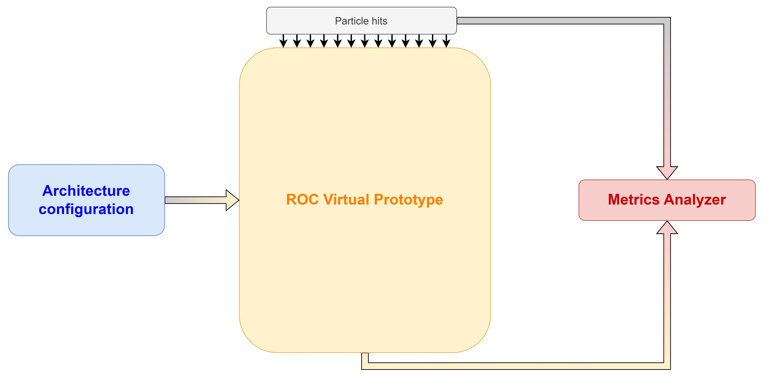
PixESL – Virtual Prototyping
PixESL applies the Electronic System Level concepts to pixel detectors design flow for a cycle-accurate simulation from analog front-end to chip/system readout.
Charge, ToA, position, …
faster runtime (~70k transactions/s)
compared to RTL simulation (x50)
Pixel matrix | 4x4
Pixel node | 2x2
Readout node | 2x2
Periphery node | 2x1
Data aggregator | 1x1
Digital packets
Notes:
PixESL is a framework where you design the virtual prototype to describe an electronic system.
Having the complete view of the electronics design allows to see limitations/bottlenecks at each step.
You have the FULL description of the system from input data to the output.
Mentions: latency, readout efficiency, losses, etc…
[Here, the slide is agnostic to the language used]

Slide 15
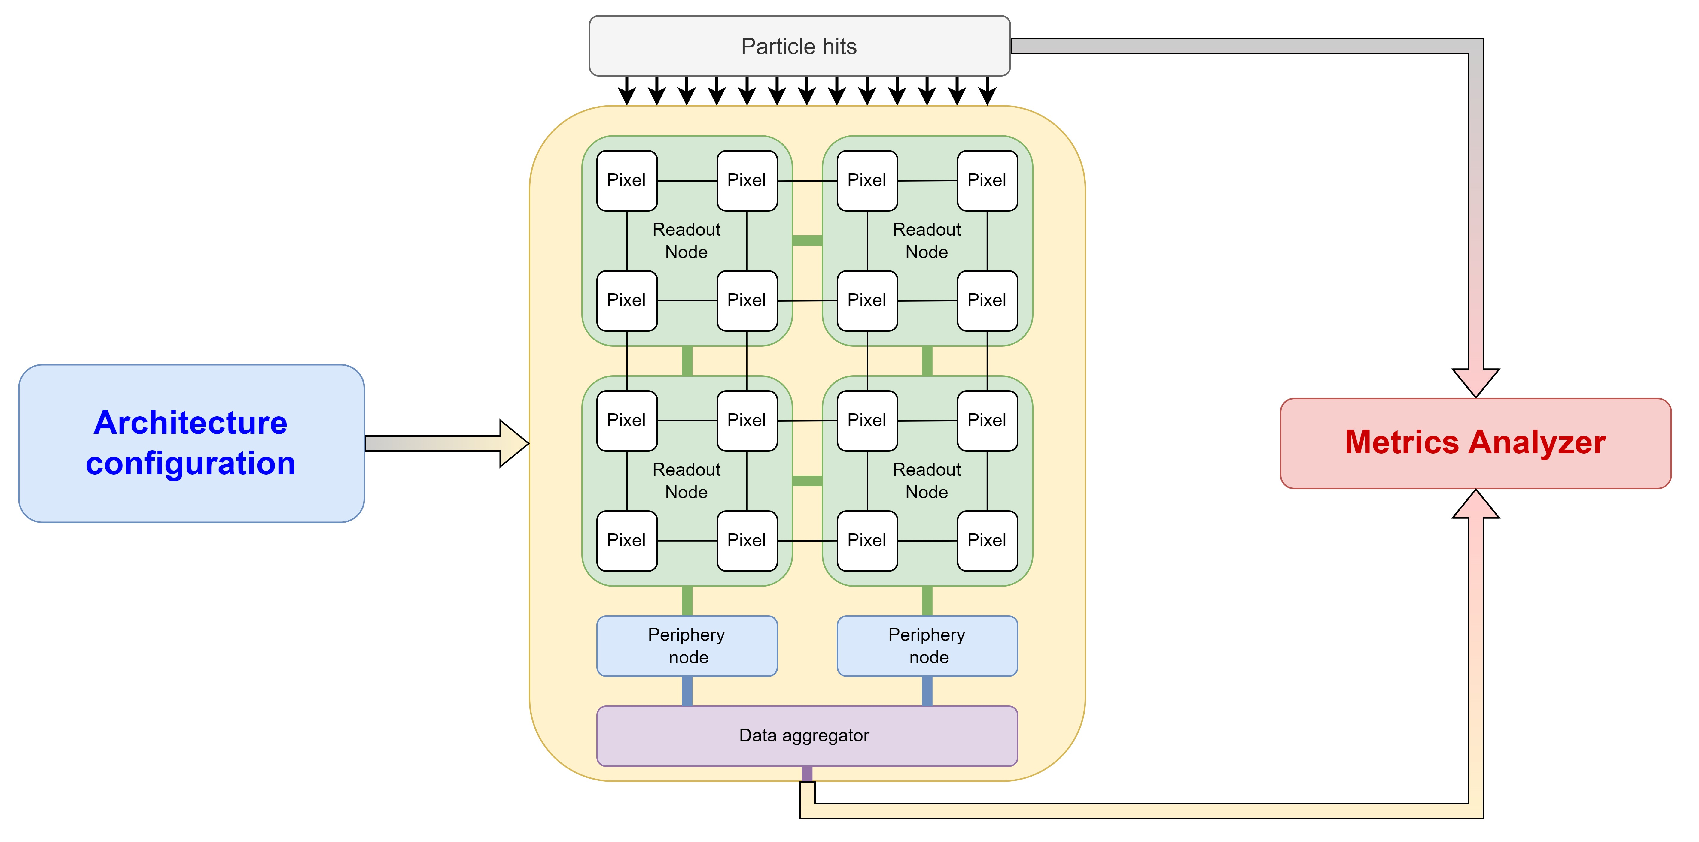
PixESL – Virtual Prototyping
PixESL applies the Electronic System Level concepts to pixel detectors design flow for a cycle-accurate simulation from analog front-end to chip/system readout.
Charge, ToA, position, …
faster runtime (~70k transactions/s)
compared to RTL simulation (x50)
Pixel matrix | 4x4
Pixel node | 4x4
Readout node | 2x2
Periphery node | 2x1
Data aggregator | 1x1
Digital packets
Notes:
The tool will generate the virtual prototype based on the architecture configuration given as input.

Slide 16
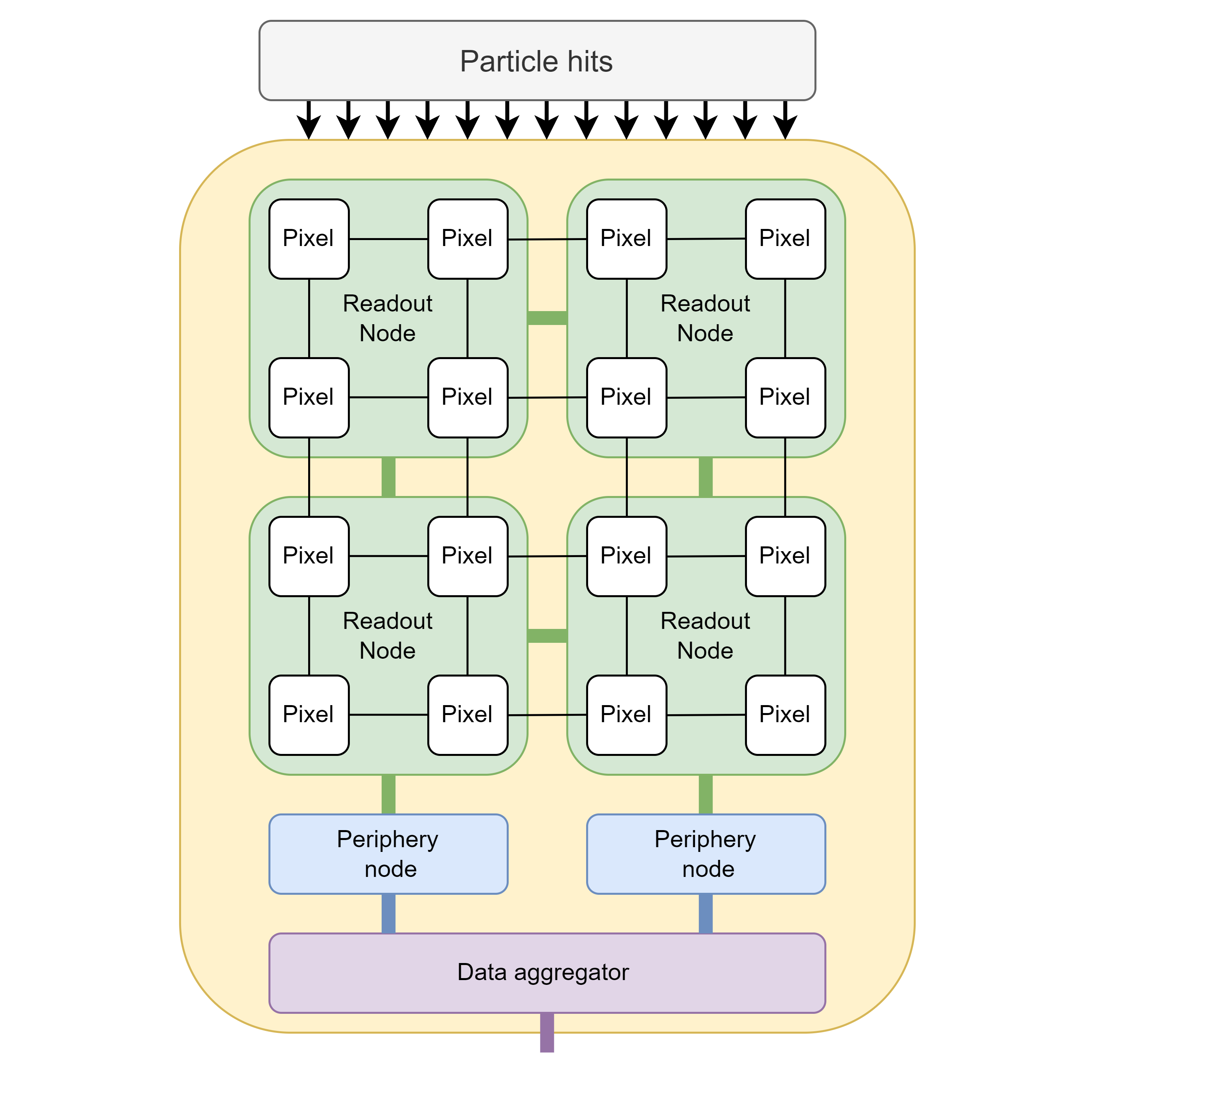
PixESL – Virtual Prototyping
PixESL applies the Electronic System Level concepts to pixel detectors design flow for a cycle-accurate simulation from analog front-end to chip/system readout.
Detector Simulation e.g. AllPix2, Geant4,...,
provides pixel hit input data with charge and time of injection
ROC Virtual Prototype in PixESL
provides a C++-based high-level
simulation platform to study the entire electronics system chain at an early stage of development.
Readout Chip output data
with performance metrics

Slide 17
PixESL – Modeling Methodology
Pixel [C++/SystemC]
  Analog Front-End
  Digital Front-End
Detector Simulation e.g. AllPix2, Geant4,...,
provides pixel hit input data with charge and time of injection
Readout & Periphery [SystemC TLM 2.0]
  Readout network
  Output link
ROC Virtual Prototype in PixESL
provides a C++-based high-level
simulation platform to study the entire electronics system chain at an early stage of development.
Data processing [SystemC TLM 2.0]
  Ex: Event aggregator
Readout Chip output data
with performance metrics
Notes:
Mention that this is an example of the architecture configuration, e.g., 2x2 pixel
When there is a readout network, you can explore new features like data processing, e.g. An Event Sorter at the periphery

Slide 18
PixESL – Front-End model
Modular design approach: each module can be easily changed to model different functionality.
Modeled with C++ and SystemC specialized classes:
Front-End node
AFE wrapper
AFE wrapper
Analog Front-End core [C++]
analytical model of the analog circuits
AFE core
AFE core
AFE Wrapper [C++ → SystemC]
translates the AFE outputs into SystemC events
TDC model
AFE core
AFE core
TDC model [SystemC]
formats the pixel packet and routes it outside the node
AFE wrapper
AFE wrapper

Slide 19
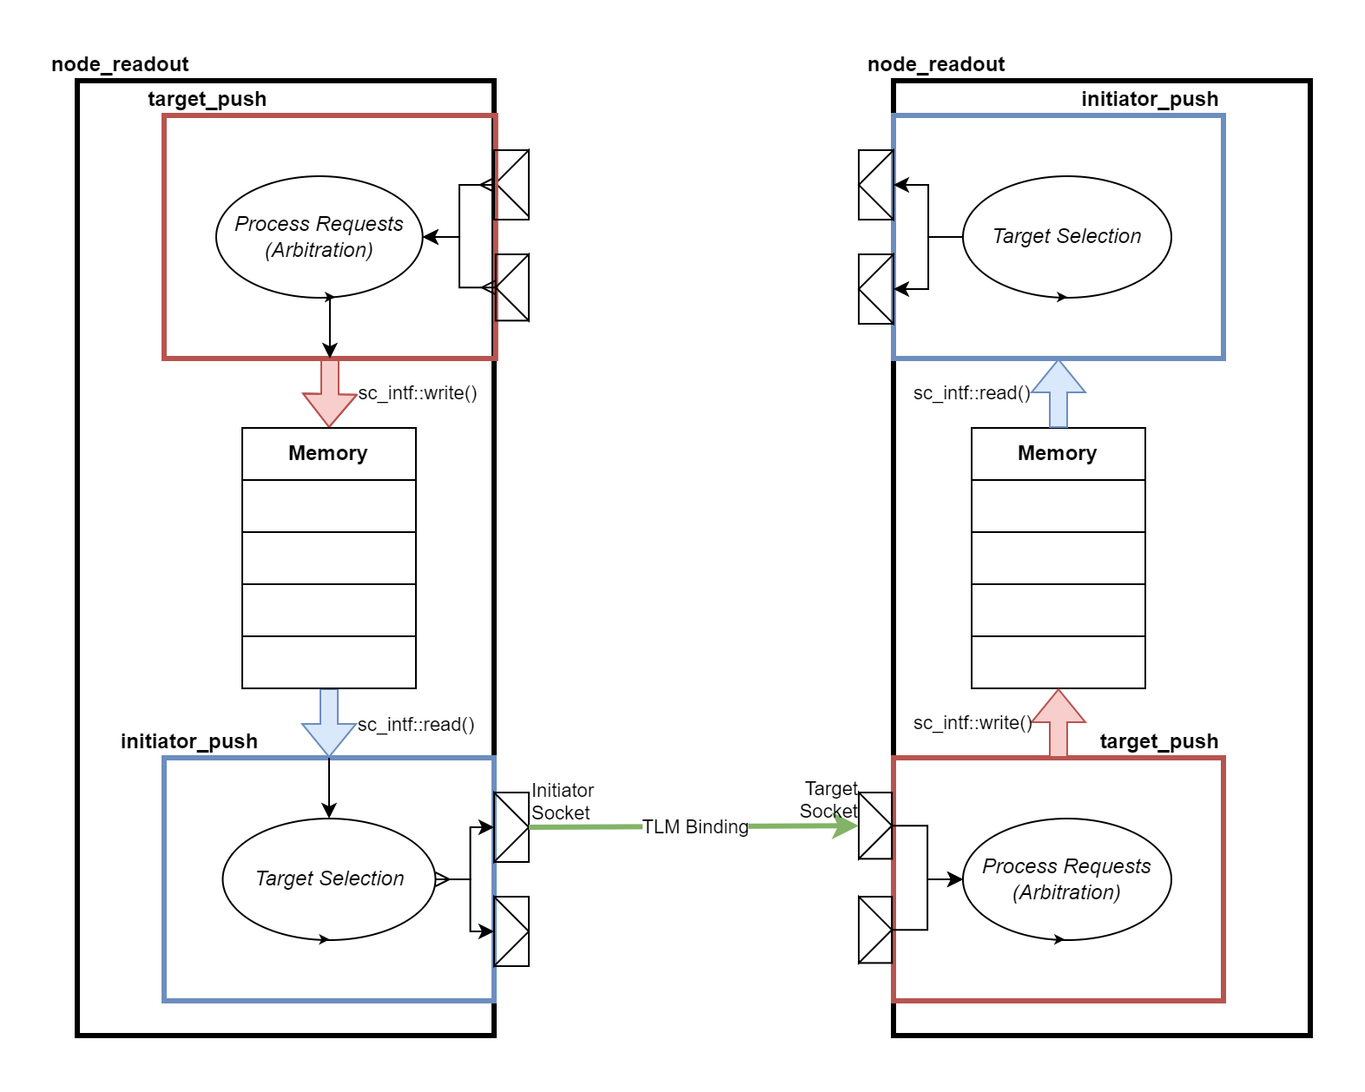
PixESL – Readout model
Modeled with SystemC Transaction Level Modeling 2.0 (TLM 2.0):
Each node contains:
  Initiator: Selects a target and transmits packets to other nodes
  Target: arbitrates incoming packets
  Memory: buffers packets between init. and target
Packet transfer protocol implemented with TLM 2.0 library
Nodes can be connected arbitrarily and their functionality customized

Slide 20

PixESL in a nutshell
Open-source
The model is based on C++ and [link]
Performance analysis is based on Python
User-friendly
Reconfigurable architectures and network
User and developer roles are separated
Reusable
Generalized layers and standardized packet transport
A library of useful layers and components
Validation of the specifications and verification of the hardware design
Notes:
From AFE to chip readout –so we want to model the whole system
We still want to keep the accuracy of the system at a cycle level
Python based analyzer to make it accessible
We want to build a library of reusable components and not just specific cases.
And we want it to be integrated in our verification framework.

Slide 21
Applications at CERN
LHCb VeLo Upgrade II (hybrid data-driven detector)
ALMIRA Alice3 Upgrade (Monolithic tracker)

Slide 22
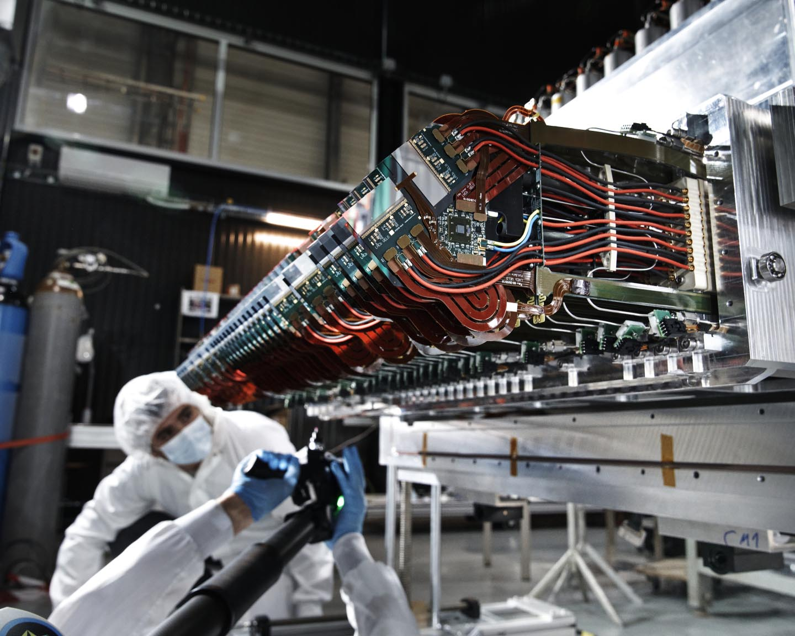
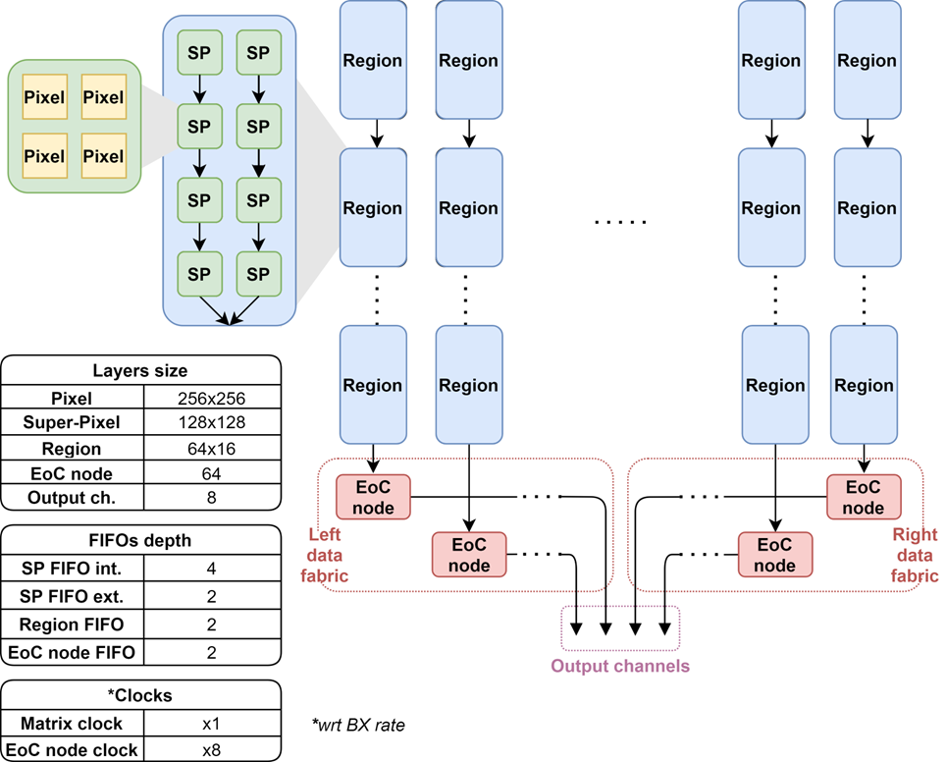
PixESL for LHCb VELO Upgrade II
Velopix
The Readout Chip for the LHCb tracker upgrade II is the prototype of Velopix2:
Data-driven readout architecture
Pixel hit rate 3.5 GHz/cm²
28 nm CMOS technology
Design derived from Velopix and Timepix4
Time resolution 25 ps, 50 μm pixel pitch
PixESL model:
The pixel emulates the Analog Front-End model
Super-Pixel, region and EoC node are digital readout stages
The simulation is based on physical events
The geometry of the architecture is user-configurable

Slide 23
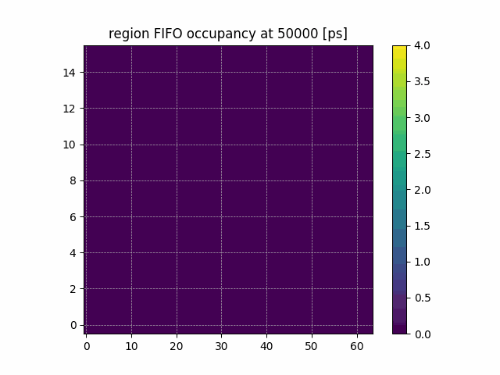
PixESL for LHCb VELO Upgrade II - Results
 | Velopix | Proposed
Pixel | 256x256 | 256x256
SP | 128x128 | 128x128
Regions | 64x8 | 128x8 *
EoC | 64 (8 ch.) | 128 (16 ch.)
Arbitration | Round-robin | Back-pressure
Readout eff. | 90 % | 99 %
Avg. latency | ~100 cy. | ~30 cy.
*By doubling the transactions per cycle
Notes:
Study of the network

Slide 24
PixESL for LHCb VELO Upgrade II - Results
PixESL allows to perform design space exploration to:
analyze bottlenecks
separate bugs from system inefficiencies
Notes:
Study of the front-end
You can classify efficiency – analog pile-up, …
You can measure what you lose at the level of the front-end, at the level of the network, etc…
How long it takes to the packet to get out of the chip.
It is important for the Back-End
Either on-chip or off-chip, someone must do sorting.
Analyzes at the level of the pixel matrix.
This is the high level view.
With a very low max. latency of the readout system, you are dominated by the network. While, if you increase it, the limitation becomes the Front-End. And this is the condition we want.
Because it means the Network does not impact the efficiency of the system.

Slide 25
PixESL for LHCb VELO Upgrade II - Results
Velopix
Notes:
Study of the network

Slide 26
PixESL for LHCb VELO Upgrade II
Co-simulation for chip verification
SystemVerilog Testbench
PixESL usage in testbench to:
Model the Analog FE to drive the DUT
Predict the output packets from pixels
Reuse of AFE and Pixel models from Validation phase.
PixESL shows a faster runtime (~70k transactions/s) compared to RTL simulation (x50)
DUT
SV Shell
LHCb VELO Upgrade II Virtual
Prototype
Stimuli
Packets
Predictions
Scoreboard
Notes:
It was a

Slide 27
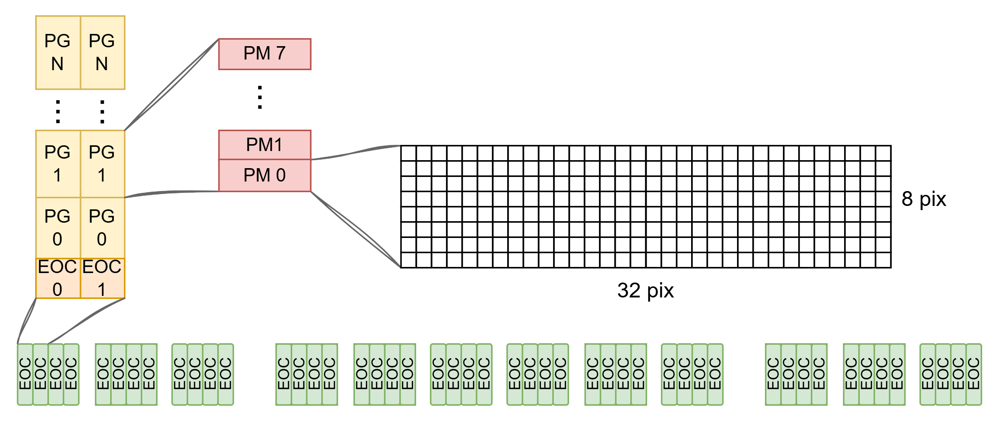
PixESL for ALICE3 Tracker Upgrade
Thanks to the ALMIRA project for these slides
ALMIRA project is developing the next generation of vertex and tracking detectors for ALICE:
Monolithic stitched sensor for wafer-sized detector chips.
Pixel hit rate 100 MHz/cm² and 70mW/cm² power target.
Pixel pitch of 10 μm with 100ns time-of-arrival resolution.
TPSCo 65nm CMOS technology.
First readout stage is asynchronous non-zero-suppressed in an 8x8 pixel area.
Synchronous data and control busses for global data transmission.
PixESL model:
Analog FE model derived from analog simulation:
  LUTs map the input charge(s) to ToT and ToA.
Asynch. model of the Pixel Macro (PM)
Pixel Group and EoC node are synch. readout stages
The simulation is based on physical events

Slide 28
ALICE3 Tracker Upgrade
Analog Front-end Studies
The analog FE is accurately modeled through automated scripts that map the AFE circuitry behaviour in the analog Spectre simulation to a LUT-based PixESL Analog FE. It models:
ToT and ToA as a function of charge and set threshold
Deadtime between two hits as function of their charges
Random Threshold Mismatch
Charge Noise

Slide 29
ALICE3 Tracker Upgrade - Grouping Efficiency in the Pixel Macro
Integration time: 175 ns
Integration time: 315 ns
10351 packets
7769 packets
Each pixel macro collects hits/tracks for a configurable integration time.
The longer the integration, the more tracks show up in a single packet, thus reducing bandwidth.
For an excessively long integration time, multiple tracks per packet can occur in the same location, thus increasing the chance of losing hits due to pileup.
More pileup
More packets

Slide 30

Conclusions
PixESL is a valid tool for high-level modelling and architectural analysis
The project is part of the ECFA DRD7 collaboration funded by
Open Source
PixESL release
VeLo Upgrade II
Picopix model
PixESL kick-off
Q2 2023
Q3 2023
Q4 2023
Q1 2024
Q2 2024
Q3 2024
Q4 2024
…
Q4 2025
Q1 2026
Q2 2026
First Velopix model
Front-End modelling
Verification integration
Architecture configurability
ALICE3 Tracker Upgrade
Contacts
PixESL Maintainers:
PixESL-maintainers@cern.ch
PixESL Project
Repo: https://gitlab.cern.ch/iod/pixesl-group/core
Docs: https://cern.ch/pixesl
Accessible upon request
Notes:
The PixESL framework proposes a rapid and efficient prototyping approach for system-level development, 50 times faster compared to RTL simulations, using well-established open-source languages like SystemC and Python.
In the first phase we

Slide 31
Thank you!

