Slide 1
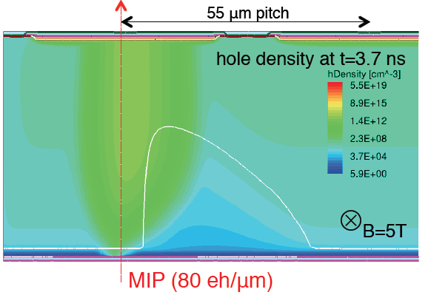
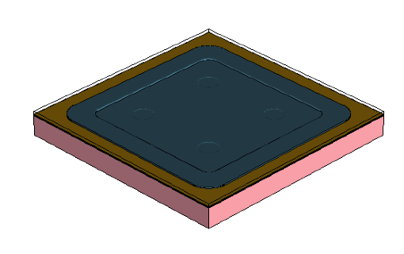
Introduction to Synopsys Sentaurus TCAD tools
(from a HEP user point-of-view)
Mathieu Benoit

Slide 2


Biosketch
2004 -2007 Université de Montreal
2007-2011: PhD in Physics, Université de Paris-Sud (XI), LAL, France
Dissertation: Study of planar pixel sensors hardened to radiation damage for the upgrade of the ATLAS vertex detector for operation at high luminosity
2011-2014: CERN, EP-LCD dept.
Research Fellow
  Conception and management of the R&D program for the CLIC Vertex and Tracking detectors
  Cooperation with the Medipix/Timepix design group for the realization of new prototypes for CERN R&D programs
2014-2020: Université de Genève, Dept. of Particle Physics
Senior Researcher and Teaching Collaborator
  Lead of the department R&D effort on CMOS sensors for ATLAS ITk
  Co-Coordination at ATLAS level of the CMOS demonstrator program since February 2017
  Convener of the CLICdp collaboration Vertex and Tracker working group since May 2016

Slide 3


Biosketch
2020-2022: Brookhaven National Laboratory
Research Associate
  Design and integration of high-speed data acquisition system
  Characterization of the ATLAS LAr Phase-II Upgrade Front-End
  Detector integration and qualification for ATLAS Lar Upgrade
  Manager for FELIX Card design and production
2022 – present : Oak Ridge National Laboratory
Staff R&D Scientist, Physics division
  R&D on Silicon detector for EIC, CMS ETL, and future HEP colliders
  EIC ePIC TOF Technical Coordinator
  R&D on Timepix4 activities for NP, HEP and BES application , collaboration with UTK
  R&D on advanced interconnect and characterization methods for microelectronics

Slide 4
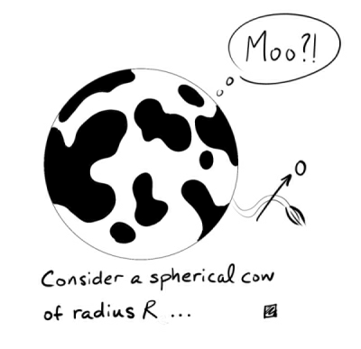
Outline
  TCAD Simulation workflow
  Sentaurus TCAD portfolio
    The Sentaurus workbench
    Documentation and training
    Execution and scheduling
  Structure generation
    Process simulation
    Geometric Structure generation
  Device simulation
    AC/DC simulation
    Transient simulation
Warning this talk contains spherical cows

Slide 5
Disclaimer
  I do not work for Synopsis and what is presented here is my personal view, as a high-energy physicist who has been using TCAD for the last ten years, of the important aspects of the Synopsis Sentaurus TCAD Suite
  SILVACO TCAD Suite is , In my opinion , a very good TCAD simulation software. As a matter of fact, my whole thesis was written using SILVACO. Availability of the tool at your institute should determine which one to use
  Many thanks to Franck Nallet and Dimitrios Tsamados from Synopsis who did this presentation at SIMDET. Many slides are taken from them as I could not put it better !

Slide 6
TCAD simulation workflow
« Old-school » process simulation
Hard-coded pixel geometry when defining processing steps
Possibility for limited parametrization
Device Simulation Conditioning
Reduce Complexity (symmetry, dead area removal)
Remesh for Device simulation (reduce oxide/nitride mesh, increase bulk)
Process Flow simulation
Work with GDSII files provided by your favorite vendor
Abstract description of the process
Device Simulation
Electric Field, Ramo Potential
Capacitance
Transient Behavior
Thermal/Mechanical Stress Simulation
Simple description of the geometry and doping using an editor
Define geometry (Shape,material)
Define doping profile (parametric description)
Post-Processing
Extract Profiles ( E(x,y,z) , etc)
Extract Values (Breakdown, Depletion Potential )

Slide 7
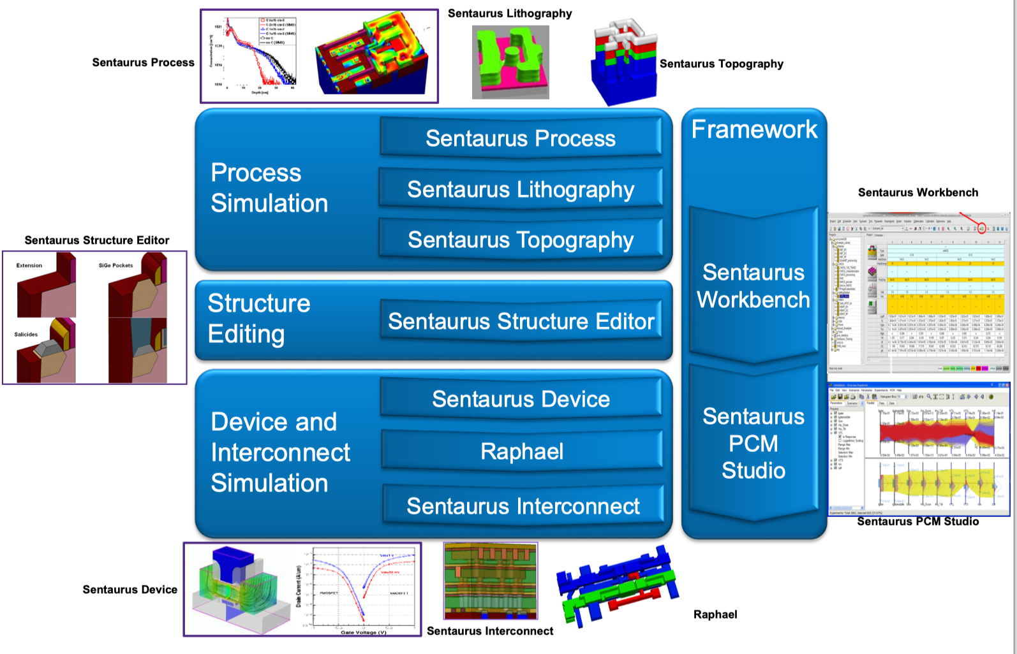
Sentaurus TCAD portfolio

Slide 8
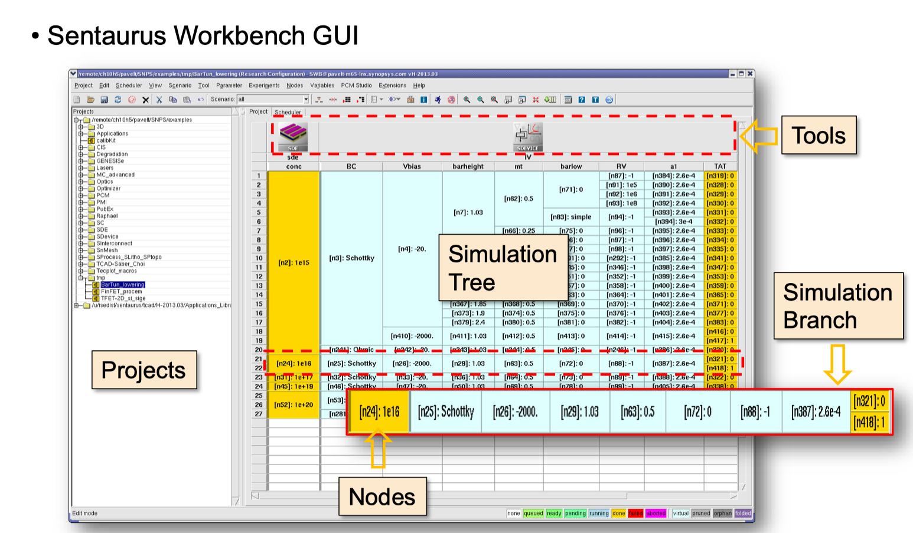
Where it all happens : The workbench

Slide 9
Where it all happens : The workbench
Tool
Parameters
Structure generation :
List of instruction on how to generate a structure.
Contain undefined parameters , for examples Width, thickness. Variables are indentified with @, ex : @Thickness@
Here we define the parameters:
Thickness :
100 µm
200 µm
300 µm
Preprocessing
Virtual nodes

Slide 10
Where it all happens : The workbench
« real » simulation
Ex: structure generation with thickness = 100 µm
Preprocessing
« real » simulation
Ex: structure generation with thickness = 200 µm
« real » simulation
Ex: structure generation with thickness = 300 µm

Slide 11
Where it all happens : The workbench
With multiple parameters and tools , we can quickly obtain large simulation trees so :
Write you simulation in a parametric way to benefit from the tools
Write parameter extraction in a procedural way to exploit the maximum of your simulation
Be careful of dependency between nodes (to be explained in more details in exercises)

Slide 12
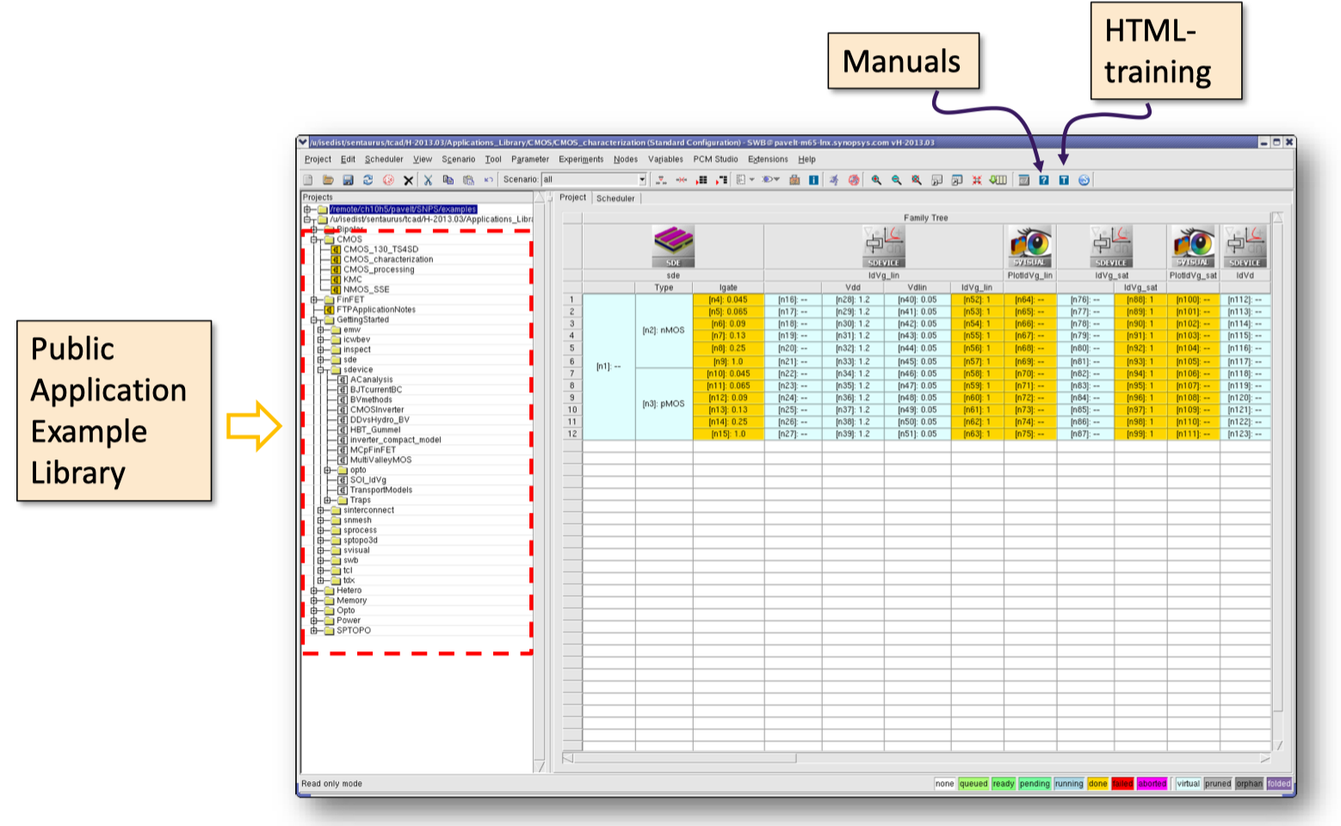
Documentation and training
  Introduction to the TCAD portfolio

Slide 13
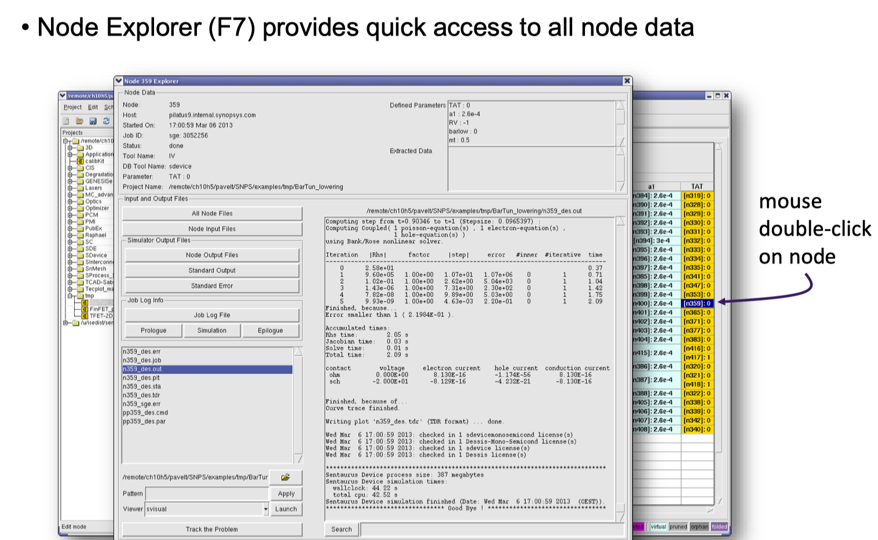
Node explorer

Slide 14
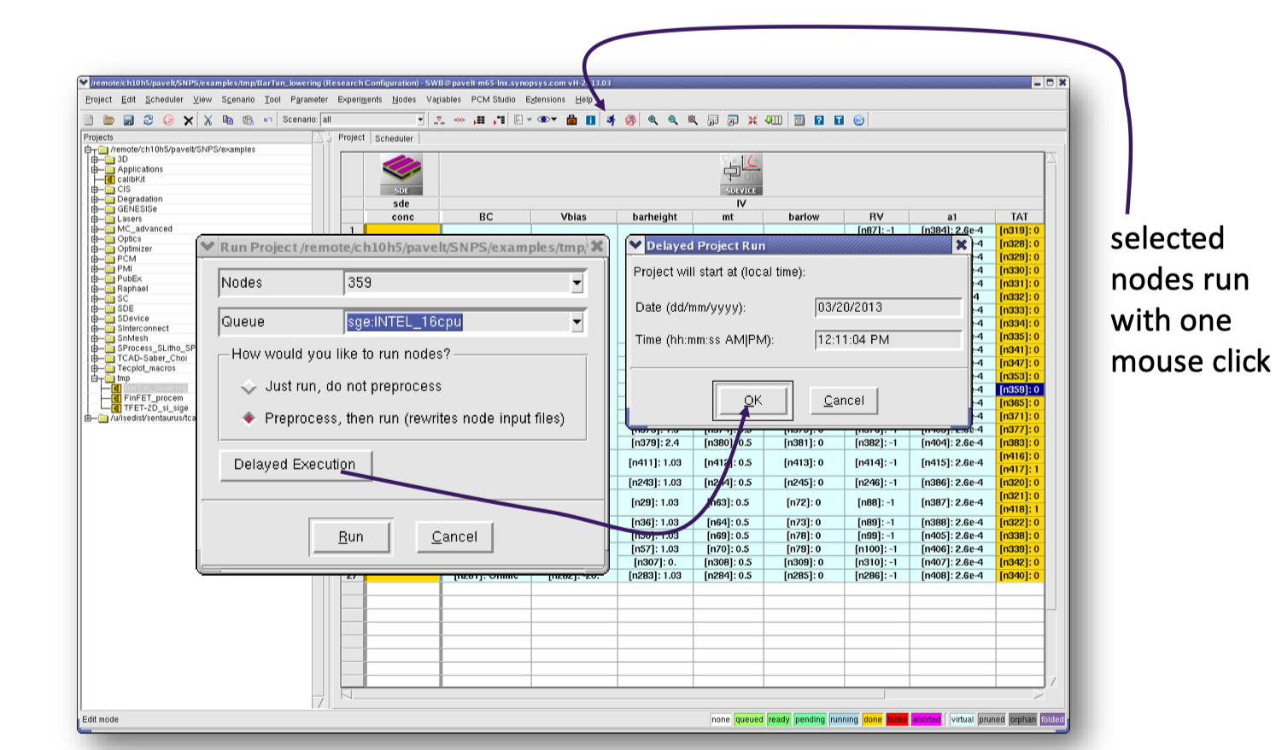
Simulation execution and scheduling

Slide 15
Simulation execution and scheduling
Simulation steps can be executed in multiple ways :
Locally on the computer running the sentaurus workbench
  Simulation are running using local CPU and memory
  Multiple simulation can run at the same time (be careful of #CPU, # of licences, amount of memory used by the simulation)
Remotely by deploying the simulation to a batch system (ex:LSF)
  For example on lxbatch at CERN
    Simulation folder must be available to the batch system
    You must provide the simulator a way to know how to submit to the batch (ex: how to specify ressources, queue tu be used , etc…)

Slide 16
Generating a structure

Slide 17
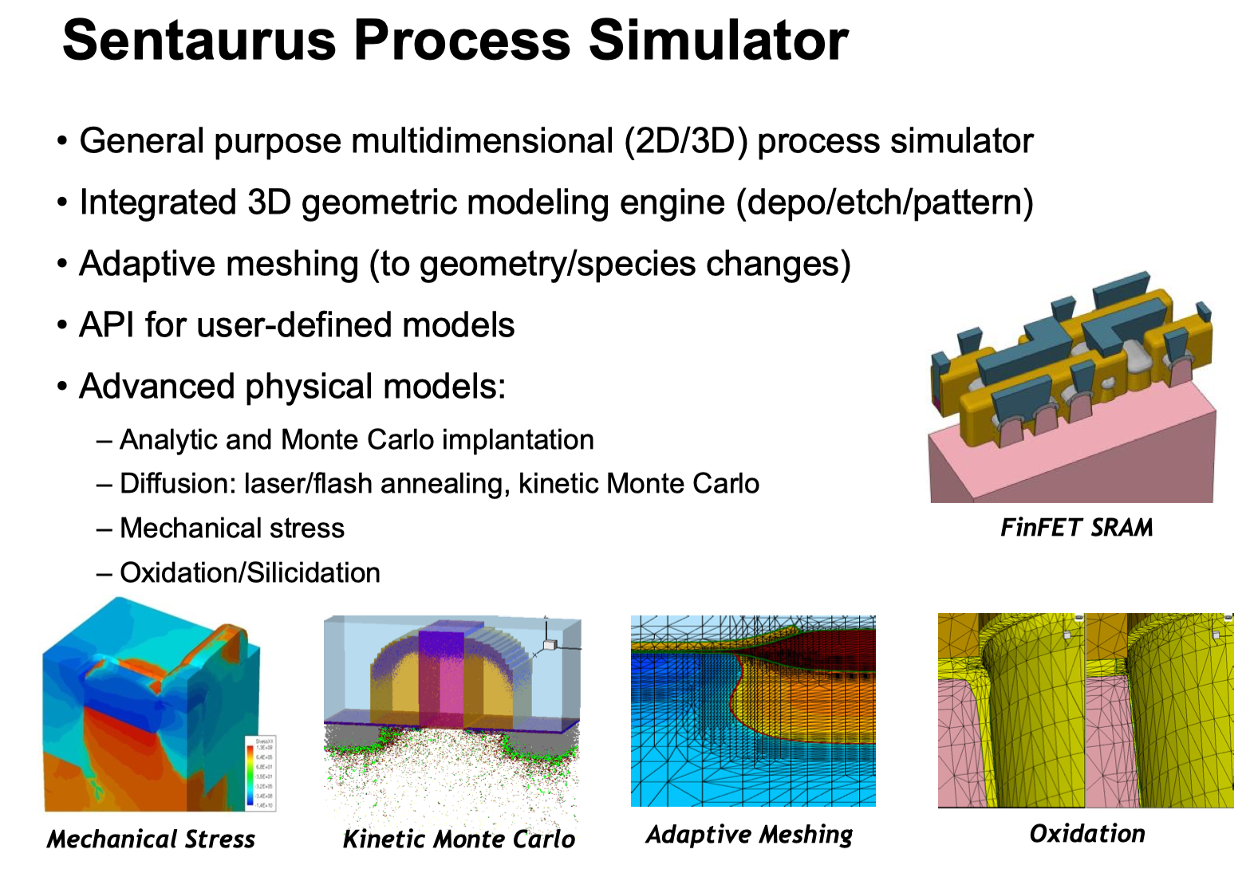
See Simple_Pixel_Process example

Slide 18
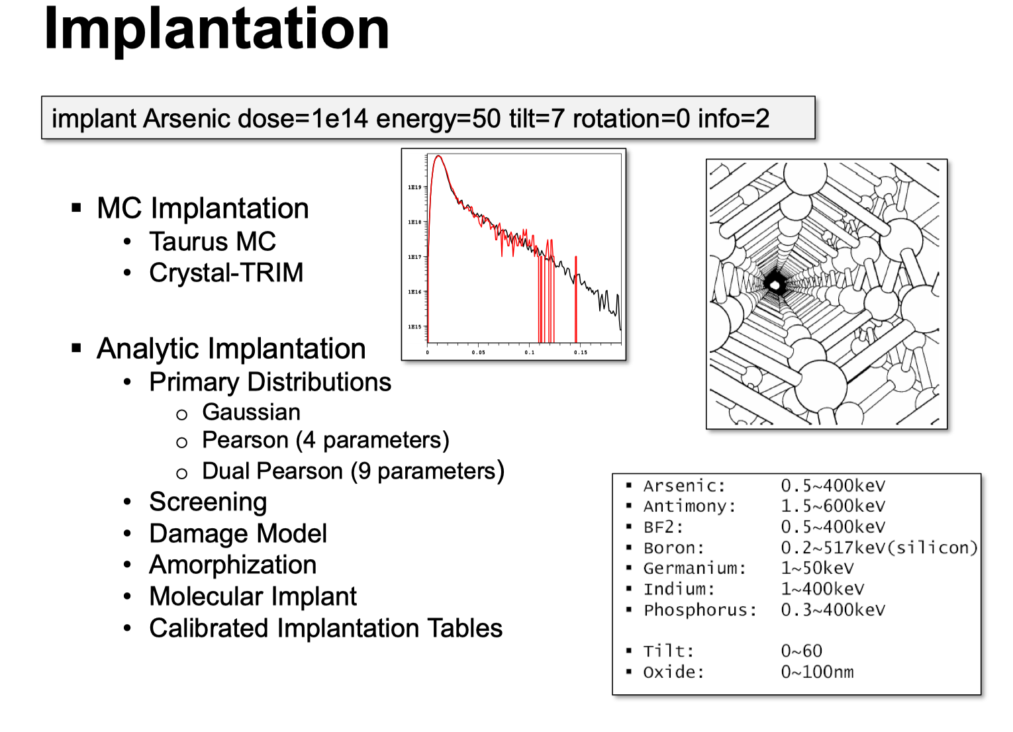

Slide 19
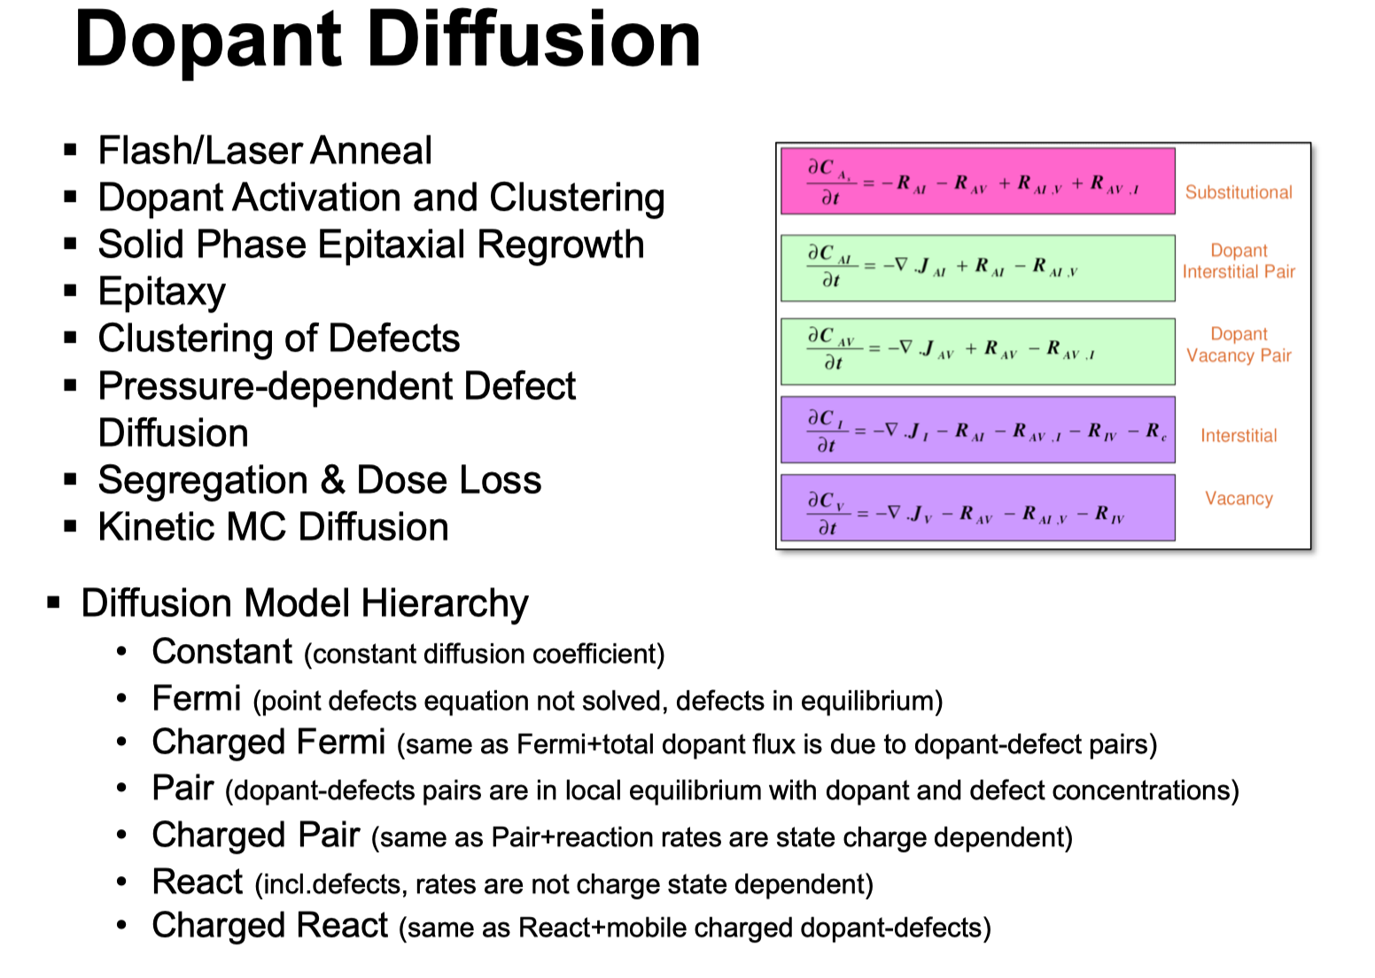

Slide 20
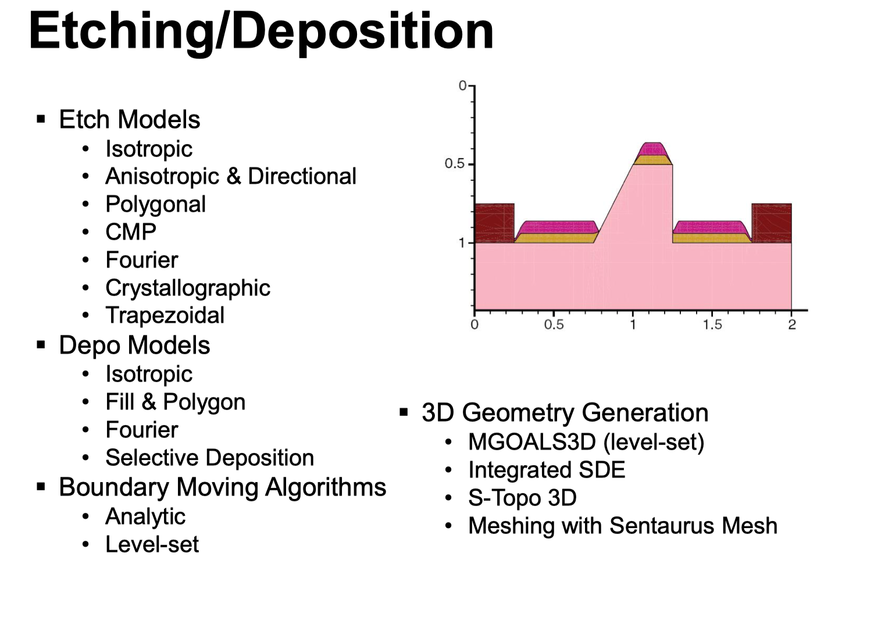

Slide 21
Ex : CMOS process simulation
Based on the great work of Lingxin Meng
Full CMOS process of HV CMOS devices provided by Foundry in TCAD

Slide 22
CMOS process simulation

Slide 23
CMOS process simulation
Based on the great work of Lingxin Meng

Slide 24
CMOS process simulation
Based on the great work of Lingxin Meng

Slide 25
CMOS process simulation
Based on the great work of Lingxin Meng

Slide 26
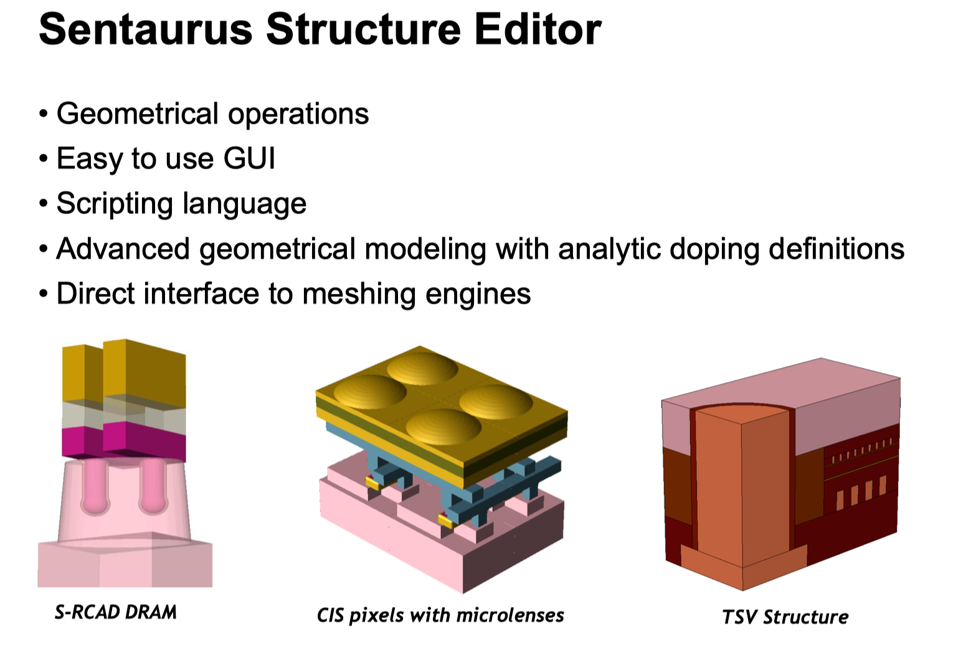

Slide 27
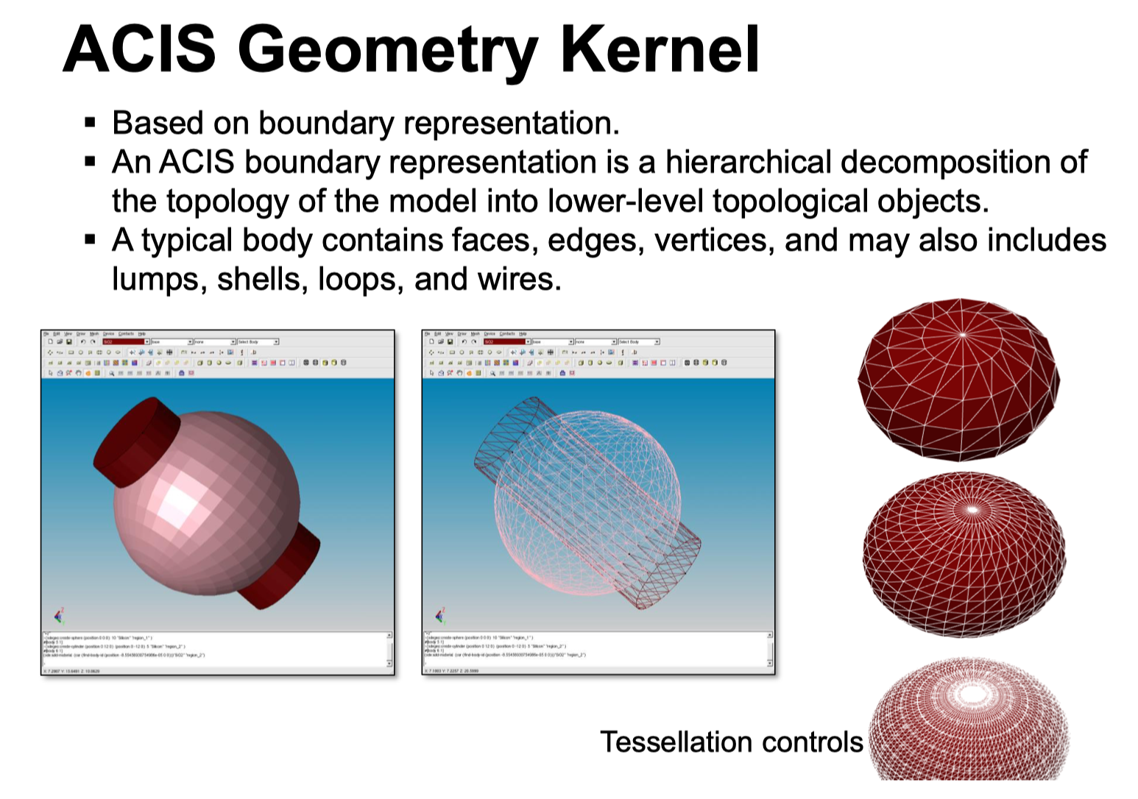

Slide 28
CMOS structure generation

Slide 29
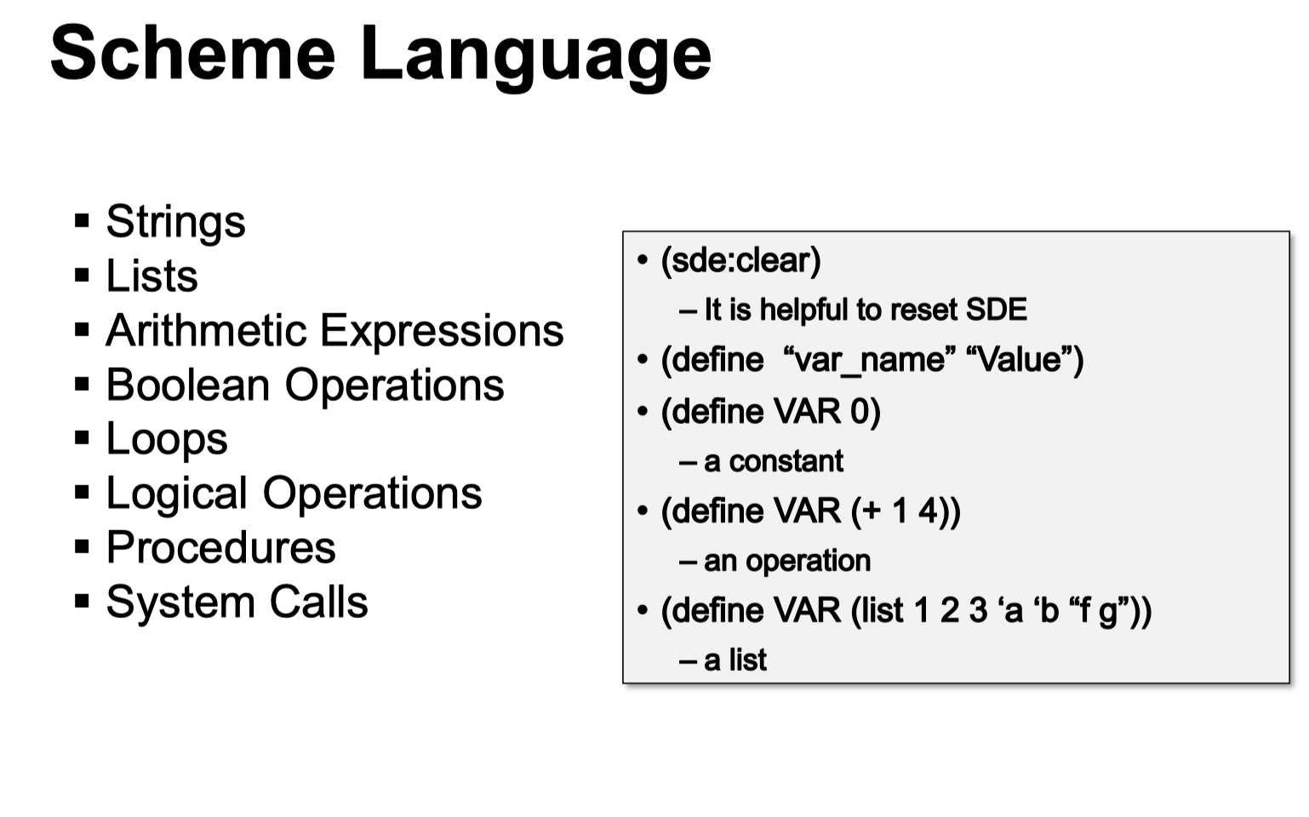

Slide 30
CMOS structure generation
Based on the great work of Lingxin Meng

Slide 31
CMOS structure generation
Based on the great work of Matthew Buckland
to the structure editor

Slide 32
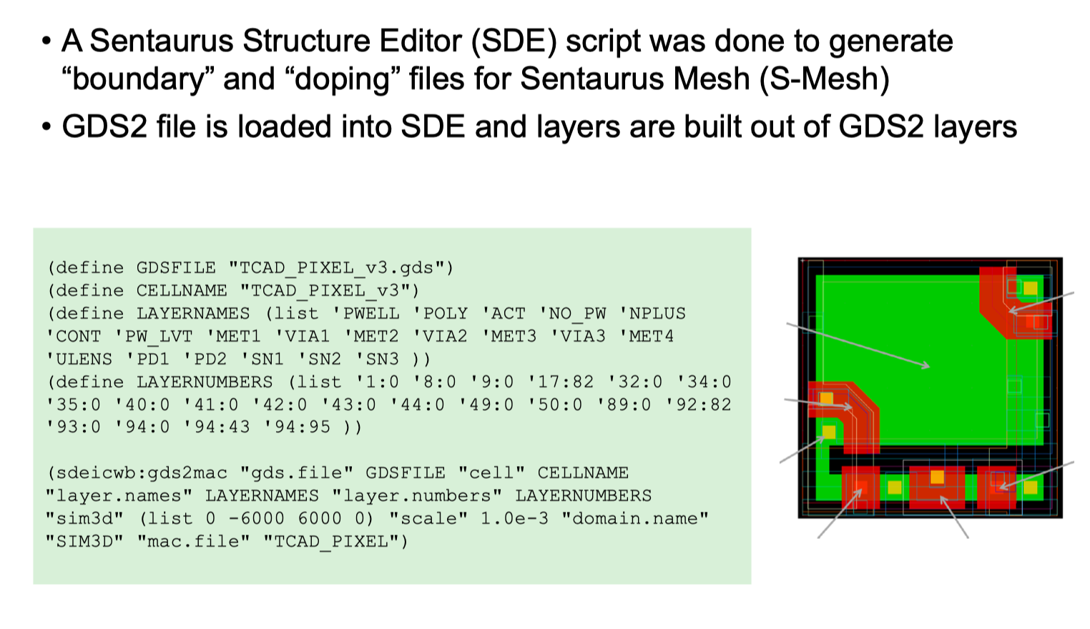

Slide 33
Based on the great work of Matthew Buckland

Slide 34
Device simulation

Slide 35
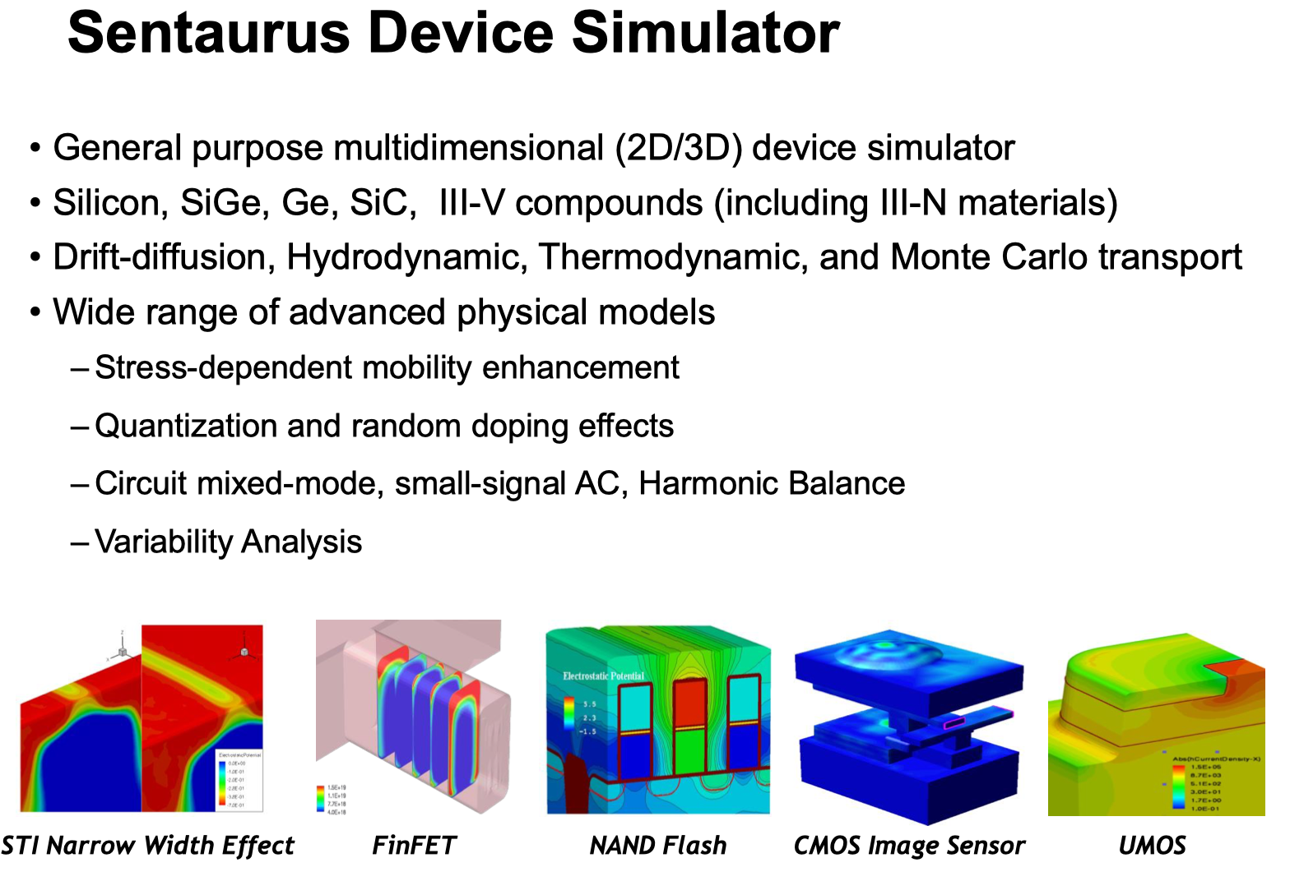

Slide 36
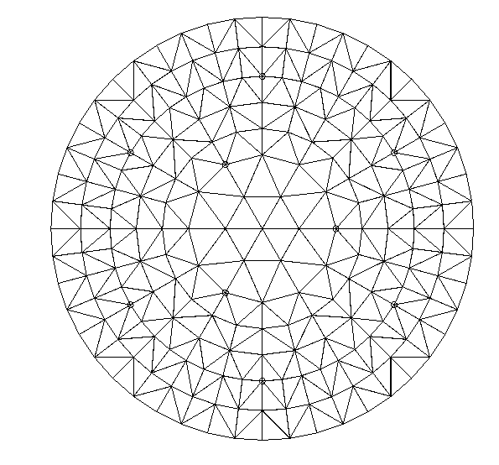
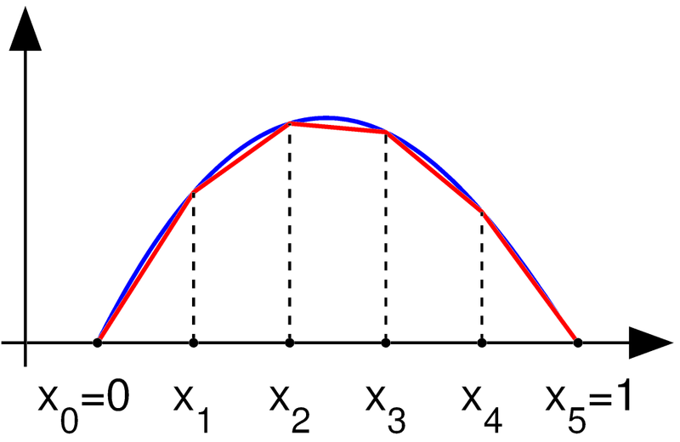
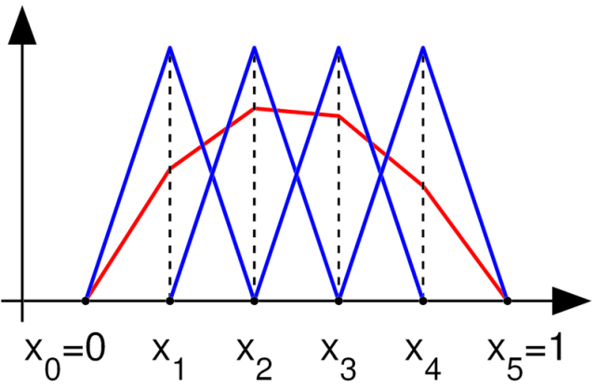
Note : TCAD Device simulation principles

Slide 37
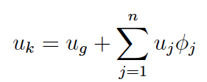
Note: TCAD Device simulation principles
MX+B – Y =0
Matrix M is as large as the number of element
In first approximation , System is linear , but SC physics involves non-linearity (Exp, logarithmic, implicit dependency)

Slide 38
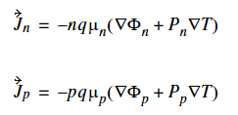
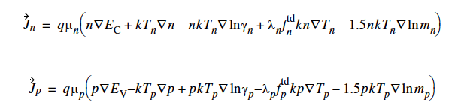
Note : TCAD simulation principles,
Beyond the standard model !
I mention here for completeness the possibility in the main TCAD simulation to perform simulation at higher orders of Boltzmann transport equation :
  The thermodynamic model
  The hydrodynamic model
journée Simulations du Réseau Semiconducteurs, 17 Juin 2013
38

Slide 39
Defining a device simulation
  Import structure generated previously with process simulation or structure generation
  Define electrodes and their initial conditions
    Voltage/Current/Charge at electrode
    Connectivity of electrodes
  Define Physics models to be use during simulation
    Select transport model
    Define Generation/Recombination models
    Define mobility models
    Define impact ionization models (breakdown simulation)
    Define direction and characteristics of particles crossing the sensor for transient simulation
  Define simulation scenario
    Which electrode to which voltage (DC or AC Simulation)
    Define time steps, duration of transient simulation
    Dfine break criteria (ex: stop when current reach a certain value)

Slide 40
Based on the great work of Matthew Buckland

Slide 41
Based on the great work of Matthew Buckland

Slide 42
Based on the great work of Matthew Buckland

Slide 43
Based on the great work of Matthew Buckland

Slide 44
Based on the great work of Matthew Buckland

Slide 45
Based on the great work of Matthew Buckland

Slide 46
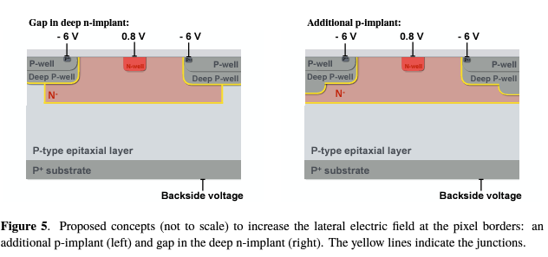
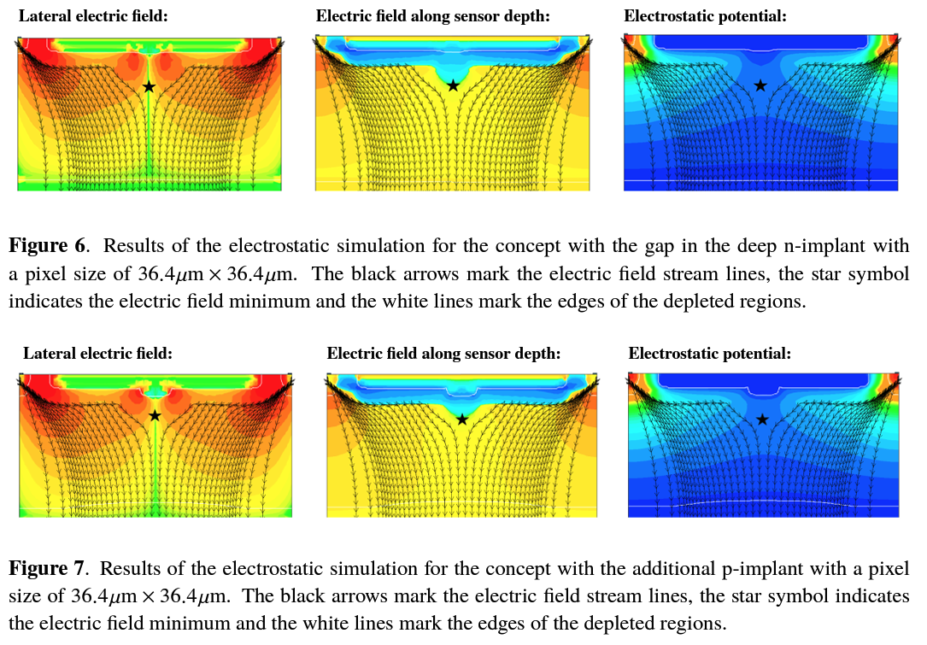
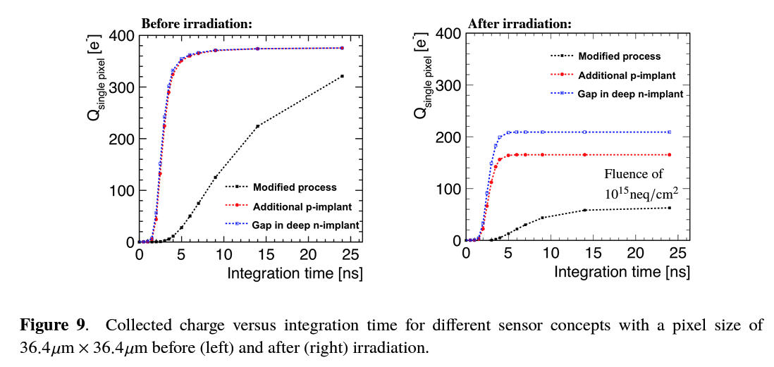
3D Device simulation with realistic profiles
Simulations of CMOS pixel sensors with a small collection electrode, improved for a faster charge collection and increased radiation tolerance

Slide 47
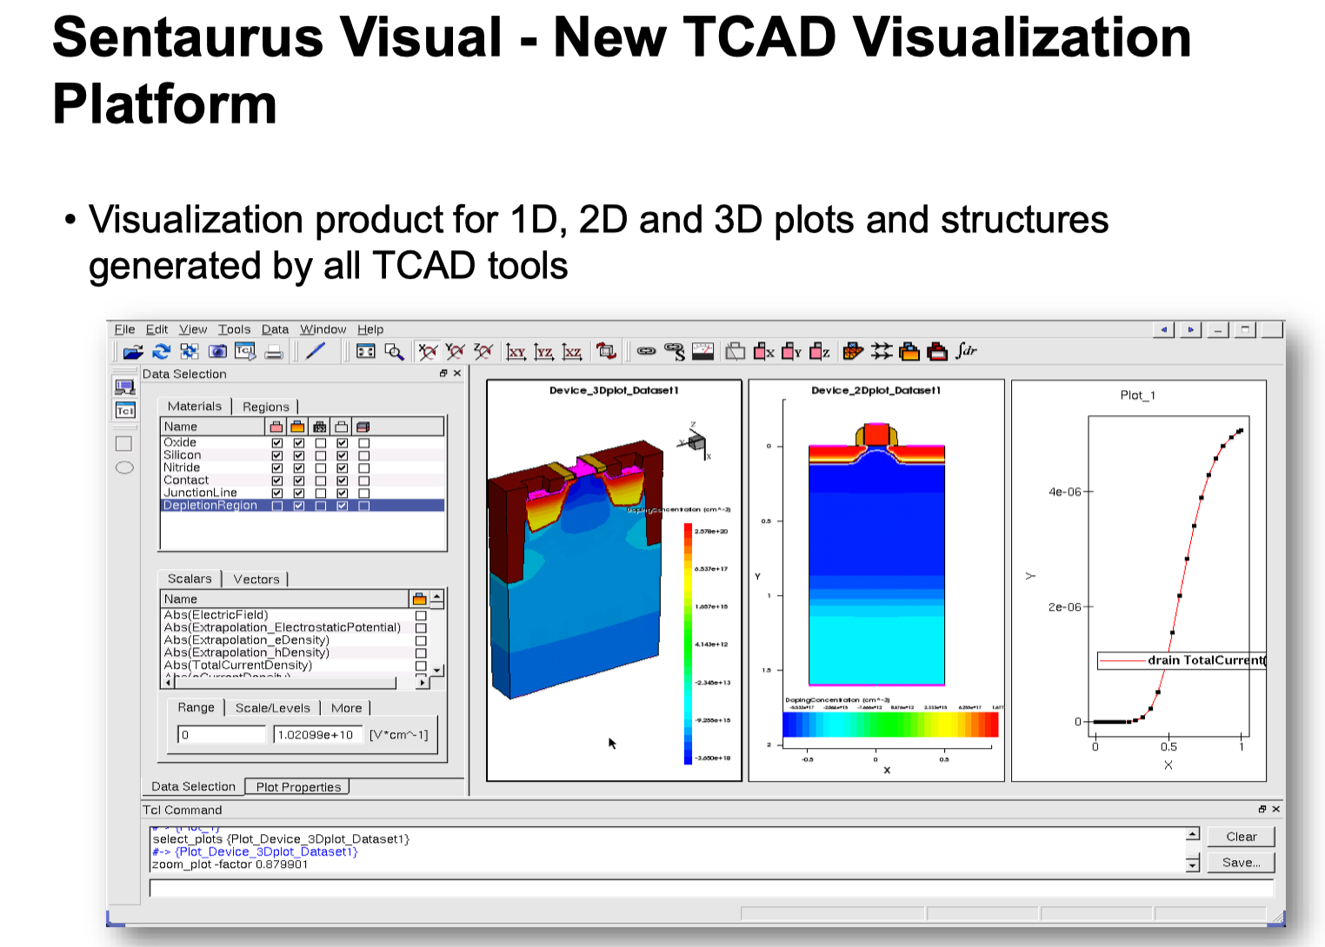

Slide 48
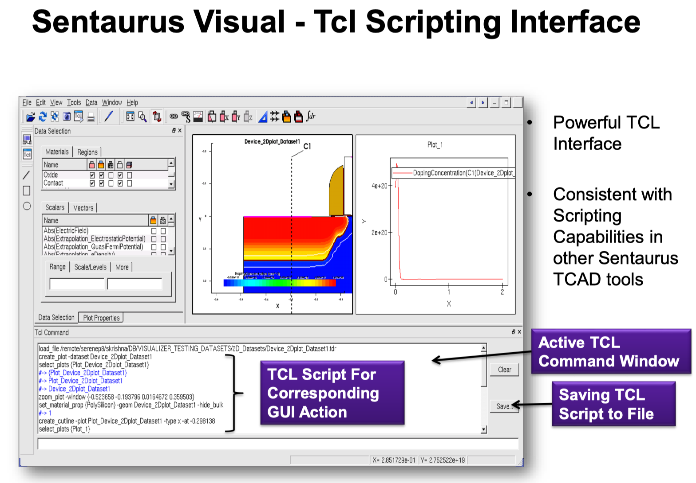

Slide 49
Final notes
Synopsis Sentaurus available:
  Through Synopsis at your institute with University discount!
  Licence available at CERN for use at CERN
Examples are available in the software, but more HEP oriented examples are available at :
  https://gitlab.cern.ch/TCADExamples
Feel free to email me (benoitm@ornl.gov) if you have specific question, I will do my best to answer !

Slide 50
Conclusion
Synopsys Sentaurus offer a complete TCAD suite that allow for :
  Full process simulation when available
  Approximation of structure using device editors
TCAD Simulation is suitable to obtain information on structure before submission
  Guard ring structure optimization
  Effect of radiation damage
  Response to particle stimulus
  Capacitance extraction
  Layout optimization
Please assist to the hands-on session to learn about :
  Process and device simulation
  The Sentaurus workbench workflow
  Extracting and interpreting results of TCAD simulation
FACULTÉ DES SCIENCES
Secton Physique

