Slide 1
Xenon Signal Denoising via Supervised, Semi-Supervised, and Unsupervised Models
(arXiv:2603.27005)
Neutrino Physics and Machine Learning 2026
June 19th, 2026
Dr. Grant Kendrick Parker, Postdoctoral Researcher
Nuclear & Chemical Sciences Division / Physical & Life Sciences Department
LLNL-CFPRES-2020399

Slide 2
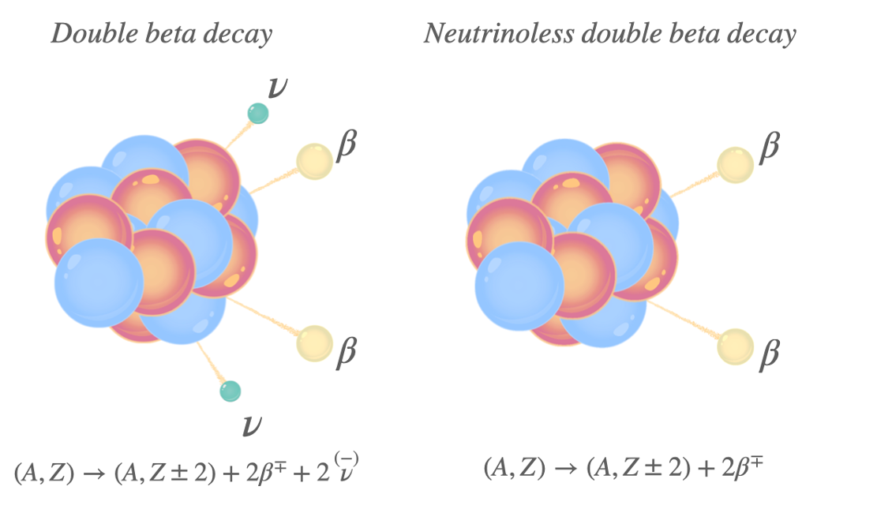
Outline
Introduction
  Motivation: Measure Neutrinoless Double Beta Decay
  Goal: Reduce Noise in Measurements
Experiment Design & Data Properties
  Decay Events & Simulation
  Charge and Energy Resolution
Solution: Machine Learning
  Architecture: U-Net Autoencoder
  Model Types
  Results
Discussion and Future Work
LLNL-CFPRES-2020399

Slide 3
Introduction
LLNL-CFPRES-2020399

Slide 4
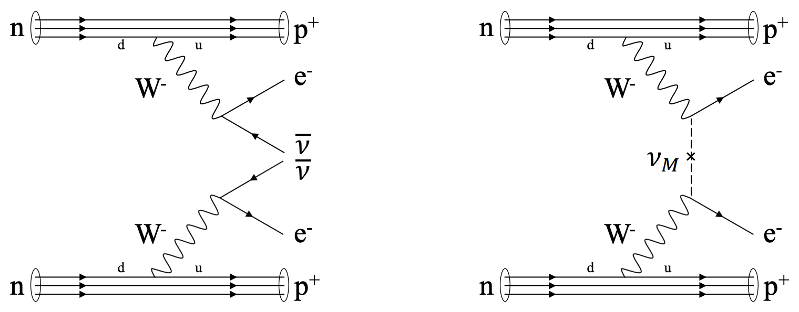
Neutrinoless Double Beta Decay
Nature of neutrino mass is unknown
  May be Dirac (all other particles)
  Or Majorana (it’s own antiparticle)
If neutrinos are Majorana, a new, neutrinoless double beta decay (0νββ) is available
  Violates conservation of lepton number
  Suggests mechanism for matter-antimatter asymmetry in the Universe
Problem: 0νββ would be much more rare than double beta decay
Double Beta Decay
Neutrinoless Double Beta Decay
Figure: Feynman diagrams [Cao 2018] and illustrations [V. Palušová] of neutrinoless / double beta decay
LLNL-CFPRES-2020399

Slide 5
The Measurement Problem
2νββ: combined β energy is a spectrum (neutrinos carry away energy)
0νββ: combined β exit with all of the product energy; signature is a mono-energetic line
Experiment: energy resolution is major 0νββ-2νββ-background discriminator
Problem: Very good energy resolution is extremely challenging
0νββ
2νββ
Background
Decay Counts [Arb. Units]
T_{1/2} (Xe¹³⁶) ~ 10²¹ yrs
T_{1/2} > 10²⁶ yrs
Combined Energy [Arb. Units]
Figure: Illustration of 2νββ spectrum with hypothetical 0νββ spectrum and background.
LLNL-CFPRES-2020399

Slide 6
Experiment & Data
LLNL-CFPRES-2020399

Slide 7
Single-Phase Time Projection Chamber (TPC)
Charge Collection Electrodes
β Particle
Ionization Electrons
Drift
Voltage
e-
e-
e-
e-
e-
e-
Absorption
Deposit
Decay Event
e-
e-
💥
Scintillation Photons
Active Volume:
Gaseous/Liquid
Noble Element
Light Collection PMTs/SiPMs
LLNL-CFPRES-2020399

Slide 8
Single-Phase Time Projection Chamber (TPC)
Charge Detection
(This Study)
Charge Collection Electrodes
β Particle
Ionization Electrons
Drift
Voltage
e-
e-
e-
e-
e-
e-
Absorption
Deposit
Decay Event
e-
e-
💥
Photon Detection
Scintillation Photons
Active Volume:
Gaseous/Liquid
Noble Element
Light Collection PMTs/SiPMs
LLNL-CFPRES-2020399

Slide 9
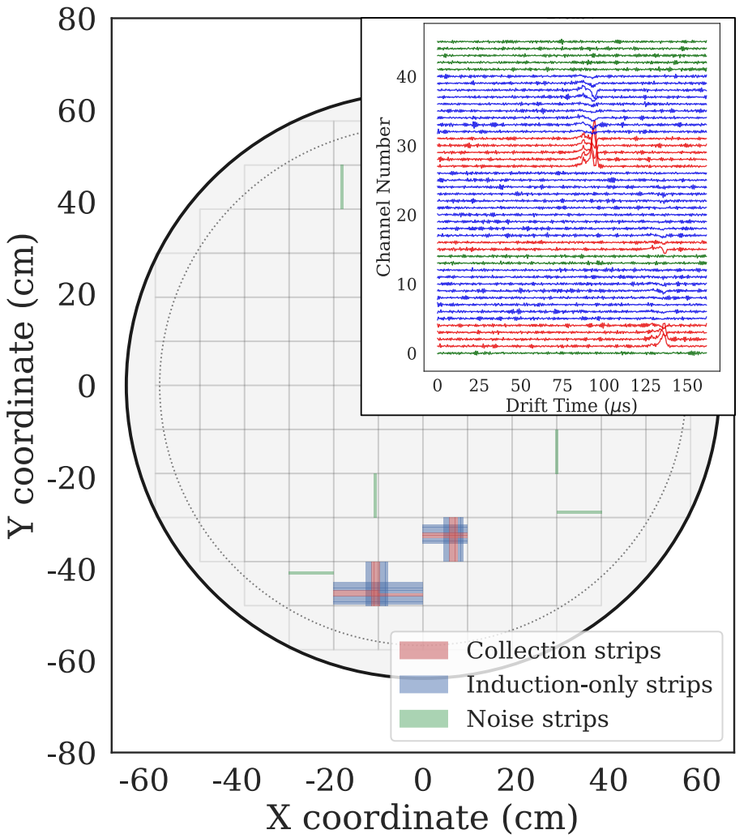
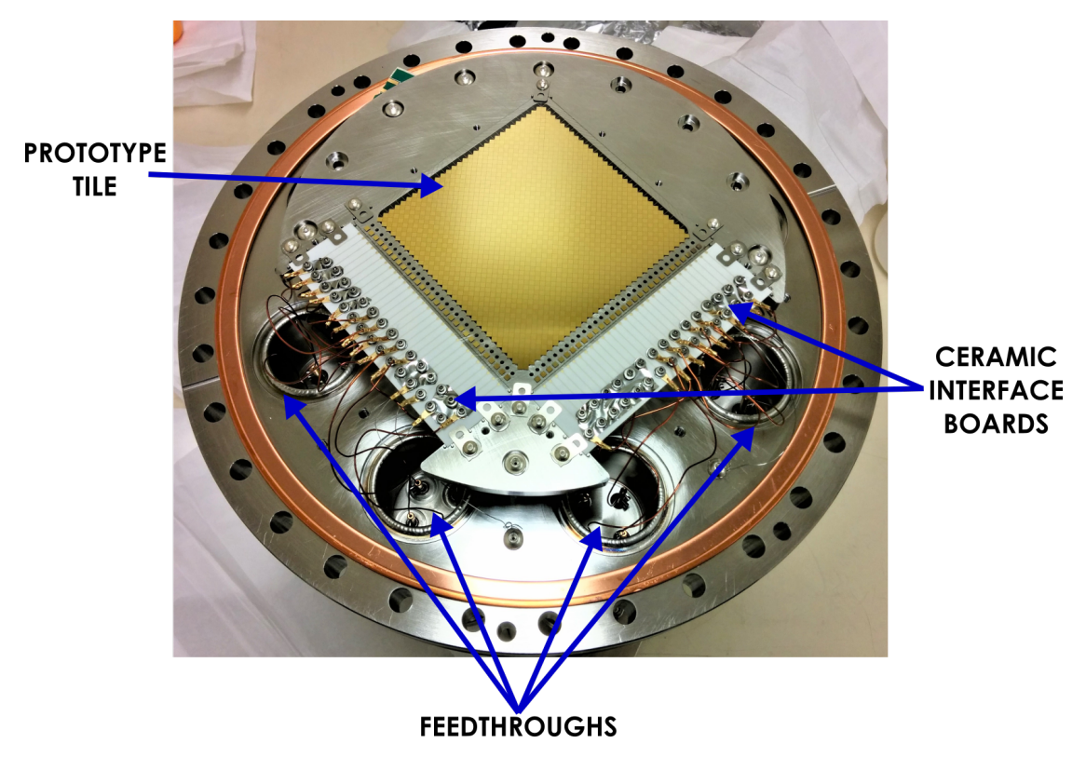
nEXO Charge Collector Conceptual Design
Figure: Left) Schematic of nEXO charge tiles. Right) Prototype nEXO charge tile.
LLNL-CFPRES-2020399

Slide 10
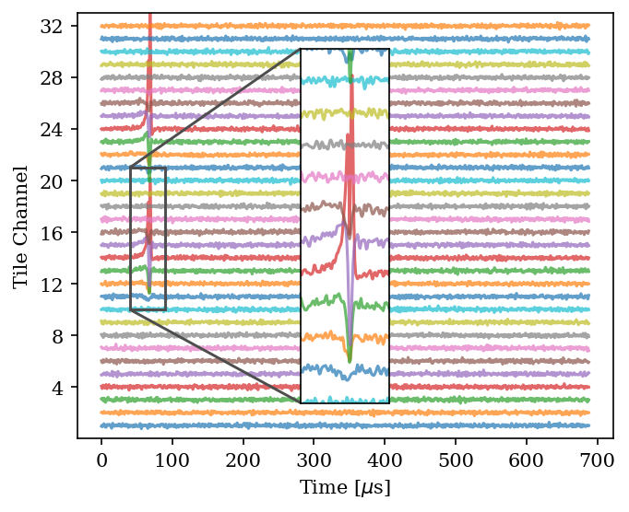
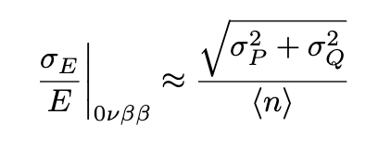
Simulated Decay Event (nEXO-Type TPC)
Energy resolution is related to charge resolution by the following:
where σ_{E}/E is the fractional energy resolution, σ_{P} is the photon resolution, σ_{Q} is the charge resolution, n is the total quanta
Target is σ_{E}/E < 1%
Figure: Simulated charge collection event for decay.
LLNL-CFPRES-2020399

Slide 11
Denoising with ML
LLNL-CFPRES-2020399

Slide 12
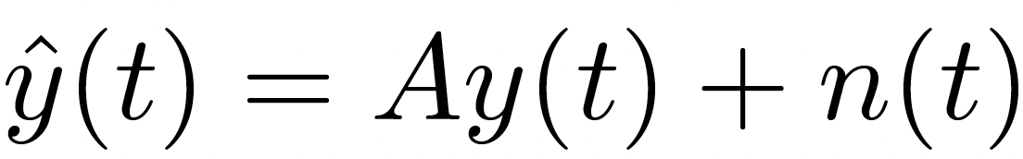
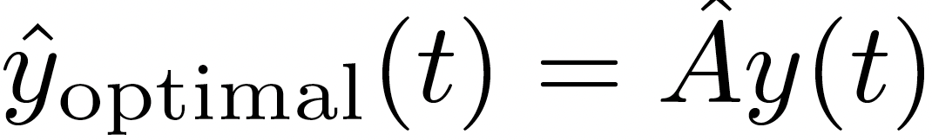
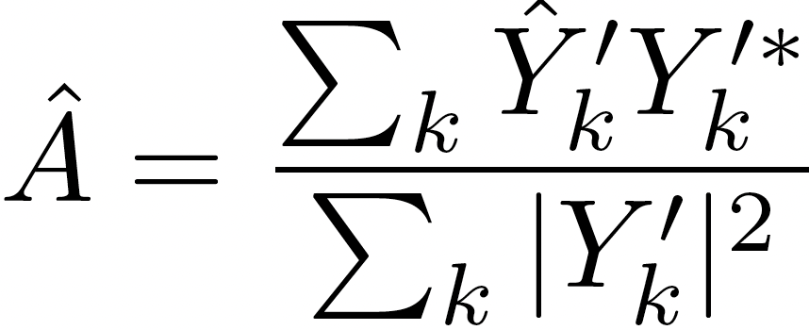
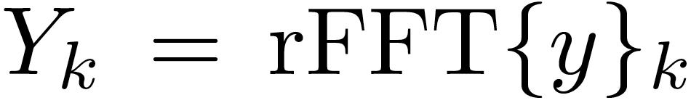
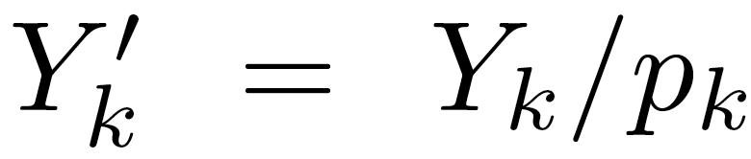
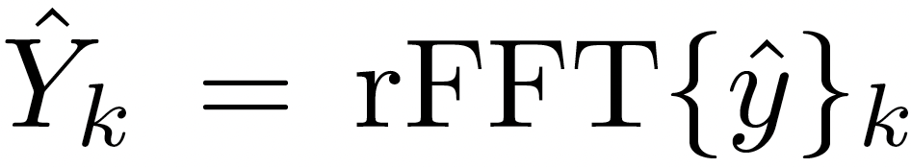
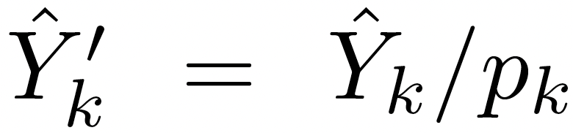
Optimal Denoising Limit: Wiener Filter
Wiener filter* assumes certain noise characteristics
  Noise has time-independent statistics, is additive
  Noise has known power spectrum
Noisy event given by , where A is a linear estimator, n is noise, y is clean true signal
Optimal filter output is given by , where:
Inaccessible in a real experiment
, such that
Real-valued Fourier coefficients
Noise amplitude spectral density
* N. Wiener, Extrapolation, interpolation, and smoothing of Stationary time series: With engineering applications (MIT Press, 1949).
LLNL-CFPRES-2020399

Slide 13
Shared Architecture: U-Net Autoencoder
Skip Connections
Input
Image
(Noisy)
1D
Strided
Convs.
1D
Upsampled
Convs.
Output
Image
(Denoised)
…
Bottleneck
…
LLNL-CFPRES-2020399

Slide 14
We Train Models of Each Scenario:
Supervised Learning
  Clean (true physics) signals and noisy counterparts, basic loss function
  Comes with uncertainty; deployed detector measurements will never exactly match simulation, so denoiser performance will be suboptimal
Unsupervised Learning
  Only noisy measurements fed to model, all instructions and knowledge encoded in loss function
  Very difficult to train, loss space fluctuates greatly
Semi-Supervised Learning (Two-Stage Learning)
  Simulated clean-noisy pairs, then just noisy (containing true physics) measurements
LLNL-CFPRES-2020399

Slide 15
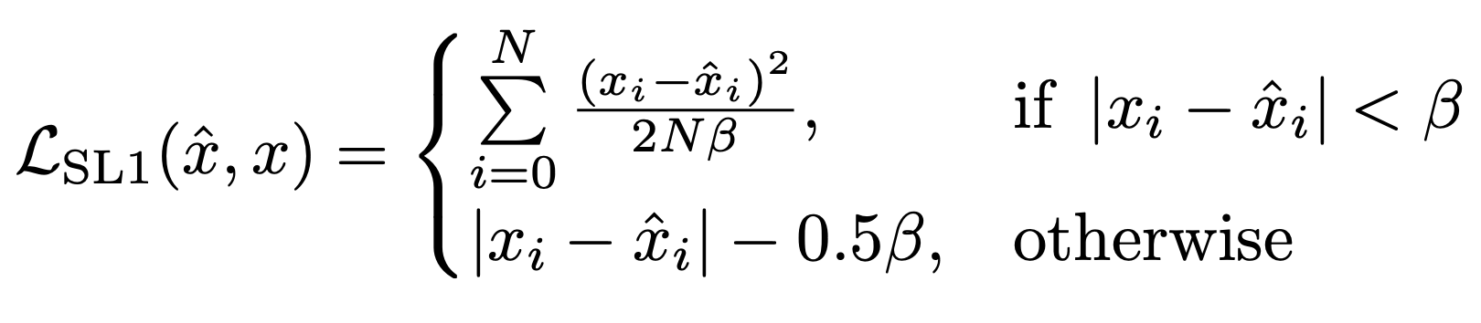
Supervised Learning
Easiest (least-realistic) learning method:
  Provide noisy-clean simulated image pairs
  Loss function is Smooth L1
Training:
  83M simulated event pairs, 200K reserved for validation, 69K for final evaluation
  300K training steps at batch size 256
LLNL-CFPRES-2020399

Slide 16
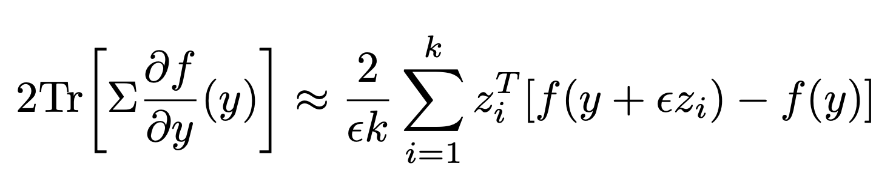
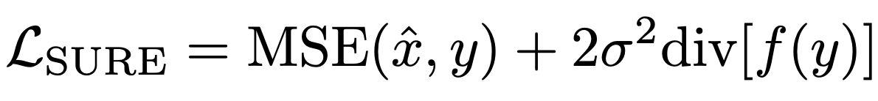
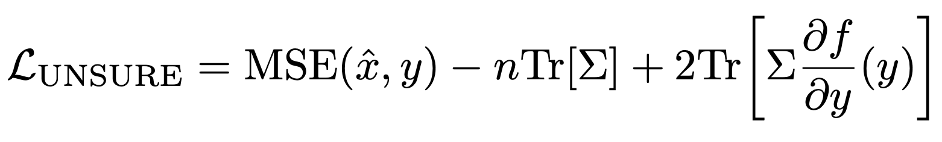
Unsupervised Learning
Hardest learning method:
  Provide only noisy simulated events, rely entirely on loss function
MC-SURE Loss Function*
  SURE** loss assumes noise is Gaussian and white with variance σ²:
  Noise in our events is colored, with covariance matrix 𝚺:
  Last term is computationally expensive
Approximation via Monte Carlo
Finite-Difference
Derivative Approximation
Scaling Factor
Independent Draw
From Noise Distribution
Note: Quantization is the performance floor for MC-SURE models, as quantized noise breaks SURE conditions
*S. Ramani, T. Blu, and M. Unser, Monte-carlo sure: A black-box optimization of regularization parameters for general denoising algorithms, Trans. Img. Proc. 17, 1540–1554 (2008).
**C. A. Metzler, A. Mousavi, R. Heckel, and R. G. Baraniuk, Unsupervised learning with stein’s unbiased risk estimator (2020), arXiv:1805.10531 [stat.ML].
LLNL-CFPRES-2020399

Slide 17
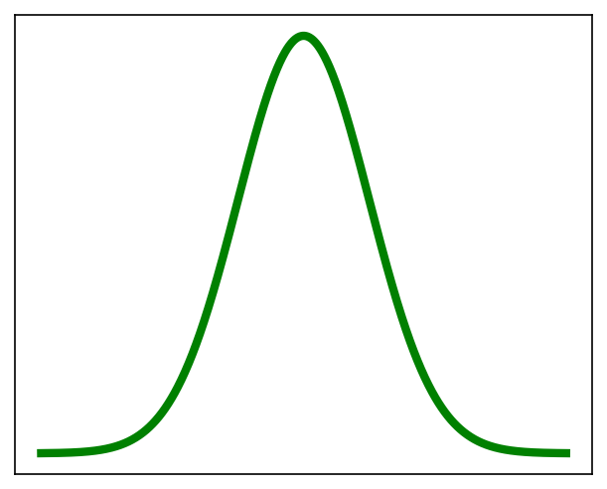
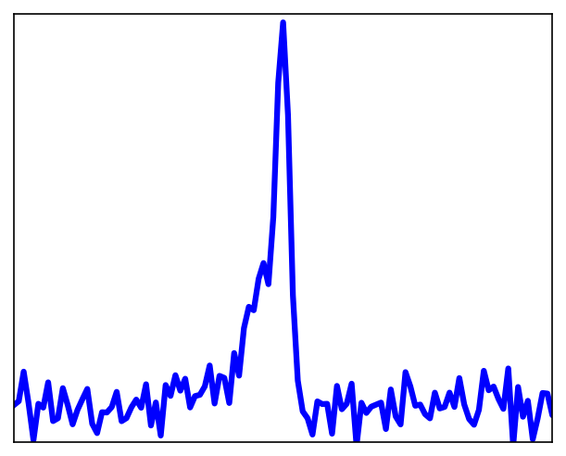
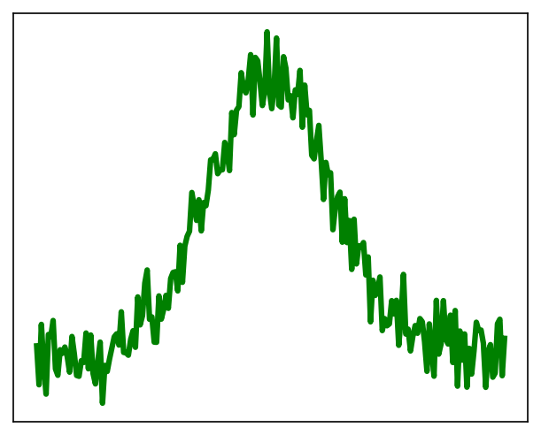
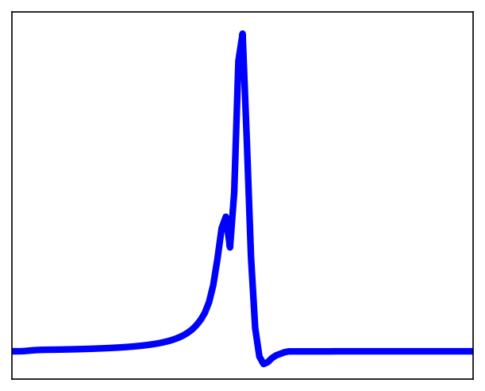
Compromise: Semi-Supervised Learning
Scenario: Experimentalist has approximate simulation of true signal, followed by noisy measurements
Stage I - Supervised:
  Train in supervised mode: pairs of events with estimated (“distorted”) signal coupled with noisy counterpart
Stage II - Unsupervised:
  Resume training in unsupervised mode with noisy measurements that contain correct signal
Available
Stage I
Stage II
Model Output
Clean Simulation
Supervised
Learning
Unsupervised
Learning
Noisy Measurements
Noisy Simulation
Smooth L1
Loss
MC-SURE
Loss
Trained U-Net
Noisy Measurements
Denoised Measurements
Transfer Model
Weights
LLNL-CFPRES-2020399
Available
Stage I
Stage II
Model Output
Clean Simulation
Supervised
Learning
Unsupervised
Learning
Noisy Measurements
Noisy Simulation
Smooth L1
Loss
MC-SURE
Loss
Trained U-Net
Noisy Measurements
Denoised Measurements
Transfer Model
Weights
Figure 4: Illustration of the two-stage semi-supervised learning procedure.

Slide 18
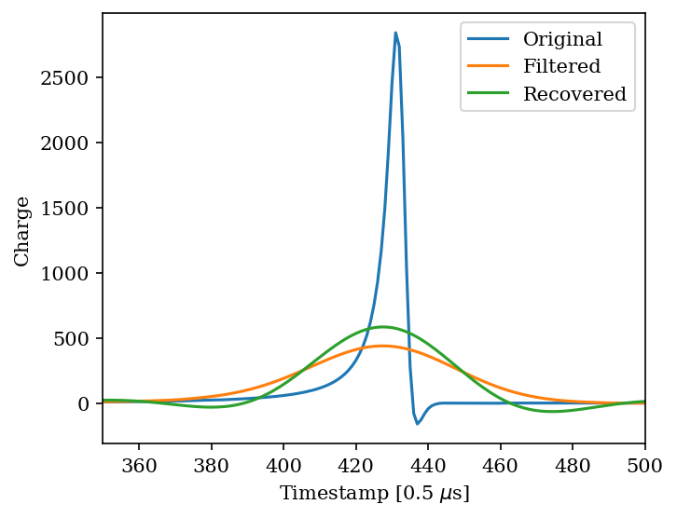
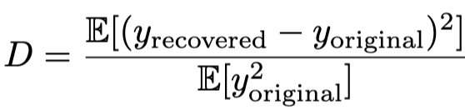
A Simulated Experimentalist: Distorting True Signals
To simulate experimentalist’s knowledge, we distort true signals
Distortion: Gaussian filter
  Distortion quantized by information loss:
Inverting the filter does not return the true signal – information is irrecoverably lost, and the ML cannot just learn the filter inversion
Figure: Example of applying Gaussian filter, output orange, to true signal (blue). Attempting to invert the filter returns green profile.
LLNL-CFPRES-2020399

Slide 19
Results
LLNL-CFPRES-2020399

Slide 20
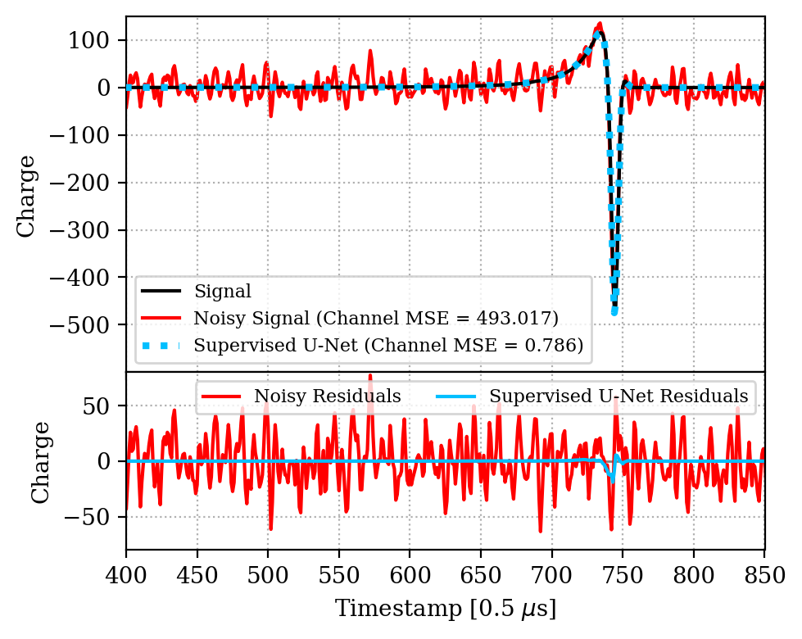
Example of Model Output
All models successfully eliminate noise in regions distant from signal
Models successfully capture bulk signal features
Primary error sources are sharp, high frequency signal regions
Figure: Top) Single-channel example of supervised model denoising output (blue) of noisy measurement (red), compared to true signal (black). Below) Corresponding residuals.
LLNL-CFPRES-2020399

Slide 21
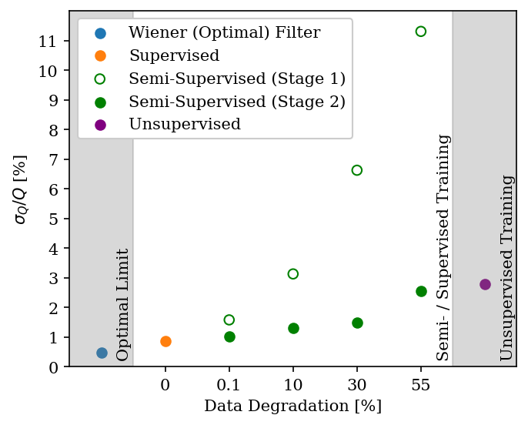
Results For All Models
Supervised model produces near-optimal denoising result
Unsupervised model performs moderately
Semi-supervised models in Stage I perform as a function of signal distortion
Stage II performance approaches optimal limit despite high amounts of signal distortion
Figure: Charge resolution as a result of denoising for all models.
LLNL-CFPRES-2020399

Slide 22
Aside: Hypothesizing Why Semi-Supervised Works
Loss Value
[Arb.]
Supervised learning has a smooth loss landscape
        The unsupervised loss landscape is riddled with local minima
              In two-stage learning, the supervised stage directs the model in the approximate direction of the global minimum. The unsupervised stage navigates closer to the global minimum with different information
Training Duration [Arb.]
LLNL-CFPRES-2020399

Slide 23
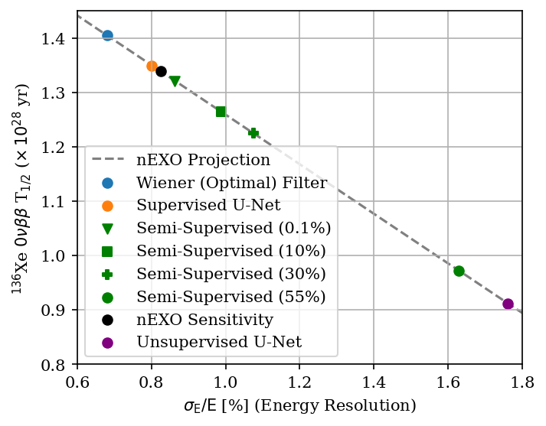
Improvement in Energy Resolution
Energy resolution (proportional to half-life sensitivity) calculated at nEXO photon resolution across all models*
Supervised model returns sensitivity greater than nEXO projection
Semi-supervised models approach nEXO sensitivity
Performing denoising on photon component of decay events could push energy resolution even lower
Figure: Decay half-life sensitivity as a function of energy resolution for all models.
*M. R. Anderson, V. Basu, R. D. Martin, C. Z. Reed, N. J. Rowe, M. Shafiee, and T. Ye, Performance of a convolutional autoencoder designed to remove electronic noise from p-type point contact germanium detector signals, Eur. Phys. J. C 82, 1084 (2022), arXiv:2204.06655 [nucl-ex].
LLNL-CFPRES-2020399

Slide 24
Discussion and Future Work
LLNL-CFPRES-2020399

Slide 25
Denoising for 0νββ and Beyond
This study demonstrates
  Supervised denoisers can reach near-optimal performance limits
  Even with limited signal knowledge, a semi-supervised denoiser can reach near-optimal performance
With the addition of photon signal denoising, 0νββ energy resolution of << 1% can be within reach
Applications not limited to 0νββ, all detectors have noise
Potential semi-supervised benefit: post-deployment detector simulation generator
  Latent space captures real physics + detector characteristics; available for fast, accurate simulation production
LLNL-CFPRES-2020399

Slide 26
Thank You
Grant Parker
parker79@llnl.gov
LLNL-CFPRES-2020399

