Slide 1
Day 2 Introduction
Emilio Nanni & Sam Posen
GARD RF Roadmap Update
4 March 2026

Slide 2
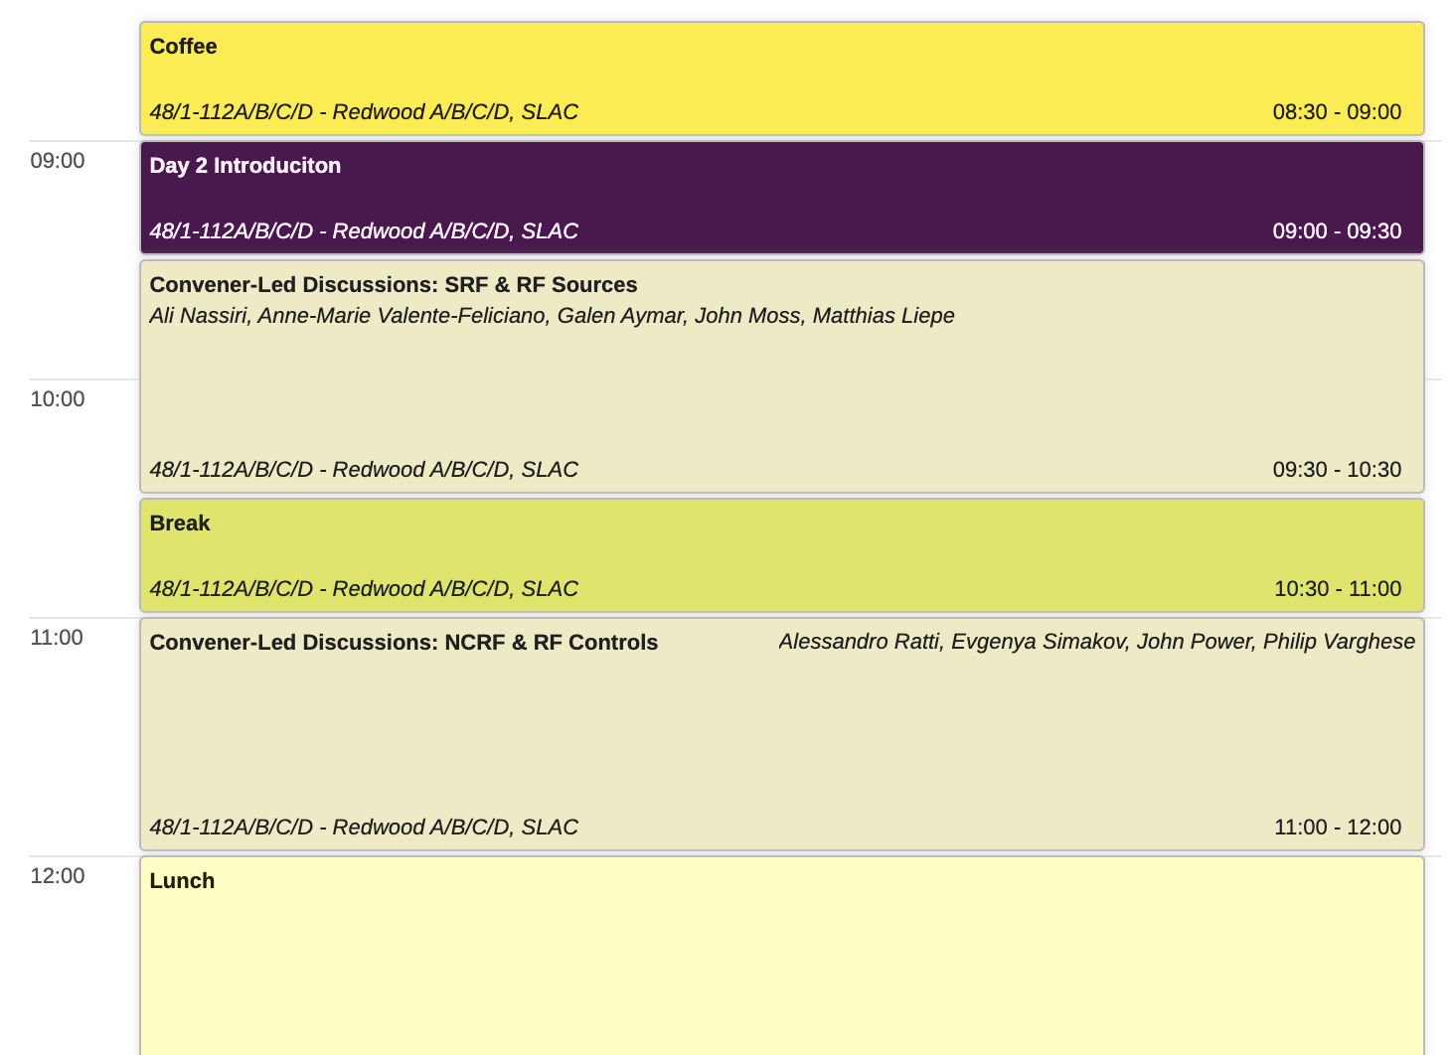
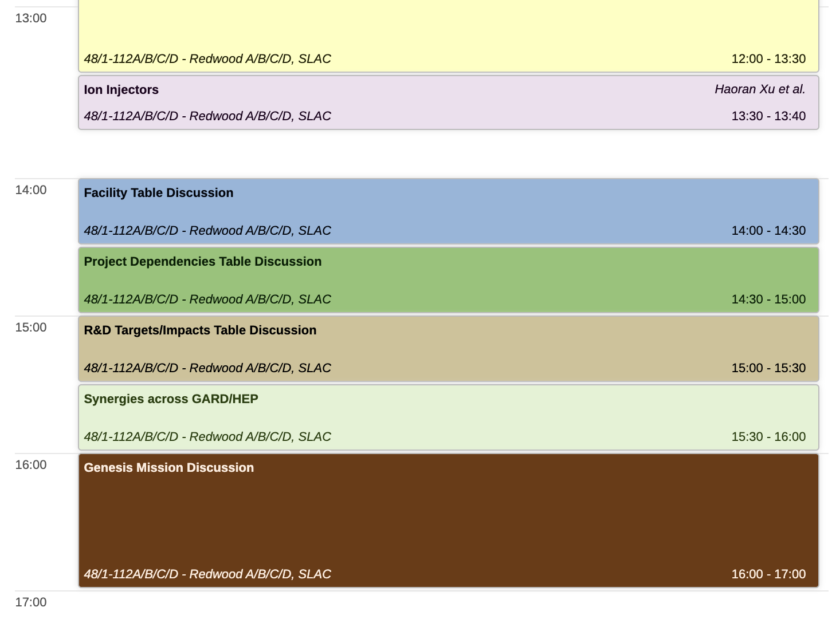
Day 2

Slide 3
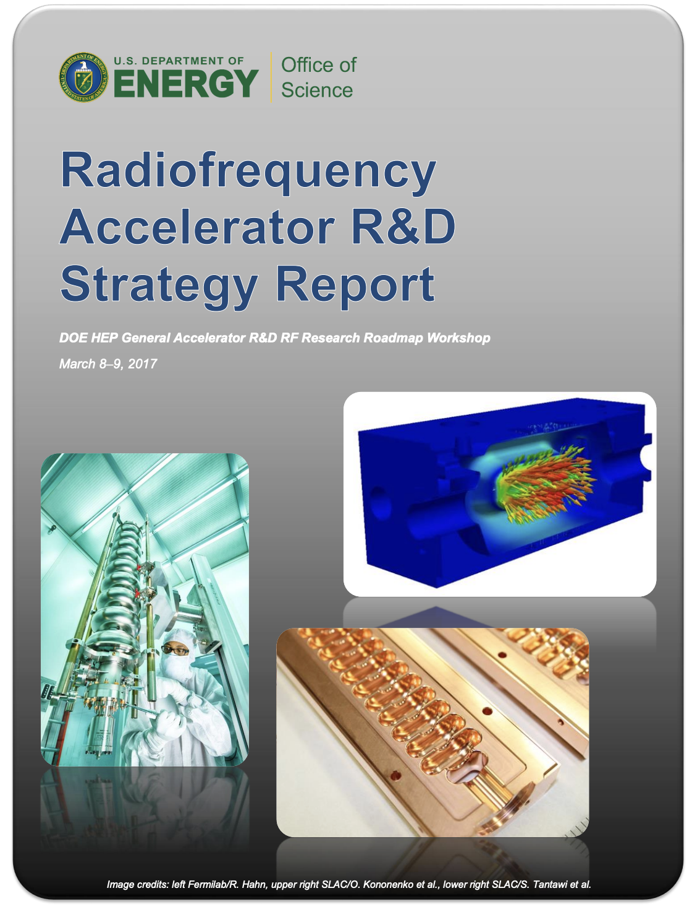
Draft Outline of Roadmap Document
Major impacts from 2017 roadmap
GARD accomplishments during the last 9 years are central to LCLS-II, PIP-II, SQMS, EIC, compact accelerators, xLight…
Introduction: current landscape & priorities: Genesis, PIP-II, etc.
Challenge Areas
Milestones
Key Motivations
Lists of benefits to different DOE offices
Tables
R&D facility table – and investments for next decade
Project/facility dependency table
R&D Targets/Impacts
Synergies: industry, quantum, across GARD/HEP
GARD RF & Genesis
Workforce development

Slide 4
Stakeholder Wins
Explicit note that while the model is that GARD is funded by HEP, it serves all offices, and has broader impact beyond SC
Impact on each of the offices: e.g. HEP {PIP-II, ACE, future colliders, stewardship}, BES {light sources (e.g. resonance control, cryocooler based SRF), SNS, compact accelerators}, NP {EIC}, FES {FPNS}, quantum {materials, RF controls}, NNSA {compact accelerators} , industry {compact accelerators, RF controls, ADS}
Numbers - how much money can we save for operations, examples from rebuilding cryomodules, power bills, impedance for main injector; Path for Fermilab accelerator complex with tuneable cavity

Slide 5
e.g. Benefits for HEP
Near Term
Ability to operate PIP-II in pulsed mode – millions of dollars savings in operating costs for RF power sources and cryogenic plant
Fewer trips/Less down time when operating PIP-II cavities close to stability limits
In-situ methods for addressing any field emission for PIP-II, and reduced costs for cryomodule refurbishment
AM to alleviate supply chain bottlenecks
Low-cost high-throughput AI-enhanced RF control
Science targets for ++FCC +EIC(NP)
Medium Term
Position US to play a significant role in FCC accelerator
Tuneable SRF cavity for Fermilab accelerator complex
Magnetic field-tolerant high Q cavities for muon collider & dark matter
Cryocooler-supported Nb₃Sn cryomodules for ??
Long Term
Transformational advances in accelerating gradient and Q
RF power on demand

Slide 6
Workforce Development
Importance of Traineeships, USPAS, university support, grad student & early career support
R&D has been demonstrated to be crucial training ground for the next generation of leaders
What else to include here?

Slide 7
Synergies
US industry synergies and benefits, stewardship
Quantum synergies and benefits, e.g. alignment of materials science
Genesis and why AI/ML is key for RF – e.g. RF controls, robotics

Slide 8
Industry
Industry development/suggested targets
What products do we want to see on the market in the coming years and what is GARD’s role to get there?
Spinoffs since the last roadmap, where to go next beyond accelerators for science, e.g. xLight, NNSA, ADS

Slide 9
Sam and Emilio’s Thoughts on Challenge Areas
Resonance control e.g. stable ops in pulsed with LFD/BW~20 and ~20 Hz
Nb₃Sn providing advantage in applications
Field emission reduction (robotics/in situ)
Layered structure cavities
Tuneable cavity
Limits for short pulse, cryo and magnetic field operation
Cold copper as a platform for injector linacs
RF source efficiency milestones / RF source target frequencies or socket /cost reduction
PIP-II reliability
High-brightness (polarized) injectors
Transformational increases in gradient & efficiency
Workforce development – maybe targets for RF trainees?
100X in simulation
Cryocooler cavities
Other materials (merge with transformational increase?)
High power MW couplers, HOM , etc. (reduced cryogenic losses) e.g tuneable cavity ACE, and for MC, for Nb3Sn
MC challenges
Supply chain and vendor partnership
AI for inverse problems (field emission problems, cathode nonuniform to beam breakup)

Slide 10
Discussion questions
What can be transformational?
What we decided not to do from the last roadmap/less prioritized areas. And exciting things we didn’t get to yet

Slide 11
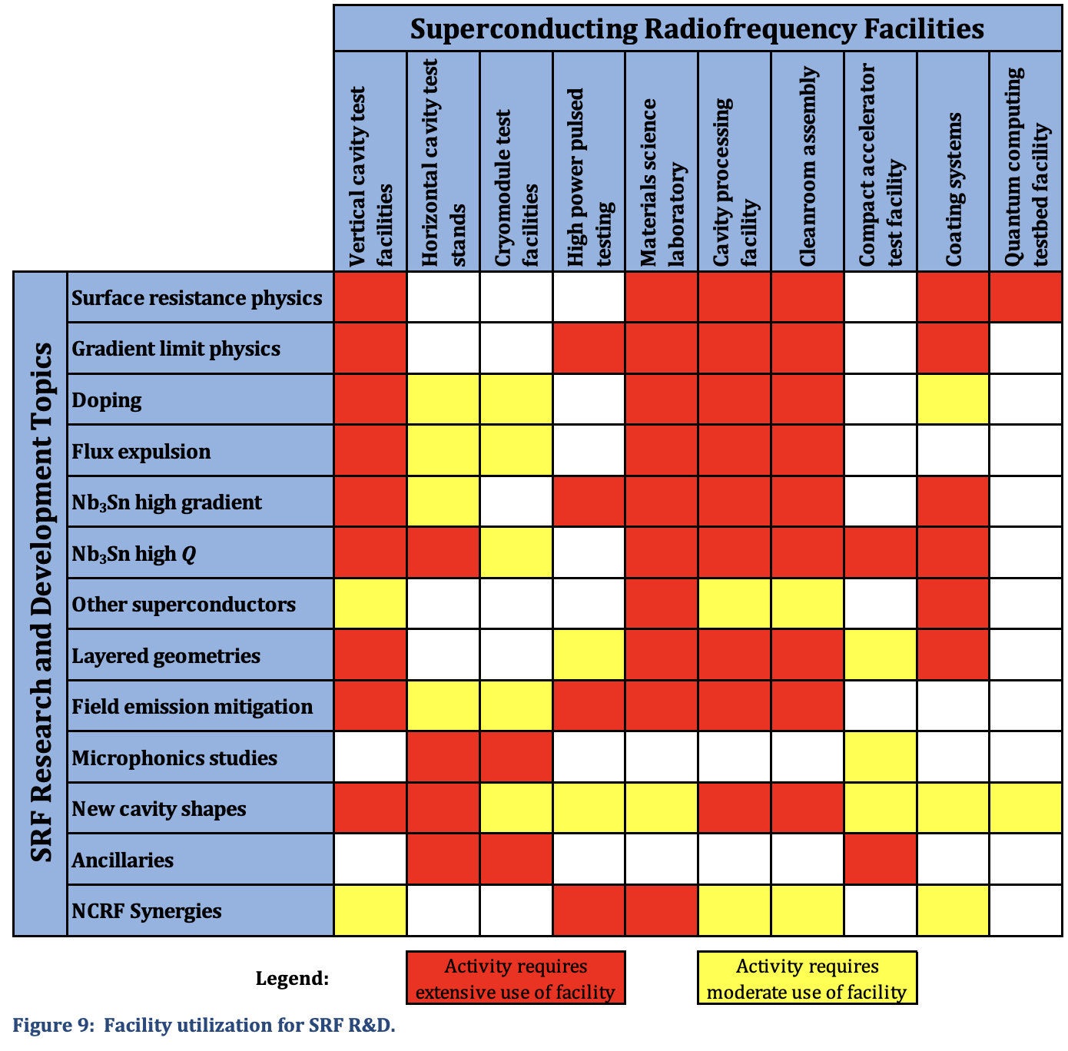
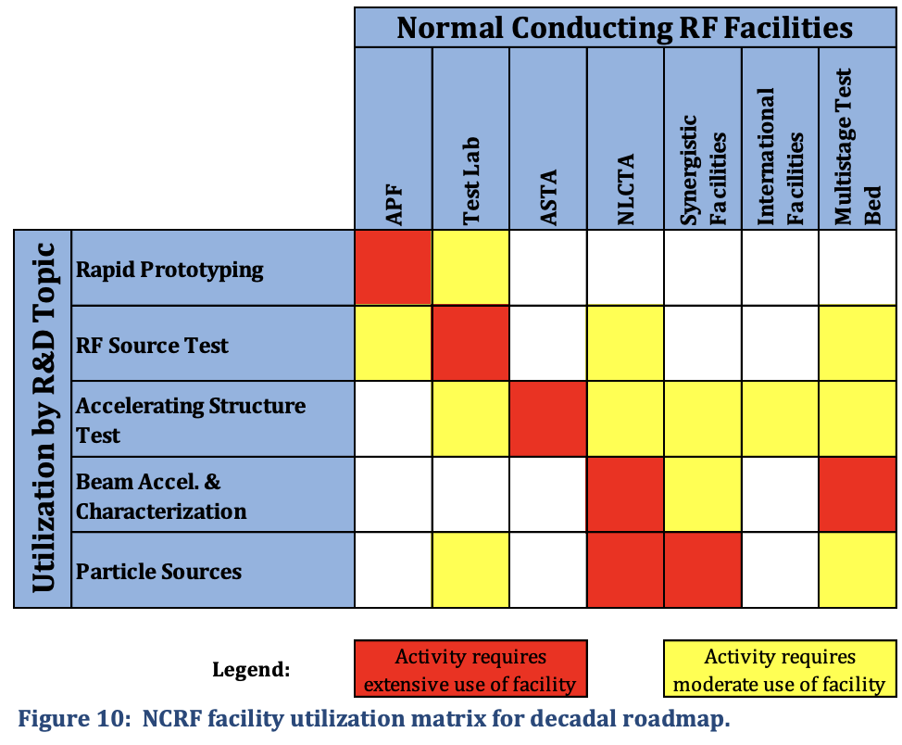
Facility Table Discussion
We want to update these tables. Any reframing?
Is it realistic to talk about facility investments? Could be in support of priorities or new opportunities

Slide 12
Project/Facility Dependencies Table
 | PIP-II | FCC-ee | Muon Collider | Fermilab Accelerator Complex | EIC | LCLS-SC | LAMP
Resonance Control | ☑️ | ☑️ | ☑️ | ☑️ | ☑️ | ☑️
Field Emission Reduction | ☑️ | ☑️ | ☑️ | ☑️ | ☑️ | ☑️
New Materials |  | ☑️ | ☑️ |  | ☑️
New Geometries |  |  |  | ☑️ | ☑️

Slide 13
R&D Targets/Impacts Discussion
Stable ops in pulsed with LFD/BW~20 and ~20 Hz
Nb₃Sn in real applications
Field emission-free result after fully robotic assembly post-HPR
First fully robotic cleanroom assembly of a cryomodule string

Slide 14
Synergies Across GARD/HEP
Fast pulsing for NCRF and SRF
Materials science synergies with quantum
Magnetic field tolerant cavities for dark matter detection – cosmic/quantum
Beam dump experiments

