Slide 1
Ion Linacs – Normal Conducting Front End
V.A. Dolgashev
SLAC
GARD RF Roadmap Update, SLAC, 3-4 March 2026

Slide 2
Contributors
James M. Potter, JP Accelerator Works, Inc.
Haoran Xu, LANL
Nikolay Solyak, FNAL
Sergey Kutsaev, RadiaBeam
Alexander Plastun, FRIB

Slide 3
Outline
Introduction
Radio Frequency Quadrupoles
Drift Tube Linacs
Interdigital H-structures
Some Resent development
High Frequency RFQ
High Gradient Traveling Wave Structures
High Gradient C-band structures
Discussion
Ion Source
Low Energy Beam Transport
Radio Frequency Quadrupole
Drift Dube Linac or
Interdigital H Structures
Typical Ion Linac Front End

Slide 4
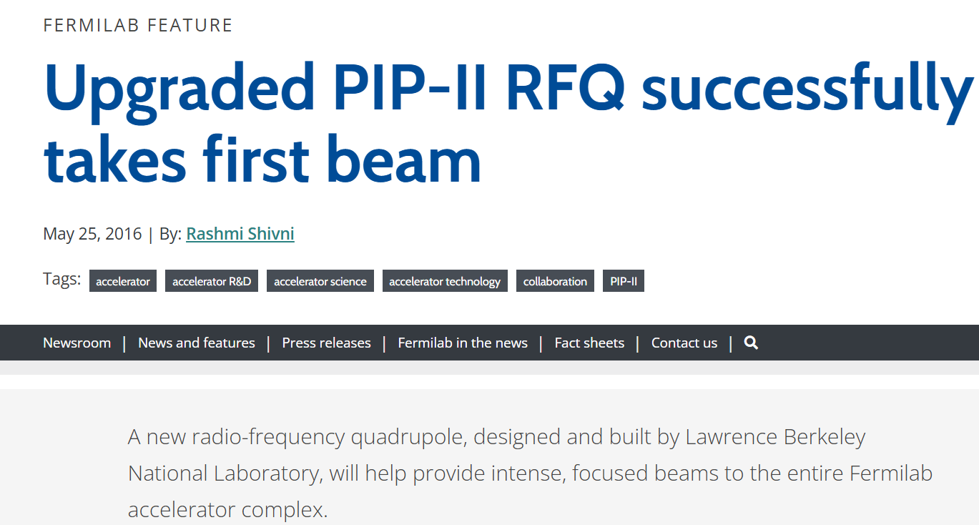
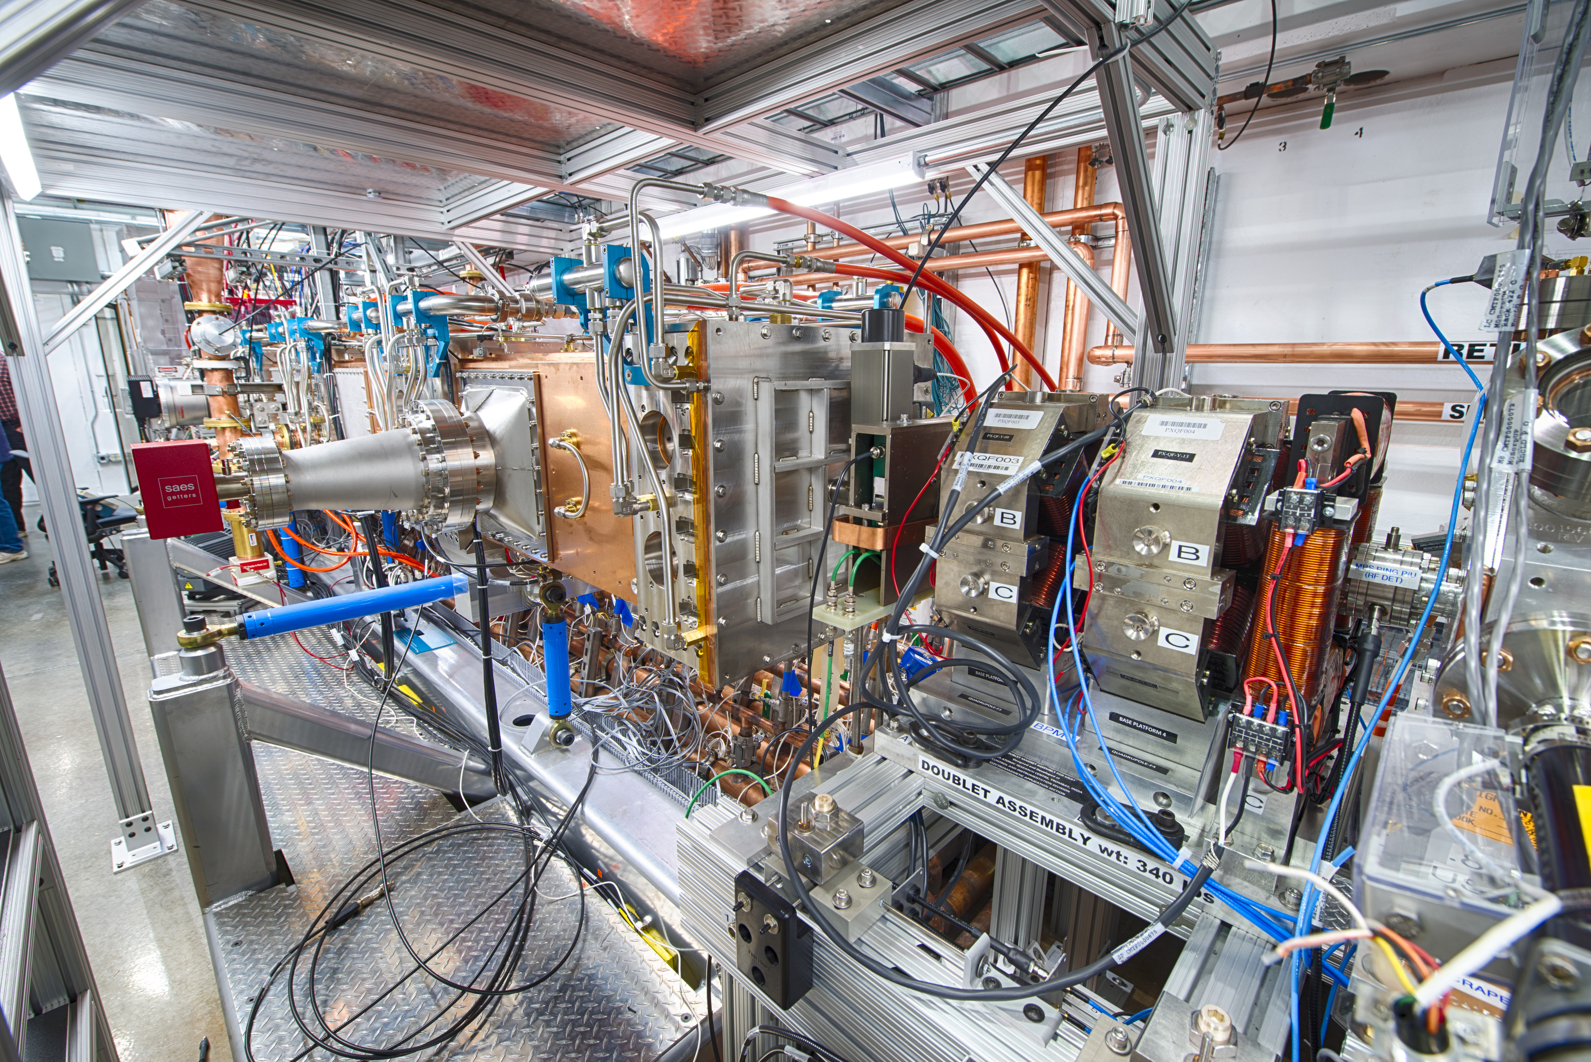
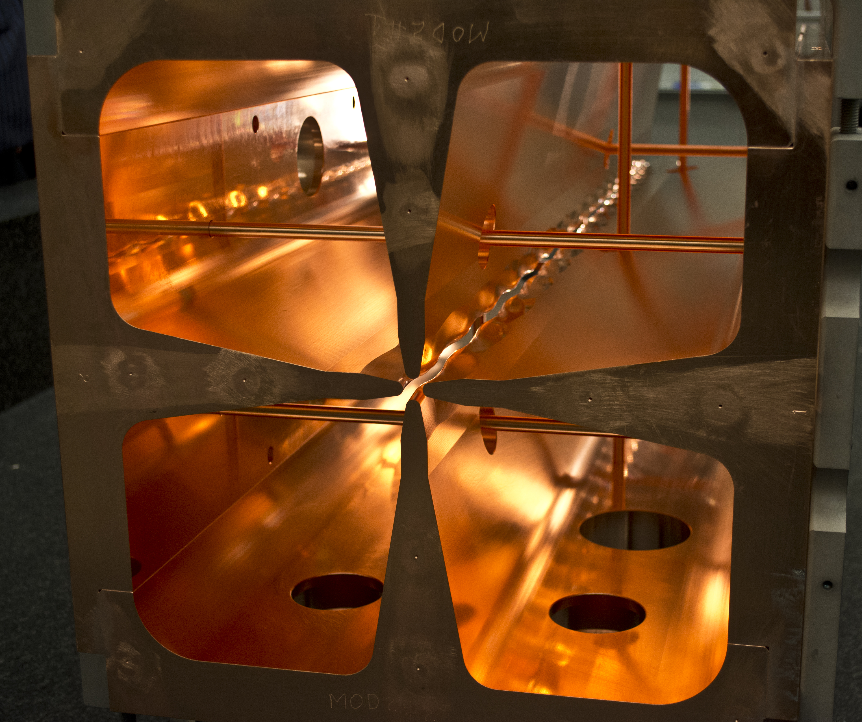
Introduction: Radio Frequency Quadrupole (RFQ)
FNAL

Slide 5
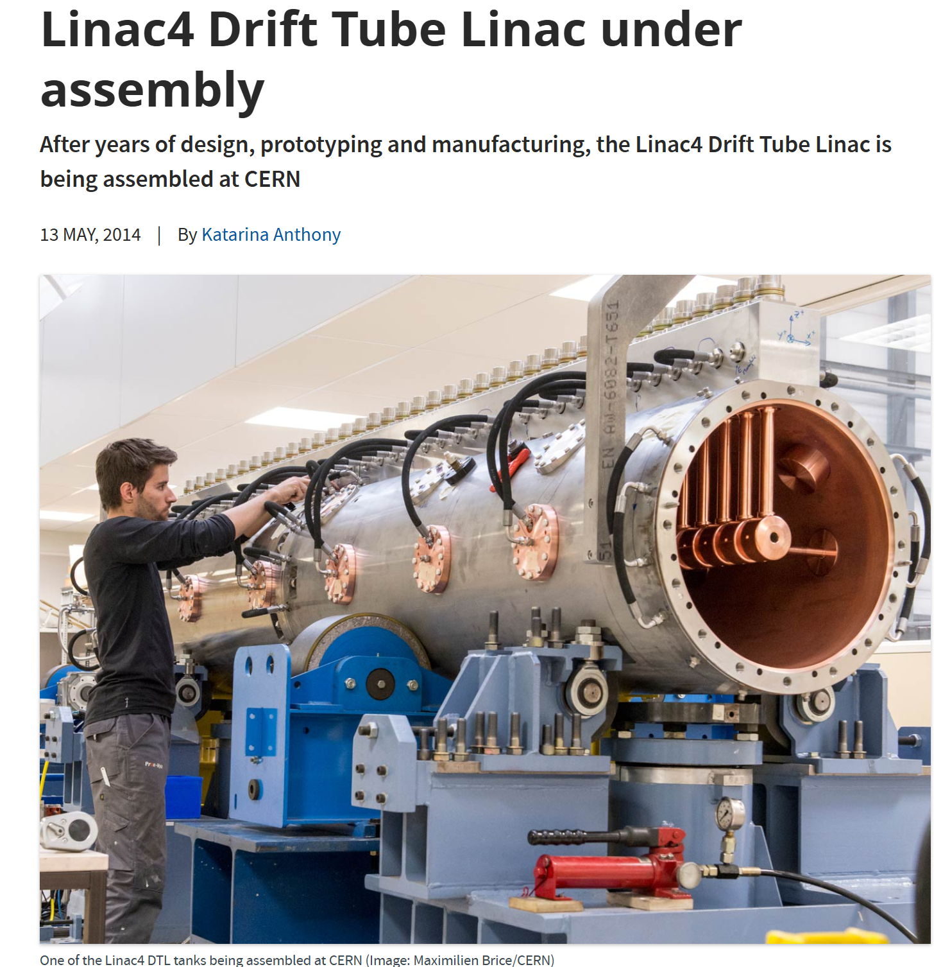
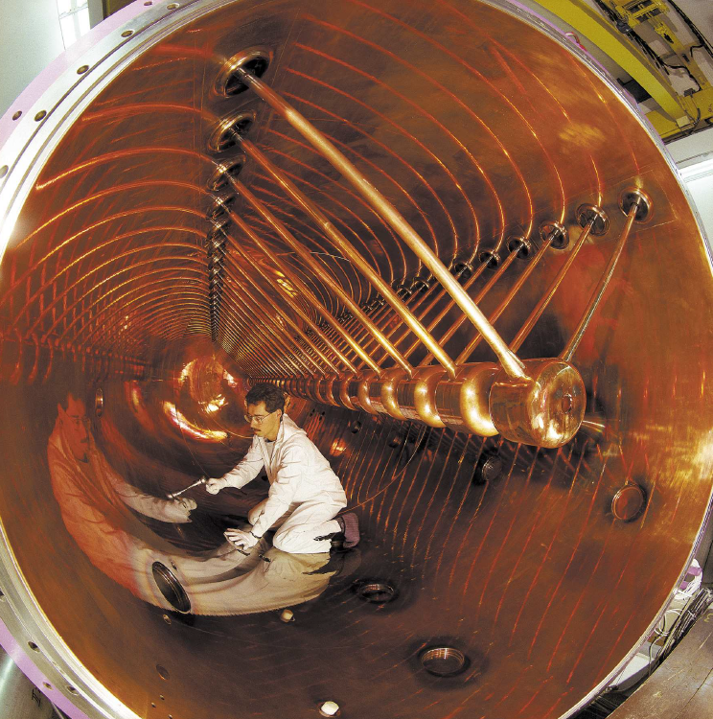
Introduction: Drift Dube Linac
Alvarez Drift Tube Linac –108 MHz, GSI, 1975

Slide 6
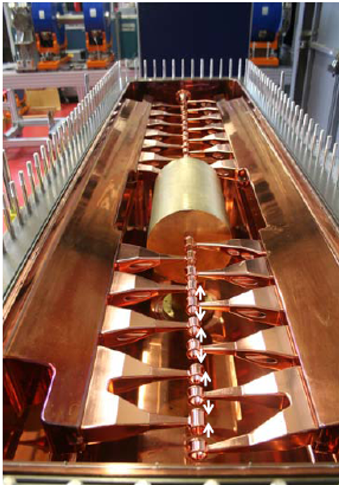
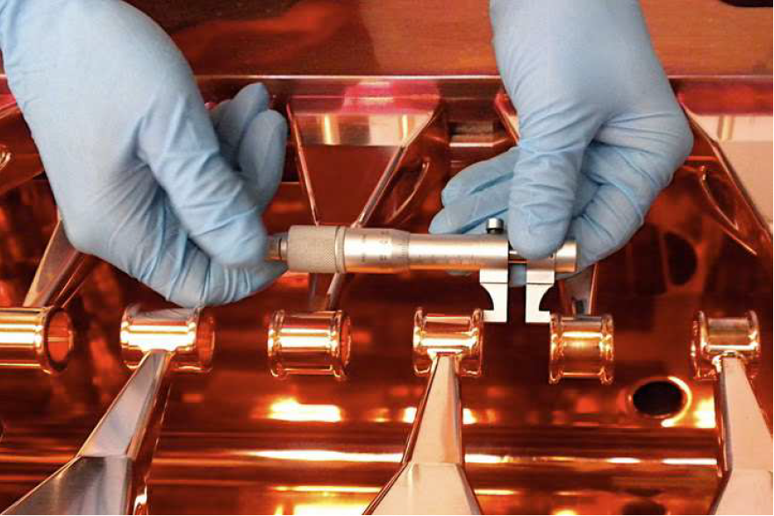
Introduction: Interdigital H structure
IH structure build by U. Ratzinger (GSI) Group for the BNL EBIS injector, 100 MHz

Slide 7
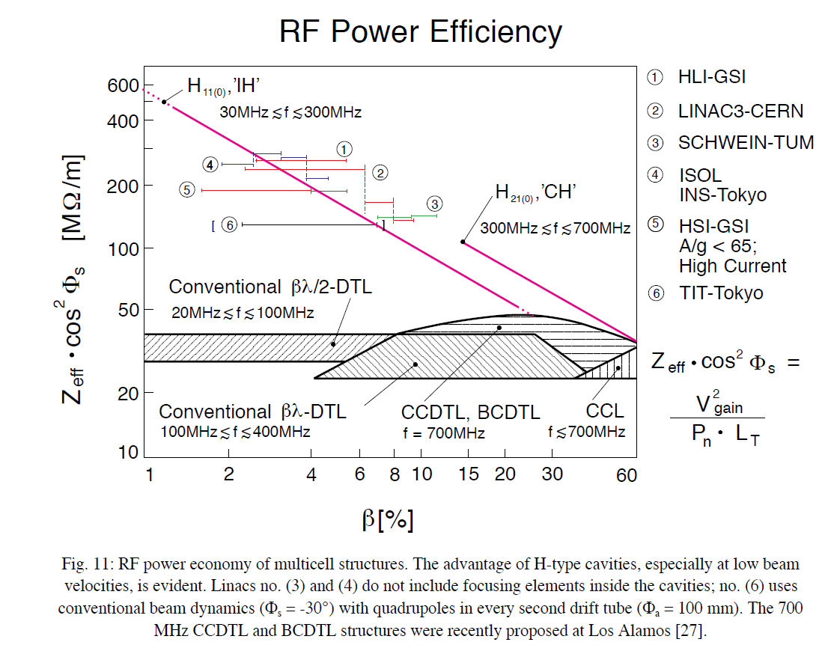
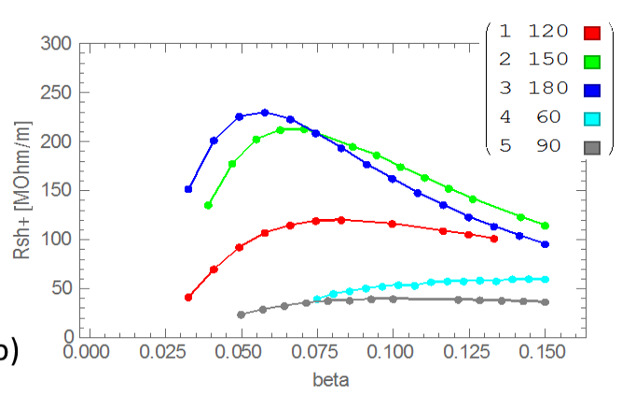
H structures have highest RF power efficiency of any structures at betas below 0.6
Standing Wave
Traveling wave
Shunt impedance of 433 MHz Interdigital H structures vs. beta for different phase advance per half-period.
U. Ratzinger, H-Type Linac Structures,CAS 2000
Shunt impedance characterizes rf-to-beam efficiency of accelerating structure. Here traditional ion linacs of different types are compared with Interdigital H-structures (IH) and Cross-Bar-H structures (CH). We found higher shunt impedance structures can sustain higher gradients.

Slide 8
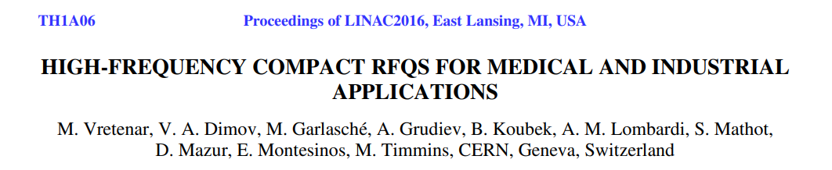
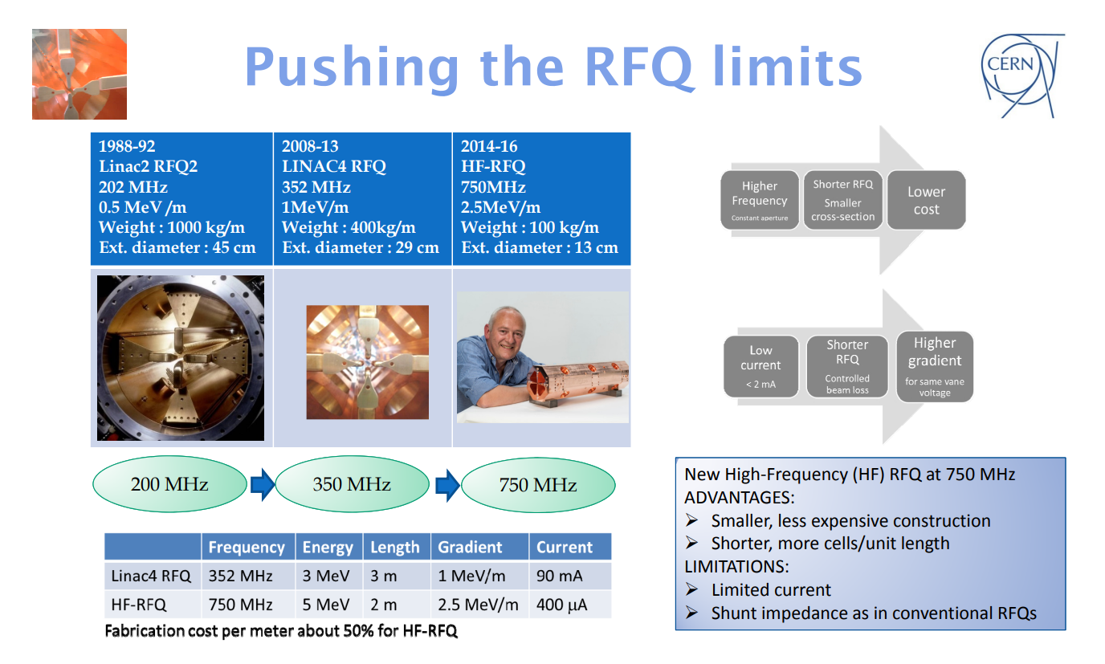
Recent Development: CERN’s Compact 750 MHz Radio Frequency Quadrupole

Slide 9

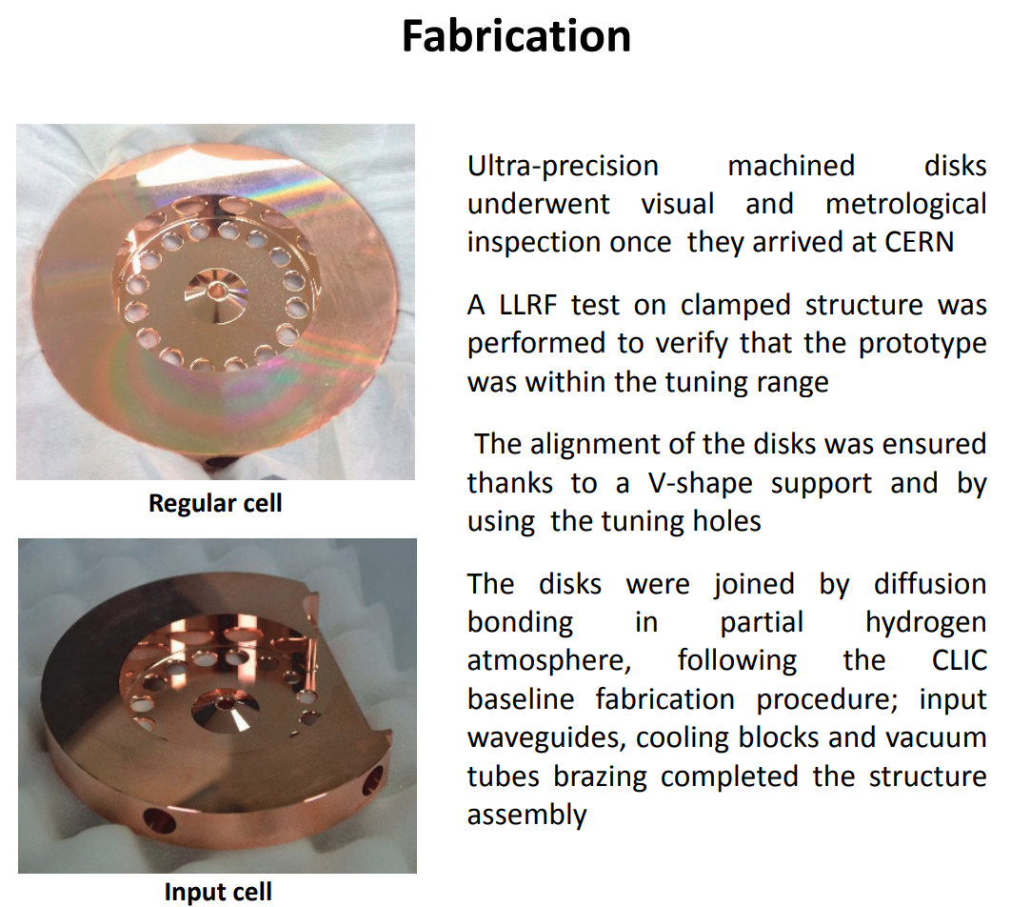
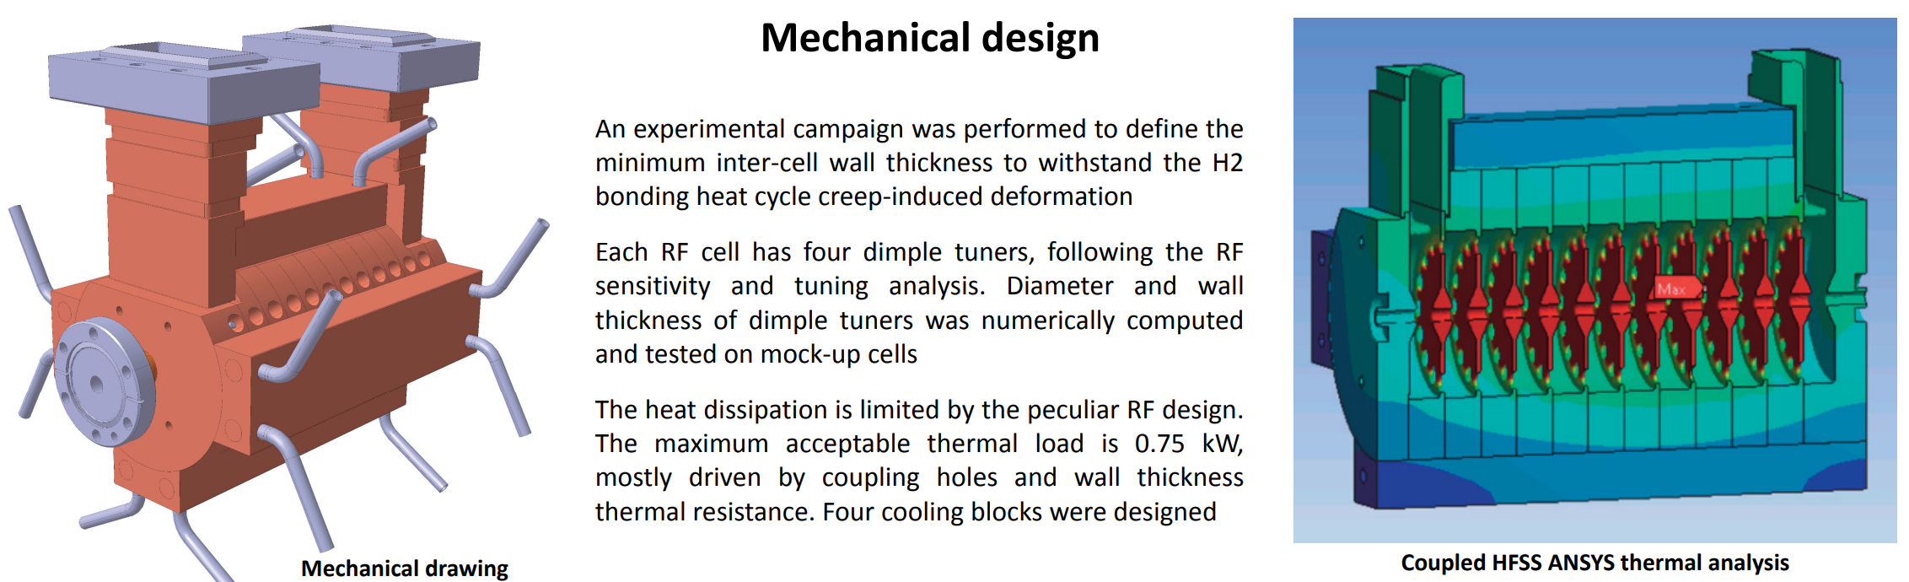
Recent Development: S-band Backward Wave Traveling Wave Linac For Proton Therapy
LINAC 2016

Slide 10
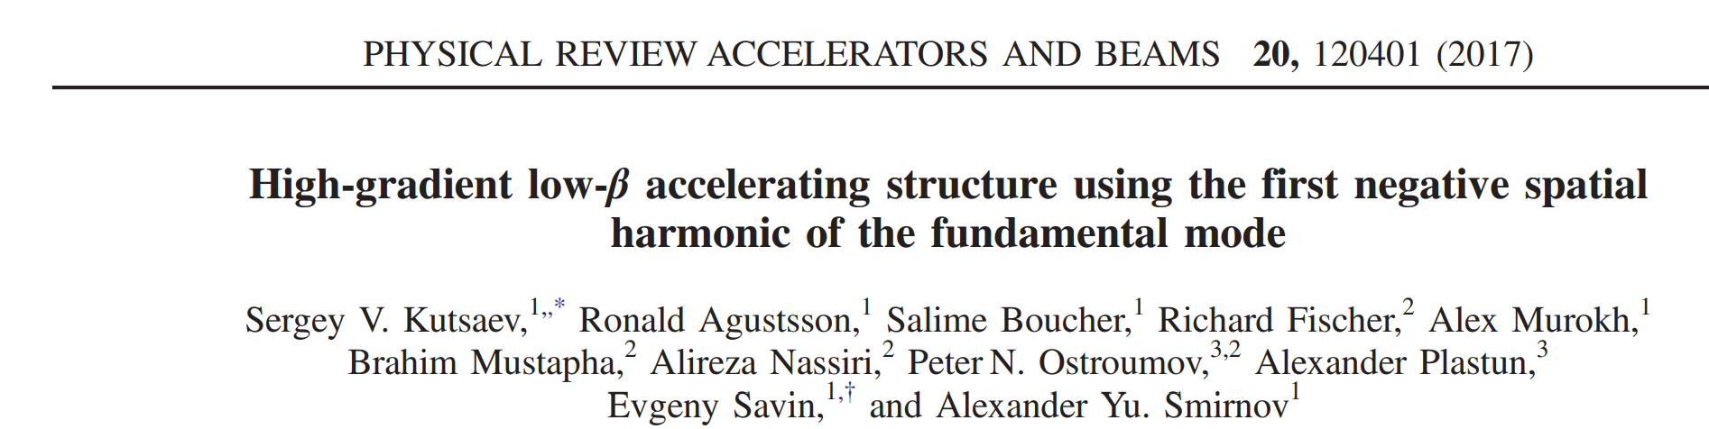
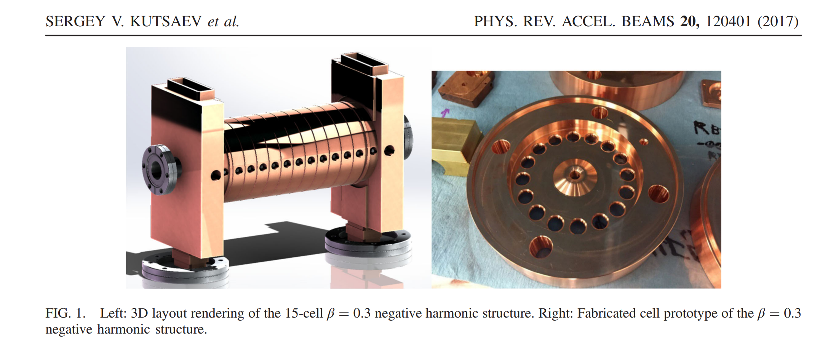
Recent Development: Proton Accelerating Structure Using the First Negative Spatial Harmonic of the Fundamental Mode

Slide 11
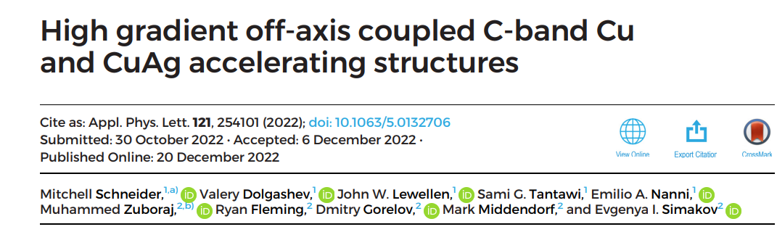
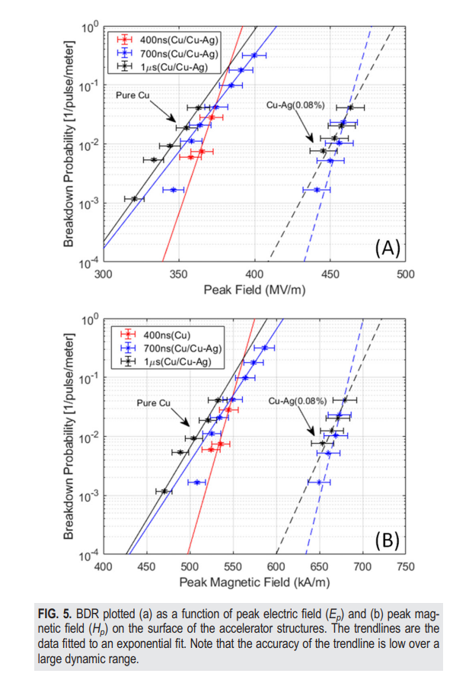
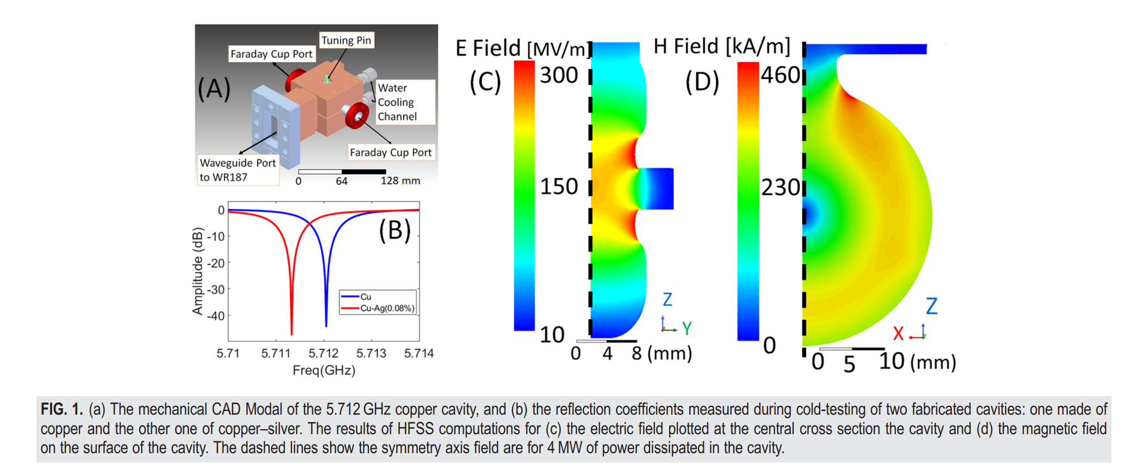
Recent Development: Off-axis coupled C-band Accelerating Structures

Slide 12
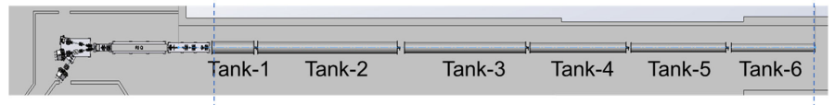
LANSCE Modernization Project (LAMP) Needs
Device | Beam Energy | Peak Power | RF Source
RFQ | 65.0 keV – 3.00 MeV | 1.2 MW | 1 diacrode
Rebuncher (3×) | 3.00 MeV | 10 kW
DTL-T1 | 3.00 – 8.63 MeV | 0.19 MW | 1 diacrode / 2 tetrodes
DTL-T2 | 8.63 – 32.48 MeV | 1.05 MW | 1 diacrode
DTL-T3 | 32.48 – 53.59 MeV | 1.17 MW | 1 diacrode
DTL-T4 | 53.59 – 70.03 MeV | 1.15 MW | 1 diacrode
DTL-T5 | 70.03 – 86.14 MeV | 1.39 MW | 1 diacrode
DTL-T6 | 86.14 – 100.21 MeV | 1.43 MW | 1 diacrode
All RF frequencies are 201.25 MHz.
All RF pulses are at 120-Hz rep-rate with pulse length 1.1 ms.
Haoran Xu, LANL

Slide 13
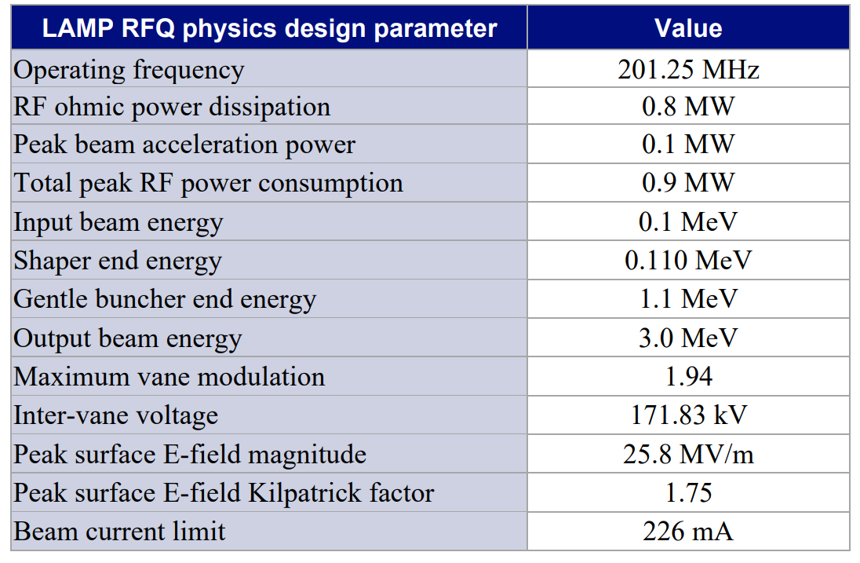
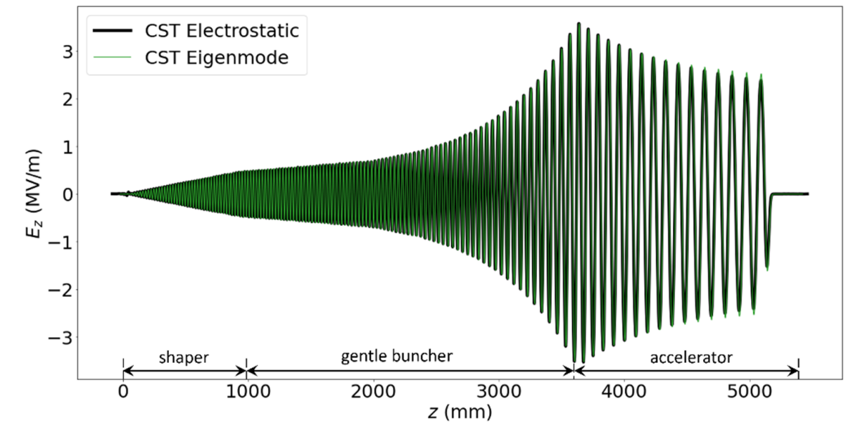
LANSCE Modernization Project RFQ
Design: PARMTEQM – CST E-static – CST Eigenmode – CST High-Frequency (not there yet)
Procurement: Subcontractor takes over design beyond the CST Eigenmode simulation model stage and complete all engineering designs, fabrication, and Factory Acceptance Test.
Haoran Xu, LANL

Slide 14
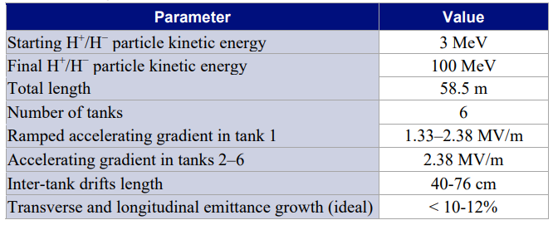
LANSCE Modernization Project Drift Tube Linac
DTL
Design: PARMILA – CST Eigenmode – CST High-Frequency (not there yet)
Procurement: Subcontractor takes over design beyond the PARMILA stage and complete all engineering designs, fabrication, and Factory Acceptance Test.
Haoran Xu, LANL

Slide 15
Competence in Ion Linac Front End
DOE Labs:
LBNL
FRIB
FNAL
ANL
LANL
BNL
ORNL
US Industry:
AccSys Technology
Nusano
Ion Linac Systems

Slide 16
Discussion
Number of labs or commercial companies which could build turn-key ion front end is very limited.
Without continuing investment or funded projects (like LAMP) this competence is at risk.
Suggestions
Talent development: Continue DOE funded graduate program which produce “ion front” PhDs, like one in FRIB. At least one per year to preserve continuation of experience.
DOE-managed knowledge base: Under DOE stewardship create a supported database with drawing packages, simulation codes, technical procedures, etc. which will maintain the-state-of-the art in absence of renewable project funding.

