Slide 1

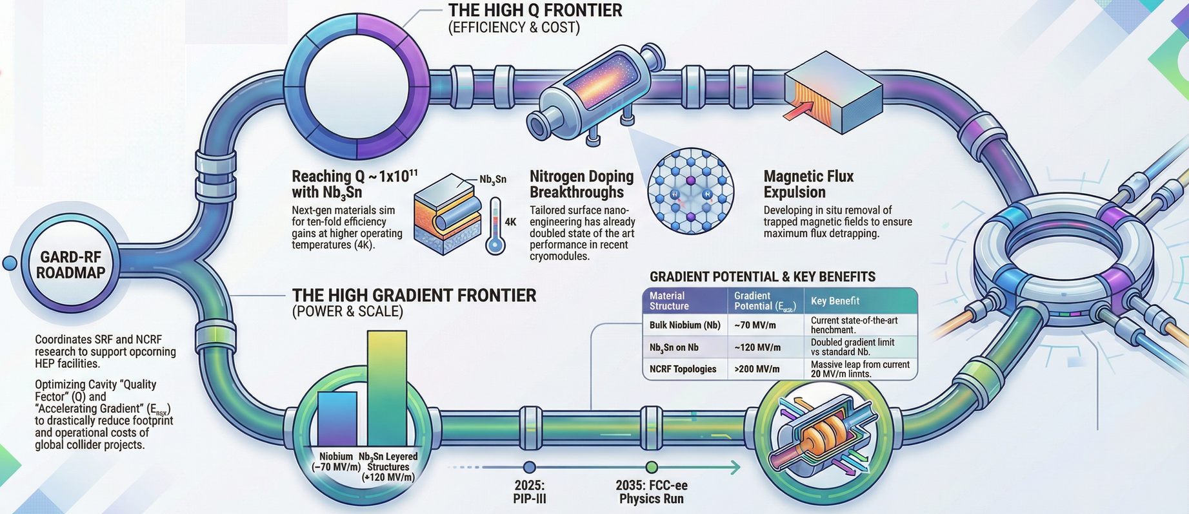

DOE RF Roadmap Update
SRF Overview and Discussion
03/03/2026
Anne-Marie Valente-Feliciano & Matthias Liepe
Notes:
Tip: Keep titles under 60 characters for readability
To change the photo: Right-click on photo and select change photo

Slide 2




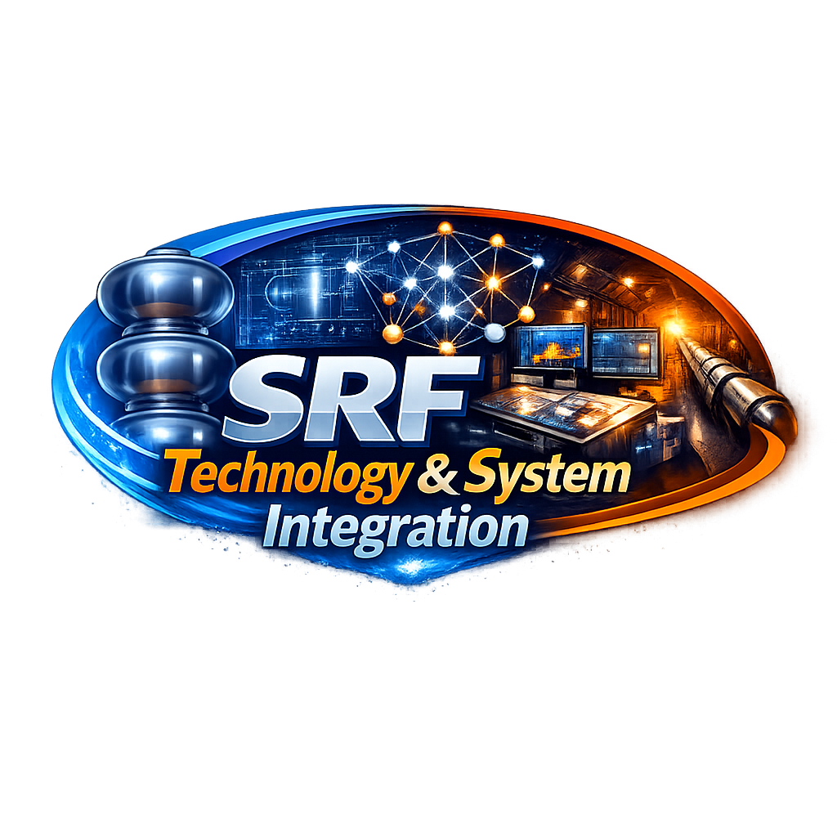
Outline
Introduction: The last decade for High Q/High G
Towards the Future: Virtual talks summaries
Challenge areas for the next decade
SRF Foundation: Fundamental SRF Research
The Last Mile: Advanced Processing for Pushing Bulk Nb to the Theoretical Max
The Next SRF Materials Frontier: Beyond bulk Nb
Fast-Tracking the Frontier: AI/ML for SRF
SRF Technology & System Integration
Discussion

Slide 3
INTRODUCTION: THE LAST DECADE

Slide 4
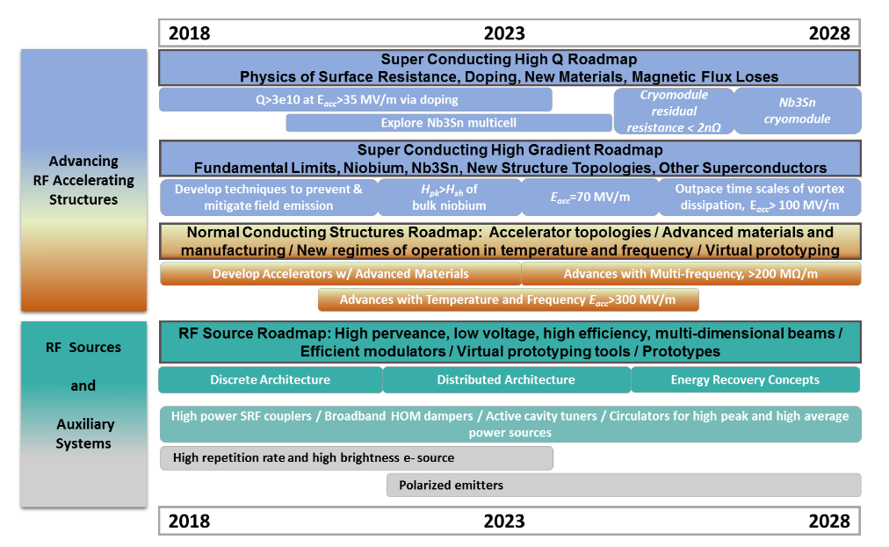
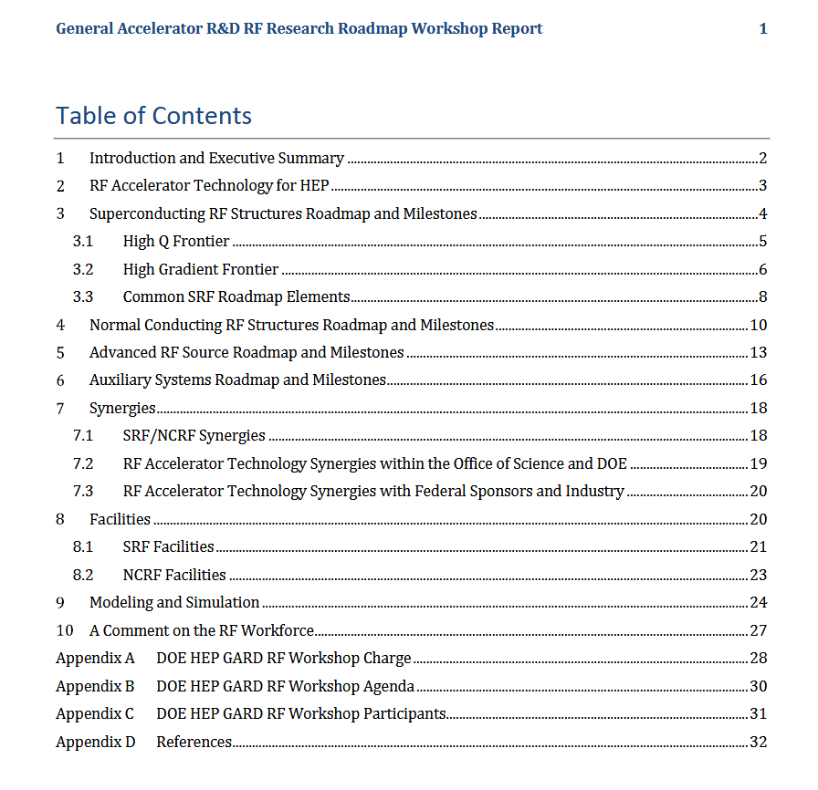
DOE GARD RF Roadmap - circa 2017
Notes:
Guidelines: 6-8 bullets per slide; Use sentence fragments for bullets

Slide 5
Decadal roadmap and milestones for the high Q SRF frontier
Notes:
Guidelines: 6-8 bullets per slide; Use sentence fragments for bullets

Slide 6
Decadal roadmap and milestones for the high Gradient SRF frontier
Notes:
Guidelines: 6-8 bullets per slide; Use sentence fragments for bullets

Slide 7
TOWARDS THE FUTURE SRF Virtual Talks Summaries

Slide 8
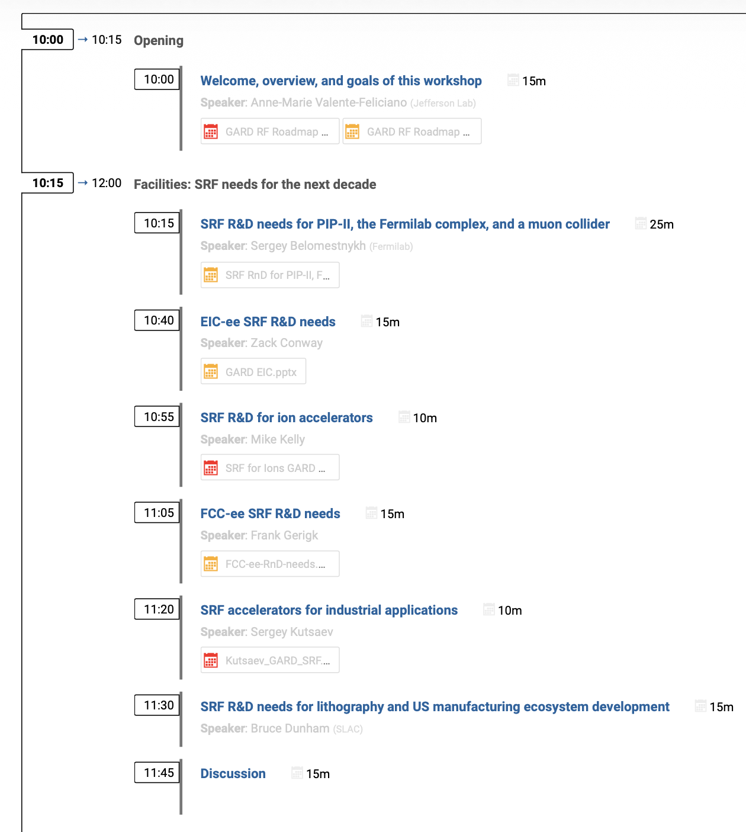
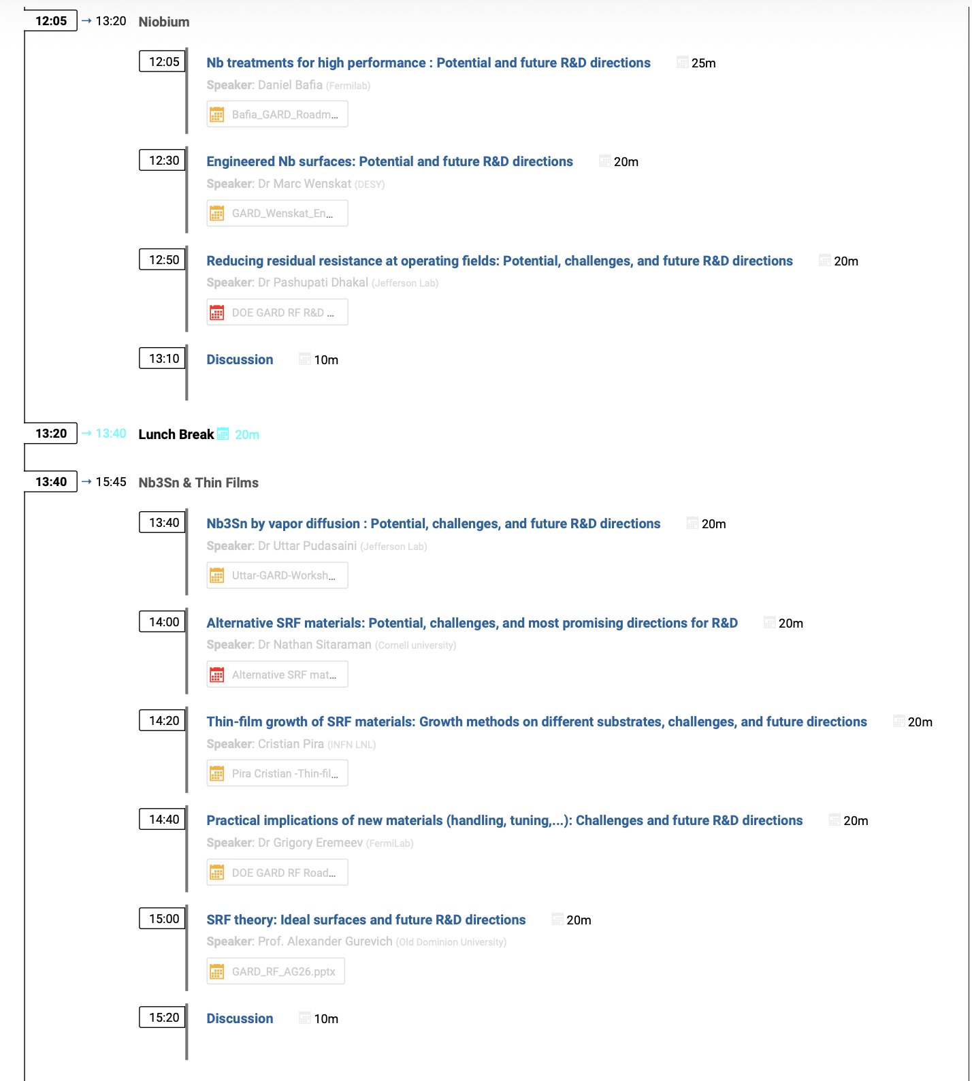
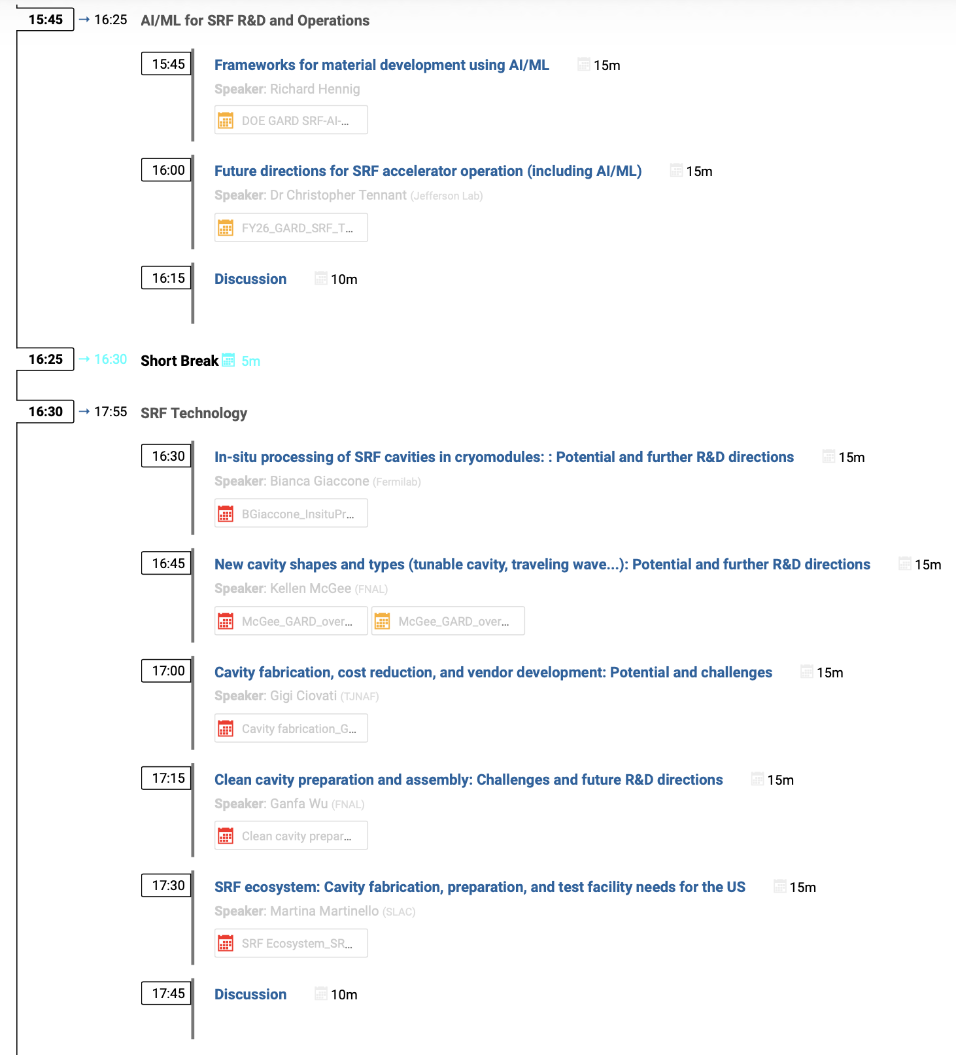
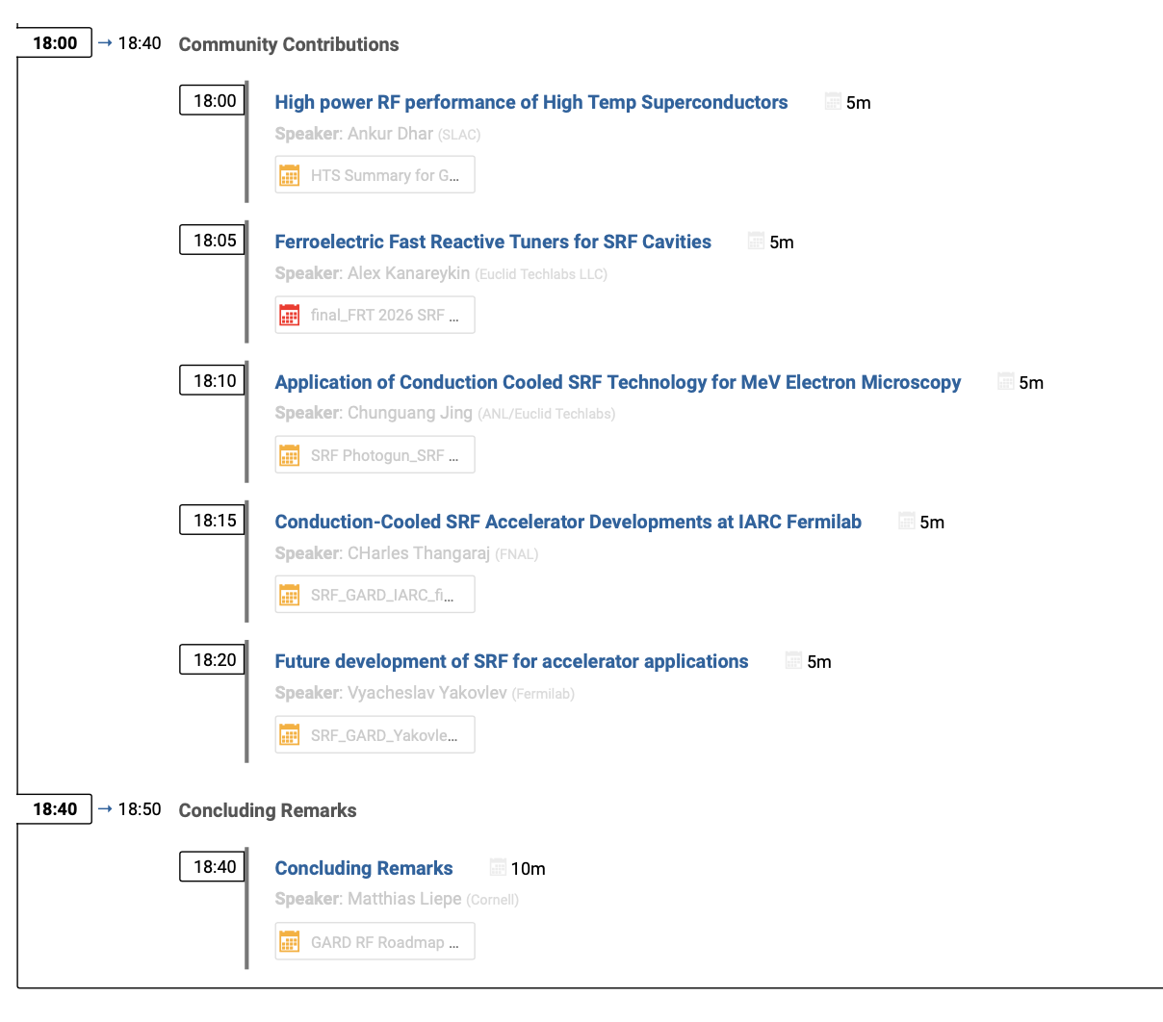
Virtual GARD SRF Roadmap Meeting: February 5
21 Invited Talks + 5 Community Contribution Talks
Facilities: SRF needs for the next decade
Niobium
SRF thin films
AI/ML for SRF R&D and Operations
SRF Technology
Community Talks

Slide 9
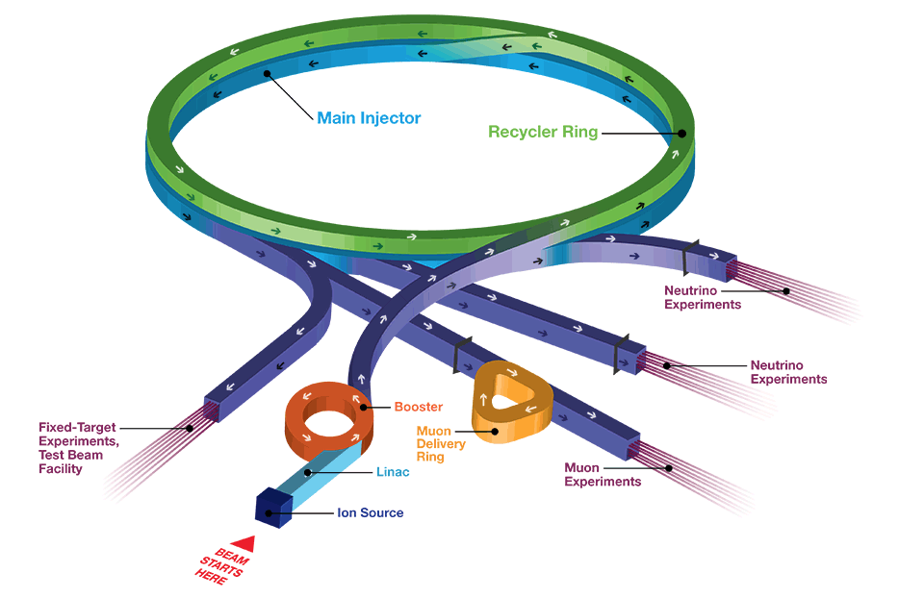
Facilities: SRF R&D needs for PIP-II, FNAL complex, and a muon collider Speaker: Sergey Belomestnykh, FNAL
Key points / Summary:
PIP-II is in production mode. No on-project R&D is planned at this stage but 2 important general R&D topics to improve SRF linac performance (project & operations):
Prevention & mitigation of field emission (FE) - Careful optimization of HPR for each cavity shape, robot assisted cleanroom assembly, in situ FE processing
Resonance control (RC)
Fermilab Accelerator Complex
Accelerator Complex Evolution (ACE) - Main Injector Ramp and Targetry (MIRT) & Booster Replacement (BR)
Muon Collider
Presents many challenges :
Very high muon bunch intensity favoring larger cavity apertures thus lower RF frequencies;
Studies required for Beam loading in RCS chain due to cavities will distributed around the rings in several stations
High gradient operation of multi-cell lower frequency cavities must be demonstrated;
352 MHz frequency dictates Nb/Cu SRF technology – requires significant R&D efforts;
Mitigate Stray magnetic fields from high-field magnets to maintain SRF cavitis performance: develop efficient magnetic shielding and/or develop SRF cavities based on alternative superconductors;
Effect of high-intensity radiation from muon decays on the performance of SRF cavities is unknown
High peak RF power per cavity,mandates R&D on fundamental power couplers.

Slide 10
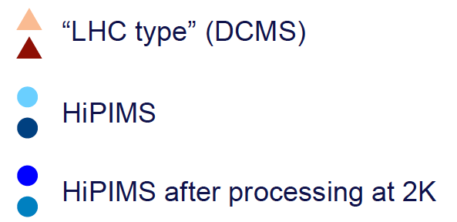
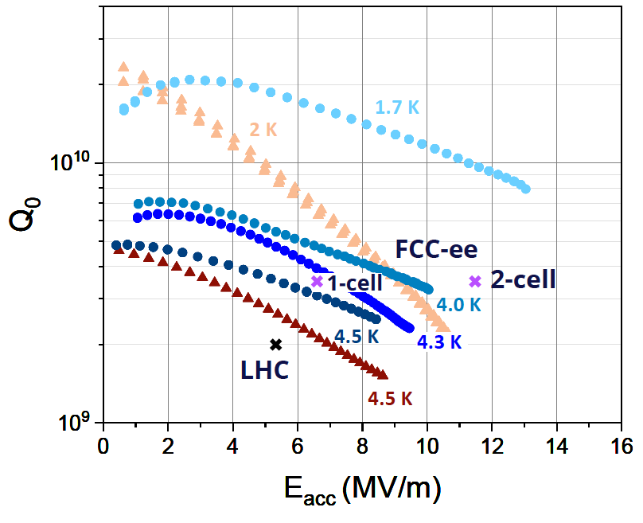
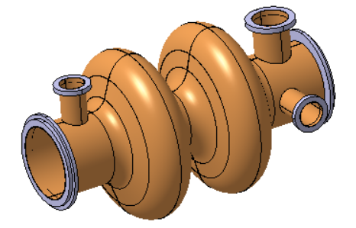

Facilities: SRF R&D needs for PIP-II, FNAL complex, and a muon collider Speaker: Sergey Belomestnykh, FNAL
Recommendations:
Short-term R&D (PIP-II)
FE prevention and mitigation (improving HPR, robot-assisted cleanroom assembly of cavity strings, in situ processing)
AI/ML Resonance Control for narrowband SRF cavities
Medium-term R&D (ACE-MIRT, MC R&D)
Low frequency tunable SRF cavities for proton synchrotrons
Frequency tuners for such cavities
Novel HOM damping schemes
High-power (MW range) fundamental power couplers
New, non-elliptical, SRF structures (88 MHz and 264 MHz) for the MC SC linac
Further improvement of $Q_{0}$ and $E_{acc}$
Long-term R&D (ACE-BR, MC Demonstrator)
Developing alternative materials to bulk Nb, e.g., Nb/Cu, Nb₃Sn
More efficient magnetic shielding

Slide 11
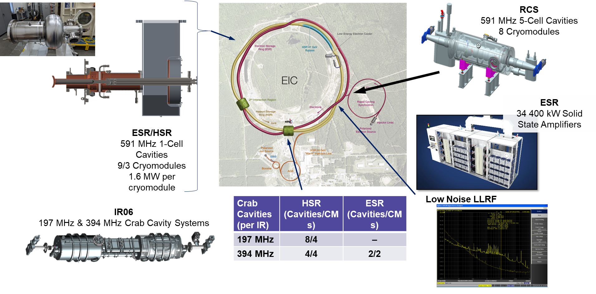
Facilities: EIC-ee SRF R&D needs Speaker: Zack Conway, JLab
Key points / Summary:
High Luminosity
Deliver 800 kW of power via 2-4.5 K SRF cavities
Beamline components strongly interacting with the beams
RF shielded bellows
Broadband absorbers
Crab cavity designs : fit limited space of EIC
Recommendations:
Cavities
FPCs
Solid State Amplifiers
LLRF
Project R&D is limited. Requires great foresight in R&D.
Low-loss, low-R/Q, heavily damped systems
Clean Assembly
High RF power generation: efficiency, and fidelity
New SRF materials and designs if they can operate at high power and fields
Broadband HOM damping
New materials :Controllable/predictable properties ,commercial availability
Alternative methods
Crab cavity design
LLRF systems capable of operating with beyond state-of-the-art amplitude and phase noise across many MHz of bandwidth.
Stable high power RF sources
LLRF techniques for ultra-low noise systems
Cavity structures
Crab cavities
Alternative materials enabling high power with low RF losses
Coupler outer conductors

Slide 12
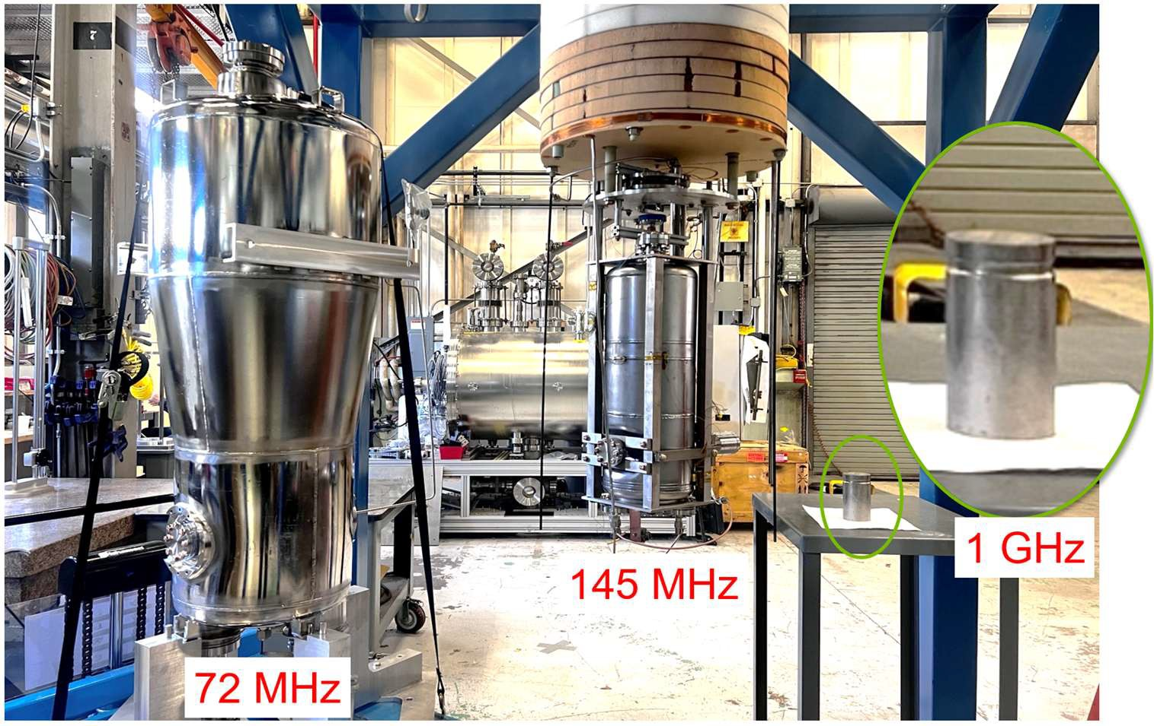
Facilities: SRF R&D for ion accelerators Speaker: Mike Kelly, ANL
Key points / Summary:
New technology for cost effectiveion linacs applications (ATLAS upgrades…)
Nb₃Sn
Proton and heavy-ion facilities for science: ATLAS, (PIP-II, FRIB, EIC?)
Our 10-year strategic plan for a high intensity ATLAS upgrade using all modern SRF structures probably only possible with cost reductions enabled by Nb₃Sn
Accelerator Driven Systems (ADS): 600 MeV to 1 GeV proton accelerators for waste transmutation, neutrons for nuclear engineering studies, energy production Cost based on Nb >$2B, drastic reduction with Nb₃Sn?…
Isotopes for medicine : Dedicated dual 40 MV electron and light-ion SRF linacs
Low intensity heavy-ion linacs: post accelerator for RIB’s, Single Event Effect facility :Candidates for higher frequency (small aperture) SRF structures
Recommendations:
Study degradation in SRF cavities from ion beams exposure (Nb samples or cavities )
2 years New diagnostics supporting Nb₃Sn coating / e.g. “coating monitor concept (FNAL)” could be used broadly to study and compare coatings on different cavities and from different facilities
2-3 years : Lattice/beam physics/cavity EM design/preliminary layout studies for future ‘green field’ proton and heavy-ion linacs that make best use of Nb₃Sn , include higher frequencies and potentially different β ranges than existing structures (Examples with cross cutting interest: a 10 MeV/u heavy-ion linac; a 1 GeV proton linac)
3-5 years :Development and demonstration of new Nb₃Sn SRF structures for ions -Protons and heavy ion linacs from Nb₃Sn will likely use similar cavities even if the overall linac designs differ

Slide 13
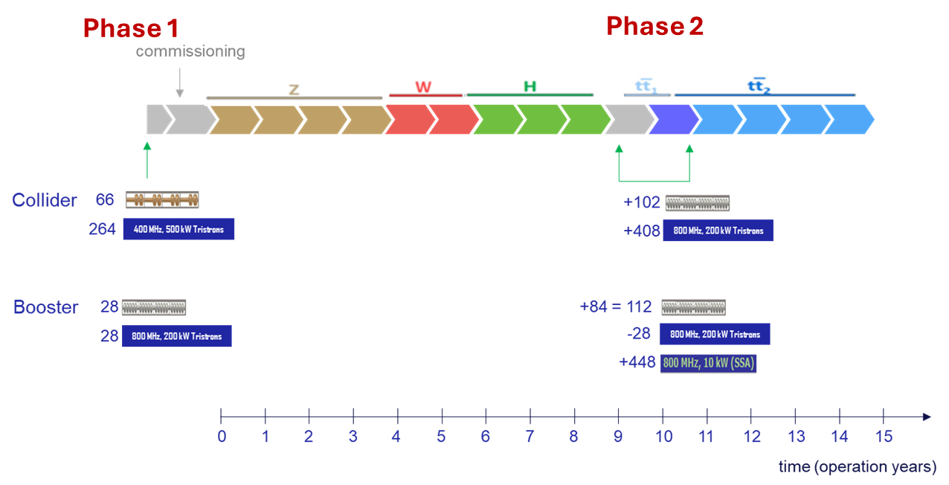
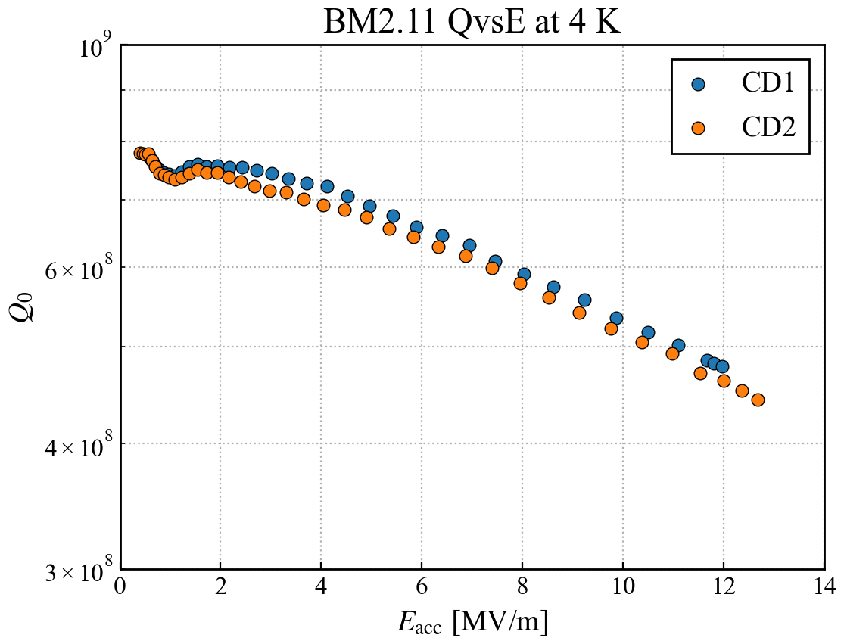
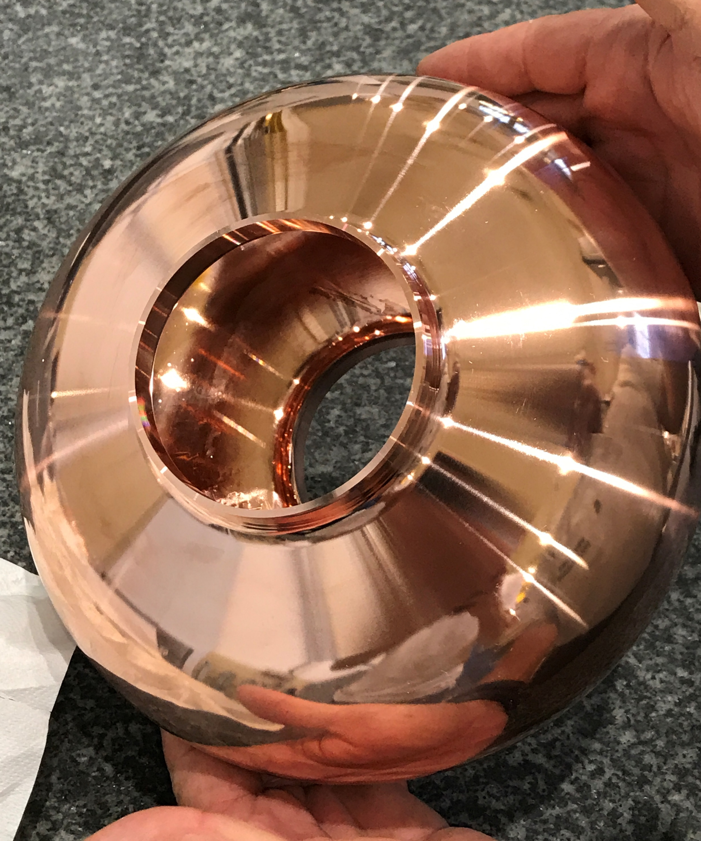
Facilities: FCC-ee SRF R&D needs Speaker: Frank Gerigk, CERN
Key points / Summary:
400 MHz 2-cell cavities Nb/Cu & 800 MHz 6-cell bulk Nb cavities
400 MHz & 800 MHz
RF power & HOM couplers
prototype CM
High-efficiency power source
Z-power sources: ~500 kW for 400 MHz, and ~50 kW for 800 MHz.
Ttbar power sources: ~90 kW for 400 MHz, ~250 kW for 800 MHz.
High-power infrastructure for coupler and system test
66 400 MHz CMs for the start of the Z.
28 800 MHz CNs for Z, + 84 CM for ttbar.
Recommendations:
400 MHz – Push Nb/Cu technology: Nb HiPIMS film deposition, seamless substrate, electropolishing
800 MHz- Define recipe to reach ultra-high quality factor Q₀ with the FCC design shape.
New materials like Nb₃Sn
Priorities :
High-Q at moderate gradients
High-efficiency RF sources (+resonant rings), and the needed development for couplers and cryomodules towards TRL6 level.

Slide 14
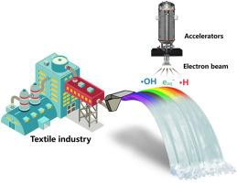
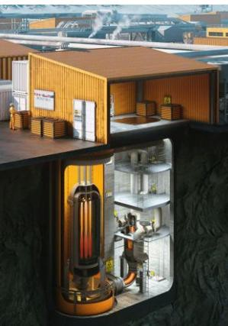
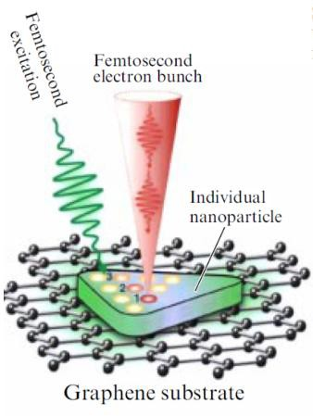
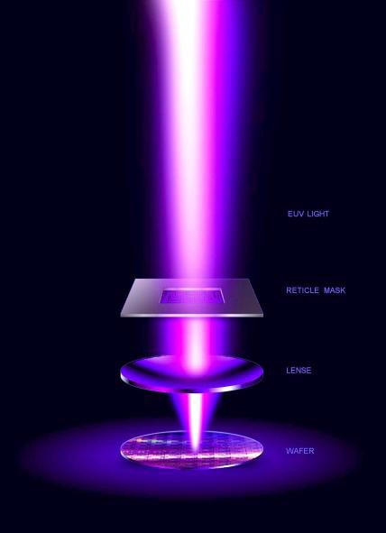
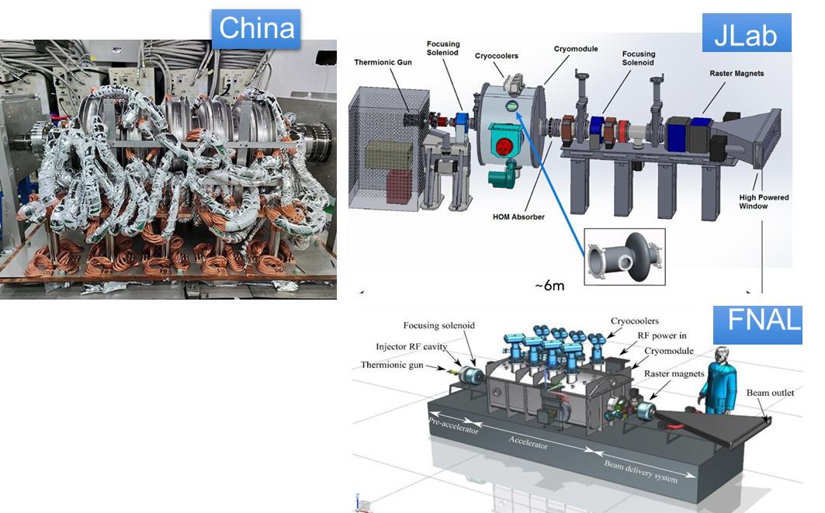
Facilities: SRF accelerators for industrial application , Speaker: Sergey Kutsaev SRF R&D needs for lithography and US manufacturing ecosystem development, Speaker: Bruce Duhnam
Key points / Summary:
xLight
Emerging applications requiring cost-efficient high-power electron accelerators:
⎼ Environmental applications. 5-10 MeV 100-1000 kW beams can used to kill pathogens or destroy chemicals in food, water, flu gases etc.
⎼ Accelerator Driven Systems. 50-150 MeV 1MW beams can be used to generate neutron flux in
modular sub-critical reactors or radioisotope production.
⎼ EUV lithography. GeV electron beams can be used to generate nm-wave EUV light for chip fabrication.
⎼ Ultrafast Electron Microscopy. SRF guns can generate c.w. high-brightness MeV beams for high-
resolution imaging.
Technological (& commercial) challenges
⎼ New materials (Nb₃Sn) reduce the losses by an order of magnitude
⎼ Compact Liquid-He-free cryocoolers with high power capacity (2-10 W)
⎼ Low-loss cryomodules based on conduction cooling
⎼ RF power sources (magnetrons, solid-state) with high efficiency (>50%) and low cost per Watt (<$3-7/W)
⎼ Reliability and serviceability
⎼ Fabrication
⎼ Beam loss management
Very few Nb cavity vendors, long lead time
Nb3Sn coating is a very complex and delicate process
Vendor hesitation to step into SRF business
(high initial investments, unstable demand, unflexible infrastructure)
Recommendations:
Mandatory
- Demonstration of high-power operation, reliability, robustness and real costs
⎼ Beam injection / extraction systems development
Wish list
⎼ Higher-efficiency / lower-price cryocoolers to enable lower power applications
⎼ Solid-state RF amplifiers with 70% <$3/W costs, or magnetron combination to MW level
Future
⎼ Technology transfer and mass-production of SRF cavities

Slide 15
Niobium: Nb treatments for high performance : Potential and future R&D Speaker: Daniel Bafia, FNAL
Key points / Summary:
Near-surface engineering is a major performance knob
Impurities, and interfaces clearly govern Q0 and gradient in Nb SRF cavities
Coupling RF measurements with materials science transformed the field
Thermal diffusion has delivered major gains
Easily accessible, but constrained by diffusion lengths and imperfect interface control
Recommendations:
The next decade is not about finding the next new bake; it’s about deterministic engineering over the surface => opens a new design space
Fundamental research with materials science needed to develop a holistic understanding of all loss mechanisms
Explore new engineering controls: CVD/ALD enables encapsulation, multilayers, high-k superconductors, and new doping schemes
Co-doping with different impurities is a promising path forward for standard thermal diffusion

Slide 16
Area | 5 Year Milestone | 10 Year Milestone
Materials Characterization | Demonstrate controlled co-doping using impurity-dependent diffusion lengths without CVD/ALD Explore feasibility of multilayer material growth | Establish predictive link between impurity profiles, microstructure, and RF loss mechanisms
Mechanistic understanding | Identify dominant RF loss mechanisms and relevant timescales | Establish a full, quantitative loss budget for RF losses in various SRF systems
Cavity Demonstration | Demonstrate Q = 4 x 10¹⁰ at 45 MV/m using co-doping and/or encapsulation | Demonstrate Q₀ ≈ 5×10¹⁰ at ~50 MV/m via encapsulation + impurity co-doping / tailoring Demonstrate predictive treatment design (“ask-and-receive”) based on materials-informed RF models
Together, these milestones transition SRF development from empirical optimization to predictive, materials-informed design.

Slide 17
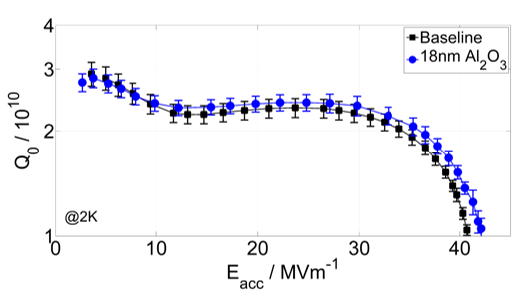

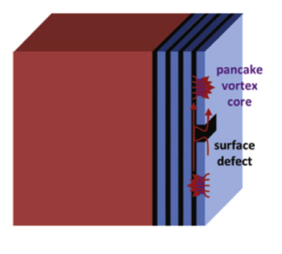
Niobium: Engineered Nb surfaces: Potential and future R&D directions Speaker: Marc Wenskat, DESY
Key points / Summary:
Surface passivation / encapsulation:
Native oxide impacts RF performance
Superconducting thin films (d ≈ λ_{L})
Several RF/DC measurements on samples show that individual pieces of the puzzle are correct
Proof-of-principle with an SRF cavity still pending
Recommendations:
For SRF the interplay between oxide properties and consequences of removing it should be studied => “Optimal” material for encapsulation? Oxides? Which one?
Theory development needed: (SI)^{N} S , roughness/transition …
Show that it works!

Slide 18
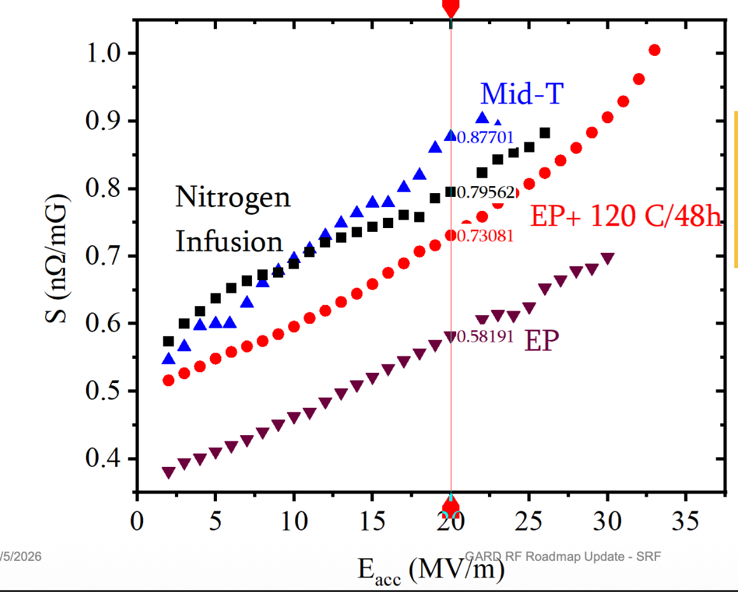
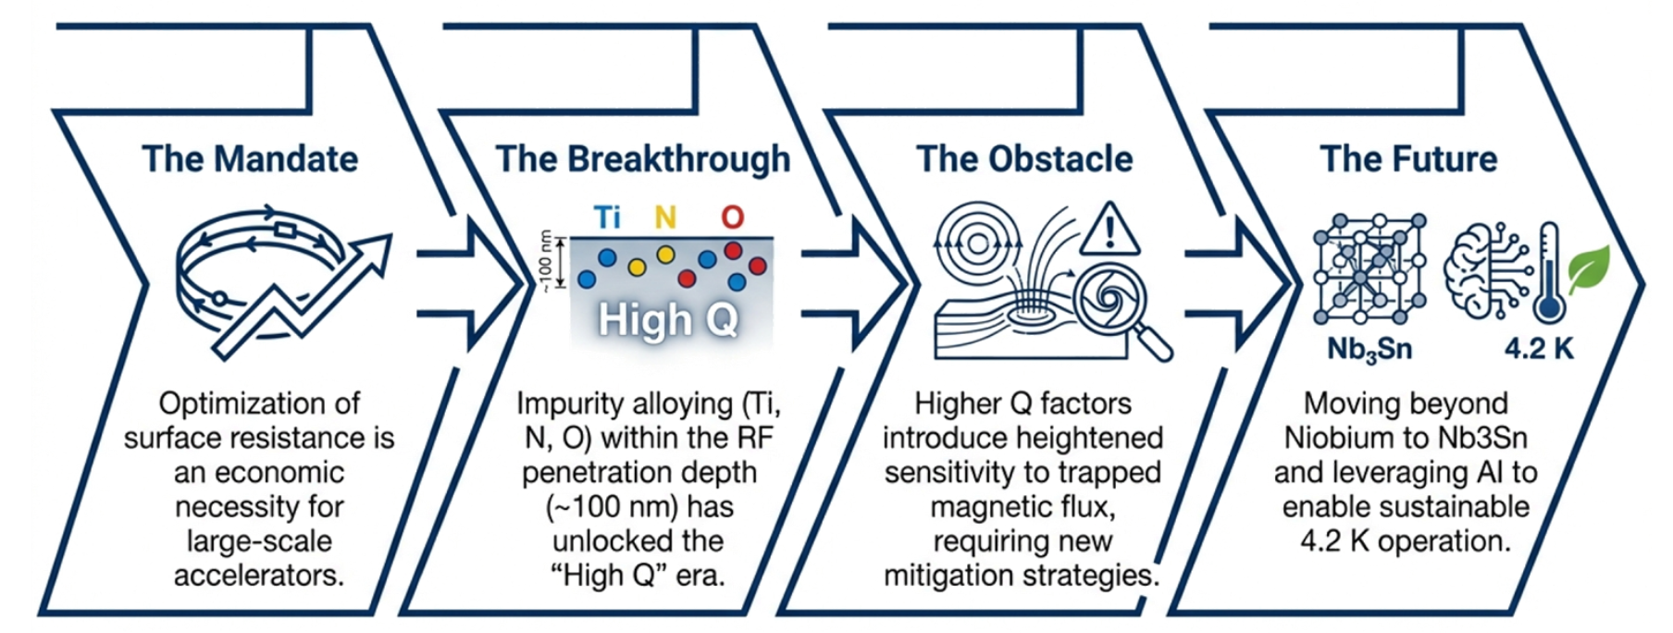
Niobium: Reducing residual resistance at operating fields Speaker: Pashupati Dhakal, TJNAF
Key points / Summary:
High Q₀ cavities are very sensitive to trapped magnetic flux during cooldown, often mask the benefit of high Q₀
Main source of residual surface resistance at operating field is due to residual flux trapping during cool down
Recommendations:
Develop new mitigation strategies

Slide 19
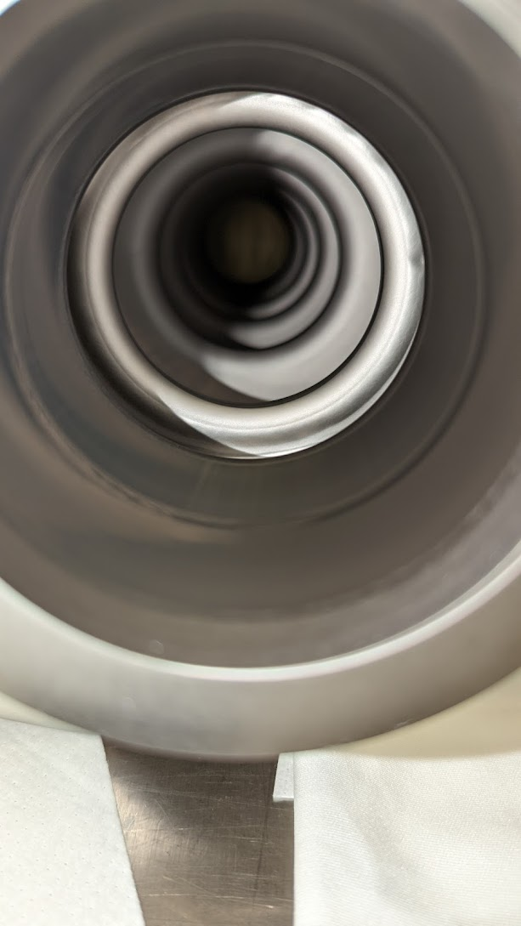
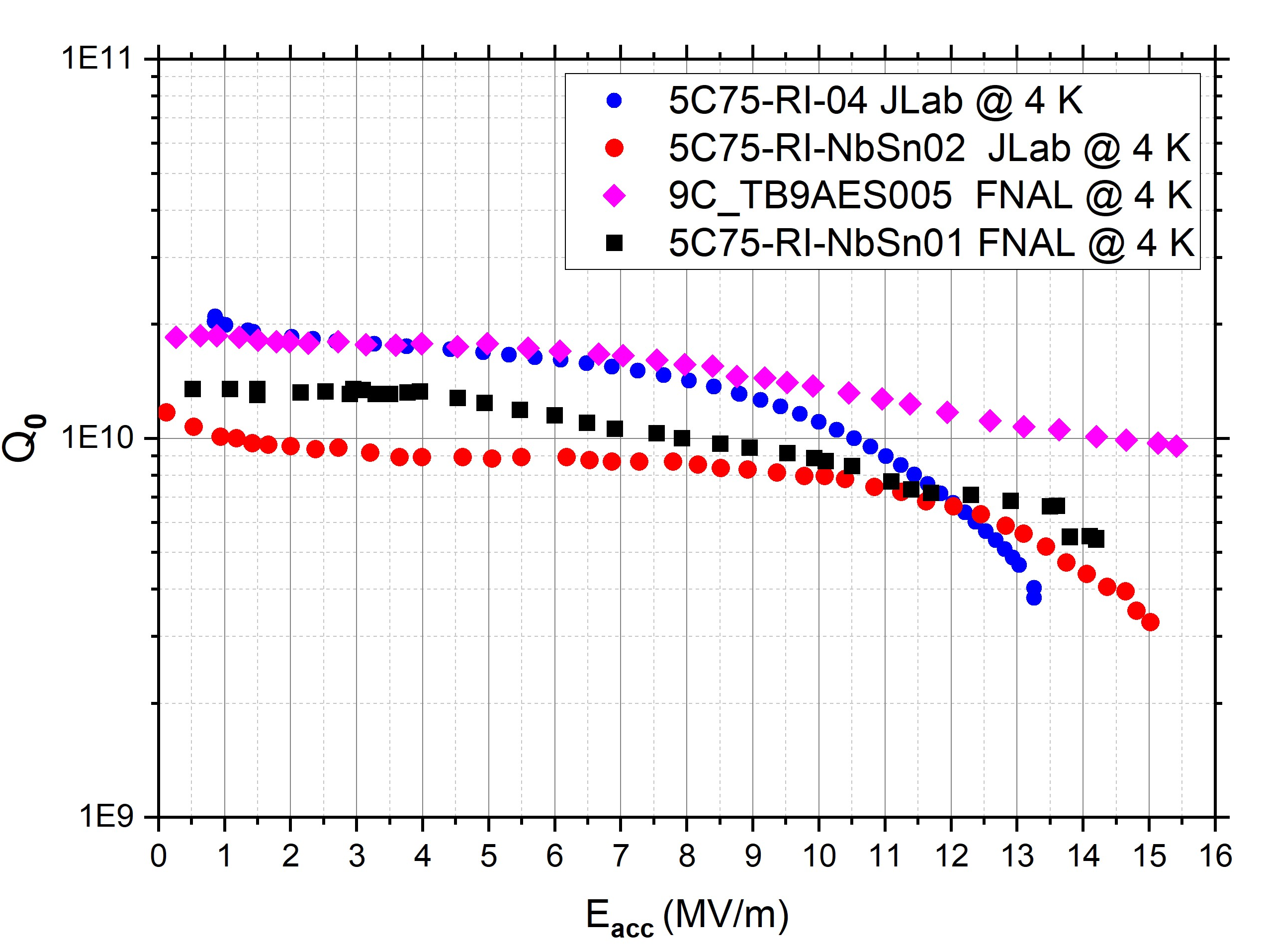
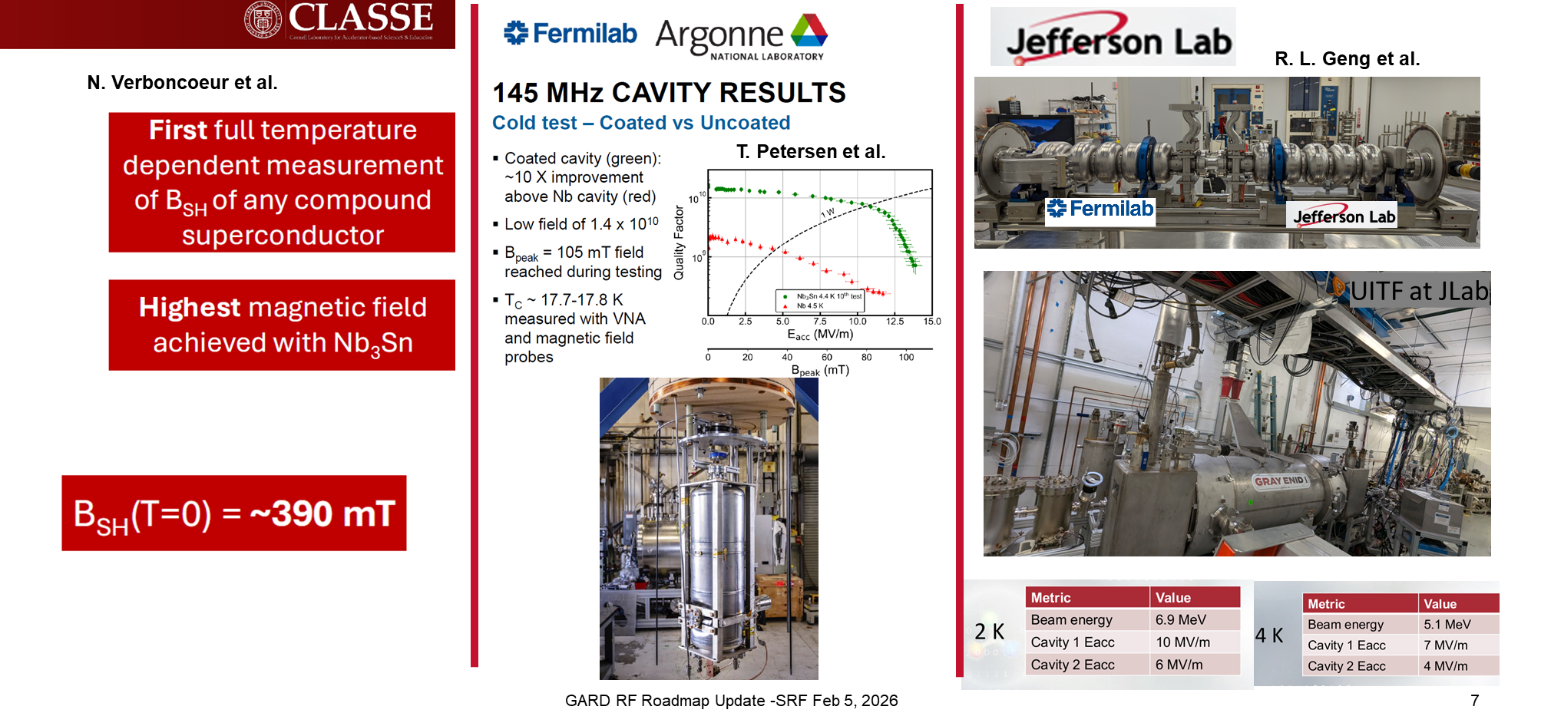
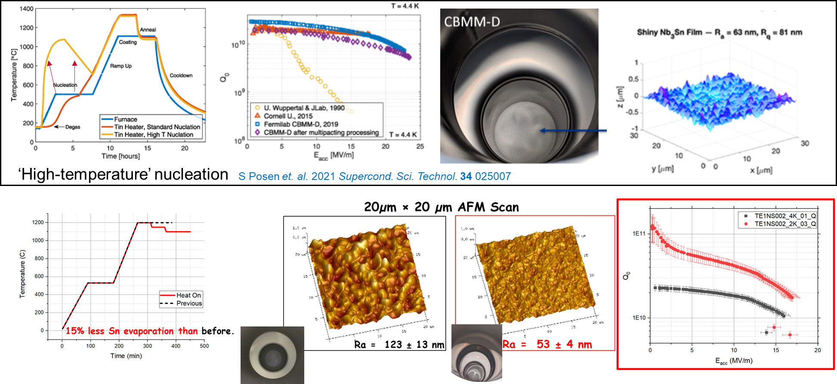
Nb₃Sn & Thin Films: Nb₃Sn by vapor diffusion
Speaker: Uttar Pudasaini, JLab
Key points / Summary:
Improve Performance through Process Optimization
Post-processing Technique development
Q-slope and quench due to material imperfections or surface defects
identify, understand, and eliminate defects towards a reproducible process

Slide 20
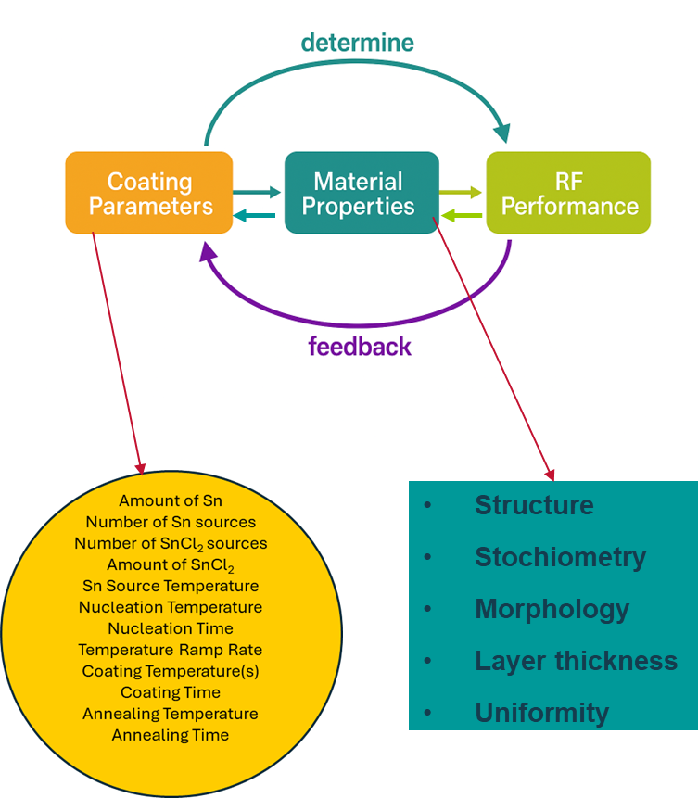
Nb₃Sn & Thin Films: Nb₃Sn by vapor diffusion
Speaker: Uttar Pudasaini, JLab
Recommendations:
Elucidate Nb₃Sn growth mechanisms in vapor diffusion coatings as a function of process parameters
Given the large parameter space, AI-assisted optimization could be attractive
Correlate material properties with RF performance to optimize coating parameters
Develop a feedback-driven coating growth model adaptable to arbitrary cavity geometries
Develop post-processing techniques for surface topography management
Study grain boundary structures and composition
Broadened, coordinated R&D efforts and resources to fullfill Nb₃Sn potential

Slide 21
Nb₃Sn & Thin Films: Alternative SRF materials
Speaker: Nathan Sitaraman, Cornell University
Key points / Summary:
Several candidate materials beyond Nb₃Sn: Nb-Zr Alloy, NbTiN, A15 compounds (Nb₃Al…), MgB₂…
Each have their own set of advantages and drawbacks, none is ideal. Fundamental R&D is still necessary to really assess their potential
High T_{c}: Easy
High Q at low fields: Easy(ish)
Minimizing defect concentration: Hard
Took decades of R&D for Nb, Nb₃Sn to perfect this and minimize residual resistance
Complete elimination of defects: Impossible!
On cavity scale, there will *always* be a nonzero number of nanoscale (~10nm+) defects
R&D efforts very productive toward minimizing defect concentration
Recommendations:
Focus on systems with potential to tolerate some defects at high fields
Thin layers necessary!
Low-loss interface with Nb substrate (and/or barrier layer) necessary!
Evaluate the potential in pulsed conditions also

Slide 22
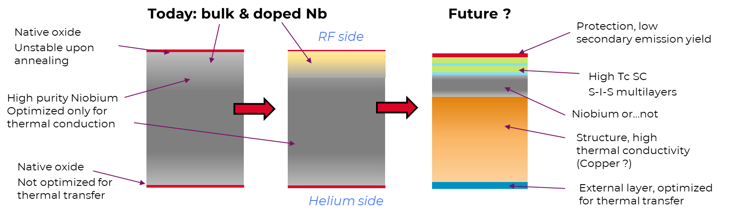
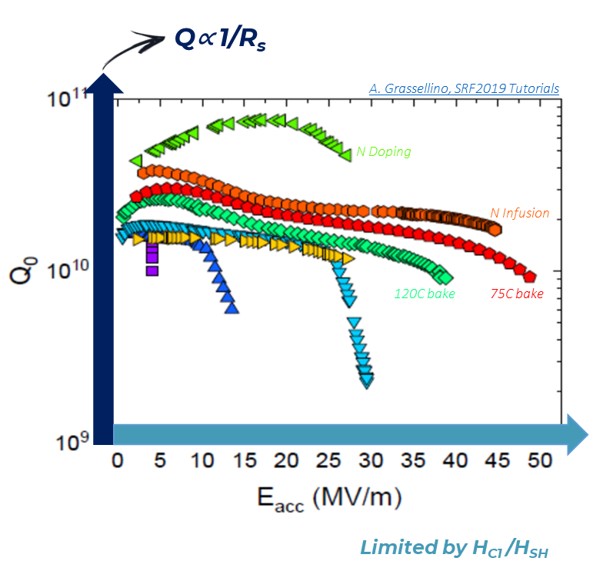
Nb₃Sn & Thin Films: Thin-film growth of SRF materials
Speaker: Cristian Pira, INFN
Key points / Summary:
Thin Film approach enables a broad portfolio of solutions, no one-size-fits-all solution,
Cavity cost reduction (Nb on Cu)
High Q / High T operation (Nb₃Sn)
High Gradient (SIS)
TProcesses needs to be tailored to the final goals,
Film(s)-substrate system dictates thermal budget, growth technique choice (Hybrid approach)
Substrate quality & preparation are paramount
Nb on Cu by PVD is a mature technology for cost reduction approach, especially for low frequencies → Emergetic Condnsation with HiPIMS seems to be the right way to increase the usable gradient
Nb₃Sn is by far the most promising material beyond Nb → Various technologies are being developed for 4K operations with Nb substrates → PVD approach looks very promising for Nb₃Sn on Cu. 1st results on elliptical cavities expected soon
Recommendations:
Developments of thin iflm based SRF at different levels of maturity, technologies mor complex than bulk Nb, require significant investments (fundamental developments, coating systems, characterization….)
Tailor development to the film/substrate system and to fit the goals Cleanroom assembly and handling are a must
Engaging industries early in the developments to industrialize the thin-film process
Functionalization of the materials
The beginning of a technological revolution for SRF!

Slide 23
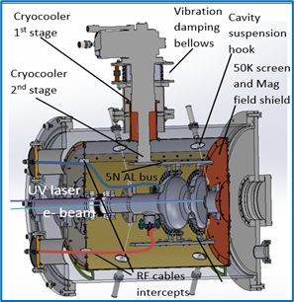
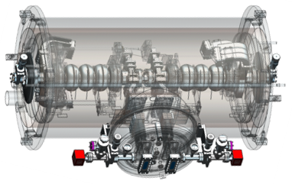
Nb₃Sn & Thin Films: Practical implications of new materials
Speaker: Grigory Eremeev, FNAL
Key points / Summary:
Nb₃Sn technology has advanced from R&D to practical accelerator applications with several coating facilities world-wide producing Nb₃Sn with performance level suitable for accelerator applications
Further understanding via careful designs and use of analytical tools is key to realizing Nb₃Sn high field potential
Current developments to improve performance and enable practical implementations :post-processing, mechanical strength, contamination (ex. Ti, Si), tuning sensitivity, handling for CM assembly,
Recommendations:
Tailor developments to the materials taking into account the bi-metallic nature of the system (Nb₃Sn/Nb)
Near-term (5yrs) First Nb₃Sn user facility First Nb₃Sn industrial demonstrators | Mid-term (10 yrs) Nb₃Sn as the technology of choice for SRF accelerators Large scale operation of Nb₃Sn industrial accelerators

Slide 24
Nb₃Sn & Thin Films: SRF theory: Ideal surfaces and future R&D directions
Speaker: Alexander Gurevich, ODU
Key points / Summary:
Switch from the MB model to the Eliashberg theory which describes realistic superconductors with strong e-p pairing (Nb, Nb₃Sn, NbN etc)
Enigma of quasiparticle subgap states which define the ultimate Q limit at T<<Tc (SRF cavities and qubits). Many possible mechanisms (TLS, correlated impurities, strong e-p coupling, etc).
Field dependent Q(H) at high rf fields: Pandora box of nonequilibrium superconductivity and complex kinetics of superconductors under strong RF fields. e-p and e-e relaxation times and their strong dependencies on T and rf field
Extended Q(H) rise, the effect of nonequilibrium kinetics of quasiparticles or two-level states
Ultimate breakdown of superconductivity - the physics of dynamic superheating field at GHz frequencies at low T
Extreme dynamics of superfast tips of trapped vortices at the SRF depairing limit. Effect of trapped flux on the high-field Q slope
The exact SRF performance limits are currently unknown
Recommendations:
SRF performance both at low and high RF fields can be improved by impurity management and surface nanostructuring, even if we do not know what the limits are.
Filling the knowledge gaps requires developing the Eliashberg + nonequilibrium theories of SRF limits in conjunction with advanced computational modeling.
Enable understanding for
Mechanisms of residual resistance, subgap states, TLS
Theoretical Q and H limits for key SRF players (Nb and Nb₃Sn)
Theory of nonequilibrium superconductivity which describes Q(H) at high rf fields
Extreme dynamics of trapped vortices driven by rf fields in SRF cavities

Slide 25
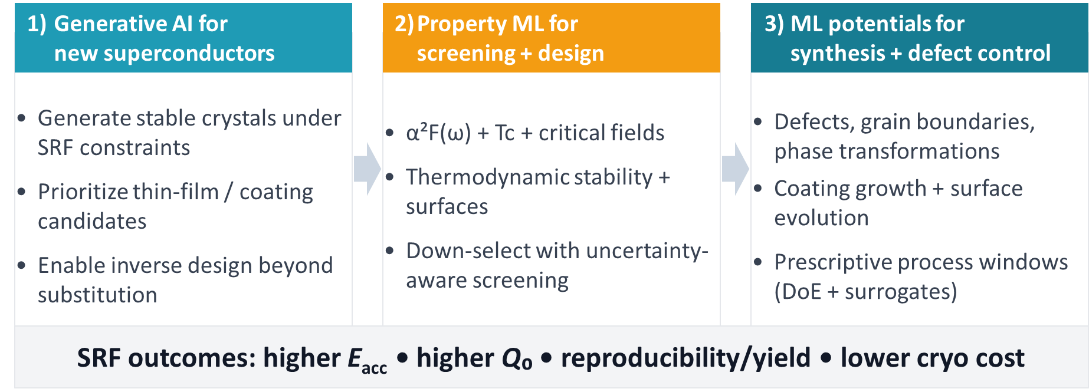
AI/ML for SRF: Frameworks for material development using AI/ML
Speaker: Richard Hennig, U. of Florida
Key points / Summary:
Accelerate the discovery & design of
SRF materials
Generative AI — new superconductors
Property ML — screening + design
ML potentials — synthesis + defects
Recommendations:
AI/ML to make SRF materials development predictive, not empirical, and couple it to validated performance.
Near-Term (1-2 yrs)
Build the framework with open SRF-relevant datasets, benchmarks with SRF metrics, build a “materials model card” standard(domain of validity + uncertainty reporting), use validation loop (synthesize + characterize with small, diverse test set)
Mid-Term (5 yrs)
Build tools for Inverse design, multiscale “digital twin” to push limits of materials and predict defects influence on performance, improve Nb₃Sn processes
Transfer to new coatings / multilayers as SRF materials mature

Slide 26

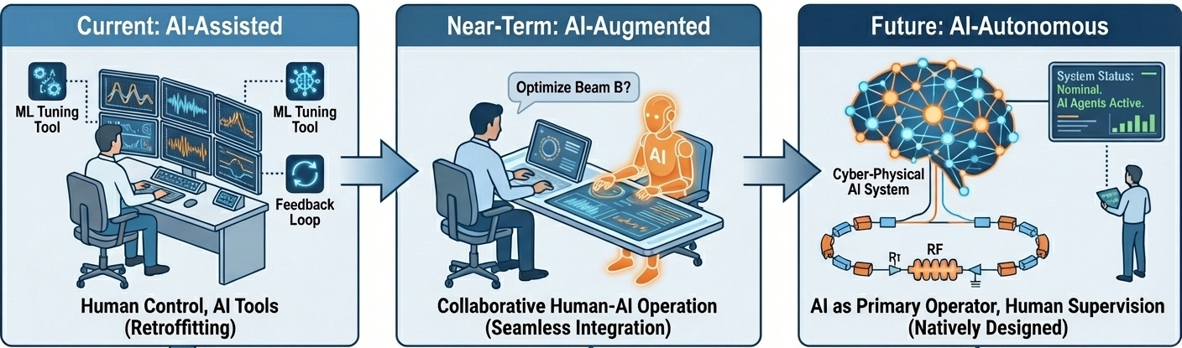
AI/ML for SRF: Future directions for SRF accelerator operation
Speaker: Christopher Tennant, TJNAF
Key points / Summary:
AI/ML already demonstrates its value for SRF operations – fault classification, prediction, optimization, anomaly detection …-successful proof-of-concept projects
Today’s Genesis Mission = inflection point
within MOAT, collaboration on a single project across accelerator user facilities from multiple offices of the Office of Science– across– remarkable progress in ~3 months
Agentic AI is a game changer, shifting from AI-assisted to AI-augmented
Recommendations:
AI-assisted (now): humans drive; AI accelerates analysis, suggests actions, and reduces “time-to-answer” → anomaly detection, offline optimization
AI-augmented (next): AI executes multi-step workflows under explicit oversight (plan-first, approvals, safe write boundaries) → Osprey-style agents
AI-autonomous (future): AI can run routine operations end-to-end, but only inside strict safety, interlock, and policy boundaries → “autopilot”

Slide 27
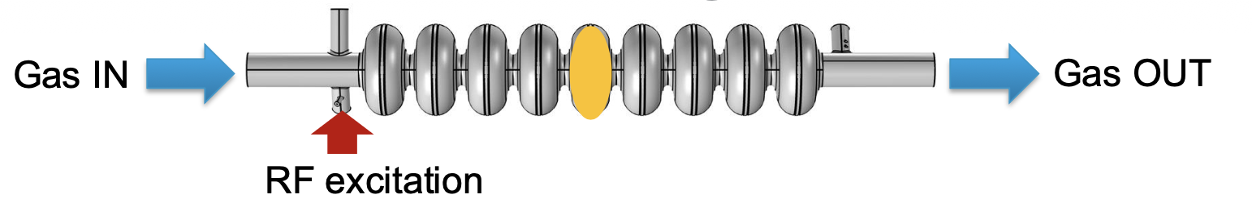
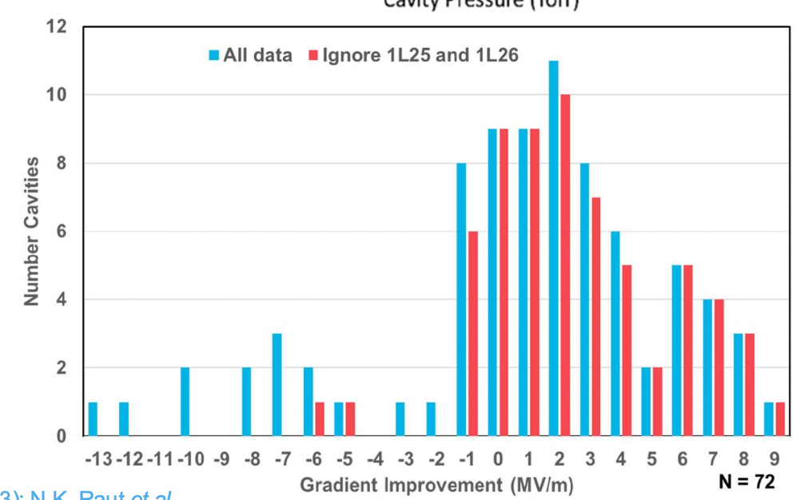
SRF Technology: In-situ processing of SRF cavities in cryomodules
Speaker: Bianca Giaccone, FNAL
Key points / Summary:
Field emission has been observed to degrade over time in SRF machines
In-situ techniques can allow to mitigate FE and MP without requiring CM disassembly
In-situ techniques are not (yet?) effective on all types of contamination
Plasma processing, helium RF processing, and ozone processing have been applied successfully
Recommendations:
Develop clear understanding of complementarity and applicability of the three in-situ techniques
Short Term R&D:
Optimize recipes and demonstrate, when needed, applicability to full sized CMs
Mid/Long Term R&D:
Gain better fundamental understanding of the physical phenomena and diagnostic techniques
Deploy ozone treatment as a safe and simple technique to address hydrocarbon-induced FE and MP in CMs
Extend plasma processing applicability beyond hydrocarbon contamination
Long Term Goal:
Techniques that can be deployed on CMs in-situ as needed to recover performance affected by FE and/or MP

Slide 28
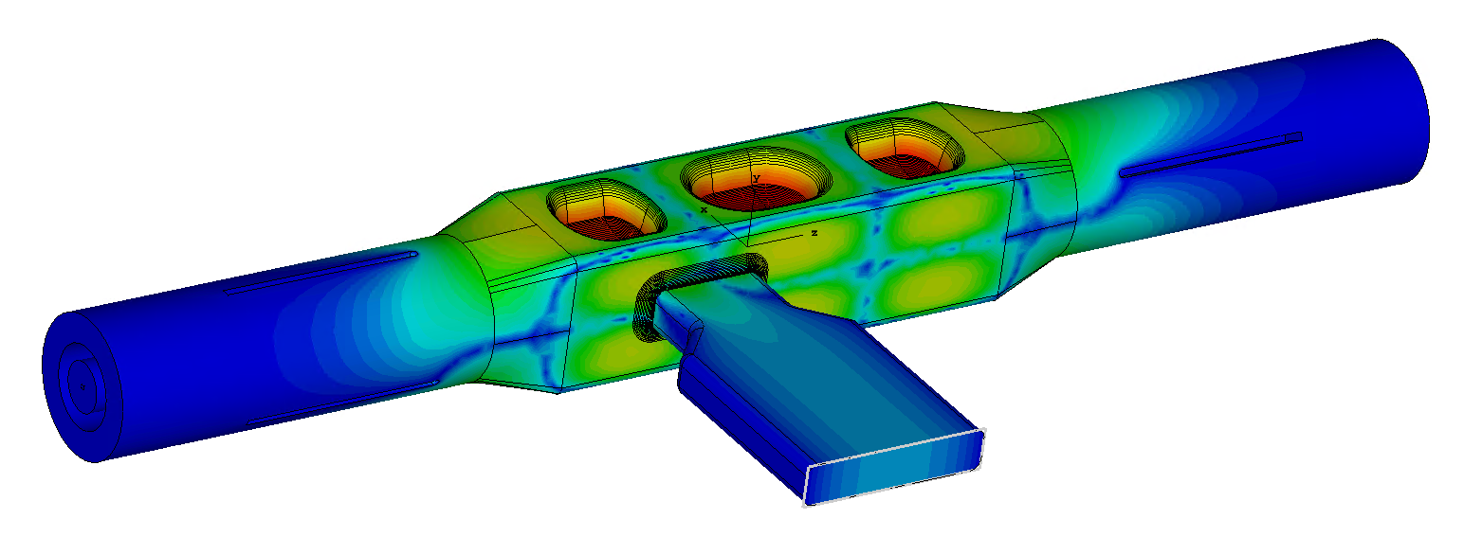
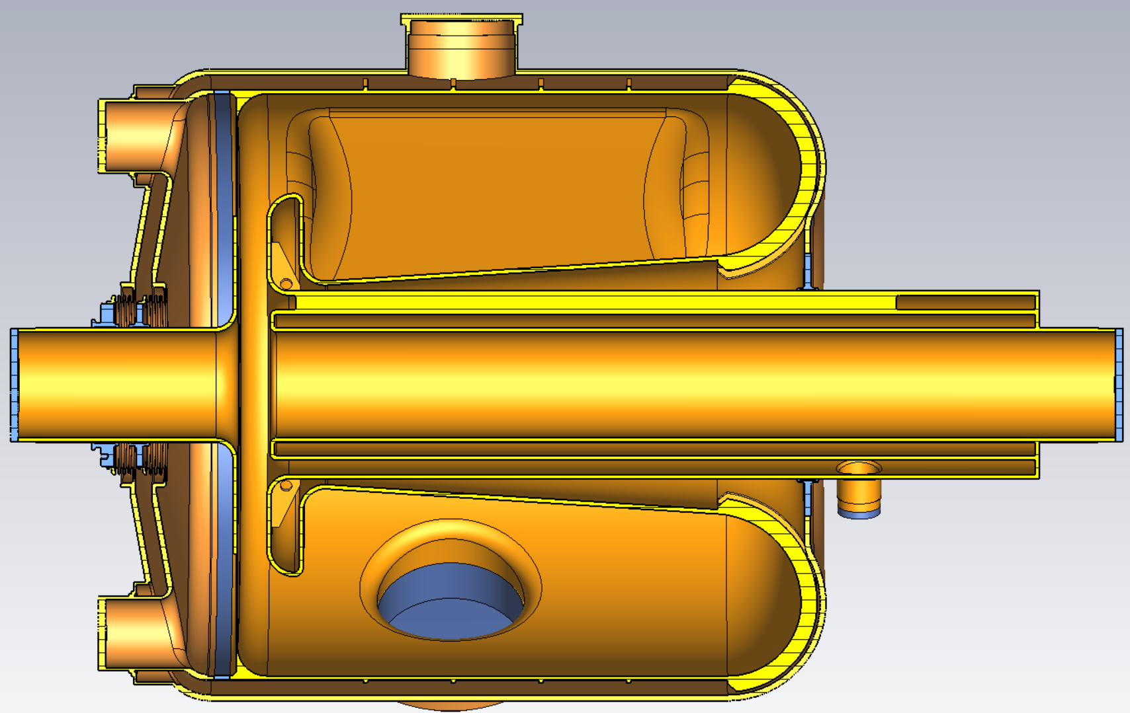
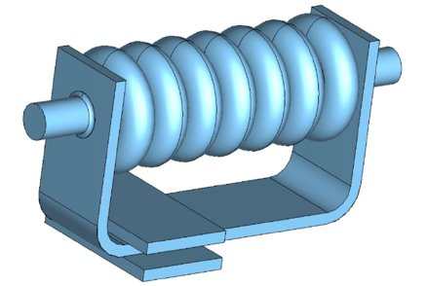
SRF Technology: New cavity shapes and types
Speaker: Kellen McGee, FNAL
Key points / Summary:
Nb structure optimizations can deliver immediate performance benefit to next generation machines
Novel SRF structures are enabling technologies for:
High gradient devices: linear higgs factories, compact devices
Next-generation SRF for RCS to reduce beam impedance/instabilities
Improved facility efficiency and flexibility is a key component of accelerator stewardship, expanding experimental reach
Recommendations:
Consistent R&D to ensure these options are well developed for adoption by future projects
Tunable cavity proof-of-principle must be demonstrated in a timely manner to become a viable candidate for ACE-MIRT
QMiR Cavity for EIC
Tunable SRF cavity for RCSs
Travelling wave cavity

Slide 29
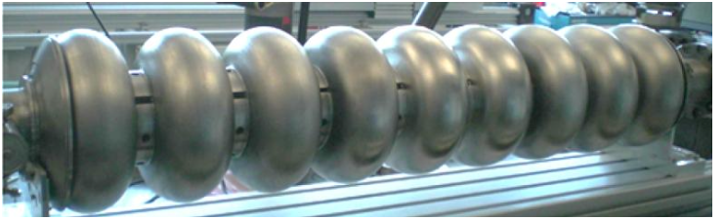
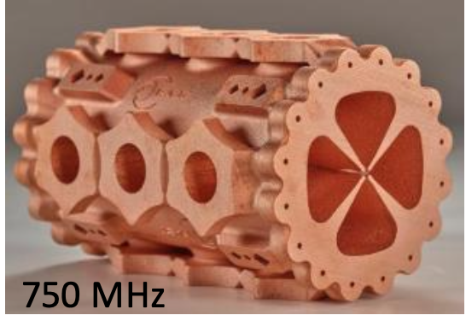
SRF Technology: Cavity fabrication, cost reduction, vendor development
Speaker: Gigi Ciovati, JLab
Key points / Summary:
Whereas innovations in material and fabrication methods have been successfully demonstrated, the ~40-year-old conventional methods are still the standard ones used for SRF cavity productions.
Recent developments focus on additive manufacturing.
Recent start-up of private companies aiming at producing large-scale SRF linacs provide a unique opportunity to drive innovation and foster a closer collaboration between public and private sector.
Recommendations:
Strategic investments and programmatic decisions by the public sector are needed to realize the potential of this opportunity.
Establish a “National SRF Consortium” with members from Labs and Universities with SRF expertise.
An industrial “third space” should be created where national laboratories and industry can effectively and efficiently collaborate on SRF R&D projects.

Slide 30
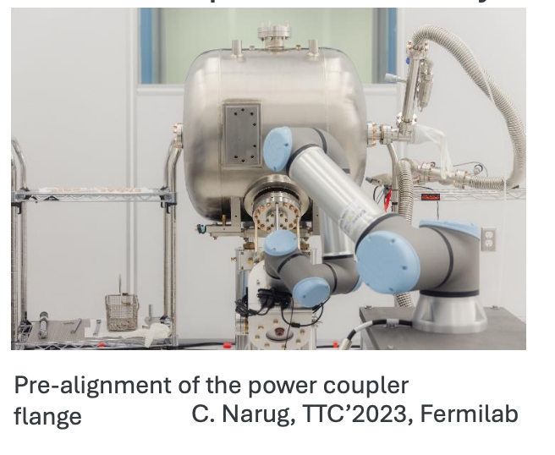
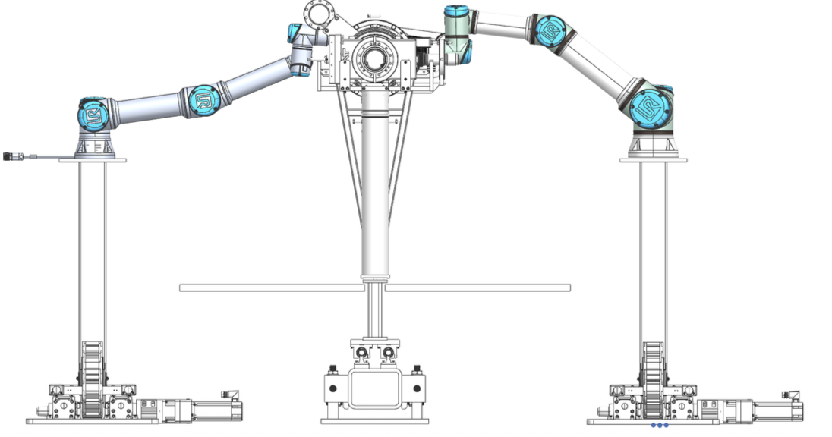
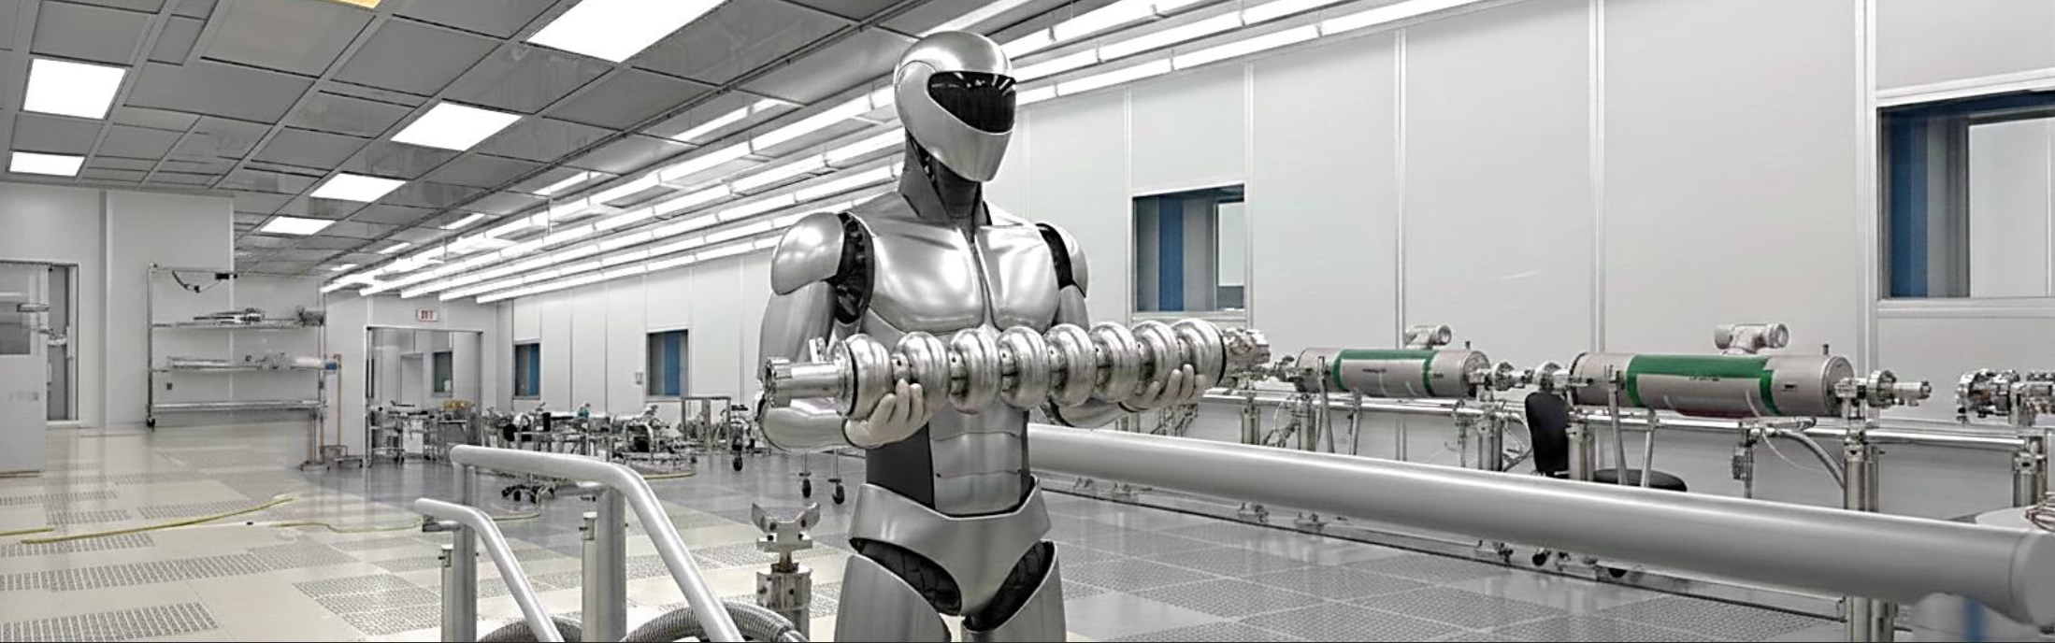
SRF Technology: Clean cavity preparation and assembly
Speaker: Ganfa Wu, FNAL
Key points / Summary:
Robotic-assisted clean assembly: Reduced potential cavity contamination risk, improved assembly ergonomics, and improved efficiency
Cavity string design needs optimization (paradigm shift) for the AI Robotic future for cryomodule gradients >40 MV/m
Recommendations:
If sufficiently supported, the future could be very “clean and FE-free”.
In 5 years, a robotic assembly with many improvements to the current cryomodule design
In 10-15 years, a new type of cryomodule design that is robotically compatible and achieves high yield, high performance

Slide 31

SRF Technology: SRF ecosystem: Cavity fabrication, preparation, and test facility needs for the US
Speaker: Martina Martinello, SLAC
Key points / Summary:
The U.S. SRF ecosystem is technically strong but structurally capacity-limited => SRF technology readiness is no longer the limiting factor
High Impact R&D actively reshape facility needs
There is no single U.S. company that provides end-to-end cavity production
Future SRF programs will be infrastructure-limited unless facility capacity and workforce pipelines evolve now.
Recommendations:
Transition from project-driven infrastructure → programmatic national capacity
Expand processing and cold-test throughput with redundancy
Strengthen domestic industry integration
Integrate workforce pipelines across labs, universities, and industry

Slide 32
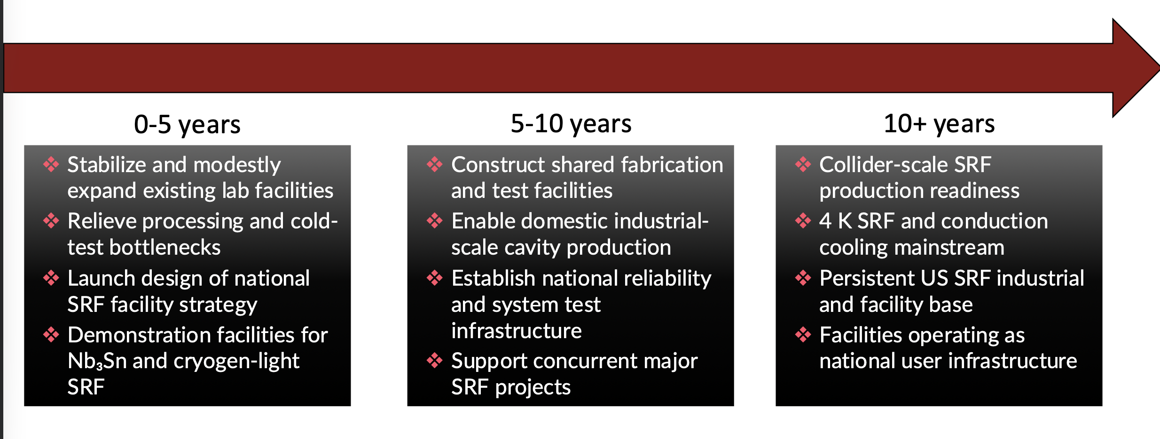

Slide 33
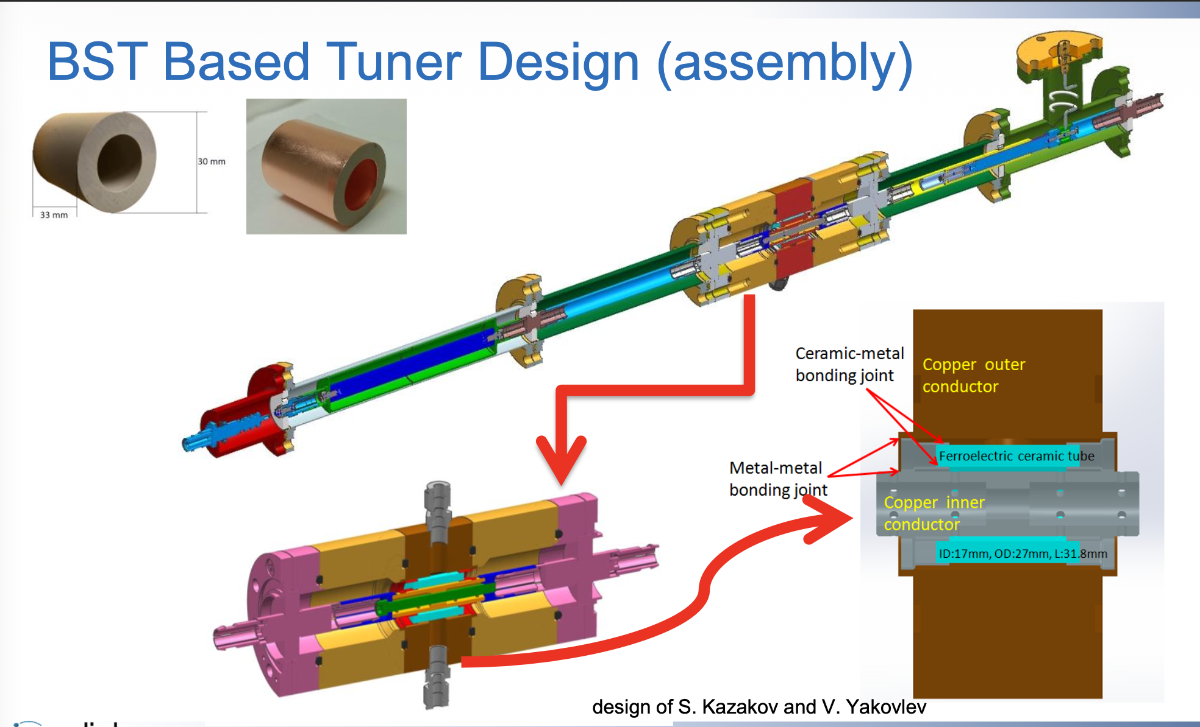


Community Contributions
Key points / Summary:
Ferroelectric Fast Reactive Tuners can provide ultra-fast frequency adjustment without mechanical motion
High Temp Superconductors (HTS) present the possibility of lower loss cavities at LN temperatures for some applications
Conduction cooled Nb3Sn SRF photo-gun prototype recently tested
Q₀ improvement directly reduces cryocooler count and system cost for conduction cooled Nb₃Sn-coated SRF cryomodules
Other SRF technology needs include new concepts for high-power couplers with low cryogenic load, new types of fast tuners for SRF cavities with a large tuning range, new HOM dampers for SRF cavities, diagnostics of field emission in SRF cryomodules, and AI/ML cavity resonance-control algorithm

Slide 34
CHALLENGE AREAS FOR THE NEXT DECADE

Slide 35
SRF Foundation: Fundamental SRF Research ​
Area definition: Advance fundamental SRF science using theory and experiment, aiming at a holistic understanding of RF dissipation, loss mechanisms, and ultimate limits to Q₀ and gradients.
Motivation: SRF materials research is evolving from an empirical optimization to predictive, materials and knowledge informed design. Continuing this paradigm-shift will enable SRF materials by design, opening new design spaces for highest-performance surfaces.
Synergies: Fundamental SRF knowledge is the foundation for materials development for any future SRF driven accelerator for science and industry as well as for quantum and digital logic materials.

Slide 36
SRF Foundation: Fundamental SRF Research ​
Milestones
Short to medium term
Develop the Eliashberg + nonequilibrium theories of SRF limits in conjunction with advanced computational modeling
Probe RF field limits in long and ultra-short pulse operation on samples with bulk and layered (nanostructured) surfaces
Identify dominant RF loss mechanisms and relevant timescales
Explore new engineering growth controls including CVD/ALD, enabling encapsulation, multilayers, high-kappa superconductors, and new doping schemes
Medium to long term
Understand mechanisms of residual resistance, subgap states, TLS losses
Advance theory of nonequilibrium superconductivity: Q(H) at high RF fields
Predict theoretical Q and H limits for key SRF players (Nb and Nb3Sn)
Establish predictive link between impurity profiles, microstructure, and RF loss mechanisms
Define & demonstrate full growth control for engineering surfaces – functionalization of materials

Slide 37
The Last Mile: Advanced Processing for Pushing Bulk Nb to the Theoretical Max ​
Area definition: Guided by fundamental SRF knowledge, and using new engineering controls for materials growth, develop optimized Nb-based surfaces that enhance performance, approaching theoretical limits (currently unknown).
Motivation: Bulk Nb is one of the baseline material for the next SRF-based frontier collider (e.g., FCC-ee). Feasibility (cost and energy consumption) of such a machine requires significantly increased Q₀ at medium to high fields (25 – 50 MV/m).
Synergies: SRF-driven accelerators for science and industry mostly will remain Nb-based short to medium term. Any advances in Nb SRF performance will have broad and enabling benefits to these applications of SRF technology.

Slide 38
The Last Mile: Advanced Processing for Pushing Bulk Nb to the Theoretical Max ​
Milestones
Short to medium term
Reduce residual resistance at medium to high operating field by developing techniques and materials that minimize flux trapping and reducing sensitivity to trapped magnetic flux.
Develop optimized oxide passivation / capping layers
Demonstrate controlled co-doping with multiple impurities via heat treatments
Goal: Demonstrate Q = 4 x 10¹⁰ at 40 MV/m (2K, 1.3 GHz)
Medium to long term
Develop optimized capping / multi layers on Nb and demonstrate enhanced performance (Q₀ and/or gradient)
Develop controlled growth methods for tailored impurity concentrations for engineered Nb-based surfaces
Demonstrate predictive “surface/treatment by design”, leading to tailed performance
Goal: Demonstrate Q > 5 x 10¹⁰ at 50 MV/m (2K, 1.3 GHz)

Slide 39
The next SRF materials frontier: Beyond bulk Nb
Area definition: Develop thin-film based SRF technologies tailored (film-substrate system, growth techniques…) to specific goals
Advance the efficiency frontier: Focus on Nb₃Sn, but also evaluate other higher-T_{c} materials
Advance the gradient frontier: Surfaces by design
Develop the copper backbone: High-performance thin-films on cost-effective substrates
Motivation: Nb/Cu is fundamental for the next SRF-based frontier collider (e.g., FCC-ee, Muon Collider). Feasibility (cost and energy consumption) of such a machine requires significantly increased Q₀ at medium to high fields. Feasibility of Nb₃Sn/Cu would be a paradigm shift for large instruments and industrial machines.
Synergies: Strong synergies, film-based SRF technology is the envisioned enabler of the future for accelerators for science and industry as well as for quantum and digital logic materials.

Slide 40
The next SRF materials frontier: Beyond bulk Nb
Milestones
Short to medium term
Establish Nb film baseline @ 1.3 GHz (2 K) & @ 800- 400MHz (4.2 K)
Demonstrate Q ^{Nb/Cu}= 4 x 10¹⁰ at 30 MV/m (2 K, 1.3 GHz) and Q ^{Nb/Cu} > 2x10⁹ at 15 MV/m (4.5 K, 400-800 MHz)
Further develop Nb₃Sn/Nb and Nb₃Sn/Cu technology and establish baseline performance
Demonstrate E_{acc} ^{Nb3Sn}> 15 MV/m with Q₀ > 4x10¹⁰ at 0.8 - 1.3 GHz, 4.5 K
Demonstrate E_{acc} ^{Nb3Sn}> 25 MV/m with Q₀ > 2x10¹⁰ at 0.8 - 1.3 GHz, 4.5 K
Demonstrate cavity operation in short pulse mode with E_{acc} > 50 MV/m
Nb₃Sn studies for cryomodule operation
Turn-key Nb₃Sn cryomodule technology (Industry transfer)
Evaluate potential of alternative film materials and SIS structures first on samples, then on cavities (depending on development maturity) – Develop tailored growth techniques (PVD/EC, CVD, ALD, electrodeposition, hybrid…)
Reduce sensitivity to magnetic flux for new materials
Develop adequate Cu substrate and processes for reproducible and reliable film deposition

Slide 41
The next SRF materials frontier: Beyond bulk Nb
Milestones
Medium to long term
Develop Nb /Cu multi-cell cavities at low frequencies
Deploy SIS structures on Nb & Nb/Cu with 30–50% E_{acc} increase and a factor of two in Q₀
Deploy Nb₃Sn/Nb and Nb₃Sn/Cu technology to multi-cell cavities and integrate in cryomodules
Demonstrate E_{acc}^{Nb}₃^{Sn} > 20 MV/m with Q₀ > 3x10¹⁰ at 800 MHz, 4.5 K
Integrate Nb, Nb₃Sn, other materials, SIS in common deposition
Potential for E_{acc} > 20 MV/m with Q₀ > 6x10¹⁰ at 800 MHz, 4.5 K
Potential for E_{acc} = 50 MV/m to 100 MV/m operation

Slide 42
Fast-Tracking the SRF Frontier: AI/ML for SRF
Area definition: Develop frameworks for predictive SRF materials coupled to validated performance and for “autonomous” optimized accelerator systems .
Motivation: Fast-track SRF material developments and provide a framework for machine operation with reliable and stable operation; AI-autonomous industrial accelerator system to steer away from expert-operation.
Synergies: AI/ML has a role to play in every aspects of SRF technology from material developments (bulk Nb, SRF films, defects…) to machine operation.

Slide 43
Fast-Tracking the SRF Frontier: AI/ML for SRF
Milestones
Short to medium term
Build the framework with open SRF-relevant datasets, benchmarks with SRF metrics, build a “materials model card” standard (domain of validity + uncertainty reporting), use validation loop (synthesize + characterize with small, diverse test set)
Develop AI executed multi-step workflows under explicit oversight (plan-first, approvals, safe write boundaries)
Establish a foundation for AI policy boundaries
Medium to long term
Build tools for Inverse design, multiscale “digital twin” to push limits of materials and predict defects influence on performance, improve Nb₃Sn processes
Transfer to new coatings / multilayers as SRF materials mature
Build AI-autonomous platform where AI can run routine operations end-to-end in autopilot, inside strict safety, interlock, and policy boundaries

Slide 44
SRF Technology & System Integration
Area definition: Develop cavity designs, auxiliary systems, technologies, and processes needed for reducing cost and for achieving, maintaining, and recovering high SRF cavity performance in HEP accelerators.
Motivation: Future SRF-driven accelerators for HEP require SRF cavity and auxiliary systems (e.g., RF couplers, HOM dampers, frequency control) performance well above the current state of the art, reliably and at a reduced cost.
Synergies: Strong synergies with SRF technology needs for future high-current accelerators (e.g., EIC), future high Q₀ / high Q_{L} SRF accelerators (e.g., SRF linac based light sources, industrial SRF linacs), SRF for synchrotrons etc.

Slide 45
SRF Technology & System Integration
Milestones
Short to medium term
Integrated workforce development across universities, labs, and industry
Fast, large tuning-range SRF cavity for RCS (>5 MHz/s tuning rate)
AI/ML cavity resonance-control for high Q_{L} cavity operation (pulsed and CW)
Robotic assisted clean assembly of SRF beam lines
Continue exploration of alternative, lower cost SRF cavity fabrication techniques
Low cost, high-power RF couplers and HOM dampers for high-power, high current operation
Launch of SRF facility strategy
Medium to long term
Integrated workforce development across universities, labs, and industry
Techniques that can be deployed in-situ to recover performance affected by FE or MP
Expanded shared SRF facilities with strengthen domestic industry integration.
Continued development of novel SRF cavity concepts and geometries
Cryomodule designs that are optimized to be robotically compatible and achieve high yield

